Slide 1
Hazardous Materials Safety & Security
Awareness Training
Section III
Gathering and Analyzing Information

Slide 2
Funding Acknowledgement
This material was produced under grant number SH-31200-SH7 from the Occupational Safety and Health Administration, U.S. Department of Labor. It does not necessarily reflect the views or policies of the U.S. Department of Labor, nor does mention of trade names, commercial products, or organizations imply endorsement by the U.S. Government.

Slide 3
Section III Objectives
List six clues for hazardous materials/WMD recognition and identification
Recognize the appropriate U.N./DOT hazard class for various substances
Identify the product name using U.N. identification numbers
Recognize the general type of container, product and hazards that may be present in various types of transportation vessels

Slide 4
Recognition and Identification Clues
Occupancy/Location
Container/Vehicle Shapes
Placards, Labels, and Markings
Non-Transportation Markings and Colors
Written resources, Safety Data Sheets
Senses

Slide 5
Clue 1: Occupancy/Location
Type of occupancy at the incident scene
  Shipboard
  Dockside
  Warehouse
  Vehicle Type
  Type of Industry

Slide 6
Clue 1: Occupancy/Location
Knowledge of the specific geographic area or transportation corridor
  Port
  Off shore facility
  Interstate highway
  Rail line
  Pipeline

Slide 7
Clue 1: Occupancy/Location
All occupancies or locations have the potential to involve hazardous substances/WMD
Awareness
Vessel Emergency Plans
Facility Emergency Plans
Always consider hazardous substances may be present!

Slide 8
Activity 3.1
Recognizing Occupancy and Location
Using the ERG, view the following slides and identify:
  Location
  Type of occupancy
    Property
    Life
  Material
  ERG page number
  Other useful information

Slide 9
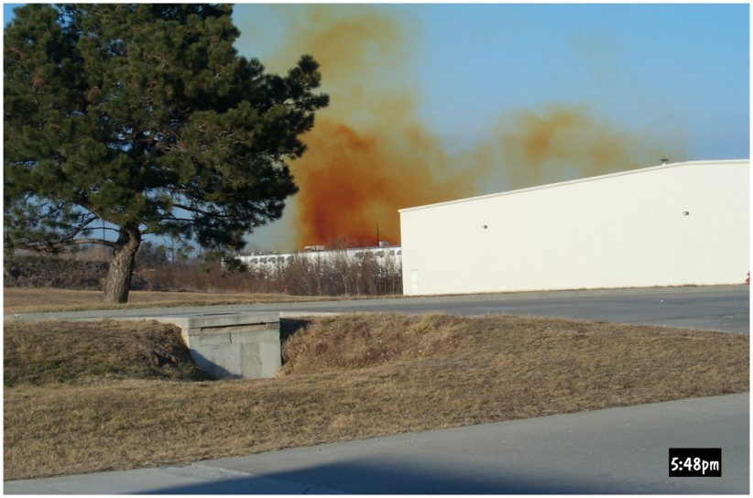
Activity 3.1: Example 1

Slide 10
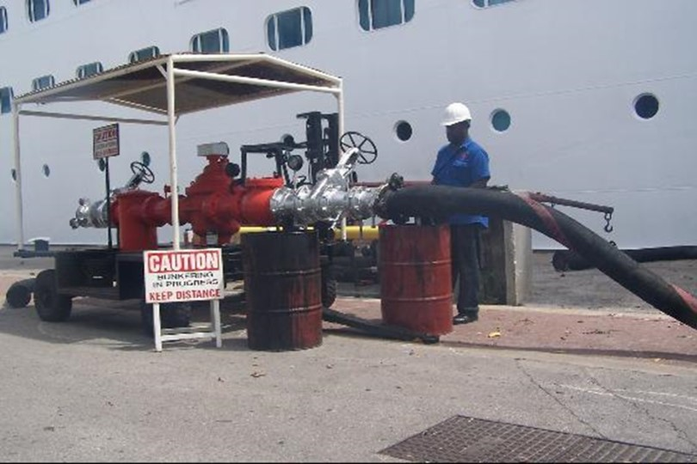
Activity 3.1: Example 2

Slide 11
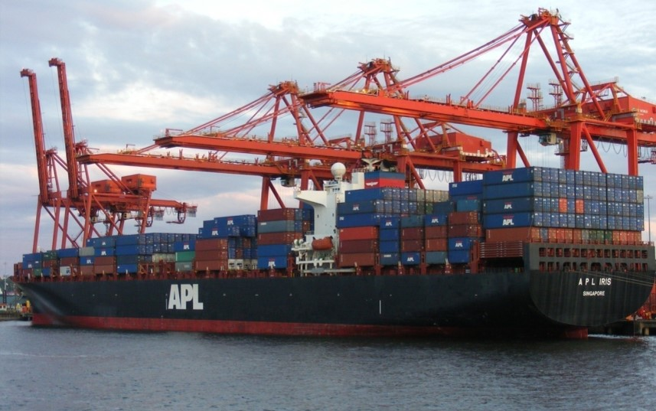
Activity 3.1: Example 3

Slide 12
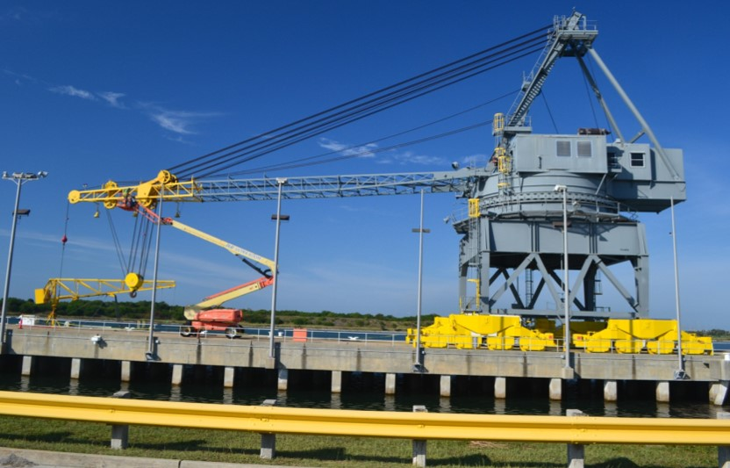
Activity 3.1: Example 4

Slide 13
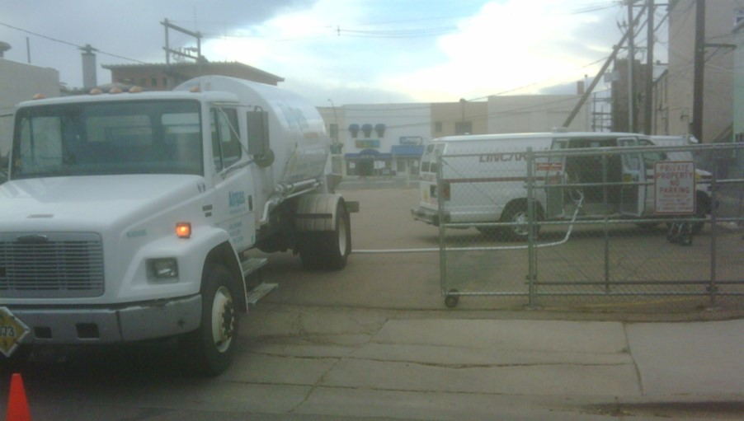
Activity 3.1: Example 5

Slide 14
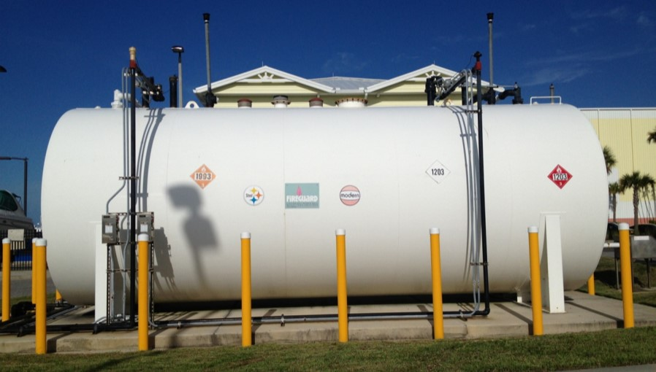
Activity 3.1: Example 6

Slide 15
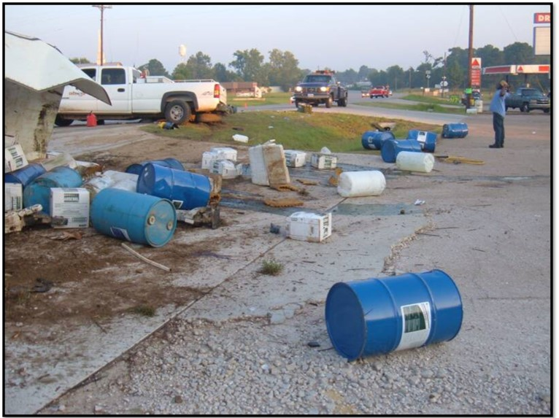
Activity 3.1: Example 7

Slide 16
Ammonia Spill Video
WATCH ON YOU TUBE
https://www.youtube.com/watch?v=sNkdAs1e7Cw
Notes:
Watch on You Tube

Slide 17
Clue 2 :Container/Vehicle Shapes
Container characteristics can indicate content/hazard
  Shape
  Size
  Composition
  Transport vehicle type

Slide 18

Transportation Modes
  Highway
  Railway
  Water
  Air
  Pipeline

Slide 19
Highway Transportation
  Box trailer
  Flatbed
  Dry bulk
  Van
  Tube trailer
  Tank trailer
  Personal or company vehicle
  Approximately 50% of all highway transports are carrying hazardous materials
    Only 50% of these transports containing hazardous materials are required to display placards

Slide 20
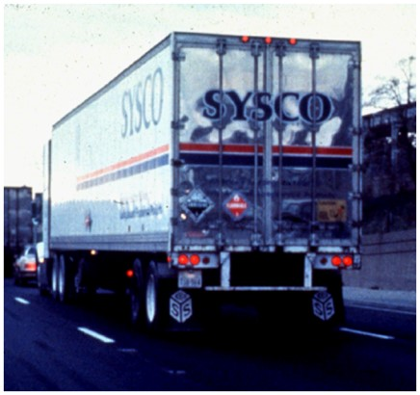
Box Trailer
  Typically mixed cargo
    bags
    boxes
    drums
    tanks
    cylinders
  Several placards or none
  Cargo not visible

Slide 21
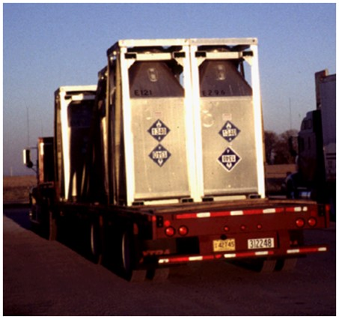
Flatbed
  Large Objects
  Bulk
  Non-bulk
  All classes of hazmat

Slide 22
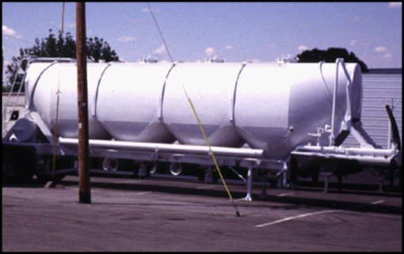
Dry Bulk Cargo Tank
  Carries solid materials
    Dusts
    Powder
    Pellets
  Guide 134
  Materials can be corrosives/oxidizers
  V or W shape on the bottom of trailer

Slide 23
Tank Trailers
  Built to government specifications
    Motor Carrier (MC)
    Dept. of Transportation (DOT)
    Transport Canada (TC)
  Various tank truck diagrams in ERG

Slide 24
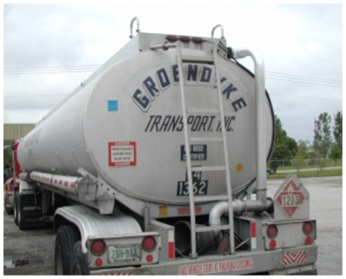
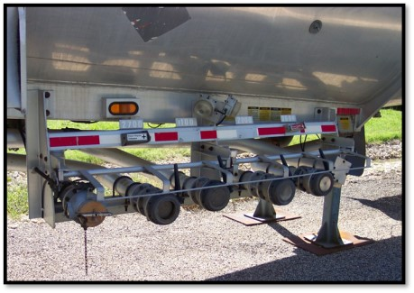
Low Pressure Chemical Tank
MC 306 / DOT 406
  Oval/Elliptical
  Aluminum construction with bottom piping
  Shell may be smooth or external ribs

Slide 25
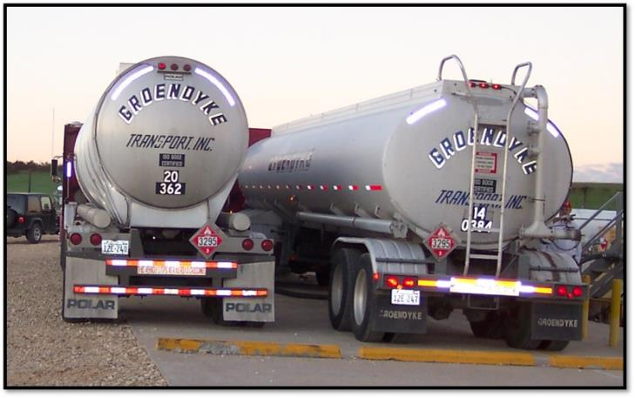
DOT 306 / 406 Compared to
DOT 307 / 407

Slide 26
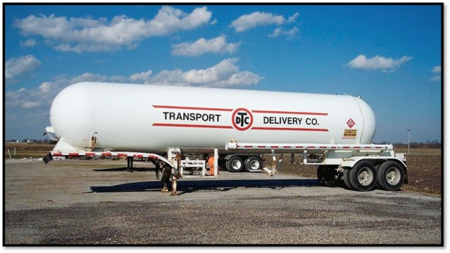
High Pressure Tank MC 331
  Round cross section
    Liquefied petroleum gases
    Liquefied compressed gases
  Subject to “Boiling Liquid Expanding Vapor Explosion” (BLEVE)

Slide 27
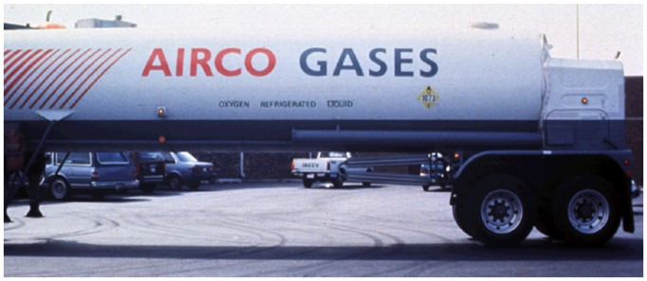
Cryogenic Liquid Tank MC 338
  Gases Transported as liquid
  Product name on each side of trailer
  Large bulky shell with heavy insulation
  Loading station in middle or end of trailed

Slide 28
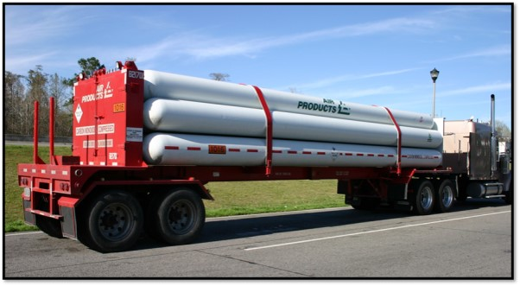
Tube Trailer
  Group of compressed gas cylinders
  Gases under high pressure
  Products carried include
    Helium/Oxygen/Hydrogen
    Refrigerant gases

Slide 29
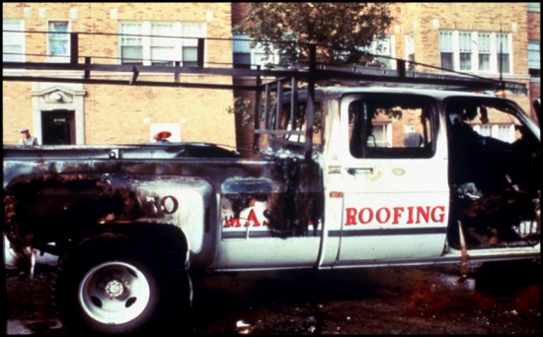
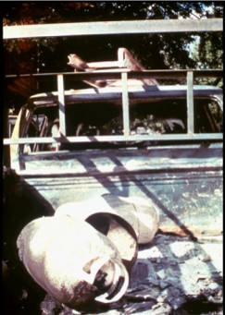
Personal or Company Vehicle
  Awareness.. Do not assume
  Items often transported
    Radioactive pharmaceuticals
    Industrial chemicals
    Household chemicals

Slide 30
Railway Transportation
  High Pressure Tank Car
  Cryogenic Tank Car
  Trailer on a Flat Car (TOFC)
  Container on a Flat Car (COFC)
  Intermodal Tank Car
  Boxcar
  Flatcar
  Gondola
  Covered Hopper Car
  Open Hopper Car
  Low-Pressure Tank Car

Slide 31
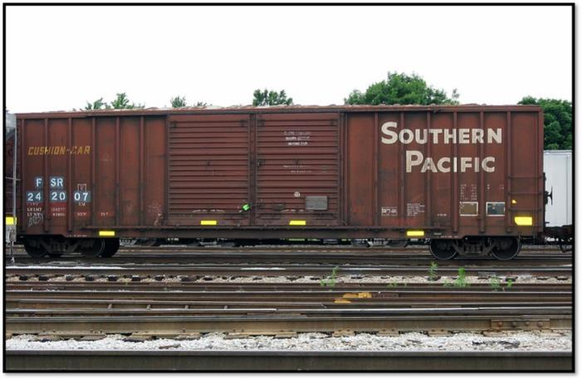
Box Car

Slide 32
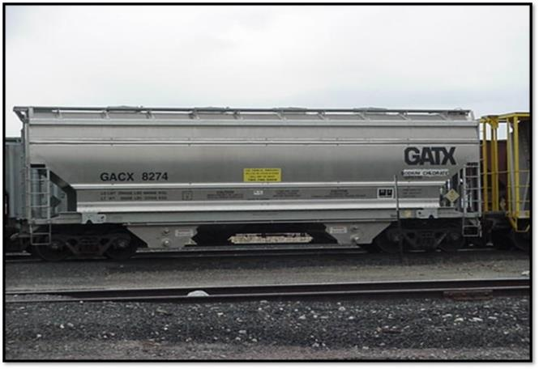
Covered Hopper Car

Slide 33
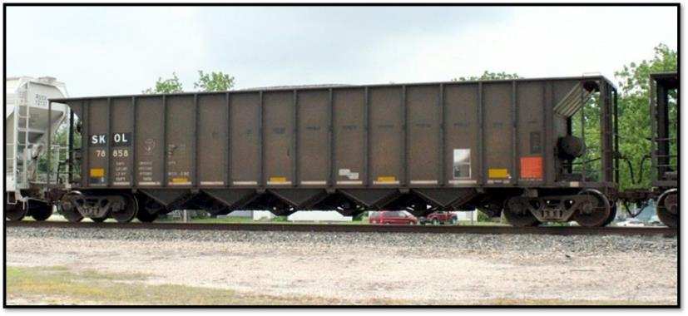
Open Hopper Car

Slide 34
Low-Pressure Tank Car
  Solids – sulfur, phosphorus
  Liquids – industrial solvents, motor fuels, food grade products
  May have 6 compartments
  Tank within a tank
    Outer shell holds insulation over an inner tank

Slide 35
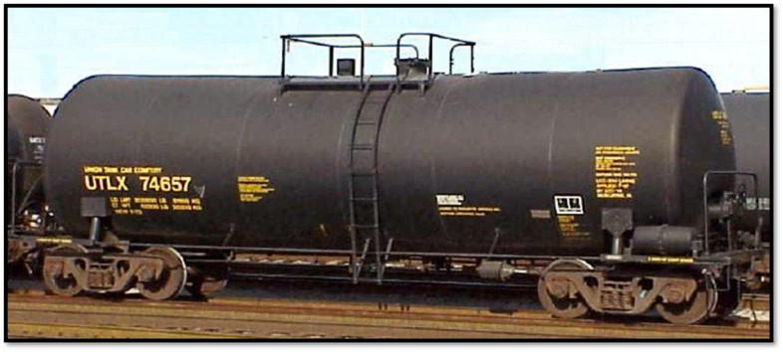
Low-Pressure Tank Car
  Non-pressure may not be accurate description
    Non-pressure may have up to 100 psi
  Man-way and fittings on top of car
  Carry solids that can be liquefied with heat for loading or unloading

Slide 36
Pressure Tank Car
  Large, round protective housing on top contains all valves
  May carry liquefied compressed gases
    Poisons
    Oxidizers
    Asphyxiants
    Other combinations

Slide 37
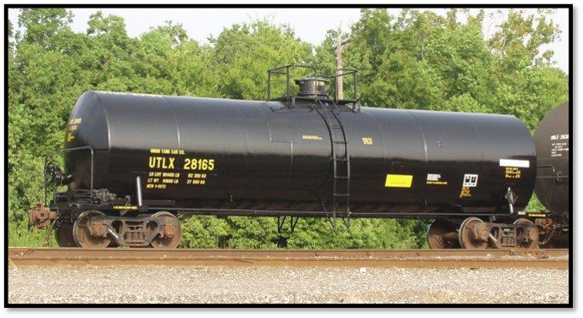
Pressure Tank Car
  Insulated or non insulated
  May have thermal protection coating sprayed on exterior
  May experience BLEVE if involved in fire

Slide 38
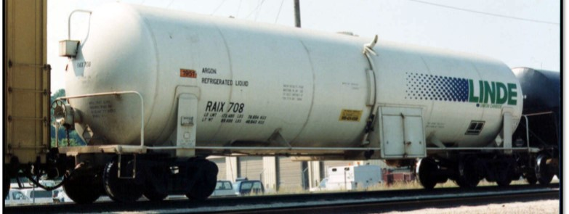
Cryogenic Tank Car
  Tank within a tank
  Loading and unloading fittings underneath at the center or end of car
  Common products shipped
    Nitrogen
    Oxygen
    Carbon monoxide

Slide 39
Intermodal (IM) Containers
  Highway to Rail to Water
  Carry any type of material
  Often affixed to railcars
  May be:
    Trailers
    Box like containers
    Tank supported by frame

Slide 40
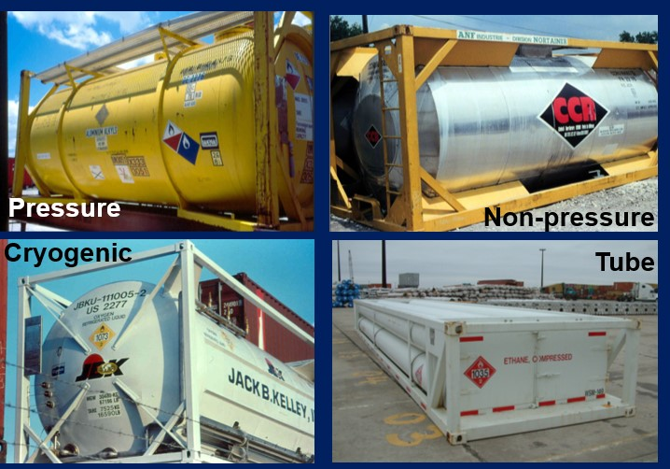
Intermodal (IM) Containers

Slide 41
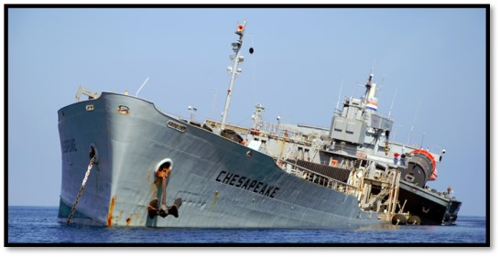
Water Transportation
  Ships and barges
  Large quantities of product
  Large problems during an incident

Slide 42
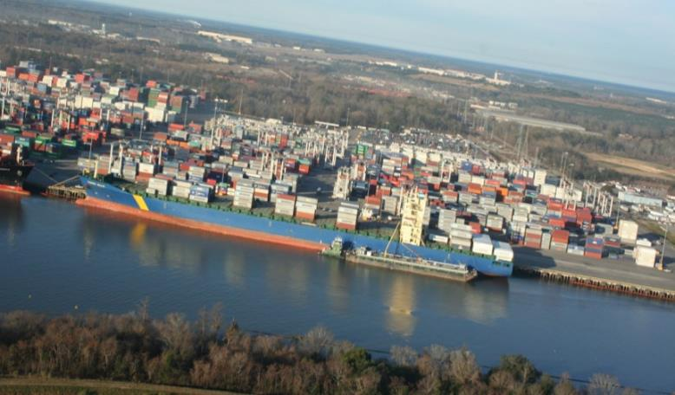
River Port

Slide 43
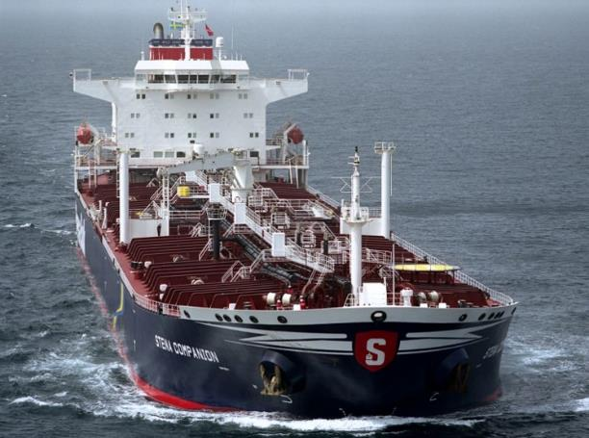
Tanker Ship

Slide 44
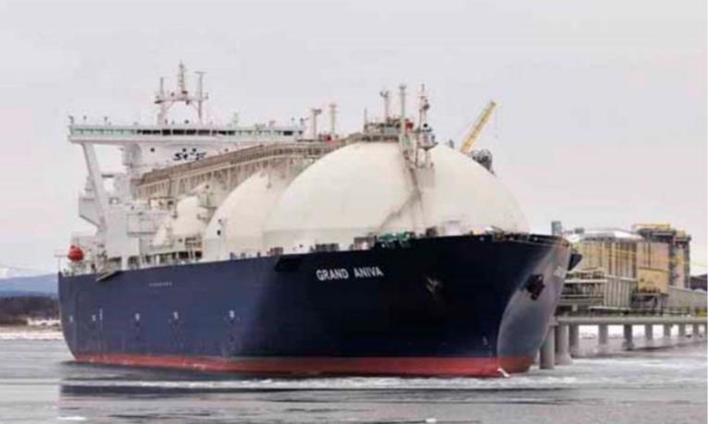
Tanker Ship

Slide 45
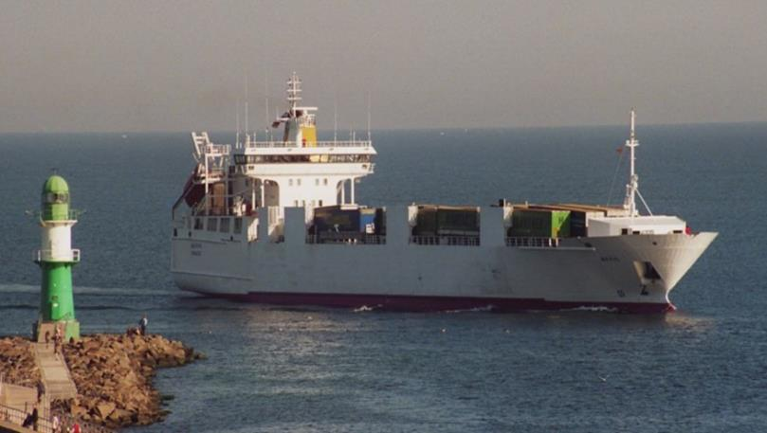
Coastal Trading Vessel

Slide 46
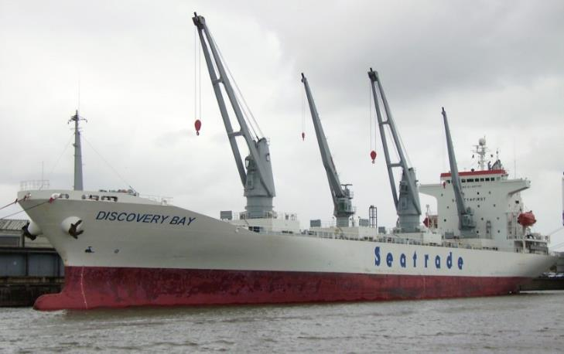
Refrigerator “Reefer” Ship

Slide 47
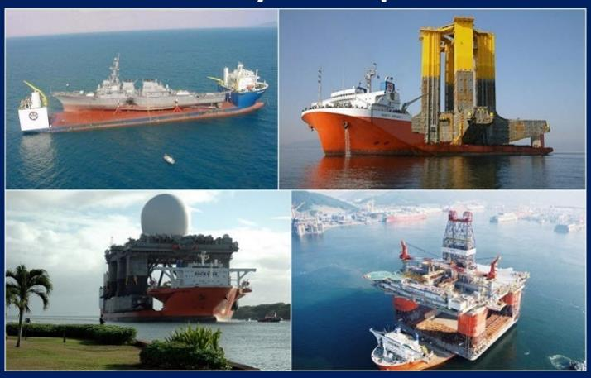
Heavy Lift Ships

Slide 48
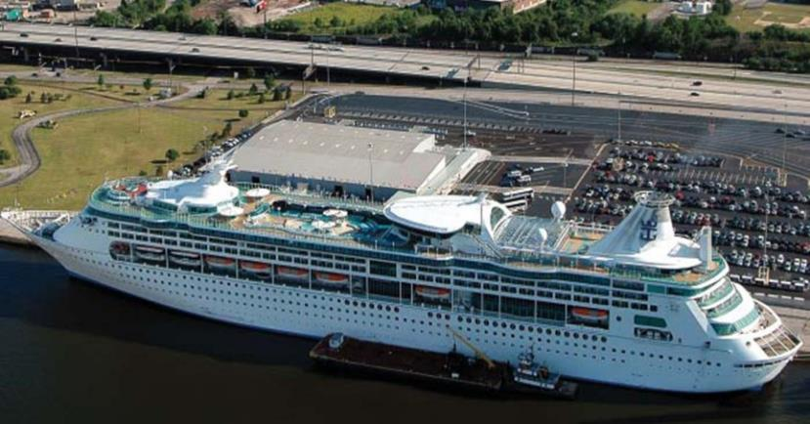
Cruise Ship

Slide 49
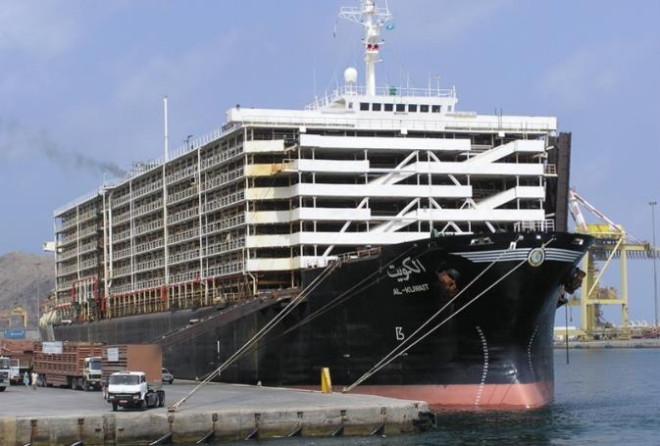
Livestock Vessel

Slide 50
Air Transportation
  Hazmats transported in dedicated cargo planes or passenger planes
  Heavily regulated
  Quantities limited by type of aircraft and chemical
  Aircraft carries large amounts of fuel
  Cargo aircraft uses containers called “Unit Load Device” (ULD)

Slide 51
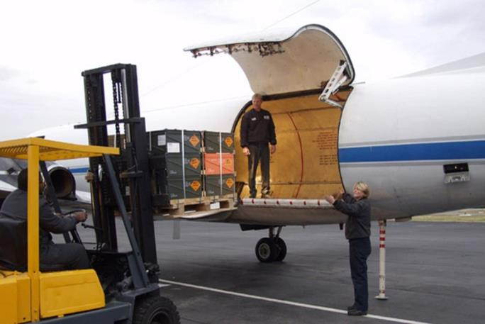
Cargo Plane

Slide 52

Pipeline Transportation
  Below or above ground
  Carries variety of products
  Multiple products may be carried
  High pressures

Slide 53

Pipeline Markers
  Indicate where line crosses or goes under water, roads, residential areas, etc.
  Pipeline rights of way are about 50ft wide

Slide 54
Activity 3.2
Recognizing transportation containers
Using the ERG, view the following slides and identify:
  Location
  Type of occupancy
    Property
    Life
  Material
  ERG page number
  Other useful information

Slide 55
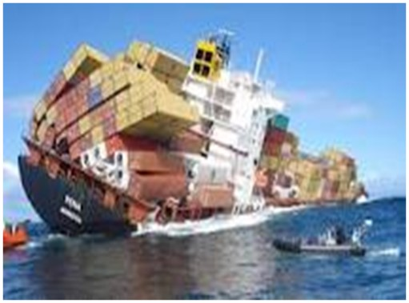
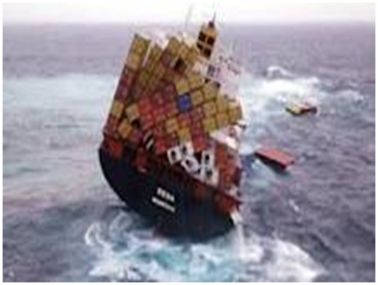
Activity 3.2: Example 1

Slide 56
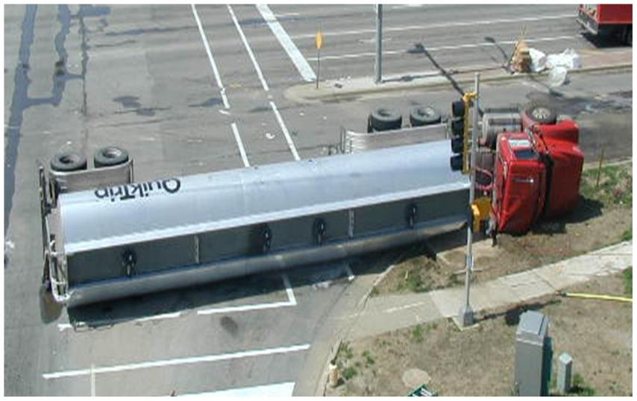
Activity 3.2: Example 2

Slide 57
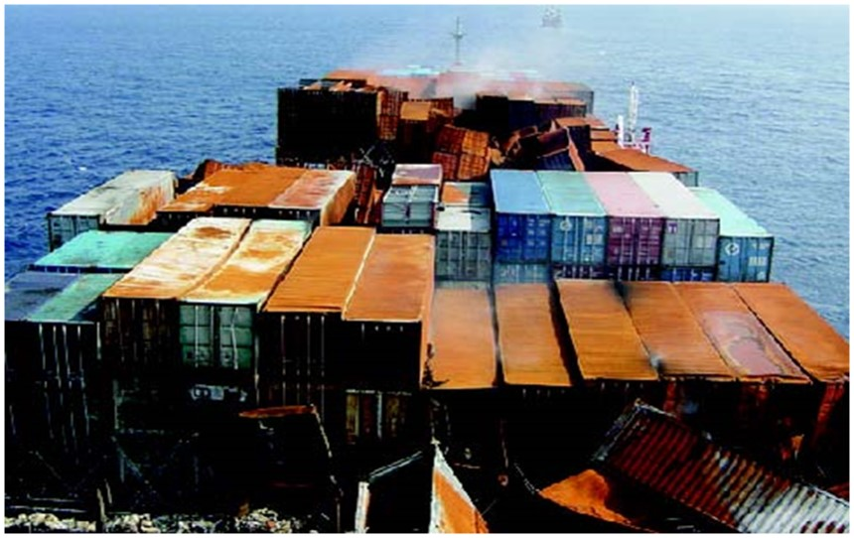
Activity 3.2: Example 3

Slide 58
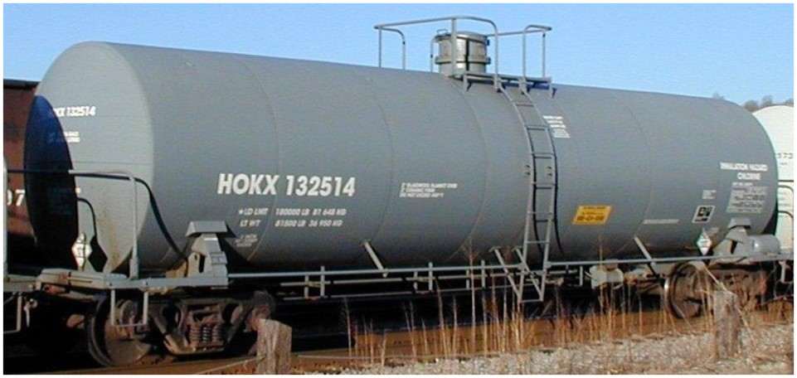
Activity 3.2: Example 4

Slide 59
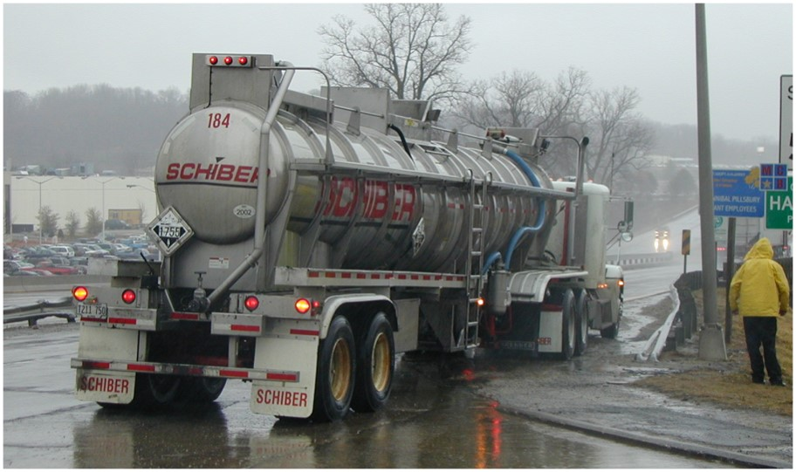
Activity 3.2: Example 5

Slide 60
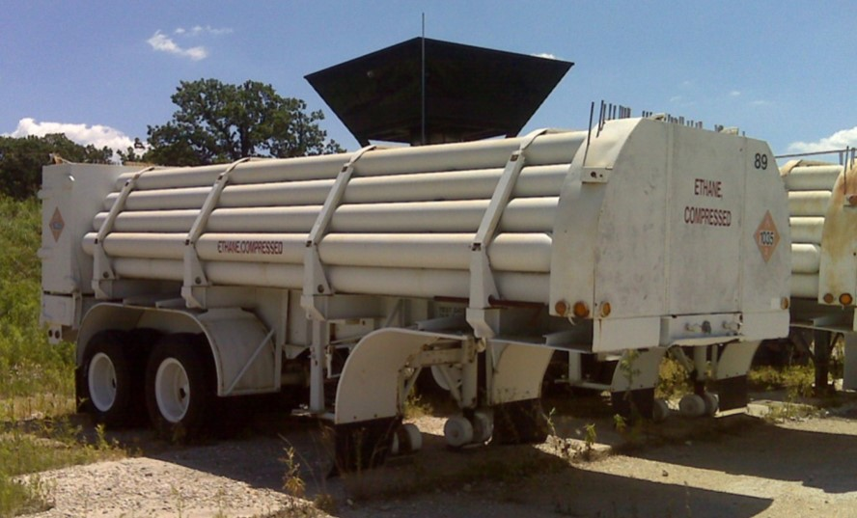
Activity 3.2: Example 6

Slide 61
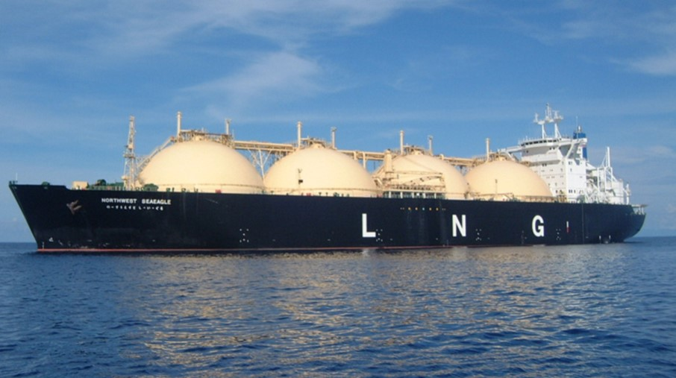
Activity 3.2: Example 7

Slide 62
Fixed-Site Containers
  Various different types of containers
  Potential for large quantities
  Can include transport containers
  Containers are classified by pressure
    Atmospheric: 0 - 5 psi
    Low pressure: 5 - 100 psi
    High pressure: 100 - 3,000 psi
    Ultra high-pressure: > 3,000 psi

Slide 63
Atmospheric
  Contains liquids or solids
  Size range and configurations vary
  Multi-container packages common
  Above and below ground fuel storage tanks
  Types of packaging
    Bags
    Jars
    Boxes
    Totes
    Cans
    Drums
    Liquid Fuel Storage Tanks

Slide 64
Individual Containers
  Smaller quantities
  Various sizes and shapes
  DOT labels affixed to packages for transportation
  Facility markings may be different on non-transport storage or usage

Slide 65
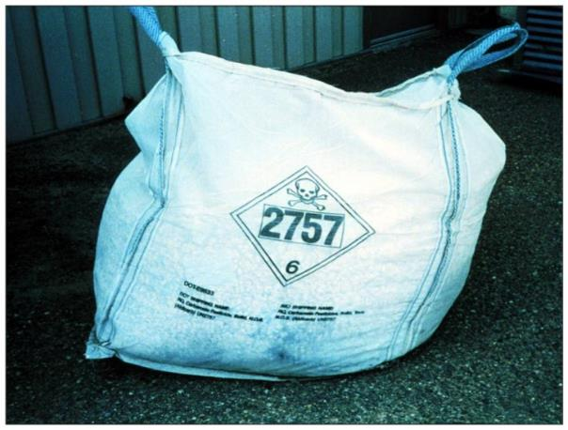
Non-Bulk Bag

Slide 66
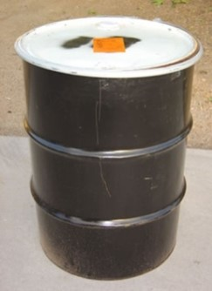
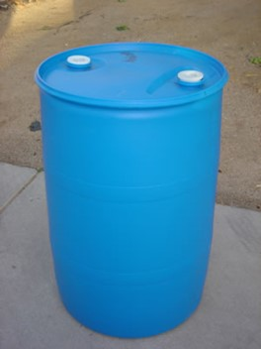
Non-Bulk Containers
Drums
  Construction materials
    Fiberboard
    Metal
    Plastic
  Openings
    Open head, chime/bolt ring
    Tight or closed head,
    bung & inspection holes

Slide 67
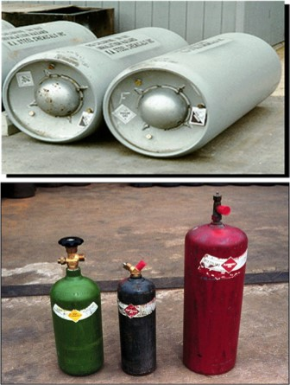
Non-Bulk Containers
Pressurized cylinders
  May hold
    Liquefied or
    non-liquefied gas
    Dissolved gases
    Solids or liquids
    Cryogenics

Slide 68
Low Pressure
  Special Drums
  Equipment/processing
  Storage Tanks
  Pipelines
  Used for Volatile liquids, solids and some gases

Slide 69
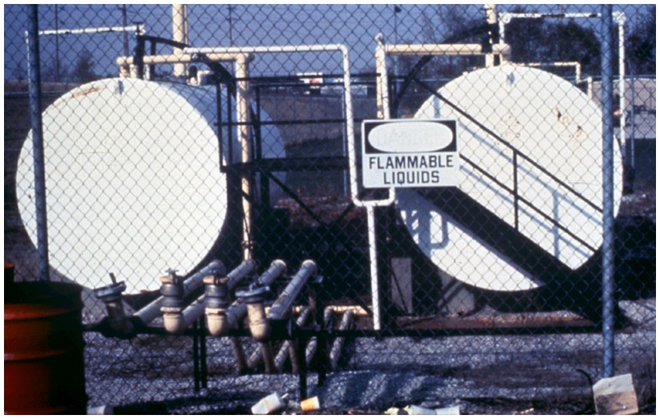
Horizontal Cylindrical Tank

Slide 70
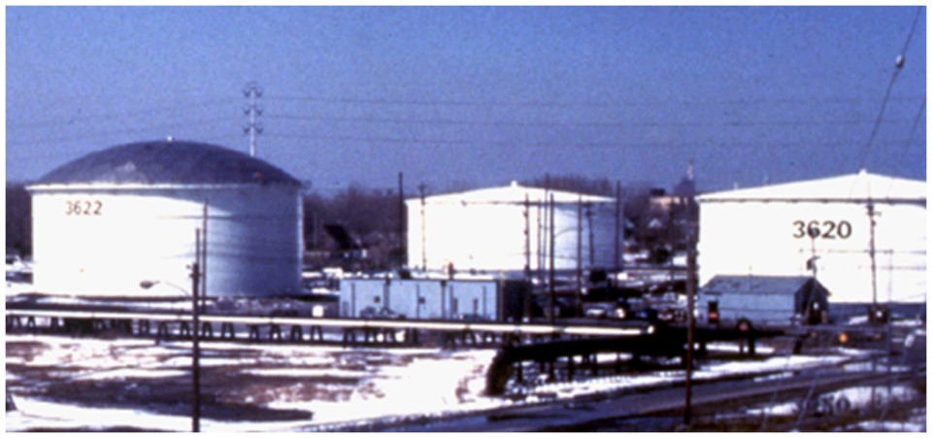
Covered Top Floating Roof Tank with Geodesic Dome

Slide 71
High Pressure
  Cylinders and spheres
    Ex. Medical oxygen cylinders
  Normally contain gases, liquids or powders
  Usually above ground

Slide 72
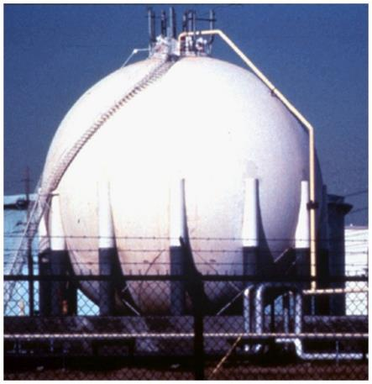
High-Pressure Spherical Tank

Slide 73

High-Pressure Horizontal “Bullet” Tank

Slide 74
Packaging of Radioactive Materials
  Packed and shipped under strict regulations
  Regulations designed to protect:
    Public
    Transportation workers
    Environment
  Packaging depends on form, type, and activity

Slide 75
Types of Packaging
  Excepted
  Strong Tight
  Type A
  Type B

Slide 76
Types of Packaging
Excepted
  For small amounts or radioactivity
  Typical shipping packages
  Not required to be labeled
  Examples:
    Smoke detectors
    Luminous watch dials
    Medical diagnostic kits

Slide 77
Types of Packaging
Strong Tight
  Low Specific Activity (LSA) materials
  Materials from laboratories, power plants, and hospitals
  Type A packaging
    Labeled “RADIOACTIVE LSA”
    Danger is minimal

Slide 78
Types of Packaging
Type A
  Greater amounts of activity
  Designed to hold contents in rough handling
  Amount is specified by radionuclide and form
  Examples
    Radiopharmaceuticals
    Industrial radiography sources
    Research sources

Slide 79
Types of Packaging
Type B
  Highly radioactive
  No recorded failures during transportation
  Designed to hold contents under:
    Extreme accident conditions
    Submersion in water
    Puncture, fall, and thermal extremes

Slide 80

Clue 3: Placards, Labels, and Markings
  Identify presence
  Identify dangers
  Identify products
  Not always uniform

Slide 81
Placards
  10.75 inch diamond
  Color-coded
  Contain symbols
  Applied to sides and ends of containers
  Nine hazard classes, listed on Chart 15
    Table 1 (placard any quantity)
    Table 2 (placard 1,001 lbs. or more)

Slide 82

Class 1: Explosives

Slide 83

Class 2: Gasses

Slide 84

Class 3: Flammable Liquids

Slide 85

Class 4: Flammable Solids

Slide 86

Class 5: Oxidizers

Slide 87

Class 6: Toxic Materials

Slide 88

Class 7: Radioactive Materials

Slide 89

Class 9: Miscellaneous

Slide 90

Class 9: Miscellaneous

Slide 91


Marine Pollutant

Slide 92

Dangerous Placard

Slide 93
Labels
  4 inch square
  Scaled-down version of placards
  Used on individual packages
  Typically found in one or two locations on package
  Multiple products
    Primary label
    Subsidiary label for each hazard

Slide 94
Clue 4: Non-Transportation Markings and Colors
  NFPA 704
  Hazard Communications
  Container Markings and Stencils
  Military Markings

Slide 95

National Fire Protection Association (NFPA) 704
  Requirements for fixed-site locations
  Identifies hazards and dangers
  4-quadrant diamond
  Color and numeric identifiers

Slide 96


NFPA 704 Diamond

Slide 97
Hazard Communications
  Referred to as Hazardous Materials Information System (HMIS)
  Colored bars or diamonds
  Similar to NFPA 704
  Found on individual containers
  For normal work environments, not for emergencies

Slide 98

Hazardous Materials
Information System (HMIS)

Slide 99
DOT HAZMAT Markings
  Hot Marking - used on elevated temperature products
  Marine Pollutant - products known to pollute water
  Inhalation Hazard – products that are poisonous when inhaled
  Infectious Substances - products that may affect public health (Class 6)

Slide 100



Markings

Slide 101
Railcar Stencils
  Reporting marks and number
    Left end when facing tank car
    Weight/volume
  DOT specifications
    Right end when facing tank car
    Tank material
    Test pressure/relief settings
    Product name (dedicated cars)
  Listed in ERG

Slide 102

Tank Car Markings
Car Initial & Number
(reporting marks)
Specification
Stencil
ABCX 123456
SAFETY VALVE 75 PSI
TESTED 00/00/00
DUE 00/00/00
TANK 100 PSI
DUE 00/00/00
LD LMT 000000 lb 00000 kg
Weight Limit
Water Capacity
Stencil

Slide 103


Reporting Rail & Intermodal Markings
  Markings can be thought of as “license plates”
  Shipping papers
  Locations
    Upper left on the side of railway cars
    Top center on railway tank heads
    Upper right on the sides and ends of intermodal containers

Slide 104

Military Markings

Slide 105
Activity 3.3
Recognizing Placards and Markings
Using the ERG, view the following slides and identify:
  Placard
  Class
  Material
  ERG page number
  Other useful information

Slide 106


Activity 3.3: Example 1

Slide 107


Activity 3.3: Example 2

Slide 108


Activity 3.3: Example 3

Slide 109


Activity 3.3: Example 4

Slide 110


Activity 3.3: Example 5

Slide 111


Activity 3.3: Example 6

Slide 112
Clue 5: Written Resources
  Manifest/Shipping Papers
  Material Safety Data Sheets (MSDS)
  Safety Data Sheets (SDS) – GHS
  NIOSH

Slide 113
Clue 5: Written Resources
DOT Required Description
  Proper shipping name
  Hazard class or division
  ID number
  Packing group
  Quantity

Slide 114
Shipping Papers
  Each mode of transportation has a specific name and location for its manifest/shipping papers
  Person in charge of vessel/vehicle must maintain these papers
  Shipping paper details
    No abbreviations (unless DOT approved)
    Emergency response phone number
    Quantity of material
    Number of containers

Slide 115
Types of Shipping Papers
Highway
  Name: Bill of Lading
  Location: Cab or driver
Railway
  Name: Consist or Waybill
  Location: Crew or engine
Waste
  Name: Hazardous Waste Manifest
  Location: Person in charge of vessel/vehicle
Water
  Name: Dangerous Cargo Manifest
  Location: Ship Captain, wheelhouse, or special container in barges
Air
  Name: Air Bill
  Location: Pilot or cockpit

Slide 116
Safety Data Sheets
Material Safety Data Sheet (MSDS)
  Format not regulated by 29 CFR 1910.1200
  Style and content vary
Safety Data Sheet (SDS)
  Global Harmonization System (GHS)
  Format is regulated

Slide 117
16-Section Safety Data Sheet
Identification of the substance
or mixture and of the supplier
Hazards identification
Composition/information on ingredients Substance/Mixture
First aid measures
Firefighting measures
Accidental release measures
Handling and storage
Exposure controls/personal protection
Physical and chemical properties
Stability and reactivity
Toxicological
Ecological information
(non mandatory)
Disposal considerations
(non mandatory)
Transport information
(non mandatory)
Regulatory information
(non mandatory)
Other information including information on preparation and revision of the SDS

Slide 118
Locating Safety Data Sheets
  Required at fixed facilities
  Might be with shipping papers
  Shipper/Manufacturer
  CHEMTREC
  LEPC
  On-line or paper collections

Slide 119
Clue 6: Senses
  Vision
    Colored clouds or fumes
    Containers that are dented, punctured, or on their side
  Hearing
    Sirens/alarms
    Chemical reactions occurring in containers (bubbles, popping, etc.)
  Smell
    Scent can be the first sign of a chemical leak/spill

Slide 120
Summary
  Occupancy/Location
  Container/Vehicle Shapes
  Placards, Labels, and Markings
  Non-Transportation Markings and Colors
  Written resources, Safety Data Sheets
  Senses

