Slide 1
Hazardous Materials Safety & Security
Awareness Training
Section II
Utilizing the 2016 Emergency Response Guide

Slide 2
Funding Acknowledgement
This material was produced under grant number SH-31200-SH7 from the Occupational Safety and Health Administration, U.S. Department of Labor. It does not necessarily reflect the views or policies of the U.S. Department of Labor, nor does mention of trade names, commercial products, or organizations imply endorsement by the U.S. Government.

Slide 3
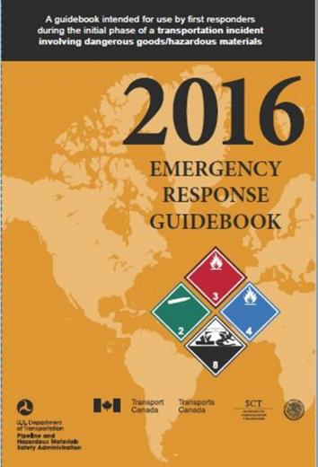
2016 Emergency Response Guide

Slide 4
Section II Objective
  Demonstrate how to use the 2016 Emergency Response Guidebook (ERG)

Slide 5
ERG History
  Developed jointly by Transport Canada, U.S. DOT and SCT of Mexico with collaboration of CIQUIME of Argentina
  DOT Transportation incidents
  Updated every Four Years

Slide 6
Primary ERG Sections
  Table of Placards (pages 7-9)
  Railcar and Road Trailers (pages 10-13)
  Yellow Section (ID numbers)
  Blue Section (name of material)
  Orange Section (guide pages)
  Green Section (isolation and protective distances)

Slide 7
Using the ERG (page 1)
  Resist rushing in!
  Approach Incident from upwind, uphill, or upstream
  Stay clear of all spills, vapors, fumes, smoke, and potential hazards
Warning: Do not use the ERG flowchart if more than one hazardous material/dangerous good is involved.

Slide 8
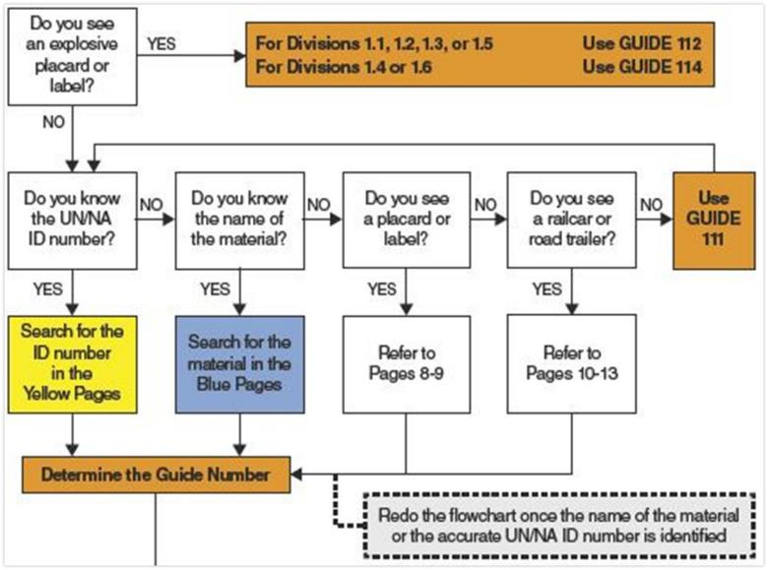
ERG Flowchart

Slide 9
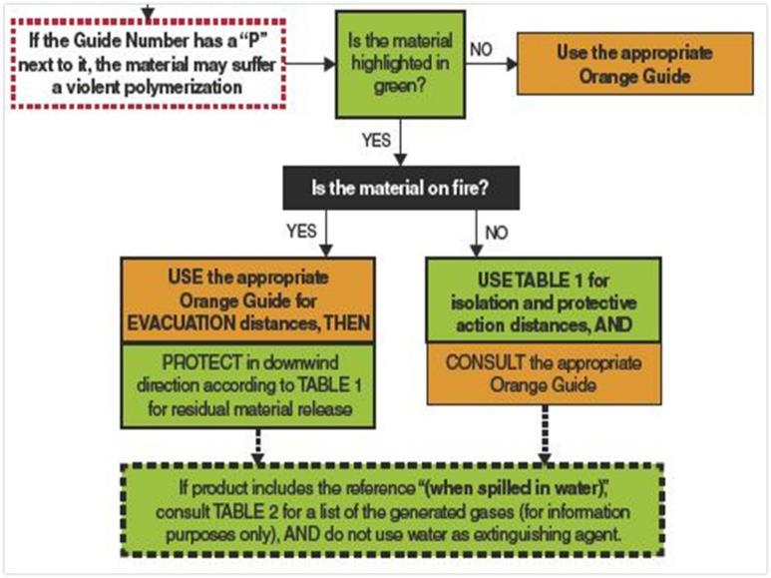
ERG Flowchart

Slide 10
Safety Precautions
Resist Rushing In (Page 4)
  Secure the scene
  Identify the hazard
  Assess the situation
  Obtain help
  Respond
  Be cautious

Slide 11
Informational Sections
  Manifest/Shipping Papers (inside cover)
  How to use the ERG (page 1)
  Hazard classification system (page 6)
  Hazard Identification Numbers (page 16-19)
  Pipeline Transportation (pages 20-25)

Slide 12
Additional Information
  Protective Actions (pages 291-292)
  Protective Clothing (pages 363-364)
  Fire and Spill Control (pages 365-367)
  Criminal / Terrorist Use of Chemical / Biological / Radiological Agents (pages 370-375)
  Glossary (pages 376-389)

Slide 13
Table of Marking, Labels, and Placards
  Transportation Placards for dangerous are located on pages 8 and 9
  Placards are grouped with a corresponding 3-digit Guide Page Number that can be referenced to the Orange section
  Placards should only be used for identification if the UN/NA ID Number or the name of the material are unavailable

Slide 14
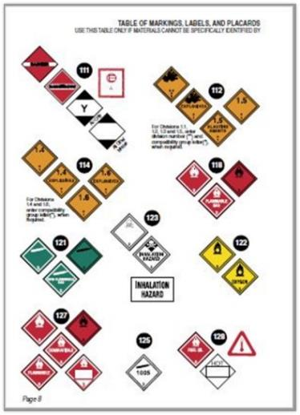
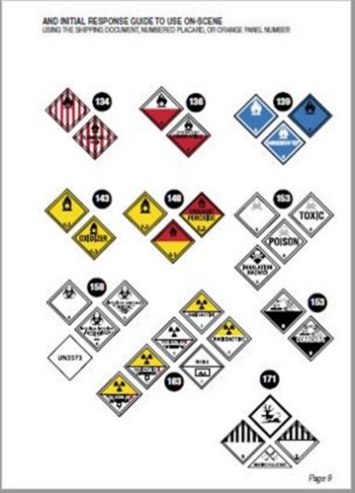
Table of Placards

Slide 15
Railcar and Road Trailers
  Generalized shapes of railcars and road trailers used for transporting dangerous goods
  Shapes are associated with a 3-digit guide number from the Orange section
  Railcar and Road Trailer Shape Guide references should be used only if product name, UN/NA number, and transportation placards can not be identified

Slide 16
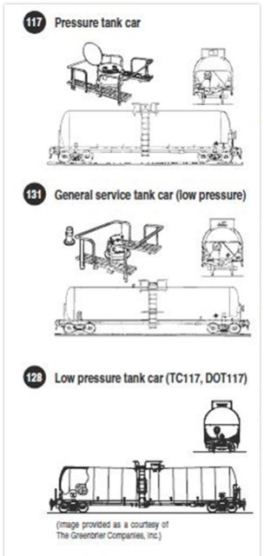
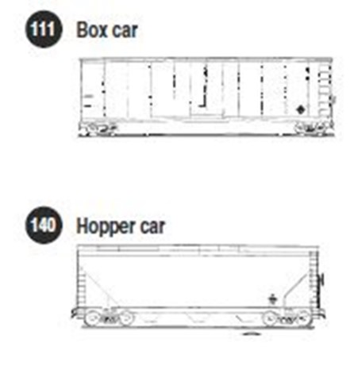
Railcar and Road Trailers

Slide 17
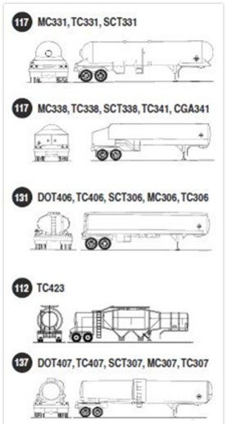
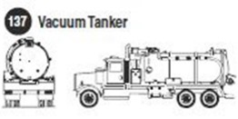
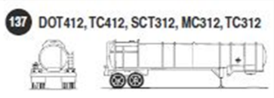
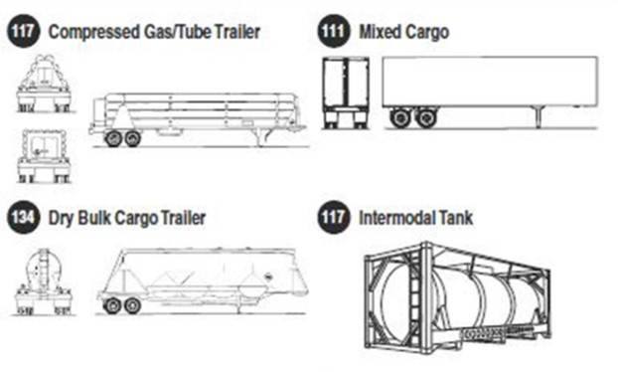
Railcar and Road Trailers

Slide 18
Globally Harmonized System of the Classification and Labeling of Chemicals
The pictogram is part of the GHS label, which also includes the following information:
  Signal word
  Hazard statement
  Precautionary statements
  Product identifier
  Supplier identification

Slide 19
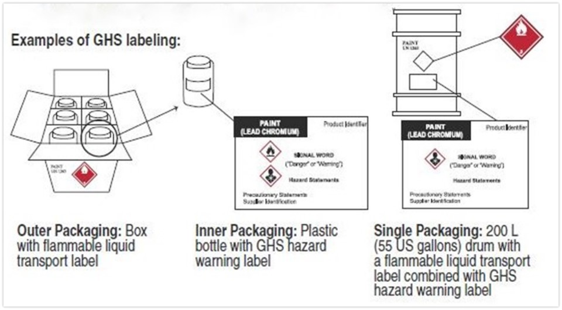
GHS Labeling

Slide 20
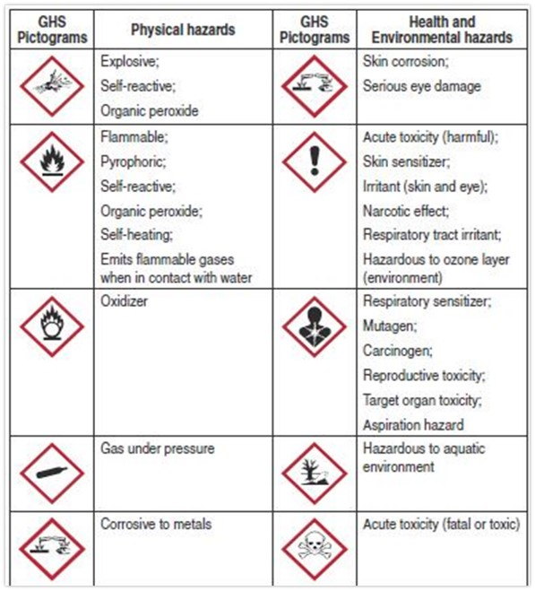
GHS Pictograms

Slide 21
Pipeline Transportation
Natural Gas Pipelines
  Transmission pipelines
  Distribution pipelines
  Gas-gathering and well production pipelines
Liquid Petroleum and Hazardous Liquid Pipelines
  Liquid petroleum pipelines
  Other hazardous liquid pipelines

Slide 22
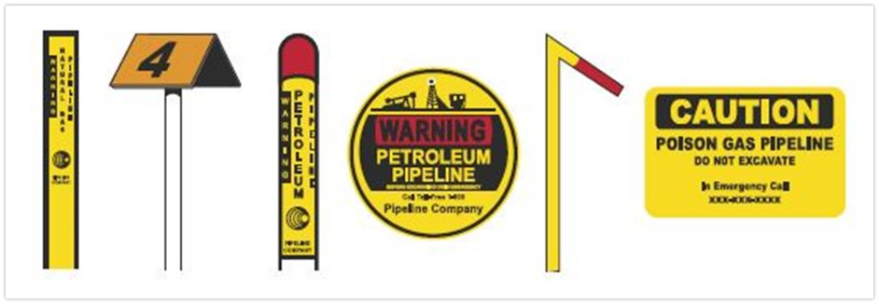
Pipeline Markers

Slide 23
Yellow Bordered Pages
  Numerical order by 4-digit UN/NA number
  UN number followed by 3-digit Orange section guide page number and name of material
  Items highlighted in Green have special considerations

Slide 24
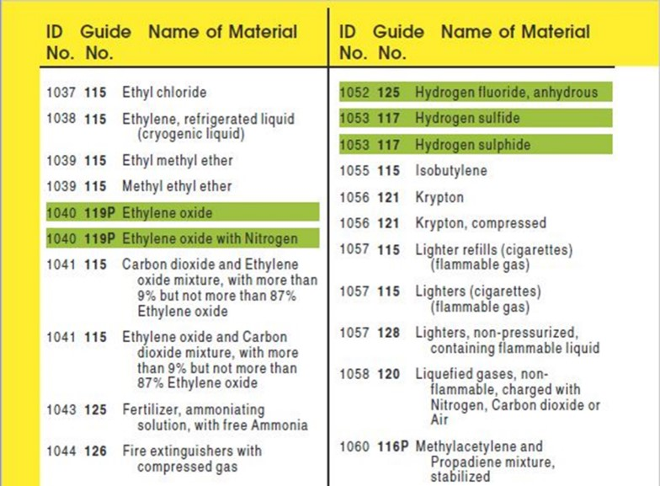
Yellow Bordered Pages

Slide 25
Blue Bordered Pages
  Alphabetical order of dangerous goods by shipping name
  Shipping name followed by 3-digit Orange section guide page number and 4-digit UN/NA number
  Items highlighted in Green have special considerations

Slide 26
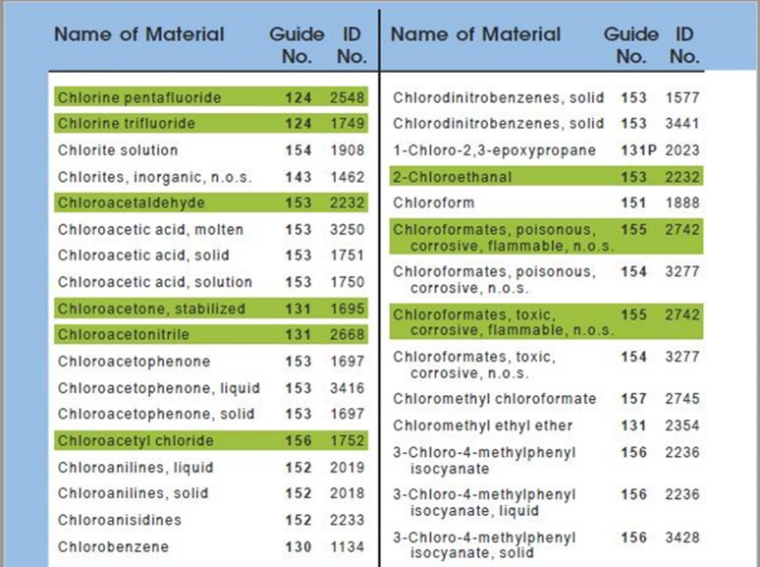
Blue Bordered Pages

Slide 27
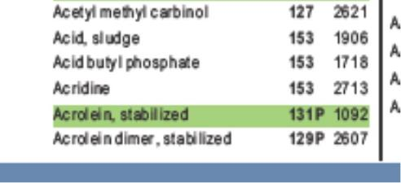
Polymerization
When the letter “P” follows guide number
  A material which presents a polymerization hazard under certain conditions
  Ex. Acrolein, stabilized, Guide 131P

Slide 28
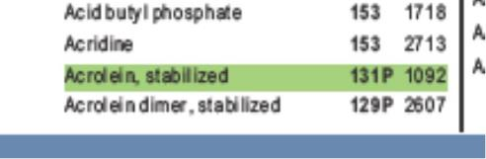
Chemicals Highlighted in Green
  Materials toxic by inhalation
  Water reactive
  Some chemical warfare agents
  Require Isolation and Protective Action Distances when NOT on fire
  Go to Green bordered pages
  Tables 1 & 3 updated based on new Toxic Inhalation Hazard (TIH) data

Slide 29
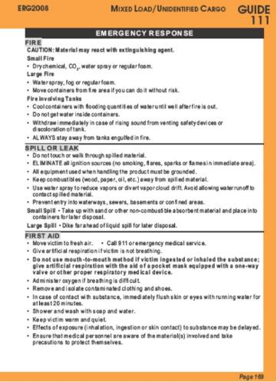
Orange Bordered Pages
Emergency Action Guides
  2-page format identified by 3-digit number
  Provides guidance for first responders
  Not applicable when materials of different classes or divisions are involved

Slide 30
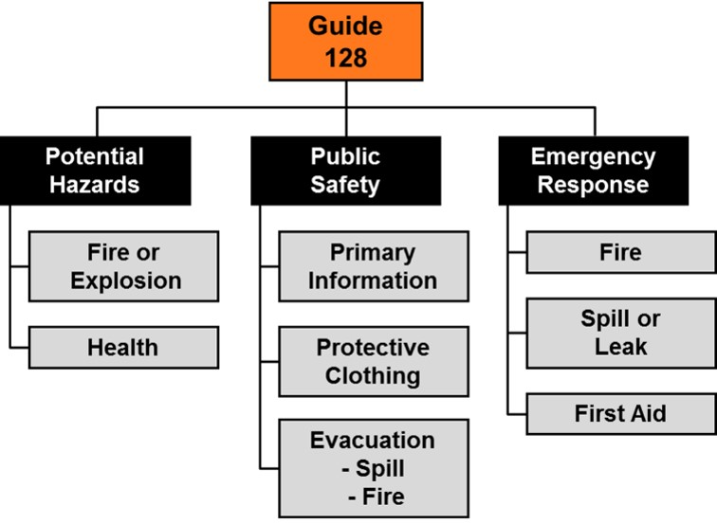
Orange Bordered Pages

Slide 31
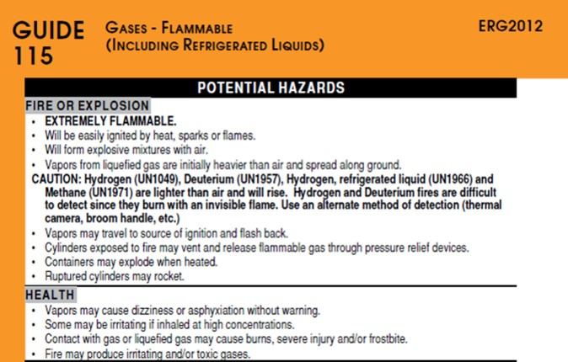
Potential Hazards
  Fire or Explosion
  Health

Slide 32
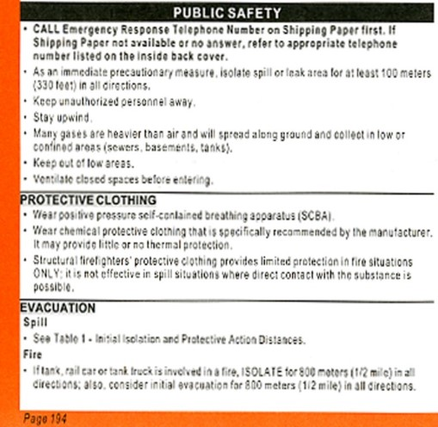
Public Safety
  Initial isolation distance
  Protective clothing recommendation
  Evacuation distance

Slide 33
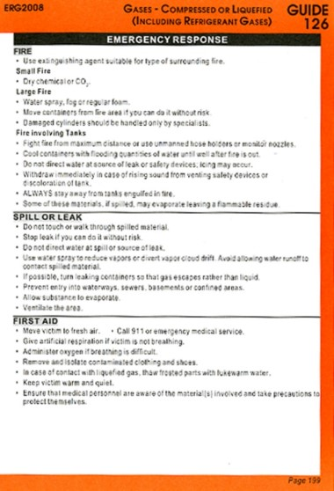
Emergency Response
  Fire
  Spill or leak
  First aid

Slide 34
Isolation Distance / Evacuation
In the Yellow and Blue sections, if the substance is NOT highlighted in Green
  Use the distances suggested in the Orange section
In the Yellow and Blue sections, if the substance IS highlighted in Green
  If there is no fire, use Green Table 1
  If there is a fire, or fire is involved, use the distances suggested in the Orange section

Slide 35
Green Bordered Pages
Contains the following sections:
  Table 1 – Initial Isolation and Protective Action Distances
  Table 2 – Water-Reactive Materials which Produce Toxic Gases
  Table 3 – Initial Isolation and Protective Action Distances for Different Quantities of Six Common TIH Gases

Slide 36
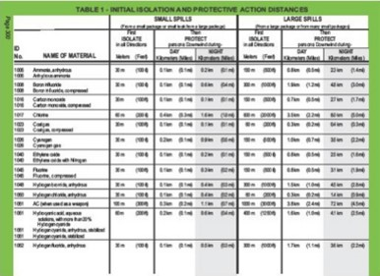
Table 1 – Initial Isolation and Protective Action Distances
Distances to protect people from vapors during a spill from a dangerous good that is:
  Toxic Inhalation Hazard (TIH)
  Chemical warfare agent
  Water reactive

Slide 37
Table 1 – Initial Isolation and Protective Action Distances
Table provides distances for:
  Initial Isolation Zone
  Protective Action Zone, downwind, for day and night
Distances show the areas likely to be affected during the first 30 minutes after the materials are spilled, and this distance could increase with time.

Slide 38
Small and Large Spills
Small Spill
  Less than 208 liters (55 U.S. gallons) for liquids and less than 300 kilograms (660 pounds) for solids
  Generally a single small package, a small cylinder, or a small leak from a large package
Large Spill
  Greater than 208 liters (55 U.S. gallons) for liquids and greater than 300 kilograms (660 pounds) for solids
  Generally a spill from a large package, or multiple spills from many small packages

Slide 39
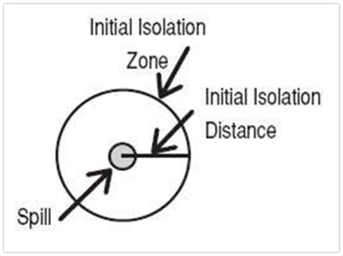
Initial Isolation Zone
Area SURROUNDING the incident in which persons may be exposed to dangerous (upwind) and life threatening (downwind) concentrations of material

Slide 40
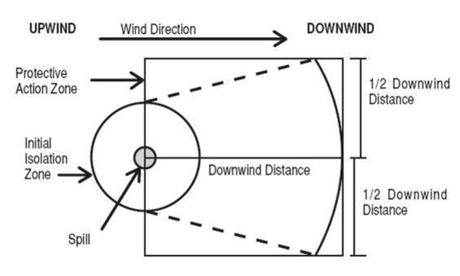
Protective Action Zone
Area DOWNWIND from the incident in which persons may become incapacitated and unable to take protective action and/or incur serious or irreversible health effects.

Slide 41
Table 2 – Water-Reactive Materials which Produce Toxic Gases
  List of materials which produce large amount of Toxic Inhalation Hazard (TIH) gases when spilled in water and identifies the TIH gases produced
  Substances are presented in numerical order of their ID Numbers
  Easily identified in Table 1 as their name is immediately followed by When Spilled in Water

Slide 42
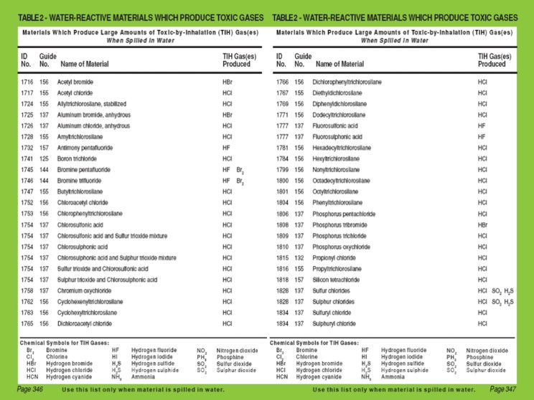
Table 2 – Water-Reactive Materials which Produce Toxic Gases

Slide 43
Table 3 – Initial Isolation and Protective Action Distances for Six Common TIH Gases
Six Toxic Inhalation Hazard (TIH) gasses commonly encountered:
  Ammonia, anhydrous (UN1005)
  Chlorine (UN1017)
  Ethylene oxide (UN1040)
  Hydrogen chloride, anhydrous (UN1050) and Hydrogen chloride, refrigerated liquid (UN2186)
  Hydrogen fluoride, anhydrous (UN1052)
  Sulfur dioxide/Sulphur dioxide (UN1079)

Slide 44
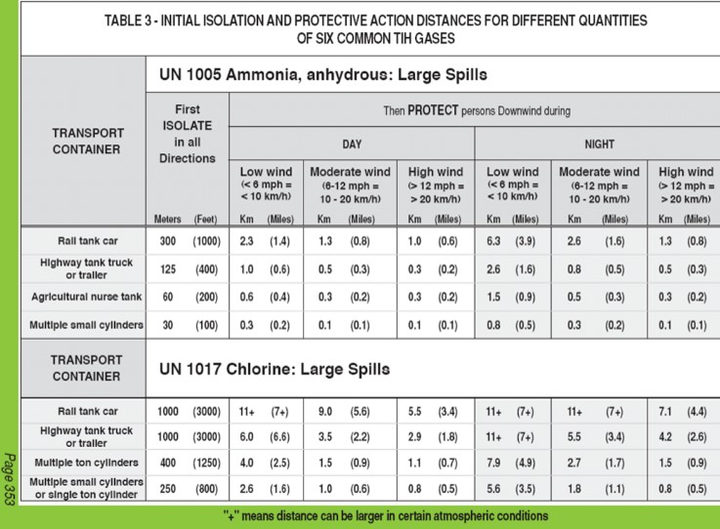
Table 3 – Initial Isolation and Protective Action Distances for Six Common TIH Gases

Slide 45
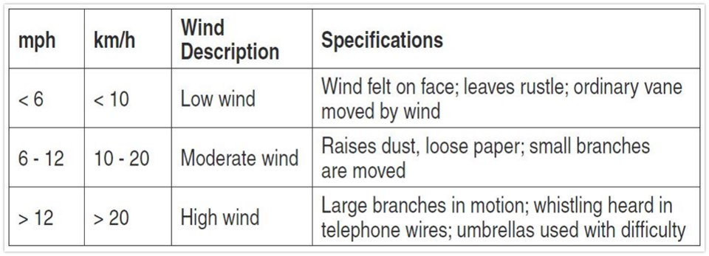
Estimating Wind Speed from Environmental Clues

Slide 46
Boiling Liquid Expanding Vapor Explosion (BLEVE)
  Occurs when a container holding a pressurized liquefied gas fails catastrophically
  Catastrophic failure of the vessel is followed by the explosive release of boiling liquid and expanding vapor
Note: A BLEVE can occur even if the material is non-flammable

Slide 47
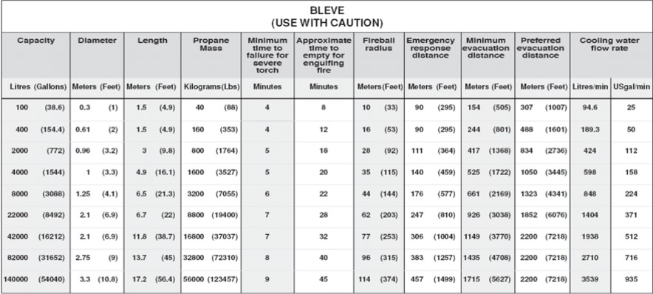
BLEVE
Table summarizing tank properties, critical times, critical distances, and cooling water flow rates for various tank sizes that may be involved in a BLEVE

Slide 48
Emergency Response Telephone Numbers
CHEMTREC®, a 24-hour emergency response communication service: 1-800-424-9300
CHEMTEL, INC., a 24-hour emergency response communication service 1-888-255-3924
INFOTRAC, a 24-hour emergency response communication service: 1-800-535-5053
3E COMPANY, a 24-hour emergency response communication service: 1-800-451-8346
See ERG page 397

Slide 49
Activity 1.1 Worksheet
  Use the Emergency Response Guidebook
  Work in pairs or small groups
  20 minutes to complete
  Review in class

Slide 50
Summary
  Sections of the ERG
    Table of Placards (pages 7-9)
    Railcar and Road Trailers (pages 10-13)
    Yellow Section (ID numbers)
    Blue Section (name of material)
    Orange Section (guide pages)
    Green Section (isolation and protective distances)
  How to use the ERG

