Slide 1
Introduction to Lathe Safety
This material was produced under Susan Harwood grant number SH-31214-SH7 Occupational Safety and Health Administration, U.S. Department of Labor. The contents in this presentation do not necessarily reflect the views or policies of the U.S. Department of Labor, nor does the mention of trade names, commercial products, or organizations imply endorsement by the U.S. Government.

Slide 2
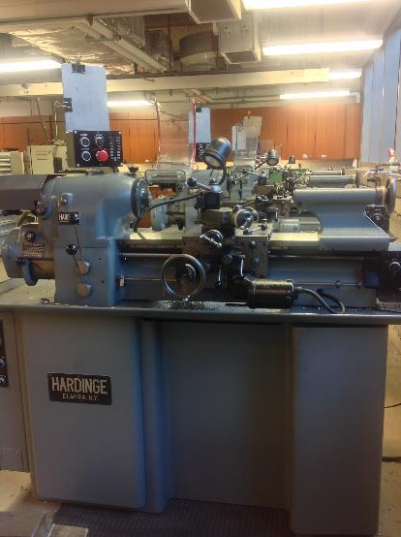
Introduction: What’s a Lathe?
The lathe is a machine tool used principally for shaping pieces of metal (and sometimes wood or other materials)
It works by rotating the workpiece itself while a tool bit is advanced into the piece to perform a cut
Several lathes in a machine shop
Notes:
The basic lathe that was designed to cut cylindrical metal stock has been developed further to produce screw threads, tapered work, drilled holes, knurled surfaces, and crankshafts.

Slide 3
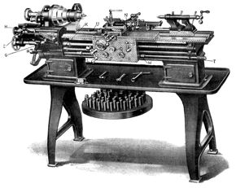
Introduction: Early lathes
Early turning machines date back to ancient times
One of the first modern examples of the lathe was patented by David Wilkinson in 1798
The Wilkinson Lathe was able to cut screw threads, an important development in the machine tool industry
An early version of the lathe

Slide 4
Safety: Who is OSHA?
With the Occupational Safety and Health Act of 1970, Congress created the Occupational Safety and Health Administration (OSHA) to assure safe and healthful working conditions for working men and women by setting and enforcing standards and by providing training, outreach, education and assistance.
OSHA is part of the United States Department of Labor. The administrator for OSHA is the Assistant Secretary of Labor for Occupational Safety and Health. OSHA's administrator answers to the Secretary of Labor, who is a member of the cabinet of the President of the United States.
Notes:
OSHA was started to protect workers in the work place. Before OSHA there was no organization that tracked work place injuries. There were also no safety standards for employers.
OSHA has 2 branches, the Enforcement Branch and the Collaboration Branch.
The Enforcement Branch investigates complaints and serious accidents.
The Collaboration Branch works on education, such as the Susan Harwood Grant.

Slide 5
Safety: Know your rights
Under federal law, you are entitled to a safe workplace.
Your employer must provide a workplace free of known health and safety hazards.
If you have concerns, you have the right to speak up about them without fear of retaliation. You also have the right to:
Be trained in a language you understand
Work on machines that are safe
Be provided required safety gear, such as gloves or a harness and lifeline for falls
Be protected from toxic chemicals
Request an OSHA inspection, and speak to the inspector
Report an injury or illness, and get copies of your medical records
See copies of the workplace injury and illness log
Review records of work-related injuries and illnesses
Get copies of test results done to find hazards in the workplace
Notes:
Read the rights to the trainees and point them to the posters available around the workplace where they can refer to for more information.
Extra resources can be found at https://www.osha.gov/workers/index.html

Slide 6

Hazards: Machine-related injuries
Possible machine-related injuries include:
Crushed fingers or hands
Amputations
Blindness
Blindness is a possible machine-related injury
Notes:
Many accidents result from persons working on, or around, moving machinery. These accidents could have been prevented by the installation and proper maintenance of guarding. The goal of this training is to make the guarding of all equipment as easily understood as possible and re-inforce the safe working procedures that must always be in place around dangerous equipment.
This list of accidents is as long as it is horrifying.
Safeguards are essential for protecting workers from needless and preventable injuries. Where the operation of a machine can injure the operator or other workers, the hazard must be controlled or eliminated.
National Emphasis Program on Amputations*. CPL 03-00-019, (August 13, 2015). Describes policies and procedures for implementing a National Emphasis Program (NEP) to identify and to reduce workplace machinery and equipment hazards which are causing or likely to cause amputations.
Resource: https://www.osha.gov/dte/outreach/construction_generalindustry/gi_outreach_tp.html
https://safetyresourcesblog.com/2014/08/16/osha-quickcards-download-here-all-free-englishspanishother/

Slide 7
Hazards: Machine-related injuries (continued)
The lathe features extremely dangerous rotating parts
Rotating motion can grip hair and clothing and can also force hand and arm into a dangerous position
Contact with rotating motion can cause severe injuries
Exposed projections such as set screws and bolts increase the risk factor
Blindness is a possible machine-related injury

Slide 8

Hazards: Machine hazard areas
Three fundamental machine areas to be aware of:
Point of operation
Power transmission device
Other moving parts - operating controls such as mechanical or electric power controls
Several lathes in a machine shop
Notes:
“All machines consist of three fundamental areas: the point of operation, the power transmission device, and the operating controls. Despite all machines having the same basic components, their safeguarding needs widely differ due to varying physical characteristics and operator involvement” (OSHA 2007).
OSHA Machine Guarding eTool -
https://www.osha.gov/SLTC/etools/machineguarding/intro.html

Slide 9
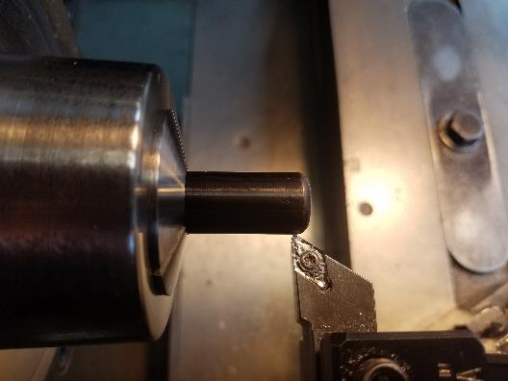
Hazards: Point of operation
The point of operation is the area on a machine where work is actually performed on the material being processed.
This image displays the point of operation on the lathe.
The point of operation of a lathe
Notes:
The primary hazards of lathes are contact with rotating parts and contact at the point of operation. An operator can be pulled into the lathe from working too close, or wearing gloves, loose clothing, loose hair, or jewelry. Trapping spaces are also created between the cutting tool, its mounting, and the workpiece or chuck. Projected parts or material such as chuck keys, unsecured workpieces, flying chips and coolant also strike or present hazards to the operator.

Slide 10
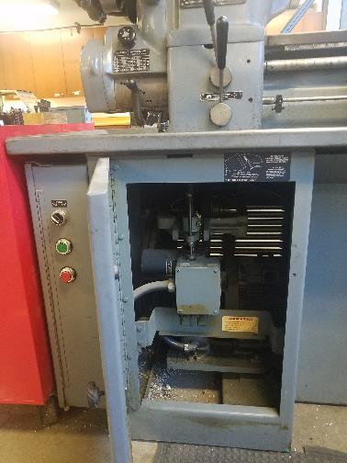
Hazards: Power transmission device
The power transmission device of the lathe is located inside the machine.
The power transmission of a lathe
Notes:
The power transmission device of the lathe is located inside the machine.

Slide 11
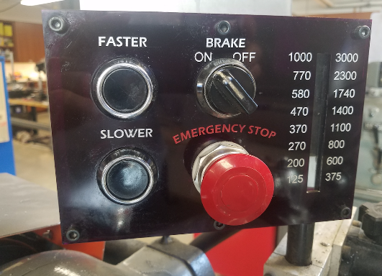
Hazards: Operating controls
The Operating Controls allow the user to turn the machine on or off and to control the spindle.
The Operating Controls of a machine are used to turn the Power Transmission Device on or off, to control the speed and direction of the spindle, turn the spindle brake on or off, and most importantly the Emergency Stop Button which is used to shut the machine down in case of and emergency of malfunction.
The operating controls of a lathe
Notes:
The Operating Controls allow the user to turn the machine on or off and to control the spindle.
The Operating Controls of a machine are used to turn the Power Transmission Device on or off, to control the speed and direction of the spindle, turn the spindle brake on or off, and most importantly the Emergency Stop Button which is used to shut the machine down in case of and emergency of malfunction.

Slide 12
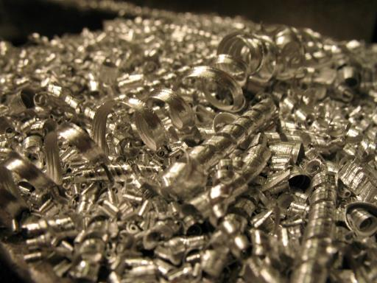
Hazards: Chips
While cutting on the lathe, chips and other pieces of material may fly off. Do not attempt to remove them with your hand when they build up as they are sharp and can injure you. Stop the machine and remove them with pliers or use a dustpan and brush​​​​​​​.
Sweep up any chips that fall to the floor as they are slip hazards.
Example of chips that may be produced by the lathe
Notes:
Lathe chips may not seem dangerous, but they are sharp and can cause cuts. Chips can also be hot so do not attempt to catch the chips while cutting. Do not allow chips to run through hands or fingers while the machine is running. Serious injury can result.
Long stringy chips are also dangerous. If these occur shut off the power feed and the spindle and remove them with pliers.

Slide 13
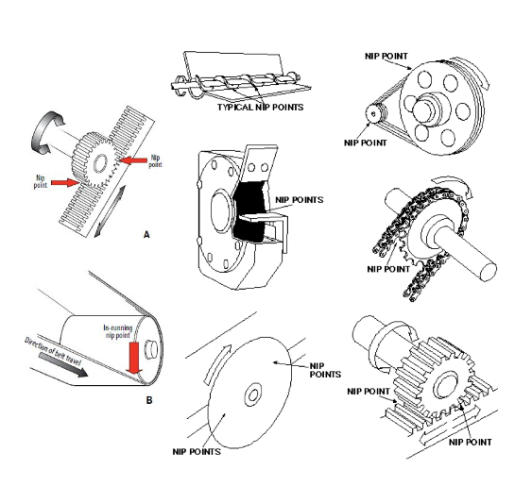
Hazards: Nip points and rotating parts
In-running nip points are commonly found among rotating or reciprocating parts. They occur in two scenarios:
When machine parts move toward each other
When machine parts run past a stationary object
Examples of nip points in different mechanisms
Notes:
In-running nip points are commonly found among rotating or reciprocating parts. They occur in two scenarios:
When machine parts move toward each other
When machine parts run past a stationary object

Slide 14
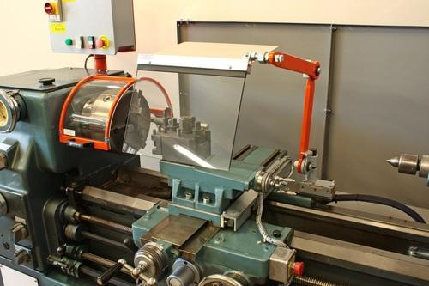
Safe operation: What is machine guarding?
To protect yourself from the aforementioned hazards, use machine guarding.
Machine Guarding is a means of shielding employees from moving or flying parts.
This image is a picture of the lathe machine guarding.
A lathe with orange and clear machine guarding
Notes:
Machine guarding is a means of shielding employees from moving or flying parts and preventing them from accidentally coming into contact with moving pieces of equipment.

Slide 15

Safe operation: Protect yourself with PPE
PPE stands for Personal Protective Equipment.
Always wear safety glasses
Always wear fully enclosed sturdy shoes that protect the top of your feet
Do not wear any rings or dangling jewelry
Long hair needs to be tied up or, preferably, put into a bun.
A sign reminding workers to wear their PPE
Notes:
Personal Protective Equipment may be a bit uncomfortable or bulky, but needs to be worn to protect the user.

Slide 16
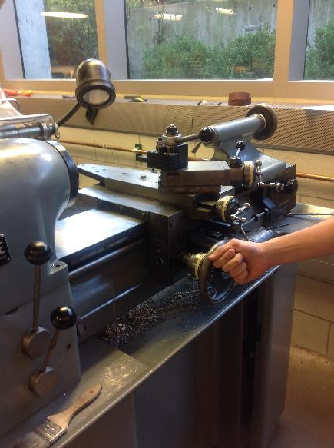
Safe operation: Preventing injuries and amputations (I)
Before you begin...
Be sure the workpiece and holding device are firmly attached
Make sure the lathe and workpiece are clear of any obstructions
Always remove the chuck key before operating the lathe
Stop the lathe before making any measurements, adjustments, or cleaning
A young worker using the lathe
Notes:
Any user needs to have taken the in person Lathe Introduction session to use the machine.
If the Emergency Stop switch is engaged, pull it out to reset it.
If a measurement needs to be made or a tool needs to be changed turn the spindle off.
Do not reach in while the cutting tool is rotating.
If the lathe is malfunctioning or something isn’t working right let one of the shop staff know.

Slide 17
Safe operation: Preventing injuries and amputations (II)
Before you begin...
Ensure all machine guarding and proper parts are in place
Identify the ON/OFF switch and emergency stop
Only trained and authorized people can operate the lathe
A young worker using the lathe
Notes:
Anyone operating the lathe must make sure that their work piece and holding devices are securely mounted to the machine.
It is a good idea to manually rotate the spindle of the lathe to make sure that the work piece or holding device does not strike anything on the lathe, especially for large work pieces.

Slide 18
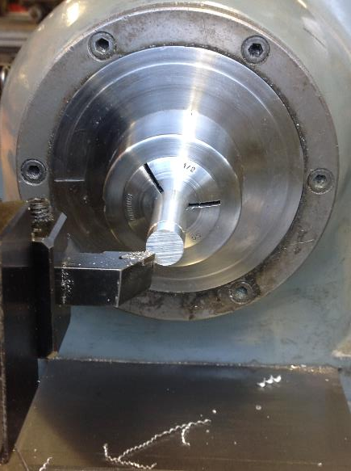
Safe operation: Preventing injuries and amputations (III)
While working...
Support all work solidly
Do not permit small diameter workpieces to project too far from the chuck (not over 3X the workpiece's diameter) without support
Always be aware of the direction of travel and speed of the carriage before you engage automatic feed
A young worker using the lathe
Notes:
Do not leave tools on the ways of apron of the machine the can get struck by the work piece or holding device.
Never reach in towards the Point of Operation while the spindle is turning.
Work pieces that need to extend more than 3 X the diameter need to be supported so that the piece will not have the chance to whip around while the work is being performed.

Slide 19
Safe operation: Preventing injuries and amputations (IV)
After operating the lathe...
Turn the spindle off and move the cutting device back to a safe distance when measuring work and loading and unloading parts.
Do not reach around the cutting tool to remove chips while the machine is in motion or not locked/tagged out.
Use the Emergency Stop button to stop the lathe immediately if any odd noise or vibration develops.
If a machine needs maintenance/service, follow lock out tag out procedures.
A young worker using the lathe
Notes:
Users always need to make sure that they move cutting tools and attachments out of the way before moving their work pieces so that they remove the risk of accidental cuts or injury.
When using the power feed on the machine users must always know which way the machine will travel so that injury or machine crashes do not occur.

Slide 20
Safe operation: Preventing injuries and amputations (V)
Always keep in mind...
Beware of rotating parts
Beware of parts projecting from the lathe
Do not wear gloves, loose clothing, or jewelry since they can get caught on rotating parts of the machine.
Always clean up the machine and surrounding area, especially the floor since chips and lubricants are slip hazards.
A young worker using the lathe
Notes:
If the lathe starts making odd noises or vibrating stop the machine and let one of the shop staff members know.
Sharp edges and burrs can cause cuts always be sure to remove them.

Slide 21

Hazards: Lockout/Tagout
Lockout/tagout procedures are safeguarding methods to prevent injury due to hazardous energy sources. If you see the machines with the signs featured in the image or that are under lock and key, please stay away and do not touch or attempt to start it.
Examples of Lockout/tagout equipment
Notes:
Lockout/tagout procedures are safeguarding methods to prevent injury due to hazardous energy sources. If you see the machines with the signs featured in the image or that are under lock and key, please stay away and do not touch or attempt to start it.

Slide 22

Hazards: Best practices
Set the guard to clear stock/workpiece
Wear Personal Protective Equipment (PPE) at all times
Clean up and clear work area
An example of hazard signage
Notes:
Personal Protective Equipment may be a bit uncomfortable or bulky, but needs to be worn to protect the user from injury.

