Slide 1
Introduction to
Horizontal Bandsaw Safety
This material was produced under Susan Harwood grant number SH-31214-17-60-F-17 Occupational Safety and Health Administration, U.S. Department of Labor. The contents in this presentation do not necessarily reflect the views or policies of the U.S. Department of Labor, nor does the mention of trade names, commercial products, or organizations imply endorsement by the U.S. Government.

Slide 2
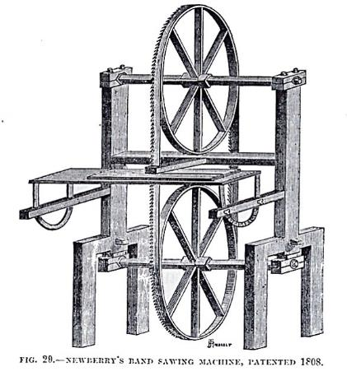
Introduction: What’s a band saw?
The Band Saw was invented by William Newberry in 1808. It is one of the most widely-used wood and metal working machines. Originally for cutting wood, band saws can now cut metal if you change the blade and speed.
An early band saw

Slide 3
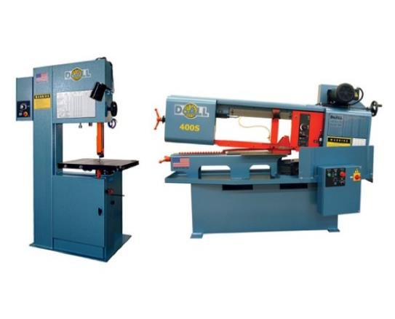
Introduction: Two types of band saw
Here are two common types of Band Saws:
1. Vertical (left)
Used to saw curves, lumber, irregular shapes
2. Horizontal (right)
Use to cut long pieces, tubes
A vertical band saw (left) and horizontal band saw (right)

Slide 4
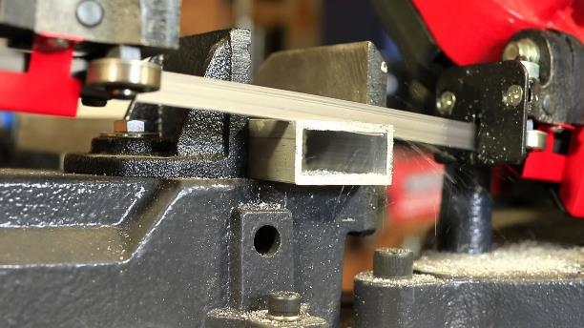
What it Does: What is a band saw used for?
Band Saws are able to cut a variety of materials such as metals, plastics, and wood.
An example of a bandsaw performing a cut

Slide 5
Safety: Who is OSHA?
With the Occupational Safety and Health Act of 1970, Congress created the Occupational Safety and Health Administration (OSHA) to assure safe and healthful working conditions for working men and women by setting and enforcing standards and by providing training, outreach, education and assistance.
OSHA is part of the United States Department of Labor. The administrator for OSHA is the Assistant Secretary of Labor for Occupational Safety and Health. OSHA's administrator answers to the Secretary of Labor, who is a member of the cabinet of the President of the United States.
Notes:
OSHA was started to protect workers in the work place. Before OSHA there was no organization that tracked work place injuries. There were also no safety standards for employers.
OSHA has 2 branches, the Enforcement Branch and the Collaboration Branch.
The Enforcement Branch investigates complaints and serious accidents.
The Collaboration Branch works on education, such as the Susan Harwood Grant.

Slide 6
Safety: Know your rights
Under federal law, you are entitled to a safe workplace.
Your employer must provide a workplace free of known health and safety hazards.
If you have concerns, you have the right to speak up about them without fear of retaliation. You also have the right to:
Be trained in a language you understand
Work on machines that are safe
Be provided required safety gear, such as gloves or a harness and lifeline for falls
Be protected from toxic chemicals
Request an OSHA inspection, and speak to the inspector
Report an injury or illness, and get copies of your medical records
See copies of the workplace injury and illness log
Review records of work-related injuries and illnesses
Get copies of test results done to find hazards in the workplace
Notes:
Read the rights to the trainees and point them to the posters available around the workplace where they can refer to for more information.
Extra resources can be found at https://www.osha.gov/workers/index.html

Slide 7

Hazards: Machine-related injuries
Possible machine-related injuries include:
Crushed fingers or hands
Amputations
Blindness
Blindness is a possible machine-related injury
Notes:
Many accidents result from persons working on, or around, moving machinery. These accidents could have been prevented by the installation and proper maintenance of guarding. The goal of this training is to make the guarding of all equipment as easily understood as possible and re-inforce the safe working procedures that must always be in place around dangerous equipment.
This list of accidents is as long as it is horrifying.
Safeguards are essential for protecting workers from needless and preventable injuries. Where the operation of a machine can injure the operator or other workers, the hazard must be controlled or eliminated.
National Emphasis Program on Amputations*. CPL 03-00-019, (August 13, 2015). Describes policies and procedures for implementing a National Emphasis Program (NEP) to identify and to reduce workplace machinery and equipment hazards which are causing or likely to cause amputations.
Resource: https://www.osha.gov/dte/outreach/construction_generalindustry/gi_outreach_tp.html
https://safetyresourcesblog.com/2014/08/16/osha-quickcards-download-here-all-free-englishspanishother/

Slide 8
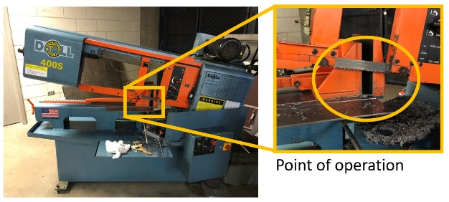
Hazards: Point of operation
The point of operation is the area on a machine where work is actually performed on the material being processed.
On the Horizontal Band Saw, the point of operation is either at the point where the saw blade meets the machine table or where the saw blade meets the part being cut.
The point of operation on a band saw
Notes:
An easy way to keep these in mind is that the Point of Operation is where the work actually happens.
Any loose article has the potential to get pulled into the saw. Users must be sure not to wear loose fitting clothing, dangling jewelry, or long hair. Long hair needs to be in a ponytail or bun.
Operators must not reach into the saw for any reason while the saw is running.

Slide 9
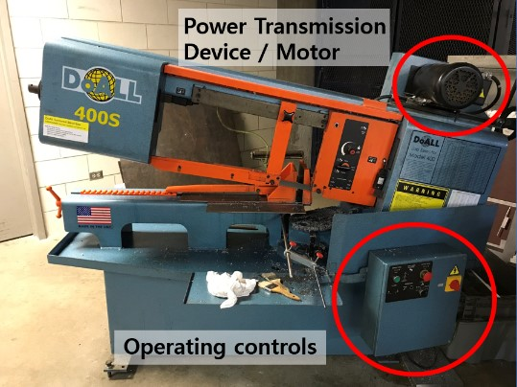
Hazards: Power transmission device
Located on the top of the Horizontal Band Saw.
Drives the wheel that makes the saw band move.
Guarded and shielded to prevent any accidental contact with its moving parts.
The power transmission device on the band saw
Notes:
The Power Transmission device is usually the motor that drives the machine.

Slide 10
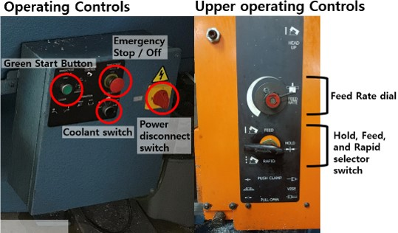
Hazards: Operating controls
Operating Controls house the switches and dials to operate the saw
Emergency Stop / off button: Shuts the machine off in an emergency if something goes wrong.
Green “On” button: Starts the saw.
Power Disconnect Button: Completely shuts the power off to the machine.
The operating controls on the band saw
Notes:
Other moving parts are anything else on the saw that moves. The operating controls are the buttons and switches that allow you to turn the saw on and off and have it do other functions.

Slide 11
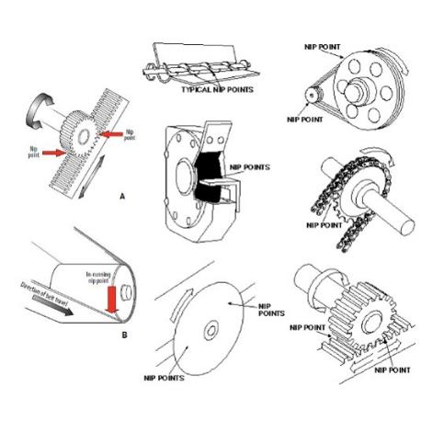
Hazards: Nip points and rotating parts
In-running nip points are commonly found among rotating or reciprocating parts. They
occur in two scenarios:
When machine parts move
toward each other
When machine parts run past a
stationary object
Examples of nip points in different mechanisms
Notes:
Nip Points exist at the saw blade and the saw blade and vise interface and at the blade drive wheels inside the saw doors.
It is important to keep your hands and fingers away from Nip Points and rotating parts of the saw. This is where your hands or fingers can get hurt.

Slide 12
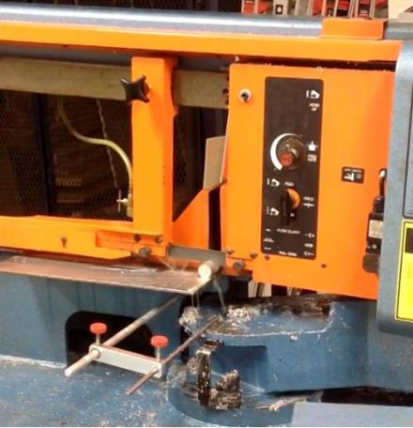
Hazards: Flying chips and wood dust
Flying chips and machine coolant are likely to be thrown in different directions due to cutting action
An example of chips and coolant during a cut
Notes:
Chips may fly up or fall to the floor.
Be sure to sweep up any chips that may fall on to the floor and mop up any coolant that may fall on the floor. Both of these present slip hazards which can cause injuries.

Slide 13
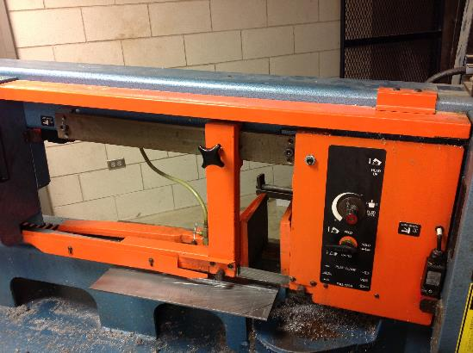
Hazards: What is machine guarding?
Machine Guard (orange part in the image) is a means of shielding employees from moving or flying parts and preventing them from accidentally coming into contact with moving pieces of equipment.
The orange machine guarding of a band saw
Notes:
Explain to trainers that some manufacturing facilities still have machines that are not properly guarded. Some types of accidents are related to poor on non-existent machine guarding can be getting fingers caught where the work is being done (Point of Operation). Dangling jewelry, loose clothing, or hair can get caught in the Point of Operation. Reaching in to grab a work piece while the saw is running can also result in an injury.

Slide 14
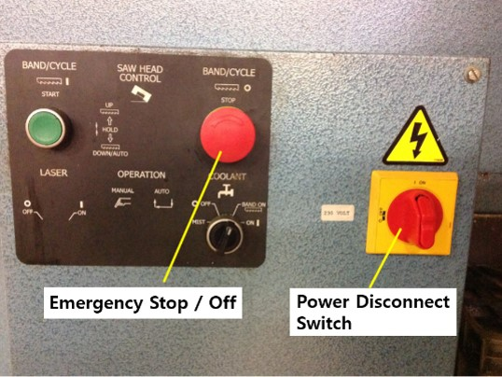
Hazards: Preventing injuries and amputations
Be trained
Identify ON/OFF or EMERGENCY button
Use a blade of an appropriate size and type
Set the guard (open wide enough) to clear stock/workpiece
Secure workpiece in the vise.
The operating controls on a horizontal band saw
Notes:
If an adjustment needs to be made or a blade needs to be changed:
Press the emergency stop button.
Turn the power disconnect switch off. This in conjunction with the door interlocks gives the user 3 levels of disconnection from the power source.
To release the emergency stop button turn it clockwise and let it pop out.
Do not remove any guards from the machine. If there is a problem with the guards let the shop staff know.
Always make sure that the workpiece is placed securely in the vise.
Always make sure that the machine is off before reaching in to grab the work piece or reaching around the blade.
If a problem arises on the saw alert the shop staff. They are the only people that can assess maintenance issues.
No one can operate any of the machinery unless they are trained by one of the student trainers or shop staff.
Before using the machine always locate the emergency stop button or power switch or button.
Guards are on the machine help keep you safe, do not remove any of the guards. If you experience problems with them let a trainer or shop staff know.
With everything going on do not forget to tighten your work piece in the vise.
You may be in a rush and want to grab your work piece while it is being cut. This can lead to injuries. Do not reach in to the Point of Operation while the saw is running.

Slide 15
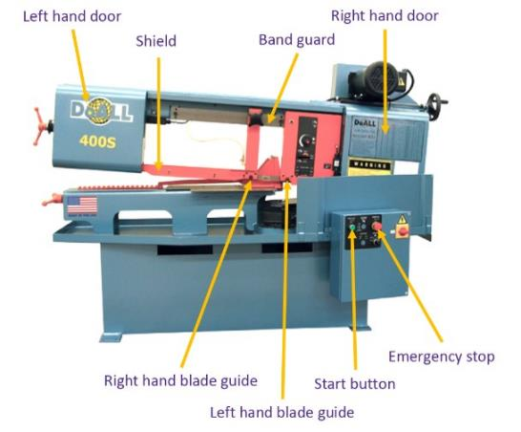
Safe operation: Best practices
Identify Emergency Stop and Off switch.
Make sure right and left guard doors are closed.
​​​​​​​Make sure all guards are in place.
Wear Personal Protective Equipment (PPE) at all times
Clean up and clear work area
The different components of the horizontal band saw
Notes:
The machine needs to be kept free of tools since they could get caught in the blade or fall off of the machine during operation.
The saw must always be stopped via the emergency stop button and power disconnect button when making measurements, adjustments, or cleaning.
Long work pieces need to be supported so that they will not tip during cutting.

Slide 16
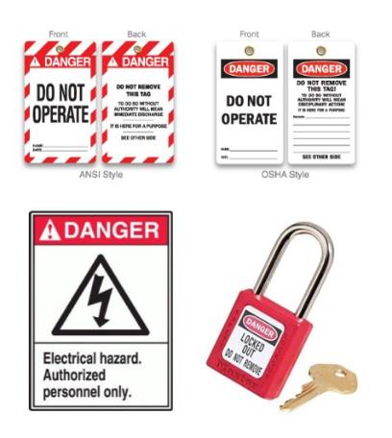
Hazards: Lockout/Tagout
Lockout/tagout procedures are safeguarding methods to prevent injury due to hazardous energy sources. If you see the machines with the signs featured in the image or that are under lock and key, please stay away and do not touch or attempt to start it.
Examples of Lockout/tagout equipment
Notes:
Lockout/tagout procedures are safeguarding methods to prevent injury due to hazardous energy sources. If you see the machines with the signs featured in the image or that are under lock and key, please stay away and do not touch or attempt to start it.

Slide 17
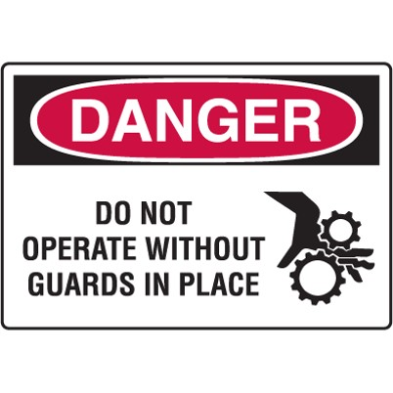
Hazards: Best practices
Set the guard to clear stock/workpiece
Wear Personal Protective Equipment (PPE) at all times
Clean up and clear work area
An example of hazard signage
Notes:
Personal Protective Equipment may be a bit uncomfortable or bulky, but needs to be worn to protect the user from injury.

