Slide 1
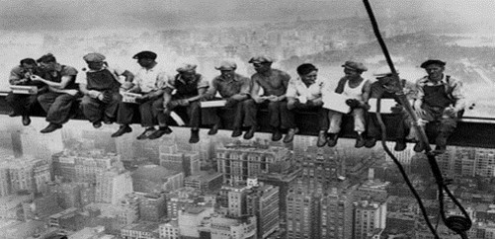
Fall Protection Training OSHA - Susan Harwood Training Grant

Slide 2
Welcome
Please sign the attendance sheet
Take one handout
Answer the pre-test

Slide 3
location
Emergency Exits
Emergency Stairs
Location of restrooms
Location of water fountains

Slide 4
Disclaimer
This material was produced under grant number SH-31201-SH7 from the Occupational Safety and Health Administration, U.S. Department of Labor. It does not necessarily reflect the views or policies of the U. S. Department of Labor, nor does mention of trade names, commercial products, or organizations imply endorsement by the U. S. Government.

Slide 5
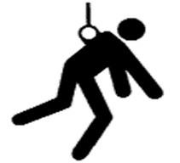
Agenda
Welcome
Introduction to OSHA
Worker’s rights
Introduction to Fall Protection
Recognition of Fall Hazards
Basic Fall Prevention Principles
Basic Fall Protection Principles
Brief Review of Applicable Standards
Break

Slide 6
Agenda
Controlling the Hazard
Hierarchy of Controls
Restrain
Components
Fall Clearance
Inspections
Rescue
Certificates

Slide 7
Introduction to osha
Overview of anti-retaliation provisions, employee rights, employer responsibilities, whistleblower laws, and OSHA’s complaint investigation procedures

Slide 8
Why is OSHA Important to You?
OSHA began because, until 1970, there were no national laws for safety and health hazards.
On average, 12 workers die every day from job injuries
Worker deaths in America are down–on average, from about 38 worker deaths a day in 1970 to 12 a day in 2013.
WORKER FATALITIES
4,836 workers were killed on the job in 2015
Falls — 364 out of 937 total deaths in construction in CY 2015 (38.8%)

Slide 9
Discussion Questions
When, during your work experience, did you first hear about OSHA?
What did you think about OSHA then?
What do you think OSHA’s job is?

Slide 10

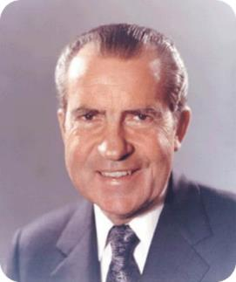
History of OSHA
OSHA stands for the Occupational Safety and Health Administration, an agency of the U.S. Department of Labor
OSHA’s responsibility is worker safety and health protection
On December 29, 1970, President Nixon signed the OSH Act
This Act created OSHA, the agency, which formally came into being on April 28, 1971

Slide 11

OSHA’s Mission
To save lives
To prevent injuries
To protect America’s workers

Slide 12
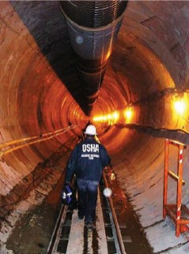


Strategies to Reduce Injuries and Deaths
Strong, fair, and effective enforcement.
Outreach, education, and compliance assistance.
Partnerships and other cooperative programs.

Slide 13
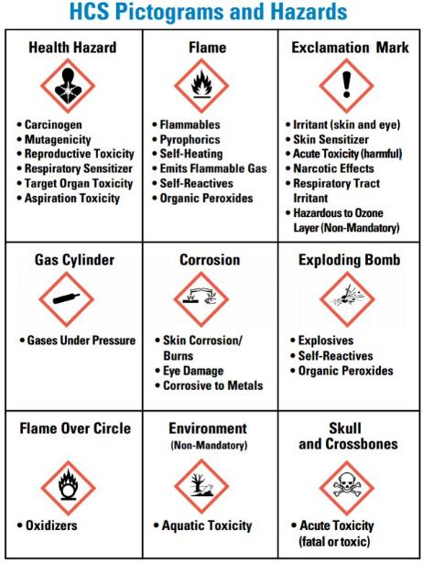
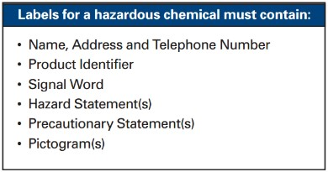
Labels for hazardous substances
Labels for hazardous substances in your workplace
Notes:
The picture shows the nine pictograms and hazards: Health hazards, Flame, Exclamation mark, Gas Cylinder, Corrosion, Exploding Bomb, Flame over circle, Environmental, and Skull
The labels for a hazardous chemilcal must contain: Name, Address, and telephone number. Product identifieer, signal word, hazard statements, precautionary statements, and pictograms

Slide 14
OSHA Inspections
The OSH Act authorizes OSHA compliance safety and health officers (CSHOs) to conduct workplace inspections at reasonable times.
OSHA conducts inspections without advance notice, except in rare circumstances (e.g. Imminent Danger)
In fact, anyone who tells an employer about an OSHA inspection in advance can receive fines and a jail term.

Slide 15
Inspections Process
A typical OSHA on-site inspection includes four stages:
Presentation of inspector credentials.
An opening conference.
An inspection walk-around.
A closing conference.

Slide 16
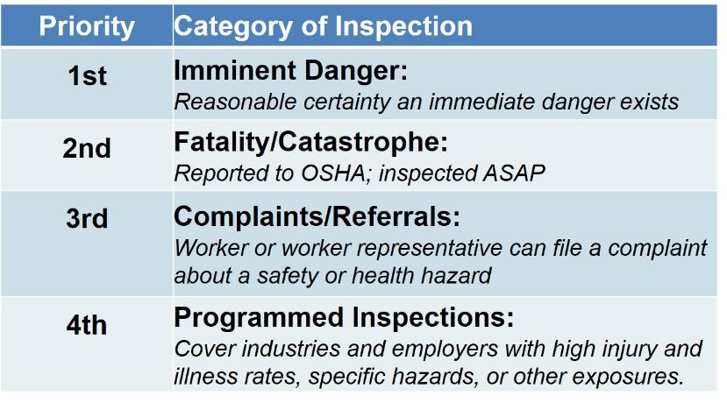
OSHA’s Inspection Priorities

Slide 17
OSHA’s Complaint Investigations
OSHA evaluates each complaint to determine how it can be handled best--an off-site investigation or an on-site inspection
Before beginning an inspection, OSHA staff must be able to determine from the complaint that there are reasonable grounds to believe that a violation of an OSHA standard or a safety or health hazard exists.
If OSHA has information indicating the employer is aware of the hazard and is correcting it, the agency may not conduct an inspection after obtaining the necessary documentation from the employer.

Slide 18
Rights as a Whistleblower
Employee may file a complain with OSHA under Section 11(c) if your employer retaliates against you by taking unfavorable personnel action because you engaged in protected activity relating to workplace safety and health.
OSHA requires that complaints must be filed within 30 days after the alleged retaliation.

Slide 19
Rights as a Whistleblower
Your employer may be found to have retaliated against you if your protected activity was a contributing or motivating factor in its decision to take unfavorable personnel action against you. Such actions may include:
Firing or laying off
Blacklisting
Denying overtime or promotion
Disciplining
Denying benefits
Failing to hire or rehire
Intimidation
Reassignment affecting promotion prospects
Reducing pay or hour

Slide 20
Questions about OSHA?

Slide 21
Introduction to Fall Protection

Slide 22
Objectives
Recognize, avoid and prevent fall hazards in construction
Identify major fall hazards
Describe types of fall hazards
Protect him/herself from fall hazards
Recognize employer requirements to protect workers from fall hazards

Slide 23
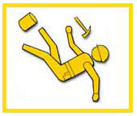
Falls in Construction
Did you know? Falls from elevation account for one third of all deaths in construction.

Slide 24
Falls in Construction
FALLS ARE THE LEADING CAUSE OF DEATH IN CONSTRUCTION.
In 2015, there were 350 fatal falls to a lower level out of 937 construction fatalities (BLS data). These deaths are preventable.

Slide 25
Falls in Construction
It is important that safety and health programs contain provisions to protect workers from falls on the job.
The following hazards cause the most fall-related injuries:
Unprotected Sides, Wall Openings, and Floor Holes
Unguarded Protruding Steel Rebars
Improper Scaffold Construction
Misuse of Portable Ladders

Slide 26
OSHA Regulations on Fall Protection
General Industry:
Fall protection required when working at 4 feet above lower level
Construction Industry:
Fall protection required when working at 6 feet above lower level
Employer’s operations will completely or mostly fall under one of the sectors listed and will follow their regulations.
Notes:
Discuss who OSHA is and its purpose.
OSHA's Mission:
“With the Occupational Safety and Health Act of 1970, Congress created the Occupational Safety and Health Administration (OSHA)* to assure safe and healthful working conditions for working men and women by setting and enforcing standards and by providing training, outreach, education and assistance.”
Organization
“OSHA is part of the United States Department of Labor. The administrator for OSHA is the Assistant Secretary of Labor for Occupational Safety and Health. OSHA's administrator answers to the Secretary of Labor, who is a member of the cabinet of the President of the United States.”
Explain that most workers will be covered under one of two sets of regulations, although there are exceptions (with work at marine terminals, shipyards, and in mines being one of the major ones).
OSHA “Parts” (1910 & 1926) can be thought of as “books,” and “Subparts” can be thought of as “chapters” within those books. Each book has a dedicated “chapter” (or, in the case of GI, two) dedicated to issues related to FP.
Explain that they will only fall under one set of regulations and need to follow what is laid out therein

Slide 27
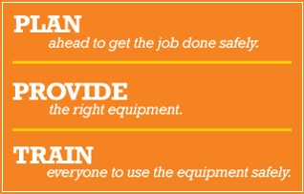
OSHA's Fall Prevention Campaign

Slide 28
OSHA's Fall Prevention Campaign
PLAN ahead to get the job done safely
When working from heights, such as ladders, scaffolds, and roofs, employers must plan projects to ensure that the job is done safely. PROVIDE the right equipment
Workers who are six feet or more above lower levels are at risk for serious injury or death if they should fall.
TRAIN everyone to use the equipment safely
Falls can be prevented when workers understand proper set-up and safe use of equipment.

Slide 29
Roof Safety
Employees must be trained to avoid fall hazards on a roof and properly use fall protection equipment-this includes safety measures like:
Make sure your harness fits and is not defective when using PFAS
Always stay connected/tie off
Ensure that all anchor points are safe
Protect all holes, openings and skylights
Don't sit or walk on skylights or other openings

Slide 30
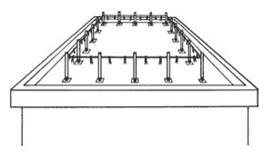
Warning Lines – 1926 Roofing
4-sided set of lines in-place to warn workers of edge hazard
NOT a guardrail
Distances from edge:
6’ - General
10’ – “Mechanical Equipment”
Permit work inside w/ no PFAS
Points of access, materials handling areas, storage areas, and hoisting areas connected by access path formed by two warning lines
Rope / Wire / Chain Gate or “Other Barricade”
Offset Access
Notes:
One of the first important points to be made on warning lines is they are what the name implies: lines that are suspended around the work area that will warn the unsuspecting worker as they back up that they are approaching an exposed edge; if a worker falls into them, they will fall over, but they are of sufficient distance from the edge to prevent a fall, so they are effective in a different way from guardrails.
The rules on distance are as follows:
In roofing activities, they need to be at least:
6’ from the edge when mechanical equipment is not being used;
10’ from the edge in the direction of travel when mechanical equipment is being used.
“Mechanical equipment” is “all human propelled wheeled equipment used for roofing work, except wheelbarrows and mopcarts.”
Unsupervised workers will often put lines up and move them closer to the edge than these specified distances, making an easy violation to spot, when they are doing roofing work that is going to take them towards the parapets.
This will be the case if they are laying felt paper or shingling, for example, on an entire roof.
Thus, a plan needs to be in-place (i.e. use of a PFPS or Safety Monitor) needs to be prepared ahead-of-time and spelled out for when this is to happen.
The beauty of these systems is that they permit work inside the lines with no need for guardrails or a PFPS, thus making mobility and setup time much faster.
OSHA permits two options for access into and egress out of a set of warning Lines: (a) barricade and (b) offset lines.
An offset access is generally the better way to go since it takes human error (i.e. not putting a chain gate back up once passing through it) out of the equation.
Ask why OSHA would want lines to be marked every 6’. (Visibility for Workers)
Note that the specified line heights are different than those that are laid-out for guardrail systems.
As is discussed in the manual, and will sometimes be asked in class, employers may want to know if painted lines around the perimeter of the roof at the prescribed distances will work. OSHA, through LOI, however, has said that they will not. In cold climates where it will snow, these lines will do not good when covered. And at night in all climates, the line will become obscured by darkness.
The “tip force” noted on this page is the force that one of the posts needs to be able to withstand without falling over.
This resistance is mainly so that posts aren’t constantly falling over when the wind blows on them.
Sites could use store-bought systems or sink posts in five-gallon buckets filled with concrete.
In regards to line strength, OSHA clearly sets out a minimum requirement. It is not difficult at all to find a site where they are attempting to demonstrate use of warning lines where you will see yellow caution tape (which doesn’t have a 500 lbs. breaking strength) right at the edge of the rooftop, thus violating two rules.
With the prevention of slack buildup clause, the idea is part of the system sags to ground level and someone can easily step over it with or without noticing, the system has lost its ability to protect.

Slide 31
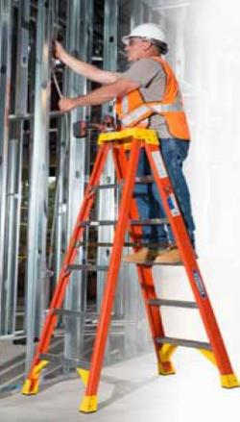
Ladder Regulations
Where are temporary ladder regulations found?
1910 – Subpart D
1926 – Subpart X
Fall protection required?
Since both of these are regulations of their own, separate from those for fall protection, OSHA does not require a PFAS.
That said, the recommendation would be to use one whenever possible.
Notes:
First, note in this picture which was taken from a Werner Ladders product catalog that 3-points of contact are not being maintained in normal use.
Now, turn the learners’ attention to the fact that safety requirements for ladders are found in a different location than all those discussed up to this point for fall protection.
Once pointing this out, ask whether or not a worker up on a ladder is required to have fall protection in the form of a Personal Fall Arrest System.
The answer is that they are not required to have it, no matter the height at which they are working. OSHA has affirmed this through letters of interpretation, pointing out that the regulations themselves are separate from those for fall protection and do not require fall protection. Also note that ladder manufacturers generally don’t require fall protection on temporary ladders as part of their safe use instructions.
This is not to say that it is not a recommended practice to have fall protection. In fact, the recommendation should be to utilize FP whenever possible even if the law doesn’t require it.

Slide 32
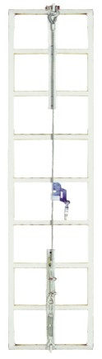
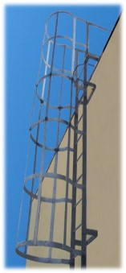
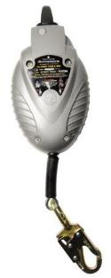
Fixed Ladders
OSHA requires F.P. on fixed ladders at the following heights:
20’ – Current Subpart D / 24’ Proposed Subpart D
24’ – Construction
Options for protection include:
Poor: Cage / Well
Better: SRL
Best: Vertical Lifeline (VLL)
VLL Components:
Flexible Cable / Rigid Rail
Rope / Cable / Bargrab
Notes:
One of the most common ways that workers will reach elevated locations is by climbing a fixed ladder. Here we will see that fixed ladders carry their own set of regulations that do not mesh with the 4 and 6 foot rules previously discussed.
Both sets of regulations as the currently stand, in their exact wording, are listed below:
1910.27(d)(1)(ii)
Cages or wells (except as provided in subparagraph (5) of this paragraph) conforming to the dimensions shown in figures D-7, D-8, and D-9 shall be provided on ladders of more than 20 feet to a maximum unbroken length of 30 feet.
1926.1053(a)(18)
Fixed ladders shall be provided with cages, wells, ladder safety devices, or self-retracting lifelines where the length of climb is less than 24 feet (7.3 m) but the top of the ladder is at a distance greater than 24 feet (7.3 m) above lower levels.
1926.1053(a)(19)
Where the total length of a climb equals or exceeds 24 feet (7.3 m), fixed ladders shall be equipped with one of the following:
1926.1053(a)(19)(i)
Ladder safety devices; or
1926.1053(a)(19)(ii)
Self-retracting lifelines, and rest platforms at intervals not to exceed 150 feet (45.7 m); or
1926.1053(a)(19)(iii)
A cage or well, and multiple ladder sections, each ladder section not to exceed 50 feet (15.2 m) in length. Ladder sections shall be offset from adjacent sections, and landing platforms shall be provided at maximum intervals of 50 feet (15.2 m).
Thus, although they read a little bit differently, the key point to take away is that fall protection requirements kick in at new activation points of either 20 or 24 feet, depending on the standard.
Also of note is that Proposed Subpart D harmonizes with the 1926 regulations, calling for one of the forms of fall protection described at 24’.
When discussing the options, the following points can be made:
Although least effective and most costly to install on a ladder, cages and wells are the most common form of fall protection seen on ladders in industry today. Unfortunately, they give workers a false sense of security when, really, their main benefit is as a place to rest one’s back when climbing. They, however, can be used as the sole form of fall protection as noted above.
SRLs mounted at the top of the ladder are the next best option. In reality, they are probably the cheapest option to implement provided that an adequate anchorage point can be found / mounted. That said, the worker will still have up to a 54” Maximum Arrest Distance and could hit the ladder fairly hard when they come to a stop using an SRL.
The best system when climbing a fixed ladder is a fixed vertical lifeline. With these systems, which can be made of regular galvanized components or stainless steel, allow a short connection (9”) to the front of the worker’s harness to a front D-ring on the chest strap and will arrest the fall in a matter of inches. Also, a built-in energy absorber will absorb the shock of the fall should the climber slip off and engage the system.
As is shown with VLL Components at the bottom, these systems can be quite varied, consisting in a flexible cable (most common) or a rigid rail that is sometimes called the “carrier” onto which a rope / cable / or bargrab is connected to arrest the fall.
Note that this is the only fall arrest situation where OSHA permits connection to the front of the harness. Otherwise, the connection must always be made to the Dorsal D-ring of the harness.

Slide 33
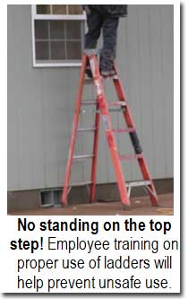
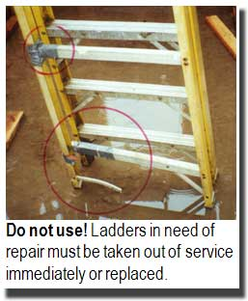
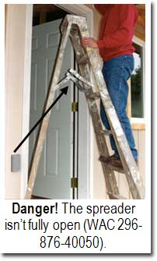
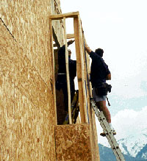
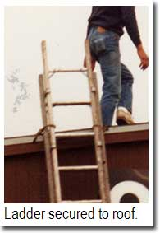
Misuse of Portable Ladders
This one seems properly inclined and secured

Slide 34
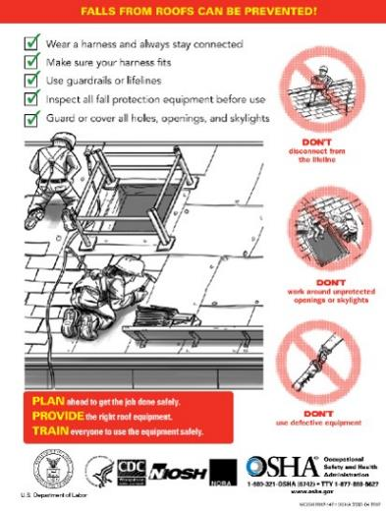
Plan-Provide-Train

Slide 35
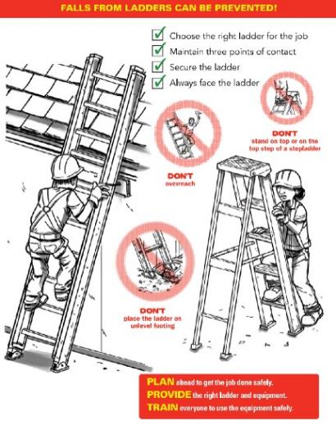
Plan-Provide-Train

Slide 36
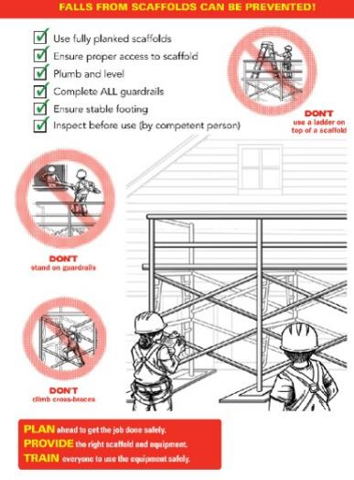
Plan-Provide-Train

Slide 37
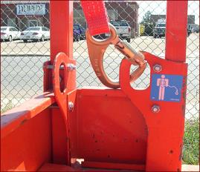
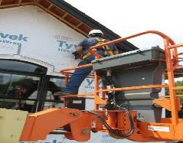
Aerial Lift Fall Protection
Is fall protection required?
Where is the correct place to attach?
What about outside the basket?
Basket guardrails?
Connector Options Hierarchy:
Restraint Lanyard
PFL
Energy-Absorbing Lanyard
General Prohibitions:
Moving large distances w/ the basket elevated
Standing on the basket guardrails
Notes:
Ask the students whether or not fall protection is required in one of these lists, per the first bullet point. The answer is “yes,” to which you should ask “why.”
The answer to the second question is that these lifts are notorious for being able to bounce a worker out of the basket, much like a catapult, if they are driving them too fast and hit an obstruction with the boom lowered or if they are at heights and, even more slowly, hit an object on the ground, causing the extended boom to flex and jettison the worker.
There are a number of videos on YouTube that can be found showing exactly this occurring.
This instructor once took a class at JLG’s Train-the-Trainer school with its lead instructor who commented that he once saw a worker fatality case where the unconnected victim was thrown higher than a utility pole.
The correct place to attach in an aerial lift is to the manufacturer-specified point(s) in the basket, as illustrated in the photo at the top of the slide. Generally these will be on a guardrail upright post somewhere inside the basket or on the floor and will have a label indicating their purpose toward this end.
As an answer to the other questions below the correct place to attach, outside the basket is generally prohibited by OSHA unless the worker is transferring out of the basket practicing 100% connection; in this case connection outside the basket will only be temporary while transition takes place.
A February 2, 2004 LOI to a Mr. Michael P. Kurtgis, states OSHA’s concerns with a worker who is attached outside the basket to an adjacent structure:
“Section 1926.453(b)(2)(v) states that fall protection is required for persons working from an aerial lift, and that the fall protection system must be attached to the boom or basket of an aerial lift. The purpose of this requirement is to protect employees from being bounced out of the aerial lift or placing themselves in a position from which they could be exposed to a fall by leaning over the basket. Further, §1926.453(b)(2)(iii) prohibits tying off fall protection to an adjacent pole, equipment or structure. This prohibition addresses, among others, the hazard of such an adjacent pole / structure failing and pulling the attached worker from a bucket. This may occur where, for example, a pole has rotted and fails while work is done to equipment attached to it, or where a traffic accident occurs in which a vehicle strikes the pole. These provisions reflect a concern that the type of "adjacent" structures typically associated with work done from aerial lifts are unreliable with respect to their condition (and so their ability to withstand loads imposed on them while work is being done) and vulnerability to traffic accidents.
…
However, limited situations may exist where an adjacent structure poses no reasonably foreseeable risk of failure. For example, such an instance might arise where the adjacent structure is a completed building or a completed (i.e., fully bolted-up) skeletal steel structure. In those instances, OSHA would consider the violation of §1926.453(b)(2)(iii) to be de minimis² and no citation would be issued.”
Attaching to aerial lift guardrails is like attaching to any other guardrails: impermissible. They were not designed for this purpose and shall not be used for it, especially when it is considered that attachment points will have been provided.
Students may have questions on the strength of anchorage points in aerial lifts.
In general, the statement can be made that if the vehicle meets ANSI / SIA A92.2 or A92.5 requirements it will be able to withstand a minimum force of 3,600 pounds (which will work for fall arrest).
Scissor lift anchorages, to be discussed shortly, have no such requirement and often may just be rated for restraint loads. In the case that the information is not provided, the company shall contact the manufacturer to determine what type of anchorage has been provided.
In regards to the connector, each of the options have benefits and limitations. A document called “Statement of Best Practices of Personal Fall Protection Systems for Aerial Work Platform Equipment” gives some guidance as to each of these options:
Restraint Lanyard
Per the above article, “In the case of a boom lift, the forces from the “catapult effect” would not cause the occupant to be thrown from the platform but rather remain within the confines of the work platform.”
A limitation with restraint lanyards is that they don’t allow mobility. When it is considered that it is fall arrest as soon as the worker’s CoG could go over the guardrails in any possible orientation, it isn’t hard to see that a really short lanyard will often be needed. The problem, however, becomes that if the worker is connected to such a short “leash,” they become tempted to disconnect at times to do work or simply have a much harder time doing their job.
One situation where this becomes less of an issue is with bucket trucks where no movement is possible anyhow.
Energy-Absorbing Lanyard
The article calls this “Fall Restraint / Arrest Using a Lanyard with an Adjuster.” This is a much more common practice where the idea is that when the worker is low to the ground moving the lift from one location to another (and don’t have hardly any clearance to fall), they keep their lanyard short. When they get to heights that give them adequate clearance, they can then adjust out for fall arrest.
A variant of this is “Fall Restraint / Arrest Using a Double-Leg Lanyard.” The only difference here is that one leg is long and one is short so that the worker doesn’t have to adjust. This method is, perhaps, a step above the former because it now makes it so that the worker doesn’t have to keep adjusting his lanyard in and out, something which many of them will neglect to do. When they are traveling at ground level, they use the short leg and when they get to heights, they can use the long leg.
PFL
This option really is a preference of many users. The benefit is that the PFL permits movement when necessary but locks off when it feels a quick jerk, as happens when the device tries to catapult the victim out. Often, with small PFL of 6’ length the worker’s feet will barely leave the floor of the basket before the device activates, stopping them from ever going over the guardrails.
Note that MSA has an article (on its FP Page on the main website where the products are shown) that permits use of the Workman Mini PFL for such a use in an aerial lift. The main stipulation that it sets out is that if this is to be done, the worker shall wear the unit with the energy absorber to their back (instead of the housing) to reduce forces to the line if it bites into the rail if the worker falls over it.
In regards to prohibitions,
The first prohibition is an issue both because it is very hard to see the ground (and obstructions that could be run over from great heights, causing the boom to flex) and because of the amount of flex / catapult action created when the boom is extended out far. Thus, it is much safer to move an aerial lift when the basket is close to the ground.
In regards to standing on the guardrails, the practice, like elsewhere, isn’t permitted. They simply can’t provide the protection they were meant to provide if the worker is standing on them.
As a note to this, often safety people on construction sites will note where workers have a board in the basket with them that seems to have nothing to do with the work task. Often, when no one is around, workers will put this board across the midrails to serve as a work platform. This, obviously, is not an okay practice.

Slide 38
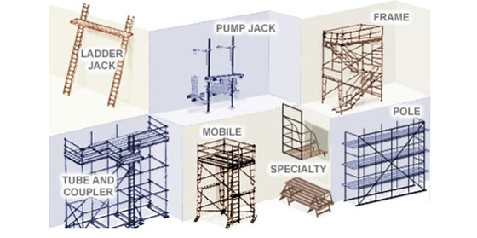
Scaffold types
Supported Scaffold

Slide 39
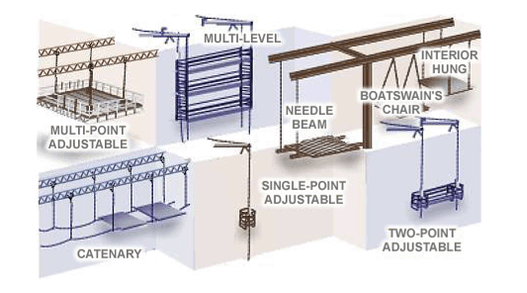
Scaffold types
Suspended Scaffold

Slide 40
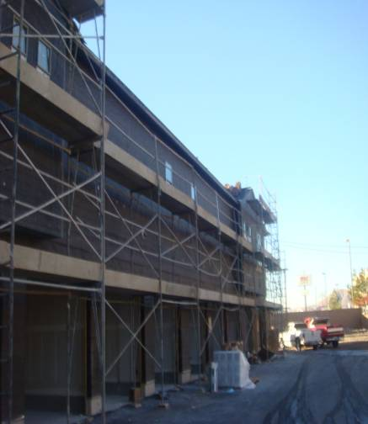
Scaffolds in construction
Avoiding risks
Follow manufacturer's instructions.
Install guardrail systems along all open sides and ends of platforms.
Personal fall arrest system should be used on scaffolds higher than 10 feet.
Notes:
Height of the scaffold should not be more than four times its minimum base dimension unless guys, ties, or braces are used.

Slide 41
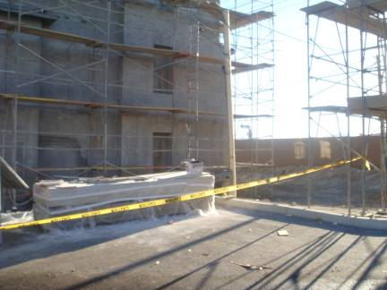
Scaffolds in construction
Falling objects
Wear hardhats
Barricade area below scaffold
Use panels or screens if material is stacked higher than the toe board.
Notes:
Toe board is the board used at the bottom side edge of the scaffold. If the material is stacked above it, there is a possibility that the materials will fall below and can hurt the workers worker below the scaffold.

Slide 42
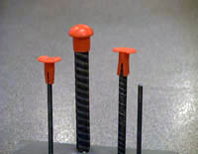
Rebar Caps
The OSHA Standard requires that rebar "be guarded to eliminate the hazard of impalement." Not all guards provide that level of protection. In some circumstances, the force of a fall can cause rebar to push clear through a plastic cap and still impale a worker, or the worker can be impaled by the rebar and the cap together.

Slide 43
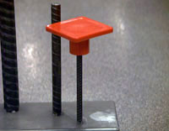
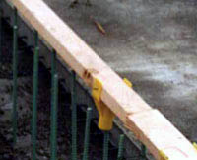
Rebar Caps
Only rebar caps designed to provide impalement protection, such as those containing steel reinforcement, should be used.
This type of cap positions a 2 x 4 over the exposed rebar, and has been approved by California OSHA.

Slide 44
What Does Fall Prevention Do?
Catch The Fall
Stop/Prevent The Fall
Fall Arrest
Restraint/Positioning
Safety Nets
Guardrails
Warning Lines
Catch Platforms
Controlled Access Zones
Controlled Decking Zones
Safety Monitors
Notes:
Explain what each of the items in the boxes means.

Slide 45
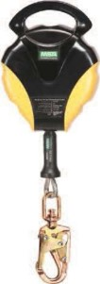

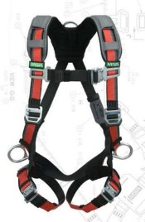
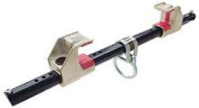
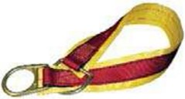
Fall Protection Definition
Fall protection is a broad term that used to describe various types of equipment, [systems], and policies that help to minimize the potential for workers to be injured when managing tasks that are high above ground level. Companies often use a combination of safety equipment along with training personnel on how to use it.

Slide 46
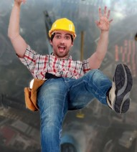
Results of a Fall
The average fatal fall is only 6 feet
A 6’ foot fall generates over 3,200 lb of force – that is the approximate weight of an average midsize car
A fall from 10 feet has an 4 out of 5 probability of causing death or permanent injury
A fall from 11 feet has an 8.5 out of 10 chance of causing death

Slide 47
Fall Prevention Planning
A fall prevention plan identifies places where regular fall prevention methods, such as guardrails, cannot be used.
These are called Controlled Access Zones.
Safety monitoring system should be installed in Controlled Access Zones
Notes:
Give examples of safety monitoring systems.

Slide 48
OSHA Regulations on Fall Protection
General Industry:
Fall protection required when working at 4 feet above lower level
Construction Industry:
Fall protection required when working at 6 feet above lower level
Employer’s operations will completely or mostly fall under one of the sectors listed and will follow their regulations.
Notes:
Discuss who OSHA is and its purpose.
OSHA's Mission:
“With the Occupational Safety and Health Act of 1970, Congress created the Occupational Safety and Health Administration (OSHA)* to assure safe and healthful working conditions for working men and women by setting and enforcing standards and by providing training, outreach, education and assistance.”
Organization
“OSHA is part of the United States Department of Labor. The administrator for OSHA is the Assistant Secretary of Labor for Occupational Safety and Health. OSHA's administrator answers to the Secretary of Labor, who is a member of the cabinet of the President of the United States.”
Explain that most workers will be covered under one of two sets of regulations, although there are exceptions (with work at marine terminals, shipyards, and in mines being one of the major ones).
OSHA “Parts” (1910 & 1926) can be thought of as “books,” and “Subparts” can be thought of as “chapters” within those books. Each book has a dedicated “chapter” (or, in the case of GI, two) dedicated to issues related to FP.
Explain that they will only fall under one set of regulations and need to follow what is laid out therein

Slide 49
Fall Prevention Planning
Fall prevention systems and work practices must be in place before you start work.
These must be prepared by a qualified person.
Plan shall be maintained at the job site
Qualified person should supervise the plan
Falls in Construction/Bridge Decking
falls in construction bridge decking video
Notes:
Discuss what makes a person “qualified.”

Slide 50
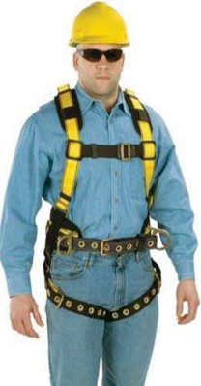
Authorized Person
Authorized Person:
A person approved or assigned by the employer to perform a specific type of duty or duties or to be at a specific location or locations at the jobsite.
This is the “user” of the equipment.
They know what they need to know in order to be able to perform their particular jobs
Notes:
The idea of “authorization” has nothing to do with whether or not someone works for a company. When one walks up to a door and sees a sign that says “no unauthorized personnel,” this means that only those who are properly trained, not anyone who is an employee, may enter. The same is true for fall protection.
At a basic level an authorized person is someone who knows what they need to know in order to be able to perform a particular job.
If that simply means knowing how to inspect FP equipment and utilize it in an aerial lift, then they must be trained on that (and not on the entire broad spectrum of everything fall protection-related).
Most workers are simply “authorized persons” who have been trained on how to use specific fall protection equipment in specific situations.

Slide 51

Competent Person
Competent Person:
One who
is capable of identifying
[a] existing &
[b] predictable hazards in surroundings or work conditions which are unsanitary, hazardous, or dangerous to employees, and
(2) who has authorization to take prompt corrective measures to eliminate them.
Notes:
Go through the definition piece-by piece:
Identifying “existing” hazards is easy enough (in most cases). Once knowing the 4’ or 6’ number (with the exceptions already discussed), it is fairly easy to pick out many FP hazards that may be present on a site.
“Predictable” hazards are addressed through doing “pre-task planning.” The majority of incidents that result in injury or a fatality happen either because of improper (or lack of) planning (as was the case with “Big Blue”) or because a plan that was established wasn’t followed (as was the case with the young worker who fell through the roof of the sports arena).
The third key part to the definition is that this person has “authorization” to take prompt corrective measures.
Essentially, this is where the job of a competent person could stop (at least per OSHA regulations). They simply need to be able to identify the issue and, then, make sure that the job process is stopped until the issue can be resolved.
However, in many cases it will be them that helps to fix the issue, but the main responsibility is to stop hazardous situations from existing until they are addressed. To do this, they need to be knowledgeable about:
The scope of the hazard;
The regulations in-place pertaining to it;
The controls set-out for them to deal with issues that arise;
The equipment that is available to control hazards, including:
Inspection Points;
Proper Use (such as donning);
Use Limitations

Slide 52

Qualified Person
Qualified Person:
One who
by possession of a
[i] recognized degree,
[ii] certificate or
[iii] professional standing, or
(2) who by extensive knowledge, training, and experience
has successfully demonstrated his ability to resolve problems relating to the subject matter, the work, or the project.
Notes:
The Qualified Person complements the work of the Competent Person. In regards to fall protection, they get involved principally in two main situations:
In cases where the fall arrest anchorage point is questionable in the eyes of the person who is selecting it (i.e. they are not sure that it can meet Option A: 5,000 pounds), this person must get involved in order to help establish whether or not they can meet Option B: Safety Factor of 2 Determined by a Q.P.
The regulations also say that this person must be involved in the design and installation of horizontal lifelines. (Although these haven’t been discussed up to this point, the instructor can quickly touch on what they are just so that the students have an idea. HLLs will be addressed again once getting to the section on “anchorage connectors.)
It should be pointed out that although the OSHA definition technically doesn’t mandate that this be a structural engineer, it will be hard for other types of workers to meet the requirements stipulated.

Slide 53
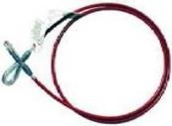

Fall Hazard Analysis
Before finding a solution – the hazard must be evaluated.
Use Hazard or Risk Prediction -- What are the conditions and behaviors to consider?
How will we get to the work area?
What are the hazards below the work area?
How high is the work area?
Are there holes or openings below or around the work area?
Are there slip or trip hazards around the work area?
How difficult is it to rescue someone if they fall?

Slide 54
Fall protection requirement
"Unprotected sides and edges." Each employee on a walking/working surface (horizontal and vertical surface) with an unprotected side or edge which is 6 feet (1.8 m) or more above a lower level shall be protected from falling by the use of guardrail systems, safety net systems, or personal fall arrest systems.
On scaffolds, fall protection is required at 10 feet.

Slide 55
Avoiding Fall Hazards
Construct all floor hole covers so they will effectively support two times the weight of employees, equipment, and materials that may be imposed on the cover at any one time.
In general, it is better to use fall prevention systems, such as guardrails, than fall protection systems, such as safety nets or fall arrest devices, because they provide more positive safety means.

Slide 56
Guardrails
3 Components:
(1) Top Rail
42” or 42” +/- 3”
Strength?
(2) Mid Rail
Midway between top rail and ground (screens / mesh an option)
(3) Toe Board
Purpose? / Height?
Note:
Rails shall not overhang (due to being a projection hazard).
No steel or plastic banding
Notes:
Guardrail construction is not a topic to discuss at any great depth, other than pointing out some of the principal requirements that they must meet. There are sections in the regulations that go through details on proper construction beyond what is presented on this slide (intended for those who are in-charge of building and / or installing them), but the point here is simply to address common G.I. and Construction parameters that need to be known and that are easily spotted by OSHA if not met.
Starting with the first component, the blue 42” is meant to indicate that the height of guardrails in General Industry is well-defined as needing to be 42 inches.
When it comes to variance from this height in G.I., OSHA has sent mixed signals. First an article titled “”General Industry Fall Protection Can be a Real Challenge” from OH&S Magazine, describes the issue thusly,
“Under 1910.23(e)(1), OSHA says that a guardrail must have a vertical height of 42 inches nominal from the upper surface of the top rail to floor, platform, runway, or ramp level. "Nominal" simply means that 42 inches has been established as the de facto standard for guardrail height. OSHA allows for variance, however. Standard Directive 1-1.10 says existing guardrails must consist of a top rail, intermediate rail, and posts, or equivalent, and have a minimum vertical height of 36 inches to 44 inches.”
That said, the most recent version of Proposed Subpart D has the following to say on the issue:
“OSHA notes that the two previous proposals on walking-working surfaces included a ‘‘grandfather provision’’ permitting a guardrail height of 36 inches, rather than the proposed 42 inches, for guardrails installed within 60 days of the effective date of the final rule. (See proposed § 1910.28(b)(3),
55 FR 13360 (April 10, 1990) and 68 FR 23528 (May 2, 2003).) The 36-inch grandfather provision is not included in this proposal, nor does OSHA consider it to be equally safe to the ‘‘42 inches nominal’’ height currently required under existing § 1910.23(e).
Therefore, to the extent that any previous OSHA letters of interpretation characterized a 36-inch guardrail height as a de minimis violation because of the grandfather provision in the two previous proposals, those interpretations are hereby superseded. (See, e.g., 08/ 27/2008 Letter to Bryan Cobb and 03/08/1995
Memorandum from John Miles to Byron Chadwick.)”
All of this said, the slide shows what the current rule for OSHA Subpart D is. Proposed D, however, allows for the same variation (+/- 3”) from 42” as the construction regulations do.
For Construction activities, per Subpart M, there is more leniency in regards to toprail height. Here, the rail could be as low as 39” from the work surface or as high as 45” from it.
In regards to midrails, the instructor can ask what the point of them is. (They are in-place to provide a barrier underneath the toprail so that the worker cannot fall underneath it.)
OSHA notes in Subpart M that instead of using a midrail an employer may choose to use a screen or a mesh that runs from the toprail all the way to the floor for the entire length of the railing system. This is seen as a good option especially in areas where there is a concern of objects being dropped into spaces where they could be a hazard for people below. This type of netting is commonly seen in-use in skyscraper construction / renovation in cities where space is tight and construction companies must work above the heads both of their own workers and of the general public.
The toeboard is mainly in-place as a form of falling object prevention. The concept is that it is a barrier at floor level at least 3 ½” tall (2” x 4” nominal boards are often used in construction) or 4” (in general industry) that is in-place at floor level to impede the ejection of a tool or other object from a floor work surface should it be kicked or otherwise displaced.
A couple more notes on guardrail construction are:
The need to not having railings overhang due to the projection hazard mentioned as well as a lack of support.
The fact that certain materials—i.e., steel or plastic banding utilized for securing items to pallets for transport—are not permitted to be utilized as guardrails.
The question sometimes comes up as to whether or not chains are allowed as rails. This answer was covered in the same OH&S article previously mentioned:
“Sometimes the installation of a guardrail isn't feasible or practical. One solution frequently considered is the use of safety chains, but are they allowed by OSHA? Even though the agency does not specifically address the use of chains in the Walking-Working Surfaces Standard, the agency has issued two LOIs on the issue that provide further guidance.
In the first letter, dated Feb. 12, 1982, OSHA makes mention of chains with regard to safety gates by saying, "if in fact the safety chains used for top and intermediate rails afford employees protection 'at least as effective as' the swinging gate, the safety chains would be adequate and noted as a de minimis violation."
This is further supported by a June 3, 1983 LOI, which says that "the anchoring of posts and installation of chains for railings must be of such construction that the completed structure shall be capable of withstanding a load of at least 200 pounds applied in any direction at any point on the top rail."
The bottom line is that if safety chains provide the same level of protection as a standard guardrail, they can be used.”
The final point here is that guardrails come in many permissible forms, provided that they meet all of the requirements previously discussed. While fixed rails are the norm, temporary, removable ones are popular, especially when they are “free-standing,” meaning that they don’t have to be attached to the work surface to be installed. These rails are designed to be easily maneuvered into a workspace and, then, when needed elsewhere moved to that location instead.

Slide 57
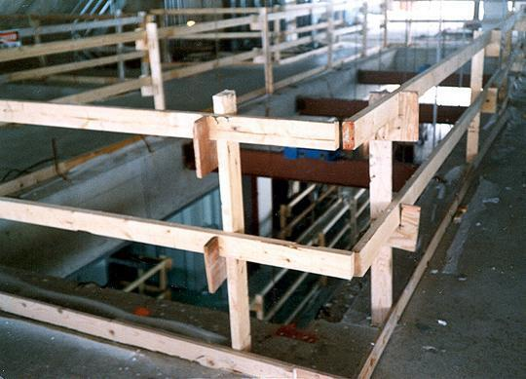
Guardrails
Top Rail
Mid- Rail
Toeboard
Top rails 42 +/- 3 in: between 39 and 45 inches tall
Toe boards at least 3 1/2 inches high

Slide 58
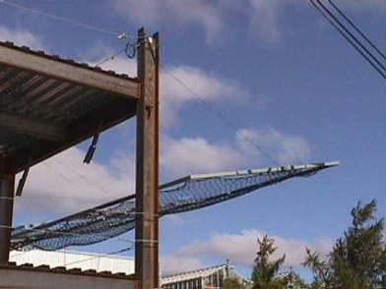
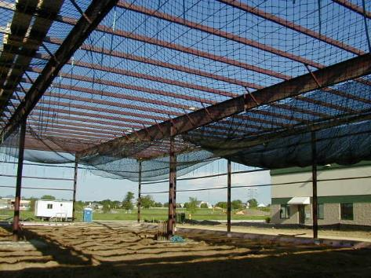
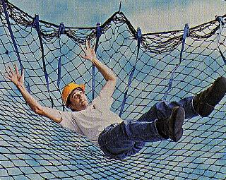
Use of Safety Nets
Assumes the fall will occur
Notes:
The instructor will explain the scenario

Slide 59
Safety Net Systems
Safety nets must be inspected for wear, damage, and other deterioration at least once a week, and after any occurrence which could affect the integrity of the system.
Defective nets shall not be used, and defective components must be removed from service.
Objects which have fallen into the safety net, such as scrap pieces, equipment, and tools, must be removed as soon as possible from the net and at least before the next work shift.

Slide 60


Safety Nets
Not a debris net
This is meant to catch falling people.
Form of collective and passive F.P.
Sometimes used during work on bridge projects or pre-fab building construction
Safety Net in Residential Construction
SafetyRespect® Safety Net System
Notes:
Safety nets for falling people are, essentially, what can be envisioned: they are put in-place to catch the falling worker much like one in a circus act would.
Although not commonly used in the majority of fall arrest situations, there are places where they are pretty frequently used such the situations shown in the pictures on the slide.
They are somewhat commonly used by iron workers during the construction of “pre-fab” buildings as is the case with the leading edge work being done by the worker in the top photograph. Here, individual components of the building itself may not be strong enough to support fall arrest forces, but a net can be used to spread out forces over the entire structure.
A similar situation can be seen with the safety net set below roof trusses on a residential construction job, again for the same reason that a net was used for the pre-fab building.
Sometimes nets will be seen on the edge of tall buildings to catch workers who may fall over the side, similar to what is shown in the “SafetyRespect” system.
One other common location where these are used would be during bridge construction where a lot of worker movement is needed and a PFAS would be too restrictive.
When going with a safety net system, OSHA spells out a number of requirements for construction. In fact, often the cumbersome nature of all of the requirements and the amount of design / testing that needs to go into their use, is what often dissuades companies from using them. That said, if they are going to be used, OSHA lays out some clear rules that must be met. The rules for Construction where they are commonly used are laid-out @ 1926.502(c).
Proposed Subpart D, at reference 1910.29(c), directs G.I. employers to the Construction regulations above for compliance requirements.

Slide 61
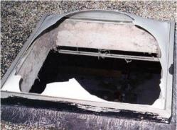
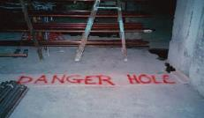
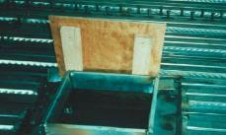
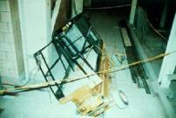
Skylights & Holes
Skylights & Roof Floor Openings
Back / Trip into;
Step on weak area of roof;
Hole hidden by non-load- supporting covering
NIOSH FACE Skylight Fatality
Hole Covers:
Be able to support at least twice the load imposed upon them
Be secured to prevent accidental displacement
Notes:
It should be noted that Subparts D & M consider both regular holes in the floor and “skylights” to be forms of “floor holes,” requiring protection against falling through both.
Floor holes, whether they be cut-out sections of roof / floor or a skylight, actually account for a significant number of fall deaths on an annual basis, both on Construction sites and in General Industry. By far the most common way that workers fall through them is by stepping onto them by accident (backing onto them or stepping on holes covered by an object such as roofing felt that has not been marked to indicate the hazard) or by tripping and simply falling through them.
OSHA lays out requirements for the “covers” that need to go over floor holes in 502 of Subpart M:
Note that requirements for current and proposed Subparts D are essentially the same.
1926.502(i)"Covers."
“Covers for holes in floors, roofs, and other walking/working surfaces shall meet the following requirements:
1926.502(i)(1)
Covers located in roadways and vehicular aisles shall be capable of supporting, without failure, at least twice the maximum axle load of the largest vehicle expected to cross over the cover.
1926.502(i)(2)
All other covers shall be capable of supporting, without failure, at least twice the weight of employees, equipment, and materials that may be imposed on the cover at any one time.
1926.502(i)(3)
All covers shall be secured when installed so as to prevent accidental displacement by the wind, equipment, or employees.
1926.502(i)(4)
All covers shall be color coded or they shall be marked with the word "HOLE" or "COVER" to provide warning of the hazard. Note: This provision does not apply to cast iron manhole covers or steel grates used on streets or roadways.”
The pictures at the bottom show examples of compliance with the regulations laid-out above, except in the case of the third photo where the floor hole couldn’t even support the weight of the load imposed on it, let alone twice it.
Skylight screens are a very common form of fall protection being utilized more and more. Here, although the worker may break the skylight when stepping on it, they will not fall through. An alternative to this is to put guardrails all the way around the skylight, as seen earlier.

Slide 62
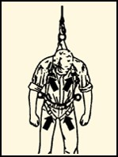
Personal Fall Arrest Systems
Includes an anchor point, a lifeline, and a safety harness

Slide 63
Personal Fall Arrest Systems
Once a Personal Fall Arrest System has been used in a fall, it must be removed from service right away.

Slide 64

Anchorage Point
Secure location of attachment for the worker’s F.P. gear:
Typical “anchorage / anchor points” include:
Large Columns | Large Beams | Concrete | Roof Panel / Understructure
OSHA Anchorage Requirements:
Option A: 5,000 lbs.
Option B: Safety Factor of 2 per a Q.P.
Notes:
One should begin by explaining that the anchorage, or “anchor,” point is the location to which the worker is going to attach their harnesses to absorb the impact forces of the fall. For that reason, it needs to be a fairly structurally sound member. One way to get workers to begin to understand why anchors need to be as strong as what the law requires (and as will be discussed shortly), is to give a hypothetical scenario.
Give workers the hypothetical scenario that there is a beam that can support 1,000 pounds but which will break if subjected to 1,001 pounds. Tell them that a worker who weighs 310 pounds (their own weight plus tools) will fall into it utilizing a cable connection (no energy absorber) a distance of just six inches. Signal this distance for effect.
Ask whether, at face value, common sense tells them that 310 pounds free falling 6” would be enough to cause the beam to fail.
This test has, in fact, been done and can demonstrate that a drop of 6 inches of a 220 pound rigid weight (once the ANSI suggested equivalent to simulate a 310 human being, (now being 282 pounds instead) will produce a force of nearly 1,300 pounds, which would obviously cause the beam to break.
Students find it interesting that each time they take a step down a set of steps their legs, which are operating to stop “controlled falls,” are absorbing more than a ½ ton of force upon contact with the next step.
Indicate that often anchorage points that will be selected will fall into one of the categories of what is listed in the various bullet points. Occasionally students will wish to be given guidelines as to what measurements on different types of points will make them adequate for fall arrest, but it should be indicated to them that the calculations are not this simple. Much goes into determining the force that different points can support when a qualified person is running the numbers:
What is the size of the anchor?
What is its condition?
What is the distance between its nearest supporting members?
How much load (if it is a roof member, for example) is it already supporting?
And although there are some companies that actually do give guidelines to workers when selecting anchorage points (the pipe must be of such and such diameter with a span between supports of no more than…, for example), this is not the norm nor is it the intent of the class. Instead, the general OSHA requirements will be described and the topic left at that.
When it comes to the OSHA requirements, both Subpart M and Proposed Subpart I give two options. The first of these is that the anchorage point needs to be capable of supporting a straight static load of 5,000 pounds. The law does not require that it actually be tested to this force but, instead, says that a worker should select something that would theoretically be able to support this load.
A common visualization that can be used to determine whether or not a something should be able to support this load is if the worker thinks that the item to which they would like to attach would be able to suspend a regular size truck, such as a Ford F-150 or a Chevy Silverado. If they think that the truck would pull it down, it will not work. On the other hand, if they think that it could support the truck, they would have to be severely mistaken (be off by more than 3,000 pounds) in order to be in danger. This will eliminate connection into many of the small objects into which people connect if they are honestly and truly doing this mental visualization.
The second option that OSHA gives is that the anchor needs to be able to support at least double the forces that will be put into it in a fall, giving a “safety factor of 2.”
Discussing this can be set up by mentioning a French study referred to by ANSI where forces in the range of 2,500 to 2,700 pounds were found to be high enough to cause significant injury to the body due to jarring of internal organs and leading to internal (potentially fatal) bleeding.
Thus, both the US and Canada have determined that systems shall be designed to stay well away from this force, arriving at what is known as a “Maximum Arrest Force” permitted of 1,800 pounds. The key point here to note is that in most fall arrest system setups, especially simple ones where the worker is attached to a rigid structure via harness and lanyard or SRL), the force that is imposed on the worker is the same that will be imposed on the point itself.
From this, many engineers (being qualified persons) will take the 1,800 force indicated as the maximum force imposed on the worker’s body on a fall and double it for what the anchorage must be able to hold. This determination, however, is very simplistic and can vary from situation to situation, serving simply as an example that is often used for anchorage points that may not be able to meet the 5,000 pound requirement but which can be certified to a safety factor of 2.
A few further notes on the two options can be spelled out at this point:
First, “Option A” is the most common one that is utilized, most likely because it doesn’t specify who has to make the determination. Essentially, any authorized person out on the job site can make the determination of whether or not they think the point into which they would like to connect could theoretically hold the required force. For this reason, this type of anchorage point is known as a “non-certified” anchor.
By contrast, Option B spells out that the determination needs to be done by a Qualified Person. These types of anchorage points are much less common, but they are preferred by some safety people because at least someone has analyzed the point and determined it to be safe for fall arrest forces (something which cannot always be said about points selected to meet Option A). Often, these anchorages will be tagged or color-coded to indicate that they have been analyzed and determined to be used for fall arrest purposes only. These anchorages are known as “certified” ones.
Regardless of which is selected, the requisite force needs to be multiplied by the number of workers attached to it. Therefore, if two workers are attached to the same beam and utilizing the 5,000-pound option, the beam needs to be able to now hold a static load of 10,000 pounds to meet the requirement. (This would go for Option B, too.)
A final note to discuss here is that the law talks about “Maximum Arrest Force,” something some people sometimes call “Maximum Allowable Force.” It could be pointed out that in the past many pieces of equipment used to say “Maximum Arrest Force” with a number of 900 lbs. and not 1,800 pounds. This meant that when using the equipment properly it would only subject the worker to ½ the limit that the law permits. However, when ANSI went from the 220 lb. test weight to the 282 lb. one, labeling of this type went out the window. Some points can be taken from this:
There was a time when some equipment was designed using Option B with a safety factor of 2 multiplying 900 lbs. times 2, for a total strength of 1,800 lbs. Granted, not a lot of engineers were comfortable with this, but it was technically legal.
Now, equipment will often say “Average Arrest Force (AAF),” listing a number of 900 lbs. in many cases. This means that we know that on average the force will be at 900 lbs., but there will likely be a peak above this (due to the heavier weight and greater resultant force in a 6’ drop). Thus, engineers cannot go by the 900 number any longer because they have to double the maximum arrest force, not the average arrest one. Thus, 1,800 pounds is the one number that we know will not be surpassed when equipment is correctly used.

Slide 65
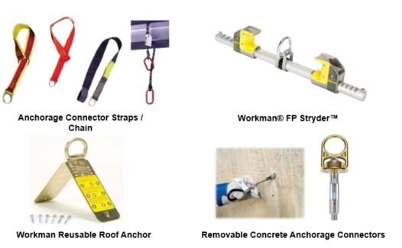
Temporary Anchorage Connectors
Notes:
These anchorage connectors are used in a temporary fashion, only to be removed to other work locations once finished in a particular spot.
This is a mandatory slide just to show some of the types of anchorage connectors available through MSA and Latchways. The preference is to have as many of these as possible in kits to hold up physically and show to the class, but these slides can be utilized as a basic supplement if none are available, just to put a picture to what is being talked about.
In addition, a booklet of user guides for MSA’s different products will be put together. This is something that should be studied at a high level to come to understand some of the main requirements for different pieces of equipment. It is relatively rare, for example, to be asked for strength requirements of the concrete into which a MEGA Swivel will be connected, but the more the instructor knows about these pieces of equipment the better.
Information on the actual pieces shown here is as follows:
Double D-Ring Anchorage Connector Strap
Standard lengths of 3 ft., 4 ft. and 6 ft.
Comes with an integral wear pad
Anchorage Connector Strap w/ Sewn Hoop on End
Here, the strap is choked through a web loop as opposed to passing a small D-ring through a big one to make the connection.
There are different versions of this strap, but the common length suggested in the catalog is 5’.
Thermatek Anchorage Connector Strap
Kevlar webbing and stitching
Includes a replaceable wear pad to protect webbing from abrasion
Is heat and burn resistant
Anchorage Connector Chain
Useful near sharp edges or in high-heat environments
Not Included (but in Catalog)
Suretyman Anchorage Sling -
1” nylon tube webbing sewn into a continuous loop
Available in 2 ft., 4 ft. and 6 ft. lengths
Can be hitched to an anchorage point using various configurations
Anchorage Cable Sling -
Standard lengths of 2’, 4’ and 6’ or custom
Vinyl coated
¼” Galvanized Cable
This one, per engineering, is only recommended when utilized overhead or with a HLL so as to keep a load on it at all times. This is because the carabiner or snaphook (a large one is suggested) connect in a “basket” fashion to the Flemish eyes. What can happen is that in other configurations (where there is slack) the eye can actually work to open a carabiner gate or put force on a snaphook gate in a fall.
Anchorage Connector Extension
Vinyl coated
¼” Galvanized Cable
Standard 5’ length
Here, the cable is wrapped around the anchorage point, connecting the snaphook of the device into the round ring. Then, the worker connects their connecting device snaphook to the round ring as well. (This may be the only product where MSA allows two snaphooks connecting into the same ring at the same time…but it is the prescribed use.)
Workman FP Stryder
Low friction wear pads with Teflon® enable effortless gliding along beam flange
An integral load indicator alerts the user if the unit has been exposed to a fall
Is designed to mount either overhead or at the worker’s feet. (It, however, cannot be used in a vertical fashion.)
There are rough and fine adjustment tabs on the Stryder.
The “rough” adjustment notches should be adjusted first and, then, the fine adjustment ones on the opposite side to ensure proper fit and connection onto the beam flange.
400 lb. working capacity
Workman® Reusable Roof Anchor
Fits up to a 12 x 12 roof pitch
Removable Concrete Anchors & MEGA Swivel Hybrid
RCA
Quickly and easily removed and reinstalled in another location
Durable stainless steel and aluminum construction
400-lb capacity
2 models:
5,000 lb. version (5K)
10,000 lb. version (10K)
The latter is larger than the other
The 10,000 lb. version can be used to anchor MSA Dyna-Line or Sure-Line HLLs as well as Gravity HLLs
MEGA SWIVEL HYBRID
Max capacity: 10,000 lbs. (44 kN)
Designed for repeated use; durable and 100% retrievable

Slide 66
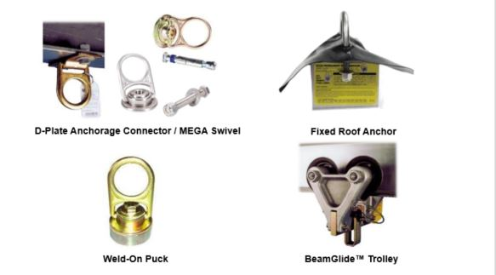
Permanent Anchorage Connectors
Notes:
This is a mandatory slide just to show some of the types of anchorage connectors available through MSA. The preference is to have as many of these as possible in kits to hold up physically and show to the class, but these slides can be utilized as a basic supplement if none are available, just to put a picture to what is being talked about.
In addition, a booklet of user guides for MSA’s different products will be put together. This is something that should be studied at a high level to come to understand some of the main requirements for different pieces of equipment. It is relatively rare, for example, to be asked for strength requirements of the concrete into which a MEGA Swivel will be connected, but the more the instructor knows about these pieces of equipment the better.
Information on the actual pieces shown here is as follows:
D-Plate Anchorage Connector
Bolts to beams or columns
Also available with 8” x 8” back-plate made of black anodized aluminum, galvanized steel, or stainless steel for attachment to concrete walls
If going this route, the piece shown is connected to the 8” by 8” back plate, which has 4 holes in it (with one in each corner). The Q.P. for the site then has to determine the method of affixing it to concrete from this point.
10K Mega Swivel (Silver)
Max Capacity: 10,000 lbs. / 44 kN
Requires PN 10144955 (bolt) to connect to steel or PN 10144956 (expansion bolt) to connect to concrete.
5K MEGA Swivel (Steel) (Gold-Colored)
Max Capacity: 5,000 lbs. / 22 kN
Two models: concrete (expansion bolt) & steel (regular bolt)
Permanent Roof Anchor
All-steel construction
Fits all pitches of roof trusses or rafters
BeamGlide™ Trolley
Provides horizontal mobility, keeping anchorage point directly overhead
Sizing to fit all beams

Slide 67
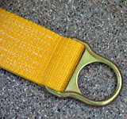


Connectors
Connectors
D- Rings
Snaphooks

Slide 68





Connecting Devices
Self-Retracting Lifelines
Drum-wound line is slowly extracted from or retracted back into the housing in normal use
Like a car seatbelt, locking off in a fall
PFL
Web SRL
Notes:
This is another area where demonstrating with physical examples is more useful than a slide, but having the slide helps to show some real-world examples.
SRLs depend on “pawls” on the inside that are held in-place by small springs. When the drum is spun fast enough, the retention force of the small springs is overcome and the pawls are allowed to flip out, locking into the housing of the unit and activating its deceleration / braking mechanism.
Many people are under the false impression that when it locks off, that is where the unit will stop paying out line. This, however, is not the case. Instead, depending on the unit, some energy absorbers will be visible on the outside in the form of a pack and others will be internal, utilizing brake pads like on a car on which the drum will turn or a more simple system of where the internal parts of the unit will compact down, absorbing force and paying out additional line. Latchways, as will discussed shortly, has still even more technologies to accomplish the same feat.)
The concept of “PFL” versus “SRL” needs to be discussed.
When “self-retracting lifelines” (SRLs) first came out they were big and bulky and, thus, were meant to be hung from an anchor point with the line hung down to the worker to connect into the back of their harness.
However, with time smaller and smaller units were designed and the concept of actually wearing them on one’s back like a lanyard was developed, thus creating the concept of a “personal fall limiter,” (“PFL”).
With these devices, the idea is that they can simply be worn at all times like a lanyard but they give the benefits of only having the needed line extracted when in use, thus limiting how far the worker goes in a fall (as opposed to a fixed length lanyard).
It should be noted that PFLs can also be turned around and utilized as regular SRLs should the user so desire, as it will not affect how they function at all.
SRLs go by various names including, “retractables,” “blocks,” and “Yo Yo’s,” among others.
The idea with the picture of the rope is to indicate that when SRLs are hung overhead, there are two major rules that must not be violated:
First, when the line is not being used, it must not be tied at the base of a ladder, for example, so that it is easily retrieved by the next worker who needs to climb the ladder later on.
This is not only because (a) the line will be left and possibly exposed to harsh elements but also (b) because tension will be kept on the internal retraction spring of the unit, thus weakening it over time due to the constant pressure on it; if this practice continues over time, eventually the unit will not retract line.
For this reason, when the system is not in-use a “tag line” must be used (attached at the snaphook and taken off when in-use) to pull the snaphook down out of the housing of the SRL to ground level where it can then be attached to the worker’s harness.
The second thing to discuss is that when allowing line back into the unit it should be done slowly as opposed to just allowing the line to shoot back up into the unit under spring power. If the user just lets go of the line instead of feeding it back in slowly with the tag line, it will cause the drum to accelerate enough that in some cases it will continue to spin once the snaphook has reached the housing, “backlashing” the spring and effectively making the unit useless.
Backlashing is where the connection between the drum of the SRL and the spring, which is a tab from the spring going into a “drum axle,” basically bend and break apart, thus disengaging the spring and making its retraction function not work anymore.

Slide 69

Lanyards
Inspections should be recorded in log
If past prescribed inspection interval, mark as “unusable.”
Many inspection points are similar to those on a harness.
Lanyard Inspection Points:
Hardware
Energy-Absorber
Webbing
Tags
Stitching
Notes:
The best way to handle inspection on pieces other than a harness (which likely was already covered prior to the donning exercise) is first to indicate that inspection criteria here will be very similar, except for where there are new elements not found on a harness.
Start by picking up a lanyard and discussing snaphook inspection:
They must meet all of the criteria met by other hardware pieces (i.e., no red rust that cannot be easily cleaned off lightly with a light wire brush, no pitting, no cracks, etc.) in addition to the fact that they must meet functionality criteria:
First, the snaphook or carabiner gate must not open unless the locking mechanism de-activated. (It must ride up against the nose of the snaphook with very little play, certainly with no daylight being able to be seen between it and the nose.)
Once opened, it shall automatically close on its own. If it doesn’t, MSA does indicate that a light penetrating oil (such as WD-40) may be used to make it operate smoothly again.
No broken parts are acceptable. This would include broken rivets or a broken gate spring.
Once having covered this, pass down the rest of the length of the lanyard and indicate how the inspection criteria will apply identically to how it did with a harness.
With tubular style (Diamond) lanyards, indicate that the folds must all be pulled apart when inspecting to look down in for cuts, tears, and abrasion.
These folds often will catch weld slag / sparks and allow them to sit and smolder; thus, care must be taken to inspect the areas in-between the folds carefully.

Slide 70

Self Retractable Lines
Snaphook or Carabiner (2)
No cracks, breaks, bends, corrosion
Check functionality.
Load Indicator
A broken indicator indicates fall force exposure.
Housing
No breaks or deformation that affects operation
Labeling
Must be present and legible
Lifeline (Web or Cable)
Check entire length of line with gloves and cloth.
Check retraction of lifeline.
Check lock-off of device.
Notes:
Inspection points for the snaphook or carabiner are exactly the same as what they were for the lanyard just covered.
In regards to the housing, the following points must be inspected:
Ensure that there are no physical breaks to the housing. (A small ding or scratch is ok.)
Check that there is no damage to the housing that affects operation; an example would be if it is bent inward, causing the internal drum to rub.
Labeling inspection is the same as it has been with every other device.
With the load indicator, if it is popped “it has seen fall arrest forces.”
There are stories of people who have been attached to an SRL at the top of a ladder and climbed to the last rung, jumping off upon reaching this point. Before getting to the ground, the SRL locks off with their feet literally inches above the ground. These people may say that the indicator broke but they weren’t involved in a fall. And although this is true, their device did “experience fall arrest forces” and must be treated as if it had been in an unintended fall.
With the lifeline, stress the following:
No amount of damage to the lifeline, including any breaks in cable is okay. Unlike with rigging, no broken wires are permitted in a lay of cable.
As a note for instructors, and not necessarily the class, know that this reflects a change in MSA policy. At one time some damage to cables was permitted and described in user manuals.
The SRL spring must have the capacity to retract its line. If it is so weak that the line doesn’t fully retract (or if there is internal damage that doesn’t allow full retraction due to drum rubbing), it must fail.
A very important check is whether or not the device locks off when pulling on the line somewhat forcefully. Instruct students to pull on the line, not on the snaphook.
With stronger individuals, if they pull hard enough on the snaphook, they could cause the indicator pin to shear; thus caution against pulling too hard.

Slide 71


Permanent Horizontal Lifelines (HLLs)
Designed by a Qualified Person
No. of workers per system?
Limits on # per span
Systems
Specially Engineered
Notes:
Latchways is perhaps best known worldwide for its engineered, permanent horizontal lifeline systems. Latchways designs and builds all of the equipment to be installed. It then relies on a select group of regionally based contracted installers (who are thoroughly vetted and trained on installation of the system in all types of situations and who can fall back on a broad resource library at Latchways for technical information when needed) to do the actual (1) initial analysis, (2) design, (3) installation, and (4) certification of the system.
Below is information taken from Latchways website on its engineered systems:
Latchways ManSafe systems provide the total solution for all horizontal safety at height industrial applications. The system’s versatility and ease of use makes it ideal for protecting workers as they go about day-today activities such as maintenance, cleaning, access and inspection.
Systems can be designed for up to five simultaneous users.
The user, wearing a full body harness and energy-absorbing lanyard, is continuously attached to the system with a Transfastener™, which rotates allowing it to pass through the intermediate cable supports.
Fixes to virtually all types of structure and roofing systems.
Follows the contours of the building by going around bends and up and down inclines.
Can be extended to include vertical sections.
The unique Latchways “Transfastener” allows workers to travel the full length of the system without having to detach and re-attach.
Normally incorporates the unique Latchways Constant Force post for assured fall arrest protection and simplified installation.
Where the Constant Force post is not applicable, in-line shock absorbers or a Constant Force energy absorber can be incorporated for equal safety assurance.
System testing must be conducted annually by suitably qualified installers to ensure that system certification is maintained. Key system checks such as deployment of shock absorbers, swage tests and torque checks are part of this process.
Latchways’ components are manufactured in marine-grade stainless steel and are individually numbered to allow complete traceability.
For systems on inclines over 15° a ClimbLatch device is required instead of the Transfastener.
User Instruction
Only attach to the system by means of a retractable fall arrest lanyard and full body harness conforming to the appropriate safety standards.
Always check pre-tension before use.

Slide 72





Vertical Lifeline/Lanyard

Slide 73


Anchorage Point
Other considerations include:
Location:
Above
Vertically inline with the worker
Note: Although the picture demonstrates a lanyard, this is a common issue when utilizing self-retracting lifelines (SRLs).
Rescue:
What does OSHA say about how quickly rescue must take place?
“Prompt”
Notes:
Two final points of significant importance in regards to anchorage points are shown here.
First, with location, it can be stated at this time quite simply that “anchor points that are located above and vertically in-line with the worker are the best kinds.” State that further discussion will be had on why above is the best place later on in the class, but ask why it being vertically inline is important:
The answer to the question is that an anchorage point that is not vertically above the worker will lead to a “swing fall” where the worker could violently hit something on the way down. It has been said that a worker can swing and hit objects sideways with as much force as what they would have hit if they had just fallen straight down. Regardless, the main point to make is that it is easier to control the trajectory of a straight-down fall than it is one where the worker is swinging.
Probably the most common time that workers violate the rule of putting themselves into a situation where swing fall is possible is with SRLs. Especially with units that have larger amounts of line, workers will often lay them at ground level and walk out horizontally. And beyond the swing fall issue, there are a number of problems with this:
The majority of these units were not designed or tested for this purpose, instead requiring to be mounted overhead.
Since they were not designed for this purpose, when their line runs over a sharp edge during a fall there is a very good chance that it will sever. There are units known as SRL-LE devices designed for this purpose (although they won’t help if the worker puts themselves in a swing fall situation) that are emerging on the market, but for now the general rule is to anchor above and vertically inline.
The other consideration when it comes to the anchorage point is whether or not the worker can be safely rescued from it in a safe period of time. This is a point that should be made several times in the class in order to stress its importance, and this is a good location to touch on it again.
OSHA’s stance on rescue is not very well spelled out. Some key points to understand / discuss include:
In all of its regulations on fall protection, OSHA dedicates a single sentence to the topic of rescue, saying that employers shall ensure that employees can self-rescue or that rescue be “prompt.”
Although OSHA has been asked through letter of interpretation to put a time period on what it means by “prompt,” it has declined to do so stating that what will meet the requirement will vary in different situations depending on what the cause of the fall was (electrical shock vs. slip or trip). Essentially, what OSHA is saying is that the employer needs to be able to get to the worker in time after the fall to be able to help them / prevent their condition from worsening due to hanging for an extended period of time.
In regards to the risks involved, many workers will have a decent idea of the risks associated with hanging in suspension for too long. Some will suggest that the issue ties back to cutting off circulation to the legs (which, in part it does), but the larger issue known as “suspension trauma” is more tied to the following sequence of events:
When in a vertical position, the heart needs assistance to pump the blood back to it and, then, on to the brain. This is due to the fact that gravity pulls on the blood in the body just as it does the outer parts of the body itself. What normally happens is that the veins of the legs intertwine with leg muscles and when the worker moves, the muscles will actually help keep the blood circulating by pushing on the veins. When the worker is hanging in suspension, however, this no longer occurs and the blood starts to settle in the legs.
With time, more and more blood will settle in the legs and less will get to the brain.
Once this happens, ask the students what won’t be getting to the brain. (Oxygen)
Ask students what will happen when they don’t get enough O2 to the brain. (They will pass out.)
Visually show the students what will happen to the position of the head when the person passes out in a hanging position. (Their head will slump forward, thus partially cutting off their airway if breathing through the mouth.)
Ask the students how long a person can live without breathing. (3 to 5 minutes)
Indicate that it is hard to pinpoint for sure how long it will take a person to pass out in harness, as that will vary depending on the severity of the fall, their conditioning, and how well they tolerate their particular harness, but that a general rule of thumb for getting them down is that it should take place within 15 minutes from the time of the incident.
Indicate that this is part of the reason for the harness suspension activity that will be coming up. The point will be to show them just how uncomfortable it is to hang in a harness in order to hopefully drive home the need to (1) adjust it properly and (2) to have a good rescue plan in-place before starting work.

Slide 74





Body Harness

Slide 75

PFAS Inspection

Slide 76

Webbing
Webbing are the ropes and straps used in lifelines, lanyards, and strength components of body harnesses. The webbing must be made from synthetic fibers.

Slide 77
Connecting Devices
Notes:
This and the slides that follow it, like anchorage connectors, are best left just to catch items missed during a hands-on visual demonstration of a lanyard for the class at the front of the room. As with a harness, a lanyard should be selected and discussed piece-by-piece.
Start by discussing the snaphooks of the lanyard, explaining that they come in a variety of materials (carbon steel w/ zinc chromate plating, stainless steel, aluminum) as well as sizes (³/₄" & 2 ¼” openings). The larger snaphooks are known by many different names, including “rebar hooks,” “pelican hooks,” and “ladder hooks,” among others.
Note that the large rebar hooks are made to connect onto larger objects, with rebar being a prime example of what they were originally designed for but also being used in many other applications where the smaller sized snaphook would not fit such as over the tube on tube and coupler scaffolding for scaffold builders / those working on a scaffold where part of the railing has been approved as a connection point.
Although not officially noted in MSA literature, the rebar hook should not be attached to the dorsal D-ring of a worker’s harness.
Snaphook compatibility discussions are a good place to discuss the OSHA requirement for double-action locking mechanisms on all snaphooks and carabiners.
Discuss how prior to 1998 non-locking snaphooks were available and simply had a spring loaded gate.
Using a “compatibility simulator” the instructor can hook up to an incompatible connection point (a simulated eyebolt) and explain that the students should, for a moment, assume that the anchorage is good for 5,000 pounds, the snaphook itself is rated for 5,000 (as the body itself was), and the line on the snaphook is good for more than that.
Then, having twisted the snaphook so as to have it oriented so that force can be put on the gate, pull down and demonstrate how “roll out” could occur where the snaphook could easily come off. (There have been anecdotal stories of workers in aerial lifts who were attached and working at the opposite side of the lift, pulling on their lanyard, only to have it come off in this way prior to the OSHA law changing. Thus, they’d become disconnected from their anchorage point and not even know it.)
Discuss how OSHA now requires an auto-locking feature (this prohibits screw-lock carabiners) on both snaphooks and carabiners, which means that at least two deliberate actions will need to be taken to open the connector.
Put an OSHA-compliant snaphook on the incompatible eyebolt, twist it, and show that it will not come off. But, ask if there is still a problem.
Try to see if you can get the students to see that pressure is still being put on the gate and see if anyone questions how strong an OSHA-compliant gate is.
Generally, they are strong enough to withstand 220 pounds from the front and 350 pounds exerted on them from the side.
Seeing that fall arrest systems won’t even begin to dissipate fall forces until reaching around 900 pounds and that high forces are generated in even a 6” drop, this strength will not be sufficient to hold if such forces are imposed. Thus, the issue that arises is what is known as “burst-out” where the snaphook gate simply fails due to the high forces.
Indicate that the issue was not one of locking versus non-locking but, rather, one of compatibility. There are three ways to determine compatibility:
First, a general rule is that if the snaphook or carabiner is bigger than the connector to which it will be connected and will not pass through inside of it, it is not compatible.
A second rule is that when the snaphook or carabiner is connected to the closed connector (with a D-ring probably being the most common example), one should not be able to cause the body to touch the opposite side of the connector by pushing on it.
Perhaps the most important way to determine compatibility or not is to attach the snaphook / carabiner to the connector and see if there is any orientation where it could sit / lay / be pushed where the gate could be loaded in the case of a fall. If so, it is incompatible. If, however, no amount of twisting or maneuvering could put force on the gate, it is compatible.
Indicate that MSA also has a whitepaper on compatibility that states the following:
“This technical brief is intended to address the question of compatibility of MSA fall protection products with fall protection products of alternate brands. MSA user instructions may state that any mixing of different brands must be approved in writing by MSA. The stance described in this technical brief supersedes the requirement for written approval by MSA.
It is acceptable to mix fall protection equipment of different brands provided the following
requirements are met:
All fall protection equipment used by an individual must meet the same industry standard or government regulation; either ANSI, CSA, EN or other applicable standard or regulation.
The fall protection equipment selected must be third party certified or independently verified to comply with the standard / regulation.
The competent person designated by the user’s organization or a qualified person must evaluate the components and determine that they are compatible for use based on capacity, size, strength, and shape of connecting elements.
Contact MSA with any additional questions regarding compatibility of equipment.”
A topic that ties in nicely at this point is snaphooks and carabiners that meet the ANSI Z359.1-2007 standard that requires that the gates be able to withstand a 3,600 pound force in any direction.
Describe how this is more than sufficient to hold in the case of a fall where the gate is loaded (seeing that maximum arrest forces shall not be more than 1,800 pounds when an appropriate fall arrest system is used correctly) but that it is still not a license to hook to incompatible anchorage connectors. Instead, describe it as a second line of defense for the case where a user makes a mistake or a bad decision.
Snaphooks and carabiners that meet this standard are easy to identify as they have the 3,600 pound strength marked on the gate.

Slide 78



Personal Fall Protection System
Restraint
Positioning
Notes:
This is a transition slide that introduces two other uses of the equipment utilized in fall arrest but not discussed up until this point: restraint and positioning.
Here, note that a difference in terminology is now used.
As opposed to “PFAS,” now “PFPS” is utilized because neither of these systems, although they all incorporate ABC components, is designed for fall arrest.
With Restraint (also known as “Travel Restraint”), the worker cannot get to the edge to fall in the first place.
With Positioning, the worker could potentially fall, but a common best practice is to have a harness on (although not required in all cases) that permits the worker to first connect with a fall arrest system to their back and, then, connect their positioning system at waist level to allow them to work hands-free.

Slide 79


Fall Clearance - Lanyard
Safety Margin: 3’
Notes:
Explain that there will always be two steps to calculating fall clearance for an energy-absorbing lanyard.
The first step is to measure from the ground (or closest obstruction below) to the bottom of the anchorage point and get a number.
For this chart, say that they have done so and come up with 20’. This tells them how much clearance is available for the fall.
The second step is to add the variables that are shown on the right side.
Indicate that in this diagram a D-ring anchorage connector is being used and, thus, its length hanging below the bottom of the anchorage point being negligible has been left off.
That said, ask if they think they’d need to add 2’ for a cross-arm strap that hangs down two feet below the beam. (The answer is yes.)
To this, add the length of the lanyard (which is usually 6 feet but, which, can vary), its elongation (another variable), the height of the worker (another variable, although 6’ is the common number suggested to use by MSA), and an additional safety margin of 3’.
Ask why they think the safety margin is necessary. Responses should include:
Stretch in the harness (which they will have seen during the lift exercise);
Possible errors in calculations
Once everything is totaled, in this case the worker’s system requires 18 ½ feet so that he won’t hit.
Tell the students that as long as the measurement that was done on the left (from the ground / nearest obstruction below to the anchor) comes up with a bigger number than the addition of the variables to the right, they are fine for clearance.
Next, to see if they really have the concept, ask the students how clearance would change if the worker were to use the same attachment point but climb atop his anchorage and his current work platform were to disappear.
Some students will say that more clearance will be needed while others will stay that it should stay the same. Help them understand the concept that more clearance is not needed by asking the following questions:
Has the distance from the ground to the anchor changed? (No)
Is the length of the lanyard different? (No)
Will the deceleration distance be longer from one traditional, OSHA-style 3 ½’ rip-out lanyard to another? (No. It cannot be. They will go all the way through the energy-absorber and hit into the back-up strap, but will only go a negligible amount further.)
Ask them if the height of the worker has changed. (No)
Ask if the safety margin has changed. (No)
Then, you can say, “When it comes to calculating fall clearance, the height of the worker is not important. What is important is the height of the…” (and they almost unanimously are able to say “anchorage point”).
Note that some workers will recognize that the worker standing atop the beam will see higher free fall and fall forces because of this setup. Acknowledge that this is an issue of significant concern, but that it is not a fall clearance issue.
Activity Suggestion:
A very good way to demonstrate this is to lay indicate an “anchor point” on the floor, lay out a completely deployed lanyard, and measure out an additional 8 ½ feet with a tape measure just to show just how much distance this really is.

Slide 80

Fall Clearance - SRL
A Typical Example
MAD = 4 ½ Feet (1.37 m) + 39” (1 m) Safety Margin ------------------------------------- D = 7’9” Feet (2.4 m)
Max Arrest Distance
Fall Clearance
Safety Factor of 39”(1 m)
Notes:
Explain that fall clearance with an SRL or with a PFL is figured out differently from the process that was followed with lanyards.
Here, we often don’t know the length of the payout of the line, especially in the case that a large SRL is being used; it may have a total length of 17 or 20’, for example, and we may not know what the exact length is.
Here as new way to calculate fall clearance was created where instead of measuring from the ground to the bottom of the anchor we simply measure from the ground to the work surface, thus eliminating the need to know the length of the connecting device as well as the height of the worker.
Now, in a best case scenario where the worker is anchored above them and is standing, we simply need to know the labeled MAD and the safety factor, here for a grand total of 7’8”.
Note that some workers will have a difficult time understanding why the worker’s height doesn’t need to be considered.
This can be explained by discussing how if they were to step off the beam instead of falling they would simply go the distance allowed by the SRL / PFL. Thus, at a maximum, they would only go 4 ½ feet before coming to a stop after having left the work surface.
Explain that since the measurement was from the ground to the work surface, nothing above the work surface needs to be measured.
If necessary, demonstrate with a ruler or pen up against the project screen to fill in for the roll of the falling person.
Not all situations will be best case scenario, however. Remind workers that if their anchor point is not elevated but is, for example, at the height of their back D-ring, they will have to add the length of the SRL / PFL as an additional “free fall” variable on top of the MAD.
Note that on all MSA SRLs and PFLs, MSA puts a limit on allowed free fall to 2 feet.
The only exception to this rule when it comes to any retractable is with the MSA Mini PFL, which allows anchorage up to a maximum of 5’ below the worker’s back D-ring.
Another issue is if the worker is to kneel down or lie on their stomach.
In these cases such as this, it is the MSA stance that the worker needs to add an additional 3’ for the worker who is kneeling and their height if they are on their stomach. This is because now their body is starting from a different position and will straighten out vertically when they fall, thus requiring the additional clearance.
Again, this may be a difficult concept for students to visualize. If so, take a pen / ruler and put it up on the screen and indicate the starting position of the fall, how the body will straighten out, and how this will now require taking into account the unfurling of the body.

Slide 81

Fall Protection - Rescue Plan
Each time PPE is used, there must be a rescue plan!
You must be able to rescue someone in a minimum amount of time.
Identify the normal conditions and allowances.
Define the plan during the Hazard and Risk Prediction.

Slide 82






Rescue Equipment
Rescue Cradle
Person is rescued in a physically neutral position.
Full Body Harness
May be different
Allows longer suspension
Anthron
Self-Rescue
Great in a panic
Rescue Equipment Kits
Rescue Utility Set
Rescue Hoist
Confined Space Application
Able to reset

Slide 83

Fall Rescue Procedures
Manage the people needed to operate the rescue equipment
Protect rescue personnel during rescue operations
Emergency medical technicians should give first aid if needed.
The fall prevention plan must include provisions for quick rescue.

Slide 84


Questions?

Slide 85
Disclaimer and Copyright Information
This material was produced under grant # SH-31201–SH7 from the Occupational Safety and Health Administration, U.S. Department of Labor. It does not necessarily reflect the views or policies of the U. S. Department of Labor, nor does mention of trade names, commercial products, or organizations imply endorsement by the U. S. Government. The U.S. Government does not warrant or assume any legal liability or responsibility for the accuracy, completeness, or usefulness of any information, apparatus, product, or process disclosed.
This material is the copyrighted property of Florida International University. By federal regulation, OSHA reserves a license to use and disseminate such material for the purpose of promoting safety and health in the workplace. Florida International University hereby authorizes employers and workplace safety and health professionals to use this material, distributed by or through OSHA, in their workplaces or practices in accordance with the guidance contained in the material.
To this end, permission is granted to use such copyrighted material solely for non-commercial, instructional, personal, or scholarly purposes. The material may be used and incorporated into other workplace safety and health programs on the condition that no fee may be charged for the subsequent use of the material. Use of the material for any other purpose, particularly commercial use, without the prior, express written permission of the copyright owner/s is prohibited. Furthermore, any modification to the material is prohibited without the prior, express written permission of the copyright owners.

Slide 86
SUPPORTING MATERIAL

Slide 87

What is a Fall Hazard?
Types of Fall Hazards:
Falls to a lower level
Falls to the same level
Slips & trips
Falls from ladders
Falls from scaffolds
Falls from roofs
Falls from equipment

Slide 88
Unprotected Sides, Wall Openings, and Floor Holes
Almost all sites have unprotected sides and edges, wall openings, or floor holes at some point during construction. If these sides and openings are not protected at your site, injuries from falls or falling objects may result, ranging from sprains and concussions to death.

Slide 89

A Fall with a 1.8 m (6 ft) lanyard
Time | Physical Response | Free-Fall Distance | Velocity
0.1 sec | Unaware | 5.1 cm (2 in) | 1.0 m/s (3.3 ft/s)
0.2 sec | Aware | 20.3 cm (8 in) | 2.13 m/s (7 ft/s)
0.5 sec | Start to Move | 1.22 m (4 ft) | 4.88 m/s (16 ft/s)
0.61 sec | Slight Movement | 1.83 m (6 ft) | 5.97 m/s (19.6 ft/s)
0.7 sec | Impact | 2.41 m (7.9 ft) | 7.01 m/s (23 ft/s)
0.9 sec | Rebound | 3.96 m (13 ft) | 8.84 m/s (29 ft/s)
1.0 sec | Suspend | 4.9 m (16 ft) | 9.75 m/s (32 ft/s)

Slide 90
Disabling Injuries
Top 4 Disabling Injuries 2016
Liberty Mutual Workplace Safety Index
---------------------------------------------------------
Notes:
Point out the difference between “falls on the same level” (those where the worker does not fall off anything but, instead, simply slips, trips, or falls from their own two feet) and “falls to a lower level” (which is where they fall over an edge or off a piece of machinery, among many other possibilities).
Discuss how combining the two would tie “falls” with “overexertion” for the top spot.
The key point here, however, is to stress that disabling injuries that are permanent.
On one end of the spectrum is a worker who once was in class who told the story about how he fell off a stepladder and went approximately 4 feet. His reaction was the same as anyone who ever falls, which is to put their hand down to try to catch themselves (a natural response to protect the head). He ended up causing permanent damage to his hand, causing him to lose some of his ability to grip. This was a problem because he had a Harley at the time and was unable to operate the brake.
Following the fall he was told by a West Virginia state trooper that because of his disability it was not legal anymore for him to ride his bike. He ultimately had to end up selling his Harley and stop riding…due to a 4’ fall from a stepladder.
From there transition to point out that other people have much more severe injuries from short falls.

Slide 91

Workplace Fatalities
Notes:
Stress the point that these numbers apply only to workplace incidents (not those at home, as many people often assume) and only to ones within the US (not factoring in numbers from around the world where safety standards are often much lower).
Thus, in the US where there are solid fall protection regulations and an enforcement body to regulate compliance, there are still nearly 2 fatalities a day. In the time that it takes to get through the first day of class two workers who are currently alive and going to / already at work, will (statistically) be dead.
Point out that there is no good reason for these fatalities to occur. If everything is done right and the person falls, at worst they should have some bumps and bruises while they hang, awaiting rescue. The people who die are those that:
Don’t Wear FP At All
Ask how common it is to see anyone on a residential construction site wearing fall protection.
It is not common at all, despite the fact that these workers are bound to the same fall protection regulations as workers on any other construction site. There was a time when Residential constructors were allowed to follow a different set of rules than other constructors, but on June 16, 2011 OSHA rescinded alternative fall protection measures due to what it saw as a lack of justification for them. The following was taken from an OSHA Fact Sheet entitled “Fall Protection in Residential Construction.”
“The United States Department of Labor's Occupational Safety and Health Administration (OSHA) has issued a directive rescinding the Interim Fall Protection Compliance Guidelines for Residential Construction (STD 03-00-001)
Prior to the issuance of this new directive, STD 03-00-001 allowed employers engaged in certain residential construction activities to use specified alternative methods of fall protection (e.g., slide guards or safety monitor systems) rather than the conventional fall protection (guardrails, safety nets, or personal fall arrest systems) required by the residential construction fall protection standard (29 CFR 1926.501(b)(13)). Employers could use the alternative measures described in STD 03-00-001 without first proving that the use of conventional fall protection was infeasible or created a greater hazard and without a written fall protection plan.
With the issuance of the new directive, all residential construction employers must comply with 29 CFR 1926.501(b)(13).”
Note that an entire webpage on residential fall protection can be found here:
https://www.osha.gov/doc/topics/residentialprotection/index.html
An especially helpful link on fall protection solutions specific to the industry is found here:
https://www.osha.gov/doc/guidance.html
Many times the body of a fallen worker rests at ground level with no harness at all.
Don’t Use the System Correctly
There are many variations on this, but it could include (1) having the harness on but not being connected, (2) having the harness on but the leg straps are not connected, (3) having the entire system on and hooked up but being connected into an anchor point that would never support fall forces, etc.
Stress that not only should class participants not “connect for show” to something that would never support their weight in a fall (just to make the safety person happy when they walk by, thinking that all is well), but that as Competent People they need to be on the lookout for people who are doing such a thing…as it is quite common.

Slide 92

Hierarchy of Controls
Notes:
The information contained below is from a second page titled “Safety & Health Management Systems eTool”:
Engineering Controls “The first and best strategy is to control the hazard at its source. Engineering controls do this, unlike other controls that generally focus on the employee exposed to the hazard. The basic concept behind engineering controls is that, to the extent feasible, the work environment and the job itself should be designed to eliminate hazards or reduce exposure to hazards. Engineering controls can be simple in some cases. They are based on the following principles:
If feasible, design the facility, equipment, or process to remove the hazard or substitute something that is not hazardous.
[Note here that “engineering” here is being used synonymously with “elimination and / or substitution. There is often quite a bit of room of interpretation open to where “engineering” falls on the hierarchy and what, exactly, it is referring to. For MSA, it is discussed as a form of “isolation,” the 2nd tier down.]
If removal is not feasible, enclose the hazard to prevent exposure in normal operations.
Where complete enclosure is not feasible, establish barriers or local ventilation to reduce exposure to the hazard in normal operations. Administrative Controls While safe work practices can be considered forms of administrative controls, OSHA uses the term administrative controls to mean other measures aimed at reducing employee exposure to hazards. These measures include additional relief workers, exercise breaks and rotation of workers. These types of controls are normally used in conjunction with other controls that more directly prevent or control exposure to the hazard. Personal Protective Equipment (PPE) When exposure to hazards cannot be engineered completely out of normal operations or maintenance work, and when safe work practices and other forms of administrative controls cannot provide sufficient additional protection, a supplementary method of control is the use of protective clothing or equipment. This is collectively called personal protective equipment, or PPE. PPE may also be appropriate for controlling hazards while engineering and work practice controls are being installed.
For specific OSHA requirements on personal protective equipment, see OSHA’s standard, 1910 Subpart I.
PPE Hazard Assessment and Training The basic element of any management program for PPE should be an in depth evaluation of the equipment needed to protect against the hazards at the workplace. The evaluation should be used to set a standard operating procedure for personnel, then train employees on the protective limitations of the PPE, and on its proper use and maintenance. Using PPE requires hazard awareness and training on the part of the user. Employees must be aware that the equipment does not eliminate the hazard. If the equipment fails, exposure will occur. To reduce the possibility of failure, equipment must be properly fitted and maintained in a clean and serviceable condition.”
https://www.osha.gov/SLTC/etools/safetyhealth/comp3.html

Slide 93

Conventional methods of control
Notes:
This is just a divider slide to show that OSHA’s conventional systems will be treated first (and to give repetition of what they are), focusing their attention on the first of the systems to be discussed: guardrails.

Slide 94



Fall Hazard Analysis
Before finding a solution – the hazard must be evaluated.
Use Hazard or Risk Prediction -- What are the conditions and behaviors to consider?
How will we get to the work area?
What are the hazards below the work area?
How high is the work area?
Are there holes or openings below or around the work area?
Are there slip or trip hazards around the work area?
How difficult is it to rescue someone if they fall?

Slide 95

Safety Nets

Slide 96






Fall Prevention Options
Platforms and Railings
Lifts
Scaffolding
Ladders
Fall Restraint Systems
Mobile Stairs

Slide 97


Commonly Used Terms
FALL RESTRAIN
Prevents people from reaching a fall hazard through a tie off system.
FALL ARREST
Stops a fall that is in progress through a tie off system.

Slide 98
Personal Fall Arrest Systems
Ensure that personal fall arrest systems will, when stopping a fall:
Limit maximum arresting force to 1,800 pounds.
Be rigged such that an employee can neither free fall more than 6 feet nor contact any lower level.
Bring an employee to a complete stop and limit maximum deceleration distance to 3½ feet.
Have sufficient strength to withstand twice the potential impact energy of a worker free falling a distance of 6 feet, or the free fall distance permitted by the system, whichever is less

Slide 99
Personal Fall Arrest Systems
Remove systems and components from service immediately if they have been subjected to fall impact, until inspected by a competent person and deemed undamaged and suitable for use.
Promptly rescue employees in the event of a fall, or assure that they are able to rescue themselves.
Inspect systems before each use for wear, damage, and other deterioration, and remove defective components from service.

Slide 100
Personal Fall Arrest System
Do not attach fall arrest systems to guardrail systems or hoists.
Rig fall arrest systems to allow movement of the worker only as far as the edge of the walking/working surface, when used at hoist areas.

Slide 101


Personal Fall Arrest System
Bodywear
Connecting Device
Anchorage Point
& connector
Rescue
Notes:
-This is simply an introductory slide to show that there are three components to the system itself, each of which will be covered in their own turn, plus the element of rescue that always must be considered but is often neglected during the planning phases of using the PFPS (Personal Fall Protection System). This is a good time to stress for the first time that if one is going to take the time to put all of the other components together and use them correctly they still must consider this 4th, extremely important aspect. A question that can be asked in this regard is, “When is the right time to plan for rescue?” The answer should always come back that it is “prior to the work beginning in the first place.” If it cannot be determined how the rescue will be carried out, work should not even start in the first place.

Slide 102

Attachment Location
The attachment of the body harness must be located in the center of the wearer's back, near the shoulder level, or above the head.

Slide 103
Body Harness
Body harnesses are designed to minimize stress forces on an employee's body in the event of a fall, while providing sufficient freedom of movement to allow work to be performed.
Do not use body harnesses to hoist materials.

Slide 104




Connecting Devices
Self-Retracting Lifelines
Drum-wound line is slowly extracted from or retracted back into the housing in normal use
Like a car seatbelt, locking off in a fall
PFL
Web SRL
Notes:
This is another area where demonstrating with physical examples is more useful than a slide, but having the slide helps to show some real-world examples.
SRLs depend on “pawls” on the inside that are held in-place by small springs. When the drum is spun fast enough, the retention force of the small springs is overcome and the pawls are allowed to flip out, locking into the housing of the unit and activating its deceleration / braking mechanism.
Many people are under the false impression that when it locks off, that is where the unit will stop paying out line. This, however, is not the case. Instead, depending on the unit, some energy absorbers will be visible on the outside in the form of a pack and others will be internal, utilizing brake pads like on a car on which the drum will turn or a more simple system of where the internal parts of the unit will compact down, absorbing force and paying out additional line. Latchways, as will discussed shortly, has still even more technologies to accomplish the same feat.)
The concept of “PFL” versus “SRL” needs to be discussed.
When “self-retracting lifelines” (SRLs) first came out they were big and bulky and, thus, were meant to be hung from an anchor point with the line hung down to the worker to connect into the back of their harness.
However, with time smaller and smaller units were designed and the concept of actually wearing them on one’s back like a lanyard was developed, thus creating the concept of a “personal fall limiter,” (“PFL”).
With these devices, the idea is that they can simply be worn at all times like a lanyard but they give the benefits of only having the needed line extracted when in use, thus limiting how far the worker goes in a fall (as opposed to a fixed length lanyard).
It should be noted that PFLs can also be turned around and utilized as regular SRLs should the user so desire, as it will not affect how they function at all.
SRLs go by various names including, “retractables,” “blocks,” and “Yo Yo’s,” among others.
The idea with the picture of the rope is to indicate that when SRLs are hung overhead, there are two major rules that must not be violated:
First, when the line is not being used, it must not be tied at the base of a ladder, for example, so that it is easily retrieved by the next worker who needs to climb the ladder later on.
This is not only because (a) the line will be left and possibly exposed to harsh elements but also (b) because tension will be kept on the internal retraction spring of the unit, thus weakening it over time due to the constant pressure on it; if this practice continues over time, eventually the unit will not retract line.
For this reason, when the system is not in-use a “tag line” must be used (attached at the snaphook and taken off when in-use) to pull the snaphook down out of the housing of the SRL to ground level where it can then be attached to the worker’s harness.
The second thing to discuss is that when allowing line back into the unit it should be done slowly as opposed to just allowing the line to shoot back up into the unit under spring power. If the user just lets go of the line instead of feeding it back in slowly with the tag line, it will cause the drum to accelerate enough that in some cases it will continue to spin once the snaphook has reached the housing, “backlashing” the spring and effectively making the unit useless.
Backlashing is where the connection between the drum of the SRL and the spring, which is a tab from the spring going into a “drum axle,” basically bend and break apart, thus disengaging the spring and making its retraction function not work anymore.

Slide 105




ANSI Z359.14 – 2014
Class A SRL
“Maximum Arrest Distance” = 24”
Average Arrest Force = 1,350 lb. (1,800 lb. peak)
Class B SRL
“Maximum Arrest Distance” = 54”
Average Arrest Force = 900 lb. (1,800 lb. peak)
“Leading Edge” (LE-SRL)
Inline energy absorber at attachment end to user’s back
Specifically tested for going over sharp edges
Factory Recertification
Based on frequency of use from date of service
Notes:
-MSA manufactures SRLs that meet either the Class A or B requirements of the ANSI standard listed at the top of the slide. Basically, with a small PFL (the only unit that we have that will meet “A” is the Mini PFL) the unit will lock off and bring the worker to a stop in no more than 24” once it has entered the “activation” phase where line is paying out. How much of that space involves “activation distance” and how much of it is “deceleration distance” is variable and does not need to be known.
-Class B SRLs are the norm. Here, the same info from above applies but the “MAD” changes and the “AAF” is also different.
-MSA is currently working on what it calls a “Leading Edge” SRL. “LE-SRL” comes from the ANSI standard. Here the concept is that when a line is run over a 90 edge (say on top of a roof), it has a very good chance of catching on the edge, whether it be of synthetic webbing or cable. When it catches, there is a very good possibility that it could sever into two pieces because the energy absorber is unable to function as normal (being in the housing, up and away from the worker), allowing more payout of line. Thus, with an LE-SRL, there is an energy-absorbing pack between the snaphook that goes into their harness and the beginning of the line that comes out of the unit. With these units, when the line catches on the edge of the roof, the shock pack will open up, reducing force put on the line to around 900 pounds and protect it from cutting.
-In regards to factory recertification, there was a period of time that the standard discussed here had a best practice recommendation for factory authorized service center (not competent person) recertification that was based on frequency of use and how rugged the environment is. ANSI, however, eventually reversed this stance, instead simply calling for competent person inspections based on frequency of use and the ruggedness of the environment. As of the writing of this version of the program, MSA’s stance will continue to follow the old ANSI chart in regards to a suggested factory recertification (although the information has yet to be published in MSA manuals).
Note 1: As opposed to MSA, Latchways products for use in the U.S. will have the same suggestions as the updated ANSI chart that has eliminated the last column calling for factory / service center recertification.
Note 2: In Canada, currently Z259.2.2-98 has three types of Self-Retracting Lifelines:
Type 1 (SRL)
A Type 1 device shall be classified as a self-retracting lanyard (SRL). An SRL shall have a work ing length of between 1.5 and 3.0 m.
Type 2 (SRL)
A Type 2 device shall be classified as a self-retracting lanyard (SRL). A Type 2 SRL shall generally have a working length of more than 3.0 m.
Type 3 (RSRL)
A Type 3 device shall be classified a self-retracting lanyard with retrieval function (RSRL). An RSRL shall have a working length of more that 3.0 m and be fitted with a retrieval device.
Under this old standard, Type II and Type III SRLs must be sent in for mandatory factory recertification (unless needed sooner due to damage) after the first two years of use, then annually thereafter. However, a new version of the standard has been released very similar in format to the retracted ANSI standard described above that will require factory recertification based on use and harshness of the environment. At the time of this writing, though, there still is no capability to test to the new standard and, thus, companies continue to follow the old regulation.

Slide 106
Horizontal Lifeline
Horizontal lifelines are to be designed, installed, and used under the supervision of a qualified person, and as part of a complete personal fall arrest system which maintains a safety factor of at least two.
On suspended scaffolds or similar working platforms with horizontal lifelines that may become vertical lifelines, the devices used to connect to a horizontal lifeline must be capable of locking in both directions on the lifeline.

Slide 107
Ladder Safety
Employees must be trained to properly use a ladder- this includes safety measures like:
Maintain three points of contact
Place the ladder on level footing
Always face the ladder
Secure the ladder by locking the metal braces at the center of the ladder
Don't overreach
Don't walk the ladder

Slide 108
Misuse of Portable Ladders
You risk falling if portable ladders are not safely positioned each time they are used. While you are on a ladder, it may move and slip from its supports. You can also lose your balance while getting on or off an unsteady ladder. Falls from ladders can cause injuries ranging from sprains to death.

Slide 109
Misuse of Portable Ladders
Position portable ladders so the side rails extend at least 3 feet above the landing.
Secure side rails at the top to a rigid support and use a grab device when 3 foot extension is not possible.
Make sure that the weight on the ladder will not cause it to slip off its support.
Before each use inspect ladders for cracked or broken parts such as rungs, steps, side rails, feet and locking components.
Do not apply more weight on the ladder than it is designed to support [For additional information, see Ladder Safety].
Use only ladders that comply with OSHA design standards [29 CFR 1926.1053(a)(1)].
link to OSHA Publicationabout portable ladder

Slide 110

Warning Lines – 1926 Non-Roofing
Originally just for roofers doing roofing work
May 12th, 2000 LOI permitted use for other activities, with restrictions
“Fall Protection Myths and Misconceptions: Working Within the OSHA System”
Notes:
A key point to make with this slide is that many Construction contractors looked at the concept of warning lines, originally specified only for roofers doing roofing work, and indicated that they would like to have access to them for their own use as well for other types of activities.
Thus, in a 2000 LOI OSHA gave permission of the use of these lines in other types of construction work following all of the prescribe criteria from before, with two main exceptions:
First, the distance from the edge of the roof to the lines no matter the use of mechanical equipment or not becomes 15’.
Second, whereas roofers could allow a worker protected only by a safety monitor to go outside the lines when doing roofing work, other workers using one of these systems will have to practice a conventional form of fall protection if going outside the lines.

Slide 111

Designated Area - 1910
4-sided set of lines in-place to warn workers of edge hazard
Permitted, in 2003, by P. Subpart D
“De Minimis Violation”
Work must be of “temp. nature”
Permit work inside w/ no PFAS
Most rules mirror 1926 requirements
Distances?
G.I. “Maintenance Work”
Notes:
Just like happened with Construction, General Industry employers also saw and liked these lines, wanting them for their workers when doing maintenance work on roofs.
Here, OSHA’s proposition of a 2003 update to Subpart D (the current General Industry fall protection rule in most cases) allowed for the use of warning lines with the new name “designated areas.”
Once again, the statements made in regards to constructors doing non-roofing work hold true here (in regards to system requirements), with one very noteworthy exception.
Eventually the 2003 rule became outdated and was replaced with a new, 2010 version which also included provisions for designated areas in regular, routine work. The interesting thing for G.I. was that the distances from the edge, instead of being 15’, were listed as 6’ and 10’, just like the1926 rule and not 15’.
Thus, remembering that compliance with a proposed regulation is a “de minimis violation,” employers in G.I. can, technically, use these in their everyday practices even though there is no mention of them in the current regulations.

Slide 112
Connectors
Connectors, including D-rings and snaphooks, must be made from drop-forged, pressed or formed steel, or equivalent materials. They must have a corrosion-resistant finish, with smooth surfaces and edges to prevent damage to connecting parts of the system.
D-Rings must have a minimum tensile strength of 5,000 pounds, and be proof-tested to a minimum tensile load of 3,600 pounds without cracking, breaking, or becoming permanently deformed.

Slide 113
Connectors
Snaphooks must have a minimum tensile strength of 5,000 pounds, and be proof-tested to a minimum tensile load of 3,600 pounds without cracking, breaking, or becoming permanently deformed. They must also be locking-type, double-locking, designed and used to prevent the disengagement of the snaphook by the contact of the snaphook keeper with the connected member.
Unless it is designed for the following connections, snaphooks must not be engaged:
Directly to webbing, rope, or wire.
To each other.
To a D-ring to which another snaphook or other connector is attached.
To a horizontal lifeline.
To any object which is incompatibly shaped in relation to the snaphook such that the connected object could depress the snaphook keeper and release itself.

Slide 114

Examples of PPE Failures
Heat damage

Slide 115

Examples of PPE Failures
Separation of layers – stitching was broken

Slide 116

Examples of PPE Failures
Top view -- Cut
Side view -- Cut

Slide 117

Examples of PPE Failures
Damage due to heat – inside fiber exposed
Hardened surface due to exposure to paint

Slide 118

Examples of PPE Failures
Outside plastic cover is damaged – inside exposed
Stretching due to force or heat – incorrect shape

Slide 119

Examples of PPE Failures
Damage due to spark or heat – surface damaged
Buckling damage

Slide 120

Examples of PPE Failures
Damage due to chemicals and paint – surface is hardened

Slide 121

Examples of PPE Failures

Slide 122



Examples of PPE Failures

Slide 123
Examples of PPE Failures
Suspension trauma, also known as orthostatic intolerance, is an effect which occurs when the human body is held upright without any movement for a period of time.
If the person is strapped into a harness or tied to an upright object they will eventually suffer the central ischemic response.
If one faints but remains vertical, one risks death due to one's brain not receiving the oxygen it requires

Slide 124

Review
Fall Hazard scenarios have options
Fall Prevention
Fall Protection
Must choose which solution works
best for your situation
Fall Protection
Inspection
Training
Rescue

Slide 125
Scaffold Safety
Employees must be trained to safely set up and use scaffolds- this includes safety measures like:
During setup: fully plank scaffolds, complete all guardrails, ensure stable footing and plumb and level
Ensure proper access to scaffolds
A competent person must inspect the scaffold before use
Don't climb over cross braces
Don't stand on guardrails
Don't use a ladder on a scaffold

Slide 126

Scaffolds in construction
Suspended Scaffold

Slide 127

Scaffolds in construction
Suspended Scaffold

Slide 128

Scaffolds in construction
Aerial Lift Scaffold

Slide 129

Scaffold in construction
How many things are wrong here?
Notes:
In correct scaffold construction
Incorrect ladder use
No use of Personal Fall Arrest System
Working very dangerously

Slide 130

Is This a Fall Hazard?
YES
Workers could fall while climbing on the shoring structure to set it up and remove it.
Ladders and lifts must be provided.
Photos in this presentation are from the OSHA Region 4 National Photo Archive and OSHA Region 5.
Notes:
TRAINER NOTE: Your options are to use:
this presentation as developed to prompt hazard recognition classroom discussions; or
the presentation as developed along with the alternative activity approach to encourage student note taking regarding hazard recognition (see “Falls_HazRec_AltActivity” folder provided); or
your own photos to cover the hazard recognition component.
PHOTO: Workers are climbing on the shoring structure during set up and removal.

Slide 131

Is This a Fall Hazard?
YES
Workers are exposed to a fall hazard greater than 6 feet, while working near stairwell opening.
Workers must be protected from falls over 6 feet.
Notes:
Worker working above ground level.

Slide 132

Is This a Fall Hazard?
YES
Unprotected open-sided floors 6 feet or more above ground level.
Guardrail systems, safety net systems or personal fall arrest systems are required.

Slide 133

Is This a Fall Hazard?
YES
Workers are installing a new metal roof without fall protection.
NOTE: Remember that ladders must extend 3 feet above the landing area.
Notes:
Workers are installing a new metal roof.

Slide 134

Is This a Fall Hazard?
YES
Planks appear to be overloaded and there is no safe access for workers.
Lack of fall protection for workers on fabricated frame scaffolds.
The workers are exposed to a 35-foot fall hazard from a scaffold while stacking blocks prior to overhand bricklaying operations.
Notes:
Workers on fabricated frame scaffolds stacking blocks.

Slide 135

Can You Identify the Fall Hazard?
YES
It must extend 3 feet above the working surface.
Ladder to work platform is not of sufficient length.

Slide 136

Is This a Fall Hazard?
YES
The top of a stepladder shall not be used as a step.
Worker is working off of the top of a step ladder.
Notes:
Worker is working off of the top of a step ladder.

Slide 137

Can You Identify the Fall Hazards?
YES
The worker inside of the window is not provided with fall protection as there is no standard guardrail for the window.
A worker is working from a carpenters' scaffold that has no guardrail, extends too far beyond either end, and is not wide enough.
The worker also does not have proper access to the scaffold.
The worker working below is exposed to the struck-by hazards of tools and equipment falling from the employees working above.
NOTE: A competent person must supervise as scaffolds are erected, moved and taken apart.

Slide 138

Is This a Fall Hazard?
Falls in Construction Re-Roofing
Link to webcast about reroofing
Notes:
Worker working on an 8:12 pitch roof with the lifeline tied to his waist as fall protection.

Slide 139
YES
Worker working on an 8:12 pitch roof with only the lifeline tied to his waist as fall protection.
Employer must provide full body harnesses.
Notes:
Employer must provide full body harnesses.

Slide 140

Is This a Fall Hazard?
Notes:
Workers were working at heights greater than 10 feet.

Slide 141
YES
Scaffold was not erected with guardrails in areas where workers were working at heights greater than 10 feet.
Notes:
The scaffold was not erected with guardrails in areas where workers were working at heights above 10 feet.

Slide 142

Fall Prevention planning
Fall Prevention Planning
Lanyards and Personal Fall Arrest System in use
Fall prevention systems and work practices
must be in place before you start work.

Slide 143

Fall Rescue Procedures
If the worker may be hurt, call 9–1–1.
Figure out the best way to rescue the fallen worker.
Locate the nearest rescue anchor
Look for the nearest safe working level for the fallen worker
Identify equipment needed to get the fallen worker to a safe working level
Notes:
Explain what a rescue anchor is.

Slide 144

Is this a good guardrail?

Slide 145

Personal Fall Arrest Systems
Body belts are not acceptable as part of a personal fall arrest system

Slide 146



Bodywear
The Body Harness
Holds the person in it during the fall
Will only work if worn correctly
Distributes fall forces to specific locations
Prior to 1998 another type of “bodywear” was permissible. What was it?
Is NOT “one size fits all.”
Notes:
The first point to make here is that the harness, obviously, is designed to hold the person in it during a fall but that it will only be able to do so if it is worn correctly:
Ask what will happen if people walk around with their leg straps undone as is sometimes the case.
The answer is that they could easily fall out of the harness.
Ask if a loose chest strap is an issue. (If it is too loose, this “shoulder strap retainer” will allow the shoulder straps to slide off the shoulders and in a head-first fall the person could, theoretically, come out of their harness, especially if they are of a smaller build.)
Explain that this is a major reason why proper harness fitting will be discussed before doing the lift exercise.
The second major point with harnesses is that they are designed to put forces on the body where it is best able to take them: (1) upper thighs, (2) pelvis, (3) chest, & shoulders.
Start the discussion by asking if they remember the bodywear that people used to use.
The bodybelt was permitted for Fall Arrest purposes until 1998.
Tell them that the bodybelt was outlawed by OSHA for fall arrest purposes starting in January of 1998 because it directly put forces where we don’t want to see them: the abdominal region.
Additionally, it would cause a falling worker’s body to bend in ways very detrimental to their body.
Ask where fall forces will be put on a worker with a FBH.
They should be able to guess, but explain that the main impact forces will be on the fat part of the legs / major leg muscles or, in the case of a head-first fall, on the shoulders.
Ask where the forces will be imparted if the leg straps are loose, as is VERY common. (This can cause very major injury for a male worker, as is evidenced by photos that can be found online of workers who have suffered major testicular injury due to straps that either started in a bad position or which rode up in a fall.)
Another way to make an important point stand out for students has to do with harness capacity.
Ask the class, by show of hands, to indicate how many of them have their harness. If many indicate that they do, ask how many of them think that they know it fairly well. (Most of the same hands will remain up.)
At this point, ask who can tell you what the capacity is on their particular harness. (Don’t be surprised if no one actually knows the capacity…or even that there was one.) Ask them where they might find this information…
Direct them at this point to the harness tag.
Points to stress with capacity are the following:
Different harnesses have different capacities. This is also true of all PFAS equipment, including anchorage connectors and connecting devices.
Explain that capacity is the max that the person and their tools can weigh and safely use the piece of equipment.
Once you tell them that most harnesses nowadays have capacities of 400 lbs., ask what they think the capacity is on a lanyard
Occasionally you’ll get an answer of 5,000 pounds. You will need to explain here that this is the required minimum ultimate breaking strength of most components, but it is not what capacity is referring to.
More frequently you’ll get a guess of 400 pounds since that was what the harness was for. Indicate that actually most other equipment is only rated to 310 pounds and that specialty equipment (lanyards / SRLs) will need to be acquired to deal with heavier workers.
When students say that they have someone who exceed the 400 pounds, it needs to be indicated that since the equipment has not been designed or tested for these heavier weights that they will be violating manufacturer requirements (and, thus, be in violation of OSHA rules) as a result if they allow the heavier worker to work in the equipment.
Show the workers the sizing chart shown here for the EVOTECH® harness. Explain that in the case of MSA there are different sizing charts for different harness lines that are based on height and weight. Point out where you, as an instructor, would fall on the chart and indicate that buying the wrong size harness will either lead to incorrect fit or lack of / too much adjustment strap for fitting.

