Slide 1
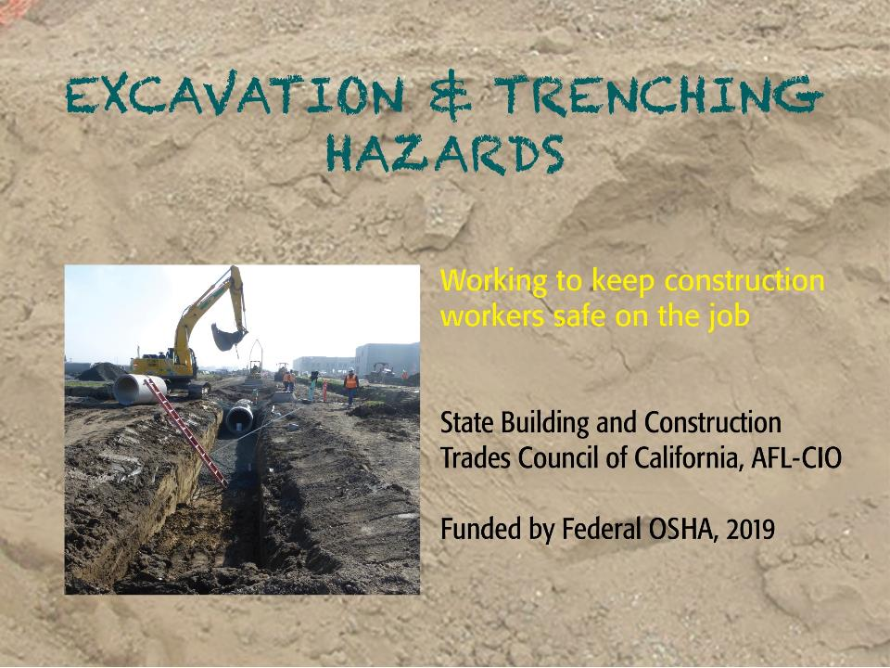
Title Slide
Notes:
IMPORTANT NOTE:
This PowerPoint presentation is designed to be used in conjunction with our State Building and Construction Trades Council
“2019 Excavation and Trenching Hazards Curriculum.”
The Curriculum includes detailed teaching notes for each slide as well as important background information and instructions for using this PowerPoint.
Before using this PowerPoint, presenters should study the Curriculum notes for each slide to familiarize themselves with the content and key talking points.
The Excavation and Trenching Hazards PowerPoint slides and Curriculum were part of a complete training package created by the State Building and Construction Trades Council of California, AFL-CIO (SBCTC) for our 2019 Train-the-Trainer program produced under grant# SH05030SH8 from the Occupational Safety and Health Administration, U.S. Department of Labor (slide 2 contains a full disclaimer).
Image credits for each slide are also available as an addendum to the Curriculum.
Material may be used for non-commercial, instructional, educational purposes ONLY, with proper accreditation to the State Building and Construction Trades Council of California, AFL-CIO.
Every effort has been made to ensure information is current and accurate, the SBCTC does not assume any liability for errors or omissions.

Slide 2

Funded by:
Training Developed By: State Building and Construction Trades Council of CA, AFL-CIO
This material was produced under grant SH-05030-SH8 from the Occupational Safety and Health Administration, U.S. Department of Labor. It does not necessarily reflect the views or policies of the U.S. Department of Labor, nor does mention of trade names, commercial products, or organizations imply endorsement by the U.S. Government.

Slide 3
Use of material and duplication
Material may be used for non-commercial, instructional, educational purposes ONLY with proper accreditation to SBCTC
Fees may not be charged for this material
Every effort has been made to ensure information is current and accurate, the SBCTC does not assume any liability for errors or omissions

Slide 4
Acknowledgements
We gratefully thank the following organizations for:
Providing technical assistance with developing this training:
Federal OSHA
Cal/OSHA
CA Department of Public Health
Elaine Nazima El-Askari, MPH, Consultant
UC Berkeley Labor Occupational Health Program (LOHP)
Sharing: photos, video, training material
CA Dept. of Industrial Relations—Commission on Health and Safety and Workers’ Compensation (WOSHTEP program)
Center for Construction Research and Training (CPWR)
Elcosh Images
McGuire and Hester
Oregon OSHA
OSHA Training Institute Education Center—Chabot-Las Positas College
Rudy Schroeder, Safety Consultant
Swinerton Builders
Existing photos and material developed by these previous OSHA grantees was incorporated into this training:
Construction Advancement Foundation of Northwest Indiana, Inc.
Maryland Fire and Rescue Institute
University of Texas at Arlington

Slide 5
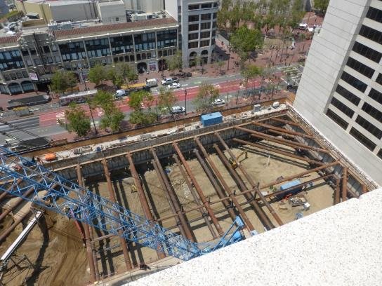
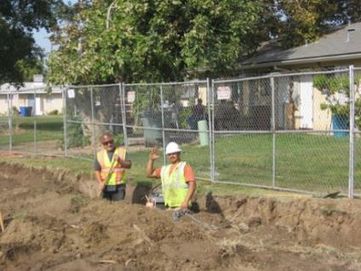
Which one is an excavation?
Notes:
Swinerton
OSHA Training Center

Slide 6
OSHA’s definition of excavation
“Any man-made cut, cavity, trench, or depression in the Earth’s surface formed by earth removal”
Notes:
LB McGuire & Hester

Slide 7
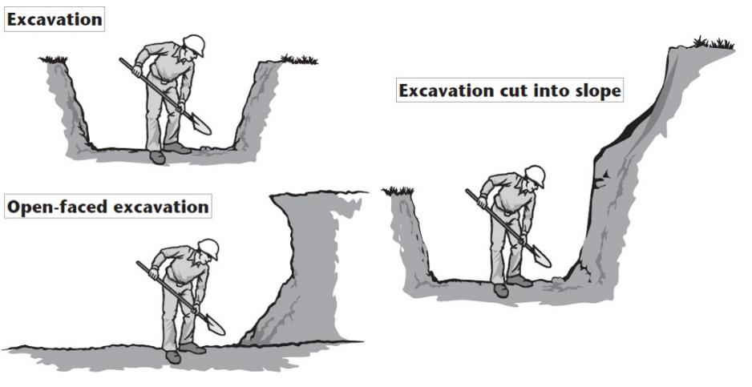
Examples

Slide 8
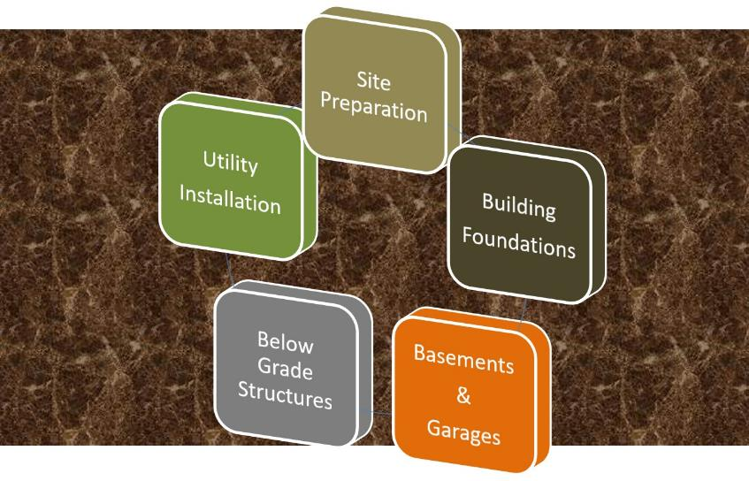
What construction projects?

Slide 9
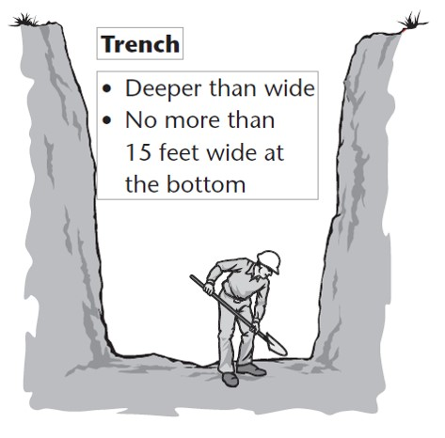
Is a trench different from an excavation?
All trenches are excavations;
not all excavations are trenches.
Notes:
OR OSHA

Slide 10
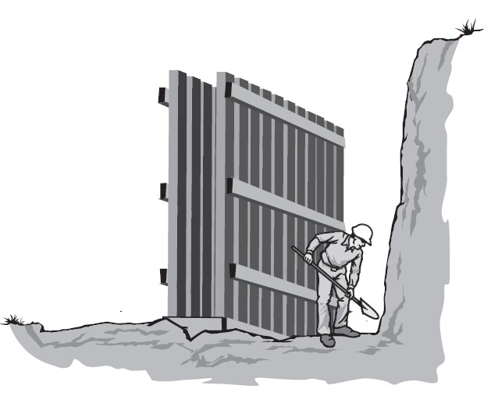
Also considered a trench
Notes:
OR OSHA

Slide 11
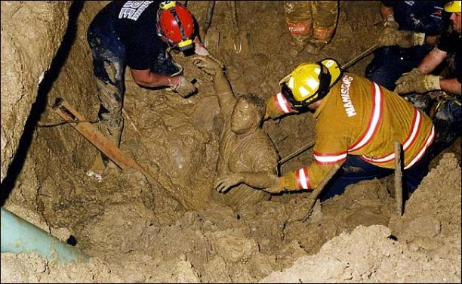
Excavations are dangerous
Known to be among most hazardous construction operations
Notes:
Jordan Barab Confined Space

Slide 12
Buried Alive: Joe’s Story http://utilitycontractoronline.com/buried-alive-joes-story/
"Buried alive. Alone. Screaming you know no one can hear. You wonder if the rescuers can get to you in time. You can’t move a muscle—not even your fingers. It is tough for you to breathe. And breathing is getting more difficult with each shallow breath because the dirt is crushing you.…

Slide 13
Buried Alive: Joe’s Story
…You have been doing this type of work for years and odds were that it would never happen to you. You may be asking yourself why you didn’t listen to the safety manager who told you never to go into an unprotected trench. And now as the last few minutes of your life pass you by, you think about your wife and kids, your parents and close friends and how much you would like to tell them you love them. But it is too late."

Slide 14
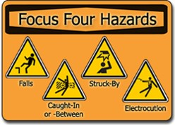
Construction fatalities

Slide 15
Excavation and trenching fatalities
15
Rate for these fatalities is 112% higher than rate for general construction
Construction averages 2 trench fatalities every month
80% of all U.S. trench/excavation fatalities from 2011-16 were in private construction industry

Slide 16
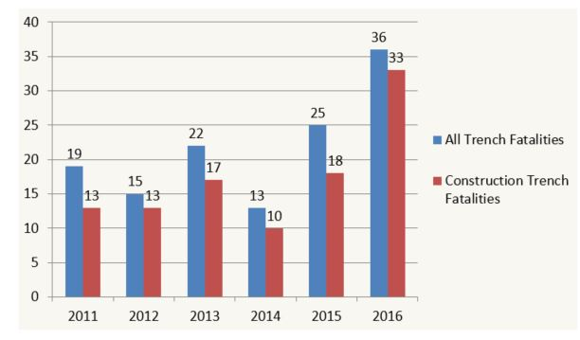
Trench fatalities 2011-16

Slide 17
Trench fatality facts 2011-14
17
Water/sewer work, site preparation
Majority contractors with <50 employees; largest % <10 employees
Most victims between 25-54 years old
75% Hispanic workers, over 1/3 foreign born
Construction laborers, plumbers & pipelayers, supervisors
Residential sites and road construction

Slide 18
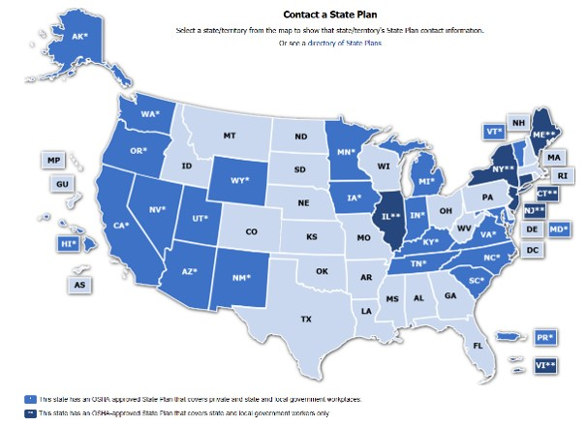
Excavation accidents are preventable
18
It’s the law!
OSHA 29CFR 1926 Subpart P
Blue indicates State Plan states

Slide 19

Goal of today’s training… you will be able to:
19
Understand excavation risk factors
Identify excavation/trenching hazards
Recognize employer requirements
Understand role of “Competent Person”
Describe protective systems and controls
Apply best practices for excavation safety
Understand rescue challenges

Slide 20
PART 1: RISKS AND HAZARDS
20

Slide 21
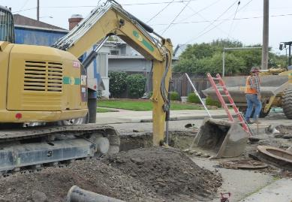
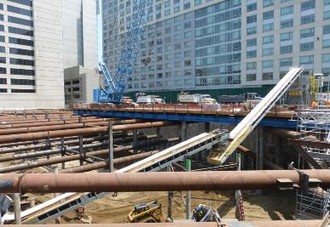
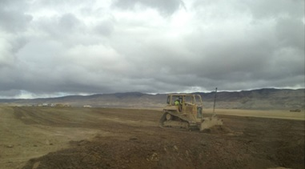
Every excavation is different
21
Buzz Group: What are the variables?
Notes:
McGuire and Hester
Swinerton
CDPH

Slide 22
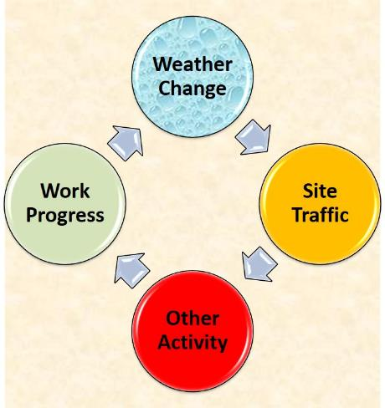
Fixed or changeable?
22
Surrounding
Environment
Natural
Topography
Existing
Infrastructure
Soil Type

Slide 23
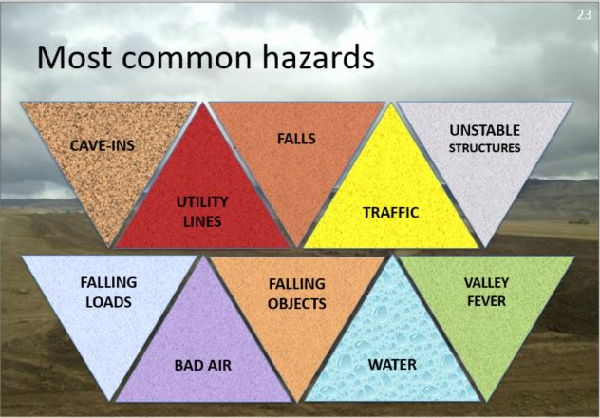
Most common hazards
23
Notes:
Background photo CDPH

Slide 24
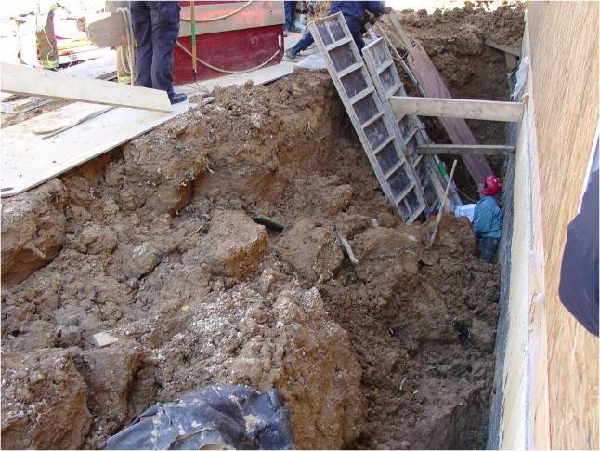
Trench cave-ins = greatest risk
24
Quickly bury workers
More likely fatal
Most in trenches 5-15’ deep
Workers are trapped
Notes:
Photo Maryland Fire harwood grant

Slide 25
Cave-ins happen suddenly Access Oregon OSHA video clip on YouTube: https://www.youtube.com/watch?v=0wmcD3aM8X4
25

Slide 26
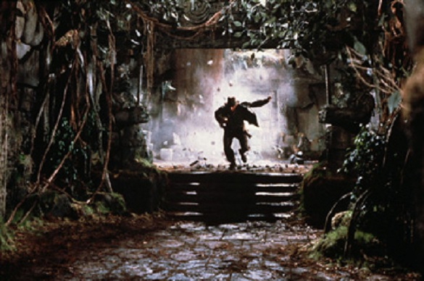
Myth: “I can get out of the way”
26
Only in Hollywood will this work!

Slide 27
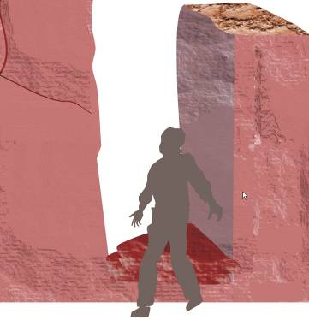
Think you can run?
27
If a trench collapses, why not just run out of the way?
Soil falls too fast.
Guess how fast it falls from a height of: 2 feet

Slide 28
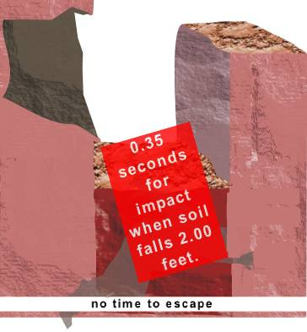
From two feet …
28
It takes only 0.35 seconds for soil to fall two feet.
Human reaction time is about 0.50 seconds.
There’s no time to escape.
What about 4 feet?

Slide 29
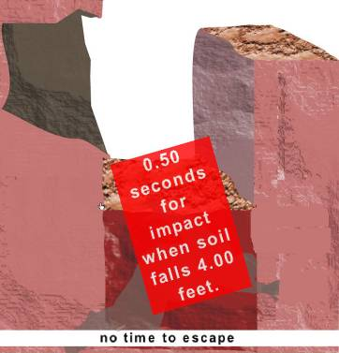
From four feet …
29
It takes only 0.50 seconds for soil to fall four feet.
Human reaction time is about 0.50 seconds.
There’s no time to escape.
What about 6 feet?

Slide 30
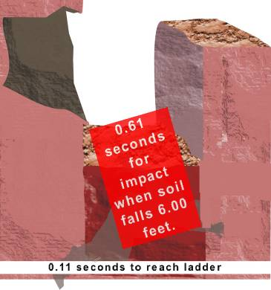
From six feet …
30
There’s no time to escape!
It takes only 0.61 seconds for soil to fall six feet.
Human reaction time is about 0.50 seconds.
It would take a worker another 0.11 seconds to reach the ladder.

Slide 31
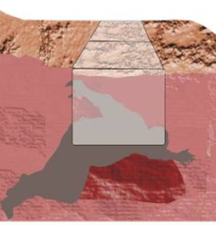
Myth: “I can dig myself out”
31
The trench has collapsed. A little bit of soil can’t weigh that much, right? Maybe you could dig out?
Wrong! Assume you’re buried three feet deep.
A cubic yard of soil is pressing on you.
How much do you think a cubic yard weighs?

Slide 32
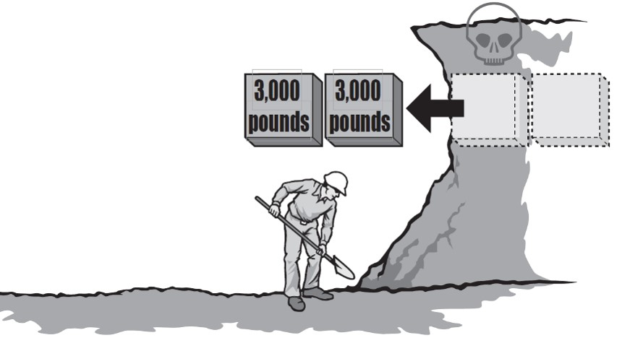
How much does soil weigh?
32
Cubic foot of soil = 100-120 lbs
Cubic yard of soil = 2,700-3,000 lbs
What does a cubic yard look like?
Notes:
Illus. OR OSHA

Slide 33
Up to two tons!
33
One cubic yard of wet excavated clay weighs 3078 lbs.
One cubic yard of wet sand and gravel weighs 3375 lbs.
One cubic yard of sandstone weighs 3915 lbs.
That’s almost two tons!

Slide 34


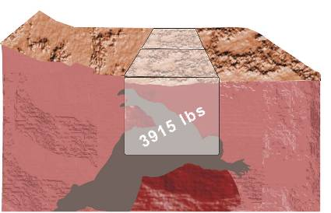

That’s equivalent to a vehicle
34
2,605-3,035 lbs (1 yd³)
3,922-4,441 lbs (1.5 yd³)
4,798-5,372 lbs (1.75 yd³)

Slide 35
How does a cave-in affect your body?
35
Impact of crushing force:
Cuts/abrasions
Broken bones
Stretched/broken ligaments
Internal bleeding
Lacerated/punctured organs
Immediate cell damage
Weight of soil:
Lack of oxygen
“Crush Syndrome”
Traumatic asphyxia

Slide 36
Recognize clues of soil stress
36
Near
Excavation
Ground settlement
Cracking in sidewalls or slopes
In Trench
Changes/bulges in wall slope
Falling flakes, pebbles, soil clumps
Bottom of
Trench
Water seepage
Walls or bottom of trench softening

Slide 37
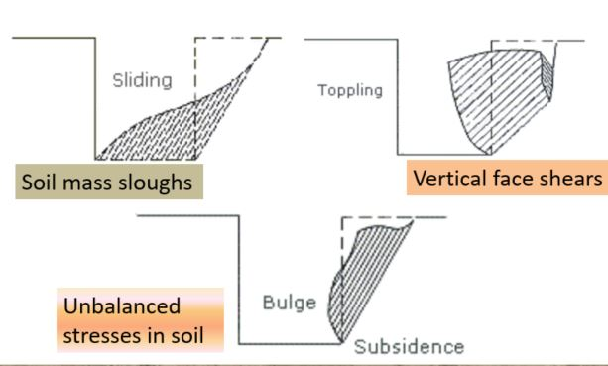
Ways an open trench can fail
37

Slide 38
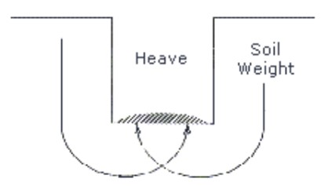
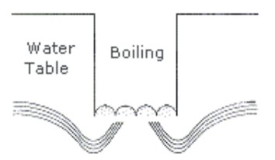
More failures
38
Downward pressure of adjoining soil causes bulge at bottom of trench
Upward water flow into bottom of cut. Soil can become like “quick sand”

Slide 39
Common trench hazards
39
Spoil Pile Slide
Lip Slide
Belly Slough
Shear Wall Collapse

Slide 40
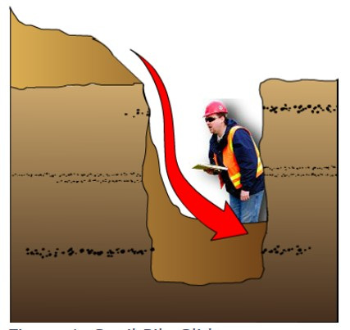
Spoil pile slide
40

Slide 41
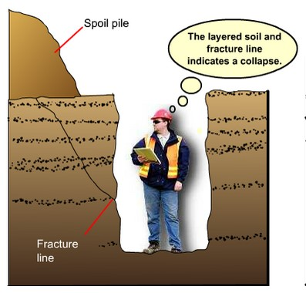
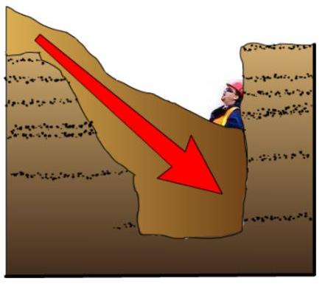
Shear wall collapse
41

Slide 42
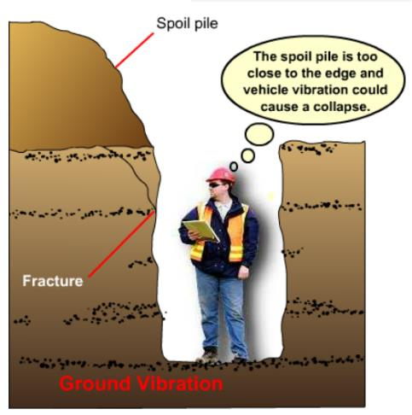
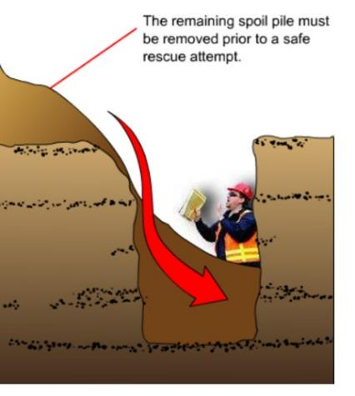
Lip slide
42

Slide 43
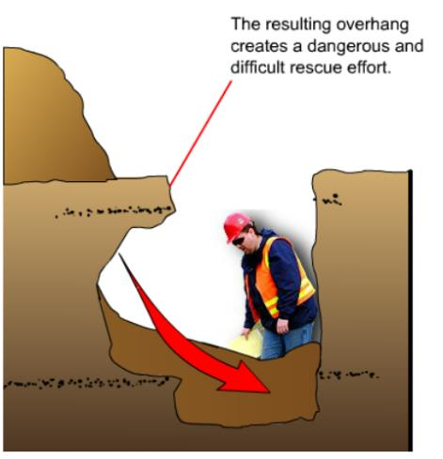
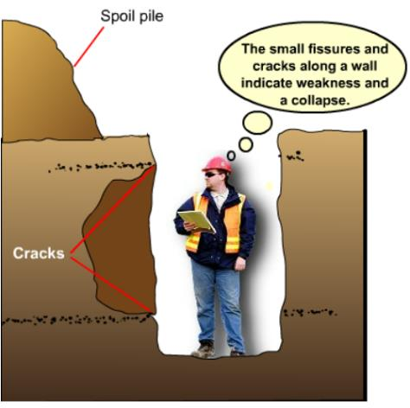
Belly slough
43

Slide 44
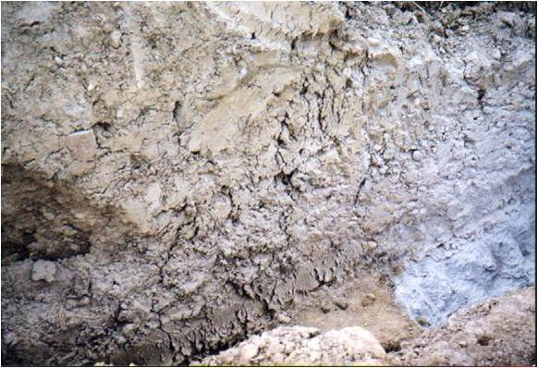
See any clues here?
44

Slide 45
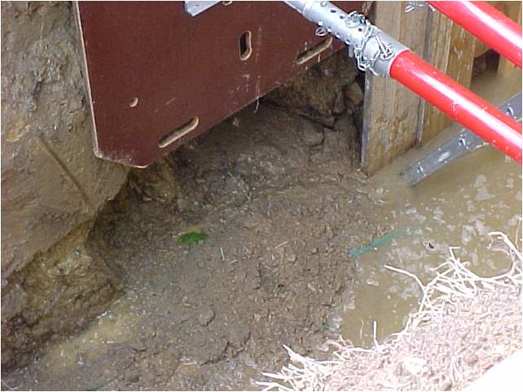
What’s happening here?
45

Slide 46
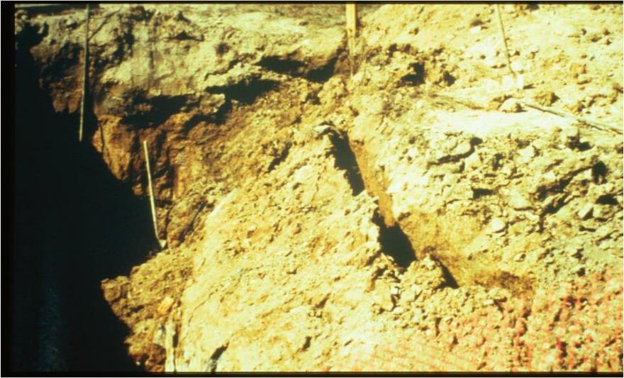
Is this a safe excavation?
46

Slide 47
Cave-in hazards are real—Review
47
Excavations are naturally unstable
Conditions can change quickly
Trench cave-ins result in more fatalities
Cave-ins happen suddenly, without warning
You cannot run away or dig yourself out
Force & weight of collapsing soil causes serious injury/death
NEVER enter a trench unless you are sure it is safe!

Slide 48



Other excavation hazards
48
CAVE-INS
UTILITY
LINES
FALLS
TRAFFIC
UNSTABLE
STRUCTURES
FALLING
LOADS
BAD AIR
WATER
VALLEY
FEVER
FALLING
OBJECTS
Notes:
Background photo CDPH

Slide 49
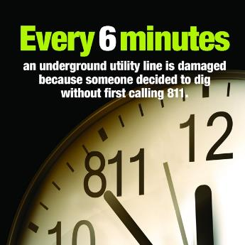
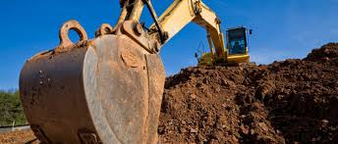
Underground utilities— what are the hazards?
Gas, Electric, Water, Sewer, Communications
Can’t see them
May be anywhere under construction site

Slide 50
What is the risk?
Without proper planning, workers are at risk for: Electrocution
Fire
Explosions
Gases
Toxic Substances
Drowning
Cave-in
Excavation equipment contacting/damaging utility lines
Handheld power equipment (concrete breakers/pneumatic drills)
Hand digging with sharp tools (shovels/picks/pry bars) close to underground utilities

Slide 51
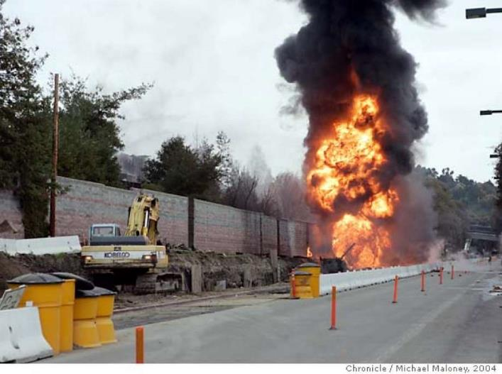
Gas line fatal blast—Nov 2004
Notes:
Photo SF Gate

Slide 52
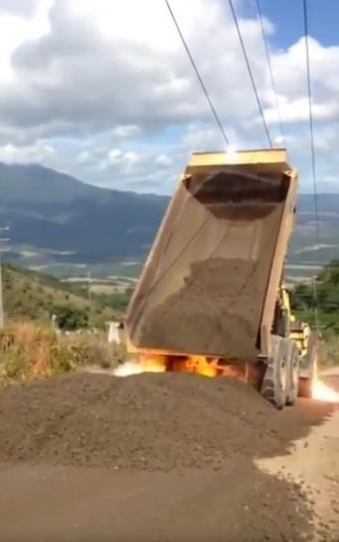
Overhead power line dangers?
High voltage—high current
Not insulated
Out of sight line— people don’t look up
Current can arc
Controlled by utility company, not job site
Notes:
Photo: YouTube

Slide 53
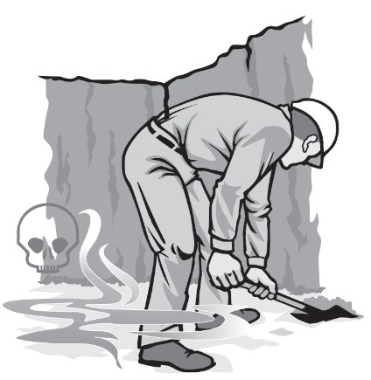
Hazardous atmospheres
Can expect in excavations >4 ft deep
Limited exits and air circulation
Buildup of gases, fumes, vapors and mists
Oxygen-deficient atmosphere
Poisoning, asphyxiation and death

Slide 54
What are potential sources of “Bad Air?”
Some Examples:
Hydrogen sulfide
Carbon dioxide
Methane
Carbon monoxide
Excavating near landfills
Leaking gas lines/storage tanks
Contaminated soil
Sewers
Gas powered tools
Generators
Vehicles

Slide 55
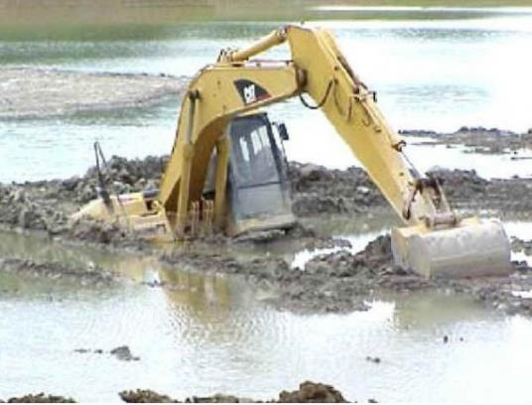
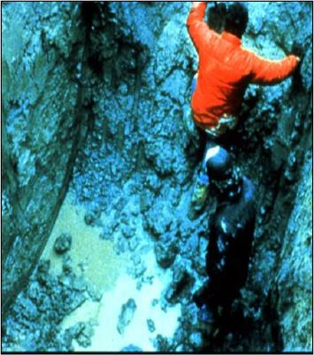
Water in the excavation

Slide 56
Dangers of water
Fills surface cracks
Softens soil
Weakens/undermines excavation walls
Can lead to cave-ins
Difficult to get out
Drowning
Electrocution risk
SOURCES:
Heavy rain
Broken pipe
Ground water
NEVER work in trenches where water has accumulated!

Slide 57
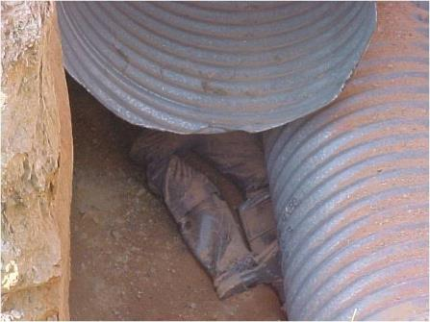
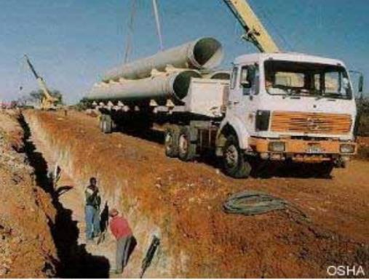
Falling loads
During loading/unloading
Rigging failures
Shifting loads

Slide 58
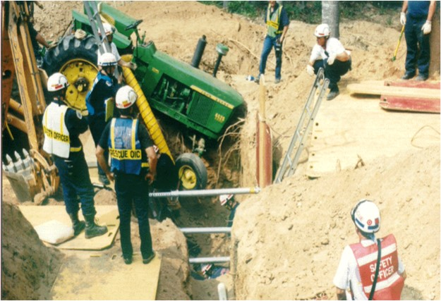
Falling objects
Loose rock or soil
Tools
Materials
Equipment

Slide 59
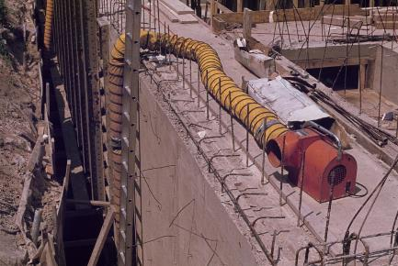
Fall hazards around excavations?
Excavations >6’ deep
Edges not clearly visible
Unguarded walkways
Pier holes, wells, pits, shafts
Unprotected remote excavations
Portable ladders

Slide 60
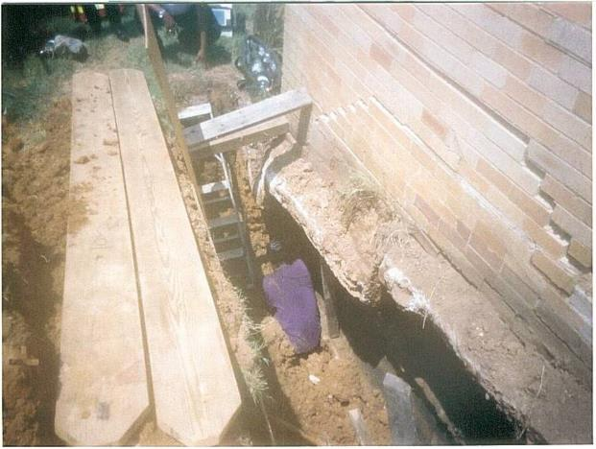

Destabilized structures
Buildings
Walls
Sidewalks
Pavement

Slide 61

Exposure to vehicular traffic

Slide 62

Exposure to Valley fever
62
What is it?
An infection caused by inhaling spores of a fungus in the soil
Just a few (<10) spores can cause disease
Scientific name of fungus: Coccidioides
Illness also known as “coccidioidomycosis” or “cocci”

Slide 63

Region where fungus is found

Slide 64

California Valley fever cases

Slide 65


How people get valley fever
65
Workers disturbing soil in areas where Valley fever is common are at highest risk
Becomes
airborne
Fungus lives
2–12” below surface

Slide 66
What are Valley fever symptoms?
Flu-like (Cough, fever, muscle aches, headache)
Fatigue
Difficulty breathing
Rash on upper trunk, arms, or legs
Joint pain in knees or ankles
Symptoms can last weeks or months
Can be fatal without treatment

Slide 67

Who is exposed here?
67

Slide 68
Hazards Review Quiz—True or False
68
T
Cave-ins happen without warning.
Dangerous gases can build-up in trenches.
Adding water strengthens the soil.
All excavations are trenches.
Valley fever is caused by fungus in the soil.
If soil begins to cave-in, you can run to safety.
A cubic yard of soil weighs about 1,000 lbs.
Excavations can have all Focus Four hazards.
T
F
F
T
F
F
T

Slide 69

Case Studies—Small Group Activity
69

Slide 70
PART 2: HAZARD CONTROLS and PROTECTIVE SYSTEMS
70

Slide 71
Who controls hazards?
71
Who is legally responsible for providing a safe and healthful workplace? The Employer
Employers must follow requirements of the OSHA Excavation standard (or State Plan standards)
Employers may be cited, fined and prosecuted for non-compliance

Slide 72
The OSHA Excavation Standard
72
“29 CFR 1926 Subpart P”
Applies to all open excavations
Requires employers to protect workers from all of the following:
Cave-ins
Exposure to vehicle traffic and falling loads
Hazardous atmospheres and water accumulation
Loose rock, soil or other falling objects
Falls from edges of excavation and walkways

Slide 73
Employers must:
73
Designate a Competent Person
Locate underground utilities
Locate/remove/stabilize surface encumbrances
Assure warning systems for mobile equipment
Provide safe access, including trench ingress/egress
Provide worker training

Slide 74

What does “competent person” mean?
74
Capable of identifying and predicting hazardous conditions AND authorized by employer to take prompt corrective action.
“The First Line of Defense from Cave-ins”
Employer decides who is qualified
Foreman, superintendent or other employee

Slide 75
Excavation competent person must:
75
Understand overlapping OSHA standards
Anticipate potential risks
Clearly communicate with workers
Recognize and eliminate hazards
Monitor employees at excavation site
Authorize when to stop work
Correct hazards and determine when it’s safe to return to work

Slide 76
What are competent person tasks?
76
Ongoing site/equipment inspections
Analyze and classify soil types
Determine required protective systems
Assure correct installation of protective systems
Design structural ramps
Test for hazardous atmospheres
Monitor water removal equipment
KNOW WHO YOUR COMPETENT PERSON IS!

Slide 77

Trench safety: Inspect—Test—Protect
77

Slide 78
How can cave-ins be prevented?
78
Different approaches:
Excavate soil back to safe angle
Install system to support trench walls
Competent Person chooses based on:
Soil type and water content
Excavation depth and width
Nature of work
Nearby activities that increase risk
Excavations >20’ deep require a system designed by registered professional engineer

Slide 79

Soil classification is critical
79
Dirt is dirt, right? NO!
Variables that affect soil stability:
Strength
Plasticity
Cohesiveness
EVERY EXCAVATION IS DIFFERENT!

Slide 80

Soil types
80

Slide 81




Soil testing by competent person
81
Visual Tests
Observe site
Examine soil samples
Tension cracks/fissures
Soil fragments falling
Water seeping
Manual Tests—Determine
Plasticity
Dry strength
Compressive strength

Slide 82




Types of protective systems
82

Slide 83


Sloping
83
Removes unstable soil back to a safe angle to prevent cave-ins
“Safe angle” varies with soil type; specified by OSHA
The less stable the soil, the more gradual the slope

Slide 84

Slope angles by soil type
84
RED FLAGS!
Your safety is at risk if:
No designated competent person
Slope angles are too steep for soil type
Conditions change and are not reassessed

Slide 85

More examples
85

Slide 86


Another option = benching
86
Cannot be used with Type C soils
Benching follows the slope line

Slide 87


Combo of benching and sloping
87

Slide 88


Shoring systems
88
Designed to support sides of trench to prevent cave-ins
Timber or metal
Custom-tailored to trench
Fit narrow spaces & around utilities
Soil arching stabilizes trench walls
Requires technical knowledge
Notes:
McGuire&Hester photo

Slide 89


Timber shoring
89

Slide 90


Hydraulic shoring
90
Prefabricated of aluminum or steel
Installed from outside trench
Adapt to various depths/widths
Vertical shore may be installed by one worker
Vertical shore
type
Horizontal wale type
w/sheeting

Slide 91



Hydraulic shoring in use
91
Protecting workers from cave-ins
Soil arching at work

Slide 92

Shoring must meet OSHA standard
92
Follow dimensions and spacing specified by OSHA
Designed for specific soil type, depth, width and length of trench
Follow OSHA standard charts
--OR--
Tabulated Data approved by registered professional engineer

Slide 93


Other shoring examples
93

Slide 94

Shielding (trench boxes)
94
Prefabricated structure that protects workers if cave-in happens
Designed by registered professional engineer
Does not support trench,
acts like “bomb shelter”
Workers must stay in confines of trench box to be protected!

Slide 95


Proper use of shields
95
Follow manufacturer’s specifications—load cannot exceed capacity
Top of shield must extend to top of trench
Cut trench no more than 2’ below bottom of shield
Backfill around box to prevent lateral shifts
May be used in combo with sloping

Slide 96




Shielding examples
96
Shield protected from cave-in

Slide 97


Safely entering and leaving a trench
97
Must be a stairway, ladder, or ramp in excavations 4’ or deeper
It must be within 25’ of the workers
Ladder should extend 3’ above the top of the trench

Slide 98
Remember the other hazards?
98
CAVE-INS
UTILITY
LINES
FALLS
TRAFFIC
UNSTABLE
STRUCTURES
FALLING
LOADS
BAD AIR
FALLING
OBJECTS
WATER
VALLEY
FEVER
Notes:
Background photo CDPH

Slide 99


Underground utilities
What must you do before you dig?
Survey and mark area
Be aware of pipeline markers
Call 811 at least 2 working days prior to starting work
Wait required time, give utilities 2 full working days to locate/mark
Call private utility locator if necessary to ID private lines
Maintain utility locator marks and respect them when digging
Underground Service Alert (USA)

Slide 100

Dig with care—hand digging
Hand dig within 24 inches of each side of marked lines
Use rounded or blunt-edged fiberglass handled shovel
See the line with your own eyes
Don’t use sharp tools or pry against a utility line

Slide 101


Overhead power lines
What are best practices?
Inspect for power lines, poles, support wires before work begins
Assume ALL lines are energized
Mark safe boundary, post warning signs at ground level, use portable safety barriers
Keep workers and equipment at least 10 feet away from lines
Use dedicated spotter for heavy equipment
Don’t guide a load and be spotter at same time
Know what to do if equipment contacts power line

Slide 102


Hazardous Atmospheres
Before workers enter excavations >4 feet deep where bad air or oxygen deficiency (<19.5%) could be expected:
Competent person must test air
Provide proper respiratory protection or ventilation
Conduct testing as often as necessary
Emergency rescue equipment must be readily available

Slide 103

Water accumulation
NEVER work in an excavation with standing water, or if water is accumulating
Precautions must be taken to protect you such as:
Special support or shield systems
Water removal equipment
Monitored by competent person

Slide 104
Exposure to falling loads
Workers are not permitted to stand or work underneath loads handled by digging or lifting equipment
Stand away from vehicle being loaded or unloaded to avoid being struck by spillage or falling materials
Operators may remain in cab of vehicle being loaded/unloaded if equipped to provide adequate protection for the operator

Slide 105

Protection from falling objects
Keep spoils, tools/equipment at least 2 feet from excavation edge
Use retaining devices to prevent material/equipment from falling/rolling into excavation
Use warning system (barricades, hand/mechanical signals, stop logs) for mobile equipment near edge
Protect from loose rock/soil falling from excavation face (scaling, barricades, retaining devices)
Wear proper PPE

Slide 106


Fall protection—Excavation Standard
Walkways must have guard rails if 6 feet or more above lower levels
Physical barrier protection at all remotely located excavations
Wells, pits, shafts must be barricaded or covered
Backfill upon completion of operations
Notes:
This refers to guard rails (1926.502(b)

Slide 107

Stabilize adjacent structures
Where stability is endangered by excavation operations
Employers must:
Not undermine sidewalks, pavement or structures unless support systems are used to protect employees
Provide shoring, bracing or underpinning

Slide 108


Exposure to vehicle traffic
Employees must wear warning vests or other suitable garments marked or made with reflectorized or highly visible material
Require a designated, trained flag person along with signs, signals, and barricades when necessary

Slide 109
Protection from Valley fever
Plan ahead—know where fungus is found
Limit dust generation—wet soil before and while digging
Cover spoils piles with tarps
Stay upwind of digging
Protect equipment operators with enclosed cabs with HEPA air filtration
Use respiratory protection
Provide training on Valley Fever hazards

Slide 110
Excavation rescue
Show a news clip showing a trench rescue

Slide 111

Danger to first responders & victims
Excavation rescue operations are dangerous and might:
Cause additional cave-ins
Create more soil pressure on buried victim
Injure the victim more severely
NEVER RUSH IN TO A COLLAPSED TRENCH—YOU MAY BECOME A VICTIM TOO!

Slide 112

Will it be rescue or recovery?
Chaotic, unstable, dangerous situation
Requires technical rescue team
Must stabilize trench before team can enter
May take several hours to free victim
High profile, lots of media attention

Slide 113

Have an emergency action plan
Outline steps for every possible excavation emergency
Include contact info for fire, police, OSHA
Have emergency equipment available on-site
Define responsibilities of workers on-site before/after rescue team arrives
Practice the plan—train to be ready for fast implementation

Slide 114


At the scene

Slide 115
PART 3: Practice What You Learned
115

Slide 116

What’s Wrong Here?
Notes:
OR OSHA

Slide 117

Photo
Notes:
OR OSHA

Slide 118

What’s wrong with these pictures?
Identify the hazards in the next slides and ask yourself:
Would you allow your kids or other loved ones into any of the following situations?
Notes:
OR OSHA

Slide 119

What’s wrong?
Notes:
Bad attempt at sloping

Slide 120

1. What’s wrong?

Slide 121

2. What’s wrong?

Slide 122

3. What’s wrong?

Slide 123

4. What’s wrong?

Slide 124

5. What’s wrong?

Slide 125

6. What’s wrong?

Slide 126

7. What’s wrong?

Slide 127

8. What’s wrong?

Slide 128

9. What’s wrong?

Slide 129

10. What’s wrong?

Slide 130

11. What’s wrong?

Slide 131

12. What’s wrong?

Slide 132

13. What’s wrong?

Slide 133

14. What’s wrong?

Slide 134

15. What’s wrong?

Slide 135

16. What’s wrong?

Slide 136

17. What’s wrong?

Slide 137

18. What’s wrong?

Slide 138

Safety best practices for workers

Slide 139

Best practices for employers

Slide 140

Be aware/be safe
Excavation accidents are preventable!
Name three important things you learned from this training…

Slide 141
Final questions?
Post-tests
Evaluations

