Slide 1
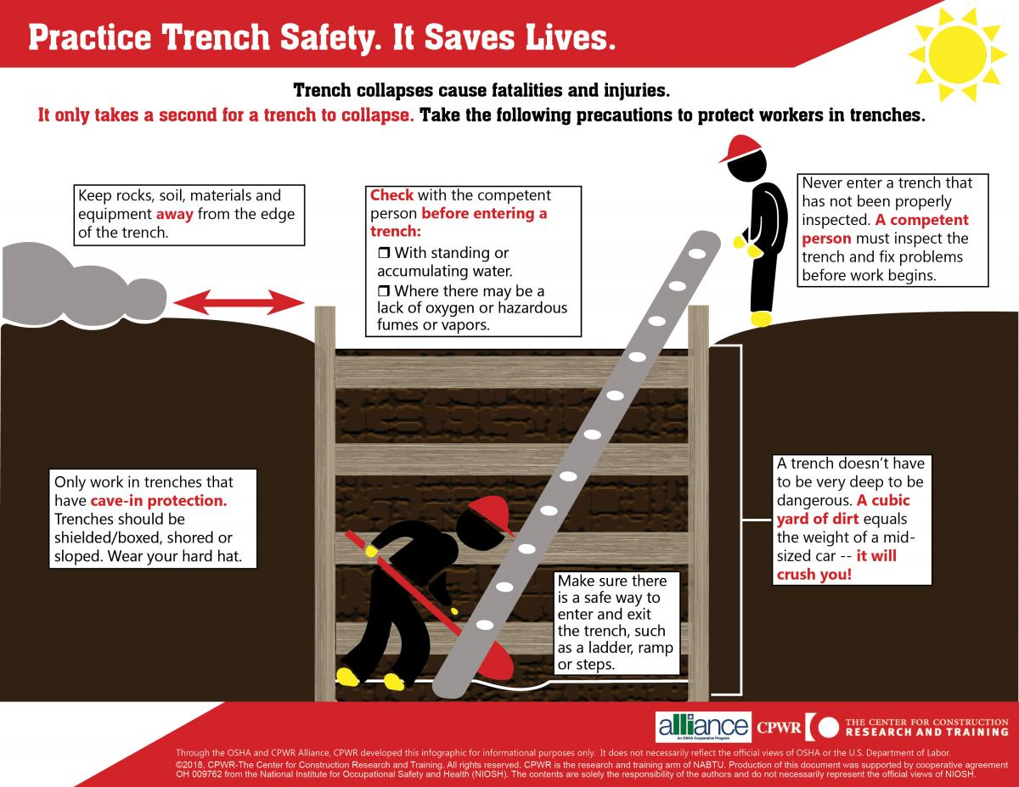
CPWR Infographic

Slide 2
Excavation numbers to remember:
2 feet = Distance soil & equipment must be kept from edge
3 feet = Length ladder must extend above top of excavation
4 feet = Depth at which ladder/ramp is required
Test for hazardous atmospheres
5 feet = Depth protective systems are mandatory
6 feet = Trigger height fall protection required for walkways
>20 feet = Protective systems must be designed by engineer
25 feet = Your maximum travel distance to an exit ladder

Slide 3
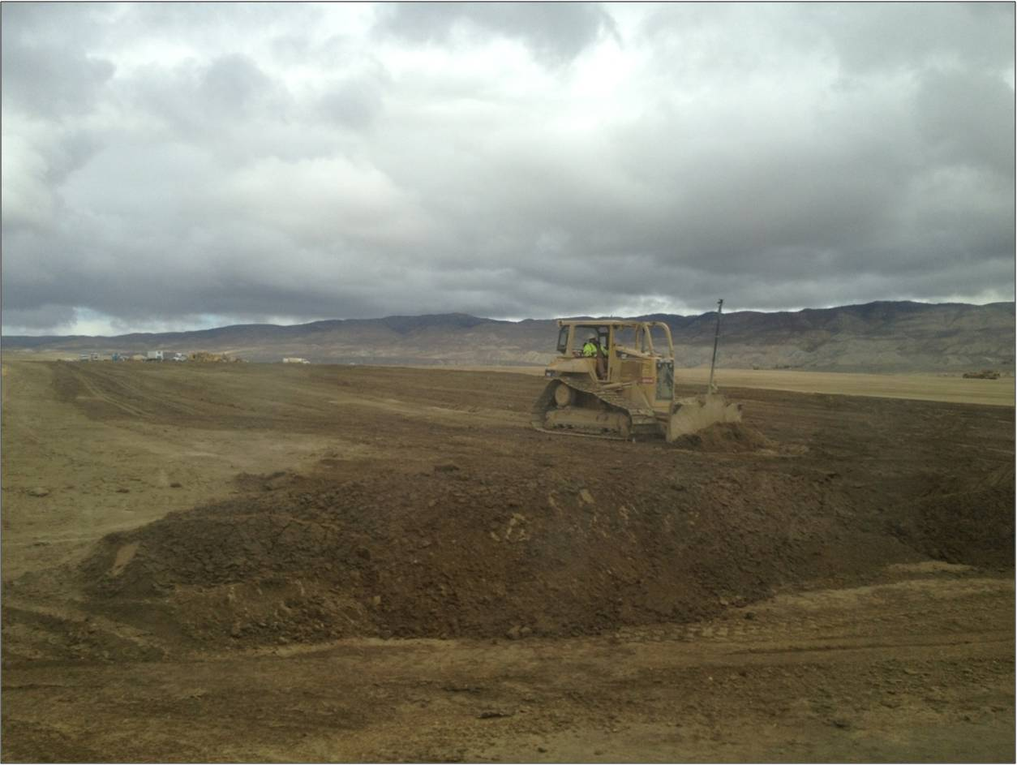



Most common hazards
CAVE-INS
UTILITY
LINES
FALLS
TRAFFIC
UNSTABLE
STRUCTURES
FALLING
LOADS
BAD AIR
FALLING
OBJECTS
WATER
VALLEY
FEVER
Notes:
Background photo CDPH

Slide 4
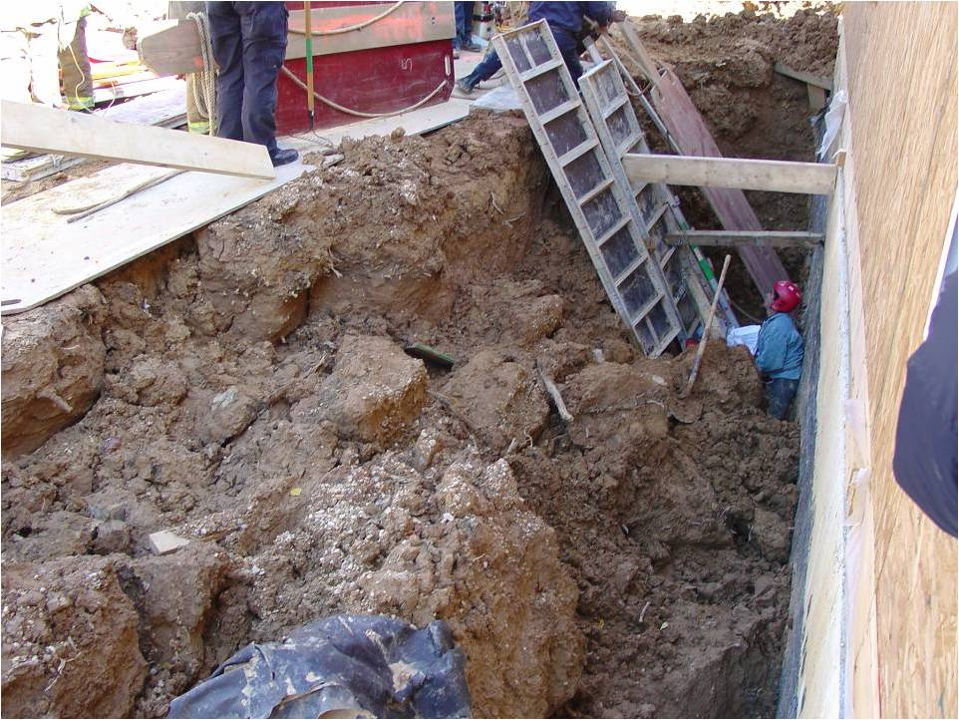
Trench cave-ins = greatest risk
Quickly bury workers
More likely fatal
Most in trenches 5-15’ deep
Workers are trapped
Notes:
Photo Maryland Fire harwood grant

Slide 5
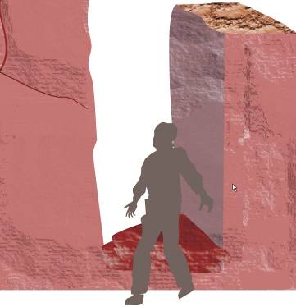
Think you can run?
If a trench collapses, why not just run out of the way?
Soil falls too fast.
Guess how fast it falls from heights of:
2 feet, 4 feet, 6 feet

Slide 6
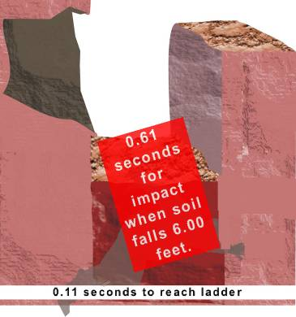
There’s no time to escape!
Human reaction time is about 0.50 seconds.
Soil falls:
2 feet in 0.35 seconds
4 feet in 0.50 seconds
6 feet in 0.61 seconds
You could not reach the ladder in time!

Slide 7
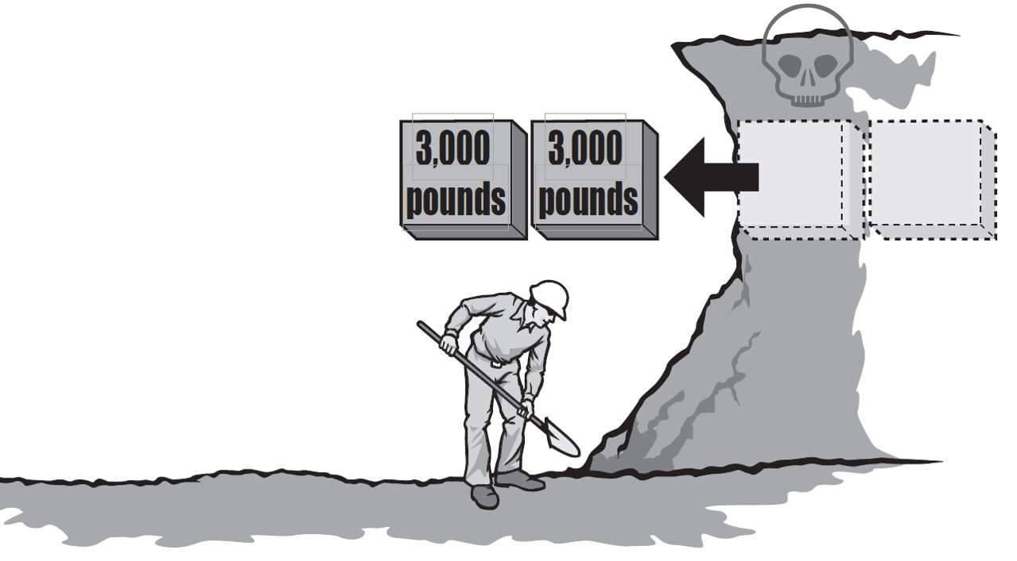
How much does soil weigh?
Cubic foot of soil = 100-120 lbs
Cubic yard of soil = 2,700-3,000 lbs
What does a cubic yard look like?
Image: Oregon OSHA
Notes:
Illus. OR OSHA

Slide 8
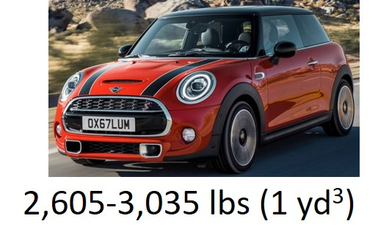

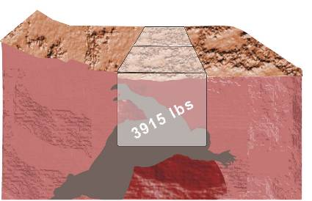

That’s equivalent to a vehicle
3,922-4,441 lbs (1.5 yd³)
4,798-5,372 lbs (1.75 yd³)

Slide 9
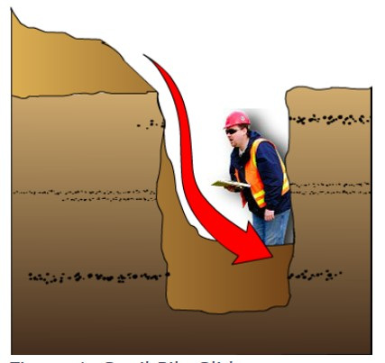
Spoil pile slide
Image: NIOSH

Slide 10
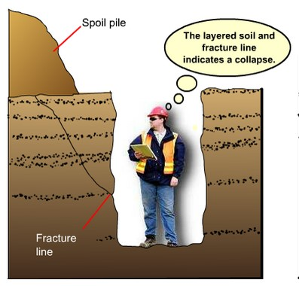
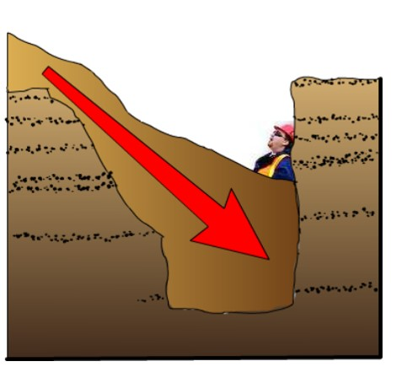
Shear wall collapse
Image: NIOSH

Slide 11
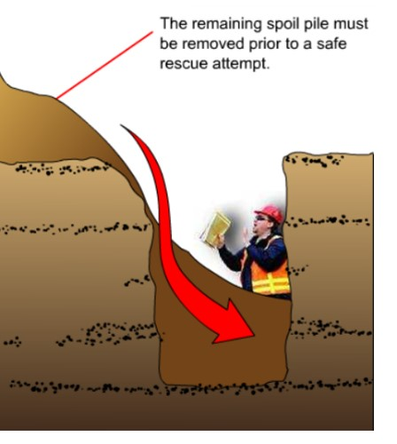
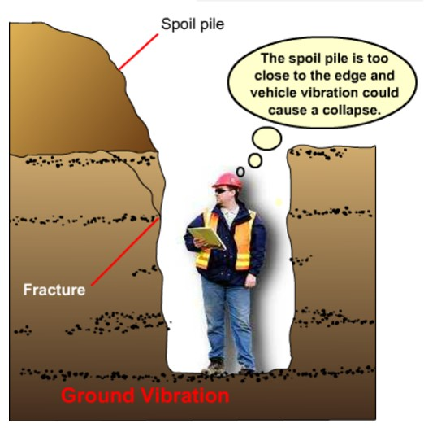
Lip slide
Image: NIOSH

Slide 12
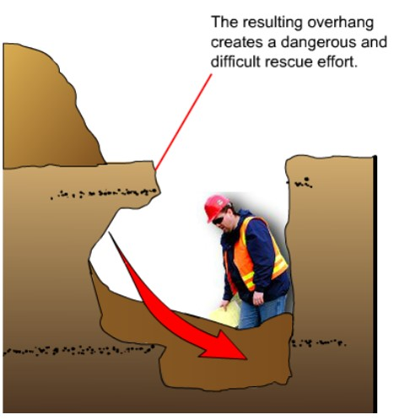
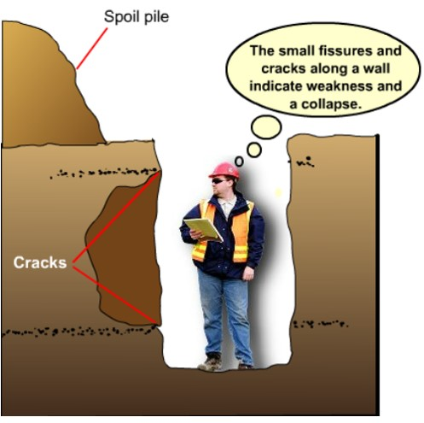
Belly slough
Image: NIOSH

Slide 13
Cave-in hazards are serious!
Excavations are naturally unstable
Conditions can change quickly
Trench cave-ins result in more fatalities
Cave-ins happen suddenly, without warning
You cannot run away or dig yourself out
Force & weight of collapsing soil causes serious injury/death
NEVER enter a trench unless you are sure it is safe! Know your competent person.

Slide 14
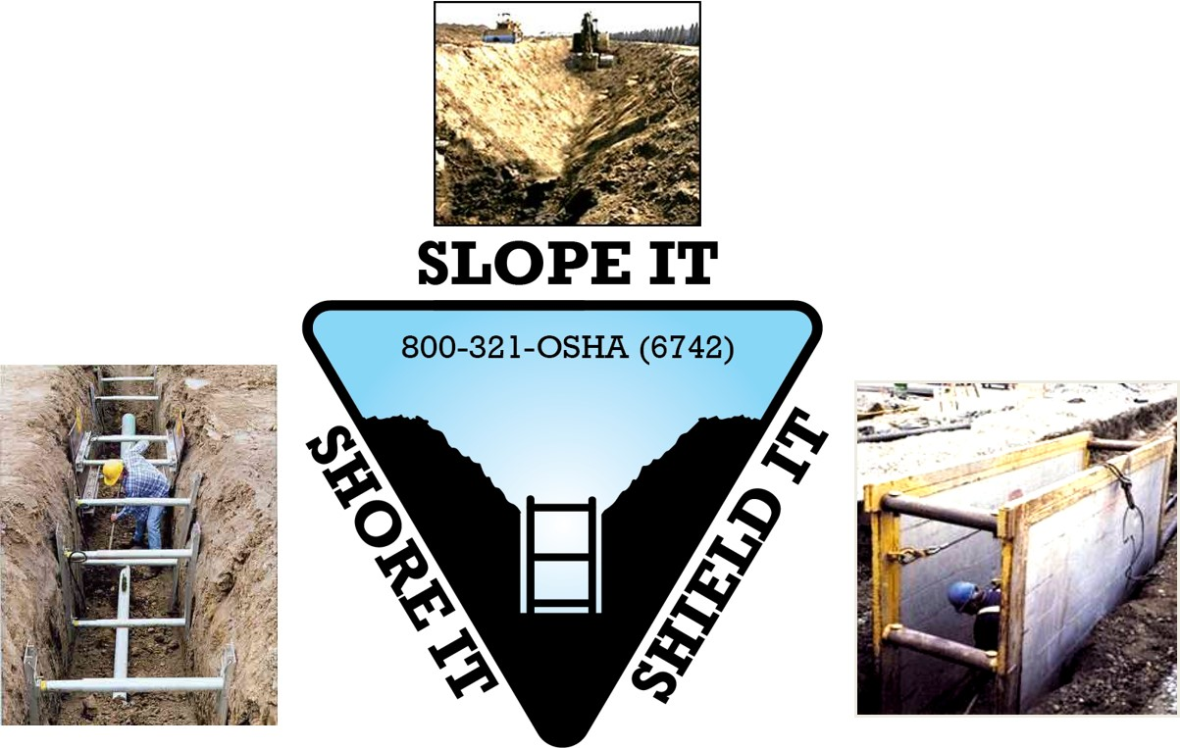
Protective systems keep you safe

Slide 15
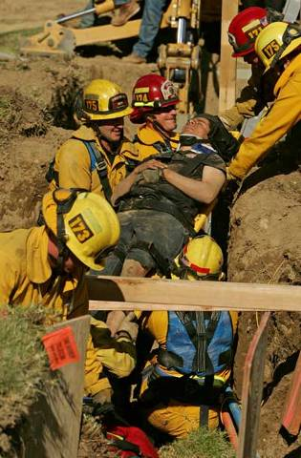
Trench rescue: dangerous & technical
Excavation rescue operations are dangerous and might:
  Cause additional cave-ins
  Create more soil pressure on buried victim
  Injure the victim more severely
  NEVER RUSH IN TO A COLLAPSED TRENCH—YOU MAY BECOME A VICTIM TOO!

Slide 16
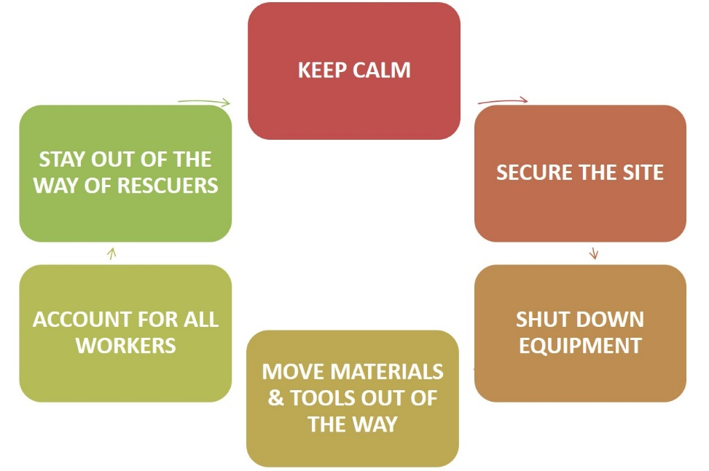
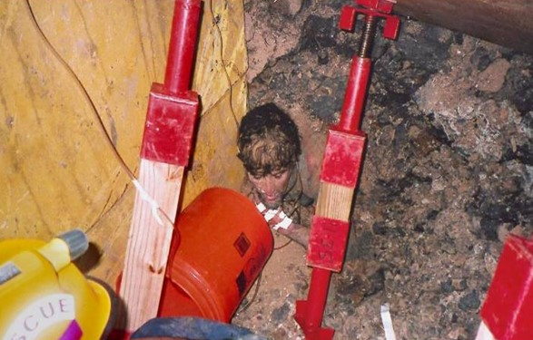
At the scene

