Slide 1
Electrical Theory
This material was produced under grant number SH-31231-SH7 from the Occupational Safety and Health Administration, U.S. Department of Labor. It does not necessarily reflect the views or polices of the U.S. Department of Labor, nor does it mention of trade names, commercial products, or organizations imply endorsement by the U.S. Government.

Slide 2
Electrical Terms
Electricity
Voltage
Current
Resistance
Circuit

Slide 3

ELECTRICITY
The flow of electrons through a conductor
Notes:
Electricity is conducted through some materials better than others. Its resistance measures how well something conducts electricity. Some things hold their electrons very tightly. Electrons do not move through them very well these things are called insulators. Rubber, plastic, cloth, glass and dry air are good insulators and have very high resistance.
Other materials have some loosely held electrons, which move through them very easily. These are called conductors. Most metals, like copper, aluminum, or steel, are good conductors.

Slide 4
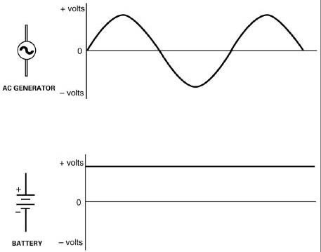
VOLTAGE
FORCE APPLIED TO ELECTRONS TO CAUSE CURRENT FLOW – V OR E
MEASURED IN VOLTS
DIRECT CURRENT
  PRODUCED BY
  BATTERIES
ALTERNATING
CURRENT
  PRODUCED BY
  GENERATORS
Notes:
Electrical pressure is called electromotive force (EMF). It is measured by the unit called the volt. The circuit pressure is often abbrieviated by the letters E for electromotive force or V for voltage

Slide 5


CURRENT
FLOW OF ELECTRONS FROM ATOM TO ATOM THROUGH A CONDUCTOR – AMPS – A OR I
MEASURED IN AMPERES
CONVENTIONAL CURRENT FLOW
  ELECTRONS MOVE FROM POSITIVE TO NEGATIVE
  DOESN’T REALLY WORK THIS WAY, BUT IS THE STANDARD CONVENTION IN THE INDUSTRY
ELECTRON FLOW
  ELECTRONS MOVE FROM NEGATIVE TO POSITIVE
  ELECTRONS ARE – AND ATTRACTED
  TO + CHARGE
Notes:
Electron current flow theory always flow from the negative terminal of the source, through the circuit and the load, to the positive terminal of the source

Slide 6
RESISTANCE
OPPOSITION OF MATERIAL TO CURRENT FLOW – R/Ω
  OHM
  KILOHM (kΩ ) - 1,000Ω
  MEGOHM (MΩ) – 1,000,000Ω
FOUR FACTORS AFFECTING RESISTANCE
  MATERIAL
  LENGTH
  CROSS-SECTIONAL AREA
  TEMPERATURE
Notes:
Resistance is abbreviated by the letter R and is measured by the unit called Ohm. It is the opposition to current flow in a circuit.

Slide 7
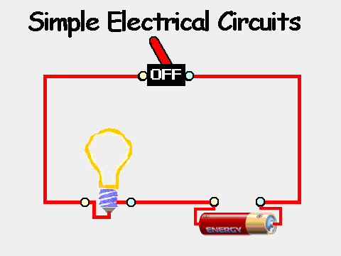
CIRCUIT
Elements of a circuit
  Difference of potential or voltage
  Complete path
  Load
Notes:
A circuit is a closed loop that electrons can travel in. A source of electricity, such as a battery, provides electrical energy in the circuit. Unless the circuit is complete, that is, making a full circle back to the electrical source, no electrons will move.

Slide 8
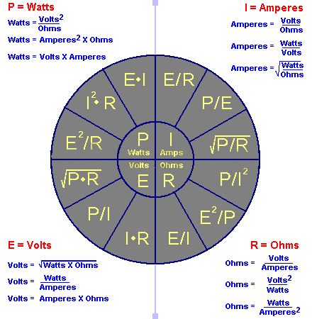
OHM’S LAW
Notes:
Ohm's law. A law relating the voltage difference between two points, the electric current flowing between them, and the resistance of the path of the current. Mathematically, the law states that V = IR, where V is the voltage difference, I is the current in amperes, and R is the resistance in ohms.

