Slide 1
Chemical Safety and Hazard Communication
This material was produced by Asian Immigrant Women Advocates under grant number SH-05002-SH8 from the Occupational Safety and Health Administration, U.S. Department of Labor. It does not necessarily reflect the views or policies of the U.S. Department of Labor, nor does mention of trade names, commercial products, or organizations imply endorsement by the U.S. Government.

Slide 2
Training Objectives
Employer requirements for chemical safety at the workplace
How to recognize chemical hazards associated with the workplace
How chemical hazards affect the body
How to handle chemicals safely in the workplace

Slide 3

Asian Immigrant Workers
Asian immigrant workers handle chemicals in their workplaces every day. These are some of the most common chemicals they work with.
  Hand soaps
  Dish washing liquids
  Cleaning sprays and powders
  Bleaches
  Alcohol solutions
  Disinfectants
  Detergents
Notes:
Graphics from Kelsie Scruggs “Safe Jobs for Youth” LOHP/UCB

Slide 4
Other Chemicals in the Workplace
Depending on their industries (restaurant, hotel, janitorial, home care, salon and beauty services, and other employment settings), Asian immigrant workers recognize and handle other chemicals in the work areas.

Slide 5
Do you work with chemicals?
What chemicals do you use in the workplace?
How does your body feel when you work with these chemicals?
[short discussion]

Slide 6
Employer Requirements:
Workers’ “Right to Know” Law
Employers are required
  to ensure that all employees know the hazards of chemicals they work with at their jobs
  to ensure that employees are provided with information about chemicals they work with through:
    Information on chemical labels
    Safety Data Sheets (SDSs)
    Training on hazard communication (HAZCOM)
    Written HAZCOM plan

Slide 7
Employee Information and Training
Employers must provide employees with information and training on hazardous chemicals in their work area.
  At the time of initial assignment
  When a new hazardous product or chemical is introduced into the workplace

Slide 8
Employee Training
Employee training shall include at least:
  The means to detect the presence of a hazardous chemicals in the work area
  The physical and health hazards of chemicals in the work area
  Measures employees can take to protect themselves

Slide 9
Have you received training?
Have you received training from your employer on the chemicals used in your work area and how to handle them safely?
[Short discussion]

Slide 10
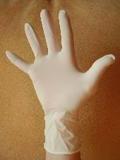
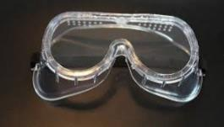

What is a chemical hazard?
Chemical hazards are gases, vapors, liquids, or dusts that can harm your body.

Slide 11




HOW DO CHEMICALS GET INTO THE BODY?
Breathing (Inhalation)
Skin or Eye Contact
Swallowing (Ingestion)
Notes:
Kelsie Scruggs, “Safe Jobs for Youth” LOHP/UCB

Slide 12
Health Hazards
Chemical exposure can cause serious health problems:
  Itching/rashes/burns
  Kidney/lung damage
  Heart problems
  Cancer
  Sterility
  Central nervous system damage

Slide 13
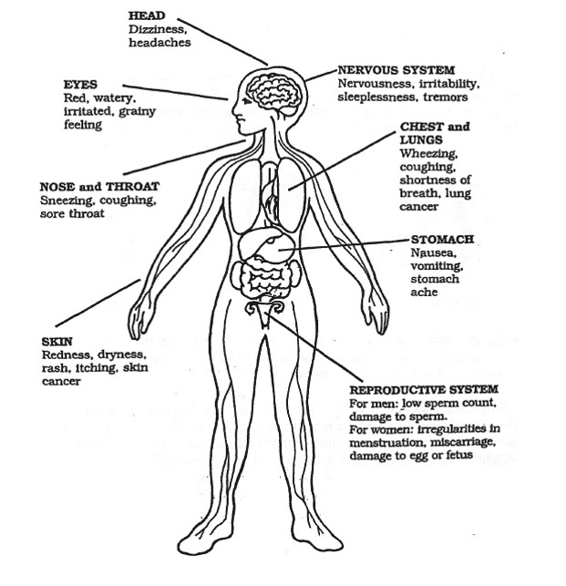
HOW CHEMICALS CAN AFFECT YOUR BODY
Notes:
Kelsie Scruggs, “Safe Jobs for Youth” LOHP/UCB

Slide 14
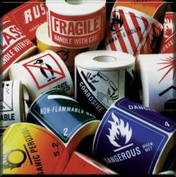
Health Hazards
Major Types
  Corrosives - cause tissue damage and burns on contact with skin or eyes
  Primary Irritants - cause intense redness or swelling of skin or eyes on contact. No permanent tissue damage
  Sensitizers - cause an allergic skin or lung reaction
  Acutely Toxic Materials - cause an adverse effect even at very low doses
  Carcinogens - may cause cancer
  Teratogens - may cause birth defects
  Organ Specific hazards - damage to specific organ systems such as liver or lungs
Notes:
“Hazard Communication Standard 1910.1200.”

Slide 15
Acute and Chronic
Acute health effects
      Happens quickly. Occur with short-term exposure and last a brief period. For example, skin irritation with chemical contact.
Chronic health effects
  May not smell, see, or feel sick right away. Occur with long-term exposure and last a long time. For example: lung cancer.

Slide 16
Chemical Hazard Protection
What can you do to protect yourself from chemical hazards?
[Short discussion]

Slide 17

Chemical Hazard Control Approaches
(1) Remove
the Hazard from Work Area
(2) Review and Follow Work Policies and Procedures
(3) Wear Personal Protective Equipment

Slide 18
(1) Remove the Hazardous Chemical
Remove the chemical hazard from work area
Choose nontoxic products
  “Green Seal Certified”
  “Ecologo UL”
  “Safer Choice”

Slide 19
(2) Work Policies and Procedures
Train on reading labels and know what symbols and warnings mean
Use small amounts of chemicals, measuring & diluting them
Use tools to avoid direct contact with chemicals
Cover and store chemicals safely

Slide 20
Learn to read Chemical Hazard Labels
Train on reading labels and knowing what symbols and warnings mean

Slide 21
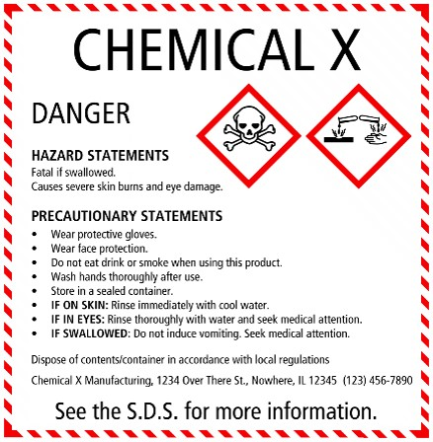
Required Elements on a Label
Information should be in the same order for all labels
Labels MUST include:
Product Identifier
Supplier Identifier
Chemical Identity
Hazard Pictograms *
Signal Words *
Hazard Statements *
Precautionary Information
The items with * are hazard warning and MUST be located together on the label!
Notes:
“Chemical Hazard and Hazard Communication” OSHA

Slide 22
Hazard Pictograms
Pictograms are required on labels to alert users of the chemical hazards. Pictograms consists of a symbol on a white background framed within a red border and represents a distinct hazard.

Slide 23
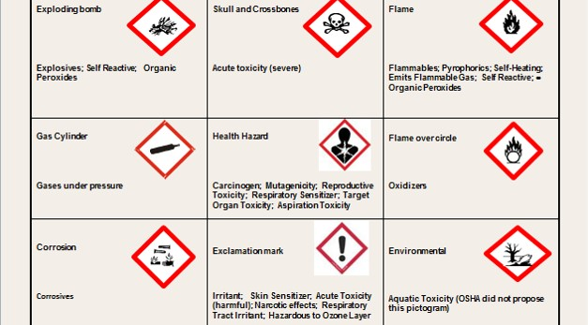
Pictograms and Hazards
Notes:
“Hazard Communication (HAZCOM)…” OSHA

Slide 24
Hazard Signal Words
There are two Signal Words used in chemical labels: DANGER or WARNING
DANGER is used for more severe hazards
WARNING is used for less severe hazards

Slide 25
Hazard Statements
Hazard statements provide wording to indicate the hazards of the chemical product, including, when appropriate, the degree of the hazard

Slide 26

Safety Data Sheets (SDS)
For information about chemical hazards, Safety Data Sheets provide valuable facts about chemicals and how to handle them. It contains:
  Product name, manufacturer, contact information and emergency number
  Hazard identification
  Information on chemical ingredients
  First-aid measures
  Firefighting measures
  Accidental release measures
  Handling and storage
Notes:
“Chemical Hazard and Hazard Communication” OSHA

Slide 27
(3) Personal Protective Equipment
Use gloves, masks, goggles, aprons, hats, shoes, and other protective covers

Slide 28
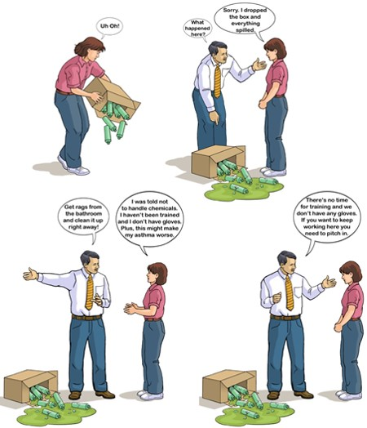
Mei’s Story: What should Mei do?
Notes:
“Staying Safe at Work” OSHA

Slide 29
Summary
Employees have the right to chemical safety information and training in the workplace.
It is important to recognize chemical hazards through labels, pictograms, signal words, and hazard statements.
It is important to use personal protective equipment for safely handling chemicals.
Take action to make your workplace safer!

Slide 30
Any Questions?

Slide 31
Acknowledgements
“Chemical Hazard and Hazard Communication” (PowerPoint Presentation). Susan Harwood Grant/OSHA.
“Hazard Communication (HAZCOM) and the Globally Harmonized System of Classification and Labeling of Chemicals (GHS)” (PowerPoint Presentation). Susan Harwood Grant/OSHA.
“Hazard Communication Standard 1910.1200” (PowerPoint Presentation). Susan Harwood Grant/OSHA.
Scruggs, Kelsie, MPH. “Safe Jobs for Youth” (PowerPoint Presentation). Labor Occupational Health Program, U.C. Berkeley. Susan Harwood Grant/OSHA

Slide 32
Also this training was created by adapting publicly available materials from Susan Harwood Training Program, UC Berkeley Labor Occupational Health Program, and Pennsylvania Department of Labor & Industry.

