Slide 1
Chemical Safety and Hazard Communication 化學品安全及危害通訊
This material was produced by Asian Immigrant Women Advocates under grant number SH-05002-SH8 from the Occupational Safety and Health Administration, U.S. Department of Labor. It does not necessarily reflect the views or policies of the U.S. Department of Labor, nor does mention of trade names, commercial products, or organizations imply endorsement by the U.S. Government.
這份文檔是亞洲移民婦女倡導者根據美國勞工部職業安全與健康管理局授權號 SH- 05002-SH8 生產的。它不一定反映美國勞工部門的觀點或政策，也未提到商品名稱，商業產品或組織有暗示美國政府的認可。

Slide 2
Training Objectives 培訓目標
Employer requirements for chemical safety at the workplace 僱主在工作場地內對化學物質安全的規定
How to recognize chemical hazards associated with the workplace 怎樣識別與工作場地相關的化學物質危害
How chemical hazards affect the body 化學物質危害怎樣影響身體
How to handle chemicals safely in the workplace怎樣在工作場地內安全地處理化學物質

Slide 3

Asian Immigrant Workers 移民勞工常見的化學物質
Asian immigrant workers handle chemicals in their workplaces every day. These are some of the most common chemicals they work with. 亞洲移民勞工每天都在工作場地內處理化學物質， 他們使用的一些最常見的化學物質有以下
Hand soaps 番梘
Dish washing liquids 洗碗液
Cleaning sprays and powders 清潔噴霧劑和番梘沙粉
Bleaches 漂白水
Alcohol solutions 酒精物質
Disinfectants 消毒劑
Detergents 清潔劑
Notes:
Graphics from Kelsie Scruggs “Safe Jobs for Youth” LOHP/UCB

Slide 4
Other Chemicals in the Workplace 其他化學物質
Depending on their industries (restaurant, hotel, janitorial, home care, salon and beauty services, and other employment settings), Asian immigrant workers recognize and handle other chemicals in the work areas. 取決於他們的相關行業（餐館，酒店，清潔，家居護理，髮型美容以及其他就業環境）亞洲移民勞工在工作場地內， 也要識別和處理其他的化學物質

Slide 5
Do you work with chemicals ? 你工作上有接觸化學物質嗎?
What chemicals do you use in the workplace? 你在工作場地使用什麼化學物質？
How does your body feel when you work with these chemicals? 當你使用這些化學物質時，你身體有什麼感覺/ 反應 ？
[short discussion] 簡短討論

Slide 6
Employer Requirements: Workers’ “Right to Know” Law 法例規定僱主：勞工有“知情權”
Employers are required 規定僱主們要
to ensure that all employees know the hazards of chemicals they work with at their jobs 確保所有員工都了解他們在工作中所使用到的化學物質的危害
.

Slide 7
Employer Requirements (continue): Workers’ “Right to Know” Law 法例規定僱主：勞工有“知情權”
to ensure that employees are provided with information about chemicals they work with through 通過以下方式確保向員工提供工作中所使用到化學物質的信息:
Information on chemical labels 有關化學標籤的知識
Safety Data Sheets (SDSs) 安全資料表
Training on hazard communication (HAZCOM) 危害通訊培訓
Written HAZCOM plan 危害通訊計劃書

Slide 8
Employee Information and Training 員工資訊和培訓
Employers must provide employees with information and training on hazardous chemicals in their work area 僱主必須適時向員工提供其工作場地內危險化學物質的資訊和培訓
At the time of initial assignment 在一開始工作分配時
When a new hazardous product or chemical is introduced into the workplace 當新的危險產品或化學物質被引入工作場地時

Slide 9
Employee Training 員工培訓內容
Employee training shall include at least 員工培訓至少應包括 :
The means to detect the presence of a hazardous chemicals in the work area 發現工作場所內是否存在危險化學物質的方法
The physical and health hazards of chemicals in the work area 工作場所內化學物質對身體和健康的危害
Measures employees can take to protect themselves 員工可以保護自己的措施

Slide 10
Have you received training? 你接受過培訓嗎？
Have you received training from your employer on the chemicals used in your work area and how to handle them safely? 您是否接受過僱主對您工作場地內使用化學物質以及其安全處理的培訓？
[Short discussion] 簡短討論

Slide 11
What is a chemical hazard? 什麼是化學物質危害？
Chemical hazards are gases, vapors, liquids, or dusts that can harm your body 能傷害您身體的化學物質危害有氣體，蒸汽，液體或灰塵。

Slide 12



HOW DO CHEMICALS GET INTO THE BODY? 化學物質如何進入身體？
Breathing (Inhalation) 呼吸（ 空氣吸入）
Skin or Eye Contact
皮膚或眼睛接觸
Swallowing (Ingestion) 食吞（食道進入）
Notes:
Kelsie Scruggs, “Safe Jobs for Youth” LOHP/UCB

Slide 13
Health Hazards 身體健康危害
Chemical exposure can cause serious health problems 不當的化學物質接觸會導致嚴重的健康問題：
Itching/rashes/burns 痕癢/皮疹/燒傷
Kidney/lung damage 腎/肺損傷
Heart problems 心臟問題
Cancer 癌症
Sterility 不育
Central nervous system damage 中樞神經系統受損

Slide 14
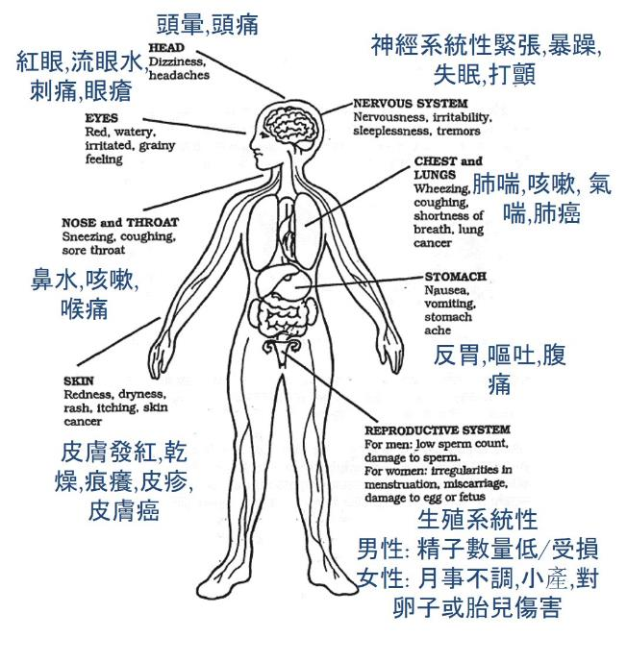

HOW CHEMICALS CAN AFFECT YOUR BODY化學物質怎樣影響你的身體
頭暈,頭痛
神經系統性緊張,暴躁,失眠,打顫
紅眼,流眼水,刺痛,眼瘡
肺喘,咳嗽, 氣喘,肺癌
鼻水,咳嗽,喉痛
反胃,嘔吐,腹痛
皮膚發紅,乾燥,痕癢,皮疹,皮膚癌
生殖系統性
男性: 精子數量低/受損
女性: 月事不調,小產,對卵子或胎兒傷害
Notes:
Kelsie Scruggs, “Safe Jobs for Youth” LOHP/UCB

Slide 15
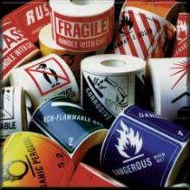
Health Hazards
身體健康危害
Major Types 主要類型
Corrosives 腐蝕性 - cause tissue damage and burns on contact with skin or eyes 與皮膚或眼睛接觸會導致組織損傷和灼傷
Primary Irritants 原發性刺激物 - cause intense redness or swelling of skin or eyes on contact. No permanent tissue damage 接觸時會導致皮膚或眼睛劇烈發紅或腫脹, 但沒有永久性組織損傷
Sensitizers 致敏劑 - cause an allergic skin or lung reaction 引起過敏性皮膚或肺部反應
Notes:
“Hazard Communication Standard 1910.1200.”

Slide 16
Health Hazards 身體健康危害
Acutely Toxic Materials 急性有毒物質 - cause an adverse effect even at very low doses - 即使在極低劑量下也會產生不良反應
Carcinogens 致癌物- may cause cancer 可能導致癌症
Teratogens 致畸物 - may cause birth defects 可能導致胎兒天生缺陷
Organ Specific hazards 器官特殊危害 - damage to specific organ systems such as liver or lungs 對肝臟或肺部等特定器官系統的損害

Slide 17
Acute and Chronic 急性和慢性
Acute health effects 急性健康影響
Happens quickly. Occur with short-term exposure and last a brief period. For example, skin irritation with chemical contact 發生迅速 ， 於短期暴露並短暫持續的一段時間後發作的。 例如， 由化學接觸引起的皮膚刺激
Chronic health effects 慢性健康影響
May not smell, see, or feel sick right away. Occur with long-term exposure and last a long time. For example: lung cancer 未必即時聞到，看到或發病，於長期暴露並持續很長時間後發作的。 例如：肺癌

Slide 18
Chemical Hazard Protection 化學物質危害的防護
What can you do to protect yourself from chemical hazards? 你能做些什麼來保護自己免受化學物質危害？
[Short discussion] 簡短討論

Slide 19

Chemical Hazard Control Approaches 化學物質危害控制途徑
(1) Remove
the Hazard from Work Area 消除工作區危害
(2) Review and Follow Work Policies and Procedures 審查並遵守工作政策和程序
(3) Wear Personal Protective Equipment 穿著個人防護裝備

Slide 20
Remove the Hazardous Chemical 消除工作區危害
Remove the chemical hazard from work area 清除工作場地內化學物質危害
Choose nontoxic products 選擇無毒產品認證
“Green Seal Certified” “綠色印章認證”
“Ecologo UL” 通過 EcoLogo 安全認證
“Safer Choice” “更安全的選擇”

Slide 21
Work Policies and Procedures 審查並遵守工作政策和程序
Train on reading labels and know what symbols and warnings mean 培訓標籤閱讀，知道什麼符號及其警告意思
Use small amounts of chemicals, measuring & diluting them 减少，量度和稀釋化學物質
Use tools to avoid direct contact with chemicals 使用工具來避免直接接觸化學物質
Cover and store chemicals safely 安全地蓋上和儲存化學品

Slide 22
Learn to read Chemical Hazard Labels 培訓閱讀標籤
Train on reading labels and knowing what symbols and warnings mean 培訓標籤閱讀，知道什麼符號及其警告意思

Slide 23
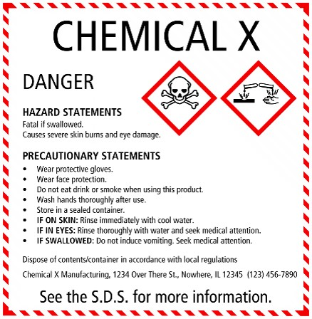
Required Elements on a Label 標籤上的必需組成
Information should be in the same order for all labels 所有標籤的資料次序應相同
Labels MUST include 標籤必需包括 :
Product Identifier 產品識別碼
Chemical Identity 化學品名稱
Hazard Pictograms * 危害標示符號*
Signal Words * 文字信號*
Hazard Statements * 危害聲明*
Precautionary Information 預防信息
Supplier Identification 供應商身份
The items with * are hazard warning and MUST be located together on the label 帶*的項目是危險警告，必須一起放在標籤上!
1.
2.
4.
5.
3.
6.
7.
Notes:
“Chemical Hazard and Hazard Communication” OSHA

Slide 24
Hazard Pictograms 危害標示符號
Pictograms (標示符號) are required on labels to alert users of the chemical hazards 標籤上必須使用象形圖的標示符號(pictogram)來提醒用戶注意化學品危害
Pictograms consists of a symbol on a white background framed within a red border and represents a distinct hazard 標示符號 (pictogram)由紅色邊框內白色背景上的符號組成，代表著獨特的化學品危害

Slide 25
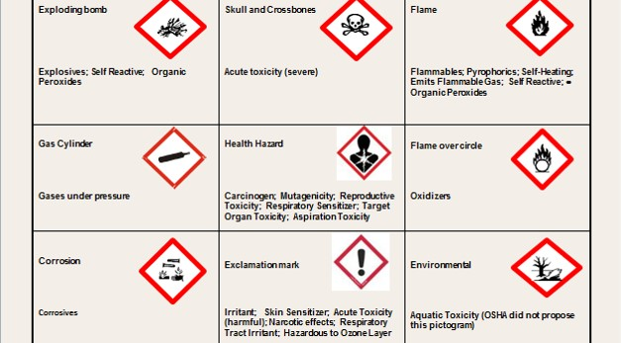
Pictograms and Hazards 危害圖示及其危害說明
炸弹爆炸
骷髅骨
火焰
爆炸品
急性毒性(嚴重)
易燃品
玻璃管
健康危害
火焰圈
器官突變/致毒/致癌
壓力下的氣體
氧化劑
嘆號
戶外
腐蝕狀態
各類刺激性
水毒性
腐蝕性
Notes:
“Hazard Communication (HAZCOM)…” OSHA

Slide 26
Hazard Signal Words 危害文字信號
There are two Signal Words used in chemical labels: DANGER or WARNING 化學標籤中使用了兩個文字信號：危險或警告
DANGER is used for more severe hazards 危險用於極嚴重的危險
WARNING is used for less severe hazards 警告用於不太嚴重的危險

Slide 27
Hazard Statements 危害聲明
Hazard statements provide wording to indicate the hazards of the chemical product, including, when appropriate, the degree of the hazard 危害聲明用文字來指出化學產品的危害，包括適當時，化學產品的的危險程度

Slide 28

Safety Data Sheets (SDS) 安全資料表
For information about chemical hazards, Safety Data Sheets provide valuable facts about chemicals and how to handle them. It contains 安全資料表提供了有關化學物質及其處理方法的寶貴信息。 它包含:
Product name, manufacturer, contact information and emergency number 產品名稱，製造商，聯絡資料和緊急號碼
Hazard identification 危害識別
Information on chemical ingredients 有關化學成分的資料
First-aid measures 急救措施
Firefighting measures 救火措施
Accidental release measures 意外信息發布措施
Handling and storage 處理和儲存
Notes:
“Chemical Hazard and Hazard Communication” OSHA

Slide 29
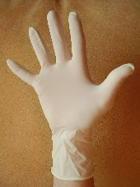
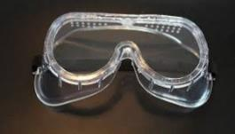

Personal Protective Equipment 個人防護裝備
Use gloves, masks, goggles, aprons, hats, shoes, and other protective covers 使用手套，口罩，護眼罩，圍裙， 戴帽/ 頭套 ， 專用鞋襪和其他保護裝備

Slide 30
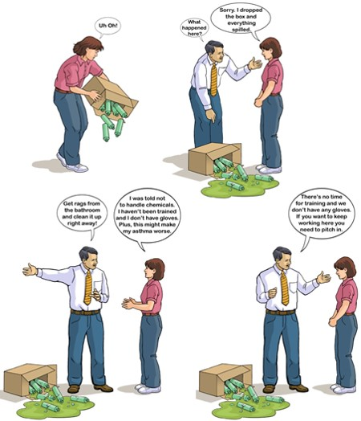
Mei’s Story: What should Mei do? 亞美的遭遇, 怎樣做好?
哎吔!
我打翻盒子,所有都溢出来了
亞美,發生了什麼事?
已經沒有時間培訓,公司也沒有手套供應,你想炒魷嗎? 快去處理它
去廁所弄塊抹布
立即清理
亞Sir,我從未學過處理這種化學品,又沒戴手套,我怕我哮喘會惡化!
Notes:
“Staying Safe at Work” OSHA

Slide 31
Summary 總結
Employees have the right to chemical safety information and training in the workplace 員工有權在工作場所獲得化學品安全信息和培訓.
It is important to recognize chemical hazards through labels, pictograms, signal words, and hazard statements 通過標籤，標示符號，文字信號和危害聲明去認識化學品危害非常重要.
It is important to use personal protective equipment for safely handling chemicals 使用個人防護設備安全處理化學品非常重要.
Take action to make your workplace safer 立刻採取行動，讓您的工作場所更安全!

Slide 32
Any Questions? 提問時間

Slide 33
Acknowledgments 銘謝聲明
我們亦謹向以下曾提供參考資料的機構 ( 或人士 ) 致謝
“Chemical Hazard and Hazard Communication” (PowerPoint Presentation). Susan Harwood Grant/OSHA.
“Hazard Communication (HAZCOM) and the Globally Harmonized System of Classification and Labeling of Chemicals (GHS)” (PowerPoint Presentation). Susan Harwood Grant/OSHA.
“Hazard Communication Standard 1910.1200” (PowerPoint Presentation). Susan Harwood Grant/OSHA.
Scruggs, Kelsie, MPH. “Safe Jobs for Youth” (PowerPoint Presentation). Labor Occupational Health Program, U.C. Berkeley. Susan Harwood Grant/OSHA

Slide 34
Acknowledgments … cont’d 銘謝聲明 … 續
Also this training was created by adapting publicly available materials from Susan Harwood Training Program, UC Berkeley Labor Occupational Health Program, and Pennsylvania Department of Labor & Industry 另外， 此培訓文檔是取裁自 Susan Harwood 撰寫的培訓計劃，加州大學伯克利分校勞動職業健康計劃和賓夕法尼亞勞工部的公開資料而撰寫的.
… 特此聲明

