Slide 1
Introduction to
Belt Sander Safety
This material was produced under Susan Harwood grant number SH-31214-SH7 Occupational Safety and Health Administration, U.S. Department of Labor. The contents in this presentation do not necessarily reflect the views or policies of the U.S. Department of Labor, nor does the mention of trade names, commercial products, or organizations imply endorsement by the U.S. Government.

Slide 2
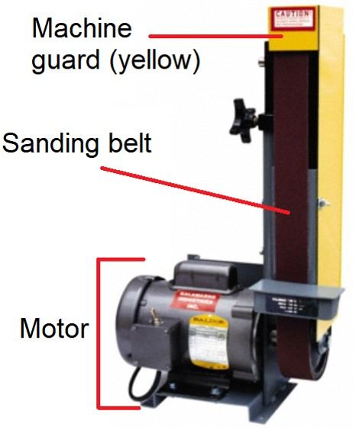
Introduction: What’s a belt sander?
Power tool used for smoothing a surface with abrasive material
Generally used for shaping and finishing wood and metal
*Power tool: tool that is operated by a power source (e.g. electric motor)
The components of a belt sander

Slide 3
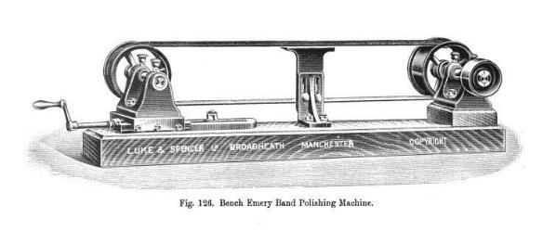
Introduction: Early belt sander
First recordings of sanding in China
Sand, crushed seeds, and shells used to sand raw materials
An early version of the belt sander

Slide 4
What it Does: Structure of a belt sander
Machine guard: ​​​​​​​shields the user from moving or flying parts
Sanding belt: An abrasive strip looped around a pair of drums which rotates to smoothen the rough workpiece
Motor: rotates the pair of drums on which the sanding belt is wrapped around
The components of a belt sander

Slide 5
Safety: Who is OSHA?
With the Occupational Safety and Health Act of 1970, Congress created the Occupational Safety and Health Administration (OSHA) to assure safe and healthful working conditions for working men and women by setting and enforcing standards and by providing training, outreach, education and assistance.
OSHA is part of the United States Department of Labor. The administrator for OSHA is the Assistant Secretary of Labor for Occupational Safety and Health. OSHA's administrator answers to the Secretary of Labor, who is a member of the cabinet of the President of the United States.
Notes:
OSHA was started to protect workers in the work place. Before OSHA there was no organization that tracked work place injuries. There were also no safety standards for employers.
OSHA has 2 branches, the Enforcement Branch and the Collaboration Branch.
The Enforcement Branch investigates complaints and serious accidents.
The Collaboration Branch works on education, such as the Susan Harwood Grant.

Slide 6
Safety: Know your rights
Under federal law, you are entitled to a safe workplace.
Your employer must provide a workplace free of known health and safety hazards.
If you have concerns, you have the right to speak up about them without fear of retaliation. You also have the right to:
Be trained in a language you understand
Work on machines that are safe
Be provided required safety gear, such as gloves or a harness and lifeline for falls
Be protected from toxic chemicals
Request an OSHA inspection, and speak to the inspector
Report an injury or illness, and get copies of your medical records
See copies of the workplace injury and illness log
Review records of work-related injuries and illnesses
Get copies of test results done to find hazards in the workplace
Notes:
Read the rights to the trainees and point them to the posters available around the workplace where they can refer to for more information.
Extra resources can be found at https://www.osha.gov/workers/index.html

Slide 7

Hazards: Machine-related injuries
Possible machine-related injuries include:
Crushed fingers or hands
Amputations
Blindness
Blindness is a possible machine-related injury
Notes:
Many accidents result from persons working on, or around, moving machinery. These accidents could have been prevented by the installation and proper maintenance of guarding. The goal of this training is to make the guarding of all equipment as easily understood as possible and re-inforce the safe working procedures that must always be in place around dangerous equipment.
This list of accidents is as long as it is horrifying.
Safeguards are essential for protecting workers from needless and preventable injuries. Where the operation of a machine can injure the operator or other workers, the hazard must be controlled or eliminated.
National Emphasis Program on Amputations*. CPL 03-00-019, (August 13, 2015). Describes policies and procedures for implementing a National Emphasis Program (NEP) to identify and to reduce workplace machinery and equipment hazards which are causing or likely to cause amputations.
Resource: https://www.osha.gov/dte/outreach/construction_generalindustry/gi_outreach_tp.html
https://safetyresourcesblog.com/2014/08/16/osha-quickcards-download-here-all-free-englishspanishother/

Slide 8
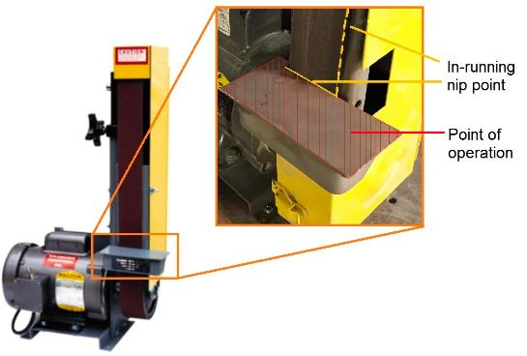
Hazards: Point of operation
Point of operation: area on a machine where work is actually performed on the material being processed
The point of operation on the belt sander is shown in this image.
The point of operation of a drill press
Notes:
The primary hazards of belt sanders are contact with rotating parts and contact at the point of operation. An operators hand or fingers can be pulled into the sanding area from working too close, wearing gloves, loose clothing, loose hair, or jewelry, or wearing loose clothing.

Slide 9
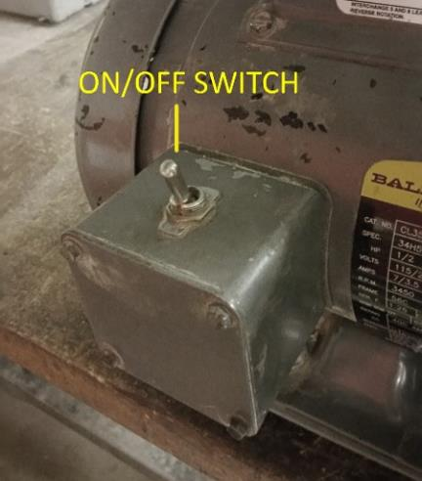
Hazards: Preventing injuries and amputations
To avoid getting injured:
Identify the ON/OFF SWITCH (pictured in this image)
Make sure the machine guards are on
Rest the workpiece on the table support, watch your hand position
​​​​​​​Sand on downward-moving side
Be trained!
The on/off switch on a belt sander
Notes:
Machine users always need to check to make sure that all of the guards are in place and that the gap between the Table and the sanding belt does not exceed 1/8”.
The Belt Sander seems to be an easy enough machine to operate, but users still need to be trained on it.
The work piece needs to be placed on the Table for safety and stability.
Operators always need to be aware where their fingers are in relation to the sanding belt when sanding the work piece.
Any machine malfunction needs to be reported to the shop staff. Machine operators cannot attempt to repair the machine.

Slide 10
Hazards: Nip points and rotating parts
In-running nip points (or pinch points): spots where danger especially arises from rotating or reciprocating part
2 scenarios:
When machine parts move toward each other
When machine parts run past a stationary object
Examples of nip points on belt sander
Notes:
The primary hazards of belt sanders are contact with rotating parts and contact at the point of operation. Nip points are also created between the sanding belt and the work rest. Projected parts or material such as unsecured workpieces or flying debris can also strike or present hazards to the operator.

Slide 11

Hazards: Hazard Signage
To prevent injuries, be aware of hazard signages next to the machinery.
An example of hazard signage

Slide 12
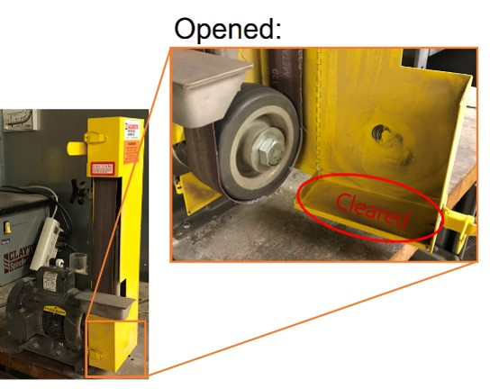
Hazards: Flying chips and wood dust
While sanding, chips, sparks and wood dust are likely to be thrown in different directions.
Before sanding STEEL: Clear any dust ​​​​​​​from the area in the figure to prevent sparks from causing FIRE​​​​​​​.
Please be sure to UNPLUG the the belt sander before opening the machine guard!
An example of a cleared wood dust collection area
Notes:
Dust is flammable and potentially explosive. Operators need to be aware of the dust that their project is creating and may need to intermittently clean up the area with a vacuum cleaner.

Slide 13
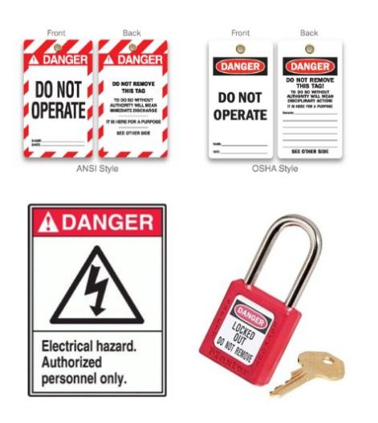
Hazards: Lockout/Tagout
Lockout/tagout procedures are safeguarding methods to prevent injury due to hazardous energy sources. If you see the machines with the signs featured in the image or that are under lock and key, please stay away and do not touch or attempt to start it.
Examples of Lockout/tagout equipment

Slide 14
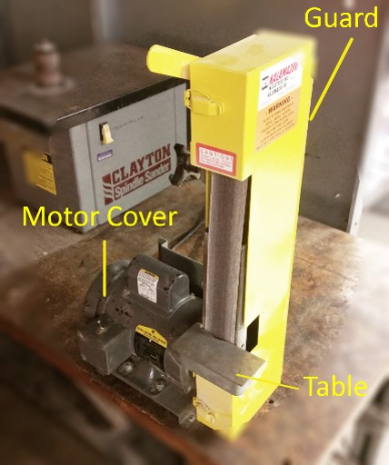
Safe Operation: Getting Started
1. Make sure that the belt guard is intact
2. Identify where the ON/OFF Switch is
3. Identify key parts of Belt Sander (guard, motor cover, table, ON/OFF switch, sanding belt)
4. Verify that gap between the table and belt is no more than 1/8” apart
The components of a belt sander
Notes:
Make sure that the Belt Guards are intact.
Verify that gap between the table and belt is no more than 1/8”.
To clean up:
Use a vacuum to suck up the dust and debris that was created on and around the Belt Sander
Sweep up or vacuum up any debris that is on the floor.
It is important to get the sanding dust off the floor since it is a slip hazard and can cause injury.

Slide 15
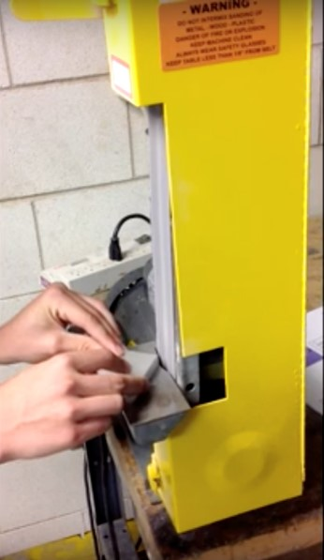
Safe Operation: Breaking a sharp corner
1. Turn on the Belt Sander
2. Place the work piece on the table at approximately 45 degrees and lightly press it into the rotating belt
3. Slightly rotate the workpiece to the left and right to break the corner
4. Turn the Belt Sander off when done
An example of a corner breaking on the belt sander
Notes:
Turn the Belt Sander on by flipping the on/off switch to the On position.
Place the work piece on the table at approximately 45 degrees and lightly press it into the rotating belt.
Slightly rotate the work piece to the left and right to break the corner.
Turn the Belt Sander off when done.

Slide 16
Safe Operation: Smoothing a rough face
1. Turn on the Belt Sander
2. Put the work piece on the table and orient it perpendicular to the sanding belt
3. Lightly press the workpiece into the rotating belt and move the piece horizontally from the left to right to minimize heat
4. Periodically check the sanded surface and repeat 2 and 3 until the desired finish has been achieved
5. Perform the corner breaking operation on both sides of the work piece (see previous)
6. Turn off the Belt Sander
7. Remember to clean up after use
The components of a belt sander
Notes:
Turn the Belt Sander on by flipping the on/off switch to the On position.
Put the work piece on the table and orient it perpendicular to the sanding belt.
Lightly press the work piece into the rotating belt and move the piece horizontally from the left to right to minimize heat.
Periodically check the sanded surface to see if the desired finish has been achieved. Do not touch the sanded surface since it will be hot.
Repeat the process if the piece needs more sanding.
The edges of the work piece will be sharp.
Perform the corner breaking operation on both sides of the work piece.
Turn off the Belt Sander by flipping the on/off switch down.

