Slide 1
Arc Hazards and Safety Related Work Practices

Slide 2
Susan Harwood Grant
This material was produced under Grant SH-31231-SH7 from the Occupational Safety and Health Administration, U.S. Department of Labor. It does not necessarily reflect the views or policies of the U.S. Department of Labor, nor does mention of trade names, commercial products, or organizations imply endorsement by the U.S. Government.

Slide 3
OSHA Regulations
Worker rights and responsibilities
  Right to a safe and healthful workplace
  Right to know about hazardous chemicals
  Right to information about injuries and illnesses in your workplace
  Right to complain or request hazard correction from employer
  Right to training
  Right to access hazard exposure and medical records
  Right to file a complaint with OSHA
  Right to participate in an OSHA inspection
  Right to be free from retaliation for exercising safety and health rights
Notes:
As an employee, you have the right to know. You have the right to work in a safe work environment, and this includes knowing about any hazardous chemicals you might be exposed to. You have the right to information regarding injuries and illnesses that occur at your workplace. You have the right to inform employers of unsafe work environments and the right to resolution of those issues. If hazards aren’t addressed, you have the right to share that information with OSHA without retaliation. It is required that you have training, and your right as an employee to be trained specifically on hazards in your facility.

Slide 4
OSHA Regulations
Worker Responsibilities
  Section 5(b) of the OSH Act states that each employee shall comply with occupational safety and health standards and all applicable rules, regulations and orders.
  Workers are encouraged to follow all appropriate safety and health rules, and wear protective equipment while working.
Notes:
As an employee or worker, you have a responsibility to comply with OSHA standards. Not only is it required by OSHA, by abiding by safety and health rules, you can assure that you are being responsible for your safety.

Slide 5
OSHA Regulations
Employer Responsibilities
  Provide a workplace free from recognized hazards & comply with OSHA standards
  Provide training required by OSHA standards
  Keep records of injuries and illnesses
  Provide medical exams and access to exposure and medical records
  Not discriminate against workers who exercise their rights
  Post OSHA citations and abatement verification notices
  Provide and pay for required PPE
Notes:
Just as workers have responsibilities, employers do as well. Employers responsibilities are centered around providing the required information necessary to workers to keep them safe. Included in those responsibilities are the right to provide a hazard free workplace and comply with OSHA standards. In addition, provide training as required by OSHA, keep records of all injuries and illnesses. In addition, employees can not be discriminated against when exercising their rights, so as an employer it is important to understand workers rights as well.
In addition, as an employer, there is responsibility of providing and paying for PPE as required to perform a job safely.

Slide 6
OSHA Regulations
If you, your co-workers and/or your union representative determine that an OSHA inspection is needed to get workplace hazards corrected, you have several options.
  You can download the complaint form from OSHA's website, complete it and mail or fax it to OSHA. A written, signed complaint submitted to the OSHA area or State Plan office is most likely to result in an onsite inspection.
  You can file a complaint online. However, most online complaints are initially considered non-formal complaints and handled by OSHA’s phone/fax system, which means they are resolved informally over the phone.
  You can telephone or visit your local, regional or area office to discuss your concerns. After the discussion, OSHA staff can give or send you a complaint form if you wish to file.
  Note that if a hazard is life-threatening, call the Regional or local office or 1-800-321-OSHA immediately.
Notes:
As an employee, you are free to file a complaint in the event that your safety and health issues aren’t addressed locally.

Slide 7
OSHA Regulations
Whistleblower Protection
  You may file a complaint with OSHA if your employer retaliates against you by taking unfavorable personnel action because you engaged in protected activity relating to workplace safety and health
  Complaints must be filed in writing, following OSHA guidelines
Notes:
Section 11(c) of the Act prohibits your employer from discharging or in any manner retaliating against you or any worker for exercising your rights under the Act. We've covered many of your rights under OSHA earlier. Can you recall some of them? Depending upon the circumstances of the case, "discrimination" can include: firing or laying off; demoting; denying overtime or promotion; disciplining; reducing pay or hours, and other actions. If you believe your employer has discriminated against you because you exercised your safety and health rights, contact your local OSHA Office right away. The OSH Act gives you only 30 days from the condition to report discrimination. If you would like any additional information regarding Whistleblower protection, please reference the appendix which further discusses the protection.

Slide 8
Introduction
Lesson objectives:
  Understand the regulations contained in OSHA 1910.331-.335, Electrical Safety Related Work Practices.
  Understand and how to use the NFPA 70E®.
  Understand how to choose proper equipment when working with energized circuits.
  Understand how to use PPE.
Notes:
Enabling Objectives:
Identify major electrical hazards.
Describe types of electrical hazards.
3. Identify and understand controls

Slide 9
29 CFR 1910.331-.335
Electrical Safety Related Work Practices 1.1
1910.331 Scope
Covered work by both qualified and unqualified persons.
The provisions of 1910.331-.335 cover electrical safety work practices for both qualified persons (those who have training in avoiding the electrical hazards of working on or near exposed energized parts) and unqualified persons (those with little or no such training)

Slide 10
29 CFR 1910.331-.335
Electrical Safety Related Work Practices 1.2
1910.331 Scope (continued)
Qualified and unqualified persons working on, near, or the following installations:
  Premises Wiring
  Wiring for the connection of supply
  Other wiring
  Optical fiber cable

Slide 11
29 CFR 1910.331-.335
Electrical Safety Related Work Practices 1.3
The provisions of 1910.331-335 do not apply to work performed by qualified persons on or directly associated with these installations:
Generation, transmission, and distribution of electric energy (including communication and metering) located in buildings used for such purposes or located outdoors
Communications installations. Installations of communication equipment to the extent that the work is covered under 1910.268
Installations in vehicles. Installations in ships, watercraft, railway rolling stock, aircraft or automotive vehicles other than mobile homes or recreational vehicles
Railway installations. Installations of railways for generation, transformation, transmission, or distribution of power used exclusively for operation of rolling stock or installation of railways used exclusively for signaling and communication purposes.

Slide 12
NFPA® documents
Refer to NFPA 70E®
Standard for Electrical Safety in the Workplace®
Refer to NFPA 70®
National Electrical Code®
Refer to NFPA 70B®
Recommended Practice for Electrical Equipment®
Copyright 2018 NFPA 70E All Rights Reserved
Copyright 2017 NFPA 70 All Rights Reserved
Copyright 2016 NFPA 70B All Rights Reserved
Notes:
The NFPA 70E® is the main document for this training. We have to discuss the other two documents to show how they work together to establish a safe working condition.

Slide 13
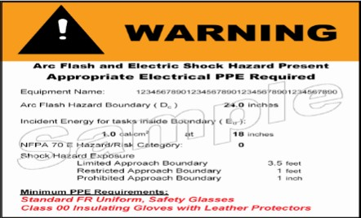
NFPA 70E®
Standard for Electrical Safety in the Workplace® 1.1
NFPA 70E® relationship to the NFPA 70®
  NFPA 70® is the National Electrical Code®
    Practical safeguarding of persons and property from hazards of use of electricity.
    Refer to Article 110
      110.16 Arc-Flash Hazard Warning Labels
    Refer to 110.16, Information Note No. 1 in the NEC®, which mentions the NFPA 70E®.
Photo courtesy OSHA
Copyright 2018 NFPA 70E All Rights Reserved
Copyright 2017 NFPA 70 All Rights Reserved
Notes:
Refer to 110.16 (A) General, and (B) Service Equipment, of the NEC® to understand labeling requirements.
Refer to 130.5 (H) Equipment Labeling in the NFPA 70E® for reference.

Slide 14
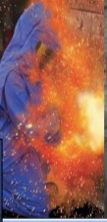
NFPA 70E®
Standard for Electrical Safety in the Workplace® 1.2
NFPA 70E® relationship to the NFPA 70B®
  Electrical installations are considered safe during normal operation.
  Maintenance is required to keep electrical equipment in proper working order.
  Proper maintenance insures that overcurrent protection devices operate normally.
  Incident energy is proportional to the clearing time of an overcurrent protection device.
    Expressed in calories per square centimeter (cal/cm²)
Photo courtesy OSHA
Copyright 2018 NFPA 70E All Rights Reserved
Copyright 2016 NFPA 70B All Rights Reserved
Notes:
Refer to Article 100, NFPA 70E®, for the definition of incident energy.

Slide 15
NFPA 70E®
Standard for Electrical Safety in the Workplace® 1.3
OSHA is the “shall”
NFPA 70E® is the “how”
  Electrical safety program
  Training
  Lock out Tag Out
  Risk assessments
  PPE
Copyright 2018 NFPA 70E All Rights Reserved
Notes:
NFPA 70E® is not required however, it is important to have some type of program implemented for electrical safety.

Slide 16
NFPA 70E®
Standard for Electrical Safety in the Workplace® 1.4
Article 90- Introduction
Chapter 1- Safety Related Work Practices
Chapter 2- Safety Related Maintenance Requirements
Chapter 3- Safety Requirements for Special Equipment
Informative Annexes
Copyright 2018 NFPA 70E All Rights Reserved

Slide 17
NFPA 70E®
Standard for Electrical Safety in the Workplace® 1.5
Article 90- Introduction
  Covered
  Not Covered
  Standard Arrangement
  Mandatory Rules
  Permissive Rules
Copyright 2018 NFPA 70E All Rights Reserved
Notes:
The purpose of the standard is to provide a practical safe working area for employees relative to the hazards arising from the use of electricity.
Covered items include everything in the employee workplace from the electrical service point on down through the electrical system.
Not covered items include ships, railways, communication utilities, electrical utilities, generation of, transmission of, and distribution of electrical energy.
The standard arrangement is an introductory section, three chapters and informative annexes. Informative annexes are not part of the requirements of the standard.
Mandatory rules include shall and shall not.
Permissive rules include shall be permitted and shall not be required.

Slide 18
NFPA 70E®
Standard for Electrical Safety in the Workplace® 1.6
Article 100- Definitions
  Arc Flash Hazard
  Arc Rating
  Boundary, Arc Flash
  Boundary, Limited Approach
  Boundary, Restricted Approach
  Exposed (energized electrical conductors or circuit parts)
  Incident Energy
  Maintenance, Condition of
  Shock Hazard
  Working On (energized electrical conductors or circuit parts)
Copyright 2018 NFPA 70E All Rights Reserved
Notes:
Please refer to your copy of the NFPA 70E®, Article 100 Definitions.

Slide 19
NFPA 70E®
Standard for Electrical Safety in the Workplace® 1.7
Article 100- Definitions
  Electrical Hazard
  Electrical Safety Program
  Electrically Safe Work Condition
  Exposed (as applied to wiring methods)
  Fault Current
  Fault Current , Available
  Qualified Person
Copyright 2018 NFPA 70E All Rights Reserved
Notes:
Please refer to your copy of the NFPA 70E®, Article 100 Definitions.

Slide 20
OSHA 29CFR1910.399
Definitions
Qualified person- One who has received training in and has demonstrated skills and knowledge related to the construction and operation of electric equipment and installations and has received safety training to identify the hazards and reduce the associated risk .
Notes:
Note 1 to the definition of "qualified person:" Whether an employee is considered to be a "qualified person" will depend upon various circumstances in the workplace. For example, it is possible and, in fact, likely for an individual to be considered "qualified" with regard to certain equipment in the workplace, but "unqualified" as to other equipment. (See 1910.332(b)(3) for training requirements that specifically apply to qualified persons.)
Note 2 to the definition of "qualified person:" An employee who is undergoing on-the-job training and who, in the course of such training, has demonstrated an ability to perform duties safely at his or her level of training and who is under the direct supervision of a qualified person is considered to be a qualified person for the performance of those duties

Slide 21
Definitions
Whether an employee is considered to be a ‘‘qualified person’’ will depend upon various circumstances in the workplace. For example, it is possible and, in fact, likely for an individual to be considered ‘‘qualified’’ with regard to certain equipment in the workplace, but ‘‘unqualified’’ as to other equipment. (See 1910.332(b)(3) for training requirements that specifically apply to qualified persons.)

Slide 22
NFPA 70E®
Standard for Electrical Safety in the Workplace® 1.8
Article 105- Application of Safety Related Work Practices and Procedures
  Purpose
  Responsibility
    Employer
    Employee
Copyright 2018 NFPA 70E All Rights Reserved
Notes:
Please refer to your copy of the NFPA 70E®,Article 105- Application of Safety Related Work Practices and Procedures.

Slide 23
NFPA 70E®
Standard for Electrical Safety in the Workplace® 1.9
Article 110- General Requirements for Electrical Safety Related Work Practices
  Electrical Safety Program
    Inspection
    Condition of Maintenance
    Electrical Safety Program Principles
    Electrical Safety Program Controls
    Electrical Safety Program Procedures
    Risk Assessment Procedure
    (continued)
Copyright 2018 NFPA 70E All Rights Reserved
Notes:
Please refer to your copy of the NFPA 70E®, Article 110- General Requirements for Electrical Safety Related Work Practices

Slide 24
NFPA 70E®
Standard for Electrical Safety in the Workplace® 1.10
Article 110- General Requirements for Electrical Safety Related Work Practices
  Electrical Safety Program (continued)
    Human Error
    Hierarchy of Risk Control Methods
    Job Safety Planning and Job Briefing
    Incident Investigations
    Auditing
Copyright 2018 NFPA 70E All Rights Reserved
Notes:
Please refer to your copy of the NFPA 70E®, Article 110- General Requirements for Electrical Safety Related Work Practices

Slide 25
NFPA 70E®
Standard for Electrical Safety in the Workplace® 1.11
Article 110- General Requirements for Electrical Safety Related Work Practices
  Training requirements
    Electrical safety training
      Qualified person
      Unqualified person
      Retraining
      Type of training
      Documentation
Copyright 2018 NFPA 70E All Rights Reserved
Notes:
Please refer to your copy of the NFPA 70E®, Article 110- General Requirements for Electrical Safety Related Work Practices

Slide 26
Qualified Electrical Worker Training
OSHA requires that a qualified electrical worker be trained in:
  Skills and techniques to determine live parts from others
  Skills and techniques to determine nominal voltage
  How to determine minimum safe approach distances for shock
  Use of special precautionary techniques, use of PPE, use of blankets and shielding, and use insulated hand tools (1910.333)

Slide 27
NFPA 70E®
Standard for Electrical Safety in the Workplace® 1.12
Article 110- General Requirements for Electrical Safety Related Work Practices
  Training requirements
    Lock out/Tag out procedure training
      Initial training
      Retraining
      Documentation
Copyright 2018 NFPA 70E All Rights Reserved
Notes:
Please refer to your copy of the NFPA 70E®, Article 110- General Requirements for Electrical Safety Related Work Practices

Slide 28
NFPA 70E®
Standard for Electrical Safety in the Workplace® 1.13
Article 110- General Requirements for Electrical Safety Related Work Practices
  Training requirements
    Emergency response Training
      Contact release
      First aid, emergency response, and resuscitation
      Training verification
      Documentation
Copyright 2018 NFPA 70E All Rights Reserved
Notes:
Please refer to your copy of the NFPA 70E®, Article 110- General Requirements for Electrical Safety Related Work Practices

Slide 29
29 CFR 1910.331-.335
Electrical Safety Related Work Practices 1.4
1910.332 Training
The training requirements contained in this
section apply to employees who face a risk of electric
shock that is not reduced to a safe level by the
electrical installation requirements of 1910.303
through 1910.308.
Note: Employees in occupations listed in Table S-4 face such a risk and are required to be trained.
Other employees who also may reasonably be expected to face comparable risk of injury due to electric shock or other electrical hazards must also be trained.

Slide 30
Table S-4
Blue collar supervisors(1)
Electrical and electronic engineers(1)
Electrical and electronic equipment assemblers(1)
Electrical and electronic technicians(1)
Electricians
Industrial machine operators(1)
Material handling equipment operators(1)
Mechanics and repairers(1)
Painters(1)
Riggers and roustabouts(1)
Stationary engineers(1)
Welders
Footnote(1)- Workers in these groups do not need to be trained if their work or the work of those they supervise does not bring them or the employees they supervise close enough to exposed parts of electric circuits operating at 50 volts or more to ground for a hazard to exist.
Notes:
Table S4 from OSHA standard 29 CFR 1910.332

Slide 31
NFPA 70E®
Standard for Electrical Safety in the Workplace® 1.14
Article 110- General Requirements for Electrical Safety Related Work Practices
  Host and Contract Employers’ Responsibilities.
    Host Employer Responsibilities
    Contract Employer Responsibilities
    Documentation
Copyright 2018 NFPA 70E All Rights Reserved
Notes:
Please refer to your copy of the NFPA 70E®, Article 110- General Requirements for Electrical Safety Related Work Practices

Slide 32
NFPA 70E®
Standard for Electrical Safety in the Workplace® 1.15
Article 110- General Requirements for Electrical Safety Related Work Practices
  Test Instruments and Equipment.
    Testing
    Rating
    Design
    Visual inspection and repair
    Operation verification
Copyright 2018 NFPA 70E All Rights Reserved
Notes:
Please refer to your copy of the NFPA 70E®, Article 110- General Requirements for Electrical Safety Related Work Practices

Slide 33
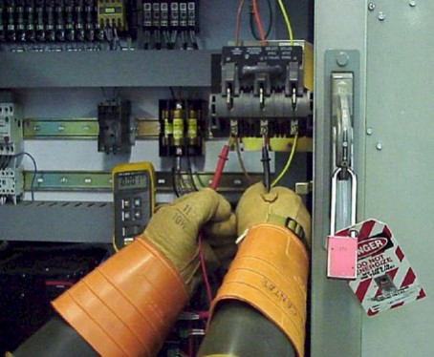
1910.334 Use of Equipment 1.1
Test Instruments and Equipment:
  Only qualified persons may perform testing work on electric circuits or equipment.
  Test instruments and equipment must be visually inspected for defects before use.
  Test instruments and equipment and their accessories must be rated for the circuits to which they will be connected.
Photo courtesy OSHA

Slide 34
Test Instruments and Equipment 1.2
Electrical Measuring Equipment
  What is the nominal voltage being tested?
  What is meters ability to withstand transient over voltages and high short circuit currents?
  Both rated voltage and the category must be considered when selecting a meter.

Slide 35
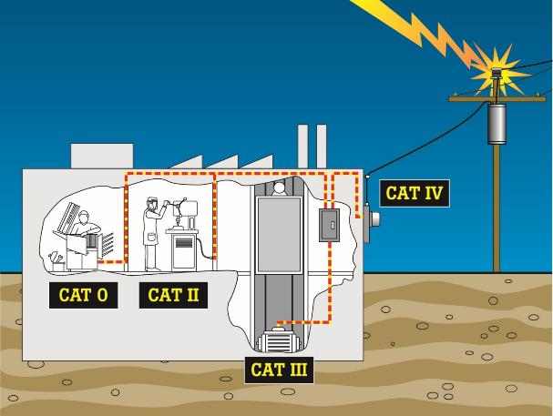
Test Instruments and Equipment 1.3
Reproduced with Permission, Fluke Corporation
Notes:
There are four categories of electrical testing meters
Category 0
Protected electronic circuits (copy machines, computers)
Category II
Receptacle outlet circuits (120/208V, 120/240V)
Category III
Distribution wiring including main bus, feeders, and branch circuits (277/480v)
Category IV
Origin of installation, utility level

Slide 36
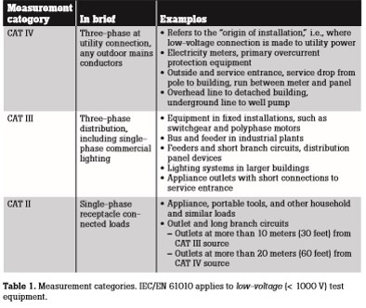
Test Instruments and Equipment 1.4
Reproduced with Permission, Fluke Corporation

Slide 37
Test Instruments and Equipment 1.5
These categories are based upon the rated voltage of the circuit being tested and proximity to the source voltage.
The closer to the source, the greater the chance of a high voltage transient surge.
These surges include
  Lightning
  Induced voltages
  Contact faults
  Switching surges
The lower the source impedance, the greater the meter category.
The higher the source impedance, the lower the meter category.

Slide 38
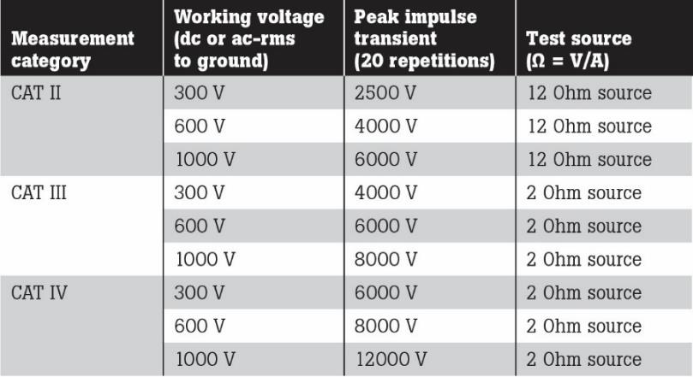
Test Instruments and Equipment 1.6
Reproduced with Permission, Fluke Corporation
Notes:
An example would be if we had a Cat II meter rated at 1000V versus a Cat III meter rated at 600V. Both have an impulse rating of 6kV. The Cat II meter uses a 12 ohm source and the Cat III uses a 2 ohm source. The Cat III, 600V, 6kV test impulse has 6 times the current of a CAT II, 1000V, 6kV test impulse. Voltage rating can be misleading. A Cat III, 1000V, 8kV transient is safer than Cat III, 600V, 6kV transient but Cat III, 600V is safer than Cat II 1000V. Some dual use meters, which measure current and voltage, may have the ammeter rated as Cat IV but a voltage rating of Cat III. Meters used in commercial and industrial applications should be rated at least Cat III, 600V, with the preference being Cat III, 1000V. All outside work requires a Cat IV 600V instrument and test leads.

Slide 39
NFPA 70E®
Standard for Electrical Safety in the Workplace® 1.16
Article 110- General Requirements for Electrical Safety Related Work Practices
  Portable Cord- and-Plug Connected Electric Equipment.
    Handling and Storage
    Grounding-Type Equipment
    Inspection
    Conductive Work Locations
    Connecting Attachment Plugs
    Manufacturers Instructions
Copyright 2018 NFPA 70E All Rights Reserved
Notes:
Please refer to your copy of the NFPA 70E®, Article 110- General Requirements for Electrical Safety Related Work Practices

Slide 40
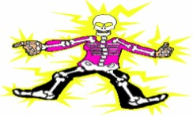
1910.334 Use of Equipment 1.1
Portable Electric Equipment
  Handled in a manner which will not cause damage.
  Visually inspected for defects before use on each shift.
  Flexible cords used with grounding type equipment shall contain an equipment grounding conductor.
  Portable electric equipment used in highly conductive locations shall be approved for those locations.
  Insulated protective equipment shall be used if employees hands are wet when plugging or unplugging flexible cords and cord and plug connected equipment.
Photo courtesy OSHA

Slide 41
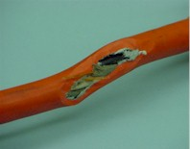
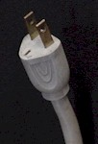
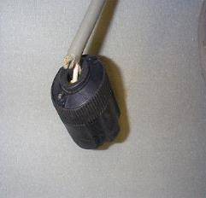
Inspecting Portable Electric Tools and Extension Cords 1.1
Visual inspection
  Signs of overheating
  Cord secure to tool or cord cap
  Cuts, breaks or other damage to cord jacket
  Missing ground prong on grounded tools and cords
  Damage to tool housing
  Loose or missing parts and hardware
Unsafe condition
Photos courtesy OSHA

Slide 42

Inspecting Portable Electric Tools and Extension Cords 1.2
Mechanical inspections – operate tool
  Sticking trigger or lock button
  Excessive sparking from motor
  Odd operation
    Sluggishness, vibration, chuck issues
  Odd noises
    Grinding, buzzing, scraping
  Excessive heating while running
Photo courtesy OSHA

Slide 43

NFPA 70E®
Standard for Electrical Safety in the Workplace® 1.17
Article 110- General Requirements for Electrical Safety Related Work Practices
  Ground-Fault Circuit Interrupter (GFCI) Protection.
    General
    Maintenance and Construction
    Outdoors
    Testing
Photo courtesy OSHA
Copyright 2018 NFPA 70E All Rights Reserved
Notes:
Please refer to your copy of the NFPA 70E®, Article 110- General Requirements for Electrical Safety Related Work Practices

Slide 44
NFPA 70E®
Standard for Electrical Safety in the Workplace® 1.18
Article 110- General Requirements for Electrical Safety Related Work Practices
  Overcurrent Protection Modification.
    Overcurrent protection of circuits and conductors shall not be modified
Copyright 2018 NFPA 70E All Rights Reserved
Notes:
Please refer to your copy of the NFPA 70E®, Article 110- General Requirements for Electrical Safety Related Work Practices

Slide 45
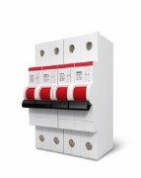
1910.334 Use of Equipment 1.2
Electric Power and Lighting Circuits:
  Load rated switches, circuit breakers or other devices specially designed as disconnecting means shall be used for the opening, reversing, or closing of circuits under load.
  After a circuit is de-energized by a circuit protective device, the circuit may not be manually reenergized until it has been determined that the equipment can be safely energized.
  The repetitive manual reclosing of circuit breakers or re-energizing circuits through replaced fuses is prohibited.
  Overcurrent protection of circuits and conductors may not be modified, even on a temporary basis.
Photo courtesy OSHA
Notes:
Note: When it can be determined from the design of the circuit and the overcurrent devices involved that the automatic operation of a device was caused by an overload rather than a fault condition, no examination of the circuit or connected equipment is needed before the circuit is reenergized.

Slide 46
1910.333
Selection and Use of Work Practices
(a) General. Safety-related work practices shall be employed to prevent electric shock or other injuries resulting from either direct or indirect electrical contacts, when work is performed near or on equipment or circuits which are or may be energized. The specific safety-related work practices shall be consistent with the nature and extent of the associated electrical hazards.

Slide 47
1910.333(a)(1)
De-energized Parts
1910.333(a)(1)
  Live parts shall be de-energized unless:
    Additional or increased hazards
    Infeasible
• Live parts less than 50 volts need not be de-energized if there is no increased exposure to electrical burns or to explosion due to electric arcs

Slide 48
Examples of increased or additional hazards
• Interruption of life support systems
• Deactivation of emergency alarm systems
• Shutdown of hazardous location ventilation
• Removal of illumination from an area

Slide 49
Examples of Infeasibility
• Testing of electric circuits
• Circuits that form an integral part of a continuous industrial process
Notes:
Please refer to your copy of the NFPA 70E®, Article 130-Work Involving Electrical Hazards, 130.2(A)(2) on Infeasibility.
infeasible
adj : not capable of being carried out or put into practice; [syn: impracticable, unfeasible, unworkable]
WordNet Princeton University
not practicable : incapable of being performed or accomplished by the means employed or at command
Webster’s Dictionary

Slide 50
1910.333(a)(2)
Energized Parts
If exposed live parts are not de-energized (i.e, for reasons of increased or additional hazards or infeasibility), other safety-related work practices shall be used to protect employees who may be exposed to the electrical hazard involved. Such work practices shall protect employees against contact with energized circuit parts directly with any part of their body or indirectly through some other conductive object. The work practices that are used shall be suitable for the voltage level of the exposed electric conductors or circuit parts.

Slide 51
1910.333(b)
Working on or near exposed de-energized parts
Application
  This paragraph applies to work on exposed de-energized parts or near enough to them to expose the employee to any electrical hazard they present. Conductors and parts of electric equipment that have been de-energized but have not been locked out or tagged in accordance with paragraph (b) of this section shall be treated as energized parts.

Slide 52
1910.333(b)(2)(ii)(A)
De-energizing Equipment
Safe procedures for de-energizing circuits and equipment shall be determined before circuits or equipment are de-energized
Refer to the NFPA 70E, Article 120, Establishing an Electrically Safe Working Condition
  120.5(1)
Copyright 2018 NFPA 70E All Rights Reserved

Slide 53
1910.333(b)(2)(ii)(B)
De-energizing Equipment
The circuits and equipment to be worked on shall be disconnected from all electrical energy sources.
Refer to the NFPA 70E, Article 120, Establishing an Electrically Safe Working Condition
  120.5(2)
Copyright 2018 NFPA 70E All Rights Reserved
Notes:
Control circuit devices, such as pushbuttons, selector switches, and interlocks, may not be used as a sole means for de-energizing circuits or equipment. Interlocks for electric equipment may not be used as a substitute for lock out and tagging procedures

Slide 54
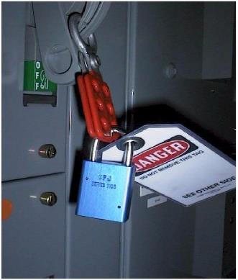
Electrically Safe Work Condition
Lockout / Tagout
  Identify all Power Sources
  Open all Disconnecting Means
  Visually Verify Opening
  (where possible)
  Apply Lockout/Tagout
  Test for Absence of Voltage
  Apply Safety Grounds
Photo Courtesy Doug Zemler
Notes:
Please refer to your copy of the NFPA 70E®, Article 120, Establishing an Electrically Safe Work Condition, 120.5(3). Visually verify opening of disconnect
If a circuit has a visible disconnect it should be verified that the blades are open before any testing is done. At one large industrial plant a switch failure occurs about once a year that leaves one pole of a three phase switch still engaged.

Slide 55
1910.333(b)(2)(ii)(C)
De-energizing Equipment
Stored electrical energy which might endanger personnel shall be released
Refer to the NFPA 70E, Article 120, Establishing an Electrically Safe Working Condition
  120.5(4)
Copyright 2018 NFPA 70E All Rights Reserved

Slide 56
1910.333(b)(2)(ii)(D)
De-energizing Equipment
Stored non-electrical energy in devices that could re-energized electrical circuit parts shall be blocked or relieved to the extent that the circuit parts could not be accidentally energized by the device.
Refer to the NFPA 70E, Article 120, Establishing an Electrically Safe Working Condition
  120.5(5)
Copyright 2018 NFPA 70E All Rights Reserved

Slide 57
1910.333(b)(2)(iii)(A)
Application of locks and tags
A lock and tag shall be placed on each disconnecting means used to de-energized circuits and equipment on which work is to be performed.
Refer to the NFPA 70E, Article 120, Establishing an Electrically Safe Working Condition
  120.5(6)
Copyright 2018 NFPA 70E All Rights Reserved

Slide 58
1910.333(b)(2)(iv)
Verification of de-energized condition
The requirements of the section shall be met:
  (A) A qualified person shall operate the equipment operating controls or otherwise verify that the equipment cannot be started.
  (B) A qualified person shall use a test equipment to test the circuit elements and electrical parts of equipment to which employees will be exposed and shall verify that all parts are de-energized.
Refer to the NFPA 70E, Article 120, Establishing an Electrically Safe Working Condition
  120.5(7)
  Before and after each test, determine the test instrument is working correctly on any known voltage source.
Copyright 2018 NFPA 70E All Rights Reserved
Notes:
Please refer to your copy of the NFPA 70E®, Article 120, Establishing an Electrically Safe Work Condition, 120.5(7), Exception No. 1 and No. 2.
Checking the meter before and after the test is essential. If the meter is not working correctly it may read “0” when the circuit is still energized. Therefore, we must eliminate meter failure as a cause of a “0” reading. Just because the meter tested fine before the test does not mean it was working during the test. The only way to be certain is to retest the meter after the circuit to be touched has been tested. The meter check should not be done on high energy circuits that could cause an arc flash burn.
If the circuit to be touched is on a DC motor, then the meter check should be done on a DC source and not an AC source. This makes sure that the meter is working correctly.
An incident occurred at one plant when the meters internal AC circuitry failed but the DC circuitry continued to work. 24 volts DC was measured before the AC Test was done. When the meter was tested on a live 480 volt circuit it indicated no voltage.
The ground to phase test is not valid without a good ground. A poor ground connection will cause the meter to show 0 volts even if voltage is present.
The ground test point must be verified if the user is not certain that the ground test point is reliable. Verification could include testing a live source to that ground point or a continuity check to a known ground.
The location of a reliable ground test point depends on the equipment and the manufacturer.

Slide 59
1910.333(b)(2)
1910.333(c)(3)(ii)(C)
The person is insulated from all conductive objects at a potential difference from that of the electrical part.
Refer to the NFPA 70E, Article 120, Establishing an Electrically Safe Working Condition
  120.5(8)
    Induced voltages or stored electrical energy
Copyright 2018 NFPA 70E All Rights Reserved

Slide 60
1910.333(b)(2)(v)
Re-energizing equipment
Re-Energizing Equipment
  Requirements shall be met in the order given, before circuits or equipment are re-energized, even temporarily.
    (A) A qualified person shall conduct tests and visual inspections.
    (B) Employees exposed to the hazard shall be warned to stay clear.
    (C) Each tag and lock shall be removed by the employee who placed it or under his/her direct supervision.
    (D) there shall be a visual determination that all employees are clear of the circuits and equipment.

Slide 61
1910.333(c)(2)
Work On Energized Equipment
• Only qualified persons may work on energized
equipment (50V and above).
• Person shall be capable of working safely.
• Shall be familiar with the proper use of special precautionary
techniques, personal protective equipment, insulating and
shielding materials, and insulated tools.

Slide 62
1910.333(c)(3)
Overhead lines
(i) Unqualified persons must maintain the following distances to overhead lines.
  For voltages to ground 50 kV or below- 10 feet
  For voltages to ground over 50 kV- 10 feet plus 4 inches for every 10 kV over 50 kV
(ii) Qualified persons must maintain the distances shown on Table S-5.

Slide 63
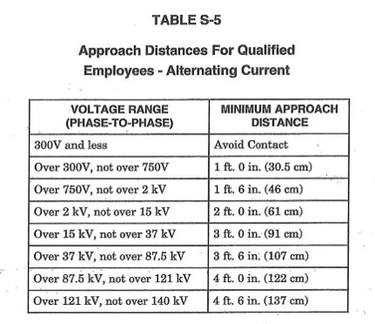
Approach Distances for Qualified Employees- Alternating Current

Slide 64
1910.333(c)(3)(iii)
Overhead lines
Vehicular And Mechanical Equipment
  If capable of contacting line must maintain clearance
  of 10 feet.
  Add 4 inches for every 10 kV above 50 kV.
    {1} If the vehicle is in transit with its structure lowered, the clearance may be reduced to 4 feet. If the voltage is higher than 50 Kv, the clearance shall be increased 4 inches for every 10 Kv over that voltage.
    {2} If insulating barriers are installed, and rated for the voltage of the line, the clearance may be reduced to a distance within the designed working dimensions of the insulating barrier.
    {3} If the equipment is an aerial lift insulated for the voltage involved, and if the work is performed by a qualified person, the clearance may be reduced to the distance given in Table S-5

Slide 65
1910.333(c)(4)
Illumination
Employees must not perform tasks near exposed
energized parts unless provided with proper illumination.
Employees may not reach blindly into areas which
contain energized parts.
Notes:
Please refer to your copy of the NFPA 70E®, Article 130- Work Involving Electrical Hazards, 130.6(C)
Copyright 2018 NFPA 70E All Rights Reserved

Slide 66
1910.333(c)(5)
Confined or enclosed work spaces
When employees are working in confined or enclosed
work spaces which contain energized parts, the
employer must provide, and the employee shall use shields, barriers, or insulating materials.
Doors and hinged panels must be secured.
Notes:
Please refer to your copy of the NFPA 70E®, Article 130- Work Involving Electrical Hazards, 130.6(F)
Copyright 2018 NFPA 70E All Rights Reserved

Slide 67
1910.333(c)(6)
Conductive materials and equipment
Conductive materials must be handled in a manner that
will prevent them from contacting exposed energized
conductors or circuit parts.
Notes:
Please refer to your copy of the NFPA 70E®, Article 130- Work Involving Electrical Hazards, 130.6(E)
Copyright 2018 NFPA 70E All Rights Reserved

Slide 68
1910.333(c)(7)
Portable ladders
Portable ladders shall have nonconductive side rails if they are used where the employee or the ladder could contact exposed energized parts.

Slide 69
1910.333(c)(8)
Conductive apparel
Conductive articles (rings, watches, bracelets, key chains, necklaces, metallized aprons, cloth with conductive thread, metal headgear) shall be removed.
Unless rendered non-conductive.
Notes:
Please refer to your copy of the NFPA 70E®, Article 130- Work Involving Electrical Hazards, 130.6(D)
Copyright 2018 NFPA 70E All Rights Reserved

Slide 70
1910.333(c)(9)
Housekeeping duties
Where live parts are present, employees shall not
perform housekeeping duties which would expose
them to accidental contact.
Notes:
Please refer to your copy of the NFPA 70E®, Article 130- Work Involving Electrical Hazards, 130.6(I)
Copyright 2018 NFPA 70E All Rights Reserved

Slide 71
1910.333(c)(10)
Interlocks
• Only Qualified person may defeat an electrical
safety interlock.
• Temporarily.
• Must be returned to its operable condition.
Notes:
Please refer to your copy of the NFPA 70E®, Article 130- Work Involving Electrical Hazards, 130.6(N)
Copyright 2018 NFPA 70E All Rights Reserved

Slide 72
1910.334
Use of Equipment
Portable electric equipment
  This paragraph applies to the use of cord and plug connected equipment, including flexible cord sets (extension cords).
Notes:
Please refer to your copy of the NFPA 70E®, Article 110- General Requirements for Electrical Safety-Related Work Practices, 110.5
Copyright 2018 NFPA 70E All Rights Reserved

Slide 73
1910.334(a)(1)
Handling
Portable equipment shall be handled in a manner which will not cause damage. Flexible electric cords connected to equipment may not be used for raising or lowering the equipment. Flexible cords may not be fastened by staples or otherwise hung in such a fashion as could damage the outer jacket or insulation.
Notes:
Please refer to your copy of the NFPA 70E®, Article 110- General Requirements for Electrical Safety-Related Work Practices, 110.5(A)
Copyright 2018 NFPA 70E All Rights Reserved

Slide 74
1910.334(a)(2)
Visual inspection
Visual inspection
  Signs of overheating
  Cord secure to tool or cord cap
  Cuts, breaks or other damage to cord jacket
  Missing ground prong on grounded tools and cords
  Damage to tool housing
  Loose or missing parts and hardware
Notes:
Please refer to your copy of the NFPA 70E®, Article 110- General Requirements for Electrical Safety-Related Work Practices, 110.5(C)
Copyright 2018 NFPA 70E All Rights Reserved

Slide 75
1910.334(a)(4)
Conductive work locations
Portable electric equipment used in highly conductive locations (such as those inundated with water or other conductive liquids), or in job locations where employees are likely to contact water or conductive liquids, shall be approved for those locations.
Notes:
Please refer to your copy of the NFPA 70E®, Article 110- General Requirements for Electrical Safety-Related Work Practices, 110.5(D)
Copyright 2018 NFPA 70E All Rights Reserved

Slide 76
1910.334(a)(5)
Connecting attachment plugs
(i) Employees hands may not be wet when plugging and unplugging flexible cords and cord and plug equipment, if energized equipment is involved.
(ii) Insulated protective equipment shall be used if employees hands are wet when plugging or unplugging flexible cords and cord and plug connected equipment.
Notes:
Please refer to your copy of the NFPA 70E®, Article 110- General Requirements for Electrical Safety-Related Work Practices, 110.5(E)
Copyright 2018 NFPA 70E All Rights Reserved

Slide 77
1910.334(b)
Electric power and lighting circuits
Routine opening and closing of circuits.
  Load-rated devices specifically designed as disconnecting means shall be used for the opening, reversing, or closing of circuits under load.
Notes:
Please refer to your copy of the NFPA 70E®, Article 130- Work Involving Electrical Hazards, 130.6(L)
Copyright 2018 NFPA 70E All Rights Reserved

Slide 78
1910.334(b)(2)
Reclosing circuits after protective device operation
After a circuit has been de-energized by a circuit protective device, the circuit may not be manually re-energized until it has been determined that the equipment can be safely energized. The repetitive manual reclosing of circuit breakers or re-energizing circuits through replaced fuses is prohibited.
Note: When it can be determined from the design of the circuit and the overcurrent devices involved that the automatic operation of a device was caused by an overload rather than a fault condition, no examination of the circuit or connected equipment is needed before the circuit is reenergized.
Notes:
Please refer to your copy of the NFPA 70E®, Article 130- Work Involving Electrical Hazards, 130.6(M)
Copyright 2018 NFPA 70E All Rights Reserved

Slide 79
1910.334(b)(3)
Overcurrent protection modification
Overcurrent protection of circuits and conductors
may not be modified, even on a temporary basis.
Notes:
Please refer to your copy of the NFPA 70E®, Article 110- General Requirements for Electrical Safety-Related Work Practices, 110.7
Copyright 2018 NFPA 70E All Rights Reserved

Slide 80
1910.334(c)
Test instruments and equipment
(1) Use
  Only qualified persons may perform testing work on electric circuits or equipment.
(2) Visual inspection
  Test instruments and equipment must be visually inspected for defects before use.
  Test instruments and equipment and their accessories must be rated for the circuits to which they will be connected.
  If any defects or evidence of damage are found, the damaged item shall be removed from service until repaired,
Notes:
Please refer to your copy of the NFPA 70E®, Article 110- General Requirements for Electrical Safety-Related Work Practices, 110.4
Copyright 2018 NFPA 70E All Rights Reserved

Slide 81
1910.334(d)
Occasional use of flammable or ignitable materials
Where flammable or ignitable material are present only occasionally, electric equipment capable of igniting them shall not be used, unless measures are taken to prevent hazardous conditions from developing.
Notes:
Please refer to your copy of the NFPA 70E®, Article 130- Work Involving Electrical Hazards , 130.6(J)
Copyright 2018 NFPA 70E All Rights Reserved
1910.307 covers electrical installation requirements for locations where flammable materials are present.

Slide 82
1910.335(a)(1)(i)
Safeguards for personnel protection
Employees working in areas where there are potential electrical hazards shall be provided with, and shall use, electrical protective equipment that is appropriate for the specific parts of the body to be protected and for the work to be performed.
Notes:
Please refer to your copy of the NFPA 70E®, Article 130- Work Involving Electrical Hazards, 130.7(A)
Copyright 2018 NFPA 70E All Rights Reserved
OSHA PPE requirements in Subpart I

Slide 83
PPE Use and Enforcement
OSHA Requires that PPE use be enforced.
  It may be necessary to discipline employees who refuse to use it.
  If they don’t use it and you don’t discipline, it is a willful violation (yours, not theirs)
Notes:
Personal Protective Equipment (PPE) refers to items typically worn by a worker to provide protection from recognized hazards. Depending on the job task to be performed, PPE for the electric power industry generally includes safety glasses, face shields, hard hats, safety shoes, insulating (rubber) gloves with leather protectors, insulating sleeves, and flame-resistant (FR) clothing. Additional PPE, such as fall protection equipment, respirators, chemical-resistant or cut-resistant gloves, and chaps, may be required, depending on the results of the hazard assessment required under 1910.132.

Slide 84
Assess the Hazards
The employer shall assess the workplace to determine if hazards are present, or are likely to be present, which necessitate the use of personal protective equipment (PPE). If such hazards are present, or likely to be present, the employer shall:
    29CFR1910.132(d)(1)
Select, and have each affected employee use, the types of PPE that will protect the affected employee from the hazards identified in the hazard assessment:
    29CFR1910.132(d)(1)(i)

Slide 85
1910.335(a)(1)
Safeguards for personal protection
(ii) Protective equipment shall be maintained in a safe, reliable condition and shall be periodically inspected or tested, as required by 1910.137.
(iii) If the insulating capability of the protective equipment may be subject to damage during use, the insulating material shall be protected.
  An outer covering of leather is sometimes used for the protection of rubber insulating material.

Slide 86
1910.137(c)(2)(vi)
PPE Is to be “stored in such a location and in such a manner as to protect it from light, temperature extremes, excessive humidity, ozone and other injurious substances and conditions”
Notes:
Please refer to your copy of the NFPA 70E®, Article 130- Work Involving Electrical Hazards, 130.7(B)
Copyright 2018 NFPA 70E All Rights Reserved

Slide 87
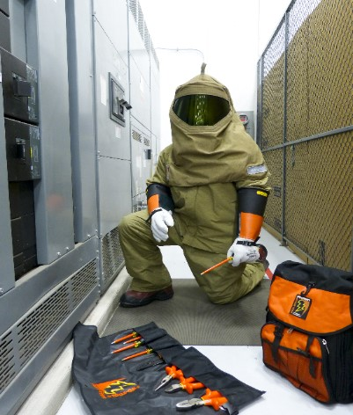
What is PPE?
Protective system for electrical hazards
Designed to protect specific areas of the body
  Head, face, neck, chin
  Eye protection
  Hearing protection
  Body protection
  Hand and arm protection
  Foot and leg protection
Photo Courtesy of Salisbury by Honeywell
Notes:
Please refer to your copy of the NFPA 70E®, Article 130- Work Involving Electrical Hazards, 130.7(C)
Copyright 2018 NFPA 70E All Rights Reserved

Slide 88
Hard Hats 1.1
1910.335(a)(1)(iv)
  Employees shall wear nonconductive head protection whenever there is a danger of head injury from electric shock or burns due to contact with exposed energized parts.

Slide 89
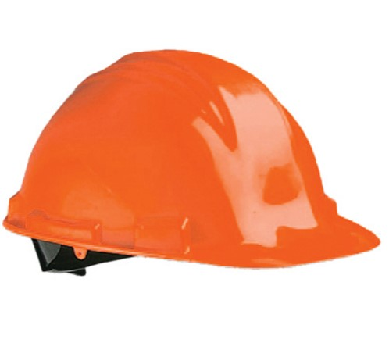
Hard Hats 1.2
Must be:
  Non-metallic
  Meet ANSI Z89.1-2014
  Be either:
    Class G – 2,200 volts
    Class E – 20,000 volts
Photo Courtesy of Salisbury by Honeywell
Notes:
ANSI/ISEA Z89.1-2014, American National Standard for Industrial Head Protection
The ANSI/ISEA Z89.1-2014 standard (the "Standard") provides performance and testing requirements for industrial hard hats. Taking into account the type of hazard a worker may face, the Standard establishes the types and classes of protective helmets to provide employers with hard hat options that provide appropriate protection for the hazards present in their specific workplaces.
ANSI has divided hard hats into three general classifications: Class G (General) is an all-purpose, general helmet that provides good impact and penetration protection, but it offers limited voltage protection (up to 2,200 volts); Class E (Electrical) provides the highest level of protection from high-voltage shock (up to 20,000 volts) and is especially well suited for electrical work; and Class C (Conductive) does not protect against electric conductors.

Slide 90
Inspecting Hard Hats
Shell for cracks and dents
  Stickers and labels cannot cover both inside and outside surfaces
Suspension for cracks and security
Sweatband/headband for flaking or cracking
Press in on sides
  If hardhat does not spring out to original shape, replace it
Notes:
Inspection, Care and Maintenance
The hard hat consists of a shell, a suspension system, and, when applicable, a chin strap. Each component requires frequent inspection and maintenance to ensure its continued ability to protect the worker. Understanding the importance of this information and applying it to safety protocols can help prevent serious injuries and save lives.
Follow these helpful tips for inspection, care, and use:
-Never store a hard hat in direct sunlight.
-Clean the hard hat shell and suspension system with mild soap; rinse with warm water.
-Inspect the shell for any sign of damage or excess wear, perforations, cracking, or deformity of the shell.
-Inspect suspension straps for cuts, frays, damage from chemicals, or any other sign of wear.
-Never drill holes in the shell of a hard hat unless instructed to do so by a manufacturer. This can lessen the impact resistance of the helmet and nullify the Class E or G electrical insulation rating.
-Do not use adhesives, paints, or cleaning solvents on your hard hat unless approved by the manufacturer.
They may damage the shell and lessen the effectiveness of the protection and prevent proper inspection.
-Never place any object under the shell and/or between the suspension and the shell. This will reduce the ability of the entire assembly to properly protect from an impact.
- Do not store close to fluorescent lighting as it disintegrates the plastic.

Slide 91
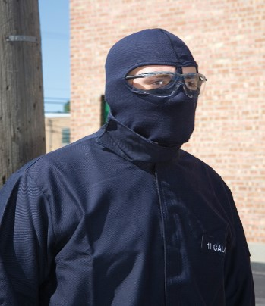
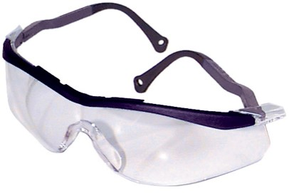
Eye Protection
Refer to OSHA 1910.133 and NFPA 70E® 130.7(C)(4) and Table 130.7(C)(14)
Photos Courtesy of Salisbury by Honeywell
Copyright 2018 NFPA 70E All Rights Reserved
Notes:
Most of the eye and face protection in today’s marketplace has been designed, tested, and manufactured in accordance with specifications provided by the ANSI Z87.1-2010 standard. Manufacturers of arc flash safety glasses protection use a variety of materials, which include acetate polycarbonate, propionate, polyethylene terephthalate glycol (PETG), and steel or nylon mesh. For the best impact and heat-resistant material, look for arc flash safety glasses manufactured from polycarbonate material.
Arc flash safety glasses must meet compliance requirement and deliver in terms of performance, durability, and style. Overall, your safety glasses should offer a level of protective eye shielding that protects the side of the eyes as well as the face.

Slide 92
Hearing Protection
Refer to the NFPA 70E® 130.7(C)(5)
  Hearing Protection
Refer to OSHA 1910.95 occupational noise exposure.
Copyright 2018 NFPA 70E All Rights Reserved

Slide 93
Rubber Insulating Gloves 1.1
Provides shock protection
Where to find information:
  OSHA 29CFR1910.137
    Provides specific design, care, and use requirements for rubber electrical protective equipment. Insulating gloves and sleeves must be rated for the voltage to which a worker will be exposed (phase to ground or phase to phase) and marked to indicate their rating. 1910.137 recognizes Class 0 (up to 1KV) through Class 4 (up to 36KV) rubber equipment.
  ASTM D120 Standard Specifications for Rubber Insulating Gloves
  Manufacturer’s guidelines

Slide 94
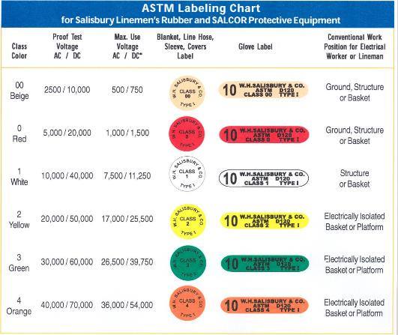
Rubber Insulating Gloves 1.2
Photo Courtesy of Salisbury by Honeywell

Slide 95
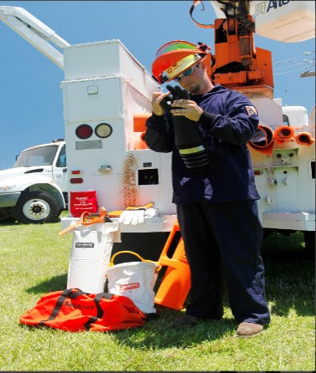
Inspecting Rubber Insulating Gloves 1.1
Use ASTM Standard F1236-96
  Standard Guide For Visual Inspection Of Electrical Protective Rubber Products
Use ASTM Standard F496
  Standard Specification for In-Service Care of Insulating Gloves
Photo Courtesy of Salisbury by Honeywell

Slide 96
Inspecting Rubber Insulating Gloves 1.2
Inspect gloves for:
  Ozone cutting
  Ultra-violet radiation checking
  Punctures
  Cuts
  Abrasions
  Oxidation
  Texture changes such as swelling, softening, hardening, becoming sticky or inelastic
  Imbedded foreign objects
Notes:
Ozone is a highly active form of oxygen occurring naturally in air. It can also be the result of electrical discharge (corona) in air.
Sources of petroleum contamination include:
Greases and oils
Hand lotions
Some baby powders
Petroleum-based hand cleaners
Petroleum distillates
Electrical tape
Almost any fuel

Slide 97
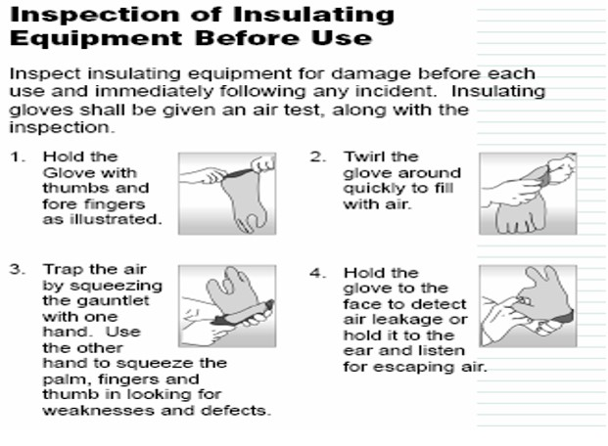
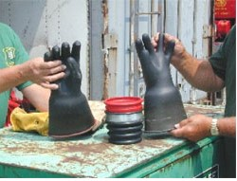
Manual Air Test By Rolling
Photos courtesy of OSHA
Notes:
Testing and Inspection. Gloves and sleeves must be electrically tested before being issued for use. They must also be visually inspected and gloves need to be air tested for any possible defects (for example, cuts, holes, tears, embedded objects, changes in texture) before each day's use and whenever there is a reason to believe they may have been damaged. Best practice is to inspect PPE and air test the gloves and sleeves before each use. [See 1910.137(b)(2)]. Insulating equipment may not be used if any of the following defects are present: holes, tears, punctures or cuts, ozone cutting or ozone checking, embedded foreign objects, texture changes, including swelling, softening, hardening, or becoming sticky or inelastic, and any other defect that damages the insulating properties. [See 1910.137(b)(2)(iii) and ASTM F1236-96, Standard Guide for Visual Inspection of Electrical Protective Rubber Products].
Insulating equipment failing to pass inspection must be removed from service and may not be used by workers.
In addition, the gloves and sleeves must be electrically tested at regular intervals of not more than 6 months for gloves and 12 months for sleeves. (See ASTM F496, Standard Specification for In-Service Care of Insulating Gloves and Sleeves for some appropriate test methods.) When gloves and sleeves are used regularly, best practice is to test as frequently as monthly. [See 1910.137(b)(2)].

Slide 98
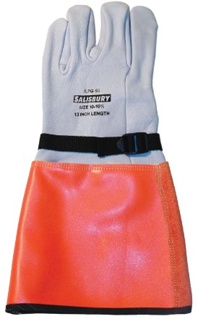

Leather Protectors
Inspect for:
  Tears
  Cuts
  Open seams
  Imbedded objects
  Petroleum product contamination
Photos Courtesy of Salisbury by Honeywell

Slide 99

Glove Liners And Talc
Should not use “off-the-shelf” talcum powder
  May contain contaminants
Use only glove powder or cotton glove liners
  Replace liners when soiled, wet or contaminated
  with any petroleum product
Photo Courtesy of Salisbury by Honeywell

Slide 100
Rubber PPE Storage
Gloves
  Clean, inspect and dry prior to storage
  Store in a relaxed condition
  Store in an appropriate bag or box
  Store cuff down in bags
  Do not roll or bend to store
  Do not store inside out
  Store in cool, dry location. Air conditioned if for longer periods of time
  Don’t store more than one pair of gloves in a bag

Slide 101
Testing Rubber PPE
Refer to Table 130.7(C)(7) Rubber Insulating Equipment, Maximum Test Intervals.
  Line Hose If insulating value is suspect
  Covers If insulating value is suspect
  Blankets Every 12 months *
  Gloves Every 6 months *
  Sleeves Every 12 months *
* Test before first use. If it has been tested, but not issued for service, it must be tested within the 12 months prior to issue
Copyright 2018 NFPA 70E All Rights Reserved

Slide 102
Eye and Face Protection 1.1
1910.335(a)(1)(v)
  Employees must wear protective equipment for the eyes and face if there is a danger of injury to the eyes and face from electric arcs, flashes, or from flying objects resulting from an electrical explosion

Slide 103
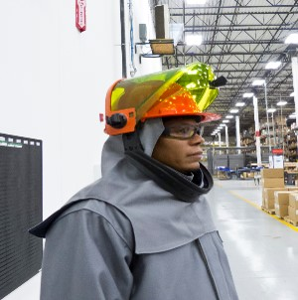
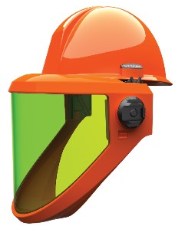
Eye and Face Protection 1.2
Face shields used for arc protection are UV & heat rated
  Don’t use grinding-type
  face shields
  Arc protective face shields
  wrap around the sides and
  below the chin.
    Flash hoods cover the entire
    head
    Prevents inhalation of molten
    arc plasma
Photos Courtesy of Salisbury by Honeywell

Slide 104
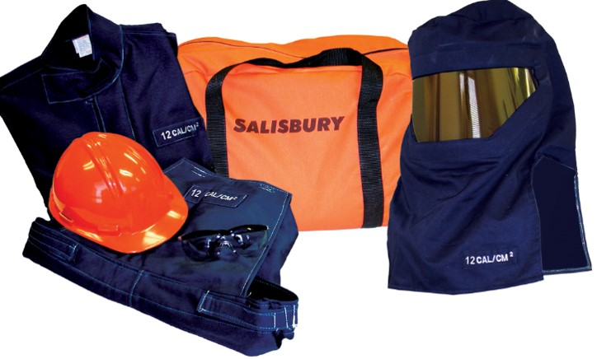
Arc Rated Clothing 1.1
Photo Courtesy of Salisbury by Honeywell

Slide 105
Arc Rated Clothing 1.2
Refer to NFPA 70E® 130.7(C)(6)
  Employees shall wear arc-rated clothing whenever there is a possible exposure to an electric arc flash above the threshold incident energy level for a second degree burn (1.2 calorie/cm²)
Copyright 2018 NFPA 70E All Rights Reserved

Slide 106
Arc Rated Clothing 1.3
Refer to NFPA 70E® 130.7(C)
  (9) Factors in Selection of Protective Clothing
  (10) Arc Flash Protective Equipment
  (11) Clothing Material Characteristics
  (12) Clothing and Other Apparel Not Permitted
  (13) Care and Maintenance of Arc-Rated Clothing and Arc-Rated Arc Flash Suits
  (14) Standards for Personal Protective Equipment (PPE)
    Table 130.7(C)(14)
Copyright 2018 NFPA 70E All Rights Reserved

Slide 107
Insulated Hand Tools 1.1
1910.335(a)(2)
  When working near exposed energized conductors or circuit parts, each employee shall use insulated hand tools or handling equipment if the tools or handling equipment might make contact with such conductors or parts.
Notes:
Please refer to your copy of the NFPA 70E®, Article 130- Work Involving Electrical Hazards, 130.7(D)(1).
Copyright 2018 NFPA 70E All Rights Reserved

Slide 108
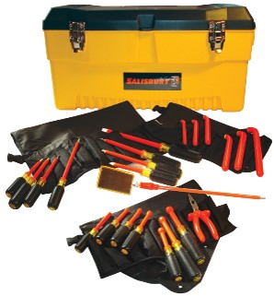
Insulated Hand Tools 1.2
Must meet ASTM F1505
  Standard Specification For Insulated And Insulating Hand Tools
Photo Courtesy Salisbury by Honeywell
Notes:
This specification covers the testing of insulated and insulating hand tools used for working on, or in close proximity to, energized electrical apparatus or conductors operating at maximum voltage of 1000 V ac or 1500 V dc.

Slide 109
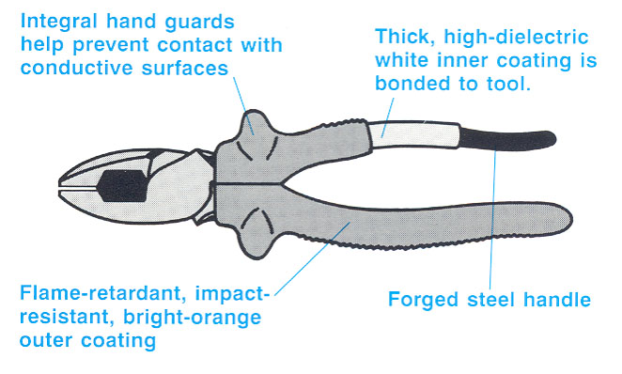
Insulated Hand Tools 1.3
Photo Courtesy of Doug Zemler

Slide 110
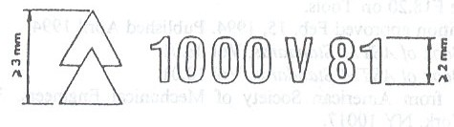
Insulated Hand Tools 1.4
ASTM REQUIRED MARKINGS
Photo courtesy of Doug Zemler

Slide 111
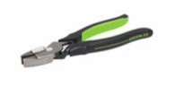
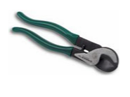
Insulated Hand Tools 1.5
Tools with dipped, plastic handles are not considered to be insulated.
Photos courtesy OSHA

Slide 112
1910.335(b)
Alerting techniques
1910.335 Safeguards for Personnel Protection
  Signs are placed to warn employees about electric
  hazards
  • Barricades shall be used in conjunction with safety signs to limit employee
access. Conductive barricades may not be used where they might cause an electrical contact hazard.
•If signs and barricades cannot provide a level
of safety sufficient to protect employees, an
attendant shall be placed
Notes:
Please refer to your copy of the NFPA 70E®, Article 130- Work Involving Electrical Hazards, 130.7(E)
Copyright 2018 NFPA 70E All Rights Reserved

Slide 113
NFPA 70E®
Standard for Electrical Safety in the Workplace® 1.19
Article 130- Work Involving Electrical Hazards
  General
    Incident Energy Analysis
    Tables
Copyright 2018 NFPA 70E All Rights Reserved
Notes:
Please refer to your copy of the NFPA 70E®, Article 130- Work Involving Electrical Hazards, 130.5(F), Incident Energy Analysis Method calculation, 130.5(G) or the arc flash PPE category method, 130.7(C)(15). Use Tables 130.7(C)(15)(a), 130.7(C)(15)(b), 130.7(C)(15)(c).

Slide 114
NFPA 70E®
Standard for Electrical Safety in the Workplace® 1.20
Article 130- Work Involving Electrical Hazards
  (A) Energized Work
  (B) Energized Work Permit
    When Required
    Elements of Work Permit
    Exemptions
Copyright 2018 NFPA 70E All Rights Reserved
Notes:
Please refer to your copy of the NFPA 70E®, Article 130- Work Involving Electrical Hazards, 130.1(B)

Slide 115
NFPA 70E®
Standard for Electrical Safety in the Workplace®
Electrical Hazard Boundaries
Shock Risk Assessment
  Shock Protection Boundaries
    Table 130.4(D)(a)
Limited Approach Boundary
  130.4(E)
Restricted Approach Boundary
  130.4(F)
Arc Flash Boundary
  130.5(E)
Copyright 2018 NFPA 70E All Rights Reserved

Slide 116
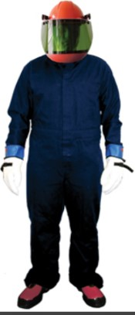
NFPA 70E®
Standard for Electrical Safety in the Workplace® 1.21
Article 130- Work Involving Electrical Hazards
  Table 130.7(C)(15)(c) Personal Protective Equipment
    Arc-Flash PPE Category
Photo Courtesy Salisbury by Honeywell
Copyright 2018 NFPA 70E All Rights Reserved
Notes:
Please refer to your copy of the NFPA 70E®, Article 130- Work Involving Electrical Hazards, 130.1(C)

Slide 117
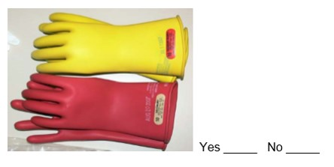
Electrically Rated 1.1?
Photo Courtesy of OSHA
Notes:
yes

Slide 118
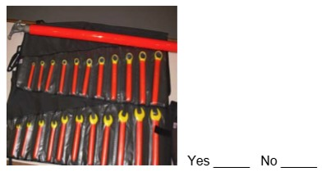
Electrically Rated 1.2?
Photo Courtesy of OSHA
Notes:
yes

Slide 119
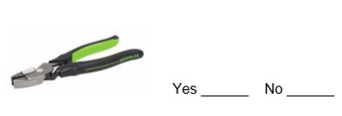
Electrically Rated 1.3?
Photo Courtesy of OSHA
Notes:
no

Slide 120
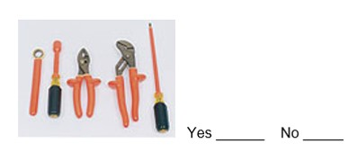
Electrically Rated 1.4?
Photo Courtesy of OSHA
Notes:
yes

Slide 121
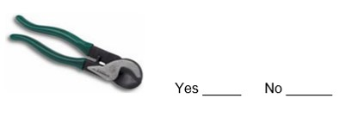
Electrically Rated 1.5?
Photo Courtesy of OSHA
Notes:
no

Slide 122
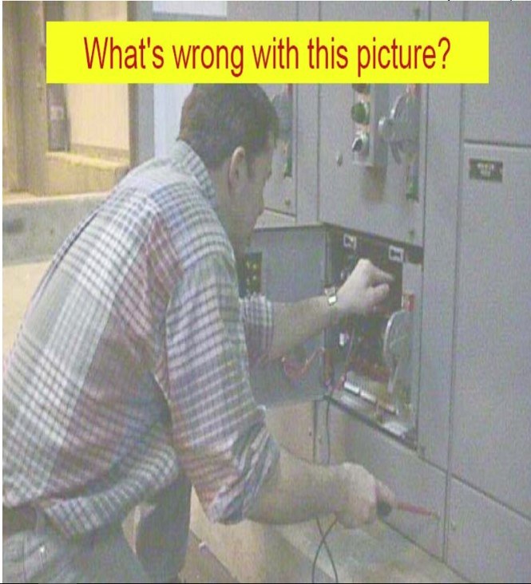
What’s wrong with this picture?
Photo Courtesy of OSHA
Notes:
not wearing proper equipment for safety

Slide 123
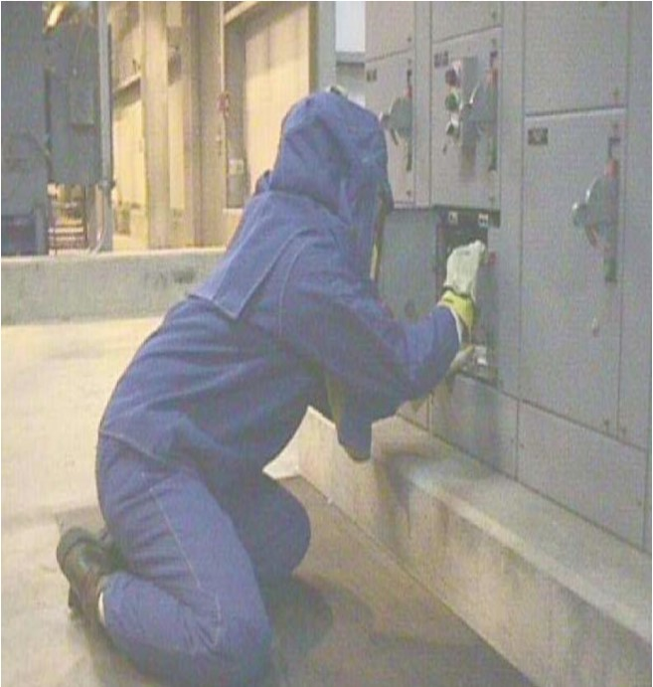
Correct way to verify!
Photo Courtesy of OSHA
Notes:
correct suit

Slide 124
Summarize
OSHA is the “shall”
NFPA 70E® is the “how”
Electrical safety is no joke!
Use these documents in your electrical safety program.

Slide 125
Conclusion
Lesson objectives:
  Understand the regulations contained in OSHA 1910.331-.335, Electrical Safety Related Work Practices.
  Understand and how to use the NFPA 70E®.
  Understand how to choose proper equipment when working with energized circuits.
  Understand how to use PPE.

