Slide 1

Workplace Safety & Health
What everyone needs to know
Provided by:
This material was produced under grant number SH-27673-SH-5 from the Occupational Safety and Health Administration, U.S. Department of Labor. It does not necessarily reflect the views or policies of the U.S. Department of Labor, nor does mention of trade names, commercial products, or organizations imply endorsement by the U.S. Government.

Slide 2
Course Overview
Attendance: Each Trainee must sign in and stay for the entire training
Instructor Introduction
Discussion of 5 main topics
Learning Activity after each topic (Workgroups, Roleplay, Demonstrations)
Questions & Answers
Evaluation
Takeaway’s include: Course Booklet, OSHA Quick Fact Sheets, Completion Certificate

Slide 3
Course Main Topics:
Workplace Violence Prevention
Workplace Safety & Health
Chemical Hazards
Universal Precautions
Reporting

Slide 4

Workplace Violence Prevention
What is Workplace Violence (WPV)
Employers Responsibilities
Worker Rights Under the OSHA Act
Healthcare Workers
Zero Tolerance
What Employers Can Do
Protecting Yourself

Slide 5
What is Workplace Violence?
Workplace violence is any act or threat of physical violence, harassment, intimidation, or other threatening disruptive behavior that occurs at the work site. It ranges from threats and verbal abuse to physical assaults and even homicide. Link to Workplace Violence
Fact sheet: Link to Workplace Violence Fact Sheet
Notes:
**Hand out OSHA fact sheet on Workplace Violence
Workplace violence is violence or the threat of violence against workers. Workplace violence is a growing concern for employers and employees nationwide.
Workplace Harassment and discrimination is a form of workplace violence. Any workplace violence, harassment or discrimination that happens because of reporting a safety or health concern is a violation and should be reported to OSHA.

Slide 6
Employers Responsibilities 1 of 5
Under the OSH law, employers have a responsibility to provide a safe workplace. This is a short summary of key employer responsibilities:
Provide a workplace free from serious recognized hazards and comply with standards, rules and regulations issued under the OSH Act.
Examine workplace conditions to make sure they conform to applicable OSHA standards.
Make sure employees have and use safe tools and equipment and properly maintain this equipment.
Use color codes, posters, labels or signs to warn employees of potential hazards.
Establish or update operating procedures and communicate them so that employees follow safety and health requirements.
Employers must provide safety training in a language and vocabulary workers can understand.
Employers with hazardous chemicals in the workplace must develop and implement a written hazard communication program and train employees on the hazards they are exposed to and proper precautions (and a copy of safety data sheets must be readily available). See the OSHA page on Hazard Communication.

Slide 7
Employers Responsibilities 2 of 5
Provide medical examinations and training when required by OSHA standards
Post, at a prominent location within the workplace, the OSHA poster (or the state-plan equivalent) informing employees of their rights and responsibilities
Report to the nearest OSHA office all work-related fatalities within 8 hours, and all work-related inpatient hospitalizations, all amputations and all losses of an eye within 24 hours. Call our toll-free number: 1-800-321-OSHA (6742); TTY 1-877-889-5627. [Employers under federal OSHA's jurisdiction were required to begin reporting by Jan. 1, 2015. Establishments in a state with a state-run OSHA program should contact their state plan for the implementation date]
Keep records of work-related injuries and illnesses. (Note: Employers with 10 or fewer employees and employers in certain low-hazard industries are exempt from this requirement

Slide 8
Employers Responsibilities 3 of 5
Provide employees, former employees and their representatives access to the Log of Work-Related Injuries and Illnesses (OSHA Form 300). On February 1, and for three months, covered employers must post the summary of the OSHA log of injuries and illnesses (OSHA Form 300A)
Provide access to employee medical records and exposure records to employees or their authorized representatives
Provide to the OSHA compliance officer the names of authorized employee representatives who may be asked to accompany the compliance officer during an inspection
Not discriminate against employees who exercise their rights under the Act. See our "Whistleblower Protection" webpage
Post OSHA citations at or near the work area involved. Each citation must remain posted until the violation has been corrected, or for three working days, whichever is longer. Post abatement verification documents or tags
Correct cited violations by the deadline set in the OSHA citation and submit required abatement verification documentation

Slide 9
Employers Responsibilities 4 of 5
OSHA encourages all employers to adopt an Injury and Illness Prevention Program. Injury and Illness Prevention Programs, known by a variety of names, are universal interventions that can substantially reduce the number and severity of workplace injuries and alleviate the associated financial burdens on U.S. workplaces. Many states have requirements or voluntary guidelines for workplace Injury and Illness Prevention Programs. Also, numerous employers in the United States already manage safety using Injury and Illness Prevention Programs, and we believe that all employers can and should do the same. Most successful Injury and Illness Prevention Programs are based on a common set of key elements. These include: management leadership, worker participation, hazard identification, hazard prevention and control, education and training, and program evaluation and improvement. OSHA’s Injury and Illness Prevention Programs topics page contains more information including examples of programs and systems that have reduced workplace injuries and illnesses.
For more information, refer to the following online publications and resources.
All About OSHA* OSHA Inspections* Top Ten OSHA Standards Cited* OSHA's enforcement page*

Slide 10
Employers Responsibilities 5 of 5
Inform employees about hazards through training, labels, alarms, color-coded systems, chemical information sheets and other methods.
Keep accurate records of work-related injuries and illnesses.
Perform tests in the workplace, such as air sampling required by some OSHA standards.
Provide hearing exams or other medical tests required by OSHA standards.
Post OSHA citations, injury and illness data, and the OSHA poster in the workplace where workers will see them.
Notify OSHA of all work-related fatalities within 8 hours, and all work-related inpatient hospitalizations, all amputations and all losses of an eye within 24 hours. [Employers under federal OSHA's jurisdiction were required to begin reporting by Jan. 1, 2015. Establishments in a state with a state-run OSHA program should contact their state plan for the implementation date].
Not discriminate or retaliate against a worker for using their rights under the law.

Slide 11
What should employers do following an incident of workplace violence?
Encourage employees to report and log all incidents and threats of workplace violence
Provide prompt medical evaluation and treatment after the incident
Report violent incidents to the local police promptly
Inform victims of their legal right to prosecute perpetrators
Discuss the circumstances of the incident with staff members. Encourage employees to share information about ways to avoid similar situations in the future
Offer stress debriefing sessions and posttraumatic counseling services to help workers recover from a violent incident
Investigate all violent incidents and threats, monitor trends in violent incidents by type or circumstance, and institute corrective actions
Discuss changes in the program during regular employee meetings

Slide 12
Worker Rights Under OSHA Act:
You have the right to a safe workplace. The Occupational Safety and Health Act of 1970 (OSH Act) was passed to prevent workers from being killed or seriously harmed at work. The law requires employers to provide their employees with working conditions that are free of known dangers. The Act created the Occupational Safety and Health Administration (OSHA), which sets and enforces protective workplace safety and health standards. OSHA also provides information, training and assistance to workers and employers. Workers may file a complaint to have OSHA inspect their workplace if they believe that their employer is not following OSHA standards or that there are serious hazards.
Know Your Rights
Under federal law, you are entitled to a safe workplace. Your employer must provide a workplace free of known health and safety hazards. If you have concerns, you have the right to speak up about them without fear of retaliation. For more information regarding Employee rights please visit: Link to Workers' Rights

Slide 13
Worker Rights Under OSHA Act:
Workers are entitled to working conditions that do not pose a risk of serious harm. To help assure a safe and healthful workplace, OSHA also provides workers with the right to:
Ask OSHA to inspect their workplace;
Use their rights under the law without retaliation and discrimination;
Receive information and training about hazards, methods to prevent harm, and the OSHA standards that apply to their workplace. The training must be in a language you can understand;
Get copies of test results done to find hazards in the workplace;
Review records of work-related injuries and illnesses;
Get copies of their medical records

Slide 14
Workers’ Rights under the OSHA Act:
Employees have the right to file a complaint if punished or discriminated against for acting as a “whistleblower”
A whistleblower is an employee who reports something that is wrong or dishonest at work. Employees have the right to file a complaint.
Notes:
under the additional 20 federal statutes for which OSHA has jurisdiction. OSHA strives to make sure that every worker in the nation goes home unharmed at the end of the work- day, the most important right of all.

Slide 15
Healthcare Settings at Risk:
Hospital settings represent large institutional medical facilities;
Residential Treatment settings include institutional facilities such as nursing homes, and other long-term care facilities;
Non-residential Treatment/Service settings include small neighborhood clinics and mental health centers;
Community Care settings include community-based residential facilities and group homes; and
Field work settings include home healthcare workers or social workers who make home visits.
Link to Workplace Violance in Healthcare

Slide 16
Healthcare Worker Risk Factors
Working directly with people who have a history of violence, abuse drugs or alcohol, gang members, and relatives of patients or clients;
Transporting patients and clients;
Working alone or poor environmental design of the workplace that may block employees’ vision or interfere with their escape from a violent incident;
Poorly lit corridors, rooms, parking lots and other areas;
Lack of means of emergency communication;
Prevalence of firearms, knives and other weapons among patients and their families and friends; and
Working in neighborhoods with high crime rates.

Slide 17
Risks Prevention examples for Healthcare & Social Service Workers:
State clearly to patients, clients and employees that violence is not permitted or tolerated
Institute a sign-in procedure with passes for visitors, especially in a newborn nursery or pediatric department
Enforce visitor hours and procedures
Establish a list of “restricted visitors” for patients with a history of violence or gang activity. Make copies available at security checkpoints, nurses’ stations and visitor sign-in areas
Review and revise visitor check systems, when necessary
For more information visit the website: Link to Guidelines for Preventing Workplace Violence for Healthcare and Social Service Workers (or)
Link not working
DOL Blog: Link not working
Notes:
Handout Healthcare and Social Service Workers Risk Sheet

Slide 18

Zero Tolerance:
Samples Include:
Discrimination
Physical Harassment
Verbal Harassment
Sexual Harassment
Bullying
Misappropriation of Property
Retaliation
Zero tolerance poster:
Link not working
Notes:
Hand out OSHA Poster on ZERO Tolerance

Slide 19
What Employers Can Do:
Zero Tolerance Policy
Workplace Violence Prevention Program
Establish an employee handbook that lists operating procedures that all claims of workplace violence will be investigated and remedied promptly.
Every complaint should be taken seriously
Notes:
The best protection employers can offer is to establish a zero-tolerance policy toward workplace violence against or by their employees. The employer should establish a workplace violence prevention program or incorporate the information into an existing accident prevention program, employee handbook, or manual of standard operating procedures. It is critical to ensure that all employees know the policy and understand that all claims of workplace violence will be investigated and remedied promptly. Every complaint should be taken seriously.

Slide 20
Protecting Yourself:
Immediately report issues
Recognize violent situations
Alert supervisor
Report incidents in writing
In case of immediate danger to yourself or others, or if you are a potential target of physical violence, call 911 for emergency assistance
Notes:
Nothing can guarantee that an employee will not become a victim of workplace violence. These steps, however, can help reduce the odds:
Immediately report violent, threatening, intimidating, harassing or other disruptive behavior observed or experienced by anyone at a work location to a supervisor or manager
Learn how to recognize, avoid, or diffuse potentially violent situations by attending personal safety training programs.
Alert supervisors to any concerns about safety including poor lighting or security issues
Report all incidents immediately in writing

Slide 21
What to do if there is a Dangerous Situation at Work
If you believe working conditions are unsafe or unhealthful, we recommend that you bring the conditions to your employer's attention, if possible.
You may file a complaint with OSHA concerning a hazardous working condition at any time. However, you should not leave the worksite merely because you have filed a complaint. If the condition clearly presents a risk of death or serious physical harm, there is not sufficient time for OSHA to inspect, and, where possible, you have brought the condition to the attention of your employer, you may have a legal right to refuse to work in a situation in which you would be exposed to the hazard.

Slide 22
Activity 1: Class Discussion
Workplace Violence Prevention
What is workplace violence?
What are employers responsibilities?
What are workers rights?
What are some samples of WPV?
How can you protect yourself?

Slide 23

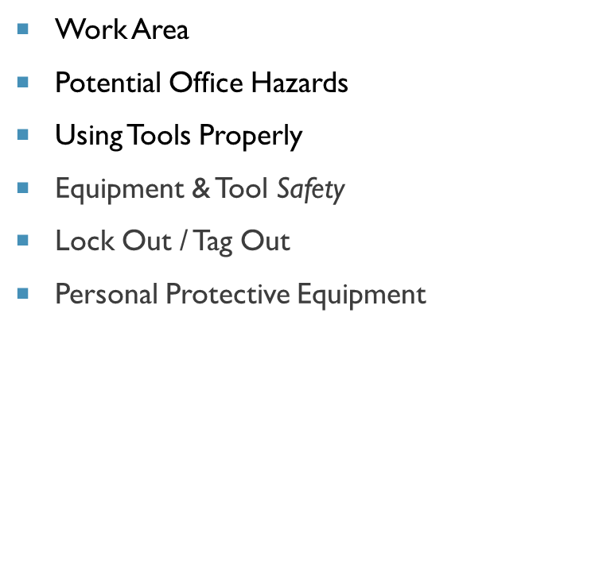
Workplace Safety & Health
Workplace Safety Defined
OSHA Law
OSHA Link for Healthcare Workers
OSHA Links for Construction
Machine Guarding
Young Worker Hazards
Ergonomics / Proper Body Mechanics
Be Good to Your Back
Safe Lifting
Regulation for Noise

Slide 24

Workplace Safety Defined:
Workplace safety is the practice of an employer using preventative measures to prevent incidents that may impact employees, customer’s and visitor’s health and personal safety. This practice includes creating plans and procedures for employees and supervisors in the workplace.
Notes:
Occupational Safety and Health Act of 1970 “To assure safe and healthful working conditions for working men and women; by authorizing enforcement of the standards developed under the Act; by assisting and encouraging the States in their efforts to assure safe and healthful working conditions; by providing for research, information, education, and training in the field of occupational safety and health...”

Slide 25
It's the Law:
Safety First!
This poster should be visible within your company.
Poster:
Link to Job Safety and Health. It's the Law poster
Notes:
Hand out Job and Health OSHA Poster

Slide 26

OSHA Link for Healthcare Workers
Link to Occupational Hazards in Long Term Care Nursing Home eTool

Slide 27

OSHA Links for Construction
link to Preventing Fatalities

Slide 28

Machine Guarding:
OSHA's regulations for machine guarding are fairly generic -- however, they are wide reaching.
Employers must train employees on machine guarding. If you’re asked to use a machine you MUST be trained
Young worker hazards:
Link to Young Workers Hazards

Slide 29

Machine Guarding continued
Machine Guarding, employers must train employees on proper machine guarding. Each machine has a unique guard and the operator must be trained on how to use each machine.
Link to Machine Guarding eTool

Slide 30
Ergonomics: Applies to Sitting Standing & Repetitive Movement
Adapting the environment to the employee verses adapting the employee to the environment!
Any repetitive movement or standing or sitting for long periods of time can cause strain to your muscles, bones and joints
Stretching, walking, proper equipment can aide in reducing carpel tunnel syndrome, back pains and other injuries
Notes:
Give stretching and movement examples!
Any repetitive movement or sitting for long periods of time can cause strain to your muscles, bones and joints.
Stretching, walking, proper equipment can aide in reducing carpel tunnel syndrome, back pains and other injuries.

Slide 31
Proper Body Mechanics:
Reduce repetitive movements
Stretch legs, arms, wrists and feet on occasion
Occasionally look away from computer screen
Stand on occasion for long phone calls or webinars
Thighs and hips are supported by a well-padded seat and generally parallel to the floor
Knees are about the same height as the hips with the feet slightly forward

Slide 32

Be good to your Back:
While at Your Desk:
Put a cushion in your chair to support your lower back if your chair has no lumbar support. A rolled towel will work
Put your elbow on your desk or chair arm rest
Use a reading support, to avoid slouching
Wear good quality rubber-soled shoes
Don’t twist your body in your chair to reach for a file or piece of equipment
Don’t hold a telephone receiver between your shoulder and cheek
Don’t overstretch to reach for a file

Slide 33
Be Good to Your Back:
When Lifting and Walking With Objects:
Hold the object you are lifting close to your body. Let go if you start to drop it
Don’t bend, twist or pivot at your waist
Don’t lift a heavy object above your chest
Don’t use a jerking action when lifting
Don’t lean forward with a weight in your hands
Don’t lift items that are too heavy for you, know your limitations
Seek assistance

Slide 34
Points to Emphasize when lifting
Points to Emphasize when lifting
First assess what you need to lift and where you’re taking it, consider the weight of the object to be lifted before attempting to lift.
Pre-lift the object, if it is stressing the muscles with that weight don’t carry it
You need to "think" about where you are going with the object before bending to pick it up
Bend the knees to lift – don’t stoop
Keep your back straight by looking slightly upward
Lift with the strong leg muscles, not the weaker back muscles
Get help if needed
Proper methods of lifting and handling protect against injury
Proper lifting makes work easier
Over time, safe lifting technique should become a habit
Under NIOSH, keep maximum weight of 50 lb. this is in ideal circumstances without lifting, walking or twisting
For Healthcare workers this would be 35 lbs. for patient safe lifting techniques.
Notes:
First assess what you need to lift and where you’re taking it
You need to "think" about where you are going with the object before bending to pick it up
Bend to lift an object - don't stoop
Keep your back straight by looking slightly upward
Lift with the strong leg muscles, not the weaker back muscles
Get help if needed
Proper methods of lifting and handling protect against injury
Proper lifting makes work easier
Over time, safe lifting technique should become a habit
Under NIOSH, keep maximum weight of 50 lb. this is in ideal circumstances without lifting, walking or twisting

Slide 35
Regulation for Noise:
OSHA sets legal limits on noise exposure in the workplace. These limits are based on a worker's time weighted average over an 8 hour day. With noise, OSHA's permissible exposure limit (PEL) is 90 dBA for all workers for an 8 hour day.
OSHA 1910.95(a) Protection against the effects of noise exposure shall be provided when the sound levels exceed those shown in Table G-16 when measured on the A scale of a standard sound level meter at slow response.
OSHA sets legal limits on noise exposure in the workplace..
Notes:
These limits are based on a worker's time weighted average over an 8 hour day. With noise, OSHA's permissible exposure limit (PEL) is 90 dBA for all workers for an 8 hour day
Protection against the effects of noise exposure shall be provided when the sound levels exceed those shown in Table G-16 when measured on the A scale of a standard sound level meter at slow response.

Slide 36
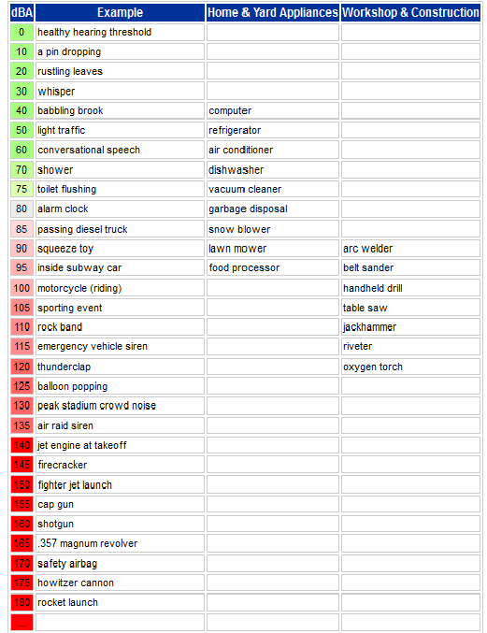
Noise Level Comparison:
Link to Noise Level Chart

Slide 37
Work Area:
Keeping our workplace clean and neat is a big contribution that everyone can make towards creating a safe and healthy work place. Housekeeping not only improves the appearance of a workplace, it also helps prevent injuries.
Notes:
Housekeeping not only improves the appearance of a workplace, it also helps prevent injuries.

Slide 38
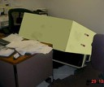
Potential Office Hazards:
Passageways and Storage:
Blockages - Keep doorways and passageways clear at all times, especially emergency exits. Make sure that any area where people walk up and down is at least 3 feet wide. DO NOT block access to fire extinguishers, fire hydrants or fire alarms
Climbing - Reaching for high objects while standing on a stack of boxes or a chair with wheels is dangerous. Always use a suitable ladder or step stool
Heavy Objects - These are dangerous if they fall. Store heavy objects near floor level
Notes:
Blockages - Large objects or groups of people standing around blocking doorways and passageways increase the likelihood of bumps and knocks, because vision is blocked and space is tight. Keep doorways and passageways clear at all times, especially emergency exits. Make sure that any area where people walk up and down is at least 3 feet wide. DO NOT block access to fire extinguishers, fire hydrants or fire alarms
Climbing - Reaching for high objects while standing on a stack of boxes or a chair with wheels is dangerous. Always use a suitable ladder or step stool
Heavy Objects - These are dangerous if they fall. Store heavy objects near floor level

Slide 39
Potential Office Hazards:
Passageways and Storage:
Toxic Chemicals - Do not store toxic chemicals in or near the office
Swing Doors and Corners - You can't guess when someone might be approaching the other side of a closed door or around a corner. Do not open doors suddenly. When working behind a closed door, lock it. Approach corners and doors cautiously
Running – Don’t Run running has no place in the office its better to arrive late than be injured
Notes:
Toxic Chemicals - Do not store toxic chemicals in or near the office
Swing Doors and Corners - You can't guess when someone might be approaching the other side of a closed door or around a corner. Do not open doors suddenly. When working behind a closed door, lock it. Approach corners and doors cautiously
Running – Don’t Run running has no place in the office its better to arrive late than be injured

Slide 40
Using Tools Properly:
Damaged tools are NOT proper tools and should be reported. Fingers are not suitable tools for jobs such as removing staples. Use the right tools for the job
Use Safety Glasses with hand tools - Eyesight is precious. Always wear safety glasses when working with hand tools
Proceed with caution when using Sharp and Pointed Objects Use and store sharp objects carefully.
Proceed with caution when using box cutters
Notes:
Damaged tools are NOT proper tools and should be reported. Fingers are not suitable tools for jobs such as removing staples. Use the right tools for the job
Use Safety Glasses with hand tools - Eyesight is precious. Always wear safety glasses when working with hand tools
Proceed with caution when using Sharp and Pointed Objects - Even paper has sharp edges, as many office workers know from experience. Scissors, knives, pencils, letter openers and paper cutters are some other common sharp objects in the office. Use and store sharp objects carefully. Sheath them before storing in a drawer. Point them away from you on your desk. Proceed with caution when using box cutters

Slide 41
Electrical Equipment & Tool Safety:
Use tools correctly
Electrical equipment (including Power-strips)must be checked by maintenance.
Do NOT run EXTENSION CORDS across hallways, doorways or floor.
ANY electrical equipment must be UL approved
Notes:
Using tools incorrectly can be hazardous, and it can be dangerous to use tools that are not properly maintained
Electrical equipment must be checked by maintenance. When using electrical tools, we should watch out for any obvious signs that something is wrong, such as loose wires, faulty connections, excessive heat, smoke or sparks. Report damaged tools to your maintenance department
Do NOT run EXTENSION CORDS across hallways, doorways or floor. Best to have maintenance secure an electric cord
Power Strips should be checked and approved by maintenance
ANY electrical equipment must be UL approved by maintenance, this includes:
Microwaves
Coffee Makers
Lamps
Heaters
ALL other electrical equipment

Slide 42
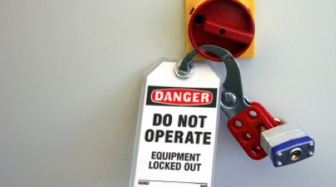
When to Lockout / Tagout:
Lockout / Tagout is required by OSHA for any maintenance or servicing operation when:
An employee is required to remove or bypass a guard or other safety device; or
An employee is required to place any part of his or her body into an area on a machine
Notes:
Lockout and Tagout is required by OSHA for any maintenance or servicing operation when:
An employee is required to remove or bypass a guard or other safety device; or
An employee is required to place any part of his or her body into an area on a machine or piece of equipment where work is actually performed upon the material being processed (point of operation) or where an associated danger zone exists during a machine operating cycle.

Slide 43
Lock Out Tag Out:
Employers Must Develop a Lockout / Tagout Program
Link to Lockout/Tagout Interactive Training Program
OSHA Fact Sheet on LOTO:
Link to Lockout-Tagout OSHA Fact Sheet
Notes:
**Handout OSHA Fact Sheet on Lockout / Tagout
What do employees need to know?
Employees need to be trained to ensure that they know, understand, and follow the applicable provisions of the hazardous energy control procedures. The training must cover at least three areas: aspects of the employer’s energy control program; elements of the energy control procedure relevant to the employee’s duties or assignment; and the various requirements of the OSHA standards related to lockout/tagout.
What must employers do to protect employees?
The standards establish requirements that employers must follow when employees are exposed to hazardous energy while servicing and maintaining equipment and machinery. Some of the most critical requirements from these standards are listed OSHA Fact Sheet:

Slide 44
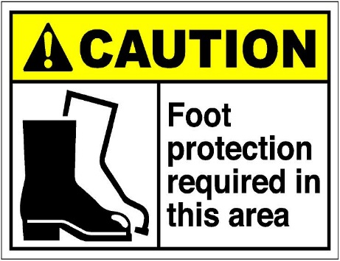
Personal Protective Equipment:
Employers must protect their employees while on the job. Part of this protections includes providing them with personal protective equipment. Below are types of PPE.
Eye protection -- Safety glasses, goggles, or face shields
Head protection -- Hard Hats
Ear protection -- ear plugs
Foot protection – safety shoes
Hand protection -- gloves
Arc Flash protection -- arc flash suits
Healthcare providers will be provided with gloves, face masks, gowns and other coverage that protects them from diseases
Notes:
When working with machinery in a manufacturing facility, Personal Protective Equipment (PPE) refers to protective clothing, hard hats, goggles, or other gear designed to protect the wearer's body from injury by workplace hazards (such as electrical and mechanical hazards). Examples of PPE include:

Slide 45
Activity 2: Demonstrations
Workplace Safety & Health
Have trainees answer and / or demonstrate the following:
What is Workplace Safety?
Properly put on a helmet / hard hat / ear plugs / safety glasses / and gloves
Properly sit in a chair
Properly lift a box to show proper body mechanics
Explain lock out tag out and why would you use it?

Slide 46

Chemical Hazards
Did you Know
Ways Chemicals Enter Your Body
Toxic Exposure
PH Levels
Guide to Global Harmonized System
Right to Know
Safety Data Sheets
Quick Cards
HCS Pictograms

Slide 47
Did you know:
Many traditional cleaning products, floor strippers and disinfectants are a source for human health and environmental problems. Cleaning products may contain chemicals that cause cancer, reproductive disorders, respiratory ailments (including occupational asthma), eye and skin irritation, central nervous system impairment and other human health effects.

Slide 48
There are four basic ways that chemicals can enter your body:
Direct contact—on the skin or eyes
Absorption—through the skin
Ingestion—through the mouth with food
Inhalation—through the lungs

Slide 49
Toxic Exposure:
There are two different types of effects that result from toxic exposure. They are acute and chronic. “Acute” means that health effects are felt at the time of exposure or shortly after, or result from a short-term, highly concentrated exposure. “Chronic” is a word that means the ill effects will not be seen for some time after exposure.

Slide 50
PH Levels:
The pH of a chemical tells you if the chemical is an acid, a base (also called alkali or caustic), or neutral. Chemicals with lower or higher pH should only be stored with chemicals of like pH and never with their opposite or a neutral chemical.

Slide 51
Guide to Global Harmonized System (GHS)
What is the GHS?
The Globally Harmonized System (GHS) is an international approach to chemical labels and safety data sheets (SDS). OSHA’s Hazard Communication standard has adopted the GHS to improve safety and health of workers through more effective communications on chemical hazards. The GHS is a system for standardizing and harmonizing the classification and labeling of chemicals. It is a logical and comprehensive approach to:
Defining health, physical and environmental hazards of chemicals;
Creating classification processes that use available data on chemicals for comparison with the defined hazard criteria; an
And Communicating hazard information, as well as protective measures, on labels and Safety Data Sheets (SDS) and Pictograms.
Full GHS Guide:
Link to Guide to Globally Harmonized System

Slide 52
Physical States
In developing GHS criteria for physical hazards it was necessary to define physical states. In the GHS, physical states can be in forms of gas, liquid or solid.

Slide 53
Types of Hazards
Physical
Chemical
Environmental

Slide 54
Environmental Hazards
Hazardous to the Aquatic Environment
  Acute aquatic toxicity
  Chronic aquatic toxicity
    Bioaccumulation potential (Hazardous Buildup)
    Rapid degradability

Slide 55

Right to Know:
Employees have both a need and a right to know the hazards and identities of the chemicals they are exposed to when working.
Supervisors should recommend additional safety training according to job description such as: Global Harmonization Standards training
Click for Hazard Communications Quick Cards
Notes:
OSHA's Hazard Communication Standard (HCS) is based on a simple concept -- that employees have both a need and a right to know the hazards and identities of the chemicals they are exposed to when working. They also need to know what protective measures are available to prevent adverse effects from occurring. OSHA designed the HCS to provide employees with the information they need to know. Personal Protective Equipment must be furnished for employees using hazardous materials.
Supervisors should recommend additional safety training according to job description such as: Global Harmonization Standards training

Slide 56
Safety Data Sheets:
A Safety Data Sheet (SDS) contains information on the potential hazards (health, fire, reactivity and environmental) and how to work safely with the chemical product.
Quick card: Link to OSHA Quick Card on Hazard Communication Safety Data Sheets
Notes:
Hand out: Hazard Communication SDS Quick Card
A Safety Data Sheet (SDS), formally known as Material Safety Data Sheet (MSDS) is a document that contains information on the potential hazards (health, fire, reactivity and environmental) and how to work safely with the chemical product. It is an essential starting point for the development of a complete health and safety program. It also contains information on the use, storage, handling and emergency procedures all related to the hazards of the material

Slide 57
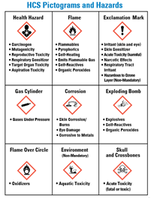
HCS Pictograms:
OSHA has updated the requirements for labeling of hazardous chemicals. As of June 1, 2015, all labels will be required to have pictograms, a single word, hazard and protective statements, the product identifier, and supplier identification.
Please note: Employers must train employees on the new label elements and safety data sheet (SDS) format, including pictogram.
As of December 1, 2013, all workers should have been trained under the revised Hazard Communication Standard (HCS).
Quick card: Link to HCS Pictograms and Hazards
Link to OSHA Brief on Hazard Communication Standard: Labels and Pictograms
Notes:
Hand out quick cards: Hazard Communications Standard Label's, Pictogram

Slide 58
Activity 3: Name That Pictogram
Chemical Hazards

Slide 59



Health hazard/toxicity

Slide 60



Flame/Flammables

Slide 61



Exclamation Mark/Irritant

Slide 62



Gas Cylinder/Gases Under Pressure

Slide 63



Corrosion/burns

Slide 64



Exploding Bomb/Explosives

Slide 65



Flame over circle

Slide 66



Environment/aquatic toxicity

Slide 67


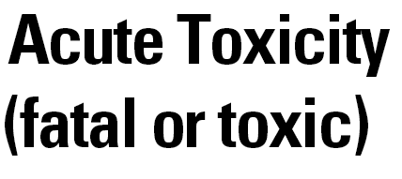
Skull and crossbones/acute toxicity

Slide 68

Universal Precautions
Healthcare Worker Hazards
Bloodborne Pathogens (e.g.: Ebola)
Universal Precautions
Effective Hand Washing Techniques

Slide 69
Healthcare Worker Hazards
Healthcare workers face a number of serious safety and health hazards. They include bloodborne pathogens and biological hazards, potential chemical and drug exposures, waste anesthetic gas exposures, respiratory hazards, ergonomic hazards from lifting and repetitive tasks, laser hazards, workplace violence, hazards associated with laboratories, and radioactive material and x-ray hazards. Some of the potential chemical exposures include formaldehyde, used for preservation of specimens for pathology; ethylene oxide, glutaraldehyde, and paracetic acid used for sterilization; and numerous other chemicals used in healthcare laboratories.
Link to Healthcare

Slide 70
Bloodborne Pathogens:
Blood and other body fluids (i.e., semen, vaginal fluids, saliva, urine, feces, vomit) can contain viruses and bacteria that can be passed on to another person through direct contact..
Universal Precautions are actions that you take to place a barrier between yourself and potentially infected body fluids. Remember everyone is presumed to be infected.
Notes:
Hepatitis B & C and HIV are diseases that can be transferred from one person to another through contact with infected blood and/or body fluids. Since there is no way to know without testing if a person has hepatitis B or C or HIV, it is recommended that you treat all body fluids as though they were infected.
Universal Precautions are actions that you take to place a barrier between yourself and potentially infected body fluids. Remember everyone is presumed to be infected

Slide 71
How are blood and body fluids passed from one person to another?
How are blood and body fluids passed from one person to another?
Vomit
All bodily fluids
Open areas
Through open areas on the skin
By splashing in the eye
Through the mouth
Injury with contaminated needles or other sharps
Prenatally (mother to baby) and during delivery
Insect bites
OSHA fact sheet: Link to OSHA Fact Sheet on OSHA's Bloodborne Pathogens Standard

Slide 72
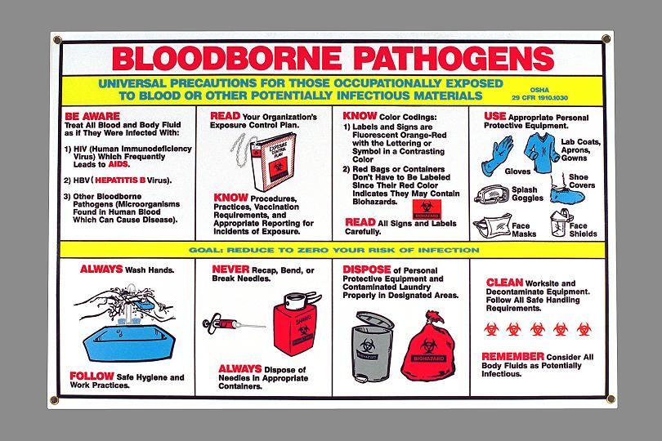
Bloodborne pathogens fact sheet
OSHA Fact Sheet: https://www.osha.gov/OshDoc/data_BloodborneFacts/bbfact01.pdf
Notes:
Hand out OSHA Bloodborne Pathogens Fact Sheet

Slide 73
Universal Precautions
Universal precautions is an approach to infection control to treat all human blood and certain human body fluids as if they were known to be infectious for HIV, HBV and other Bloodborne pathogens, Bloodborne Pathogen Standard requires:
Treat all blood and other potentially infectious materials with appropriate precautions such as wearing gloves, masks, and gowns.
Notes:
Universal precautions is an approach to infection control to for HIV, HBV and other Bloodborne pathogens, Bloodborne Pathogen Standard requires:
Employees to observe Universal Precautions to prevent contact with blood or other potentially infectious materials (OPIM).
Under circumstances in which differentiation between body fluid types is difficult or impossible, all body fluids shall be considered potentially infectious materials.
Treat all blood and other potentially infectious materials with appropriate precautions such as: Use gloves, masks, and gowns if blood or OPIM exposure is anticipated

Slide 74
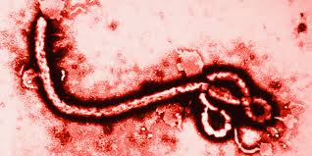
Safety and Health on Ebola:
Additional personal protective equipment need to be worn when caring for patients diagnosed with Ebola, including; PPE’s for the eyes, face, head, and extremities, protective clothing, respiratory devices, and protective shields and barriers.
Click for information on Ebola
Notes:
Additional personal protective equipment need to be worn when caring for patients diagnosed with Ebola, including; PPE’s for the eyes, face, head, and extremities, protective clothing, respiratory devices, and protective shields and barriers.

Slide 75
Assisting the Employee:
Cover opened areas to protect yourself and others from Bloodborne pathogens
Wear gloves and other personal protective equipment when helping someone in need
Fact sheet: ttps://www.osha.gov/OshDoc/data_BloodborneFacts/bbfact01.pdf
Notes:
Bloodborne Pathogen Exposure Incidents OSHA’s Bloodborne Pathogens standard (29 CFR 1910.1030) requires employers to make immediate confidential medical evaluation and follow-up available for workers who have an exposure incident, such as a needle-stick. An exposure incident is a specific eye, mouth, other mucous membrane, non-intact skin, or parenteral contact with blood or other potentially infectious materials (OPIM), as defined in the standard that results from the performance of a worker’s duties.

Slide 76
Cleaning the Area:
Wear personal protective equipment (gloves, gowns)
Wash and disinfect the area as recommended by company policy and remember to consult the container label or SDS for differences in recommendations due to product strength
Use disposable cleaning materials if possible
Dispose of cleaning materials and gloves in a sealed red plastic bag
Wash hands with soap and running water (disinfectant waterless hand cleaners or “towelettes” may be used if soap and running water are not available) Follow effective hand washing techniques
Notes:
Wear protective gloves and other protective equipment, goggles, gowns etc.
Wash the area with soap and water, and dry the area. Disinfect as recommended by company policy and remember to consult the container label or SDS for differences in recommendations due to product strength
Use disposable cleaning materials if possible, such as paper towels instead of cloth
Dispose of cleaning materials and gloves in a sealed red plastic bag
Wash hands with soap and running water (disinfectant waterless hand cleaners or “towelettes” may be used if soap and running water are not available)
Follow effective hand washing techniques, remember to wash for at least 20 seconds

Slide 77
Cough and Sneezing:
Use a tissue to cover your mouth and nose
If you don’t have a tissue, sneeze or cough into your arm

Slide 78

Effective Hand washing Techniques:
Use warm running water and soap
Rub hands together for at least 20 seconds paying particular attention to under the fingernails and between fingers
Rinse hands with warm running water
Dry hands with paper towel, turn faucets off with paper towel, and then discard into the proper receptacle. When possible use dryer
Effective hand washing is the first line of defense in spreading germs

Slide 79
Activity 4: Proper Hand Washing Demonstration
Universal Precaution
Have a volunteer or appointed trainee demonstrate proper hand washing techniques, see if the employer has a sink or restroom close by.

Slide 80

Reporting
Link to New Reporting Requirements
Reporting
Filing a Complaint / Reporting Safety Concerns
Where to go for Assistance
Whistleblower Protection
Retaliation
Remember: Know Your Rights
Under federal law, you are entitled to a safe workplace. Your employer must provide a workplace free of known health and safety hazards. If you have concerns, you have the right to speak up about them without fear of retaliation. For more information regarding Employee rights please visit: Link to Workers' Rights

Slide 81
Reporting :
Remember to report incidents to your supervisor even if there are no injuries, better to be proactive than reactive
Unreported Injuries - Reporting injuries reduces the chances of the same injury happening to someone else in the future. Report incidents to help make the company safer for others
Report injury and illness, 300 300A Log
Link to OSHA.gov
Report all incident(s) before they become injuries
Notes:
Hand out 300 & 300A LogRemember to report incidents to your supervisor even if there are no injuries, better to be proactive than reactive
Unreported Injuries - Reporting injuries reduces the chances of the same injury happening to someone else in the future. Report incidents to help make the company safer for others
Report injury and illness, 300 300A Log
www.osha.gov

Slide 82
Reporting an Incidents:
In case of immediate danger to yourself or others, or if you are a potential target of physical violence, call 911 for emergency assistance.
Notes:
It’s best to report violent acts, remember workplace violence ranges from verbal threats to homicide and should never be taken lightly, verbal threats often escalate to a physical confrontation
In case of immediate danger to yourself or others, or if you are a potential target of physical violence, call 911 for emergency assistance

Slide 83
Filing a Complaint / Reporting Safety & Health Concerns:
It’s important to report workplace safety and health concern so that appropriate measures can be taken to prevent injuries.
Notify your supervisor of any unsafe behavior, equipment plant or grounds.
Notes:
Go over 300 and 300A log
It’s important to report workplace safety and health concern so that appropriate measures can be taken to prevent injuries.
Notify your supervisor of any unsafe behavior, equipment plant or grounds.

Slide 84
As of January 1, 2015, all employers must report
All work-related fatalities within 8 hours
All work-related inpatient hospitalizations, all amputations and all losses of an eye within 24 hours
You can report to OSHA by
Calling OSHA's free and confidential number at 1-800-321-OSHA (6742)
Calling your closest Area Office during normal business hours
Using the new online form that will soon be available
Employers under Federal OSHA's jurisdiction must begin reporting by January 1

Slide 85
Time Constraints for Filing a Complaint
Section 11(c) of the OSH Act prohibits employers from discriminating against their employees for exercising their rights under the OSH Act. These rights include filing an OSHA complaint, participating in an inspection or talking to an inspector, seeking access to employer exposure and injury records, reporting an injury, and raising a safety or health complaint with the employer. If workers have been retaliated or discriminated against for exercising their rights, they must file a complaint with OSHA within 30 days of the alleged adverse action.
Since passage of the OSH Act in 1970, Congress has expanded OSHA's whistleblower authority to protect workers from discrimination under twenty-two federal standards . Complaints must be reported to OSHA within set timeframes following the discriminatory action, as prescribed by each law.
These standards , and the number of days employees have to file a complaint, are: Link not working

Slide 86
Where to go for Assistance:
In case of immediate danger to yourself or others, or if you are a potential target of physical violence, call 911 for emergency assistance
Internal Reporting:
Report Incidents to your immediate supervisor or Human Resources
Report assaults and security issues to the police
External Reporting:
To file a complaint about workplace safety and health hazards in the workplace Phone: toll-free at (800) 321-OSHA (6742)
The tele-typewriter (TTY) number is (877) 889-5627
Link to OSHA.gov

Slide 87
Whistleblower Protection:
Your Rights as a Whistleblower You may file a complaint with OSHA if your employer retaliates against you by taking unfavorable personnel action because you engaged in protected activity relating to workplace safety or health, asbestos in schools, cargo containers, airline, commercial motor carrier, consumer product, environmental, financial reform, food safety, health insurance reform, motor vehicle safety, nuclear, pipeline, public transportation agency, railroad, maritime, motor vehicle safety, and securities standards .
Visit website at: Link to OSHA.gov
Link to Whistleblower Protection Program
Fact Sheet: Link to OSHA Fact Sheet on Your Rights as a Whistleblower
Notes:
Hand out OSHA Fact Sheet “Your Rights as a Whistleblower
You may file a complaint with OSHA if your employer retaliates against you by taking unfavorable personnel action because you engaged in protected activity relating to workplace safety or health, asbestos in schools, cargo containers, airline, commercial motor carrier, consumer product, environmental, financial reform, food safety, health insurance reform, motor vehicle safety, nuclear, pipeline, public transportation agency, railroad, maritime, motor vehicle safety, and securities standards .
Section 11(c) of the OSH Act prohibits employers from discriminating against their employees for exercising their rights under the OSH Act. These rights include filing an OSHA complaint, participating in an inspection or talking to an inspector, seeking access to employer exposure and injury records, reporting an injury, and raising a safety or health complaint with the employer. If workers have been retaliated or discriminated against for exercising their rights, they must file a complaint with OSHA within 30 days of the alleged adverse action.
Since passage of the OSH Act in 1970, Congress has expanded OSHA's whistleblower authority to protect workers from discrimination under twenty-two federal standards . Complaints must be reported to OSHA within set timeframes following the discriminatory action, as prescribed by each law. These standards , and the number of days employees have to file a complaint, are:
Occupational, Environmental, and Nuclear Safety standards
Transportation Industry standards
Consumer and Investor Protection standards
Visit website at: www.osha.gov
Fact Sheet: https://www.osha.gov/OshDoc/data_General_Facts/whistleblower_rights.pdf

Slide 88
What is Retaliation:
Retaliation claims comprise the fastest growing area of employment discrimination litigation.
Retaliation occurs when an employer, employment agency, or labor organization takes an adverse action against a covered individual because he or she engaged in a protected activity.
Example: It is illegal for an employer to refuse to promote an employee based on them filing out an incident report regarding workplace safety, health, violence, Harassment and/or discrimination.

Slide 89
Retaliation:
Retaliation against anyone acting in good faith who has made a complaint regarding workplace safety, who has reported witnessing an unsafe work environment, or who has been involved in reporting, investigating, or responding to an unsafe work environment, is a violation of the policy and will not be tolerated.
Remember harassment and discrimination can be a form of retaliation

Slide 90
Activity 5: Call on the class to Answer the Questions Below
Reporting
What are the steps in reporting an incident?
What must employers report?
Where would you go for assistance?
What is a whistleblower protection?
Give examples of retaliation.

Slide 91
Questions & Answers
Thank you for Attending
Full list of OSHA Fact Sheets: https://www.osha.gov/pls/publications/publication.AthruZ?pType=Types&pID=2

Slide 92
References:
Link to OSHA Fact Sheet on Workplace Violence
Link not working
Link to Policies, Regulations, and Laws Related to Workplace Violance for Fed Employers
Link not working
Link to Material Safety Data Sheets
Link to SHS
Link to Hazard Communication Guidelines for Compliance
Link to HOW TO MAKE YOUR WORKPLACE SAFE
Link not working
Link not working
hLink to Infection Control and Prevention - Educational Tools
Link to Safety Tips for Traveling for Work

Slide 93
References:
Link to Guidelines for Preventing Workplace Violence for Healthcare and Social Service Workers
Link not working
Link to Job Safety and Health. It's the Law poster
Link to OSHA Quick Card Hazard Communication Safety Data Sheets
Link to HCS Pictograms and Hazards
Link to OSHA Brief Hazard Communication Standard: Labels and Pictograms
Link to OSHA Quick Card on Hazard Communication Standard Labels
Link to Fact Sheet on OSHA's Bloodborne Pathogens Standard
Link to how to plan for workplace emergencies and evacuations
Link to Hospital eTool - (Lack of) Universal Precautions
Link to OSHA Fact Sheet on Lockout/Tagout
Link to OSHA Fact Sheet on Personal Protective Equipment

