Slide 1
Reducción del riesgo de resultados adversos en el embarazo y enfermedades perinatales para las mujeres productoras agrícolas
Notes:
Introduction Slide- Reducing the Risk of Adverse Pregnancy Outcomes and Perinatal Illness for Female Agricultural Producers
Presenter: Knesha Rose- Davison, MPH
Health communications director
AgriSafe Network
Reducing the Risk of Adverse Pregnancy Outcomes and Perinatal Illness for Female Agricultural Producers
Adverse: Preventing Success of Development; harmful; unfavorable.
Perinatal: relating to the time, usually a number of weeks, immediately before and after birth. The perinatal period is defined in diverse ways. Depending on the definition, it starts at the 20th to 28th week of gestation and ends 1 to 4 weeks after birth.
The perinatal period commences at 22 completed weeks (154 days) of gestation and ends seven completed days after birth. Perinatal and maternal health are closely linked. ( World Health Organization, WHO)

Slide 2
Nuestro fundador
Este material fue producido bajo el número de subvención SH -05068-SH 8 de la Administración de Seguridad y Salud Ocupacional del Departamento de Trabajo de los EE. UU. No refleja necesariamente las opiniones o políticas del Departamento de Trabajo de los EE. UU., la mención de nombres comerciales, productos comerciales u organizaciones no implica el respaldo del gobierno de los EE. UU
Notes:
Our Funding is provided on behalf of Department of Labor- Occupational Safety and Health Administration, Susan G Harwood Training grant.

Slide 3

Protecting the peopl who feed the world
copyright@2018
Notes:
How we Protect:
1. Ongoing needs assessment of Ag producer needs (following Total Farmer Health)
2. Train rural health professionals across the nation
3. Establish partnerships with NIOSH Ag Centers, rural research centers, and other NPOs
4. Maintain a culture of readiness and organizational expectation to
protect and respond

Slide 4

Objetivos
Al terminar esta presentación, el participante podrá:
Identificar los riesgos/exposiciones asociados a los quehaceres en la granja.
Identificar por lo menos 4 problemas para la salud y seguridad reproductiva femenina.
Localizar 3 recursos actuales basados en evidencia en el campo de salud agropecuaria.
Seleccionar el EPP adecuado para reducir o eliminar las lesiones y riesgos en las granjas.
©
Notes:
Upon completion of this presentation, participants will be able to:
Identify unique exposures/risks associated with farm tasks.
Identify at least four reproductive health and safety issues for women.
Locate three current evidenced based resources in the field of agricultural health.
Select appropriate PPE for farm tasks to reduce or eliminate exposures and or risks.
EPP equipo de proteccion personal = PPE

Slide 5
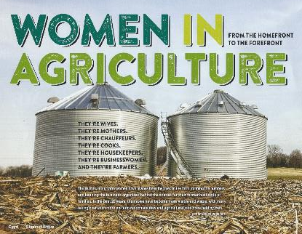
De la casa a la vanguardia
Ellas son operadoras secondarias
Ellas son mamás
Ellas son miembros de la junta directiva agricultural
Ellas son defensoras de la alfabetización en la agricultura sostenible.
Ellas son administradoras de granjas,
Ellas son expertas en ganadería
Ellas son emprendedoras
Ellas son contadoras
Ellas son mediadoras familiares
Ellas son mujeres de negocios
Y ellas son agricultoras
Notes:
Source: Channel Arrow – public AG publication
Women are taking on greater roles in the field of agriculture they include
They’re Secondary Operators
They’re Mothers
They’re Agricultural board/advisory council members
They're Sustainable Ag literacy advocates
They're Farm Managers,
They’re Animal husbandry experts
They’re Entrepreneurs
They’re Bookkeepers
They’re Family Mediators
They're Businesswomen
And They're Farmers

Slide 6
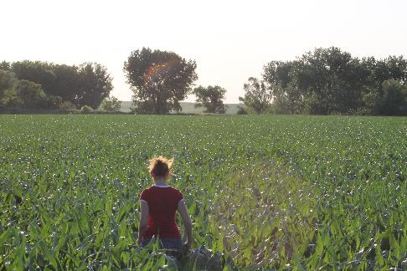
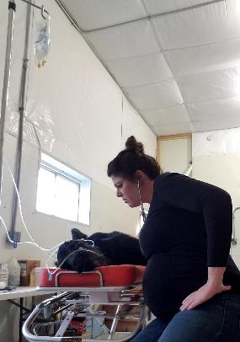
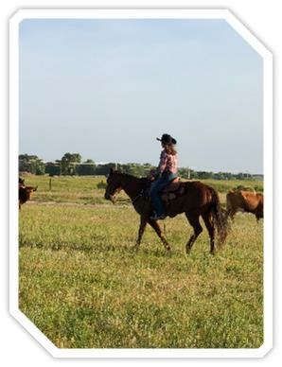
El perfil de la mujer agricultora
Notes:
Examples of the various roles women engage on the farm and ranch. Row Crop Operations, Ranching, working with Large and Small Animals ( veterinarian)
Linda Emanual, Ag Producer and RN Nebraska ( Left)
Women riding a horse news cows ( middle)
Dr. Bailey Lammers, DVM
Owner of Gavins Point Veterinary Services out of Crofton, NE. Practice some small animal, and mainly food animal medicine with an emphasis of cattle reproduction and cow/ calf management. (right) Image of Vet with sick animal.

Slide 7
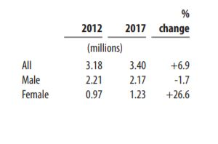
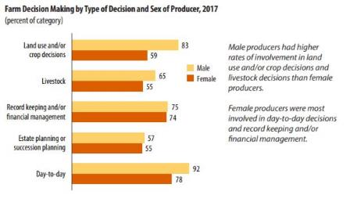
Censo de agricultura 2017
Productores totales
Decision granjera en base al tipo de decisión y sexo del productor.

Slide 8
Granjas y sus operadores
Más de un tercio de granjas tienen múltiples operadores, las granjas grandes tienden a tener múltiples generaciones de operadores.
La mayoría del segundo operador en granjas pequeñas son las esposas del operador principal.
Las empresas de generación múltiple son más comunes entre las granjas familiares a gran escala y las granjas no familiares. (20-25 %).
Fuente: America’s Diverse Family Farms 2017
Notes:
Farms and Farm Operators
More than a third of farms have multiple operators, and larger farms are more likely to have multiple generations of farm operators.
Most secondary operators on small farms are the spouse of the principal operator.
Multiple-generation enterprises are most common among large scale family farms and non-family farms (20-25 percent).
Source: America’s Diverse Family Farms 2017

Slide 9

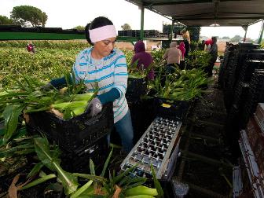
Trabajadores inmigrantes
Se estima que entre 1 y 2.7 millones de trabajadores son contratados en granjas en los USA. Incluyendo, migrantes, trabajadores temporales, anuales y trabajadores invitados. (Red de clínicas migrantes, 2018)
  79% hombres; 21% mujeres; prom. Edad 33 años
HRSA(x sus siglas en inglés) define que al menos el 51% de los ingresos se deriva del empleo agrícola en cualquier momento dentro de los últimos 24 meses o antes de la jubilación o discapacidad.
➢ Migrante: (se muda para trabajar y proporciona un hogar temporal para fines de empleo)
Estacional: no se mueve por empleo, trabaja estacionalmente, no durante todo el año.
Photo Credit- Agri-Pulse Feb 14, 2018 Simon Schuster
Notes:
A migrant farmworker is defined as an individual who is required to be absent from a permanent place of residence for the purpose of seeking remunerated employment in agricultural work. “Migrant farmworkers” are also called “migratory agricultural workers” or “mobile workers”. Seasonal farmworkers are individuals who are employed in temporary farmwork but do not move from their permanent residence to seek farmwork; they may also have other sources of employment.
https://www.migrantclinician.org/issues/migrant-info/migrant.html
Resources: Migrant Clinicians Network
Rural Women’s Health Project
Concern for this population Reproductive Health Effects on Pesticides
Tool kits

Slide 10
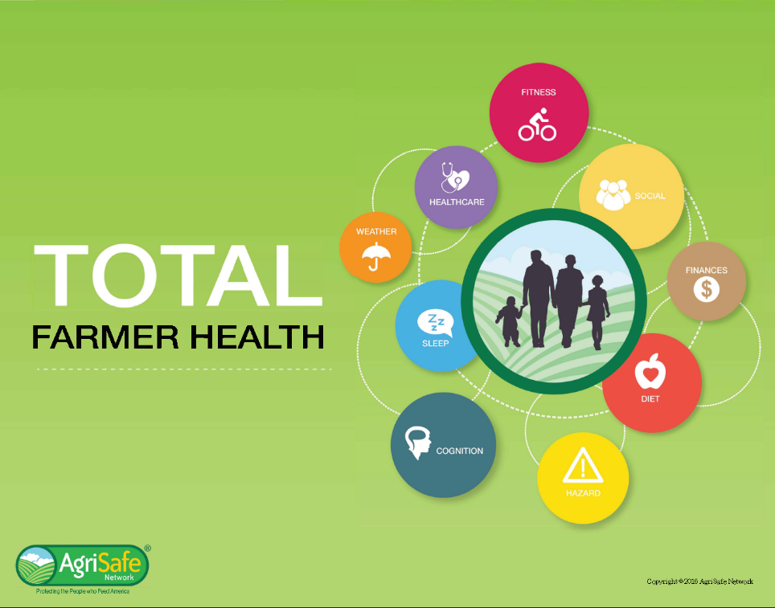

Total farmer health
Adaptation of Total Worker Health® to Agriculture
SM
Notes:
CDC/NIOSH Total Worker Health Affiliate since August 2017
This is AgriSafe’s platform to share information to producers on where they work and live and how it impacts their health. Cover a couple of examples.
Hazard
Farmworkers are at high risk for fatal and nonfatal injuries, work-related lung diseases, noise-induced hearing loss, skin diseases, and certain cancers associated with chemical use and prolonged sun exposure. Variety of exposures in agriculture result in multiple hazards:
Dusts (organic: bacteria, endotoxin, fungal spores; pesticide residues)
Pesticides and chemicals
Gases (Anhydrous ammonia, hydrogen sulfide, welding)
Vapors (fumigants, gasoline, diesel)
Confined space (oxygen deficient atmosphere)
Flying objects (cutting, grinding, sawing, drilling, mowing)
Noise (machinery, livestock, tools)
Hazardous equipment and machinery
Livestock
Off Road Vehicles
Sleep
Sleep plays a critical role in immune function, metabolism, memory, learning, and other vital functions. It is more difficult to take in new information following a night of inadequate or disturbed sleep.
It is just as important to get a good night’s sleep after learning something new in order to process and retain the information that has been learned.
Healthcare
Health insurance coverage places a significant financial burden on farm families.
Farmers are more likely than their rural counterparts to purchase in the individual insurance market which had limitations in care benefits.
Farmers are at high risk to be underinsured.
Finances
Financial health is a term used to describe the state of one's personal financial situation. There are many dimensions to financial health, including the amount of savings you have, how much you are setting away for retirement and how much of your income you are spending on fixed or non-discretionary expenses.
In farming, your financial health is impacted greatly by your business- the two are inherently connected.

Slide 11

Predominio
La gama de actividades agrícolas agrava el problema de garantizar un lugar de trabajo seguro para las mujeres que tienen sus propias contraindicaciones inherentes.
El Instituto Nacional para la Seguridad y Salud Ocupacional (NIOSH) enumera numerosos problemas de seguridad y salud de las mujeres relacionados con un trabajo agrícola que incluyen:
exposiciones agudas y crónicas a pesticidas.
bronquitis crónica entre mujeres campesinas no fumadoras.
riesgos relacionados con el embarazo.
lesiones relacionadas con el trabajo agrícola.
exposiciones a sustancias inhaladas en el lugar de trabajo.
factores de riesgo de infertilidad femenina en una región agrícola.
Notes:
Prevalence- How common a fact or condition occurs.
The range of farm activities compound the problem of assuring a safe worksite for farm women who have their own inherent contraindications.
The National Institute for Occupational Safety & Health (NIOSH) lists numerous women’s safety and health issues related to an agricultural job including:
acute and chronic pesticide exposures,
chronic bronchitis among nonsmoking farm women,
pregnancy related risks,
farm work-related injuries,
exposures to inhaled substances in the workplace and
risk factors for female infertility in an agricultural region.

Slide 12

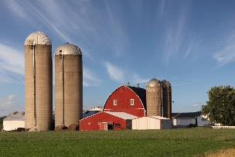
Consideraciones Culturales
Cada familia tiene sus valores, basados en su etnia, estatus socioeconómico, nivel de educación y tradiciones culturales.
Estos valores influyen en la división de tareas en las granjas y las mujeres están expuestas a múltiples roles. Estos factores contribuyen a una enfermedad ocupacional, estrés, fatiga y lesiones agrícolas. ( Weinert & Burman, 1994)
Notes:
Cultural Considerations
Each farm family has its own set of values that are influenced by the family's ethnicity, socioeconomic status, level of education, and cultural traditions
These values influence the division of labor on farms, and women's potential exposure to multiple roles, factors contributing to occupational illness, stress, fatigue, and agricultural injuries. ( Weinert & Burman, 1994)
Source: (Weinert & Burman, 1994)

Slide 13

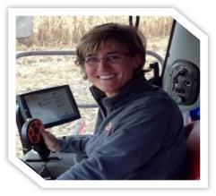
El Baile
Retos
“Yo trato de estar en todo en la granja, si me permito profundizar mucho pierdo la oportunidad de tomar decisiones u oportunidades más eficientes.”
“Esta operación require de un baile delicado mientras apreciamos nuestra herencia y nos embarcamos en cambios que aseguren que el legado continue.”
  Tracy (age 47) Operadora principal de una granja familiar
Notes:
Source: Interviews with farm women. Permission to use quotes.

Slide 14
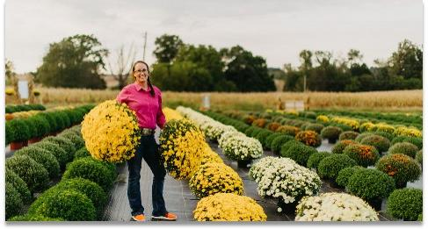
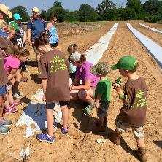
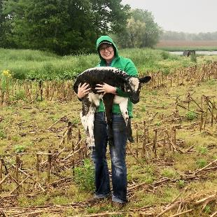
Diversificación de un optimista
Laney 28 años, empresaria productora femenina.
“Veo que nuestra generación regresa a diversas operaciones agrícolas. ¡Me encanta contar la historia de nuestras granjas y creo que las mujeres lo hacen mucho! ”
“Creo que mi rol de liderazgo en nuestra granja es mediador y eterno optimista. Me gusta ser la persona que encuentra los lados brillantes y las soluciones ".
Notes:
Source: Interviews with farm women. Permission to use quotes.

Slide 15
Diferencias en salud– Mujeres Rurales
Resultados más pobres en salud
Menor acceso a la salud que las mujeres urbanas.
Número limitado de Proveedores del cuidado de la salud (Women’s Health)
Comparación
  ↑ Enfermedad Isquémica del corazón (fatalidades)
  ↓ Servicios de exámenes preventivos (Cáncer de seno y cervical)
Fuente: Diferencias en salud; mujeres rurales
ACOG Committee Opinion
Committee on Health Care for Underserved Women
February 2014
Notes:
Comparisons include increased Alcohol Consumption
Triple Duty – Family Farm and off-farm careers ( health insurance and pensions) self-employed

Slide 16
Exposiciones Ocupacionales
Exposiciones Ocupacionales
  Muertes/lesiones relacionadas con ganado vacuno
  Caídas (Mujeres mayores de 60 años)
  Lesiones no fatales/fatalidades relacionadas con accidentes de maquinaria
  “Triple responsabilidad” – Aumenta el riesgo de estrés y lesiones agrícolas
  Pesticidas/ Químicos/ Exposición a herbicidas ( Mezcla y aplicación)
  Exposición al polvo agrícola
Exposición a gases de confinamiento (cerdo)
  Infecciones Zoonóticas
Notes:
Agromedicine pages 44-48
Data from Finland….
Livestock related injuries –
Cow (agent of injury)
Crushed or stricken by an animal (women 15-59)
Women over 60 years (Falls)
Machine Related nonfatal injuries/fatalities
Tractors (most common agent of death for adult women)
Tractor run-overs
“Triple Duty” – Increased Risk of Stress and Agricultural Injury
Pesticide Exposures
Triple Duty – Family Farm and off-farm careers ( health insurance and pensions) self-employed

Slide 17
Salud Reproductiva
copyright@2018
Notes:
Within the framework of WHO's definition of health as a state of complete physical, mental and social well-being, and not merely the absence of disease or infirmity, reproductive health addresses the reproductive processes, functions and system at all stages of life. Reproductive health, therefore, implies that people are able to have a responsible, satisfying and safe sex life and that they have the capability to reproduce and the freedom to decide if, when and how often to do so.
Preconception health is a woman's health before she becomes pregnant. It means knowing how health conditions and risk factors could affect a woman or her unborn baby if she becomes pregnant. For example, some foods, habits, and medicines can harm your baby — even before he or she is conceived. Some health problems, such as diabetes, also can affect pregnancy.
Interconception health involves helping a woman understand the importance of being healthy between pregnancies and the need to wait at least 18 months before becoming pregnant again to help optimize birth outcomes.

Slide 18
Riesgos de resultados adversos durante el embarazo
Exposiciones relacionadas al trabajo
  Herbicidas Dicamba, glifosato, ácidos fenoxiacéticos, tiocarbamat)
  Monóxido de carbono
  Toxicidad de nitrato(Formula para infantes)
  Producción de ganado vacuno.
    Oxitocina
    Prostaglandina
  Infecciones zoonóticas
Brucelosis, fiebre Q, listeria (causa aborto)
Notes:
Work Related Exposures
Herbicides: lower rates of fertility, (20%); when women on farms did not report these same exposes fertility rates were higher.
Exposures: Mixing and Applying herbicides and fungicides up to 2 years before attempting conception association w observed lower fertility
Carbon Monoxide- a toxic gas encountered in livestock buildings, fossil fuel heating units or high pressure washers powered by internal combustible engines. Risk to women is small; risk to unborn fetus, due to level of exposure (2x higher 20% carboxyhemoglobin LBW, slowed mental development)
Nitrate Toxicity- Young infants who are formula fed made up with water high in nitrate concentrations (>10 mg/L) have the potential to be poisoned. The most common cause of blue baby syndrome is water contaminated with nitrates. After a baby drinks formula made with nitrate-rich water, the body converts the nitrates into nitrites. These nitrites bind to the hemoglobin in the body, forming methemoglobin, which is unable to carry oxygen. Blue baby syndrome is rare in industrialized countries, but it does occasionally occur in rural areas.
Livestock Production Hormones – Needle sticks
Oxytocin – Can cause abortion in pregnant women who may be accidentally inoculated, more likely to cause abortion in later stages of pregnancy. Assists uterine contractions and milk let down.
Prostaglandin – Used in Cattle and Swine to terminate pregnancy early. May cause abortion at any time during pregnancy in pregnant women. Used to induce parturition, terminate pregnancy, or stimulate and synchronize estrous)
Zoonotic Infections ( next slide more details)
Brucellosis, Q Fever, Listeria (cause abortion)

Slide 19
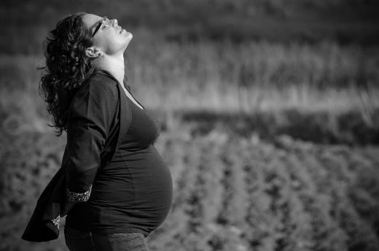
Zoonotic Disease
Fiebre Q
Clamidiosis
Toxoplasmosis
T. Gondii
Listeria
Leptospirosis
Brucelosis
Notes:
Zoonotic Infections
Quote from Animal Veterinarian- "I stayed away from kidding and lambing small ruminants, even if they had a normal pregnancy and no abortions," she explains. "Q fever can be shed at normal parturition and can be aerosolized, so I stopped doing small ruminant C-sections/dystocias. Any aborting animal, I think, would be a risk.“- Christine Navarre, DVM, MS, Dipl. ACVIM, Louisiana State University
Brucellosis, Q Fever, Listeria (cause abortion)
https://www.drovers.com/article/zoonoses-and-pregnancy
Women who are pregnant and have been exposed to brucellosis should consult with their obstetricians/healthcare provider for evaluation. Laboratory tests and a short course of antibiotics also known as post-exposure prophylaxis (PEP) may be recommended.
https://www.cdc.gov/brucellosis/transmission/index.html
Prompt diagnosis and treatment of brucellosis during pregnancy can be lifesaving for the fetus.
While rare, human-to-human transmission from lactating mothers to their breastfed infants has been reported.
If you have been diagnosed with brucellosis, please consult with your obstetrician/healthcare provider for healthy nursing options.
Q fever is caused by Coxiella burnetii and can cause reproduction problems in livestock and severe respiratory (lung) and liver disease in humans. People usually get Q fever by breathing contaminated barnyard dust or by direct contact with infected animals while assisting with the delivery of newborn animals.
In pregnant women, infections can cause premature delivery, abortion and infection of the placenta. Veterinarians should avoid contact with the placenta, birth tissues, fetal membranes and aborted fetuses of sheep, cattle and goats. If you are assisting the delivery of newborn animals, wear gloves, masks and eye protection. Pregnant women should be especially careful around pregnant sheep, cattle and goats.
Listeriosis from Listeria monocytogenes can be shed by infected animals in the feces, milk and uterine discharges. It is also found in aborted fetuses and occasionally in the nasal discharges and urine of symptomatic animals. Listeria can spread via ingestion, inhalation or direct contact. A majority of the cases are due to specific populations consuming unpasteurized milk but direct contact with an infected animal can spread the disease.
Infections are transmitted either transplacentally or from an infected birth canal. Humans can also be infected by direct contact with infected animals during calving, lambing or necropsies. Cases have been reported after contact with sick birds or the carcasses of asymptomatic poultry. Pregnant women may experience either a mild, flu-like syndrome with fever, chills, headache, slight dizziness or gastrointestinal signs, or an asymptomatic infection. This may be followed in a few days to weeks by abortion, stillbirth, premature birth or septicemia in the newborn. Newborns may be infected either in in utero or from bacteria found in the vagina during delivery.

Slide 20
Rates of infant, neonatal and post neonatal mortality in the U.S. from 2013 to 2015 by urbanization level (per 1,000 live births)
Notes:
Infant- The term "infant" is typically applied to young children under one year of age; however, definitions may vary and may include children up to two years of age.
Neonatal- 27 days
Infant, Newborn. A newborn infant, or neonate, is a child under 28 days of age. During these first 28 days of life, the child is at highest risk of dying.
Post neonatal- 28 days and 11 months or 1 year.

Slide 21
Administración de los pesticidas
EPA – Reconocimiento y administración de pesticidas tóxicos.
Las mujeres embarazadas o intentando quedar embarazadas, especialmente las que actualmente desarrollan trabajos granjeros deberían ser informadas sobre las implicaciones de estar expuestas a pesticidas antes, durante y después del embarazo. Así mismo, tomar decisiones que sean las apropiadas para sus trabajos y hogares.
Efectos de la salud reproductiva por la exposición a pesticidad
Problemas para los proveedores de salud a los campesinos.
Red de clínicos migrantes
Pamela Rao PhD
Justicia Campesina
Notes:
Further recognition:
Providers should encourage mothers to avoid exposure that might contaminate breast milk without unduly alarming them, perhaps by associating it with the importance of not smoking or drinking alcohol during pregnancy and nursing .
Breast feeding should continue to be strongly encouraged since all evidence indicates that the known benefits far outweigh the potential risks.
Source: Reproductive Health Effects of Pesticide Exposure
Issues for Farmworker Health Service Providers
Pamela Rao PhD, Farmworker Justice
Migrant Clinicians Network
Documented health effects include a wide variety of illnesses and diseases,
from eye irritation, skin rashes and respiratory problems to neurological damage, birth defects, cancer
and death. The risk for and severity of adverse health effects from pesticide exposure varies significantly
depending on many factors, including individual characteristics such as age and health status, the
specific pesticide, and exposure circumstances. Exposure to pesticides at certain developmental stages
of life can result in irreversible damage to organ structure and function. Of particular concern is the
effect of exposure at during the reproductive cycle, from preconception to breast feeding, because of
the possibility of poor birth outcomes, congenital anomalies, developmental deficits, and possibly
childhood cancer
EPA - Recognition and Management of Pesticide Poisonings
Reproductive Health Effects of Pesticide Exposure
Issues for Farmworker Health Service Providers
Migrant Clinicians Network
Pamela Rao PhD
Farmworker Justice

Slide 22

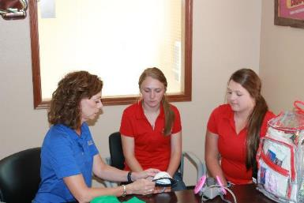
Mantra segura del pesticida
Lea la etiqueta
Use el equipo de protección personal (EPP) adecuado
Encuentre un EPP que se ajuste a ud.
  Guantes
  Lentes
  Proteccion de ropa
  Respirador
Notes:
Photo Property of AgriSafe Network

Slide 23
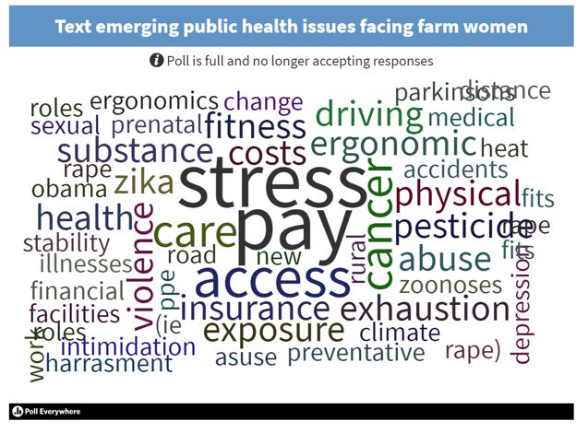
AgriSafe Think Tank Feedback

Slide 24

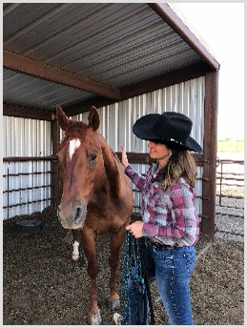

Estrés fuera y dentro de la granja
Mujeres en agricultura – Múltiple roles
    Trabajo fuera de la granja
    Vivir con riesgo todos los días
    Vida familia y Vida laboral 24/7
    Falta de proveedores para la salud mental.
Revisión de la literatura que apoya el trabajo de las mujeres en las granjas con múltiples roles.
  ”Una mujer de granja con un trabajo fuera de la misma enfrenta demandas muy difíciles, además, de ser la crianza tradicional. (Moolgaard and Miller, 1996)
      No mucho ha cambiado en los últimos 20 años

Slide 25
Derechos y responsabilidades del empleado
Usted tiene el derecho a:
  Un lugar de trabajo sano y seguro
  Conocer las amenazas químicas
  Informarse sobre lesiones y peligros en el área de trabajo
  Quejarse o pedir soluciones a un problema con el empleador
Notes:
Review Employee Rights www.osha.gov

Slide 26
Derechos y responsabilidades del empleado
Usted tiene derecho a:
  Entrenamiento
  Acceso a los records de problemas en el lugar de trabajo
  Llenar una queja con OSHA
  Participar en las inspecciones del OSHA
  Estar libre de represalias por exigir sus derechos sobre salud y seguridad.
Notes:
Review Employee Rights www.osha.gov

Slide 27
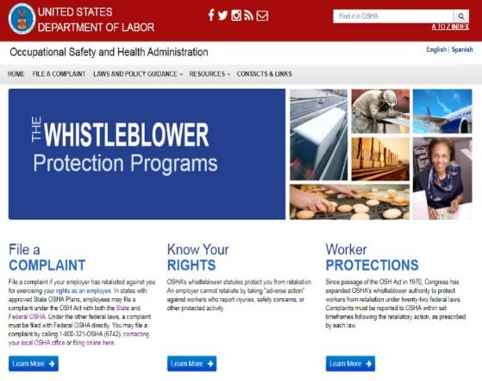
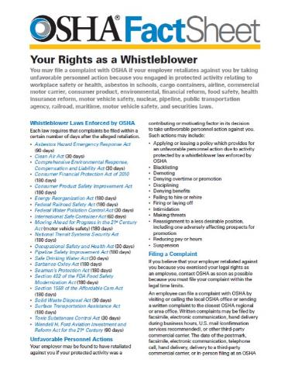
Whistleblower Protection Program

Slide 28
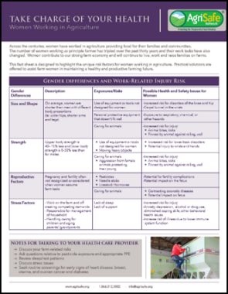
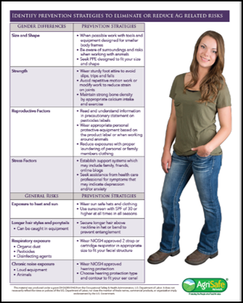
Recursos para la salud de las mujeres

Slide 29
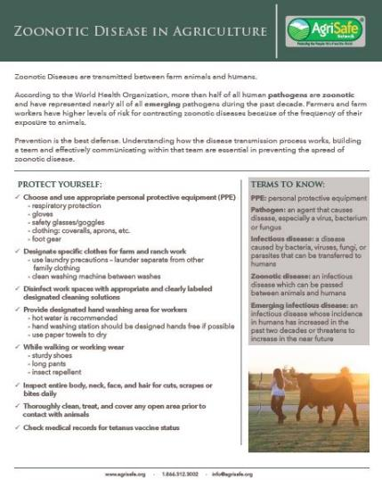
Recursos para las enfermedades Zoonóticas

Slide 30

Recursos de bienestar mental AgriSafe

Slide 31


Agrisafe pilates and yoga

Slide 32
Enfoque Clínico
Evaluar los riesgos de salud agrícola
Evaluación clínica para determinar signos de lesión que pueden estar relacionados con el trabajo agrícola.
Investigar la posibilidad de adaptar herramientas y tareas a las personas que las realizan de tal manera que se maximicen las fortalezas del cuerpo humano y la psicología y se minimice la exposición de las debilidades a los estresores

Slide 33

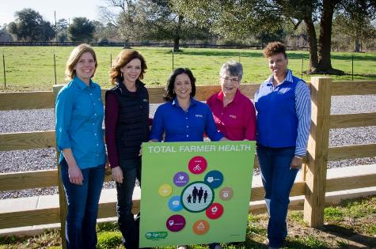
GRACIAS!
Este material fue producido bajo el número de subvención SH -05068-SH 8 de la Administración de Seguridad y Salud Ocupacional del Departamento de Trabajo de los EE. UU. No refleja necesariamente las opiniones o políticas del Departamento de Trabajo de los EE. UU., la mención de nombres comerciales, productos comerciales u organizaciones no implica el respaldo del gobierno de los EE. UU
Notes:
Thank you! Image of AgriSafe Staff Team holding Total Farmer Health Sign.

