Slide 1

The Disclaimer
This material was produced under a Susan Harwood grant (SH-31230-SH7) from the Occupational Safety and Health Administration, U.S. Department of Labor. It does not necessarily reflect the views or policies of the U.S. Department of Labor, nor does the mention of trade names, commercial products, or organization imply endorsement by the U.S. Government
Notes:
Acknowledge Susan Harwood Training Grant support

Slide 2
Focus Areas
The primary goal of this webinar is to highlight the components of an effective respiratory protection program for the agricultural workplace.
Upon completion of this webinar, participants will be able to:
  Recognize the diverse respiratory hazards unique to agricultural, especially grain handling, and the justification for a comprehensive respiratory program.
  Identify the OSHA respirator standards that apply to an agricultural setting.
  Understand key components of an effective respiratory protection program.
  Access resources, templates, medical evaluations, and further trainings to effectively implement a respiratory program.
  The intended audience for this presentation includes healthcare and safety professionals who provide care in agricultural communities and business owners, managers, and workers in production agriculture.
Notes:
Review focus /objectives of webinar:
The primary goal of this webinar is to highlight the components of an effective respiratory protection program for the agricultural workplace.
Upon completion of this webinar, participants will be able to:
Recognize the diverse respiratory hazards unique to agricultural, especially grain handling, and the justification for a comprehensive respiratory program.
Identify the OSHA respirator standards that apply to an agricultural setting.
Understand key components of an effective respiratory protection program.
Access resources, templates, medical evaluations, and further trainings to effectively implement a respiratory program.
The intended audience for this presentation includes healthcare professionals who provide care in agricultural communities and business owners, managers, and workers in production agriculture.

Slide 3
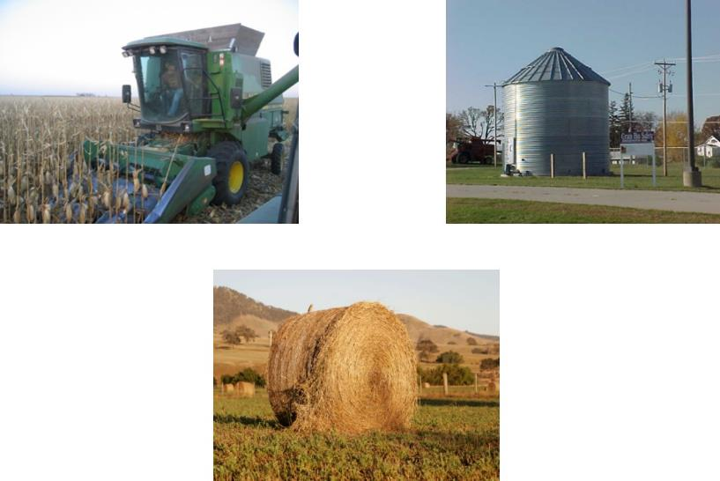
Grain handling can present several opportunities for exposures
Notes:
Grain dust and its components are present in planting & harvesting, storage, and feeding areas. Because the work place is also home this adds more complexity to protecting the person and family members who may be exposed to respiratory and other agricultural hazards
Photos property of AgriSafe Network. Pictures show combine harvesting corn, a grain bin, and a large round bale in the field.

Slide 4
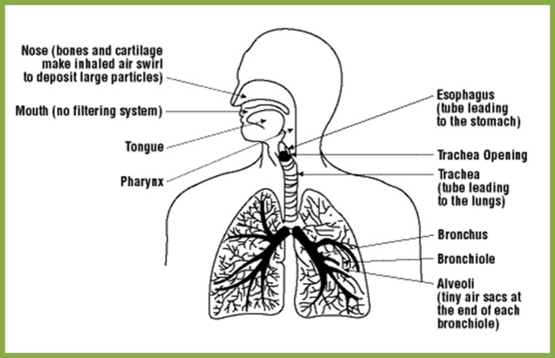
The respiratory system – where does all that dust go?
Notes:
When we talk about protecting the respiratory system we need to understand the respiratory system includes the “entire” respiratory track which includes from the nose, sinuses, upper airways, bronchioles and lungs.
Diagram depicts respiratory tract from nose to alveoli – Canadian Centre for Occupational Health & Safety

Slide 5

This is serious – and these dust particles can have multiple components
Smaller particles can reach the smaller airways and aren’t trapped by mucus or cilia
Less than10 m can reach the alveoli and are considered Respirable
Notes:
We are concerned about the particles that can reach the tiny airways of the lungs called Alveoli.
Respirable dust - along with fumes and gases can reach these areas of the lung where the exchange of oxygen takes place.
http://www.bluebulbprojects.com/measureofthings/results.php?comp=area&unit=m2&amt=354.2&sort=pr&p=2. Image is a cut away of alveoli.

Slide 6
Symptoms of respiratory illness -
Headache
Dizziness
Runny or sore eyes
Sore throat
Stuffy nose or sneezing
Cough
Wheezing or tightness in chest
Shortness of breath
Nausea or vomiting
Monday morning syndrome
Notes:
There are signs and symptoms that we need to be aware of that can signal problems related to respiratory exposures and illnesses.
Monday morning syndrome – when you are gone for a few days and your symptoms subside and when you return to the exposures then they come back.

Slide 7
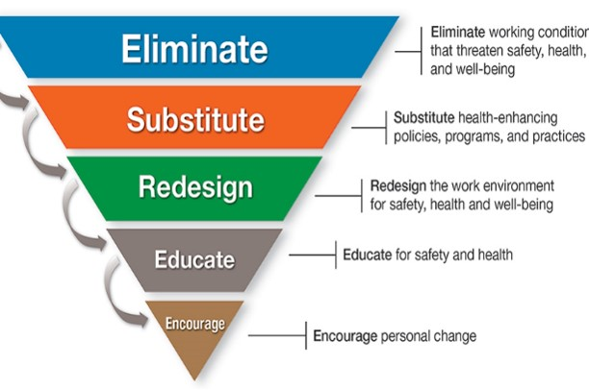
Do You Need to Implement a Respirator Program?
Engineer dangers out of environment if at all possible!
Personal protective equipment – may be only feasible solution
The last line of defense!
www.osha.gov Link to NIOSH Total Worker Health
Notes:
The CDC/NIOSH Total Worker Health initiative has turned the hierarchy of order around and looks at the steps to determine need for a Respiratory Program. We recommend several sets of eyes take a fresh look at opportunities for hazard elimination or substitution and an emphasis on education. In agriculture, the efforts to eliminate or redesign may not be at all feasible. Therefore education and program implementation of respirator use is paramount.

Slide 8
Permissible Practice Hierarchy – may be difficult in Agriculture
The primary means to control occupational diseases caused by breathing contaminated air is through the use of feasible engineering controls, such as enclosures, confinement of operations, ventilation, or substitution of less toxic materials.
When effective engineering controls are not feasible, or while they are being instituted, appropriate respirators shall be used pursuant to this standard.
Employer shall provide respirators, when necessary, which are applicable and suitable for the purpose intended.
Employer shall be responsible for establishment and maintenance of a respirator program which includes the requirements of the OSHA Respiratory Protection Program.
Notes:
Hierarchy of Industrial Hygiene - this can be difficult in Agriculture – many times PPE is the only option
The primary means to control occupational diseases caused by breathing contaminated air is through the use of feasible engineering controls, such as enclosures, confinement of operations, ventilation, or substitution of less toxic materials
When effective engineering controls are not feasible, or while they are being instituted, appropriate respirators shall be used pursuant to this standard
Employer shall provide respirators, when necessary, which are applicable and suitable for the purpose intended
Employer shall be responsible for establishment and maintenance of a respirator program which includes the requirements of paragraph (c), Respiratory protection program

Slide 9
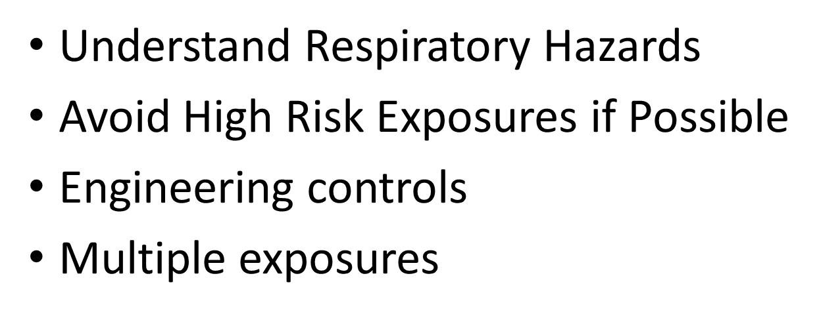
Choosing Appropriate Respirator Protection
Notes:
The first decision to make is – Do you need respiratory protection?
In order to choose the right protection, we need to discern the potential for avoiding the risk altogether.

Slide 10
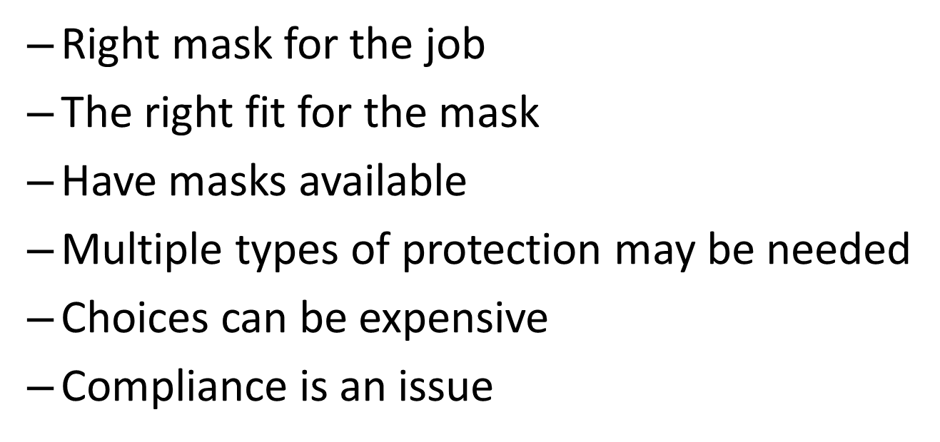
If Respiratory Protection is Necessary…
Choose the Right Protection
Notes:
Decision 2 – if you do need a Respirator then you need to decide this
Right mask for the job
The right fit for the mask
Have masks available
Choices can be expensive
Compliance can be an issue – going to discuss the Respiratory Standard and Respirator Program

Slide 11
OSHA Respiratory Standard
This standard applies to
General Industry (Part 1910),
Shipyards (Part 1915),
Marine Terminals (Part 1917),
Longshoring (Part 1918), and
Construction (Part 1926).
There is no respiratory standard specific to agriculture – this can be confusing !
Notes:
Since there is no respiratory standard for agriculture, we rely on the established OSHA standards for best management practices

Slide 12
Applicable OSHA Standards
General Industry Standard : 29CFR 1910:134 Respiratory Protection
- although not specific to agriculture
The General Duty clause: [5(a)(1)] of the OSH Act:
a) Each employer --
(1) shall furnish to each of his employees' employment and a place of employment which are free from recognized hazards that are causing or are likely to cause death or serious physical harm to his employees
Notes:
OSHA can cite under General Industry Standards & the General Duty Clause. This can be confusing for agriculture settings.
We have another webinar – Ag Exempt; this discusses Enforcement Guidance for Small Farming Operations.

Slide 13
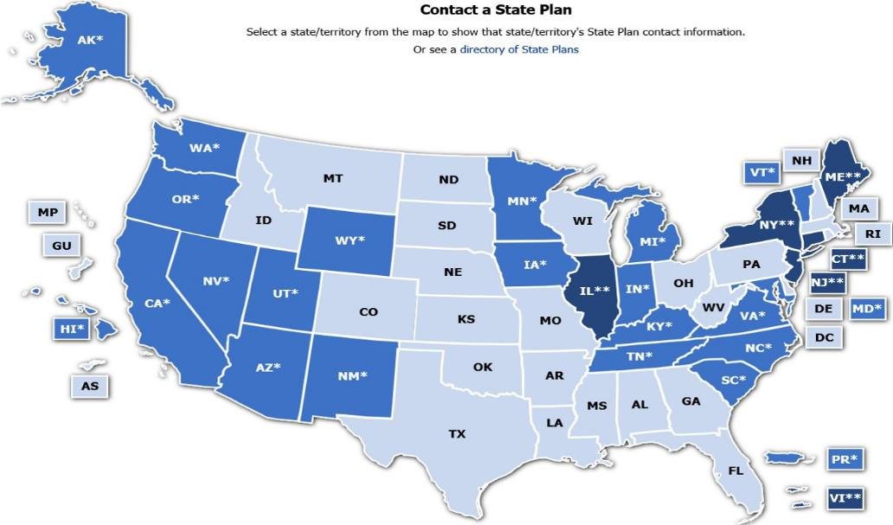
Contact a State Plan Map
Notes:
Source: www.OSHA.gov
Many states have different OSHA Instruction
Could require more under each state plan – be sure to check with your state
State OSHA can be a resource

Slide 14
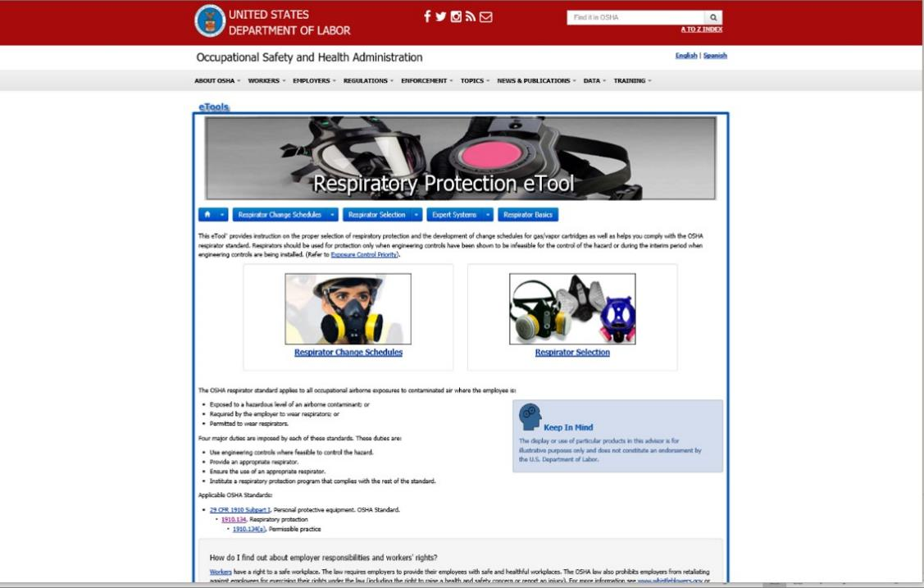
Respiratory Protection eTool
Notes:
This depicts an OSHA eTool page The OSHA website has so much information at your fingertips – www.osha.gov and fill in the search bar. In the A to Z section, scroll to Respiratory and all your information will be there.

Slide 15
Respiratory Protection Program
The OSHA General Industry respiratory standard (OSHA’s Respiratory Protection Standard - 29 CFR 1910.134 ) requires a written respiratory protection program for situations in which PELs - the permissible exposure levels - of airborne contaminants could be exceeded, or when the employer requires use of respirators by workers.
Notes:
Source: www.osha.gov
Standard is organized to assist employers in following all aspects of the Respiratory Standard [29 CFR 1910.134]
The OSHA General Industry respiratory standard (OSHA’s Respiratory Protection Standard - 29 CFR 1910.134 ) requires a written respiratory protection program for situations in which PELs - the permissible exposure levels - of airborne contaminants could be exceeded, or when the employer requires use of respirators by workers.

Slide 16
Respiratory Program Elements
Section C of the Standard is the OSHA Respiratory Program
1. Selection
2. Medical evaluation
3. Fit testing
4. Use
5. Maintenance and care
6. Breathing air quality and use
7. Training
8. Program evaluation
Notes:
These are the components of the OSHA Respiratory Program – well organized to make sure your operation covers all the required elements. These eight parts can be found in Section C of the Respiratory Standard.
1. Selection
2. Medical evaluation
3. Fit testing
4. Use
5. Maintenance and care
6. Breathing air quality and use
7. Training
8. Program evaluation

Slide 17
A Respiratory Program that meets the OSHA standard must:
develop a written program with worksite-specific procedures when respirators are necessary or required by the employer
update program as necessary to reflect changes in workplace conditions that affect respirator use
designate a program administrator who is qualified by appropriate training or experience to administer or oversee the program and conduct the required program evaluations
provide respirators, training, and medical evaluations at no cost to the employee
Note: OSHA has prepared a Small Entity Compliance Guide that contains criteria for selection of a program administrator and a sample program – Publication OSHA 3384 - 09 2011
Notes:
An OSHA Respiratory Protection Program must: develop a written program with worksite-specific procedures when respirators are necessary or required by the employer;
update program as necessary to reflect changes in workplace conditions that affect respirator use;
designate a program administrator who is qualified by appropriate training or experience to administer or oversee the program and conduct the required program evaluations;
provide respirators, training, and medical evaluations at no cost to the employee
Note: OSHA has prepared a Small Entity Compliance Guide that contains criteria for selection of a program administrator and a sample program – Publication OSHA 3384 - 09 2011

Slide 18
Respirator Program -voluntary use
Employer may provide respirators at employee’s request or permit employees to use their own respirators, if employer determines that such use in itself will not create a hazard
If voluntary use is permissible, employer must provide users with the information contained in Appendix D
Employer must establish and implement those elements of a written program necessary to ensure that employee is medically able to use the respirator and that it is cleaned, stored, and maintained so it does not present a health hazard to the user
Exception: Employers are not required to include in a written program employees whose only use of respirators involves voluntary use of filtering face pieces (dust masks).
Notes:
When a Respirator is not required:
Employer may provide respirators at employee’s request or permit employees to use their own respirators, if employer determines that such use will not create a hazard.
Exception: Employers are not required to include in a written program employees whose only use of respirators involves voluntary use of filtering face pieces (dust masks).

Slide 19
OSHA – Voluntary Use of Respiratory Protection
Voluntary use of a dust mask
If an employee wants to use a dust mask on a voluntary basis, then there are very limited requirements with which employers must comply.
OSHA places two requirements on employers when it comes to allowing employees to wear dust masks voluntarily:
The employer must:
  1. determine that the masks themselves do not pose a hazard to workers; and
  2. provide the information found in Appendix D to 1910.134 of OSHA's Respiratory Protection Standard to workers on a one-time basis. This appendix provides important information the employee needs to know about wearing dust masks.
Employers are not required to provide any medical evaluation or fit test for voluntary use of a dust mask.
https://ohsonline.com/Articles/2011/05/01/Voluntary-Use-of-Respirators.aspx
Notes:
If an employee wants to use a dust mask on a voluntary basis, then there are very limited requirements with which employers must comply.
OSHA places two requirements on employers when it comes to allowing employees to wear dust masks voluntarily:
The employer must:
1. determine that the masks themselves do not pose a hazard to workers; and
2. provide the information found in Appendix D to 1910.134 of OSHA's Respiratory Protection Standard to workers on a one-time basis. This appendix provides important information the employee needs to know about wearing dust masks.
Employers are not required to provide any medical evaluation or fit test for voluntary use of a dust mask.
https://ohsonline.com/Articles/2011/05/01/Voluntary-Use-of-Respirators.aspx

Slide 20
OSHA – Voluntary Use of Respiratory Protection
Respirators other than dust masks:
For voluntary use of respirators other than dust masks, the OSHA requirements are more involved. They still don't rise to the level of that required under the full Respiratory Protection Program but do require employers to take quite a few protective measures.
The employer must:
Determine that the respirator use will not in itself create a hazard
Provide the respirator users with the information contained in the standard's Appendix D
Ensure that the respirator users are medically qualified to wear respirators, and
Ensure that the respirators are properly cleaned, stored, and maintained.
https://ohsonline.com/Articles/2011/05/01/Voluntary-Use-of-Respirators.aspx
Notes:
Respirators other than dust masks:
For voluntary use of respirators other than dust masks, the OSHA requirements are more involved. They still don't rise to the level of that required under the full Respiratory Protection Program but do require employers to take quite a few protective measures.
The employer must:
Determine that the respirator use will not in itself create a hazard
Provide the respirator users with the information contained in the standard's Appendix D
Ensure that the respirator users are medically qualified to wear respirators, and
Ensure that the respirators are properly cleaned, stored, and maintained.
https://ohsonline.com/Articles/2011/05/01/Voluntary-Use-of-Respirators.aspx

Slide 21
Appendix D to Sec. 1910.134
(Mandatory) Information for Employees Using Respirators When Not Required Under the Standard
Employees:
1. Read and heed all instructions provided by the manufacturer on use, maintenance, cleaning and care, and warnings regarding the respirator's limitations.
2. Choose respirators NIOSH certified for use to protect against contaminant. A label or statement of certification should appear on the respirator or respirator packaging. It will tell you what the respirator is designed for and how much it will protect you.
3. Do not wear your respirator into atmospheres containing contaminants for which your respirator is not designed to protect against.
4. Keep track of your respirator so that you do not mistakenly use someone else's respirator.
Notes:
Employees have responsibilities:
1. Read and heed all instructions provided by the manufacturer on use, maintenance, cleaning and care, and warnings regarding the respirators limitations.
2. Choose respirators NIOSH certified for use to protect against contaminant. A label or statement of certification should appear on the respirator or respirator packaging. It will tell you what the respirator is designed for and how much it will protect you.
3. Do not wear your respirator into atmospheres containing contaminants for which your respirator is not designed to protect against.
4. Keep track of your respirator so that you do not mistakenly use someone else's respirator.

Slide 22
Remember!
Respirators are an effective method of protection against designated hazards when properly selected and worn.
Respirator use is encouraged, even when exposures are below the exposure limit, to provide an additional level of comfort and protection for workers.
However, if a respirator is used improperly or not kept clean, the respirator itself can become a hazard to the worker.
Notes:
Respirator use is encouraged, even when exposures are below the exposure limit, to provide an additional level of comfort and protection for workers.
However, if a respirator is used improperly or not kept clean, the respirator itself can become a hazard to the worker.
Respirators are an effective method of protection against designated hazards when properly selected and worn.

Slide 23
Agricultural Exemptions
Enforcement Guidance for Small Farming Operations
The Appropriations Act exempts small farming operations from enforcement of all rules, regulations, standards or orders under the Occupational Safety and Health Act. A farming operation is exempt from all OSHA activities if it:
  •Employs 10 or fewer employees currently and at all times during the last 12 months; and
  •Has not had an active temporary labor camp during the proceeding 12 months.
Source: OSHA Instruction CPL 02-00-051
Notes:
Enforcement Guidance for Small Farming Operations
The Appropriations Act exempts small farming operations from enforcement of all rules, regulations, standards or orders under the Occupational Safety and Health Act. A farming operation is exempt from all OSHA activities if it:
•Employs 10 or fewer employees currently and at all times during the last 12 months; and
•Has not had an active temporary labor camp during the proceeding 12 months.
Source: OSHA Instruction CPL 02-00-051

Slide 24
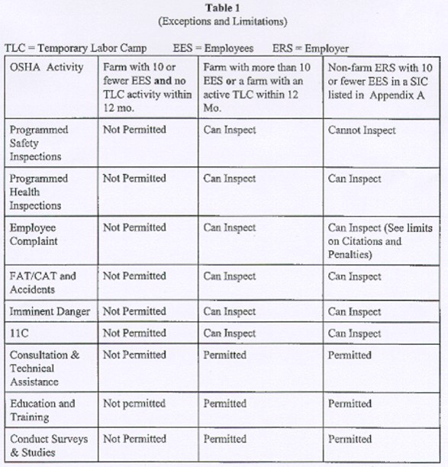
OSHA General Enforcement Guidelines Table
OSHA General Enforcement Guidelines Table
Notes:
OSHA General Enforcement Guidelines Table - describes the exceptions and limitations related to OSHA’s ability to inspect.

Slide 25
Enforcement
What does exempt from enforcement of all rules, regulations, standards or orders mean?
  Can not use Federal funds to inspect or cite.
  A state plan can not use federal funds to inspect
  But the state plans can use state funds to inspect.
Notes:
What does exempt from enforcement of all rules, regulations, standards or orders mean?
Can not use Federal funds to inspect or cite.
A state plan can not use federal funds to inspect
But the state plans can use state funds to inspect.

Slide 26
OSHA Jurisdiction on Farms
In 2011 OSHA determined that the agency has jurisdiction over family farms, if they are involved in post‐harvest grain handling operations such as crop cleaning, sun drying, shelling, fumigating, curing, sorting, grading, packing, and cooling.
Source: National Grain & Feed Association
Notes:
OSHA Jurisdiction on Farms: This is relatively new and not all operations, such as small grain elevators are aware of it.
In 2011 OSHA determined that the agency has jurisdiction over family farms, if they are involved in post‐harvest grain handling operations such as crop cleaning, sun drying, shelling, fumigating, curing, sorting, grading, packing, and cooling.

Slide 27
Best Management Practices
Although OSHA cannot inspect or cite farms with 10 or fewer employees…
  One important reason for understanding that small farms could fall under OSHA is that, in a court of law, OSHA rules and regulations may be used to identify safe and unsafe conditions on the farm.
  State plan - state may be more stringent based on the state regulations.
Notes:
Although OSHA cannot inspect or cite farms with 10 or fewer employees…
One important reason for understanding that small farms could fall under OSHA is that, in a court of law, OSHA rules and regulations may be used to identify safe and unsafe conditions on the farm.
State plan - state may be more stringent based on the state regulations.

Slide 28
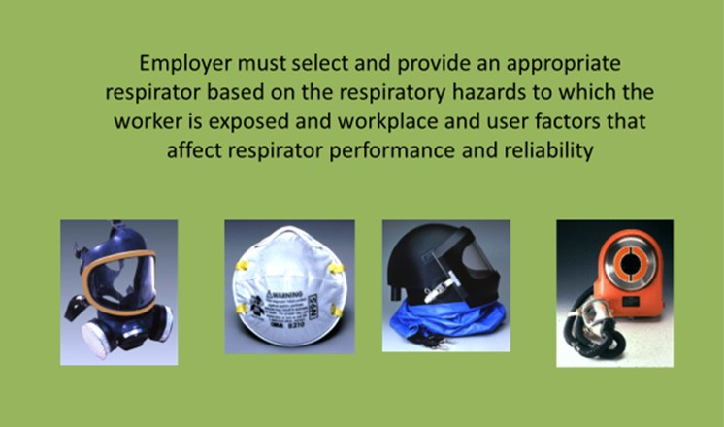
Respirator Selection
Notes:
Photos from OSHA.gov power point depict a full face respirator, an N95 filtering face piece, a welding hood
Employer must select and provide an appropriate respirator based on the respiratory hazards to which the worker is exposed and workplace and user factors that affect respirator performance and reliability

Slide 29
Respirator Selection Directives
Select a NIOSH-certified respirator that shall be used in compliance with the conditions of its certification
Identify and evaluate the respiratory hazards in the workplace, including a reasonable estimate of employee exposures and identification of the contaminant’s chemical state and physical form
Where exposure cannot be identified or reasonably estimated, the atmosphere shall be considered Immediately Dangerous to Life or Health (IDLH)
Select respirators from a sufficient number of models and sizes so that the respirator is acceptable to, and correctly fits, the user
Notes:
Select a NIOSH-certified respirator that shall be used in compliance with the conditions of its certification
Identify and evaluate the respiratory hazards in the workplace, including a reasonable estimate of employee exposures and identification of the contaminant’s chemical state and physical form
Where exposure cannot be identified or reasonably estimated, the atmosphere shall be considered Immediately Dangerous to Life or Health (IDLH)
Select respirators from a sufficient number of models and sizes so that the respirator is acceptable to, and correctly fits, the user

Slide 30
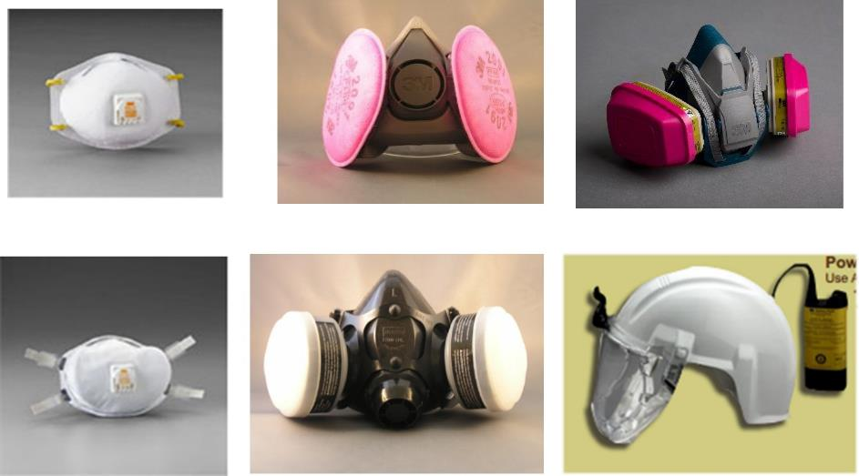
Air Purifying Respirators
Notes:
All of these are considered air purifying respirators – they do not rely on another air supply but utilize ambient air. Picture shows an N95 2 strap respirator, a half face with pancake P100 filters, a half face with multigas and P100 dual cartridge, a P100 2 strap respirator, a half face respirator with organic vapor cartridge filters and dust caps, and a powered air respiratory protection (PAPR).
Select a NIOSH-certified respirator that shall be used in compliance with the conditions of its certification

Slide 31
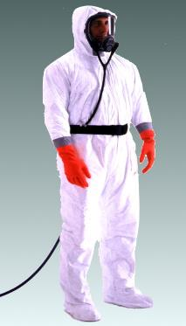
Supplied Air Respirator
An atmosphere-supplying respirator for which the source of breathing air is not designed to be carried by the user. Also called airline respirator.
When to use:
Manure pits or confinement buildings during pit agitation or pumping
Environments with poor ventilation creating high levels of carbon monoxide
Fumigation in enclosed areas
Notes:
A supplied air respirator is an atmosphere-supplying respirator for which the source of breathing air is not designed to be carried by the user. Also called airline respirator. Picture shows a man in a Tyvek suit, taped gloves, foot protection and an airline respirator. OSHA
When to use:
Manure pits or confinement buildings during pit agitation or pumping
Environments with poor ventilation creating high levels of carbon monoxide
Fumigation in enclosed areas

Slide 32
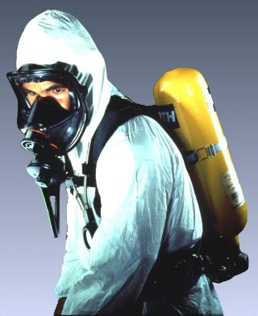
Self-Contained Breathing Apparatus (SCBA)
An atmosphere-supplying respirator for which
the breathing air source is designed to be carried by the user –trained in SCBA use.
When to use:
Manure pits or confinement buildings during pit agitation or pumping.
Environments with poor ventilation creating high levels of carbon monoxide.
Fumigation in enclosed areas.
Silo entry that is oxygen limiting.
Notes:
Self-contained breathing apparatus is an atmosphere-supplying respirator for which
the breathing air source is designed to be carried by the user –trained in SCBA use.
When to use:
Manure pits or confinement buildings during pit agitation or pumping.
Environments with poor ventilation creating high levels of carbon monoxide.
Fumigation in enclosed areas.
Silo entry that is oxygen limiting.
Picture shows man in Tyvek suit and using a SCBA protective system. OSHA photo

Slide 33
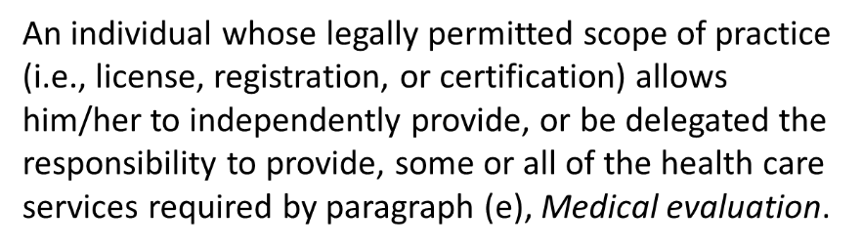
Medical Evaluation Provider
Notes:
This does not have to be a physician – may be a physician assistant, nurse practitioner.

Slide 34
Medical Evaluation Procedures
Must provide a medical evaluation to determine employee’s ability to use a respirator, before fit testing and use
Must identify a PLHCP to perform medical evaluations using a medical questionnaire or an initial medical examination that obtains the same information
Medical evaluation must obtain the information requested by the questionnaire in Sections 1 and 2, Part A of App. C
Follow-up medical examination is required for an employee who gives a positive response to any question among questions 1 through 8 in Section 2, Part A of App. C or whose initial medical examination demonstrates the need for a follow-up medical examination
Notes:
PLHCP – Physician or other Licensed Health Care Professional
Must provide a medical evaluation to determine employee’s ability to use a respirator, before fit testing and use
Must identify a PLHCP to perform medical evaluations using a medical questionnaire or an initial medical examination that obtains the same information
Medical evaluation must obtain the information requested by the questionnaire in Sections 1 and 2, Part A of App. C
Follow-up medical examination is required for an employee who gives a positive response to any question among questions 1 through 8 in Section 2, Part A of App. C or whose initial medical examination demonstrates the need for a follow-up medical examination

Slide 35
Additional Medical Evaluation
Annual review of medical status is not required
At a minimum, employer must provide additional medical evaluations if:
  Employee reports medical signs or symptoms related to the ability to use a respirator
  PLHCP, supervisor, or program administrator informs the employer that an employee needs to be re-evaluated
  Information from the respirator program, including observations made during fit testing and program evaluation, indicates a need
  Change occurs in workplace conditions that may substantially increase the physiological burden on an employee
Notes:
Annual review of medical status is not required- depends on each person
At a minimum, employer must provide additional medical evaluations if:
Employee reports medical signs or symptoms related to the ability to use a respirator
PLHCP, supervisor, or program administrator informs the employer that an employee needs to be reevaluated
Information from the respirator program, including observations made during fit testing and program evaluation, indicates a need
Change occurs in workplace conditions that may substantially increase the physiological burden on an employee

Slide 36
Fit Testing
*Before an employee uses any respirator with a negative or positive pressure tight-fitting face piece, the employee must be fit tested with the same make, model, style, and size of respirator that will be used.
Notes:
Source: www.osha.gov
Fit testing must be done for each employee prior to use of a respirator
The employee must be fit tested with the same make, model, style, and size of respirator that will be used.

Slide 37
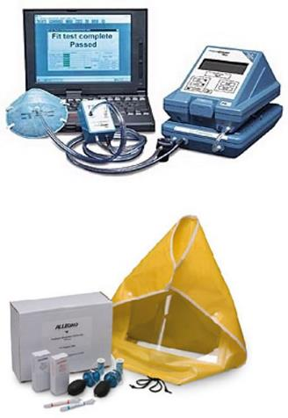
Type of Fit Testing
Type of Fit Testing
  Quantitative
  - Portacount test
Qualitative (pass/fail)
- Bitrex, Saccharin.
  Use OSHA approved fit test protocols (Appendix A to § 1910.134: Fit Testing Procedures)
  Available on OSHA.gov website
Notes:
Phoot property of AgriSafe Network & courtesy of TSI Portacount depicts quantitative Portacount and a Qualitative testing set.

Slide 38
Fit testing
Employees using tight-fitting face piece respirators must pass an appropriate qualitative fit test (QLFT) or quantitative fit test (QNFT):
  prior to initial use
  whenever a different respirator face piece (size, style, model or make) is used, and
  at least annually thereafter
  must conduct an additional fit test whenever the employee reports, or the employer or PLHCP makes visual observations of, changes in the employee’s physical condition (e.g., facial scarring, dental changes, cosmetic surgery, or obvious change in body weight) that could affect respirator fit
Notes:
Employees using tight-fitting face piece respirators must pass an appropriate qualitative fit test (QLFT) or quantitative fit test (QNFT):
prior to initial use,
whenever a different respirator face piece (size, style, model or make) is used, and
at least annually thereafter

Slide 39
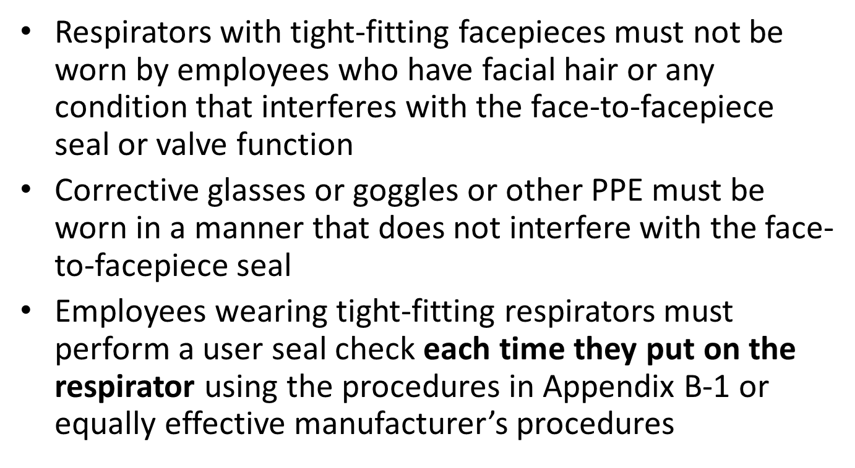
Use of Respirators
- Face Seal
Notes:
Paragraph G of the Standard

Slide 40
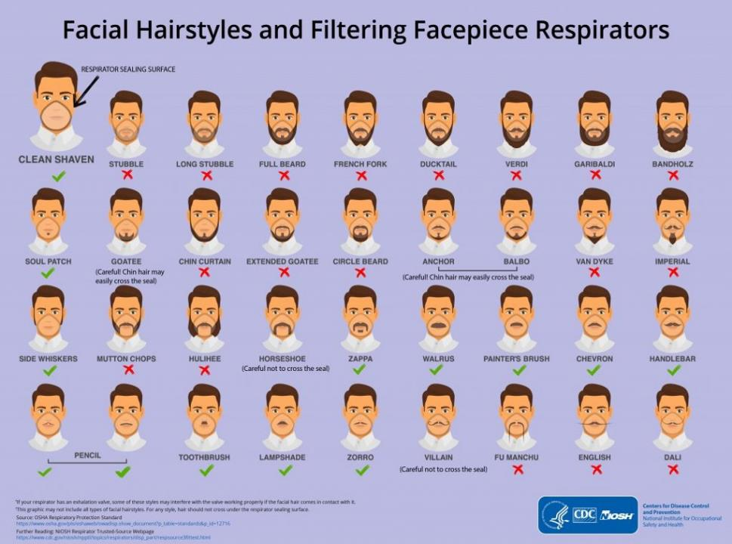
Facial Hairstyles and Filtering Facepiece Respirators
Notes:
Picture shows facial hair styles and areas protected by respirators CDC/NIOSH

Slide 41
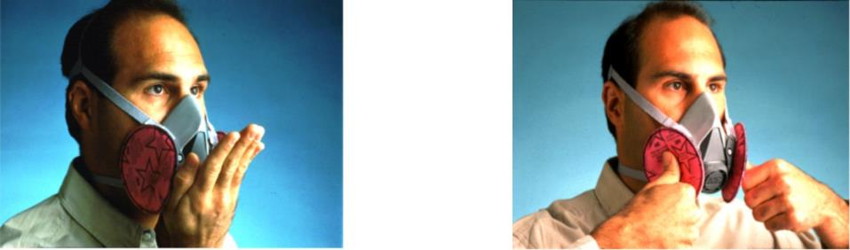
Fit Check Procedure is an employee (wearer) responsibility
Positive Pressure Check Negative Pressure Check
Notes:
Photos from OSHA Website showing positive pressure check on the left and negative pressure check n the right.
User Seal check is part of teaching user to determine proper fit test when using respiratory protection

Slide 42
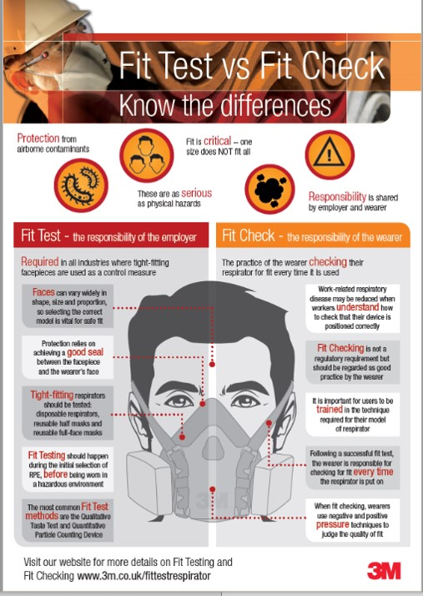
Fit Test vs Fit Check
Source: 3M of UK
Notes:
Source: www.3m.co.uk/fittestrespirator provides information on fit check procedure

Slide 43
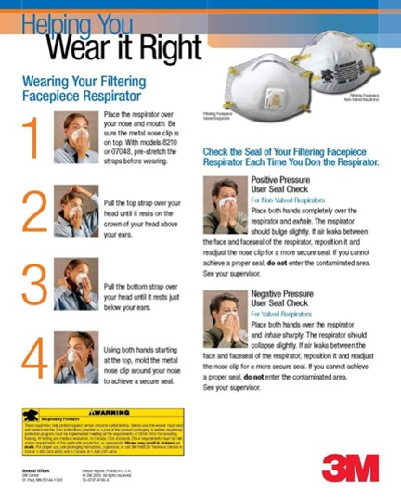
Fit Testing a Filtering Facepiece
Notes:
Filter face piece fit test method
Educational poster from 3M

Slide 44
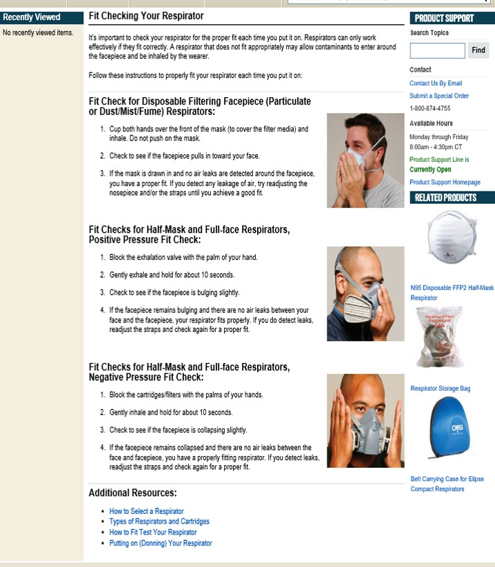
Gempler’s.com
Notes:
Fit check information found on Gemplers.com

Slide 45
Respirator Effectiveness
Maintain appropriate surveillance of work area conditions and degree of exposure or stress; reevaluate the respirator’s effectiveness when it may be affected by changes.
Employees must leave the respirator use area:
  to wash their faces and respirator facepieces as necessary
  if they detect vapor or gas breakthrough, changes in breathing resistance, or leakage of the facepiece
  to replace the respirator or filter, cartridge, or canister
If employee detects vapor or gas breakthrough, changes in breathing resistance, or leakage of the facepiece, employer must replace or repair the respirator before allowing employee to return to the work area.
Notes:
Maintain appropriate surveillance of work area conditions and degree of exposure or stress; reevaluate the respirator’s effectiveness when it may be affected by changes.
Employees must leave the respirator use area:
to wash their faces and respirator facepieces as necessary
if they detect vapor or gas breakthrough, changes in breathing resistance, or leakage of the facepiece
to replace the respirator or filter, cartridge, or canister
If employee detects vapor or gas breakthrough, changes in breathing resistance, or leakage of the facepiece, employer must replace or repair the respirator before allowing employee to return to the work area.

Slide 46
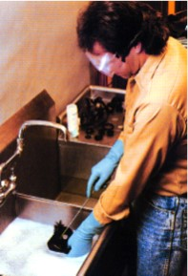
Maintenance and Care
Provide each user with a respirator that is clean, sanitary and in good working order.
Use procedures in equipment manufacturer’s recommendations.
Clean and disinfect at the following intervals.
  As often as necessary when issued for exclusive use
  Before being worn by different individuals when issued to more than one employee.
  After each use for emergency respirators and those used in fit testing and training.
Notes:
Photo from OSHA website sows man cleaning a half face respirator in a tub of soapy water.
Maintenance and Care is a critical part of the respiratory program
Follow procedures in Appendix B-2 or by manufactures recommendations
Establish a cleaning procedure and guidelines

Slide 47
Maintenance and Care
Important to store the respirator properly.
Do not seal it tight in a plastic bag or container after use - moisture will create a mold environment.
Store in paper sack or a canister with air flow
Throw away the 2-strap dust mask (filtering face piece) when you taste or feel the contaminant coming through.
Notes:
Important to store the respirator properly.
Do not seal it tight in a plastic bag or container after use - moisture will create a mold environment.
Store in paper sack or a canister with air flow
Sometimes may throw away the 2 strap dust mask (filtering face piece).

Slide 48
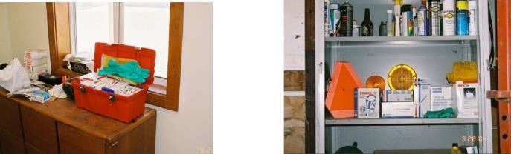
Storage
We recommend a central location on the farm or work place for storing most PPE supplies.
This could be a cabinet in the office or machine shed or a tackle box or rubber maid container – the main thing is that PPE is clean and easily accessible.
Notes:
Pictures show a box similar to a fishing tackle box for ppe storage in an accessible place. The photon the right shows a larger central storage area with a larger supply

Slide 49
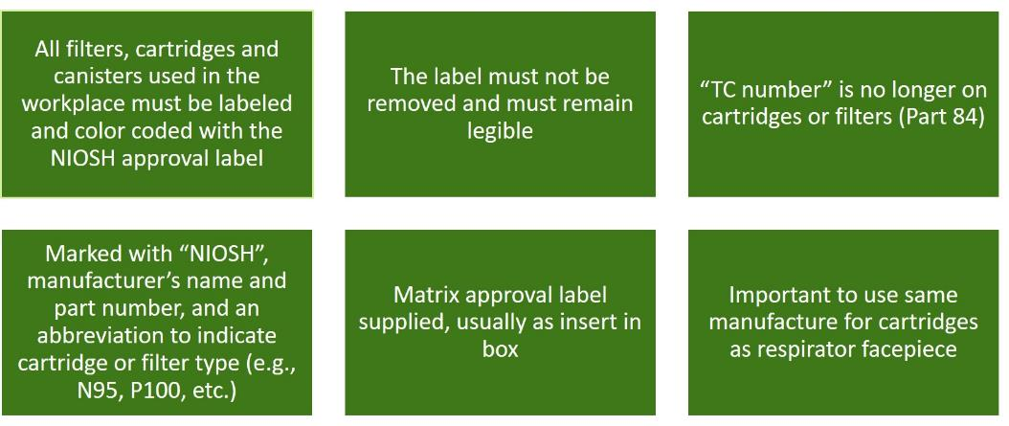
Identifying cartridges and filters
Notes:
All filters, cartridges and canisters
used in the workplace must be labeled
and color coded with the NIOSH approval label
The label must not be removed and must remain legible
“TC number” is no longer on cartridges or filters (Part 84)
Marked with “NIOSH”, manufacturer’s name and part number, and an abbreviation to indicate cartridge or filter type (e.g., N95, P100, etc.)
Matrix approval label supplied, usually as insert in box

Slide 50
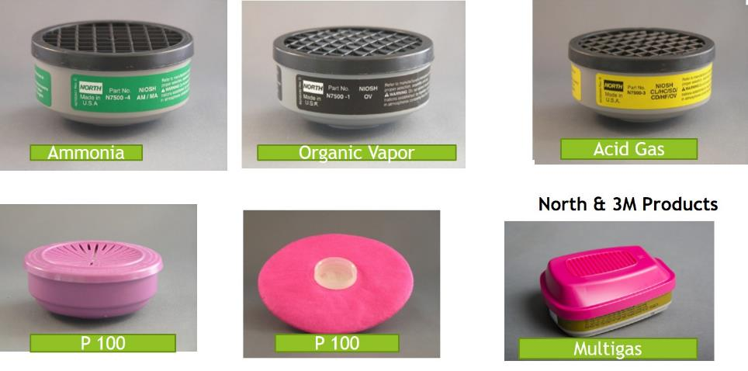
Cartridge Identification
Mention of any company name in our presentations does not constitute endorsement by AgriSafe Network
Notes:
Photos property of AgriSafe Network
These pictures show examples of the labeling on filters and cartridges.
All filters, cartridges and canisters
used in the workplace must be labeled
and color coded with the NIOSH approval label
The label must not be removed and must remain legible
“TC number” is no longer on cartridges or filters (Part 84)
Marked with “NIOSH”, manufacturer’s name and part number, and an abbreviation to indicate cartridge or filter type (e.g., N95, P100, etc.)
Matrix approval label supplied, usually as insert in box

Slide 51
Respirator Training and Information
Employees who are required to use respirators must be trained such that they can demonstrate knowledge of at least:
  why the respirator is necessary and how improper fit, use, or maintenance can compromise its protective effect
  limitations and capabilities of the respirator
  effective use in emergency situations
  how to inspect, put on and remove, use and check the seals
  maintenance and storage
  recognition of medical signs and symptoms that may limit or prevent effective use
  general requirements of this standard
Notes:
Effective training is part of training and information for employees who are required to wear respirators. Demonstration and return demonstration are key components of effective training sessions.

Slide 52
Respirator Training and Information
Training must be provided prior to use, unless acceptable training has been provided by another employer within the past 12 months
Retraining is required annually, and when:
  changes in the workplace or type of respirator render previous training obsolete
  there are inadequacies in the employee’s knowledge or use
  any other situation arises in which retraining appears necessary
The basic advisory information in Appendix D must be provided to employees who wear respirators when use is not required by this standard or by the employer
Notes:
Training must be provided prior to use, unless acceptable training has been provided by another employer within the past 12 months
Retraining is required annually, and when:
changes in the workplace or type of respirator render previous training obsolete
there are inadequacies in the employee’s knowledge or use
any other situation arises in which retraining appears necessary
The basic advisory information in Appendix D must be provided to employees who wear respirators when use is not required by this standard or by the employer

Slide 53
Program Evaluation
Must conduct evaluations of the workplace as necessary to ensure effective implementation of the program
Must regularly consult employees required to use respirators to assess their views on program effectiveness and to identify and correct any problems
Factors to be assessed include, but are not limited to:
  respirator fit (including effect on workplace performance)
  appropriate selection
  proper use
  proper maintenance
Notes:
Must conduct evaluations of the workplace as necessary to ensure effective implementation of the program
Must regularly consult employees required to use respirators to assess their views on program effectiveness and to identify and correct any problems
Factors to be assessed include, but are not limited to:
respirator fit (including effect on workplace performance)
appropriate selection
proper use
proper maintenance

Slide 54
Record Keeping
Records of medical evaluations must be retained and made available per 29 CFR 1910.1020
A record of fit tests must be established and retained until the next fit test is administered.
A written copy of the current program must be retained.
Written materials required to be retained must be made available upon request to affected employees and OSHA.
Notes:
Records of medical evaluations must be retained and made available per 29 CFR 1910.1020
A record of fit tests must be established and retained until the next fit test is administered
A written copy of the current program must be retained
Written materials required to be retained must be made available upon request to affected employees and OSHA

Slide 55
OSHA Standards Applicable to Chemical Handling
1910.111, Storage and handling of anhydrous ammonia
1910.111(a), General
1910.111(b), Basic rules
This standard is intended to apply to the design, construction, location, installation, and operation of anhydrous ammonia systems including refrigerated ammonia storage systems
Notes:
1910.111, Storage and handling of anhydrous ammonia
1910.111(a), General
1910.111(b), Basic rules
This standard is intended to apply to the design, construction, location, installation, and operation of anhydrous ammonia systems including refrigerated ammonia storage systems

Slide 56
Hazard Communication Standard
1910.1200 Hazard Communication
  The purpose of this section is to ensure that the hazards of all chemicals produced or imported are evaluated, and that information concerning their hazards is transmitted to employers and employees.
  This transmittal of information is to be accomplished by means of comprehensive hazard communication programs, which are to include container labeling and other forms of warning, material safety data sheets and employee training.
Notes:
1910.1200 Hazard Communication
The purpose of this section is to ensure that the hazards of all chemicals produced or imported are evaluated, and that information concerning their hazards is transmitted to employers and employees.
This transmittal of information is to be accomplished by means of comprehensive hazard communication programs, which are to include container labeling and other forms of warning, material safety data sheets and employee training.

Slide 57
Worker Protection Standard
The Worker Protection Standard is intended to protect employees on farms, forests, nurseries, and greenhouses that are occupationally exposed to agricultural pesticides.^{[1]}
This is managed by the United States Environmental Protection Agency (EPA), and is separate from the Hazard Communication Standard managed by Occupational Safety and Health Administration (OSHA).
Employers must provide training as specified by the Environmental Protection Agency [EPA 170.130]
Employer must provide respirator and fit testing, training, and medical evaluation that conforms to OSHA standards for any handler required to wear any respirator by the labeling. Require recordkeeping of completion of fit test, training, and medical evaluation.
Notes:
The Worker Protection Standard is intended to protect employees on farms, forests, nurseries, and greenhouses that are occupationally exposed to agricultural pesticides.[1]
This is managed by the United States Environmental Protection Agency (EPA), and is separate from the Hazard Communication Standard managed by Occupational Safety and Health Administration (OSHA).

Slide 58
Worker Protection Standard
The changes that went into effect in 2017 impact young workers.
Handlers and early-entry workers must be at least 18 years old.
(Members of owner’s immediate family are exempt from this and most other requirements of the WPS.)
Definition of family has changed: Previously Included spouse, parents, stepparents, foster parents, children, stepchildren, foster children, brothers, and sisters.
  Expanded to also include all in-laws, grandparents, grandchildren, aunts, uncles, nieces, nephews and first cousins.
Notes:
The changes that went into effect in 2017 impact young workers.
Handlers and early-entry workers must be at least 18 years old.
(Members of owner’s immediate family are exempt from this and most other requirements of the WPS.)
Definition of family has changed: Previously Included spouse, parents, stepparents, foster parents, children, stepchildren, foster children, brothers, and sisters.
Expanded to also include all in-laws, grandparents, grandchildren, aunts, uncles, nieces, nephews and first cousins.

Slide 59
OSHA Resources available on www.osha.gov

Slide 60

OSHA Resources
Notes:
OSHA Resources available on OSHA. Gov
How to get to this location
Search Bar
A-Z Index

Slide 61
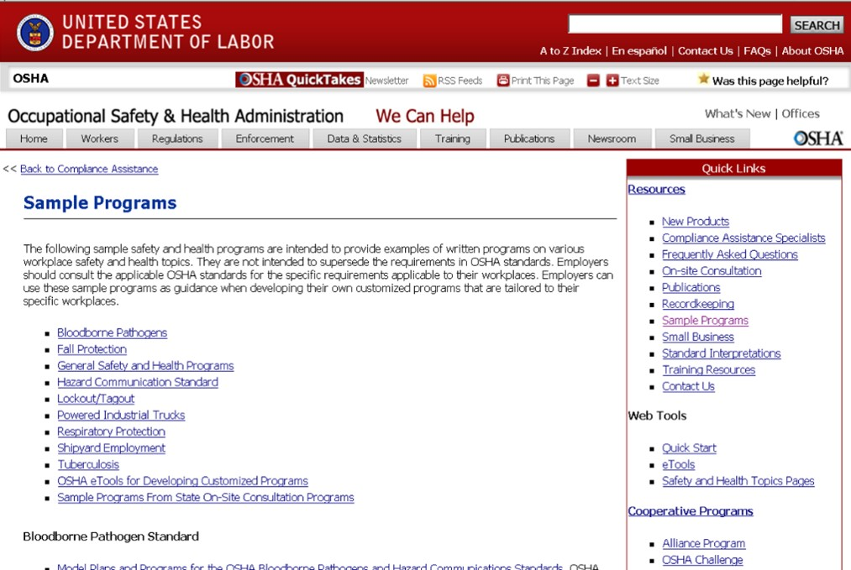
OSHA Sample Programs
Notes:
Step by step directions

Slide 62
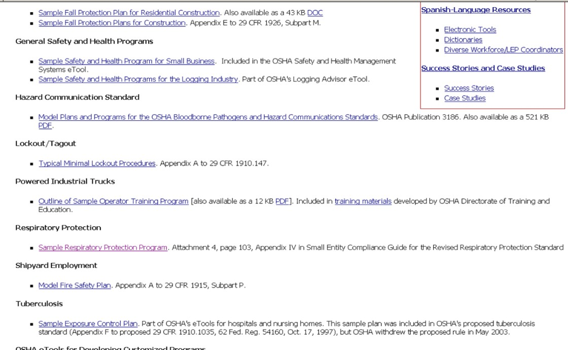
Sample of OSHA Respiratory Program
Notes:
Sample of OSHA Respiratory Program

Slide 63
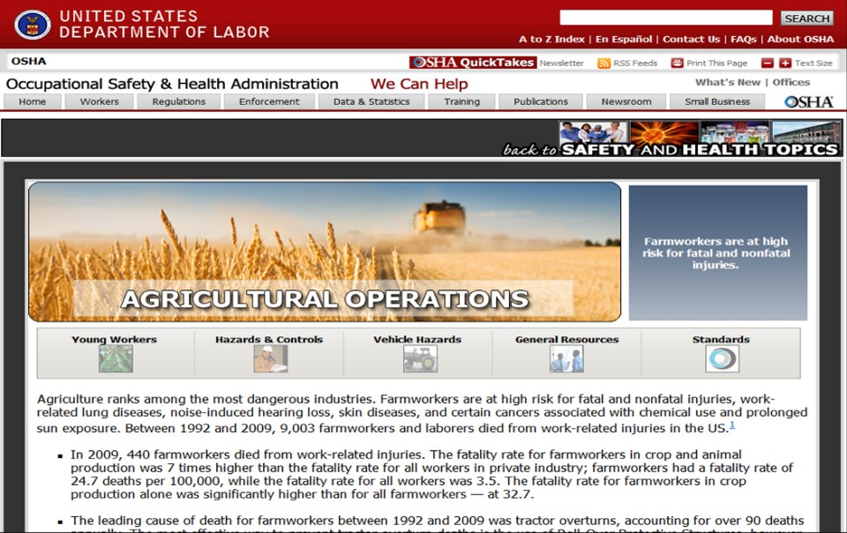
Agricultural Operations Quick takes
Notes:
Agricultural Operations Quick takes Topics Page
www.osha.gov

Slide 64
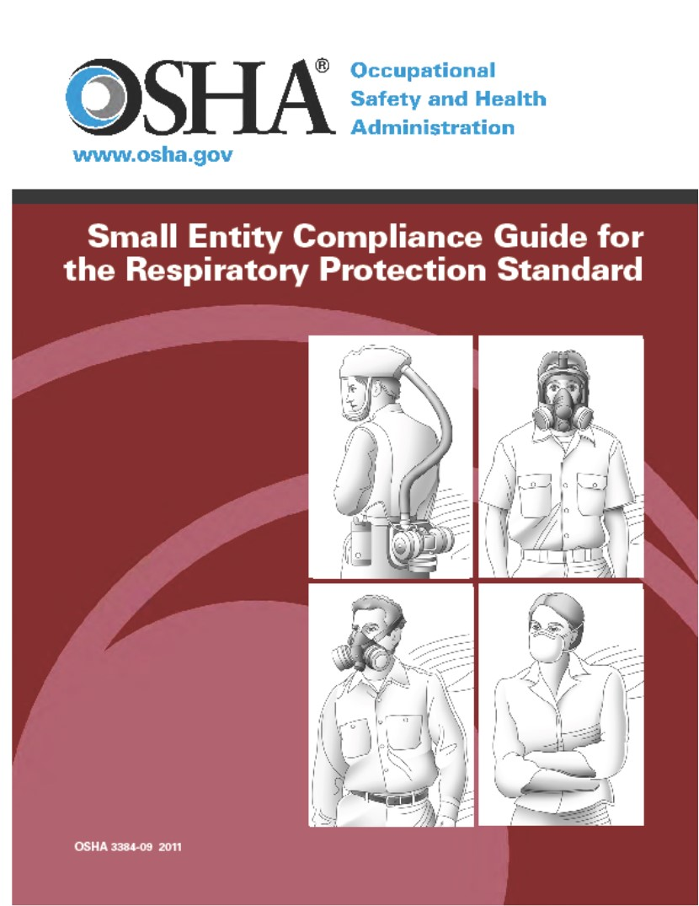
OSHA Small Entity Compliance Guide
Notes:
OSHA Small Entity Compliance Guide is a useful tool in Respiratory Program Development

Slide 65
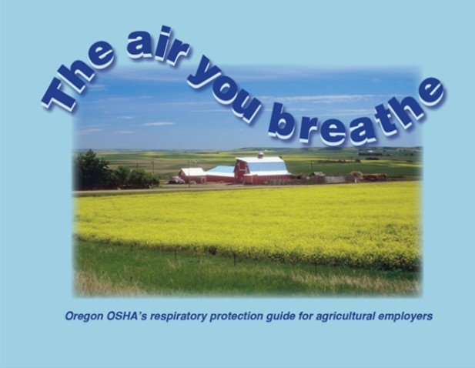
Oregon OSHA
Notes:
This contains an agriculture respiratory protection guide: The Air You Breathe
Oregon OSHA resources include an agricultural specific respiratory protection guide for agricultural employers
How to find this resource:
Oregon OSHA

Slide 66
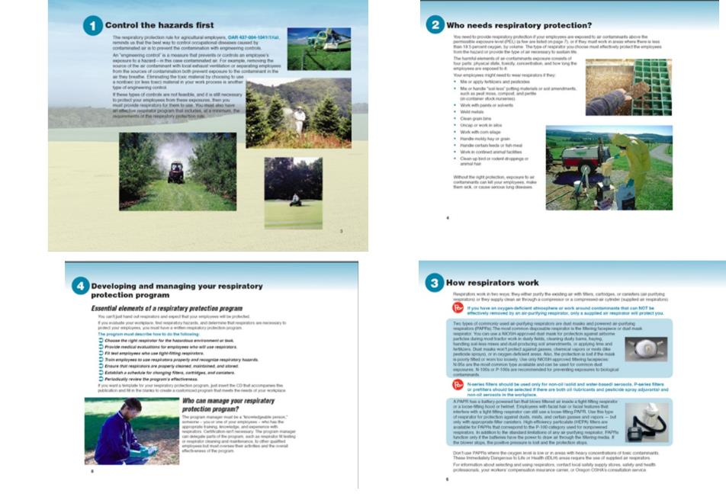
Resoucres
Notes:
Pages from the Air You Breathe – Oregon OSHA

Slide 67
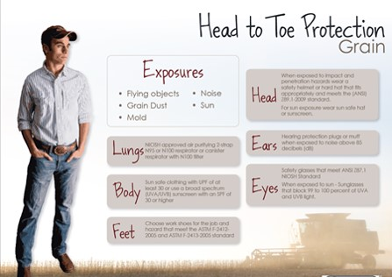
AgriSafe Resources
Notes:
Resource for producers and employees developed by AgriSafe Network

Slide 68
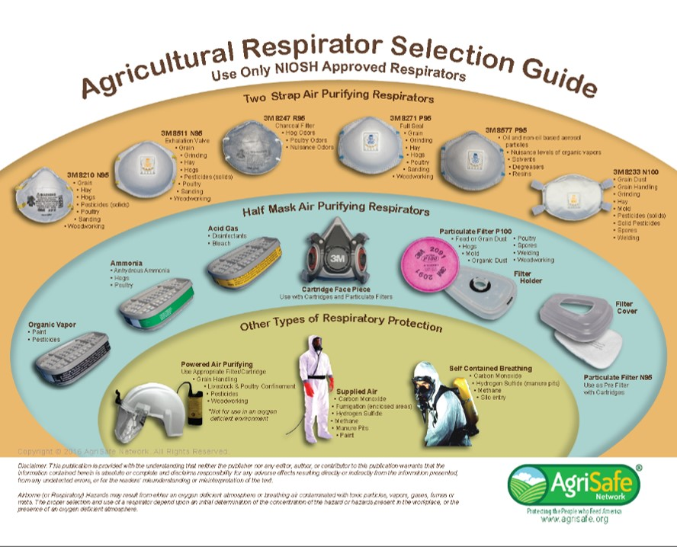
Agricultural Respirator selection guide
Notes:
Respirator selection guide developed by AgriSafe and 3M

Slide 69
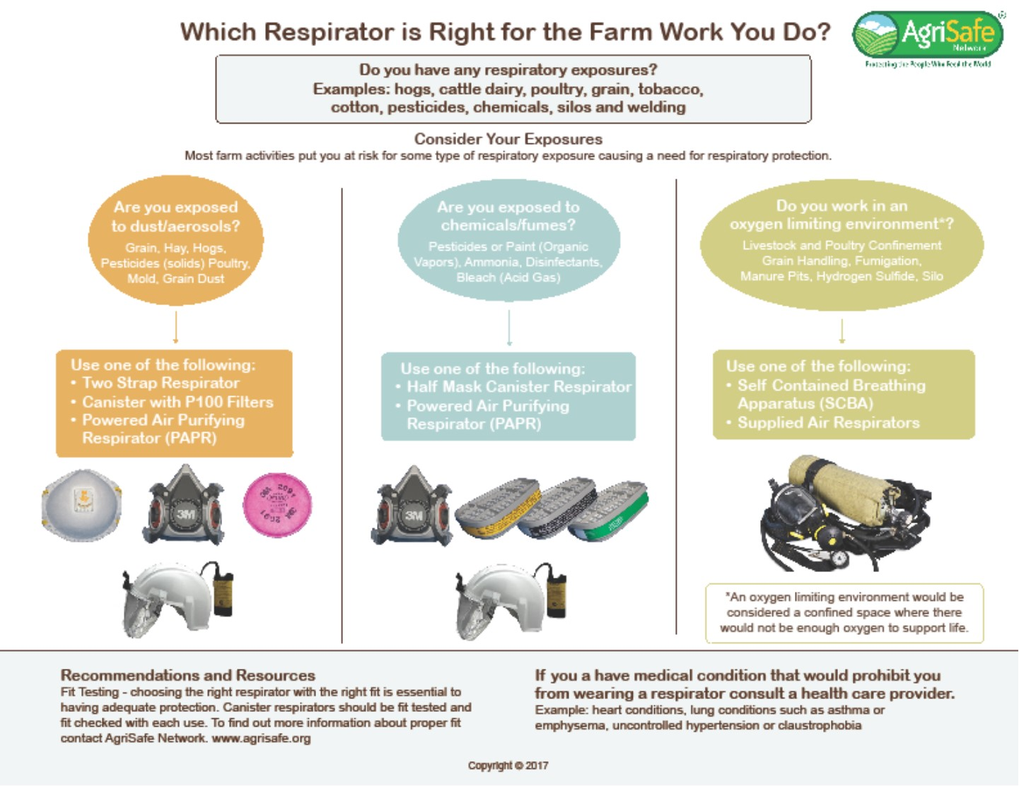
Agricultural Respirator selection guide
Notes:
Resource developed by AgriSafe Network. Currently on the reverse side of the previous selection guide page.

Slide 70
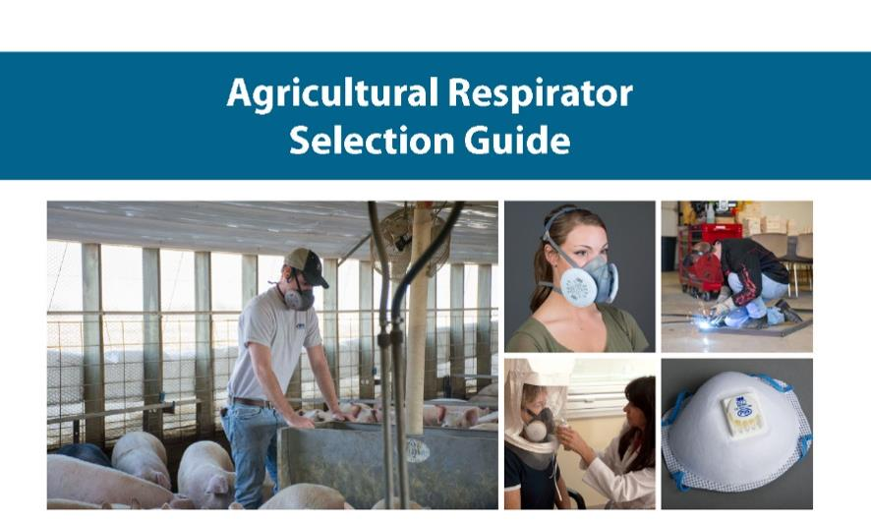
AgriSafe Respirator Selection Guide
Notes:
AgriSafe Respirator Selection Guide

Slide 71
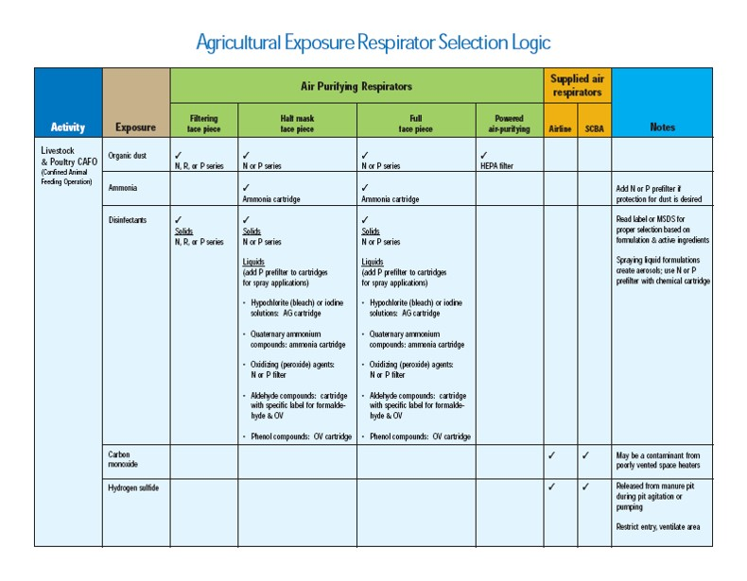
Agricultural Exposure Respirator Selection Logic
Notes:
Picture of a page from the AgriSafe Respirator Selection Guide

Slide 72
Employee Rights and Responsibilities
You have the right to:
  A safe and healthful workplace
  Know about hazardous chemicals
  Information about injuries and illnesses in your workplace
  Complain or request hazard correction from employer
Notes:
Review Employee Rights www.osha.gov

Slide 73
Employee Rights and Responsibilities
You have the right to:
  Training
  Access to hazard exposure and medical records
  File a complaint with OSHA
  Participate in an OSHA inspection
  Be free from retaliation for exercising safety and health rights
Notes:
Review Employee Rights www.osha.gov

Slide 74
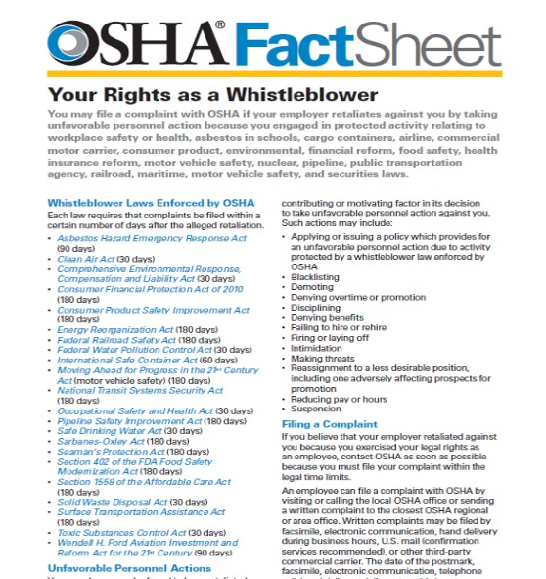
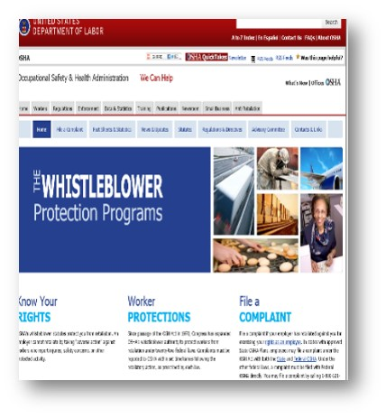
OSHA Whistleblower Protection Program
Whistle Blower Protection Program
Notes:
OHSA Whistleblower Protection Program

Slide 75
Evaluation
Please take a few minutes to honestly evaluate this program. Your input and suggestions will help us in our effort to continually improve our work on behalf of the agricultural community.
Notes:
Provide us with valuable Evaluation information to help improve our presentations

