Slide 1
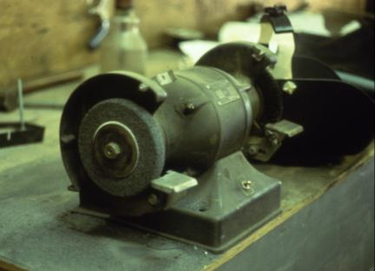
Machinery Safety
What is wrong with this picture?
Machine Guarding for Warehouse and Maintenance Workers
This material was produced under grant number SH-31178-SH7 from the Occupational Safety and Health Administration, U.S. Department of Labor. It does not necessarily reflect the views or policies of the U.S. Department of Labor, nor does mention of trade names, commercial products, or organizations imply endorsement by the U.S. Government. Revisions were made to this material under grant number SH-31177-SH7 from the Occupational Safety and Health Administration, U.S. Department of Labor.
Notes:
Bench grinder – personal picture
Unguarded wheel, no tongue guard

Slide 2
Objectives
Explain the general requirements for guarding the hazards of machines
Describe precautions to be taken around machinery
Identify important terms associated with guarding machinery

Slide 3
Machinery Safety 29CFR1910.212
Discussion
General requirements for machine guards. Guards shall be affixed to the machine where possible and secured elsewhere if for any reason attachment to the machine is not possible. The guard shall be such that it does not offer an accident hazard in itself.

Slide 4
Machinery Safety
Machines have the potential to cause
Crushed fingers or hands
Amputations
Burns
Blindness

Slide 5
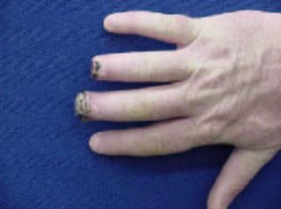
The Problem
Workers who operate and maintain machinery each year suffer approximately
18,000 amputations, lacerations, crushing injuries, and abrasions
800 deaths
OSHA 7100
Notes:
Data from http://www.osha.gov/SLTC/etools/machineguarding/index.html

Slide 6
High-Risk Machinery
Mechanical power presses
Power press brakes
Powered and non-powered conveyors
Printing presses
Roll-forming and roll-bending machines
Shearing machines
Food slicers
Meat grinders
Meat-cutting band saws
Drill presses
Milling machines
Shears, grinders, and slitters
Table and portable saws

Slide 7
The Problem: Machinery Associated with Amputations
Mechanical power presses
Power press brakes
Powered and non-powered conveyors
Printing presses
Roll-forming and roll-bending machines
Shearing machines
Food slicers
Meat grinders
Meat-cutting band saws
Drill presses
Milling machines
Grinding machines
Notes:
OSHA 3170

Slide 8
Causes of Machine Incidents
Reaching in to “clear” equipment
Not using Lockout/Tagout
Unauthorized person doing maintenance or using the machines
Missing or loose machine guards
Lack of training

Slide 9
Prevention
Safeguarding any machine part, function, or process which may cause injury
Controlling or eliminating all hazards where the operation of a machine can injure the operator or other workers
Training workers on the hazards of machines and how to safely operate and repair machinery

Slide 10
Applicable OSHA Standards
29 CFR Part 1910
Subpart J (1910.147): The control of hazardous energy (Lockout/Tagout)
Subpart O: Machinery and machine guarding
Subpart P (1910.243): Guarding of portable powered tools
Subpart R: Special industries (e.g., Bakery equipment)

Slide 11
OSHA Citations Fiscal Year 2016
Lockout/Tagout (1910.147)
5th most frequently cited standard
Machines, general requirements (1910.212)
8th most frequently cited standard

Slide 12
OSHA Requirements for Recordkeeping and Reporting
Employers of 11 or more employees must maintain records of occupational injuries and illnesses
All employers must display the OSHA poster
All employers must report to OSHA within 8 hours a fatality, any in-patient hospitalization, any amputation, and any loss of an eye within 24 hours
These reports maybe made by telephone or in person to the nearest OSHA area office listed at www.osha.gov or toll-free number telephone(800)321-OSHA(6742)
Employers maybe subject to other reporting requirements in other OSHA standards as well

Slide 13
Employers’ responsibilities under OSHA
Employers’ responsibilities Under OSHA
Provide a safe and healthful workplace free of recognized hazards
Follow OSHA standards
Provide worker training in an understandable language
Maintain injury/illness records (Information on the OSHA 300A log)
Provide required safety gear

Slide 14
Employees’ rights under OSHA
Filing an OSHA complaint
Participating in OSHA inspections and talking to an inspector
Accessing employer exposure and injury records
Reporting an injury
Complaining to the employer about a safety and health concern

Slide 15
Whistleblower Laws
Section 11(c) of the OSHA Act prohibits employers from discriminating against employees who exercise their rights
OSHA also enforces anti-discrimination laws for 22 other statutes

Slide 16
Employer Prohibited Retaliatory
Firing or laying off
Blacklisting
Demoting
Denying overtime or promotion
Disciplining
Denial of benefits
Failure to hire or
rehire
Intimidation and harassment
Making threats
Reassignment
Reducing pay or hours

Slide 17
Complaint Procedures
Safety and health complaints should be filed when problem is noticed
Whistleblower complaints must be filed within 30 days of alleged reprisal
Complaints may be filed online, fax, mail or telephone
Complaints are confidential

Slide 18

Machine Guarding
OSHA’s 1910 Subpart O
Notes:
Safety Sign created by hand

Slide 19
Basic Areas To Be Safeguarded
Point of Operation
Power Transmission Apparatus
Other Moving Parts
Notes:
Point of Operation - The point where work is performed on the material, such as cutting, shaping, boring or forming of stock.
Power Transmission Apparatus - All components of the mechanical system which transmit energy to the part of the machine performing the work. Including flywheels, pulleys, belts, connecting rods, couplings, cams, spindles, chains, cranks and gears.
Other moving parts - all parts which move while machine is working. Includes reciprocating, rotating and transverse moving parts, feed mechanisms etc.

Slide 20
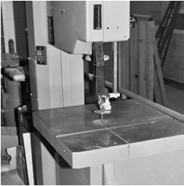
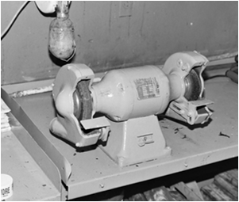
Point of Operation
Point of Operation
Source: NJAFL-CIO
17

Slide 21
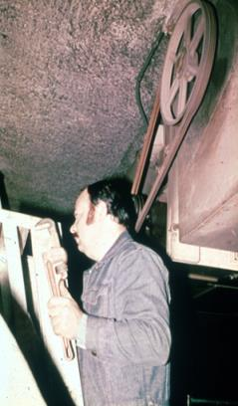
Power-Transmission Apparatus
Power-Transmission Apparatus
apparatus (shafting, flywheels, pulleys, belts, chain drives, etc.) less than 7 feet from the floor or working platform must be guarded.
Unguarded belt and pulley
OSHA

Slide 22
Hazard Identification
Motions
Rotating (including in-running nip points)
Transverse
Reciprocating
Actions
Cutting
Punching
Shearing
Bending

Slide 23
Rotating Motion
Hazard – Machinery grips and moves clothing, hair and body parts into danger area
Danger increases when projections are present
Screws, bolts, nicks, abrasions, etc.

Slide 24
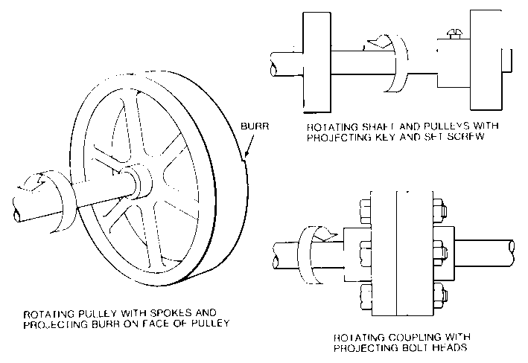
Rotating Parts with Projections
BURR
Rotating shaft and pulleys with projecting key and set screw
Rotating pulley with spokes and projecting burr on face of pulley
Rotating coupling with projecting bolt heads
OSHA 3067

Slide 25
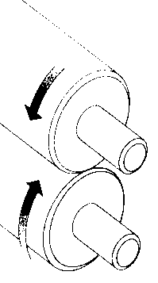
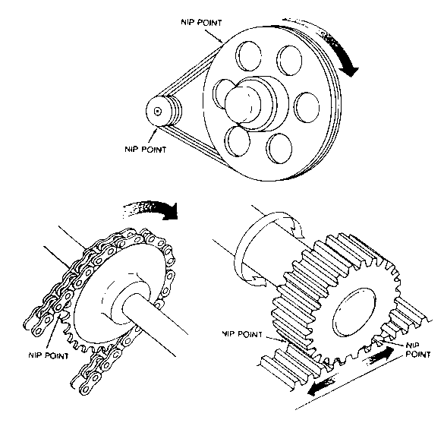
In-Running Nip Points OSHA 3067
Nip Point
Nip Point
Nip Point
OS
Nip Point
Notes:
Pressure rollers, belt and pulley; chain and sprocket; and rack and pinion
In-running nip point hazards are caused by the rotating parts on machinery. There are three main types of in-running nips.
Parts can rotate in opposite directions while their axes are parallel to each other. These parts may be in contact (producing a nip point) or in close proximity to each other (where the stock fed between the rolls produces the nip points). This danger is common on machinery with intermeshing gears and rotating cylinders.
Another type of nip point is created between rotating and tangentially moving parts; for example, a chain and a sprocket, a rack and pinion, or the point of contact between a power transmission belt and its pulley.

Slide 26
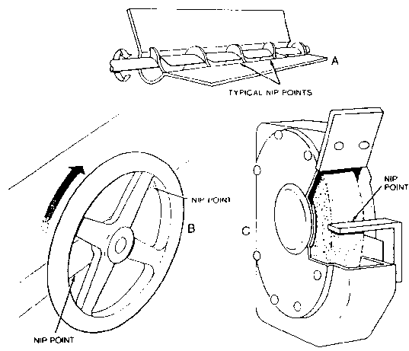
In-Running Nip Points
Nip Points
OSHA 3067
Nip Point
Nip Point
Notes:
Nip points can also occur between rotating and fixed parts which create a shearing, crushing, or abrading action; for example, spoked handwheels or flywheels, screw conveyors, or the periphery of an abrasive wheel and an incorrectly adjusted work rest.

Slide 27
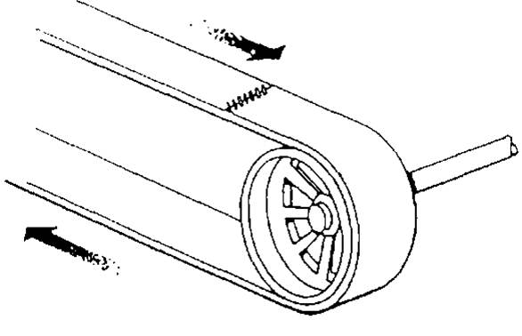
Transverse Motion
Movement in a straight, continuous line around rotating component
Hazard may strike or catch employee a pinch or shear point OSHA3067
Notes:
Motion may strike or catch an employee in a pinch or shear point created by the moving part and a fixed object.

Slide 28
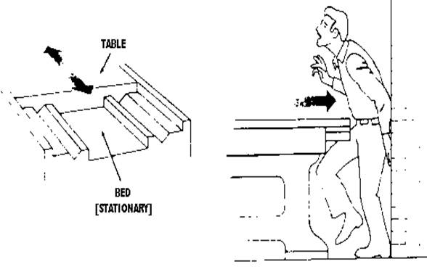
Reciprocating Motion
Back and forth / up and down
Hazard - Caught between moving part and stationary object
OSHA 3067

Slide 29
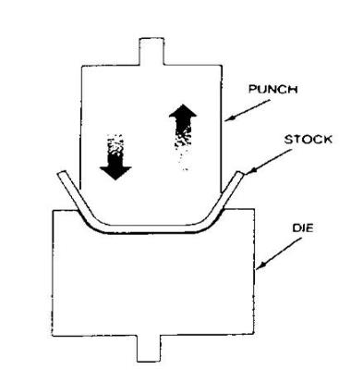
Bending Actions
Power applied to slide to draw or stamp metal or other materials in a bending motion
Example: Press Brake, Tube Benders
OSHA 3067
Notes:
The hazard occurs at the point of operation where the employee typically inserts, holds, or withdraws the stock by hand.

Slide 30
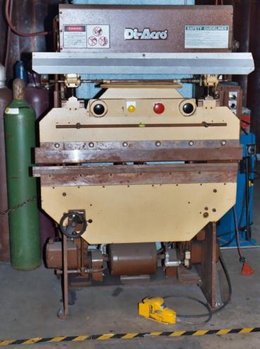
Bending Actions Press Brake
OSHA GI 10 Hour
Notes:
Press Brake – personal picture. The hazard occurs at the point of operation where the employee typically inserts, holds, or withdraws the stock by hand.

Slide 31
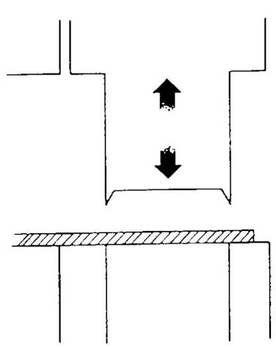
Punching Actions
Power applied to slide ram for purpose of blanking, drawing or stamping
Example: Power press
OSHA 3067
Notes:
The hazard occurs at the point of operation where the employee typically inserts, holds, or withdraws the stock by hand.
OSHA 3067

Slide 32
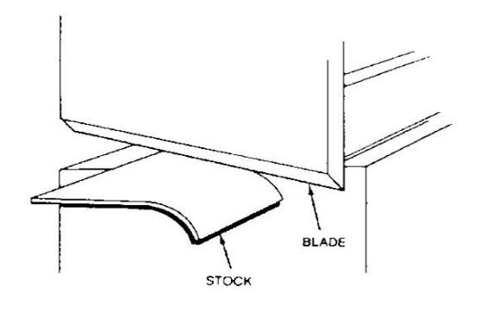
Shearing Actions
Apply power to slide or knife to trim or cut
OSH A3067
Notes:
The hazard occurs at the point of operation where the employee typically inserts, holds, or withdraws the stock by hand.

Slide 33
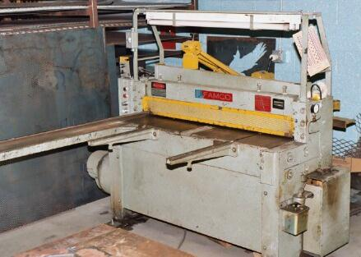
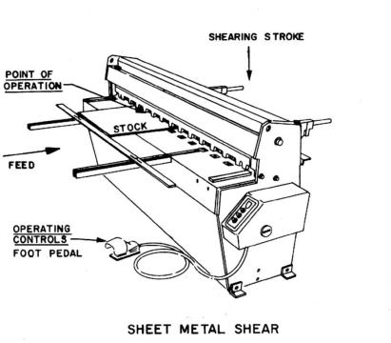
Shearing Actions Sheet Metal Shear
NJAFL-CIO
OSHA 7100

Slide 34
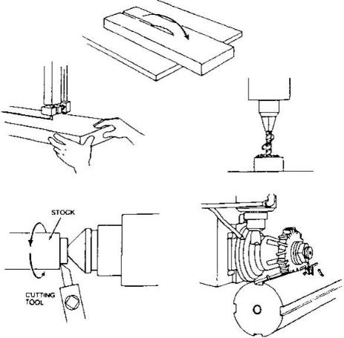
Cutting Actions
Rotating, reciprocating or transverse motion
Examples: Band saw, circular saws, lathes, drills
OSHA 3067

Slide 35
Types of Safeguards
Guards
Devices
Location/distance
Automatic/semiautomatic feed or ejection
Miscellaneous
Notes:
Guards: physical barriers that enclose dangerous machine parts and prevent employee contact
Devices: Controls or attachments that, when properly designed, applied and used, usually prevent inadvertent access by employees to hazardous machine areas.
Location/distance: may involve an operator holding and supporting a work-piece with both hands at a predetermined minimum safe distance or, if both hands cannot be used to hold the work-piece at a distance so that the operator cannot reach the hazard with the free hand.

Slide 36
Types of Guards
Fixed
Provide secure barrier
Interlocked
Cuts off power when guard opened or removed
Adjustable
Barrier manually moved to accommodate stock or operation
Self-adjusting
Barrier automatically moves to accommodate operation

Slide 37
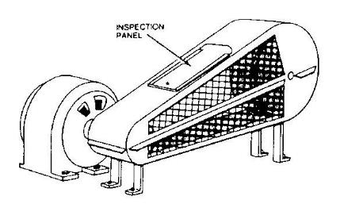
Fixed Guards
Advantages
Maximum protection
Variety of applications
In-house fabrication
Low cost & maintenance
Disadvantages
Poor visibility
Must remove for repairs requiring LOTO
OSHA3067
OSHA
OSHA 3067
Notes:
Advantages: Can be constructed to suit many applications; permanently encloses the point of operation or hazard area; provides protection against machine repeat; and allows simple, in-plant construction, with minimal maintenance.
Disadvantages: Sometimes not practical for changing production runs involving different size stock or feeding methods; machine adjustment and repair often require guard removal; and other means of protecting maintenance personnel often required (lockout/tagout).

Slide 38
Interlocked Guards
Switch that when opened stops power
Advantage
Maximum protection
Portion of guard easily removed for access
Disadvantage
Can be overridden by employee
High cost
Maintenance required
Notes:
Advantages: Allows access for some minor service work, in accordance with the lockout/tagaout exception, without time-consuming removal of fixed guards.
Disadvantages: May require periodic maintenance or adjustment; movable section cannot be used for manual feeding; some designs may be easy to defeat; and interlock control circuitry may not be used for all maintenance and servicing work.

Slide 39
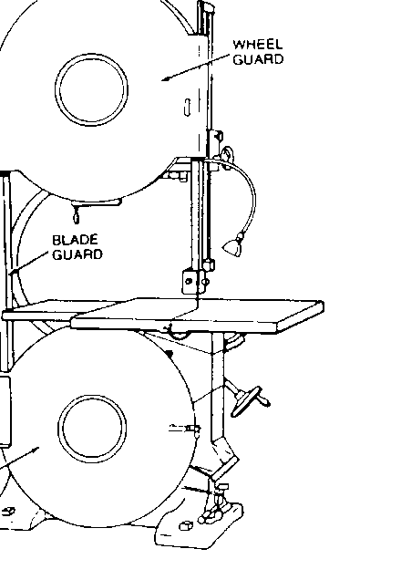
Adjustable Guards
Advantage
Flexibility
In-house fabrication
Disadvantage
Not maximum protection
Rely on worker to properly position
May prohibit easy access
OSHA 3067
Bandsaw blade adjustable guard
OSHA 3067
Notes:
Advantages: Can be constructed to suit many applications; and can be adjusted admit varying stock sizes.
Disadvantages: May require frequent maintenance or adjustment; and operator may make guard ineffective

Slide 40
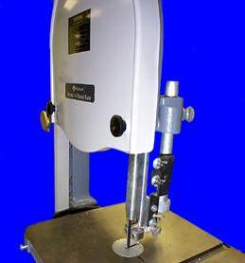
Adjustable Guards Bandsaw
Barrier may be adjusted for variable operations
What are the drawbacks?
Bandsaw blade adjustable guard
OSHA 10 Hour GI Presentation

Slide 41
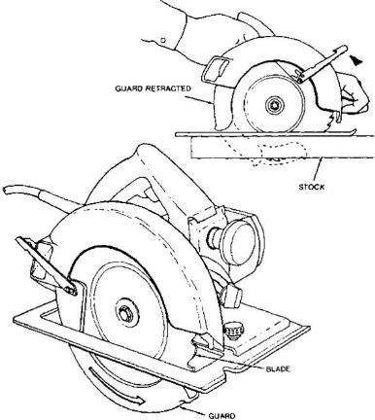
Self-adjusting Guards
Advantage
Employee not involved in positioning
Readily available
Disadvantage
Not maximum protection
May need frequent fine tuning
OSHA 3067
Notes:
Advantages: Off-the-shelf guards are often commercially available
Disadvantages: Does not provide maximum protection; and may require frequent maintenance and adjustment.

Slide 42
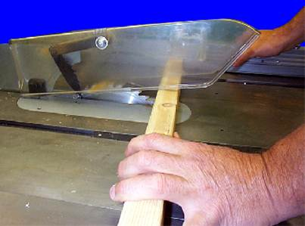
Self-adjusting Guard Table Circular Saw
OSHA GI 10 Hour

Slide 43
Devices
Presence sensing
Photoelectrical
Radiofrequency
Electromechanical
Pullback
Restraint
Safety Controls
Safety trip control
Two-hand control/trip
Gates

Slide 44
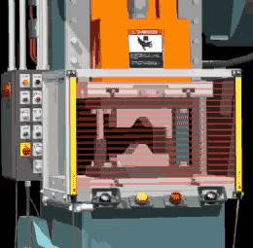
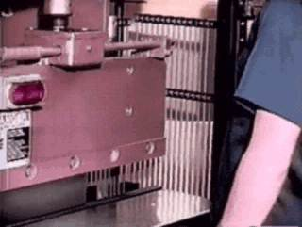
Presence-Sensing Device
www.osha.gov/SLTC/etools/machineguarding/presses/psd.html
Notes:
Interlocks into the machine’s control system to stop operation when the sensing filed (photoelectric, radio frequency, or electromagnetic) is disturbed.
Advantages: adjust to fit different stock sizes; allows access to load and unload the machine; and allows access to the guarded area for maintenance and set-up activities.
Disadvantages: Restricted to machines that stop operating cycle before operator can reach into danger area (e.g., machines with partial revolution clutches or hydraulic machines); Must be carefully maintained and adjusted; does not protect operator in the event of a mechanical failure; and operator may make device ineffective.
There are also presence-sensing mats that interlock into machine’s control system to stop operation when a predetermined weight is applied to the mat. A manual reset switch must be located outside the protected zone.

Slide 45
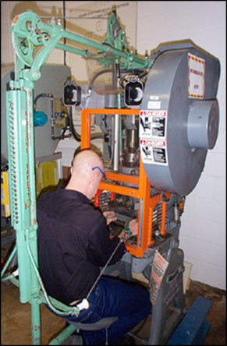
Pullback Device
Utilizes a series of cables attached to the operator’s hands, wrists, and/or arms
Primarily used on machines with stroking action
Allows access to the point of operation when the slide/ram is up
Withdraws hands when the slide/ram begins to descend
OSHA 10 Hour GI Presentation

Slide 46
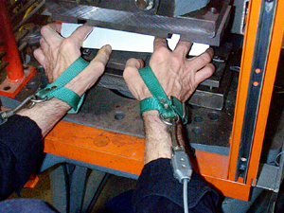
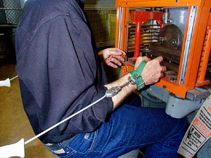
Types of Machine Safe Guards Hands in die, feeding Point of operation exposed Pullback device attached and properly adjustedHands in die, feeding Point of operation exposed Pullback device attached and properly adjusted
OSHA 10 Hour GI Presentation

Slide 47
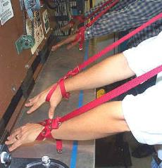
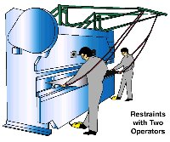
Restraint Device
Uses cables or straps attached to the operator’s hands and a fixed point
Must be adjusted to let the operator’s hands travel within a predetermined safe area OSHA GI 10 Hour
Hand-feeding tools are often necessary if the operation involves placing material into the danger area
NJAFL-CIO

Slide 48
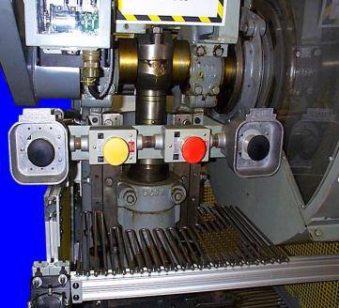
Two-Hand Control
Requires constant, concurrent pressure to activate the machine
The operator’s hands are required to be at a safe location (on control buttons) and at a safe distance from the danger area while the machine completes its closing cycle
OSHA GI 10 hour
.
Notes:
This kind of control requires a part-revolution clutch, brake, and brake monitor if used on a power press as shown.
A similar device, known as a two-hand trip, requires concurrent application of both of the operator’s control buttons to activate the machine cycle, after which the hands are free. This device is used with machines equipped with full-revolution clutches. The trips must be placed far enough from the point of operation to make it impossible for the operators to move their hands from the trip buttons or handles into the point of operation before the first half of the cycle is completed to prevent them from being accidentally placed in the danger area prior to the slide/ram or blade reaching the full “down” position.
Advantages: operator’s hands are at a predetermined safe distance; and operator’s hands are free to pick up new parts after completion of first part of cycle.
Disadvantages: Requires a partial cycle machine with a brake and anti-repeat feature; operator may make devices without anti-tiedown ineffective; and protects the operator only.

Slide 49
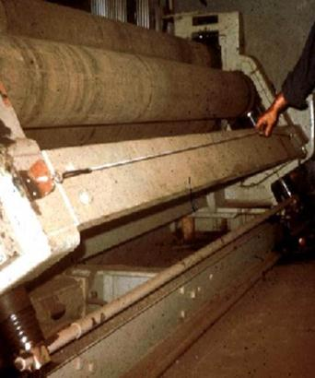
Safety Tripwire Cables
Device located around the perimeter of or near the danger area
Operator must be able to reach the cable to stop the machine
OSHA GI 10 hour
Notes:
Safety trip controls provide a quick means for deactivating the machine in an emergency situation. For example a pressure-sensitive body bar, when depressed, will deactivate the machine. If the operator or anyone trips, loses balance, or is drawn toward the machine, applying pressure to the bar will stop the operation. Trip-rods and trip-wires are also used in the same fashion. Tripwire cables must be manually reset to restart the machine.

Slide 50
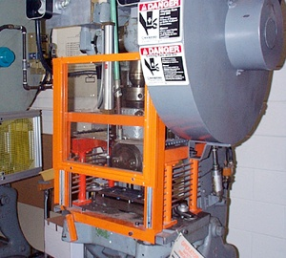
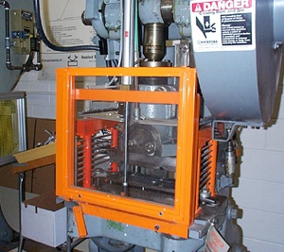
Gate
Movable barrier device which protects the operator at the point of operation before the machine cycle can be started
If the gate does not fully close, machine will not function
OSHA GI 10 hour
Gate Open
Gate Closed
Notes:
Power Press: Provides barrier between danger area and operator until completion of machine cycle. Another potential application of this type of device is where the gate is a component of a perimeter safeguarding system. Here the gate may provide protection not only to the operator but to pedestrian traffic as well.
Advantages: prevents operator from reaching into danger area during machine cycle; and provides protection from machine repeat.
Disadvantages: may require frequent inspection and regular maintenance; and may interfere with operator’s ability to see work.
On some machines, gate may only prevent access on the downstroke. This may increase production by allowing the operator to remove and feed the press on the upstroke.

Slide 51
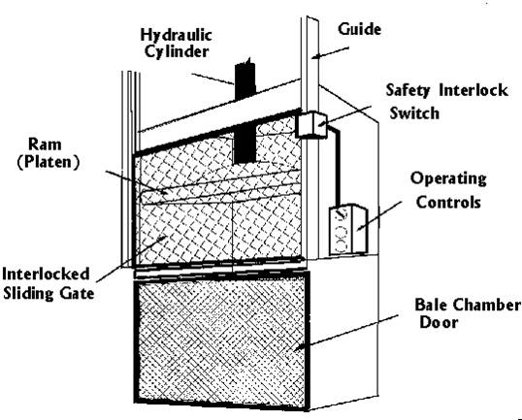
Gate Vertical Downstroke Baler
www.cdc.gov/niosh/hc14.html
Notes:
When gate is lifted, interlock switch prevents baler from operating.

Slide 52
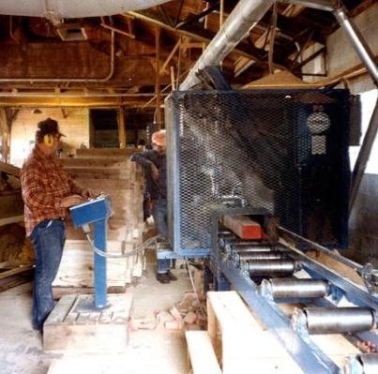
Safeguard by location/distance
Position dangerous parts of machine in inaccessible areas during normal operation
Moving parts more than 7 feet above floor
Controlled access room
Control station at safe distance from machine
OSHA GI 10 hour
Notes:
One approach to safeguarding by location is shown in this photo. Operator controls may be located at a safe distance from the machine if there is no reason for the operator to tend it.
Another approach is to locate the machine so that a plant design feature, such as a wall, protects the worker and other personnel. Enclosure walls or fences can also restrict access to machines. Another possible solution is to have dangerous parts located high enough to be out of the normal reach of any worker.
Another example of a safe distance safeguarding method is the use of gravity feed methods that reduce or eliminate employee exposure to machine hazards as the part slides down a chute into the point of operation.

Slide 53
Feeding and Ejection Methods
Automatic / semiautomatic feed
Automatic / semiautomatic ejection
Robots
Notes:
In these devices and employee places the part in a magazine which is then fed into the point of operation. Automatic and semiautomatic ejection methods include pneumatic (jet of air), magnetic, mechanical *such as an arm), or vacuum.

Slide 54
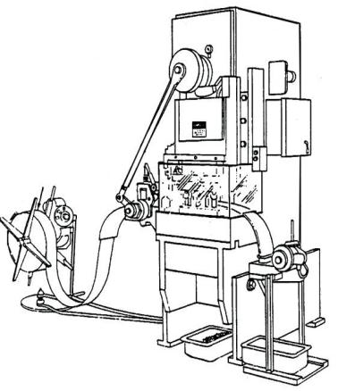
Automatic Feed (shown on power press)
Transparent
Enclosure
Guard
Stock Feed
Roll
Danger
Area
Completed Work
OSHA 3170
Notes:
Many feeding and ejection methods do not require operators to place their hands in the danger area. In some cases, no operator involvement is necessary after the machine is set up. In other situations, operators can manually feed the stock with the assistance of a feeding mechanism. Properly designed ejection methods do not require operator involvement after the machine starts to function.
Using feeding and ejection methods does not eliminate the need for safeguarding. Guards and other devices must be used wherever they are necessary to provide protection from hazards.
Automatic feeds reduce the operator exposure during the work process, and sometimes do not require any effort by the operator after the machine is set up and running.
The power press shown in the photo above has an automatic feeding mechanism. Notice the transparent fixed enclosure guard at the danger area.

Slide 55
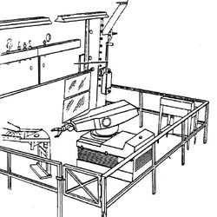
Robots
Machines that load and unload stock, assemble parts, transfer objects, or perform other tasks
Best used in high-production processes requiring repeated routines where they prevent other hazards to employees
Press
Robot
Stock
Conveyor
Fixed
Barrier
OSHA 3170
Notes:
Robots may create hazards themselves. If they do, appropriate guards must be used. The most common technique is to use perimeter guarding with interlocked gates.
The American National Standards Institute (ANSI) safety standard for industrial robots, ANSI/RIA R15.06-1999, presents certain basic requirements for protecting the worker. However, when a robot is used in a workplace, the employer should accomplish a comprehensive operational safety and health hazard analysis and then implement an effective safeguarding system which is fully responsive to the situation. [Various effective safeguarding techniques are described in ANSI B11.19-1990 (R1997).]
Studies in Sweden and Japan indicate that many robot accidents did not occur under normal operating conditions, but rather during programming, program touch-up, maintenance, repair, testing, setup, or adjustment. During these operations, workers may temporarily be within the robot’s working envelope where unintended operation could result in injuries.

Slide 56
Miscellaneous
Awareness Barriers
Protective Shields
Hand tools

Slide 57

Awareness Devices
Alert employees to hazard
Signs
Awareness signals (audible or visual)
Awareness barriers (allows access to machine danger areas, but is designed to contact employee, creating an awareness that employee is close to danger point)

Slide 58
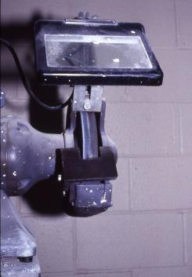
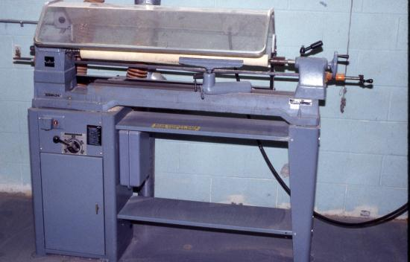
Protective Shields
These do not give complete protection from machine hazards, but do provide some protection from flying particles, splashing cutting oils, or coolants.
OSHA 3067
OSHA 3067
Notes:
Personal pictures.
Miscellaneous aids, such as these, do not give complete protection from machine hazards, but may provide the operator with an extra margin of safety.

Slide 59
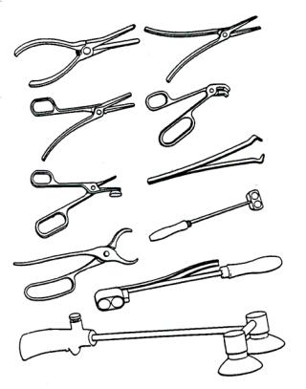
Holding Tools
Used to place and remove stock in the danger area
Not to be used instead of other machine safeguards, but as a supplement
OSHA 3067
Notes:
Tools can be used to remove material instead of placing body part in dangerous area

Slide 60
General Requirements for Safeguards
Prevent contact
Secure, tamper-resistant, and durable
Protect from falling objects
Create no new hazards
Create no interference
Allow safe lubrication and maintenance
Notes:
Prevent Contact – Prevent worker’s body or clothing from contacting hazardous moving parts. A good safeguarding system eliminates the possibility of the operator or other workers placing parts of their bodies near hazardous moving parts.
Secure – firmly secured to machine and not easily removed. A safeguard that can easily be made ineffective is no safeguard at all. Guards and safety devices should be made of durable material that will withstand the conditions of normal use and be firmly secured to the machine.
Protect from falling objects – Ensure that no objects can fall into moving parts. A small tool which is dropped into a cycling machine could easily become a projectile that could strike and injure someone.
Create no new hazards – Must not have shear points, jagged edges or unfinished surfaces. A safeguard defeats its own purpose if it creates a hazard of its own such as a shear point, a jagged edge, or an unfinished surface which can cause a laceration. The edges of guards, for instance, should be rolled or bolted in such a way that they eliminate sharp edges.
Create no interference – Must not prevent worker from performing the job quickly and comfortably. Any safeguard which impedes a worker from performing a job quickly and comfortably might soon be overridden or disregarded. Proper safeguarding can actually enhance efficiency since it can relieve the worker’s apprehensions about injury.
Allow safe lubrication – If possible, be able to lubricate the machine without removing the safeguards. Locating oil reservoirs outside the guard, with a line leading to the lubrication point, will reduce the need for the worker to enter the hazardous area.

Slide 61
General Requirements for Safeguards
Fixed guards should be used whenever possible
Prevent contact
Secure, tamper-resistant, and durable
Protect from falling objects
Create no new hazards
Create no interference
Allow safe lubrication and maintenance

Slide 62
Machinery: General Safety Principles
Securely fasten equipment to eliminate movement or “walking”
No loose clothing, long hair, jewelry, or gloves around rotating machine parts
Respect machine guards
Keep electrical cords and plugs intact
Inspect machinery before each use

Slide 63
Machinery: General Safety Principles
Do not leave machines running and
unattended
Never attend to brush debris from the table surface while the machine is running
An active brake mechanism adds greatly to safety
Easily reached “off” switch increases safety

Slide 64
Machine Safety Responsibilities
Management
ensure all machinery is properly guarded
Supervisors
train employees on specific guard rules in their areas
ensure machine guards remain in place and are functional
immediately correct machine guard deficiencies

Slide 65
Machine Safety Responsibilities
Employees
do not remove guards unless machine is locked and tagged
report machine guard problems to supervisors immediately
do not operate equipment unless guards are in place

Slide 66
Employee Training
Hazards associated with particular machines
How the safeguards provide protection and the hazards for which they are intended
How and why to use the safeguards
How and when safeguards can be removed and by whom
What to do if a safeguard is damaged, missing, or unable to provide adequate protection

Slide 67
Machine Guarding
Checklist

Slide 68
Machine Guarding
Case Studies

Slide 69
Control of Hazardous Energy Lockout/Tagout (LOTO) 29 CFR 1910.147

Slide 70
LOTO Purpose
To prevent serious injury or death from the unexpected release of stored energy during servicing and maintenance of machines
To establish procedures to physically isolate stored energy from the equipment being serviced or repaired

Slide 71
Types of Stored Energy Needing Isolation
Electrical
Mechanical
Hydraulic
Pneumatic
Chemicals
Thermal
Other energy sources

Slide 72
LOTO Applies
When servicing and maintaining equipment, and unexpected startup of the machine or released of stored energy could occur
When, during normal production, workers must remove or bypass a guard or safety device
When, during normal production, workers place and part of their body into the danger zone or near the machine’s point of operation
During all set up activities

Slide 73
LOTO Exemption Normal Production Operations
Routine, repetitive, & integral to production
Guards/safety devices not bypassed
Body part not placed in the point of operation or other dangerous area during machine cycle
Need to use alternative measures for protection

Slide 74
LOTO Exemption Cord & Plug Connected Equipment
Plug is only source of energy
Plug is under continuous control of one person
Cord is unplugged from energy source

Slide 75
Important LOTO Elements
Written procedures
Documentation of each source of energy
Locking and tagging devices
Verification of energy isolation
Proper locks at proper places (isolation points)
Training (including skills demonstration) in the primary language(s) of employees.
Auditing of work process

Slide 76
Worker Categories
Authorized employee – Person who does LOTO to perform servicing
Affected employee – Person required to use machines/equipment on which servicing is performed under LOTO or who must work in such an area
Other employees – All employees who are or may be in an area were LOTO may be utilized

Slide 77
LOTO Steps Shutdown
Notify affected employees
Prepare for LOTO: review LOTO procedures, identify energy sources, confirm LOTO methods to be used and obtain necessary LOTO equipment
Shutdown machine following normal procedures
De-activate energy isolating devices

Slide 78
LOTO Steps Shutdown
Lock out the energy isolating device(s)
Dissipate or restrain stored or residual energy
Verify machine is disconnected from the energy source(s)

Slide 79
LOTO Steps Startup
Inspect machine and surrounding area to ensure machine ready for normal operation
Ensure affected employees are away from hazards
Remove locks and tags from isolation devices and reenergize machine
Notify affected employees of restart and verify machine is working properly

Slide 80
Energy Isolating Devices
Device that physically prevents the transmission or release of energy
Includes: electrical circuit breakers, disconnect switches, line valves and a blocks
Excludes: push buttons and selector switches

Slide 81
LOTO Devices
Includes locks, tags, chains, wedges, key blocks, and self-locking fasteners
Uniquely identified and used only for controlling energy
Durable
Standardized
Substantial
Identify employee applying device
Tags must have special warnings

Slide 82
Training
All employees must be trained based on worker categories
Must ensure employees understand LOTO program
Must address limitations of tags if they are used as part of LOTO

Slide 83
Retraining
Authorized/Affected Employees: when change in job, change in machines and change in LOTO program
When evidence indicates employees lack knowledge of LOTO program

Slide 84
Some Examples of Machine Guarding

Slide 85

Unguarded Fan Blade

Slide 86
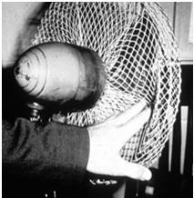
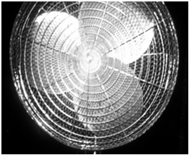
Guarding Fan Blades
Guard when periphery of blades is less than 7’ above the floor or working level
Guards with openings no larger than ½”
Source: OSHA
OSHA 3067
Source: OSHA
84

Slide 87
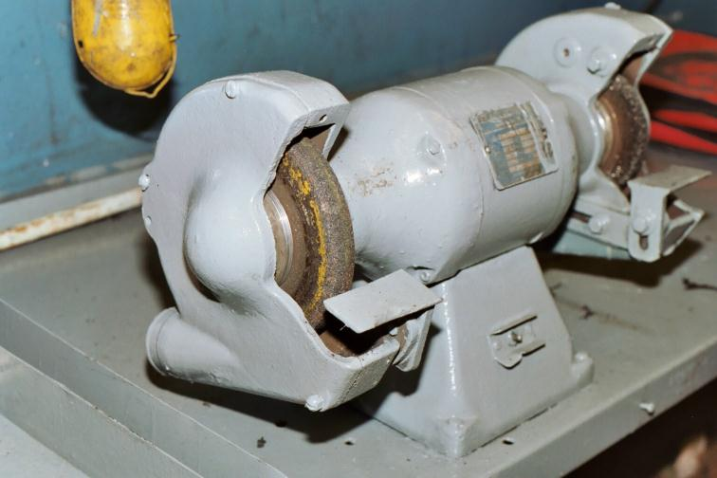
Abrasive Wheel Machinery Improper Work Rest and Tongue
OSHA 3067
Notes:
Personal picture
Work rests are used to support the work.. Work rests shall be kept adjusted closely to the wheel with a maximum opening of one-eighth inch to prevent the work from being jammed between the wheel and the rest, which may cause wheel breakage

Slide 88
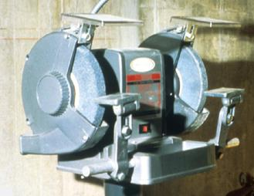
Abrasive Wheel Machinery
Work rests on offhand grinding machines must be kept adjusted closely to the wheel with a maximum opening of 1/8-inch to prevent the work from being jammed between the wheel and the rest, which may result in wheel breakage.
OSHA 3067

Slide 89
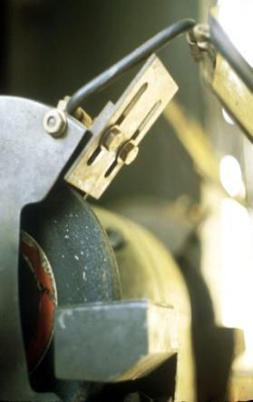
Abrasive Wheel Machinery
The distance between the wheel periphery and the adjustable tongue must never exceed 1/4-inch.
OSHA GI 10 hour

Slide 90
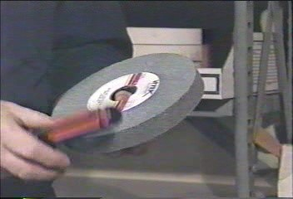
Abrasive Wheel Machinery
When installing new abrasive wheel
Inspect for condition and compatibility
Conduct ring test
OSHA 7100

Slide 91
Abrasive Wheel Machinery
Checklist

Slide 92

Bench Grinder Explodes
https://youtu.be/2ou6HSwj-IU

Slide 93

Portable Circular Saws
OSHA 3067
Guard Retracted
Stock
Blade
Notes:
1910.243(a)(1)(i) All portable, power-driven circular saws having a blade diameter greater than 2 in. shall be equipped with guards above and below the base plate or shoe. The upper guard shall cover the saw to the depth of the teeth, except for the minimum arc required to permit the base to be tilted for bevel cuts. The lower guard shall cover the saw to the depth of the teeth, except for the minimum arc required to allow proper retraction and contact with the work. When the tool is withdrawn from the work, the lower guard shall automatically and instantly return to covering position.
1910.243(a)(2)(i) All hand-held powered circular saws having a blade diameter greater than 2 inches, electric, hydraulic or pneumatic chain saws, and percussion tools without positive accessory holding means shall be equipped with a constant pressure switch or control that will shut off the power when the pressure is released. All hand-held gasoline powered chain saws shall be equipped with a constant pressure throttle control that will shut off the power to the saw chain when the pressure is released.

Slide 94
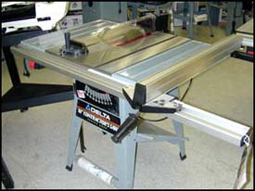
Table Saw
On/off switch should be located at knee height -- so you can turn off machine while your hands are on the material
Blade must be guarded
Automatic brake a good safety feature
Guard
www.osha.gov/SLTC/etools/machineguarding/saws/tablesaws.html

Slide 95
Table Saw -- Kickback
Back of the blade, as it rises out of table, is the critical “kickback zone”
Material tends to be lifted off of the table
If wood moves sideways at this point, it will be caught by the rotational motion and will be flung back toward the operator!

Slide 96
Preventing Kickbacks
Use a splitter or wedge inserted into the saw kerf to separate material
Make sure rip fence is perfectly parallel to the blade

Slide 97
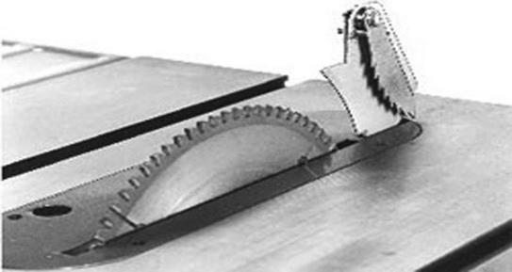
Table Saw - Splitters
Metal fins, secured behind and in line with the blade -- must move freely & not stick open
Anti-kickback pawls also attached
www.osha.org/pdf/pubs/2980.pdf
Splitter & anti-kickback pawls
Notes:
OSHA requires splitter and anti-kickback pawls for hand-fed ripsaw
OSHA does not required a splitter and anti-kickback pawls for hand-fed crosscut saw

Slide 98
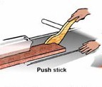
Table Saw - Push Sticks
NJAFL-CIO
Notes:
Picture from http://www.osha.gov/SLTC/etools/machineguarding/saws/tablesaws.html

Slide 99

Radial Arm Saw
www.osha.gov/SLTC/etools/machineguarding/saws/tablesaws.html
Anti-Kickback Device
Lower Blade Guard
Notes:
Personal picture
1910.213(h)(1) The upper hood shall completely enclose the upper portion of the blade down to a point that will include the end of the saw arbor. The upper hood shall be constructed in such a manner and of such material that it will protect the operator from flying splinters, broken saw teeth, etc., and will deflect sawdust away from the operator.
1910.213(h)(2) Each radial saw used for ripping shall be provided with nonkickback fingers or dogs located on both sides of the saw so as to oppose the thrust or tendency of the saw to pick up the material or to throw it back toward the operator. They shall be designed to provide adequate holding power for all the thicknesses of material being cut.
1910.213(h)(3) An adjustable stop shall be provided to prevent the forward travel of the blade beyond the position necessary to complete the cut in repetitive operations.
1910.213(h)(4) Installation shall be in such a manner that the front end of the unit will be slightly higher than the rear, so as to cause the cutting head to return gently to the starting position when released by the operator.

Slide 100

Meat Cutting Band Saw
OSHA 3170
OSHA 3170

Slide 101
Meat Cutting Band Saw
Follow LOTO Procedures
Install Brake
Use Push Guard or Fence
Adjust Blade Guard
Use Only Sharp Blades
Only Remove Meat When Blade Stopped
Unplug When Not In Use

Slide 102

Jointer
Large, high-speed cutterheads are main hazard
Knives rotating at high speed become invisible
OSHA 3170

Slide 103
Jointer
Do not pass material over planing head by hand
– Only one layer of material between your hands and the cutters
Keep guards in place -- open cover only enough to allow material to pass through

Slide 104

Jointer
OSHA 3170

Slide 105
Food Slicer
Case History: an employee was cleaning a meat slicer that was turned off but was still plugged in. He inadvertently turned the machine on by bumping the on/off switch, resulting in an amputation of his right ring fingers.

Slide 106

Food Slicers
Never hand-feed slicer
Retract the slicer blade during cleaning
Unplug when servicing or use lockout/tagout
OSHA

Slide 107
Meat Grinder
Use properly sized plungers
Operate with feeding tray and throats installed
Follow LOTO procedures

Slide 108
Machinery: General Safety Principles
Securely fasten equipment to eliminate movement or “walking”
No loose clothing, long hair, jewelry, or gloves around rotating machine parts
Respect machine guards
Keep electrical cords and plugs intact
Inspect machinery before each use
Notes:
1910.212(b) Anchoring fixed machinery. Machines designed for a fixed location shall be securely anchored to prevent walking or moving.

Slide 109
Machinery: General Safety Principles
Do not leave machines running and unattended
Never attend to brush debris from the table surface while the machine is running
An active brake mechanism adds greatly to safety
Easily reached “off” switch increases safety

Slide 110
Quiz

Slide 111
Meat Grinder
Use proper size plungers
Operate with feeding tray and
throats installed
Follow LOTO procedures
OSHA 3170

Slide 112
Meat Grinder
Use properly sized plungers
Operate with feeding tray and throats installed
Follow LOTO procedures
OSHA 3170

Slide 113
Resources
OSHA Machine Guarding Website
http://www.osha.gov/SLTC/machineguarding/index.html
OSHA Machine Guarding eTool
http://www.osha.gov/SLTC/etools/machineguarding/index.html
OSHA Amputation Fact Sheet
http://www.osha.gov/OshDoc/data_General_Facts/amputation-factsheet.pdf
Safeguarding Equipment and Protecting Employees from Amputations
http://www.osha.gov/Publications/osha3170.pdf

Slide 114
Resources LOTO
Resources LOTO
OSHA LOTO Website
https://www.osha.gov/SLTC/controlhazardousenergy/index.html
NIOSH Workplace Solutions: Using Lockout and Tagout Procedures to Prevent Injury and Death during Machine Maintenance https://www.cdc.gov/niosh/docs/wp-solutions/2011- 156/pdfs/2011-156.pdf
OSHA LOTO Fact Sheet
https://www.osha.gov/OshDoc/data_General_Facts/factsheet- lockout-tagout.pdf
OSHA 3120: LOTO
https://www.osha.gov/Publications/osha3120.pdf

