Slide 1
Hazard Communication Standards
for Women in Agriculture
OSHA Standard 29 CFR 1910.1200
Susan Harwood Training Grant (SH-05068-SH8)
This material was produced under a Susan Harwood Training Grant (SH-05068-SH8) from the Occupational Safety and Health Administration (OSHA), U.S. Department of Labor. It does not necessarily reflect the views or policies of the U. S. Department of Labor, nor does mention of trade names, commercial products, or organizations imply endorsement by the U. S. Government. The U.S. Government does not warrant or assume any legal liability or responsibility for the accuracy, completeness, or usefulness of any information, apparatus, product, or process disclosed.

Slide 2
Objectives
Upon completion of this training, participants will be able to:
Describe the purpose of OSHA’s Hazard Communication Standard (HCS).
Explain the basic requirements of the HCS.
Recall the requirements of a written hazard communication program.
Describe the requirements and purpose of hazard warning labels.
Interpret the information contained in Safety Data Sheets (SDS).
List the components of a hazard communication training program.
Differentiate between physical and health hazards of agricultural chemicals.
Identify and safely use chemicals/pesticides and respiratory protection.

Slide 3
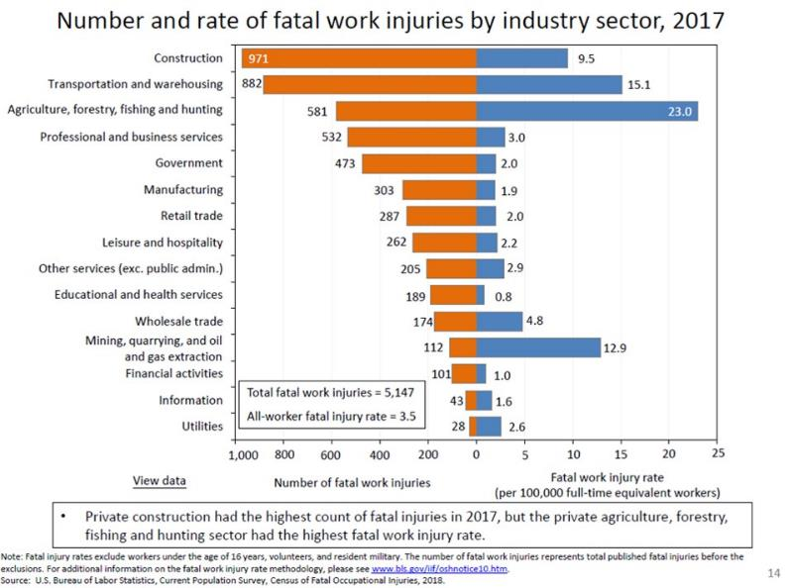
Agriculture – Hazardous Industry
Notes:
Source: US DOL BLS-CFOI- 2017
581 Fatalities (2017) or 23 deaths per 100,000 workers

Slide 4

Women in Agriculture Now
Farming is the occupation most associated with injury to women.
The number of women engaged in production agriculture is increasing.
More women are farm owners and are more actively involved in day-to-day farming operations.
www.pexels.com
Meyers, et al (2001), Recognizing & Preventing the Industry’s Most Widespread Health & Safety Problem
https://www.nass.usda.gov/Publications/AgCensus/2012/Online_Resources/Race,_Ethnicity_and_Gender_Profiles/cpd99000.pdf
Notes:
Nearly 300,000 women serve as principal operators on over 62 million acres of land, accounting for almost $12.9 billion in agricultural products sold.

Slide 5

Considerations for Women in Agriculture
Fertility and pregnancy are often not considered when women assume farm tasks. Pesticide and other chemical exposures, particularly during the childbearing years, present challenges.
www.pexels.com
AgriSafe Network Reducing the Risk of Adverse Pregnancy Outcomes and Perinatal Illness for Female Agricultural Producers Webinar
Notes:
Agricultural chemicals are used for many purposes around the farm. These chemicals may include:
Pesticides
Insecticides
Rodenticides
Cleaning solvents
Medications
United States Environmental Protection Agency (EPA) – Recognition and Management of Pesticide Poisonings (EPA 735K13001)
Women who are pregnant or planning a pregnancy, especially those currently performing farm work, should be informed of the implications of exposure before, during, and after pregnancy, and assisted in making decisions that are appropriate for their individual work and home situations.
Pesticides may cause the most damage in humans during periods of rapid development, especially in utero.
Studies have found that preconception exposure of either the mother or father may have an effect on reproductive outcome and offspring.
Maternal exposure to pesticides should be minimized during pregnancy and during the preconception period.
https://www.epa.gov/sites/production/files/2015-01/documents/rmpp_6thed_final_lowresopt.pdf
Reproductive Health Effects of Pesticide Exposure: Issues for Farmworker Health Service Providers – Farmworker Justice/Migrants Clinician Network
Exposure to pesticides at certain developmental stages of life can result in irreversible damage to organ structure and function. Of particular concern is the effect of exposure at during the reproductive cycle, from preconception to breast feeding, because of the possibility of poor birth outcomes, congenital anomalies, developmental deficits, and possibly childhood cancer
https://www.migrantclinician.org/files/repproductive_eng_span_final.pdf
Work Related Exposures
--Herbicides: lower rates of fertility, (20%); when women on farms did not report these same exposes fertility rates were higher.
Exposures: Mixing and Applying herbicides and fungicides up to 2 years before attempting conception association w observed lower fertility
--Livestock Production with Hormones – avoid Needle sticks
Oxytocin – Can cause abortion in pregnant women who may be accidentally inoculated, more likely to cause abortion in later stages of pregnancy. Assists uterine contractions and milk let down.
Prostaglandin – Used in Cattle and Swine to terminate pregnancy early. May cause abortion at any time during pregnancy in pregnant women. Used to induce parturition, terminate pregnancy, or stimulate and synchronize estrous)
Beyond the other precautions we will talk about today, it is important to also reduce exposures with proper laundering of personal or family members clothing.

Slide 6

Importance for Women in Agriculture
Because of the diverse nature of work and the many occupational exposures for workers in production agriculture, there is confusion and misunderstanding related to OSHA standards and exemptions.
www.istockphoto.com
AgriSafe Network Understanding OSHA Agricultural Standards
Notes:
Agricultural chemicals are used for many purposes around the farm. These chemicals may include:
Pesticides
Insecticides
Rodenticides
Cleaning solvents
Medications
Important to protect you, any employees you may have, and your entire farming operation, whether it be from the risks of chemical exposures or the risk of liability from not complying with OSHA standards.

Slide 7
OSHA Exemption Status – Farms
A farming operation is exempt from all OSHA activities if it:
Employs 10 or fewer employees* (currently and at all times during the last 12 months) and
Has not had an active temporary labor camp during the last 12 months
* Family members of farm employers are not counted when determining the number of employees
In a court of law OSHA rules and regulations can be used to identify and prosecute for unsafe conditions that could lead to worker injury or death. If no other standards apply, the OSHA General Duty Clause is a frequent reference point.
https://www.osha.gov/enforcement/directives/cpl-02-00-051
AgriSafe Network Understanding OSHA Agricultural Standards

Slide 8
OSHA General Duty Clause
Requires employers to furnish each employee a place of employment free from recognized hazards that are causing or are likely to cause death or serious physical harm.
Is used to cite employers for recognized hazards where there is no direct standard that applies to the operation.
If there is not a standard that applies directly to agricultural operations, OSHA could utilize the General Duty Clause, referencing the applicable standard.
AgriSafe Network Understanding OSHA Agricultural Standards

Slide 9
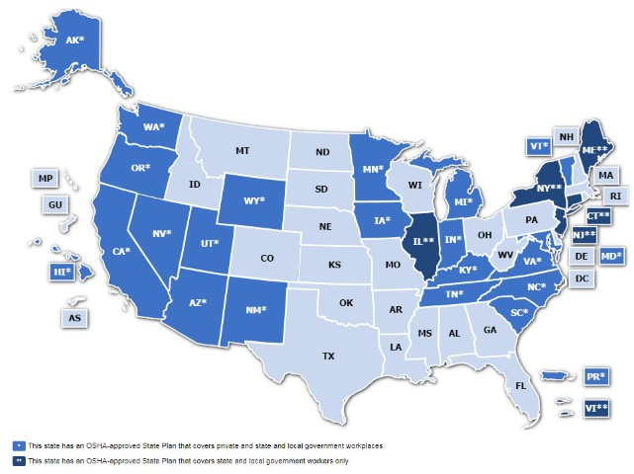
OSHA-Approved State Plans
OSHA-approved workplace safety and health programs operated by individual states or U.S. territories.
State Plans are monitored by OSHA and must be at least as effective as OSHA in protecting workers and in preventing work-related injuries, illnesses and deaths.
https://www.osha.gov/dcsp/osp/
Notes:
Currently 22 State Plans covering both private sector and state and local government workers and 6 State Plans covering only state and local government workers.

Slide 10
State Plans
If you are operating in an OSHA-approved State Plan state, you must comply with the state’s requirements (which may be different than those of the Federal rule).
Many State Plan states had hazard communication laws prior to the federal rule.
Employers in State Plan states should contact their state OSHA offices for more information.
Hazard Communication: Small Entity Guide for Employers that Use Hazardous Chemicals (OSHA 3695-03 2014); Occupational Safety and Health Administration, U.S. Department of Labor
Hazard Communication Guidelines for Compliance (OSHA 3111 2000); Occupational Safety and Health Administration, U.S. Department of Labor

Slide 11

29 CFR 1910 – General Industry
Applicable to agriculture – addresses:
Storage and handling of anhydrous ammonia
Temporary labor camps
Hearing conservation and noise exposure
Eye and face protection
Respiratory protection
Hazard communications
www.pexels.com
AgriSafe Network Understanding OSHA Agricultural Standards
Notes:
These standards that we are talking about today are only a few examples of OSHA standards that an employer must consider. It is the responsibility of the employer to review, understand, and implement the standards that apply to their workplace.

Slide 12
What is a hazardous chemical?
Any chemical classified as a physical hazard or a health hazard, or a hazard not otherwise classified
Chemicals in all forms are covered by the Hazard Communication Standard – liquids, solids, gases, vapors, fumes, and mists – whether they are contained or not
Hazard Communication: Small Entity Guide for Employers that Use Hazardous Chemicals (OSHA 3695-03 2014); Occupational Safety and Health Administration, U.S. Department of Labor
Notes:
Hazards Not Otherwise Classified (HNOC) - Hazards that do not meet the specified criteria for the physical and health hazard classes provided in HazCom
People can prevent injuries and deaths caused by chemical exposures by learning about the hazards they present. Some injuries are caused by sudden reactions that happen when the wrong chemicals are accidently mixed together. Other injuries and deaths happen because chemicals can explode or catch fire, burning your skin, causing respiratory distress, or cause dizziness and nausea, or lead to the future long term health problems.

Slide 13
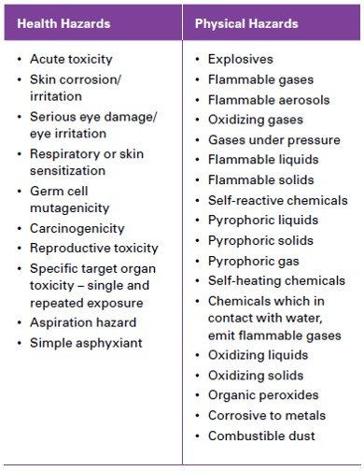
HCS Health and Physical Hazards
Hazard Communication: Small Entity Guide for Employers that Use Hazardous Chemicals (OSHA 3695-03 2014); Occupational Safety and Health Administration, U.S. Department of Labor
Notes:
A chemical can have both physical and health hazards.

Slide 14
Short and Long Term Health Hazards
Acute Effects
Fast
Immediate
High concentrations delivered
Chronic Effects
Takes years before any symptoms appear
Small doses over a long period of time accumulate to form a large dose
Notes:
A 911 response may be needed for a chemical release with acute effects while non-urgent healthcare might be needed to diagnosis and treat chronic effects that may occur with a lifetime of exposure.

Slide 15

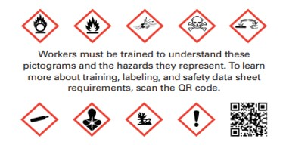
HCS Purpose
To ensure that the hazards of all chemicals produced or imported are classified, and that information concerning the classified hazards is transmitted to employers and employees
Hazard Communication: Small Entity Guide for Employers that Use Hazardous Chemicals (OSHA 3695-03 2014); Occupational Safety and Health Administration, U.S. Department of Labor
https://www.osha.gov/Publications/OSHA3658.pdf
Notes:
HCS (HazCom Standard)
The Hazard Communication (HazCom) standard requires manufacturers and importers to evaluate the chemicals they produce or import, classify the chemical hazards, and provide hazard information to employers and workers. They must put labels on containers and prepare safety data sheets (SDSs). These safety data sheets must be made available for employees and for and responding emergency personnel. SDS are generally stored in readily available binders or via an online subscription.

Slide 16
Brief HCS History
1983 – First published; covered the manufacturing sector
1987 – Expanded to cover all industries where workers are potentially exposed to hazardous chemicals
2012 – Modified to align with the United Nations’ Globally Harmonized System of Classification and Labeling of Chemicals (GHS)
Helps ensure imported chemicals are accompanied by consistent hazard and precautionary information to protect workers in the U.S.
Facilitates trade of chemicals since it reduces potential barriers of differing global requirements for classification and labeling of chemicals
Hazard Communication: Small Entity Guide for Employers that Use Hazardous Chemicals (OSHA 3695-03 2014); Occupational Safety and Health Administration, U.S. Department of Labor

Slide 17
Overview - Requirements of HCS
Written Hazard Communication Program
Labeling
Safety Data Sheets (SDS)
Training
Hazard Communication: Small Entity Guide for Employers that Use Hazardous Chemicals (OSHA 3695-03 2014); Occupational Safety and Health Administration, U.S. Department of Labor

Slide 18
How is the HCS unique?
Incorporates a downstream flow of information from chemical manufacturers, importers, and distributors to employers using the products
Performance-oriented, meaning that you have the flexibility to adapt the rule to the needs of your workplace. It also means that you have to exercise more judgment to implement an appropriate and effective program.
Hazard Communication: Small Entity Guide for Employers that Use Hazardous Chemicals (OSHA 3695-03 2014); Occupational Safety and Health Administration, U.S. Department of Labor
Hazard Communication Guidelines for Compliance (OSHA 3111 2000); Occupational Safety and Health Administration, U.S. Department of Labor
Notes:
Compared to other OSHA standards

Slide 19
Three-Part Approach
For downstream communication of information to employers and employees:
Labeling containers of hazardous chemicals, which serves as an immediate warning of hazards
SDSs, which are sources of detailed information on the hazardous chemical
Training on the hazards
Hazard Communication: Small Entity Guide for Employers that Use Hazardous Chemicals (OSHA 3695-03 2014); Occupational Safety and Health Administration, U.S. Department of Labor

Slide 20
Chemical Manufacturer/Importer/Distributor Responsibilities
Classify the hazards of the chemicals they produce or import
Prepare appropriate labels and safety data sheets (SDSs) to convey the hazards, as well as recommended protective measures
Ensure that the containers of hazardous chemicals are labeled when shipped and that SDSs are provided downstream with the first shipment and when the SDSs are updated
Hazard Communication: Small Entity Guide for Employers that Use Hazardous Chemicals (OSHA 3695-03 2014); Occupational Safety and Health Administration, U.S. Department of Labor

Slide 21
Employer Responsibilities
Establish hazard communication programs
Receive labels and SDSs from suppliers
Provide workers with access to labels and SDSs
Inform and train workers
Hazard Communication: Small Entity Guide for Employers that Use Hazardous Chemicals (OSHA 3695-03 2014); Occupational Safety and Health Administration, U.S. Department of Labor

Slide 22
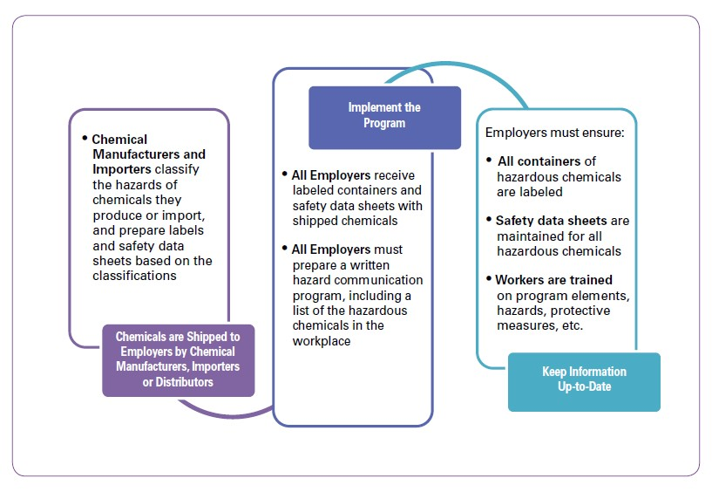
How Hazard Communication Works
Hazard Communication: Small Entity Guide for Employers that Use Hazardous Chemicals (OSHA 3695-03 2014); Occupational Safety and Health Administration, U.S. Department of Labor

Slide 23
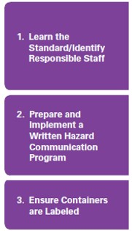
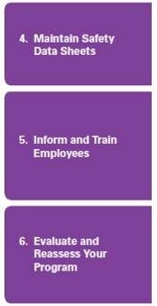
Six Steps to an Effective Hazard Communication Program
Hazard Communication: Small Entity Guide for Employers that Use Hazardous Chemicals (OSHA 3695-03 2014); Occupational Safety and Health Administration, U.S. Department of Labor

Slide 24
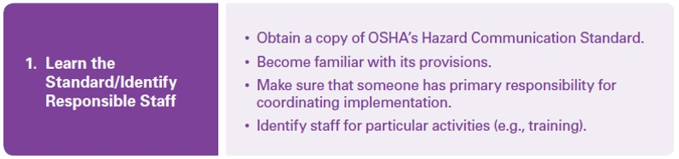
First Step to an Effective Hazard Communication Program
Hazard Communication: Small Entity Guide for Employers that Use Hazardous Chemicals (OSHA 3695-03 2014); Occupational Safety and Health Administration, U.S. Department of Labor
Notes:
Part of what we are doing today

Slide 25
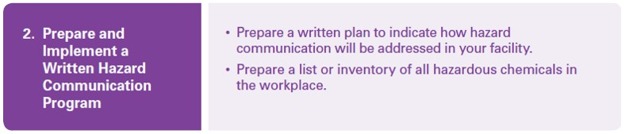
Second Step to an Effective Hazard Communication Program
Hazard Communication: Small Entity Guide for Employers that Use Hazardous Chemicals (OSHA 3695-03 2014); Occupational Safety and Health Administration, U.S. Department of Labor

Slide 26
Written Hazard Communication Program
All workplaces where workers are exposed to hazardous chemicals must have a written hazard communication program that describes how the HCS is implemented in that facility.
Significant benefits for employers and employees
Hazard Communication: Small Entity Guide for Employers that Use Hazardous Chemicals (OSHA 3695-03 2014); Occupational Safety and Health Administration, U.S. Department of Labor
Notes:
OSHA does not require the employer to have a written hazard communication program if workers only handle chemicals in sealed containers that are not opened under normal conditions of use (such as cargo handling, warehousing, or retail sales).
A written HazCom program describes how the employer meets the HazCom requirements for: * Labeling * Safety data sheets * Employee information and training. * A list of hazardous chemicals in the workplace,

Slide 27
Employer Benefits
Enables employers to assess the safety and health of their workplace
Helps employers select needed control measures for chemicals that are present
May use information provided on SDSs to select the least hazardous chemical available to accomplish what is needed in the workplace
Information received on labels and SDSs help meet requirements for a safe and healthful workplace
Helps with effective management of chemicals resulting in increased productivity, decreased workers’ compensation costs, etc.
Hazard Communication: Small Entity Guide for Employers that Use Hazardous Chemicals (OSHA 3695-03 2014); Occupational Safety and Health Administration, U.S. Department of Labor

Slide 28
Employee Benefits
Access to information to be able to protect themselves
Knowing the health effects so that any signs or symptoms of exposure can be evaluated
Being aware of chemicals and hazards can help determine how exposure may affect any preexisting medical conditions
Decrease in illness and injuries caused by chemicals in the workplace
Hazard Communication: Small Entity Guide for Employers that Use Hazardous Chemicals (OSHA 3695-03 2014); Occupational Safety and Health Administration, U.S. Department of Labor
Notes:
Being able to identify the proper PPE for the chemicals they have the opportunity to come in contact with.

Slide 29
Written Hazard Communication Program
Does not need to be lengthy or complicated
To help ensure that compliance with the standard is done in a systematic way and that all elements are coordinated
Hazard Communication: Small Entity Guide for Employers that Use Hazardous Chemicals (OSHA 3695-03 2014); Occupational Safety and Health Administration, U.S. Department of Labor
Notes:
Companies can contact NECAS to develop a written program

Slide 30
Written Hazard Communication Program Requirements
Must describe how the employer will address the following in the workplace:
Labels and other forms of warning
Safety Data Sheets
Employee information and training
A list of hazardous chemicals known to be present in the workplace
Methods to inform employees of the hazards of non-routine tasks
Details regarding when there is more than one employer operating on a site
Hazard Communication: Small Entity Guide for Employers that Use Hazardous Chemicals (OSHA 3695-03 2014); Occupational Safety and Health Administration, U.S. Department of Labor
Notes:
The list should use a product identifier that is referenced on the label safety data sheet.
The list may be compiled for the workplace as a whole or for individual work areas

Slide 31

Third Step to an Effective Hazard Communication Program
Hazard Communication: Small Entity Guide for Employers that Use Hazardous Chemicals (OSHA 3695-03 2014); Occupational Safety and Health Administration, U.S. Department of Labor

Slide 32
Hazard Warning Labels - Purpose
Labels are the primary part of communicating information downstream.
A label is an immediate warning, since it is present in the work area on the chemical container.
It is a snapshot of the hazards and protective measures and summarizes the SDS.
Hazard Communication: Small Entity Guide for Employers that Use Hazardous Chemicals (OSHA 3695-03 2014); Occupational Safety and Health Administration, U.S. Department of Labor
Notes:
The purpose of labels is to warn about potential chemical dangers. Labels are not intended to be the only source of information regarding the hazards or identity of hazardous chemicals in the workplace. They serve as an first warning and as a reminder of the more detailed information provided in other documents such as SDSs. All container labels must be in English, but information may also be presented in other languages for non-English speaking employees. Pictograms are provided to show a picture of the immediate danger for low literacy employees.
Pipes, fuel tanks, engines are not containers.

Slide 33
Hazard Warning Labels - Requirements
Labels must have the following information, located together:
Product identifier
Signal word
Hazard statement(s)
Pictogram(s)
Precautionary statement(s)
Name, address, and phone number of the responsible party
Supplemental information can also be provided on the label as needed.
Hazard Communication: Small Entity Guide for Employers that Use Hazardous Chemicals (OSHA 3695-03 2014); Occupational Safety and Health Administration, U.S. Department of Labor
Notes:
Chemical manufacturers or importers classify a chemical's hazards, and they use that information to prepare the labels that you see on shipped containers of hazardous chemicals. --Labels for shipped containers must have these required elements: --Product identifier. This is the name or number used to identify the chemical.
--Signal word. This helps you know how severe the hazard is. Examples include Danger or warning
--Hazard statement. This is a statement for a hazard class and category to describe the nature of the hazard. --Pictogram. This is a symbol used to show you the chemical's hazard class. There are eight pictograms used to meet the HazCom standard's labeling requirements
--Precautionary statement. This recommends the steps you should take to safely use, handle, and store the chemical. --Name, address, and telephone number of the chemical manufacturer, importer, or other responsible party.

Slide 34
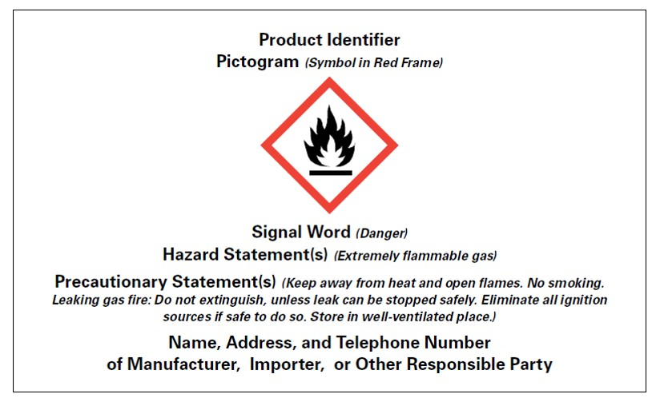
Example of Required HCS Label Elements
Hazard Communication: Small Entity Guide for Employers that Use Hazardous Chemicals (OSHA 3695-03 2014); Occupational Safety and Health Administration, U.S. Department of Labor
Notes:
Chemical manufacturers or importers classify a chemical's hazards, and they use that information to prepare the labels that you see on shipped containers of hazardous chemicals. --Labels for shipped containers must have these required elements: --Product identifier. This is the name or number used to identify the chemical.
--Signal word. This helps you know how severe the hazard is. Examples include Danger or warning
--Hazard statement. This is a statement for a hazard class and category to describe the nature of the hazard. --Pictogram. This is a symbol used to show you the chemical's hazard class. There are eight pictograms used to meet the HazCom standard's labeling requirements
--Precautionary statement. This recommends the steps you should take to safely use, handle, and store the chemical. --Name, address, and telephone number of the chemical manufacturer, importer, or other responsible party.

Slide 35
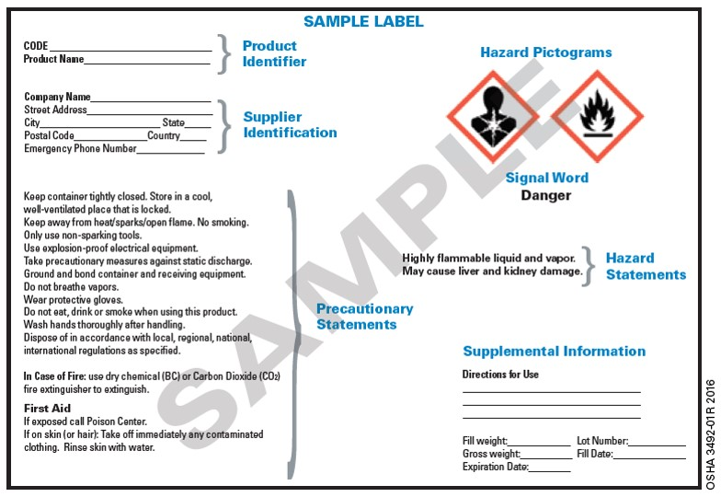
Another Sample HCS Label
Hazard Communication: Small Entity Guide for Employers that Use Hazardous Chemicals (OSHA 3695-03 2014); Occupational Safety and Health Administration, U.S. Department of Labor
Notes:
Chemical manufacturers or importers classify a chemical's hazards, and they use that information to prepare the labels that you see on shipped containers of hazardous chemicals. Labels for shipped containers must have these required elements: --Product identifier. This is the name or number used to identify the chemical.
--Signal word. This helps you know how severe the hazard is. Examples include Danger or warning
--Hazard statement. This is a statement for a hazard class and category to describe the nature of the hazard. --Pictogram. This is a symbol used to show you the chemical's hazard class. There are eight pictograms used to meet the HazCom standard's labeling requirements
--Precautionary statement. This recommends the steps you should take to safely use, handle, and store the chemical. --Name, address, and telephone number of the chemical manufacturer, importer, or other responsible party.

Slide 36
Pictograms
Required to be on labels to alert users of hazards to which they may be exposed.
Each pictogram has a symbol on a white background framed within a red border.
The pictogram on the label is determined by the chemical hazard classification.
Hazard Communication: Small Entity Guide for Employers that Use Hazardous Chemicals (OSHA 3695-03 2014); Occupational Safety and Health Administration, U.S. Department of Labor
Notes:
The label's pictograms are possibly the most visible aspect of the labeling system. There are nine pictograms used.

Slide 37
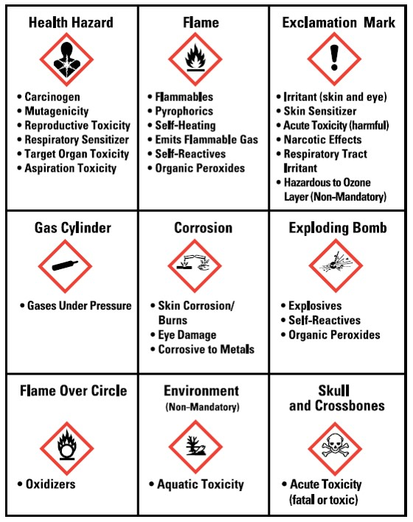
The 9 Pictograms
Hazard Communication: Small Entity Guide for Employers that Use Hazardous Chemicals (OSHA 3695-03 2014); Occupational Safety and Health Administration, U.S. Department of Labor
Notes:
The nine pictograms – Names of pictograms at top of each box with what the pictogram indicates listed below pictogram.
Health Hazard - The red frame around the white diamond contains a black silhouette of a person’s head and torso with a white star shape spreading through the chest area.
Flame - The red frame around the white diamond contains a white flame within black flames above a black line.
Exclamation Mark - The red frame around the white diamond contains a large black exclamation point in the center.
Gas Cylinder - The red frame around the white diamond contains a black shape like a rolling pin missing one handle.
Corrosion - The red frame around the white diamond contains an image of two test tubes. One tube pours dripping liquid onto a solid black line, and the other tube drips liquid onto a hand. Both the solid line and hand image are eaten away where the liquids splash, emitting fumes.
Exploding Bomb - The red frame around the white diamond contains a black round shape breaking apart with radiating black lines and fragments being ejected.
Flame Over Circle - The red frame around the white diamond contains a black circle resting on a black line with black flames on top of the black circle. It looks like the circle is on fire.
Environment - The red frame around the white diamond contains a black leafless tree silhouette and an upside-down fish image, both looking dead.
Skull and Crossbones - The red frame around the white diamond contains the image of a human skull with two bones crossed at an angle behind it.
https://www.safetyworksmaine.gov/training/online_classes/hazard_communication/GHS%20Pictogram%20Descriptions.pdf

Slide 38
Reminder
Always read the label before you move, handle, or open a chemical container.
Hazard Communication: Small Entity Guide for Employers that Use Hazardous Chemicals (OSHA 3695-03 2014); Occupational Safety and Health Administration, U.S. Department of Labor

Slide 39
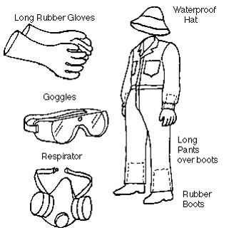
Personal Protective Equipment (PPE)
Would you recommend pesticide workers wear rubber gloves, rubber boots, goggles, and a respirator for all pesticide use?
http://www.pesticides.montana.edu/PAT/images/MTPPE.gif

Slide 40
Proper PPE - Labels
Using the wrong respiratory equipment can lead to inhalation exposure.
Rubber gloves are not chemically resistant to all pesticide products.
Chemically resistant boots and gloves can trap fumigant pesticides near the skin and cause burns.
Training for pesticide workers should emphasize PPE is selected based on label requirements and product use.
Notes:
–Use of Label:
Large Label on easel in front of room
Would you recommend pesticide workers wear chemical protective gloves, rubber boots, and a dust masks for all pesticide use? Check answers from audience. If no, why?
Pesticide products have varied toxicity levels, each with specific PPE requirements, proper selection of protective equipment can be difficult. Proper training for pesticide handlers should emphasize:
there is no single assembly of personal protective equipment that can be used for all pesticides or all applications of a single pesticide
PPE should be selected based on the requirements of a specific product label and how the product will be used.

Slide 41
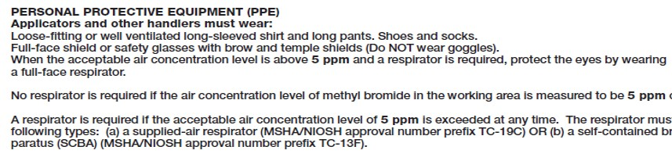
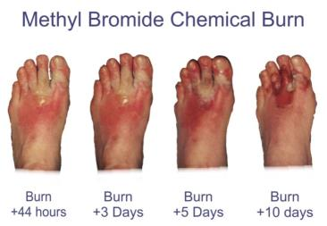
Proper PPE – Labels
PPE should be selected based on the requirements of a specific product label and how the product will be used
Example: Chemical-resistant gloves and footwear should not be worn when handling certain fumigant gasses, such as methyl bromide.
Methyl Bromide Label
Notes:
Use of Label:
While many pesticide labels require the use of chemical-resistant PPE, some fumigants prohibit the use of chemical-resistant PPE. Methyl bromide and other fumigant gases can become trapped inside chemical protective gloves or boots and can cause chemical burns to the skin. Since some pesticide handling activities increase the chance of exposure, such as mixing and loading, the label may require higher levels of protection during these activities. Levels of respiratory protection also vary among different pesticides and different levels of exposure for a single pesticide.
Wearing inappropriate PPE can lead to overexposure. Adequate training is needed to ensure pesticide handlers properly select the PPE that must be worn with each product and each product use.

Slide 42
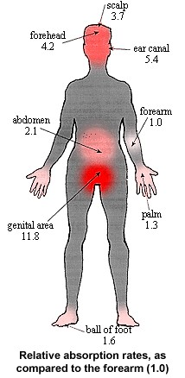
Head to Toe Protection
Absorption rates of body - why PPE is important
Donning and doffing proper methods of putting PPE on and taking PPE off
Practical use - long sleeves, long pants – when is that okay.
Resources in Agricultural Safety, University of Missouri-Columbia
Notes:
For a given chemical, if the forearm was assign a arbitrary base rate of 1.0, in comparison to the forearm, other parts of the body will absorb the same chemical from a range of 1.3 to11.8 times faster than the forearm.
Used by permission

Slide 43

Proper Personal Protective Equipment (PPE)
Women often have difficulty finding personal protective equipment that fits properly.
Seek PPE designed to fit your size and shape.
Do not use damaged or malfunctioning PPE.
Notes:
Don’t just wear PPE, make sure it is the right fit to give you the most protection.

Slide 44

AgriSafe Network Resource
Notes:
The AgriSafe Network provides training and can provide PPE for women in Agriculture

Slide 45
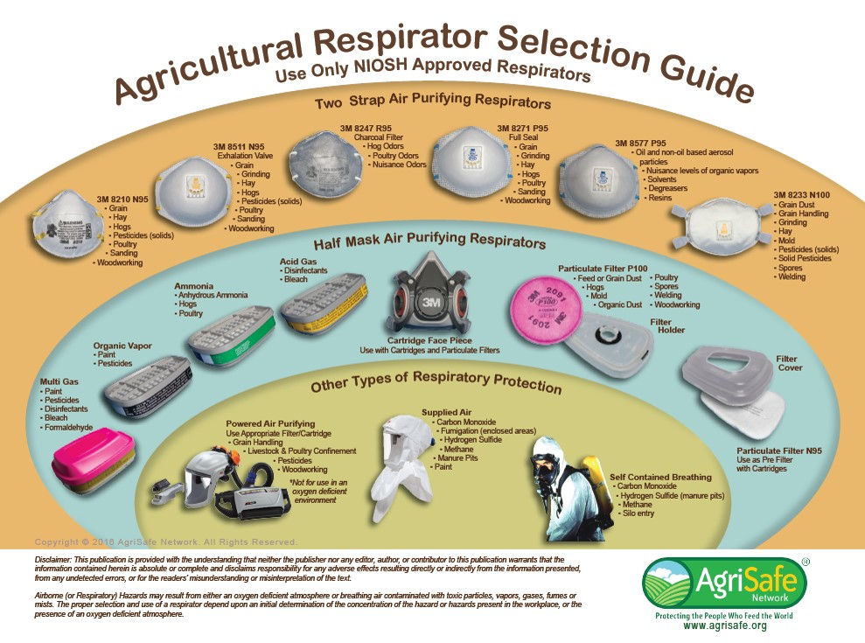
AgriSafe Network Respirator Guide
Notes:
Employees can look at this chart to find the proper respiratory PPE that they should be wearing.

Slide 46
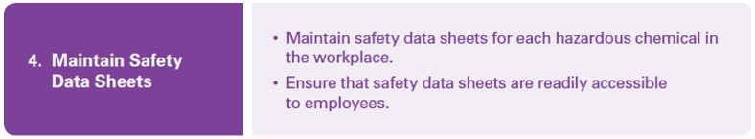
Fourth Step to an Effective Hazard Communication Program
Hazard Communication: Small Entity Guide for Employers that Use Hazardous Chemicals (OSHA 3695-03 2014); Occupational Safety and Health Administration, U.S. Department of Labor

Slide 47
Safety Data Sheets (SDS) – Basics
The second part in communicating information
Used by manufacturers and vendors to convey hazard information
Obtained when a chemical is purchased
SDSs must be in English
Many larger manufacturers also produce SDSs in other languages.
Hazard Communication: Small Entity Guide for Employers that Use Hazardous Chemicals (OSHA 3695-03 2014); Occupational Safety and Health Administration, U.S. Department of Labor
Notes:
Labels provide an immediate hazard warning, but you can find detailed information about a chemical's hazards on its SDS. An SDS is a fact sheet for a hazardous chemical. There must be an SDS available for each hazardous chemical in the workplace. SDS’s can be kept in a binder in the work area or in an on-line software which must be available to employees at all times
If you have workers that speak languages other than English, you may be able to obtain SDSs in those languages to ensure effective hazard communication.

Slide 48
Safety Data Sheets (SDS)
Detailed information on hazardous chemicals for many different audiences
Information of most use is in the beginning, while the more technical details are in the later sections
HCS establishes section headings for SDSs and the order they are provided, as well as the minimum information required to be included in each section
Hazard Communication: Small Entity Guide for Employers that Use Hazardous Chemicals (OSHA 3695-03 2014); Occupational Safety and Health Administration, U.S. Department of Labor
Notes:
Audiences – employers, workers, safety and health professionals, emergency responders, government agencies, and consumers.

Slide 49
SDS Sections
Identification
Hazard identification
Composition/information on ingredients
First aid measures
Firefighting measures
Accidental release measures
Handling and storage
Exposure control/personal protection
Physical and chemical properties
Stability and reactivity
Toxicology information
Ecological information*
Disposal information*
Transport information*
Regulatory information*
Other information
* Non-mandatory section
Hazard Communication: Small Entity Guide for Employers that Use Hazardous Chemicals (OSHA 3695-03 2014); Occupational Safety and Health Administration, U.S. Department of Labor
Notes:
Information is not mandatory in non-mandatory sections because they address information/requirements of other government bodies (not under OSHA’s jurisdiction).
Even though these sections are not mandatory by OSHA, the headings are still required to be present on the SDS.
SDSs must contain the following sections in the order listed: * Section 1, Identification includes the product identifier; manufacturer or distributor name, address, and phone number; emergency phone number; recommended use; and restrictions on use. * Section 2, Hazard(s) identification includes the hazard classification and the required label elements. * Section 3, Composition/information on ingredients includes the chemical name, common name and synonyms, Chemical Abstract Service (CAS) number, percentages of ingredients in mixtures, and trade secret claims. * Section 4, First aid measures includes necessary measures for each route of exposure, important acute or delayed symptoms/effects, and any immediate or special treatment requirements. * Section 5, Fire-fighting measures lists suitable extinguishing techniques/equipment; hazardous combustion products, equipment and special precautions for firefighters. * Section 6, Accidental release measures lists personal precautions, protective equipment, emergency procedures, and proper methods and materials for containment and cleanup. * Section 7, Handling and storage lists precautions for safe handling and storage, including any incompatibilities. * Section 8, Exposure controls/personal protection lists OSHA's Permissible Exposure Limits (PELs), Threshold Limit Values (TLVs), other recommended exposure limits, appropriate engineering controls, and personal protective equipment (PPE). * Section 9, Physical and chemical properties lists the chemical's appearance; its odor and odor threshold; and physical properties such as pH, flash point, upper and lower flammability or explosive limits (UFL and LFL or UEL and LEL), vapor pressure and density, auto-ignition temperature, decomposition temperature, viscosity, relative density, etc. * Section 10, Stability and reactivity lists chemical stability, they possibility of hazardous reactions, conditions to avoid, incompatible materials, and hazardous decomposition products. * Section 11, Toxicological information includes routes of exposure, symptoms, immediate and chronic effects, available toxicity data, and whether the chemical is considered to be a carcinogen. * Section 12, Ecological information (non-mandatory) would include aquatic and terrestrial ecotoxicity, bioaccumulative potential, and ecological persistence and degradability. * Section 13, Disposal considerations (non-mandatory) would include a description of waste residues and information on safe handling and disposal. * Section 14, Transport information (non-mandatory) would include the proper DOT shipping name, UN number, hazard class, and packing group. * Section 15, Regulatory information (non-mandatory) would include any product-specific safety, health, and environmental regulations. * Section 16, Other information includes the date of preparation or last revision of the SDS. The SDS will indicate if there is no relevant information available within a Section. OSHA does not enforce Sections 12 through 15, so an SDS may not have complete information in these sections.

Slide 50

The Hierarchy of Hazard Controls
Engineering Controls
Administrative Controls
Product Substitution
Personal Protective Equipment (PPE)
Notes:
Engineering Controls are changes to the environment to prevent employee exposure to potential hazards.
Administrative Controls directly effect workplace policies and procedures. Administrative Controls include the following (but are not limited to):
Employee Training
Alarms
Job Rotation
Product Substitution - To replace a dangerous chemical with one that is not as dangerous
PPE is the last level of control because the hazard is still present.
The participants will discuss the different types of PPE. The discussion will help the participants to understand that the hazards are still present even if PPE is being used.

Slide 51
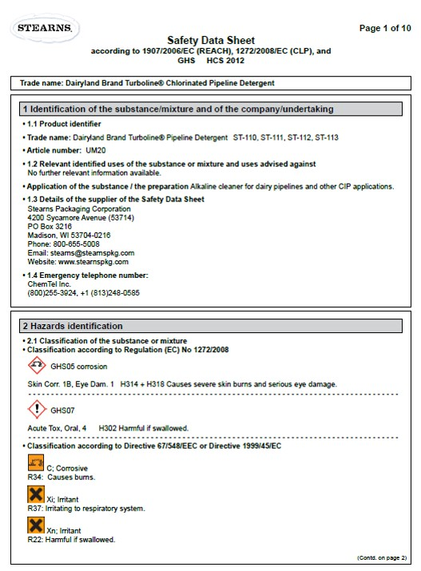
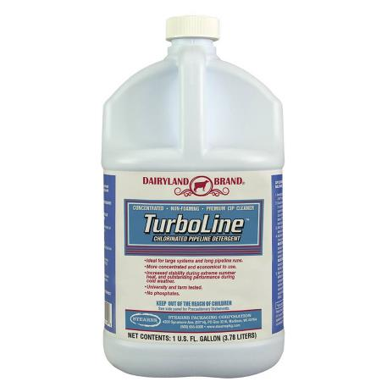
Cleaning Solutions for Dairy Operations
https://www.stearnspkg.com/consumer-brands/farm-sanitation-products/item/227-turboline-prem-chlorinated-pipeline-cleaner.html
Notes:
Dairy operations use a variety of chemicals, both acid- and alkali-based for cleaning barns, parlors, and equipment. Most of these solutions are highly concentrated – powerful cleaning agents formulated for industrial settings.
For example, alkali cleaners that are used to disinfect and clean residual milk out of pipelines. These cleaners are so corrosive that when they come into contact with skin or mucous membranes, they produce immediate chemical burns.
https://www.marshfieldresearch.org/Media/Default/NFMC/PDFs/ChildrenandDairyChemicals.2.pdf

Slide 52

Dairy Cleaning Solutions
Engineering control - some dairies use a closed system to pump cleaning solution directly into pipelines, protecting workers from spills and splashes.
www.istockphoto.com
https://www.marshfieldresearch.org/Media/Default/NFMC/PDFs/ChildrenandDairyChemicals.2.pdf

Slide 53
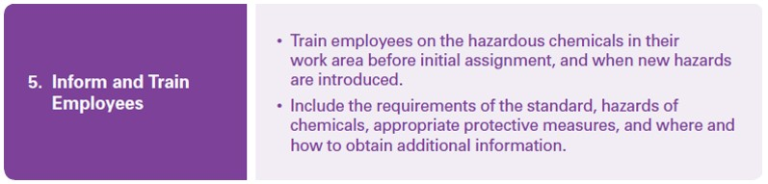
Fifth Step to an Effective Hazard Communication Program
Hazard Communication: Small Entity Guide for Employers that Use Hazardous Chemicals (OSHA 3695-03 2014); Occupational Safety and Health Administration, U.S. Department of Labor

Slide 54
Hazard Communication Training
The third part of HCS communication
When properly conducted, training will ensure worker comprehension and understanding.
Not sufficient to just read materials to workers or hand them material to read.
Must be presented in a manner and language that employees can understand.
Create a climate where workers feel free to ask questions – help ensure information is understood
Hazard Communication: Small Entity Guide for Employers that Use Hazardous Chemicals (OSHA 3695-03 2014); Occupational Safety and Health Administration, U.S. Department of Labor
Notes:
Employers needs to create and open door policy with employees so they are comfortable in asking questions to their supervisor. There is a return on investment in a good HazCom Policy.
Manner of presentation - Language other than English? Limited vocabulary? Illiterate?

Slide 55
Hazard Communication Training Considerations
Designation of person(s) responsible for conducting training
Instructional format of the program
Elements of the information and training program
Procedure to train new workers at the time of their initial assignment to work with a hazardous chemical, and to train workers when a new chemical is introduced into the workplace.
Hazard Communication: Small Entity Guide for Employers that Use Hazardous Chemicals (OSHA 3695-03 2014); Occupational Safety and Health Administration, U.S. Department of Labor

Slide 56
Components of a Hazard Communication Training Program
Training must address the following:
Methods and observations that may be used to detect the presences or release of a hazardous chemical in the work area.
The physical, health, simple asphyxiation, combustible dust and pyrophoric gas hazards, as well as hazards not otherwise classified, of the chemicals in the work area.
The measures employees can take to protect themselves and procedures the employer has implemented to protect employees.
The details of the hazard communication program developed by the employer
Hazard Communication: Small Entity Guide for Employers that Use Hazardous Chemicals (OSHA 3695-03 2014); Occupational Safety and Health Administration, U.S. Department of Labor
Notes:
Methods – monitoring conducted by the employer, continuous monitoring devices, visual appearance or odor of hazardous chemicals, etc.
Protection – appropriate work practices, emergency procedures, personal protective equipment to be used, etc.

Slide 57
Retraining
Not required on a regular schedule
Required if a new chemical hazard is introduced into the work area
It is good practice to repeat and reinforce training to ensure workers retain hazard information.
Hazard Communication: Small Entity Guide for Employers that Use Hazardous Chemicals (OSHA 3695-03 2014); Occupational Safety and Health Administration, U.S. Department of Labor
Notes:
New employees are required to be trained before working and current employees need to be retrained if a new chemical is added to the worksite.
Yearly retraining is highly recommended but not required. Even though there is no requirement to retrain yearly it is highly suggested retrain yearly on HAZCOM. It only has to take a few minutes.

Slide 58
Training Documentation
Employers are not required to maintain records of employee training, but many choose to do so.
Hazard Communication: Small Entity Guide for Employers that Use Hazardous Chemicals (OSHA 3695-03 2014); Occupational Safety and Health Administration, U.S. Department of Labor
Notes:
Keeping records is helpful to document compliance with OSHA’s training requirement in case of an inspection.

Slide 59
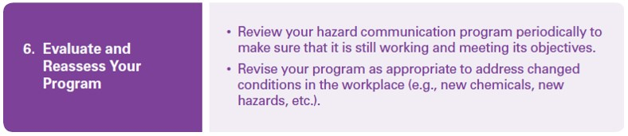
Sixth Step to an Effective Hazard Communication Program
Hazard Communication: Small Entity Guide for Employers that Use Hazardous Chemicals (OSHA 3695-03 2014); Occupational Safety and Health Administration, U.S. Department of Labor

Slide 60
HazCom Compliance Checklist
Obtained/accessed a copy of the standard.
Read and understood the requirements.
Assigned responsibility for tasks.
Prepared an inventory of chemicals.
Ensured that containers are labeled.
Obtained SDSs for each chemical.
Prepared written program.
Made SDSs available to workers.
Conducted training for workers.
Established procedures to maintain current program.
Established procedures to evaluate program effectiveness, including maintenance of SDSs.
☑
Hazard Communication: Small Entity Guide for Employers that Use Hazardous Chemicals (OSHA 3695-03 2014); Occupational Safety and Health Administration, U.S. Department of Labor

Slide 61

An Effective Hazard Communication Program
Hazard Communication: Small Entity Guide for Employers that Use Hazardous Chemicals (OSHA 3695-03 2014); Occupational Safety and Health Administration, U.S. Department of Labor

Slide 62
HCS Enforcement Statistics
#2 on OSHA’s Top 10 Most Frequently Cited Standards Violated in FY2018 (October 1, 2017, through September 30, 2018)
Most frequently cited HCS provisions
Employers shall maintain any safety data sheets that are received with incoming shipments of hazardous chemicals, and ensure that they are readily accessible during each work shift to employees when they are in their work areas.
Chemical manufacturers and importers are required to evaluate the hazards of the chemicals they produce or import, and prepare labels and safety data sheets to convey the hazard information to their downstream customers.
All employers with hazardous chemicals in their workplaces must have labels and safety data sheets for their exposed workers, and train them to handle the chemicals appropriately.
https://www.ishn.com/articles/107820-osha-hazard-communication-standard-hazcom

Slide 63
Employee Rights - Overview
Under federal law, you are entitled to a safe workplace.
Your employer must provide a workplace free of known health and safety hazards.
If you have concerns, you have the right to speak up about them without fear of retaliation.

Slide 64
Employee Rights
Be trained in a language you understand
Work on machines that are safe
Be provided required safety gear, such as gloves or a harness and lifeline for falls
Be protected from toxic chemicals
Request an OSHA inspection, and speak to the inspector
Report an injury or illness, and get copies of your medical records
See copies of the workplace injury and illness log
Review records of work-related injuries and illnesses
Get copies of test results done to find hazards in the workplace
Notes:
You also have the right to:

Slide 65

OSHA Whistleblower Protection Programs
Notes:
Within OSHA is the whistleblower program
Website resources
22 statutes

Slide 66
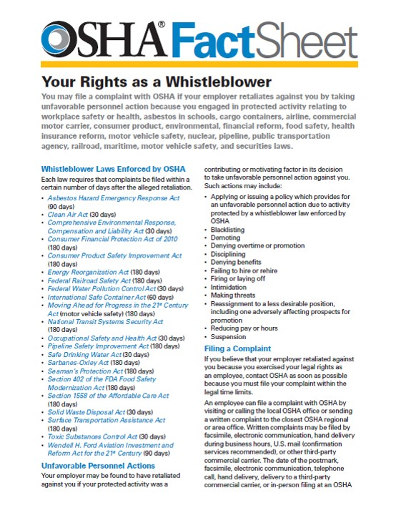
Whistleblower Rights – Fact Sheet (FS-3638)

Slide 67
Resources Available
OSHA website: www.osha.gov
OSHA phone: 800.321.OSHA
OSHA educational materials
Compliance Assistance Specialists in OSHA Regional and State Offices
National Institute for Occupational Safety and Health (NIOSH) – OSHA’s sister agency
OSHA Training Institute Education Centers
Doctors, nurses, other healthcare providers
Public libraries
Other local, community-based resources
Notes:
Educational materials of many types available in English, Spanish, Vietnamese, and other languages. In print or online. Brochures, fact sheets, guidance documents, posters.

Slide 68


Disclaimer
This material was produced under a Susan Harwood Training Grant (SH-05068-SH8) from the Occupational Safety and Health Administration (OSHA), U.S. Department of Labor. It does not necessarily reflect the views or policies of the U. S. Department of Labor, nor does mention of trade names, commercial products, or organizations imply endorsement by the U. S. Government. The U.S. Government does not warrant or assume any legal liability or responsibility for the accuracy, completeness, or usefulness of any information, apparatus, product, or process disclosed.

