Slide 1
Section 2
Ladders

Slide 2
Disclaimer
This material was produced under grant number SH-31198-SH7 from the Occupational Safety and Health Administration, U.S. Department of Labor. It does not necessarily reflect the views or policies of the U.S. Department of Labor, nor does mention of trade names, commercial products, or organizations imply endorsement by the U.S. Government.
This presentation is intended to discuss Federal Regulations only - your individual State requirements may be more stringent as many states operate their own state OSHA and they may have adopted construction standards that are different from information presented in this training. If you live in a state with an OSHA approved state plan, you should contact your local administrator for further information on the standards applicable in your state.
These materials are meant for informational purposes only.
No representation is made as to the thoroughness of the presentation.
Notes:
This material was produced under the Susan Harwood training grant number SH-31198-SH7 from the Occupational Safety and Health Administration, U.S. Department of Labor.

Slide 3
Disclaimer, cont.
It is not the intent to provide compliance-based training in this presentation, the intent is more to address hazard awareness in the residential construction (i.e. home building) industry, and to recognize the overlapping hazards present in many construction workplaces.
Photos shown in this presentation may depict situations that are not in compliance with applicable OSHA/safety requirements.
No legal advice is offered or implied, and no attorney-client relationship is intended or established. If legal advice or other expert assistance is required the services of a competent professional person should be sought.
It is the responsibility of the employer and its employees to comply with all pertinent OSHA/safety rules and regulations in the jurisdiction in which they work.
Notes:
Please read the disclaimer for legal purposes, this is required under the Susan Harwood Training Grant program.

Slide 4
Copyright Information © 2018
This material is the copyrighted property of the Job-Site Safety Institute and the National Association of Home Builders. By federal regulation, OSHA reserves a license to use and disseminate such material for the purpose of promoting safety and health in the workplace. The Job-Site Safety Institute and the National Association of Home Builders hereby authorizes employers and workplace safety and health professionals to use this material, distributed by or through OSHA, in their workplaces or practices in accordance with the guidance contained in the material.
To this end, permission is granted to use such copyrighted material solely for non-commercial, instructional, personal, or scholarly purposes. The material may be used and incorporated into other workplace safety and health programs on the condition that no fee may be charged for the subsequent use of the material. Use of the material for any other purpose, particularly commercial use, without the prior, express written permission of the copyright owner/s is prohibited. Furthermore, any modification to the material is prohibited without the prior, express written permission of the copyright owners.
Notes:
Note that the these materials are copyrighted by the Job-Site Safety Institute and the National Association of Home Builders. Permission is granted to use such copyrighted material in accordance with the terms on the slide.

Slide 5
Learning Objectives: Section 2
Determine the proper ladder to use based on weight capacity and height.
Calculate the proper pitch of extension ladders for proper set-up, and identify how to secure and stabilize ladders.
Identify how to maintain a safe position when using a ladder.
Notes:
Discuss the learning objectives for Section 2. In this section we will address ladder and scaffold safety, including:
Determine the proper ladder to use based on weight capacity and height.
Calculate the proper pitch of extension ladders for proper set-up, and identify how to secure and stabilize ladders.
Identify how to maintain a safe position when using a ladder.

Slide 6
Ladders

Slide 7
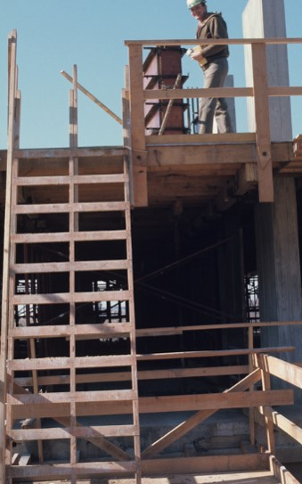
Ladder Hazards
The likelihood of surviving a fall from a ladder at least 10 feet high is only 50%.
Approximately half of all injuries caused by slips, trips or falls from ladders and stairways require time off work.
Notes:
Your chances of surviving a fall from a ladder at least 10 feet high is only 50%. Additionally, approximately half of all injuries caused by falls from ladders require time away from work to heal. This can lead to reduced income for your family, and also unnecessary pain and suffering.
Photo from the Electronic Library of Construction Occupational Safety & Health (ELCOSH) http://www.elcosh.org/image/625/i000230/230.html

Slide 8
Ladder Training Requirements
Each employee using ladders should be trained to recognize hazards.
Hazards Include:
  Nature of the fall hazards in the work area.
  Correct procedures for placement, use and maintenance.
  Maximum intended load-carrying capacities.
Notes:
Discuss the training requirements when using ladders. Additionally, employees need to understand the nature of fall hazards, correct procedures for placing and using ladders and the maximum intended load-carrying capacities of ladders so you do not exceed their maximum working load rating.

Slide 9


Ladder or Scaffold?
Notes:
Discuss the unsafe work practice that is utilized here. Rather than use a stepladder, trestle scaffold or other approved equipment, the worker is placing himself in harm’s way by standing on three stacked 5-gallon paint buckets. It is important to always use the right tool for the job.

Slide 10
Choosing the Right Ladder
Before stepping onto a ladder, think about these things:
What capacity can it hold?
Height of the ladder—too short or too tall?
Condition of the ladder and instructions unique to the ladder selected.
We’ll look at each of these in detail.
Notes:
Explain how to pick the right ladder for the task being performed. Remember to pay close attention to the task(s) being performed. Try to think about what capacity the ladder can hold, the height of the area you need to access, and always remember to perform a visual inspection of the ladder prior to use.

Slide 11
Proper Duty Rating/Capacity
OSHA Requirement
Ladders shall not be loaded beyond the maximum intended load for which they were built nor beyond their manufacturer's rated capacity.
Notes:
Discuss the proper duty rating capacity of ladders. Ladders must not be loaded beyond the manufacturers maximum intended load for which they were built to handle.

Slide 12
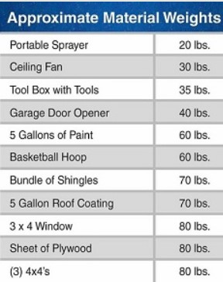
Proper Duty Rating/Capacity
How much weight will be on the ladder?
  Factor your weight plus tools and materials being handled.
  NOTE: workers must not carry any tools/materials when climbing a ladder that could cause them to lose balance and fall.
Duty rating is the maximum safe load capacity of the ladder.
Notes:
Discuss the proper duty rating capacity of ladders. When calculating the duty rating or ladder you need, remember to factor in your weight plus the weight of tools and materials being carried. The duty rating is the maximum safe load capacity of the ladder.
Photo Source: https://www.wernerco.com/us/support/ladder-safety-tips/how-to-choose-a-ladder

Slide 13
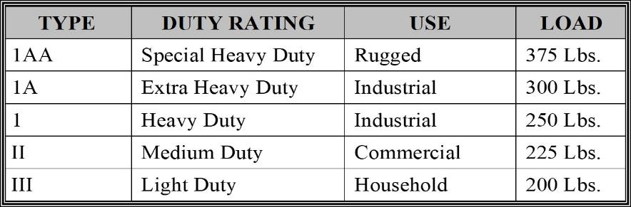
Proper Duty Rating/Capacity, cont.
Select a ladder with the proper duty rating for your weight and the materials you are handling.
Notes:
Explain the table showing duty ratings for a variety of ladder types. For example, a type III light-duty ladder is meant for household use and its maximum intended load rating is 200 lbs. On the opposite spectrum, a type IAA ladder is meant for special heavy duty rugged use and its maximum intended load rating is 375 lbs.

Slide 14
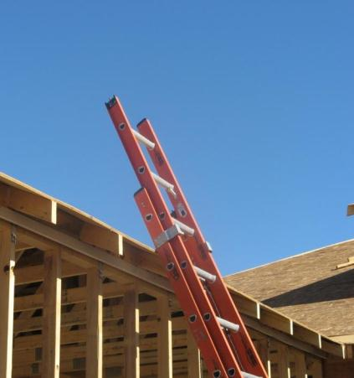
“3 Feet Rule” for Extension Ladders
When using an extension ladder for access to another level, the ladder must extend at least 3 feet (.9 m) above the landing to provide a hand hold for getting on and off the ladder.
Notes:
Emphasize this important rule, requiring the ladder to expend at least 3 feet above the landing or area being accessed. The reason for this requirement is to provide a hand hold for employees to be able to safely get on and off the ladder.

Slide 15
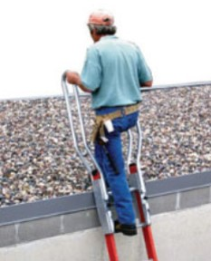
“3 Feet Rule” for Extension Ladders, cont.
Add-on extensions to ladders which allow workers to walk-through the top of an extension ladder are acceptable if they extend at least 3 feet (.9 m) above the landing.
Notes:
Recognizing that it is important to provide a safe hand hold for workers to get on and off of a ladder, many manufacturers are beginning to make walk-through extensions to avoid having to navigate around the rungs of a ladder. An example of this type of walk-through ladder extension is shown in the slide.
Photo: https://www.osha.gov/pls/oshaweb/owadisp.show_document?p_table=INTERPRETATIONS&p_id=25177

Slide 16
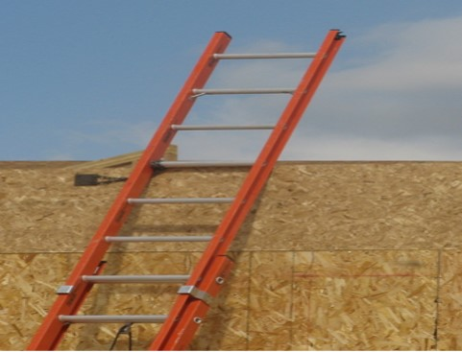
“3 Feet Rule” for Extension Ladders, cont.
3 feet
Notes:
This picture helps illustrate that a ladder must extend 3 feet beyond the level being accessed. A general rule is that a ladder must extend 3-rungs above the level being accessed as most rungs are placed approximately 12 inches apart.

Slide 17
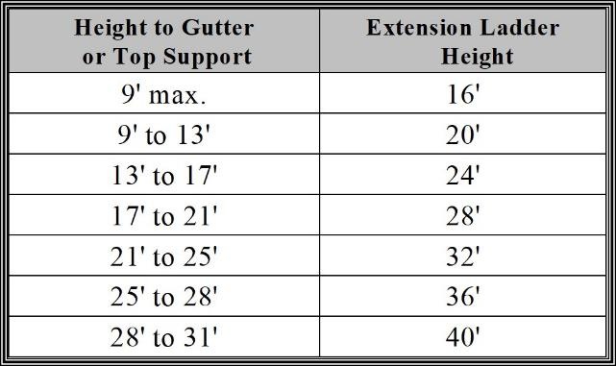
Calculate length of Ladder Needed
Extension ladders should be 7 to 10 feet longer than the highest contact point.
  Allows for proper positioning angle and extension above the roof line or landing
Notes:
Explain that extension ladders should be at least 7 to 10 feet longer than the height being accessed. This allows for the proper angle for the ladder to be placed, in addition to adding the 3 feet extension above the level being accessed. The chart on the right helps explain this further by providing examples of the height being accessed and also the corresponding ladder height needed.

Slide 18
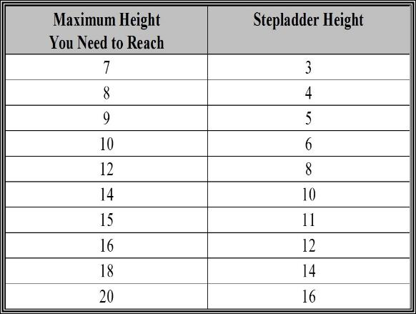
Proper Height Stepladders
Choose a stepladder that is no more than 4 feet shorter than the height being reached.
Notes:
A stepladder must be no more than 4 feet shorter than the area being reached. This prevents employees from needed to stand on the top 2-rungs of a stepladder, which is unsafe and against OSHA regulations.

Slide 19
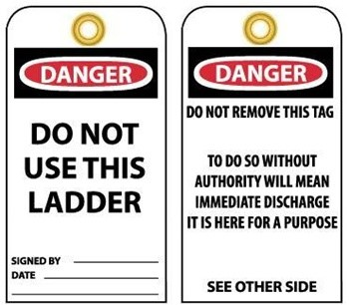
Inspect your Ladder
Inspect ladders prior to use for visible defects.
  Never use a ladder that is broken or otherwise damaged.
  Remove damaged ladders from service, tag them as damaged, and discard them immediately, if feasible.
Notes:
Ladders must be inspected at least daily for visible defects. Employees must never use a ladder that is broken or otherwise damaged. Damaged ladders must be removed from service and tagged as defective. An example of a tag to mark a ladder as unsafe and to not use is shown on this slide.

Slide 20
Inspection of Ladders
Missing, broken or loose rungs.
Damaged or worn non-slip feet.
Loose nails, screws, bolts, rivets.
Loose or faulty spreaders, locks, other materials.
Rot, decay of wooden ladders.
Cracked, split, worn or broken rails, braces, steps.
Missing identification or safety labels.
Do not paint ladders since defects may be concealed.
Notes:
Discuss different areas of a ladder to inspect prior to use. Look for damaged rungs, feet, missing connectors, rot or decay, broken rails and missing identification labels.

Slide 21
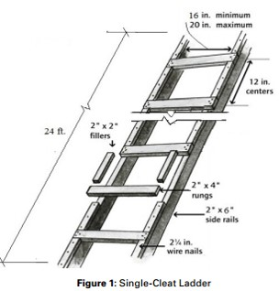
Job-Made Wooden Ladders
Job-made wooden ladders are permissible, if constructed according to OSHA and ANSI specifications.
  Must be constructed to ANSI A14.4-2009 standard.
  Standard contains very specific requirements for type of materials to use, as well as spacing and limitations.
  Do not use job-made ladders unless you have reviewed the OSHA and ANSI regulations and standards.
Notes:
Discuss that job-made ladders are permissible, but must be made pursuant to specific OSHA and ANSI requirements. These standards contain specific instructions for the type of materials to use, spacing and limitations of job-made ladders.

Slide 22
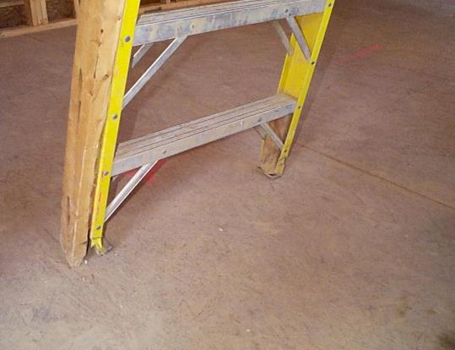

Damaged Ladder Photos
This ladder shows the use of 2x4 wood to repair damaged side-rails and feet of a ladder.
  This ladder should be tagged and removed from service.
Notes:
This photo shows a ladder with a 2x4 used to repair the siderail, which is not permitted. Ladders that are damaged must be tagged and removed from service. Also, notice the lumber used to support the bottom step.

Slide 23
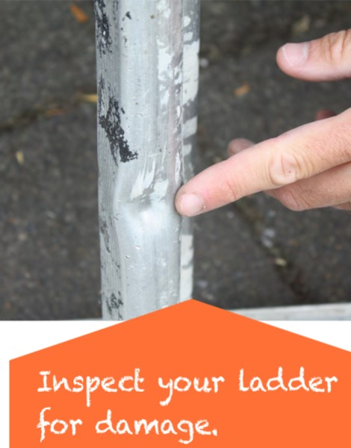

Damaged Ladder Photos
The side-rail of this ladder is dented.
  This ladder should be tagged and removed from service.
Notes:
The slide shows a photo of a damaged ladder siderail. This ladder should be tagged and removed from service.
Source: http://osha.oregon.gov/OSHAResourceNewsletter/2013/08-2013/images/ladder/fig-03.jpg

Slide 24
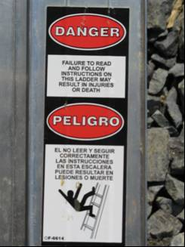
Ladder Labels
Check the labels to learn about:
  Warnings
  Duty rating
  Set-up
Notes:
Ladder manufacturers must affix labels which show warnings, duty rating and discuss proper set-up.

Slide 25
Ladder Setup - Placement
Avoid setting up a ladder in high traffic areas or barricade areas around ladder.
Do not use metal or aluminum ladders near electrical lines.
Place ladders on stable and level surfaces.
Notes:
Avoid setting up ladders in a high traffic area or barricaded areas. Do not use metal or aluminum ladders near electrical lines. Additionally, ladders must be placed on stable and level surfaces.

Slide 26
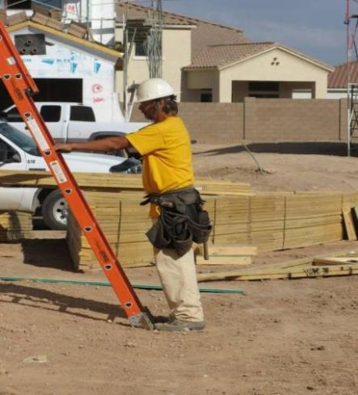
Ladder Setup – Proper Pitch
Extension ladders should be used at a 4 to 1 pitch (1.2 to .3 m).
For every 4 ft. (1.2 m) in height, the bottom of the ladder should be 1 ft. (.3 m) away from the structure.
Example:
20 ft. (height) ÷ 4 ft. = 5 ft. pitch
Notes:
A good rule of thumb to determine if the ladder is at the proper pitch is to stand at the base of the ladder and extend your arms. If you can touch the ladder while standing straight up the pitch is approximately 4:1.

Slide 27
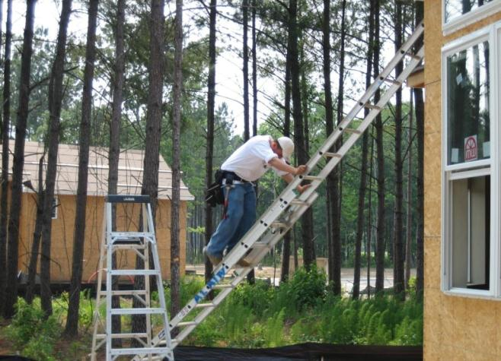

Correct Pitch?
Remember, for every 4 ft. (1.2 m) in height, the bottom of the ladder should be 1 ft. (.3 m) away from the structure.
Notes:
Discuss the unsafe work practices utilized in this photo. A worker is shown climbing an extension ladder leaning against a residential home under construction at an improper pitch.

Slide 28
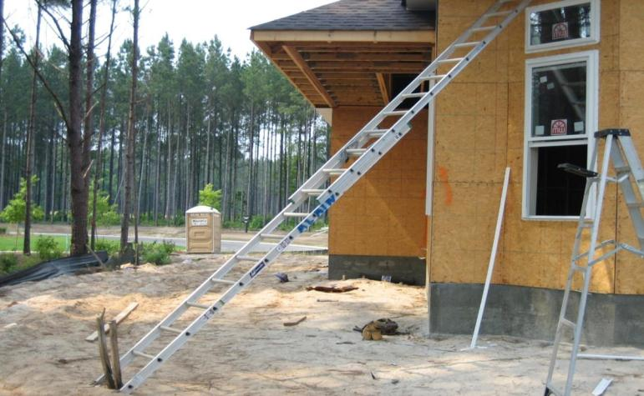

Identify the Hazards
How many hazards do you see in this photo?
Notes:
A ladder is shown at an improper angle. Additionally, a stepladder is shown without being fully opened.

Slide 29
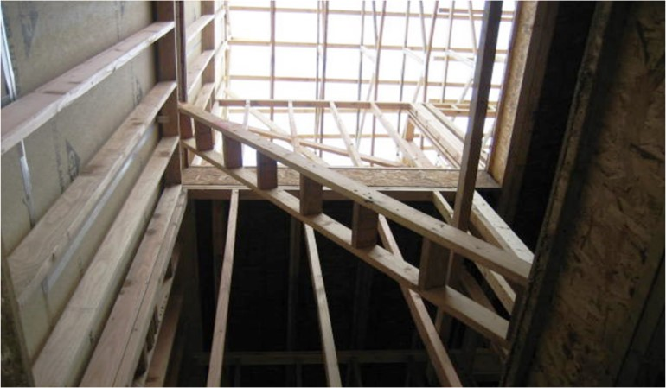

Identify the Hazards
How many hazards do you see in this photo?
Notes:
A job-made wooden ladder is shown over a floor opening. Floor openings should be properly secured with a cover suitable to handle 2-times the maximum intended load.

Slide 30
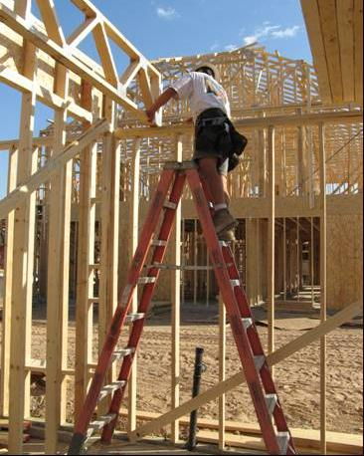
Stepladders
Stepladders are designed for use in an opened-and-locked position.
Do not use a stepladder that is folded or in a leaning position.
Notes:
Stepladders are only to be used in an opened and locked position. Do not use a stepladder leaning against a structure or in a folded position.

Slide 31
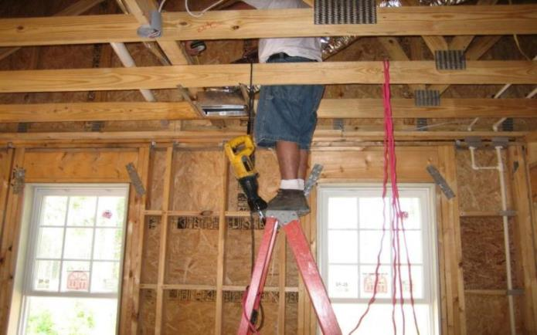

Stepladders, cont.
Never stand on the top 2 rungs of a stepladder.
Notes:
Never stand on the top 2 rungs of a stepladder as you are at a higher risk to lose your balance and fall.

Slide 32
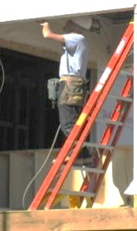
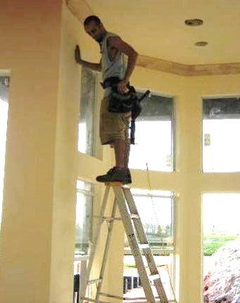


Identify the Hazards
How many hazards do you see in these photos?
Notes:
These photos show employees improperly using stepladders. One worker is shown using a stepladder in a leaning position and the other worker is shown on the top rung of a stepladder.

Slide 33
Secure and Stabilize Ladders
Secure extension ladders at the top or bottom to prevent movement.
The base of an extension ladder must be secured in place by using the safety feet on the ladder or other effective means.
Notes:
Ladders should be secured at the top and bottom to prevent movement or displacement. The base of an extension ladder must be secured by using the feet on the ladder or by other effective means.

Slide 34
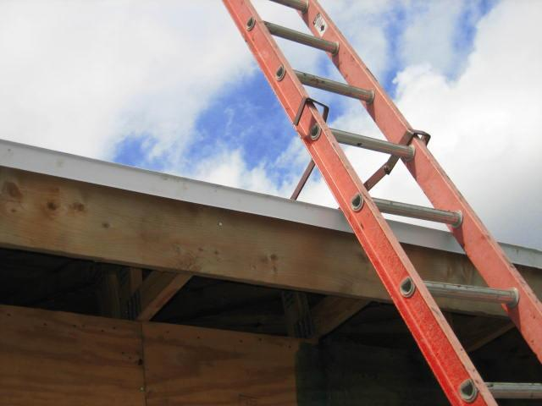
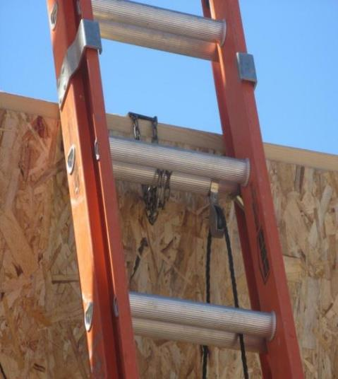
Ladder Secured at the Top
Notes:
These photos show two types of ways to secure ladders at the top to prevent displacement. The photo on the left shows a brace or bracket system and the photo on the right shows a chain.

Slide 35
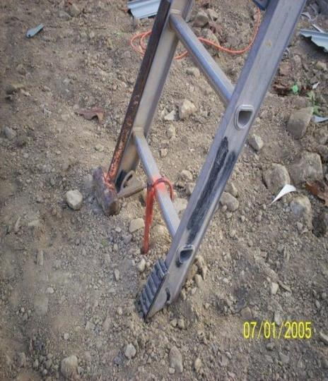
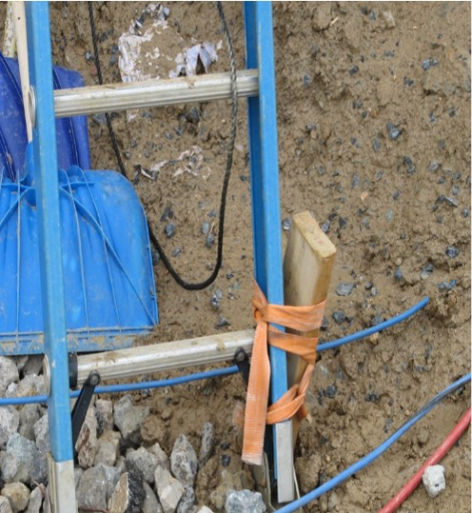
Ladder Secured at the Bottom
Notes:
These photos show examples of ways to secure ladders at the bottom or base. Beyond securing the feet of a ladder into the ground, you can also use an anchor type device, as shown on the photos.

Slide 36
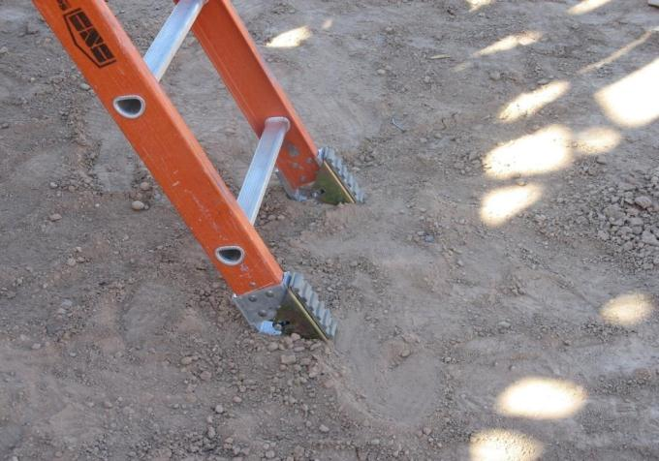
Securing Ladders in Loose Soil
Dig feet/cleat of extension ladder into soil.
  The feet should face outward and dig into the ground to prevent ladder from kicking out.
Notes:
On loose soil or a soft base, dig feet into the ground. The feet should face outward and dig into the ground to prevent the ladder from kicking out.

Slide 37
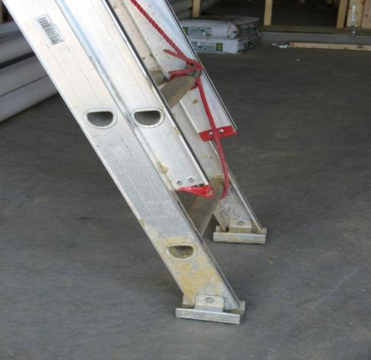
Securing Ladders on Firm Base
Use anti-slip shoes/ safety feet on firm ground.
Install a kick-plate or have someone hold the ladder while in use.
Notes:
On a firm base, set feet level and on the rubber pads. You can also install a kick-plate or have someone hold the ladder to prevent it from slipping out when in use.

Slide 38
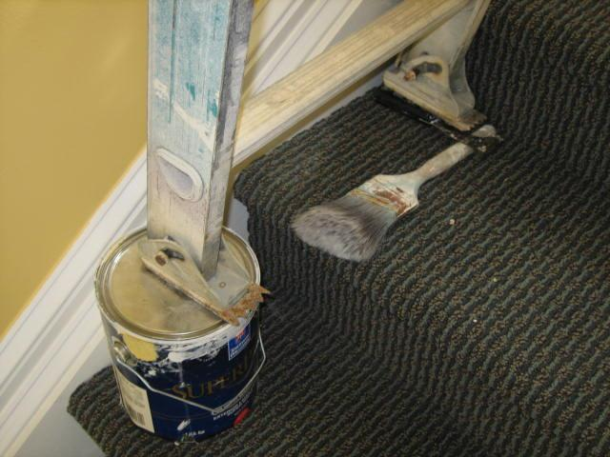
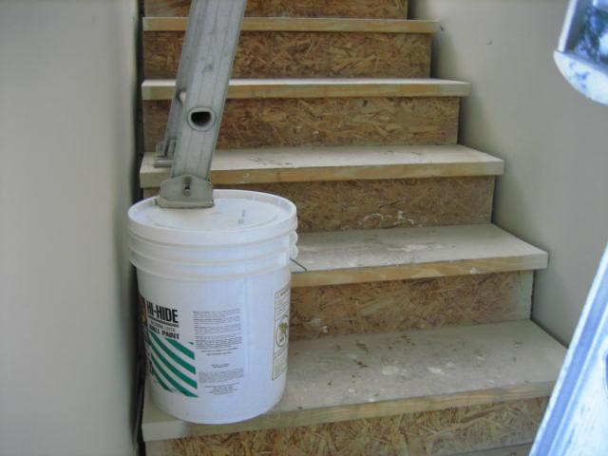

Identify the Hazards
How many hazards do you see in these photos?
Notes:
This photo shows improper and unsafe ways to stabilize a ladder on an uneven surface. In these photos buckets are used on stairs to assist in leveling a ladder. This is an unsafe practice and is against OSHA regulations, specifically those found in 29 CFR 1926.1053.

Slide 39
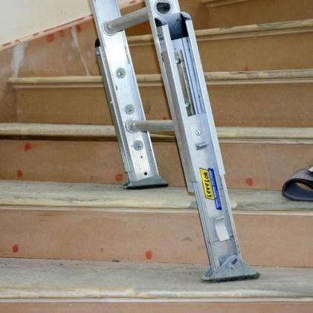
Securing Ladders on Uneven Surfaces
When the surface is not level, use a ladder leveler (accessory) to provide even contact points.
Notes:
To assist in leveling ladders on uneven surfaces, you should use an approved ladder leveling accessory; an example of which is shown in the slide.

Slide 40
Safely Working from Ladders
Face the ladder when ascending or descending.
Keep your body centered on the ladder.
Never let your belt buckle pass either ladder side-rail.
Notes:
When working from a ladder:
Face the ladder when ascending or descending.
Keep your body centered on the ladder.
Never let your belt buckle pass either ladder side-rail.

Slide 41
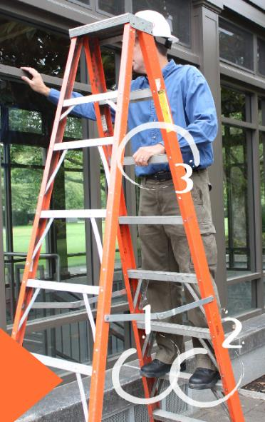
Safely Working from Ladders
Maintain three points of contact when ascending or descending a ladder.
Notes:
When working from ladders it is important to maintain three points of contact when ascending or descending a ladder. In the photo, a worker is shown with both feet firmly affixed to the ladder and also one hand used as support.
Photo from http://www.orosha.org/resource-newsletter/2013/08-2013/Feat01.html#.VLKkbSvF9qU

Slide 42
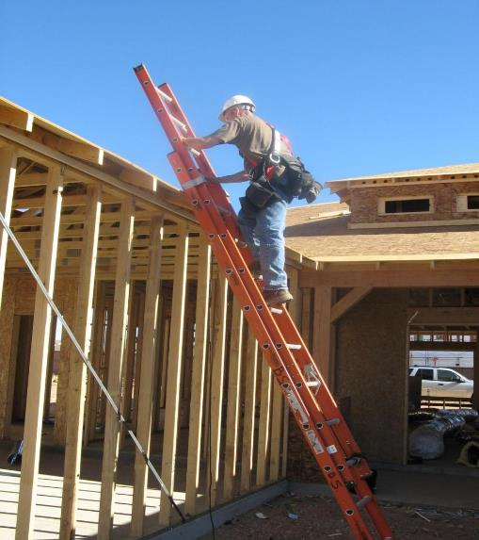
Safely Working from Ladders
Remember:
Maintain three points of contact when ascending or descending.
Secure the ladder at the top or bottom.
Extend the ladder at least 3 feet above the level being accessed.
Notes:
Recap important ladder safety tips:
Maintain three points of contact when ascending or descending ladder.
Secure the ladder at the top or bottom.
Extend the ladder at least 3 feet above the level being accessed.

Slide 43
Safely Working from Ladders, cont.
Do not overreach when working from the ladder.
Do not stand on the top two rungs of a stepladder.
Do not allow another person on a ladder at any given time, unless you are using a double-cleated ladder that is intended for two-way traffic.
Notes:
Recap important ladder safety tips:
Do not overreach when working from the ladder.
Do not stand on the top two rungs of a stepladder.
Do not allow another person on a ladder at any given time, unless you are using a double-cleated ladder that is intended for two-way traffic.

Slide 44
Safely Working from Ladders - Review
Do not carry anything that may cause loss of balance.
Consider using rope to raise/lower material.
Do not stand on top 2 rungs of stepladder.
Use a pulley system to get materials to your working level.
Notes:
Recap important ladder safety tips:
Do not carry anything that may cause loss of balance.
Consider using rope to raise/lower material.
Do not stand on top 2 rungs of stepladder.
Use a pulley system to get materials to your working level.

