Slide 1

Promoting Chemical Safety on the Job
Promoting Chemical Safety on the Job
Juliana Simmons, MSPH, CHES
Environmental and Occupational Health Program Manager
Migrant Clinicians Network
Notes:
This presentation is about making promoting chemical safety on the job.

Slide 2

We offer health and safety training at no cost to employees.
We offer health and safety training.
Notes:
We offer health and safety training at no cost to employees.

Slide 3
This project is funded by OSHA, but MCN does NOT take part in any enforcement. We are not a regulatory agency.
This project is funded by OSHA, but MCN does NOT take part in any enforcement. We are not a regulatory agency.
Notes:
This project is funded by OSHA, but MCN does NOT take part in any enforcement. We are not a regulatory agency.

Slide 4
Video:
https://www.youtube.com/watch?v=9XluYVm8oS4&feature=youtu.be
Notes:
Please take a moment to watch this video to better understand chemical safety.

Slide 5

Employer Responsibilities
Notes:
This is an abbreviated look at some key employer responsibilities per OSHA. For this presentation, we are going to hone in specifically on hazard communication

Slide 6
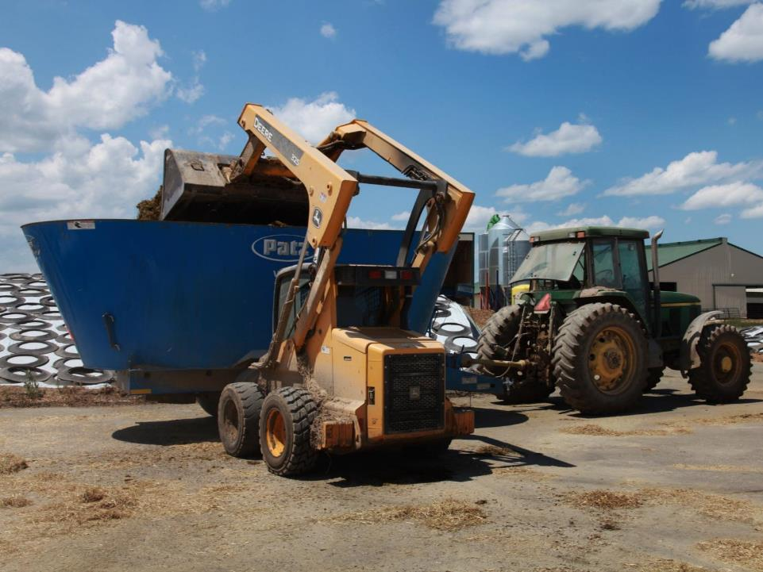
Provide a workplace free from serious hazards
Provide a workplace free from serious hazards
Notes:
Provide a workplace free from serious hazards

Slide 7

Provide employees with safe tools and personal protective equipment
Provide employees with safe tools and personal protective equipment
Notes:
Provide employees with safe tools and personal protective equipment

Slide 8

Use signs and labels to warn employees of potential hazards
Use signs and labels to warn employees of potential hazards
Notes:
Use signs and labels to warn employees of potential hazards

Slide 9

Training must be provided in a language that workers understand.
Training must be provided
in a language that workers understand.
Notes:
Training must be provided
in a language that workers understand.

Slide 10

Keep records of work-related illnesses and injuries
Notes:
Keep records of work-related illnesses and injuries

Slide 11

Develop and implement a written hazard communication program and train employees on the hazards they are exposed to.
Develop and implement a written hazard communication program and train employees on the hazards they are exposed to.
Notes:
Develop and implement a written hazard communication program and train employees on the hazards they are exposed to.

Slide 12

OSHA’s Hazard Communication Standard
Employers that have hazardous chemicals in their workplaces are required to implement a hazard communication program.
Notes:
This is where we are going to dive in to a little more detailed information about OSHA’s Hazard Communication Standard. Employers that have hazardous chemicals in their workplaces are required to implement a hazard communication program.

Slide 13
How Hazard Communication
Works
How Hazard Communication
Works
Implement the Program
  All Employers receive labels containers and safety data sheets with shipped chemicals
  All Employers must prepare a written hazard communication program, including a list of the hazardous chemicals in the workplace.
  Employers must ensure:
    All containers of hazardous chemicals are labeled
    Safety data sheets are maintained for all hazardous chemicals
    Workers are trained on program elemetns, hazards, protective measures, etc.
  Chemical Manufactuers and Importers classify the hazards of chemicals they produce or import, and prepare labels and safety data sheets based on the classifications.
Chemicals are Shipped to Employers by Chemical Manufacturers, Importers or Distributors
Keep Information Up to Date
Source: https://www.osha.gov/Publications/OSHA3695.pdf
Notes:
This image depicts the general flow of how hazard communication works. You can take a moment to read through this slide.

Slide 14
Steps to an Effective Hazard Communication Program
1: Learn the standard and identify a champion
2: Prepare and implement a written Hazard Communication Program
3: Ensure containers are labeled
4: Maintain Safety Data Sheets (SDS)
5: Inform and Train Employees
6: Evaluate and Reassess Your Program
Notes:
These are the steps to an effective hazard communication program:
1: Learn the standard and identify a champion
2: Prepare and implement a written Hazard Communication Program
3: Ensure containers are labeled
4: Maintain Safety Data Sheets (SDS)
5: Inform and Train Employees
6: Evaluate and Reassess Your Program

Slide 15
Learn the standard and identify a champion
Download the standard: www.osha.gov/ dsg/hazcom
Hazard communication coordinator should be someone who can ensure that the training and other activities take place according to the written plan
Notes:
Identifying a staff champion in the workplace is very important. This person will ensure that the written plan is being abided by.

Slide 16

Prepare and implement a written Hazard Communication Program
Must address:
  Labels and other forms of warning
  Safety data sheets
  Employee training in the workplace
Notes:
• Prepare a written plan to indicate how hazard communication will be addressed in your facility.
• Prepare a list or inventory of all hazardous chemicals in the workplace.

Slide 17
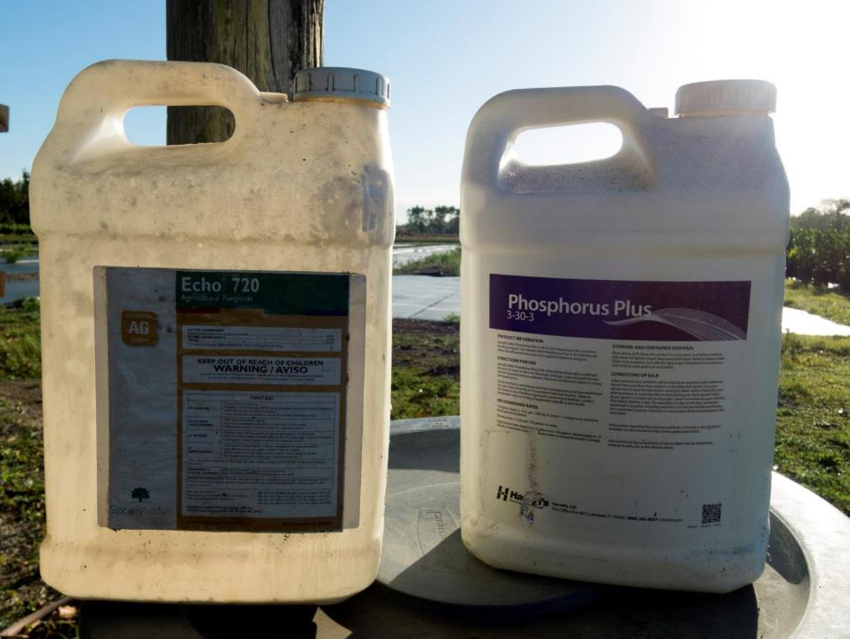
Ensure containers are labeled
Notes:
All containers must be appropriately labeled

Slide 18


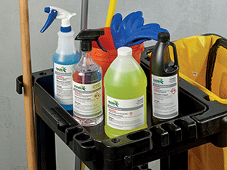
Labels
Can use manufacturer labels or labels from a third party system
Labels must include at least:
  A product identifier
  General information concerning the hazards of the chemical
Notes:
• Keep labels on shipped containers.
• Label workplace containers where required.
Can use manufacturer labels or labels from a third party system
Labels must include at least:
A product identifier
General information concerning the hazards of the chemical

Slide 19
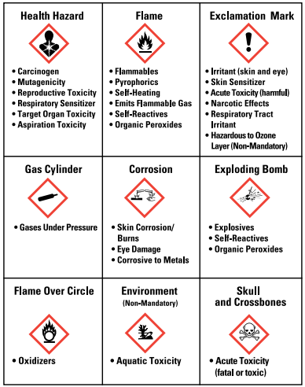
Pictograms
Source: https://www.osha.gov/Publications/OSHA3695.pdf
Notes:
Pictograms are an important addition to the hazard communication tools in the standard. A pictogram draws the attention of a label reader, and you and your workers should be aware that the appearance of a pictogram in a red diamond frame means that a hazard of concern is present in the product. Some of the pictograms in the standard have symbols that resemble the hazardous effect, and others are merely meant to attract attention. Pictograms may be used for several different hazardous effects as well

Slide 20
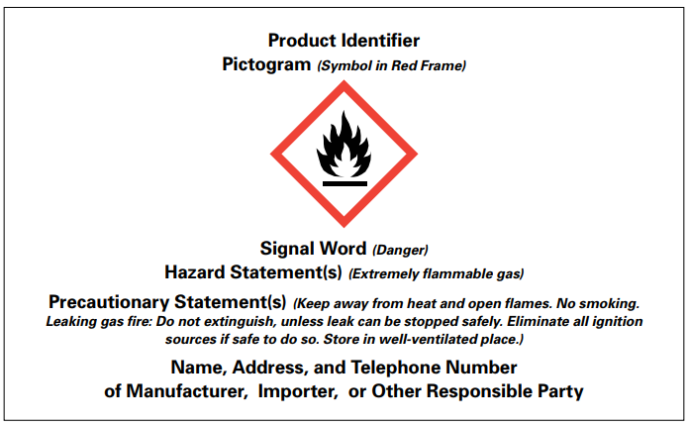
Required Label Elements
Source: https://www.osha.gov/Publications/OSHA3695.pdf
Notes:
Here are required label elements

Slide 21
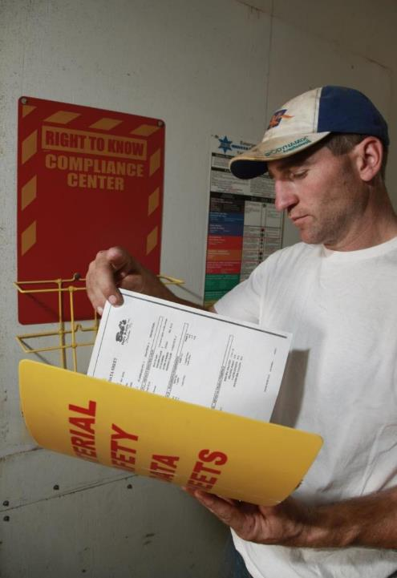
Safety Data Sheet
Safety Data Sheet
(SDS)
©Earl Dotter- NFMC
Notes:
Safety Data sheets are required for all chemicals used in the workplace

Slide 22
Maintain Safety Data Sheets (SDS)
Request SDSs from chemical manufacturer if they are not already supplied
SDSs must be readily accessible to workers
  Examples:
    In a pickup truck on a construction site
    In a binder in a central location in a warehouse
    Electronically stored, with hard copy backup
Notes:
• Maintain safety data sheets for each hazardous chemical in the workplace.
• Ensure that safety data sheets are readily accessible to employees.
Request SDSs from chemical manufacturer if they are not already supplied
SDSs must be readily accessible to workers
Examples:
In a pickup truck on a construction site
In a binder in a central location in a warehouse
Electronically stored, with hard copy backup

Slide 23
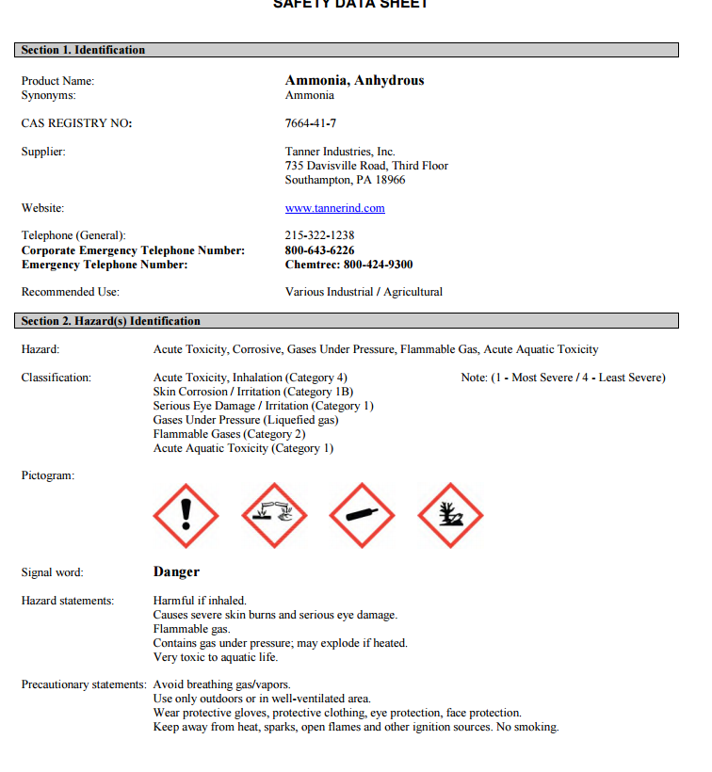

Ammonia 1
Notes:
Where to find the name of the chemical. What kind of hazards are associated with the chemical
Danger
Harmful if inhaled
Causes sever burns and serious eye damage
Flammable gas
Contains gas under pressure; may explode if heated

Slide 24
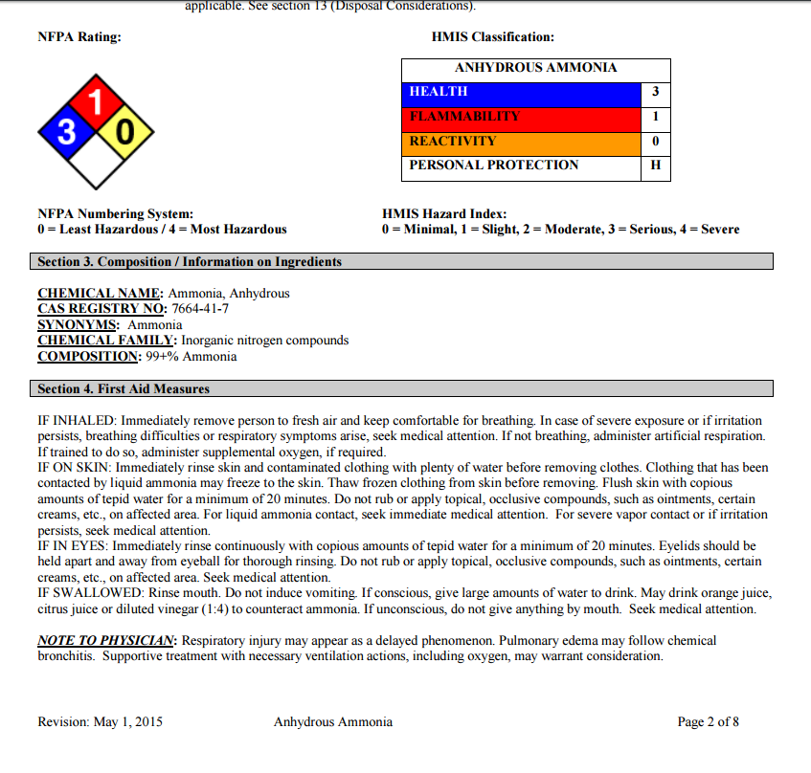
Ammonia 2
Notes:
First Aid Measures – shows what to do if you come into contact with the chemical

Slide 25
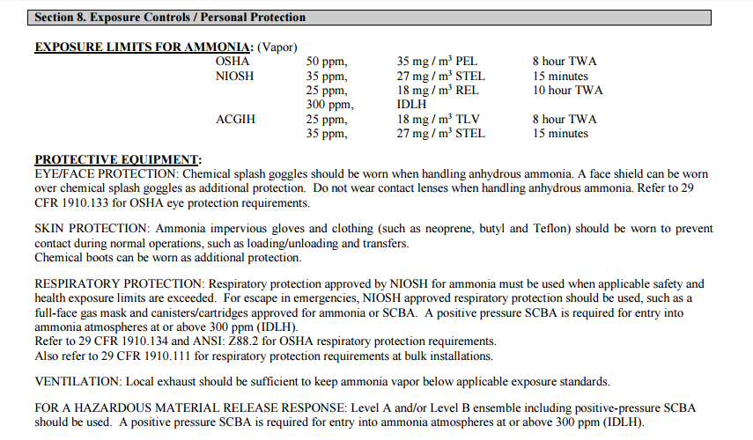
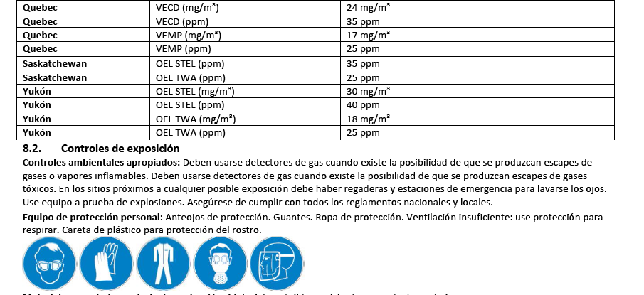
Ammonia 3
Notes:
PPE section shows what PPE is recommended when using this chemical

Slide 26





Personal Protective Equipment
Face Shield
Respiratory protection
Gloves
Coveralls
Safety glasses with side shields
Notes:
These are examples of personal protective equipment that may be needed for use with hazardous chemicals

Slide 27
Inform and Train Employees
Training must take place before the initial assignment and when new hazards are introduced
Must be in a language that employees understand
Training must address:
  how workers can find information on hazards
  protective measures
  who to contact if an issue arises
  what information is available on labels and SDSs
Notes:
• Train employees on the hazardous chemicals in their work area before initial assignment, and when new hazards are introduced.
• Include the requirements of the standard, hazards of chemicals, appropriate protective measures, and where and how to obtain additional information.
Here is some basic information on training employees, and we will circle back to this in a few minutes.

Slide 28
Evaluate and Reassess Your Program
No required evaluation component
Plan must be updated as new hazards are introduced, so system should be in place to review program periodically to ensure it is still relevant and comprehensive
Notes:
• Review your hazard communication program periodically to make sure that it is still working and meeting its objectives.
• Revise your program as appropriate to address changed conditions in the workplace (e.g., new chemicals, new hazards, etc.).

Slide 29

An Effective Hazard Communication Program
Source: https://www.osha.gov/Publications/OSHA3695.pdf
Notes:
All of these elements are important for an effective hazard communication program. Please take a moment to review this slide

Slide 30
Provide worker trainings
Provide worker trainings
Culturally appropriate
Spanish or English
Designed to be inclusive of all literacy level
Notes:
Culturally appropriate
Spanish or English
Designed to be inclusive of all literacy level

Slide 31

Worker trainings will address…
How workers are exposed to chemicals
The effects of chemicals on worker health
Understanding safety data sheets
Basic safety practices such as PPE and what to do in case of an emergency
Notes:
Trainings will address:
How workers are exposed to chemicals
The effects of chemicals on worker health
Understanding safety data sheets
Basic safety practices such as PPE and what to do in case of an emergency

Slide 32
Resources
OSHA Hazard Communication Fact Sheet
Guide for Small Employers
OSHA Direct Assistance:
  Regional Offices (find your region online)
  On-site Consultation Services
    www.osha.gov/consultation or 1-800-321-OSHA
  Compliance Assistance Specialists
    www.osha.gov/dcsp/compliance_assistance/cas.html or 1-800-321-OSHA
Notes:
Here are some additional resources

Slide 33
We would love to work with you!
For more information, please contact:
Notes:
Please contact us for more information

Slide 34
OSHA GRANT
This material was produced under grant SH-29622-SH6 from the Occupational Safety and Health Administration, U.S. Department of Labor. It does not necessarily reflect the views of policies of the U. S. Department of Labor, nor does it mention of trade names, commercial products, or organizations imply endorsement by the U. S. Government.”
Revisions were made to this material under grant number SH-31222-SH7 from the Occupational Safety and Health Administration, U.S. Department of Labor.

