Slide 1
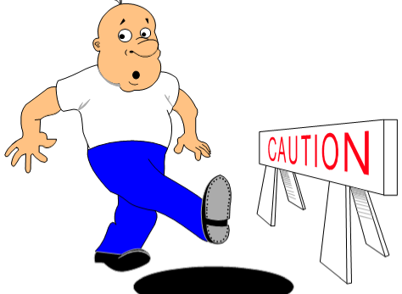
Preventing Slips, Trips and Falls: A Training Program for Small Businesses
Notes:
Welcome everyone! Introduce yourself and explain your background-Certifications, Training Experience and job experience. This course is Preventing, Slips, Trips and Falls: A training program for small businesses

Slide 2
Grant Information
The free safety awareness training for small businesses, is funded by the Susan Harwood grant
Originally produced under grant number 46EO-HT10 by the National Safety Council, 2006
Harper College grant number SH05064-SH8, 2019
Disclaimer: This material was produced under grant number 46EO-HT10 by the National Safety Council and revised under SH-05064-SH8 from the Occupational Safety and Health administration, U.S. Department of Labor. It does not necessarily reflect the views or policies of the U.S. Department of Labor, nor does mention of trade names, commercial products, or organizations imply endorsement by the U.S. government.
Notes:
This free course if funded by the Susan Harwood grant. This course has been revised based on a former course. Harper College grant number is SH05064-SH8, 2019. State the grant disclaimer and state the complete disclaimer statement.

Slide 3

Course information
Emergency evacuation procedures and emergency exits
Location of rest rooms and classroom phone
Course starting and ending times
Break
Campus Smoking policy
Please silent all electronic devices
Medical Concerns
Participation
Notes:
Emergency evacuation procedures, course start and end times, including breaks, campus and or building no smoking policy. Smoking and vaping are allowed, only inside vehicles. Location of the rest rooms in hallway outside of classroom. Point out the location of classroom phone on the wall and advise campus has a police department and number is one the wall or call 911. Point out emergency exits for building are outside the hallway. Please silent all mobile phones. Participation is welcomed and encouraged. Later in course, there will be group break-out sessions.

Slide 4
Program agenda
Program Introduction
Module 1: Introduction to Preventing Slips, Trips and Falls
Module 2: Recognizing Slip, Trip and Fall Hazards
Notes:
This course is a four (4) course that includes module 1 and module 2. This slide outlines the program agenda-Program Introduction; Module 1-Inroduction to the prevention of slips, trips and falls; Module 2-Recognizing Slip, Trip and Falls Hazards.

Slide 5
Program Goals
Identify the impact of slips, trips and falls in your workplace
Distinguish the various types of slips, trips and falls
Know the OSHA rule, regulations and other industry standards relating to slips, trips and falls
Recognize the slip, trip and fall hazards at your workplace
Conduct a baseline slip, trip and fall evaluation of your workplace
Select controls for your organization relating to slips, trips and falls
Identify actions you can take to prevent slips, trips and falls when you return to your job
Notes:
Program Goals: Identify slips, trips and falls; Distinguish various types; Know OSHA regulations and industry standards; Recognize slip trips and fall hazards in their workplace; Conduct baseline slip, trip an fall evaluation; Select controls for organization, for slips, trips and falls; Identify actions that can be taken to prevent slips, trips and falls upon returning to your job.

Slide 6

Introduction
Name
Where you work
What you do
Common slips, trips and falls
Notes:
Introduction-Have each student state their name, where they work, title. Ask everyone at end of introductions if they would like to share common slips, trips and falls in their workplace and if they would like to share specific accidents they may be concerned about or have occurred in their workplace. Based on participant comments, this could take 20 minutes or more, depending on class size and responses. Note allowable time and adjust accordingly.

Slide 7
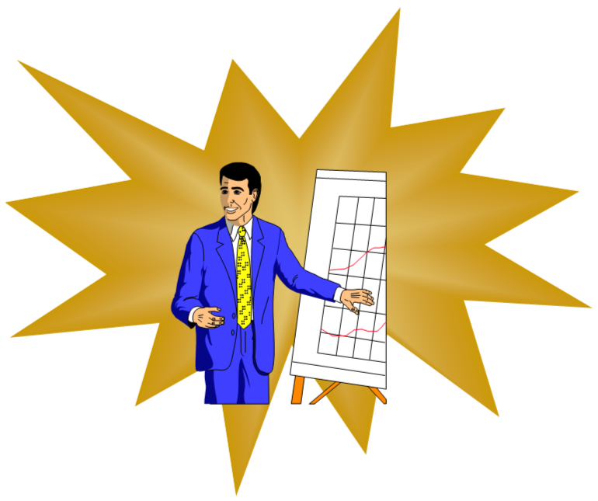
Learning Goal
What is your learning goal?
Notes:
Ask if anyone would like to share what is their learning goal, what is their biggest concern (s) and what they want to achieve from the course. Note, this could take 20 minutes depending on answer description and class size. Adjust accordingly.

Slide 8

Module 1: preventing slips, trips and falls: A FREE Training program for small businesses
INTRODUCTION TO PREVENTING SLIPS, TRIPS AND FALLS
Notes:
Module 1: Introduction to preventing slips, trips and falls: A free training program for small businesses.

Slide 9
objectives
After completing this module, you will be able to:
Identify the impact of slips, trips and falls in the workplace
Know key slip, trip and fall terminology
Recognize OSHA rules and regulations and other standards relating to slips, trips and falls
State the three (3) components of effective slip, trip and fall prevention
Notes:
Objectives of Module 1-Identify impact of slips, trips and falls in the workplace; Know key slip, trip and fall terminology; Recognize OSHA regulations and other standards for slips, trips and falls; State three components of effective slip, trip and fall prevention.

Slide 10

Test your slip, trip and fall IQ
Take the quiz to determine your knowledge of slip, trip and fall facts
Notes:
Announce to class, there will be two tests. The first test, is a pre-test. The other test, is a post-test, after course completion. This is to measure the level of knowledge gained. Instructor passes out the pretest to all of the participants. Instruct participants to ensure their name is on pre test and return the pre-test to instructor or facilitator.

Slide 11
Be free from retaliation
Workers have the right to be free from retaliation for exercising safety and health rights
Workers have a right to seek safety and health on the job without fear of punishment
This right is spelled out in Section 11(c) of the OSH Act
https://www.osha.gov/laws-regs/regulations/standardnumber/1977/1977.3
Whistleblower information can be found at the following link and fact sheet
https://www.whistleblowers.gov/
https://www.osha.gov/OshDoc/data_General_Facts/whistleblower_rights.pdf
Workers have 30 days to contact OSHA if they feel they have been punished for exercising their safety and health rights
Notes:
Workers are free from retaliation and have rights exercising safety and health rights, without fear of punishment. Section II © of the OSH Act and information regarding Whistleblower Protection Plan can be found at the websites listed and fact sheet. Workers have 30 days to contact OSHA if they feel they have been punished for exercising their safety and health rights. State any other pertinent information that would be helpful.

Slide 12
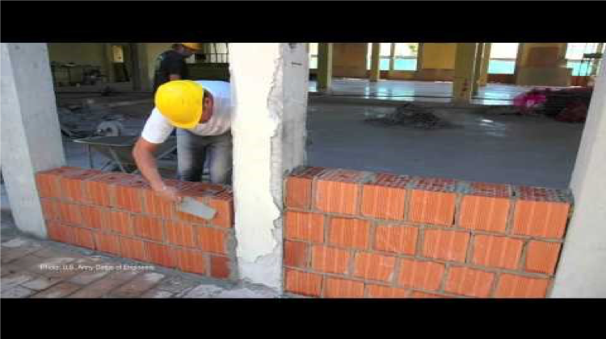
Workers’ rights
Know your rights.
To learn more visit: osha.gov/workers
OSHA Workers’ Safety and Health Rights on the job
Notes:
OSHA Workers Rights Video. 1 minute and 25 seconds. This video is included for visual learners to better understand their rights when reporting workplace occupational health and safety. Note, there is no speaking in this video.

Slide 13
Why is osha important to you?
5,147 workers were killed on the job in 2017
4.5 million work related injuries in 2017
Cost $161.5 billion in 2017
Notes:
Why is OSHA important to you? Ask, students if they would like to guess what they think the number of persons killed on the job was in 2017. Ask students if they would like to guess how many work related injuries do they think occurred in 2017. Ask students what the number of workers killed, number of work related injuries and the cost was in 2017. Show slide after guesses have been provided. Discuss briefly.

Slide 14
Did you know?
There were 882,730 occupational injuries and illnesses in 2017 that resulted in days away from work in the private industry, essentially unchanged from 2016.
227,716 occupational injuries were caused by slips, trips and falls in 2017.
697 occupational deaths were caused by falls in 2016.
There were 882,730 occupational injures and illnesses in 2017 that resulted in days away from work in the private industry, essentially unchanged from 2016.
Notes:
Provides 2016 and 2017 statistics from occupational injuries, illnesses, deaths and days missed from work, caused by slips, trips and falls.

Slide 15
In the year 2017, a median of …
12 work days were lost due to falls to a lower level
9 work days were lost due to falls on the same level
9 work days were lost due to slips and trips
Notes:
Median number of work days that were lost in 2017, due to slips, trips and falls from lower and same level.

Slide 16

In the years 2016 – 2017 ….
The average incurred workers’ compensation cost per slip, trip and fall exceeded the average cost of other injuries by 15%.
Notes:
Average incurred workers’ compensation cost per slip, trip and fall exceeded the average cost of other injuries in 2016 and 2017 by 15%.

Slide 17
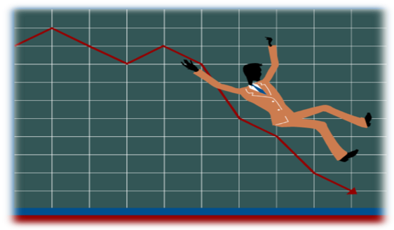
Slip, trip, and Fall definitions
Slip: Loss of balance when there is too little friction between the foot and the floor.
Trip: Loss of balance when the foot collides with, strikes or hits and in its path.
Fall: To move downward, typically rapidly and freely, from a higher to a lower level.
Notes:
Defines what a slip is, a trip and a fall.

Slide 18

Friction definitions
Friction: The resistance that one surface or object encounters when moving over another. The resistance between the shoe and the walking surface.
Tribology: The study of friction.
Tribometer: An instrument for measuring friction in sliding.
Notes:
Definitions of friction terms: Fiction; Tribology; Tribometer.

Slide 19
slip resistance and high traction definitions
Slip Resistance: The relative force that resists the tendency of a shoe or foot to slide along a floor.
High Traction: Amount of walkway slip resistance often associated with preventing a slip, trip or fall.
Notes:
Definitions of Slip Resistance and high traction. Read both definitions. Explain why both of these are important.

Slide 20
Regulation 1910 Osha Subpart d, final rule, FACT SHEET and osha publications
The Standard Regulation1910 OSHA Subpart D, Walking and Working Surfaces:
https://www.osha.gov/laws-regs/regulations/standardnumber/1910
Final Rule on the General Industry Walking-Working Surfaces and Fall Protection Standards:
https://www.osha.gov/walking-working-surfaces/
Fact Sheet:
https://www.osha.gov/Publications/OSHA3903.pdf
OSHA Website publications can be found at:
https://www.osha.gov/pls/publications/publication.html
Notes:
Regulation, Fact Sheet, Final Rule and publications can be found on the OSHA site and the handouts.

Slide 21
Additional Regulations and Standards
OSHA Regulatory requirements
https://www.osha.gov/laws-regs
Individual State Building Codes
Voluntary Consensus Standards
National Fall Safety Institute (NFSI): https://nfsi.org/
American National Standards Institute (ANSI): https://www.ansi.org/
American Standard for Testing Materials (ASTM): https://www.astm.org/
National Fire Protection Association (NFPA): https://www.nfpa.org/
Notes:
OSHA Regulations requirements –OSHA laws and regulations ; Individual State Building Codes-Each state has different codes. Advise students to visit their states’ website for further information. Mention, it could be possible that each county and cities could further have more codes and/or regulations. Voluntary Consensus Standards-NFSI, ANSI, ASTM, NFPA. Explain what voluntary census standards means.

Slide 22
APPLYING THE STANDARDS
Become familiar with the standards, especially OSHA Subpart D.
Set a goal to learn the standards one at a time.
Target areas that you want to improve, then learn the related standard.
Use the Internet to do more research.
Contact your contractors, vendors and insurance company for assistance and to provide information.
Notes:
Applying standards-Become familiar with the standards-OSHA Subpart D; Set a goal to learn the standards one at a time. Target areas that need improvement and learn the related standard; Use the internet to do more research; Contact your contractors, vendors and insurance company for assistance.

Slide 23
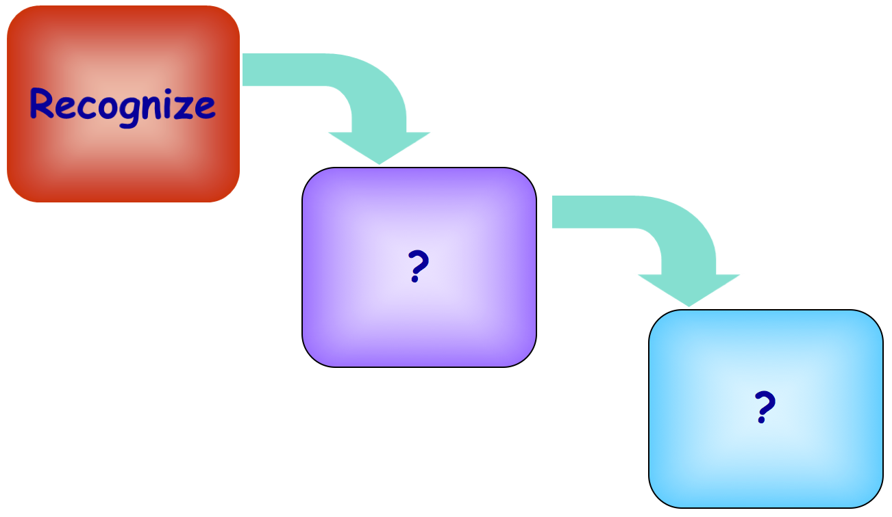
Recognize Slip, trip and fall prevention
Notes:
Recognize slip, trip and fall prevention. The first step in fall prevention is recognize. Advise students to be aware of their surroundings and to be proactive. Give examples of how they can recognize, including what to look for.

Slide 24
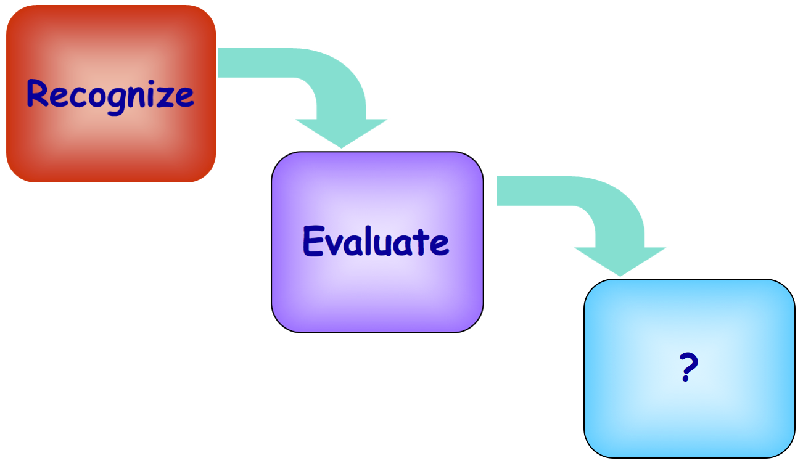
Evaluate Slip, trip and fall prevention
Notes:
The second step in fall prevention is evaluate. Give a few examples of evaluation. Ask students if they have questions on this step. If so, talk it through until student (s) have full understanding.

Slide 25
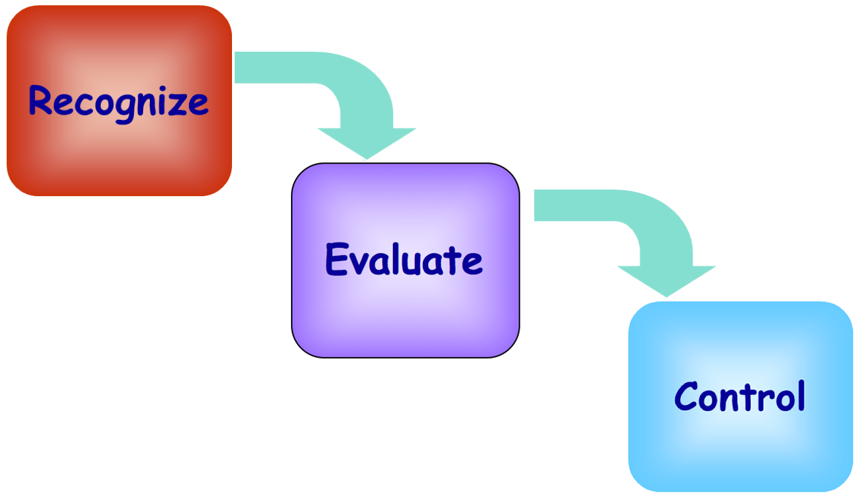
Control Slip, trip and fall prevention
Notes:
The third step in fall prevention is control. Give a couple examples of control. Ask students if they are encountering any pressing, unresolved issues or reoccurring issues. Discuss how they can change issue (s).

Slide 26
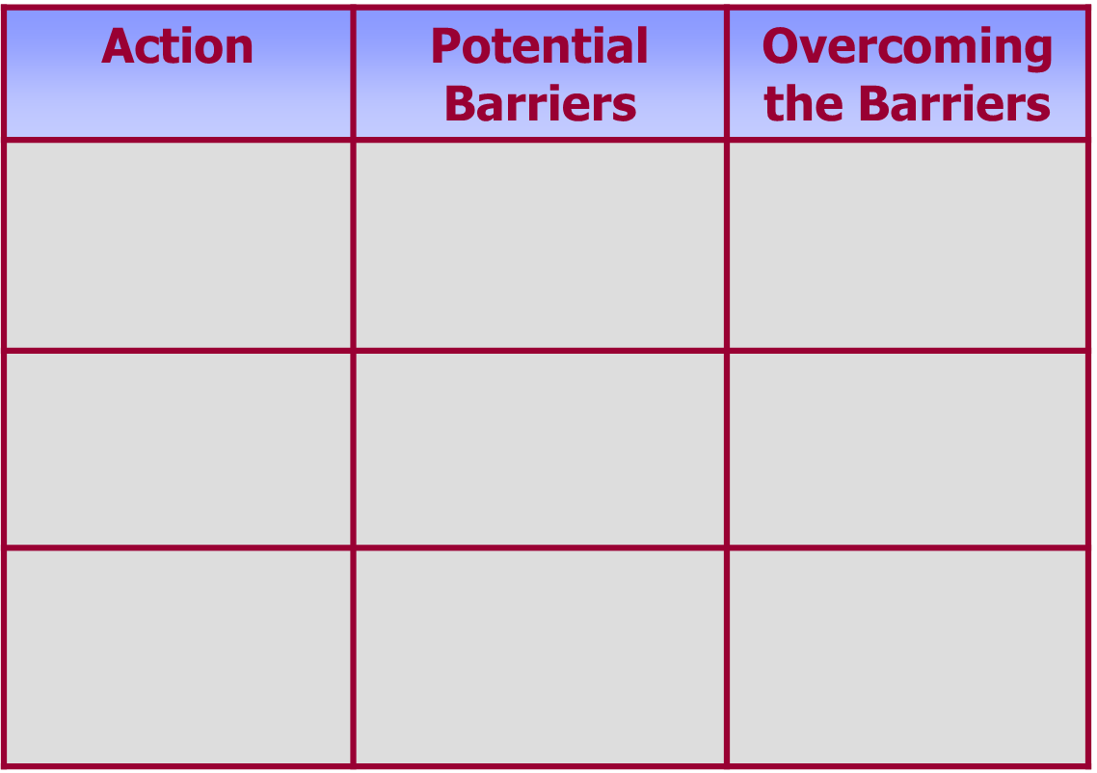
Action plan Template
Notes:
The action plan template is a matrix showing three (3) columns: Action; Potential Barriers; Overcoming the Barriers. Discuss the action plan including, how will they overcome the barriers, the pain points and addressing push back.

