Slide 1
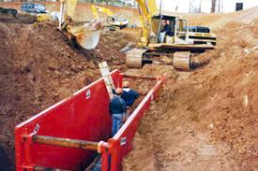
Excavation and Trenching
Safety Training
Based On
OSHA 29 CFR 1926
SUBPART P

Slide 2
Acknowledgement
UNITED STATES
DEPARTMENT OF LABOR
Occupational Health and Safety Administration (OSHA)
Susan Harwood Training Grant
SH-31218-SH7
This material was produced under a grant (SH-31218-SH7) from the Occupational Health Administration, U.S. Department of Labor. It does not necessarily reflect the views or policies of the U.S. Department of Labor, nor does the mention of trade names, commercial products, or organization imply endorsement by the U.S. Government.

Slide 3
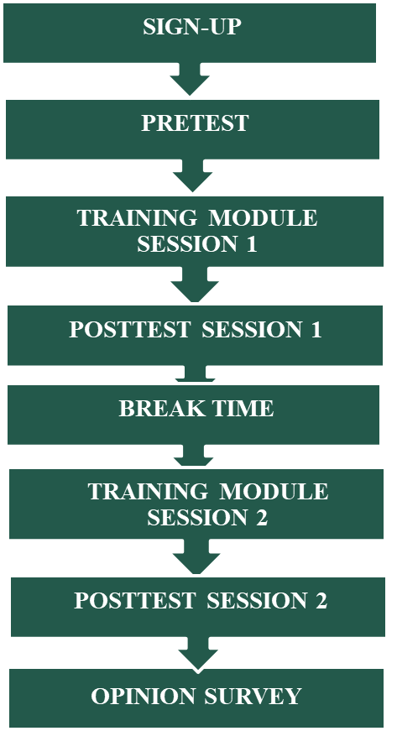
The Training Steps
Notes:
A typical training session flowchart is presented above. Training starts with sign-up to collect demographic and background information on the trainees. This is followed by a pretest consisting of 25 questions that aim to measure the existing knowledge level of the trainees on Excavation and Trenching Safety. This will establish a baseline that can be compared to the posttest results to assess the effectiveness of the training on increasing the knowledge of the participants. Next is the presentation of the training module which is divided in to two sessions. After finishing the first session, a posttest covering that session will be given. A short break will be given after the posttest-1. Presentation of the second part of the training module will continue after the break followed by the posttest-2. Both posttests are identical to the pretest. Improvement of scores from pretest to posttest will signify learning attributable to training. Lastly, trainees will fill out the opinion survey designed to measure the trainees’ feedback to the training. This feedback is used to make an overall assessment of the training, and to establish strategies for improving the module, and training delivery.

Slide 4
PLEASE START THE
PRETEST
Maximum: 15 minutes.
Notes:
Trainer hands out the “Pretests” to the trainees.

Slide 5
Training Content
    Introduction
      Workers’ Rights under the OSH Act
      Excavations and trenches
      How cave-ins occur and cause fatality
      Excavation and trenching fatality and injury
      OSHA Standard on excavations (29 CFR 1926 Subpart P)
Notes:
This training covers workers rights under OSH Act, health hazards associated with excavation and trenching operations, specific workplace tasks that could expose employees to cave-in hazards , and specific measures that can be implemented to protect employees from cave-ins.

Slide 6
Training Contents
Soil Classification
  Categories (Solid Rock, Type A, Type B, Type C)
  Soil testing
Cave-in Hazard Controls
  Engineering Controls
    Protective systems (Sloping, benching, shoring)
    Access and egress (Ramps and ladders)
    Protective system selection - Flowchart
    Protective system installation, maintenance and removal

Slide 7
Training Content –cont.
      Workplace Controls
        Training and Site inspection
        Competent Person (roles and responsibilities)
        Professional Engineer
    Other Excavation Hazards
      Struck-by (Equipment, material and falling object)
      Fall into (Signs/barricades)
      Overhead/underground utilities
      Stability and adjacent structures
      Hazardous atmosphere
    Rescue Operations

Slide 8

Worker Rights under OSH Act
Right to Know and Whistleblower Provisions
Federal Hazard Communication Standard, Title 29, Part 1910.1200 mandates that “Workers have the right to know and understand the hazardous chemicals they use and how to work with them safely.”
  The hazard communication standard
  applies to any business, including manufacturers
  that use hazardous chemicals.
Employers may not retaliate by taking unfavorable personnel action against them for whistleblowing.
  For more information refer to the hyperlink below
  Whistleblowers’ Rights
Notes:
This regulation (29 CFR 1910.1200) is designed to make information about hazardous chemicals that are present in work places available to exposed employees.
The hazard communication standard applies to any business as long as the business use hazardous chemicals, regardless of the number of individuals employed.
Workers may file a complaint with OSHA if the employer retaliates by taking unfavorable personnel action against employees for whistleblowing for engaging in protected activity (legal rights as an employee) relating to workplace safety or health.
Employers cannot punish workers in any way for:
Reporting an injury or illness;
Complaining to your employer, union, OSHA or other agencies about safety and health problems;
Filing safety and health grievances;
Participating in safety and health committees; or
Participating in OSHA inspections and other OSHA-related activities.
If the employer retaliated against the employee because of exercising his/her legal rights, the worker must contact OSHA as soon as possible. the complaints must be filed within the legal time limits. An employee can file a complaint with OSHA by visiting or calling the local OSHA office or sending a written complaint to the closest OSHA regional or area office. Written complaints may be filed by facsimile, electronic communication, hand delivery during business hours, U.S. mail (confirmation services recommended), or other third-party commercial carrier.
If a worker is fired, demoted, transferred or discriminated against in any way for using his/her rights under the law, he/she must he/she must file a complaint with OSHA within 30 days.

Slide 9
INTRODUCTION

Slide 10
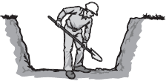
Excavations and Trenches
Excavation: a man-made hole (cut) that is dug in the earth surface
  Varying size: wide, narrow, deep, or shallow.
Notes:
According to OSHA, excavation is defined as any man-made cut, cavity, trench, or depression in the Earth’s surface formed by earth removal. Excavation can be of any size i.e. wide, narrow, deep, or shallow.

Slide 11
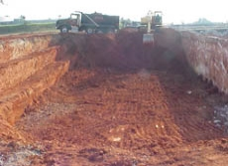
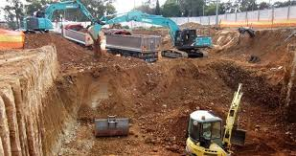
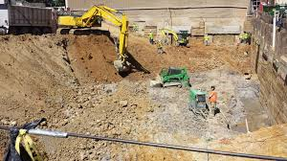
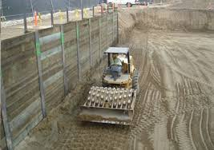
Examples of Excavations
Notes:
Some examples of excavations. Excavations can be any size . Usually, excavations are large and open digs with more than 15 ft of bottom width

Slide 12
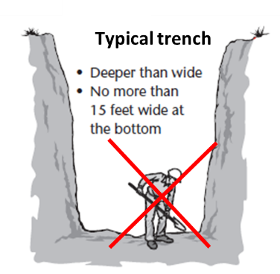
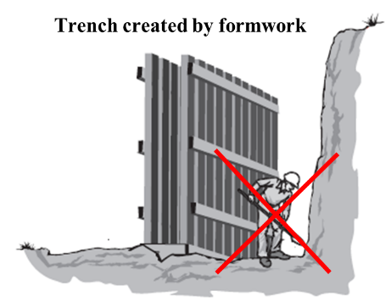
Excavations and trenches – cont.
Trench is a special excavation
  Depth is larger than width
  Usually narrow, less than 15 feet (ft) at the bottom
  Installation of formwork can create a trench
Notes:
Trench is basically a special type of excavation. A trench is defined as a narrow excavation (in relation to its length) made below the surface of the ground.
In general, the depth of a trench is greater than its width (D>B), but the width of a trench (measured at the bottom) is not greater than 15 feet (4.6 m). If formworks or other structures are installed in an excavation that reduce its width to less than 15 feet, measured at the bottom, that excavation is also considered a trench

Slide 13
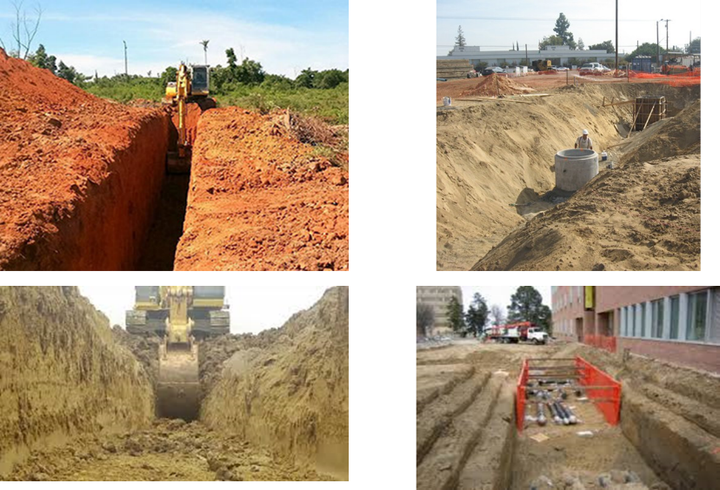

Examples of trenches
Notes:
Examples of different forms of trenches are shown in the pictures. Also, you can clearly see the commonly used protective systems e.g. sloping and benching.
Top right picture ( identified with red x) displays a noncompliance with the OSHA’s Excavation Standard, a worker must not be in a trench where no egress is present.

Slide 14
Cave-in Hazard in Excavations and Trenches
Excavation and trenching is dangerous work
Many workers are crushed or suffocated in unprotected trenches - collapsing soils and cave-ins
Cave-ins cause 3 out of every 4 excavation fatality
Fatality rates are twice the fatality rate of other construction work.
Notes:
Excavation and trenching are recognized as highly dangerous construction activities. They present serious hazards to all workers involved. Cave-ins pose the greatest risk and are more likely than some other excavation-related incidents to result in worker fatalities. Each year, large numbers of workers in unprotected excavations and trenches are crushed or suffocated mainly due to collapsing soils and cave-ins. Research reports reveals that:
75% (3 out of 4) of the fatalities in excavation works are from cave-ins
Struck-by accidents and electrocutions have been mainly responsible for the remaining 25%
Generally, employees performing excavation work have had twice the fatality rate of those engaged in other types of construction work.

Slide 15
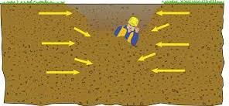
Forces of Trench Collapse
A cubic foot of soil weighs 100 pounds or more
  A cubic yard of soil may weigh as much as a small car (2700 pounds).
  A cave-in in an unprotected 8 ft deep trench can easily have 3-6 cubic yards burying him
  Soil does not need to bury to kill a worker!
Notes:
Trench collapse, known as cave-in, can trap workers in the trench within seconds and may result in severe injuries and fatalities within minutes. As seen in the picture, workers may be exposed severe compressive forces in a cave-in. Here are some facts about these severe forces:
A cubic foot of soil weighs 100 pounds or more
A chunk of earth the size of a washing machine can weigh 1,500 pounds or more
A cubic yard, the capacity of most backhoe loader front buckets weighs about 2700 pounds, which is roughly equal to the weight of a small car.
Here is how cave-ins occur. In the natural state undisturbed soil stays in place because opposing horizontal and vertical forces are evenly balanced. However, when you create an excavation, you remove the soil that provides horizontal support. Soil will eventually move downward into the excavation. The longer the face (a side of the excavation) remains unsupported, the more likely it is to cave in.
Cave-ins are serious events; a person working in an unprotected 8ft deep trench could easily have 3-6 cubic yards (8100-16200 pounds) which will totally bury him in a cave-in. It should also be noted that soil does not need to bury the worker to kill him because just 24 inches of soil on a person’s chest weighs 750-1000 lbs., enough to crush his lungs.

Slide 16

Reasons for Fatality
Lack of appropriate protection
  Protective systems not employed / improperly installed
  Environmental conditions – rain, ice, vibrations
  Competent person was not assigned
Soil type not determined/considered
Non-compliance with the OSHA regulations
Notes:
The main reason for collapsing of trenches is that they are not properly protected. Some statistical facts showed that that:
Protective systems were properly employed in only 24% of the trenches where fatalities occurred.
For the rest, a protective system was either
improperly used (24 %);
was available but not used (12%); or
was simply unavailable (64 %).
Environmental conditions were a contributing factor in 68 % of the fatalities
Excavation sites with out an assigned competent person were also prone to accidents. A competent person was not present onsite in 86% of the cases, when the fatality occurred.
Also, previous accident data analysis revealed that most of the time (65%), the employer had not identified the soil type.
Based on these identified reason, it can be concluded that lack of adhering to OSHA regulation is the fundamental reason or fatalities.

Slide 17

OSHA Standard on Excavations
(29 CFR 1926 Subpart P)
1926 Subpart P - Excavations
1926.650 - Scope, application, and definitions
1926.651 - Specific Excavation Requirements.
1926.652 - Requirements for protective systems.
1926 Subpart P App A - Soil Classification
1926 Subpart P App B - Sloping and Benching
1926 Subpart P App C - Timber Shoring for Trenches
1926 Subpart P App D - Aluminum Hydraulic Shoring for Trenches
1926 Subpart P App E - Alternatives to Timber Shoring
1926 Subpart P App F - Selection of Protective Systems
Notes:
The Occupational Safety and Health Administration’s (OSHA) Excavation standards, 29 Code of Federal Regulations (CFR) Part 1926, Subpart P, contain requirements for excavation and trenching operations. Below is the list of sections from the Subpart P
1926.650 - Scope, application, and definitions
1926.651 - Specific Excavation Requirements.
1926.652 - Requirements for protective systems.
1926 Subpart P App A - Soil Classification
1926 Subpart P App B - Sloping and Benching
1926 Subpart P App C - Timber Shoring for Trenches
1926 Subpart P App D - Aluminum Hydraulic Shoring for Trenches
1926 Subpart P App E - Alternatives to Timber Shoring
1926 Subpart P App F - Selection of Protective Systems
The standards apply to all open excavations made in the Earth’s surface, including trenches. Following the requirements of the standards will prevent or greatly reduce the risk of cave-ins and other excavation-related incidents

Slide 18
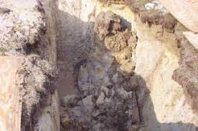
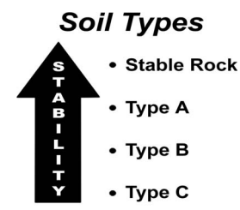
OSHA’s Soil Classification
Soils have different levels of stability
OSHA classifies soils into 4 types
  Stable rock – the most stable type
  Type A – very stable. (e.g. clay, cemented soils)
  Type B – less stable than type A (crushed rock, sand – silt mixtures)
  Type C – less stable than type B. (unstable gravel and sand )
OSHA requires protective systems for excavations deeper than 5 ft (except in stable rock)
Notes:
In order to know how soil behaves in excavation, you need to understand soil stability . Soils have different levels of stability, some are more stable than others. The type of soil is one of the factors that determines the level of stability and hence affecting the chance that an excavation will cave in.
OSHA follows a simple soil classification consisting of 4 types: stable rock, and Types A, B and C.
Stable rock – the most stable type
Type A – very stable. Clay is an example.
Type B – less stable than type A soil; examples include crushed rock, silt, and soils that contain an equal mixture of sand and silt.
Type C – less stable than type B soil and include unstable gravel and sand
Where soils are configured in layers, i.e., where a layered geologic structure exists, the soil must be classified on the basis of the soil classification of the weakest soil layer. Each layer may be classified individually if a more stable layer lies below a less stable layer, i.e., where a Type C soil rests on top of stable rock.
OSHA requires that all excavations 5ft deep or greater make use of protective system except in stable rock!

Slide 19
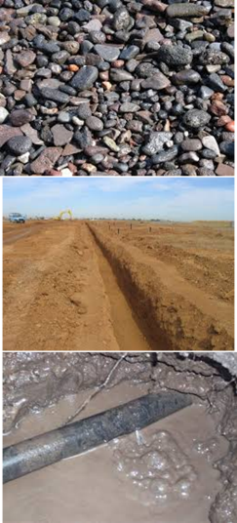
Factors Affecting Soil Stability
  Granularity – makes soil less stable
  (sloughing)
  Cohesiveness - soil holding together (example- clay) – more stable
  Water-weakens soil (extreme case- slurry)
  External forces – usually make soil less stable (surcharge, vibrations)
  Unconfined compressive strength – Load per unit area to collapse soil (tons per square feet – tsf) is a measure of strength and stability
Notes:
Soil has other qualities that affect its stability. These include granularity, saturation, cohesiveness, and unconfined compressive strength.
Granularity – refers to the size of the soil grains; the larger and less angular the grains, the less stable the soil.
Cohesiveness – means how well soil holds together; for example clay is a cohesive soil.
Saturation/water – how much water soil has absorbed. As the cohesive soil gets wetter, it loses strength and stability
External forces such as surcharge (loads on surface) and vibrations have affects on soil stability
Unconfined compressive strength – is determined by a test that measures how much pressure it takes to collapse a soil sample. For example, Type A soil must have an unconﬁned compressive strength of at least 1.5 tons per square foot.

Slide 20
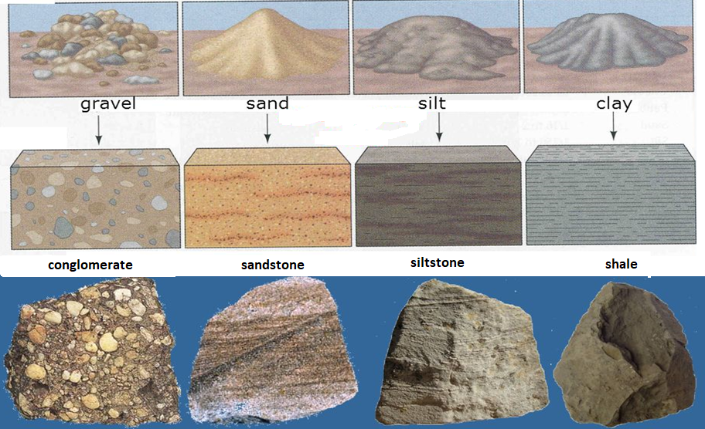
Gravel, Sand, Silt and Clay
Soils
Notes:
These are the different varieties of soils likely to be encountered in excavations and trenching. This pictures illustrates mainly gravel, sand, silt and clay which comes from conglomerate, sandstone, siltstone and shale respectively.

Slide 21

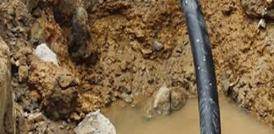
Visual Soil Examination
Soil testing can be visual or manual.
Visual – look at the soil/site for signs of instability
  Cracks or fissures
  Water seeping from the sides of excavation
  Previously disturbed soil
  Vibrations from construction activity or highway traffic nearby
  Layers of different soil types and angles of layers (> 4:1) in the face of excavation
Notes:
Before anyone enters an excavation, soil testing must be conducted. There are two ways to conduct soil testing. These test are visual and manual soil tests.
Visual and manual tests are a critical part of determining the type of protective system that will be used.
Visual tests: involves looking at the soil and the area around the excavation site for signs of instability. The soil should be observed as it is excavated. Soil that remains in large clumps when excavated may be cohesive. Soil that breaks up easily is granular. Also, excavated soil’s particle sizes should be examined to determine how they hold together.
When visually examining a given soil, always look for:
cracks or fissures in the faces of the excavation.
layers of different soil types and the angle of the layers in the face of the excavation that may indicate instability (>4:1).
water seeping from the sides of the excavation.
signs of previously disturbed soil from other construction or excavation work.
vibrations from construction activity or highway traffic that may affect the stability of the excavation.

Slide 22
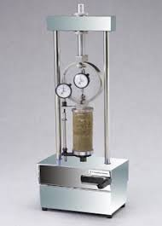
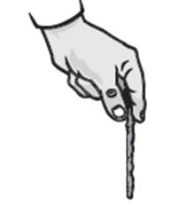
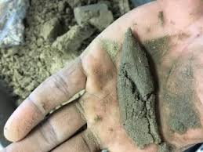
Soil Testing - Manual Tests
Manual tests involve testing a sample of soil from the excavation to determine granularity, cohesiveness (plasticity) and unconﬁned compressive strength
The unconfined strength test can be
done on or off site; should be completed quickly to preserve natural moisture
  Plasticity test. Shape a sample of moist soil into a ball and try to roll it into threads. Cohesive soil will roll into 1/8 inch threads without crumbling.
Notes:
Manual testing involves evaluating a sample of soil from the excavation to determine qualities such as cohesiveness, granularity, and unconfined compressive strength. Soil can be tested either on site or off site, but should be tested as soon as possible to preserve its natural moisture.
Some examples of manual tests:
Plasticity test: To conduct this test , you mold a wet sample of soil into a ball and attempt to roll it into threads as thin as 1/8 inch in diameter.
Cohesive soil can be successfully rolled into threads without crumbling.
If at least a 2 inch length of 1/8 inch thread can be held on one end without tearing, the soil is cohesive.

Slide 23
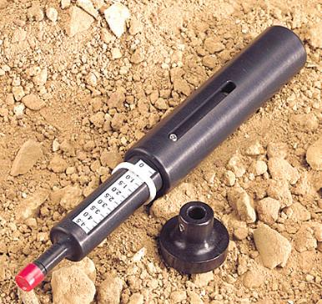
Soil testing - Manual tests – cont.
  Pocket penetrometers: used to estimate the unconﬁned compressive strength of saturated cohesive soils. When pushed into the sample, the indicator sleeve reads an estimate in tons per square foot
  Device is pressed into soil to calibration mark
  Spring loaded piston displaces the scale ring
  Produces a compressive strength reading rated in tsf
Notes:
Pocket penetrometer test: As its name implies, this test is conducted by using a simple and handy tool, “penetrometer”. Penetrometers are direct-reading, spring-operated instruments used to determine the unconfined compressive strength of saturated cohesive soils. This device gives relatively more accurate estimates of unconﬁned compressive strength.
When the pocket penetrometers is pressed into soil , a spring loaded piston displaces the scale ring which in turn indicate the compressive strength in tons/sq. ft (TSF) of the soil. However, penetrometers have error rates in the range of ± 20 to 40%.

Slide 24

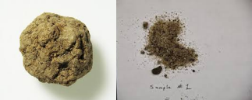
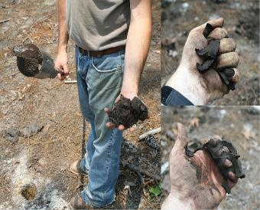

Soil Testing - Manual Tests – cont.
  Dry strength test: Hold a dry soil sample in your hand.
    If the soil is dry and crumbles on its own or with moderate pressure into individual grains, it is granular.
    If the soil breaks into clumps that are hard to break it may be clay (often combined with gravel, sand, or silt)
  Thumb penetration test: Roughly estimates unconﬁned compressive strength. Press your thumb into the soil. If the sample resists hard pressure, it is likely Type A
    If sample is easy to penetrate, soil may be Type C
Notes:
Dry strength test: To conduct this test, hold a dry soil sample in your hand
If the soil is dry and crumbles on its own or with moderate pressure into individual grains or ﬁne powder, it’s granular.
If the soil breaks into clumps that are hard to break into smaller clumps, but the smaller clumps can only be broken up with difficulty, it may be clay combined with gravel, sand, or silt.
If the soil breaks into clumps that do not break into smaller clumps (and the soil can be broken only with difficulty), the soil is considered unfissured unless there is visual indication of fissuring.
Thumb penetration test: This test roughly estimates the unconfined compressive strength of a sample. The test is conducted on an undisturbed soil sample, such as a large clump of spoil, as soon as practicable after excavation to limit the effects of exposure to drying influences.
Press your thumb into the soil sample.
If the sample resists hard pressure it may be Type A soil.
If it’s easy to penetrate (several inches), the sample may be Type C.

Slide 25

Soil testing - Manual tests – cont.
  Shearvane/Torvane: . is a simple soil testing instrument for the rapid determination of shear strength of cohesive soils, either in the field or in the laboratory.
  The tester is simple to use and sample trimming is eliminated. All that is required is a reasonably flat surface 25 mm in diameter
  Select fresh clod or block of undisturbed soil from spoil pile
  Cut a smooth surface on the clod
  Insert vanes of device into the soil
  Retract vanes to show foot imprint
  Set indicator at zero
  Hold device firmly against soil and twist in clockwise manner until soil fails in shear
Notes:
Shearvane/Torvane: This is a simple soil testing instrument for the rapid determination of shear strength of cohesive soils, either in the field or in the laboratory. The tester is simple to use and sample trimming is eliminated. All that is required is a reasonably flat surface 25 mm in diameter. Shearvane/tovane testing can be conducted as follows:
Select fresh clod or block of undisturbed soil from spoil pile
Cut a smooth surface on the clod
Insert vanes of device into the soil
Retract vanes to show foot imprint
Set indicator at zero
Hold device firmly against soil and twist in clockwise manner until soil fails in shear

Slide 26
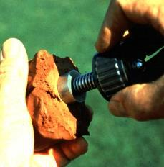
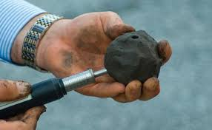
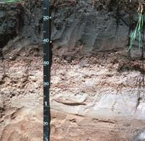
Soil Types Based on Strength
Solid stable rock- High strength
Type A soil – Unconfined compressive strength (Q_{u}) of 1.5 tsf
Type B soil - Unconfined compressive strength (Q_{u}) between 0.5 and 1.5 tsf
Type C soil - Unconfined compressive strength (Q_{u}) less than 0.5 tsf
Reclassify (downgrade) soil type if you
observe
  Cracks and/or fissures
  Water seeping from sides
  Previously disturbed soil
  Layers of different soils inclined towards the bottom
  Vibration from equipment or traffic nearby
    Reclassification must be determined by a trained Competent Person
Notes:
Per OSHA soil classification, there are 4 types of soils. Each soil type has different unconfined compressive strength. Unconfined compressive strength means the load per unit area at which a soil will fail in compression. And this strength can be determined by laboratory testing or estimated in the field using a pocket penetrometer, thumb penetration tests, or other methods. Belo is the list of soil types and their strength.
Solid (Stable) rocks: These are natural solid mineral material that can be excavated with vertical sides and will remain intact while exposed due to high strength. Solid rocks also don’t need protection at shallower depths
Type A soil: This type is a cohesive soil with an unconfined compressive strength of 1.5 ton per square foot.
Type B soil: The unconfined compressive strength between 0.5 and 1.5 ton per square foot for the Type B soil
Type C soil: These type soils are submerged soil or soil from which water is freely seeping. Their unconfined compressive strength less than 0.5 ton per square foot
If any of the following conditions are observed , It is imperative to downgrade soil type,
Fissured
Subjected to vibration
Previously disturbance
Seeping water
Layered soil (>4:1)

Slide 27
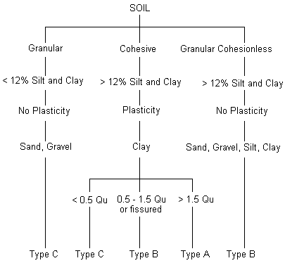
Soil Classification Chart for
Excavation
Source: OSHA Salt Lake Technical Center
Notes:
Source: OSHA Salt Lake Technical Center (2014) https://www.osha.gov/dts/sltc/methods/validated/id194/id194.pdf

Slide 28
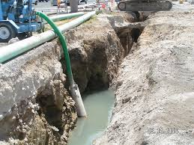
Water Effects on Soil
Water makes soil unstable by reducing the cohesive forces between the soil particles.
Excavations should not be entered when water has built up unless there is protection for the unstable soil and water-removal equipment is present
The competent person must inspect excavation and monitor the methods used to control water accumulation.
Storm water must be carefully diverted away from the excavation site.
All laborers must be withdrawn from trench during rain storms.
Notes:
Water in an excavation can undermine the sides of the excavation and make it more difficult for workers to get out of the excavation. Water makes soil unstable by reducing the cohesive forces between the soil particles. Employers are prohibited from allowing workers to enter an excavation where water has accumulated or is accumulating unless adequate precautions are taken to protect workers.
Excavations should not be entered when water has built up unless there is protection for the unstable soil and water-removal equipment is present
If an employer uses water removal equipment to control or prevent water accumulation, the equipment and operations must be monitored by a competent
Storm water must be carefully diverted away from the excavation site.
All laborers must be withdrawn from trench during rain storms.

Slide 29
PLEASE START THE
POSTTEST - SESSION 1
Maximum: 10 minutes.
Notes:
Trainer distributes the handout “Posttest-1” to the trainees.

Slide 30
CAVE-IN HAZARD CONTROLS

Slide 31
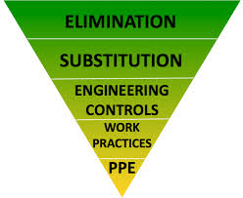
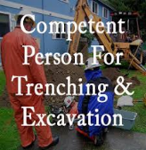
Cave-In Hazard Controls
  Workers must be protected from cave-in hazard by
    Engineering controls
      Sloping and benching
      Shoring
      Shielding
    Workplace controls
  Decision for most appropriate protective system will depend on soil type, water content, excavation depth and width, and nature of work
  The competent person is responsible for for determining the appropriate protective system.
Notes:
Engineering Controls are used to make changes to the work environment, machine or piece of equipment, often reducing the hazard at the source. Employees working in the trench must be protected from all excavation and trench related hazards. The basic methods for protection from cave-ins are
Sloping and benching
Shoring, and
Shielding
Which method to use depends on factors such as soil type and water content, excavation depth and width, nature of the work, and nearby activities that could increase the risk of a cave-in. The competent person has the responsibility for considering these factors and for determining the appropriate protective system.
Trenching and excavation work requires specialized knowledge because its technical in nature (refer to OSHA Subpart P) ; its inherent hazards may require a greater level of training and experience than what a common worker would normally possess.
If a competent person determines that there’s a potential for an excavation to cave-in, you must be protected regardless of its depth, even if it is less the 5 ft.

Slide 32
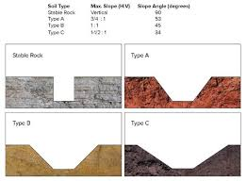
Engineering Controls- Sloping and Benching
Sloping and benching provide protection by removing material from the face of excavation
  The flatter the angle, greater
  the protection
Benches are cuts in the slope
that give it a stair-step form
  Two types of benches:
    simple and multiple
  (refer to the next slide)
Use Appendix A and B of the Standard to determine slope angle (Link to 1926 Subpart P - Subpart P—Excavations)
Notes:
Sloping is an engineering control method of protecting employees from cave-­ins. It provides protection by removing material from the face of an excavation at an angle to its floor so as to prevent cave-­ins. In general, the flatter the angle, the greater the protection.
On the other hand, Benches are cuts in the slope that give it a stair-step appearance. There are two types of benches: simple and multiple.
After classifying the type of soil using Appendix A (subpart P), the relevant angle of slope required is determined from Appendix B
The type of soil determines the horizontal to vertical ratio of the benched side.
OSHA provides slope information based on the maximum allowable slope. To use the maximum allowable slope, site conditions must be ideal. If any signs of distress are observed, the actual slope is required to be less than the maximum allowable slope.
(https://www.osha.gov/pls/oshaweb/owadisp.show_document?p_table=standards&p_id=10930)

Slide 33
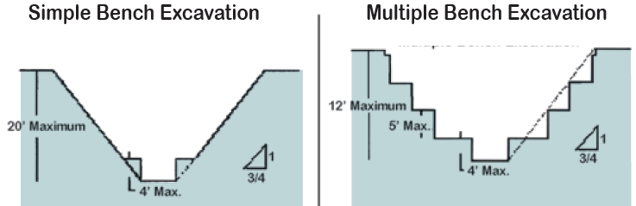
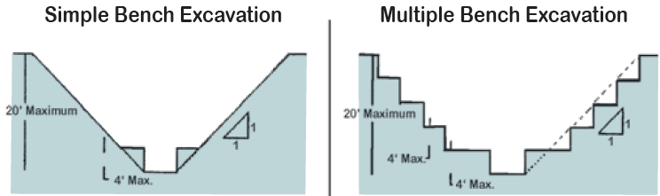
Sloping and Benching
Type A Soil
Type B Soil
Type C Soil: slope with 1.5:1 …. Generally, benching in type C soil is not permitted
Notes:
Here is an example of benching practice for soil Type A and B single and multiple bench. Generally, benching in Type C is not permitted; however in special cases OSHA permits benching practice for Type C soil.
Standard “§1926.652(b) “ may permit an employer to cut steps into the slope of type C soil in extraordinary circumstances, such as, where a registered professional engineer approves cutting steps into the slope of type C soil under § 1926.652(b)(4)
https://www.osha.gov/pls/oshaweb/owadisp.show_document?p_table=INTERPRETATIONS&p_id=27506

Slide 34
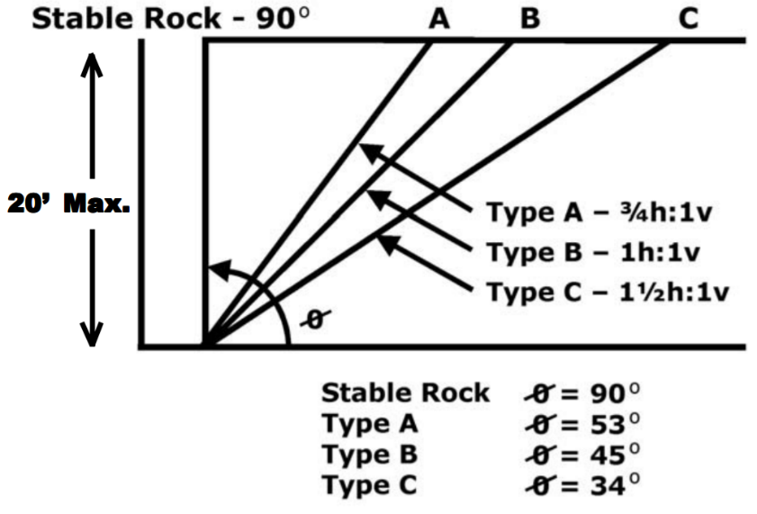
Sloping (angle) Charts for
Different Soil Types
Notes:
Here is a chart displaying the maximum allowable slopes for excavations less than 20 feet deep.
As shown, when the soil stability decrease , the slope also decreases.
If any signs of distress are observed, the actual slope is required to be less than the maximum allowable slope. Signs of distress that OSHA lists are: · Development of fissures in trench face; · Appearance of stress cracks; · Material slumping from face; · Bulging or heaving of the trench bottom; Spalling or raveling.

Slide 35
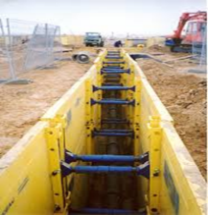
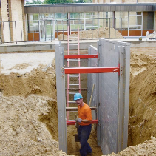
Engineering Controls - Shoring and Shielding
Shores are vertical supports that prevent an excavation from collapsing
Shields are box like structures that provide employees a safe work area, protecting them from collapsing soil.
  Shields (trench boxes) do NOT prevent cave-ins; they “shield” workers if a face collapses
Both shoring and shielding can be used with or without sloped or benched faces.
All shoring should be installed from top down and removed from bottom up
Manufacturers provide shoring and shielding systems with tabulated data so it can be custom-built (PE approval may be needed)
Notes:
Shoring is the provision of a support system for trench faces used to prevent movement of soil, underground utilities, roadways, and foundations. Shoring or shielding is used when the location or depth of the cut makes sloping back to the maximum allowable slope impractical.
Shores are vertical supports that prevent the faces of an excavation from collapsing.
Shoring systems consist of posts, wales, struts, and sheeting. There are two basic types of shoring, timber and aluminum hydraulic.
Shields are box like structures that provide employees a safe work area by protecting them from collapsing soil.
Shields don’t prevent cave-ins but “shield” workers if a face does collapse
The excavated area between the outside of the trench box and the face of the trench should be as small as possible. The space between the trench boxes and the excavation side are backfilled to prevent lateral movement of the box. Shields may not be subjected to loads exceeding those which the system was designed to withstand.
Both shoring and shielding can be used with or without sloped or benched faces.
Manufacturers provide shoring and shielding systems accompanied with tabulated data, so it can be custom-built by approval of a registered professional engineer.
All shoring should be installed from the top down and removed from the bottom up. Hydraulic shoring should be checked at least once per shift for leaking hoses and/or cylinders, broken connections, cracked nipples, bent bases, and any other damaged or defective parts.

Slide 36
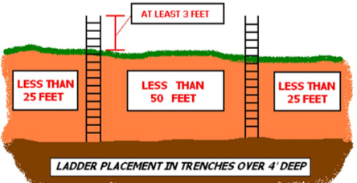
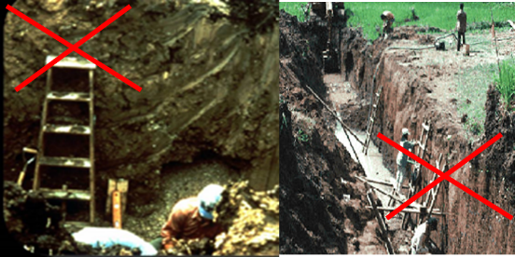
Excavation Access and Egress
(Ramps and Ladders)
Excavation with a depth of 4 ft or more must have means for entering (access) and exiting (egress)
  Stairways, ladders, or ramps
  Within 25 ft of employees
  Ladders must extend 3 ft above edge of excavation
Ramps for entry and egress must have nonslip surfaces and be designed by a Competent Person
Notes:
OSHA standards require that an excavation of depth 4 ft or more must have a means for entering (access) and exiting (egress)
Come in the form of stairways, ladders, or ramps
Should be within 25 ft of employees
Ladders must extend 3 ft above the edge of the excavation
Metal ladders should be used with caution, particularly when electric utilities are present.
Ramps that are used to enter and exit the excavation must have nonslip surfaces and be designed by a competent person

Slide 37
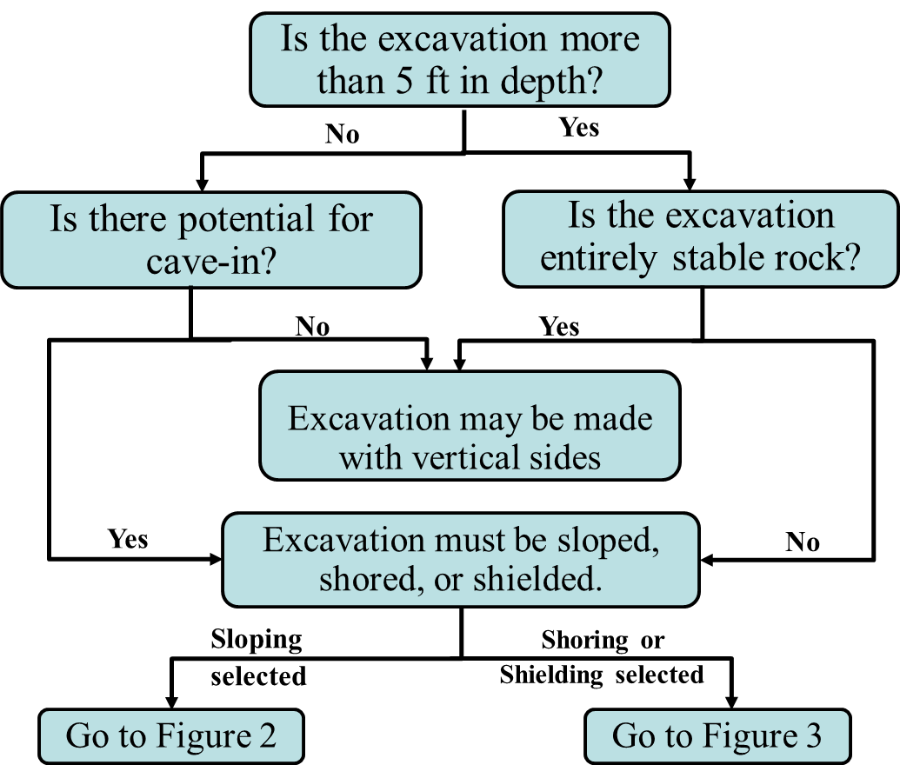
Protective System Selection
(Figure 1: Preliminary Decisions Flowchart)
Notes:
The following figures are a graphic summary of the requirements contained in subpart P for excavations 20 feet or less in depth.
Protective systems for use in excavations more than 20 feet in depth must be designed by a registered professional engineer in accordance with 1926.652(b) and (c)

Slide 38
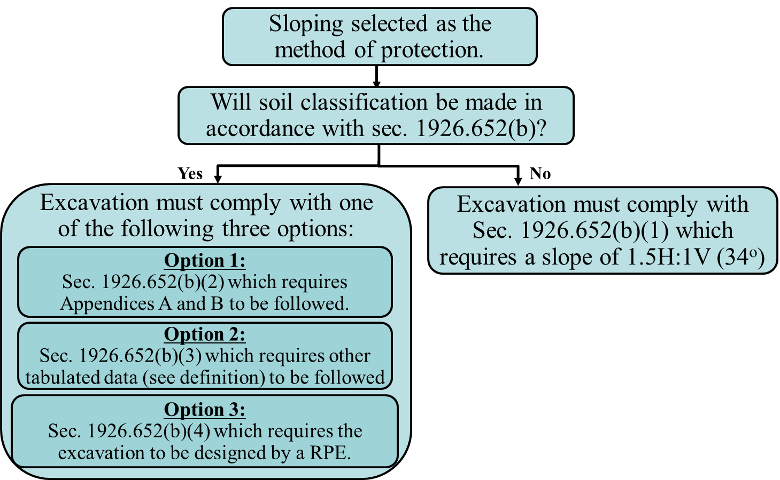
Protective System Selection
(Figure 2: Sloping Options Flowchart)
Notes:
If sloping selected as the method of protection based on the previous figure; there are 4 options to be chosen.
If the soil classification is made in accordance with sec. 1926.652(b); there are three options. The sloping angles and bench dimensions can be determined by using any of the following options:
Use Appendix A (Soil Testing) and Appendix B (Sloping and Benching). Soil testing required.
Use of Tabulated Data approved by a Registered Professional Engineer. Data must include system selection parameters, data limits, and explanatory information. A copy of the tabulated data is required to be at the job site during construction. Soil testing required.
Use a slope or benching configuration designed by a Registered Professional Engineer. A copy of the design data is required to be at the job site during construction. Soil testing required.
If the soil classification is not made in accordance with sec. 1926.652(b);
1. Assume TYPE C soil. This gives a maximum allowable slope of 34 degrees (1.5H: 1V). No benching is allowed. Soil testing is not required.

Slide 39
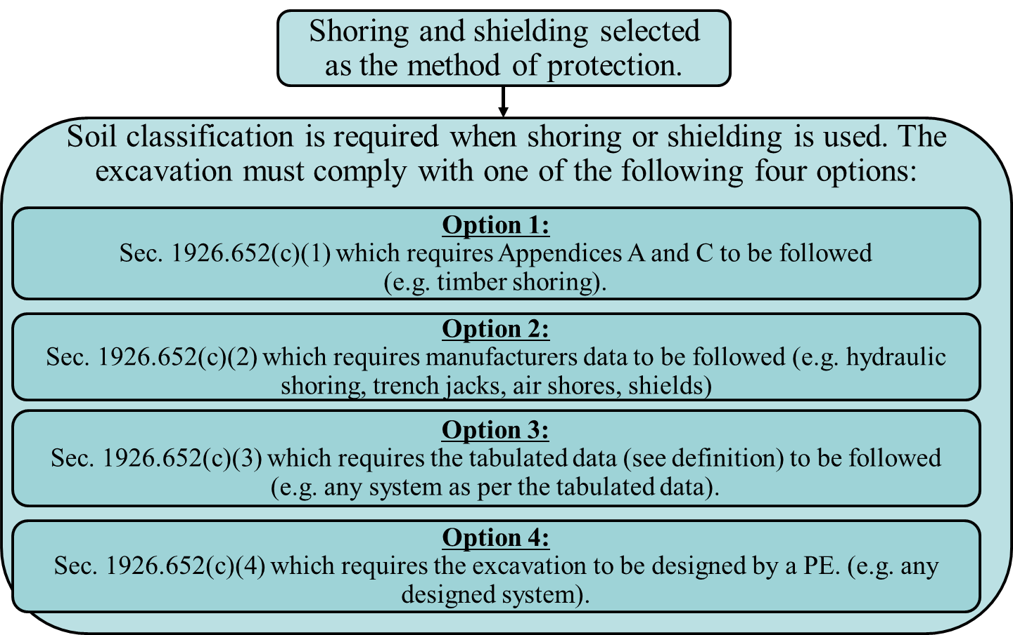
Protective System Selection
(Figure 3: Shoring and Shielding Options Flowchart)
Notes:
If shoring and shielding is selected as the method of protection, there are four options to be chosen. The excavation must comply with one of these four options.

Slide 40
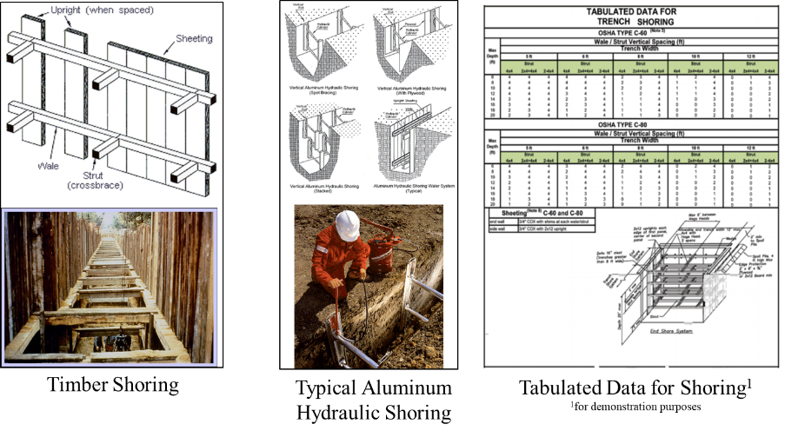
Shoring and Shielding Options - Examples
Notes:
Some examples that illustrate the shoring and shielding options discussed previously.

Slide 41
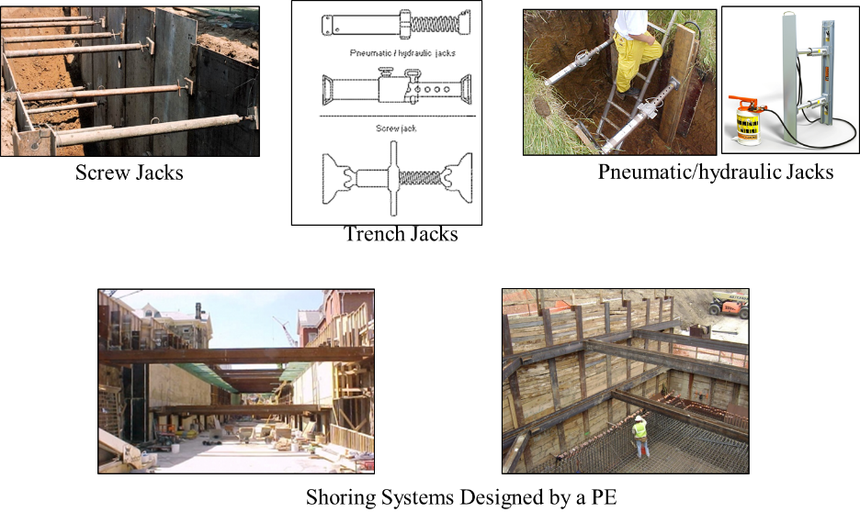
Shoring and Shielding Options - Examples
Notes:
Some examples that illustrate the shoring and shielding options discussed previously.

Slide 42
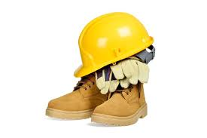
Workplace Controls
A Competent Person must be designated by the employer
  should be well trained and well acquainted with the mechanics of soil failures; and
  capable of identifying the signs of failure.
Workers must have a basic safety training on soil excavation accident prevention
  including use of PPE, such as hardhats, gloves, etc. all the time.
Notes:
A Competent Person must be designated by the employer; should be well trained and well acquainted with the mechanics of soil failures; capable of identifying the signs of failure.
Also, workers need to have basic safety training (knowledge) in regard to soil excavation accidents and the need to wear the PPE, such as hardhats, gloves, etc. all the time.

Slide 43
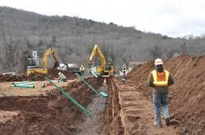
Competent Person Qualifications and Responsibilities
The Competent Person must be knowledgeable of
    conditions leading to cave-ins
    soil testing/classification, and
    Options for different protective systems
Must inspect the site and protective system daily
    for signs of instability
    damage (to protective systems)
Inspect after heavy rain, high risk activities (e.g. blasting)
Determine underground utilities likely to be encountered before the excavation
Detect and test for hazardous atmosphere(s) before anyone enters the excavation if oxygen deficiency is foreseen
Have the authority to immediately correct any hazard(s) and order employees to leave the excavation until corrective action is taken
If there are no existing hazard(s), the competent person can leave the excavation site for a short time, but must be present when a protective system is moved.
Notes:
One of the most important jobs that the competent person performs is soil testing. As covered here, the results of soil testing are a major determining factor in the design of certain types of protection systems. Also, the competent person has the responsibility to inspect the trench and the area around the trench for any hazard which could cause a cave-in or other hazard to the employees and the keep the employees out of the trench until the safety problem has been remedied. This person must inspect the trench area for any evidence of a cave-in hazard, which might include: Fissures, Tension cracks, Sloughing, Undercutting, Water seepage, Bulging at the bottom. The protection system integrity should also be evaluated. Unlike any other worker, the competent person may stand on the shoring system during the inspection process. Like the other employees, the competent person may not enter a trench for inspection until all appropriate protective systems are in place.
The competent person must :
be knowledgeable about the type of soil excavated
be knowledgeable of conditions leading to cave-ins and different protective systems
inspect the protective system daily for signs of instability, damage, or other hazards.
utility installations reasonably expected to be encountered must be determined before excavation.
detect hazardous atmosphere. Atmospheres must be tested BEFORE workers enter excavations greater than 4 feet where hazardous chemicals are likely to exceed.
inspect after heavy rain or activities such as blasting that may increase the risk of cave-in.
have authority to immediately correct any hazards and order employees to leave the excavation until the hazards have been corrected
It should be noted that an employee who is trained and can identify excavation hazards but doesn’t have the authority to correct them is not a competent person.
If there are no existing hazard(s), the competent person can leave the excavation site for a short time, but must be present when a protective system is moved.
Competent person has the right to require shoring for dangerous conditions, he/she believes to exist even if excavation is under 5 feet.

Slide 44

Professional Engineer Responsibilities
According to OSHA Subpart P,
  Sloping and benching should be designed by a Registered Professional Engineer (PE) for excavations
    Deeper than 20 ft for any soil type
    Exceeding 5 ft in depth in Type C soils
  Shoring and shielding protection systems based on manufacturer’s data must be built by the contractor after approval by a PE.
  When an alternate system (e.g. sheet piling) is to be used, for which the OSHA Subpart P does not provide guidance, a PE must design that system and supervise construction.
Notes:
In some situations, the hazard potential is so great or the protection system design so complicated, the design of the trenching and protective systems operation can only be done by a professional. This is the job of the Registered Professional Engineer (PE). PE’s duties include
Approval of protective system designs where the trench is over 20 feet deep;
Approval of protective systems which involve working close to or under
footings, foundations, retaining walls, or other structures;
Custom design of protective systems;
Approval of tabulated data for protective systems;
Approval of major repairs to protective systems.
In short, PE’s are considered to be the "experts" in designing and approving protective systems.
The law states that the RPE needs to be registered in the state where the
work is performed. It goes on to state, however, that an out of state
PE can approve tabulated data or manufactured protective systems that are used in
interstate commerce. Therefore, a construction company from Michigan can
come into Iowa and use their tabulated data or their protective systems that were
designed by a PE back in Michigan.

Slide 45
OTHER EXCAVATION HAZARDS

Slide 46
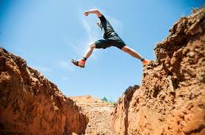
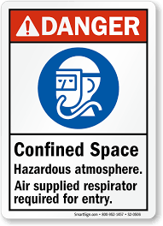
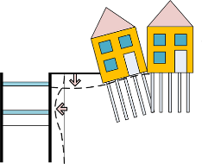
Other Excavation and Trenching
Hazards
Besides cave-ins, hazards include
  Workers struck-by equipment/loads
  People falling from above into trenches
  Falling loads or equipment into trenches
  Contact with overhead and underground power lines
  Hazardous atmospheres - toxic fumes, fire, explosion, electrocution and water/pressure
  Stability of adjacent structures
Notes:
Besides collapsing of soils and cave-ins, there are other excavation and trenching hazards that has to be put in to consideration to protect employees while performing these tasks. These hazards can be listed as:
People falling from above into trenches or lower areas of excavations
Falling loads or equipment into excavations or trenches
Contact with overhead and underground power lines
Hazardous atmospheres, toxic fumes, fire, explosion, electrocution and water accumulation
Stability of adjacent structures; and
Use of heavy machinery near an excavation site (surcharge load and vibrations)

Slide 47
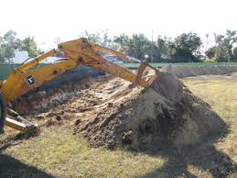
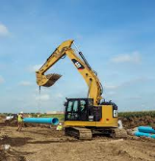
Struck-by Hazards
Struck-by hazards are caused by falling loads or materials (from moving equipment), or by moving traffic in road highway workzones
Some of the common reasons for struck-by accidents
  Entering the excavator’s swing area (moving equipment/parts)
  Unsafe rigging methods (e.g. when dragging a trench shield)
  Not taking necessary precautions in workzones (e.g high visibility vests)
Soil spoil and other equipment must be placed at least 2 ft from excavation edge
No one allowed under a suspended load, or the boom, arm, or bucket
Notes:
Struck-by injuries are produced by forcible contact or impact between the injured person and an object or piece of equipment.
During the excavation and trenching work, struck-by hazards are caused by falling loads or materials moving equipment. Some of the common reasons resulting in accidents are:
Entering the excavator’s swing area
Using quick-coupling devices improperly: coupling devices not locked properly
Using unsafe rigging methods to drag a trench shield
Other leading causes of fatalities are rollovers, electrocutions, and slides into trenches after cave-ins.
Soil spoil and other equipment must be positioned at least 2 ft from the excavation edge. No one should be allowed to stand under a suspended load or the boom, arm, or bucket. Load capacities when lifting materials shall not be exceeded.
Workers shall not be allowed to stand under suspended loads or suspended machine components such as the boom, arm, or bucket. Workers shall not approach the equipment until they signal the operator to shut down the machine and receive acknowledgment from the operator.

Slide 48
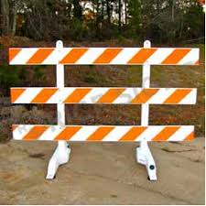

Falling Into Hazards
Proper protection (such as signs/barricades) must be installed around the excavation to prevent direct falls into excavation floor.
Besides people, machinery (equipment) can fall into the trench.
Notes:
Proper protection (in the form of Signs/Barricades) must be installed around (sometimes over) the excavation to prevent direct falls into the excavation floor.
It is not only people that fall into the excavation, many times machineries (equipment’s) and materials which are not positioned safely also fall into the trench. Employees must be protected from loads or objects falling from lifting or digging equipment. Procedures designed to ensure their protection include:
Employees are not permitted to work under raised loads.
Employees are required to stand away from equipment that is being loaded or unloaded
Equipment operators or truck drivers may stay in their equipment during loading and unloading if the equipment is properly equipped with a cab shield or adequate canopy.

Slide 49

Underground/Overhead Utilities
OSHA requires underground utility lines to be located before starting work
  they pose fire, explosion or electrocution hazards
Besides injury hazard, there is also potential for disruption of utility services
No work must be conducted within 10 ft of power lines.
  If work must be within 10 ft of power lines, the utility company must be informed so as to coordinate work schedules (to de-energize, or temporarily relocate/raise the lines)
Notes:
Underground utility lines need to be located either by contacting utilities or by careful hand digging as these are potential source of high cost. Before starting work, the Excavation standards require employers to do the following:
Determine the approximate location(s) of utility installations — including sewer, telephone, fuel, electric, and water lines. One common industry practice is to call 811, the “Call Before You Dig” number, to establish the location of any underground utility installations in the work area.
Contact and notify the utility companies or owners involved to inform them of the proposed work within established or customary local response times.
Ask the utility companies or owners to establish the location of underground installations prior to the start of excavation work. If they cannot respond within 24 hours (unless the period required by state or local law is longer) or cannot establish the exact location of the utility installations, employers may proceed with caution, which includes using detection equipment or other acceptable means to locate utility installations.
Determine the exact location of underground installations by safe and acceptable means when excavation operations approach the approximate location of the installations.
Ensure that while the excavation is open, underground installations are protected, supported or removed as necessary to safeguard workers.
https://www.osha.gov/pls/oshaweb/owadisp.show_document?p_table=STANDARDS&p_id=10775
Besides being source of direct injury (fire, explosion and/or electrocution) to the workers, there is a huge potential of disruption of electrical, gas or communication services to the end-users in the surrounding areas.
In the vicinity of high-voltage power lines, no work should be conducted within 10 ft of the power lines. For works within 10 ft of the power lines, the utility company must be informed so as to coordinate work schedules (to De-energize and ground the lines, temporarily raise or move the lines)

Slide 50



Hazardous Atmosphere and
Respiratory Protection/Ventilation
Hazardous atmospheres may occur in excavations near landfills, leaking gas lines or storage tanks; also in sewers, and in other confined spaces.
  A competent person must test for oxygen deficiency and other hazards before anyone enters the excavation.
    Oxygen levels should not be less than 19.5 %
Proper respirators and/or ventilation system must be used when hazardous atmospheres are present in a trench/ excavation.
Notes:
Hazardous atmospheres could occur in excavations near landfills, sites contaminated by leaking gas lines or storage tanks, in sewers, and in other confined spaces.
Atmospheric testing is required before workers enter an excavation greater than 4 feet (1.22 meters) in depth where an oxygen deficiency or a hazardous atmosphere is present or could reasonably be expected, such as in excavations in landfill areas or excavations in areas where hazardous substances are stored nearby
In such cases, a competent person must test for oxygen deficiency and hazardous atmospheres before entering the excavation.
oxygen levels should not be less than 19.5 % (1926.651(g)(1)(i) https://www.osha.gov/pls/oshaweb/owadisp.show_document?p_table=standards&p_id=10775
If hazardous atmospheric conditions exist or may reasonably be expected to develop in an excavation, the employer must ensure the ready availability of emergency rescue equipment, such as breathing apparatus, a safety harness and line, or a basket stretcher. This equipment must be attended when in use. In the case of hazardous atmosphere proper respirators and/or ventilation system must be used.

Slide 51

Adjacent Structures
Excavation work endangers stability of adjacent structures
  Collapse of adjacent structures puts occupants and workers at risk
Structures, roadways, and sidewalks adjacent to excavations must be adequately supported when conducting excavation
Use an appropriate support system (such as shoring or bracing) if stability of nearby buildings, sidewalks, and roads is affected.
  Do not excavate below the base of footing / foundation, unless
    A support system that keeps the structure stable and protects workers is in place
    A registered Professional Engineer (P.E.) determines the structure will not be affected by the excavation.
Notes:
Excavation operations endanger the stability of adjoining structures which may put the occupant as well as the workers at risk in the event of a collapse of adjacent structure.
To prevent such events, employers have to make sure that structures, roadways, and sidewalks adjacent to the excavation are adequately supported when conducting excavation works.
An appropriate support system – such as shoring or bracing – must be used if the excavation could affect the stability of nearby buildings, sidewalks, and roads. Do not excavate below the base or footing of any foundation that might endanger employees unless you do one of the following:
Use a support system that protects employees and keeps the structure stable.
Ensure that the excavation is in stable rock.
Have a registered professional engineer determine that the structure will not be affected by the excavation work.
Have a registered professional engineer determine that the excavation work will not endanger employees

Slide 52
Emergency Rescue Operations
65 % of all would be rescuers become victims, because proper safety procedures are not followed.
In the event of any emergency situation requiring rescue from an excavation
  Workers will not enter an unprotected excavation to perform rescue.
  Local emergency services will be notified
If hazardous atmospheric conditions exist or may reasonably be expected to develop in an excavation, the employer must ensure the ready availability of emergency rescue equipment, such as breathing apparatus, a safety harness and line, or a basket stretcher
Rescue operations that can be performed safely from outside the excavation, such as hoisting a harnessed victim, will be carried out.
Other personnel in the excavation will exit immediately and may provide assistance only when their own safety is ensured.
Notes:
Trench rescue is hazardous for responding personnel. Per OSHA’s newsletter, 65 % of all would be rescuers become victims, because proper safety procedures are not followed. A collapsed trench or excavation has greater than a 50 percent chance of collapsing again, particularly when rescuers are digging out the original victims. This potential secondary collapse, combined with numerous other factors such as adverse weather, hazardous atmospheres, release of gas from ruptured lines, broken water lines, the number of victims, and department capabilities, makes such a response challenging.
If hazardous atmospheric conditions exist or may reasonably be expected to develop in an excavation, the employer must ensure the ready availability of emergency rescue equipment, such as breathing apparatus, a safety harness and line, or a basket stretcher
In the event of any emergency situation requiring rescue from an excavation workers shall not enter an unprotected excavation to perform rescue and local emergency services must be notified. Rescue operations that can be performed safely from outside the excavation, such as hoisting a harnessed victim, will be carried out. Other personnel in the excavation will exit immediately and may provide assistance only when their own safety is ensured.
Sources: https://www.osha.gov/SLTC/trenchingexcavation/newsletter.html and https://www.osha.gov/Publications/osha2226.pdf

Slide 53
Emergency Rescue Operations – cont.
Get general description of the incident, the number and location of victims.
Determine if it is a rescue or a recovery
Remove non-essential personnel from the area, restrict entry, and establish visible access control points.
Locate incident scene hazards including disrupted or exposed utilities, flowing water; locate all utilities.
No personnel shall be allowed to enter an unprotected trench to render patient care or help.
All trenches shall be safe and protected using approved methods prior to entry.
Shut down all heavy equipment operations.
Notes:
Here are some safe practices to be followed in the event of emergency rescue operations:
Get general description of the incident, the number and location of victims.
Determine if it is a rescue or a recovery
Remove non-essential personnel from the area, restrict entry, and establish visible access control points.
Locate incident scene hazards including disrupted or exposed utilities, flowing water; locate all utilities.
No personnel shall be allowed to enter an unprotected trench to render patient care or help.
All trenches shall be safe and protected using approved methods prior to entry.
Shut down all heavy equipment operations.

Slide 54
Emergency Rescue Operations – cont.
Personnel shall approach the trench from the end.
Place ladders at each end of the trench for emergency egress.
Support any unbroken utilities.
Provide a helmet, goggles and oxygen (if needed) for the victim.
If the victim is conscious and trapped pass them a shovel so that they can attempt to self rescue.
Notes:
Personnel shall approach the trench from the end.
Place ladders at each end of the trench for emergency egress.
Support any unbroken utilities.
Provide a helmet, goggles and oxygen (if needed) for the victim.
If the victim is conscious and trapped pass them a shovel so that they can attempt to self rescue.

Slide 55

Safe Practices Checklist and Summary
Notes:
This checklist is representative of the topics covered in this training presentation. It is not comprehensive and exhaustive and should not be used to replace the provision of OSHA Standard Subpart P.

Slide 56
Additional Resources
Additional resources for trainees:
    OSHA Excavation Standard <https://www.osha.gov/pls/oshaweb/owadisp.show_document?p_table=STANDARDS&p_id=10930>
    OSHA Safety and Health Topics Page on Trenching and Excavation
    <https://www.osha.gov/SLTC/trenchingexcavation/index.html>
    ELCOSH Excavation Safety <http://www.elcosh.org/record/document/4236/d001520.pdf>
    OSHA Trenching and Excavation Safety Publication
    <https://www.osha.gov/Publications/osha2226.pdf>
    OSHA Fact Sheet <https://www.osha.gov/OshDoc/data_Hurricane_Facts/trench_excavation_fs.pdf>

Slide 57
QUESTIONS?

Slide 58
PLEASE START THE
POSTTEST – SESSION 2
Maximum: 15 minutes
Notes:
Trainer distributes the handout “Posttest - 2” to the trainees.

Slide 59
PLEASE FILL OUT THE
OPINION SURVEY
Notes:
Trainer distributes the handout “Opinion Survey” to the trainees.

Slide 60
INTERACTIVE Q/A SESSION
PLEASE GRADE YOUR POSTTEST
Notes:
Trainer distributes the handout “Opinion Survey” to the trainees.

Slide 61
PLEASE HAND IN THE FOLLOWING TRAINING PACKAGE TO THE TRAINER
Sign-up
Pretest
Posttest 1
Posttest 2
Opinion survey
Notes:
Once a trainee finishes the opinion survey, all of the handouts are collected from trainees (sign-up, pre-test, post-test and the opinion survey).

Slide 62
THANK YOU!

