Slide 1
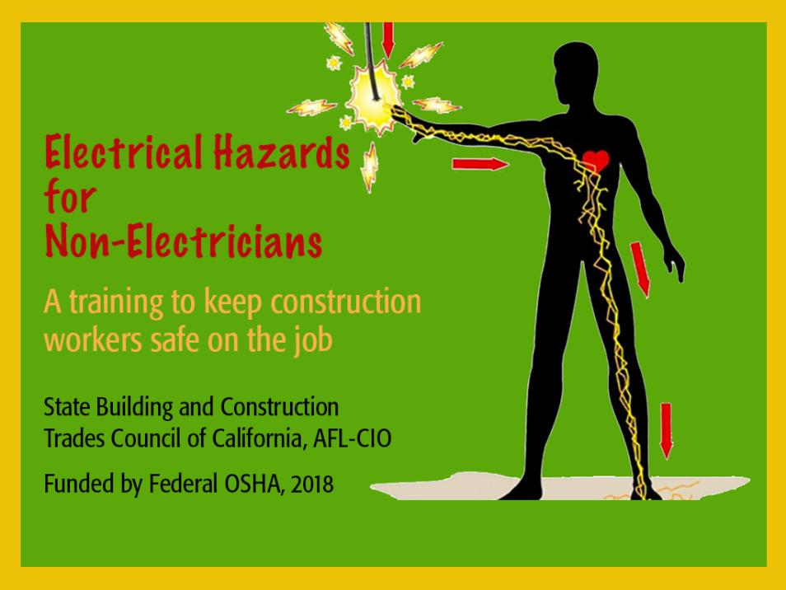
Electrical hazards for Non-Electricians

Slide 2
Acknowledgements
Funded by OSHA
This material was produced under grant SH-31244-SH7 from the Occupational Safety and Health Administration, U.S. Department of Labor. It does not necessarily reflect the views or policies of the U.S. Department of Labor, nor does mention of trade names, commercial products, or organizations imply endorsement by the U.S. Government.
  We thank the following organizations for:
  Providing technical assistance with developing this training
    International Brotherhood of Electrical Workers (IBEW)
    UC Berkeley Labor Occupational Health Program (LOHP)
    Cal/OSHA
    Federal OSHA
  Sharing photos, video, training material
    CA Dept. of Industrial Relations—Commission on Health and Safety and Workers’ Compensation (WOSHTEP program)
    Center for Construction Research and Training (CPWR)
    WorkSafe BC (Canada)

Slide 3


How often do you use electricity?
Any electrical
incidents or accidents?
Class Brainstorm:
Questions or concerns
about electricity at work?

Slide 4
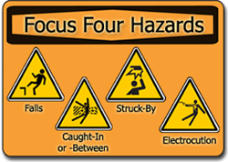
Electrocutions—3rd leading cause of construction fatalities
Electrical Hazards—among OSHA’s
“Focus Four”
Have you been trained?

Slide 5
Course objectives:
Increase electrical hazard awareness among non-electricians.
By the end of this training, participants will be able to:
Identify causes of electrical fatalities
Understand basic electrical concepts and terms
Describe how electricity can harm the body
Recognize common electrical hazards
Use best practices to work safely around electricity
Will NOT teach how to do electrical work!

Slide 6

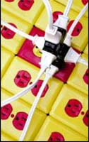
Electrical incidents are caused by:
Unsafe Conditions
Unsafe Equipment
Unsafe Acts

Slide 7
Five electrical hazards covered
Contact with live circuits: Power lines
Lack of ground fault protection
Missing or discontinuous path to ground
Equipment not used in manner prescribed
Improper use of extension and flexible cords

Slide 8
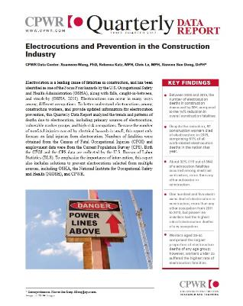

Section 1:
Electrical Fatality Trends in Construction
Fatal injury data compiled by:
What’s the first thing that comes to
mind when you hear
“Electrocution?”

Slide 9
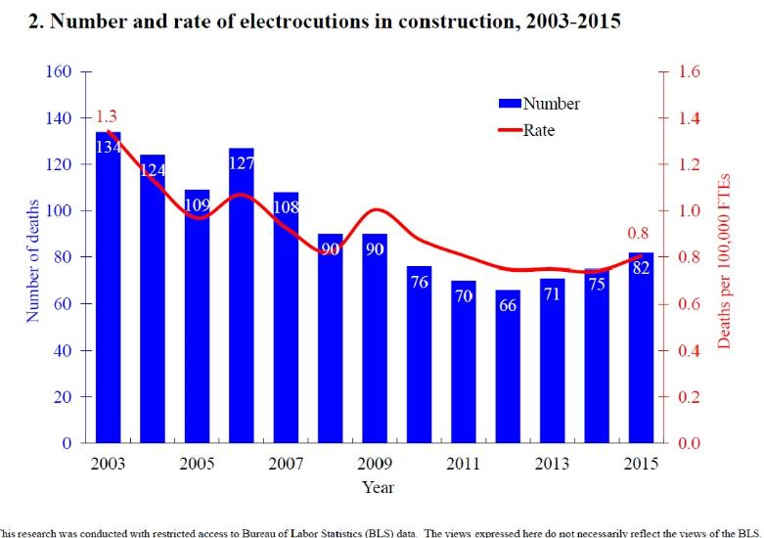
Good news…

Slide 10
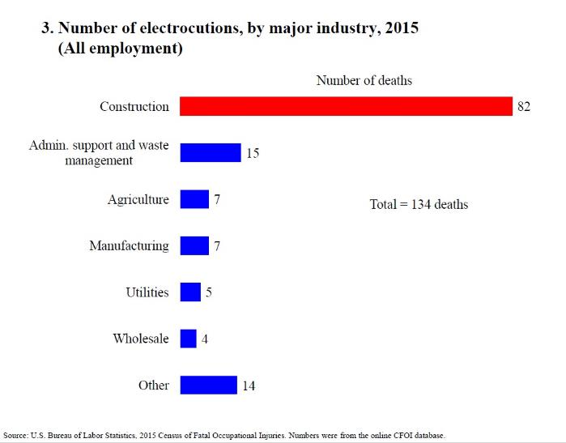
Bad news…

Slide 11
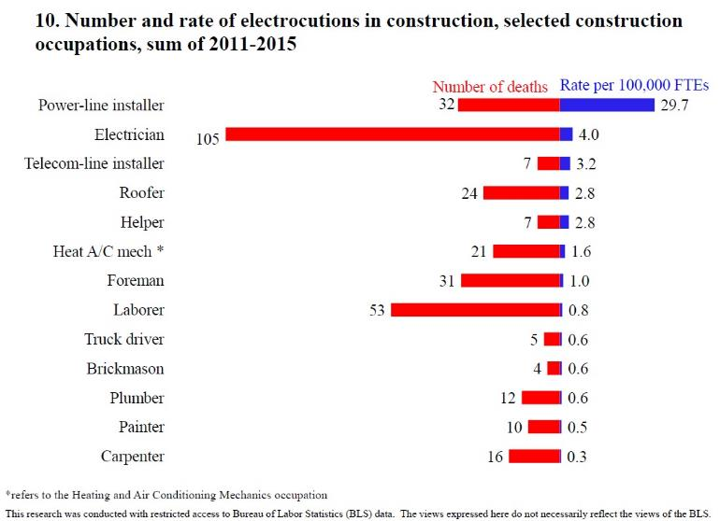
More non-electrician fatalities

Slide 12
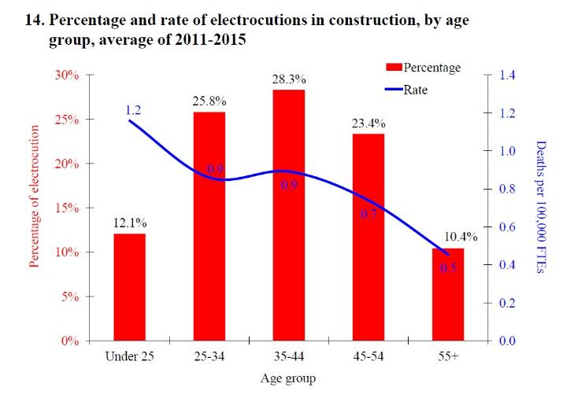
By age: Under 25 have highest electrocution rate

Slide 13
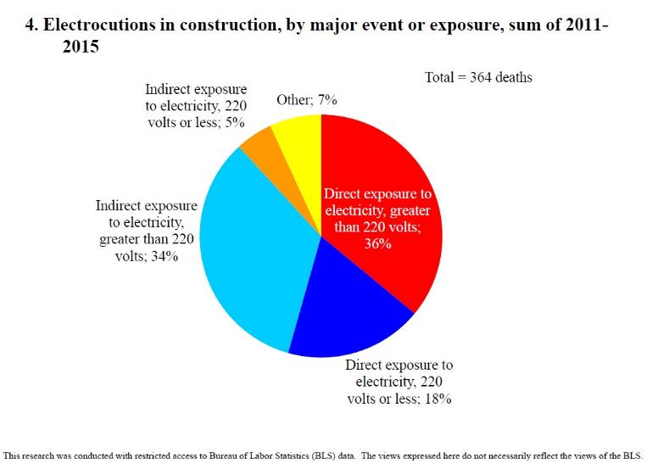
Main causes of electrocution

Slide 14
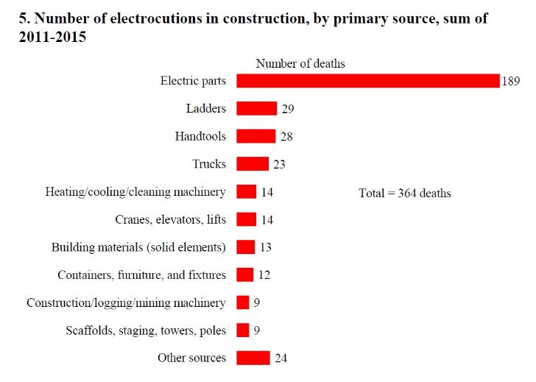
Sources of electrocution

Slide 15
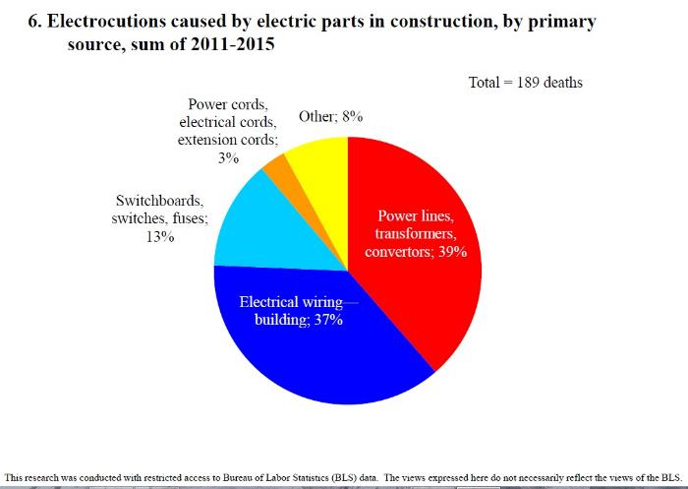

“Electric parts” breakdown
Electrocutions are PREVENTABLE!

Slide 16
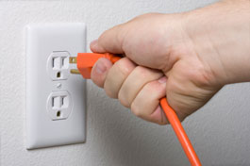
Section 2:
Understanding Electricity Basics
What IS electricity?

Slide 17

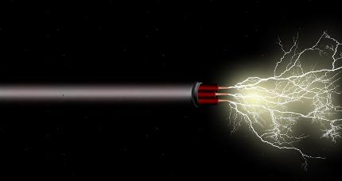
Electricity is…
Movement or flow of electrons from
one atom to another
Flow of current
through a conductor

Slide 18

5-Minute Buzz Group Activity
Name That Term

Slide 19
Some basic electrical terms
Movement or flow of electrical energy
CURRENT
RESISTANCE
CONDUCTOR
INSULATOR
Opposition to
current flow
Material through which
current moves easily
Material through which current does NOT move easily

Slide 20

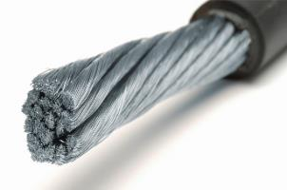
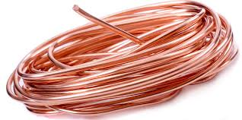
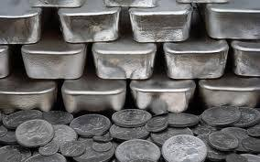

Examples of conductors
Most metals: Copper, silver, gold and aluminum are excellent conductors

Slide 21



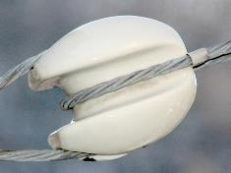

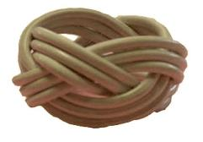
Examples of Insulators
Glass, rubber, plastic, dry wood, ceramics, paper
#1 level of protection from electrical hazards

Slide 22
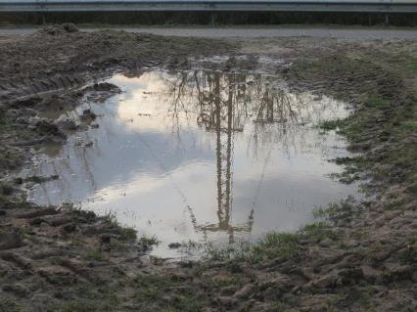
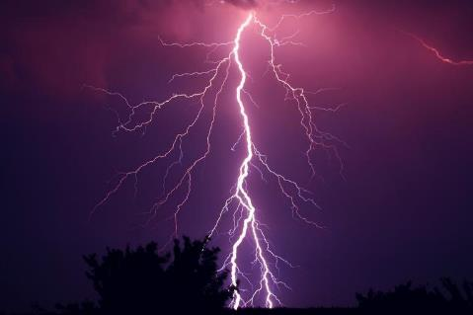
Conductor, insulator or both???
Water and air can be both under different conditions
Unless totally “pure,” water is an excellent conductor and potentially dangerous in combo with electricity on-the-job.
Air is a good insulator. But a big enough electrical charge can turn it into a
conductor, as happens with lightning.

Slide 23
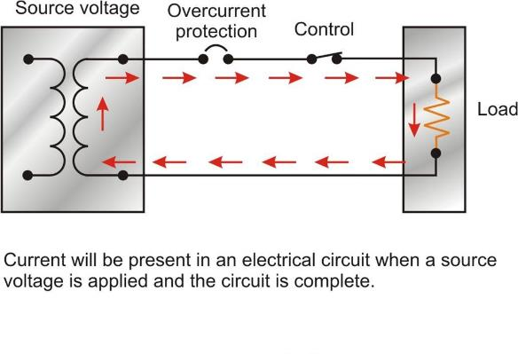
Flow of electricity—loops and paths
Electricity travels through circuits
Current cannot flow through open circuits
Switches open and close circuits
Tools and devices powered by the circuit are the “load”
Electricity flows back to the source

Slide 24
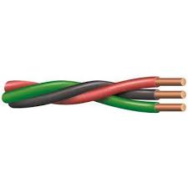


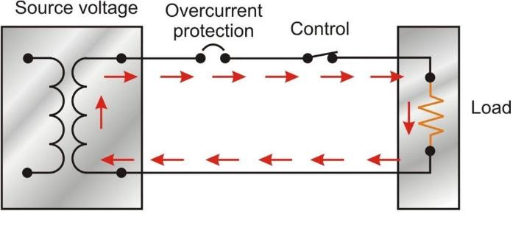


Find the circuit components
1 Conductor
3 Current
2 Insulator
4 Resistance
Resistance any part of the circuit that has opposition to current flow

Slide 25
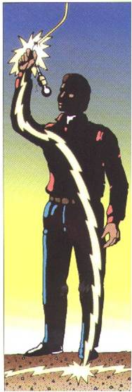
Circuits and worker safety
What do current, conductors, and circuits have to do with safety?
Workers are injured or killed when they accidentally become part of energized electrical circuits!

Slide 26
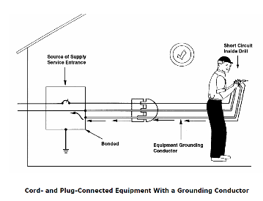
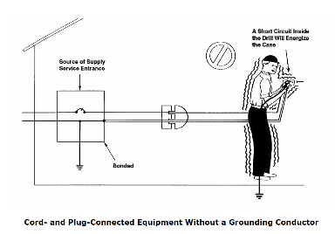
Electrical grounding—saves lives
Proper grounding of circuits and devices protects workers
Provides low-resistive path for current back to the source
Without grounding, current may flow through you!!

Slide 27
More electrical terms
Voltage
Amperage
Wattage
Pushes current through a conductor
Volts = measure of electrical FORCE
Strength of electrical current
Amperes “amps” = measure current FLOW
How much power is produced or consumed
Watts = measure electric POWER

Slide 28

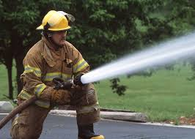

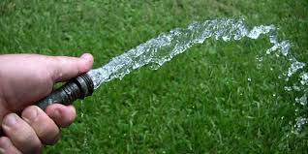
Water comparison
Low pressure = Low voltage = Less flow
High pressure = High voltage = More flow
At constant pressure…
More resistance = Less flow
Less resistance = More flow

Slide 29
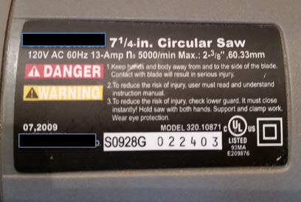
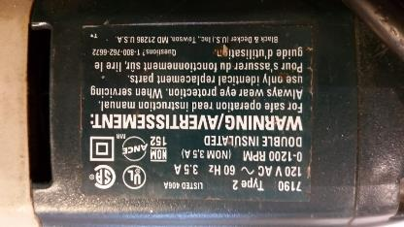
Volts/amps/watts and power tools
Power tool labels tell you:
Required voltage
Current the tool draws
Power the tool consumes
Would you use these two tools at the same time on a 120V 15 amp circuit?

Slide 30
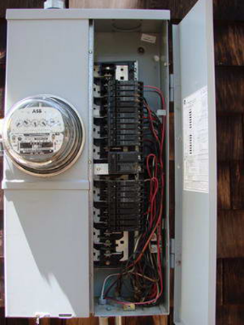
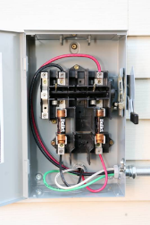

Overcurrent protection
Circuit breakers and fuses:
Protect circuits from overload
Detect current, if too much…
Shut down circuit
Designed to protect equipment, not people!

Slide 31


Review and Questions
Name three important things you learned in this section.

Slide 32
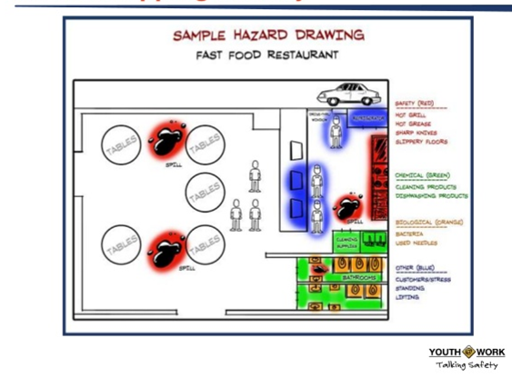
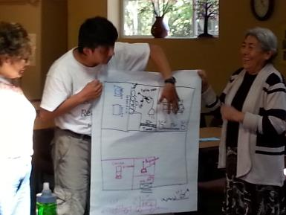
Hazard Mapping Activity

Slide 33
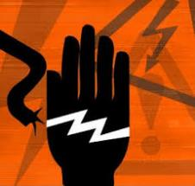
Section 3:
Effects of Electricity on the Human Body
How workers are exposed to electricity
What happens when you contact electricity
Most common injuries
What to do if someone is injured

Slide 34

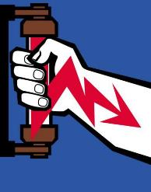
Making dangerous contact
Workers are injured or killed when they accidentally become part of a circuit
Electrical shock happens when current passes through the body
How do you become part of a circuit?

Slide 35
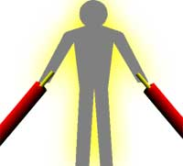


How we become part of a circuit
By touching:
A live wire and another wire at a different potential in a circuit
A live wire and an electrical ground
An ungrounded metallic part energized by contact with an energized conductor

Slide 36
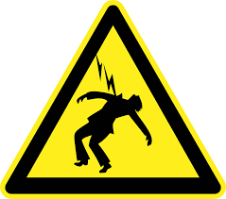
Four main electrical-related injuries
Electric shock
Electrocutions
Burns
Falls

Slide 37
Electric shock—from tingle to death
Three factors affect severity of shock:
PATH of the current through body
AMOUNT of current
LENGTH OF TIME body is in circuit

Slide 38
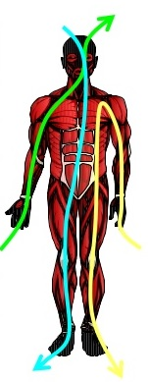
Path through the body
Current through the heart, lungs or nervous system--most dangerous
Hand-to-hand across the chest
Hands to feet
Head contacting live conductor

Slide 39
Current and exposure time
As amount of current increases
As length of exposure time
increases
Risk for injury and death increases

Slide 40
Review of amps and volts
Amperage “amps” measure?
What’s a milliamp (mA)?
Common household voltages?
Cal/OSHA standards:
Low voltage = ?
High voltage = ?
Flow of current
through conductor
120/240 volts
≤ 600 volts
1/1000 of an amp
> 600 volts
Low voltage does not mean low hazard!

Slide 41
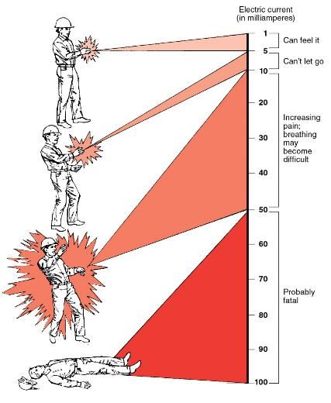
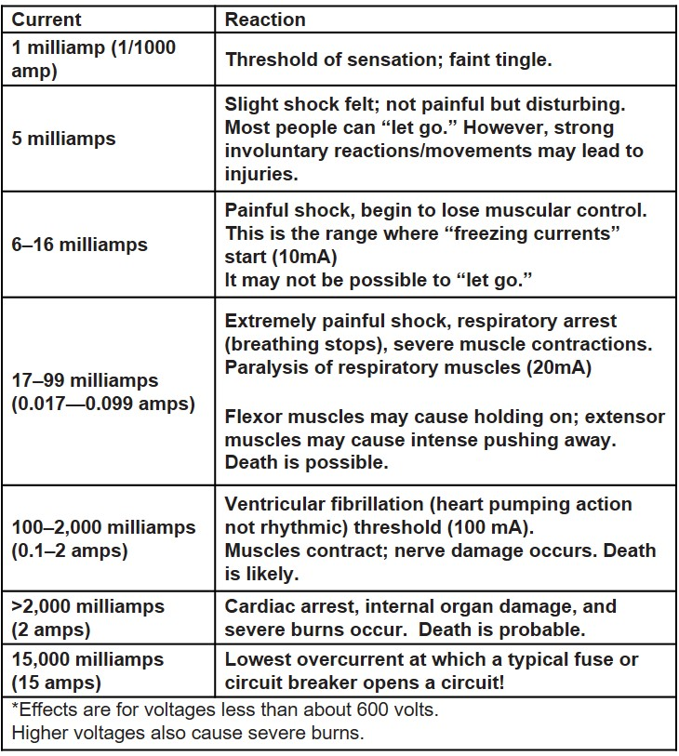
It doesn’t take much to do harm
© WorkSafeBC (Workers’ Compensation Board), used with permission

Slide 42
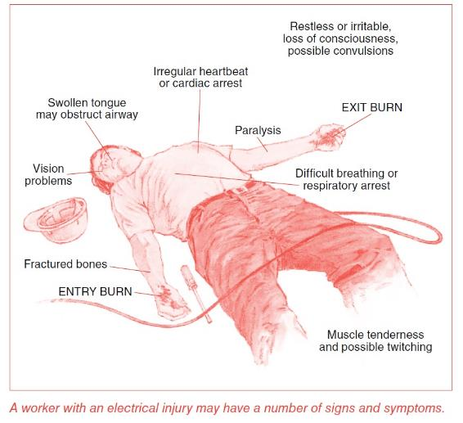
Electrical injury signs and symptoms
© WorkSafeBC (Workers’ Compensation Board), used with permission

Slide 43
Duration of Exposure
The longer electricity flows through your body, the more damage it can do
In seconds and fractions of seconds
100 mA current applied for 3 seconds is as dangerous as 900 mA applied for 0.03 seconds

Slide 44
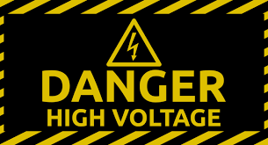
Other factors:
Voltage
Greater voltages produce greater currents
@600 V = current through body may be 4 amps!
@500 V = resistance in skin breaks down
@>600 V = breaks down electrical insulators
High voltage violent muscular contractions and severe burns

Slide 45
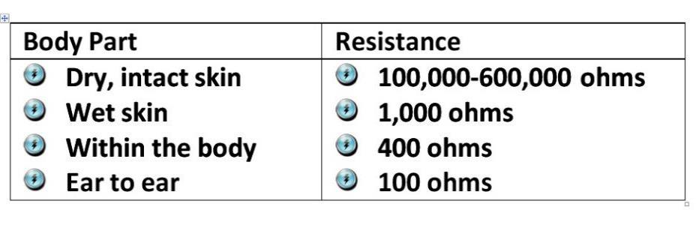
Body resistance and moisture
What happens when resistance goes down?

Slide 46
Burns
Electricity causes 3 types of burns:
Electrical
Arc
Thermal

Slide 47
Electrical burns
Extremely serious injuries
Current through body generates heat
Up to 5,000◦ F
Typically occur on hands
Damages: internal tissues, nerves, muscles, blood vessels, and organs
We’re not going to show you the horrific photos here.
Many images can be found online if you want to see them.

Slide 48
Arc burns—what is “arcing”

Slide 49
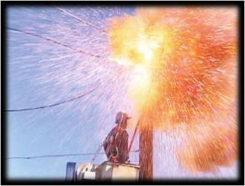
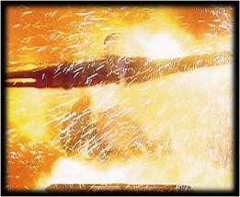
Arc flash and arc blast
Release of dangerous thermal energy
Extreme high temperatures up to 35,000◦F
That’s 3x hotter than the surface of the Sun!
Intense bright light
High voltage produces pressure waves creating a blast

Slide 50
Electrical Hazards for Non-Electricians video

Slide 51
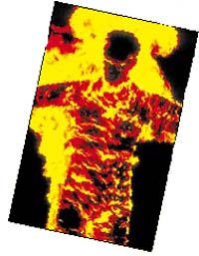

Thermal contact burns
Contact with overheated conductors
Electricity is a common cause of fire
Ignites clothing/flammable material
Ignites explosive combustible vapors/gasses/dusts in air

Slide 52
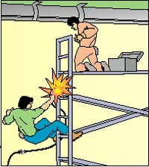
Falls—how is electricity related?
Shock is the beginning of a chain of events
Startle reaction
Muscle contraction
The shock may be minor—the fall may be deadly!

Slide 53
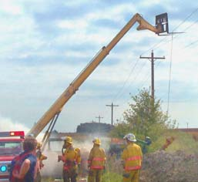
What to do if someone gets shocked?
Call 911
Don’t touch worker in contact with energized circuit-- You could get shocked too!
De-energize circuit if possible
If not, use non-conductive object to push victim away from source of current Does not apply to high voltage lines
Start CPR or other first aid.

Slide 54

Quick Review of Concepts Learned So far…
Electrical hazards are a leading cause of fatalities/injuries
The human body is a conductor of electricity
Workers are exposed to electricity through accidental contact with live circuits
Low voltage doesn’t mean low hazard
Severity of shock depends on amount of current, path through body, and duration
Main electrical injuries are: electrocution, shock, burns, falls

Slide 55
Section 4: Electrical Hazards
Live circuits: Power Lines/Hidden Electrical
Lack of ground fault protection
Missing or discontinuous path to ground
Equipment not used in manner prescribed
Improper use of extension and flexible cords

Slide 56
Hazard Assessment Model
RECOGNIZE hazards
EVALUATE risk
CONTROL hazards

Slide 57
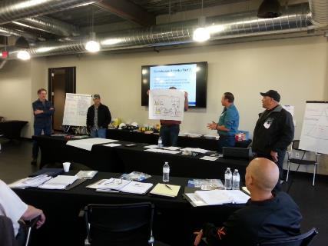
Small Group Activity:
Hazard Challenge—You’re the Expert
6 stations—6 teams
Scenarios/case studies
Identify the hazard
Assess risk factors
Brainstorm solutions
Report back to class

Slide 58
Hazard #1: Overhead Power Lines
Power lines, transformers, converters are the primary source of electrocutions in construction (39% of deaths 2011-15)
TEAM 1—Report Back
Video case study

Slide 59
WorkSafe BC video case study

Slide 60

Why are power lines dangerous?
High voltage—high current
Not insulated
Out of sight line— people don’t look up
Current can arc
Controlled by utility company, not job site

Slide 61
WorkSafe BC video—A Bright Arc

Slide 62


Power lines are all around

Slide 63


Workers at risk near power lines
Operating equipment (cranes, backhoes, dump trucks, concrete pumpers, aerial lifts/booms)
Working on ground around equipment
Elevated work (roofs, scaffolds, ladders)
Using long-handled tools (cement finishing floats, aluminum extension poles)

Slide 64



Best practices near overhead lines
Assume lines are energized
Inspect area before work begins
Always maintain minimum distance of 10 feet
Contact utility company—de-energize, guard, isolate or insulate lines
Notify workers of hazards—provide training
Assign dedicated spotter heavy equipment
Post warning signs at ground level—use portable safety barriers

Slide 65


Ladders near electrical circuits
Aluminum
Must be non-conductive (fiberglass or wood)
Clean and dry
Labeled by manufacturer
Metal ladders are prohibited

Slide 66
Underground power lines
TEAM 2—Report Back
Case Study: Laborer electrocuted when jackhammer strikes underground power line

Slide 67

Underground line hazards
Potential high voltage
Can’t see them
May be anywhere under construction site

Slide 68

What is the risk?
Without proper planning, these activities put workers at risk for electrocution.
Excavation equipment contacting energized power line
Handheld power equipment (concrete breakers/pneumatic drills) can penetrate insulation
Hand digging with sharp tools (shovels/picks/pry bars) close to energized conductors

Slide 69


Best practices near underground lines
Assume lines are energized
Call 811 at least 2 full days before digging to locate and mark lines
Mark excavation area
De-energize if possible
Maintain utility locator marks and follow them

Slide 70

Dig with care—hand digging
Hand dig within 24 inches of each side of marked lines
Use rounded or blunt-edged fiberglass handled shovel
See the line with your own eyes
Don’t use sharp tools or pry against a utility line

Slide 71

What should you do if you contact a power line?
If you have to get off equipment:
Don’t run!
Jump clear with both feet together
Don’t touch any part of equipment when you’re on ground
Shuffle away with small steps or hop away keeping feet together
Move equipment to break contact with circuit
Stay on equipment, unless it’s not safe
Call 911
Warn other workers to stay at least 35 feet away

Slide 72

What if a co-worker hits a power line?
Stay clear
Call 911
Don’t try to rescue victim
Stay away until circuit is de-energized

Slide 73

Hidden electrical hazards
Energized conductors can be concealed in walls, floors, ceilings
Drilling, cutting, demolition may expose workers to live circuits
Energized conductors don’t look any different from de-energized
Photo courtesy of L.Vergeront

Slide 74
Employers must assess hazards
These steps are required:
Locate energized circuits, exposed or concealed, before work is begun
Mark location of energized circuits
Post warning signs
Advise workers of location, hazards, and protective measures

Slide 75



Best practice—de-energize circuits
Lock Out/Tag Out (LOTO)

Slide 76
Review Quiz
Always maintain a minimum distance of ___________from overhead power lines.
What should contractors do before digging?
Always assume lines are what?
T/F Metal ladders are OK to use around electrical hazards.
Best way to protect from live circuits is to do what?
10 feet
Call 811 to locate lines
Energized
FALSE! Only non-conductive
De-energize them and LOTO

Slide 77
Hazards related to grounding
A Quick Review
Grounding
Ground wire
Resistance
Ground fault
Physical electrical connection to the earth
Conductor taking fault current safely to ground
Opposition to current flow
Current flows through grounded connection, not through intended load

Slide 78
Hazard #2
Lack of ground fault protection
TEAM 3—Report Back
Case Study: Death due to lack of ground fault protection—journeyman HVAC worker

Slide 79
Ground fault hazards and risk
Widespread use of portable power tools/extension cords
Electrical equipment, tools, and cords take heavy wear-and-tear daily in construction and may be damaged
A break in grounding system not obvious to users
Required safety devices not in place to protect workers
Ground faults can cause current to flow through a worker to ground, resulting in shock or electrocution

Slide 80

Required safety devices
Ground Fault Circuit Interrupter (GFCI)
Detects small current imbalances (5 mA)
Shuts down circuit in 1/40 of a second
Circuit breakers protect equipment, GFCIs protect YOU!

Slide 81





Have you seen these on-the-job?

Slide 82
OSHA and Cal/OSHA require:
GFCIs on construction sites for all 120-volt AC single phase, 15- and 20-amp receptacles not part of permanent wiring
      OR
A written
“Assured Equipment Grounding
Conductor Program”
(AEGCP)

Slide 83
Safe practices: ground fault hazards
Know type of ground fault protection being used on-the-job
Ask if GFCIs have been tested prior to use
Identify the assigned qualified person
Inspect equipment daily for defects and remove from service if damaged
Speak-up if you notice: tools/cords overheating; GFCIs shutting off circuits; worn or frayed insulation on conductors
USING A GFCI CAN SAVE YOUR LIFE

Slide 84
Hazard#3
Path to ground missing or discontinuous
TEAM 4—Report Back
Case Study: Short in power saw/ungrounded temporary power supply

Slide 85

What’s wrong here?

Slide 86


What are the risks?
Missing ground prong on cord (broken or removed intentionally)
Improper wiring; altered or damaged conductors or receptacles
If circuit is not grounded, quickest/easiest path for current is through a worker's body

Slide 87

Safe practices and solutions
Ground all power systems, circuits, equipment
Inspect electrical systems—insure path to ground is continuous
Inspect tools and cords; remove defective equipment from service
DO NOT REMOVE ground prongs
Use double-insulated tools

Slide 88


What does “double-insulated” mean?
Manufactured to prevent live conductors from energizing parts of tool that you can touch.
Non-metallic tool cases (usually plastic) protect user from electrocution
Approved tools do not require grounding; have 2-prong plugs.

Slide 89
Hazard #4
Equipment not used in manner prescribed
TEAM 5—Report Back
Case Study: Electrical equipment in poor condition.

Slide 90






Examples of misused equipment

Slide 91


And more…

Slide 92


Activities that put you at risk
Disregarding manufacturer specifications
Altering equipment/disabling grounding
Using damaged equipment
Ignoring signs of electrical problems
Failing to speak-up about potential hazards

Slide 93
Best practices
Use equipment that meets OSHA standards
Follow manufacturers’ instructions
Do not modify equipment
Use approved covers on electrical panels and boxes
Close unused openings in cabinets, boxes and fittings

Slide 94
Hazard #5 Improper use of extension and flexible cords
TEAM 6—Report Back
Case Studies:
Flexible cord not 3-wire, hard service variety
No strain relief

Slide 95






Would you use these?

Slide 96





What’s wrong with these cords?

Slide 97
Safe work practices
Extension cords
Use factory assembled cord sets
Use only 3-wire type with ground prong
Continually audit cords on-site
Discard frayed/damaged cords
Use only cords rated for hard or extra-hard usage

Slide 98

Where do I find usage codes?
(and other good information)
Must be indelibly marked every 1’ along length of cord
Ratings from the
National Electrical
Code (NEC)
Image courtesy of NABTU; used with permission

Slide 99


Two more safety requirements
Use only cords equipped with strain relief
Use cords rated for correct level of amperage
Sample manufacturer info:
The lower the wire gauge number, the bigger the conductor

Slide 100

Don’t abuse your power cords!
Things you should NEVER do:
Jerk on cord to unplug
Pull or strain cords
Carry tool by the cord
Break off ground prong
Tie cords in tight knots
Allow vehicles to drive over

Slide 101

Do the right thing!
Watch for hazards
Recognize risks
Use safe practices
Speak-up if you
identify a hazard

Slide 102
Use of material and duplication
Material may be used for non-commercial, instructional, educational purposes ONLY
Fees may not be charged for this material
While every effort has been made to ensure information is current and accurate, the grantee does not assume any liability for errors or omissions

Slide 103

Work safely around electricity and enjoy a healthy career in the trades
Thank you for attending this training

Slide 104

Safety and Health HUB safety.sbctc.org

