Slide 1

Promoting Chemical Safety on the Job
Promoting Chemical Safety on the Job
Juliana Simmons, MSPH, CHES Environmental and Occupational Health Program Manager
Migrant Clinicians Network
Notes:
Add Amy as presenter. Change date to Dec 13

Slide 2
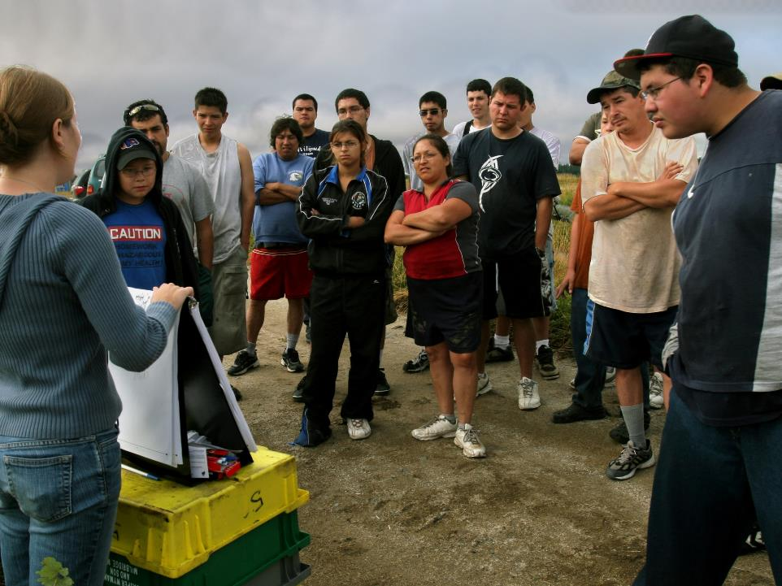
We offer health and saftey training at no cost to employees.
We offer health and safety.

Slide 3
This project is funded by OSHA, but we do NOT take part in any enforcement. We are not a regulatory agency.

Slide 4
Video:
https://www.youtube.com/watch?v=9XluYVm8oS4&feature=youtu.be

Slide 5

OSHA’s Hazard Communication Standard
Employers that have hazardous chemicals in their workplaces are required to implement a hazard communication program.

Slide 6
Steps to an Effective Hazard Communication Program
1: Learn the standard and identify a champion
2: Prepare and implement a written Hazard Communication Program
3: Ensure containers are labeled
4: Maintain Safety Data Sheets (SDS)
5: Inform and Train Employees
6: Evaluate and Reassess Your Program

Slide 7
How can we help?

Slide 8
How to help
Provide worker trainings
Culturally appropriate
Participatory
Spanish or English
Designed for workers with low-literacy levels
Provide employer training about the Hazard Communication Standard
Help employers comply with OSHA worker training requirement

Slide 9
We would love to work with you!
For more information, please contact:

Slide 10
OSHA Grant info
This material was produced under grant SH-29622-SH6 from the Occupational Safety and Health Administration, U.S. Department of Labor. It does not necessarily reflect the views of policies of the U. S. Department of Labor, nor does it mention of trade names, commercial products, or organizations imply endorsement by the U. S. Government.”
Revisions were made to this material under grant number SH-31222-SH7 from the Occupational Safety and Health Administration, U.S. Department of Labor.

