Slide 1
Protective Systems
This material was produced under a grant (SH-31234-SH7) from the Occupational Safety and Health Administration, U.S. Department of Labor. It does not necessarily reflect the views or policies of the U.S. Department of Labor, nor does the mention of trade names, commercial products, or organization imply endorsement by the U.S. Government.

Slide 2
Objectives:
Define Different types of Protective Systems
Identify uses and limitations of different protective systems
Understand the usage characteristics of different protective systems
Understand how to safely implement the protective system

Slide 3
October 2015 through September 2016
Standard | Citations | Inspections | Penalty | Description
Total | 742 | 292 | $2,179,654 | All Standards cited for Site Preparation Contractors
Notes:
Source; https://www.osha.gov/pls/imis/citedstandard.naics?p_esize=&p_state=FEFederal&p_naics=238910

Slide 4
4 types of Protective Systems
Benching- means a method of protecting workers from cave-ins by excavating the sides of an excavation to form one or a series of horizontal levels or steps, usually with vertical or near vertical surfaces between levels. Benching cannot be done in Type C soil.
Sloping- involves cutting back the trench wall at an angle inclined away from the excavation.

Slide 5
4 types of Protective Systems Continued
Shoring- requires installing aluminum hydraulic or other types of supports to prevent soil movement and cave-ins.
Shielding- protects workers by using trench boxes or other types of supports to prevent soil cave-ins.
Combination- using more than one type of protective system at the same time.

Slide 6
Benching

Slide 7
How to use Benching
Benching can only be used for type A and B soils
If it is type C sloping or some other means of protection must be used
Benching is cutting into sides of excavations and making stair like shelves into the sides

Slide 8
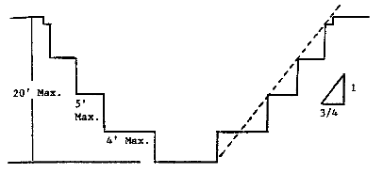
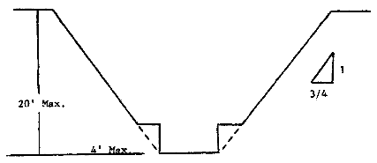
Benching type a soil
All benched excavations 20 feet or less in depth shall have a maximum allowable slope of 3/4 to 1 and maximum bench dimensions as follows
MULTIPLE BENCH
SIMPLE BENCH

Slide 9
Sloping

Slide 10
Sloping
Sloping or benching for excavations greater than 20 feet deep shall be designed by a registered professional engineer
Can be used for every soil type (the slope will vary depending on soil type)

Slide 11
How to determine Sloping
SOIL OR ROCK TYPE | MAXIMUM ALLOWABLE SLOPES FOR EXCAVATIONS LESS THAN 20 FEET DEEP
STABLE ROCK TYPE A (2) TYPE B TYPE C | VERTICAL (90⁰) 3/4:1 (53⁰) 1:1 (45⁰) 1 ½:1 (34⁰)

Slide 12
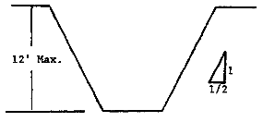
Simple Sloping type a soil
simple slope excavations which are open 24 hours or less (short term) and which are 12 feet or less in depth shall have a maximum allowable slope of ½:1.
Notes:
https://www.osha.gov/pls/oshaweb/owadisp.show_document?p_table=STANDARDS&p_id=10932

Slide 13
Shoring

Slide 14
Timber Shoring
Shoring is the provision of a support system for trench faces used to prevent movement of soil, underground utilities, roadways, and foundations.
Shoring or shielding is used when the location or depth of the cut makes sloping back to the maximum allowable slope impractical.
Shoring systems consist of posts, wales, struts, and sheeting. There are two basic types of shoring, timber and aluminum hydraulic.

Slide 15
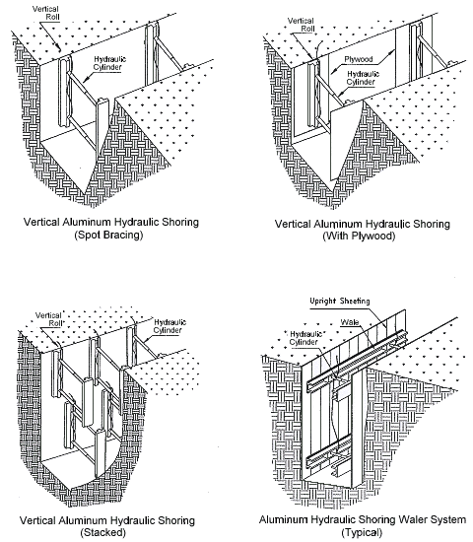
Hydraulic Shoring
All shoring should be installed from the top down and removed from the bottom up. Hydraulic shoring should be checked at least once per shift for leaking hoses and/or cylinders, broken connections, cracked nipples, bent bases, and any other damaged or defective parts.
Notes:
https://www.osha.gov/dts/osta/otm/otm_v/otm_v_2.html

Slide 16
Hydraulic Shoring
The trend today is toward the use of hydraulic shoring, a prefabricated strut and/or wale system manufactured of aluminum or steel. Hydraulic shoring provides a critical safety advantage over timber shoring because workers do not have to enter the trench to install or remove hydraulic shoring. Other advantages of most hydraulic systems are that they:
Are light enough to be installed by one worker;
Are gauge-regulated to ensure even distribution of pressure along the trench line;
Can have their trench faces "preloaded" to use the soil's natural cohesion to prevent movement; and
Can be adapted easily to various trench depths and widths.
Notes:
https://www.osha.gov/dts/osta/otm/otm_v/otm_v_2.html

Slide 17
Pneumatic Shoring
Screw Jacks. Screw jack systems differ from hydraulic and pneumatic systems in that the struts of a screw jack system must be adjusted manually. This creates a hazard because the worker is required to be in the trench in order to adjust the strut. In addition, uniform "preloading" cannot be achieved with screw jacks, and their weight creates handling difficulties.
Single-Cylinder Hydraulic Shores. Shores of this type are generally used in a water system, as an assist to timber shoring systems, and in shallow trenches where face stability is required.
Underpinning. This process involves stabilizing adjacent structures, foundations, and other intrusions that may have an impact on the excavation. As the term indicates, underpinning is a procedure in which the foundation is physically reinforced. Underpinning should be conducted only under the direction and with the approval of a registered professional engineer.
Notes:
https://www.osha.gov/dts/osta/otm/otm_v/otm_v_2.html

Slide 18
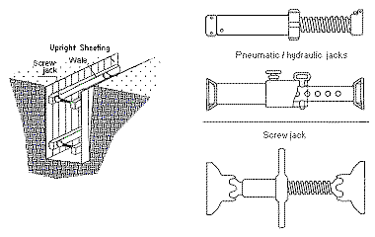
Pneumatic Shoring continued
Installed from the top down, to give the most protection while installing it
Made with a series of uprights and horizontals

Slide 19
Sloping and shoring part 1
Source: https://www.youtube.com/watch?v=USat6LdENzU
This video depicts how to install an shoring system into a trench
Notes:
Source: https://www.youtube.com/watch?v=USat6LdENzU
This video depicts how to install an shoring system into a trench

Slide 20
Sloping and shoring part 2
Source: https://www.youtube.com/watch?v=1Y5lsem9r4U
This video depicts how to install an shoring system into a trench
Notes:
Source: https://www.youtube.com/watch?v=1Y5lsem9r4U
This video depicts how to install an shoring system into a trench

Slide 21
Shielding

Slide 22
Shielding
Trench Boxes are different from shoring because, instead of shoring up or otherwise supporting the trench face, they are intended primarily to protect workers from cave-ins and similar incidents.
The excavated area between the outside of the trench box and the face of the trench should be as small as possible.
The space between the trench boxes and the excavation side are backfilled to prevent lateral movement of the box.
Shields may not be subjected to loads exceeding those which the system was designed to withstand.

Slide 23
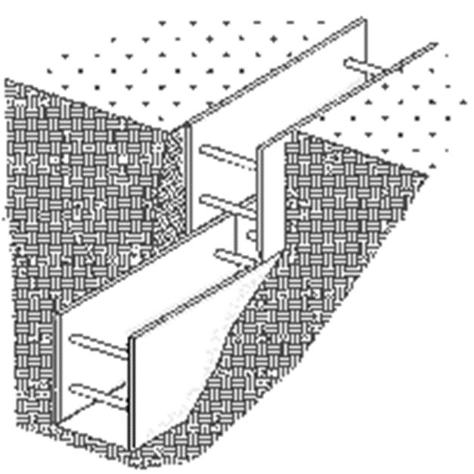
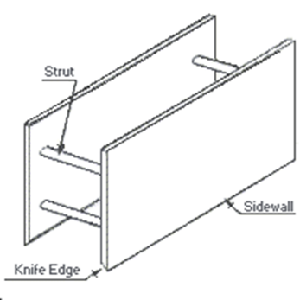
How to use Shielding
Stacking Trench Boxes
Trench box
Notes:
Source: https://www.osha.gov/dts/osta/otm/otm_v/otm_v_2.html
The reason behind stacking the trench boxes is to provide protection in deeper excavations, they will need to be compatible and have the ability to be locked together.

Slide 24
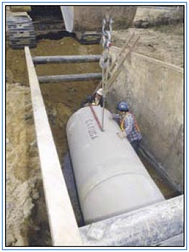

Use of shielding
Top of the trench box needs to be at least 18” above soil level, not the top of the excavation
Boxes can be stacked and locked into each other, they need to be compatible to be stacked
Ensure no employee is inside trench between a moving object and wall Do not stand under suspended load
Notes:
Source: https://www.osha.gov/pls/oshaweb/owadisp.show_document?p_table=INTERPRETATIONS&p_id=23845

Slide 25
Spoil Piles

Slide 26
Spoil Pile
Temporary Spoil
Temporary spoil must be placed no closer than 2 ft (0.61 m) from the surface edge of the excavation, measured from the nearest base of the spoil to the cut. This distance should not be measured from the crown of the spoil deposit. This distance requirement ensures that loose rock or soil from the temporary spoil will not fall on employees in the trench.
Spoil should be placed so that it channels rainwater and other run-off water away from the excavation. Spoil should be placed so that it cannot accidentally run, slide, or fall back into the excavation

Slide 27
Spoil Pile Continued
Permanent Spoil
Permanent spoil should be placed at some distance from the excavation. Permanent spoil is often created where underpasses are built or utilities are buried. The improper placement of permanent spoil, i.e. insufficient distance from the working excavation, can cause an excavation to be out of compliance with the horizontal-to-vertical ratio requirement for a particular excavation. This can usually be determined through visual observation. Permanent spoil can change undisturbed soil to disturbed soil and dramatically alter slope requirements.

Slide 28
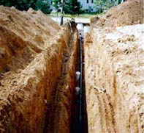

Improper placement of spoil pile
Unsafe placement of spoil pile
Unsafe benching
Notes:
Source: https://www.osha.gov/SLTC/etools/construction/trenching/mainpage.html

Slide 29
Hazard identification

Slide 30
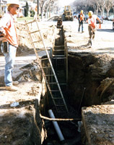
Hazard identification 1
No safe access or egress
No protective system in place
Housekeeping in trench
Heavy equipment close by
No limited access zone
Notes:
Source: https://www.osha.gov/SLTC/etools/construction/trenching/mainpage.html

Slide 31
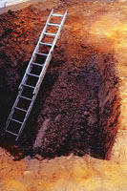
Hazard identification 2
No safe access or egress
No protective system in place
Notes:
Source: https://www.osha.gov/SLTC/etools/construction/trenching/mainpage.html

Slide 32
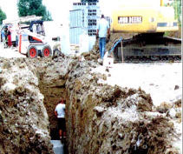
Hazard identification 3
No safe access or egress
No protective system in place
Housekeeping in trench
Heavy equipment close by
No limited access zone
Notes:
Source: https://www.osha.gov/SLTC/trenchingexcavation/newsletter.html

Slide 33
Worker Rights and responsibilities

Slide 34
Employee Rights & Responsibilities
Occupational Safety and Health Act of 1970
To assure safe and healthful working conditions for working men and women
By authorizing enforcement of the standards developed under the Act
By assisting and encouraging the States in their efforts to assure safe and healthful working conditions
By providing for research, information, education, and training in the field of occupational safety and health…
Notes:
Workers Rights
http://www.osha.gov/Publications/osha3021.pdf
The instructor will discuss employee rights and responsibilities with the participants.

Slide 35
Employee Rights & Responsibilities
You have the right to:
  A safe and healthful workplace
  Know about hazardous chemicals
  Information about injuries and illnesses in your workplace
  Complain or request hazard correction from employer
Notes:
The information above was taken from the new 2 hour Intro to OSHA PPT, slide #10.
The instructor will discuss employee rights and responsibilities with the participants.

Slide 36
Employee Rights & Responsibilities
You have the right to:
File a confidential complaint with OSHA to have their workplace inspected.
Receive information and training about hazards, methods to prevent harm, and the OSHA standards that apply to their workplace. The training must be done in a language and vocabulary workers can understand.
Get copies of their workplace medical records and exposure records.
Participate in an OSHA inspection and speak in private with the inspector.
Notes:
Workers Rights
http://www.osha.gov/Publications/osha3021.pdf

Slide 37
Employee Rights & Responsibilities Continued:
File a complaint with OSHA if they have been retaliated or discriminated against by their employer as the result of requesting an inspection or using any of their other rights under the OSH Act.
File a complaint if punished or discriminated against for acting as a “whistleblower” under the additional 21 federal statutes for which OSHA has jurisdiction.
Notes:
Workers Rights
http://www.osha.gov/Publications/osha3021.pdf
Incorporate into all 4 modules. 3-4 slides need to be added.
Provide handouts to minimize amount of info on slides.

Slide 38

Whistleblower Protection
http://www.whistleblowers.gov/
Notes:
The Whistleblower Protection Program
http://www.whistleblowers.gov/

