Slide 1
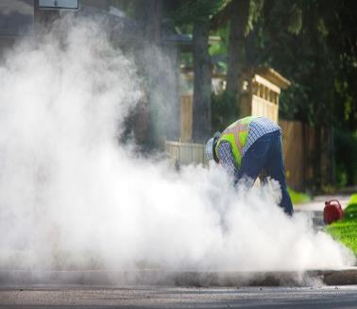

Silica Why You Want to Keep Silica Dust Out of your Lungs and How to Do It
Photo by Development Partner
Worker in cloud of dust
Notes:
Welcome to the presentation entitled, “Silica. Why You Want to Keep Silica Dust out of your Lungs and How to Do It”. The photograph on the left shows a man using a piece of power equipment on a sidewalk creating a large amount of dust containing silica, which surrounds him in a large cloud. Under the new OSHA silica standard for construction, this will be a thing of the past, as engineering control measures will prevent this type of dust cloud from being generated.

Slide 2
Disclaimers
This presentation was produced under grant number SH-29668-SH6 from the Occupational Safety and Health Administration, U.S. Department of Labor. It does not necessarily reflect the views or policies of the U.S. Department of Labor, nor does mention of trade names, commercial products, or organizations imply endorsement by the U.S. Government.
Notes:
Please read the disclaimer

Slide 3

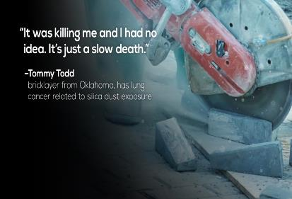
Why are we here?
Photo by OSHA available under public domain from www.OSHA.bov
Understand silica
Respirable crystalline silica dust
Know when you can be exposed to it
Understand why you don’t want to breathe it into your lungs
Quote from worker with lung cancer
Learn how to keep it from being in the air you breathe
Notes:
The purpose of this presentation is to help you learn more about silica, and specifically, more about “respirable crystalline silica dust”. For simplicity, the term silica dust will be used throughout the presentation, but it is important to keep in mind that we are referring to respirable crystalline silica dust. The goal is to help you understand what respirable crystalline silica dust is, identify when you can be exposed to it, understand why you don’t want to breathe it in to your lungs, and learn how to keep it from being in the air that you breathe. More information about OSHA’s silica standard for the construction industry can be found on the OSHA website. OSHA has also produced a fact sheet entitled “Workers’ Exposure to Respirable Crystalline Silica: Final Rule Overview”, which outlines the requirements of the standard. The image on the right depicts a quote taken from the OSHA website. The quote is from a bricklayer who had been diagnosed with lung cancer. He said, “It was killing me, and I had no idea. It’s just a slow death”. That is the problem with silica dust. Diseases caused by silica do not develop until years to decades after exposure, without warning signs or symptoms.

Slide 4
PreTest
Please provide one answer to each question.
Notes:
Pretest. The pretest consists of 15 questions, each question appearing on a separate slide. There is one correct answer to each question. The questions should be read by the trainer who will describe how the answers will be gathered and tallied.

Slide 5
Sample Question
Silica dust can be detected by a specially trained Building Badger.
True
False
Photograph of a badger
Notes:
Sample question for trainees to practice the way the questions are to be answered. The answer to this sample question is “false”. The remainder of the answers will be provided on the post test slides.

Slide 6
Pre Test #1
1) Silica is in which of the following?
Granite, and other types of rock
Concrete
Some dry wall joint compound
All of the above

Slide 7
Pre Test #2
2) Which of the following activities create large amounts of visible and invisible silica dust?
Cutting
Grinding
Dry wall finishing
All of the above

Slide 8
Pre Test #3
3) The silica dust that is small enough to get deep into your lungs (respirable silica dust) is too small to see. It is invisible.
True
False

Slide 9
Pre Test #4
4) You can have the same amount of respirable silica dust exposure, or even more, from tasks someone else is doing near you - beside you, above you, or below you.
True
False

Slide 10
Pre Test #5
5) Chronic silicosis is a lung disease that develops slowly over years due to the invisible respirable silica dust that gets deep into your lungs, which makes it gradually harder and harder to breathe.
True
False

Slide 11
Pre Test #6
6) Controls to reduce exposure to respirable silica include which of the following:
Wet cutting
Shrouds and HEPA dust collection system
Equipment in good working condition
All of the above

Slide 12
Pre Test #7
7) Excluding hood type respirators, a respirator needs to have a tight seal to the skin of the face in order to keep dust out of your lungs.
True
False

Slide 13
Pre Test #8
8) You can check to see if a product you are going to use contains silica by reading the product label and safety data sheet (SDS).
True
False

Slide 14
Pre Test #9
1
9) Wet methods mean a stream of water is applied to the surface as it is being cut. This is best done using a continuous feed water system that has been built into the equipment.
True
False

Slide 15
Pre Test #10
0
10) Use of a handkerchief or one strap mask will protect your lungs from respirable silica.
True
False

Slide 16
Pre Test #11
11) Under the Occupational Safety and Health Act, workers have the right to:
Two ten minute breaks and a lunch break
A safe work place
Overtime pay
Two weeks of vacation

Slide 17




Pre Test #12
12) OSHA Table 1 requires use of APF 25 respirators when tuckpointing (hand held mortar routing) is done for more than 4 hours a day. Which of the following are both at least APF 25 respirators:
A
2. B
3. C
4. D
Elastomeric half-face respirator
Elastomeric full-face respirator
Elastomeric half-face respirator
Powered Air-Purifying Respirator
Elastomeric full-face respirator
Powered Air-Purifying Respirator
Elastomeric half-face respirator
Disposable respirator (N95)
Notes:
When this question is asked, the names of the respirator should be stated: 1) an elastomeric half-mask and a full-face negative pressure respirator, 2) an elastomeric half-mask and a powered air purifying respirator (PAPR), 3) a full-face elastomeric negative pressure respirator and a PAPR, and 4) a half-mask elastomeric negative pressure respirator and a disposable filtering face piece respirator, an N-95.

Slide 18
Pre Test #13
13) When should compressed air be used for cleaning up dust that might contain silica?
When no one is looking
To clean a part before you work on it
To clean off clothing at the end of the day
Never

Slide 19
Pre Test #14
14) If you can see visible silica dust being generated, it probably means the level of respirable silica dust is too high.
True
False

Slide 20
Pre Test #15
15) For any given task (if all other conditions remain the same) the concentration (level) of dust in the air will be higher inside than the same task done outside.
True
False

Slide 21
What is OSHA?
Occupational Safety and Health Administration
Government agency responsible for worker safety and health protection
Created in 1970 by the Occupational Safety and Health (OSH) Act
Allows states to take responsibility for implementing OSH Act providing their regulations are at least as stringent as Federal OSHA
OSHA’s mission:
Save lives
Prevent injuries and illnesses
Protect the health of America’s workers
Notes:
OSHA is the Occupational Safety and Health Administration, the governmental agency responsible for worker safety and health protection. It was created in 1970 by the Occupational Safety and Health Act, also known as the OSH Act. OSHA is a federal program, but it allows states to take responsibility for implementing the OSH act providing their regulations are at least as stringent as federal OSHA. OSHA’s mission is to save lives, prevent injuries and illnesses, and protect the health of America’s workers.

Slide 22
Does the silica standard apply to you?
Are you exposed to silica dust in your current job?
Do you think the place you work is safe?
Do you think the places you will work will always be safe?
Do you ever want to start your own business?
Notes:
As you view this presentation, we recommend you think about your answer to the following question: how does the OSHA standard apply to you? Questions to consider: Are you exposed to silica dust in your current job? Do you think the place you work is safe? Do you think the places you will work will always be safe? Do you ever want to start your own business?

Slide 23
What are employers’ responsibilities under OSHA?
Provide employment and a workplace that is:
Free from recognized hazards that are causing or are likely to cause death or serious physical harm to employees.
In compliance with established OSHA standards.
Notes:
Under OSHA, employers are required to provide employment in a workplace that is free from recognized hazards that are causing or are likely to cause death or serious physical harm to employees, and a workplace that is in compliance with established OHSA standards.

Slide 24
Workers Have Rights and Responsibilities
Under OSHA, workers have the right to a safe workplace
Workers need to do their part to help keep themselves safe
Workers and employers can help make the workplace safer by working together to identify and control hazards
Notes:
Workers have rights and responsibilities. Under OSHA, workers have the right to a safe workplace. Workers need to do their part to help keep themselves safe. Workers and employers can help make their workplace safer by working together to identify and control hazards.

Slide 25
OSHA’s Crystalline Silica Rule For Construction
Enacted in 2016
Enforcement began on June 23, 2017 September 23, 2017
Establishes maximum amount silica dust allowed in the air you breathe
Permissible exposure limit (PEL)
Outlines measures to control silica dust
What needs to be done if you can’t control the dust
Notes:
OSHA’s crystalline silica rule for construction was enacted in June of 2016. Enforcement began on September 23rd, 2017, 3 months after originally planned. The standard establishes the maximum amount of silica dust allowed in the air that you breathe, which is called the permissible exposure limit (PEL). The standard outlines ways to control silica dust and what needs to be done if you cannot control the levels of dust. These will be described in detail.

Slide 26
Quiz Bowl #1
What does OSHA stand for?
Occupational Safety and Health Alliance
Occupational Security and Health Association
Occupational Safety and Health Administration
Ordinary Super Hero Alliance
Notes:
Answer: 3. Occupational Safety and Health Administration

Slide 27
Quiz Bowl #2
Everyone working on a job site has a right to and is responsible for workplace safety.
True
False
Notes:
Answer: 1. True

Slide 28
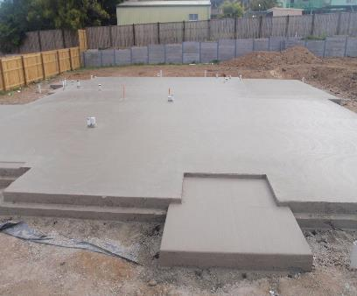
Silica is in Rock
Quartz
Products that contain rock contain silica
Do you work with rock or products that contain rock?
What contains silica in this picture?
Photo by Haselden Construction
Concrete foundation on a construction site
Notes:
Silica is in rock. Quartz is a type of crystalline silica, and is found commonly in many types of rock including granite. Therefore, products that contain rock contain silica. We recommend you think about your answer to the following question, do you work with rock or products that contain rock? The photograph on the right is a poured foundation in a residential lot. The trainer should ask the trainees to identify what in the picture contains silica. The answers are: the concrete, the dirt, and the small rocks in the dirt.

Slide 29
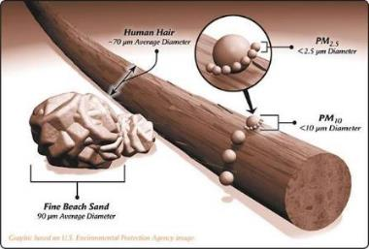
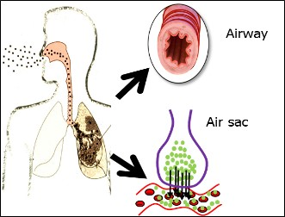
Respirable Crystalline Silica Dust
Crystalline silica dust
dust from rocks and products made of rocks
Respirable
dust small enough to get into the deepest part of your lungs
Size of respirable particles compared to a human hair
Image by National Jewish Health
Path oxygen into the lung and blood stream
Notes:
This slide will provide the definition of respirable crystalline silica dust. Crystalline silica is a type of silica, which has a crystalline structure. The most common type of crystalline silica is quartz. The other forms of crystalline silica regulated by OSHA are crystobalite and tridymite. These are typically found in volcanic rock, and are much less common. Respirable means the dust is small enough to get into the deepest part of the lungs. The diagram at the bottom right shows the human airway, extending from the nose and mouth into the lungs. When a person breathes in through the mouth and nose, air containing oxygen travels down into the lungs, through progressively smaller airways to the alveoli, or air sacs, where oxygen travels into the blood stream. This is shown by the green dots. When dust in the air is inhaled, the large particles of dust will get trapped in the nose, mouth, and upper airways, but the tiniest particles will continue to travel down through the progressively smaller airways and some can make it all the way to the air sacs. This is called respirable dust. This dust is very tiny, much smaller than a human air. The diagram on the top right shows the relative size of respirable dust compared to a human hair. The long structure in the center is a human hair, which is an average of about 70 microns in diameter, although varies from person to person. This is about the size of a fine grain of beach sand, shown on the lower left. The small beads shown encircling the human hair on the right are labeled PM₁₀, are much smaller, 10 microns of less in size. The respirable particles are much smaller than this, about 2.5 microns in size, which are labeled PM_{2.5} in the diagram. The trainer should ask the trainees to consider how small this respirable dust is and whether or not they think they could see it. To help think about this, the trainer could ask the trainees to isolate a single strand of hair on the head or face to consider as a comparison.

Slide 30

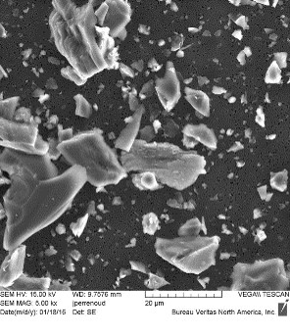
Where Do You See Respirable Crystalline Silica Dust?
Photo by Development Partner
Dust under scanning electron microscope
Worker in cloud of dust
Notes:
The photograph on the left is the same one that was shown on the introductory slide, depicting a man working on concrete surrounded by a large cloud of dust. The question is meant to be a trick question. The answer is you cannot see respirable crystalline silica dust because it is too small to see. However, you know that when that type of dust cloud is being generated by using power tools on concrete, in addition to all of the larger dust particles that can be seen, there will always also be large amounts of invisible respirable crystalline silica dust as well. The image on the right is what dust in this cloud would look like under a microscope. Mixed in with the big dust particles you can see are many smallest particles, including the tiniest particles of respirable size.

Slide 31
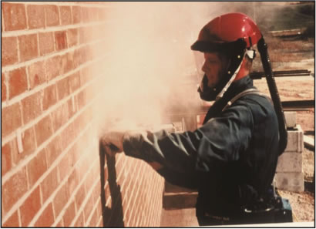

High Speed and Power Tools Create Respirable Crystalline Silica Dust
Cutting
Grinding
Drilling
Sawing
Sandblasting
Polishing
Jackhammering
Pneumatic equipment
Sweeping
Image from OSHA (Elcosh)
Worker grinding (tuckpointing) without engineering controls
Notes:
High speed and power tools create respirable crystalline silica dust. The photograph on the right shows a worker grinding, specifically tuckpointing, without dust controls, and a large amount of dust is being generated. Other tasks that can create large amounts of respirable crystalline silica dust include cutting, drilling, sawing, sandblasting, polishing, jackhammering, use of pneumatic equipment. It is very important to keep in mind that the respirable crystalline silica dust is not only created while those tasks are being performed, but that same dust can become re-entrained back up into the air if dry methods are used for cleaning up afterwards.

Slide 32
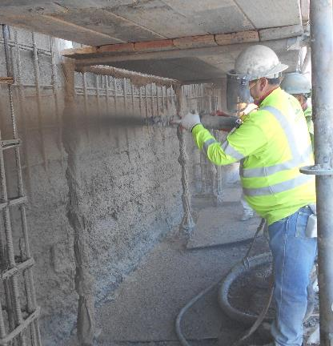

Silica Exposure from Work Done by Others Around You
Photo courtesy of Patty Jeffries
Silica levels can be just as high or even higher from work done by others around you
Worker applying shotcrete
Notes:
Workers can be exposed to respirable crystalline silica dust not only from work they are doing, but also the work being done by others in the area. The photograph on the right shows a gentleman applying shotcrete. The trainer should ask the trainees who they think would be exposed to higher levels of silica dust: this gentleman applying the shotcrete or the workers shown above him in the photograph on the next slide.

Slide 33
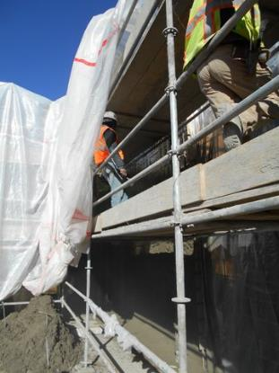
Silica Exposure from Work Done by Others Around You (pt. I)
Photo courtesy of Patty Jeffries
Beside you
Below you
Above you
Workers on scaffolding above the shotcrete application
Notes:
The photograph on the right shows workers standing up on scaffolding. Below them, and not visible in the photograph, is the worker applying the shotcrete shown in the previous slide. The answer to the question about who had the higher exposure to silica dust is these workers on the scaffolding above. When sampling was done with personal air monitoring performed on each of these workers, the level of respirable crystalline silica dust were higher for these workers above. On a construction site, work can be done by others beside you, above you, or below you.

Slide 34
Quiz Bowl #3
Silica is in which of the following?
Granite, and other types of rock
Concrete
Some dry wall joint compound
All of the above
Notes:
Answer: 4. All of the above

Slide 35
Quiz Bowl #4
Which of the following tasks can create large amounts of visible and invisible (respirable) silica dust?
Cutting
Grinding
Dry wall finishing
All of the above
Notes:
Answer: 4. All of the above

Slide 36
Quiz Bowl #5
You can have the same amount of respirable silica dust exposure, or even more, from tasks someone else is doing near you - beside you, above you, or below you.
True
False
Notes:
Answer: 1. True

Slide 37
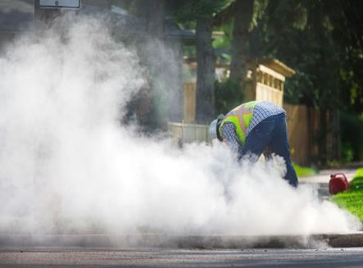
Can You Know if there is respirable Crystalline Silica Dust in the air?
Yes!
Any time you can see the dust, there will be respirable crystalline silica in the air
Photo by Development Partner
Worker in cloud of dust
Notes:
Can you know if there is respirable crystalline silica dust in the air if it is too small to see? The answer is yes! Anytime you can see dust clouds being generated from work being done on concrete, rock, or other silica-containing material, there will be respirable crystalline silica dust in the air.

Slide 38
Am I Safe if I Can’t See the Dust?
Photo by Development Partner
Maybe
There can be high levels of respirable crystalline silica in the air even when you can’t see the dust
Worker applying shotcrete
Notes:
Do you know you are safe if you can’t see the dust? The answer is maybe. The photograph on the right depicts that same gentleman applying the shotcrete. The answer for the workers on the scaffolding above him would depend on whether or not they were aware of the work being done down below. There can be high levels of respirable crystalline silica dust in the air even when you can’t see the dust, making it important that you be aware of the work others are doing around you.

Slide 39
How Can You Know If You are Safe When You Can’t See the Dust?
You Can’t
Silica has no smell
Silica has no taste
Breathing respirable silica dust causes no immediate, observable signs or symptoms
The dust that causes you to cough and your nose to get stuffy is the big dust that gets caught in your nose and throat
Notes:
How can you know if you are safe when you can’t see the dust? The bottom line is that you cannot. Unfortunately silica has no warning properties. It has no smell, it has no taste. Breathing respirable silica dust causes no immediate observable signs or symptoms. Some trainees may point out that when they are exposed to dust, they will cough, sneeze, or get a stuffy nose. The answer to this question (or to point out even if no one asks) is that the dust that causes you to cough and your nose to get stuffy is the larger sized dust that gets caught in the nose and throat. The much smaller sized respirable silica dust that gets down into the deepest part of the lungs causes no signs or symptoms.

Slide 40
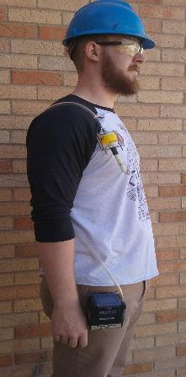
How To Know You are Safe When You Can’t See Dust? (pt. I)
Measure the amount of silica dust in the air
Photo by CSU
Sample collected in “breathing zone”
Personal air sample
Measured over an entire shift
Worker wears sampling pump
Worker wearing sampling device
Notes:
The way to know you are safe when you can’t see the dust is to measure the amount of silica dust in the air. The photograph on the left shows a worker wearing a sampling device. The box at the waist is a sampling pump, which draws in air through a hose from a sampler attached to the workers shirt within a foot of the mouth and nose (called the “breathing zone”). The sampler draws air in and silica dust in the air is collected on the filter. This is called a personal air sample. It should be measured over an entire shift to reflect the entire exposure. This will be explained in more detail in a later slide.

Slide 41

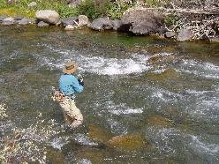
Why Should I Care if I am Breathing Respirable Crystalline Silica Dust?
By DefeatDespair (Own work) [CC BY-SA 4.0 (http://creativecommons.org/licenses/by-sa/4.0)], via Wikimedia Commons
Health effects of silica develop slowly over time
What do you want to be doing 10-30 years from now?
Man with grandchild
By Mike Cline (Own work) [Public domain], via Wikimedia Commons
Man fly-fishing in river
Notes:
Why should I care if I am breathing respirable crystalline silica dust? The answer to consider is the answer to the question, “what you want to be doing 10, 20, 30, 40 years from now when you retire”? This is usually things that you like to do now in your free time, for which you will have more time when you retire. If this includes physical activities, such as playing with the grandchildren (shown in the picture on the right), or being up in the mountains fishing (shown in the photo graph on the lower left) they will not be as much fun to do - or you may not be able to do them at all - if you become short of breath or winded because of lung problems.

Slide 42
Health Effects of Silica
Lung disease
Silicosis
Lung cancer
Increased risk of tuberculosis (TB)
Chronic obstructive pulmonary disease (COPD)
Other Diseases
Kidney disease
Immune system effects
Rheumatoid arthritis
Lupus
Scleroderma
Notes:
The most common health effects of respirable crystalline silica are lung problems. Lung diseases caused by silica include silicosis and chronic obstructive pulmonary disease (COPD). Silica increases risk of lung cancer and increases the risk of certain types of infections, such as tuberculosis. Silica can also cause other types of diseases, including kidney disease and immune system diseases, such as rheumatoid arthritis, lupus, and scleroderma. We will focus on the lung diseases in this presentation.

Slide 43
What is Chronic Silicosis?
An excellent video showing what happens with silica exposure and the development of chronic silicosis:
YouTube Video: Silica Exposure
By: Work Safe BC
Worksafe BC "Silica Exposure" YouTube Link
Notes:
We recommend you watch the excellent video called “Silica Exposure” made by WorkSafeBC, which shows what happens with silica exposure and how chronic silicosis develops. The link to the YouTube video is shown on the slide. While watching the video, pay particular attention to the immune cells called macrophages and what happens to them as they try to clear away the silica from the lungs.

Slide 44
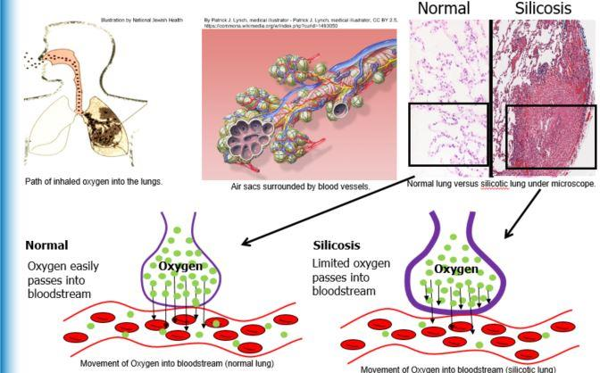
Silicosis Lowers Oxygen in the Blood
Movement of Oxygen into bloodstream (normal lung)
Movement of Oxygen into bloodstream (silicotic lung)
Illustration by National Jewish Health
Illustration by National Jewish Health
Notes:
Silicosis causes lower levels oxygen in the blood. The diagram on the upper left shows dust entering the human airway and lung. The diagram next to it shows a close-up of the air sacs, which are grape-like structures in the deepest part of the lung surrounded by blood vessels depicted in red and blue, which is how oxygen travels from the airway into the blood stream. The photographs on the right are what those air sacs would look like under a microscope, if you cut a very thin section through a cluster of air sacs. The photograph on the right is from a normal lung, in which most of what you see is the air within the air sacs, and each air sac is made up of a single layer of cells. This makes it very easy for the oxygen in the air to travel from the airway into the blood stream, which is shown in the diagram on the lower left. In contrast if you took that same very thin section through air sacs from the lung of workers with silicosis, you would see something very different, which is shown in the photograph on the far right labeled “silicosis”. The amount of air is relatively small, and there are many more cells. The large pink structure in the lower right is a silicotic nodule. In the diagram below, the purple line depicting the wall of the air sac is much thicker than in the normal lung, which makes it much harder for oxygen to travel from the airways into the blood stream, and limited oxygen passes into the blood.

Slide 45
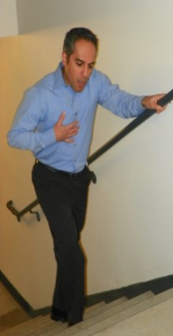

Low Oxygen Levels Cause Shortness of Breath with Activity
Photo by National Jewish Health
May require you to wear oxygen
Photo from Wikimedia Commons
Man wearing nasal cannula oxygen
Man short of breath
45
Notes:
45
45
Low oxygen levels cause shortness of breath with activity. When people are sitting at rest, their bodies require much less oxygen than when they are performing physical activities such as climbing stairs, walking up a hill, carrying a heavy load. People with silicosis will first start to feel winded or short of breath when performing these physical activities. If the disease worsens and gets severe enough, people may also have low oxygen levels in the blood at rest and will be required to wear supplemental oxygen, shown in the picture on the right.

Slide 46
Increased Risk of Tuberculosis
YouTube video: Tuberculosis (TB) Transmission and Pathogenesis Video
By: Centers for Disease Control
www.youtube.com/watch?v=NT-HNQWJjek
Notes:
We recommend you watch the excellent video called “TB transmission and pathogenesis” made by the Centers for Disease control which shows what happens with silica exposure and how chronic silicosis develops. The link to the YouTube video is shown on the slide. As you watch the video, pay particular attention to the immune cells called macrophages and their role in protecting the lung from TB infection. After watching the video, consider what happened to the macrophages in the first video with silica. When macrophages are disabled or killed by the silica dust, they cannot help control or clear infections like TB, which is why silica increases the risk of infections like TB (tuberculosis) and other infections (atypical mycobacterial and fungal infections).

Slide 47

Silica Causes Some of the Same Lung Diseases Caused by Smoking
Photo by National Jewish Health
Lung Cancer
Chronic Obstructive Pulmonary Disease (COPD)
Smoker coughing
Notes:
Silica causes some of the same lung diseases that are caused by smoking. The gentleman on the right is coughing and holding a cigarette. Silica increases risk similar to cigarette smoking, silica increases risk of lung cancer and chronic obstructive pulmonary disease (COPD) which is a disease of the airways that can cause cough, wheeze, and shortness of breath.

Slide 48
Quiz Bowl #6
The silica dust that is small enough to get deep into your lungs (respirable silica dust) is too small to see. It is invisible.
True
False
Notes:
Answer: 1. True

Slide 49
Quiz Bowl #7
Silicosis is a lung disease that develops slowly over years due to the invisible respirable silica dust that gets deep into your lungs, which makes it gradually harder and harder to breathe.
True
False
Notes:
Answer: 1. True

Slide 50
Quiz Bowl #8
In addition to silicosis, health effects of silica include which of the following?
Increased risk of TB
Lung Cancer
Kidney problems
All of the above
Notes:
Answer: 4. All of the above

Slide 51
How Much Silica is Too Much?
OSHA Permissible exposure limit (PEL)
50μg of respirable crystalline silica per cubic meter (m³) of air averaged over 8 hours
Notes:
About 2.3 million U.S. workers are exposed to respirable crystalline silica in their workplaces, including 2 million construction workers. Now, the maximum amount of respirable crystalline silica dust to which workers may be exposed is 50 micrograms of respirable crystalline silica dust per one cubic meter of air averaged over an eight-hour work day. This is a very low concentration and may be difficult to achieve. However, if employers can comply with this concentration of silica dust, OSHA estimates that the silica rule will save over 600 lives and prevent more than 900 new cases of silicosis each year.

Slide 52





Silica PEL (50μg/m³)
50μg = One grain of sand
Average car gas tank holds 16-17 gallons
50μg/m³ =
1/15th of a grain of sand in a car gas tank
Notes:
It’s difficult to imagine what 50 micrograms per cubic meter looks like. So let’s visualize it in a different way. Think of a single grain of sand. One grain of sand is equal to about 50 micrograms. Now think of a car gas tank that holds about 16-17 gallons of gas. Now imagine crushing the grain of sand and dividing it into 15 equal parts. If one were to take one part of the crushed sand grain, that is, one fifteenth of the grain of sand, and then sprinkle that one fifteenth grain of sand into a car gas tank, that is equivalent to 50 micrograms of silica per one cubic meter of air. A very small concentration!

Slide 53
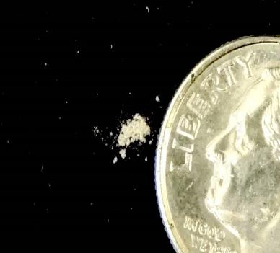
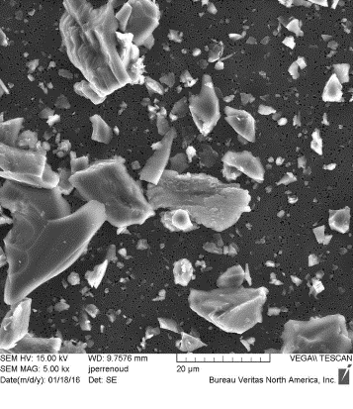
Daily Maximum Silica Exposure: Pimples on the Nose on the Dime
NIOSH,USGS
500 micrograms
500 micrograms of dust next to a dime
Silica PEL: 50 µg/m³
Average amount of air breathed in 8 hours: 10 m³
Daily maximum: 500 µg
Dust under scanning electron microscope
Notes:
Now let’s visualize what 50 micrograms of respirable crystalline silica per one cubic meter of air looks like over an eight-hour workshift. On average, an adult will breath in about 10 cubic meters of air over an eight-hour work day. If a person were exposed at the permissible exposure limit of 50 micrograms per cubic meter, that person could potentially breath in 500 micrograms of respirable crystalline silica over her/his workshift (50 μg/m³ X 10 m³ = 500 μg). This amount of respirable crystalline silica is depicted on the illustration on the left of this slide. It is about as big as President Roosevelt’s nose on the dime…a very small amount of dust! It could be considered as “pimples” on President Roosevelt’s nose. The illustration on the right of the slide is an electron micrograph of silica dust particles. Notice how sharp and jagged the particles are and the difference in sizes. Again, it is the very smallest of these particles that reach the deep part of the lung.

Slide 54
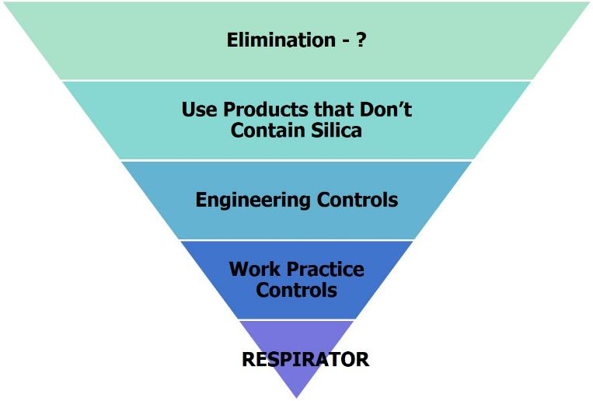
Ways to Keep Silica Dust Out of the Air
Most effective
Least effective
The “Hierarchy of Controls”
Notes:
This inverted pyramid is known as the Hierarchy of Controls. Near the top of the illustration, we find the most effective controls; the bottom of the illustration represents those controls that aren’t as effective. Whenever we are assessing the hazards of crystalline silica dust exposure, we need to think about implementing controls in the order presented on this slide. For example, if possible, do not work with silica-containing materials: eliminate the hazard. Secondly, try to identify products that do not contain silica, such as silica-free drywall joint compound. Engineering controls include things such as HEPA vacuums to capture the silica dust. Work practice controls include, for example, following your company’s standard operating procedures. Please note that the least effective control is personal protective equipment, such as respiratory protection. It is very important to consider the more effective controls before employees are provided respiratory protection as the primary control against silica dust exposure.

Slide 55

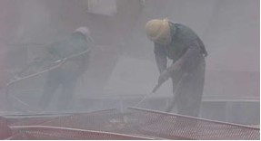
Ways to Keep Silica Dust Out of the Air #1
Use materials that don’t contain silica
Rock
Concrete
Abrasive blasting material
X
OSHA Fact Sheet: Protecting Workers from the Hazards of ​Abrasive Blasting Materials, DSG FS-3697 11/2013 ​
Men working in a cloud of dust
Notes:
We’re going to talk about two major concepts: how to keep silica dust out of the air in general, and how to keep silica dust out of your personal space. Following the Hierarchy of Controls, if you can’t avoid eliminating silica work all together, the second method is using materials that do not contain silica. We can’t really use rock and concrete that is silica free, but we can identify non-silica containing products such as silica-free abrasive blasting materials. So the question is, how do we know if a product contains silica? Answer: look at the safety data sheet.

Slide 56
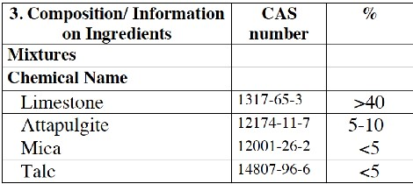
How To Know if a Product Contains Silica
Example SDS “composition” section
ACTIVITY:
Product Label and Safety Data Sheet
Notes:
This slide illustrates the chemical composition of a dry-wall joint compound taken from a safety data sheet. Do you see silica as a component?

Slide 57

Safety Data Sheets (SDS): MSDS with standardized sections
Identification
Hazard identification
Composition
First aid measures
Fire fighting measures
Accidental release measures
Handling and storage
Exposure controls/PPE
9. Physical and chemical properties
10. Stability and reactivity
11. Toxicological info
12. Ecological info
13. Disposal considerations
14. Transport info
15. Regulatory info
16. Other info
Notes:
For the products you use at work, your employer is required to make safety data sheets, or SDSs, available to you. SDSs were formerly called material safety data sheets (MSDSs). The difference between SDS and MSDS is that SDS are now standardized, unlike MSDS, which had different sections depending on the manufacturer. The items listed on this slide are the 16 standardized sections of an SDS. I think that a lot of people had a hard time reading MSDS because each one was a little different and each manufacturer presented information differently. Now that the sections are standardized I think they are a little easier to follow. The sections that are really helpful to us are sections 2 (hazard ID), 3 (composition), 8 (exposure controls/PPE), and 11 (toxicological information). If you want to know if a product contains silica, go immediately to section 3 and look for the words silica or quartz.
[Ask the participants review an SDS with a silica-containing compound. Ask them to go to section 3 and determine if silica or quartz is in the product. Also refer them to section 8 and ask them to identify what exposure controls and PPE are recommended. Then ask them to review an SDS for a non silica-containing product and have them determine if silica is a component of the product]

Slide 58
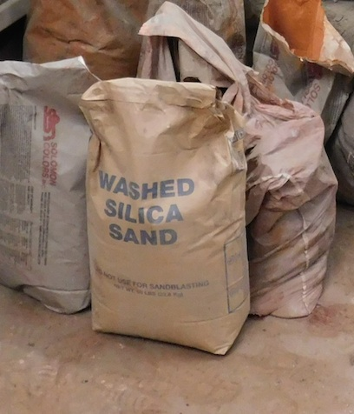
Product Label Example
Photo courtesy of Colorado State University
Silica containing product label
Notes:
This is a photograph of a bag of sand that contains silica.

Slide 59
Quiz Bowl #9
You can check to see if a product you are going to use contains silica by reading the product label and safety data sheet (SDS).
True
False
Notes:
Answer: 1. True

Slide 60
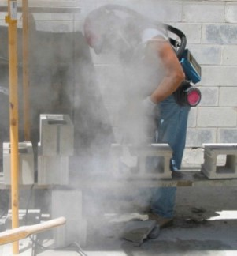
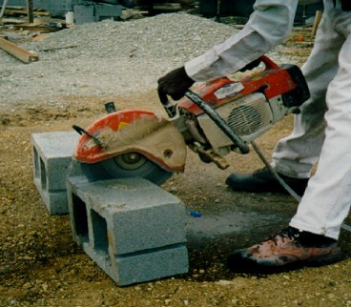
Ways to Keep Silica Dust Out of the Air #2
X
Cutting masonry block without engineering controls
Cutting masonry block with engineering controls
Keep it wet with water
Source: OSHA, OSHA Fact Sheet: Controlling Silica Exposures in Construction While Operating Handheld Masonry Saws. DSG FS 3627 2/2013
Notes:
[Ask the participants what the difference is between the two pictures. Ask them why dust is not being generated in the photograph on the right]
In keeping the Hierarchy of Controls in mind, the next control strategy is engineering controls. The first engineering control method we’ll talk about is the use an integrated water system to control the dust. Notice that the employees are both performing the same task. The person on the left is surrounded by silica-containing dust, but the employee on the right is not exposed to any visible silica-containing dust by using an integrated water system.

Slide 61
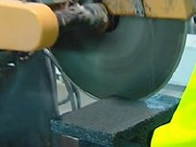
Water = Wet Methods
Spray water on the point of operation
Point of operation: where the tool is on the material
When cutting with a saw, water is sprayed onto the blade where it is cutting the masonry block
Point of operation
Masonry saw with incorporated wet methods
Notes:
The point of operation for any tool, such as a drill, saw, or chipper, is where the tool meets the material (i.e., where the work is done). It is important to make sure that when using water as a control method, that the water is sprayed on the point of operation to control the dust.

Slide 62
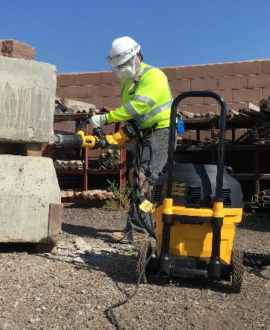
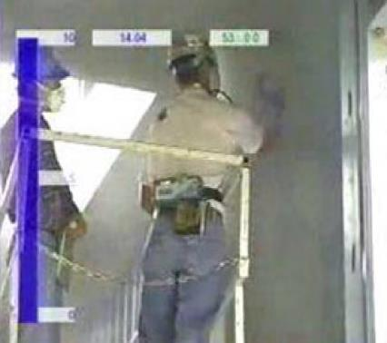

Ways to Keep Silica Dust Out of the Air #3
Source: NIOSH: link/
grinders.html. Accesses 2-27-2017
Photo by Haselden Construction
Grinding without engineering controls
Worker chips concrete with engineering controls
Suck it up with a Shop Vac with HEPA Filter
Notes:
The second engineering control method is the use of a vacuum system with a high efficiency particulate air filter, or HEPA filter. A HEPA filter will filter out 99.97% of particulates down to 0.3 micrometers in size. The person on the right is using a shop vac with a HEPA filter while working on a silica-containing material. Notice the dust in the air in the picture on the left where the employee is grinding cement without a HEPA vacuum system in place.

Slide 63
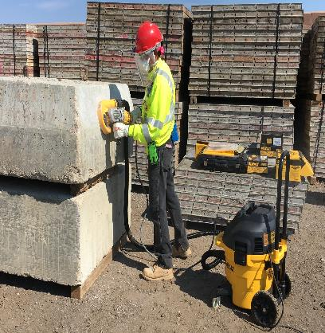
Ways to Keep Silica Dust Out of the Air #4
Photo by Haselden Construction
X
Worker cuts masonry block without engineering controls
Worker grinds concrete with engineering controls
Use a Cover (Shroud)
Notes:
In addition to the use of a vacuum system, another control method is the use of a shroud or cover over the tool. A shroud helps contain the dust that is being generated to make the HEPA vacuum system more effective by capturing more of the dust. It is important when using a shroud to keep it in contact or flush with the surface of the material that is being worked on.

Slide 64
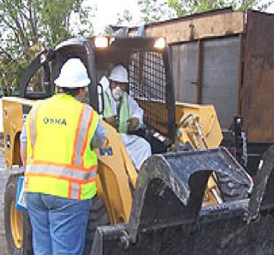
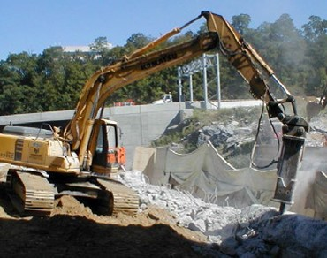

Ways to Keep Silica Dust out of your Air #1
Source: OSHA. link
hurricane/heavy-equip.html. Accesses 2-27-2017
Source: OSHA: Small entity Compliance Guide for the Respirable Crystalline Silica Standard for Construction. OSHA 3902-11 2016
Rig without engineering controls
Rig with engineering controls
Use enclosed cabs
Keep windows closed
Keep cabs clean – wet wiping and/or HEPA vacuuming
Notes:
We talked about strategies or controls to keep dust out of the general air spaces to avoid personal and co-worker exposures to silica dust. Now let’s talk about how to keep silica dust out of your personal space. The first is the use of enclosed cabs or booths on heavy equipment. Notice on the right that this hoe-ramming operation is generating dust, but the employee is protected by an enclosed cab. If by-stander exposure to silica dust is a concern, the hoe ram should be sprayed with water at the point of operation. There are several OSHA requirements concerning cabs or booths that we’ll discuss on the next slide.

Slide 65
Enclosed Cabs or Booths
Requirements
Maintain as free as practicable from settled dust
Door seals and closing mechanisms work properly
Gaskets and seals in good condition and work properly
Under positive pressure
Continuous delivery of fresh air
Filtered intake air (95% efficient)
Heating and cooling capabilities
Notes:
[Read the requirements]

Slide 66
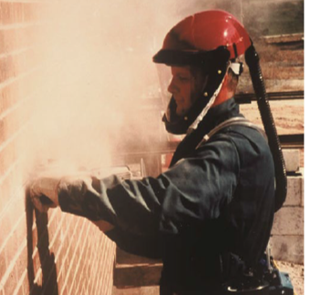
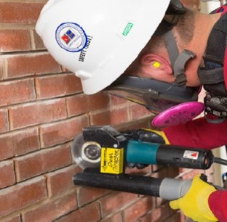

Ways to Keep Silica Dust Out of your Air #2
Source: OSHA: Fact Sheet: Controlling Silica Exposures in Construction While Doing Tuckpointing/Mortar Removal, DSG FS 3632
Source: OSHA: Small entity Compliance Guide for the Respirable Crystalline Silica Standard for Construction. OSHA 3902-11 2016
Grinding without engineering controls
Grinding with engineering controls
Use Respiratory Protection
Notes:
The second way to keep silica-containing dust out of your personal space is the use of respiratory protection. Keep in mind, again, that this is the least effective control method because respirators can fail, which can cause the dust to penetrate the respirator. The person on the right is using respiratory protection in combination with a HEPA vacuum system to protect himself while doing a tuckpointing operation. Please note that the OSHA standard requires respiratory protection whenever tuckpointing is performed. The person on the left is also using respiratory protection, but notice the cloud of dust that is generated when not using a HEPA vacuum system.
[Note: Tuckpointing is removing and replacing mortar between stone, brick, block, and other masonry building materials.]

Slide 67
Quiz Bowl #10
Wet methods mean a stream of water is applied to the surface as it is being cut. This is best done using a continuous feed water system that has been built into the equipment.
True
False
Notes:
Answer: 1. True

Slide 68
Quiz Bowl #11
Which of the following is the best kind of control to lower silica dust in the air?
Wet cutting
Shrouds and HEPA dust collection system
Equipment in good working condition
All of the above
Notes:
Answer: 4. All of the above

Slide 69
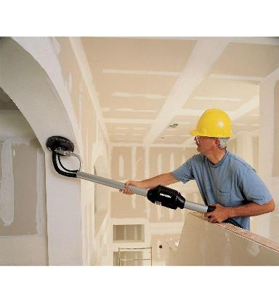
Drywall Joint Compound Silica Controls
Silica-free joint compound
Check the SDS
Use the wet sponge method
Use a sander with a dust collection system
Use the pole method
Keeps you farther away from the point of dust generation
Photo Courtesy of Haselden Construction
Worker sanding drywall joint with engineering controls
Notes:
Sanding dry wall joint compound can create large amounts of respirable silica dust. There are several methods to control silica-containing dust when finishing drywall joint compound. First, try to substitute the drywall joint compound with a silica-free drywall joint compound. Again, check the safety data sheet. Second is the wet-sponge method. This method involves the use of a wet sponge to finish the drywall joint compound rather than sanding the dried joint compound. Using a wet sponge will take longer, but this method generates no dust. A good engineering control method for sanding drywall joint compound is the use of a sander with a HEPA dust collection system. In addition, a pole can be used to keep you farther away from the point of dust generation.

Slide 70
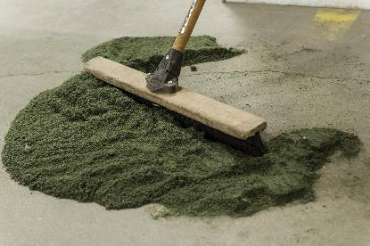
Silica Dust Can Get into the Air When You Clean Up
Ways to clean up dry dust
Wet wiping
HEPA vacuuming
Use floor sweeping material
When using water - clean up before slurry dries out
Photo by Haselden Construction
Sweeping up dust using floor sweeping material
Do NOT use
Compressed air
Dry sweeping
Dry brushing
Leaf Blower
Kitty litter
Notes:
Also keep in mind that employees can be exposed to silica-containing dust when cleaning up dust. There are several methods to keep the dust controlled [read slide]. When using a wet method to control dust, a “slurry” may be formed which is simply the wet silica-containing material. The slurry needs to be cleaned up before it dries out. Once dried, if the material is disturbed, employees can be exposed to airborne silica-containing dust. Do not use [read slide] as these can re-entrain silica particles into the air to cause potential employee exposure to silica-containing dust. Please note that the OSHA standard contains a provision for housekeeping that prohibits the use of dry sweeping, dry brushing, and compressed air.

Slide 71
Quiz Bowl #12
When should compressed air be used for cleaning up dust that might contain silica?
When no one is looking
To clean a part before you work on it
To clean off clothing at the end of the day
Never
Notes:
Answer: 4. Never

Slide 72

Don’t Take Silica Home with You
Change into disposable or washable clothes at the worksite
HEPA vacuum clothing
Park your car away from the site
Cover the seat and rug of your car
Photo by National Jewish Health
Cab of a Truck
Notes:
We don’t want to take silica dust home with us on our clothing, therefore, we should try to keep the silica dust away from our clothes or try to get the silica dust off of our clothes before leaving work. The following methods are recommended [read slide]

Slide 73

Does Silica Need to be Measured?
Photo by CSU
Are you using tools and equipment listed in Table 1
16 pieces of equipment and controls
Are you using them under the conditions described in Table 1?
Are all of the control measures, work practices, and respiratory protection fully implemented—
If yes to all three - your silica exposure does not have to be measured
Worker wearing sampling device
Full information is in your Table 1 handout
Notes:
The OSHA standard provides a table that lists 16 pieces of equipment and their required controls. The table is simply known as Table 1. To comply with the standard, you first need to determine if the equipment you are using is listed in Table 1. If yes, you can then determine if an employee’s exposure to silica needs to be measured. [read slide]

Slide 74
What is the Equipment in Table 1 (I)?
Saws
Stationary masonry saws
Handheld power saws
For cutting fiber-cement board
Blade diameter < 8”
Any other blade for any other purpose
Walk-behind saws
Drivable saws
Rig-mounted saws
Notes:
[Read slide]

Slide 75
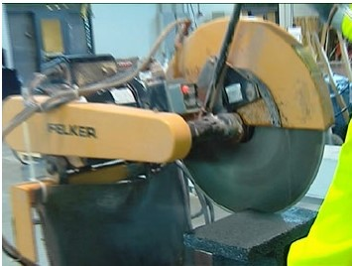
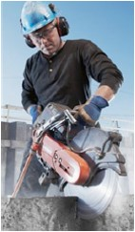
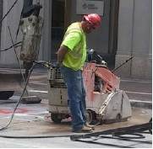
Table 1 Equipment Examples (I)
Stationary masonry saw with water delivery system
Hand-held power saw with water delivery system
Walk-behind saw with water delivery system
Stationary Masonry Saw, Hand-held Power Saw, Walk-Behind Saw with Water Delivery Systems
Source: OSHA: Small entity Compliance Guide for the Respirable Crystalline
Silica Standard for Construction. OSHA 3902-11 2016
Notes:
These are all examples of wet methods required by Table 1 when using saws to cut silica-containing materials.

Slide 76
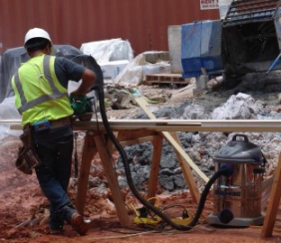
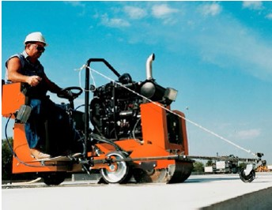
Table 1 Equipment Examples (II)
Hand-held power saw with dust collection system.
Hand-held Power Saw with a Dust
Collection System
Drivable saw with water delivery system.
Drivable Saw with Integrated Water System
Source: OSHA: Small entity Compliance Guide for the Respirable Crystalline
Silica Standard for Construction. OSHA 3902-11 2016
Notes:
The picture on the left is an example of using a HEPA vacuum system as a dust control when cutting fiber cement board. The picture on the right is an example of a wet method when using a drivable saw.

Slide 77
What is the Equipment in Table 1 (II)?
Drills
Rig-mounted core drills
Handheld and stand-mounted drills
Includes impact and rotary hammer drills
Dowel drilling rigs for concrete
Vehicle-mounted drilling rigs for rock and concrete
Notes:
[Read slide]

Slide 78
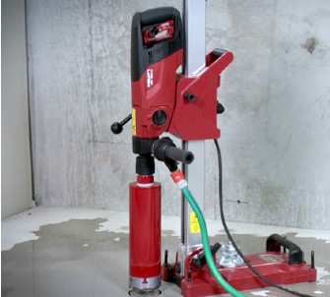
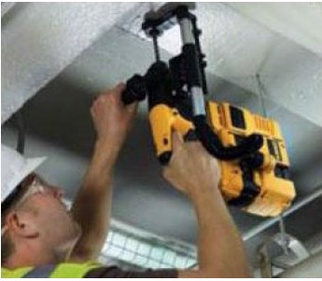
Table 1 Equipment Examples III
Rotary hammer with shroud and dust collection system
Rig Mounted core drill
Standing Core Drill with Water Delivery System and Rotary Hammer with Shroud and Dust Collection System
Source: OSHA: Small entity Compliance Guide for the Respirable Crystalline
Silica Standard for Construction. OSHA 3902-11 2016
Notes:
These are two examples of the controls required by Table 1 when drilling. The picture on the left is an example of a wet method when drilling, and the picture on the right is an example of a HEPA vacuum system and a shroud. Note in the left picture that a slurry may result from the wet method. Again, the slurry needs to be cleaned up before it dries.

Slide 79
What is the Equipment in Table 1 (III)?
Grinders
Handheld grinders
For mortar removal (tuckpointing)
For uses other than mortar removal
Walk-behind floor grinders
Notes:
[Read slide]

Slide 80
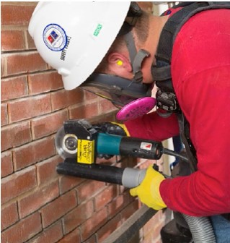

Table 1 Equipment Examples (IV)
Grinder with engineering controls
Always requires respiratory protection
“Tuckpointing”
Hand-held Grinder with Shroud and Dust Collection System
Source: OSHA: Small entity Compliance Guide for the Respirable Crystalline
Silica Standard for Construction. OSHA 3902-11 2016
Notes:
This is an example of a tuckpointing operation. Note the use of the HEPA vacuum system, the shroud, and respiratory protection.

Slide 81
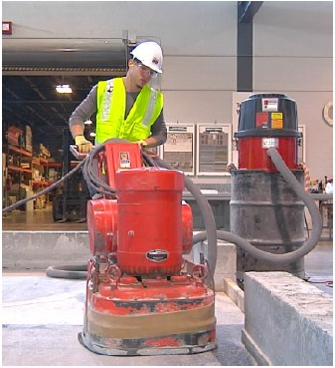
What is the Equipment in Table 1 (IV)?
Milling Machines
Walk-behind milling machines
Small drivable milling machines
Less than half-lane
Source: OSHA: Small entity Compliance Guide for the Respirable Crystalline
Silica Standard for Construction. OSHA 3902-11 2016
Walk-Behind Milling Machine with
Dust Collection System
Milling machine with dust collection system
Notes:
This is a milling operation. Note the HEPA vacuum dust collection system and the shroud around the bottom of the milling machine.

Slide 82
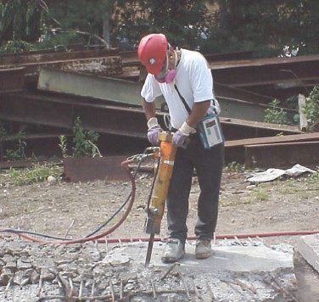
What is the Equipment in Table 1 (V)?
Jackhammers and handheld powered chipping tools
Source: OSHA: OSHA Fact Sheet. Controlling Silica Exposures in Construction While Operating Jackhammers (2/2013)
Jack Hammer with Water Delivery System
Jackhammer with water delivery system
Notes:
This is an example of a jackhammering operation with an integrated water system.
[Note: this employee should have foot protection on his left foot and should be wearing a face shield]

Slide 83
What is the Equipment in Table 1 (VI)?
Large drivable milling machines
Half-lane and larger
Crushing machines
Heavy equipment and utility vehicles
Used to abrade or fracture silica-containing materials
Or used during demolition activities involving silica-containing materials
Notes:
[Read slide]

Slide 84
What is the Equipment in Table 1 (VII)?
Heavy equipment and utility vehicles
Used for grading and excavating
Not including demolishing, abrading, or fracturing silica-containing materials
Notes:
[Read slide]

Slide 85
Table 1 Equipment Examples (V)
Rig with engineering controls
Excavator with an Enclosed Cab
Source: OSHA: Small entity Compliance Guide for the Respirable Crystalline
Silica Standard for Construction. OSHA 3902-11 2016
Notes:
This hoe-ramming operation is an example of a silica-generating task. The enclosed cab helps protect the employee from silica-containing dust exposure.

Slide 86
What if You are Not Following Table 1?
If you are using equipment in Table 1 but not using the specified controls:
OR
If you are using equipment not listed in Table 1
Then
You need to determine what dust controls to use
AND
Silica levels in the air must be measured
OR
There is published data about the level
Notes:
Now that we’ve covered what is in Table 1, the question is, “What if you are not following Table 1?” If an employee is using equipment found in Table 1 but is not using the specified controls, work practices, or respiratory protection; or if employees are using equipment not found in Table 1 and are generating respirable crystalline silica particulate, then the employer needs to do two things: (1) determine what dust controls to use; and (2) determine the concentration of respirable crystalline silica in the air. Employee exposure to respirable crystalline silica can be measured or the levels can be determined by using published data about the concentration of respirable crystalline silica in the air for specific tasks or products.
Note: Objective data (i.e., published data) means information, such as air monitoring data from industry-wide surveys or calculations based on the composition of a substance, demonstrating employee exposure to respirable crystalline silica associated with a particular product or material or a specific process, task, or activity. The data must reflect workplace conditions closely resembling or with a higher exposure potential than the processes, types of material, control methods, work practices, and environmental conditions in the employer's current operations.

Slide 87
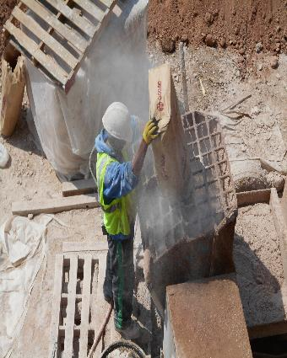

Examples of Tasks and Equipment Not in Table 1
Photo Courtesy of Patty Jeffries
Photo Courtesy of Patty Jeffries
Worker dumping silica containing material into hopper
Worker applying shotcrete
Notes:
The photograph on the left is of an employee dumping a silica-containing material into a hopper. Notice the dust exposure to the employee. The photograph on the right is a shotcrete operation (i.e., spraying of wet concrete) that emits silica-containing material at a high velocity that may release silica partculates into the air. Neither of these tasks are found in Table 1.

Slide 88
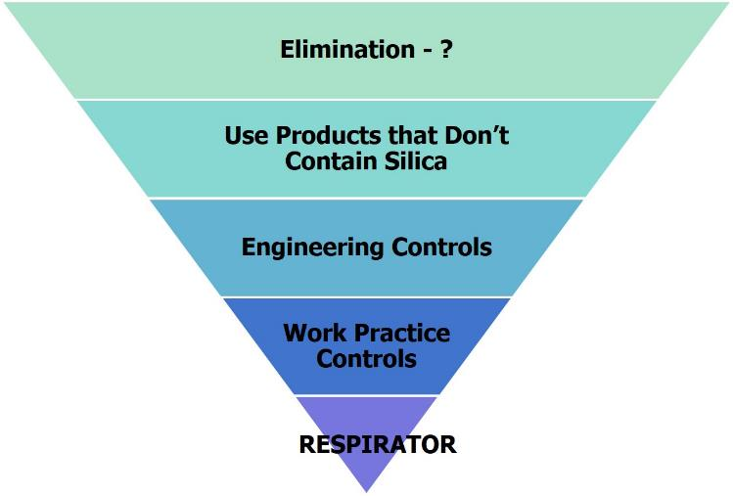
Ways to Keep Silica Dust Out of the Air (pt. II)
Most effective
Least effective
The “Hierarchy of Controls”
Notes:
If an employee is not using all of the controls, work practices, or respiratory protection in Table 1 or if she/he is using a piece of equipment not found in Table 1, then the employer and employee should identify controls using the Hierarchy of Controls.

Slide 89



Engineering Controls to Keep Silica Dust Out of the Air
Photos by Haselden Construction
Cutting masonry block with engineering controls
Water
Chipping concrete with engineering controls
Vacuum with HEPA Filter
Grinding concrete with engineering controls
Use a Shroud
Notes:
[Review the controls methods that were covered earlier]

Slide 90
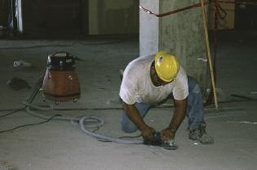
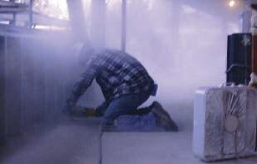

Engineering Controls
Grinding without engineering controls
Operating grinder with engineering controls
Operating grinder without engineering controls
Grinding using a vacuum
dust collector
Notes:
Again, just to reinforce the concept of appropriate controls for respirable crystalline silica, notice the dust cloud on the left generated by a grinding task versus the picture on the right that shows no dust cloud when using a HEPA vacuum ventilation system.

Slide 91
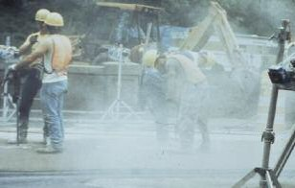
Engineering Controls (cont.)
Jackhammer use without engineering controls
Operating jackhammer with engineering controls
Jackhammer use with water spray to control dust
Operating jackhammer without engineering controls
Notes:
Again, the photograph on the left illustrates why it is important to use an integrated water system while doing jackhammering work to avoid dust generation as compared to the lack of dust in the right photograph by keeping the dust wet at the point of operation.

Slide 92

Work Practice Controls to Keep Silica Dust Out of the Air
Photos by Patty Jeffries
Don’t work around someone creating silica dust
Enclose your work area with plastic sheeting
Cut and grind silica-containing materials outdoors when possible
Keep equipment in good working condition
Use equipment according to manufacturer’s instructions
Workers on scaffolding above shotcrete application
Notes:
[Read the slide. Emphasize that co-worker exposure is an important consideration. Explain that when cutting and grinding indoors that the concentration of respirable crystalline may be higher than when doing the same task outdoors.]

Slide 93
Quiz Bowl #13
For any given task (if all other conditions remain the same) the concentration (level) of dust in the air will be higher inside than the same task done outside.
True
False
Notes:
Answer: 1. True

Slide 94
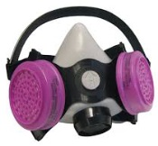
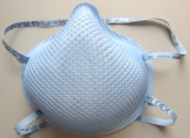
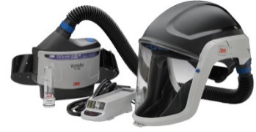

Respirators to Keep Silica Dust Out of the Air You Breathe
APF 10
APF 10
Disposable half-face respirator
Elastomeric half-face air purifying respirator
APF 25
APF 50
Powered air-purifying respirator
Elastomeric full-face air purifying respirator
Notes:
We have already mentioned that respiratory protection is at bottom of the hierarchy of controls. This is because respirators can only protect the person wearing the respirator, and they are only protective if used properly. This slide shows the four most common types of respirator worn for protection from silica dust, with their assigned protection factor (APF) above each image. APF is the level of protection that each of these respirators will provide. For example: an APF of 10 affords protection to concentrations of contaminants in the air up to 10x higher than the PEL. The two respirators in the top row have an APF of 10, a disposable filtering face piece respirator on the top left and a half-face elastomeric negative pressure air purifying respirator on the top right. The two respirators on the bottom row provide a higher level of protection. The powered air purifying respirator (PAPR) on the bottom right has an APF of 25 and the full-face elastomeric negative pressure air purifying respirator on the bottom right has an APF of 50. It is important to remember these APF numbers assigned to each of these respirators , as the required respirators are listed by APF in Table 1 of this standard.

Slide 95

Respirators with Assigned Protection Factor of 10
APF 10
If fit tested
N95/P100
½ Face
Elastomeric
Air purifying
HEPA filter for silica
Other filters
Organic vapor
Acid mist
Disposable half-face respirator
Photos by National Jewish Health
Elastomeric half-face respirator
Various respirator filters
Notes:
The two most common respirators with an APF of 10 are disposable filtering face piece respirators and half-face air purifying elastomeric respirators, if they have been fit tested. They have the same rating because protection depends on a tight seal of the mask to the face, and the most vulnerable part of the seal is around the nose. The National Institute for Occupational Safety and Health (NIOSH) tests respirators to be sure they meet their quality standards. Approved respirators will be stamped “NIOSH”, along with the protection they provide as designated by the letters N, R, or P followed by a number. You should check to be sure the respirators you use have these stamped on the disposable facepiece mask, exhalation valve, or headstraps. The letters N, P, and R indicate the filter’s resistance to oil: N is not resistant, R is somewhat resistant, and P is oil “proof”. For silica, oil resistance is not needed in most cases. The number after the letter represents the percentage of the particles in the air that will be filter out as the air passes through the mask before you breath the air into your lungs. For example, an N95 respirator is not resistant to oil and filters out at least 95% of airborn particles such as silica dust. The main benefits of the half-face elastomeric respirator over the disposable respirator are the fact that they are reusable and they can afford protection from a wide variety of other exposures besides particles in the air. High efficiency particulate air (HEPA) filters, typically pink or purple color, protect against particles like silica, and other filters are available to protect against exposures like organic vapors and acid mists.

Slide 96


Respirators: Assigned Protection Factor ≥25
APR 25 (or more)
Powered Air-Purifying Respirator (PAPR)
APF 25
Loose fitting
Full Face piece
APF 50
Needs to be fit tested
Powered air-purifying respirator (PAPR)
Elastomeric full-face respirator
Notes:
A higher level of protection is afforded by powered air purifying respirator (PAPRs) and full face elastomeric filtering facepiece respirators, which provide an APF of 25 or greater. The PAPR has a battery-powered pump and blows filtered air into the hood. The blowing air makes it more comfortable, easier to breath, and PAPRs are a good choice for people with lung problems that make it hard for them to breath in a tight-fitting respirator and for people with facial hair, because a tight seal to the face is not required. The PAPR shown in the top image also provides hard and eye protection. The highest APF respirator that we will be discussing in this presentation is the full-face elastomeric air purifying respirator depicted in the lower image. This respirator filters air through cartridges like the half-face respirator, but the sealing surface is much larger, much sturdier, and does not cross as many contours, i.e. the nose, which makes it fit more securely to the face; however, a good seal does need to be confirmed by fit testing.

Slide 97


Will These Provide Protection?
Photos by National Jewish Health
Worker wearing respirator with bottom strap cut
Worker wearing handkerchief
Notes:
Will these respirators provide protection? The answer is no. Tight fitting respirators must be kept at manufacturer’s condition. The image on the left shows a problem we have seen at construction sites. Workers cut the bottom strap off of their disposable respirators so that they are more comfortable, it is easier to breath, and prevent eye protection from fogging up. The problem is that it breaks the tight seal of the respirator to the face, and particles will be breathed in through the bottom of the mask without being filtered. The image on the right depicts another common respiratory protection misconception. While a handkerchief can help prevent the inhalation of large particles that would normally get stuck in the nose, mouth, or upper airways, it will not protect this worker from the invisible respirable crystalline silica dust that can increase the risk of silicosis.

Slide 98


ACTIVITY: Respirator Demonstration
Photos by National Jewish Health
Disposable half-face respirator
Worker wearing disposable half-face respirator
Elastomeric half-face respirator
Notes:
Respirator demonstration activity [See activity description]. The image on the right shows an N95 respirator with an exhalation valve. This can be a good choice, because makes it easier to breathe and decreases eye protection fogging while maintaining a tight seal to the face.

Slide 99


Respiratory Protection Requirements
Medical clearance
Annual fit testing
Annual training
Proper respirator use
Cleaning
Maintenance
Storage
Must be clean shaven
Written plan and record keeping
Photo from OSHA
Technician performing quantitative fit test
Size of respirable particle compared to a human hair
Notes:
In order to be in compliance with the OSHA standard for respirator use, a number of requirements must be met. Briefly, these include the wearer must be medically cleared to use a respirator, as they can put additional strain on the respiratory and cardiovascular systems. The wearer must undergo fit testing annually to assure the respirator still fits properly and for re-training. Training includes the proper use and care for the respirator, including cleaning, maintenance, and proper storage, including keeping it out of sunlight and heat. The respirator must be stored in a bag, labeled with the worker’s name. The photo in the upper right shows a quantitative fit test being performed. Another requirement of the standard is that the wearer must be completely clean shaven whenever wearing a tight-fitting respirator. We showed the image on the bottom right earlier in the presentation, depicting the size of a human hair versus the size of a respirable crystalline silica particle. If there is any hair or other obstruction between the respirator’s seal and the user’s skin, air will pass through that break in the seal instead of through the filter. The standard also requires that records of fit testing and medical clearance must be kept by the employer for each individual wearing respiratory protection within that organization.

Slide 100
Respirators are only effective if properly used, stored and maintained
Follow the manufacturer’s instructions
Check filtering respirators before each use
Seal check
Tight seal requires a clean-shaven face
Clean respirator after each use
Properly store your respirator
Avoid conditions that could damage it (e.g., heat, light, moisture, etc.)
Keep it stored in a bag, labeled with your name
Know when to change the respirator cartridge
Notes:
Respirators are only effective if properly used, stored, and maintained. If a respirator is not at manufacturer’s condition, it may not protect the wearer adequately. It is important to read and follow the manufacturer’s instructions for use, check the respirators before use (including seal checks), and make sure the respirator is being properly cared for. It is also important read and follow the manufacturer’s recommendations on when to change the cartridges. For HEPA filters, this is often after 8 hours of continual use.

Slide 101




Tuckpointing
If performed for less than 4 hours, APF 10 or higher required
If performed for more than 4 hours, APF 25 or higher required.
Disposable half-face respirator
Elastomeric half-face respirator
Powered air-purifying respirator (PAPR)
Elastomeric full-face respirator
Worker operates grinder with controls
Notes:
Very high levels of respirable silica dust can be generated by mortar removal, called tuckpointing. To be compliant with Table 1 in the standard, respiratory protection must always be worn when tuckpointing, at minimum a disposable filtering face piece or a half-face elastomeric respirator. If performing the task for more than 4 hours, an APF 25 respirator is needed, which would include a PAPR or a full-face elastomeric respirator.

Slide 102
Quiz Bowl #14
10
The single most effective method for controlling silica exposure is:
Using products that don’t contain silica
Wearing a respirator
Engineering controls
Work practice controls
Notes:
Answer: 1. Using products that don’t contain silica.

Slide 103
Quiz Bowl #15
Proper use of a respirator includes which of the following:
A clean-shaven face.
Fit testing one time only
Hanging it out in the sun to dry after use
Cartridge changes once a year
Notes:
Answer: 1. A clean shaven face

Slide 104
Quiz Bowl #16
Use of a handkerchief or one strap mask will protect your lungs from respirable silica.
True
False
Notes:
Answer: 2. False

Slide 105

ACTIVITY: Sampler Demonstration
Photo by CSU
Worker wearing sampling device
Notes:
Sampler demonstration activity [See activity description].

Slide 106

Silica levels in air are measured with a sampler over an 8 hour shift
Photo by CSU
Sampling pump attaches to belt
Tubing is attached from the pump to a sampling device called a cyclone
Captures silica particles you cannot see onto a filter
The filter is sent to a lab to measure the amount of silica
Is the amount below the:
PEL (50μg/m³)?
Action Level (25μg/m³)?
Cyclone
Pump
Worker wearing sampling device
Notes:
[Ask for a volunteer and attach a sampling pump and cyclone sampler to the volunteer]
[While showing the cyclone, explain that the pump will pull air through the cyclone in a circular pattern and will “eject” the relatively larger silica particles due to centrifugal force; but will capture a “fraction” or percentage of the respirable crystalline silica particles on the filter inside of the sampling cassette. Explain that the sampling cassette is sent to the laboratory for analysis. Explain that by knowing the amount of respirable crystalline silica dust and the amount of air that was sampled, the concentration of respirable silica dust in the air can be determined and compared to the exposure limit and action limit]

Slide 107
What if You are Above the Action Level?
Check your exposure controls
Are they working the way they should?
Are additional controls needed?
Measure the levels again
Notes:
If an employee’s exposure is below the OSHA action level of 25μg/m³, then monitoring may cease. If an employee’s exposure limit is above the action level but below the permissible exposure limit, then the employer must repeat the sampling within six months. Before resampling, the employer and employee should check their exposure controls to determine if they are working correctly (e.g., correct flow rate on a HEPA vacuum filtration system) and they should consider additional controls if necessary by using the Hierarchy of Controls.

Slide 108
What if You are Above the PEL?
Check your exposure controls
Are they working the way they should?
Are additional controls needed?
Respiratory protection is needed
Medical surveillance
If respiratory protection is used for 30 or more days per year
Measure the levels again
Notes:
If an employee’s exposure is above the OSHA permissible exposure limit (PEL) of 50μg/m³, then the employer must resample within three months. Before resampling, the employer and employee should check their exposure controls to determine if they are working correctly and they should consider additional controls by using the Hierarchy of Controls. In addition, the employee is required to wear respiratory protection if her/his exposure is above the PEL. If the employee wears a respirator for more than 30 days, then medical surveillance must be offered to the employee.
After repeat exposure monitoring indicates that employee exposures are below the action level, the employer shall repeat such monitoring within six months of the most recent monitoring until two consecutive measurements, taken seven or more days apart, are below the action level, at which time the employer may discontinue monitoring.

Slide 109
ACTIVITY: What would you do if co-workers or subcontractors are not using silica exposure controls?
Source: OSHA: Controlling Silica Exposures in Construction. OSHA 3362-05 2009
Worker operating grinder without controls
Notes:
[Read slide]

Slide 110
Scenario I
Several co-workers or subcontractors are not using silica exposure controls and are not using the required respiratory protection
They are trying to get the job done quicker
Notes:
[Read the scenario]

Slide 111
Questions about this Scenario
How would you approach these employees to get them to protect their health?
What would you report to your supervisor?
What would you suggest to the General Contractor?
Notes:
[Ask the participants to answer the three questions. Emphasize that the employee should not immediately call OSHA to report this problem, but rather she/he should feel comfortable to inform supervisors and managers that there is a problem. Emphasize that it is best if the problem can be resolved at the site]

Slide 112
ACTIVITY: What would you do if you felt in danger at work?
Source: OSHA: Controlling Silica Exposures in Construction. OSHA 3362-05 2009
Worker operating jackhammer without controls
Notes:
[Read slide]

Slide 113
Scenario II
You are jackhammering concrete and there is a cloud of visible dust around you
You ask your supervisor about using a wet method to reduce the dust cloud or at least a respirator so you don’t breath in the dust
Your supervisor said that he doesn’t have the time or the money and that you must continue to get your job done on time
Notes:
[Read the scenario]

Slide 114
Scenario Question
Are you going to work under those conditions?
What would you do?
Notes:
[Ask the participants to answer the two questions. Emphasize that the employee has a right to a safe workplace. Emphasize that if the employer will not address the problem and if the employee believes that her/his health is at risk, then she/he has a right to report the problem to OSHA]

Slide 115
OSHA Reporting
Under the OSH Act, employees have the right
To a safe workplace
To file a complaint with OSHA if they believe their employer is not following OSHA safety and health requirements
To maintain confidentiality
Notes:
[Read the slide]

Slide 116
OSHA Reporting II
OSHA
Will inform the employee of actions taken regarding the employee complaint
If requested, will provide an informal review of any decision not to inspect
Notes:
[Read the slide]

Slide 117

OSHA Provides Protection for Reporting
Section 11(c) of the OSH Act and more than twenty statutes protect employees who report violations
Employees must be allowed to exercise rights including reporting injuries, reporting violations, and participating in health and safety activities
Employers are prevented from discriminating against employees for exercising their rights under OSHA
Notes:
[Read the slide and emphasize that the employee has a right to a safe workplace. Emphasize that the employer may not discriminate against the employee for reporting to OSHA.]

Slide 118
Quiz Bowl #17
Which of the following is not a right under the whistleblower protection program?
You can report violations
You can participate in health and safety activities
You can report injuries
Your employer can replace you until the hazard is fixed
Notes:
Answer: 4. Your employer can replace you until the hazard is fixed

Slide 119
Post Test
Please provide one answer to each question
Notes:
Post test. The posttest consists of 15 questions, each question appearing on a separate slide. There is one correct answer to each question. The questions should be read by the trainer who will describe how the answers will be gathered and tallied.

Slide 120
Post Test #1
1) Silica is in which of the following?
Granite, and other types of rock
Concrete
Some dry wall joint compound
All of the above
Notes:
Answer: 4. All of the above

Slide 121
Post Test #2
2) Which of the following activities create large amounts of visible and invisible silica dust?
Cutting
Grinding
Dry wall finishing
All of the above
Notes:
Answer: 4. All of the above

Slide 122
Post Test #3
3) The silica dust that is small enough to get deep into your lungs (respirable silica dust) is too small to see. It is invisible.
True
False
Notes:
Answer: 1. True

Slide 123
Post Test #4
4) You can have the same amount of respirable silica dust exposure, or even more, from tasks someone else is doing near you - beside you, above you, or below you.
True
False
Notes:
Answer: 1. True

Slide 124
Post Test #5
5) Chronic silicosis is a lung disease that develops slowly over years due to the invisible respirable silica dust that gets deep into your lungs, which makes it gradually harder and harder to breathe.
True
False
Notes:
Answer: 1. True

Slide 125
Post Test #6
6) Controls to reduce exposure to respirable silica include which of the following:
Wet cutting
Shrouds and HEPA dust collection system
Equipment in good working condition
All of the above
Notes:
Answer: 4. All of the above

Slide 126
Post Test #7
7) Excluding hood type respirators, a respirator needs to have a tight seal to the skin of the face in order to keep dust out of your lungs.
True
False
Notes:
Answer: 1. True

Slide 127
Post Test #8
8) You can check to see if a product you are going to use contains silica by reading the product label and safety data sheet (SDS).
True
False
Notes:
Answer: 1. True

Slide 128
Post Test #9
9) Wet methods mean a stream of water is applied to the surface as it is being cut. This is best done using a continuous feed water system that has been built into the equipment.
True
False
Notes:
Answer: 1. True

Slide 129
Post Test #10
10) Use of a handkerchief or one strap mask will protect your lungs from respirable silica.
True
False
Notes:
Answer: 2. False

Slide 130
Post Test #11
11) Under the Occupational Safety and Health Act, workers have the right to:
Two ten minute breaks and a lunch break
A safe work place
Overtime pay
Two weeks of vacation
Notes:
Answer: 2. A safe work place.

Slide 131
Post Test #12
12) OSHA Table 1 requires use of APF 25 respirators when tuckpointing (hand held mortar routing) is done for more than 4 hours a day. Which of the following are both at least APF 25 respirators:
A
B
C
D
Elastomeric half-face respirator
Elastomeric full-face respirator
Elastomeric half-face respirator
Powered Air-Purifying Respirator
Elastomeric full-face respirator
Powered Air-Purifying Respirator
Elastomeric half-face respirator
Disposable respirator (N95)
Notes:
When this question is asked, the names of the respirator should be stated: 1) an elastomeric half-mask and a full-face negative pressure respirator, 2) an elastomeric half-mask and a powered air purifying respirator (PAPR), 3) a full-face elastomeric negative pressure respirator and a PAPR, and 4) a half-mask elastomeric negative pressure respirator and a disposable filtering face piece respirator, an N-95.
Answer: 3. A full face respirator and a PAPR

Slide 132
Post Test #13
13) When should compressed air be used for cleaning up dust that might contain silica?
When no one is looking
To clean a part before you work on it
To clean off clothing at the end of the day
Never
Notes:
Answer: 4. Never

Slide 133
Post Test #14
14) If you can see visible silica dust being generated, it probably means the level of respirable silica dust is too high.
True
False
Notes:
Answer: 1. True

Slide 134
Post Test #15
15) For any given task (if all other conditions remain the same) the concentration (level) of dust in the air will be higher inside than the same task done outside.
True
False
Notes:
Answer: 1. True

Slide 135
Thank you

