Slide 1
T
3
Train
The
Trainer
“Transferring Skills and Knowledge”
A Course for Shipyard Workers
This material was produced under grant SH-31243-SH7 from the Occupational Safety and
Health Administration, U.S. Department of Labor. It does not necessarily reflect the views or policies
of the U.S. Department of Labor, nor does mention of trade names, commercial products or
organizations imply endorsement by the U.S. Government.

Slide 2

TRAIN THE TRAINER

Slide 3

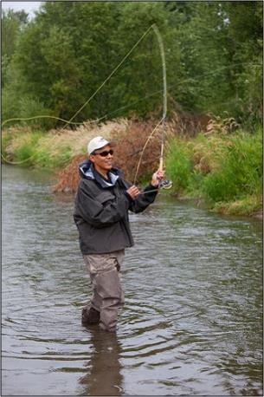
TRAIN THE TRAINER

Slide 4
EMPLOYEE DEVELOPMENT
“I believe the desire and ability of an organization to continuously learn from any source, anywhere, and rapidly convert this learning into action is its ultimate competitive advantage.”… Jack Welch, Former-CEO General Electric Company.
The skills and knowledge an organization possesses is fast becoming recognized as its most important asset. A key element of organizational excellence is the skills and knowledge its employees possess. To fully empower an individual, that individual must have the ability to be empowered. To hold employees accountable, they must be capable of performing the activity or the job.
The purpose of this course is to build upon your ability to train others.

Slide 5
COURSE OBJECTIVES
Upon completion of this training course, the
learners will have the ability to:
Demonstrate four qualities of a good trainer
List four things to prepare for training
Create an effective learning environment
Use at least two types of classroom training media effectively
Use three participative training methods
Use vocal, verbal and visual skills to conduct an effective training class

Slide 6
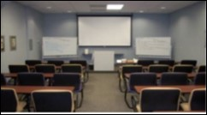
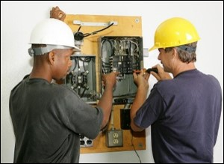
DEFINING TRAINING
“An organized activity designed to bring about change.”
CLASSROOM
ON-THE-JOB

Slide 7
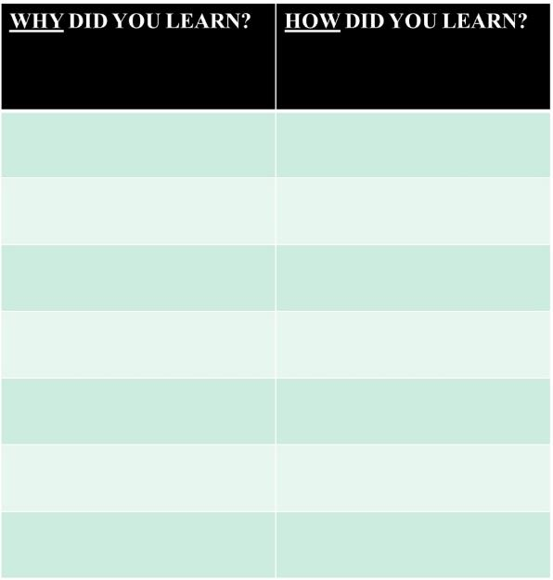
THINK OF SOMETHING YOU LEARNED!

Slide 8
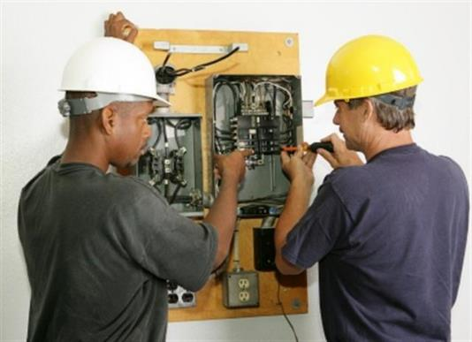
CREATING A LEARNING ENVIRONMENT
The Trainer
The Material
The Physical Space

Slide 9
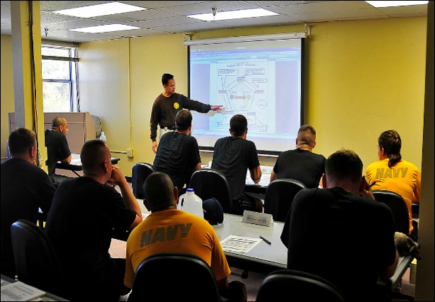
THE TRAINER

Slide 10
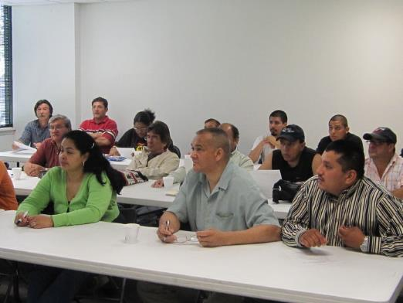
THE QUALITIES OF A GOOD TRAINER
“The mediocre teacher tells. The good teacher explains. The superior teacher demonstrates. The great teacher inspires.”
- William Arthur Ward

Slide 11
NUMBERS!
25
1
26
6
29
2
30
38
41
14
3
13
18
27
4
15
37
16
17
5
39
28
40
42
31
43
32
7
9
44
20
21
34
19
24
36
23
33
22
46
11
10
35
12
48
47
45
8

Slide 12

A GOOD TRAINER

Slide 13

THE TRAINER
Don’t…
Rush
Overwhelm
Doubt
Compare

Slide 14
SELF ASSESSMENT
Rate yourself 1 (low) to 5 (highest) on each of the trainer skills below.
Speaks clearly
Organized
Approachable
Patient
Uses a consistent approach
Reads their participant(s)
Knowledgeable
Confident
Prepared
Flexible
Good Listener
Doesn’t downplay task
Has a positive attitude
Makes others feel comfortable
Gives positive feedback

Slide 15
YOUR “TRAINER” RESPONSIBILITIES
As a trainer, please list below what you believe your responsibilities to be:
__________________________________________________________________________________________________________________________________________________________________________________________________________________________________________________________________________________________________________________________________________________________________________________________________________________________________________________________________________________________________________________________________________________________________
____________________________________________________________________________________
____________________________________________________________________________________

Slide 16
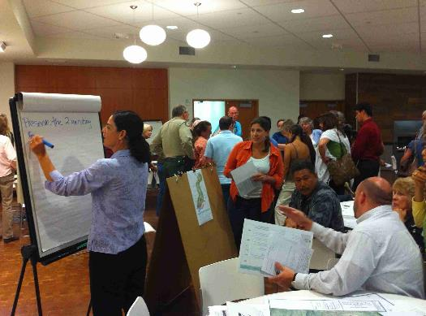
A KEY TRAINER RESPONSIBILITY
Creating a Learning Environment!

Slide 17

PREPARING FOR TRAINING
“You can’t drive a car by looking in the rear view mirror.”
- Deming

Slide 18
PREPARING TO TRAIN
Design and use a checklist
Know the material
Know skill/knowledge level of trainees
Know your contact’s contact information
Anticipate questions
Arrive to training location early
Set up and test technology
Know where the lights are and how they function
Establish the physical environment
Know the location of restrooms, lunch areas, etc.
Before Arriving
After Arriving

Slide 19
SAMPLE CHECKLIST
Trainer’s Guide (Notes)
Trainee Books
Handout
Notepaper
Pens
LCD Projector
LCD Screen
Lap Top Computer with course and videos
All Cord(s)
Two Flipchart Stands
Two Flipchart Pads
Set of Flipchart Markers
Masking Tape
Feedback Handout

Slide 20
YOUR CHECKLIST
COURSE TITLE: _________________________
___________________________________________
___________________________________________
___________________________________________
___________________________________________
___________________________________________
___________________________________________
___________________________________________
___________________________________________
___________________________________________
___________________________________________
___________________________________________
___________________________________________
___________________________________________
___________________________________________

Slide 21

THE MATERIAL

Slide 22

THE MATERIAL
There is a need
Right level
Maintains interest
Purpose and objectives
Digestible chunks

Slide 23
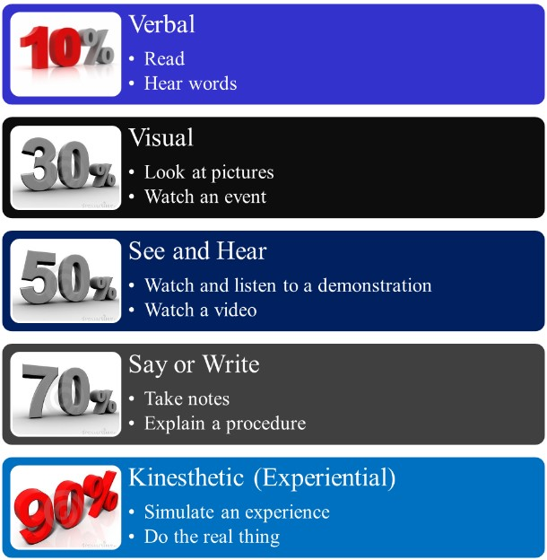
WHAT PEOPLE REMEMBER!

Slide 24

RULE OF THUMB ONE
Tell your audience what you're going to tell them. (Pre-Test)
Tell them. (A variety of training methods)
Then tell them what you told them. (Section Summaries)
Let them tell you! (Questioning, Post-Test)
Notes:
State:
Explain that during the course of this workshop you will be presenting 4 “Rules of Thumb” which are important points. This is the first. Introduce this slide by pointing out that they have probably heard the first three points before during a political speech or debate. Read each bullet. The information in parenthesis are some of the methods that were used in your training to achieve each bullet.
Ask:
If there are questions.
Target Response/Key Points
The last bullet in bold is perhaps the most important.

Slide 25

THE PHYSICAL SPACE
What’s wrong with this picture?

Slide 26

TRAINING IN A CLASSROOM
The power of questions
Use training media effectively
Participative training methods
Learning is purely a voluntary activity!

Slide 27
THE PHYSICAL ENVIRONMENT
List below what you believe to be the optimum physical environment for training.
1.____________________________________________________2.____________________________________________________
3.____________________________________________________
4.____________________________________________________
5.____________________________________________________
6.____________________________________________________
7.____________________________________________________
8.____________________________________________________
9.____________________________________________________
10.___________________________________________________
11.___________________________________________________
12.___________________________________________________
13.___________________________________________________
14.___________________________________________________
15.___________________________________________________
16.___________________________________________________

Slide 28
PHYSICAL ENVIRONMENT ELEMENTS
Temperature
Comfort of chairs
Space
Distractions
Furniture arrangement
Lighting
Restrooms

Slide 29
RATING THIS ENVIRONMENT
___ Temperature
___ Comfort of Chairs
___ Room Size & Dimensions
___ Screen or Chart Locations
___ Distractions
___ Furniture Layout
___ Lighting
___ Restrooms

Slide 30
ROOM CHECKLIST
Lighting
How is it controlled?
Is dimmer switch available?
All bulbs/fixtures working?
Windows have shades/blinds?
Do you know how to operate?
Electrical Outlets
Where are they?
Is an extension cord needed?
Do you need an adapter?
Microphone
Are there more than 40 people?
What type of microphone?
Did I practice using it?
Audience Comfort
Temperature Control?
Room dimensions?
Screen location?
Comfort of chairs?
Noise/distractions?
Restroom locations?
Room Set-up
Theater style?
U-shape style?
Herringbone style?
Classroom style?
Conference style?
Buzz style?
Stage
Practice walking/climbing?
Is there a podium?
Are there lights?
Is it adjustable?

Slide 31
YOUR ENVIRONMENT
WHERE YOU WILL BE TRAINING?
___________________________________________
How can the environment be improved?
___________________________________________
___________________________________________
___________________________________________
___________________________________________
___________________________________________
___________________________________________
___________________________________________
___________________________________________

Slide 32
POP QUIZ!
Please fill in the blanks
What do the trainer, the materials and the physical space create? Fill in the blanks.
A _ _ a _ _ _ _ g E _ _ _ r _ _ _ _ n _
One characteristic of a good trainer is being C _ _ _ _ _ _ _ t .
Designing and using a checklist is a key element in P_ _ _ _ _ _ _ _ for training.
In creating an effective physical space it is important to consider d _ _ _ _ _ c _ _ _ _ _.

Slide 33

TRAINING IN A CLASSROOM
Use training media effectively
Participative training methods
V3 (Vocal, Verbal and Visual)

Slide 34
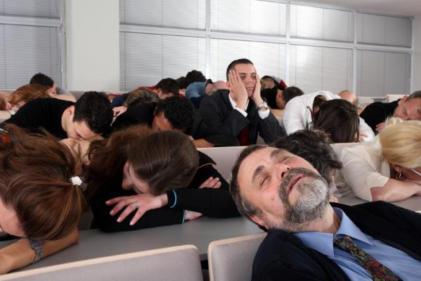
USING THE RIGHT MEDIA …RIGHT!
Not the goal!

Slide 35
DEVELOPING AND USING MEDIA
Presenters use media to both increase their persuasiveness and heighten audience retention.
Increase Persuasiveness
  Presenters using visual aids conduct meetings in 28% less time
  Proposals are approved twice as often
Heighten Retention
  Participants learn vocabulary twice as well
  People comprehend about 7% of information delivered verbally. They comprehend 87% when the information is delivered both verbally and visually

Slide 36
WHAT PEOPLE REMEMBER!

Slide 37


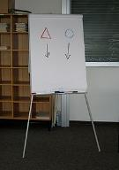


TYPES OF MEDIA
PowerPoint
Video
Flipcharts /
Handouts
White Board

Slide 38

THE PROS AND CONS OF POWERPOINT
THE PROS AND CONS OF POWERPOINT
The Pros The Cons
__________________________ ___________________________ __________________________ ___________________________
__________________________ ___________________________ __________________________ ___________________________ __________________________ ___________________________
__________________________ ___________________________ __________________________ ___________________________ __________________________ ___________________________
__________________________ ___________________________ __________________________ ___________________________

Slide 39

POWERPOINTING TO DEATH!

Slide 40
THE POWER OF POWERPOINT
How do we avoid “death by PowerPoint?”
___________________________________________________________________________________________________________________________________________________________________________________________________________________________________________________

Slide 41


POWERPOINT WITH DISCUSSION
See and Hear
  Watch and listen to a demonstration
  Watch a video

Slide 42

REMEMBER!
With any type of projection device, the darker the room the clearer the picture.
However……
The darker the room the more difficult it is to see and hear you.
The darker the room the more difficult it is to take notes.
The darker the room the less audience participation you will receive.

Slide 43
THE PROS AND CONS OF VIDEO
THE PROS AND CONS OF VIDEO
The Pros The Cons
__________________________ ___________________________ __________________________ ___________________________
__________________________ ___________________________ __________________________ ___________________________ __________________________ ___________________________
__________________________ ___________________________ __________________________ ___________________________ __________________________ ___________________________
__________________________ ___________________________ __________________________ ___________________________

Slide 44
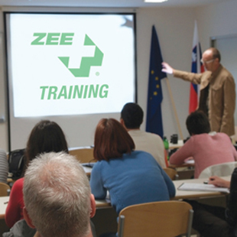

TAKING NOTES WHILE WATCHING A VIDEO
See and Hear
  Watch and listen to a demonstration
  Watch a video

Slide 45
VIDEO EXERCISE
Step 1: Watch the video
Step 2: Discuss with your team “What should have been done differently?” and list below
Step 3: Be prepared to share your list with the class
_________________________________________________________________________________________________________________________________________________________________________________________________________________________________________________________________________________________________________________________________________________________________________________________________________________________________________________________
Notes:
State:
This is a 6 minute exercise.
Watch the video.
Discuss in your teams “What should have been done differently?”
Feedback to the class your findings
Reward what you consider the “best” answer with 10 points.
Reward all responses with a fruit snack.
Ask:
What did you like about this exercise?
What didn’t you like about this exercise?
Target Response/Key Points
Explain that this activity incorporated the following training methods:
Video
Team Competition
Rewards
Let the participants know that these videos are available on OSHA’s website.

Slide 46
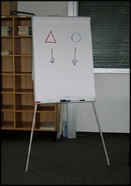

THE PROS AND CONS OF FLIPCHARTS/WHITE BOARDS
THE PROS AND CONS OF FLIPCHARTS/WHITE BOARDS
The Pros The Cons
__________________________ ___________________________ __________________________ ___________________________
__________________________ ___________________________ __________________________ ___________________________ __________________________ ___________________________
__________________________ ___________________________ __________________________ ___________________________ __________________________ ___________________________
__________________________ ___________________________ __________________________ ___________________________

Slide 47

White board
Don’t talk to me
Don’t stand in front of me
Write legibly
Use bullets to separate lines
Use different colors
Be sure all can see
Write large
Write fast / Be concise

Slide 48
THE PROS AND CONS OF HANDOUTS
THE PROS AND CONS OF HANDOUTS
The Pros The Cons
__________________________ ___________________________ __________________________ ___________________________
__________________________ ___________________________ __________________________ ___________________________ __________________________ ___________________________
__________________________ ___________________________ __________________________ ___________________________ __________________________ ___________________________
__________________________ ___________________________ __________________________ ___________________________

Slide 49
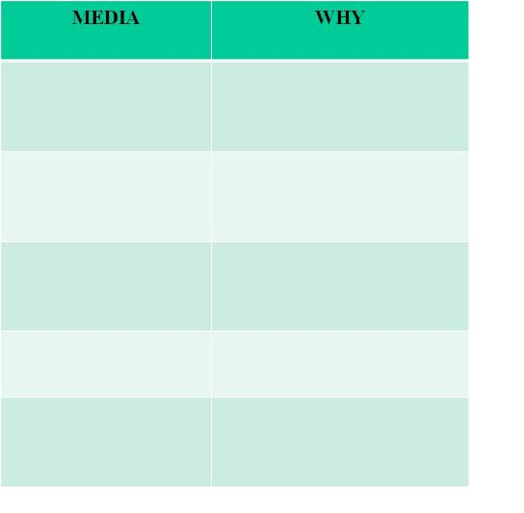
YOUR MEDIA
  Write below the media you are planning to use for your presentation and why you have selected that media.

Slide 50
PARTICIPATIVE
TRAINNG METHODS
Questions
Tests/Quizzes
Graphics/Pictures
Individual Exercises
Demonstration
Summaries
Videos
Games
Every training method should
have a learning objective!
Notes:
State:
Explain that these were some of the methods used to transfer learning. This list came from going through the classes and identifying each method. Explain that you will be explaining each method as we move forward.
Ask:
No Questions
Target Response/Key Points
We often have more learning methods than we realize.
Reiterate: Every method should have a learning purpose. Different methods help keep attention, but each method should support your training objectives.

Slide 51
TRAINING METHODS
Why use a variety of learning methods?
_________________________________________________________________________________________________________________________________________________________________________________________________________________________________________________________________________________________________________
Notes:
State:
Explain that this is the first “team” activity. Have each table, or group of 2-4 participants brainstorm this together.
While the teams work on this exercise, set up a flipchart to record team scores (see below).
Identify who has the most number of responses and ask them to read them. Give this team 10 points. Ask if any other teams have anything to add. Give those that responded a fruit snack. Explain that you will be using the team competition method for the rest of the workshop.
Ask:
If there are any questions.
Target Response/Key Points
Explain that these are two method that are used consistently in the training. 1) Team competition 2) rewards
Team 1
Team 2
Team 3
Team 4
10

Slide 52

USING DIFFERENT METHODS
Generates interest
People learn in different ways
People learn at different rates
People learn from different experiences
People learn from fun experiences
Notes:
State:
Read slide. Acknowledge those that are the same as the participant responses and point out any that are different.
Ask:
No Questions
Target Response/Key Points
Reiterate that these are the reasons for using a variety of training methods.

Slide 53

THE POWER OF QUESTIONS

Slide 54
THE DIFFERENCE
Let me tell you why you need to …
You shouldn’t do this because…
The best way to do this is…
My experience in this is…
If you use this tool, be sure to…
I am going to do this because…
Who can tell me why you need to …?
If I were to do this, what would happen?
What do you think is the best way to do this?
What is your experience in this?
How should you use this tool?
Why would I do this?

Slide 55

ANOTHER GOOD REASON TO QUESTION
It makes the trainer’s life a lot easier!

Slide 56
QUESTIONING
In the space provided below, write 5 statements regarding the
training you will be conducting. After finishing those 5
statements, turn them into open ended questions.
STATEMENTS QUESTIONS
____________________________________
____________________________________
____________________________________
____________________________________
____________________________________
____________________________________
____________________________________
____________________________________
____________________________________
____________________________________

Slide 57
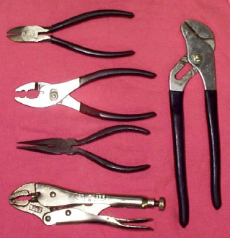
PRE-POST TEST
Circle the letter of that matches the pliers:
A B C D E Slipjoint
15. A B C D E Needle nose
A B C D E Multi-groove / Channel Lock
A B C D E Diagonal
18. A B C D E Vise Grip / Locking
A
B
C
E
D
Notes:
State:
This is one example of part of a pre and/or post test. Explain that a variety of testing methods are used, such as; true/false, fill-in-the-blank, connect the picture to the description, put-in-order, etc.
Ask each team to complete the “quiz” on the slide together.
Allow 2 minutes to complete
Ask:
Who would like to share your answers. Pick the first hand that goes up. If they answer correctly give the team 10 points. If they answer incorrectly give the team fruit snacks for participating.
Target Response/Key Points
Learning can and should be fun!

Slide 58
RULE OF THUMB TWO
Seven Slide Rule:
No more than seven slides/pages without a change in media.
Notes:
State:
Explain that this slide means that if you are just lecturing for more than 7 or 8 slides (about 10 minutes) you will lose your audience. If you show more that two videos in succession for over 10 minutes, you will lose your audience.
Ask:
If there are questions.
Target Response/Key Points
If your training materials are great and you are a great trainer it will not matter if your audience is not listening.

Slide 59
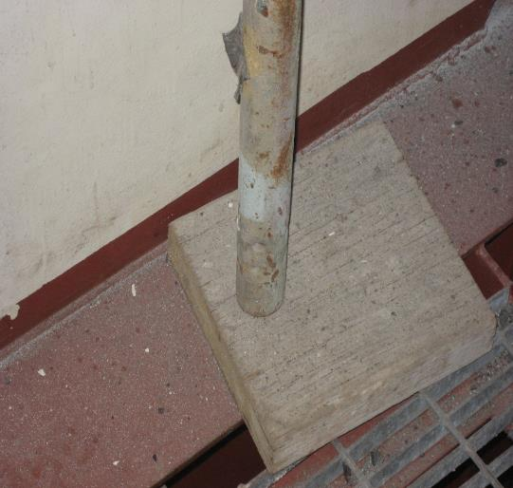

GRAPHICS/PICTURES
GRAPHICS/PICTURES
Notes:
State:
Explain that pictures are a powerful learning tool. A picture does speak a thousand words. Explain that photos are often used in training sessions to identify what is right and what is not. It is difficult to take your participants to the work site so this is one way of taking the work site to them.
Ask:
What’s wrong with this picture?
Target Response/Key Points
The leg of the scaffold should be held in the middle of the mud sill by a base plate (see next slide)
“What’s wrong with this picture” is a learning tool that teaches right from wrong but also generates discussion.

Slide 60
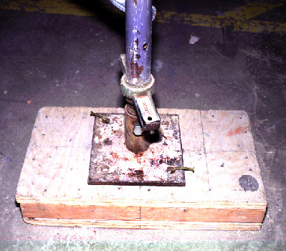
GRAPHICS/PICTURES
Mudsill
Base plate
Notes:
State:
Explain that this is correct.
This leads us to the next slide…
Ask:
No Questions
Target Response/Key Points
None

Slide 61
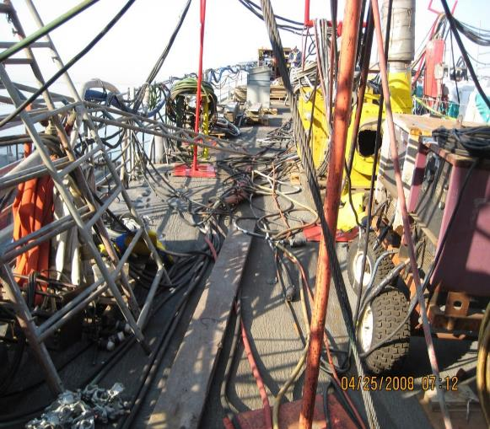
WHAT’S WRONG WITH THIS PICTURE?
dd
Notes:
State:
If time permits, ask the teams to list on a piece of paper “What’s wrong with this picture.”
Reward the team that has the most comprehensive list with 10 points or fruit snacks!
If time does not permit, just explain that this is an example of using the technique and in this photo there are about 10 things wrong with this picture.
Ask:
No Questions
Target Response/Key Points
Reiterate the “Power of the Picture.”

Slide 62

RULE OF THUMB THREE
If you show a negative picture, graphic or example, always show the positive.
Notes:
State:
Read the slide.
Ask:
Why is this important?
Target Response/Key Points
What we see is often what we do. Plus it is difficult sometimes to “see” the opposite of what is being shown.

Slide 63
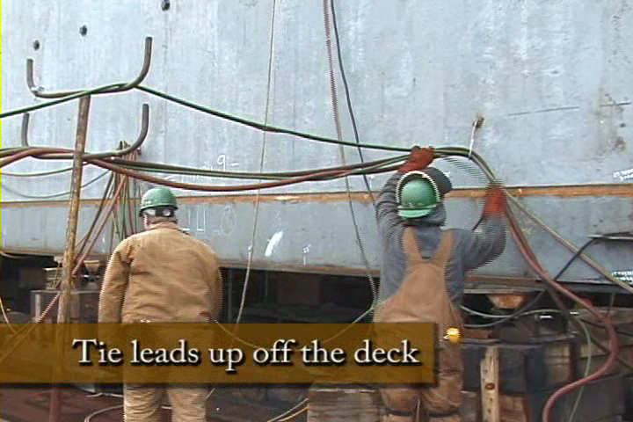
GOOD EXAMPLE!
Notes:
State:
This is an example of “What’s right with this picture.”
Ask:
If there are questions.
Target Response/Key Points
Now the participant knows how to correct a hazard the proper way.

Slide 64
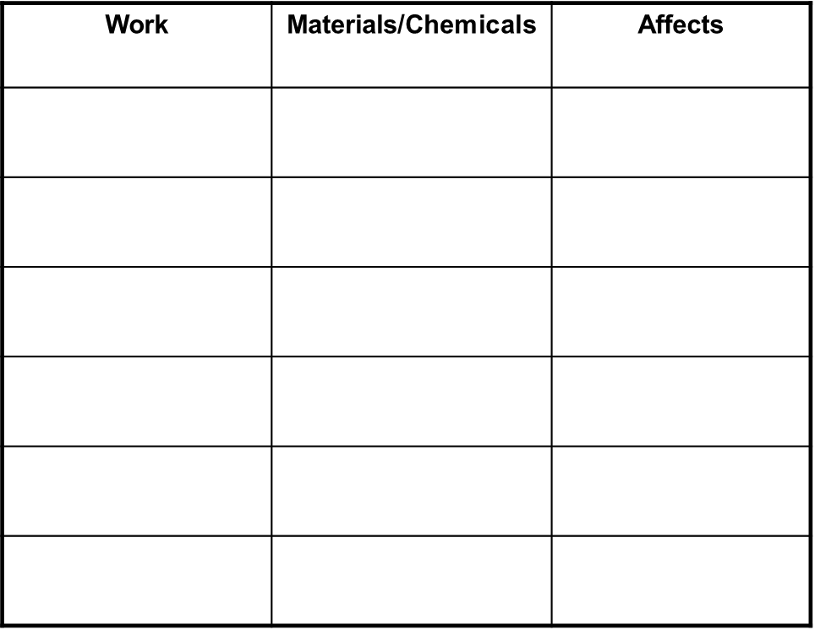
INDIVIDUAL EXERCISE
Using the table below, list the work you perform in the left column,
the hazardous materials and/or chemicals you use to perform that
work in the middle column and the potential adverse health affects
in the right column.
Notes:
State:
Often team exercises are not effective. If you have participants from different organizations that do different jobs, a team exercise may not be effective, and may in fact be confusing. This is an example of an individual exercise.
Ask:
What is the purpose of this exercise?
Target Response/Key Points
To encourage participants to realize that the materials they frequently use, may in fact be harmful to them.

Slide 65
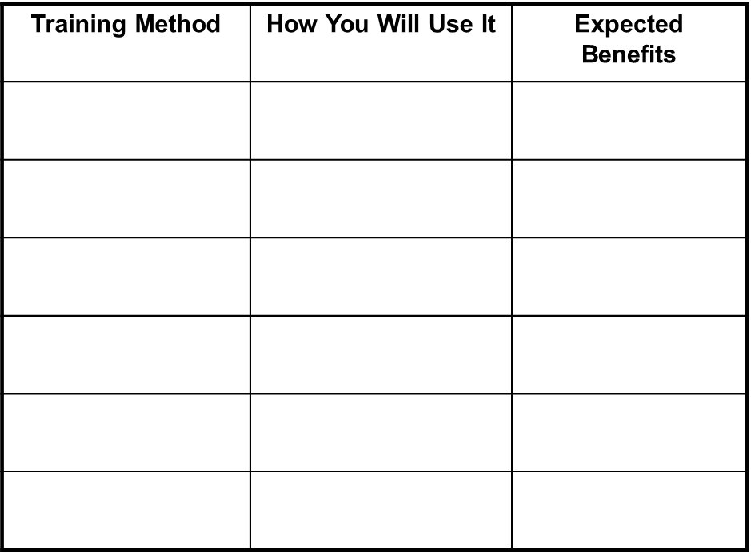
YOUR INDIVIDUAL EXERCISE
Based on the training you are or will be conducting, complete the table below. List the training method(s) you will be using in the left column, how you will use it in the middle column and the benefits you expect in the right column.
Notes:
State:
So far we have covered pre-post testing, team competition, rewards, and individual exercises. Please complete this individual exercise.
Provide about 3 minutes to complete.
Ask:
If anyone would like to share their information.
“What was the objective for this individual exercise.”
Target Response/Key Points
To encourage the participants to integrate additional training methods into their presentations.

Slide 66
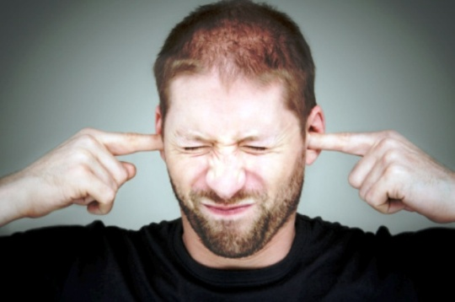
DEMONSTRATION
For a fruit snack, who would demonstrate how to properly put in ear plugs?
Notes:
State:
Many people learn by “doing.” When possible I, or one of the participants, will demonstrate a skill. This can be incorporated into the team competition.
Ask:
Who would like to demonstrate putting in earplugs?
Ask the participants for feedback regarding their demonstration.
(Reward the volunteer with a fruit snack!)
Target Response/Key Points
Demonstrating a skill helps learning stick!

Slide 67
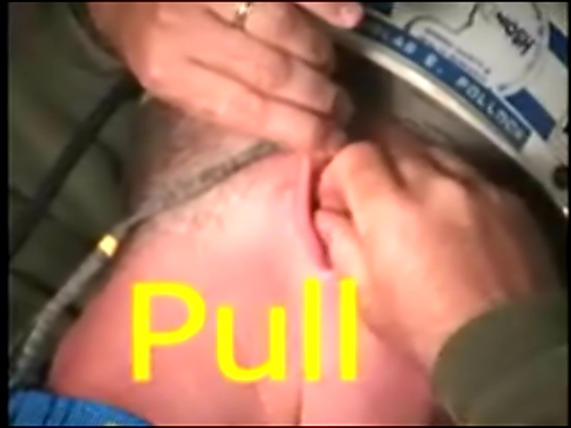
DEMONSTRATION
Notes:
State:
If the ear plugs were not put in correctly, demonstrate the correct way. If so, move on.
Ask:
No Questions
Target Response/Key Points
None

Slide 68




SECTION SUMMARIES
Draw a Line From the Type of Eye Protection
to the Key Feature It Possesses
Notes:
State:
At the end of key training sections, in this case the training module was addressing eye protection, we will often do a review of the training. In this method, using pictures, we are asking the participant to draw a line from the type of eye protection to the best description. Explain that often these summaries help make up the pre-post tests.
If time permits, allow participants to complete this exercise in teams. If not, move on.
Ask:
What is the purpose of this exercise?
Target Response/Key Points
To learn some different types of eye protection and to differentiate the purpose of each.

Slide 69

VIDEO EXERCISE
Step 1: Watch the video
Step 2: Discuss with your team
“What should have been done
differently?” and list below
Step 3: Be prepared to share
your list with the class
_________________________________________________________________________________________________________________________________________________________________________________________________________________________________________________________________________________________________________________________________________________________________________________________________________________________________________________________
Notes:
State:
This is a 6 minute exercise.
Watch the video.
Discuss in your teams “What should have been done differently?”
Feedback to the class your findings
Reward what you consider the “best” answer with 10 points.
Reward all responses with a fruit snack.
Ask:
What did you like about this exercise?
What didn’t you like about this exercise?
Target Response/Key Points
Explain that this activity incorporated the following training methods:
Video
Team Competition
Rewards
Let the participants know that these videos are available on OSHA’s website.

Slide 70

RULE OF THUMB FOUR
When structuring a game or activity, assume the training participants have no idea what you are talking about (See Rule of Thumb One!).
Notes:
State:
It is very important to structure activities in detail. Activities take time and if they are structured incorrectly will cause confusion.
Ask:
If time permits, ask participants to share what they have learned in the past regarding structuring activities.
Target Response/Key Points
Do not rush introducing an activity. Go into detail each step that is expected.

Slide 71

GAMES
GAMES
  Stump the Class
  Jeopardy
  Hangman
  Put-In-Order
Notes:
State:
These are some of the learning games we commonly use in training.
Read the list.
Explain that you will be discussing each of these, except for jeopardy, which we have been “playing” during our workshop.
Ask:
No Questions
Target Response/Key Points
None

Slide 72
STUMP THE CLASS
With a partner, write a question from this section (Training Methods) that you believe the rest of the class will be challenged in answering correctly. (Questions must be reasonable! If your instructor can’t answer, it doesn’t count!)
________________________________________________________________________________________________________________________________________________________________________________________________________________________________________________________________________________________________________________________________________________
Notes:
State:
Read the slide and ask each team to write two “reasonable” questions from the material discussed so far.
This may be shortened by asking them to write one question.
Let them know that if they “Stump The Class” their team will be given 10 points.
Ask:
What is the purpose of this exercise?
Target Response/Key Points
Serves as a fun way to review material.
Encourages discussion between team mates.

Slide 73
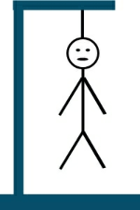
HANGMAN
s _ _ _ _ s _ _ _ _ R _ _ _
The three words above a “rule of thumb”. When you are ready to solve please raise your hand,
discuss with your team, give the answer and an explanation.
Notes:
State:
Hangman is a fun way to reinforce key points. You will need a flipchart and pad.
Explain that the team that solves the “puzzle” must also be able to explain three elements of the “puzzle”.
Explain that the words are a slide header that you recently discussed.
Go around the room and have each team give you a letter. When they give you a letter that fits the words on the slide fill them in. At any time a team can solve the puzzle instead of giving you a letter.
The team that solves the puzzle receives 10 points.
If they are incorrect or cannot provide you with 3 of the elements they will lose 10 points.
The words are Video Benefits.
Ask:
What was the purpose of this exercise?
Target Response/Key Points
A fun way to review key points of a learning objective.

Slide 74
PUT-IN-ORDER
PUT-IN-ORDER
Number the steps below in the correct order.
Put the number 1 in the box in front of the first step, the number 2 in the box in front of the second step and so on.
The RA shall review accuracy of proposed tag out and sign block 10 of the TORS sheet (Tag-out record sheet).
The RA and the Watch / Duty Officer will sign block 14 of the WAF form once the system and or component has been verified to have been drained / de-energized / depressurized and cooled down when working with steam.
The ship’s Engineering Duty Officer will authorize the tag outs for engineering related systems.
Ship will prepare tags based on the WAF.
The RA shall conduct an independent review for the validation and accuracy of the tags, print name, badge, and company and sign block 7 of the hung tag and initial block 18b of the TORS.
Tags will be hung by the ship’s force representative first signer (Authorizing Officer).
A second qualified ship’s force representative shall conduct an independent review and sign tag.
The RA will have the Watch / Duty Officer Sign block 13 of the WAF form after verification of tags has been completed by the RA.
The ship’s Combat System Officer of the Watch will authorize tag outs for combat related systems.
Notes:
State:
This is an example of an exercise used in your Lock Out – Tag Out class. Explain that this is not an exercise that the participants will be completing.
Read the slide instructions and give the participants one minute or so to review.
Ask:
What are the benefits of this activity?
Target Response/Key Points
To learn the proper procedure of Tag Out on a Navy Vessel. It is much more likely to “stick” than simply reading the process because of the involvement and sharing required to complete.

Slide 75
POP QUIZ!
True or False
T or F 1. People remember about 40% of the information they just read.
T or F 2. Using questions is a powerful way to solicit participation from trainees.
T or F 3. When structuring an exercise you should assume your trainees have no idea about what you’re talking about.
T or F 4. When showing a graphic to illustrate the right and wrong way of doing something, you should always show both.
T or F 5. The seven slide rule has to do with the amount of information on each slide.

Slide 76
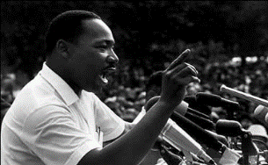

V3 - DELIVERY
Vocal
Verbal
Visual

Slide 77
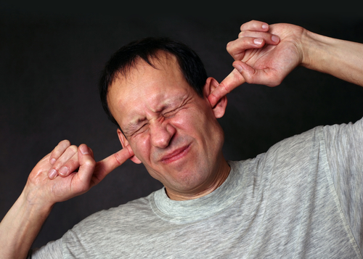
VOCAL

Slide 78

VOCAL ELEMENTS
How you speak can be almost as important as what you say!
Pitch
Pace
Volume
Resonance
Pausing

Slide 79
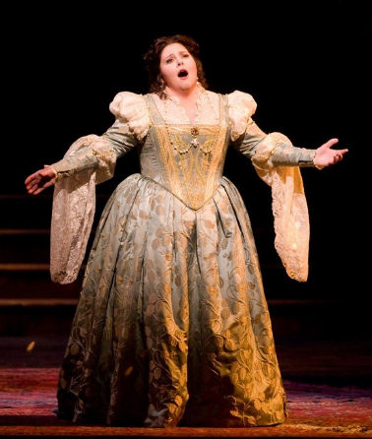
PITCH
Pitch, in speech, the relative highness or lowness of a tone as perceived by the ear, which depends on the number of vibrations per second produced by the vocal cords.

Slide 80


LOW – MIDDLE - HIGH
LOW | MIDDLE | HIGH
SERIOUS RESPECTFUL IMPORTANT | GENERAL | INSPIRE EXCITE MOTIVATIONAL

Slide 81
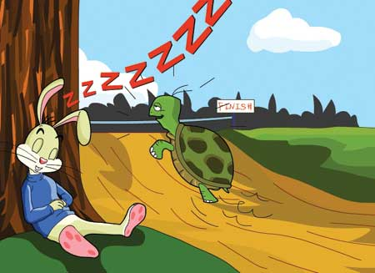
PACE
Pace is the speed in which you speak. Make sure that the speed of your delivery is easy to follow. If you speak too quickly or too slowly your audience will have difficulty following your talk. To add life to your presentation, try changing the pace of your delivery.

Slide 82


SCALE ONE TO TEN
SLOW | MEDIUM | FAST
SERIOUS RESPECTFUL IMPORTANT | CONVERSATIONAL | CHANGE EXCITEMENT PASSION
SLOW | MEDIUM | FAST
TOO SLOW FOR TOO LONG WILL BE MONOTONOUS | CONVERSATIONAL TOO LONG WILL BE MONOTONOUS | TOO FAST FOR TOO LONG WILL LOSE THE TRAINEES

Slide 83


QUESTIONING
QUESTIONING
Who can tell me the four “Rules of Thumb?”
_________________
_________________
_________________
_________________
Notes:
State:
Speaking of questions….
Ask:
Who can give me one rule of thumb?
Two?
Three?
Four?
Target Response/Key Points
Give the team that can give you the most “rules of thumb” 10 points!

Slide 84

VOLUME
Volume, like the sound of a television, is the level of loudness you speak. Variety of volume as well as speech rate, tone, and pitch, is key to making your presentation easy and enjoyable to listen to. When you suddenly increase or decrease your volume, it shocks or alerts your audience to a change that jolts their attention.

Slide 85
VOLUME
VOLUME… loudness on a scale extending from quiet to loud.
Loud enough to hear
Not too loud to annoy
Vary to heighten interest
Remember: Conversational

Slide 86

RESONANCE
Resonance refers to the amplification, richness and quality of your voice. Practically speaking, you can do little to alter the nasal cavity, but go for optimal resonance with your throat and mouth. Alleviate tension in the throat, keeping the airspace open for your voice to pass seamlessly through.

Slide 87
RESONANCE
RESONANCE… The timbre, tone and intensity of our voice.
Clear (Articulate)
Energetic
Aligned with Message
Not: Nasal
Not: Squeaky

Slide 88

PAUSING
Briefly, stop speaking. Use the Power of Pause When Speaking. Whenever effective public speakers end a sentence or phrase, they usually pause. This gives listeners time to absorb their words. Nervous presenters often do the opposite: The stress of being in front of an audience causes them to speak faster and faster, rushing past the pauses.

Slide 89

PAUSING
PAUSING… Stop talking.
Conveys confidence
Allows trainees to think
Signals a transition
Creates impact and emphasis

Slide 90
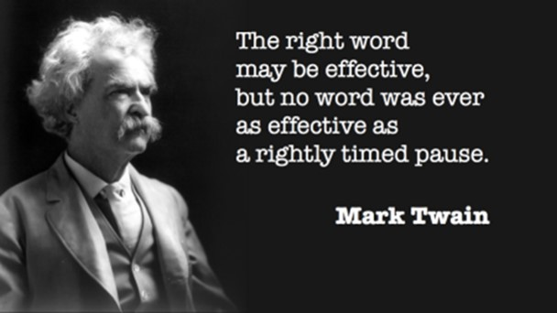
THE POWER OF THE PAUSE

Slide 91
SECTION SUMMARY
Draw a line from the picture to the vocal element.
Notes:
State:
At the end of key training sections, in this case the training module was addressing eye protection, we will often do a review of the training. In this method, using pictures, we are asking the participant to draw a line from the type of eye protection to the best description. Explain that often these summaries help make up the pre-post tests.
If time permits, allow participants to complete this exercise in teams. If not, move on.
Ask:
What is the purpose of this exercise?
Target Response/Key Points
To learn some different types of eye protection and to differentiate the purpose of each.

Slide 92
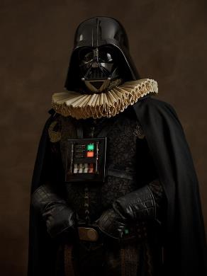
VOCAL DON’TS
Filler words
Harshness
Breathlessness
Voice change at the end of sentences
Mumbling or slurring

Slide 93
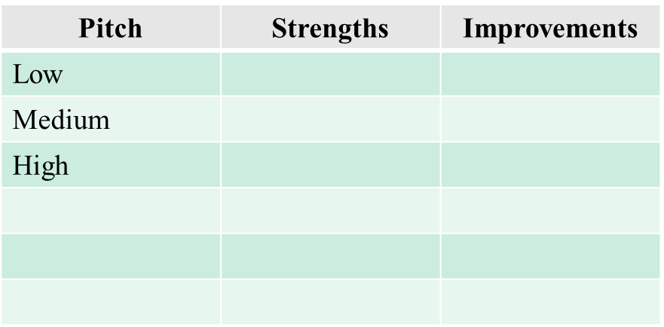
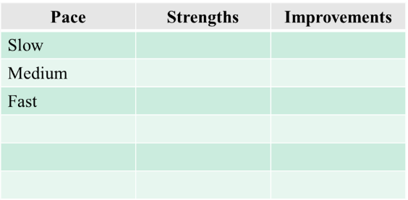
CRITIQUE SHEET
As I read the following article please identify my Strengths and Areas of Improvement in the table below.)

Slide 94
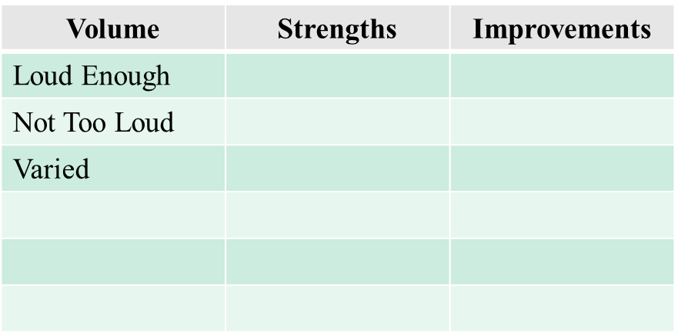
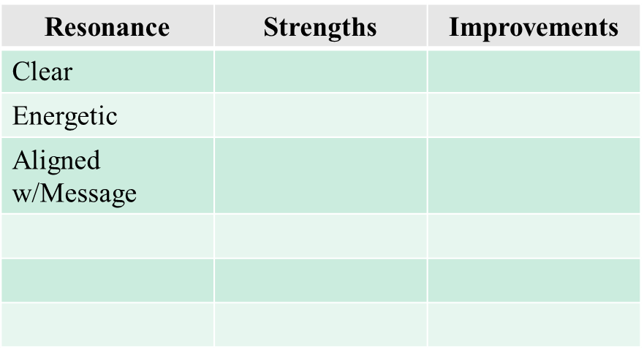
CRITIQUE SHEET
As I read the following article please identify my Strengths and Areas of Improvement in the table below.)

Slide 95
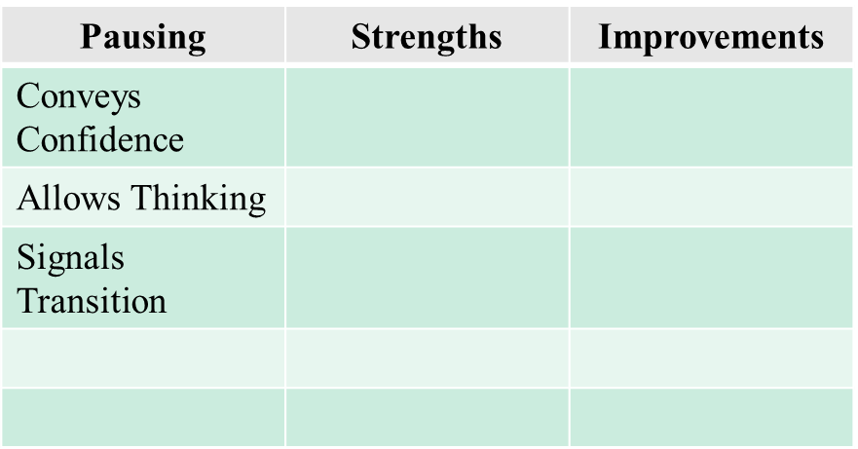
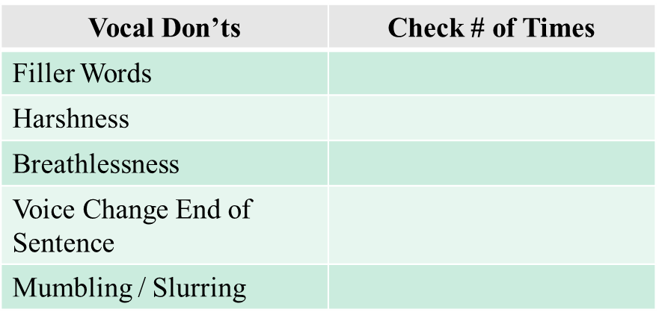
CRITIQUE SHEET
As I read the following article please identify my Strengths and Areas of Improvement in the table below.)

Slide 96
MOTIVATION
Motivation is fundamental to employee engagement and performance. It is what drives us to set and attain goals. The goal of employee engagement is to enhance employees to exercise discretionary effort and the best way to achieve it is through motivating them. When employees are motivated, they engage each other through teams to improve the performance of the organization. Motivation is categorized into two ways, intrinsic and extrinsic motivation. Intrinsic motivation is derived from internal desires. It includes things such as happiness, recognition, and responsibilities. On the contrary, extrinsic motivation is the desire to gain external rewards or avoid punishment. It includes cash prizes, promotion, and bonuses among others.

Slide 97

PRACTICE AND FEEDBACK
Practice and honest feedback are effective methods to improve your delivery. One way to do this is to record yourself. Another is to deliver training to an objective person willing to give you honest feedback.

Slide 98
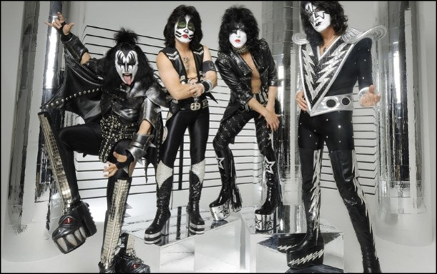
VERBAL

Slide 99
VERBAL
A good rule to follow when making a presentation is KISS (Keep It Short and Simple). Using simple, clear words and phrases makes your meaning clear. Remember, people can process your words 3 times faster than you can speak so keeping key points short reduces the chance that your audience will take “side trips” during your presentation. Using rare words or inflated statements also marks you as a “show-off”.

Slide 100
SPECIFIC EXPRESSIONS
Introduction
Connection
Purpose/Main Points
Objectives or Main Topics
How You Will Answer Questions
Responding to Questions
Responding to Tough Questions
Transitions
Ending

Slide 101
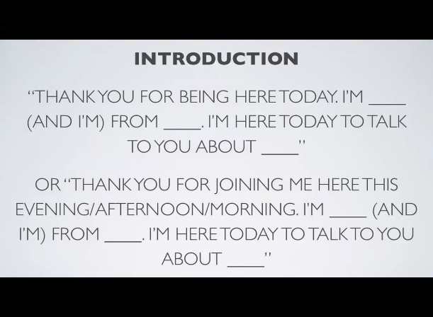
INTRODUCTION

Slide 102
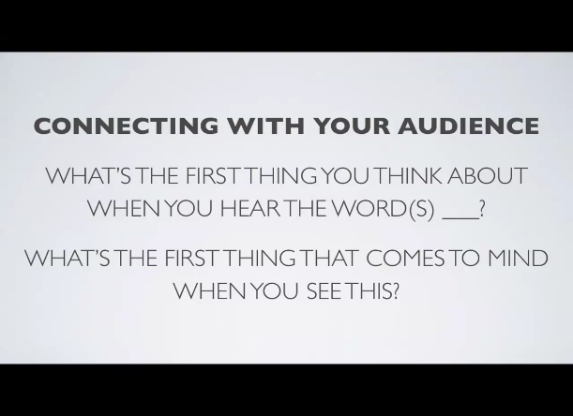
CONNECTING

Slide 103

PURPOSE

Slide 104
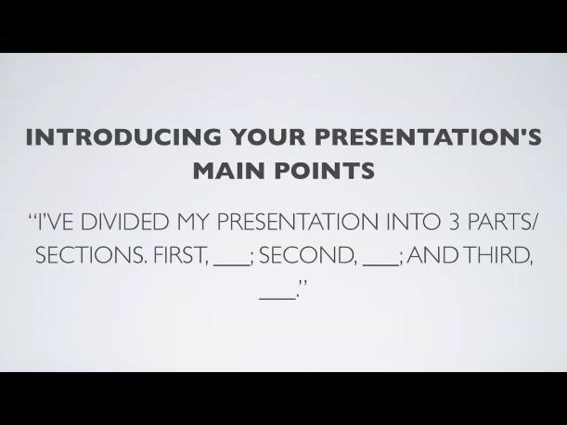
OBJECTIVES

Slide 105
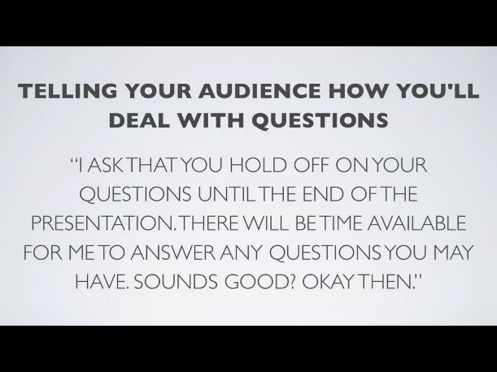
QUESTIONS

Slide 106
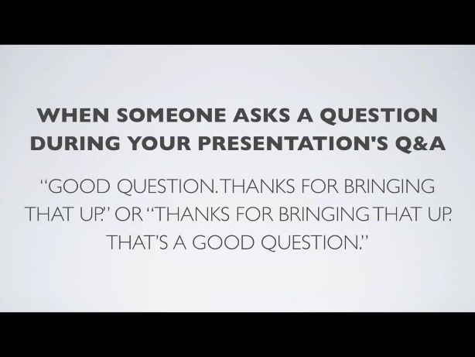
RESPONDING

Slide 107
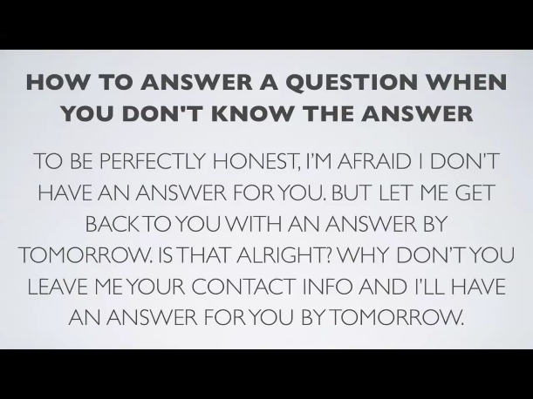
TOUGH QUESTIONS

Slide 108
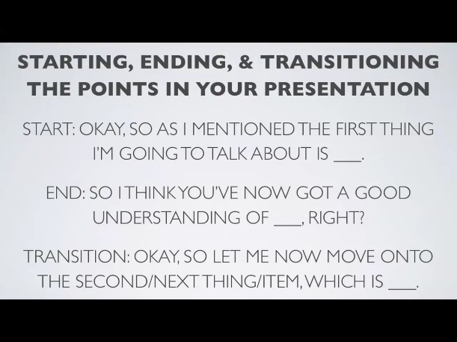
TRANSITIONS

Slide 109
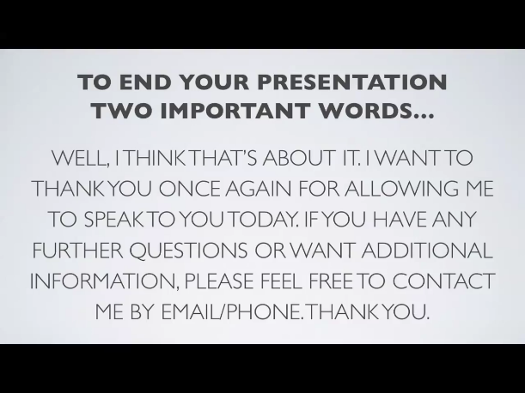
ENDING

Slide 110
YOUR EXPRESSIONS
  You will soon be asked to pick a topic that you will present to the class. In the space below, select the topic and write out each expression you may use when delivering your presentation.
  Topic _______________________________________
Training Section | Your Expressions
Introduction
Connection
Purpose
Objectives
How You Will Answer Questions
Transition (One Example)
Ending

Slide 111
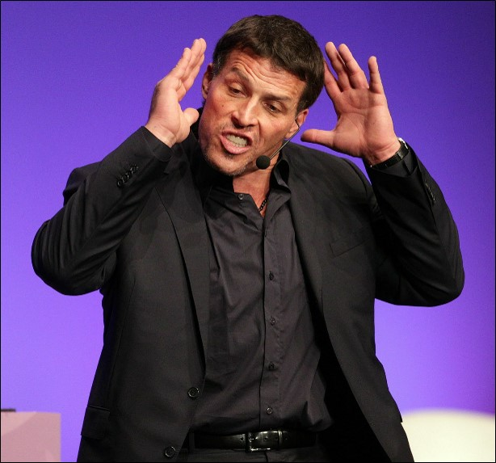
VISUAL

Slide 112
YOUR VISUAL IMAGE
Your voice never conveys your whole message. Nor does your choice of words. A critical part of your presentation success is your personal appearance; your posture, eye contact, facial expressions, head movements, gestures and dress.
Avoid Distractions
  Swaying or rocking
  Pacing too much
  Thumping or tapping
  Staring at notes
  Jingling keys or coins
  Slouching or slumped shoulders

Slide 113
NON-VERBAL DOS
You will connect with your listeners when you look at them. You will feel more relaxed, less isolated and your audience will have more confidence in you.
Eye Contact
  With small group, focus on each person
  With a large group use the 10 AM, 12 PM, 2 PM and 4 PM approach, or pick out several friendly faces, address each person and move on
Head movements convey information
  Nodding = affirmation
  Shaking = denial or disagree
  Tilting = curiosity or uncertainty
  Holding head high = confidence

Slide 114
NON-VERBAL DON’TS
Facial Expression
  Do not tense facial muscles
  Do not smile constantly
  Do not over use poker face
Posture
  Stand straight… but not stiff!
  Point feet at audience with weight evenly distributed
  DO NOT put hands in pockets
      Cross arms
      Wring hands
      Cling for life!

Slide 115
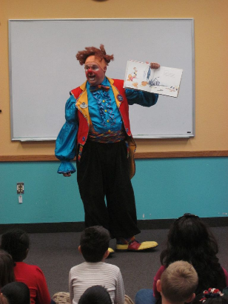
DRESS
  Dress for your audience (audience “level” plus one)
  Be conservative
  Aim for neat

Slide 116

STRESS REDUCERS
Fear: A distressing emotion aroused by an impending pain, danger or evil; or by the illusion of such. According to some surveys, presenting before a group
is a leading “fear creator”. No matter what nervous symptoms you experience before your audience, the secret is to control nervousness - not eliminate it.

Slide 117
STRESS REDUCERS
Physical
Deep breathing
Psychological
Acceptance
Exercising
Eye contact (Think “Old School” Dr. Pepper)
Positive attitude
Visualization
Worst/best case
Practice
Perspective
Caffeine

Slide 118
POP QUIZ!
True or False
T or F 1. V3 has to do with the three most important elements of writing training objectives.
T or F 2. A transition can be used in place of an adjective.
T or F 3. When speaking to your training audience you should use a filler word when you lose your train of thought.
T or F 4. Vocal has to do with the expressions we use.
T or F 5. The faster you speak, the more energy you generate with your audience.

Slide 119
YOUR TURN!
You will be making a 5-10 minute training presentation on any topic that you like.
You may use any media or props you like. If they are not available in the current training room, you may provide them yourself.
You must use at least two types of the following media:
PowerPoint, Video, Flipchart/Whiteboard and/or Handouts (See Page 36)
You must use at least 3 Participative Training Methods (See page 49).

Slide 120
YOUR PRESENTATION
Your presentation will be observed by your class mates (see following pages).
You will also observe others (see following pages)!
Observation feedback should be candid and respectful. We are all here to learn together.
You will have 30 minutes to prepare at the beginning of the next session, but you may also prepare between classes.

Slide 121
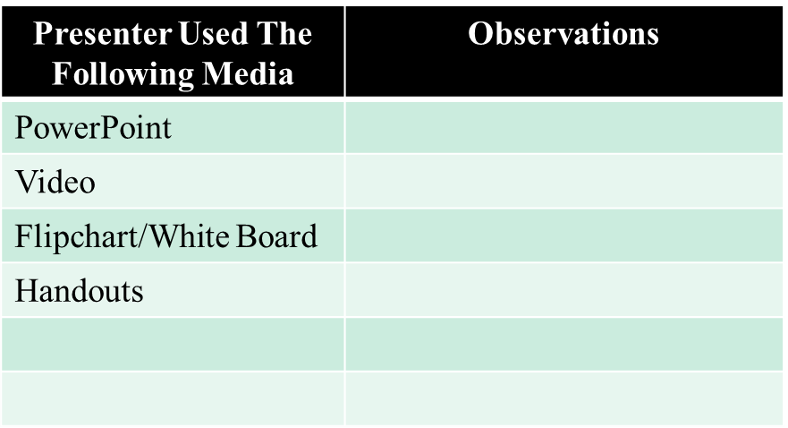
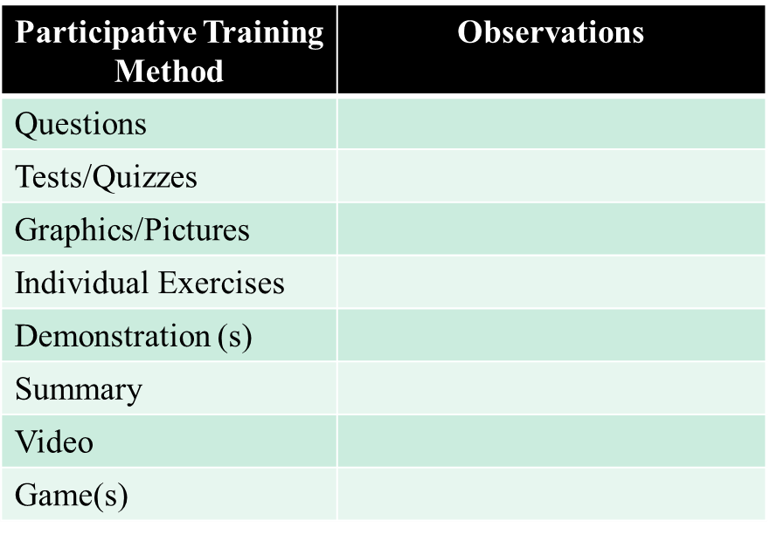
OBSERVATION SHEET 1
Good Trainer Characteristics (Page 15)

Slide 122

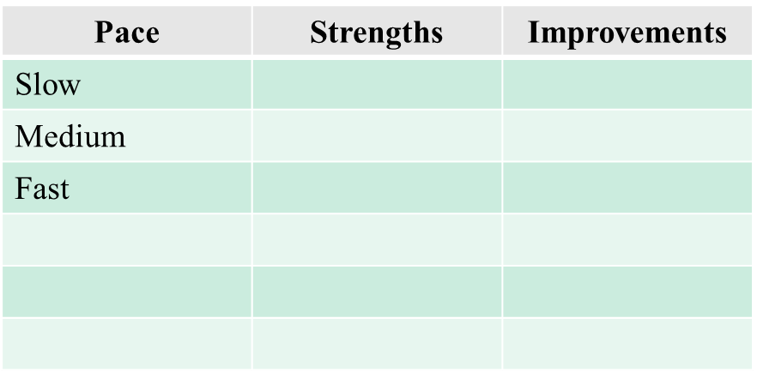
OBSERVATION SHEET 2

Slide 123


OBSERVATION SHEET 3

Slide 124


OBSERVATION SHEET 4

Slide 125




IMPROVEMENT NOTES

Slide 126



IMPROVEMENT NOTES

Slide 127
QUESTIONS
Notes:
State:
(Tally up the “winners” based on the flipchart scores)
Have the participants give the winners a hand.
Explain to the winners that they just received their reward! for winning!
Also, give them each a fruit snack.
Ask:
If there are questions.
Target Response/Key Points
None

