Slide 1
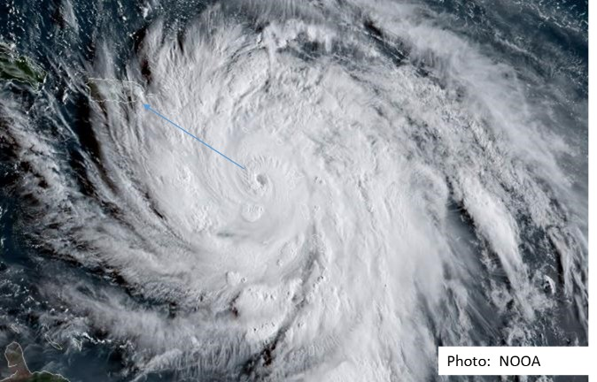
Safety measures after a hurricane:
"Keeping workers safe from chemicals, electric, fall hazards, caught or struck by and dangers on the road during reconstruction, after a hurricane"
Notes:
TRAINERS NOTES:
An effective safety program for workers mobilized in a disaster area must have provisions for the systematic identification, evaluation and the prevention or control of General hazards in the workplace, of specific hazards for a particular task and for potential hazards that may be caused by predictable conditions.
A good safety program will be distinguished more by its practical effectiveness than for its technical depth. None the less it must have the capability of being adaptable to complex situations. Therefore the document must be coherent, clear and based on sound safety practices. It must include at least the basics of a good management system such as management leadership, employee participation, identification , control and prevention of hazards, training, and clear communication between all parties affected.

Slide 2
Disclaimer
This material was produced under Susan Harwood grant number SH31182-SH7 Occupational Safety and Health Administration, U.S. Department of Labor and previously prepared material by NIH. The contents in this presentation do not necessarily reflect the views or policies of the U.S. Department of Labor, nor does the mention of trade names, commercial products, or organizations imply endorsement by the U.S. Government..

Slide 3
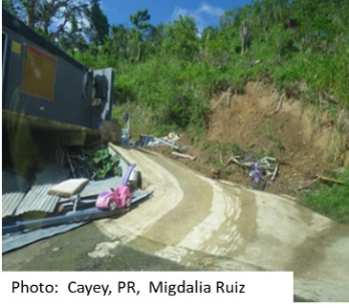
Training Objectives
Identify the hazards in the field
Explain how to protect yourself from these hazards
Increase safety and health awareness
Notes:
TRAINER NOTES:
State and federal agencies deploy in support of hurricane relief efforts
Environmental and occupational health hazards are a potential threat to deployed personnel
Hurricane at or above category 4 can create devastation on their path. It is extremely important to heighten the safety awareness of these workers.

Slide 4
Workers’ Rights
What are employers' responsibilities?
The Occupational Safety and Health Act requires employers to provide a safe and healthful workplace free of recognized hazards and to follow OSHA standards. Employers' responsibilities also include providing training, paying for medical examinations when required by a standard and maintaining injury and illness records.
For more information about OSHA, go to http://www.osha.gov or call 1-800-321-OSHA (6742)
Notes:
TRAINER NOTES:

Slide 5
Workers’ Rights (continued)
What are workers' responsibilities?
Follow the employer's safety and health rules and wear or use all required gear and equipment.
Follow safe work practices for your job, as directed by your employer.
Report hazardous conditions to a supervisor.
Report hazardous conditions to OSHA, if employers do not fix them.
Notes:
TRAINER NOTES:
For compliance with local laws and responsibilities please refer to your state or territory applicable safety law

Slide 6
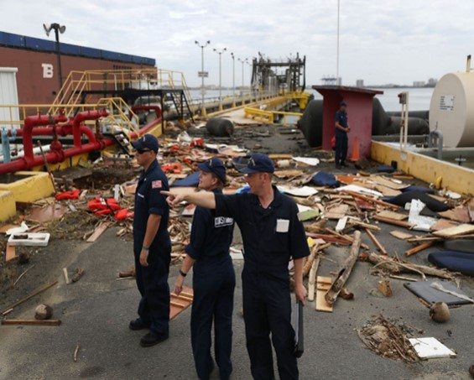
Hazard Analysis
Personnel from the US Coast Guard examine the damage done to a petroleum port after hurricane María passed through this area on September 20, 2017 in San Juan, Puerto Rico. (Photo: Joe Raedle / Getty Images
Notes:
TRAINER NOTES:
Identification of potential hazards wthin a disaster area
Start by recognition. Note the work environment. Ask employees how they carry out their work. Look for potential sources of injuries such as:
• Objects that can fall.
• Pipelines or exposed beams at the working level.
• Exposed liquid chemicals.
• Sources of heat, bright light, noise or dust.
• Equipment or materials that could release particles into the air.
A good way to measure the noise: If you need to raise the voice so people can hear you, means that it is necessary to wear ear protection.
The permissible exposure to noise for the construction industry is currently 90 DB for a duration of 8 hours.
Consult the thecnical links from OSHA reegarding noise and hearing protection
-- www.osha-slc.gov/SLTC
-- www.osha.gov/SLTC/constructionnoise/index.html

Slide 7
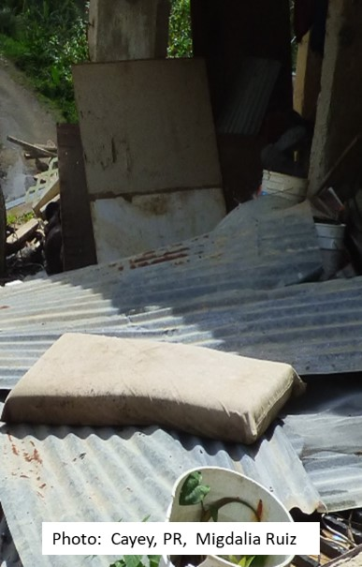
Health Hazards

Slide 8
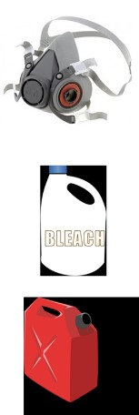
Potential Chemical Exposures
Symptoms: Eye, nose, throat, upper respiratory tract, and skin irritation; flu like symptoms; central nervous system depression, fatigue, loss of coordination, memory difficulties, sleeplessness, mental confusion. Chronic effects depend on the extent and the duration of exposure.
Works affected
Debris removal - there may be paint, solvents, corrosive, among others.
Cleaning of a place - requires use of detergents, bleach or disinfectant.
Spraying for pests such as rodents or mosquitoes, or spraying for mold removal by use of biocides.
Filling up fuel, oil in equipment and machinery.
Notes:
TRAINER NOTES:
Photos from 3M.com, http://www.clker.com/ (free clipart)
Fire Fighting or Entry into unknown concentration: Use Self Contained Breathing Apparatus (SCBA) with full face piece in pressure demand or other positive pressure mode.
Rescue operations with vapors present: Use gas mask with front mounted organic vapor canister (OVC) or chemical cartridge respirator with an organic vapor cartridge
Dusty environments: Use combination HEPA/Organic Vapor Cartridge.
General cleaning: Use at least a particulate respirator (N95) if mold or dust is present
Hazardous materials spills, leaks, and releases (including oil)
The release, spill, or leak of any hazardous material (including oil) shall be reported to U.S. EPA and/or USCG for appropriate handling. The cleanup of hazardous materials releases will be handled by properly trained and protected individuals in accordance with the requirements of 29 CFR 1910.120.
In case of unanticipated discoveries, such as tanks, drums, or cylinders of hazardous materials, or unexploded ammunitions, all work shall cease in the vicinity, the area shall be cordoned off, and appropriate public safety agencies shall be summoned.

Slide 9
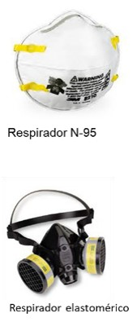
Hazard: Inhalation of Dust Containing Asbestos, Silica and Other Toxins
Present on removal and disposal of debris, while loading trucks and during demolition work.
Use only NIOSH approved respirators.
A N-95 respirator is acceptable for the majority of the activities, including silica and Portland cement dust.
If there is asbestos, use a half-face elastomeric respirator with filter N, R, or P-100 series.
The use of respirators must comply with the requirements of the OSHA respiratory protection standard.
If in doubt about respirators, ask your supervisor or competent person.
Notes:
TRAINER NOTES:
A medical evaluation is required prior to using a respirator other than a nuisance dust mask. Protect yourself from breathing dust, it can contain toxic material.
Make sure you are fit-tested for a respirator, it must fit properly to protect you.
Surgical masks should not be used because they do not provide adequate protection.
If in doubt about respirators, see your supervisor.
An N-95 or greater respirator is acceptable for most activities, including silica and portland cement dust.
If asbestos is present, use a half-mask elastomeric respirator with N,R, or P-100 series filters.
If airborne contaminants are causing eye irritation, full-face respirators with P-100 OV/AG combination cartridges should be used. Do a positive and negative seal check every time you wear your respirator and wash it at least once a day.

Slide 10

Chemical Exposure(cont.)
Protection
After the hazard identification, the use of personal protective equipment may be required:
Goggles, face shields
Safety gloves (nitrile, neoprene, butyl)
Safety shoes
Apron or coverall for the body
Notes:
TRAINER NOTES:
Photos from Lowes.com and 3M.com
Other Personal Protection Equipment : consider the use safety shoes/boots, gloves, eye and face protection and protective clothing depending upon the task at hand. Safety shoes and gloves may vary depending on which chemical is present at the site.
To obtain more information on required equipment, contact the nearest OSHA or NIOSH office

Slide 11

Chemical Exposure (cont.)
Protection
Identify the hazards of the material according to the pictograms on the label on the container.
Use of cleaners, disinfectants and pesticides, among others, will require the Safety Data Sheet (SDS) to determine the danger and appropriate protections when handling the product.
Notes:
TRAINER NOTES:
Chemical exposure : always read the labels and SDS of chemical products such as cleaners, disinfectants, pesticides and others to properly identify safety measures when handling using and disposing of such materials
Workers must be made aware of the potential hazards, personal hygiene, and personal protective measures required when handling chemical materials.
Each agency and contractor will establish a hazard communication program in conformance with 29 CFR 1910.1200. Safety data sheets (SDS) will be maintained by the individual employers, and will be shared upon request with employees, other agencies, and other contractors. Employees shall be informed of the existence and location of SDSs. Containers of chemicals shall be labeled with the contents, hazards, and target organs.

Slide 12
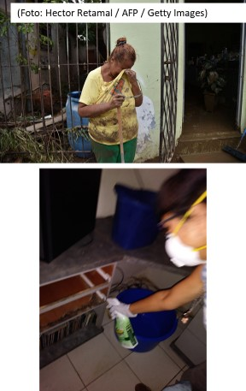
Hazard: Mold
Symptoms: sneezing, severe nasal irritation, and possibly accompanied by eye and skin irritation.
At a minimum, use a N-95 disposable respirator approved by NIOSH for working with wet or moldy materials.
Wear long gloves that reach you until the forearm. If you use a disinfectant, a biocide such as chlorine or a strong cleaning solution, you must choose neoprene, nitrile, polyurethane or PVC gloves.
Avoid touching mold or moldy things with unprotected hands.
Notes:
TRAINER NOTES:
Avoid breathing dust (fungal spores) generated by wet building materials. Use an N-95 NIOSH-approved disposable respirator as a minimum when working with moldy or damp materials.
Wear long gloves that reach the middle of your forearm. If you are using a disinfectant, a biocide such as chlorine bleach, or a strong cleaning solution, you should select gloves made from natural rubber, neoprene, nitrile, polyurethane, or PVC. Avoid touching mold or moldy items with your bare hands. Wash exposed skin immediately after contact with spores.
Consider discarding all water-damaged materials.

Slide 13

Hazard: Carbon Monoxide Inhalation
Symptoms: Headache, dizziness, drowsiness, or nausea; progressing to vomiting, loss of consciousness, and collapse, coma or death under prolonged or high exposures.
Carbon Monoxide has no warning properties;
it is a colorless, odorless gas!
Areas affected from gasoline- or propane-powered generators or heavy machinery:
  Near operating equipment
  Near generators
  Fire pits
  Debris reduction sites
  Burning and compacting
Notes:
TRAINER NOTES:
General Recommendations:
Use CO warning sensors when using or working around combustion sources.
Shut off engine immediately if symptoms of exposure appear.
Warning! Do not use gasoline generators or portable fuel driven tools in confined spaces or poorly ventilated areas.
Warning! Do not work in areas near the generator exhaust (CO poisoning occurs even outdoors if engines generate high concentrations of CO and worker is in the area of the exhaust gases). If symptoms of exposure appear, shut off the engine.
OSHA 1926.302(c)
If using a fuel powered tool in an enclosed area such as a trench, be aware that carbon monoxide generated can displace or deplete oxygen. Mechanical ventilation and testing needs to be done.

Slide 14
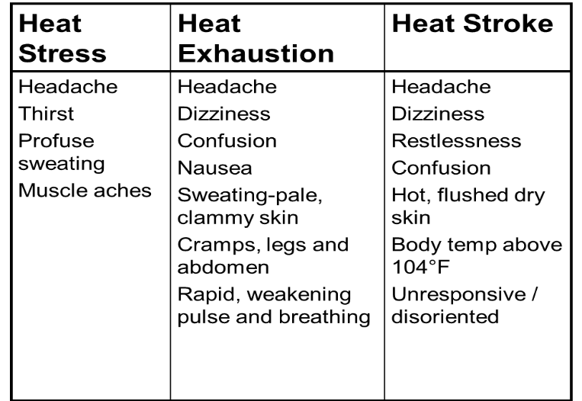

Hazard: Heat Related Illness
Notes:
TRAINER NOTES:
Photo: Tony Emmolo
Know the signs of heat-related illnesses. Monitor yourself and coworkers and use the buddy-system
Block out direct sun or other heat sources. Work under a shade if possible and wear lightweight, light-colored, loose-fitting clothes
Use cooling fans/air-conditioning and rest regularly. Drink lots of water, about 1 cup every 15 minutes
Avoid alcohol, caffeinated drinks, or heavy meals
Get medical help for symptoms such as altered vital signs, confusion, profuse sweating, excessive fatigue
Take shelter in shaded areas and, for firemen, unbutton and remove bunker gear.

Slide 15
Heat Stress and Heat Stroke
Drink plenty of fluids. Hydration is Critical!!
Take regular rest periods, and protect yourself in the shade
Know the symptoms of heat related illness
Be watchful of yourself and others
Block direct sunlight or other heat sources, if possible
Use light colored clothes, that fit loosely
Avoid alcohol, caffeine beverages or heavy meals
Get medical help if your vital signs are altered, if you feel confused, if you are sweating heavily or if you feel excessively tired while working
Notes:
TRAINER NOTES:
Excessive heat presents a serious hazard for employees. When the body is unable to cool itself by sweating, several heat-induced illnesses such as heat stress or heat exhaustion and the more severe heat stroke can occur, and can result in death. High temperature and humidity, direct sun or heat, limited air movement, physical exertion, poor physical condition, some medicines, and inadequate tolerance for hot environments are all factors that can lead to heat stress.
To help prevent heat stress, workers and supervisors should be familiar with the signs and symptoms of heat-related illnesses, and should be monitored for same. Direct sun or other heat sources should be blocked, if possible. Cooling fans, air conditioning, or misting should be provided when possible. Regular rest periods should be permitted. Workers should drink when they are thirsty. Drink sports drinks, instead of water, if possible; avoid alcohol, caffeinated drinks, or heavy meals. Workers should wear lightweight, light-colored, loose-fitting clothes.

Slide 16
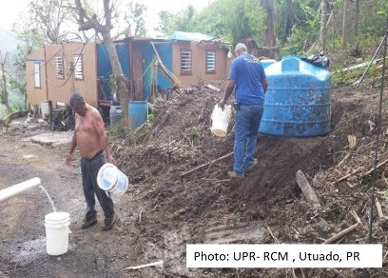
Hazard: Water-borne Disease
Communicable disease outbreaks of diarrhea and respiratory illness can occur when water and sewage systems are not working and personal hygiene is hard to maintain as a result of a disaster.
Wash Your Hands Often With Soap and Use Water-Free Sanitizers!!
Notes:
TRAINER NOTES:
Listen to and follow public announcements.
Local authorities will tell you if tap water is safe to drink or to use for cooking or bathing.
If the water is not safe to use, follow local instructions to use bottled water or to boil or disinfect water for cooking, cleaning, or bathing.
Wash Your Hands often.
If you develop a high fever OR, nausea, vomiting, diarrhea, jaundice or flu-like symptoms, seek medical attention immediately!

Slide 17

Hazard: Animals and Insects
Fire ants and spiders
Protect yourself from mosquitoes:
  Use screens on dwellings.
  Wear long pants, socks, and long-sleeved shirts.
  Use insect repellents that contain Deet or Picaridin.
  Eliminate mosquito harvesting areas.
  It might be necessary to apply pesticides such as larvae poison to control insect population.
Notes:
TRAINER NOTES:
Picture from https://www.gograph.com/vector-clip-art/mosquito.html (free clipart)
To control mosquito populations, drain all standing water left in open containers, such as flower pots, tires, pet dishes, or buckets, outside your home.
To help avoid insect and snake bites, observe areas before beginning work to locate nests or creatures. Try to avoid working in standing water. Use caution before reaching into voids or other spaces. If possible, map likely problem areas and warn workers. Workers should use insect repellent containing DEET; repellent should be used and reapplied according to the manufacturer’s instructions. Workers should be encouraged to wear long pants and sleeves, if practical (balanced with heat stress concerns). Identify persons with allergies and either administratively control exposure or coordinate with medical authorities for first aid supplies (including auto-injector medications, if indicated)
Mosquitoes – Mosquitoes can carry diseases such as West Nile virus or dengue fever. Use screens on dwellings, and wear long pants, socks, and long-sleeved shirts. Use insect repellents that contain DEET or Picaridin. (Make sure you follow the directions written on the label.)
• Fire Ants – Flood water will often destroy fire ant mounds and the fire ants will look for a new place to live (this can be indoors or outdoors). Fire ant bites are painful and cause blisters and/or severe allergic reactions in some people. To avoid being bitten, stay alert for fire ants and stay away from them. Wear long pants, socks, and long-sleeved shirts to protect your skin. Treat stings with over-the-counter products that relieve pain and prevent infection. If chest pain, nausea, severe sweating, shortness of breath, swelling or slurred speech occurs following a sting, the person should be immediately taken to an emergency medical facility.
• Spiders – Depending on the area of the country black widow and brown recluse spiders maybe present. If you suspect being bitten by a venomous spider seek medical attention and bring in the spider if available for identification.

Slide 18
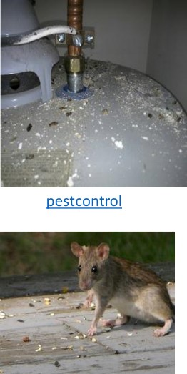
Hazard: Animals
Be aware of rodents:
  Avoid touching surfaces, without glove protection, where there is evidence of rodents. You could be at risk of contracting Leptospirosis.
    Symptoms – fever, headaches, shivers, vomit, strong leg discomfort or pain
  If you show any symptoms and suspect contact with rodent contaminated surfaces, seek medical help immediately.
  Do not manipulate dead animals . Report this situation to local authorities
Notes:
TRAINER NOTES:
Picture from pestcontrol.
To control animal populations,
Flood waters may have displaced wild and domestic animals. It will therefore not be uncommon to come into contact with animals you usually wouldn’t under normal circumstances. Dead and live animals can spread diseases such as Rat-Bite Fever and Rabies.
• Beware of wild or stray animals. Avoid wild or stray animals. Call local authorities to handle animals. Get rid of dead animals according to local guidelines. Wear proper protective clothing when handling carcasses.
• Avoid contact with rats or rat-contaminated dwellings. In addition to Rat bite fever, contact with rodents, rodent droppings, and dead rodents may result in other infectious diseases. If you cannot avoid contact with rats, wear protective gloves, practice regular hand washing.
• If you do get bitten or scratched by an animal, seek medical attention immediately, even if it is a domestic animal.

Slide 19
Additional Protective Measures
Key items to have:
Personal floatation device (life vest)
Earmuffs
Bottled water
Sunscreen
Rain gear
First aid kit with alcohol, or iodine for disinfecting cut and scrapes
Notes:
TRAINER NOTES:
Other equipment:
Lifejacket
Earplugs
Bottled water
Anti-sunburn lotion
Waterproof clothing
See fact sheet on the personal protective equipment which can also be found in Spanish at the address:-www.osha.gov/OshDoc/toc_fact.html
See the publications: - OSHA 3077, Personal Protective Equipment (Personal protective equipment)
- OSHA 3151, Assessing the Need for Personal Protective Equipment: A Guide for Small Business Employers (assessment of the need for protective equipment (staff: Guide for employers of small businesses)

Slide 20
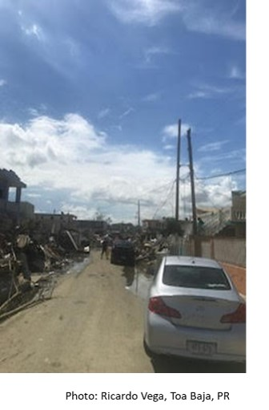
Physical hazards
Notes:
TRAINER NOTES:
Physical hazards include electrical, road hazards, fall hazards and tool handling among others

Slide 21
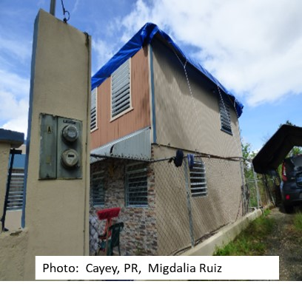
Hazard: Falls
To protect from falls
Use railings or safety nets
Cover all openings or holes as soon as they produced.
Make sure that covers to protect openings in the floor can withstand twice the weight of workers, equipment and materials.
Workers must be careful that tools do not fall to a lower level where there might be people below
Notes:
TRAINER NOTES:
Employees shall be protected from falls greater than six feet to a lower level. Fall protection such as guardrails, coverings over floor holes, or personal fall arrest systems can be used.
A qualified person must determine if the walking / working surface is adequate to support the weight of workers, tools, and materials. This is especially important in areas that have been compromised by floodwaters or suffered structural damage from high winds.
Use of scaffolds shall conform to 29 CFR 1926 Subpart L. Use of ladders shall conform to 29 CFR 1926 Subpart X. The use of aerial lifts and scissor lifts shall conform to the applicable portions of 29 CFR 1926 as well as relevant ANSI standards.
Workers shall pay extra attention to the walking / working surfaces to minimize slip/trip/fall hazards. Extra care should be exercised when stepping into areas that are unstable or uneven, such as debris field, or where the surface cannot be visualized (i.e., if covered by water).
Objects that may dislodge and fall, especially broken glass, present a serious hazard to employees. Whenever possible, such objects or glass should be removed before employees work beneath them. If objects cannot be removed, then controls such as debris netting, sidewalk sheds, canopies, or catch platforms shall be installed.

Slide 22
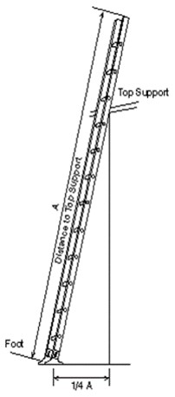
Hazard: Falls from Ladders
Ladders can create a falling hazard. Make sure your ladder is secured:
  Position portable ladders so the side rails extend at least 3 feet above the landing.
  Secure side rails at the top to a rigid support and use a grab device when 3 foot extension is not possible.
  Do not apply more weight on the ladder than it is designed to support and make sure that the weight on the ladder will not cause it to slip off its support.
  Before each use, inspect ladders for cracked, broken, or defective parts.
  Use only ladders that comply with OSHA standards.
Notes:
TRAINER NOTES:
You risk falling if portable ladders are not safely positioned each time they are used. While you are on a ladder, it may move and slip from its supports. You can also lose your balance while getting on or off an unsteady ladder. Falls from ladders can cause injuries ranging from sprains to death.
• Position portable ladders so the side rails extend at least 3 feet above the landing
• Secure side rails at the top to a rigid support and use a grab device when 3 foot extension is not possible.
• Make sure that the weight on the ladder will not cause it to slip off its support.
• Before each use, inspect ladders for cracked, broken, or defective parts.
• Do not apply more weight on the ladder than it is designed to support.
• Use only ladders that comply with OSHA standards.

Slide 23
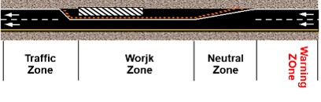
Road Zone Hazards
Check the condition of the road; slopes, landslides or debris.
There has to be a traffic control plan for the movement of vehicles, with legible traffic signs.
When signs and barricades may not offer adequate protection to the worker, there must be properly trained persons to give warning signs.
Watch for drivers and possible passers.
Notes:
TRAINER NOTES:
§1926.201 Signaling
Flagmen
When operations are such that signs, signals, and barricades do not provide the necessary protection on or adjacent to a highway or street, flagmen or other appropriate traffic controls shall be provided.
Signaling directions by flagmen shall conform to American National Standards Institute D6.1-1971, Manual on Uniform Traffic Control Devices for Streets and Highways.
Hand signaling by flagmen shall be by use of red flags at least 18 inches square or sign paddles, and in periods of darkness, red lights.
Flagmen shall be provided with and shall wear a yellow or orange warning garment while flagging. Warning garments worn at night shall be of reflectorized material.

Slide 24
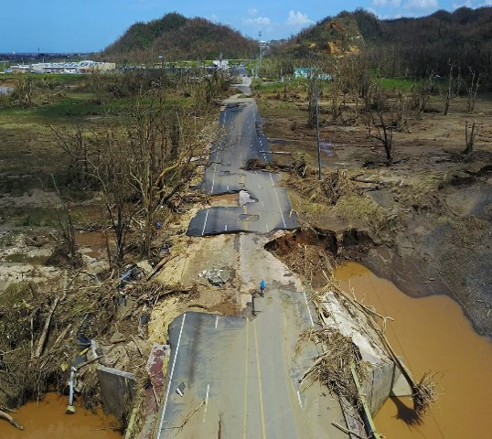
Road hazards – Landslides
Notes:
Notas para el capacitador;
Foto: Toa Baja, PR Vox.com
Lluvias intensas e inundaciones pueden destrozar las vias de rodaje, ya sea por deslizamientos o por alterar la superficie de las vias.

Slide 25
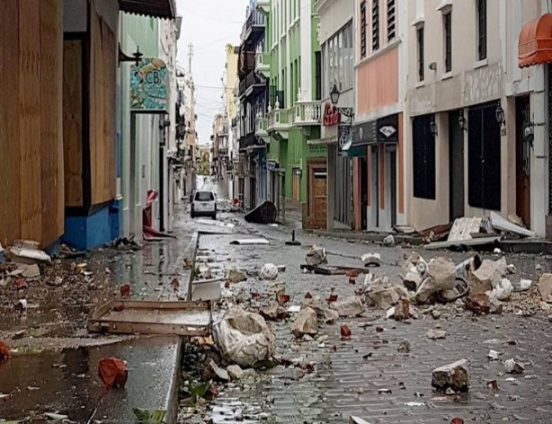
Road Hazard - Debris
Notes:
Notas para el capacitador:
Foto: San Juan, Reuters news
Los peligros en la carretera pueden surgir de estructuras cercanas donde el efecto de los vientos afecte esructuras creando escombros de todo tipo

Slide 26
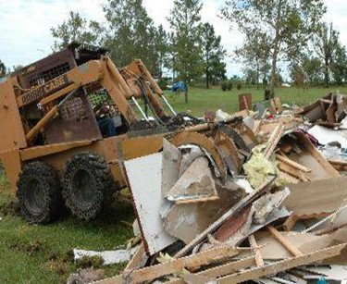
Hazard: Struck/Caught by Heavy Equipment
OSHA requires all machinery be inspected by the worker prior to use
Be alert of all activities in the area.
Do not exceed the load capacity of cranes and other lifting equipment.
Do not walk under or through areas where cranes and other heavy equipment are lifting objects.
Do not climb onto or ride loads being lifted or moved. Do not ride in or on buckets, forks or blades of heavy equipment.
Notes:
TRAINER NOTES:
Photo NIH
Operate equipment correctly and safely.
Inspect by a qualified worker before each use

Slide 27
Hazard: Electrical, Overhead Power Lines, Downed Electrical Wires, Cables
Hazard Control
Stay clear of downed electrical lines. Assume all powerlines are energized
Use appropriately grounded low-voltage equipment.
Use ground fault circuit interrupters (GFCI).
Jobs Affected
Debris removal
Tree pruning
Notes:
TRAINER NOTES:
Treat all power lines and cables as energized until proven otherwise. Workers most at risk are removing debris from roadsides and in the process of pruning trees.
Verifying that a line is not energized may not ensure your safety. Lines on both the load and supply side of the work area must be grounded. Grounding is necessary to protect you from the hazards of feedback electrical energy from a secondary power source, such as a portable generator.
When an electrical shock enters the body it may produce different types of injuries. Electrocution results in internal and external injury to body parts or the entire body – often resulting in death. After receiving a “jolt” of electricity all or part of the body may be temporarily paralyzed and this may cause loss of grip or stability. A person may also involuntarily move as a result of receiving an electrical shock, resulting in a fall. Internal or external burns may result from contact with electricity.
Electricity travels in closed circuits, and its normal route is through a conductor. Electric shock occurs when the body becomes a part of the circuit.
Grounding is a physical connection to the earth, which is at zero volts.
The metal parts of electric tools and machines may become energized if there is a break in the insulation of the tool or machine wiring. A worker using these tools and machines is made less vulnerable to electric shock when there is a low-resistance path from the metallic case of the tool or machine to the ground. This is done through the use of an equipment grounding conductor—a low-resistance wire that causes the unwanted current to pass directly to the ground, thereby greatly reducing the amount of current passing through the body of the person in contact with the tool or machine.
OSHA 1926 Subpart K ‑ Electrical 1926.416, 1926.417
Employees must not work near any part of an electric power circuit that the employee could contact in the course of work, unless the employee is protected against electric shock by de-energizing the circuit and grounding it or by guarding it effectively by insulation or other means.
* In work areas where the exact location of underground electric power lines is unknown, employees using jack‑hammers, bars, or other hand tools which may contact a line shall be provided with insulated protective gloves.
* Before work is begun, inquire or observe by instruments whether any part of an energized electric power circuit is so located that the performance of the work may bring any person, tool, or machine into physical or electrical contact with the electric power circuit. Post and maintain proper warning signs where such a circuit exists. The employer shall advise employees of the location of such lines, the hazards involved, and the protective measures to be taken.

Slide 28
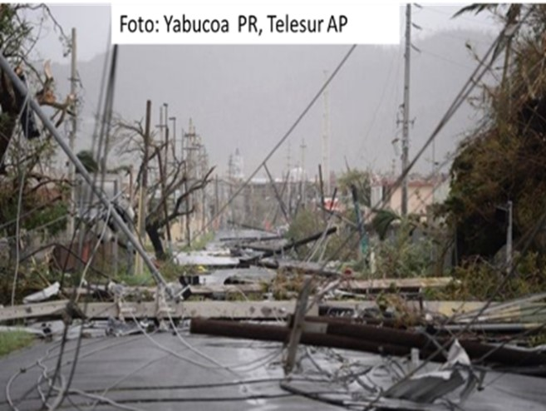
Overhead lines, high voltage
Notes:
TRAINERS NOTES :
Pretend that all cables and electrical wires are electrically energized until proven otherwise. Workers who are more exposed to risks are those who removed debris from roads or highways and the prune trees.
The employee may not work near any part of an electric circuit which could enter into contact during their work, unless the employee has already protected against electric shock it by cutting off power to the circuit and grounding it, or protecting it effectively by insulation or other means.

Slide 29
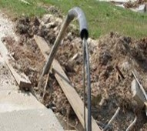
Hazard: Exposed
Underground Power Lines
Avoid dangers by
Locating aerial high-voltage cables and indicators pointing to where there are buried electrical cables. Put warning signs.
Contacting the utilities companies to know where are the buried electrical cables.
Staying at least 10 feet away from high voltage conductors.
Making the owner or operator of the wires cut electricity and put ground wires when working near them.
Other measures of protection include protecting or insulating wires.
Use nonconductive wood or fiberglass ladders when working near electrical wires.
Notes:
TRAINER NOTES:
This is an example of damaged and exposed power lines and cables.
Whenever you work with power tools or electrical circuits there is a risk of electrical hazards, especially electrical shock. Risks are increased at construction sites because many jobs involve electric power tools.
Electrical trades workers must pay special attention to electrical hazards because they work on electrical circuits. Coming in contact with an electrical voltage can cause current to flow through the body, resulting in electrical shock and burns. Serious injury or even death may occur.
Avoid Hazards
Look for overhead power lines and buried power line indicators. Post warning signs.
Contact utilities for buried power line locations.
Stay at least 10 feet away from overhead power lines.
Unless you know otherwise, assume that overhead lines are energized.
Get the owner or operator of the lines to de-energize and ground lines when working near them.
Other protective measures include guarding or insulating the lines.
Use non-conductive wood or fiberglass ladders when working near power lines.
All electrical equipment, including generators, extension cords, lighting, and power tools, shall meet applicable OSHA, NFPA, and NEC standards. Ground fault circuit interrupters (GFCI) shall be installed on all 15A and 20A temporary wiring circuits.

Slide 30
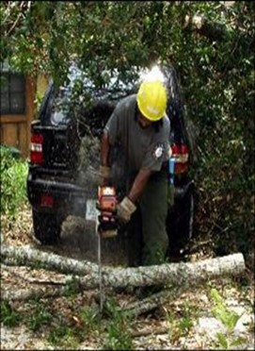
Hazard: Struck by while Operating a Chain Saw
Operate, adjust and provide maintenance to the saw according to the manufacturer's instructions.
Sharpen and lubricate correctly the blade with special lubricant ("bar and chain oil").
The operator must review and periodically adjust blade tension to ensure a good cut.
Choose the correct size of saw according to the work.
Include safety considerations like brake chain, front and rear hand guards, stop switch, ratchet chain and the spark arrestor.
Notes:
TRAINER NOTES:
Photo NIH
OSHA 1926 Subpart I - Tools – Hand and Power
Operate, adjust, and maintain the saw according to manufacturer’s instructions provided in the manual accompanying the chain saw.
Ensure the chain is sharpened and lubricated. If you notice that the saw is cutting crooked, or the cut shows fine sawdust instead of chips, or you find yourself pressing down hard to keep cutting, or smell burnt wood, your saw needs sharpening. Follow the instructions outlined in the owner's manual when sharpening the chain. Use bar and chain oil to lubricate. Additionally, the operator should periodically check and adjust the chain tension to ensure good cutting action.
Choose the proper size of chain saw to match the job. Choose a chain saw that includes safety features such as a chain brake, front and rear hand guards, stop switch, chain catcher and a spark arrester.

Slide 31
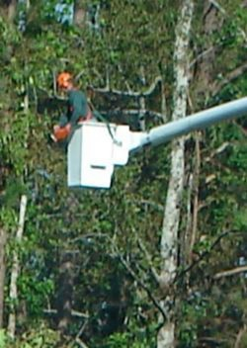
Hazard: Struck by While Operating a Chain Saw (cont.)
Wear the appropriate protective equipment
  Hard hat and safety glasses
  Ear protectors
  Gloves for heavy work
  Protection for legs (cuts)
Always cut at waist level or below
Avoid contact with power lines
Bystanders or coworkers should remain at least:
  2 tree lengths (at least 150 feet) away from anyone felling a tree.
  30 feet from anyone operating a chain saw to remove limbs or cut a fallen tree.
Notes:
TRAINER NOTES:
Photo from NIH
Wear the appropriate protective equipment:
Hard hat
Safety glasses
Hearing protection
Heavy work gloves
Cut-resistant legwear (chain saw chaps) that extend from the waist to the top of the foot, and boots which cover the ankle.
Avoid contact with power lines until the lines are verified as being de-energized.
Always cut at waist level or below to ensure that you maintain secure control over the chain saw.
Bystanders or coworkers should remain at least 2 tree lengths (at least 150 feet) away from anyone felling a tree and at least 30 feet from anyone operating a chain saw to remove limbs or cut a fallen tree

Slide 32
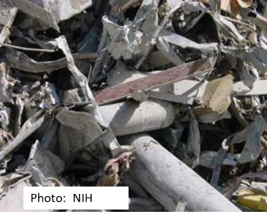
Hazards from Flying Debris/
Material Handling
Flying Debris
  Wear personal protective equipment, including hard hats, safety shoes, eye glasses, and work gloves to avoid injury
Material Handling
  Do not walk under or through areas where cranes and other heavy equipment are being used to lift objects
Notes:
TRAINER NOTES:
Always be aware of uneven surfaces and hidden hazards such as metals, glass, or puncture/ cut hazards when removing debris
Keep your tetanus vaccine up to date

Slide 33
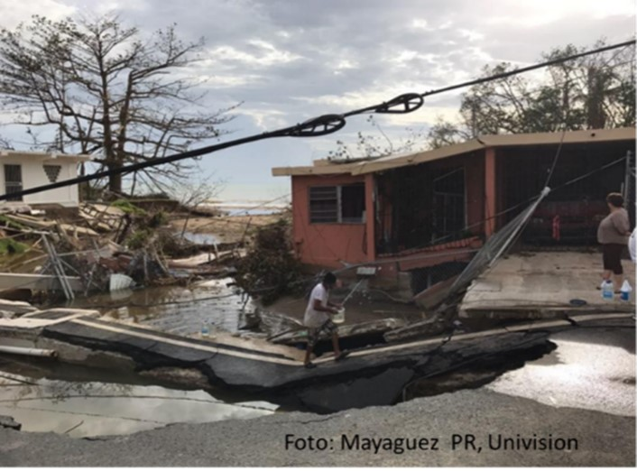
Fall and Tripping Hazards:
Debris and unstable surfaces

Slide 34
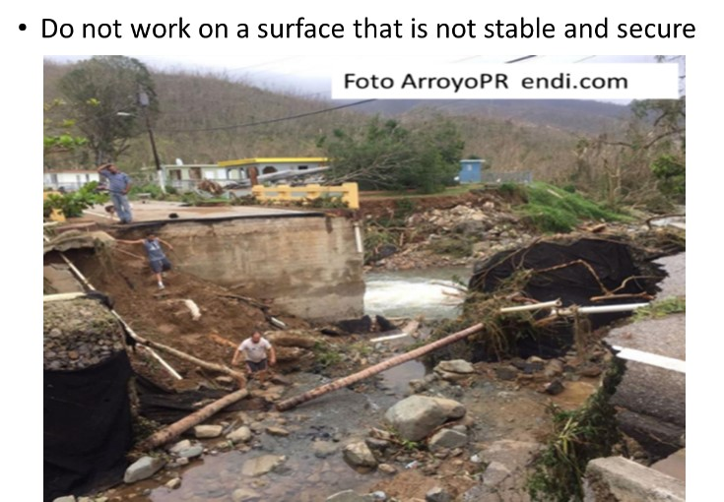
Fall and Tripping Hazards

Slide 35
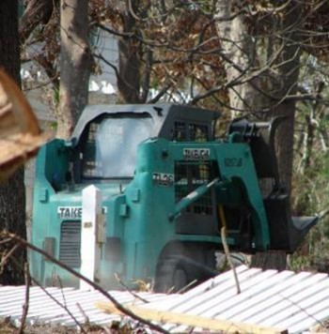
Hazard: Noise
Use appropiate protection for your ears when the work area is too noisy.
  Examples: chainsaws, dirt moving equipment, pneumatic tools, heavy equipment.
A worksite is considered noisy if you have to scream to be heard at a distance of only three (3) feet.
Notes:
TRAINERS NOTES:
1926.101 and 1926.52
Employee exposure to excessive noise varies upon certain conditions:
- How loud is the noise? Do you have to shout to be heard?
- How long is the employee exposed to that noise?
- Do employees move around so that the are exposed to different noise levels?
- Is the noise coming from only one source or different sources?
Hearing protection: use earplugs, ear muffs or a combination of both when working above the permitted noise levels. Refer to OSHA CFR 29, 1910.95.

Slide 36
Protect yourself
Consider using non-slip industrial boots with steel parts that protect you fingers and feet.
Use working gloves when handling debris
Use earmuffs if there is noise
If you have any questions, talk to your supervisor!

Slide 37
Protect yourself when…
Walking on top of unstable debris and handling them can result in wounds, scratches, bruises, or sprains.
  Keep up to date your tetanus vaccination
  If you are injured and the wound gets dirty, and your tetanus has more than 5 years, return to get vaccinated
  if taking care of patients or if in contact with the body fluids of victims, get vaccinated against Hepatitis B
Avoid coming into contact with standing water
  Standing water is unhealthy and can be contaminated. Wash and clean immediately with clean water if you touch it.
Notes:
Notas para el capacitador:
Always inform your supervisor about any observed hazards and immediately notify of any accidents or injuries while performing the task at hand.

Slide 38
Summary
The hazards and issues after a hurricane are dynamic and require vigilance and flexibility, especially during the recovery/ reconstruction phase.
The key to a safe response is attention to the safety issues of your work environment.
  The physical hazards are similar to those present in any construction or demolition site.
  The health hazards include the hazards associated with the environment such as presence of dusts, mold, or airborne contaminants.
Notes:
TRAINER NOTES:
All workers must adhere to the following work rules:
Follow their employer’s safety & health policies at all times.
Follow supervisors’ instructions and adhere to the chain of command.
Follow personnel accountability instructions; check-in and check-out.
Obtain vaccinations in conformance with the employer’s medical direction.
Promptly report all injuries, accidents, and near misses. Seek medical attention as needed.
Report all unsafe conditions. Do not perform tasks until proper safety & health controls have been put into place. Employees may refuse to perform tasks that expose them to an imminent danger.
Wear all personal protective equipment (PPE) needed for the task.
Maintain constant awareness of your surroundings.

Slide 39
Additional Information
This training program is based on recommendations from FEMA, NIEHS, NIOSH, OSHA, CDC, USACE and the Graduate School of Industrial Hygiene, University of Puerto Rico
  You can find a link to their fact sheets and other important information at the National Clearinghouse for Worker Safety and Health Training website, http://tools.niehs.nih.gov/wetp/
  More information on the OSHA website and these links:
  https://www.osha.gov/OshDoc/data_Hurricane_Facts/mold_fact.pdf
  https://www.osha.gov/SLTC/etools/hurricane/recommendations.html#ppe
  https://www.osha.gov/Publications/OSHA3698.pdf
  https://www.osha.gov/Publications/OSHA3713.pdf
  https://www.osha.gov/OshDoc/data_Hurricane_Facts/elect_safety.pdf
  https://www.osha.gov/OshDoc/data_Hurricane_Facts/floodcleanup.pdf
Notes:
TRAINER NOTES:
All agency and contractor personnel engaged in response operations must be trained to recognize and avoid hazards. This training is composed of several elements:
General and Site –specific training for disaster site workers. Site-specific training includes an overview of conditions specific to the locales where the employee will be deployed
Pre-deployment and pre-job briefings. These briefings are conducted on a daily basis by the worker’s immediate supervisor to cover the day’s work plan.
Task specific training, including any mandated training requirements. Task-specific training includes items such as hazard communication, PPE, use of tools, safety at elevations, etc. Training that is mandated by various agencies, such as OSHA, EPA, USCG, DOT, etc., shall be provided in accordance with those agencies’ guidelines.
Employers (agencies and contractors) shall maintain records of employee training available for inspection by agencies having jurisdiction. Training records include documentation such as, but not limited to, training certificates, attendance rosters, course curriculum matrices, etc. Employers shall provide competent and qualified persons as required by various standards. Training activities will be coordinated with the National Institute of Environmental Health Sciences (NIEHS), OSHA’s Office of Training and Education, and OSHA’s Ed Centers.

