Slide 1
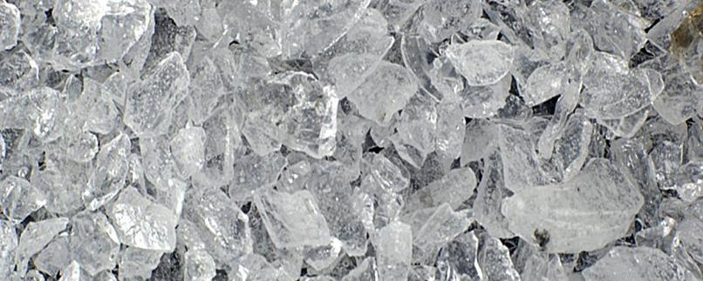
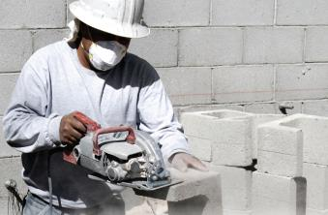
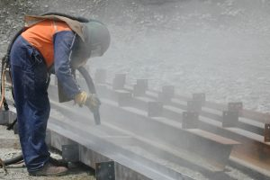
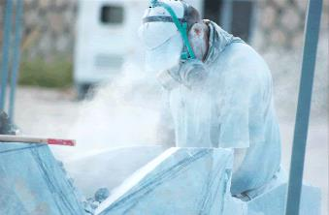
Respirable Crystalline Silica
Employee Safety Training
Notes:
This training is intended for employees that are exposed to respirable crystalline silica in their jobs.
Image credits:
http://www.accidentfund.com/newsletter/oshas-new-respirable-crystalline-silica-standard/
https://www.red-on-line.com/hse/2016/09/21/respirable-crystalline-silica-rule-corrected-003797
https://unitedsafetynet.com/product/silica-osha-safety-traning/
https://www.spi-s.com/en/blog/item/crystalline-silica-choosing-the-right-protective-mask

Slide 2
Disclaimer
This material was produced under grant number SH05047SH8 from the Occupational Safety and Health Administration, U.S. Department of Labor. It does not necessarily reflect the views or policies of the U.S. Department of Labor, nor does mention of trade names, commercial products, or organizations imply endorsement by the U.S. Government.

Slide 3

Trainee Learning Objectives
By the end of the training session, each trainee will be able to:
  Identify silica hazards in their workplace
  Describe controls to reduce silica exposure
  Understand the OSHA requirements for silica safety
  Identify specific steps they can take to reduce their exposure to silica hazards at their job
Notes:
These four learning objectives describe what the trainees will be able to do by the end of the training session.
Image credits:
1. https://www.communityvfd.com/ems-landing/checklist/

Slide 4
Course Roadmap
Section 1: Why Silica is Hazardous
Section 2: Controlling Exposure to Silica
Section 3: Employer Requirements & OSHA Silica Standard
Section 4: Summary and Practical Steps
Notes:
The training is divided into four sections. In the first section, trainees will learn why silica is hazardous. In the second section, trainees will learn ways to control exposure to silica. In section three, trainees will learn about employer requirements and the OSHA silica standard. They will also learn what their role is with regards to silica safety. In the last section, material will be summarized.

Slide 5
Why Silica is Hazardous
Notes:
Section 1: Why Silica is Hazardous
In this section, training will focus on the first learning objective: “Identify silica hazards in their workplace.”
Image credits:
http://www.accidentfund.com/newsletter/oshas-new-respirable-crystalline-silica-standard/
https://www.red-on-line.com/hse/2016/09/21/respirable-crystalline-silica-rule-corrected-003797
https://unitedsafetynet.com/product/silica-osha-safety-traning/
https://www.spi-s.com/en/blog/item/crystalline-silica-choosing-the-right-protective-mask

Slide 6
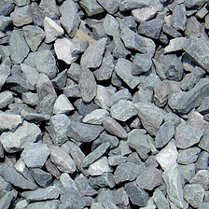
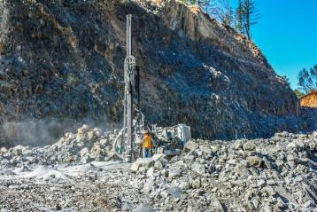
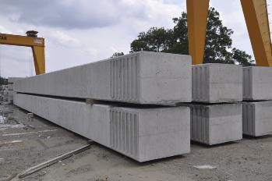
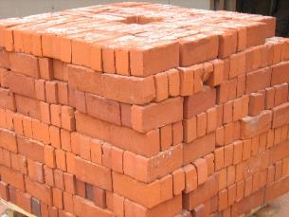
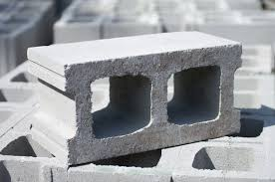
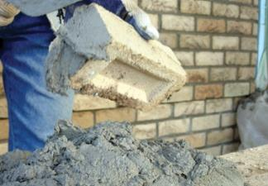
About Silica
Crystalline silica is a mineral found in many materials
Notes:
Crystalline silica is a mineral found in many materials:
Stone
Rock
Concrete
Brick
Block
Mortar
Image credits:
http://www.gotmulchli.com/3-4-blue-stone-per-yard/
https://static1.squarespace.com/static/556e478ae4b0efb9f31e762b/t/59de4fbc8fd4d2037cbaf0c4/1507743693339/
http://img.archiexpo.com/images_ae/photo-g/105235-4391403.jpg
https://static1.squarespace.com/static/53c3ea54e4b0e10af0daef4d/5564b70be4b084eaa4873a2e/5629ac6ee4b0f81918bee983/1445571695309/bricks.jpg
http://www.constructioncanada.net/wp-content/uploads/2014/09/Opening-Figure.jpg
https://www.specmix.com/wp-content/uploads/2012/05/masonry_cement_sand.jpg

Slide 7
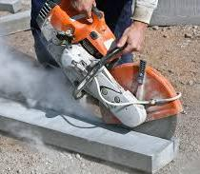
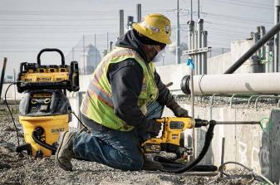
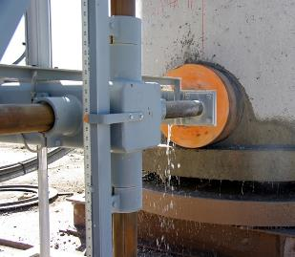
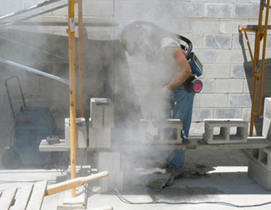
Silica in Industrial Processes
Industrial processes on these materials can cause workers to be exposed to small silica dust particles
  Cutting, sawing, grinding, sanding, crushing, and drilling
Notes:
Industrial processes on these materials can cause workers to be exposed to small silica dust particles
Cutting, sawing, grinding, sanding, crushing, and drilling
Affected industries include:
Construction
Glass manufacturing
Pottery products
Structural clay products
Concrete products
Foundries
Dental laboratories
Paintings and coatings
Jewelry production
Refractory products
Ready-mix concrete
Cut stone and stone products
Abrasive blasting in maritime, construction, and general industry
Refractory furnace installation and repair
Railroad transportation
Oil and gas operations
Image Credits:
http://www.bnproducts.com/wp-content/uploads/2015/06/Depositphotos_5731912_l-2015-1.jpg
https://precast.org/wp-content/uploads/2016/05/manhole-coring-2.jpg
http://www.mytooltalk.com/wp-content/uploads/2017/01/DEWALT-Perform-and-Protect.jpg
https://groundbreakcarolinas.com/wp-content/uploads/2017/04/OSHA-Silica1.png

Slide 8
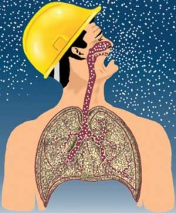
The Hazards of Silica
Small dust particles = respirable crystalline silica
Small enough to travel into a worker’s lungs!
These particles are at least 100 times smaller than ordinary sand!
Notes:
The small silica dust particles are often called respirable crystalline silica
The particles are small enough to travel into a worker’s lungs
These particles are at least 100 times smaller than ordinary sand
Image credits:
http://safetysolutionsatwork.com/blog/dangers-of-silica-dust-2/

Slide 9
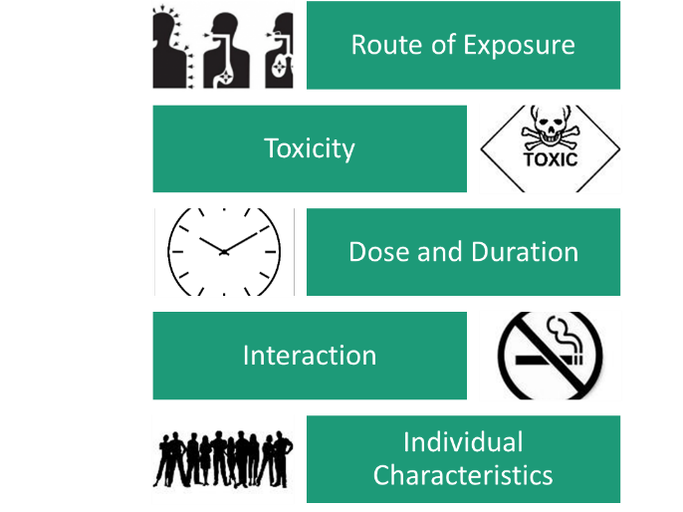
Is Exposure Hazardous?
Is exposure to crystalline silica hazardous? It depends on various factors:
Route of exposure
Toxicity
Dose and duration
Interaction
Individual characteristics
Notes:
Factors that determine if exposure is hazardous
Route of exposure: contact, ingestion, inhalation
Toxicity: how much substance is needed to cause harm
Dose and duration: amount of substance entering body; amount of time you are exposed
Interaction: being exposed to other substances at the same time can lead to negative interactions (e.g. smoking)
Individual characteristics: age, gender, diet, use of medication
Image credits:
https://www.ablemployment.com/about-abl-employment/abl-blog/item/first-aid-for-chemical-exposure-are-you-prepared
https://store.vitalsd.co.uk/hazard/hazard-signs/ha067-toxic-hazard-signs.html
https://openclipart.org/detail/192402/clock-icon
https://www.zazzle.com/no+smoking+black+and+white+stickers
https://www.clipart.email/clipart/clipart-of-a-group-of-people-43372.html

Slide 10
Possible Health Effects
Once respirable crystalline silica reaches a worker’s lungs,
it can cause:
  Silicosis – an incurable lung disease that can lead to disability and death
  Lung cancer
  COPD – chronic obstructive pulmonary disease
  Kidney disease
Notes:
Once respirable crystalline silica reaches a worker’s lungs, it can cause:
Silicosis – an incurable lung disease that can lead to disability and death
Lung cancer
COPD – chronic obstructive pulmonary disease
Kidney disease
Often times it takes years of exposure to respirable crystalline silica for these diseases to manifest
Silica is hazardous because:
It is found in many construction materials
Airborne particles are too small to see
Silica dust travels deep into your lungs
Long-time exposure to small amounts causes harm
Short-term exposure to large amounts causes harm
Effects are worse if you also smoke
Causes lung disease, cancer, even death

Slide 11
Common Work Tasks and Industries where Silica Hazards Exist
Manufacturing
  Glass, pottery, ceramic, brick, concrete, asphalt roofing, jewelry, artificial stone, dental, porcelain, or structural clay products
Industrial sand
  Use of industrial sand in operations such as foundry work and hydraulic fracturing
  Use of industrial sand for abrasive blasting
Notes:
Manufacturing
Glass, pottery, ceramic, brick, concrete, asphalt roofing, jewelry, artificial stone, dental, porcelain, or structural clay products
Industrial sand
Use of industrial sand in operations such as foundry work and hydraulic fracturing
Use of industrial sand for abrasive blasting

Slide 12
Activity #1
Small Group Discussion
Think/Pair/Share
Notes:
For the first activity, small groups will discuss the following questions. As the course instructor, it is recommended that you use a think-pair-share approach. In this approach, you state the question, then encourage trainees to think about their own answer quietly. Then, after 30 seconds has passed, ask them to turn to a trainee near them (forming a pair), and tell the other trainees their answer. After 60 seconds of the pairs talking, bring the class back together and ask for volunteers to share responses with the entire class. The think-pair-share exercise should take no more than five minutes. The questions for this small group discussion activity are:
Are you exposed to crystalline silica at work? If so, describe.
What could be the consequences of that exposure?

Slide 13
Controlling Exposure to Silica
Notes:
Section 2: Controlling Exposure to Silica
In this section, training will focus on the second learning objective: “describe controls to reduce silica exposure.”
Image credits:
http://www.accidentfund.com/newsletter/oshas-new-respirable-crystalline-silica-standard/
https://www.red-on-line.com/hse/2016/09/21/respirable-crystalline-silica-rule-corrected-003797
https://unitedsafetynet.com/product/silica-osha-safety-traning/
https://www.spi-s.com/en/blog/item/crystalline-silica-choosing-the-right-protective-mask

Slide 14
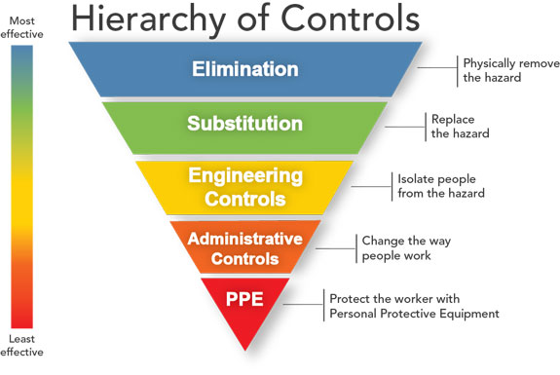
Types of
Controls
The hazards related to crystalline silica can be controlled using a variety of techniques. The types of controls include Elimination, Substitution, Engineering and Administrative controls, and PPE.
Notes:
The hierarchy of controls describes the effectiveness of various types of controls. It starts on top with the most effective types of controls – elimination. The least effective types of controls are PPE (personal protective equipment). The five types of controls are:
Elimination: Physically remove the hazard.
Substitution: replace the hazard.
Engineering controls: Isolate people from the hazard.
Administrative controls: Change the way people work.
PPE: Protect the worker with personal protective equipment.
In the case of respirable crystalline silica, the two most effective controls (elimination and substitution) are often infeasible due to the nature of the work being completed and the materials required to complete the work. However, if non-silica materials are available, they may present a useful and safer alternative. In this training, we will focus on controls that fit into the last three categories: engineering controls, administrative controls, and PPE.
Image Credits:
(1) https://www.cdc.gov/niosh/topics/hierarchy/default.html

Slide 15
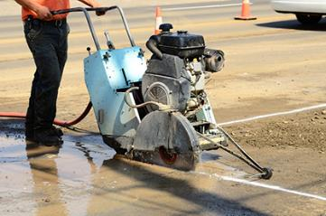
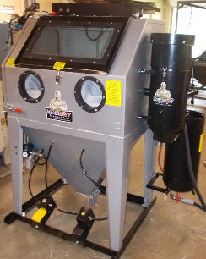
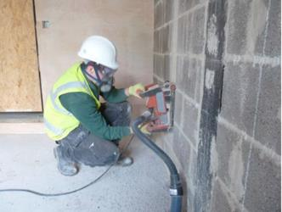
Engineering Control Methods
Wet methods:
Apply water where silica dust is made
Local exhaust ventilation: Removes silica dust at or near the point where the dust is made
Enclosures:
Isolate the work process or the worker
Notes:
Engineering controls isolate people from the hazard. Engineering controls for crystalline silica include wet methods, local exhaust ventilation, and using enclosures. These methods focus on minimizing the amount of dust that reaches the worker.
Image Credits:
https://www.lhsfna.org/LHSFNA/assets/File/walk%20behind%20saw%20wet%20cutting.jpg
https://diamondenv.wordpress.com/2014/06/26/silica-exposure-in-construction/
https://badboyblasters.com/wp-content/uploads/2015/04/BB-850XLD-FL-PR.png

Slide 16
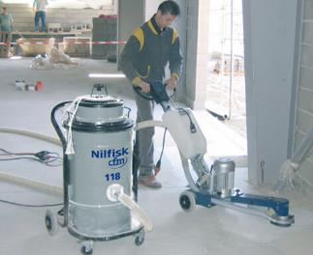


Administrative Control Methods
Housekeeping
Work schedules &
Job rotation
Inspections and job hazard analysis
Notes:
Administrative controls change the way people work. They reduce the amount of time a person is exposed to the hazard by using methods such as scheduling and job rotation. Housekeeping and job hazard analysis are also used to reduce risk related to silica safety.
Image Credits:
https://www.nilfiskcfm.com/wp-content/uploads/2016/12/Nilfisk_Vac_sanding.jpg
https://marcvaneynde.com/wp-content/uploads/2014/05/punching-the-clock.jpg
https://cdn.tsheets.com/images/crew_page_v2_1920/1920_crew_panel_1.jpg

Slide 17
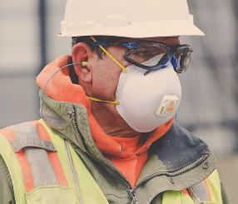
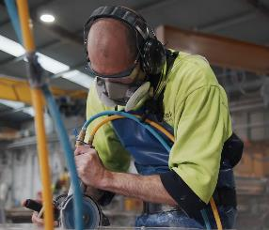
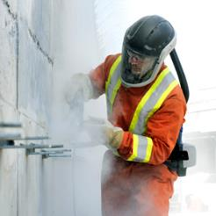
Personal Protective Equipment
Only engineering and administrative controls are not enough
Employers must provide appropriate respirators, and comply with requirements of the silica standard and the OSHA respiratory protection standard (29 CFR 1910.134)
Notes:
PPE required varies based on level of exposure at work. The PPE can include (from low protection to high):
Half face respirator
Full face respirator
PAPR (powered air purifying respirator)
Additional PPE that can be used to prevent exposure via contact through skin include:
Gloves
Coveralls
Image credits:
http://tilt-up.org/tilt-uptoday/wp-content/uploads/2017/05/Silica-2-1080.jpg
https://prod.wsvdigital.com.au/sites/default/files/2018-12/dust-containing-crystalline-silica-image-005.jpg
(2) https://workersafety.3m.com/blog/wp-content/uploads/2017/10/3M_PPE_KPH_TURCOT_0469_rev_300x300.jpg

Slide 18
Activity #2
Video Case Study
Link to Video
Notes:
For the second activity, play the video that is in the hyperlink above. The video address is: https://www.youtube.com/watch?v=QAkAEcOzb2Q. In this video, a man is using a concrete saw to cut a straight line through a slab of concrete. Notice the amount of dust that is coming up from the saw. The man is wearing a face mask to protect himself from the dust. There is sound in the video, but the activity does not require the sound. After the video plays, ask the trainees to answer the following questions. The questions can be answered using think-pair-share, or as a class-based discussion. The questions are:
What silica hazards were in the video?
Possible answers: Silica dust from sawing concrete
What types of controls were used for the silica hazard?
Possible answers: Face mask (PPE)
What additional controls could be put in place for this job?
Possible answers: Ventilation or wet methods (engineering controls), housekeeping and job rotation (administrative controls)

Slide 19
Employer Requirements
OSHA Silica Standard
Notes:
Section 3. Employer Requirements and OHSA Silica Standard.
In this section, training will focus on learning objective three (“Understand the OHSA requirements for silica safety”) and learning objective four (“Identify specific steps they can take to reduce their exposure to silica hazards at their job”).
Image credits:
http://www.accidentfund.com/newsletter/oshas-new-respirable-crystalline-silica-standard/
https://www.red-on-line.com/hse/2016/09/21/respirable-crystalline-silica-rule-corrected-003797
https://unitedsafetynet.com/product/silica-osha-safety-traning/
https://www.spi-s.com/en/blog/item/crystalline-silica-choosing-the-right-protective-mask

Slide 20

OSHA Silica Standard: 29 CFR 1926.1153
Provides silica safety requirements for employers
Notes:
OSHA has a standard that addresses silica safety: 29 CFR 1926.1153. This is a federal standard that applies to exposure respirable crystalline silica in construction work.
Who must comply with standard: All employers if exposure is above 25 micrograms per cubic meter of air (25 μg/m³) for an 8-hour time weighted average
When it went into effect: 2016, with enforcement beginning in 2017.
Image credits:
(1) https://www.discoveryhealthmd.com/wp-content/uploads/2017/04/OSHA-Logo.png

Slide 21
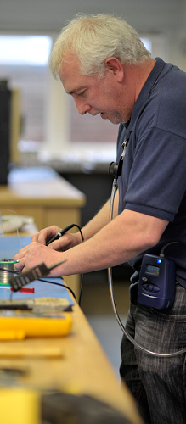
Employer Requirements
Determine the amount of silica that workers are exposed to
  Action level = 25 μg/m³,
  averaged over an 8-hour day
Provide worker protection when respirable crystalline silica exposure is above the permissible exposure limit
  Permissible exposure limit = 50 μg/m³, averaged over an 8-hour day
Notes:
Under the OSHA standard, employers are required to measure and monitor workers’ exposure to crystalline silica. If the amount of exposure is higher than 25 μg/m³, averaged over an 8-hour day, the employer much take action. The employer must provide worker protection if the exposure is higher than 50 μg/m³, averaged over an 8-hour day.
Image credits:
(1) https://www.skcltd.com/images/pumps/airchek-3000-worker_500x500.png

Slide 22

Additional Employer Requirements
Limit access to areas with respirable crystalline silica
Use dust control and safer work methods
Provide respirators when other controls cannot limit exposure
Provide a written exposure control plan
Restrict housekeeping practices that expose workers to silica
Offer medical exams (chest x-rays and lung function tests) every thee years to workers exposed at or above the action level for 30+ days per year
Train workers on silica exposure
Keep records of exposure and medical exams
Notes:
Besides monitoring, employers have additional responsibilities as well. These requirements are important in keeping workers safe and minimizing risk related to silica hazards.
Image Credits:
(1) http://www.engineersjournal.ie/wp-content/uploads/2016/12/Temperature-matched-curing.jpg

Slide 23

Employee’s Role
Use equipment and controls properly
Be aware
Participate in training, exposure monitoring, and screening programs
Don’t bring dust home
Don’t eat, drink, smoke, or apply cosmetics while near silica dust
Wash hands and face outside of dusty areas
Notes:
As the employee, you have a responsibility as well. Attending this training is an important step in staying safe. Employees must also stay aware and alert for silica hazards. It is important that employees use all equipment and controls properly, including PPE. The engineering and administrative controls are only effective if employees use them properly. Employees should also take care to not bring dust home after work. This will limit exposure time and reduce risk. To do this, employees may choose to change clothes prior to going home, or brush off and shower. Employees should not eat, drink, smoke, or apply cosmetics near areas with silica dust. Employees should wash their hands and face when outside of dusty areas.
Image Credits:
(1) https://images.mysafetysign.com/img/lg/S/responsibility-safety-first-sign-s-4141.png

Slide 24
Activity #3
Action Plan
Notes:
This final activity encourages trainees to create an action plan based on the information learned in the training session. The instructor should distribute a few post-it notes and pens to each trainee. Tell the trainees: “Keeping our workplace safe is everyone’s responsibility. Your employer has responsibilities such as monitoring the amount of silica you are exposed to, and providing a control plan, training, and PPE. But the employee is also responsible for keeping the workplace safe. What can you do to reduce the risks associated with silica dust? Write your ideas on the post-it notes, then bring them to the front of the room.” As trainees complete their notes, you should display them for the entire class to review. It may be helpful to group similar answers together. After all trainees have posted their ideas, review the results with the class. Reiterate the employee’s role items from the presentation:
Use equipment and controls properly
Be aware
Participate in training, exposure monitoring, and screening programs
Don’t bring dust home
Don’t eat, drink, smoke, or apply cosmetics while near silica dust
Wash hands and face outside of dusty areas

Slide 25
Wrap Up
Notes:
Section 4. Wrap Up
In this section, material from the training course is summarized for the trainees. The material in this section is organized by the four learning objectives.
Image credits:
http://www.accidentfund.com/newsletter/oshas-new-respirable-crystalline-silica-standard/
https://www.red-on-line.com/hse/2016/09/21/respirable-crystalline-silica-rule-corrected-003797
https://unitedsafetynet.com/product/silica-osha-safety-traning/
https://www.spi-s.com/en/blog/item/crystalline-silica-choosing-the-right-protective-mask

Slide 26
Learning Objective 1
Review & Summary
1. Identify silica hazards in their workplace
Crystalline silica is a mineral found in many materials: Stone, Rock, Concrete, Brick, Block, Mortar
Industrial processes (cutting, sawing, grinding, sanding, crushing, drilling) on these materials can cause workers to be exposed to small silica dust particles
Notes:
Crystalline silica is more common than some people may think. Many construction jobs include materials that create silica dust when processed. Employees need to be aware of where they are exposed to crystalline silica in their jobs.

Slide 27
Learning Objective 2
Review & Summary
2. Describe controls to reduce silica exposure
Engineering Controls
>
Administrative Controls
>
Personal Protective Equipment
Notes:
The best way to reduce exposure to a hazard is to remove the hazard completely. When silica dust can’t be removed from the workplace, using engineering controls is the best approach, followed by administrative controls, and then PPE.

Slide 28
Learning Objective 3
Review & Summary
3. Understand the OSHA requirements
for silica safety
Some of the requirements of OSHA’s Silica Standard are:
  Measure and monitor silica exposure
  Provide worker protection when necessary
  Train workers
  Keep records
Notes:
The employer requirements for silica safety, as outlined in the OSHA silica standard, include measuring and monitoring exposure, providing worker protection, keeping records, and training workers.

Slide 29
Learning Objective 4
Review & Summary
4. Identify specific steps they can take to reduce
their exposure to silica hazards at their job
Use equipment and controls properly
Be aware
Participate in training, exposure monitoring, and screening programs
Don’t bring dust home
Don’t eat, drink, smoke, or apply cosmetics while near silica dust
Wash hands and face outside of dusty areas
Notes:
Employees should take an active role to keep themselves safe from silica hazards. Employees can reduce their exposure by using equipment properly, participating in training, and being aware.

Slide 30
Stop Silicosis Video
https://www.youtube.com/watch?v=HAByIIzQSuU.
Notes:
Play the video that is hyperlinked. The web address is: https://www.youtube.com/watch?v=HAByIIzQSuU. This video, produced by the U.S. Department of Labor, summarizes many of the topics from this training course, and also clearly communicates the importance of silica safety. The video requires sound, and should be played if enough time remains in the training session. Run time is 3 minutes 15 seconds.

Slide 31
End of Training
Notes:
Image credits:
http://www.accidentfund.com/newsletter/oshas-new-respirable-crystalline-silica-standard/
https://www.red-on-line.com/hse/2016/09/21/respirable-crystalline-silica-rule-corrected-003797
https://unitedsafetynet.com/product/silica-osha-safety-traning/
https://www.spi-s.com/en/blog/item/crystalline-silica-choosing-the-right-protective-mask

