Slide 1
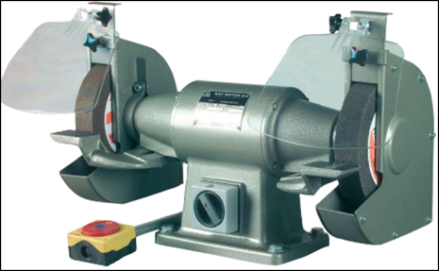
Shipyard Machinery
and
Power Tool Safety
A Course for Shipyard Workers
This material was produced under grant SH-31243-SH7- from the Occupational Safety and
Health Administration, U.S. Department of Labor. It does not necessarily reflect the views or policies
of the U.S. Department of Labor, nor does mention of trade names, commercial products or
organizations imply endorsement by the U.S. Government.

