Slide 1
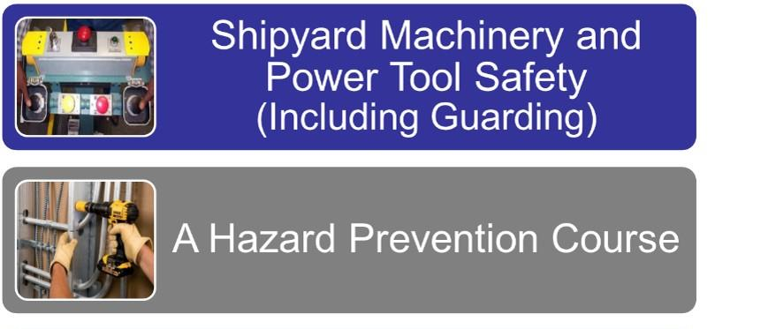
Faculty Guide
This material was produced under grant SH-31243-SH7 from the Occupational Safety and Health Administration, U.S. Department of Labor. It does not necessarily reflect the views or policies of the U.S. Department of Labor, nor does mention of trade names, commercial products or organizations imply endorsement by the U.S. Government.
1
Notes:
1
KEY QUESTION TARGET ANSWER KEY POINT
QUIZ
EXERCISE FLIPCHART POINTER VIDEO
Use the symbols above as a guide to support you in facilitating your class. Also, look for section headers, designated by sentences that are bolded and italicized, which state the key area(s) of focus for that section.
You will need a pointer to facilitate this class.
INTRODUCTION – Introduce yourself to include background and experience with topic. Address all classroom logistics, including emergency signal and muster area.
Ask participants to read page one. When finished read last paragraph (purpose statement) and Note at the bottom. Ask if there are questions.

Slide 2

Table of Contents
Notes:
Table of Contents
Explain that this is the table of contents which could support your participants in the future if looking for specific information.
Ask if there are questions.

Slide 3
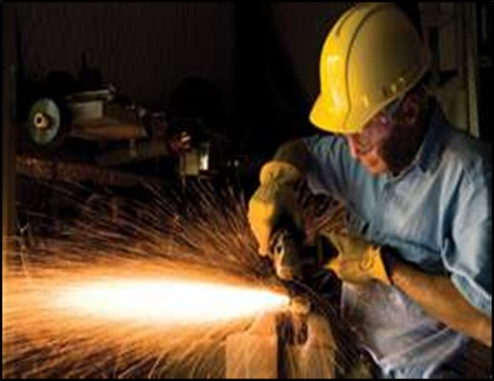
Course Objectives
Notes:
Course Objectives
Read course objectives.
Note: All training sessions must cover the first bullet. If you are only doing Machinery Hazards, have the participants cross out “Portable Power Tool Hazards” in the second and third bullets. If you are only doing Portable Power Tool Hazards, have the participants cross out “Machinery Hazards” in the second and third bullets.
Training Manual content will include materials for both topics for reference.
Handout Pre/Post Test and explain by completing this test they will have a good understanding of the material being covered. Explain this will also establish a benchmark to determine how well the trainer conveyed the information.
Ask if there are questions.
Have them circle “Pre” at the top of the test. Have them write the date in the appropriate space. Explain that they will not need to write their names on the pre-test. Allow 5-10 minutes to complete the pre-test and collect the tests. Coordinator will grade tests.

Slide 4

OSHA
Notes:
OSHA and You!
Ask participants to review both sides of the Whistleblower Fact Sheet in the front pocket. Allow 5 minutes to review.
Ask the following questions:
1. How are you protected by the Whistleblower Act?
2. What is an unfavorable personnel action?
3. How can you file a complaint?
1. If the evidence supports the employee’s allegation and a settlement cannot be reached, OSHA will generally issue an order, to make the employee whole to include employment reinstatement, pay back wages, restore benefits, and other possible remedies. The employer may contest OSHA’s decision.
2. Actions that adversely impact you to include:
Blacklisting, demoting, denying overtime or promotion, disciplining, denying benefits, failing to hire/rehire, firing/laying off, intimidation, threats, reassignment to a less desirable position, reducing pay or hours and suspension
3. Visit, call, mail, fax or email. Provide local OSHA phone #619-557-5030. Reinforce that is always best to start with their companies chain of command.

Slide 5

Recent and Real Machinery Hazards
Notes:
Recent and Real Machinery Hazards
Ask participants to review the recent accidents below. Ask:
How many of the accidents caused death?
All
How many involved machinery?
All
How many do you think were avoidable?
All
Working with machinery can be hazardous, but there are measures we can put in place to keep us safer.

Slide 6
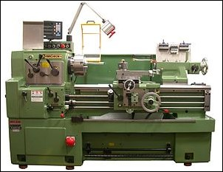
Machinery Hazards Exercise
A lathe is a machine that rotates the workpiece about an axis of rotation to perform various operations such as cutting, sanding, knurling, drilling, deformation, facing, turning with tools that are applied to the workpiece to create an object with symmetry about that axis.
Notes:
Common Shipyard Shop Machines
In this section (pages 6-13) the key focus areas are the significant hazards created by shop equipment and two categories of hazards, motion and action.
Read page 6
Ask participants to put a check mark next to each of the shop machines they are exposed to. This could be machines they operate or work in the vicinity. Allow 2 minutes to complete.
Ask, “How many of you checked multiple pieces of equipment?
Likely many participants will raise their hands.
Most/all of us are exposed to machines that can create significant hazards.

Slide 7
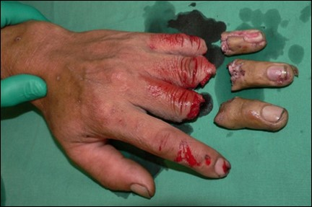
Your Risk Exercise
Notes:
Common (Too Common) Machine Shop Injuries
Ask participants to check the box next to the potential injuries that they could suffer based on the machines they are exposed to from the previous page.
They could be seriously injured or killed by the hazards they are personally exposed to.

Slide 8
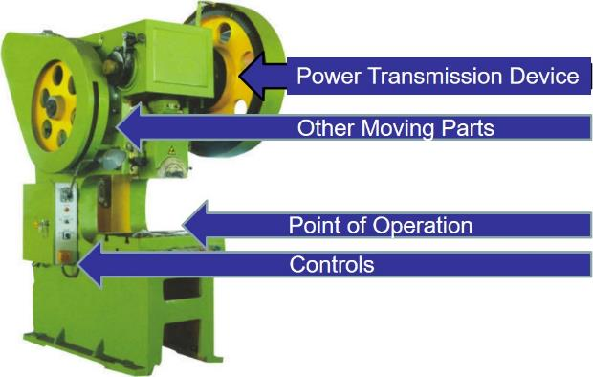
Where Mechanical Hazards Occur
Other Moving Parts
Point of Operation
Controls
Notes:
Where Mechanical Hazards Occur
Read this page and as you reach each hazard point,
use a pointer to illustrate that hazard point on the graphic above.

Slide 9
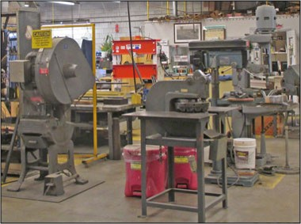
Hazards to be Guarded
Notes:
Hazards to be Guarded
Read this page by column.
Explain that you will be going into detail on the following pages.

Slide 10
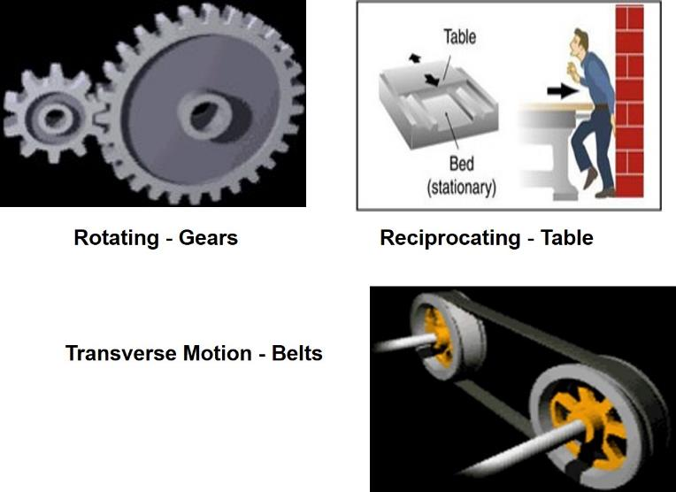
Motions
Notes:
Rotating Motions
Ask a participant to read this section and point out the gears graphic above.
Reciprocating Motion
Ask a participant to read this section and point out the reciprocating table graphic above.
Transverse Motion
Ask a participant to read this section and point out the pulley/belt graphic above.
Ask if there are questions.

Slide 11

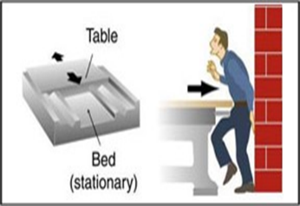
In-Running Nip Points
Rotating - Gears
Reciprocating - Table
Notes:
In-Running Nip Points
Read this page. When you read each bullet use a pointer
to illustrate each hazard location.
Ask if there are questions.

Slide 12
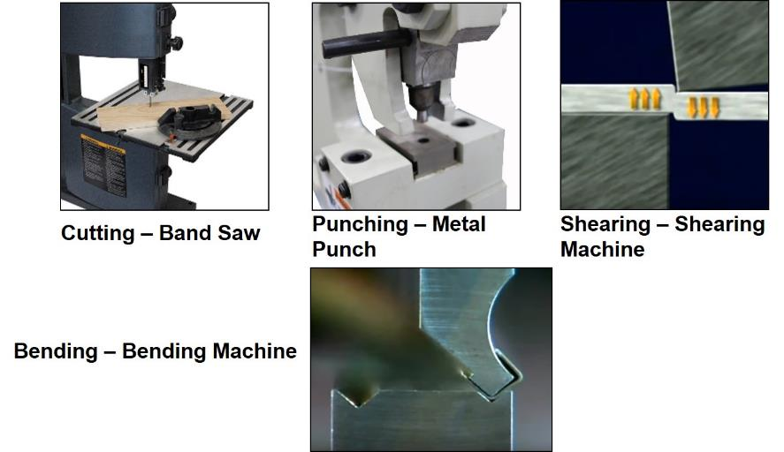
Action
Notes:
Cutting
Ask a participant to read this paragraph and use your pointer to illustrate the cutting hazard on the band saw.
Punching
Ask a participant to read this paragraph and use your pointer to illustrate the punching hazard on the metal punch.
Shearing
Ask a participant to read this paragraph and use your pointer to illustrate the shearing hazard on the shearing machine.
Bending
Ask a participant to read this paragraph and use your pointer to illustrate the bending hazard on the bending machine.

Slide 13
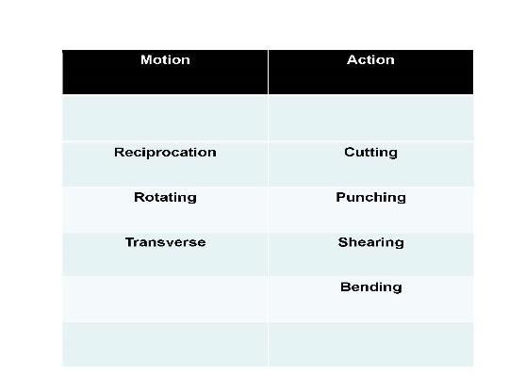
Exercise
Notes:
Ask participants to pair up, preferably with the person sitting next to them, and work together on this exercise.
Explain that each word in the bottom half of their page 13 is either a motion or action hazard.
Ask them to write each hazard in a row under the appropriate column labeled “Motion” or “Action”.
Ask the participants not to use their notes or review this material in their Training Manual.
Allow 3 minutes to complete.
Ask if there are questions.
Recap exercise by asking the participants, one hazard word at a time, which column they placed each word.

Slide 14
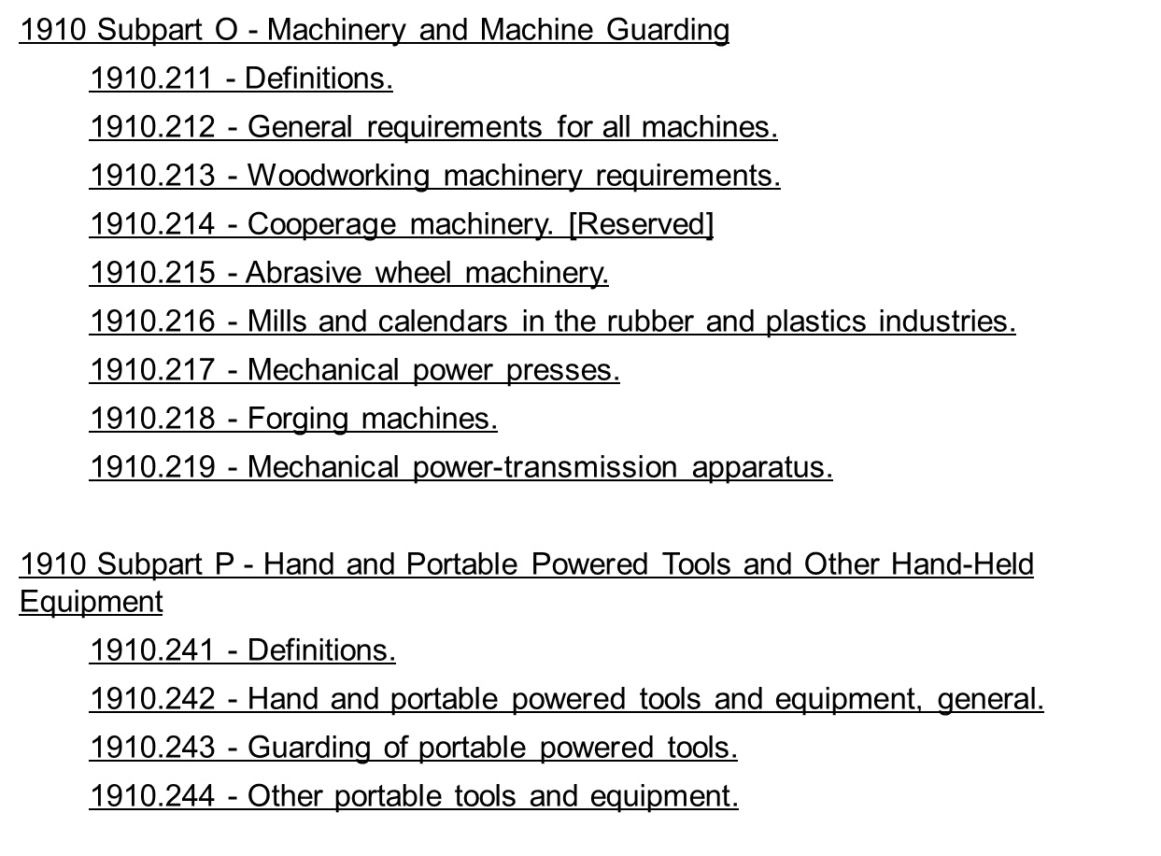

Applicable Regulations
Notes:
Applicable Regulations
Explain that this is a reference page for those that want to read the OSHA regulations that apply to the following section of this Training Manual.

Slide 15
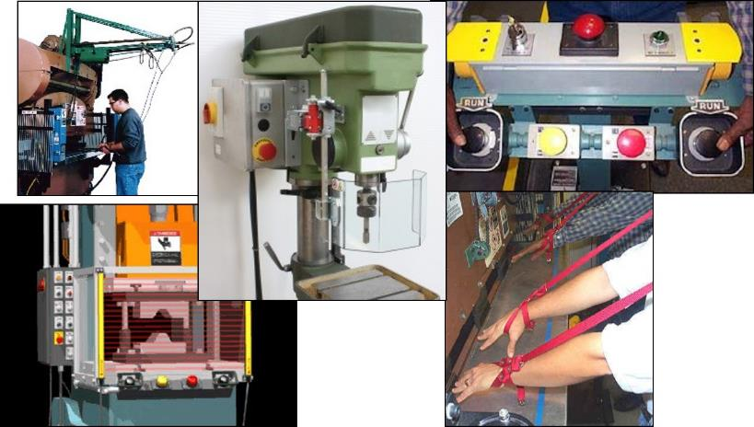
Machine Guards and Devices
Notes:
Machine Guards and Devices
In this section (pages 15-23) key focus areas are safety guards & devices.
Explain that you have been discussing machinery hazards and now its time to discuss hazard solutions.
Explain that you will be discussing the following Guards, Devices/ Controls:
When you get to the
following guards and
devices use your pointer
to point to the corresponding
guard or device:
Pullback
Gate
Adjustable
Guard
Two-handed
Controls
Restraint

Slide 16
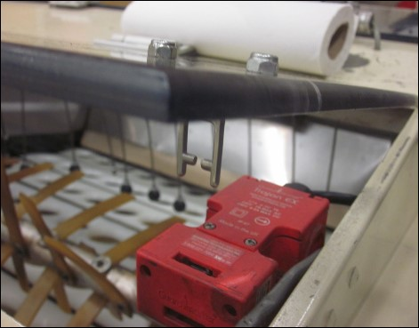
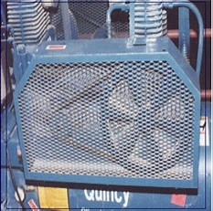
Machine Guards – Fixed and Interlocked
Fixed
Interlocked
Notes:
Fixed and Interlocked Guards
Fixed
Ask a participant to read this paragraph.
Ask if there are questions.
Interlocked
Ask a participant to read this paragraph.
Use your pointer to point to the cover being opened on the above machine and that when it opens the machine will shut down.

Slide 17
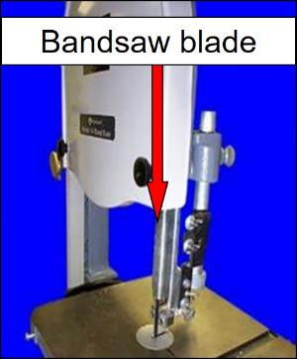
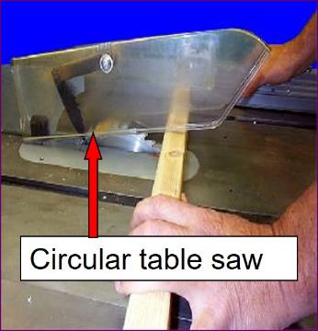
Machine Guards – Adjustable and Self-Adjusting
Adjustable
Self-Adjusting
Notes:
Adjustable and Self-Adjusting Guards
Adjustable
Ask a participant to read this paragraph.
Ask if there are questions.
Self-Adjusting
Ask a participant to read this paragraph.
Ask if there are questions.

Slide 18
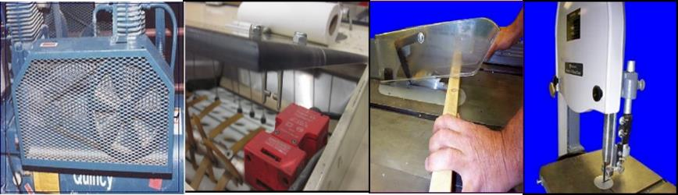
Exercise
From a safety perspective identify the pros and cons of each type of guard below.
Notes:
Ask participants to pair up, preferably with the person sitting next to them, and work together on this exercise.
Explain that for each type of guards there are pros and cons.
Each team is to complete the pros and cons for each type of guard.
(Note: If needed to save time, have teams complete only one guard type. Be sure to assign the teams so that each type of guard is evaluated. Allow 5 to 20 minutes depending on if the teams are completing their assessments on all four guards or on one guard.)
Flipchart the pros and cons for each type of guard as you go around the room asking each team for their input.
Ask, “What was the purpose of this exercise?”
To know which guards are most appropriate and provide the most protection for the machines that you use.

Slide 19
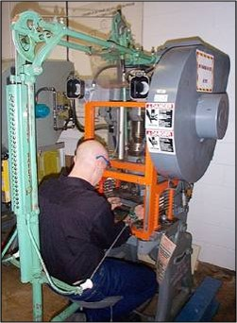
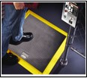
Guarding Devices – Presence Sensing and Pullback
Presence sensing device
Cables attached to operator’s hands or wrists
Removes hands from point of operation during danger period
Pullback
Notes:
Presence Sensing and Pullback Devices
Explain that the photos on the screen correlate to the types of devices being discussed.
Presence Sensing
Ask a participant to read this paragraph.
Ask if there are questions.
Pullback
Ask a participant to read this paragraph.
Ask if there are questions.

Slide 20
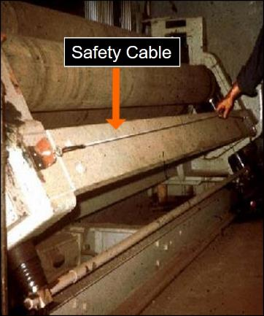
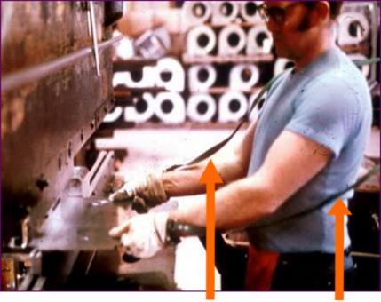
Guarding Devices – Restraint and Safety Controls
Restraint
Safety Controls
Notes:
Restraint and Safety Controls
Explain that the photos on the screen correlate to the types of devices being discussed.
Restraint
Ask a participant to read this paragraph.
Ask if there are questions.
Safety Controls
Ask a participant to read this paragraph.
Ask if there are questions.

Slide 21
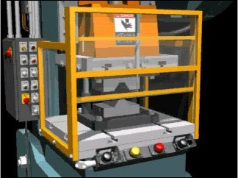
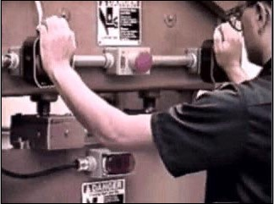
Guarding Devices – Gates and Two-Handed Controls
Gates
Two-Handed Controls
Notes:
Gates and Two-Handed Controls
Explain that the photos on the screen correlate to the types of devices being discussed.
Gates
Ask a participant to read this paragraph.
Use your pointer to support what is being read.
Ask if there are questions.
Two-Handed Controls
Ask participant to read this paragraph.
Use your pointer to support what is being read.
Ask if there are questions.

Slide 22
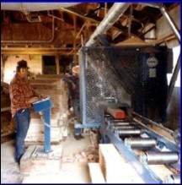
Safeguarding by Location and Distance
Notes:
Safe Guarding by Location and Distance
Ask a participant to read this paragraph.
Use your pointer to show the distance between the operator and the work that is being done.
Ask if there are questions.
Emphasize “Always Follow Manufacturers Instructions”

Slide 23
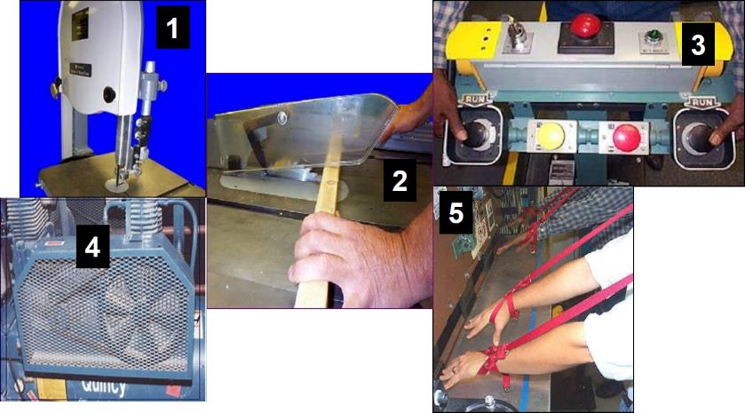
Exercise
Notes:
Ask participants to pair up, preferably with the person sitting next to them, and work together on this exercise. Explain that the pictures of the guards and devices above are numbered. For each number/picture (column 1) write the type of guard or device the picture represents (column 2) and how the guard or device keeps the worker safe (column 3). Allow 3-5 minutes to complete.
Recap one picture at a time by asking the participant pairs to share what they wrote.

Slide 24
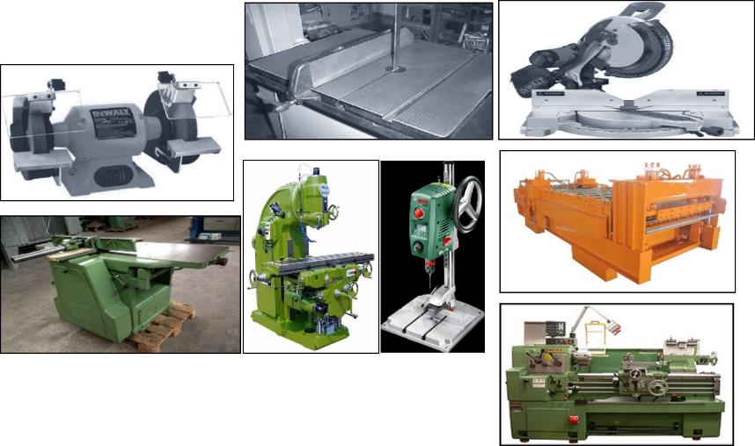
Specific Machines Hazards and Solutions
Notes:
Common Shipyard Shop Machines
Areas of focus for this section -- Explain that is this section you are going to talk about specific machines often found in shipbuilding and ship repair shops.
Explain that the machines you will be discussing and are not all inclusive but many of the same hazards and safety principles apply to different machines.
As you read the list of machines use your pointer to identify the corresponding machine.
As you read the list ask for a show of hands how many of the participants work with or work around each piece of equipment.

Slide 25
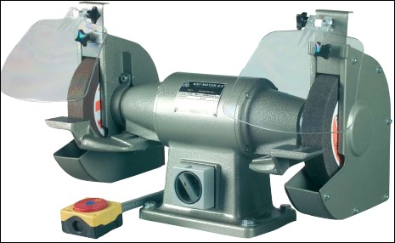

Abrasive Wheel and Grinder
Rotating
(Motion)
Cutting
(Action)
Protective Shields
Notes:
Abrasive Wheel and Grinder
What is the Motion Hazard of an abrasive wheel and grinder?
Rotating
What is the Action Hazard of an abrasive wheel and grinder?
Cutting
Ask a participant to read page.
Ask if there are questions.

Slide 26
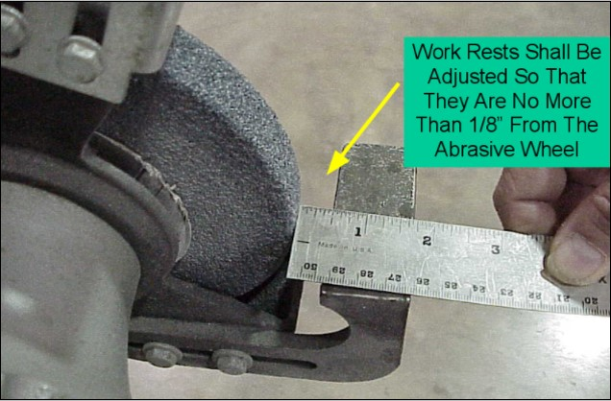
Abrasive Wheel and Grinder Hazards
Notes:
Hazards
Read the first paragraph and use pointer to highlight the nip point at the work rest.
Ask a participant to read the second paragraph.
Ask if there are questions.

Slide 27
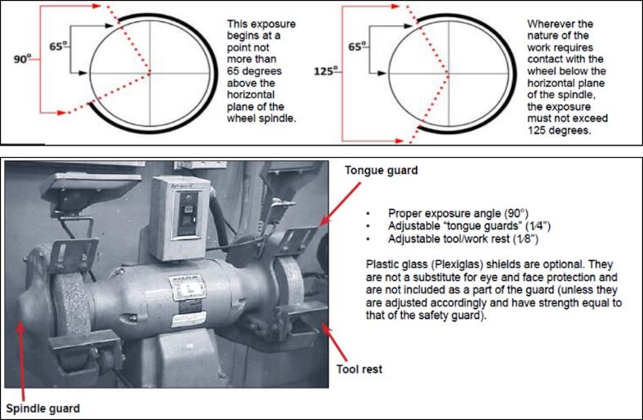
Abrasive Wheel and Grinder Solutions
Notes:
Solutions
Now that you have discussed the hazards of abrasive wheels it is time to discuss solutions.
Ask a participant to read the first paragraph.
When they are finished use your pointer to highlight the top graphic above and discuss the graphic and what is written.
Read the second paragraph.
Use your pointer to highlight key points.

Slide 28
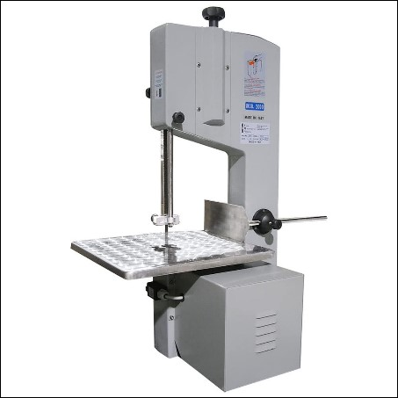
Band Saw
??????
(Motion)
??????
(Action)
Notes:
Band Saw
What is the Motion Hazard of a band saw?
Reciprocating
What is the Action Hazard of a band saw?
Cutting
Ask a participant to read the paragraph.
Ask if there are questions.

Slide 29
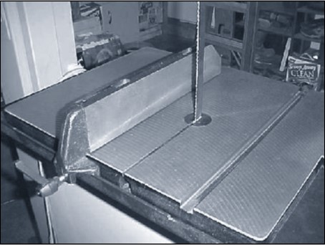
Band Saw Hazards
Notes:
Hazards
Read the first sentence.
What hazard do you readily see in the photo?
No blade guard
No transparent guard
No air hose
Possible poor lighting

Slide 30
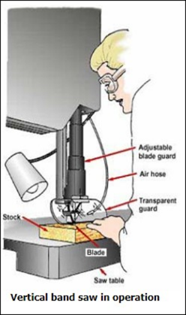
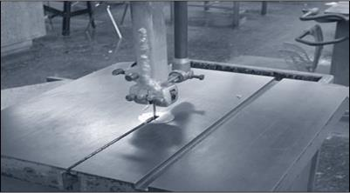
Band Saw Solutions
Properly adjust the blade guide to fit the thickness of the stock and ensure the guard is as close as possible to the stock.
Notes:
Solutions
Read page 30.
As you read, use your pointer to highlight Training Manual text.
Go over the safety precautions in illustration two above.

Slide 31
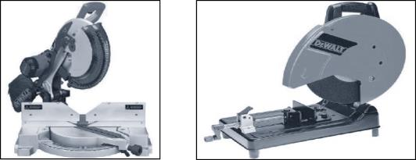
Shop Saw (Cut-Off Saws)
Rotating
(Motion)
Cutting Miter Saw Chop Saw
(Action)
Notes:
What is the Motion Hazard of a Miter Saw?
Rotating
What is the Action Hazard of a Chop Saw?
Cutting
Cut-Off Saw
Ask participant to read. Ask if there are questions.
Miter Saw
Ask participant to read. Ask if there are questions.
Chop Saw
Ask participant to read. Ask if there are questions.

Slide 32
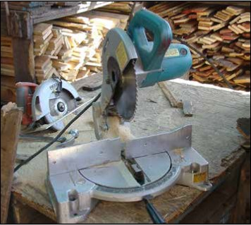
Shop Saw Hazards
Notes:
Hazards
What’s wrong with this picture?
No guard
Saw not secured
No solid foundation for the saw to rest
Housekeeping issues
Ask participant to read page 32.
Ask if there are questions.

Slide 33
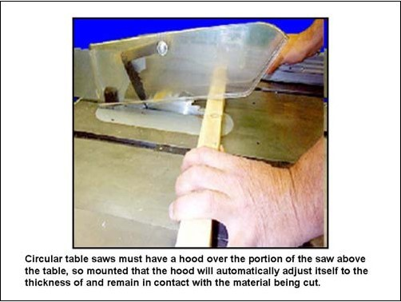
Shop Saw Solutions
Notes:
Solutions
Ask a participant to read first paragraph of page 33.
As participant is reading, use your pointer to highlight the picture corresponding to the text.
Ask if there are questions.
Additional Safety Measures
Read this section of page 33.
Ask if there are questions.

Slide 34
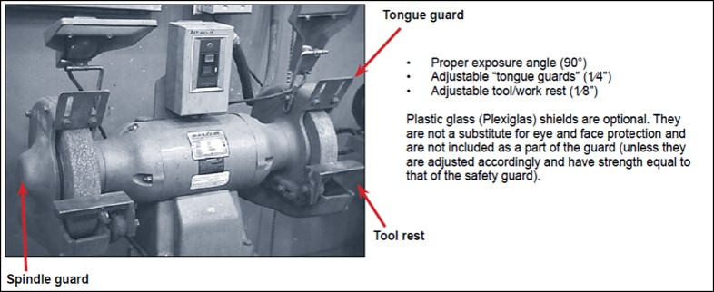
EXCERCISE
Notes:
Ask -- What does a circular saw have in common with a grinder that it does not have in common with a band saw?
Rotating Motion Hazard and Cutting Action Hazard.
Have participants pick a machine previously discussed and identify hazards and solutions and complete the chart on page 34. Have them do this without referring to training materials.
Ask for two participants to volunteer to share their answers.

Slide 35
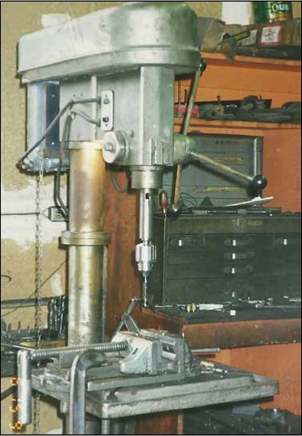
Drill Press
???????
(Motion)
???????
(Action)
Notes:
Drill Press
Ask a participant to read page 35
What is the Motion Hazard of a drill press?
Reciprocating
What is the Action Hazard of a drill press?
Cutting
.

Slide 36
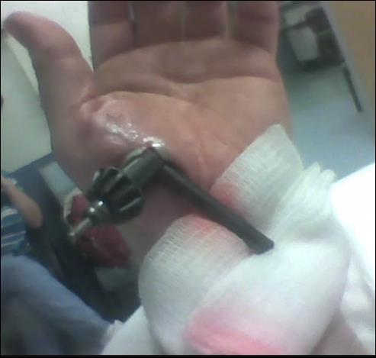
Drill Press Hazards
Notes:
Hazards
Read page 36.
Ask for a show of hands from participants that work with tools with a “chuck”.
Reminder that every detail is important – even properly tightening the chuck.
Ask if any questions.

Slide 37
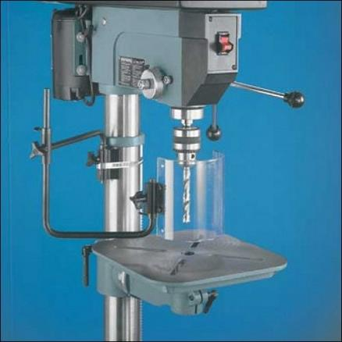
Drill Press Solutions
Notes:
Solutions
Have a participant read page 37.
Ask if questions.

Slide 38
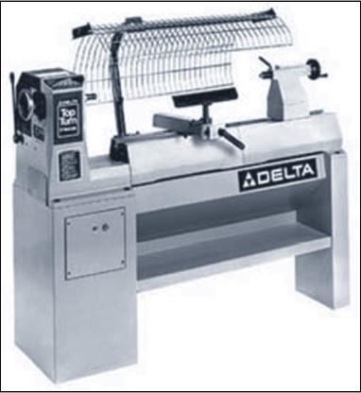
Wood Lathe
???????
(Motion)
???????
(Action)
Notes:
Lathe
Have the class read this page.
Ask for a participant that works on this type of lathe to describe how it works, where the safety features/guards are located. Be prepared to explain.
What is the Motion Hazard of a lathe?
Rotating
What is the Action Hazard of a drill lathe?
Cutting

Slide 39
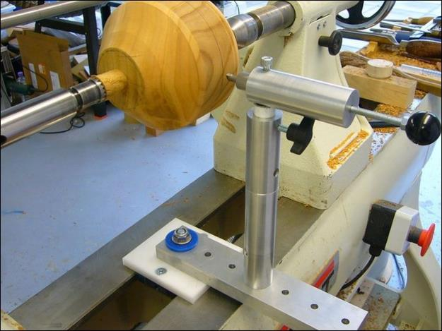
Wood Lathe Hazards
Notes:
Hazards
What is are the hazards presented in this picture?
Using your pointer, identify what’s wrong with this picture.
No guards to minimize rotating or cutting hazards.

Slide 40
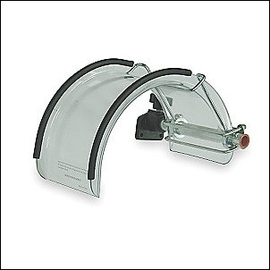
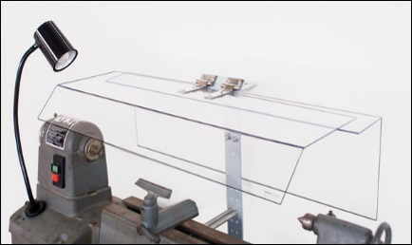
Wood Lathe Solutions
Notes:
Solutions
Ask a participant to read this page.
Ask if questions.
Use your pointer to identify the chuck guard on this lathe.

Slide 41
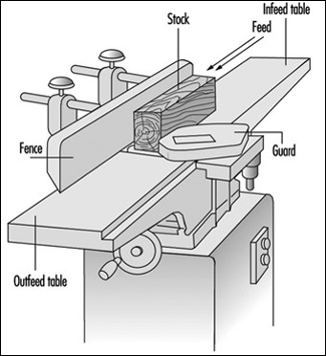
Planer
???????
(Motion)
???????
(Action)
Notes:
Planer
Read page 41.
Use your pointer to identify various parts of the planer as you read.
What is the Motion Hazard of a planer?
` Rotating
What is the Action Hazard of a planer?
Cutting

Slide 42
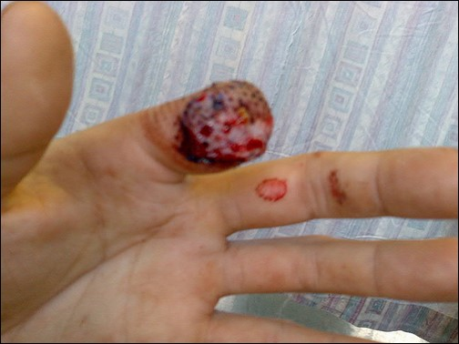
Planer Hazards
Notes:
Hazards
Read page 42.
Ask the class if anyone knows what “kickback” is.
When material is shot backwards. Kickbacks usually occur with a rotating motion and a cutting action. Often when using a rotating saw but they can occur with a planer as well.
Ask if any questions.

Slide 43
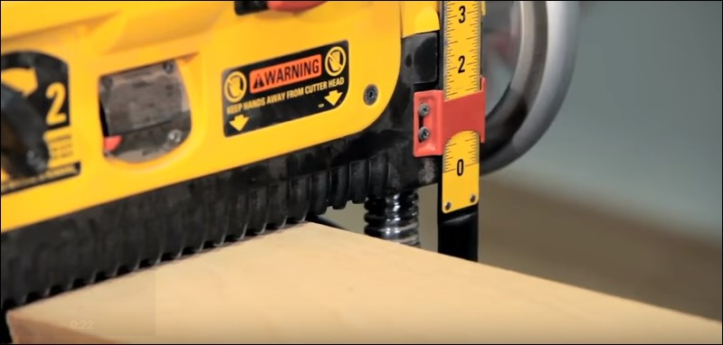
Planer Solutions
Notes:
Solutions
Ask a participant to read the first paragraph.
Ask if questions.
Review the Additional Safety Measures:
Wear safety glasses or goggles, or a face shield (with safety glasses or goggles), and use the appropriate hearing protection.
Disconnect the planer from the power supply before making any adjustments to the cutter head or blades.
Ensure switch is in “off” position before plugging in.
Ensure that the blade-locking screws are tight.
Remove adjusting keys and wrenches before turning on power.
Check stock thoroughly for staples, nails, screws, or other foreign objects before using a planer.

Slide 44

What Should Have Been Done Differently? Show appropriate video
Notes:
www.osha.gov/video/#m
Explain that this video is found on the OSHA website.
Explain that this video is part of a 6 minute exercise. Prior to showing the video review the following three steps with the participants below. After review implement the three step process.
Step One: Have participants watch the video (about 2 minutes).
Step Two: Have participants in small teams discuss the video with the goal of “identifying what should have been done differently.”
Step Three: Ask participant teams to each feedback to the class one thing that should have bee done differently.
Be prepared to add any safety measures missed by the teams.

Slide 45
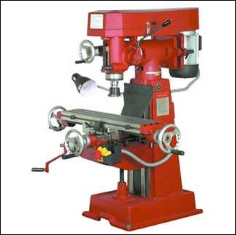
Milling Machine
???????
(Motion)
???????
(Action)
Notes:
Milling Machine
Ask the class if anyone uses or has used a Milling Machine.
Ask that participant to tell the class about it. If no volunteers, have a participant read the paragraph on page 45.
What is the Motion Hazard of a Milling Machine?
Rotating
What is the Action Hazard of a Milling Machine?
Cutting

Slide 46

Milling Machine Hazards
Notes:
Hazards
Read the paragraph on page 46.
Ask if questions.
Emphasize and say:
“Material might spin and strike an operator if the material is not secured to the table. Injuries can also occur from a projected wrench if it is left in the spindle.”

Slide 47
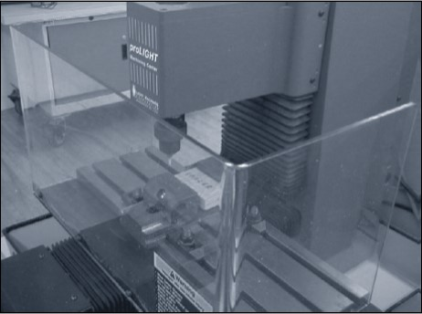
Milling Machine Solutions
Notes:
Solutions
Have a participant read the first sentence on page 47.
Ask another participant to read the NOTE.
Trainer reads final paragraph.
Use your pointer to identify the shield as you read.

Slide 48
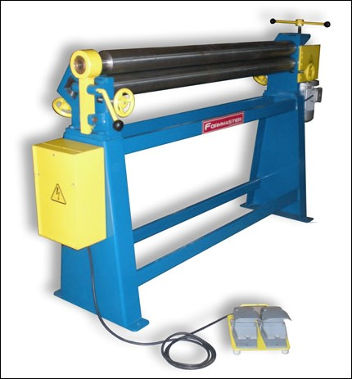
Roll-Forming & Roll-Bending
???????
(Motion)
???????
(Action)
Notes:
Roll-Forming & Roll-Bending Machines
Trainer reads page 48.
Ask these questions:
What is the Motion Hazard of a Roll-Forming and Bending Machines?
Rotating
What is the Action Hazard of a Roll-Forming and Bending Machines?
Bending
Ask if any questions.

Slide 49

Roll-Forming & Roll-Bending Hazards
Notes:
Hazards
Trainer – read page 49.
Ask if any questions.
Ask if any participant has worked on this type of roll-forming equipment.
If yes, ask them to describe the experience and project they were assigned.
If no, move on.

Slide 50

Roll-Forming & Roll-Bending Solutions
Notes:
Solutions
Have a participant read the first sentence on page 50.
As they read, point out the safety features within the paragraph.

Slide 51

Machine Guarding Checklists
Notes:
Checklists
Refer to the checklists in the pocket of the Training Manual. Ask participants too review. Allow 5 minutes to do so.
Is the checklist valuable? If so, how? If not, why not?
If no one finds value with the checklists offer suggestions such as to review the lists before beginning work on equipment or sharing with machine operators.
How will I (we) use the checklist?
How often will I (we) use the checklist?

Slide 52

Questions/Comments
Notes:
Questions/Comments
Explain that you have just finished the section regarding Shipyard Machinery.
Ask if there are questions.
If you are also training Portable Power Tools move on to the next page.
If not, conduct the Feedback form and the Post Test process.

Slide 53

Portable Power Tools
Notes:
Read page 53.
Ask participants which power tools they use in the photo.
Ask them how they use the tool.
Ask if there are questions.

Slide 54

Power Tool Hazards - Exercise
Notes:
From OSHA’s Website
This is an individual exercise.
Trainer says – “Above are 19 injuries recorded in the first four months of 2017.”
Go over the questions and ask if there is a need for clarification.
Provide 8 minutes to complete.
Ask each question and have one participant answer each question with the exception of the last question.
With the last question open it up for discussion.

Slide 55


Applicable Regulations
Notes:
Applicable Regulations
Explain that this is a reference page for those that want to read the OSHA regulations that apply to the following section of this Training Manual.

Slide 56

OSHA Precautions
Notes:
From OSHA’s Hand and Power Tool Booklet
Ask the participants to read this page to themselves. Ask them to identify one bullet they would be willing to elaborate on by explaining the hazard associated with not following a rule.
Allow 3-5 minutes to complete.
Ask one participant at a time to share the hazards they identified.
End exercise after 4-5 responses.

Slide 57


More OSHA Precautions
Notes:
More OSHA Precautions
Read page 57. Ask if there are questions.

Slide 58

Controls and Switches
Notes:
Operating Controls and Switches (OSHA Quick Takes)
Ask participants to read page 58 on their own.
Ask them to circle the following terms which you will put on flipchart or white board.
Constant pressure switch.
Lock-On control.
Positive On-Off switch.
Ask participants, one at a time, what each of the terms means.
Constant pressure switch – a switch requiring pressure to operate and will shut off the power when the pressure is released.
Lock-On control - lock-on control provides that turnoff can be accomplished by a single motion of the same finger or fingers that turn it on.
Positive On-Off switch – A switch that turns the tool on and off (least effective).

Slide 59

Specific Tool Hazards and Solutions
Notes:
Commonly Used Portable Power Tools Used On Board
Read page 59 to the participants to introduce the section on Commonly Used Portable Power Tools Used On Board.
Abrasive Grinders
Drills
Sawzalls
Needle Guns

Slide 60

Abrasive Grinders
Notes:
Hand Grinders
Read Page 60.
Emphasize:
Hand Grinders are also one of the most abused, or misused tools.

Slide 61

Exercise
Notes:
Have participants get back with their partners to complete the chart for hazards and solutions.
Ask each group to share their answer with the class.
Target answers include:

Slide 62

Abrasive Grinder Hazards
Notes:
Abrasive Grinder Hazards
Ask for a volunteer to read page 62 or trainer reads page 62 to the class.
Ask if any questions.

Slide 63

Abrasive Grinder Hazard Solutions
Notes:
Using Portable Grinders Safely
Trainer says: “Listed on page 63 is the safety procedure as outlined by OSHA when using Portable Grinders”.
Read items 1 – 10.
Ask if questions.

Slide 64

Hazard Solutions - Preparation
Notes:
Using Portable Grinders Safely
Trainer says: “The following slides will expand on each of the ten safety items I previously read on page 63.”
Have the participants read page 64 silently.
Ask for volunteer(s) to summarize Preparation step of safety.
• Remove flammable materials.
• Ensure work area is clean.
• Keep the power cord clear from the grinding wheel and materials.
• Have personnel not involved step away.
• Secure work with clamps or a vice to free both hands to operate the tool.

Slide 65

Hazard Solutions - Inspection
Notes:
Using Portable Grinders Safely
Go around the room and have individual participants read each bullet.
Emphasize:
*OSHA Guard Removal Exception only allows the guard to be removed for “internal grinding. The term "internal grinding" is defined as "the precision grinding of the inside surface of the hole in a work piece." This does not include snagging or off hand grinding operations such as grinding the welds inside a box or frame or the concave areas of auto bodies.

Slide 66

Hazard Solutions – Ring Test – Replacing the Wheel
Notes:
Using Portable Grinders Safely
Ask the class “Who works with Portable Grinders?”
If anyone, ask “Who can describe a Ring Test?”
Compare answer and review with bullets under 3. Ring Test.
Ask “Who can describe Replacing the Wheel?”
Compare answer and review with bullets under 4. Replacing the Wheel.
If no participants have worked with Portable Grinders, read and review each step 3 & 4.

Slide 67

Hazard Solutions – PPE – Switch the Grinder On
Notes:
Using Portable Grinders Safely
Read page 67 ( #5 and #6).
Ask if questions.
Ask for a volunteer to read #6.

Slide 68

Hazard Solutions – Grinding – Switch the Grinder Off
Notes:
Using Portable Grinders Safely
Read item #7.
Ask if questions.
Ask for volunteer to read #8.

Slide 69

Hazard Solutions–Other Precautions – Maintenance/Storage
Notes:
Using Portable Grinders Safely
Read #9.
Read #10.
Remind participants they should refer to their Training Manuals in the future as there are so many safety and proper handling procedures when working with Small Portable Tools.

Slide 70

Hand Grinder Do's and Don’ts
Notes:
Review Do’s and Don’ts.
Trainer read or ask for volunteer.
Ask if questions.

Slide 71

What Happened?
Notes:
Have each participant look at the picture and list the answers to the question: “What May Have Caused This?” Allow 1 minute.
Ask the class to share their answers.
Cracked wheel
RPM rating of the grinder does exceeded the RPM rating on each abrasive wheel.
Spindle too tight

Slide 72
Exercise
Notes:
Have each participant complete one method in the right column
for each solution in the left column. Suggest they can refer to previous pages 64-69.
Pages 64-69.

Slide 73

Portable Power Drills
Notes:
Portable Drills
Ask the class if any work with portable drills.
For those that raised their hands, ask what the hazards are when working with portable drills?
Lacerations
Entanglement
Material strikes you
Projected chuck
Read page 73 or ask for a volunteer.

Slide 74

Portable Power Drill Hazards
Notes:
Power Drill Hazards
Trainer says: “Look at this picture which is an example of potential minor injury from improper use of a Power Drill”.
Read page 74.
Ask if questions or comments.

Slide 75

Exercise
Notes:
Have the participants complete page 75 by answering the question completing the solution(s) to avoid the injury.
Review the scenarios by asking 2-3 participants to share their answers. (If time does not permit, ask for only one example.)
Proper PPE
Secure Chuck
Bit is tight
Not putting undue pressure on bit
Proper type bit for material

Slide 76

Portable Power Drill Solutions
Notes:
Portable Drill Solutions
Trainer says: “Here’s a good diagram of a cordless power drill.”
Point to key tool parts.
“The next few pages will discuss safety before you pull the trigger, while you’re drilling and what NOT to do while using a power drill.”

Slide 77

Before You Pull The Trigger!
Notes:
Before You Pull the Trigger
Trainer says: “We’ll start with before you even pull the trigger.”
Read page 77.
Ask if questions.

Slide 78

While Drilling!
Notes:
While Drilling
Trainer says: “Next we’ll discuss what to do while actually drilling.”
Read Page 78.
Stop mid-way and ask if any questions.
Point out that holes should be predrilled for woodscrews not all screws. This is a quiz item.
Complete reading of page 78.

Slide 79

More While Drilling!
Notes:
More While Drilling
Trainer says: “There are lots of things to remember while you operate this tool. Many of these rules apply to ALL hand tools.
Let’s read page 79. Any volunteer?”
If time permits, use volunteer. Otherwise, trainer selects good reader from class or reads for the class.

Slide 80

Drilling Don’ts
Notes:
Drilling Don’ts
Trainer says: “Lastly, we will cover what NOT to do while drilling.”
Trainer summarizes:
No loose clothes
Roll up sleeves
Tie back long hair
No rings, watches or bracelets
Remove the chuck
Make adjustments and remove chuck key IMMEDIATELY
Do NOT place hands under material being drilled
Do NOT stop rotation of chuck and spindle with your hand

Slide 81
Portable Power Drill Exercise
Notes:
Have the participants mark the answers to the following questions. Allow 3-4 minutes to complete. Review each question as a class.
How often should you inspect a drill? Every time used
Regardless of the job, should you pre-drill all holes? NO
Should you always wear gloves that are loose fitting? NO
To avoid binding you should you always keep steady pressure on the bit? NO
Should you use higher speed for thicker wood and slower speed for metals? NO
Regardless of the material you are drilling should you lubricate the drill bit? NO
Can a drill motor run with the chuck in place? YES
Should you always mount the chuck key at the end of the power cable just above the plug? NO
Ask if any questions.

Slide 82

Sawzalls
Notes:
Sawzalls
Trainer asks: “Do any of you work with Sawzalls?”
If yes, and time permits, ask what tasks they use it for.
If no, move on.
Sawzalls can be used for many things!
Ask a different participant to reach each paragraph.

Slide 83

Sawzall Hazards
Notes:
Sawzall Hazards
Trainer says: “Now we’re going to talk about the hazards of Sawzalls.”
Trainer reads bullet points.
Trainer reads anecdote.
Trainer says: “OUCH!”

Slide 84

Sawzall Solutions
Notes:
Sawzall Solutions
Trainer says: “Here’s a good diagram of a Sawzall.”
“The next few pages will discuss safety before you pull the trigger, while you’re using a Sawzall and what NOT to do while using a Sawzall.”

Slide 85

Before You Pull The Trigger!
Notes:
Before You Pull the Trigger
Trainer reads page 85 and points to diagram of Sawzall on page 84 with pointer when appropriate.

Slide 86

While Sawing!
Notes:
While Sawing
Trainer says: “Here are the common-sense points when sawing with a Sawzall.”
Trainer reads page 86 or asks for a volunteer.

Slide 87

Sawzall Don’ts
Notes:
Sawzall Don’ts
Trainer says: “Here is what NOT to do when working with a Sawzall.”
Trainer reads page 87.

Slide 88
More Sawzall Don’ts
Notes:
More Sawzall Don’ts
Trainer says: “Page 88 includes a few more things NOT to do when using a Sawzall.”
Ask for volunteer to read page 88.

Slide 89
Sawzall Exercise
Notes:
Stump the Class!
Ask the class to get with their partner to create 2 questions from the Sawzalls section. Allow 2-3 minutes. (Remind the class that questions must be reasonable and if the instructor can’t answer it, it doesn’t count.)
Go around the room and have each group share one of their questions. Ask if a participant knows the answer.
As the trainer, answer the question if no one volunteers.

Slide 90

Needle Gun
Notes:
Needle Gun
Trainer asks: “Does anyone use a needle gun?”
Trainer acknowledges.
If ‘yes” response and time permits, ask participant to describe their experience(s).
If “no” response, move on.
Trainer reads page 90.
Ask if questions.

Slide 91


Needle Gun Hazards
Notes:
Needle Gun Hazards
Trainer asks for volunteer to read the 5 hazard bullet points.
Trainer reads remainder of page 90.
Emphasize VWF has been understood as a hazard since 1970 when it was given a term and definition as a result of Needle Gun Hazard.

Slide 92

Needle Gun Solutions
Notes:
Needle Gun Solutions
Trainer says: “Here we have a diagram of a Needle Gun.”
“The next few pages will discuss safety before you pull the trigger, while you’re using a Needle Gun and what NOT to do while using it.”

Slide 93

Before You Pull The Trigger!
Notes:
Before You Pull the Trigger
Trainer says: “Here is the list of what to do before you use the Needle Gun. “
Read the bullets on page 93.
Ask if there are questions.

Slide 94

While Needle Gunning!
Notes:
While Needle Gunning
Trainer instructs participants to go around the class room and each read a bullet until all have been read. Pause for questions, if any, in between each bullet.

Slide 95
Needle Gunning Don’ts
Notes:
Needle Gunning Don’ts
Trainer reads “Don’t” bullets on page 95.
Trainer reads and emphasizes the NEVER bullets.

Slide 96
Needle Gunning Exercise
Notes:
Have the participants get with their partner to complete page 96.
Remind participants they can refer to pages 90-95. Allow 2-3 minutes. If running short on time have a pair of participants complete only one of the columns.
Prepare flip chart with column headings

Slide 97

Questions/Com ments
Notes:
Ask I there are any questions or comments.
Complete Trainer Feedback Form (Administrator may do this).
Complete Post Test (Administrator may do this).

