Slide 1
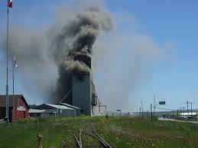



Prevention of GRAIN Dust ExplosionS
Source: United States Department of Labor
Notes:
Welcome to the Combustible Grain Dust workshop. This training program is being delivered to create awareness on combustible grain dust to workers and supervisors in the grain handling and processing industry.
This training program consists of six modules covering grain dust explosion fundamentals and prevention. We will be starting the training program by giving an overview on the past incidents that happened in the U.S. and the components that lead to grain dust explosion. At the end of this training program, dust explosion will be demonstrated outside. Overall, our objective is to increase awareness to prevent grain dust explosion. To achieve our objective, we will be covering grain dust explosion fundamentals, ignition sources that leads to grain dust explosion, good housekeeping practices, grain unloading and grain handling practices, and engineering controls to prevent grain dust explosion.
Thank you for being here, let’s go around and introduce ourselves!

Slide 2
Prevention of Grain Dust Explosion
Grantor: U.S. Department of Labor, Occupational Safety & Health Administration, Susan Harwood Training Grant Program Award Number: SH-31232-SH7
Project Title: Training on Prevention of Grain Dust Explosion
Project Period: 2017-2018

Slide 3
Disclaimer
This material was produced and revised under grant number SH-31232-SH7 from the Occupational Safety and Health Administration (OSHA) of the U.S. Department of Labor. It does not necessarily reflect the view or policies of the U.S. Department of Labor, nor does mention of trade names, commercial products, or organizations imply endorsement by the U.S. Government.

Slide 4
Module –I
Introduction
Notes:
In this first module we will show the perils of grain dust explosion and the devastating damage an explosion can cause to an industry and a facility.

Slide 5
Learning Objectives – Module I
Describe characteristics of past grain dust explosion incidents in the U.S.
Explain the relationship between the dust explosion pentagon and the probability of explosion
Differentiate between primary and secondary explosions

Slide 6
Westwego, LA December, 1977
https://www.youtube.com/watch?v=fcc6a0zmJ48
Show YouTube video about the Westwego Grain Elevator Disaster
Notes:
A video documentary produced by the History Channel was on grain dust explosion covering the incident that happened at Westwego, LA on the 23rd of December 1977. 36 people were killed in this incident. This major incident led to the formation of OSHA regulations in 1982. As illustrated in the video, grain dust explosions are devastating and has deep impacts on the community.

Slide 7
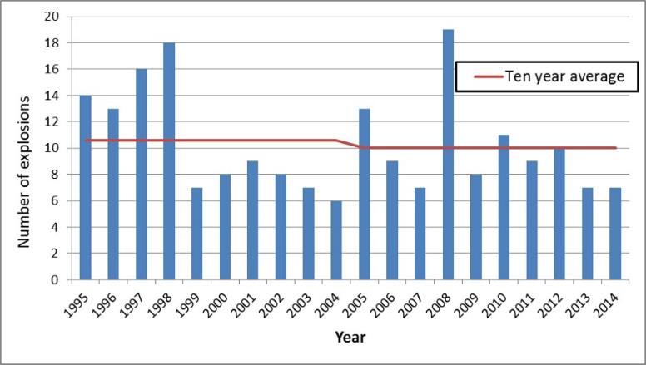
Grain Dust Explosions in the U.S.:
10 Year Average
1995 - 2014
Five year average of grain dust explosions in the U.S.
Notes:
In 2013 and 2014, about 7 incidents happened in the U.S. In the last 10 years, with increased awareness on the perils of grain dust explosion the number of incidents were comparatively lower than the previous decade. Except in the year 2008, where there were about 19 incidents.

Slide 8
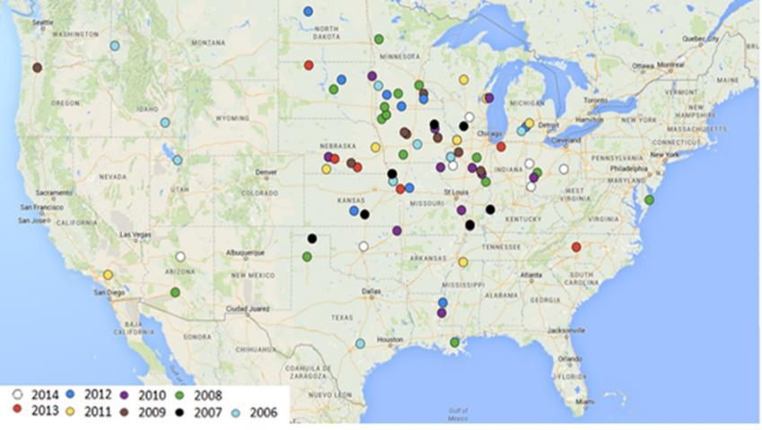
Grain Dust Explosions in the U.S.
Source: Ambrose and Sanghi, 2014, World Grain
Five year average of grain dust explosions in the U.S.
Notes:
It is no surprise that the majority of grain dust explosions occur mostly in parts of the U.S. that focus on grain production, handling, and processing. However, as seen in the earlier video, explosions occur wherever grain dust and other explosion-inducing materials are located.

Slide 9
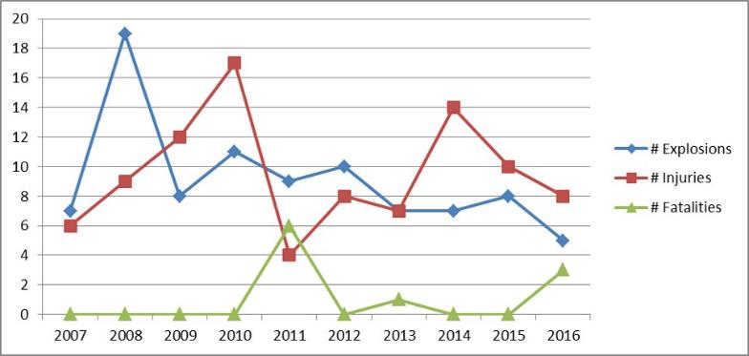
Grain Dust Explosions in the U.S.
2007 - 2016
Source: Ambrose, 2017
Notes:
This graph presents the grain dust explosion incidents occurring in the U.S. from 2007 to 2016. Though grain dust explosion fatalities are low, explosions are still happening in the U.S. The number of injuries remains steady. Fatalities do not occur every year, but even when total number of explosions are low, the number of fatalities is relatively high, as in 2016, where only 5 explosions were observed, but 3 of these involved a fatality. The continued grain dust explosion incidents are discouraging, and as an industry, our goal should be to bring the number of incidents to ‘zero’

Slide 10
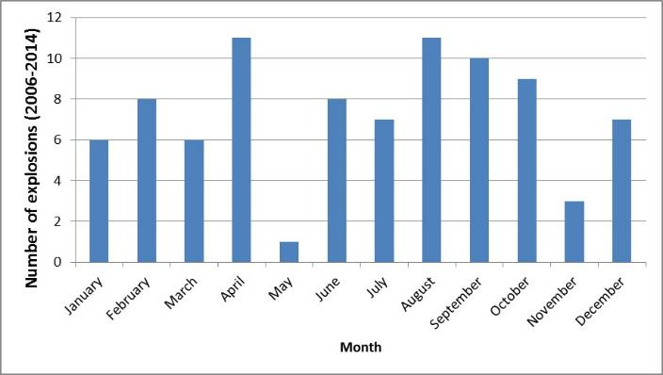
Number of Explosions (by month)
2006 - 2014
Source: Ambrose and Sanghi, 2014, World Grain
Five year average of grain dust explosions in the U.S.
Notes:
From this graph, we could see that explosions could occur any time of the year. The incidents are high starting from August. It is obvious that with the harvest season starting in August, the dust generation is high and the number of incidents also increased. In addition, moving large volumes of grain in April to prepare for the maintenance and harvest season could have resulted in higher number of incidents.

Slide 11
Why Worry About Grain Dust?
Workers and managers unaware of and fail to recognize serious nature of grain dust hazards
Facility management fails to conform to existing standards designed to prevent or reduce impact of explosions
Facilities contain unsafe accumulations of combustible grain dust; Housekeeping was inadequate
Warning indicators were accepted as normal and their causes were not identified and resolved

Slide 12
Key Contributing Factors to Incidents
Dust Collectors: inadequately designed and maintained to actually minimize explosions
Process changes were made after installation without adequate review for new hazards
Outside parties who inspect facilities may not always identify dust explosion hazards:
  Government enforcement
  Insurance underwriters
  Health and safety professionals (even those whose expertise is in dust!)

Slide 13
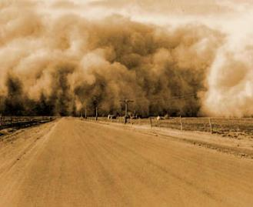
Hazards associated with combustible grain dust

Slide 14
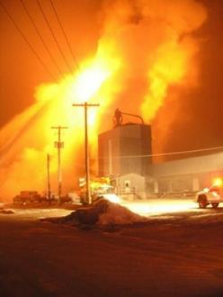
Grain Dust Combustibility
Grain dust is HIGHLY combustible
  December 23, 2009 explosion destroyed 30,000 bushel wheat elevator in Chadron, NE
Source: http://dustexplosions.blogspot.com/2009/12/chadron-nebraska-grain-elevator-catches.html
Notes:
This photo shows what remained of the structure by 11 a.m. A fast spreading fire totally destroyed a grain elevator containing about 30,000 bushels of wheat in Chadron, Nebraska USA Tuesday morning, {Dec. 23rd 2009}
Photo: http://dustexplosions.blogspot.com/2009/12/chadron-nebraska-grain-elevator-catches.html

Slide 15
OSHA Definition: “combustible dust”
Combustible particulate solid
Presents fire or deflagration hazard
When suspended in air or other oxidizing medium
Over a range of concentrations
Regardless of particle size or shape

Slide 16
Several Definitions Apply to Combustible Dust
Combustible Dusts (NFPA 400-2016)
Combustible Dusts (NFPA 499-2017)
Deflagrable Wood Dusts (NFPA 664-2017)
Agricultural Dusts (NFPA 61-2017)
Combustible Metal Dusts (NFPA 484-2015)
All involve solid material composed of distinct pieces that when processed, have the potential to become combustible

Slide 17
What are Combustible Dust Hazards?
Flash Fire: fire that spreads through flame front quickly through diffuse fuel without damaging pressure – may last 3 seconds or less
Deflagration: creation of “combustion zone” that develops in the unreacted medium – usually moving less than speed of sound
Explosion: bursting or rupturing of enclosure or container due to internal pressure from deflagration

Slide 18
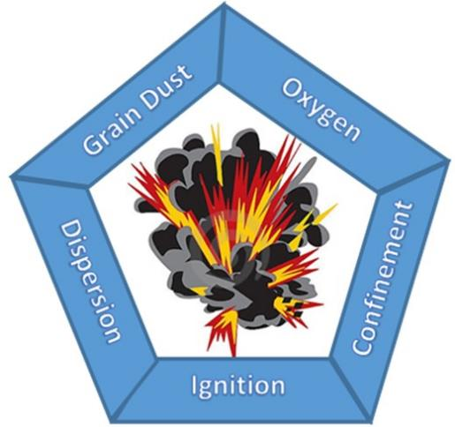
Grain Dust Explosion Pentagon
Notes:
Only three elements are needed for a fire, an ignition source, fuel or for the purposes of our discussions, combustible dust, and oxygen. A fire will burn hot, or flash, but add confinement and dispersion to the mix and you have the deadly ingredients for an explosion. The confinement is important because that is what leads to the explosion. Combining grain dust, oxygen, and ignition will lead to a fire, but not an explosion – dispersion and the pressure created because of the confined space is what contributes to the explosion.
Due to the smaller particle size, grain dust is even more explosive than coal dust.
Lets talk about each one individually.
Air is approximately 20% oxygen and cannot be eliminated in grain handling and processing facilities
So what is oxygen? It is the third most abundant chemical element in the universe.
It is all around you and not something that can be controlled easily.
Grain dust is always present in grain facilities
One metric ton of grain contains about 1-5 kg of dust. So, housekeeping is key. Whenever we see dust, make sure to clean.
What do you think are some potential ignition sources in your facility?
There are several different potential contributing factors listed here that could provide the spark or heat needed for an explosion. I talked about the fire triangle, all you really need is oxygen, fuel and an ignition source to create a fire, but if you add the two additional elements, confinement and dispersion, you have an explosion, so it is important to reduce the possibility of an ignition source through behavioral and engineering controls. These include preventive maintenance grating on dump pits to prevent tramp metal from being introduced to a system as well as hot work permits when performing welding activities. This is the second area that can be controlled of the five elements needed for an explosion.
The particle size of dust is very small and the dust particles gets dispersed in air as dust clouds. Dispersion of dust, in air, leads to secondary explosion. The dispersed dust also settles on the surfaces of equipment or on the walls. This settled dust could lead to primary explosion.
Dispersion is the effect of moving the cloud of dust from one place to another, may it be by mechanical processes such as transporting grain or occur during unloading. In addition, dispersion often happens as the result of a primary explosion, which will be discussed later in this lesson. The best way to control dispersion is through good housekeeping, by preventing dust accumulation in areas that can’t always been seen, such as high ledges. In addition, mineral oil can be applied to reduce the amount of dust generated and there are other engineering controls that will be discussed later in this course.
So far we have discussed almost all of the elements needed for an explosion, the last is confinement. Confinement doesn’t always mean an enclosed space, it really means restricted movement.
There are several places in a grain handling facility that are confined, can you think of a few…Several of these areas also have some of the other elements required for an explosion. Some examples of confined space are: The building itself (dust dispersed in air), conveying/handling equipment, dust collectors.

Slide 19
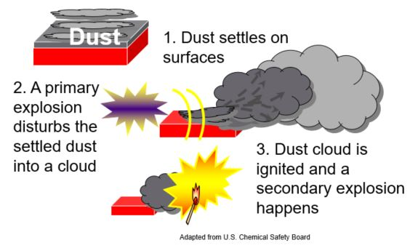
Primary and Secondary Explosions
Adapted from U.S. Chemical Safety Board
Notes:
Grain dust explosions originate from a fire or a primary explosion from the ignition of dust. This primary explosion spreads the dust collected in surfaces as dust cloud or disperses within the confined space. The ignition from the primary source then ignites the dust cloud and leads to the major secondary explosion. The secondary explosion is more devastating and the magnitude of secondary explosion could destroy the facility.

Slide 20
Dust (Re) Collection: Module 1
What are the five components of the grain dust explosion pentagon?
What times of the year see increased grain dust explosions? Why?
Notes:
Ignition source (grain), Fuel (spark), Oxygen, Dispersion, and Confinement
We see additional grain dust explosions in the spring, as well as other times of the year when grain is transported

Slide 21
Learning Objectives – Module I
Describe characteristics of past grain dust explosion incidents in the U.S.
Explain the relationship between the dust explosion pentagon and the probability of explosion
Differentiate between primary and secondary explosions

Slide 22
Module – II
Grain Dust Properties
Notes:
In this module we will be learning about the properties of grain dust that relate to grain dust explosion.

Slide 23
Module II Learning Objectives
Characterize the combustibility potential of grain dust
Understand how grain dust explosions happen
Become aware of the Dust Explosion Pentagon

Slide 24
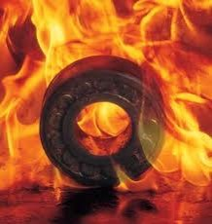
Ignition Sources
Name few possible ignition sources
Leading sources
  Unknown
  Welding or Cutting – any hot work
  Fire from any source
  Overheated bearings
  Friction from choked leg & rubbing pulley
  Tramp metal
  Friction sparks or other sparks
  Static electricity
Notes:
Have participants brainstorm possible sources
Show the leading sources: often, the source of the explosion is not known as it is difficult to find where the initial spark came from.
Discuss whether any of these are present in their current location
Other sources: flame or glowing embers; hot surfaces;

Slide 25
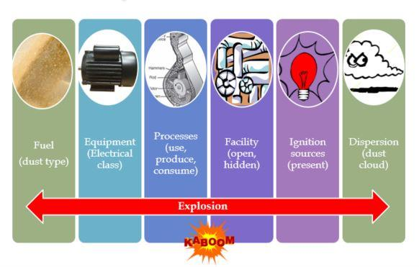
Explosion - Factors
Explosion
Notes:
Aligned with the dust explosion pentagon, there are several factors that must be considered to assess the grain dust explosion threats and dangers. Fuel/dust type, equipment used (that includes electrical, mechanical, motors, etc), processes that produce or use dust (hammer mill, roller mill, dust collectors, etc), facility (open or with confined space), ignition sources (open electrical wires, sparks, etc) and dust dispersion.
Actually there are several elements to take into account when assessing an installation to determine if there is a fire hazard or combustible dust explosion. This chart summarizes these factors: Materials that can be combustible when particle size is reduced; Processes that use (cleaning processes), consume (as part of its raw material) or produce combustible dusts; Equipment on which dust can concentrate or are not appropriate for the electrical rating of that area; Open areas where combustible dust may accumulate; Hidden areas where combustible dust may accumulate, and Means by which dust can be dispersed in the air.

Slide 26
Primary Dust Explosion-Locations
Unknown
Bucket elevator
Storage bins
Hammer mills/roller mills
Dust collector
Headhouse
Grain dryer
Electrical equipment
Notes:
Based on the past history of grain dust explosions, at most incidents (about 60%), the primary location where the incident happened remains a mystery. Can anybody guess, why we couldn’t locate the exact place where the dust explosion originated? Yes, when dust explodes the pressure is so high that it damages everything in the vicinity. The other major location is the bucket elevator. With constant moving of grains, there is continuous dust generation. And with moving mechanical parts, there is always a high probability of an ignition source developing from the moving mechanical parts. In this workshop, we will learn about some preventive precautions for bucket elevators and other mechanical handling devices. In addition, we will be covering the general maintenance of material handling and other equipment that are used by the grain handling and processing industry.

Slide 27
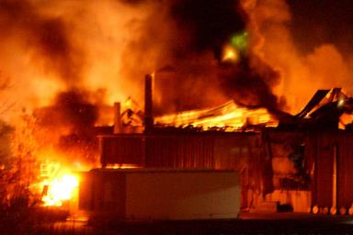
Dust Explosiveness
Dust is considered explosive if, after igniting the dust/air mixture with a suitable source, there is flame propagation in combination with a rise in pressure (Bartknecht, 1989)
Notes:
Dust – similar to chemicals, is explosive. If there is any ignition due to sparks or any other fire source, dust will explode. The low moisture, high surface area of this small dust particles, high ash content make them to explode instantly. This simultaneous explosion and burning leads to flame propagation. The explosion of minute suspended dust particles will add to the explosion and increases the pressure of flame propagation.

Slide 28
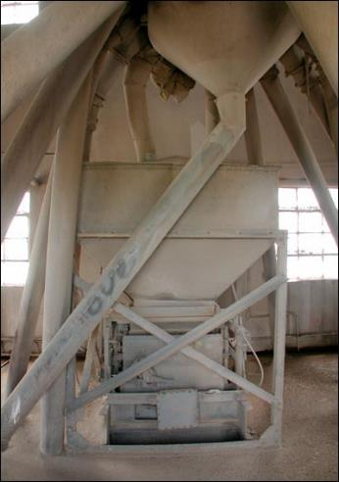
Enough for an Explosion
How much dust is too much?
  “If you can’t distinguish the color of the floor, the dust is too thick”
Source: www.pawneerock.org
Notes:
Everyone wants to know: how much dust can I get a way with?!? The answer is really NONE. Keep your facility as clean as possible. In an animal feed mill, grain elevator or flour mill there will always be dust and there will be times of the year when you will have more dust. We cannot stress enough the importance of housekeeping. Remember: housekeeping is not part of your job or an extra part of your job when you have time. Housekeeping IS your job.
We have permission to use the quote, but not his name. Craig from Cargill, he is listed in the acknowledgements at the very end.
Suspended dust concentrations of this type represent a severely dense cloud through which a 100 watt light bulb cannot be seen at a distance of approximately 3 m or your hand cannot be seen at arm’s length. Such concentrations make breathing extremely difficult

Slide 29
Dust Particle Size
Common Material | Size (microns)
Mash Feed | 300-1200
Granulated white sugar | 450-600
Human hair | 40-300
Salt | 100
Flour | 1-100
Sand | 50+
Mold spores | 10-30
Talc, Dust | 10
Source: OSHA and Filtercorp International Ltd.
Notes:
Another way to understand particle size is to compare dust with the other small things listed in the table. As we can see dust has similarly small particles as mold spores and the fine flour – all very small.

Slide 30
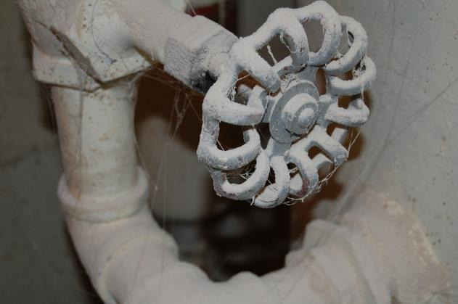
Is This a Problem?
YES!: KSU
Notes:
Is this a problem?
Yes, it is a problem. This amount of dust can fuel a secondary explosion. A primary explosion will throw this dust into the air and fuel a secondary explosion. Also, this picture shows us the dust collection in hidden areas or in the places (within the facility) that were not frequently used. This accumulation of the dust in not so frequently used areas then becomes a potential fuel source. In addition, the dust also has the potential to become an ignition source due to friction with the turning of the valve, and will cause the accumulated dust on the valve and pipe to become airborne. There are two problems here – an ignition source and disturbance of dust.

Slide 31
Grain Dust Concentration
Minimum explosion concentration (MEC) for grain dust: 40 g/m³ (varies with particle size)
Maximum pressure from corn dust explosion is greater than 100 psi.
Maximum rate of pressure approaching 8500 psi per second
Concrete structures (like elevators) withstand about 25 psi.
Most grain handling equipment will fail at pressures less than 6 psi.
Notes:
Whenever we ignite any material, there will be release of energy (similar to burning coal for electricity generation). Unfortunately, in grain handling and processing industry, we are dealing with fine and dry dust particles that burn instantaneously. And here we are not talking about burning a single particle, but millions and billions of dust particles that are suspended in air as dust cloud or settled in the floor or walls or on top of equipment in our facility. If this millions and billions of dust particles ignite and burn at a single instance, we could imagine the amount of heat that it could produce and we all know the resulting effects from this burning – a devastating explosion that completely damages the facility.
Minimum explosion concentration (MEC) is the concentration of dust required to initiate an explosion. Minimum explosion concentration varies based on their particle size, moisture content, environmental humidity, distance from ignition source, etc. If the particle size of dust is higher or if the moisture content, environmental relative humidity is high, then the MEC will be high. i.e. the threshold level to start an explosion will be high. Optimum explosive concentration (OEC) is the concentration of dust that could explode even at a lower temperature spark from an ignition source.
Though the MEC is lower than the OEC, presence of dust at minimum EC could trigger a primary dust explosion. So it is our duty to clean up dust and be careful that the level does not reach to OEC level. Dust at OEC level could aid a secondary dust explosion.
Data from U.S. Bureau of Mines
“Maximum explosive pressures can exceed 100 psi with the maximum rate of rise of pressure approaching up to 8500 [psi per second] which is an indication of the intensity and speed of a grain dust explosion. When the rate of rise of pressure is higher, explosions are more severe.” – James E. Maness, “Grain Industry’s approach to Dust Explosions”
James. E. Maness has giving his permission to use the quote.

Slide 32
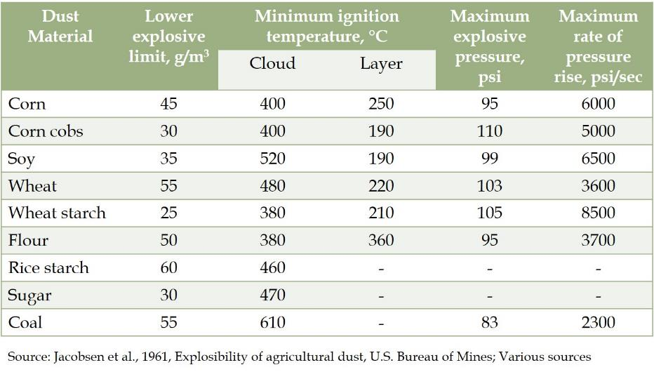
Dust Explosibility Properties
Notes:
This table lists the lower limit of grain dust explosive concentration limit, ignition temperature, explosive pressure and the rate of pressure. From this table we could see that the lower limit, at which an explosion could happen, is very low for most of the grain based dusts. As a safety precaution, if there is too much dust in the air of deposited on the walls, it will be better to stop the operations and clean the place by removing all suspended and settled dust particles.
Most of the dust particles could ignite above around 200 deg C. Can anybody guess the temperature from a welding spark? We will be covering the temperature details in next slide. So, we could see that a spark or minimum temperature is required to ignite the grain dust. A primary explosion from this dust ignition could lead to a major secondary explosion.
In the previous slide, we saw that most facilities fail at or below 25 psi. But, the pressures developed from grain dust explosion is almost 4 times the magnitude. Now you could relate this to the pictures/videos that you see from a grain dust explosion incident. The facilities are usually completed damaged.

Slide 33
Dust (re)collection!!
What is the particle size below which dust could explode (based on NFPA 654)?
  a) 100 microns
  b) 200 microns
  c) 420 microns
  d) 500 microns
Which organization has developed ‘standards’ for testing dust for explosibility?
  a) Grain Elevator and Processing Society (GEAPS)
  b) Occupational Safety and Health Administration (OSHA)
  c) American Society for Testing and Materials (ASTM)
  d) National Grain and Feed Association (NGFA)
Notes:
Answers
c
c

Slide 34
Heat from Ignition Sources
Welding
  Arc welding: ~ 10,000°F (~5538°C)
  Gas welding: ~ 5,000 °F (~2760°C)
Mechanical spark: ~ 2,500 °F (~1371°C)
Grinding steel: ~ 1,200 °F (~649°C)
Static electricity
Hot rolls and beams
Notes:
Combining the small size of dust with heat from a spark can cause an explosion. Any of these will easily generate enough heat to ignite dust.

Slide 35
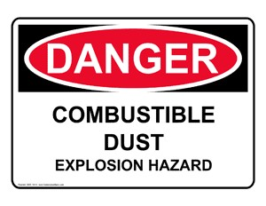
Testing Dust
  Screening test (based on ASTM E1226-10 standard): This is a general classification of powders being either ‘explosible’ or ‘non-explosible’. This test determines the explosibility of dust clouds when exposed to an ignition source.
Notes:
American Society for Testing and Materials (ASTM) and National Fire Protection Association (NFPA) has specific standards and recommendations for classifying powders based on combustibility. For determining the appropriate fire and explosion protection options, the powder has to be tested based on ASTM standards. All the tests are influenced by moisture content and the particle size of powders. Most of the testing laboratories prepare samples for testing such that the particle size is less than 75 µm and moisture content is less than 5%. Some of the tests are given below

Slide 36
Testing Dust (continued)
Minimum ignition energy (MIE) – Electrostatic hazards (based on ASTM E2019 standard): This test determines the minimum electrostatic or spark energy that is capable of igniting a dust cloud. This test characterizes the susceptibility of dust clouds formed from powders to ignition by electrostatic discharges or mechanical sparks.
Minimum explosible concentration (MEC, based on ASTM E1515 standard): This test determines the minimum concentration of dust-air mixture or the cloud that can propagate flame upon ignition. Though this test could evaluate the lowest concentration required for a dust cloud to ignite, achieving a limit lower than MEC would not be always practical in a facility with continuous operation.
Notes:
Minimum ignition energy would give an approximate temperature at which a dust layer or a cloud could ignite. Similarly, the minimum explosible concentration would give a measure of the dust cloud/dust concentration in air that could lead to a secondary explosion.

Slide 37
Testing Dust - continued
  Minimum ignition temperature of a dust cloud (MIT_{cloud}, based on ASTM E2021 standard): This test determines the minimum temperature that is capable of igniting a dust cloud. This is an important test to assess the dust clouds that could form in heated operations, hot surfaces, and sparks.
  Minimum ignition temperature of dust layer (MIT_{layer}, based on ASTM E2012 standard): This test will determine the ignition temperature needed to ignite dust/powders in a layer of thickness ranging from 5 to 12.7 mm. As per National Electric Code (NEC), MIT_{layer} and MIT_{cloud} defines the selection of Class II electrical devices that could be used in hazardous areas.
Notes:
While testing, it is important to test for the minimum ignition temperature of dust cloud and dust layer. Dust clouds are more related to secondary explosion which will have a higher magnitude of pressure and pressure rate. While, minimum ignition temperature of dust layer is related to the primary explosion where an ignition source could ignite or burn the dust particle in the vicinity. We all know that a primary explosion could lead to a major secondary explosion.

Slide 38
Dust (re)collection!! Part 2
What is the maximum pressure a concrete structure can withstand?
  a) 5 psi
  b) 25 psi
  c) 125 psi
  d) 55 psi
Which test characterizes the susceptibility of dust clouds for explosibility?
  a) Screening test
  b) Minimum ignition energy
  c) Minimum explosible concentration
  d) None of the above
Notes:
Answers
b
c

Slide 39
Pentagon
Remember the pentagon – What do we need for an explosion?
Notes:
Review the pentagon: what 5 elements do we need for an explosion? How about in a bucket elevator, conveyor, storage bin, etc.

Slide 40
Learning Objectives – Module II
Characterize the combustibility potential of grain dust
Understand how grain dust explosions happen
Become aware of the Dust Explosion Pentagon

Slide 41
Disclaimer
This material was produced and revised under grant number SH-31232-SH7 from the Occupational Safety and Health Administration (OSHA) of the U.S. Department of Labor. It does not necessarily reflect the view or policies of the U.S. Department of Labor, nor does mention of trade names, commercial products, or organizations imply endorsement by the U.S. Government.

Slide 42
Module – III
Dust Mitigation:
Good Housekeeping, Preventive Measures, and Grain Handling
Notes:
In this module we will be learning about where dust is generated, good housekeeping practices, and grain handling techniques to minimize dust

Slide 43
Module III Learning Objectives
Understand primary dust generation points
Recognize and maintain good housekeeping practices
Understand the importance of proper grain handling techniques to minimize dust

Slide 44
Pentagon
Remember the pentagon – What do we need for an explosion?
Notes:
Review the pentagon: what 5 elements do we need for an explosion? How about in a bucket elevator, conveyor, storage bin, etc.
Have the participants discuss a particular place and then share within bigger groups or with the whole class. Also, look at the poster again, in each place 1-7 where is there a potential pentagon?

Slide 45
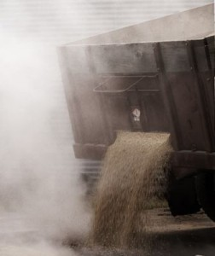
Potential Dust Generation
In your facility, what generates dust?
Which grain generates the most
dust?
Source: www.naturalrabbitfood.com
Notes:
Discuss where the dust gets generated
Brainstorm places in their facility where grain moves
List the normal and exceptional places, especially if any are missed in the brainstorm
Most dust is from corn.
It is important to note that as grain travels through the grain system (farm to county elevator to large elevator to mill or export elevator) the explosiveness of the dust increases. Right off the farm, most of the dust is from soil – especially for soybean dust and the explosiveness of soybeans is low. Corn dust has the highest explosion potential. As any grain moves through the system and starts to break apart, the explosiveness increases exponentially.

Slide 46
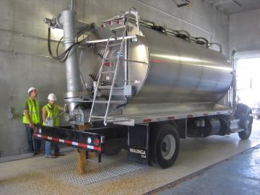
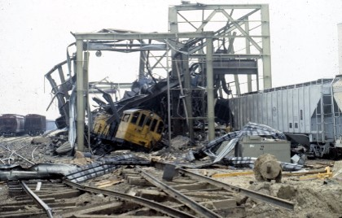
Grain Receiving
High dust generation
Turbulence and impact
Photo: KSU
Source: k-rex.k-state.edu
Photo: KSU
Notes:
As we saw in the previous module presentation, grain receiving is the high dust generation area. The higher turbulence due to flow of grains and the impact of grains leads to higher dust generation. The bottom (left) picture shows an explosion that has occurred/originated in a grain receiving area.
How we can reduce high dust generation in grain receiving area?

Slide 47
Dust Emission at Grain Receiving
Emission source | PM (lb/ton) | PM₁₀ (lb/ton) | PM_{2.5} (lb/ton)
Straight truck | 0.18 | 0.059 | 0.010
Hopper truck | 0.035 | 0.0078 | 0.0013
Railcar | 0.032 | 0.0078 | 0.0013
Barge unloader | 0.029 | 0.0073 | 0.0019
Source: OSHA
Source: Emission factors – grain elevators, seed cleaning & animal feed mills; www.deq.state.or.us

Slide 48
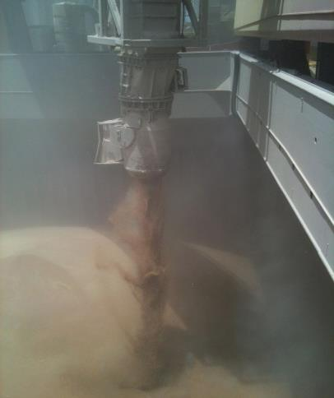
Example:
Photo: KSU
Notes:
Picture taken of loading vessel with wheat at CHS Myrtle Beach grain export elevator located in Belle Chasse, LA in July 2012
Explanation of example:
1- Bucket elevator: as grain or its co-products (i.e. Dried Distillers Grains, Soybean Meal) falls through the down leg in the elevator, separation will occur due to the different particle sizes and weight.
2- Unloading spout: as grain is unloaded, bigger particles will fall down faster due to gravity (bigger size and weight), smaller particles tend to stay in the air causing a grain dust cloud.

Slide 49
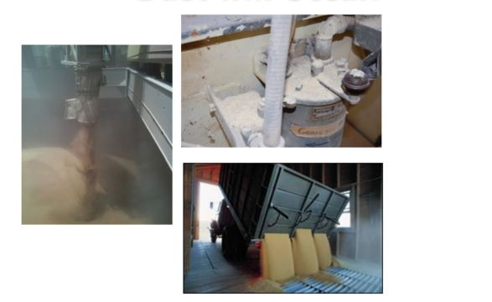
When Grain is Conveyed, Dust will Occur!
Photo: KSU
Notes:
Show examples of equipment that has not received any maintenance! Pictures from Kansas State University.
Explanation of examples:
1- Hole in the cyclone will make it not work properly for dust separation – NOT WORK EFFICIENTLY
2- Opening in bucket elevator leg will allow grain and dust to leak out and produce contamination and possible hazards
The possible hazards are:
Dust dispersion within the premises and ineffective dust collection

Slide 50

How Dust And Small Particles Separate
Physics and gravity!
When moving grain down through spouts, loading a bin or down leg in an bucket elevator separation occurs:
  Smaller particles tend to stay in the air longer producing a grain dust cloud!
Notes:
The entrapped air in the grain bed increases the air turbulence during grain handling. The air adds to effect of flow and impact in separating the dust adhered on the grain surface. Since the dust particles are low in density, they suspend in air for longer duration forming dust clouds.

Slide 51
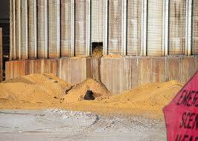
Identifying Dust Hazards
Materials that can become combustible when they are finely ground or milled
Processes that use or produce combustible dust
Leaking conveyors and spouts
Modifications to new equipment – process flow
http://www.cross-countiesconnect.com/
Notes:
We learned that dust/ground particles below 420 microns are explosible. So, it is very easy to identify dust hazards and potential dangers. Most products and processes that we use in our industry produces fine particles that are explosible when ignited. Leaking conveyors and process modification are some high dust generators. But, the hazards doesn’t end there. Shown is a picture where the smoldering grain ignited the dust. So, in our industry, from the grain receiving area till load-out section, dust is present everywhere.

Slide 52
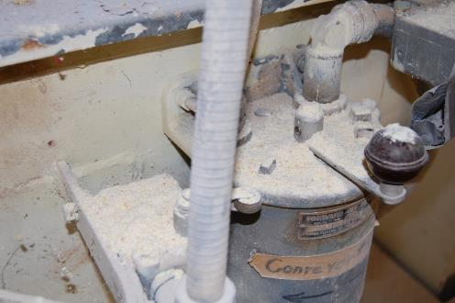
The Dust Collects
What happens to the dust?
Source: agfax.com
Notes:
Where does the dust collect in your facility?
It collects and collects: on the floor, on top of pipes, light fixtures, beams, on the walls, ledges, or any flat surface, etc. until someone cleans it up.
Who is responsible for dust collection in your facility?
What are other reasons to collect dust, other problems that dust generates?
Collecting dust causes a number of problems: increases pest infestation, respiratory problems and decreases the safety culture - along with increasing the risk for a secondary explosion.

Slide 53
Dust (re)collection!!
What action generates the most dust?
  a) Grain receiving/handling
  b) Storage
  c) Conditioning
  d) Harvest
The _______ the particle, the ________ its explosibility.
  a) Smaller, less
  b) Smaller, greater
  c) Wetter, greater
  d) Larger, greater
Notes:
Answers
a
d

Slide 54
Discussion
How can we reduce high dust generation in grain receiving area?
Notes:
Discussion should focus on movement of grain and use of tools when moving and receiving: move grain less, use dust control tools at receiving and loading areas; enclose dump pits to minimize dust; we will discuss these further in upcoming slides.

Slide 55
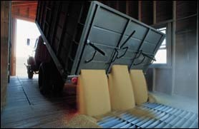
Grain Receiving - unloading
Controls used at unloading and loading areas:
  cyclones
  fabric filters
  baffles in unloading pits
  choke unloading
  use of deadboxes
  specially designed spouts for grain loading
Source: OSHA
Notes:
Grain receiving is an area with potential for high amount of dust generation. To avoid this high amount of dust that potentially could settle in the industry premises, controls like cyclones, fabric filters, etc., could be used. These control the flow of grains during unloading and resist the separation of dust from grain surface.
Capture and collection systems control emissions after they occur. Typical devices used in grain handling and processing are cyclones (mechanical collectors) and fabric filters. Both devices must be properly operated and maintained to do an effective job. Malfunctions can actually cause increased emissions until repairs are made, according to KSU.
Cyclones tend to collect a higher percentage of larger particles, which can be returned to the grain stream. Smaller particles typically pass through the cyclone to the filter, where they are collected for disposal in some other manner.
Use of cyclones before a fabric filter can lower the dust loading on the filter. However, the filter is less efficient because the larger particles captured by the cyclone would otherwise contribute to the collection efficiency of the mat of dust that builds up on the filter fabric, according to the National Research Council. The lower dust loading and lower efficiency tend to balance each other.

Slide 56
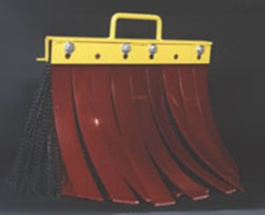
Grain Receiving - baffles
Install dump pit baffles on truck dump pits to provide a major reduction in airborne dust during dumping operation.
Chute baffles for unloading/conveyor – Reduces about 30% dust emissions
Notes:
Dump pit baffles and chute baffles are other common flow restrictors that could be used in grain receiving areas. If we can control the air borne dust, the secondary explosion risks can be greatly reduced.

Slide 57
Grain Receiving- dump pits
Dump pits with enclosures reduces dust emission and dispersion
Dump pits with draft fans – at least 50 cfm/sq. feet of airflow at the effective grate surface
Notes:
Source: Best management practices (BMPs) for grain elevators (www.iowadnr.gov)

Slide 58
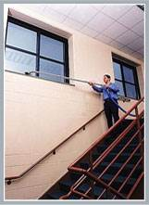
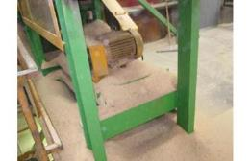
Practicing Good Housekeeping
Prevent dust accumulation
  Vacuum with proper equipment (NFPA 61)
  Compressed air (1910.272)
  Dry sweep with brooms
Establish a consistent housekeeping procedure and schedule
Pay attention to “hidden areas”
    On top of beams
    Light fixtures
    Ledges
Photo: KSU
www.spencerturbine.com
Industrialfireprevention.blogspot.com
Notes:
When sweeping, use a natural soft-bristle and dissipated (anti-static) broom and non-sparking collection equipment (dust pans/collection containers). Take care when sweeping to not stir the dust up into the air.
Train all employees on good housekeeping practices

Slide 59
Housekeeping - Precaution
Vacuums – dust explosion proof
Electrical devices – Class II Div 2 or must be de-energized (including lifts)
Reduce overhead surface area
Minimize dust accumulation in structures - through proper design
Source: NFPA-654

Slide 60
Materials Handling Techniques
Avoid grain turbulence at grain transfer points
  Unload grain uniformly to avoid changes in flow that can create turbulence
  Any time a stream “opens up” (fans out), dust and other smaller particles escape the stream/are released
  Unload grain in well ventilated areas outside of buildings

Slide 61
Materials Handling Techniques: equipment
Use of appropriate equipment for grain conveying and handling
  Size or adjust speed of handling equipment to reduce dust
  Use grain cushions at the end of a down spouts into a bin to reduce grain breakage.
  Put covers on drag and belt conveyors and keep them closed when not in use.

Slide 62
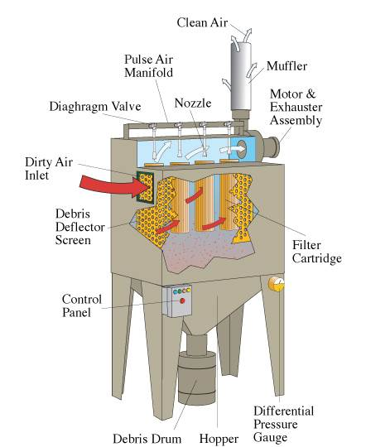
Bag Dust Collection Systems
Notes:
This image shows a typical bag dust collection system. In this image you can see the differential pressure gauge which is an important component of the system. If the set point is exceeded, better check the entire system for proper working conditions. A differential pressure gauge can be connected to an alarm system of the overall facility based monitoring and control system. The idea here is to carefully monitor the pressure level always!

Slide 63
Dust Collection System Points
Maintain dust aspiration or ventilation systems at grain transfer points
Maintain dust aspiration systems on enclosed bucket elevators and conveyors
Clean out dust collectors and change filter bags at scheduled intervals
Clean out dust cyclone collector holding bins at scheduled intervals
Notes:
Grain turbulence and air entrainment will be very high at transfer points. High turbulence leads to separation of smaller dust particles entrained in the grain stream which results in higher dust generation. To contain the dust, aspiration systems should be connected at grain transfer points to collect the dust. Or else, a ventilation system should be designed at the transfer points to avoid dust accumulation within the grain conveying systems.
Dust aspiration systems (such as dust collectors) should be standard in bucket elevators and other closed conveyor systems such as drag conveyors. This will keep the dust collected within the conveying system at a low level.
Dust collectors in the facility should be cleaned at scheduled intervals by changing the filter bags to avoid clogging of the filter bags. Clogging of the bags reduces the efficiency of dust collection within the entire facility.
Dust cyclone collector bins should be cleaned and the dust collected removed frequently to keep the efficiency of the dust collection systems at the optimum performance level.

Slide 64
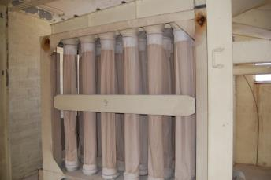
Warning Signs of a Failing Dust Collection Systems
Duct work with too much flexible hose
Duct blast gate not locked in position
The pressure drop across the filter media is higher than the design pressure drop
Visible dust emission
Source: KSU
Notes:
These are some of the initial warnings that indicate something is going wrong in the dust collection system. As soon as you observe any of these issues, it is best to stop the process and check the dust collection system.

Slide 65
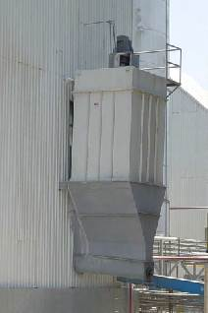
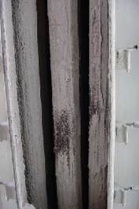
Perform Maintenance on Equipment
Photo: KSU
Notes:
Show example of equipment that has not received any maintenance!
Pictures from KSU.
Filter of dust collection system were not cleaned causing a decrease in dust collection efficiency.

Slide 66
Monitoring Dust Collection Systems
Check for leaks in bags, filters, connectors and air system
Check if suction system is working properly and at the right pressure
Do maintenance and sanitation to equipment
Change bags and filters when they are worn out
Notes:
During maintenance of dust collection systems and during daily operations, follow these simple checks to keep dust collection systems in proper working conditions. An efficient dust collection system will avoid dust spreading throughout your facility.

Slide 67
Dust (re)collection!! Part 2
I. What are the pros and cons of the following housekeeping methods?
Compressed air
Vacuuming
Dry sweeping
II. List some hidden areas in your facility!
Notes:
What do we do with the dust? We can’t allow it to accumulate in our facility, we need to remove it. How do we do that? What are the pros and cons to these methods? Discuss as a group.
Answers
Compressed Air blowing:
Pros - gets accumulated dust off of surfaces quickly and efficiently. Can use it to remove dust in hard-to-get-to areas.
Cons - disperse dust back into the air that leads to dust cloud formation. OSHA standard 1910.242(b), allows use of compressed air, but standard requires less than 30 psi, which requires a nozzle that reduces psi and must be utilized at all times when blowing down. Ideally, compressed air should not be used, as it is difficult to keep psi at less than 30 psi.
“I have seen this used a lot in elevators where the goal is just to clean off equipment, machinery, walls, tools, etc in the quickest way possible. We also used compressed air to get grain dust off of our clothes and skin, but this was not advised nor allowed where we were. ‘Looks good’, but the dust is still there somewhere.” said Dr. Kingsly Ambrose.
Vacuuming:
Pros - Gets rid of the dust completely.
Cons - May not be able to reach hard to reach spots. Requires a specific vacuum rated to handle dust. Works well on curved surfaces, conduits and equipment with a brush attached to the nozzle.
Dry Sweeping:
Pros - minimum equipment cost. Collects most of the dust without dispersing it into the air again. Can get to most places with a broom and/or brush but overall this method would be effective to capture most of the standing dust. There are specific bristles that are recommended as well as using a compound that minimizes dust particles in the air.
Cons - May leave some dust residues in hard-to-reach areas, can also disperse dust into the air. This can be prevented when using with a compound that prevents the dust from dispersing into the air.

Slide 68
Recognizing Dust Hazards
Conduct general facility-wide appraisals of dust explosion possibilities on a periodic basis
Conduct internal and external audits in order to identify potential explosion hazards
Encourage a preventative attitude among employees for eliminating dust explosions
Have employees and supervisors identify explosion hazards
Source: OSHA
Notes:
How do we recognize the presence of dust and its danger? Listed are some of the measures that we should undertake to identify dust hazards. Recognizing the presence of hazards will prepare us to develop and implement housekeeping strategies and to undertake preventive measures.

Slide 69
Small Groups
In small groups discuss:
  What you do in your facility to accomplish preventive measures?
  What are the bottlenecks that prevent doing them?
Notes:
In small groups discuss:
What you do in your facility to accomplish preventive measures?
Maintain the housekeeping schedule; clean the floor and equipment surfaces. Clean the hard-to-reach areas. Have safety sensors in the equipment that you are using. Electrical connections in safe conditions and adhere to NFPA standards. Do not allow welding inside the facility without a hot work permit.
What are the bottlenecks that prevent doing them?
Shift changes, worker-supervisor and/or worker-management communication gaps, not enough cleaning instruments available, no proper schedule for housekeeping, no time allotted for housekeeping
What are the results if they are done or not done?
Dust accumulation, dust cloud formation, potential primary explosion could occur.

Slide 70
Explosion Pentagon
Remember the pentagon – What do we need for an explosion?
Notes:
Review the pentagon: what 5 elements do we need for an explosion? How about in a bucket elevator, conveyor, storage bin, etc.
Have the participants discuss a particular place and then share within bigger groups or with the whole class. Also, look at the poster again, in each place 1-7 where is there a potential pentagon?

Slide 71
Learning Objectives – Module III
Understand primary dust generation points
Recognize and maintain good housekeeping practices
Understand the importance of proper grain handling techniques to minimize dust

Slide 72
Disclaimer
This material was produced and revised under grant number SH-31232-SH7 from the Occupational Safety and Health Administration (OSHA) of the U.S. Department of Labor. It does not necessarily reflect the view or policies of the U.S. Department of Labor, nor does mention of trade names, commercial products, or organizations imply endorsement by the U.S. Government..

Slide 73
Module – IV
Controlling Ignition Sources, Equipment Maintenance, and Material Handling
Notes:
In this module we will be learning about ignition sources and their control, use of equipment maintenance to monitor hazards and material handling techniques that minimizes dust on specific equipment.

Slide 74
Learning Objectives – Module IV
Learn about potential sources of ignition
Understand how equipment maintenance and hazard monitoring reduces the risk of ignition
Understand the need for proper handling equipment sizing
Understand the use of appropriate material handling techniques

Slide 75
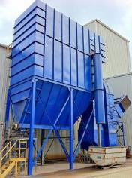
Challenges
Real risk? or Compliance??
Cost impact?
Work load of workers and supervisors
Timeline/Downtime
Source: baghouse.com
Notes:
What are some of the challenges that we face when implementing housekeeping practices and preventive measures?
Most often, it might go through our mind that is ‘dust’ a real risk? I never saw an explosion or I have been working here for more than 20 years or are we doing it for compliance to avoid penalties?
Do employees focus more on cost impact than safety? Do we opt for inferior safety measures to cut costs?
With the volume of grain and product that we handle, do we have enough time to spend on housekeeping and preventive measures?
If I stop the process for cleaning, what will be downtime? What will be my cost on production expenses?
We encounter these questions when practicing housekeeping or preventive measures. What are your views? Do you all think that we overcome our inhibitions for our own safety?

Slide 76
Preventive Maintenance
What are the important preventive maintenance in grain handling and processing industry?
Why we should conduct preventive maintenance?
Notes:
As a group, let us revisit the important preventive maintenance programs that we should have in our grain handling and processing industry.
If we do not have a preventive maintenance program, the dangers would include downtime and the probability of primary explosion will be higher.

Slide 77
Preventive Precaution –
Ignition Control
Prohibit smoking, open flames and control sparks
  Consider zero tolerance policy
Control friction and mechanical sparks
Separate heated surfaces/heating systems from dust
Use appropriate electrical equipment and wiring methods
  Conform to the NFPA standard and National Electric Code
Notes:
Smoking (within the facility and near by the facility) should be prohibited near the facility. Though the industry has better controls now, just to avoid any untoward incident, smoking should be prohibited. Similarly, burning with open flames should be prohibited near the facility.
Check the bearings and motors frequently for friction heating. If heating is very high in this rotating part, mechanical sparks could easily generate during continuous operation and ignite a dust cloud.
Dust collection or aspiration systems should not be in contact with hot surfaces. A hot dust particle will be easy to ignite.
Electrical motors, switches, light fixtures, and wiring should adhere to the NFPA standard.

Slide 78
Equipment Maintenance
Routine maintenance: Lubrication of bearings, replacing hammermill screens, checking drives, belts, checking oil levels
Emergency maintenance: Unscheduled breakdowns – must be done immediately
Call-in maintenance: Through contractor or millwright service
Preventive maintenance: Scheduled inspections and making adjustments and repairs to equipment; replacement of worn parts prior to failure.
Notes:
Equipment maintenance is an integral part of developing a preventive safety program. Maintenance program should include routine maintenance, emergency maintenance, call-in maintenance and preventive maintenance. This will keep the facility prepared for any maintenance issues.

Slide 79
Preventive Maintenance - continued
All mechanical and electrical equipment must be kept in proper operating condition
Annual inspection of all the equipment
Must be lubricated and maintained according to manufacturer’s recommendations
Malfunctioning equipment must be repaired or removed from service
Date of inspection!
Notes:
In the preventive maintenance program, date of inspection should be included. This will keep the workers informed on the schedule to change parts and accessories.

Slide 80
Equipment Maintenance Components
Principle of operation
Components
Function and characteristics
Linking different equipment
Notes:
Principle of operation: How the equipment works? Is it pneumatic or mechanical or gravity conveying? How many moving parts it has? Typical load on the equipment?
Components: All the components with their specifications, including spacers, washers, nut, bolts, etc should be prepared as a list
Function and characteristics: The operational requirement, capacity, motor type and capacity, overload factors, sensor controls, etc should be listed
Linking equipment: Material transfer, through different type of equipment, is very common in grain handling and processing industry. To avoid turbulence, overload, choking, etc, the equipment capacities should be matched. These details should also be included in the maintenance program.

Slide 81
Equipment Maintenance Components - continued
Equipment list and their specs
Equipment manufacturer
Installation and maintenance manuals
Electrical components and electrician
Suppliers of components

Slide 82
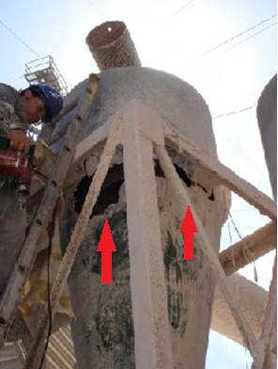
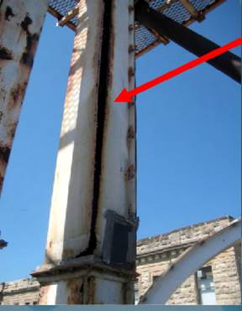
Perform Maintenance in Equipment
Photo: KSU
Notes:
Show examples of equipment that has not received any maintenance! Pictures from Kansas State University.
Explanation of examples:
1- Hole in the cyclone will make it not work properly for dust separation – NOT WORK EFFICIENTLY
2- Opening in bucket elevator leg will allow grain and dust to leak out and produce contamination and possible hazards
The possible hazards are:
Dust dispersion within the premises and ineffective dust collection

Slide 83
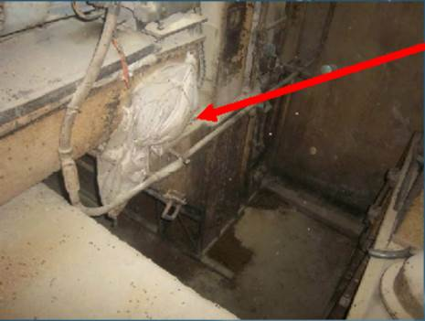
Avoid Possible Hazards
Photo: KSU
Notes:
Show example of what to avoid using red arrow (hole in the screw conveyor covered by duct tape). See dust all over the surrounding area.
Picture from KSU.
Screw conveyor has a hole and was partially repaired by putting a plastic bag and duct tape. This repair will not work properly and will allow grain and dust to leak out of the screw conveyor causing dust accumulation and possible grain dust hazards.

Slide 84
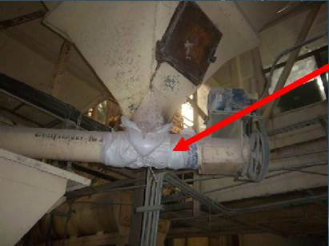
Avoid Possible Hazards - continued
Photo: KSU
Notes:
Show example of plastic bag covering hole in screw conveyor below a hopper. Picture from KSU.
Screw conveyor has a hole and was partially repaired by putting a plastic bag and duct tape. This repair will not work properly and will allow grain and dust to leak out of the screw conveyor causing dust accumulation and possible grain dust hazards.

Slide 85
Electrical Hazards
Lockout/tag out program
Report broken/defective electrical equipment
Reset a circuit breaker only once
Do not bypass fuses
Do not use metal ladders around electrical equipment
Ground all electrical equipment
Do not overload electrical circuits
The resistance to ground in the wire should be less than 10⁶ ohms (NFPA 77 – Recommended practice on static electricity)

Slide 86
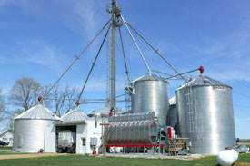
Material Handling Techniques
Manual
Gravity
Mechanical
Pneumatic

Slide 87
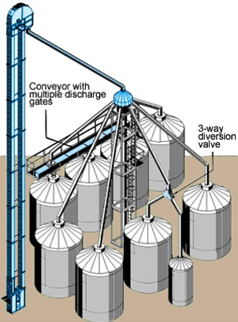
Spouting
Spouting must be steep enough for the material being conveyed to slide down the spout.
Spout must be of adequate size to convey materials at the rate required.
Notes:
Spouting are used to convey the materials by gravity. Due to the speed and volume of grain movement, there will be potential high amount of dust that generates inside the spouting. So, if there is a choke or leakage, the dust becomes airborne within the grain handling facility.

Slide 88
Spouting Types and Sizes
Recommended Minimum Spout Slopes (Industry Practice):
Whole Grains
  A. Dry Grain 40 deg.
  B. Wet Grain 45 deg.
Ingredients
  C. Free Flowing 50 deg.
  D. Difficult Flowing 60 deg.
Feed
  E. Mash Types 50 deg.
  F. Pellets 45 deg.
Spout
Slope
Angle
Horizontal Plane
Notes:
These are some of the recommended minimum spout slopes to avoid grain being choked within the spout. If there is a choke in the spouting, this could lead to overload in the bucket elevator system that precedes the spouts. We do not want to overload the bucket elevators for the primary explosion risks that could arise.

Slide 89
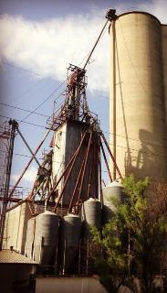
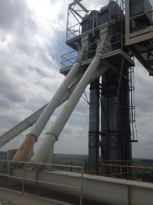
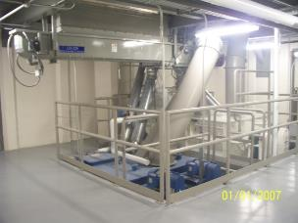
Spouts
  Designed to relieve or stop if the discharge end is plugged
  Dust tight spouts
  Spouts – lining at impact points and
  on wear surfaces
Photos: KSU
Notes:
These are some common precautions that we can follow to avoid overloading of spouts and/or for avoiding leaks in spouts.

Slide 90
Spout Liners
Liners are used on the interior of spouts, usually square spouting to provide a longer wearing surface.
Lining material may be:
  Abrasion Resistant (AR) steel
  Ultra High Molecular Weight (UHMW)
  Ceramic tile
  Most liner materials are bolted in to allow replacement when worn out.
Notes:
Spout liners help in longevity of the pipes by protecting its inner surface and prevents crack formation in the spouts due to grain impacts and friction.

Slide 91
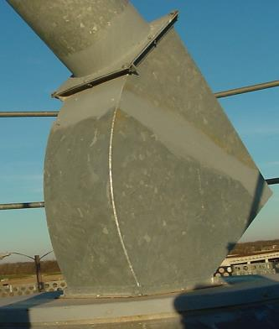
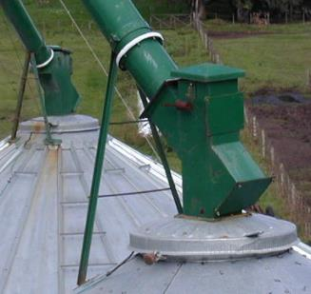
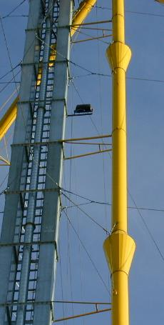
Usage of Appropriate Spouting Design
Cushions boxes
velocity reducers
Photos: KSU
Notes:
Usage of grain cushions to reduce speed of grain when coming through a spout. Picture taken from a grain elevator from Argentina.
Explanation: Cushions boxes allows grain to accumulate in one side creating a sort of cushion that allows the incoming grain from the spout to slow down by hitting the accumulated grain instead of hitting directly the metal of the connecting metal piece (between spout and grain bin) that can cause it to break into smaller pieces (grain dust).
Yellow spout: Has velocity reducers for grain that is falling through the vertical spout by gravity. In the velocity reducers, when the area or diameter of the spout is increased, the velocity is reduced, since flow of grain (Q) = cross sectional area (A) times grain velocity (v). Grain flow stays constant, so increase area will reduce velocity, Q/A = v.

Slide 92
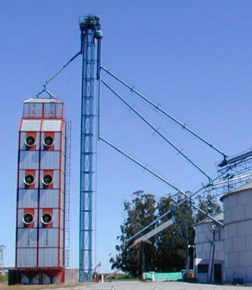
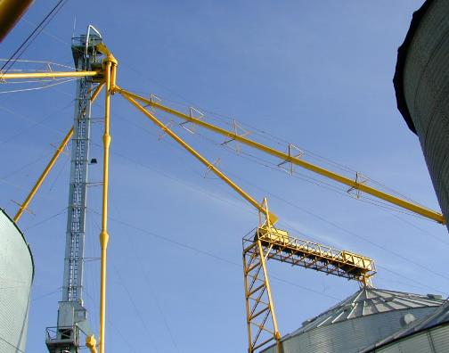
Avoid These Design in Spouts
Photo: KSU
Notes:
Example of problems in grain handling equipment that can create grain breakage (grain dust). Pictures from grain elevators in Argentina.
What is the problem? See red circles.
Answer: Vertical spouts (gravity) will increase the grain velocity, then it will hit the angle spouts to unload grain into the bins.
Avoid vertical spouts from grain distributors to grain bins. A vertical part will cause grain to increase its velocity so when it hits the other section of the angled spout, it can break into smaller pieces (grain dust).

Slide 93
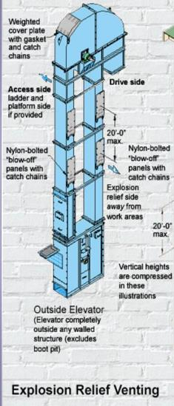
Bucket Elevators
Bucket elevators located within 3 m (10 ft) of an exterior wall
Proper vents (NFPA 68) and explosion suppression (NFPA 69)
Outside legs provided with explosion relief panels
Outside legs – Explosion vent in head section
Source: essmueller.com
Notes:
Bucket elevators have four elements required for a grain dust primary explosion to occur. So, our duty is to prevent the occurrence of ignition or ignition source in the bucket elevators.

Slide 94
Bucket Elevators - continued
  Significant dust is continually stirred up inside elevator legs
  Could have damaged or loosened buckets
  Could have worn bearings, belt misalignment, tramp metal – Ignition Source
  Could lack proper ventilation to avoid dust accumulation due to confinement
  Must maintain diligence to avoid sparks
  In grain industry, the bucket elevator is the most common source of a primary dust explosion
Notes:
100% of the time, a bucket elevator moving grain has four of the five elements needed for an explosion, it is just lacking the ignition source- typically a spark. Therefore, the primary explosion often starts in a bucket elevator. Let’s examine why:

Slide 95
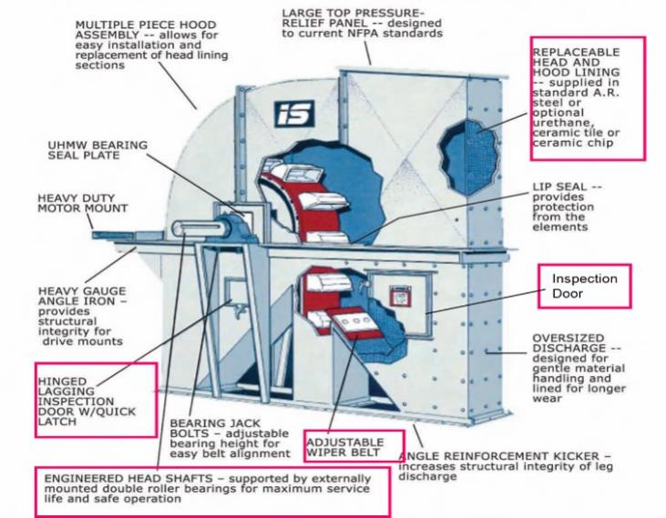
Safety Precautions
OSHA Requirements
Notes:
Let us take a look at the OSHA requirements of safety in a bucket elevator. These components together increase safety because bucket elevators are highly prone to dust accumulation
(OSHA Standard 1910.272 and NFPA (ANSI) standard)
Replaceable head and hood lining – The head section of the bucket elevator gets damaged easily due to grain impact and dust accumulation. This section should be made replaceable to avoid wear and ignition due to impact of grains.
Inspection doors – Frequent inspection for mis-aligned belts and damaged buckets is very important to avoid spark generation inside the system. To assist inspection, the inspection door and inspection door with quick latches should be provided in the head section.
Adjustable wiper belt- this is an important component to avoid re-transfer of dust back into the boot section and assumes safe passage of grains into the discharge chute.

Slide 96
Sensors for Bucket Elevators
Belt alignment sensor
  Non-contact magnetic sensor
  Not affected by dust or material build up
  Adjustable Sensing Range of 1 to 3 Inches
Notes:
Belt alignment sensors – Tripping due to overload is a commonly faced issue in bucket elevator systems. An alignment sensor will warn the operator about the tripping issues so that it can be rectified before any mis-happenings.

Slide 97
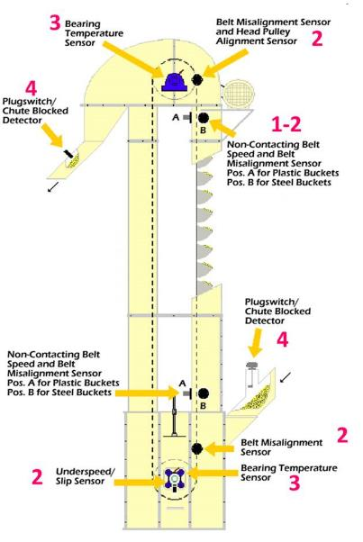
Safety Precautions - continued
1. Belt speed sensors
2. Belt alignment sensors
3. Bearing temperature sensors
4. Plug switches
Safety Devices
Notes:
Safety devices in a bucket elevator to avoid dust related incidents. It is very important to have belt speed sensors, belt alignment sensors, bearing temperature sensors and plug switches to reduce the potential for sparking and avoid an explosion incident.
Belt speed sensors – If the belt speed is too fast or slow, that should give an indication that there are issues within the bucket elevator system. A slow speed indicates overload on the system causing increase in bearing temperature. A high speed could indicate that the conveyor is not carrying enough material or some buckets are damaged resulting in less load and increased speed.
Belt alignment sensors – Tripping due to overload is a commonly faced issue in bucket elevator systems. An alignment sensor will warn the operator about the tripping issues so that it can be rectified before any mis-happenings.
Bearing temperature sensors – Continuous use of bucket elevator system (without proper maintenance) could increase the temperature of bearings. This could result in generation of a spark leading to primary explosion of dust collected in head section.
Plug switches – Plug switches should be used to avoid overload of materials.
Anytime there are sensors, it is important to stress calibration and preventative maintenance. Go back to the manufacturer to understand what the frequency should be.

Slide 98
Storage Bins and Conveyors
Moving grain
Transfer points
Screw conveyors or sweep augers can create friction with metal bin floors (false floors)
Notes:
Explosions, either primary or secondary can originate from storage bins and conveyors.

Slide 99
Bucket Elevators -mitigation
Replace steel cups with plastic cups in elevator legs to prevent possibility of a spark
Use anti-static belting material in legs and horizontal belt conveyors
Install quick-opening cleanout doors on leg boot side panels for grain and dust cleanout
Appropriate vents in bucket elevators
Notes:
These are some of the precautions that could be followed to avoid primary dust explosions from happening in a bucket elevator.

Slide 100
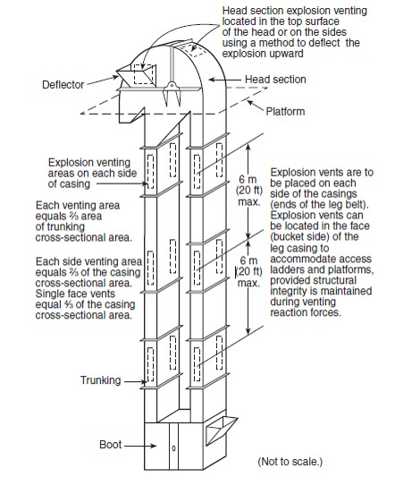
Venting
Typical elevator explosion venting
Fig: Typical elevator explosion venting for a double casing leg (Source: NFPA-61)
Notes:
This design is based on NFPA 61 standard to have proper venting in a double casing leg.

Slide 101
Safeguards in Materials Handling Equipment
Perform maintenance on handling equipment
    Change worn bearings
    Do not over-grease bearings
    Change damaged drags or screw conveyors
    Replace worn head pulleys in bucket elevators
    Repair lose metal parts in any handling equipment
      Especially important when you have grinding or milling equipment in your facility

Slide 102
Materials Handling Techniques
Use of appropriate equipment for grain conveying and handling
  Install magnets to catch metals ahead of processing equipment (Hammer mill).
  Have easy access removal doors for inspection at the head and bottom of the bucket elevators.
  Make sure all motors and pulleys are properly aligned.

Slide 103
Materials Handling Techniques - continued
Avoiding overload during handling
  Do not use handling equipment at the limits of their rated capacity.
  Do not overfill bucket elevator, screw and drag conveyors to avoid spills or to overload the motor.
  At transfer points, do not reduce handling capacity to avoid overflow or chokes.
  Bucket elevators shall not be jogged to clear a choked leg (Jogging is when an employee tries to force a loaded/choked belt to run).
Plastic bags for shipping and transfer of material should be anti-static.
During transfer of materials, operators should stand on a grounded surface.
Material transfer equipment should be made of metal and must be grounded.
Spouts and chutes should be grounded

Slide 104
Learning Objectives – Module IV
Learn about potential sources of ignition
Understand how equipment maintenance and hazard monitoring reduces the risk of ignition
Understand the need for proper handling equipment sizing
Understand the use of appropriate material handling techniques

Slide 105
Disclaimer
This material was produced and revised under grant number SH-31232-SH7 from the Occupational Safety and Health Administration (OSHA) of the U.S. Department of Labor. It does not necessarily reflect the view or policies of the U.S. Department of Labor, nor does mention of trade names, commercial products, or organizations imply endorsement by the U.S. Government.

Slide 106
Module – V
Advanced Engineering Controls
Notes:
In this module we will be learning about advanced engineering controls that can minimize and mitigate grain dust hazards.

Slide 107
Module V Learning Objectives
Become aware of preventive measures available
Learn about dust explosion suppression devices
Become aware of various OSHA regulations concerning combustible dust
Notes:
In this module, we will look into some of the safety precautions for grain handling equipment and learn about dust explosion suppression devices.

Slide 108
Preventive Measures
Measures that prevent/limit formation of explosive atmospheres
Measures that prevent results of a dust explosion to a harmless level
Notes:
Preventive protection measures:
By keeping preventive measures in place, enough care should be taken so that we are not creating explosive atmospheres within the facility that we are working in.
It will be better if we use approved and appropriate explosion venting devices (generally in filter/bag house) within our systems so that we vent the flame and pressure formed due to grain dust explosion safely to an open environment without confining the pressure within our facility. Those systems vent the explosion once it starts in milliseconds. Venting is safely by-passing the pressure and flame through devices that discharges them to an open environment (mostly mechanical devices). Suppression systems suppress the fire or formation of fire and explosion (mostly chemicals are used).

Slide 109
Preventive Precaution –
Damage Control
Separation of the hazard (isolate with distance)
Segregation of the hazard (isolate with a barrier)
Deflagration venting of a building, room or area
Pressure relief venting of equipment
Use of specialized suppression systems
Notes:
Separation of the hazard: If a situation involves a potential ignition source type of work (e.g. welding), these should be carried out at a sufficiently far distance from potential dust accumulation zones.
Segregation of the hazard: If separation is not possible, the source of ignition should be segregated from potential dust accumulation zones using explosion proof panels.
Venting: Deflagration venting of a building, room or area, using dust explosion venting devices, will help reduce the damages caused due to primary explosion and could avoid secondary explosion.
Pressure relief venting: In some cases, due to clogging of filters in the dust collection systems, the pressure inside the filter house could increase rapidly reducing the efficiency of dust collection. This increase in pressure could also lead to primary explosion within the system.
Specialized suppression systems: In the grain handling industry, application of oil is one method suggested by experts to avoid dust accumulation. Based on the processing requirement and end product use, this method of suppression could be followed to avoid dust accumulation.

Slide 110

Deflagration Venting
Notes:
The vent is designed to be the weakest part of the structure, so if there is an explosion this vent will blow out first. Of course, it is put on the outside wall.
Photo: Explosion vent.jpg http://www.farrapc.com/articles/explosion-venting-requirements/affected

Slide 111
Preventative Safety Program
Fire and explosion protection and prevention equipment
Dust control equipment
Housekeeping schedules and completed duties
Potential ignition sources
Electrical process and mechanical equipment
Process changes
Bearing lubrication

Slide 112
Preventive Safety Measures - continued
Use separator devices to remove foreign materials capable of igniting combustible dusts
Execute an emergency action plan
Train employees on the risks of combustible dusts
Maintain emergency exit routes

Slide 113
Preventive Measures - OSHA
OSHA regulations:
  1910.22 (housekeeping)
  1910.307 (hazardous locations)
  1910.1200 (hazard communication)
  1910.269 (electric power generation, transmission and distribution)
  1910.271 (grain handling facilities)

Slide 114
Perform Maintenance on Equipment
Photo: KSU
Notes:
Show example of equipment that has not received any maintenance!
Pictures from KSU.
Filter of dust collection system were not cleaned causing a decrease in dust collection efficiency.

Slide 115
Preventive Measures - continued
Always have a hot work permit
  Enforce established hot work procedures
Have hazard monitoring/sensors on moving equipment (like conveyors and bucket elevators)
Watch for anything creating a spark or
fire
Check the electrical wiring and conduits
for breaks/wear
  or rats chewing
Notes:
As a worker or supervisor, one has to be always cautious about difference in noise, smell, and range of view in their working environment. For e.g. if there is an unusual noise/sound, it is better to stop the equipment, check for its working condition, and take corrective measures. Minor mechanical or frictional issues could lead to a primary explosion.

Slide 116
Establishing a Systematic
Safety System
Emphasize good housekeeping practices
  Have practices documented, scheduled and posted
  Recognize good housekeeping
Make sure all co-workers, employees and contract workers understand that grain dust is explosive
Create a safety culture in your facility
Supervisors must lead by example
Safety first!

Slide 117
PPE
Eye – safety glasses
Face – face shields
Head – hard hats
Feet – safety shoes
Hands and arms – gloves
Bodies – vests, flame resistant clothing
Hearing – earplugs
Respirator – dust masks
PPE is the last level of control!
Notes:
In this module, we will look into some of the safety precautions for grain handling equipment and learn about dust explosion suppression devices.

Slide 118
Safety Precautions
1. Belt speed sensors
2. Belt alignment sensors
3. Bearing temperature sensors
4. Plug switches
Safety Devices
Notes:
Safety devices in a bucket elevator to avoid dust related incidents. It is very important to have belt speed sensors, belt alignment sensors, bearing temperature sensors and plug switches to reduce the potential for sparking and avoid an explosion incident.
Anytime there are sensors, it is important to stress calibration and preventative maintenance. Ask the supplier/manufacturer to understand what the frequency of calibration and/or preventive maintenance should be.

Slide 119
Sensors for Bucket Elevators – belt speeds
Belt speed sensor
  10% change in speed – alarm
  20% change in speed – shut down
Notes:
Belt speed sensors – If the belt speed is too fast or slow, that should give an indication that there are issues within the bucket elevator system. A slow speed indicates overload on the system causing increase in bearing temperature. A high speed could indicate that the conveyor is not carrying enough material or some buckets are damaged resulting in less load and increased speed.

Slide 120

Sensors for Bucket Elevators - continued
Bearing temperature sensor
Source: www.directindustry.com
Notes:
Bearing temperature sensors – Continuous use of bucket elevator system (without proper maintenance) could increase the temperature of bearings. This could result in generation of a spark leading to primary explosion of dust collected in head section.
Plug switches – Plug switches should be used to avoid overload of materials.
Photo: public website

Slide 121

Explosion Suppression Systems
Depending on the industry and end use of grains:
Oil suppression systems
Dry chemical suppression systems
Pressure containment
Source: Johnson, Powder and Bulk Engineering, 2012
Notes:
In general, these are the three suppression or containment systems used by the industry to either suppress dust or to contain an explosion. Use of these systems depend on the end use of grains, the facility design and the type of equipment. In the following slides, we will have a detailed view on the suppression systems.
Photo: public, magazine article

Slide 122

Dust Explosion Protection Options
Source: BS&B Systems
Notes:
Due to advancement in science, we have different options to contain or suppress dust explosion and its effects. These are some of the examples of protection options that we have for containing dust explosion. As we talked about earlier, the protection options depends on the type of facility, type of equipment and the potential dust accumulation or collection. With the focus on employee safety and minimizing damage to the facility, if an explosion occurs, industry is free to adopt any of these methods.

Slide 123


Venting
Explosion Venting:
  Explosion flame, pressure and unburned mixture are vented to a safe area.
Source: BS&B Systems
Source: FIKE Corp.
Notes:
Explosion venting is the most common and most used method for protection from dust explosion. Venting the flame, pressure, and unburned mixture saves the facility from damage and prevents further explosion from happening within the facility.
Photo: permission granted from BS&B Systems and FIKE Corp.

Slide 124

Vent Closures
Composite Vent:
Round, Square, Rectangular shapes
50-75% operating ratio of set burst pressure
Applicable both in extremely hot and cold conditions
Source: FIKE Corp.
Notes:
In this part of presentation we will learn about some of the available vent closure types. Composite vent covers most applications and provides an excellent service life for static to light pressure cycling conditions and partial vacuum conditions.
Photo: permission granted from FIKE Corp.

Slide 125

Vent Closures – other option
Composite Vent (CV) with Support:
Provides all the features of the CV, with vacuum capabilities up to a full atmosphere, and when pressure cycles and /or equipment vibration are present.
Source: FIKE Corp.
Notes:
Photo: permission granted from FIKE Corp.

Slide 126

Vent Closures - options
Vmax Single Element Vent
Is provided for high vacuum service, or for applications involving heavy cyclic, or pulsing, duty.
Source: Fike Corporation
Notes:
Photo: permission granted FIKE Corp.

Slide 127



Flameless Venting
Deflagration venting through a listed dust retention and flame-arresting device
For indoor installations – eliminates need for equipment relocation or duct work
Must ensure that the room or building can withstand the pressure released during venting.
Source: FIKE Corp.
Source: BS&B Systems
Notes:
Graphic: permission granted from BS&B Systems and FIKE Corp.

Slide 128

Suppression Systems
Source: BS&B Systems
Notes:
The fireball that develops from a dust explosion could have a velocity of up to 30 ft/s with a pressure wave moving at a speed of up to 1100 ft/s. So, the pressure wave moves faster than the fireball. So, the explosion suppression devices are based on detecting the pressure and then quenching the pressure and the fire.

Slide 129

Deflagration Suppression
Source: NFPA 664
Notes:
From this slide we could see that a suppression system contains the pressure and fire from an explosion within 80 milli seconds. The suppression will be continued till the fire stops burning and there is no more dangers of secondary explosion in that vicinity.

Slide 130

Suppression System Advantages
No major damage to dust collector
Limited downtime
Low Pressure System
Mounting flexibility
Customer Refit and Quarterly Inspections
Source: BS&B Systems
Notes:
Graphic: permission granted from BS&B Systems

Slide 131


Isolation Equipment
To interrupt or mitigate flame, deflagration pressure, pressure increase, and ignition between enclosures that are interconnected by pipes or ducts.
Means of Isolation:
Chemical barrier
Fast-acting mechanical valve
Externally actuated float valve
Actuated pinch valve
Source: BS&B Systems
Notes:
Photos: permission granted from BS&B Systems

Slide 132

Explosion Isolation Methods
Chemical Isolation
Protect any size duct
Can trigger with pressure sensor or vent burst sensor
Lowest cost option
Mounting options
Source: BS&B Systems
Notes:
Photo: permission granted from BS&B Systems

Slide 133



Explosion Isolation Methods - continued
Mechanical Isolation
Prevent propagation of flame through piping
Fast acting knife gate valve.
Pinch valve
Rotary valve of suitable construction
Source: BS&B Systems
Notes:
Photos: permission granted from BS&B Systems

Slide 134
Chemical vs. Mechanical Isolation
Chemical Isolation
Most Economical
Fast response~2 msec
Requires 4’ to 12’ of duct length
Easy retrofit or new installation
Flexible; functions with round or rectangular ducts
Can be triggered by pressure sensor or vent with burst sensor
Mechanical Isolation
More expensive
Slower response requiring between 20’ and 50’ of duct length
Available in round configuration only
Heavier construction
Can be triggered by pressure sensor or vent with burst sensor

Slide 135

Bucket Elevator Protection:
Suppression & Isolation
Potential Sources of Ignition:
Head / Boot Friction
Head / Boot Bearing Heat
All Zones Electrostatic Discharge*
All Zones Tramp Metal Sparks
* High risk ignition source for materials having low MIE (minimum ignition energy).
Source: BS&B Systems
Notes:
Since we learned from the previous modules that bucket elevators are the major ignition source that we see in a grain handling and processing industry. In this part of presentation, we will take a look at the potential areas where ignition could occur and the places in a bucket elevator where we could place a suppression or isolation device.
Graphic: permission granted from BS&B Systems

Slide 136

Bucket Elevator Protection:
Suppression & Isolation
Single Leg Construction:
Protect the ‘head’ with suppression (red) and isolation (orange) cannons
Protect the ‘boot’ with suppression (red) and isolation (orange) cannons
Protect the legs with suppression (red) cannons triggered by sensors distributed to detect ignition at any location
Source: BS&B Systems
Notes:
Graphic: permission granted from BS&B Systems

Slide 137

Bucket Elevator Protection:
Suppression & Isolation cont.
Double Leg Construction:
Protect the ‘head’ with suppression (red) and isolation (orange) cannons
Protect the ‘boot’ with suppression (red) and isolation (orange) cannons
Protect the legs with isolation (orange) cannons as flame propagation barriers*
Notes:
Graphic: permission granted from BS&B Systems

Slide 138
Learning Objectives – Module V
Become aware of preventive measures available
Learn about dust explosion suppression devices
Become aware of various OSHA regulations concerning combustible dust
Notes:
In this module, we have looked into some of the safety precautions for grain handling equipment and learned about dust explosion suppression devices.

Slide 139
Disclaimer
This material was produced and revised under grant number SH-32312-SH7 from the Occupational Safety and Health Administration (OSHA) of the U.S. Department of Labor. It does not necessarily reflect the view or policies of the U.S. Department of Labor, nor does mention of trade names, commercial products, or organizations imply endorsement by the U.S. Government

