Slide 1
Tasks and Tools that Create Silica Dust
Module # 3

Slide 2
Aviso de exención de responsabilidad
Aviso de exención de responsabilidad
Este material fue producido bajo la subvención de la propuesta número SH-05053-SH8 de la Administración de Seguridad y Salud Ocupacional, del Departamento de Trabajo de los Estados Unidos.
No refleja necesariamente las opiniones o políticas del Departamento de Trabajo de los EE. UU. La mención de nombres comerciales, productos comerciales u oganizaciones NO implica el respaldo del Gobierno de los EE. UU.
Notes:
Crystalline silica is a basic component of soil, sand, granite, and many other minerals. For example, sandstone contains more than 70% silica, whereas granite might contain 15-30%.
ASK: Does anyone know what we mean by "mineral?"
ANSWER: A mineral is a naturally occurring chemical compound, usually of crystalline form and not produced by life processes.
ASK: In which products do we use mineral?
The construction industry is the largest consumer of mineral commodities.
Crushed stone is used for foundations, road base, concrete, and drainage.
Sand and gravel are used in concrete and foundations.
Clays are used to make cement, bricks, and tile.
Iron ore is used to make reinforcing rods, steel beams, nails, and wire.
Gypsum is used to make drywall.
Dimension stone is used for facing, curbing, flooring, stair treads, and other architectural work.
The term “silica” broadly refers to the mineral compound silicon dioxide (SiO₂).

Slide 3
Actividades y herramientas que crean polvo de sílice(1)
Actividades y herramientas que crean polvo de sílice(1)
  La sílice es un mineral natural que se encuentra en cualquier lugar.
  La sílice cristalina es del tipo peligroso que causa enfermedades pulmonares entre los trabajadores de la construcción.
  Varios materiales de construcción con los que puede trabajar contienen sílice cristalina.
  El peligro ocurre cuando se realizan tareas como: el corte, taladrado, desgaste, rectificado, lijado, arenado, pulido, mezclado en seco, limpieza en material que contiene sílice.
Notes:
ASK: Does anyone know what silica is?
ANSWER: Silica is a naturally occurring chemical compound and not produced by life processes. Silica, also known as silicon dioxide or SiO₂, is a colorless, white, chemical compound. Silica is made of the most common elements on earth, silicon (Si) and oxygen (O₂). It’s also the most abundant compound in the earth's crust, where it makes up 59% of the total composition.
You’ll find silica in a lot of places — food, rocks, plants, medicine, cosmetics, and of course in construction materials. There’s even silica in your body. The most common form of silica is quartz, a component of stone, concrete, and sand. Simply put, silica is everywhere. If you’ve touched a rock or been to the beach, you’ve handled silica. Don’t worry— it’s mostly harmless and can even be beneficial.
ASK: Why do we consider silica as a harmful substance?
ANSWER: Because crystalline silica (one of the 2 forms of silica) has been classified as a human lung carcinogen, and can cause serious lung disease and lung cancer. It only takes a very small amount of respirable silica dust to create a health hazard. Respirable silica dust is created when the tasks mentioned in this slide are performed.

Slide 4
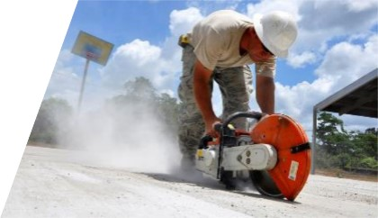
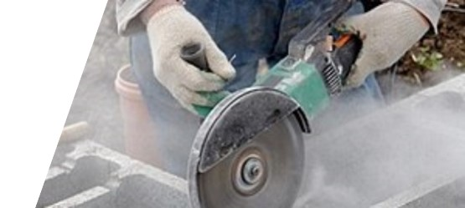
Actividades y herramientas que crean polvo de sílice(2)
Actividades y herramientas que crean polvo de sílice(2)
  Tareas que crean sílice respirable:
  Aserraduras
  - Concreto
  - Albañilería
  Herramientas:
  Sierras estacionarias de albañilería.
  Sierras de mano
  Sierras de paso
  Sierras transportables
Notes:
1- Stationary masonry saws (Table 1)
Crystalline silica is a common mineral that is found in construction materials such as sand, stone, concrete, brick, and mortar. ... According to OSHA statistics, about 2.3 million construction workers are exposed to respirable crystalline silica in over 600,000 workplaces.
Respirable crystalline silica – very small particles at least 100 times smaller than ordinary sand you might find on beaches – is created when cutting and sawing concrete, brick, CMU block, and mortar. Such activities result in creating silica dust which makes construction workers being exposed to respirable crystalline silica.
ASK: What kind of tools come to your mind when we talk about silica dust created by concrete or masonry sawing?
ANSWER: All different kind of saws used in construction for concrete or masonry sawing. More specifically, we do have (1) Stationary Masonry Saws, (2) Handheld power saws that most of you use almost every day, (3) Walk-behind Saws, used especially in concrete slabs jointing, and (4) Drivable Saws.

Slide 5
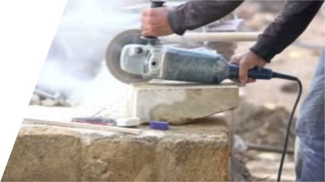
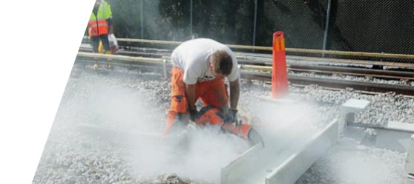
Actividades y herramientas que crean polvo de sílice(3)
Actividades y herramientas que crean polvo de sílice(3)
  Tareas que crean sílice respirable:
  Corte:
  - Trabajo en Piedra
  - Concreto
  - Placa de cemento
  Herramientas:
  - Amoladora
  - Sierras de mano
Notes:
2- Handheld power saws (Table 1)
3- Handheld power saws for cutting fiber-cement board (with blade diameter of 8 inches or less) (Table 1)
The same results as in Sawing are obtained from cutting of stone work or concrete. Again, crystalline silica is produced from the tasks performed while cutting stone work or concrete.
ASK: Who can identify the tools that create silica dust during this task?
ANSWER: The main tools used in cutting of silica containing materials that contribute to respirable silica particles and to potential lung diseases later on are grinders and handheld Power Saws. I believe that everyone is very familiar with these tools and their performance.

Slide 6
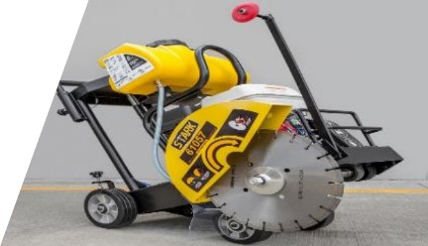
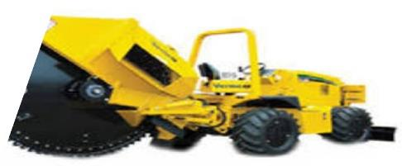
Actividades y herramientas que crean polvo de sílice(4)
Actividades y herramientas que crean polvo de sílice(4)
  Tareas que crean sílice respirable:
  Aserradura
  - Concreto
  - Asfalto
  Herramientas:
  - Sierras de paso
  - Sierras transportables
Notes:
4- Walk-behind saws (Table 1)
5- Drivable saws (Table 1)
ASK: What kind of tools come to your mind when we talk about silica dust created by concrete joint sawing in big size projects?
ANSWER: Walk-behind Saws and Drivable Saws are especially used in concrete slabs jointing in big size projects.

Slide 7
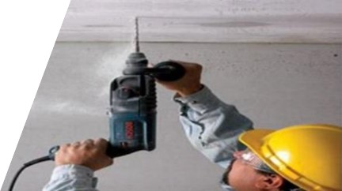
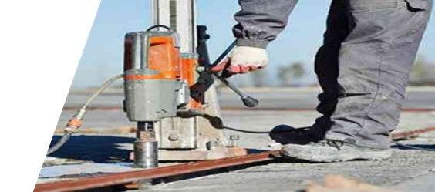
Actividades y herramientas que crean polvo de sílice(5)
Actividades y herramientas que crean polvo de sílice(5)
  Tareas que crean sílice respirable:
  Perforación
  - Hormigón
  - Albañilería
  - Taladrar el núcleo
  Herramientas:
  - Brocas helicoidales montadas en plataforma
  - Taladros de mano y
  de pie
Notes:
6- Rig-mounted core saws or drills (Table 1)
7- Handheld and stand-mounted drills (including impact and rotary hammer drills) (Table 1)
The use of handheld and stand-mounted drills, impact and rotary hammer drills, and similar tools used to drill holes in concrete, masonry, or other silica-containing materials can generate respirable crystalline silica dust.

Slide 8
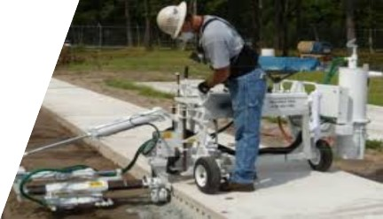
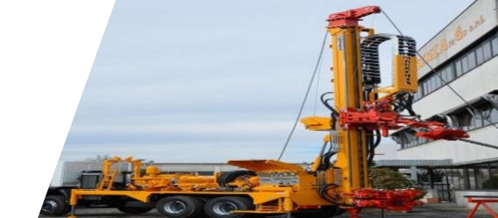
Actividades y herramientas que crean polvo de sílice(6)
Actividades y herramientas que crean polvo de sílice(6)
  Tareas que crean sílice respirable:
  Perforación
  - Concreto
  - Piedra/piedrín
  Herramientas:
  - Plataformas de perforación de pasadores
  - Taladros montados en vehículos / grua
Notes:
8- Dowel drilling rigs for concrete (Table 1)
9- Vehicle-mounted drilling rigs for rock and concrete (Table 1)
The use of Dowel Drilling Rigs and Vehicle-Mounted Core Drills used to drill holes in concrete or rock (silica containing materials) can generate respirable crystalline silica dust.

Slide 9
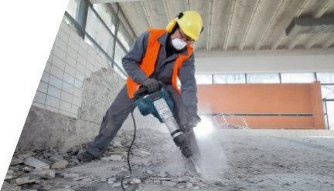
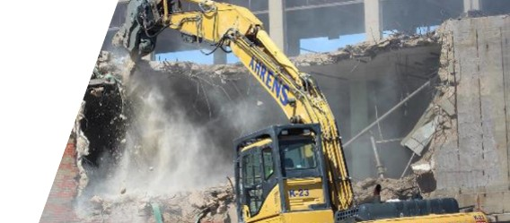
Actividades y herramientas que crean polvo de sílice((7)
Actividades y herramientas que crean polvo de sílice((7)
  Tareas que crean sílice respirable:
  Demolición
  - Maquinaria
  - Manual
  Herramientas:
  - Martillos
  - Excavadoras
  - Bolas de demolición
Notes:
10- Jackhammers and handheld powered chipping tools (Table 1)
17 -Heavy equipment and utility vehicles used to abrade or fracture silica containing materials (e.g., hoe-ramming, rock ripping) or used during demolition activities involving silica-containing materials (Table 1)
ASK: Who can tell me which is the first construction task that comes into your mind when silica dust is mentioned?
ANSWER: Demolition is one of the primary construction tasks that contributes the most at creating dust, and therefore respirable silica dust.
Demolition, performed manually or by machinery, involves a lot of concrete, masonry, brick grinding and breaking which release silica particle in the air that can be respirated by the construction workers being in the vicinity of the demolition activities.
Among the tool and equipment used in these activities, the main ones are (1) jackhammers, (2) excavators, backhoe loaders, (3) wrecking balls.

Slide 10
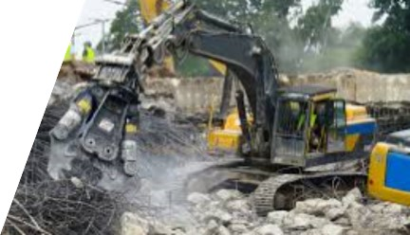
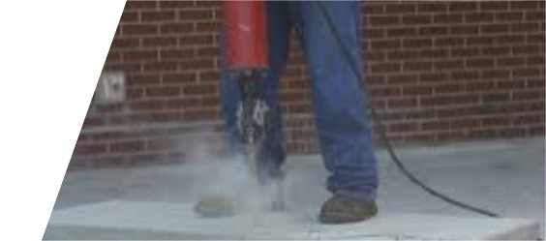
Actividades y herramientas que crean polvo de sílice(8)
Actividades y herramientas que crean polvo de sílice(8)
  Tareas que crean sílice respirable:
  Rompiendo concreto
  - Maquinaria
  - Manual
  Herramientas:
  - Martillos manual
  - Excavadoras
  - Martillo electrico
Notes:
10- Jackhammers and handheld powered chipping tools (Table 1)
17 -Heavy equipment and utility vehicles used to abrade or fracture silica containing materials (e.g., hoe-ramming, rock ripping) or used during demolition activities involving silica-containing materials (Table 1)
Concrete breaking is also a construction activity that releases respirable silica particles.
The use of a jackhammer or handheld power chipping tools to break concrete, stone, masonry or other silica-containing materials can generate respirable crystalline silica dust. When inhaled over time, the small particles of silica can irreversibly damage the lungs. Therefore, whenever using tools such (1) jackhammers, (2) pneumatic hammers, or (3) excavators for concrete breaking special measurements identified by OSHA shall be followed to minimize the amount of airborne dust.

Slide 11
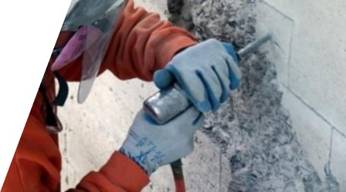
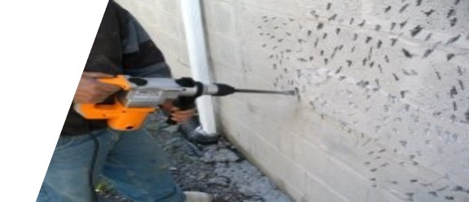
Actividades y herramientas que crean polvo de sílice(9)
Actividades y herramientas que crean polvo de sílice(9)
  Tareas que crean sílice respirable:
  Astillado / Picado
  - Concreto
  - Albañilería
  - Mortero
  Herramientas:
  - Herramientas de mano (martillo, cincel)
  - Taladros de mano
  - Pistolas de cincel
  - Martillos manual o eléctrico
Notes:
11- Handheld grinders for mortar removal (i.e., tuckpointing) (Table 1)
12- Handheld grinders for uses other than mortar removal (Table 1)
ASK: Who can tell if chipping may have harmful impact on our health and why?
ANSWER: Chipping consists in breaking and grinding concrete or masonry particles. As already explained, concrete or masonry contain silica and when these materials are grinded, chipped, broken using tools such as (1) Common hand tools (hammer, chisel), (2) Handheld drills, (3) Chisel Guns, (4) Jackhammers, they release very small harmful crystalline silica particles which can easily be respired in our lungs.

Slide 12
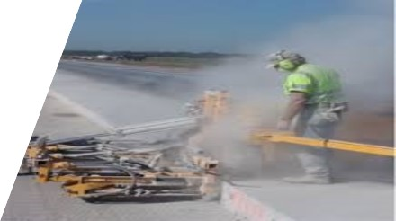
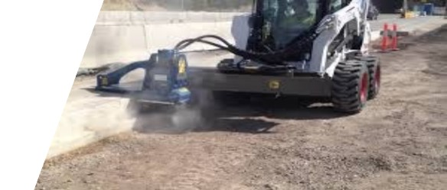
Actividades y herramientas que crean polvo de sílice(10)
Actividades y herramientas que crean polvo de sílice(10)
  Tareas que crean sílice respirable:
  Fresado - Suavizante superficies de concreto
  - Manual
  - Maquinaria
  Herramientas:
  - Máquinas de fresado a pie
  - Pulidores
  - Amoladoras de piso
  - Maquinaria de fresado
Notes:
13- Walk-behind milling machines and floor grinders (Table 1)
All the activities that involve smoothing of concrete, asphalt surfaces are a source of silica dust. These activities can be performed manually or by machinery as shown in these pictures and the silica dust will be present in both cases unless being controlled.
Therefore, extreme care shall be shown during milling activities or whenever you are using equipment such (1) Walk-behind milling machines, (2) Polishers, (3) Floor grinders, (4) Milling machinery

Slide 13
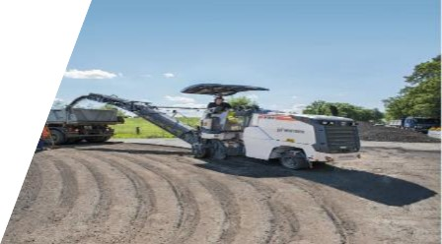
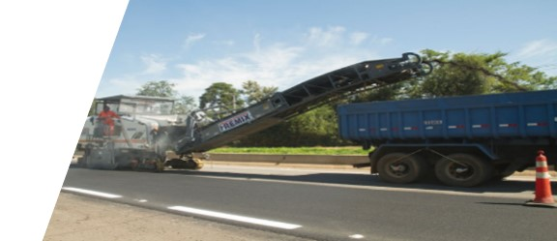
Actividades y herramientas que crean polvo de sílice(11)
Actividades y herramientas que crean polvo de sílice(11)
  Tareas que crean sílice respirable:
  Molienda de pavimento / Perfilado de carreteras
  el proceso de remover al menos parte de la superficie de un área pavimentada como una carretera, un puente o un estacionamiento.
  Equipo:
  - Pequeñas fresadoras accionables
  - Grandes fresadoras accionables
Notes:
14- Small drivable milling machines (less than half-lane) (Table 1)
15- Large drivable milling machines (half-lane and larger) (Table 1)
ASK: Are you familiar with pavement milling or roadway profiling processes?
ANSWER: Pavement milling or roadway profiling is the process of removing at least part of the surface of a paved area such as a road, bridge, or parking lot.
Asphalt pavement milling machines use a rotating cutter drum to remove the deteriorated road surface for recycling. Consequently, the removal of the road surface has the potential to release respirable crystalline silica, to which workers can be exposed.
A variety of machinery are employed in asphalt pavement recycling, including cold-planers, heater-planers, cold-millers, and heater-scarifiers which are categorized as Small or Large drivable milling machines. Approximately 251,000 U.S. workers are employed in highway, street, and bridge construction. A number of these workers use cold-milling machines or work in close proximity to the machine. Dust generated from the machines often contains respirable crystalline silica. This respirable dust can be transported by air currents to worker breathing zones near the milling machine.

Slide 14
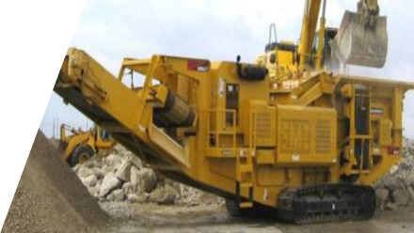
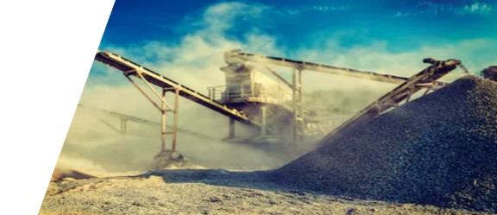
Actividades y herramientas que crean polvo de sílice(12)
Actividades y herramientas que crean polvo de sílice(12)
  Tareas que crean sílice respirable:
  Trituración de material
  - Arena
  - Gravalla
  - Cal
  Equipo:
  - Maquinas trituradoras
  - Cargadoras
  - Plantas trituradoras de material
Notes:
16- Crushing Machines (Table 1)
Using crushing machines at construction sites to reduce the size of large rocks or other materials can generate respirable crystalline silica dust. Respirable Silica Crystalline is created during the crushing process of crystalline silica-containing materials, such as sand, gravel, lime.

Slide 15
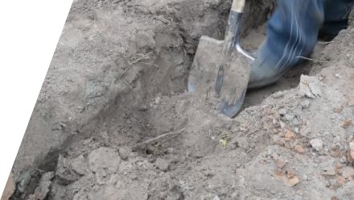
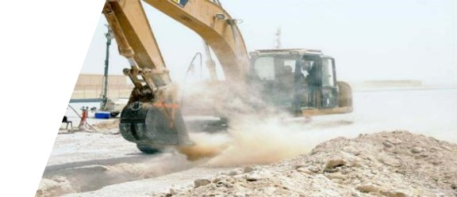
Actividades y herramientas que crean polvo de sílice(13)
Actividades y herramientas que crean polvo de sílice(13)
  Tareas que crean sílice respirable:
  Excavación
  - A mano
  - Maquinaria
  Herramientas:
  - Herramientas de mano (palas, colchonetas)
  - Excavadoras
  - Retroexcavadoras
  movedoras de tierras
Notes:
18- Heavy equipment and utility vehicles for tasks such as grading and excavating but not including: demolishing, abrading, or fracturing silica- containing materials (Table 1)
As mentioned earlier, silica is the dominant component of the solid material of many soils, and dissolved silica is commonly a major solute of soil solutions.
Therefore, any interreference in the soil by means of excavation, digging, or scarifying results in dust which contains respirable silica particles.
As shown in the pictures, the impact was much greater when these activities are performed by machineries, especially excavating or earth moving in dry soil. The operators of these machineries (excavators, backhoe loaders, earthmovers, etc) are the most exposed ones.

Slide 16
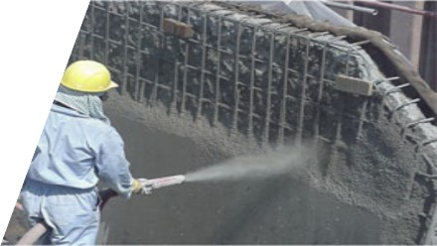
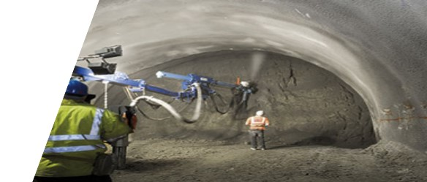
Actividades y herramientas que crean polvo de sílice(14)
Actividades y herramientas que crean polvo de sílice(14)
  Tareas que crean sílice respirable:
  Las aplicaciones de concreto proyectado
  manual, maquinaria
  subterránea, espacio abierto
  Herramientas:
  Maquinas y Bombas de concreto de alta presión
Notes:
Task NOT in Table 1
Another process that might result harmful for the workers performing these task is the shotcrete application.
ASK: How many of you have done shotcrete applications before?
Shotcrete is applied mainly during tunneling works, where sprayed concrete lining is applied to the surfaces of the tunnel to provide reinforcement of the excavated area and is usually repeated a number of times to apply various layers.
This process can generate a large quantity of airborne dust which, if inhaled, exposes workers to respiratory health risks. The highest risk to a concrete sprayer's health is likely to be from breathing in dust, and in particular, silica dust.

Slide 17
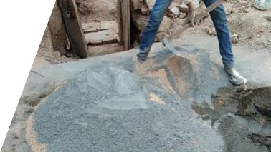
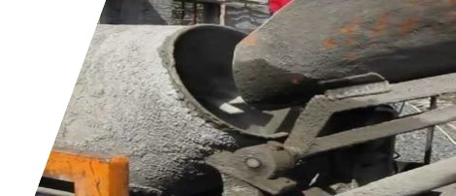
Actividades y herramientas que crean polvo de sílice(15)
Actividades y herramientas que crean polvo de sílice(15)
  Tareas que crean sílice respirable:
  Producción de concreto y mortero
  - Planta de procesamiento por lotes en el sitio
  Herramientas:
  - Planta dosificadora de concreto
  - Transmixers de concreto
  - Tambor mezclador de concreto
  - Herramientas manuales
Notes:
Task NOT in Table 1
Concrete can contain large amounts of crystalline silica. While mixing different components found in concrete, depending on how the powder is handled, airborne crystalline silica might be released. Therefore, these activities performed on site or in batching plant can be harmful to the workers found in the vicinity of production.
Workplaces that use Portland Cement and other cement products must now comply with OSHA’s new Respirable Crystalline Silica exposure standards.

Slide 18
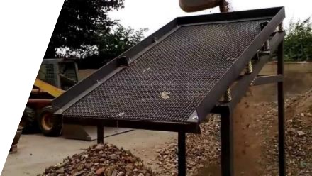
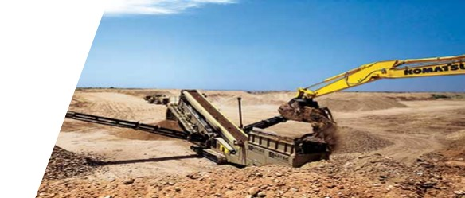
Actividades y herramientas que crean polvo de sílice(16)
Actividades y herramientas que crean polvo de sílice(16)
  Tareas que crean sílice respirable:
  Proyección de arena y grava
  - A mano
  - Maquinaria
  Herramientas:
  - Tamices
  - Plantas de cribado
  - Máquinas de tamizado manual
  - Herramientas de mano y pantallas
Notes:
Task NOT in Table 1
Materials like sand or stone, concrete contain crystalline silica. Hence, screening activities of these materials might result in airborne silica particles. Whenever a dust is created while these materials are being screened manually or by machinery, respirable silica particles are present.

Slide 19
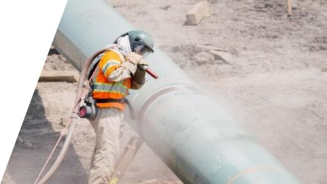
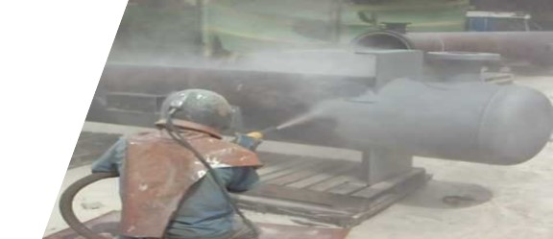
Actividades y herramientas que crean polvo de sílice(17)
Actividades y herramientas que crean polvo de sílice(17)
  Tareas que crean sílice respirable:
  Chorro abrasivo (arenado)
  - Proceso de tratamiento de superficie mediante el cual un medio abrasivo se acelera a través de una boquilla de chorreado de alta presión.
  Herramientas:
  - Sistemas de chorro abrasivo húmedo y de vapor.
  - Sistemas de explosión abrasiva
  - Secadores de aire
Notes:
Task NOT in Table 1
ASK: Are you familiar with Abrasive blasting?
ANSWER: Abrasive blasting is the operation of forcibly propelling a stream of abrasive material against a surface under high pressure to smooth a rough surface.
There are several variants of the process, using various media; some are highly abrasive, whereas others are milder. The most abrasive are shot blasting (with metal shot) and sandblasting (with sand). Sandblasting is a generic term for the process of smoothing, shaping and cleaning a hard surface by forcing solid particles across that surface at high speeds; the effect is similar to that of using sandpaper, but provides a more even finish with no problems at corners.
In 1974, NIOSH recommended that silica sand (or other substances containing more than 1% free silica) be prohibited as abrasive blasting material and that less hazardous materials be used in blasting operations.

Slide 20
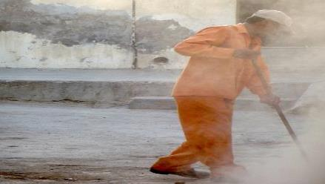
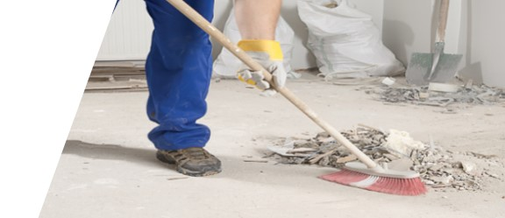
Actividades y herramientas que crean polvo de sílice(18)
Actividades y herramientas que crean polvo de sílice(18)
  Tareas que crean sílice respirable:
  Gestión interna / Limpieza
  El barrido en seco y el cepillado en seco pueden contribuir a la exposición a la sílice.
  Herramientas:
  - Cepillos y escobas
  - Compresores de aire
  - Dejar los sopladores
  - Aspiradoras
Notes:
Task NOT in Table 1
Certain cleaning methods can increase employee exposures to silica by releasing dust into the air. Cleaning methods such as dry sweeping, dry brushing, and using compressed air can cause silica dust to become airborne and inhaled.
Therefore, the silica standard requires employers to avoid cleaning methods that release dust into the air and use cleaning methods that reduce the likelihood of exposures.

Slide 21
Actividades y herramientas que crean polvo de sílice(19)
Actividades y herramientas que crean polvo de sílice(19)
  ¿Estás en peligro?
  Si realiza las siguientes tareas a los materiales que contienen sílice:
Corte o sierra
Aplastar o demoler
Moler o pulir
Taladro
Astillado
Abrasivo o chorro de arena
Limpieza en seco
proyección de concreto
Excavando o escarificando
Molienda de pavimento
  Entonces la respuesta
  es Sí.
  El polvo a su alrededor contiene partículas de sílice respirables, y respirarlas puede ser mortal.
Notes:
Tip: Follow the content in the slide.

Slide 22
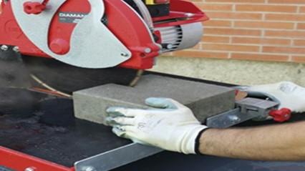
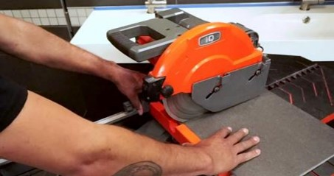
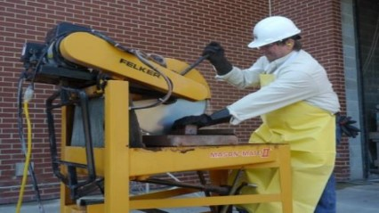
Actividades y herramientas que crean polvo de sílice(20)
Actividades y herramientas que crean polvo de sílice(20)
  Equipos que generan exposición al polvo de sílice:
  Sierras estacionarias:
  - Sierras de ladrillo / bloque
  - Sierras de mesa
  - Sierras para azulejos de cerámica
Notes:
As mentioned in previous slides, cutting of bricks, CMU blocks, stones results in airborne silica particles. Using a stationary masonry saw to cut bricks, concrete blocks, pavers, or other silica-containing materials can generate respirable crystalline silica dust. The most common types of saws used in these tasks are (1) brick/block saws, (2) table saws, and (3) ceramic tile saws.
Based on OSHA new regulations, when using a stationary masonry saw, wet cutting with an integrated water delivery system that continuously feeds water to the blade is an
effective way to reduce exposure to silica dust. Many stationary masonry saws come equipped with a water basin that holds several gallons of water. A pump recirculates the water through a nozzle that directs a continuous stream onto the blade where it wets the material being cut and reduces the amount of dust generated.

Slide 23
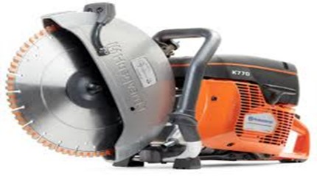
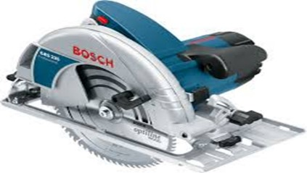
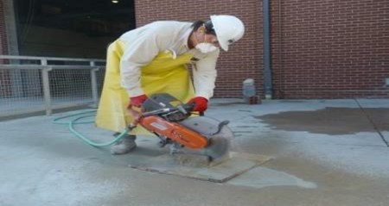
Actividades y herramientas que crean polvo de sílice(21)
Actividades y herramientas que crean polvo de sílice(21)
  Equipos que generan exposición al polvo de sílice:
  Sierras eléctricas de mano:
  Sierra de cortar
  Sierra mojada
Notes:
Handheld power saws generate similar results as stationary masonry saws mentioned in the previous slide. Using a handheld power saw (also called a cut-off saw) to cut masonry, concrete, stone, or other silica-containing materials can create respirable crystalline silica dust.
Many handheld power saws come equipped with an integrated water delivery system designed to cool the blade by directing a continuous stream of water onto the blade where it wets the material being cut and reduces the amount of dust generated when cutting.

Slide 24
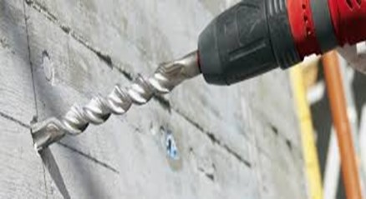
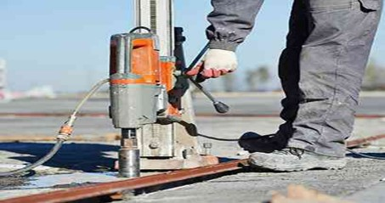
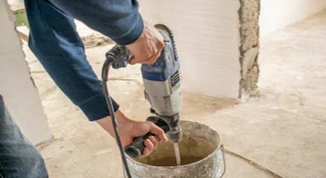
Actividades y herramientas que crean polvo de sílice(22)
Actividades y herramientas que crean polvo de sílice(22)
  Equipos que generan exposición al polvo de sílice:
  Herramientas eléctricas:
  - Taladros
  - Máquinas de perforación con coronas
  - Maquinas mezcladoras
Notes:
ASK: Can you name some common power tools that you are using in your daily activities?
Power tools are among the most used equipment in construction. They are very handy in a wide range of activities, such as drilling, chipping, coring, mixing, etc. Since these materials are used on silica containing materials, after the before mentioned activities, they become source of releasing crystalline silica in the air. Therefore, to keep a safe environment, special controls shall be applied in order to minimize the airborne silica exposure within the identified OSHA exposures.

Slide 25
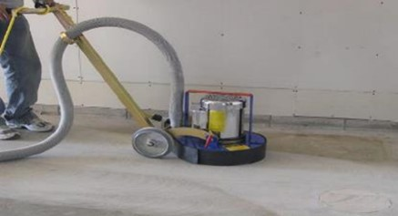
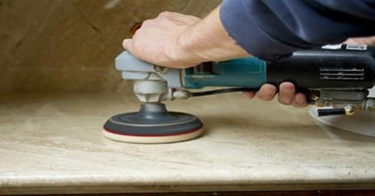
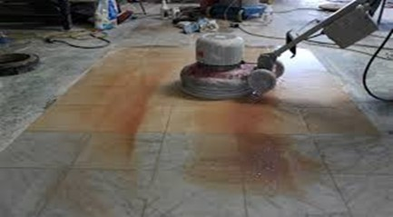
Actividades y herramientas que crean polvo de sílice(23)
Actividades y herramientas que crean polvo de sílice(23)
  Equipos que generan exposición al polvo de sílice:
  Rectificadoras / Pulidoras:
  - Amoladora de concreto
  - Pulidores de encimera
  - Pulidores de mármol
Notes:
Smoothing activities on different surfaces such as concrete, marble, or stone work require certain types of grinders or polishers. As already mentioned, these are silica containing materials and any activity on them such as polishing would produce airborne crystalline silica. Therefore, in order to keep the silica exposure within the OSHA requirements, water is recommended to be applied while these tasks are performed. This will reduce the amount of dust and silica particles in the air.

Slide 26
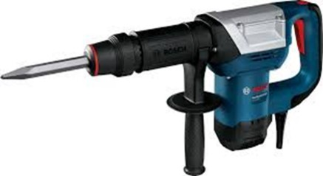
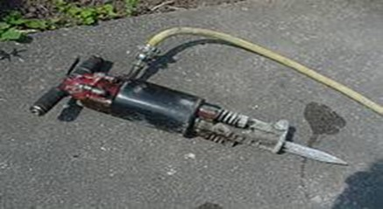
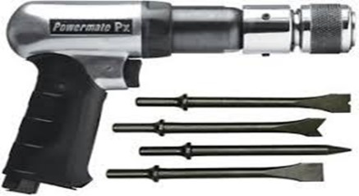
Actividades y herramientas que crean polvo de sílice(24)
Actividades y herramientas que crean polvo de sílice(24)
  Equipos que generan exposición al polvo de sílice:
  Martillos y herramientas de astillado de mano:
  - Martillo neumático
  - Martillo perforador
  - Martillo picador
  - Pistola de cincel
Notes:
Jackhammers are very common in construction industry used in several tasks such demolition, chipping, drilling, etc. They are used to perform tasks on silica containing materials such as concrete, masonry, stonework which generate airborne silica particles.
Based on new safety regulations, jackhammers now require dust suppression controls. Engineering controls is always a good idea to be used to reduce the level of potential hazards. If the engineering controls have been determined to be non-effective (say too many jackhammers at one time), the respiratory protection is required in addition to the use of the non-effective engineering controls.

Slide 27
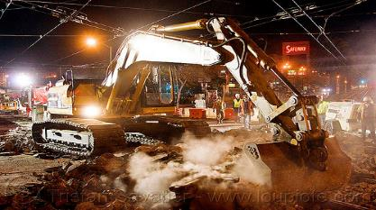


Actividades y herramientas que crean polvo de sílice((25)
Actividades y herramientas que crean polvo de sílice((25)
  Equipos que generan exposición al polvo de sílice:
  Excavadoras:
  - Excavación
  - Demolición
  - Rotura de concreto
  - Carga de suelo
Notes:
Due to the amount of dust and airborne silica particles, excavator operators are among the most exposed workers in construction.
The use of an enclosed cab when operating heavy equipment and utility vehicles during demolition activities, or when fracturing and abrading silica-containing materials, can reduce operator exposures to silica dust. Otherwise dust control methods are required. Currently manufacturers have started making enclosed cabs positive pressure with ventilation systems equipped with HEPA filtration to provide clean air to the inside of the cab.

Slide 28
Actividades y herramientas que crean polvo de sílice(26)
Actividades y herramientas que crean polvo de sílice(26)
  ¿Estás en peligro?
  Si utiliza las siguientes herramientas para materiales que contienen sílice:
Sierras estacionarias de albañilería.
Sierras de mano
Sierras de paso
Sierras transportables
Molinillos
Pulidores
Martillos
Taladros
Máquinas de granallado
Excavador
Fresadoras
Maquinas trituradoras
  Entonces la respuesta es Sí.
  El polvo a su alrededor contiene partículas de sílice respirables, y respirar puede ser mortal.
Notes:
Tip: Follow the content in the slide.

Slide 29
Actividades y herramientas que crean polvo de sílice(27)
Actividades y herramientas que crean polvo de sílice(27)
  Materiales de construcción que contienen sílice cristalina:
  La sílice cristalina se usa ampliamente en una variedad de aplicaciones en la construcción:
  Las pinturas
  Piedras decorativas / rocas
  Cemento
  Productos quimicos
Notes:
Crystalline silica is found in many materials used in construction.
This includes natural materials such as sand, rock, and stone.
It also includes man-made materials such as concrete, brick, block, mortar, tile, and artificial stone.

Slide 30






Actividades y herramientas que crean polvo de sílice(28)
Actividades y herramientas que crean polvo de sílice(28)
  Materiales de construcción que contienen sílice cristalina:
  Concreto :
  Arena:
  Mortar:
  Block (CMU):
  Ladrillo:
  Suelo :
Notes:
1- Concrete produces respirable silica particles during: (1) sawing, (2) cutting, (3) breaking, (4) production, (5) drilling, (6) chipping, (7) surface smoothing, (8) demolition
2- The most common constituent of sand is silica (silicon dioxide, or SiO2), therefore activities such as abrasive blasting with sand will result in release of silica dust.
3- Mortar releases cement dust during mixing which contains crystalline silica. Ready mixed mortar creates silica dust while being stirred up during preparation.
4- CMU Blocks release respirable silica particles during: (1) sawing, (2) cutting, (3) breaking, (4) drilling, (5) chipping, (6) demolition
5- Bricks release respirable silica particles during: (1) sawing, (2) cutting, (3) breaking, (4) drilling, (5) chipping, (6) demolition
6- Silica in free and combined forms is a dominant component of the solid material of many soils, therefore activities such as excavation, earth moving, soil dumping, etc will produce silica dust.

Slide 31






Actividades y herramientas que crean polvo de sílice(29)
Actividades y herramientas que crean polvo de sílice(29)
  Materiales de construcción que contienen sílice cristalina:
  Arenisca
  Tablilla :
  Paneles de yeso
  Porcelana:
  Terrazo :
  Piedra (granito, cuarzo)
Notes:
1- Sandstone is practically pure silica, therefore any action taken to this material (cutting, smoothing, grinding, etc) will result in silica dust.
2- Roof shingle that uses asphalt for waterproofing contain silica and activities such as cutting, and sawing will produce respirable silica particles.
3- Drywall joint compounds are made from many ingredients (among them silica). Mixing of the dry powder used as drywall finishing is one of the most silica dust releasing activities.
4, 5 – Dry cutting and dry grinding of Porcelain & Terrazzo tiles lead to silica dust which exposes the construction works to respirable silica particles.
6- Granite and other natural stones are quarried and cut into large stone slabs where exposure to crystalline silica dust is very likely. These materials will expose the construction workers to silica dust during cutting, grinding, drilling, chipping and polishing these stones.

Slide 32






Actividades y herramientas que crean polvo de sílice(30)
Actividades y herramientas que crean polvo de sílice(30)
  Materiales de construcción que contienen sílice cristalina:
  Thinset:
  Enlechar::
  Estuco:
  Asfalto:
  Yeso:
  Pintura:
Notes:
1, 2, 3- Mixing of thinset, grout, and stucco dry powder creates silica dust associated with the risk of respirable silica particles.
4- Milling, cutting, or otherwise disturbing asphalt pavement can create airborne dust containing silica.
5- The main respiratory hazard associated with plastering activities is exposure to airborne plaster dust when mixing the material from a dry state to wet in preparation for use, and during sanding down of dried materials.
6- Latex paints contain crystalline silica, which when inhaled causes lung disease.

Slide 33
Tasks and Tools that Create Silica Dust (31)
Tasks and Tools that Create Silica Dust (31)
  Quien esta en riesgo?
  Constructoras más afectados por la sílice cristalina:
  Explosivos abrasivos
  Acabadores de paneles de yeso
  Operadores de equipos pesados
  Taladros de orificio utilizando taladros de mano
  Martillo perforador y taladradoras de impacto
  Cortadoras de albañilería con sierras portátiles.
  Cortadoras de albañilería con sierras estacionarias.
  Fresadoras que utilizan máquinas portátiles o móviles.
  Perforadoras de roca y hormigón
  Operadores y licitadores de máquinas trituradoras de rocas.
  Picadores y molinillos
  Trabajadores de la construcción subterránea
Notes:
Tip: Follow the content in the slide.

Slide 34

Preguntas y comentarios
Preguntas y comentarios
Nombra tres cosas importantes que aprendiste en esta sección.

