Slide 1
Safety for workers in the oil and gas industry
This material was produced under grant number SH-31238-SH7 from the Occupational Safety and Health Administration, US Department of labor. It does not necessarily reflect the views or policies of the US Department labor, nor does mention of trade names, commercial products, or organizations imply endorsement by the US Government

Slide 2
Training Pre-assessment
To begin our training on safety, lets consider a few questions…
True or False?
  A safety plan is a document that records all work-related injuries?
  Electrocution is a major workplace hazard?
  A major workplace hazard is to be struck by a moving instrument?
  A permit is not needed for all confined spaces?
  The employer is responsible for providing all PPE?

Slide 3
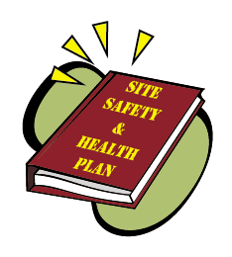
overview
In 2016, there were 422,593 employees in the oil and gas extraction industry in the United States.
89 fatalities were cited in 2015 in this industry.
Examples of safety, health hazards and dangerous conditions that can result in fatalities for oil and gas workers include:
  Falls
  Struck-by/Caught in or between
  Electrical hazards
  Vehicle collisions
  Explosions and fires
  Chemical exposures
Safety plans are essential to recognizing and
reducing potential hazards.

Slide 4
Question / Response
Which of the following is not a health or safety concern in your workplace?
Vehicle accidents
Falls
Overtime pay rates
Electrical hazards
10

Slide 5
ANSWER 1
C. Overtime pay rates

Slide 6

What is a Safety and Health plan?
A safety and health plan is a written document that describes potential workplace hazards, methods for identifying and minimizing those hazards, as well as procedures, policies, and controls to prevent accidents.
In addition, a safety plan should outline steps to take when accidents occur.

Slide 7
Question / Response
The purpose of a safety plan is to make sure your company is not held liable when someone gets injured.
True
False
10

Slide 8
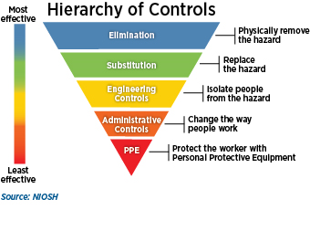
ANSWER 2
False
The purpose of a safety plan is to minimize hazards in the work environment and to provide direction for appropriately handling accidents when they do occur.

Slide 9

Basic elements of a safety plan
Recommendations for a safety plan:
  Policy or goals
  Hazard identification and control
  Safe practices
  Emergency and accident response
  Designate responsible person(s)
  Employee
  Training
  Keep records

Slide 10
Question / Response
Which of the following is not a recommendation for a written safety plan?
Responsible persons
Recordkeeping
  Hazard controls and safe practices
  Hazard identification
  Supply order forms
10

Slide 11
ANSWER 3
E. Supply order forms

Slide 12
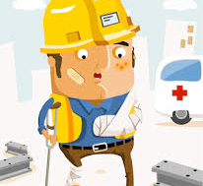
Major workplace Hazards
Safety and health hazards and dangerous conditions that can result in fatalities for oil and gas workers include:
  Falls
  Chemical exposures
  Ergonomic hazards
  Struck-by/Caught in or between
  Electrical hazards
  Vehicle collisions
  Explosions and fires
  Confined spaces
  High pressure lines and equipment
  Electrical and other hazardous energy
Notes:
The first 3 topics will be covered by Andria, Joemy and Matt

Slide 13
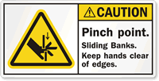
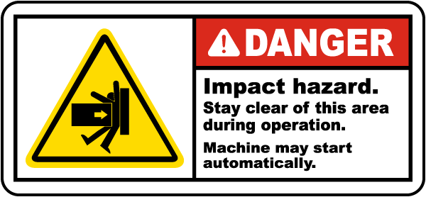

Struck-by/caught in or between
Struck-by is an accident where the worker is struck by an object.
Caught in or between is an accident where the worker or part of the worker is caught between an object(s).
Struck-by/caught-in/caught-between hazards are the cause of 3 of every 5 on-site fatalities in the oil and gas extraction industry.
Examples of struck-by/caught-in/caught-between hazards are…
https://www.mysafetylabels.com/MSL/Caution-Pinch-Point-Safety-Label/SKU-LB-0141.aspx
https://www.mysafetylabels.com/equipment-starts-automatically-lockout-and-tagout-label/sku-lb-2409
http://www.safetysign.com/products/6143/danger-impact-hazard-label?s=st1zsk1fyszsp2hjzbp108
https://www.mysafetylabels.com/equipment-starts-automatically-lockout-and-tagout-label/sku-lb-2409

Slide 14
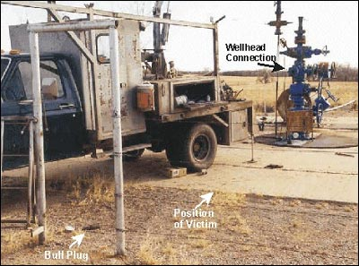
Struck-by/caught in or between
https://www.cdc.gov/niosh/face/stateface/ok/00ok004.html
Notes:
“A 19-year old wireline operator trainee died on January 12, 2000 from head and neck trauma received at an oil well when he was struck by a bull plug, needle valve and pressure gauge assembly that had been blown out of a wellhead connection. At the time of the incident, the victim was standing approximately 15 feet away from the wellhead near the wireline truck where he and the wireline operator were changing wireline tools while the well operator and an oilfield chemical service representative were attempting to gauge the well pressure. When the well operator opened the wellhead gate valve, the bull plug, needle valve and gauge assembly blew out of the connection and struck the victim in the head and neck inflicting fatal injuries”

Slide 15
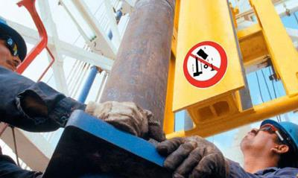
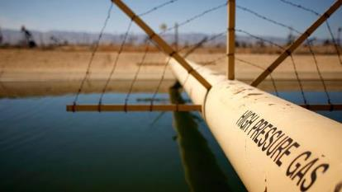
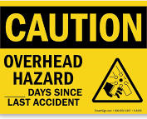
Struck-by/caught in or between
https://www.cnbc.com/2014/04/11/ohio-links-fracking-to-tremors.html
https://www.oilandgaspeople.com/news/11560/new-website-promotes-safety-to-prevent-dropped-object-accidents/
Notes:
Falling equipment and high-pressure lines

Slide 16
Electrical hazards
Things that shock you!
For example…

Slide 17
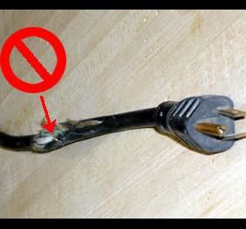
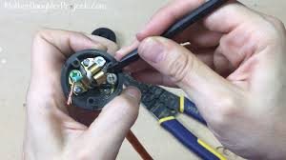
Electrical hazards
http://environmentalhealth.buffalostate.edu/commonsafetyhazards
Notes:
Damaged extension cords
Extension cords without grounding prongs
Extension cords not GFCI-protected
REPAIR OR DISPOSE

Slide 18
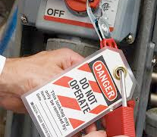
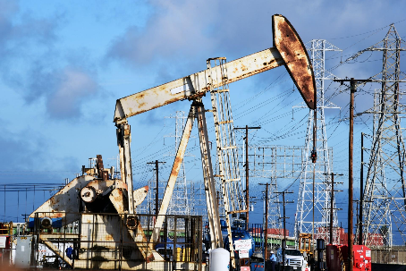

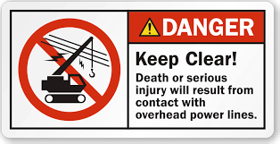
Electrical hazards
https://seekingalpha.com/article/4133443-chevron-looks-like-bitcoin-oil-cash-flow-dividend-accelerate
http://www.safetyandhealthmagazine.com/articles/12332-lockouttagout-responsibility
Notes:
Accidental re-energization of equipment
Not controlling the key for your own lock
Overhead powerlines – numerous fatalities are related to servicing rigs near power lines

Slide 19

Vehicle collisions
Workers are often required to drive vehicles on highways and roads as part of their job.
Highway vehicle crashes are the leading cause of death among oil and gas extraction workers.
https://www.safetysupplywarehouse.com/NOTICE_PLEASE_DRIVE_SAFELY_SIGN_p/30274.htm
Notes:
Fracking operations are typically in rural settings, many quite remote. The local roads are seldom designed for heavy traffic, specifically heavy truck traffic.
A fracking operation brings a LOT of daily traffic to an area. The roads are many times the same roads that school buses and daily commuters use. The traffic patterns are “new” to the areas and to the traditional users of the roads.
Many of the associated trucking operations are paid by the load. This could increase the speed of the vehicles.
Some health and safety researchers have commented that the change in the local traffic is actually the most hazardous condition associated with fracking.

Slide 20
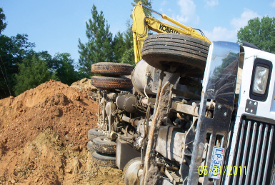
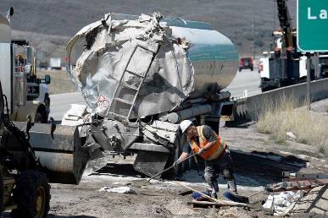
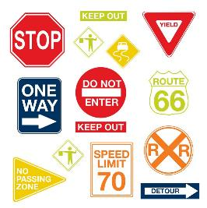
Vehicle collisions
https://pixabay.com/en/photos/accident/
https://www.wsj.com/articles/how-to-transport-oil-more-safely-1442197722
https://www.wayfair.com/decor-pillows/pdp/wallpops-wall-art-kit-road-signs-wall-decal-wpp1266.html

Slide 21
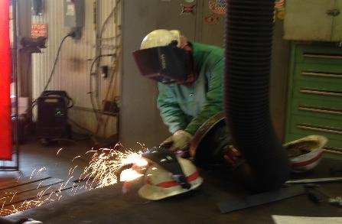
Explosions and fires
Explosions and fires are a higher risk for those working in oil and gas industry due to the presence of flammable gasses.
Ignition can occur from many sources:
  Open flames
  Welding
  Cigarettes
  Lightening
  Static electricity
  Friction sparks
  Use of explosives
  Internal combustion engines
  Pumps
  Motors

Slide 22
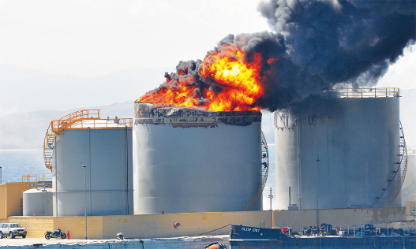
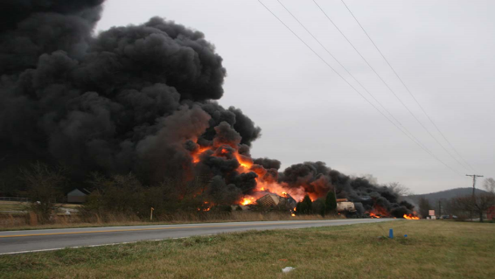
Explosions and fires
http://miradikwanza.blogspot.com/2014/08/oil-and-gas-production-managing-oil.html

Slide 23
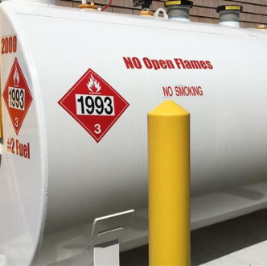
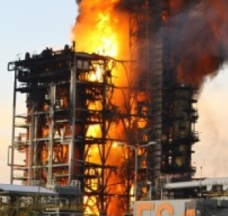
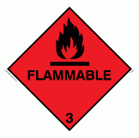
Explosions and fires
https://www.bizbuysell.com/Business-Opportunity/Fuel-and-Oil-Tank-Installations-Removal-and-Remediation/1418661/
https://oilprice.com/Latest-Energy-News/World-News/Fire-Breaks-Out-At-Eni-Refinery-In-Northern-Italy-No-Injuries-Reported.html

Slide 24
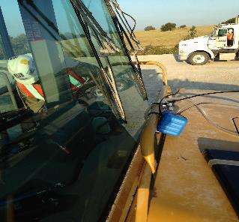
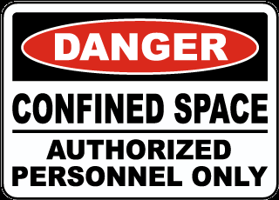
Confined spaces
“A confined space has limited or restricted means for entry or exit, large enough for bodily entry, and is not designed for continuous occupancy. Confined spaces include, but are not limited to, tanks, vessels, silos, storage bins, hoppers, vaults, pits, manholes, tunnels, equipment housings, ductwork, pipelines, etc.”
-- OSHA, Confined Spaces
Notes:
OHSA definition in slide

Slide 25
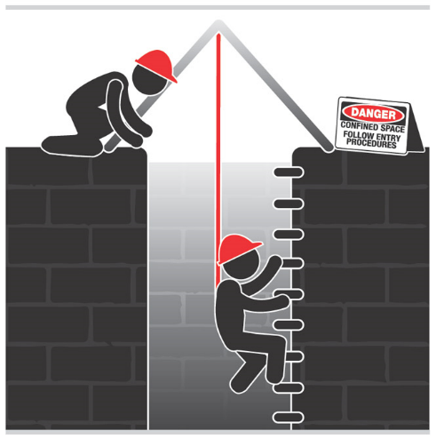
Confined spaces
http://www.elcosh.org/document/3706/d001243/Confined%2BSpaces.html
Notes:
Oil and gas workers may have to enter a confined space such as petroleum and other storage tanks, and other confined spaces around a wellhead.

Slide 26
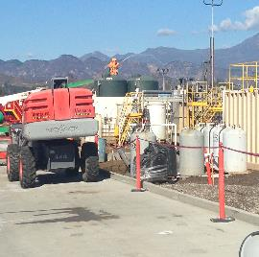
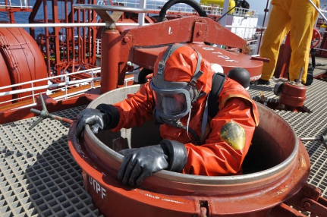
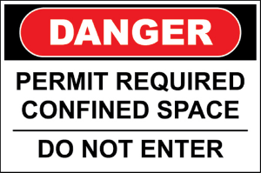
Confined spaces
http://blog.rmiwyoming.com/tag/oil-and-gas
http://www.powermag.com/safe-work-practices-in-confined-spaces-at-power-plants/
Notes:
Ignition of flammable vapors or gases is a safety concern.
Health hazards may exist, such as asphyxiation or exposure to hazardous chemicals.

Slide 27
High pressure lines and equipment
High pressure lines and equipment, such as hydraulic lines or compressed gases, pose several risks.
  Lines can leak or burst, causing struck by fatalities.
  Unsecure high pressure lines and hoses can also be a hazard.
  Proper handling and management of lines is important!

Slide 28

High pressure lines and equipment
http://www.emedco.com/danger-high-pressure-gas-line-sign-40372.html

Slide 29
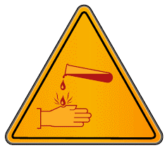
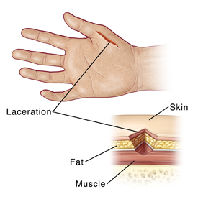
High pressure lines and equipment
https://www.mountnittany.org/articles/healthsheets/37164
https://www.jimdodsonlaw.com/library/justice-for-florida-burn-victims.cfm
Notes:
Chemical burns and lacerations to the hand

Slide 30
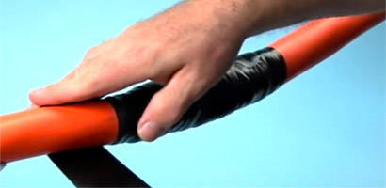
Question / Response
Using tape to cover a damaged electrical cord is safe
True
False
10

Slide 31

Answer 4
False
You should no longer use a power cord once it has been damaged.

Slide 32
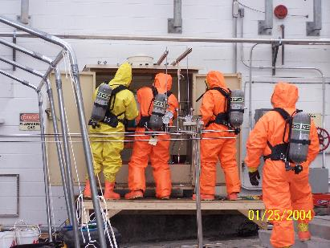
Personal protective equipment
Personal Protective Equipment (PPE)
When all feasible engineering and administrative work practice controls have been implemented to eliminate and reduce hazards but additional hazards still exist, PPE can be used.

Slide 33
PPE
Select the right PPE for the job:
Body part | PPE
Head | Hard hats
Eye | Safety glasses/goggles
Hands | Gloves
Feet | Steel toe boots
Ears | Earplugs, earmuffs
Whole body | Chemical resistant suits
Whole body | Flame resistant/retardant clothing

Slide 34

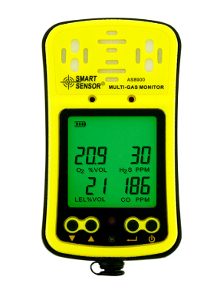
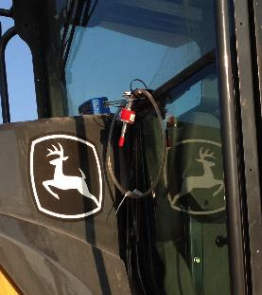
Monitoring
Monitoring for hazardous dust, gas and vapors
https://www.aliexpress.com/store/product/Smart-Sensor-AS8900-Portable-Multi-Gas-Detection-Monitor-Tester-For-Oxygen-Carbon-Monoxide-Hydrothion-Combustible/237042_32337075900.html
https://woodgears.ca/dust/dylos.html
Notes:
Air particle monitor and 4 gas meter

Slide 35
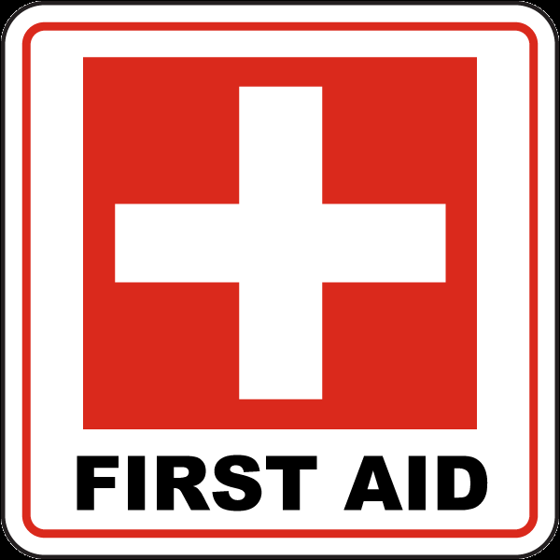
Emergencies
Where are the hospitals?
Where are the AEDs?
Where are the first aid kits?
Who is trained in first aid and CPR?
Whom do you report accidents to?
http://www.safetysign.com/products/1542/first-aid-sign
Notes:
Familiarize yourself with where and/or who to go to for first aid

Slide 36
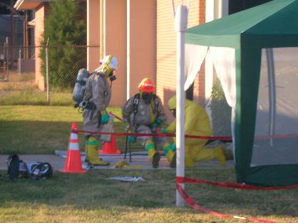
Question / Response
Your employer is responsible for providing you with PPE required for the job.
True
False
10

Slide 37
Answer 5
True.

Slide 38
summary
A safety plan helps guide workers and maintain an environment that is as safe as possible.
Many workplace hazards exist that you should be aware of:
  Struck-by/Caught in or between
  Falls
  Electrical/Explosion and fire
  Vehicle accidents
  Confined spaces
  High pressure lines
  Chemical exposure
Know what PPE is right for your job and use it!
Know what equipment you need to monitor your environment.

Slide 39
Training Post-assessment
To begin our training on safety, lets consider a few questions…
True or False?
  A safety plan is a document that records all work-related injuries?
  Electrocution is a major workplace hazard?
  A major workplace hazard is to be struck by a moving instrument?
  A permit is not needed for all confined spaces?
  The employer is responsible for providing all PPE?

Slide 40

Any Questions?

Slide 41
references
BLS. United States Bureau of Labor statistics. https://www.bls.gov/iif/oshcfoi1.htm#2015
OSHA. Occupational Safety and Health Administration Regulations (Standards - 29 CFR). https://www.osha.gov/laws-regs/regulations/industry
OSHA. Occupational Safety and Health Administration OSH ACT of 1970. https://www.osha.gov/laws-regs/oshact/completeoshact

Slide 42
Safety guidelines
  OSH Act of 1970, Section 5 - General Duty Clause
  OSHA - General Industry Standards (29 CFR 1910)
    Hazard Communication (29 CFR 1910.1200(e))
      Requires a written chemical worker right-to-know safety plan
    HAZWOPER Safety and Health Plan (29 CFR 1910.120(b))
    Emergency Action Plan and Fire Prevention Plan (29 CFR 1910.38 and 29 CFR 1910.39)
    Blood borne Pathogens Exposure Control Plan (29 CFR 1910.1030(c))
  OSHA - Construction Standards (29 CFR 1926)
Notes:
EXTRA!!!
Employers must protect the safety and health of workers involved in oil and gas operations according to these guidelines

