Slide 1
FALL PREVENTION WORKSHOP
This material was produced under a Susan Harwood Grant SH-31247- SH7 from the Occupational Safety and Health Administration, U.S. Department of Labor. It does not necessarily reflect the views or policies of the U.S. Department of Labor, nor does mention of trade names, commercial products, or organizations imply endorsement by the U. S. Government. The U.S. Government does not warrant or assume any legal liability or responsibility for the accuracy, completeness, or usefulness of any information, apparatus, product, or process disclosed.

Slide 2
Workshop Agenda
Introduction & Agreements
Video and Reflection
Dangers and Solutions
Closing

Slide 3
Workshop Objective
Create conciousness around the dangers of working at heights.
How to use scaffolds, harnesses and ladders in a safe manner.
Workers’ rights and responsibilities

Slide 4

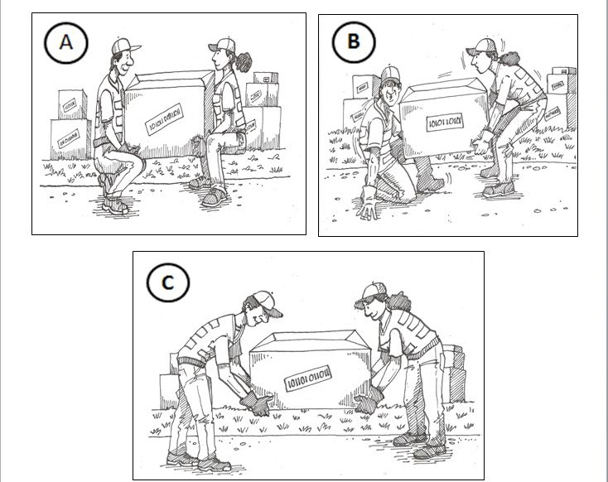
Example
If you would do the job like in the drawing, mark a inside the box.
If you would not do the job like in the drawing, mark a inside the box.
When you’re done, there should only be one and two for each page.

Slide 5
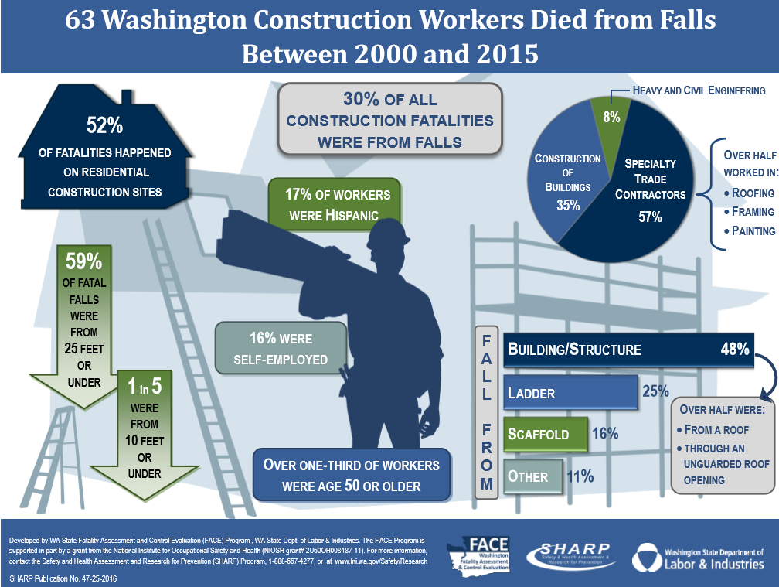
Stats

Slide 6
Video 1
Story of an Accident Video

Slide 7
Identifying Dangers

Slide 8
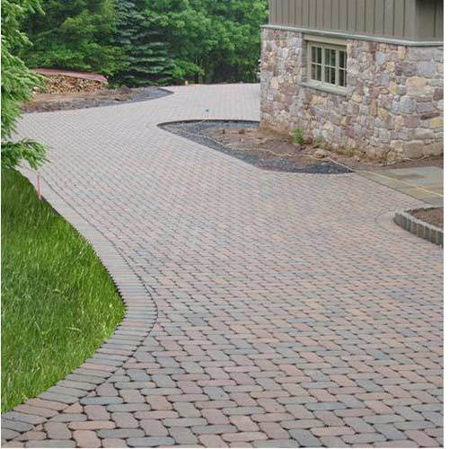
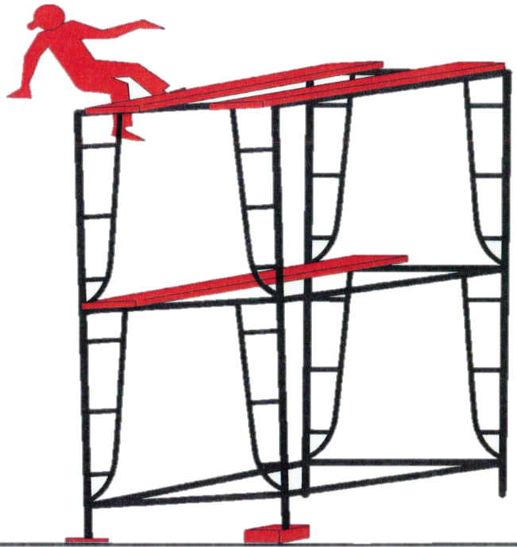
Scaffold

Slide 9
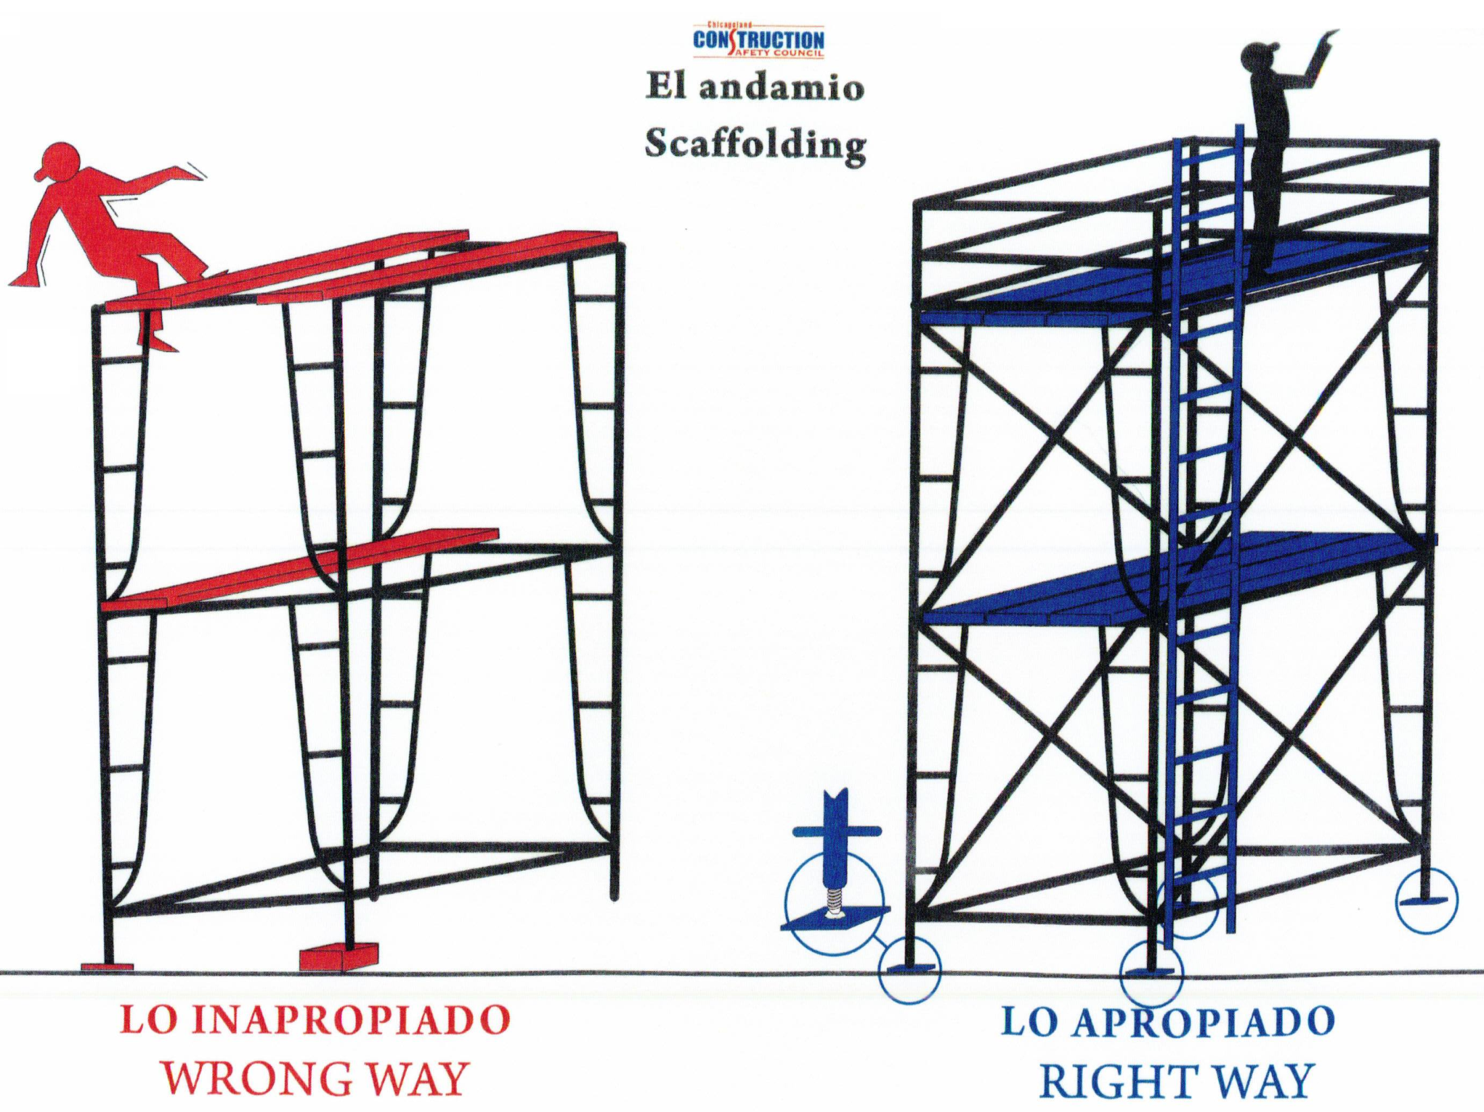
Scaffolds
No protections against falls
Missing Planks
No ladder
Missing reinforcing crosses
Unbalanced scaffold
Scaffolds should be inspected at the beginning of every work day.

Slide 10
Harness
At what height should one use a harness when working on a roof?
6 ft de Alturas

Slide 11
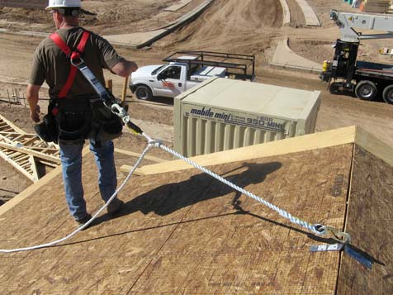
Harness

Slide 12
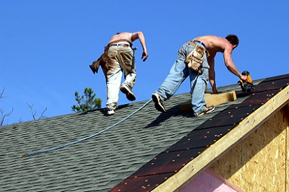
Harness

Slide 13
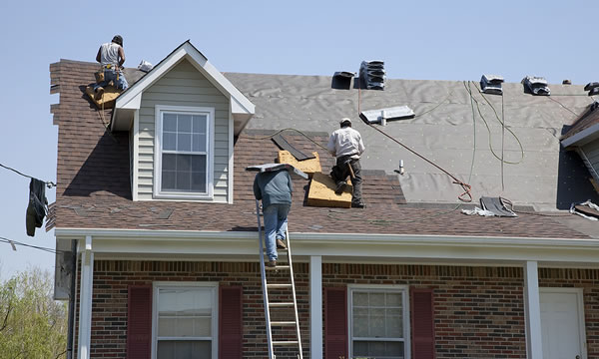
Harness

Slide 14
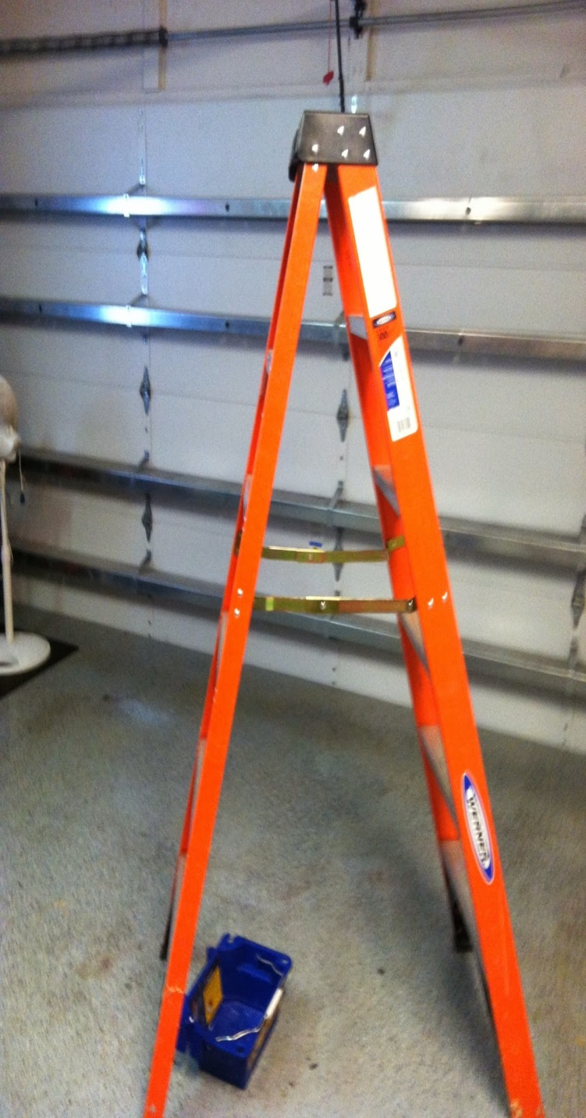
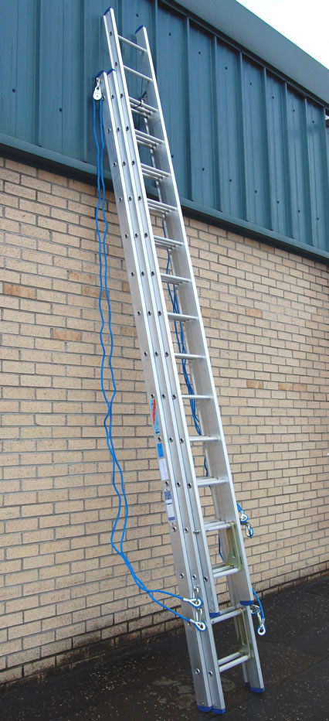
Ladder
Ladders
Notes:
Los 3 tipos mas comunes de escaleras, step ladder, extension ladder & multi-use ladder

Slide 15
VIDEO
Falling from Top Step Video—Simulation
Notes:
Los 3 tipos mas comunes de escaleras, step ladder, extension ladder & multi-use ladder

Slide 16
Video 2
Falling from Top Step Video--Real

Slide 17
Video 3
Falling from Straight Ladder Video

Slide 18
Video 4
Falling from Extension Ladder Video

Slide 19
Workers’ Rights
Workers’ Rights
We have the right to :
1- Receive the necessaryprotective equipment without cost.
2- Receive information about the work site. 3- Report a health or safety violation with OSHA without fear of retaliation or discrimination.
4- Receive fair pay for the work done.

Slide 20
R
Responsabilities
We have the responsibility to:
1. Respect all the health and safety standards.
2.Check all tools and equipment before starting to work.
3. Work at the worksite.
4. Not use drugs, alcohol or any other substance that prevents us from working and puts other workers at risk.

Slide 21
Contact
US Department of Labor (OSHA)
Phone: 800-423-7233
OSHA_Website

Slide 22
Closing
Closing
Deaths caused by falls can be prevented.
Inspect work tools and equipment before every use.
Always use a harness when you work at heights of more than 6 feet.
Ladders are the tools most commonly used but also the most dangerous.
Just like we have rights as workers, we also have responsibilities.

Slide 23
Thank you!
Thank you for your attention!

