Slide 1
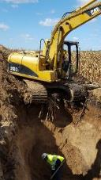
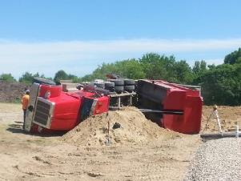
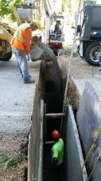
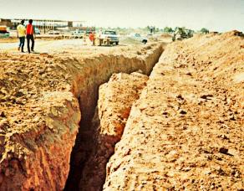
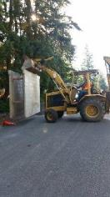

Excavation and Trenching Onsite Wastewater Systems
This material was produced under grant number SH-31249-SH7 from the Occupational Safety and Health Administration, U.S. Department of Labor. It does not necessarily reflect the views or policies of the U.S. Department of Labor, nor does mention of trade names, commercial products, or organizations imply endorsement by the U.S. Government.
Notes:
Introduction slide: Instructor will scope the discussion which will include a description of any additional handouts that are used. This is also a good moment to assess the make up of the audience with a few questions: “How many installers/designers are here today?”, “How many do additional utility work in the public right of way in addition to septic system projects?” “How many of you have ever had an excavation collapse while you were working in or around it? This activity sets the stage for the discussion, but also indicates to attendee’s that it is a participative training, not simply a presentation.

Slide 2
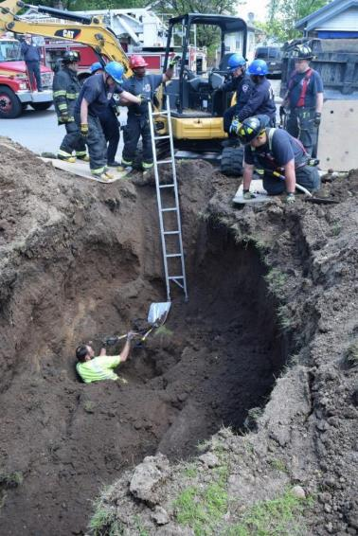

Excavation and Trenching Operations For Contractors in On-Site 1
Course objective:
To raise awareness of the excavation, trenching and shoring regulations and requirements in:
29 CFR 1926.650,
29 CFR 1926.651,
29 CFR 1926.652
Subpart P
Notes:
Instructors notes are inclusive on each slide and assumes that the instructor has both knowledge and experience in construction/excavation and a working knowledge of the referenced administrative code. Instructors should review the code prior to teaching this program for updates and changes.
Instructors should also check to determine if the state they are training in is an “OSHA state” or if the state has its own rules under the OSHA standard. The addition of a reference slide to the state rule would be appropriate.

Slide 3
Excavation and Trenching Operations For Contractors in On-Site 2
Disclaimer
This material was produced under grant:
SH-31249-SH7 from the Occupational Safety and Health Administration, U.S. Department of Labor.
It does not necessarily reflect the views or policies of the U.S. Department of Labor, nor does mention of trade names, commercial products , or organizations imply endorsement by the U.S. Government.
Notes:
Mandatory Disclaimer

Slide 4
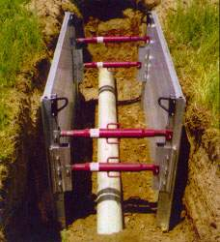
Topics covered
Introduction to Trench Safety & Review of the OSHA Excavation and Trench Safety Rules
Definitions
Competent Person Responsibilities
Soil classification
Trench protective systems:
Shoring & sloping
Shielding Guidelines
Protective Systems Options
Common OSS Scenario’s
Notes:
This slide identifies the learning objectives for the training session.

Slide 5

Introduction to the osha Excavation standard 1
What is OSHA?
Occupational Safety and Health Administration
Why was it created?
Because of an increase in the number of fatalities, in 1970 Congress created the Agency.
What is their Authority?
OSHA is responsible to create and enforce standards for employers and their employee to follow for safety in the workplace.
Notes:
The instructor will review the historical creation of OSHA in 1972, it’s purpose, authority, regulation development and enforcement.

Slide 6
Introduction to the osha Excavation standard 2
Excavating is recognized as one of the most hazardous construction operations.
OSHA recently revised Subpart P, Excavations, of 29 CFR 1926.650, 29 CFR 1926.651, and 29 CFR 1926.652 with a purpose to:
Make the standard easier to understand
Permit the use of performance criteria where possible, and
Provide employers with options when classifying soil and selecting employee protection methods
Notes:
This slide identifies hazards associated with construction in the On-site industry and recognizes that installation companies also augment their business models with side sewer, site development and utility work. Discussion on the use of standards as a “guide” for safe work under a variety of conditions that are dynamic instead of a “rule book” to avoid getting fines is a mental shift for the small business owner to raise at the beginning of the training.

Slide 7
How are the Standards set up?
29 CFR- 1926 Safety & Health for Construction
Subpart – P
Standard – 1926.650 – Scope, Application and Definitions
Standard – 1926.651 – General Requirements
Standard – 1926. 652 – Requirements for protective systems
Notes:
This slide outlines the structure of 29CFR1926 Subpart P
It’s relevance is to give participants the ability to navigate to specific sections of the Code as needed to answer questions when they are on a project.

Slide 8
The Standards also include Appendices A through F
Appendix A – Soil Classification
Appendix B – Sloping and Benching
Appendix C – Timber Shoring for Trenches
Appendix D – Aluminum Hydraulic Shoring for Trenches
Appendix E – Alternatives to Timber Shoring
Appendix F – Protective Systems Flow Chart
Notes:
This slide outlines the structure of 29CFR1926 Subpart P Appendices A through F
It’s relevance is to give participants the ability to navigate to specific sections of the Code as needed to answer questions when they are on a project.

Slide 9
What’s the best way to use them?
Two Things to remember:
The standards go from “General” to “Specific” in their application on any particular project.
Review the standards regularly to apply them properly to typical trench and excavation tasks, but use them to work through different or changing conditions in the work.
Notes:
This slide provides additional awareness for participants as they navigate to specific sections of the Code as needed to answer questions when they are on a project. Visual case studies used later in the presentation will allow the instructor to conduct a group activity with the group to learn how to navigate more thoroughly into the standard to identify applicable standards to any construction project.

Slide 10
Excavation, Trenching and Shoring
Scope, Application and Definitions
“This part applies to all open excavations made in the earth's surface. Excavations are defined to include trenches.”
Most common field exposures that the on-site industry are involved with include:
Tank Excavations
Side Sewer
Soil Test Pits
Other – Utility work, Sewer Mains
Notes:
This slide defines “Scope and Application” and the general definition of excavations. It will also define and provide examples of construction and septic industry applications that follow in the subsequent slides.

Slide 11
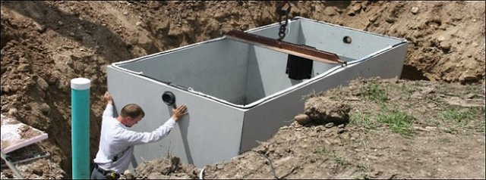
Excavation Definition
Any person-made cut, cavity, trench, or depression in the earth's surface, formed by earth removal.
Notes:
This slide provides the definition of an excavation under code.

Slide 12
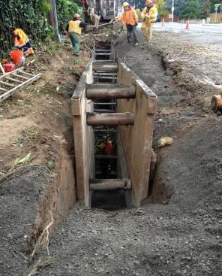
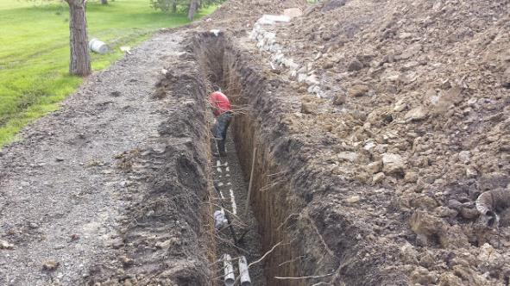
Trench Definition
A narrow excavation in relation to its length made below the surface of the ground. In general, the depth is greater than the width, but the width of a trench (measured at the bottom) is not greater than 15 feet (4.6m).
Notes:
Relative to the industry, this would include side sewer work, utility work, and trench excavations. In particular, an area often not considered for both the septic design community and the regulatory community, are soil log test pits.

Slide 13
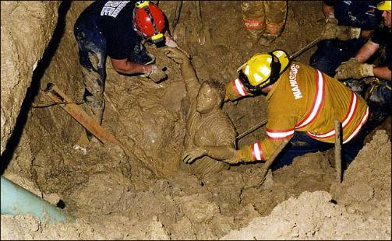
Cave-In Definition
The separation of a mass of soil or rock material from the side of an excavation, or loss of soil from under a trench shield or support system, and its sudden movement into the excavation in quantity that it could entrap, bury, injure, or immobilize a person.
Notes:
This slide defines the term Cave-in – Instructor can reference for later discussion, that soil type affects the failure mode, and it is always changing. Duration of trench exposure, weather, introduction of water, vibration, equipment loading, and excavation spoils can all contribute to cave-ins or collapse.

Slide 14
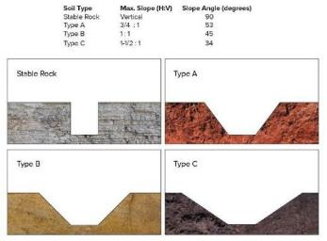
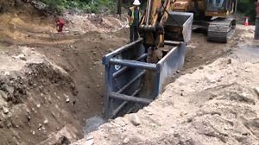
Protective System Definition
A method of protecting employees from cave-ins, from material that could fall or roll from an excavation face or into an excavation, or from the collapse of adjacent structures.
Protective systems include support systems, sloping and benching systems, shield systems, and other systems that provide the necessary protection.
Notes:
This slide defines the term: Protective system

Slide 15
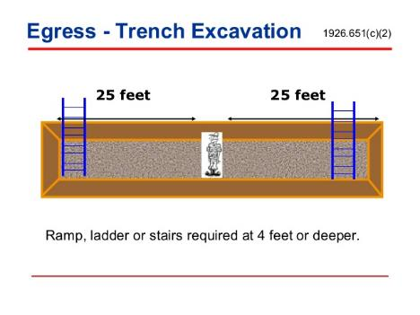
Ramp Definition
An inclined walking or working surface that is used to gain access to one point to another, and is constructed from earth or from structural materials such as steel or wood
Notes:
This slide defines the term: Ramp

Slide 16
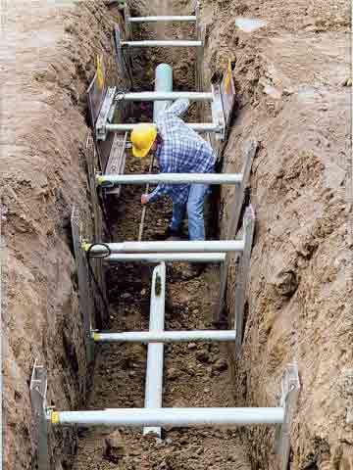
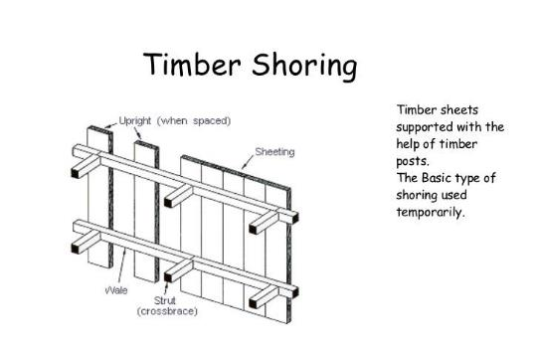
Shoring Definition
A structure such as a metal hydraulic, mechanical, or timber shoring system that supports the sides of an excavation and which is designed to prevent cave-ins.
Notes:
This slide defines the term: Shoring
Instructor should highlight there are different methods and different ways to meet the standard that will be discussed later.

Slide 17

Sloping Definition
A method of protecting employees from cave-ins by excavating to form sides of an excavation that are inclined away from the excavation so as to prevent cave-ins.
The angle of incline required to prevent a cave-in varies with differences in such factors as the soil type, environmental conditions of exposure, and application of surcharge loads.
Notes:
This slide defines the term: Sloping

Slide 18
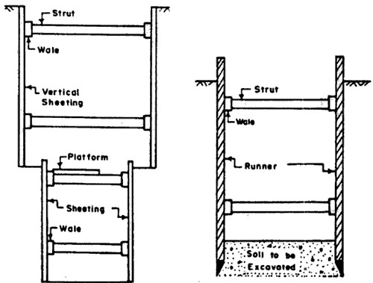
Sheeting Definition
The members of a shoring system that retain the earth in position and in turn are supported by other members of the shoring system.
Notes:
This slide defines the term: Sheeting

Slide 19
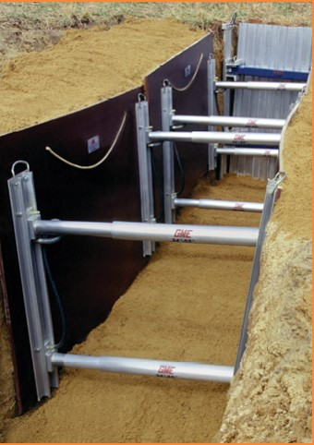
Hydraulic Definition
A pre-engineered shoring system comprised of aluminum hydraulic cylinders (cross-braces) used in conjunction with vertical rails (uprights) or horizontal rails (walers).
Such system is designed, specifically to support the sidewalls of an excavation and prevent cave-ins.
Notes:
This slide defines: Aluminum hydraulic shoring

Slide 20
Cross Brace Definition
The horizontal members of a shoring system installed perpendicular to the sides of the excavation, the ends of which bear against either uprights or wales.
Notes:
This slide defines the term: Cross braces

Slide 21
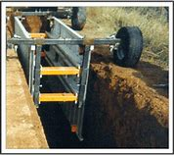
Shield Definition
A structure that is able to withstand the forces imposed on it by a cave-in and thereby protect employees within the structure. Shields can be permanent structures or can be designed to be portable and moved along as work progresses.
Additionally, shields can be either pre-manufactured or job-built in accordance with the rule.
Notes:
This slide defines the term: Shield

Slide 22
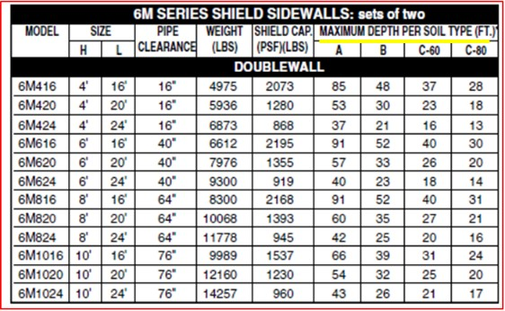
Tabulated Data Definition
According to the OSHA Subpart P - Excavations standard, “tabulated data” means tables and charts approved by a registered professional engineer and used to design and construct a protective system.
Notes:
This slide defines the term: Tabulated data

Slide 23
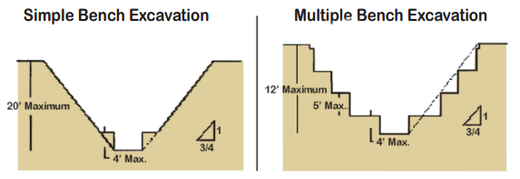
Benching Definition
A method of protecting employees from cave-ins by excavating the sides of an excavation to form one or a series of horizontal levels or steps, usually with vertical or near-vertical surfaces between levels.
Notes:
This slide defines the term: Benching

Slide 24
Competent Person Definition
One who can identify existing or predictable hazards in the surroundings that are unsanitary, hazardous, or dangerous to employees.
Has authorization or authority by the nature of their position to take prompt corrective measures to eliminate them.
The person must be knowledgeable in the requirements of this position.
Notes:
This slide defines the term: Competent person

Slide 25
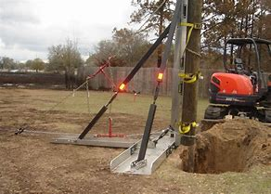
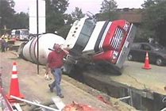
General Protection Requirements 1
Surface encumbrances
You must remove or support surface encumbrances that are located so as to create a hazard to employees, as necessary, to safeguard employees.
Notes:
This includes excavation spoils, equipment, rolling stock, crossover structures and basically anything that could fall into the excavation onto the entrant(s) in the excavation.

Slide 26
General Protection Requirements 2
(2) Underground Installations
You must locate utility installations, such as sewer, telephone, fuel, electric, water lines, or any other underground installations that reasonably may be expected to be encountered during excavation work, prior to opening an excavation.
You must contact utility companies or owners within established or customary local response times, advised of the proposed work, and asked to locate the underground utility installation prior to the start of actual excavation.
Notes:
General protection requirements “Call 811 before you dig”.
The instructor can either poll the participants or reference personal knowledge regarding the accuracy of “locates” which can vary widely. It could also be noted that locates are limited in that they do not provide any useful information on depth and care should be taken.
The instructor should point out that in addition to the locates done by 811, private property locates are the responsibility of the project owner to identify and protect their employees. Handheld locate equipment is available for companies to accomplish this.

Slide 27
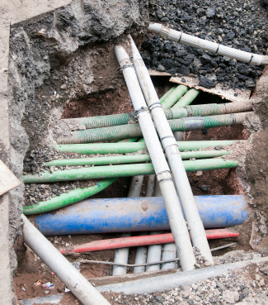
General Protection Requirements 3
(2) Underground installations
(c) When excavation operations approach the location of underground installations, you must determine the exact location of the installations by safe and acceptable means.
(d) While the excavation is open, you must protect underground installations, supported, or removed as necessary to safeguard employees.
Notes:
Appropriate methods for identification and protection of underground installations of utilities are the responsibility of the contractor.

Slide 28
General Protection Requirements 4 1
(3) Access and egress (a) Structural ramps.
Structural ramps that are used solely by employees as a means of access or egress from excavations must be designed by a competent person. Structural ramps used for access or egress of equipment must be designed by a competent person qualified in structural design, and must be constructed in accordance with the design.
(ii) Ramps and runways constructed of two or more structural
members must have the structural members connected together to prevent displacement.
.
Notes:
The instructor should highlight the requirements of this section and emphasize the qualification and knowledge of a “competent person”. Often, this is understood to be the job supervisor or most senior person, but may not be adequate to the requirements of the standard.

Slide 29
General Protection Requirements 5
(3) Access and egress (a) Structural ramps.
(iii) Structural members used for ramps and runways must be of uniform thickness.
(iv) Cleats or other appropriate means used to connect runway structural members must be attached to the bottom of the runway or must be attached in a manner to prevent tripping.
(v) Structural ramps used in lieu of steps must be provided with cleats or other surface treatments on the top surface to prevent slipping.
Notes:
The instructor could highlight this as an example of how the standard can be “specific” to meet the requirements of this requirement properly. If the project owner is unprepared to protect excavations and/or does not have a program in place, employees will use whatever material is at their disposal and could worsen the exposure with materials and bits that are cobbled together. Oversite of these activities fall under the responsibility of the competent person.

Slide 30
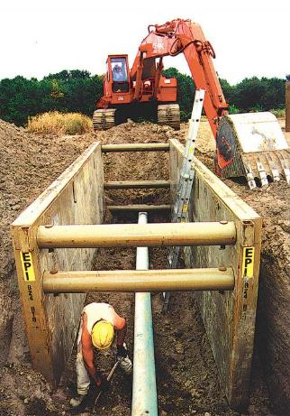
General Protection Requirements 6
(3) Access and egress
(b) Means of egress from trench excavations.
A stairway, ladder, ramp or other safe means of egress must be located in trench excavations that are 4 feet or more in depth so as to require no more than 25 feet of lateral travel for employees.
Notes:
The instructor should highlight the 4’ rule and relate it principally to applications of septic tank excavations and soil log excavations. These types of excavations are the most unmanaged exposures to the workers in our industry.

Slide 31
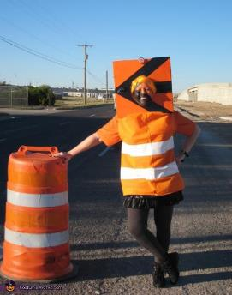
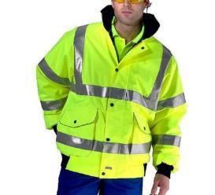
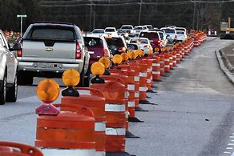
General Protection Requirements 7
(4) Exposure to vehicular traffic
You must provide employees exposed to vehicular traffic with, and they must wear, high-visibility garments meeting the requirements of the rule and general requirements for personal protective equipment (PPE).
Notes:
The instructor may speak to this protection requirement in relationship to companies that do utility work in the right of way and side sewer projects that may need protection under this standard.

Slide 32
General Protection Requirements 9
(5) Exposure to falling loads
You must not permit any employee underneath loads handled by lifting or digging equipment. You must require employees to stand away from any vehicle being loaded or unloaded to avoid being struck by any spillage or falling materials.
Operators may remain in the cabs of vehicles being loaded or unloaded when the vehicles are equipped, in accordance with the rule to provide adequate protection for the operator during loading and unloading operations.
Notes:
The instructor will relate the Case Studies examples of this requirement with backfilling trenches and dump trucks in the normal course of the project workflow. Consideration of the working space for both equipment (digging) and employees in protected areas (trench boxes) should be evaluated by the competent person during work.

Slide 33
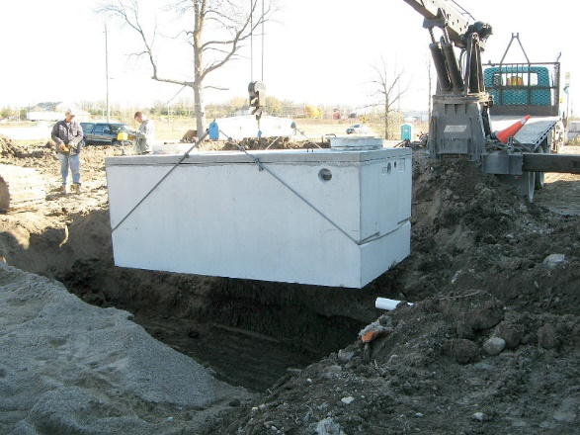
Installation of OSS tank
Notes:
Example of a worker shown installing a septic tank appropriately, standing an appropriate distance away from the edge of the excavation.

Slide 34
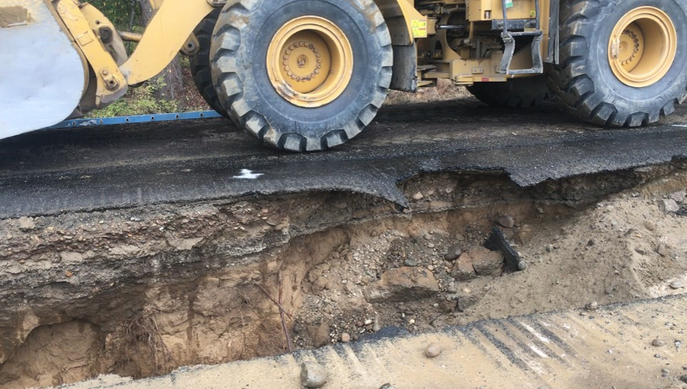
Point loading at edge of excavation
Notes:
Instructor may highlight the weight of the vehicle? What is the square footage (or inches) of weight distribution (point loading) and it’s potential impact on the excavation?
The obvious potential is for further undermining of the road surface and a collapse with equipment and operator in the trench…Possible solutions? Shoring, spotter (this is out of the line of vision of the operator)?
The instructor can use this picture and ask participants, using their handout with the excavation standard to identify the section of the standard that addresses this activity.

Slide 35
General Protection Requirements 10
(6) Warning system for mobile equipment
When mobile equipment is operated adjacent to an excavation, or when such equipment is required to approach the edge of an excavation, and the operator does not have a clear and direct view of the edge of the excavation, you must utilize a warning system such as barricades, hand or mechanical signals, or stop logs.
If possible, the grade should be away from the excavation.
Notes:
The instructor should review these critical points.

Slide 36
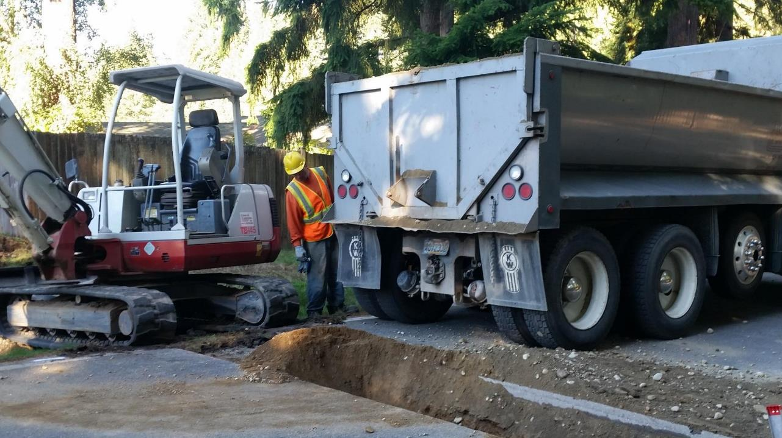
Excavation project
Notes:
Fairly tight working conditions require extra attention from the competent person. Should workers be pulled from the trench if they are just 15-20 feet away, on the right of the picture, or be allowed to continue working if they stay within their protection?

Slide 37
General Protection Requirements 11
(7) Hazardous atmospheres
Testing and controls. In addition to the requirements in the rule to prevent exposure to harmful levels of atmospheric contaminants and to assure acceptable atmospheric conditions, the following requirements apply:
Occupational Health and Environmental Control
Personal Protective & Life Saving Equipment
Fall Protection Requirements for Construction
Notes:
The instructor should review these critical points. Consideration of the operation of generators and equipment exhaust flow placement at a point on the site where it will not accumulate in the excavation.

Slide 38
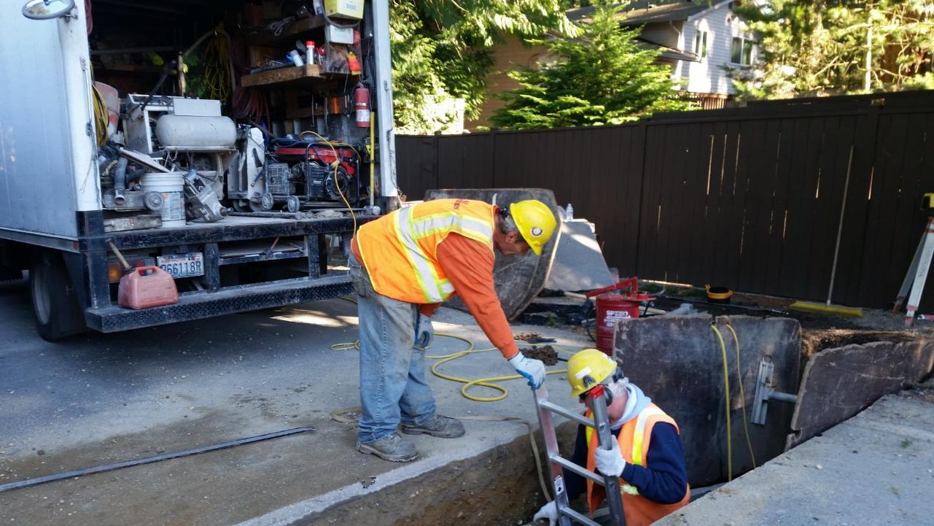
Excavation project 6
Notes:
This is a third party contractor coming to cut the tap into the sewer main. With an electric saw, he backed up his truck to its location and started the gas generator. Exhaust fumes within a few feet of the excavation were excessive. The contractor had plugged his hole saw into a 100’ extension cord.
It would have been a simple matter for the “competent person” to organize to the sub-contractor when he set up, to park an additional 25-30 feet or more away from the trench to minimize or eliminate the potential exposure of exhaust fumes in the trench and mitigate the confined space entry exposure under the rule.

Slide 39
General Protection Requirements 13
(7) Hazardous atmospheres (cont’d)
Testing and controls. In addition to the requirements in the rule to prevent exposure to harmful levels of atmospheric contaminants and to assure acceptable atmospheric conditions, the following requirements apply:
(i) Where oxygen deficiency (atmospheres containing less than 19.5 percent oxygen) or a hazardous atmosphere exists or could reasonably be expected to exist, such as in excavations in landfill areas or excavations in areas where hazardous substances are stored nearby, you must test the atmospheres in the excavation before employees enter excavations greater than 5 feet in depth.
Notes:
The instructor should review the confined space entry and testing requirements and be prepared to relate that standard to construction application or situations to the requirements of the confined space entry standard.

Slide 40
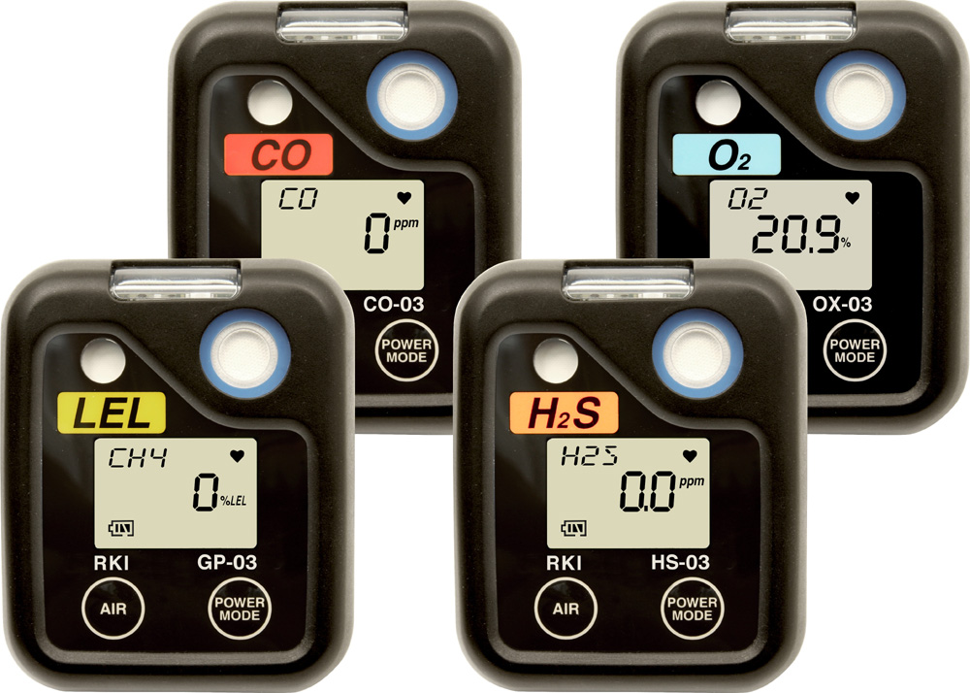
Atmosphere testing equipment
Notes:
There are a variety of monitors on the market. Raise participant awareness to the need to use a device that will monitor the anticipated air quality triggers and gasses (especially sewer gasses). Instructor should also note any additional steps they may want to consider if the equipment is rented vs owned. It will have an impact on employee training/orientation to the equipment and its use.

Slide 41
General Protection Requirements 14
(7) Hazardous atmospheres (cont’d)
(a) Testing and controls. In addition to the requirements set forth in the rule to prevent exposure to harmful levels of atmospheric contaminants and to assure acceptable atmospheric conditions, the following requirements apply:
(ii) You must take adequate precautions to prevent employee exposure to atmospheres containing less than 19.5 percent oxygen and other hazardous atmospheres. These precautions include providing proper respiratory protection or ventilation.
.
Notes:
The instructor should refer to situations similar to needs of confined space entry programs and requirements: Septic Tanks, Pump Trucks, Sewer structures that maintenance is performed, pump chambers, lift stations, but also mention potential situation in excavations that could be impacted by running equipment adjacent to the excavation.

Slide 42
General Protection Requirements 15
(7) Hazardous atmospheres (cont’d)
(b) Emergency rescue equipment.
(i) Emergency rescue equipment, such as breathing apparatus, a safety harness and line, or a basket stretcher, must be readily available where hazardous atmospheric conditions exist or may reasonably be expected to develop during work in an excavation. This equipment must be attended when in use.
Notes:
The instructor should refer to situations similar to the needs of confined space entry programs and requirements. Explain the difference between self rescue capability and the advantages of having an actual rescue plan in place. Highlight that 911 as a “rescue plan” is generally unacceptable unless specific steps with the 911 responder (interview for capability and availability) must be documented to the employer’s plan.
Raise awareness to the commonality of rural work settings, working alone, volunteer fire responses and a general reliability issue of cell phone coverage in rural areas.

Slide 43
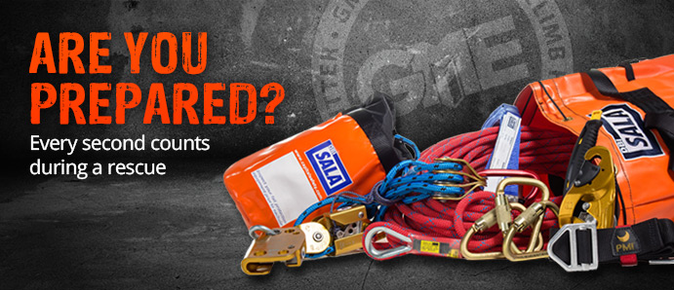
Minimum equipment
Notes:
Transitional slide for discussion. What equipment would be most useful. Does it change depending on the scope (size) of the project. Is the project only done during daylight? Only done at night? Weather and seasonal considerations should also be anticipated.

Slide 44
General Protection Requirements
(7) Hazardous atmospheres (cont’d)
(a) Testing and controls. In addition to the requirements set forth in the rule to prevent exposure to harmful levels of atmospheric contaminants and to assure acceptable atmospheric conditions, the following requirements apply:
(iii) You must take adequate precaution such as providing ventilation, to prevent employee exposure to an atmosphere containing a concentration of a flammable gas in excess of 10 percent of the lower flammable limit of the gas.
(iv) When controls are used that are intended to reduce the level of atmospheric contaminants to acceptable levels, you must conduct testing as often as necessary to ensure that the atmosphere remains safe.
Notes:
The instructor to refer to situations similar to the needs of confined space entry programs and requirements….including (iii) supplied air.

Slide 45
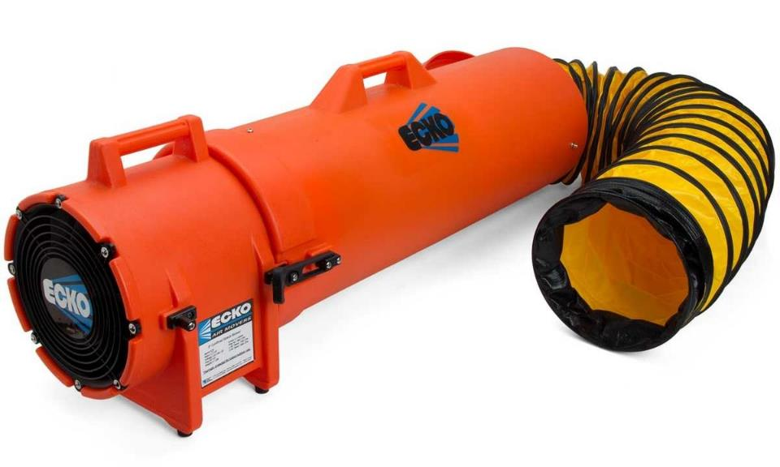
Mechanical air supply
Notes:
Example of equipment typically used to supply air into a space that needs confined space atmosphere controls.

Slide 46
General Protection Requirements 16
(8) Protection from hazards associated with water accumulation.
(a) Employees must not work in excavations in which there is accumulated water, or in excavations in which water is accumulating, unless adequate precautions have been taken to protect employees against the hazards posed by water accumulation.
The precautions necessary to protect employees adequately vary with each situation, but could include special support or shield systems to protect from cave-ins, water removal to control the level of accumulating water, or use of a safety harness and lifeline.
Notes:
The instructor should emphasize the involvement of decision making with the competent person on site.

Slide 47
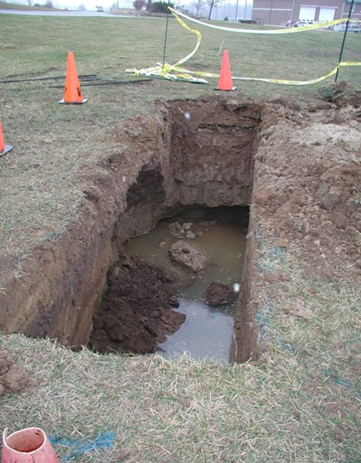
Water accumulation in excavation
Notes:
Soil stability changes dramatically with the addition of water: Rain, surface runoff, and subsurface should be considered.

Slide 48
General Protection Requirements 17
(8) Protection from hazards associated with water accumulation – cont’d
(b) If water is controlled or prevented from accumulating by the use of water removal equipment, the water removal equipment and operations must be monitored by a competent person to ensure proper operation.
(c) If excavation work interrupts the natural drainage of surface water (such as streams), you must use diversion ditches, dikes, or other suitable means to prevent surface water from entering the excavation and to provide adequate drainage of the area adjacent to the excavation. Excavations subject to runoff from heavy rains will require an inspection by a competent person and compliance with this subsection.
Notes:
The instructor should emphasize the involvement of decision making with the competent person on site.

Slide 49
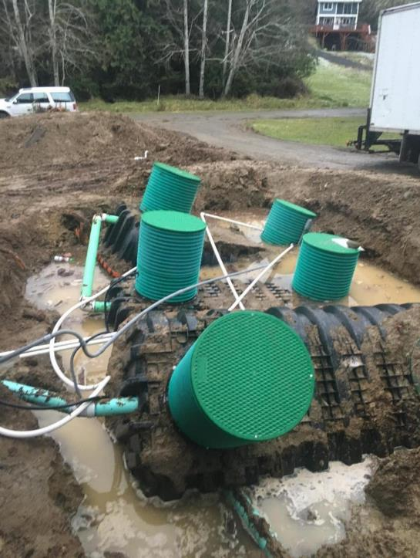
Floated tanks in a repair situation
Notes:
In repair situations, an exposure like this includes poor footing, access to cut the tankage apart so it can be taken out and falling into the excavation. Dewatering should be a consideration at a minimum, but the presenter can use this as a topic to raise awareness to the exposure associated with water accumulation and invite the participants into discussion to assess hazard recognition.

Slide 50
General Protection Requirements 18
(9) Stability of adjacent structures
(a) Where the stability of adjoining buildings, walls, or other structures is endangered by excavation operations, you must provide support systems such as shoring, bracing, or underpinning to ensure the stability of such structures for the protection of employees.
Notes:
The instructor should emphasize the involvement of decision making with the competent person on site. Focus would principally be on side sewer scope of work projects.

Slide 51
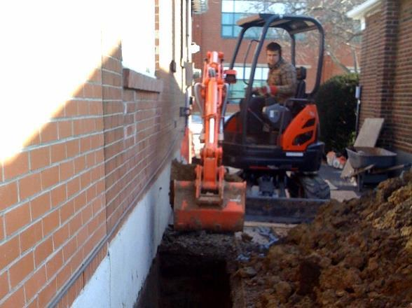
Tight working conditions
Notes:
Tight working conditions, make this challenging. Added to the exposure, the potential of cracked or weakened concrete walls, presents an additional hazard from falling or collapsing material. If someone is in the excavation while the operator is digging, a wrong move could put the bucket into the wall causing a collapse.

Slide 52
General Protection Requirements 19
(9) Stability of adjacent structures – cont’d
(b) You must not permit excavation below the level of the base or footing of any foundation or retaining wall that could be reasonably expected to pose a hazard to employees except when:
(i) A support system, such as underpinning, is provided to ensure the safety of employees and the stability of the structure; or
(ii) The excavation is in stable rock; or
(iii) A registered professional engineer has approved the determination that the structure is sufficiently removed from the excavation so as to be unaffected by the excavation activity; or
(iv) A registered professional engineer has approved the determination that such excavation work will not pose a hazard to employees.
Notes:
The instructor should emphasize the involvement of decision making with the competent person on site. This discussion can also include the idea that the competent person may need an additional consult from a licensed professional engineer to support a decision.

Slide 53
General Protection Requirements 20
(9) Stability of adjacent structures – cont’d
(c) Sidewalks, pavements, and appurtenant structure must not be undermined unless a support system or another method of protection is provided to protect employees from the possible collapse of such structures.
Notes:
The instructor should emphasize the involvement of decision making with the competent person on site. This discussion can also include the idea that the competent person may need an additional consult from a licensed professional engineer to support a decision.

Slide 54
General Protection Requirements 21
(10) Protection of employees from loose rock or soil.
You must provide adequate protection to protect employees from loose rock or soil that could pose a hazard by falling or rolling from an excavation face.
Such protection must consist of scaling to remove loose material; installation of protective barricades at intervals as necessary on the face to stop and contain falling material; or other means that provide equivalent protection.
Notes:
The instructor should emphasize the involvement of decision making with the competent person on site. This discussion can also include the idea that the competent person may need an additional consult from a licensed professional engineer to support a decision.

Slide 55
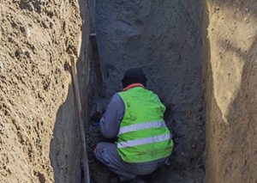
Worker in bottom of excavation
Notes:
In addition to the obvious exposures, the instructor can also use this slide to highlight the worker kneeling down in the excavation. If the excavation is under the minimum, there is provision in rule for the employer to consider the need for protection. The worker here still has 3-4 feet of soil above him when he is kneeling or laying down in the excavation.

Slide 56
General Protection Requirements 22
(10) Protection of employees from loose rock or soil.
(b) You must protect employees from excavated or other materials or equipment that could pose a hazard by falling or rolling into excavations.
Protection must be provided by placing and keeping such materials or equipment at least two feet from the edge of excavations, or by the use of retaining devices that are sufficient to prevent materials or equipment from falling or rolling into excavations, or by a combination of both if necessary.
Notes:
The instructor should emphasize the responsibility of the competent person monitoring the excavation and that the 2’ setback is a “minimum”, and refer to examples provided in the Case Studies.

Slide 57
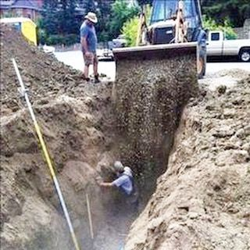
How does this happen?
Notes:
Instructor discussion to identify the obvious hazards with the participants. Ask participants for their opinion as to how decision making led to this situation being a reality.

Slide 58
General Protection Requirements 23
(11) Inspections
(a) Daily inspections of excavations, the adjacent areas, and protective systems must be made by a competent person for evidence of a situation that could result in possible cave-ins, indications of failure of protective systems, hazardous atmospheres, or other hazardous conditions.
An inspection must be conducted by the competent person prior to the start of work and as needed throughout the shift.
Inspections must also be made after every rainstorm or other hazard increasing occurrence. These inspections are only required when employee exposure can be reasonably anticipated.
Notes:
The instructor should emphasize the involvement and process of the results of the inspection and follow on decision making with the competent person on site. This discussion can point out that verification may include a visual inspection and possible soil inspection, but at least two methods would be used.

Slide 59
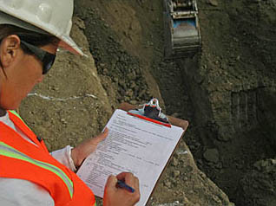
Daily inspections and records
Notes:
Note documentation requirements. Highlight that the employer/competent person will be more consistent in the daily inspections if there is a requirement for supporting documentation.

Slide 60
General Protection Requirements 24
(11) Inspections - cont’d
(b) Where the competent person finds evidence of a situation that could result in a possible cave-in, indications of failure of protective systems, hazardous atmospheres, or other hazardous conditions, you must remove exposed employees from the hazardous area until the necessary precautions have been taken to ensure their safety.
Notes:
The instructor should emphasize the involvement of decision making with the competent person on site and that the competent person should have an appropriate level of authority up to and including work stoppage until the exposure is addressed.

Slide 61
General Protection Requirements 25
(12) Fall protection
You must provide walkways where employees or equipment are required or permitted to cross over excavations.
You must provide adequate barrier physical protection at all remotely located excavations.
You must barricade or cover all wells, pits, shafts, etc. Upon completion of exploration and similar operations, you must backfill temporary wells, pits, shafts, etc.
Notes:
The instructor should review/comment on to raise awareness to the requirement, but note that scenario (a) would be uncommon in the industry. Local or state requirements of soil test pits and items (b) and (c) above have more relevance for the rural nature of septic system installation.

Slide 62
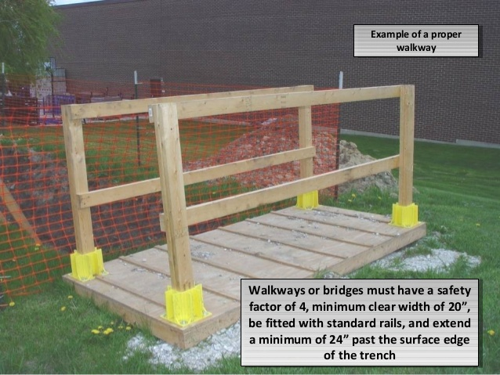
Example of Walkway
Notes:
Review and discuss the requirements of constructed walkways built on site.
Fall protection
You must provide walkways where employees or equipment are required or permitted to cross over excavations.

Slide 63
Requirements for Protective Systems 1
Protection of employees in excavations.
(a) You must protect each employee in an excavation from cave-ins by an adequate protective system designed in accordance with the rule except when:
(i) Excavations are made entirely in stable rock; or
(ii) Excavations are less than 4 feet in depth and examination of the ground by a competent person provides no indication of a potential cave-in.
(b) Protective systems must have the capacity to resist without failure all loads that are intended or could reasonably be expected to be applied or transmitted to the system.
Notes:
This slide identifies the exceptions under rule (a) (i) is less likely a consideration for septic systems, due to design requirements requiring a soil component, but could be a potential factor when doing side sewer or utility work.

Slide 64
Requirements for Protective Systems 2
(2) Design of sloping and benching systems.
The slopes and configurations of sloping and benching systems must be selected and constructed by the employer or employer's designee and must be in accordance with the requirements of subdivision (a); or, in the alternative, subdivision (b); or, in the alternative, subdivision (c); or, in the alternative, subdivision (d), as follows:
Notes:
The instructor should principally focus on the fact that 95% or greater of the work done with septic system or side sewer work is typically 20’ or less.

Slide 65
Requirements for Protective Systems 3
(2) Design of sloping and benching systems.
4 options:
Option 1—Allowable configurations and slopes.
Excavations must be sloped at an angle not steeper than 1 1/2 horizontal to one vertical (34 degrees measured from the horizontal), unless the employer uses one of the other options listed below.
Slopes specified in item (i) of this subdivision, must be excavated to form configurations that are in accordance with the slopes shown for Type C soil in Appendix B to this part.
Notes:
The instructor should principally focus on the fact that 95% or greater of the work done with septic system or side sewer work is typically 20’ or less.

Slide 66
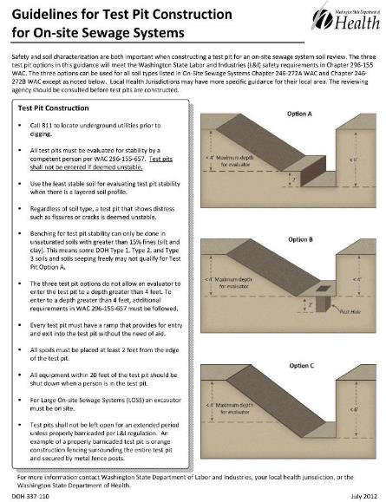
Soil Test Pit Configurations 1
All test pits must be evaluated for
stability by a competent.
Test pits shall not be entered if deemed unstable.
Use the least stable soil for
evaluating test pit stability when
there is a layered soil profile.
Regardless of soil type, a test pit that
shows distress such as fissures or
cracks is deemed unstable.
Notes:
The instructor should review the following with participants: Key questions with consideration of current practice from industry. The lack of understanding of the standard and the negative impact of a properly dug excavation on the drainfield component. Site limiting conditions (small lots and repair scenario’s) would also raise debate on an inability to construct a soil test pit to the standard.
Responses would be to seek alternatives to identifying soil characteristics with other means.
Nationally, digging soil log test pits is not universal. If auger hole (called “perk holes”) are used locally where the training occurs, these slides can be passed over.

Slide 67
Soil Test Pit Configurations 2
Every test pit must have a ramp
that:
Provides for entry and exit into
the test pit without the need of
aid.
All spoils must be placed at least 2 feet from the edge of the test pit.
All equipment within 20 feet of
the test pit should be shut down
when a person is in the test pit.
Notes:
The instructor should review the following with participants: Key questions with consideration of current practice from industry. The lack of understanding of the standard and the negative impact of a properly dug excavation on the drainfield component. Site limiting conditions (small lots and repair scenario’s) would also raise debate on an inability to construct a soil test pit to the standard.
Responses would be to seek alternatives to identifying soil characteristics with other means.
Nationally, digging soil log test pits is not universal. If auger hole (called “perk holes”) are used locally where the training occurs, these slides can be passed over.

Slide 68
Soil Test Pit Configurations 3
CAUTION
Test pits shall not be left open for an extended period unless properly barricaded per L&I
regulation.
An example of a properly barricaded test pit is:
Orange construction fencing
surrounding the entire test pit
and secured by metal fence
posts.
Notes:
The instructor should review the following with participants: Key questions with consideration of current practice from industry. The lack of understanding of the standard and the negative impact of a properly dug excavation on the drainfield component. Site limiting conditions (small lots and repair scenario’s) would also raise debate on an inability to construct a soil test pit to the standard.
Responses would be to seek alternatives to identifying soil characteristics with other means.
Nationally, digging soil log test pits is not universal. If auger hole (called “perk holes”) are used locally where the training occurs, these slides can be passed over.

Slide 69
Requirements for Protective Systems 4
(2) Design of sloping and benching systems.
(b) Option 2—Determination of slopes and configurations using Appendices A and B.
Maximum allowable slopes, and allowable configurations for sloping and benching systems, must be determined in accordance with the conditions and requirements set forth in appendices A and B to this part.
Notes:
The instructor will principally focus on the fact that 95% or greater of the work done with OSS or side sewer work is typically 20’ or less.

Slide 70
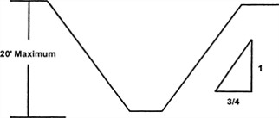
Slope Configurations for Type A Soil
Notes:
Typical slope angles. Instructor should introduce and note the soil type “A” is a limitation. In most of the septic and side sewer work, type B or C soils are more common and slope angles will be less.

Slide 71
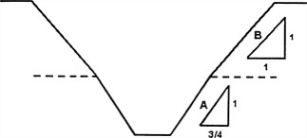
When There Are Two distinct layers
Notes:
This slide can be used to raises awareness to different soil configurations that the competent person needs to be able to recognize and plan for.

Slide 72
Requirements for Protective Systems 5
(2) Design of sloping and benching systems.
(c) Option 3—Designs using other tabulated data.
(i) Designs of sloping or benching systems must be selected from and be in accordance with tabulated data, such as tables and charts.
(ii) The tabulated data must be in written form and must include all of the following:
(A) Identification of the parameters that affect the selection of a sloping or benching system drawn from such data;
(B) Identification of the limits of use of the data, to include the magnitude and configuration of slopes determined to be safe;
Notes:
Review key points on slide including the program administrative requirements listed in the content of the slide.

Slide 73
Requirements for Protective Systems 6
(2) Design of sloping and benching systems.
(C) Explanatory information as may be necessary to aid the user in making a correct selection of a protective system from the data.
(iii) You must maintain at least one copy of the tabulated data which identifies the registered professional engineer who approved the data at the job site during construction of the protective system.
After that time the data may be stored off the job site, but you must make a copy of the data available to the director upon request.
Notes:
Review key points on slide including the program administrative requirements listed in the content of the slide.

Slide 74
Requirements for Protective Systems 7
(2) Design of sloping and benching systems.
(d) Option 4—Design by a registered professional engineer.
Sloping and benching systems not utilizing Option 1 or Option 2 or Option 3 under subsection (2) of this section must be approved by a registered professional engineer.
(ii) Designs must be in written form and must include at least the following:
(A) The magnitude of the slopes that were determined to be safe for the particular project;
Notes:
Review key points on slide including the program administrative requirements listed in the content of the slide.

Slide 75
Requirements for Protective Systems 8
(2) Design of sloping and benching systems.
(d) Option 4—Design by a registered professional engineer.
(ii) Designs must be in written form and must include at least the following:
(C) The identity of the registered professional engineer approving the design.
(iii) You must maintain at least one copy of the design at the job site while the slope is being constructed. After that time the design need not be at the job site, but you must maintain a copy available upon request.
Notes:
Review key points on slide including the program administrative requirements listed in the content of the slide.

Slide 76
Requirements for Protective Systems 9
(3) Design of support systems, shield systems, and other protective systems.
Designs of support systems, shield systems, and other protective systems must be selected and constructed by the employer or employer's designee and must be in accordance with the requirements of subdivision (a); or, in the alternative, subdivision (b); or, in the alternative, subdivision (c); or, in the alternative, subdivision (d) as follows:
Notes:
The instructor will principally focus on the fact that 95% or greater of the work done with septic or side sewer work is typically 20’ or less.

Slide 77
Requirements for Protective Systems 10
(3) Design of support systems, shield systems, and other protective systems.
Option 1—Designs using appendices A, C, and D. Designs for timber shoring in trenches must be determined in accordance with the conditions and requirements set forth in appendices A and C.
Designs for aluminum hydraulic shoring must be in accordance with subdivision (b) of this subsection, but if manufacturer's tabulated data cannot be utilized, designs must be in accordance with appendix D.
Notes:
Review key points on slide, the instructor should either reference availability of these appendices or have them available as a handout.

Slide 78
Requirements for Protective Systems 11
(3) Design of support systems, shield systems, and other protective systems.
(b) Option 2—Designs using manufacturer's tabulated data.
Design of support systems, shield systems, or other protective systems that are drawn from manufacturer's tabulated data must be in accordance with all specifications, recommendations, and limitations issued or made by the manufacturer.
Deviation from the specifications, recommendations, and limitations issued or made by the manufacturer must only be allowed after the manufacturer issues specific written approval.
Notes:
Review key points on slide including the program administrative requirements listed in the content of the slide.

Slide 79
Requirements for Protective Systems 12
(3) Design of support systems, shield systems, and other protective systems.
(b) Option 2—Designs using manufacturer's tabulated data.
(iii) Manufacturer's specifications, recommendations, and limitations, and manufacturer's approval to deviate from the specifications, recommendations, and limitations must be in written form at the job site during construction of the protective system.
After that time this data may be stored off the job site, but you must make a copy available to the director upon request.
Notes:
Review key points on slide including the program administrative requirements listed in the content of the slide.

Slide 80
Requirements for Protective Systems 13
(3) Design of support systems, shield systems, and other protective systems.
(c) Option 3—Designs using other tabulated data.
Designs of support systems, shield systems, or other protective systems must be selected from and be in accordance with tabulated data, such as tables and charts.
(ii) The tabulated data must be in written form and include all of the following:
(A) Identification of the parameters that affect the selection of a protective system drawn from such data;
Notes:
Review key points on the slide.

Slide 81
Requirements for Protective Systems 14
(3) Design of support systems, shield systems, and other protective systems.
(c) Option 3—Designs using other tabulated data.
(B) Identification of the limits of use of the data;
(C) Explanatory information as may be necessary to aid the user in making a correct selection of a protective system from the data.
(iii) You must maintain at least one copy of the tabulated data, which identifies the registered professional engineer who approved the data at the job site during construction of the protective system. After that time the data may be stored off the job site, but you must make a copy of the data available to the director upon request.
Notes:
Review key points on slide including the program administrative requirements listed in the content of the slide.

Slide 82
Requirements for Protective Systems 15
(3) Design of support systems, shield systems, and other protective systems.
(d) Option 4—Design by a registered professional engineer.
Support systems, shield systems, and other protective systems not utilizing Option 1, Option 2 or Option 3, above, must be approved by a registered professional engineer.
(ii) Designs must be in written form and must include the following:
(A) A plan indicating the sizes, types, and configurations of the materials to be used in the protective system; and
Notes:
Review key points on slide including the program administrative requirements listed in the content of the slide.

Slide 83
Requirements for Protective Systems 16
(3) Design of support systems, shield systems, and other protective systems.
(d) Option 4—Design by a registered professional engineer.
(B) The identity of the registered professional engineer approving the design.
(iii) You must maintain at least one copy of the design at the job site during construction of the protective system.
After that time, the design may be stored off the job site, but you must maintain a copy of the design available to the director upon request.
Notes:
Review key points on slide including the program administrative requirements listed in the content of the slide.

Slide 84
Requirements for Protective Systems 17
(4) Materials and equipment.
Materials and equipment used for protective systems must be free from damage or defects that might impair their proper function.
You must use and maintain manufactured materials and equipment used for protective systems in a manner that is consistent with the recommendations of the manufacturer, and in a manner that will prevent employee exposure to hazards.
.
Notes:
Review key points on slide including the program administrative requirements listed in the content of the slide.

Slide 85
Requirements for Protective Systems 18
(4) Materials and equipment.
(c) When material or equipment that is used for protective systems is damaged, a competent person must examine the material or equipment and evaluate its suitability for continued use.
If the competent person cannot assure the material or equipment is able to support the intended loads or is otherwise suitable for safe use, then you must remove such material or equipment from service, and it must be evaluated and approved by a registered professional engineer before being returned to service.
Notes:
Review key points on slide including the program administrative requirements listed in the content of the slide.

Slide 86
Requirements for Protective Systems 19
(5) Installation and removal of support.
General.
Members of support systems must be securely connected together to prevent sliding, falling, kick-outs, or other predictable failure.
You must install and remove support systems in a manner that protects employees from cave-ins, structural collapses, or from being struck by members of the support system.
Notes:
Review key points on slide including the program administrative requirements listed in the content of the slide.

Slide 87
Requirements for Protective Systems 20
(5) Installation and removal of support.
(a) General.
(iii) You must not subject individual members of support systems to loads exceeding those which those members were designed to withstand.
(iv) Before temporary removal of individual members begins, you must take additional precautions to ensure the safety of employees, such as installing other structural members to carry the loads imposed on the support system.
Notes:
Review key points on slide including the program administrative requirements listed in the content of the slide.

Slide 88
Requirements for Protective Systems 21
(5) Installation and removal of support.
(a) General.
(v) Removal must begin at, and progress from, the bottom of the excavation. You must release members slowly so as to note any indication of possible failure of the remaining members of the structure or possible cave-in of the sides of the excavation.
(vi) Backfilling must progress together with the removal of support systems from excavations.
Notes:
Review key points on slide including the program administrative requirements listed in the content of the slide.

Slide 89
Requirements for Protective Systems 22
(6) Sloping and benching systems.
You must not permit employees to work on the faces of sloped or benched excavations at levels above other employees except when employees at the lower levels are adequately protected from the hazard of falling, rolling, or sliding material or equipment
Notes:
Review key points on slide including the program administrative requirements listed in the content of the slide.

Slide 90
Requirements for Protective Systems 23
(7) Shield systems
General.
You must not subject shield systems to loads exceeding those which the system was designed to withstand.
You must install shields in a manner to restrict lateral or other hazardous movement of the shield in the event of the application of sudden lateral loads.
You must protect employees from the hazard of cave-ins when entering or exiting the areas protected by shields.
You must not allow employees in shields when shields are being installed, removed, or moved vertically.
Notes:
Review key points on slide including the program administrative requirements listed in the content of the slide.

Slide 91
Requirements for Protective Systems 24
(7) Shield systems.
(b) Additional requirement for shield systems used in trench excavations.
Excavations of earth material to a level not greater than two feet below the bottom of a shield is permitted, but only if the shield is designed to resist the forces calculated for the full depth of the trench, and there are no indications while the trench is open of a possible loss of soil from behind or below the bottom of the shield.
Notes:
Review key points on slide including the program administrative requirements listed in the content of the slide.

Slide 92
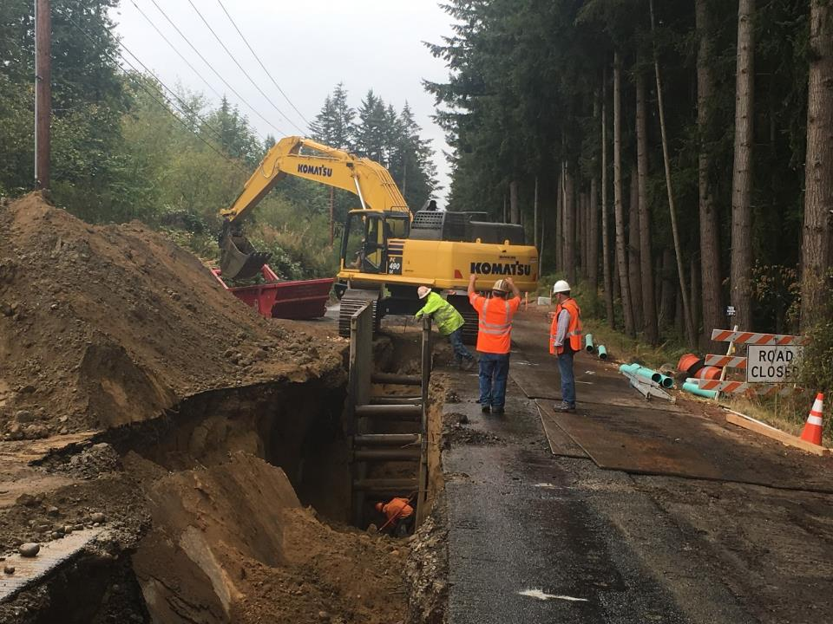
Utility project
Notes:
Very tight working conditions: Single length, double stack trench boxes with worker in the trench box. You can see the worker has placed a shovel at the back of the box to give him a physical warning of the limits. The competent person is monitoring, but the rule says egress must be provided. The instructor should point out in this slide: “Where is the ladder?” You can see it on the right hand side of the picture laying on the ground. The discussion can expand with a question to the group about “why is the ladder not in place?” “ What could be a solution?” The depth of the excavation and the limited reach of the equipment barely allows the worker to be in the trench. The solution would have been to double the length of the protection by adding two more boxes.

Slide 93
Competent Person
Employer Requirements: Every excavation must have a “Competent Person”
“One who can identify existing or predictable hazards in the surroundings that are unsanitary, hazardous, or dangerous to employees. Also has authorization or authority by the nature of their position to take prompt corrective measures to eliminate them. The person must be knowledgeable in the requirements of this part.”
Notes:
Review this definition of “competent person”. Key points are their ability to recognize hazards, authority to do something to mitigate them and understands the application of the rule to do so responsibly.

Slide 94
Competent Person Responsibilities 1
Responsibilities include:
Understand the standards and rule
Conduct tests for Soil Classification
Determine proper protective system
Recognize and reclassify soil when conditions change
Monitor and inspect protective systems for damage and take it out of use if it becomes inadequate for protection
Notes:
Review key points on the slide.

Slide 95
Competent Person Responsibilities 2
Responsibilities include:
Evaluate site conditions and conduct air tests for hazardous atmosphere if needed
Design of structural ramps within the scope of rule
Locate underground installations and utilities
Monitor water removal equipment and operation if used and when in use
Perform and document daily inspections
Notes:
Review key points on the slide. This area of responsibility is often not well defined, documented or enforced by small business employers.

Slide 96
Classifying Soils 1
It is important to correctly classify soil type before selecting and using a protective system.
In order to classify soil, at least one visual test and one manual test are required to determine if the soil is Type A, Type B, or Type C.
Generally, as soon as a Type A soil is disturbed, it must be down graded to a Type B.
NOTE: If you designate the soil as Type C, no testing is required.
Notes:
Review key points on the slide. The instructor should highlight the differences between soil classification under the OSHA Excavation and Trench Safety standards are a different scheme than that of OSS design soil classification methods for application loading rates. While the two overlap, they are inherently different. The competent person onsite should be trained to understand the variation in standards of application and how they relate to each other.

Slide 97
Classifying Soils 2
Cohesive Soil
A-soils - Hard, very stiff like frozen “playdough”
B-soils - Medium, stiff like cold “playdough”
C-soils– Soft like warm “playdough”
Granular Soil
C-soils – Very loose
C-soils – Loose
C-soils – Medium loose
C-soils – Medium
B – Dense (hardpan or cementation)
Notes:
Review key points on the slide, if possible the instructor should provide some basic examples of soils for a more hands on approach to soil texturing.

Slide 98

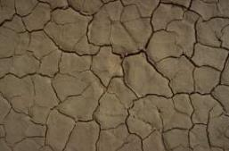
Soil Classification 1
Type A
Fine grained
Doesn’t crumble
Hard to break up when dry
Examples:
Clay
Hardpan
Silty or sandy clay, clay loam
Clay Loam
Clay
As more organic matter, silt and sand (together known as loam) gets mixed in and as the grains get larger, the classification will be degraded to type B. As the mix has less and less clay and organic matter in it becoming closer to pure sand or gravel it is further degraded to Type C.
Notes:
Review key points on the slide, if possible the instructor should provide some basic examples of soils for a more hands on approach to soil texturing.

Slide 99
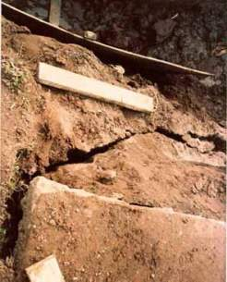
Soil Classification
Type A
Even if soil has high clay content and is plastic when moist, it cannot be classified as “Type A” if it is:
fissured,
has been previously disturbed, or
subject to vibration from heavy traffic, etc.
This soil is fissured changing the classification from A to B
Clues for previously disturbed soil: soil discoloration, lack of vegetation, you dig and discover pipes or something else. If the work orders are specific to replacing existing pipes---this is a heads up that you are dealing with previously disturbed soil.
Notes:
Review key points on the slide, if possible the instructor should provide some basic examples of soils for a more hands on approach to soil texturing.

Slide 100
Classifying Soils 3
Type B: Cohesive soil with a moderate compressive strength (0.5 tsf but less than 1.5 tsf).
Silt, silty clay, sandy clay, clay loam, silt loam, sandy loam, angular gravel (similar to crushed rock), any previously disturbed fissured or soil or subject to vibration are type B.
Previously disturbed
Meets Type A, but has been previously disturbed
Dry Rock that is not stable
Some situations when the material is part of a sloped, layered systems where the layers dip into the excavation
Notes:
Review key points on the slide, if possible the instructor should provide some basic examples of soils for a more hands on approach to soil texturing.

Slide 101
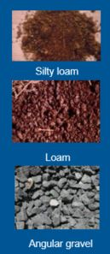
Soil Classification 2
Type B
Granular: coarse grains
Little or no clay content
Crumbles easily when dry
Examples:
Silt-fine mineral particles in size between clay and sand
Loam-from fragments of rock deposits in water
Angular gravel-crushed rock-the angular nature of the individual rocks provides some resistance to movement
Notes:
Review key points on the slide, if possible the instructor should provide some basic examples of soils for a more hands on approach to soil texturing.

Slide 102
Classifying Soils 3a
Type C: Cohesive soil with a low compressive strength (less than .05 tsf) such as: granular soils including gravel, sand, and loamy sand or submerged soil or rock that is not stable or soil from which water is freely seeping
Can be cut to near vertical sidewalls and will stand unsupported long enough to allow shoring and shielding to be properly installed.
The competent person must monitor the excavation for signs of deterioration indicated by freely seeping water or flowing soil into the excavation
Notes:
Review key points on the slide, if possible the instructor should provide some basic examples of soils for a more hands on approach to soil texturing.

Slide 103



Soil Classification 4
Type C
Granular soil: very coarse
Minimal cohesion
Examples:
Sand
Gravel
Loamy sand
Submerged soil or soil with freely seeping water
Submerged rock that is not stable.
Sand
Gravel
Loamy sand
Notes:
Review key points on the slide, if possible the instructor should provide some basic examples of soils for a more hands on approach to soil texturing.

Slide 104
Classifying Soils- Manual Tests
Plasticity
Ribbon test: Cohesive material can be rolled into threads without crumbling.
If at least a two inch length of 1/8 inch thread can be held on one end without tearing, the soil is “Cohesive”.
Notes:
Review key points on the slide, if possible the instructor should provide some basic examples relative to the area that the training is being taught.

Slide 105
Other Soil Considerations 1
Moisture Content
Freezing
Previous Disturbance (Fill)
Surcharge loads
Spoil Piles
Equipment
Structures
Notes:
Review key points on the slide, if possible the instructor should provide some basic examples relative to the area that the training is being taught.

Slide 106
Other Soil Considerations 2
Vibration
Liquefaction
Duration of Exposure
Undermining
Notes:
Review key points on the slide, if possible the instructor should provide some basic examples relative to the area that the training is being taught.

Slide 107
Other Soil Considerations 3
Moisture Content
Freezing
Previous Disturbance (fill)
Factors affecting downward force:
Gravity, Surcharge loads, Spoil piles, Equipment
1000 lbs
2’
5’
2’
Notes:
Review key points on the slide, if possible the instructor should provide some basic examples relative to the area that the training is being taught. Highlight the “weight” of the relatively small amount of soil by volume that it takes to cover a person. Even if a persons head and face are free, they may still asphyxiate from the weight on their chest.

Slide 108
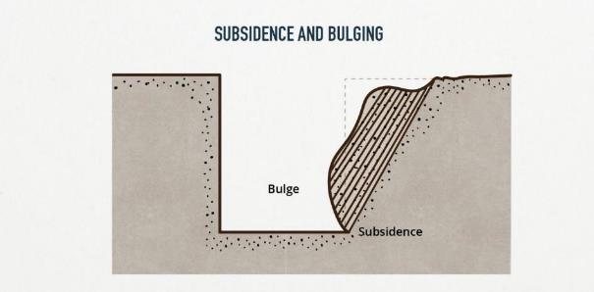

Soil Failure Modes 1
Notes:
Review key points on the slide, if possible the instructor can ask for feedback from the participants on failure modes that they have experienced and any contributors: rain, weather, vibration, etc.

Slide 109


Soil Failure Modes 2
Notes:
Review key points on the slide, if possible the instructor can ask for feedback from the participants on failure modes that they have experienced and any contributors: rain, weather, vibration, etc.

Slide 110
Classifying Soils- Manual Tests 2
Dry strength:
If the soil is dry and crumbles on its own or with moderate pressure into individual grains or fine powder, it is “granular”.
If dry and falls into clumps which break into smaller clumps which only break down with difficulty, it may be clay in any combination with sand, gravel or silt.
If the clumps have no visual indication of fissures, then it may be considered “unfissured”.
Notes:
Review key points on the slide, if possible the instructor should provide some basic examples of soils for a more hands on approach to soil texturing.

Slide 111

Classifying Soils- Manual Tests 3
Penetrometer
1.5 = A
1.0 = B
.05 = C
Notes:
Review key points on the slide, if possible the instructor should have equipment available to pass around to the class participants.

Slide 112

Classifying Soils- Manual Tests 4
Thumb Penetration Test
Dent-able (Dry Wall) = Type A
Push to the bottom of the nail = Type B
Unrestricted penetration (sand) = C
You can also use a
“Ribbon” test and a
“Thread” Test
Notes:
Review key points on the slide, if possible the instructor should provide some basic examples of soils for a more hands on approach to soil texturing.

Slide 113
Types of Protection Systems
Your Choices are:
Sloping and Benching
Shoring System
Timber, Aluminum-Hydraulic
Shield System
- Steel Shield Box, Aluminum Box
Notes:
The instructor should outline the choices and differences. Discussion with the participants for common use, experience can be reviewed.

Slide 114
What are the protective system requirements?
Use protective systems when there is potential for cave-in for Class A, B, and C soils:
Under 4’ deep if a potential for a cave-in exists
4’ to 20’ deep
Sloping or Benching (benching is not an option in C soil)
Shield or Shoring
Over 20’ deep - protective system must be designed by Registered Professional Engineer or approved in manufacturer’s tabulated data
Protective system is not required for stable rock
Notes:
The instructor should outline the choices and differences. Discussion with the participants for common use, experience can be reviewed.

Slide 115

Sloping
Sloping is the process of removing soil to eliminate the chance of a cave in.
The required maximum allowable slope is determined by the class of soil.
The requirements are as follows:
- For each foot of trench depth, the ratio of slope measured from the trench edge at ground height must be:
Soil Type A – ¾ to 1 (53°)
Soil Type B – 1 to 1 (45°)
Soil Type C – 1 ½ to 1 (34°)
Notes:
The instructor should outline the key points and differences. Discussion with the participants for common use, experience can be reviewed.

Slide 116

Shoring
Shoring is one of the most common used methods of worker protection. It is light-weight, portable and easy to install.
The manufacturer provides tabulated data with the shoring that provides the limitations, precautions, required spacing and proper use.
This photo shows an example of aluminum hydraulic shoring.
Notes:
The instructor should introduce and review various options. This is a good opportunity to draw the class into a deeper experience in the application of tabulated data and how it is used.

Slide 117

Shields
Shields are manufactured by a number of companies and are designed to protect workers working within the confines of the shield.
Check tabulated data for the maximum allowable depth it can be used. The tabulated data must accompany the shield when it is being used.
Additionally, the shield must be designed by a Registered Professional Engineer, be in good condition, and used properly.
Notes:
The instructor should review key points on slide. The instructor should also note that while many small business rely on the company they rent this equipment from, it is critical to provide the company renting the equipment with as much information as possible. It is also the employer’s responsibility to ensure that the calculations or selections of protective equipment should be reviewed by the business owner to ensure its suitability for the work.

Slide 118
RPE-Designed Protective System
A Registered Professional Engineer can design a protection system for use on a specific project.
The system must be used as designed by the RPE.
Even with an RPE, the Competent Person must still perform daily inspections checking site conditions and any change.
Notes:
Explain the elements and responsibilities of the RPE.

Slide 119





Other Shoring Method Examples
Must be designed by a registered professional engineer regardless of depth
Notes:
The instructor should provide examples. Depending on the training environment and participants, pictures in this slide can be substituted with examples that have more relevance to the group.

Slide 120

What makes trenches hazardous?
The factors shown in this illustration can create deadly conditions for workers.
The spoils pile and the equipment being too close to the vertical walls of the trench are called “surcharge loads” which increase the likelihood of collapse.
Additionally, equipment vibration, adverse weather conditions and ground water can change the condition and classification of the soil.
A “Competent Person” must take all of these factors into consideration and re-evaluate the jobsite periodically.
Notes:
In a work setting, discuss how both an individual event can increase risk but coupling combined impacts (vibration and three days of rain)…can exacerbate the risk potential.

Slide 121

Example of a Hazardous Trench
This trench is well over 4’ deep, cut into loose sand (class C soil), that is sloughing off the trench walls. The spoils pile is a surcharged load.
The shear weight of the spoils not being set at least 2 feet back from the vertical face increases the likelihood of a cave-in and it adds to the depth of the trench.
If the trench is 8’ deep and the spoils pile is 8’ high directly at the edge, the trench is now 16’ deep!
Notes:
Instructor should point out that situational awareness is very low. The lack of perceived risk by the workers can be worse than the actual risk. Ask participants to identify key exposures.

Slide 122

Hazardous Trench Example (con’t.)
The weight & vibration of the track-hoe also increases the probability of a collapse.
The employees working in the trench are exposed to:
- overhead hazards (no hard hats), and
- trench collapse without a protective system
It does not appear that safe access or egress has been provided.*
*A stairway, ramp, ladder or other safe means of egress must be located so workers don’t have to travel more than 25 feet laterally in the trench.
Notes:
Review the risk enhancements and discuss with the group potential remedies.

Slide 123

Another hazardous trench example
Nearby heavy equipment and the spoils pile directly on the right edge of the excavation both create a surcharge load. The protective system in this photo does not extend far enough up the trench to provide adequate protection for the two workers in the trench.
Notes:
Review the risk enhancements and discuss with the group potential remedies.

Slide 124
Process for Safe Trench Work 1
Identify knowledgeable competent person
Check and verify above and below ground utility locations, any adjacent structures or surface encumbrances, and water table
Determine soil classification through testing
Choose the correct protective system for soil type
Notes:
Review elements of the slide. The instructor can do Q&A with the group to anchor process controls as checklists so things are not forgotten.

Slide 125
Process for Safe Trench Work 2
Verify protective system installation and set-up
Provide safe access
Comply with requirements specified in the Excavation, Trenching, and Shoring regulations
Conduct daily inspections prior to the start of work, after any weather event, and as needed
Notes:
Review elements of the slide. The instructor can do Q&A with the group to anchor process controls as checklists so things are not forgotten.

Slide 126



First: you must locate utilities before digging!
Go to:
www.callbeforeyoudig.org or
Call 1-800-425-5555
It’s Free!
Notes:
The instructor should review the use of 811, but also to provide a context for the accuracy of the utility ID. It is commonly wrong or missed to a high unreliability. Beware!

Slide 127
Underground Installations (utilities)
You are required to to call for utility locates and once the locates have been identified onsite, the employer must do an exact locate as specified by rule.
“When excavation operations approach the location of underground installations, the exact location of the installations shall be determined by safe and acceptable means.”
Why do you need to do exact utility locates?
Because they are rarely spot-on, and older installations may not show up on current utility maps.
Notes:
Discuss the learning points on the slide, ask participants for examples.

Slide 128

Controlling heavy vehicle surcharge loads
What does the 45-degree angle represent?
It represents the zone of influence or affected area. In other words, it represents the shear plane (weakest area), at which the excavation or trench wall will fail, and that is why it should always be kept clear of heavy equipment or machinery, and the spoils pile, unless the trench can be properly shored.
Notes:
The instructor can provide relational discussions depending on the audience, but an easy visualization would be to replace the trucks with excavation equipment.

Slide 129

Controlling water accumulation
Water accumulation in a trench is hazardous because it erodes and changes soil; which means the stability of the soil is likely weakened.
Prevent water accumulation by using sump pumps, or create diversion ditches and dikes for natural drainage of streams interrupted by the excavation or in anticipation of heavy rainwater runoff, or consult with an RPE.
Notes:
This slide shows how water impact to an excavation can take you from a 6 to a 10 (increased risk) in very short order. Ask participants to share stories if they have them.

Slide 130

Water Accumulation Control Systems
Water accumulation hazards should be prevented by either using a special support or shield systems designed for water drainage issues, and use of a safety harness and lifeline by workers inside excavation.
Water controlled through the use of pumps must be monitored by a competent person to ensure proper operation.
Diversion ditches, dikes, can be used to prevent surface water or rainwater from entering and accumulating in the excavation.
A water control system that got out of hand!
Notes:
There is the rule applied and real life. The instructor should engage the participants with their stories.

Slide 131

Provide safe entry and exit 1
A means of egress is required to be within 25’ of lateral travel.
The most common method for access is a straight ladder or an extension ladder.
If a ladder is used, it must extend a minimum of 3’ above the landing. The use of step ladders is not permitted.
Other means could be a stairway or ramps or other means as designed by a RPE.
Notes:
It is not uncommon for this element to be missed or ignored. Examples of this are highlighted in case study slides.

Slide 132

Provide safe entry and exit 2
Buckets of excavators, backhoes, etc.
are not to be used as a means of egress.
Notes:
The instructor should point out that this is unsafe, but not uncommon.

Slide 133

Worker in tank excavation
Notes:
Typical excavation for a replacement Septic Tank. Typical workflow of minimizing the potential for cracking the bottom of the tank when it is being set in place is to place and rake pea gravel into the excavation. Instructor can open discussion on risk awareness or risk acceptance.

Slide 134


Solutions
Notes:
Instructor to lead discussion. Key point not often considered by workers is there a way to do the job differently to “eliminate” rather than just mitigate the risk?

Slide 135

Workers in deep OSS install doing a repair
Notes:
Deep installation of tanks can present a hazard when standard O&M work is being done. Instructor to ask participants to identify the exposures.
In addition to the practical application of hazard recognition, these discussions also provide feedback to the instructor on comprehension and retention of material by participants.

Slide 136

Workers in OSS installation
Notes:
The slide shows a deep installation of a septic tank. Shown are very dangerous conditions both from excavation collapse as well as unstable equipment potential. The follow on story here is that the project owners representative was onsite during this operation. The instructor should engage the class on responsibility and liability. Should the project owners representative have ordered a stop to the work?
Let the class work through a discussion to see if they come up with the correct action.
Which would be for the project owner to immediately advise the competent person of the unsafe condition, and report the situation to the general contractor’s representative to the owner.

Slide 137

Workers in OSS installation 2
Notes:
Deep installation of tanks can present a hazard when standard O&M work is being done. Instructor to ask participants to identify the exposures.
In addition to the practical application of hazard recognition, these discussions also provide feedback to the instructor on comprehension and retention of material by participants.

Slide 138

Utility project 1
Notes:
Introduction of Case Study:
Deep installation (22’) of a sewer line 2.100 feet long. The instructor should ask participants to identify exposures that will need to be managed (power line, etc). The underlying soil in the excavation is pure sand to 25’ plus, and unstable due to recent rain activity as well as the basic nature of the soil.

Slide 139

Utility project 2
Notes:
Deep installation (22’) of a sewer line 2.100 feet long showing lots of equipment on site, ground is sand as deep as you can dig and impacted by water/rainfall due to the time of year. How would the class rate this soil profile based on what they see?

Slide 140

Utility project 3
Notes:
Deep installation (22’) of a sewer line 2.100 feet long showing lots of equipment on site, ground is sand as deep as you can dig and impacted slightly by water/rainfall due to time of year. Excavation collapse is severe and continuous. Spoils are not adequately set back from excavation and was caused by operating limits on equipment adjacent to the power lines.

Slide 141
Utility project 4
Notes:
Very tight working conditions: Single length, double stack with worker in the trench box. You can see he has placed a shovel at the back of the box to give him a physical warning of the limits. The competent person is monitoring, but the rule says egress must be provided. The instructor should point out in this slide: “Where is the ladder?” You can see it on the right hand side of the picture laying on the ground.

Slide 142

Utility project 5
Notes:
Intermittent rain and weather the previous several days contribute to worsening the ongoing and continual collapse of material into the excavation. Instructor should engage participants for observations or solutions.

Slide 143

Utility project 7
Notes:
The ladder from the previous picture now is absent all together. The depth of the excavation and limit of the reach of the equipment make for very tight working conditions. The entrant in the bottom of the trench must communicate with the surface, who then communicates with the equipment operator. What are the exposures? How can they be remedied?

Slide 144

Utility project 8
Notes:
Preparations are being made to move the boxes forward along the excavation progression. Instructor can ask “if the box is only being moved horizontally and not vertically, can the worker stay inside the trench box?

Slide 145

Utility project 9
Notes:
This slide is showing the ladder being made available to the worker, but the ladder was taken in and out of the excavation when the employee was working.

Slide 146

Excavation Project 11
Notes:
Additional equipment is being put into service as barrier protection for additional wall collapse.

Slide 147

Utility project 12
Notes:
New case study:
This is not the same project in the previous case study picture, but an example of competent person site management with a third party delivery and dumping of material for backfill. The driver had delivered approximately 3 or 4 loads progressively along the excavation that was at the bottom of a slight slope and did not see that the slope angle had modestly changed, when the dump was raised, the trucks center of gravity shifted, spilling the load. Under other circumstances, the material had the potential to spill into the excavation where workers were.

Slide 148

Utility project 13
Notes:
New Case Stud: This slide shows a residential side sewer job. The pavement has been cut, and the sewer line installation will run from right (of picture) to left.

Slide 149


Utility project 14
Notes:
This slide is showing work on the site, trench box and equipment used for placement, backfilling, additional protection above the trench box to protect the worker.

Slide 150

Utility project 15
Notes:
The site is well organized (housekeeping).

Slide 151

Utility project 16
Notes:
A closer look at the sidewall of the trench excavation (8’ deep). Instructor can discuss soil type, change over time, if wet, if raining, etc.

Slide 152


Type C ?? How does the competent person make the decision? In a trench like we do for soil determination for Soil application loading rates?
Notes:
Although the side walls of the excavation appear stable, once disturbed it is more like gravelly sand. The side walls of the trench once exposed to the air will begin to deteriorate. The competent person should evaluate and classify the soil using both visual and physical testing of the soil with samples taken from the spoil pile.

Slide 153

Excavation project 17
Notes:
Because they did not set the choker chain correctly to pick and place the box, the worker climbed down to unhook chains, exposing himself to falls and struck-by exposures in the excavation that was not yet ready for workers, rescue etc.

Slide 154

Excavation project 18
“Situational Awareness and Personal Safety”
Worker Close to Edge
Working Equipment
8’ Fall
Toes!
Notes:
This slide shows a worker’s situational awareness when placing the box (toes).

Slide 155

Excavation project 19
Notes:
This slide shows a trench box placed and the vertical height of the box is too short. Under the rule, adjustments to protect the workers below must be made.

Slide 156

Excavation project 20
Notes:
This and the next several slides show how to combine protection to make it effective.
The presenter should also point out the need to ensure that the wood used to provide protection is determined from the tabulated data.

Slide 157

Excavation project 22
Notes:
This and the next several slides show how to combine protection to make it effective.

Slide 158

Excavation project 23
Notes:
This and the next several slides show how to combine protection to make it effective. However, the instructor should begin to raise awareness to the lack of protection for the workers in the excavation of the end of the trench seen in the picture.
Workers will be sitting on the ground, and core drilling into the sewer pipe at the toe of the footwall. No protection is provided to the end of the trench.
The instructor should point out this deficiency and ask the class to work through a solution.

Slide 159

Excavation project 24
Notes:
This slide highlights that while most aspects of excavation safety are being addressed, not all are being met. The ladder needs to extend a minimum distance outside the excavation to specifically avoid these kind of entry and exit issues.
Instructor can ask the participants what the minimum is (3 feet).

Slide 160

Excavation project 25
Notes:
Workers are in the protection of the box but will be doing a principle task in tapping and connecting to the sewer main with no protection from the ends of the excavation.

Slide 161

Excavation project 26
Notes:
Workers in the protection of the trench boxes still have some exposure to material from the end of the trench face. The instructor should engage the class participants in what remedial action they would recommend to correct the exposure.

Slide 162

Excavation project 27
Notes:
After the hole is cut, the worker has to extend outside of the protection to accomplish the next step in the project exposing himself. The instructor should emphasize that this is a rule violation.

Slide 163


Excavation project 28
Notes:
This slide shows the depth of the trench and insufficient ladder length for the job. Should they stop work? Should the competent person stop work and address the issue?

Slide 164


Excavation project 29
Notes:
There is not enough protection for the job. Why didn’t they move the box? The slide shows the project supervisor outside the protection when the pipe is being laid and extended. The worker inside the trench box is safe, but has only been on the job for two months. What example is being set by the supervisor?

Slide 165
Most Common Trenching Violations
No cave-in protective system being used when required by soil classification, depth, and code
Excessive surcharge load (spoils piles too close to excavation wall or equipment or traffic too close to excavation operations)
No access/egress for excavations 4 feet or more in depth
No competent person/and requirements
Notes:
The instructor should review the points on the slide of the most common trenching violations.

Slide 166
An Employer only working in an unprotected excavation/trench can be cited by DOSH
If the employer is working in the trench alone (no employees in the trench) without using a protective system, the employer can be cited since, in the event of a cave-in, you are exposing every employee to cave-in hazards if they jump into the excavation to attempt rescue.
Notes:
In the on-site industry, there are many small business that are “sole” proprietors. This information address a commonly asked question regarding application of the rule.

Slide 167
More information and training
“Excavations: Hazard Recognition in Trenching and Shoring”
OSHA.gov
Check with your state LNI if you have an OSHA State approved plan
Notes:
This slide provides additional reference material.

Slide 168
Summary 1
Build your Team…Hazard Recognition Training
Employee’s should know enough to keep themselves out of trouble.
Can they recognize and avoid entering unsafe excavations (depth/no shoring) and if in, know to get out if conditions change?
Notes:
This slide provides additional reference material.

Slide 169
Summary 2
Know the danger signs…
Bulges in the walls of an excavation
Cracks running parallel to the edge
Loose material or debris that may fall in from the walls
Vibration Hazards
Undermined structures, equipment or utility poles
Spoil pile or other heavy surcharge affecting conditions
Water entering and accumulating in the excavation
Parallel or crossing utilities exposed by the excavation
Notes:
This slide provides additional reference material.

Slide 170
Questions?
If you have more questions on trenching and excavation:
Call your local Labor and Industries office and ask to speak to a safety consultant.
Notes:
Wrap up

Slide 171

Final slide
Notes:
This slide shows a generic picture of an excavation collapse. There were decent conditions, dry, spoils well set back from edge, no equipment. Having an understanding of the soil profile changes when exposed to air over time is a critical tool for the competent person to understand.

