Slide 1
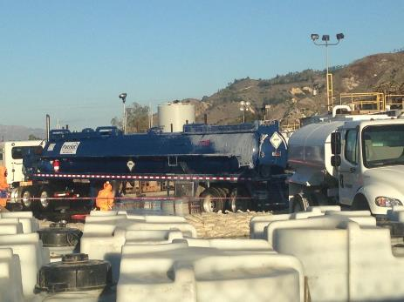
Global harmonization system & overview of Chemical hazards in the oil & Gas industry
This material was produced under grant number SH-31238-SH7 from the Occupational Safety and Health Administration, US Department of labor. It does not necessarily reflect the views or policies of the US Department labor, nor does mention of trade names, commercial products, or organizations imply endorsement by the US Government.

Slide 2

Training pre-assessment
How much do you already know about chemical hazards?
True or False:
Hazard communication programs tell you about chemical hazards in your workplace.
Hazard communication only tells you about health hazards for a chemical.
GHS is a system for classifying & labeling chemicals.
What are the ways a chemical can enter your body?

Slide 3
Overview of Chemical Hazards

Slide 4

Chemical Hazard communication
Hazcom is a company-specific program
Tells employees about:
Workplace chemical hazards in their work areas
Effects of chemicals
How to protect yourself
Source: Globally Harmonized system of Classification and Labelling of Chemicals. Available at: https://en.wikipedia.org/wiki/GHS_hazard_pictograms

Slide 5

Health Hazards
Any chemical that can do harm to your body
Most industrial/commercial chemicals can harm you, depends on
How much gets into your body (dose)
How the chemical enters the body (pathway)
Physical form of the chemical (state of matter)
How toxic the chemical is (poisonous)
Toxicity
Dose

Slide 6
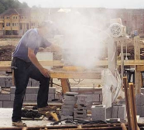
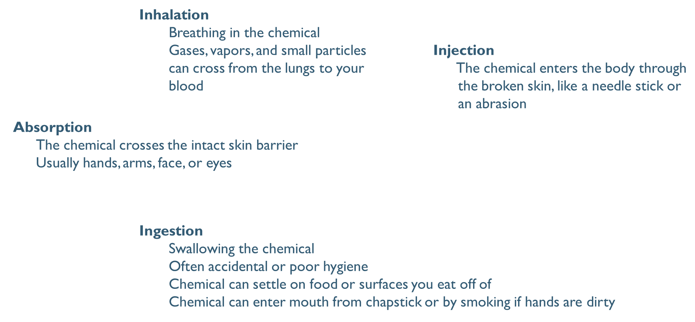

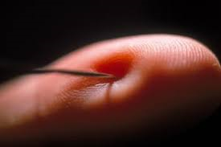

How chemicals can enter the body

Slide 7
Chemical Toxicity
Dose
The seriousness of the effect depends on how much gets into the body
Acute toxicity
The chemical causes effects quickly with/after exposure
Chronic toxicity
The chemical causes effects after repeated or long-term exposure
Target
The chemical can cause effects in the whole body or to a specific organ or system
Kidney, liver, brain, heart, lungs, & circulatory system

Slide 8

Types of toxicity
Carcinogen
Chemicals that are known or suspected to cause cancer
Mutagenicity
Chemicals that cause changes in genes
Can lead to cancer or genetic changes could be passed onto children
Reproductive toxicity
Chemicals can affect fertility and/or harm developing babies and can lead to birth defects or death
Sensitizers
With repeated exposure smaller amounts can cause a reaction and the reaction can become more serious, possibly producing allergic type reaction
Target organ toxicity
Chemical causes damage to a specific organ or system in the body

Slide 9
Question / Response 1
Question / Response 1
Which of the following does not effect how hazardous a chemical is:
How much gets into your body (dose)
How the chemical enters your body (pathway)
Color of the chemical (appearance)
How toxic the chemical is (poisonous)
10

Slide 10
Answer 1

Slide 11


physical Hazards – corrosives
Can cause burns and/or irritation
Skin
Eyes
Lungs & respiratory tract if inhaled
Seriousness of burn depends on
Time exposed
Concentration of chemical
Can breakdown storage container if stored
incorrectly

Slide 12

physical Hazards – Flammables & Explosives
Chemicals that can burn or explode
Concentration must be in explosive range
Above the Lower Explosive Limit (LEL — too lean to burn)
Below the Upper Explosive Limit (UEL — too rich to burn)
Be aware that in rich atmospheres, incomplete ventilation may result in lowering the flammable concentration to the explosive range
Explosive Range (5-17%)
0%
100%
Non-Explosive (too rich)
LEL
UEL
Non-Explosive (too lean)

Slide 13
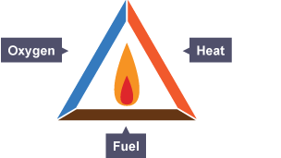


physical Hazards – oxidizers
Chemicals that increase flammability or explosiveness of other chemicals
Produce or release oxygen
May or may not be flammable/explosive themselves, but greatly accelerate the flammability or explosiveness of another substance
Ignition
Oxygen
Dispersion
Confinement
Fuel

Slide 14

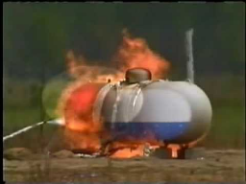
Physical Form of chemical
Effects on health & physical hazards
How chemical enters body
How chemical reacts with itself & its surroundings
Solid
Can be broken down into dusts
Can form fumes or fibers when heated or abraded
Liquid
Can be broken down into vapors, fogs, and mists
Gas
In gaseous state naturally or upon application of heat
and/or pressure

Slide 15
Question / Response 2
Question / Response 2
Based on the chart shown for natural gas (methane), will it explode if the concentration in air is 50%?
Yes
No
Explosive Range (5-17%)
0%
100%
Non-Explosive (too rich)
LEL
UEL
10
Non-Explosive (too lean)

Slide 16
Answer 2

Slide 17
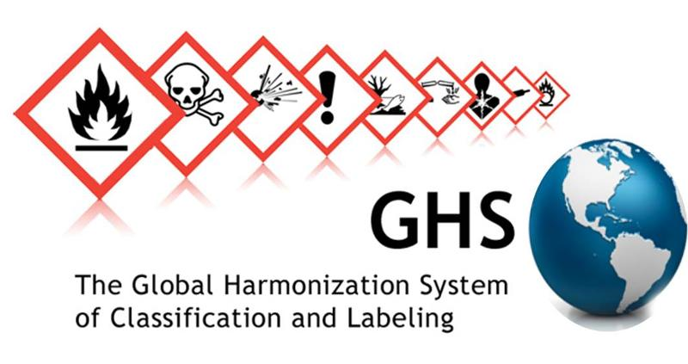
Global Harmonization System

Slide 18



What is GHS
Globally Harmonized System of Classification & Labeling of Chemicals
Communicates
Health hazards
Physical hazards
Environmental hazards
Requirements for
Product label
Product Safety Data Sheet (SDS)
Worker training

Slide 19
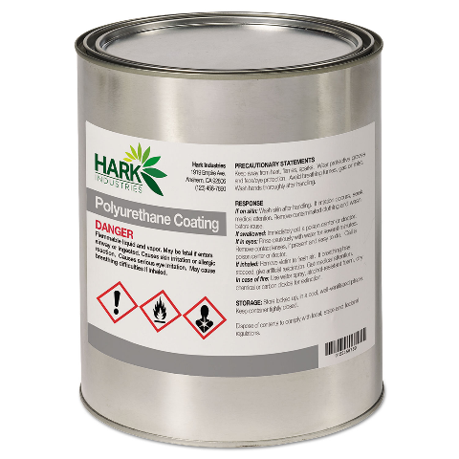
Product Label: Required elements
Name or product identifier
Signal word
Danger or Warning
Hazard statement
Pictogram(s)
Precautionary statement
Contact information of manufacturer
Name, address, telephone

Slide 20
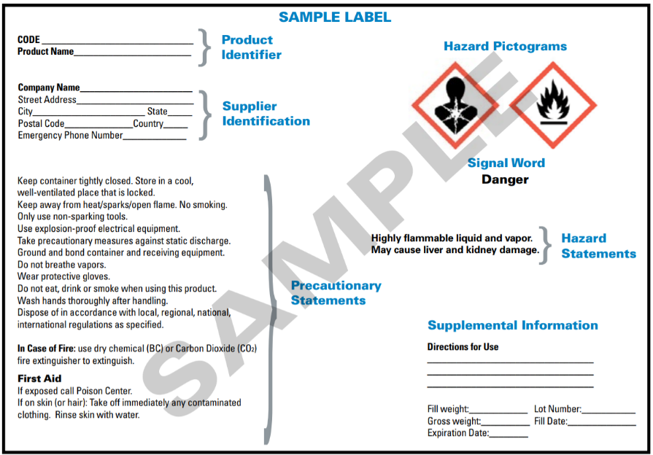
Sample Label

Slide 21


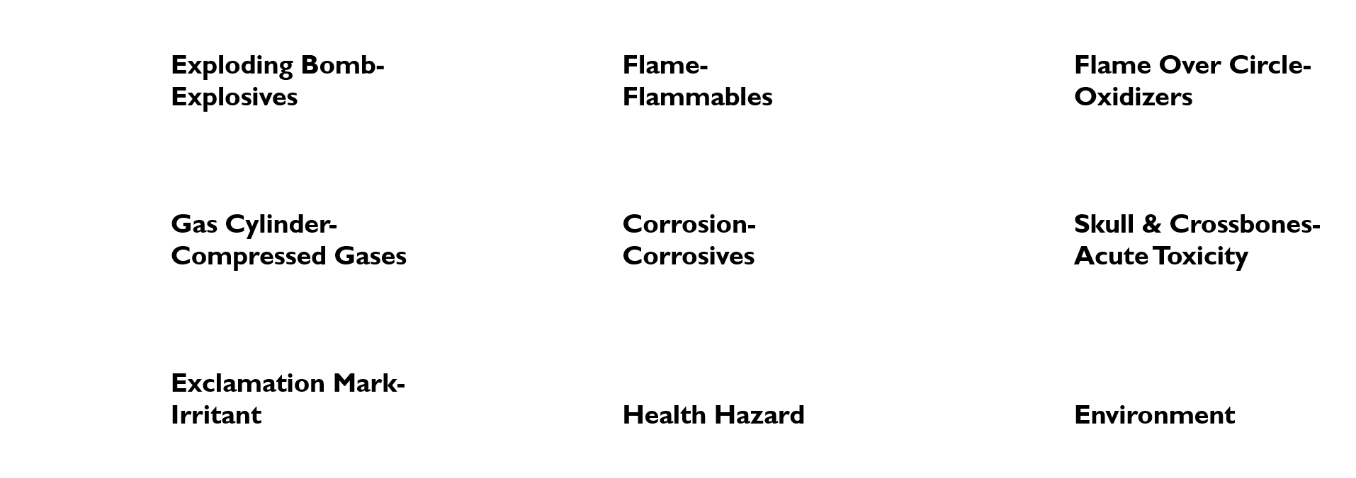






pictograms

Slide 22
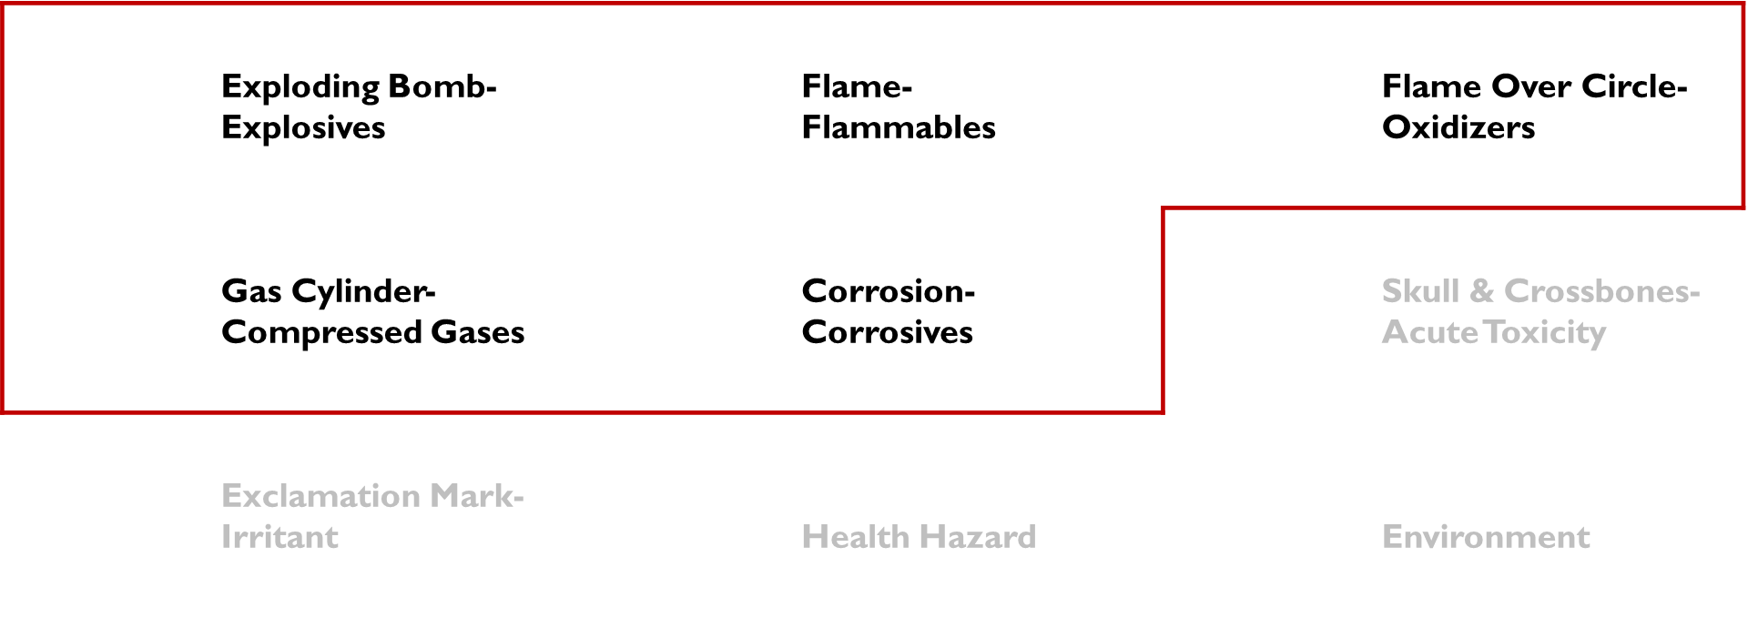
Pictograms (Cont.)
PHYSICAL HAZARDS

Slide 23

Pictograms (Cont.)

Slide 24
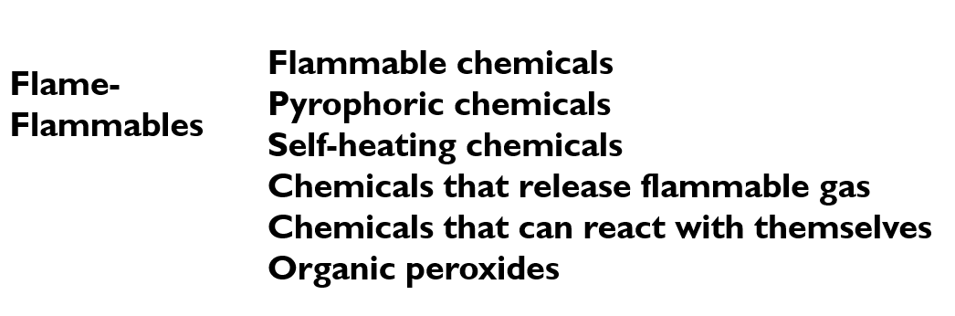
Pictograms (Cont.)

Slide 25

Pictograms (Cont.)

Slide 26
Pictograms (Cont.)

Slide 27
Pictograms (Cont.)

Slide 28
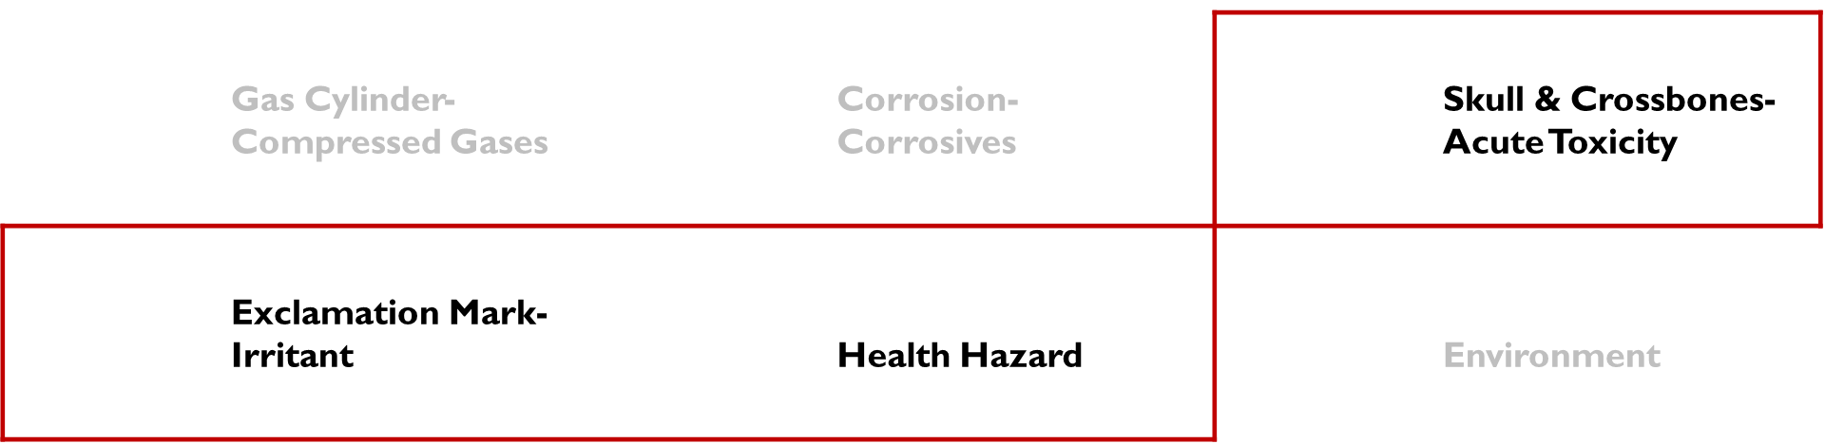
Pictograms (Cont.)
HEALTH HAZARDS

Slide 29
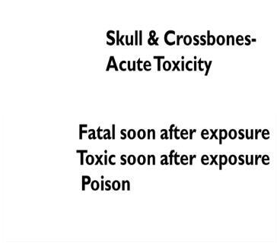
Pictograms (Cont.)

Slide 30

Pictograms (Cont.)

Slide 31

Pictograms (Cont.)

Slide 32

Pictograms (Cont.)

Slide 33

14
Question / Response 3
Which of the following pictograms means health hazard?
A
B
C
D
10

Slide 34
Answer 3

Slide 35


signal word
Only one signal word on label
Picked based upon the most serious hazard
Danger
More serious hazards
Warning
Less serious hazards

Slide 36
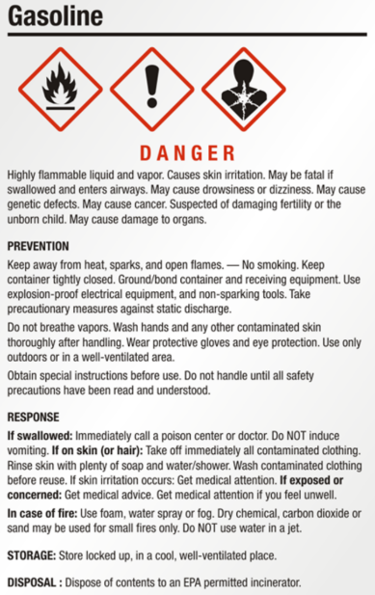
statements
Hazard Statement(s)
Type of hazard from chemical
Level of hazard
Precautionary Statement(s)
Prevention
Ways to minimize exposure
Ways to minimize hazards
Response
Spills, first-aid
Storage
Disposal

Slide 37
Product Safety Data Sheets (SDS) Required & optional sections
Identification
Hazard identification
Information on ingredients
First-aid measures
Fire-fighting measures
Accidental release measures
Handling & storage
Exposure controls/Personal protection
Physical & chemical properties
Stability & reactivity
Toxicological information
Ecological information (Optional)
Disposal considerations (Optional)
Transport information (Optional)
Regulatory information (Optional)
Other information

Slide 38
How can you use an SDS?
Ingredients: Section 3
What chemicals are in the product
How much of each chemical is there
Chemical Hazards: Section 2
Hazards associated with the chemical(s)
Safe Handling of Chemicals: Sections 7-8
What Personal Protective Equipment (PPE) you should wear
Other instructions on how to protect yourself

Slide 39
Question
Which of the following pieces of information are found in an SDS?
Ingredients
Chemical hazards
Safe handling of chemicals
First-aid measures
All of the above

Slide 40
Question / Response 4
Question / Response 4
Which of the following pieces of information are found in an SDS?
Ingredients
Chemical hazards
Safe handling of chemicals
First-aid measures
All of the above
10

Slide 41
Answer 4

Slide 42
Chemical hazards & GHS in oil & Gas

Slide 43
types of Hazardous chemicals in oil & Gas
Acids
Volatile Organic Carbons (VOCs)
Condensate, produced water, benzene
Toxic Gases
Hydrogen sulfide
Naturally Occurring Radioactive Material (NORM)
Other Chemicals
Silica
Methanol
Glycols (ethylene glycol, triethylene glycol)
Heavy metals

Slide 44


Acids
Corrosive/caustic chemicals
Irritants
Ways to protect yourself
Skin protection – gloves & protective clothing
Eye protection – goggles or face shield
Example:
Hydrochloric Acid (HCl)

Slide 45

Volatile organic compounds (VOCs)
Usually are flammable
Can cause acute and chronic health effects
Ways to protect yourself
Skin protection – gloves & protective clothing
Eye protection – goggles or face shield
Respiratory protection – ventilation &/or respirator (chemical specific)
Examples:
Produced water
BTEX: benzene, toluene, ethylbenzene, xylene
Petroleum distillates & condensate
Petrochemicals

Slide 46
Toxic gases
Can be flammable
Can cause acute health effects
Ways to protect yourself
Monitor for gas (multi-gas meter)
Ventilate area
Respiratory protection – chemical specific respirator
Example:
Hydrogen sulfide (sour gas) or benzene (sweet gas)

Slide 47
Naturally Occurring Radioactive Material (NORM)
Potential for carcinogenic health effects
Inhaled or ingested particles
Can be released from oil & gas formations
At-risk activities:
Handling pipes or equipment contaminated with sludge, drilling mud, and pipe scale
Cutting and reaming oilfield pipe
Removing solids from tanks and pits
Refurbishing gas processing equipment

Slide 48
Other Chemicals – silica
Health hazards
Cancer, lung, and kidney damage
Ways to protect yourself
Ventilate area
Respiratory protection – respirator (high efficiency particulate)

Slide 49
Other Chemicals: Heavy Metals
Can be flammable in some forms
Can cause acute & chronic health effects
Ways to protect yourself
Respiratory protection – ventilation &/or respirator (high efficiency dust, fume, mist)
Practice good hygiene – wash hands & face before eating
or drinking
Examples:
Barium
Cadmium
Chromium
Lead
Mercury

Slide 50
Other Chemicals: Methanol & Glycols
Can be flammable
Can cause acute and chronic health effects
Ways to protect yourself
Skin protection – gloves & protective clothing
Eye protection – goggles or face shield
Respiratory protection – ventilation &/or respirator (chemical specific)

Slide 51

Question / Response 5
Question / Response 5
You are working around a new chemical that can be inhaled. Which of the following pictograms would make you think about using a respirator?
A
B
C
D
10

Slide 52
Answer 5

Slide 53
Questions?

Slide 54
References & Resources
Oil & Gas Industry:
OSHA. Oil and Gas Extraction. Accessed November 2017. Available at: https://www.osha.gov/SLTC/oilgaswelldrilling/index.html
OSHA. Oil and Gas Well Drilling, Servicing and Storage—Storage Tanks. Accessed November 2017. Available at: https://www.osha.gov/SLTC/storagetank/index.html
GHS:
UNECE. Globally harmonized System of Classification and Labelling of Chemicals (GHS). Seventh revised edition. Accessed November 2017. Available at: https://pubchem.ncbi.nlm.nih.gov/ghs/
OSHA. Hazard Communication. Accessed November 2017. Available at: https://www.osha.gov/SLTC/oilgaswelldrilling/safetyhazards.html

Slide 55
Training Post-assessment
How much do you already know about chemical hazards?
True or False:
Hazard communication programs tell you about chemical hazards in your workplace.
Hazard communication only tells about health hazards for a chemical.
GHS is a system for classifying & labeling chemicals.
What are the ways a chemical can enter your body?

