Slide 1
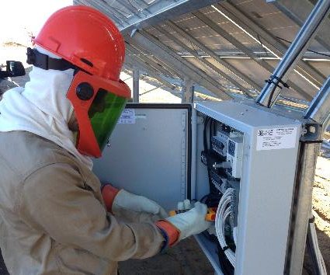
Solar Electrical Safety
Disclaimer: This material was produced under grant number SH-31237-SH7 from the Occupational Safety and Health Administration, U.S. Department of Labor. It does not necessarily reflect the views or policies of the U.S. Department of Labor, nor does mention of trade names, commercial products, or organizations imply endorsement by the U.S. Government.

Slide 2
Learning Objectives
Identify how OSHA, NFPA 70E, and NFPA 70 (the NEC) relate to electrical safety
Determine electrical hazards on the PV job site
Understand shock and arc flash hazards to identify and implement protective measures
Define lockout / tagout methods and procedures as applied to PV systems
Review installation, maintenance, and PV testing hazards
Notes:
Identify how OSHA, NFPA 70E, and NFPA 70 (the NEC) relate to electrical safety
Determine electrical hazards on the PV job site
Understand shock and arc flash hazards to identify and implement protective measures
Define lockout / tagout methods and procedures as applied to PV systems
Review installation, maintenance, and PV testing hazards

Slide 3

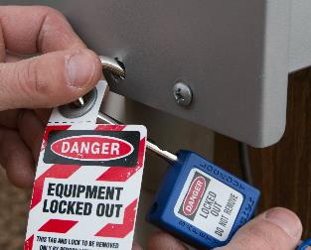
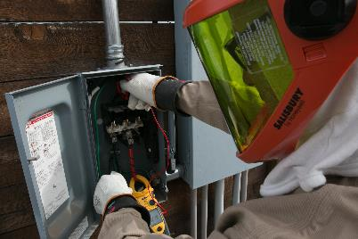
OSHA Electrical Regulations
Provides requirements for “what to do”
  OSHA 1910 Subpart I - Personal Protective Equipment
  Electrical safety
    OSHA 1910 Subpart S - Safeguarding of employees in their workplaces
    OSHA 1926 Subpart K - Safeguarding of employees involved in construction work
Notes:
Explain how the mission of OSHA relates to electrical safety requirements
Identify OSHA sections relating to electrical safety

Slide 4
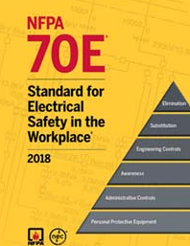
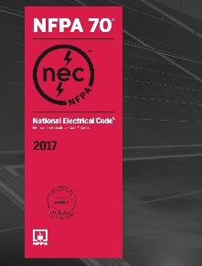
NFPA 70E and NFPA 70
  Provides guidance on “how to do it”
  NFPA 70E and NFPA 70 are national consensus standards
  Recognized by OSHA as providing guidance for worker protection
NFPA 70E – Standard for Electrical Safety in the Workplace
  Intent is to reduce exposure to hazards of shock
  and arc-flash during electrical work
  Tailored to fulfill OSHA’s guidelines and be
  consistent with National Electrical Code (NEC)
NFPA 70 – National Electrical Code (NEC)
  Benchmark for safe electrical design, installation, and inspection to protect people and property from electrical hazards
Notes:
Explain how NFPA 70E and NFPA 70 NEC are related to OSHA
Explain how NFPA 70E and NFPA 70 NEC apply to electrical safety

Slide 5
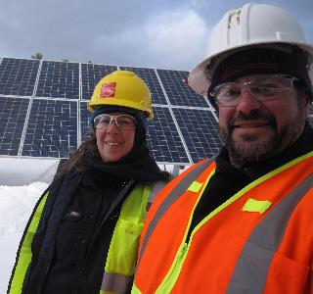
Qualified Person
OSHA 1910.332, NFPA 70E Article 100 & 110
Qualified person
  One who has skills and knowledge related to the construction, operation, and installation of electrical equipment and the hazards involved
Training requirements
  Safety-related work practices
  Skills and techniques necessary to distinguish exposed live parts from other parts of electric equipment
  Skills and techniques necessary to determine nominal voltage of exposed live parts
  Determine approach distances and corresponding voltages
Notes:
Review the definition of ”qualified person”
Explain general training requirements and skills required to be qualified to work safely with electrical equipment

Slide 6
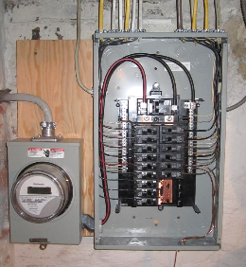
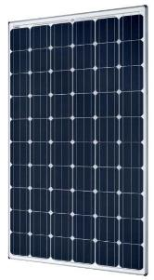
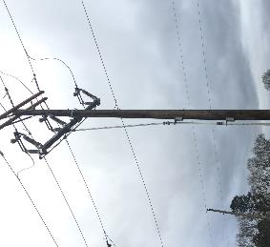
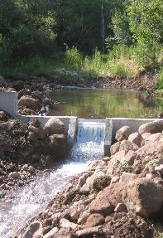
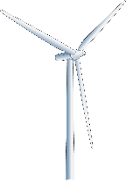
Electrical Hazards May Include,
But Are Not Limited To…
Utility Grid
AC Service Panel(s)
Solar PV
Source: Honey Electric Solar, Inc.
Wind Generator
Battery Bank
Generator
Microhydro
Notes:
Details of common electrical hazards that may be found on the PV job site
Utility connected vs. off-grid hazards
Energy storage system hazards
Isolate equipment before performing work

Slide 7
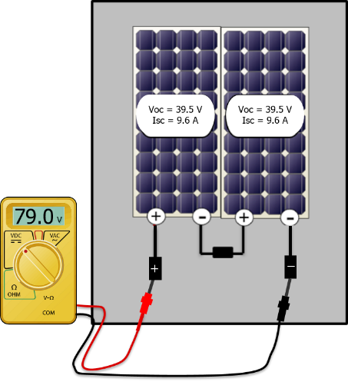
PV Hazard: Series Connections
Negative from one module connects with positive from another
Voltage is additive
Current remains the same
(through all parts of the circuit)
Modules in series form a “series-string” or PV source
circuit
Open positive and negative “homeruns” are energized at PV open circuit voltage!
  PV source circuits may be designed up to 1,500 VDC
Notes:
Series connections are made between two solar modules when the negative connector of one module is plugged into the positive connector of the other module
In series connections voltage is additive, however current remains the same.
When multiple modules are wired in series they form what is commonly called a “series-string” or Photovoltaic (PV) source circuit per NEC definition
After making the series connection, positive on one module and a negative on the other become the leads (or “homerun” wires) for the PV source circuit. Eventually, they’ll run to a combiner box or DC disconnect.
PV source circuits may be designed up to 1,500 VDC and are a significant electrical hazard that must be isolated
In the example above, the voltage of the two modules is added together, however the current is still equal to that of one module, at all points in the circuit.
Current should only be tested with a clamp on meter, do not short circuit modules!
Voc of this single module is 39.5 V, we would expect the multimeter to read 2 x 39.5 =79 V
Series and Parallel

Slide 8
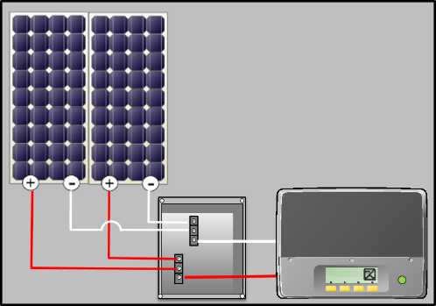
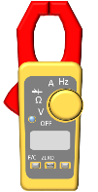
PV Hazard: Parallel Connections
31.0
Positive to positive and negative to negative
Current is additive
Voltage remains the same
PV source circuits in parallel form a PV output circuit
Parallel connections increase available fault current!
Vmp = 31 V
Imp = 9.1 A
Vmp = 31 V
Imp = 9.1 A
Charge Controller
+
≈564.2 W
System operating
9.1A
18.2A
31 18.2 564.2 W
___V x _____A = _________
Notes:
In this slide we are wiring two modules in parallel
The positive (+) from one module connects to the positive (+) of the other at the positive bus bar in the combiner box. This also happens with both negative (-) leads.
When wired in parallel, the current of the modules is additive, while the voltage stays the same.
When modules or strings of modules are connected in parallel, the combined output is called a PV output circuit. This “PV Output Circuit” wire must be sized to handle the higher current.
Here, two PV source circuits of one module each are paralleled to form a PV output circuit.
In this example, the PV output circuit will measure 31 volts DC, and produce 18.2 amps of current. The total power is 564.2 watts. The voltage is half of what it would be if the modules were wired in series, but the current is double.
Notice that the total power of the two modules is the same whether it is wired in series or parallel. In this example we wired the modules in parallel and calculated the power to be 31V x 18.2 A = 564.2W. If we wired these modules in series the voltage would be additive and the current would remain the same. However the calculated power would be the same because 62V x 9.1A =564.2W.
Series and Parallel

Slide 9
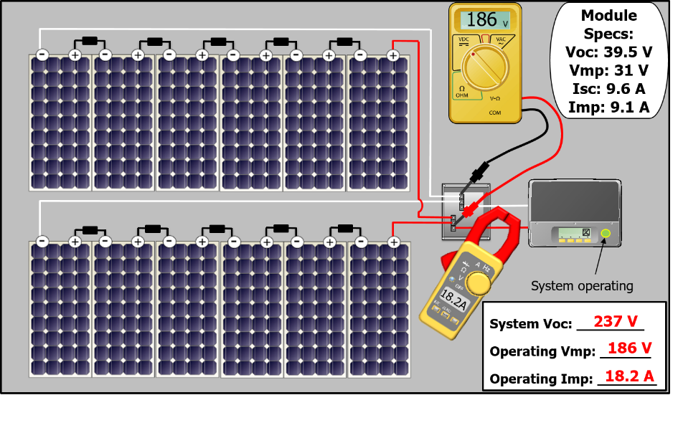
PV Hazard: System Voltage and Amperage
6 Modules in Series x 2 Source Circuits in Parallel
System Voc: ________
Operating Vmp: ______
Operating Imp: _______
Note: Actual PV circuit voltage and current are dependent on variables such as temperature and irradiance
Notes:
Here we have a PV system that has two source circuits (6 modules per source circuit), wired in parallel.
To wire this system we would want to first make all the series connections within the two source circuits. Note that this now increases the voltage to a hazardous level.
It is important to be able to understand how to calculate the expected voltage and amperage of a PV System. In this example we are assuming STC values for temperature and irradiance. In the field, site conditions must be measured and factored into these calculations, however this is an advanced topic and not covered in this course.
Explain the difference between Voc/Vmp and Isc/Imp
System Voc is determined by the number of modules in a source circuit multiplied by the Voc rating of the module.
If we tested the open circuit voltage with a multi-meter of one of these source circuits we would expect this voltage to be 39.5V x 6 Modules = 237V.
Notice that we use the Voc value in this calculation because at this point the circuit is open and not operating.
System Voc should also be tested in the combiner box after all “homerun” leads are landed.
We would expect to see the same System Voc value of 237V inside the combiner box because here we are making a parallel connection and thus voltage remains unchanged from the source circuit value.
To test the operating voltages and currents of the system, the system must be completely wired and operating. This means that the PV output circuit from the combiner box to the inverter must be connected and the inverter must be running.
To calculate the operating voltage you must use the Vmp of the module. Vmp is always lower than Voc because the circuit is supplying the ”load” of the inverter, ideally at it’s maximum power point. Therefore the operating voltage in this case would be 31V x 6 Modules = 186V. This can also be tested within the combiner box using a multi-meter.
Operating Imp: To calculate an expected Imp we would want to use the Imp value of the module. Since we have 2 source circuits in parallel we would make the following calculation 9.1A x 2 Source Circuits = 18.2 A. The system’s DC operating current could be measured with a clamp-on meter which would clamp around either the positive or negative wire of the PV output circuit.
Do not test current with the probe tips (leads) of the multi-meter!
Series and Parallel

Slide 10
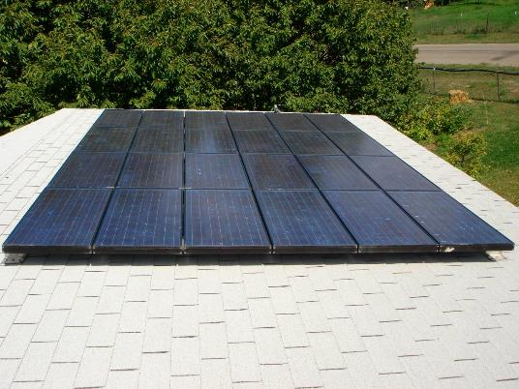
Electrical Hazard - PV Array
PV Array is always energized when exposed to light!
1,440 W PV Array:
24 Solarex MSX-60
12 modules in series
2 PV source circuits
Voc: 252 V
Vmp: 202 V
Isc: 7.74 A
Imp: 7.12 A
Notes:
PV modules are unique in that they are electrically energized when exposed to the sun - there is no ”off” button
It is critical to isolate the array from work area and check for current and voltage on conductors before performing work - use lockout/ tagout methods
There is literature, in equipment operating manuals in some cases, that suggests covering the array will make it safer to work on. However, this is not a safe and reliable way to isolate the PV array
Consider the practicality of covering the array - What is most likely to be used? Cardboard from modules? Blankets? Tarps? And how will it be secured to the array to ensure that it doesn’t blow off while service is being performed elsewhere on the system, possibly energizing conductors that are being worked on?

Slide 11
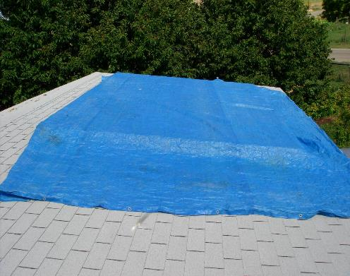
Electrical Hazard - PV Array
Test 1 - PV array covered in blue tarp
Operating (Inverter On):
Power: 199 W
Voltage: 161 V
Current: 1.2 A
Open Circuit (Inverter Off):
Voltage: 198 V
Current: 1.35 A
Values for specific example only, Irradiance varied throughout tests
Notes:
In this example a blue tarp is used on a sunny day to completely cover the PV array
The array still produces a lethal voltage and current level
In no way is the array, or any downstream conductor, electrically safe to work on

Slide 12
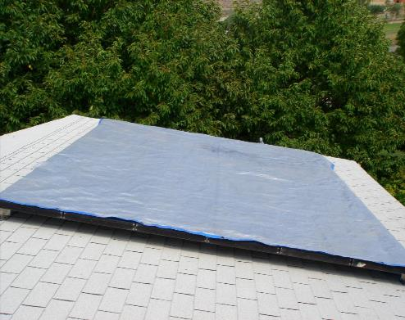
Electrical Hazard - PV Array
Test 2 - PV Array covered in thick reflective tarp
Operating (Inverter On):
Power: 26 W
Voltage: 162 V
Current: 0.16 A
Open Circuit (Inverter Off):
Voltage: 185 V
Current: 0.237 A
Values for specific example only, Irradiance varied throughout tests
Notes:
In this example, a heavier, more reflective tarp is used
The array still produces a lethal voltage and current level
Again, this is not an electrically safe working environment.

Slide 13
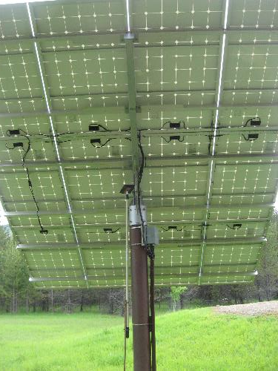
Electrical Hazard - PV Array
PV array must be treated as live at all times!
  Covering method is not appropriate to de-energize PV array
    Nearly impossible to apply cover reliably
    Material can easily be moved and blown out of placed
    Exposure to sunlight through PV module back sheets
Notes:
The PV array must be treated as live at all times!
Using a covering on the array is not sufficient - LOTO should be applied
Many tarps and other coverings still let through enough light to produce dangerous levels of current and voltage
Securing a covering in place is very difficult and does not ensure an electrically safe working environment
Additionally, the PV cells can receive exposure to sunlight through PV module back sheets, this is especially problematic for ground mounted systems

Slide 14
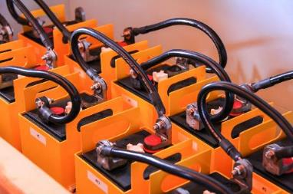
Battery Hazards
OSHA 1926.441 & 1910.305(j)(7) & NFPA 70E Article 320
Batteries cannot be de-energized!
Do not short circuit!
  Arc-flash
  Fire & explosion
  Dangerous chemicals
Prepare for the hazard!
  Use disconnects to isolate batteries from charging sources and loads
  Use proper PPE (personal protective equipment)
Specific battery types have additional specific hazards, such as vent gas combustibility, acid, and toxicity
Work only to be performed by a qualified person!
NPFA 70E Article 320, OSHA 29 CFR 1926.441 & 1910.305(j)(7)
Notes:
Voltage may be above touch-safe levels
Batteries cannot be de-energized!
Do not short circuit! (define short circuit)
Batteries have a tremendous amount of available fault current compared to PV modules which are current limited
Arc-flash
Fire & explosion
Dangerous chemicals
Prepare for the hazard!
Use disconnects to isolate batteries from charging sources and loads
Use proper PPE (personal protective equipment)
Specific battery types have additional specific hazards, such as vent gas combustibility, acid, and toxicity
Work only to be performed by a qualified person!

Slide 15
Flooded Lead-acid Battery Safety
Keep open flames and sparks away from batteries
Eye protection and face shield
Insulated hand tools
Acid resistant gloves
Properly ventilate the battery area
Fresh water for electrolyte splashes. Located within 25’
Remove all jewelry
Apron
Racks and trays resistant to electrolyte
Baking soda to neutralize acid
NPFA 70E Article 320, OSHA 29 CFR 1926.441 & 1910.305(j)(7)
Notes:
Before working on a battery, there are precautions which need to be followed.
First, be sure that the wiring of a battery system is documented on a battery schematic or wiring diagram. This will be very helpful when installing the interconnecting cables, or if they are removed and need to be reinstalled.
Keep all sources of flames and sparks – including smoking – away from the batteries to prevent ignition of the hydrogen gas produced during recharging.
There must be proper ventilation of the battery enclosure and in the room where the batteries are located. Improper ventilation can result in gas build up and increased danger.
Insulated hand tools should be used when working on batteries to avoid accidental short circuit.
Be sure to remove all metallic jewelry – including watches and necklaces - before working on batteries, as they can cause short circuits between the battery terminals.
Wearing protective clothing and eye protection will prevent any spilled or splashed electrolyte from causing harm
Acid resistant racks and trays should be used to contain the impact of a spill
It is also important to have an adequate and accessible supply of baking soda and water to neutralize acid spills
Fresh water is necessary for washing any electrolyte splashes on skin or eyes
In general, squeeze bottles should not be used except where the hazard severity or distance from plumbed eyewash equipment requires personal equipment at work stations for immediate flushing prior to prolonged flushing at a plumbed or self-contained unit. (https://www.ishn.com/articles/98713-understand-the-limitations-of-eyewash-bottles)
Typical emergency treatment for the eyes requires flushing of affected area with fresh water for 5 to 10 minutes. Be sure to contact a physician immediately for further instructions and examination.
Those working around batteries to should get additional training!

Slide 16
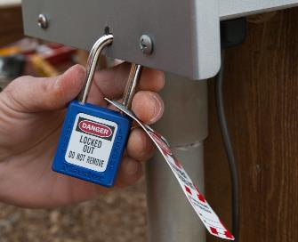
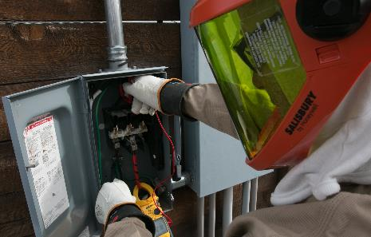
Create an Electrically Safe Work Environment
Do not work on energized circuits during installation
  Only access energized circuits during
    Testing
    Commissioning
    Troubleshooting
Identify then eliminate or mitigate hazards
Notes:
Do not work on energized circuits during PV system installation
Access to energized circuits is only needed during testing, commissioning, and troubleshooting
Identify then eliminate or mitigate hazards
If you are working on an energized circuit during installation, you are likely doing something wrong!

Slide 17
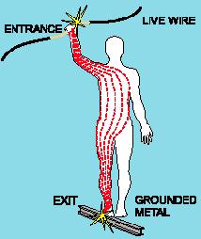
Electrical Shock Hazards
Risk and severity depend on
  Electrical potential (voltage)
  Amount, path and duration of current
Very small current levels can cause damage or death
  > 60 milliamps (0.060 A) can paralyze or “freeze” muscles
  ≥ 226 mA can cause rapid, ineffective heartbeat (fibrillation)
    Death may occur unless a defibrillator is used immediately
Notes:
Electrical shocks are one of the major dangers on PV jobsites, causing burns, permanent injury, or even death.
Shock severity depends on the path, duration, and the amount of current.
The resistance of the body determines at what voltage a shock can occur, but varies based on:
The amount of moisture on the skin (less moisture = more resistance)
The size of the area of contact (smaller area = more resistance) The pressure applied to the contact point (less pressure = more resistance)
Muscular structure (more muscle = more resistance)
Very small current levels can cause damage or death
Low voltages can be extremely dangerous because, all other factors being equal, the degree of injury increases the longer the body is in contact with the circuit.
17

Slide 18

Outcomes of Electrical Shock
Loss of consciousness
Electrical burns
Fibrillation or cardiac arrest
  Can occur hours after the shock
Headaches
Problems with breathing, swallowing, vision, hearing
Muscle spasms and pain
Injuries common after shock when the worker loses balance and falls
  Be aware of hazards and keep a safe working distance
  Always use appropriate fall protection
Notes:
Electrical Shock can injure or kill, the outcomes may include:
Loss of consciousness
Electrical burns
Fibrillation or cardiac arrest
Headaches
Problems with breathing, swallowing, vision, hearing
Muscle spasms and pain
Injuries common after shock when the worker loses balance and falls
Be aware of hazards and keep a safe working distance
Always use appropriate fall protection

Slide 19
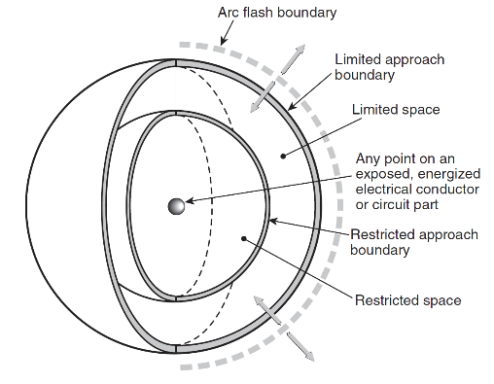
Shock Hazard
Shock risk assessment
  Identify shock hazard
  Estimate likelihood and severity of occurrence
  Determine protective measures
Limited Approach Boundary
SHOCK HAZARD!
Shock protection boundaries
  Limited approach boundary
    Unqualified persons shall not pass, except with continuous guidance and escort from qualified person
  Restricted approach boundary
    Qualified persons shall not pass, except with appropriate PPE
    Unqualified persons not permitted
Restricted Approach Boundary
Limits of Approach
NFPA 70E Annex C Figure C.1.2.3
Notes:
To prevent shock and hazard, NFPA 70E categorizes the physical space around energized circuits in electrical equipment to limited-approach boundaries and restricted-approach boundaries.
A limited-approach boundary has a greater distance from equipment than a restricted-approach boundary, and only qualified personnel will be allowed within the tighter restricted boundary. Unqualified personnel can work outside of the limited-approach boundary. The actual distance of the boundary varies depending upon voltage levels.
Shock risk assessment
Identify shock hazard
Estimate likelihood and severity of occurrence
Determine protective measures
Shock protection boundaries
Limited approach boundary
Unqualified persons shall not pass, except with continuous guidance and escort from qualified person
Restricted approach boundary
Qualified persons shall not pass, except with appropriate PPE
Unqualified persons not permitted
There is also an arc-flash boundary to consider, as described in the coming slides

Slide 20
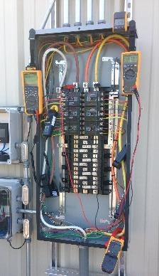
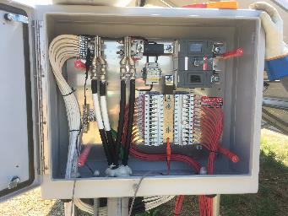
Shock Hazard Boundaries
NFPA tables based on system voltage
  AC circuits - 2018 NFPA 70E Table 130.4(D)(a)
  DC circuits - 2018 NFPA 70E Table 130.4(D)(b)
  480 V AC Inverter Service Panel
  Limited Approach Boundary: 3.5 feet
  Restricted Approach Boundary: 1 foot
  1,500 V PV System - DC Combiner Box
  Limited Approach Boundary: 5 feet
  Restricted Approach Boundary: 1.5 feet
Notes:
Shock hazard boundaries can be determined by using NFPA 70E tables
Note the increased distance at the higher DC voltage
Per NEC, PV Source circuits are limited to 600V for residential systems, but can be designed up to 1500V for some non-residential systems!

Slide 21
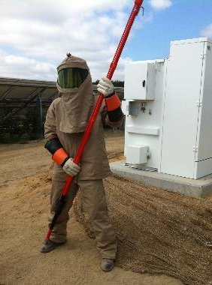
Arc Flash
A source of possible injury or death due to the release of energy caused by an electric arc
  Arc flash - extreme temperatures, blinding light
  Arc blast - intense pressure and sound associated with arc flash
Incident energy
  The level of thermal energy generated from an electrical arc
  Determined by fault current available during short circuit condition, overcurrent protection device(s), and fault clearing time
Notes:
An Arc Flash is an additional danger that is presented by the utility grid and from PV systems with high DC current
Arc flash hazard
A source of possible injury or death due to the release of energy caused by an electric arc - accidental short circuit, faulty equipment, faulty installation.
An arc flash fed by high current can result in an explosive blast and intense heat. This can vaporize copper and aluminum conductors and sear surrounding metal, fabric, and flesh as it expands outwards. Often victims are blasted across the ground, left unconscious, and on fire.
Arc flash - extreme temperatures, blinding light
Arc blast - Intense pressure and sound associated with arc flash
Incident energy
The level of thermal energy generated from an electrical arc
Determined by fault current available during short circuit condition, overcurrent protection device(s), and fault clearing time
PV arrays are current-limited, meaning a module or group of modules can only produce a certain amount of current. The utility grid, however, can provide nearly unlimited fault current. Both are extremely dangerous and must be treated with caution.

Slide 22
Arc Flash Boundary
Arc flash risk assessment
  Identify arc flash hazard
  Estimate likelihood and severity of occurrence
  Determine protective measures
Arc Flash Boundary
ARC FLASH HAZARD!
Arc flash boundary
  Distance at which a worker could be exposed to incident energy ≥ 1.2 cal/cm²
    Minimum 2nd degree burns
Limits of Approach
NFPA 70E Annex C Figure C.1.2.3
Notes:
Arc flash risk assessment
Identify arc flash hazard
Estimate likelihood and severity of occurrence
Determine protective measures
An arc flash boundary
The distance within which a worker could be exposed to the danger of second degree burns or worse
Determined by the amount of available incident energy as known as “available fault current” - The largest amount of current capable of being delivered at a specified point of the system during a short circuit condition

Slide 23
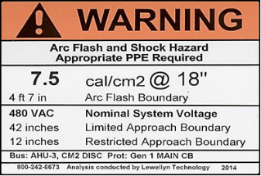
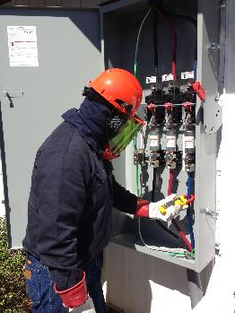
Arc Flash Boundary & PPE
Determined based on
Incident energy analysis method
  NFPA 70E Annex D calculations used to determine incident energy available
    Analysis by engineer may be required
    PPE selected based on incident energy level
    Or
Arc flash PPE category method
  NFPA 70E Tables used to determine exposure level and PPE
  Task must correspond to one of the categories
    Does not address all PV circuit configurations, voltages, and current levels
Notes:
NFPA 70E provided two option for determining fault current available
Incident energy analysis method
NFPA 70E Annex D calculations used to determine incident energy available
Analysis by engineer may be required
PPE selected based on incident energy level
Arc flash PPE category method
NFPA 70E Tables used to determine exposure level and PPE
Task must correspond to one of the categories
Does not address all PV circuit configurations, voltages, and current levels
Unfortunately, the NFPA 70E does not sufficiently address PV system DC circuits - professional engineering assistance may be required to determine appropriate PPE

Slide 24
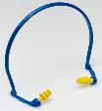


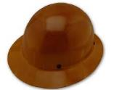
Personal Protective Equipment (PPE)
Electrical PPE may include, but is not limited to:
Arc-rated clothing
  Long-sleeve shirt
  Pants
  Coveralls
  Suit hood
  Jacket, parka, rainwear, or hard hat liner
  Balaclava
  Gloves
Protective equipment
  Face shield
  Hard hat
  Safety glasses or safety goggles
  Hearing protection
  Leather footwear
Notes:
Make sure you have the proper PPE for the work you may be doing at any site - consult NFPA 70E and/or a professional engineer as needed
As mandated by NFPA 70E, when working on energized equipment within the arc-flash boundary and shock hazard boundary, arc-rated clothing and protective equipment must be worn
Do not performed the work if you are not a qualified person!

Slide 25
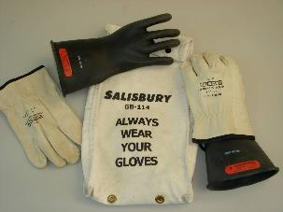
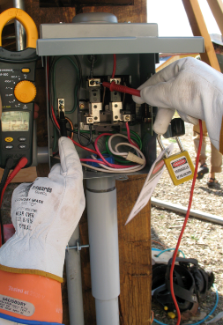
Electrically Insulated Gloves
Working in restricted approach boundary
  Qualified person must be insulated or guarded from hazard
  Insulating gloves are considered insulation only from energized parts being worked on
Rated for AC & DC voltage
  Class 00 = 750 VDC, 500 VAC
  Class 0 = 1,500 VDC, 1,000 VAC
Treat with care
  Inspect for holes before each use
  Keep out of the sun, away from sharp objects
  Bag them correctly
  Only use when needed: they’re not “work gloves”
  Always use leather protectors
Get them recertified
  Typically every six months for in-service gloves
Notes:
Working in restricted approach boundary
Qualified person must be insulated or guarded from hazard
Insulating gloves are considered insulation only from energized parts being worked on
Never use without protective leathers!
Rated for AC & DC voltage
Class 00 = 750 VDC, 500 VAC
Class 0 = 1,500 VDC, 1,000 VAC
Treat with care
Inspect for holes before each use
Keep out of the sun, away from sharp objects
Bag them correctly
Only use when needed: they’re not “work gloves”
Get them recertified
Typically every six months for in-service gloves

Slide 26
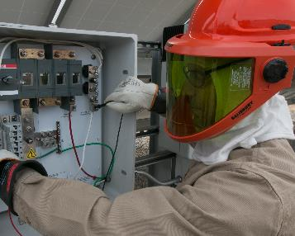
Lockout / Tagout Principles (LOTO)
  Do not work on energized circuits during installation!
Identify and isolate all power sources
  Utility grid, PV circuits, batteries, generator, or other
Leave all switches in the open / off position
  Remove fuses as needed
Apply Lockout / Tagout
PPE is your last line of defense! First identify, eliminate, and/or mitigate hazards!
Notes:
Do not work on energized circuits during installation!
Identify and isolate all power sources
Power source may include the utility grid, PV circuits, batteries, generator, or other
Leave all switches in the open / off position
Remove fuses as needed
Apply Lockout / Tagout - we will look at application option in the next slides

Slide 27
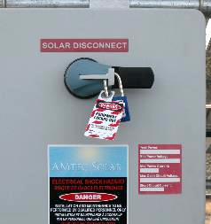
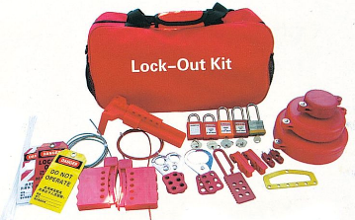
Lockout / Tagout Principles (LOTO)
OSHA 1910.147, 1910.333(b)(2), 1926.417, & NFPA 70E Article 120
Equipment or circuits that are deenergized for work to be performed
  Shall be rendered inoperative
  Shall have lock and tag at each disconnecting means
  Tags placed to identify the equipment or circuits being worked on
    Statement to prohibit unauthorized operation and removal
Notes:
OSHA and 70E require LOTO to isolate hazard from location where work is being performed
Equipment or circuits that are deenergized for work to be performed:
Shall be rendered inoperative
Shall have lock and tag at each disconnecting means
Tags placed to identify the equipment or circuits being worked on
Statement to prohibit unauthorized operation and removal

Slide 28
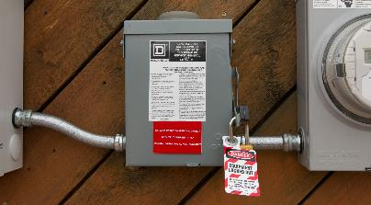
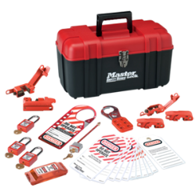
Employer LOTO Responsibilities
OSHA 29 1910.333(b)(2), NFPA 70E Article 120
Establish, document, and implement LOTO program
Provide equipment necessary to execute LOTO
Provide training to employees
Audit execution of the procedures
Audit the procedure for improvement opportunity and completeness
Notes:
Employer LOTO Responsibilities:
Establish, document, and implement LOTO program
Provide equipment necessary to execute LOTO
Provide training to employees
Audit execution of the procedures
Audit the procedure for improvement opportunity and completeness
Employer should encourage a safety culture by having zero tolerance for de-energized circuits not being locked and tagged out.

Slide 29
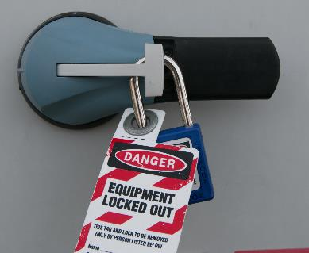
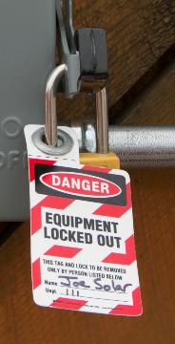
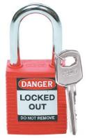
LOTO: Padlocks
Ensure no one else can remove LOTO device
Each employee has a unique
lock & key
Each lock has employee’s name & phone number
Notes:
Padlocks are a very common lock out method used to ensure the circuit stays isolated by the person who applied the lock
Most disconnects, service panel covers, PV inverters, and PV combiner boxes have a location where a lock can be easily applied
Each employee should have their own key and lock to ensure it can not be removed without their knowledge
Each lock should have employee's name and phone number so they can be easily contacted

Slide 30
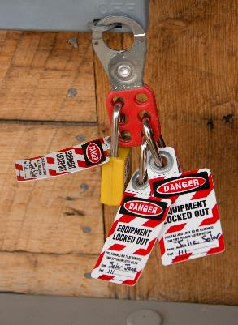

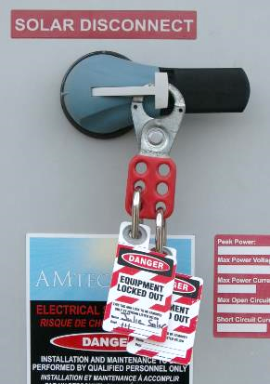
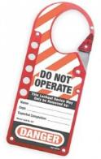
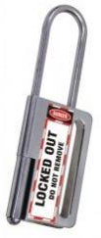
LOTO: Hasps
Can be used by multiple technicians
Attaches to disconnects & other equipment
Notes:
Hasps are used so multiple technicians can apply their own lock to a single lock out point
In order for the lock out to be removed, all technicians must have knowledge of it
Most disconnects, service panel covers, PV inverters, and PV combiner boxes have a location where a hasp can be easily applied

Slide 31
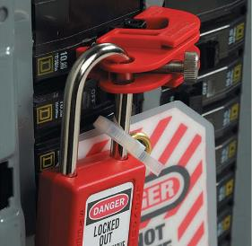
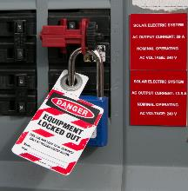
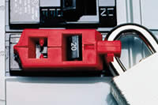
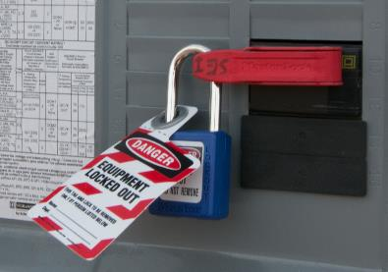
LOTO: Circuit Breakers
Available LOTO for single & multi-pole breakers
Follow manufacturers instructions
Notes:
Circuit breaker lock outs are available in numerous sizes and fit options
It is good to carry a variety of types in LOTO pouch
Available for both single and multi-pole breakers
Be sure to follow manufacturers instructions for application

Slide 32

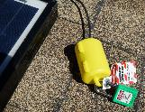


PV Source Circuit Lockout
Voltage Hazard!
Extension cord lockout device
PV module w/ quick connectors
LOTO applied to PV source circuit homeruns
Notes:
LOTO procedures are also applied to the PV array.
Each PV source circuit must be safely isolated to ensure equipment “downstream” is not energized during the installation
The application of LOTO must happen in coordination with the wiring of each PV source circuit
Extension cord type lock-out devices can be applied to positive and negative “homeruns” to ensure series strings cannot get plugged in without the key holder for that lock being present to unlock AND plug together the quick-connects.

Slide 33



PV Source Circuit Tagout
OSHA 29 CFR 1910.333, NFPA 70E 120.4
Tagout without lock
  Permitted by OSHA if lock cannot be applied or if employer can demonstrate tag provides safety equivalent of a lock
  Additional safety measure required
    Removal of isolating fuses
    Opening an additional isolating disconnect
Dummy quick-connect
w/ tag out
PV combiner boxes with fuses removed
Notes:
Another option to isolate PV source circuits, without using a lock, is to make ‘dummy’ quick-connect plugs with a tag on them— the tag will remind the PV installer that they cannot plug in the homeruns until all personnel are finished with their related work.
Application of Tagout without lock is only permitted by OSHA if lock cannot be applied or if employer can demonstrate the tag provides safety equivalent of a lock
Additional safety measure required if applying tagout only
Removal of isolating fuses
Opening an additional isolating disconnect

Slide 34

LOTO Applied: PV Array Management
Install PV modules & make series connections
Apply LOTO to isolate the PV power source
LOTO applied to ensure worker is not exposed to power source.
LOTO applied to prevent wiring mistakes, such as short circuit.
Notes:
This simplified schematic (grounding conductors are not shown) is used to demonstrate the application of LOTO applied to the PV array
Note that lock and tag are applied to the homeruns going to the junction box to ensure the worker is not exposed to the PV array power source.
Also lock and tag are applied to the energized side on the PV array to prevent wiring mistakes, such as short circuit.
Prewiring homeruns to a locked out disconnect (possibly integrated into a combiner box) is another option for larger systems where multiple PV source circuits must be installed and safely managed
Wiring

Slide 35








Grid Connected: LOTO Considerations
Grid-direct PV system (no energy storage)
  Inverter is not a power source
  Utility grid must be present for inverter to operate – no power from inverter when grid is isolated
No grid = No AC power from inverter
PV Array
Inverter
Meter
AC
Service Panel
Utility Grid
DC Power source
Not a power source*
AC Power source
*Confirm inverter DC capacitors have discharged before work
Notes:
The most common PV system configuration is the grid-direct system.
Energy goes straight from the PV array into the inverter, which changes the DC electricity into AC electricity.
This AC electricity then flows into an AC service panel to operate any active loads, extra energy is exported onto the utility grid.
When the amount of energy being produced by the PV system is less than the total AC load, electricity from the grid is used to make up the difference.
When the PV system is not producing anything, such as at night, all of the electricity comes from the utility grid.
A grid-direct system eliminates the batteries and associated maintenance and cost, but requires the grid to be present to function.
When the grid goes down (a utility failure, brownout, or blackout) the grid-direct inverter is designed and listed to shut off instantly in order to ensure that no electricity will be sent out onto the utility lines where it could endanger linemen.
In order to have electricity when the grid is down, a system must have a back-up loads panel and energy storage equipment
Isolate all power sources before performing work - may include PV array, utility grid, or other

Slide 36

Battery-based: LOTO Considerations
Battery-based off-grid system (no utility grid)
  Inverter can produce AC power if connected to the battery bank
  Isolate all power sources before performing work
DC power source
AC power source
Notes:
Battery-based off-grid system (no utility grid)
Review power flow of an operating off-grid system
Inverter/charger can output AC power if connected to the battery bank and it can also convert the AC into DC to charge the batteries and operate DC loads.
Back-up energy sources, such as a generator, are frequently installed with stand-alone systems for times when there’s not enough sunshine to operate all of the loads and keep the batteries charged with just the PV array.
Isolate all power sources before performing work - may include battery bank, PV array, generator, or other

Slide 37



Follow Proper LOTO Procedures
NFPA Article 120, CFR 29 OSHA 1910.147
Identify all power sources
Notify affected employees
Isolate (open disconnecting device)
Consider stored electrical energy
  Inverter capacitors, read manual
Apply lockout/tagout (LOTO) devices
Verify meter on known voltage source
Verify each circuit is de-energized (no voltage)
Re-verify meter on known source
Notes:
Follow proper LOTO procedures
Identify all electrical energy sources
Notify affected employees
Isolate (open disconnecting device)
Consider stored electrical energy
Inverter capacitors, read manual
Apply lockout/tagout (LOTO) devices
Verify meter on known voltage source
Verify each circuit is de-energized (no voltage)
Re-verify meter on known source

Slide 38

LOTO Applied: Grid-direct
Notes:
Review simplified schematic (no grounding shown) of a residential size grid-direct PV system.
LOTO applied to PV source circuit homeruns, both positive and negative
LOTO installed with pad lock on DC disconnect and AC disconnect
LOTO is also applied to circuit breaker of inverter output circuit and main service panel breaker
It is critical that LOTO be applied to the correct locations to ensure equipment being working on is de-energized, this can vary depending on system specifics and task being performed.
Wiring

Slide 39

What is a DC Ground-fault?
PV circuit conductor makes contact with
  Grounding conductor
  Metal enclosure
  Racking system
  Metal conduit
  PV module frame
Ground-fault between ungrounded conductor and grounded conduit
Notes:
A DC Ground Fault occurs when a current carrying PV circuit conductor inadvertently makes contact with one of the following:
Grounding conductor
Metal enclosure
Racking system
Metal conduit
PV module frame

Slide 40

What Causes a Ground-fault?
Damaged conductor insulation
  Nicked or chaffed wires
  Pinched wires between module frames and mounting structure
Thermal movement – expansion and contraction
  Improperly supported conduit
  Sharp wire bends
  Sharp edges
Junction box or conduit filling with water
Ground-fault protection (GFP) must be provided per NEC by a ground-fault detection and interruption device (GFDI)
Possible future ground-fault
Normally non-energized equipment may be energized if ground fault is present!
Notes:
There are many possible causes of ground-faults - ground fault are typically due to a design or installation error
Damaged conductor installation
Nicked or chaffed wires
Pinched wires between module frames and mounting structure
Thermal movement – expansion and contraction
Improperly supported conduit
Sharp wire bends
Sharp edges
Junction box or conduit filling with water
Ground-fault protection (GFP) must be provided per NEC by a ground-fault detection and interruption device (GFDI)

Slide 41




What is an Arc-fault?
Series fault
  A current-carrying conductor has a high resistance failure point that current arcs across
Parallel fault
  Inadvertent connection between two current-carrying conductors
Notes:
Arc-faults are different than ground-faults. There are two types of arc-faults – series and parallel.
A series arc-fault occurs when a high-resistance point occurs in a current-carrying circuit
The connection loses good continuity but the flow of current isn’t stopped – rather it arcs across the failure point, generating enormous amounts of heat very quickly.
Because the current in the circuit is not different than normal, overcurrent protection devices don’t help, nor does ground-fault protection, since the fault isn’t to ground.
As a result, undetected arc-faults are very likely to cause a fire.
In some cases the arc will burn itself open, consuming the conductor so much that a gap is formed and the arc extinguished. Unfortunately, even if the conductor does burn open, there is the possibility of a fire continuing.
Parallel arc-faults occur between two current-carrying conductors. In many cases it is much like a short circuit, except that there is an arc (and the intense heat it creates) involved.

Slide 42



What Causes an Arc-fault?
Loose wire terminations
  Torque terminals to specification!
Improper connections
  Loose PV quick connectors
  Incorrectly made crimps
  Manufacturing defects
Arc-fault protection is required per NEC for most PV Systems
  Introduced in 2011 Code cycle
    Most older systems do not have it
    Many large (MW) systems do not have it
Notes:
Common causes of arc faults include:
Loose wire terminations
Torque terminals to specification!
Improper connections
Loose PV quick connectors
Incorrectly made crimps
Manufacturing defects
Arc-fault protection is required per NEC for most PV Systems
Introduced in 2011 Code cycle, so most older systems do not have it
Many existing large (MW) systems do not have
With a central inverter, an arc-fault detecting combiner box is a good option. Some inverter manufacturers have their own arc-fault detecting combiner boxes which they have tested with their central inverter.

Slide 43



Equipment Grounding
Equipment Grounding
  Bonding all non-current-carrying, exposed metal parts of an electrical system to ground
Grounding bus bar in an enclosure
Lay-in lug on array rack
  Equipment grounding is required in all systems!
Equipment Grounding Conductor (EGC)
  A conductor or conductive path installed to connect normally non-current-carrying metal parts of equipment together to ground
Notes:
Equipment grounding is absolutely necessary on all PV systems.
Equipment grounding conductors (EGC) are wires or conductive paths used to bond together all non-current-carrying, exposed metal parts of the entire PV system to ground, including:
Metal frames of PV modules
Metal racking and array mounting components
The metal chassis of equipment such as inverters, disconnects, and meters
Metallic junction boxes, combiner boxes, and metal conduit
Any other exposed metal that could become energized in a fault situation but would not normally carry current.
Under normal conditions, there’s no current in the equipment grounding conductor or the components to which it’s connected. The only time EGC carries current is when there’s a fault, when it provides a low resistance path to ground for the fault current. This provides protection from shock caused by a ground fault and is required in all PV systems.
The equipment grounding conductor must never be fused, switched, or interrupted in any fashion. It must provide electrical continuity, but can be joined on bus bars or spliced with other suitable connectors.
PV modules with metal frames need to be connected to the EGC. One way to do this is with traditional tin-coated copper “lay-in” lugs as shown here. These are bolted with the appropriate (stainless steel) hardware to the marked equipment grounding location on each module. Because of the possibility of corrosion between different types of metal— the aluminum of module frames and copper wire in particular— it’s very important to use the correct type of lug and hardware to ensure long-lasting, reliable connections.

Slide 44



Rack Integrated Equipment Grounding
Lay-in lugs bond each row of modules to equipment grounding conductor (1 per rail)
Hardware bonds mounting feet to rails
Mid clamps
bond module to rail
Grounding washer may be used to bond modules to rail
Notes:
Integrated equipment grounding reduces material and labor costs
Mechanical connections of the rack also become electrical connections (bonding metal parts together).
Typically accomplished by the use of module clips or grounding washers that have “pins” that pierce the module frames, bonding them to racking rails. Rack rails are bonded together through similar connections, or are connected via lugs and copper wire to the rest of the equipment grounding system.
Be sure to follow the installation instructions and use listed products, and keep in mind that the goal is to make all the exposed metal into one “piece” – so separate rows may need to be bonded to each other and an equipment grounding conductor (EGC) will have to be installed alongside the current carrying circuit conductors from the array to the other equipment of the system.

Slide 45

Electrical Safety:
Common PV Array Installation Errors
Series and parallel wiring mistakes
  Plan and layout homeruns before module installation
  Do not short circuit PV array!
  Test for correct voltage and polarity
Inadequate equipment grounding
  NEC and equipment manufacturer grounding requirements
Wire management
  Suitable for the application
    USE-2 or PV Wire
  Secure and Support
  Protect against physical damage
Notes:
Some common PV array installation errors include:
Series and parallel wiring mistakes
Plan and layout homeruns before module installation
Do not short circuit PV array!
Test for correct voltage and polarity
Inadequate equipment grounding
NEC and equipment manufacturer grounding requirements
Wire management
Suitable for the application
USE-2 or PV Wire
Secure and Support
Protect against physical damage

Slide 46




Good Array Wire Management
Notes:
These photos show examples of good wire management within the PV array
Clips and coated steel ties secure the conductors to the modules and mounting rails, keeping all the conductors secured and within the array.
The conductors aren’t susceptible to movement caused by snow, ice, rain or wind, which could cause damage to the conductors by causing them scrape over sharp surfaces.
They are not draped on or touching the roof.
Good wire management means foreseeing and avoiding situations that can compromise the conductor insulation, which can lead to faults and possibly fires.

Slide 47





POOR Array Wire Management
Notes:
These photos show some examples of poor array wire management.
Many conductors are not properly supported
Some conductors are running behind sharp pieces of metal without proper protection of the conductor insulation
In the photo on the top right side, the conductors are just coiled up and hooked onto a purlin/mounting rail. They are not secured or supported, and are resting against potentially sharp metal edges that can cut through insulation. Additionally, the wires are likely to droop over time, increasing the likelihood of damage.
The bottom right photo also shows PV source circuits that are not properly supported. The conductors are likely going to swing around during storms and eventually the insulation on the PV source circuits will fail. At best, this will mean reduced output; at worst, this is how arc-faults, ground-faults and fires occur.

Slide 48


Wiring Methods
DC PV circuits inside a building must be in metal raceway, metal enclosure, or metal clad cable (Type MC) from point of penetration to first readily accessible disconnecting means
Notes:
Because DC PV circuits are energized whenever modules are exposed to sunlight, extra precautions are required to protect these circuits from damage, and to provide a low impedance path to ground.
The NEC requires a metal raceway (such as EMT or FMC) or metal clad cable (MC) for DC PV circuits inside a building prior to the first readily accessible disconnect.
It is a good idea to provide this additional level of extra protection for all DC PV circuits anywhere inside a building.

Slide 49

Disconnecting Means
OSHA 1910.308 (f)(2) & 1926.403(c), NFPA 70 NEC 690 Part II & Article 705
PV System Disconnect
Equipment Disconnects (Inverter)
Note: many configurations possible;
disconnects may be integrated into combiners or inverters
Notes:
The NEC requires disconnects in PV systems for the PV system, the PV source, and for equipment.
Disconnects can fill one or more of these roles, depending on their location in the system and the overall system layout.
Local regulations, especially those enforced by the utility company, may require additional disconnecting means beyond those required in the NEC.

Slide 50

Identification and Grouping
OSHA 1910.308 (f)(1) , NFPA 70 NEC 690.31(B)
DC PV system conductors must be in separate raceways, junction boxes, etc., or be separated by partition, from
  Any inverter output circuit (AC)
  Circuits from any non-PV system
Notes:
DC PV system conductors must be in separate raceways, junction boxes, and enclosures unless separated by a partition from:
Any inverter output circuit (AC)
Circuits from any non-PV system

Slide 51


Working Space: Depth, Width, & Height
OSHA 29 CFR 1926.403 & 1910.303
Many conditions to consider - must be referenced appropriately
Up to 1,000 volts
  NFPA 70 NEC 110.26
Over 1,000 volts
  NFPA 70 NEC 110.32, 110.34
Manufacturer’s instructions often have additional space and mounting requirements - these must be observed per NEC 110.3(B)
Source: SolarEdge
Notes:
Working space requirements (including height, width, and depth) vary depending on design and site specifics
In general, higher voltage equipment requires more clearance
Be sure to reference the NEC for minimum clearance requirements for all electrical installations
Additional manufacturer specified clearances are often required for equipment specific considerations, such as space for ventilation and cooling

Slide 52



Safe Meter Testing Procedures
Testing is the most dangerous electrical activity for a PV technician
  Use appropriate PPE
  Before testing - confirm correct meter setting and probe socket
  Check for current in all circuits before operating non-load-break rated devices
Test DC voltage and polarity in each piece of equipment before
  Performing work
  System commissioning
    Closing switches
    Installing fuses
Notes:
During construction and installation, all energized circuits should be locked out/tagged out. The only time PV installers and technicians should be working with energized circuits is during testing procedures. As a result, testing procedures are among the most dangerous electrical tasks.
Use appropriate PPE
Before testing - confirm correct meter setting and probe socket - 80% of the reported multimeter accidents result in critical injuries to the victim
Check for current in all circuits before operating non-load-break rated devices
It is critical to always use a clamp-on meter to check for current before opening any fuses or non-load break rated connectors or devices such as tip-out fuse folders or PV module connectors. If current is flowing where or when it shouldn’t be, opening non-load break rated devices under load can result in arcing fires.
Test DC voltage and polarity in each piece of equipment before
Performing work
System commissioning
Closing switches
Installing fuses
If you are testing a circuit and don’t know what value you expect to get, how can you know if the value is correct? Always calculate expected values to compare against measured values, using correct system and environmental conditions.

Slide 53

Meter Safety Check
Inspect before each use!
Look for
  Cracked or oily case
  Worn probe wire insulation
  Loose or broken probe tips
Other considerations
  Proper voltage and safety rating
  Fused leads
  Manufacturer approved replacement fuses
  Proper storage and care
  Use quality meters from reputable brand
Notes:
Any meters being used must be in good condition and be appropriate for the job at hand. Before using a meter it should be examined for:
Cracked or oily case
Worn probe wire insulation
Loose or broken probe tips
If any of these conditions are found, get new parts, or replace the meter. Always replace meter parts with the appropriately rated components, as recommended by the manufacturer.
Other considerations
Proper voltage and safety rating
Fused leads
Manufacturer approved replacement fuses
Proper storage and care
Use quality meters from reputable brand

Slide 54

Meter Category (CAT) Ratings
CAT I and II
  Electronic equipment, portable tools, plug connected loads
  In general not acceptable for PV system use
CAT III
  Permanently installed loads
  Distribution panels
  Feeders and short branch circuits
  Heavy appliance outlets, large lighting systems
CAT IV
  Utility transformers, meters and primary overcurrent protection
  Service entrances
  Any exterior conductor runs
Source: Fluke Corporation
In general, look for meters rated:
CAT III 1000V /
CAT IV 600V
Selection of CAT IV 1000V and CAT III or IV 1500V meters is limited
Notes:
CAT ratings indicate to what extent the meter’s circuitry has been designed to protect the user from voltage transients, which are commonly found in electrical environments and can carry high currents.
Currently, there are four CAT ratings, CAT I – IV, the higher the CAT rating, the more resistant to higher transients. The CAT ratings also correlate to different electrical distribution categories, such as those outlined in the slide.
CAT IV is for ‘any exterior conductor runs.’ This includes PV source or output circuits outside – whether on a roof, in conduit on the side of a building, or buried.
CAT IV meters should be used when checking voltage at the service entrance (for example, in the main service panel at a house on the line side of the service disconnect).
Voltage ratings must also be considered depending on the system being tested
While the CAT IV 600V rating is sufficient for residential PV systems (because they are limited to 600V), many commercial and utility scale systems are now up to 1500 V. These CAT IV 600V meters are NOT the correct meters when working on PV systems over 600V!
Be sure to have properly rated meters and tools for higher voltage PV systems.

Slide 55

Job Hazard Analysis
Jane Rockstar
1/2/2018
123 Main St. Paonia, CO
Delta Hospital, 911
Existing residential, single story building, no other work crews onsite
Install grid-direct inverter, route wire & conduit from both AC and DC sides
Group LOTO applied by all employees working on positive and negative of each PV source circuit
Group LOTO applied by all employees working on main service panel breakers as needed
Remind crew daily of hazard, keep safe distance
No energized work will be performed. Shock and arc flash risk isolated by LOTO procedures
Notes:
Importance of having a safety plan for the specific job site
Provide emergency contact phone numbers, location of basic first-aid supplies, and location of the nearest hospital
Review Job Hazard Analysis form
To be executed for each job site and work task category
Note that this is the installation phase, so all power sources will be isolated from areas where work is to be performed

Slide 56
Additional Resources
Home Power issue #175
  Working Safely with Electrical Systems
NECA NFPA 70E Lockout Tagout Guide
OSHA factsheet: Lockout Tagout
Fluke
  ABCs of Multimeter Safety
  ABCs of Clamp Meters
  Ten Dumb Things Smart People do When Testing Electricity

