Slide 1
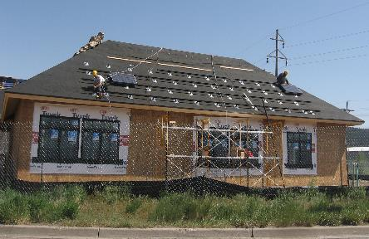
Safe PV Roof Mounting Methods
Disclaimer: This material was produced under grant number SH-31237- SH7 from the Occupational Safety and Health Administration, U.S. Department of Labor. It does not necessarily reflect the views or policies of the U.S. Department of Labor, nor does mention of trade names, commercial products, or organizations imply endorsement by the U.S. Government.
Notes:
Welcome to this presentation on safe PV roof mounting methods
This is Sarah Wilder again, with Solar Energy International
So by now you’ve completed the introductory lesson, as well as lesson 1 on PV ladder and lift safety, and lesson 2 on fall protection
If you haven’t completed completed those lessons yet, I highly encourage you to do so- at this point we’re ready to start doing some work on the roof, so it’s important that you’ve gone through those other lessons first.

Slide 2
Learning Objectives
Identify common hazards workers are exposed to when installing PV mounting equipment on a roof
Determine safe working practices and PPE
Describe ways to manage equipment, tools, and small parts on a sloped roof
Identify safe methods for handling and mounting PV modules on a roof
Notes:
Ok so let’s check out the learning objectives for this lesson. At the end of this lesson, students should be able to:
Identify common hazards that workers are exposed to when installing PV mounting equipment on a sloped roof
Determine safe working practices- what are the actions that you, your employer, your co-workers can do to minimize, or control, some of these hazards
Then we’ll dive even further in to hazards unique to PV installations- describe ways to manage equipment (from flashings to rails to modules), tools (tape measures, wrenches, drills), and small parts (hardware- lag bolts, mid/end clips, etc.) on a sloped roof
Talk about not only safety requirements but also best practices for working safely and efficiently- not everything in this lesson is necessarily an OSHA requirement
Finally, students will be able to identify safe methods for handling and mounting PV modules on a roof.
Note: Focus is on rail-based, roof-mounted (sloped) PV installations, primarily residential.

Slide 3
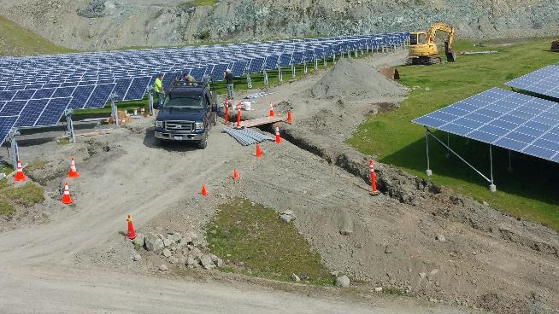
Mounting Types NOT Covered in this Presentation
Carports, ground mounts, pole mounts
Many hazards exist, seek additional training!
Notes:
Just a heads up, I mentioned this in the introductory lesson, but this presentation does not cover carports, ground mounts, or pole mounts- more specific to working on a sloped roof
If you are installing these types of systems, we encourage you to seek additional safety training, as many hazards exist- for example caught in/between hazards when working in and near trenches and/or doing excavation work.
Though within this lesson, some the hazards we discuss, such as environmental exposure and overexertion, do apply to all installations.
.

Slide 4

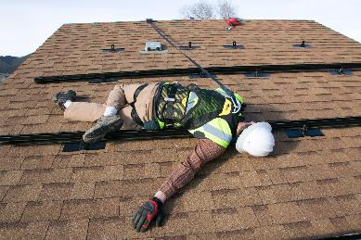
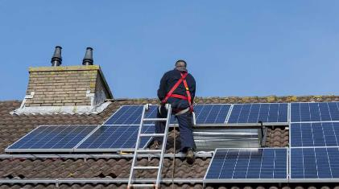
PV Installation Hazards
Environmental exposure
Overexertion
Respiratory / noise
Slips, trips, falls
Struck by
Caught/in between
Electrical
Hazards are site-specific!
Notes:
In this lesson, we’ll go through some of the hazards that may be present during PV mounting work and how to avoid or mitigate these hazards
Environmental exposure: installers can be exposed to extreme temperatures and direct sunlight
Overexertion: Solar modules and other equipment can be really heavy and awkwardly sized.. Combine that with working and carrying equipment on pitched roof, and there’s a real potential for injurty
Respiratory/noise: Installers often working in in attics or using loud power tools like sawzall- need proper PPE
Slips, trips, falls on or off the roof
Struck by: an object- impact creates injury
Caught in machinery or tool (think about drills)
Compressed or crushed between objects
Electrical hazards- won’t dive into during this lesson but which we’ll cover in great depth lesson 4
And then just a reminder that hazards are site specific!

Slide 5
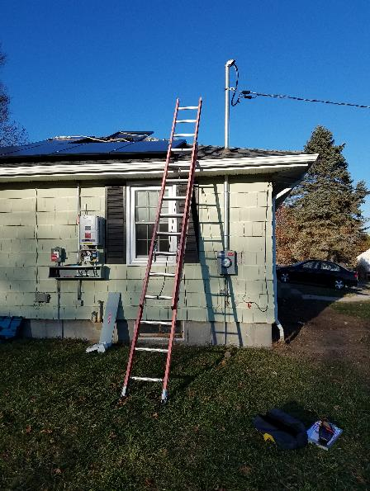

Jobsite-Specific Hazards
Electrical Hazard!
Overhead power line
Hazard!
Sun exposure
Remember, each jobsite is unique!
Trip Hazard!
Vent stack
Trip/Fall Hazard!
Skylights
Struck by Hazard!
Falling objects near electrical work zone
Source: gogreenleafsolar.com
Notes:
Remember, each site is unique, which is why it’s important to do the pre-installation hazard assessment.
Lots of circumstances that may very- different weather, roof pitch/access/fall hazard, in picture on left, you can see the balance of system is being installed right underneath the array area, so there’s the hazard of any falling objects, you can also see that there’s an overhead service entrance and the ladder is set up really it, you might have some vents/skylights near the array area like you see in the photo on the right.
So this is why it’s really important to complete a job hazard analysis for every installation and have safety check ins every day or anytime the conditions change

Slide 6
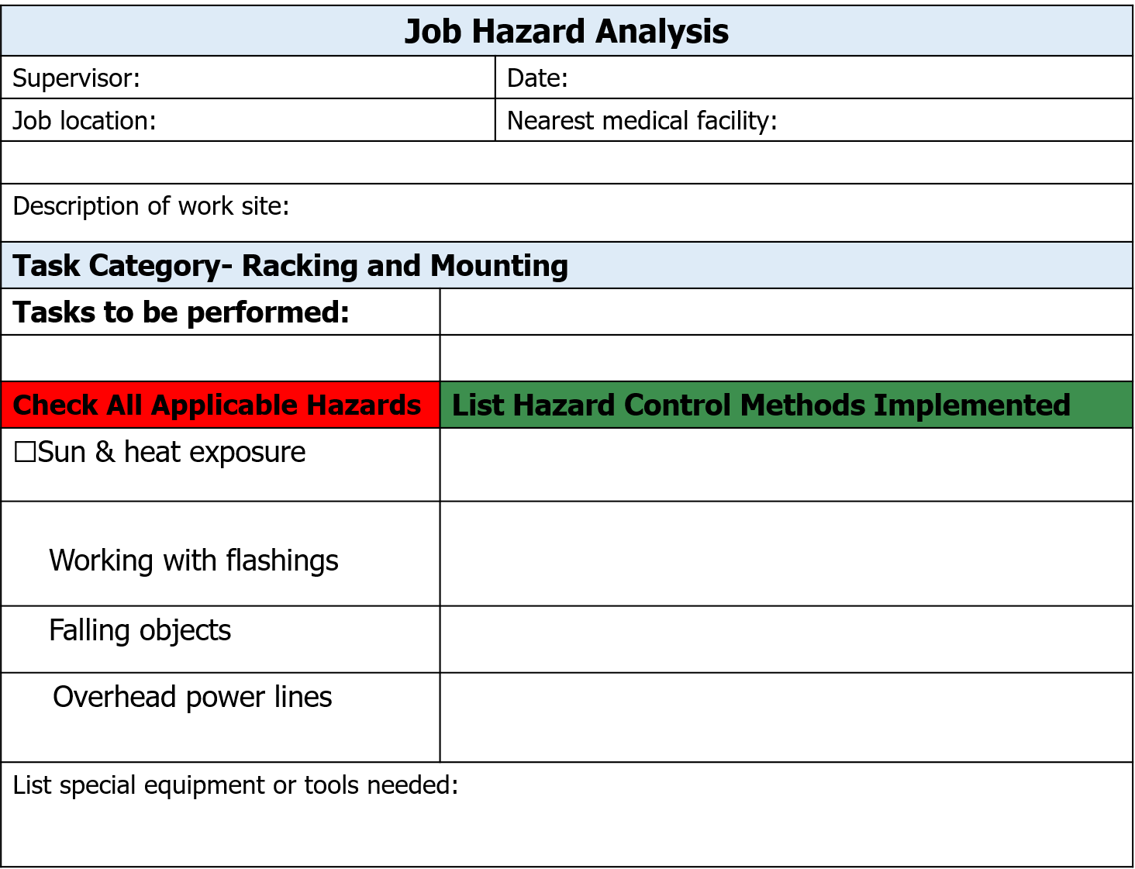
JHA
Kayla
1/1/2018
602 Clarke Ave.
Greensboro, NC
Cone Memorial Hospital
1121 N. Church St.
Two story building with attached garage
Racking installation
☑
Sunscreen, stay hydrated, take breaks in shade
☑
Wear gloves; keep flashings secure
☑
Wear hard hats, keep workspaces organized
☑
Set up ladder and bring rails up min 10’ away
Sun screen, water cooler, shade structure, fall arrest equipment, gloves
Notes:
So here’s the job hazard analysis form again
See the list of applicable hazards during racking installation- sun and heat exposure, working with flashing, falling objects, overhead power lines and the hazard control methods to eliminate or mitigate those hazards to an acceptable risk level

Slide 7
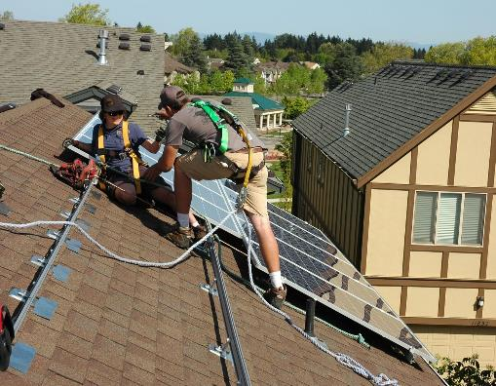
Promote A Culture of Safety
Work mindfully
Work at a safe pace
Think before each step
Never work alone
Minimum 2 installers on roof (best practice)
Notes:
Again, it’s critical that both employers and employees have buy in to this “culture of safety”
Work mindfully: work at a safe pace
Getting the job done is important, but remember- working in a hurry or under pressure can not only lead to unsafe work practices, it can also lead to poor quality installation work, which will inevitably lead to another truck roll and additional expense some time in the future.
Think before each step- if you don’t take the time to prepare to go to roof- what tools and materials do you need- you’ll waste time going up and down ladder
Be cautious of employers offering a pay-by-production model: paid per module so there’s a monetary incentive to rush
Ask yourself “what safety training and equipment do they have available to ensure that I can work both efficiently AND safely?”- for instance some sort of lift to get modules to roof like we discussed in lesson 1, vs. hauling them unsafely up a ladder
Rackers are often paid the lowest in a PV installation; they are most eager for that new job- need to make sure not being asked to do something unsafe
Also should never work alone- buddy system is best for both safety and efficiency, as many tasks are better completed with 2 people, for instance mounting modules.

Slide 8
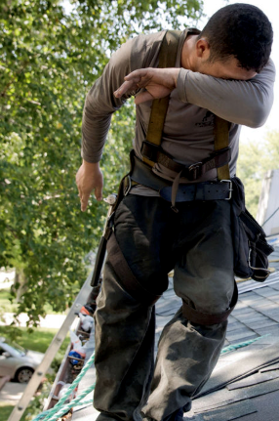

Heat Stress
Exposure to extreme conditions
Risk factors
High temperature / humidity
Direct sun exposure
Heavy physical labor
No wind or breeze
Low liquid intake
Waterproof clothing
No recent exposure to hot work places
Working while sick
Source: osha.gov/publications/osha3154.pdf
Notes:
First let’s talk about environmental exposure
Solar installers can be exposed to some extreme conditions- in the summertime, days are long and companies try to get a lot done.. It’s common that crews will work 4 10-hour days or even more.
Some of the most popular solar markets are in really sunny dry places
OSHA has a great publication available called “Protecting Workers from Heat Stress” (included as a resource with this lesson) that identifies heat-related risk factors, symptoms and steps you can take to prevent injuries.
If you look at the risk factors listed there, you’ll recognize that a lot of these exist for installers- since solar modules are installed on the sunniest and most exposed parts of the roof, this means that installers are also exposed to these conditions.
Sometimes that weather changes quickly and installers need to pause what they’re doing and take the time to adapt.
Working while sick includes being hung over!

Slide 9
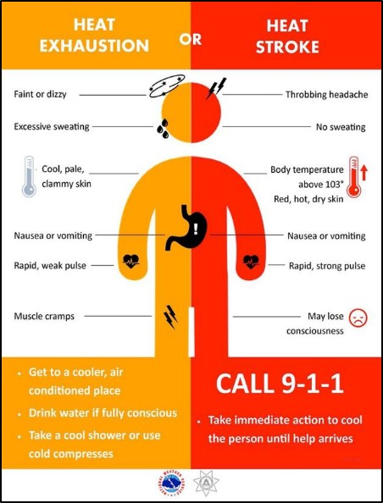
Recognizing Heat Illness
Consider the consequences if you or a co-worker suffered from heat illness while on a roof!
Source: National weather service
Notes:
-Intense heat stress can result in heat illness, which is serious & comes on unexpectedly-.
Someone suffering from heat exhaustion can get faint or dizzy, get nauseous or have their muscles cramp up.
Someone suffering from heat stroke could lose consciousness
So consider the consequences if you or a co-worker suffered from heat illness while on a job site, especially on a roof- this really exemplifies the importance of wearing fall protection and not working along

Slide 10
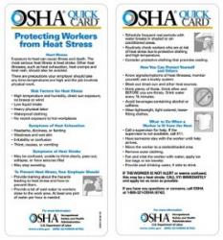
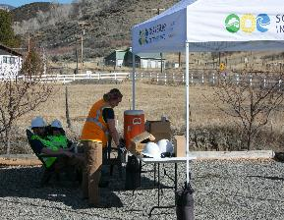
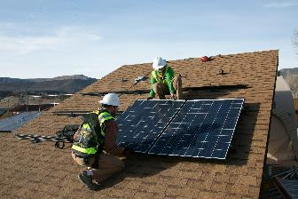
Preventing Heat Stress
Provide employees with…
Training
Prevent
Recognize
Treat
Clean water & shade
Frequent breaks
Large water jugs
1 pint per hour per worker
Buddy system
Never work alone!
Notes:
So how to prevent heat stress and heat illness? Remember that it’s the employer’s responsibility to provide training and control methods to prevent it
Training: How to prevent, recognize, treat- : First-Aid training is great for knowing what to do if someone has a heat-related illness
- Encourage frequent breaks, provide water fill stations, on an exposed job site with no trees or shady areas, erect a canopy structure for installers to take breaks under.
And then again that safety culture concept.. Buddy system of at least 2 workers on a roof. Obviously if someone gets heat stroke on a job, they’re done for the day.
Then it’s also the employees role needs to take some responsibility- Workers need to know their limits and take care of themselves. Employer can’t force you to drink water- should drink 1 pint per hour (take an insulated water bottle up to the roof if they’re not willing to come down frequently). Monitor color of urine.
Lastly, if you don’t take care of yourself because you feel like your employer is pushing you too hard, you’re going to burn out quickly. Employers should consider turn over rates of rooftop workers.

Slide 11
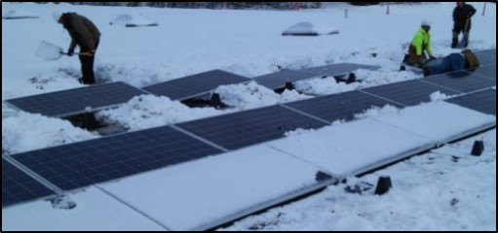
Cold Stress
Many solar installers work year-round
Exposure to cold inclement weather
Risk factors
Improper clothing
Wet clothing / skin
Exhaustion
Can lead to
Hypothermia and frostbite
Unsafe / poor quality work
Bad judgement
Source: sunvest.com
Notes:
And then on the other extreme- Unless you work in a year-round warm climate, chances are that as a solar installer you will work through the winter.
Some of the risk factors include improper/wet clothing or skin, exhaustion
In the winter days are shorter- installers are especially susceptible to cold stress at the end of a long day when they’re tired and racing to finish up a job, when temperatures drop, it’s getting dark out, and the body is exhausted- many of us have certainly been there.
This is a dangerous time for your health and safety- could get hypothermia or frostbite, you might drop something off a roof or forget to perform LOTO on equipment.
This is also a challenging time for system quality- you might forget to tighten down some bolts or plug in or secure connectors.

Slide 12
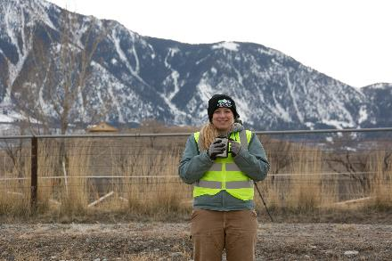
Preventing Cold Stress
Plan ahead
Perform interior work during cold or bad weather
Provide warm spaces
Space heaters
Building or truck
Drink warm, sweet beverages
Avoid caffeine
Dress properly
Layers of loose-fitting clothes
Insulated jacket, gloves, hat
Insulated, waterproof footwear
Notes:
What are some of the work practices you can do?
Plan ahead: this is something your company can do with scheduling. Do interior work during bad weather- conduit runs, BOS, etc. or diversify your product and service offerings so that there’s more indoor work in the winter- some companies will do general electrical work, energy efficiency retrofits, etc.
If you do need to work during super cold, wet weather- company can help provide hand and foot warmers, radiant heater to set up in the customer’s garage, go warm up in the truck.
Also recommended to drink warm, sweet fluids- avoid caffeine.
Then finally, dress properly: companies sometimes provide nice branded gear like a waterproof jacket or a warm hat. Some companies even provide an annual stipend for footwear.
Then again, your responsibility to play a role in your own safety by what you choose to wear on the jobsite and how well you take care of yourself

Slide 13
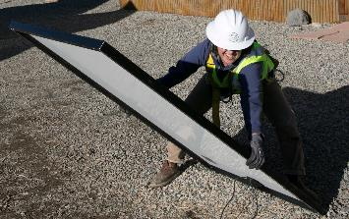
Overexertion
Work beyond your exertion abilities / physical limits
Lifting, pushing, pulling, holding, carrying, throwing
Lifting / mounting heavy equipment
Modules, inverters
Repetitive motions
Many modules
Pulling wire
Can lead to strains, sprains, tears, soreness, pain
Back injuries
Shoulder, arm, wrist, knee injuries
Notes:
-Moving on, let’s talk about overexertion
So what are you doing during a PV installation? Going up and down a ladder, working with tools and equipment on a sloped surface, pulling wire, mounting inverters, - you’re lifting, pushing, pulling, holding, carrying, tossing things
It’s not just about the first time you do something like lift a module. It’s what happens after the 10th or the 20th module you lift, after you’ve been pulling wire for 10 mins- those repetitive motions.
-These motions can lead to injuries- strains, sprains, tears, soreness, pain
-Back injuries are most frequent, followed by injuries to the shoulder, arms, wrists, knees
-These injuries can happen to anyone, I don’t care how young or strong you might be (sometimes it’s the over-ambitious people that wind up getting hurt)

Slide 14
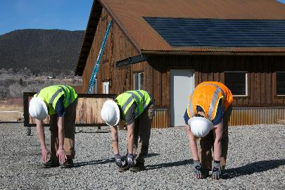
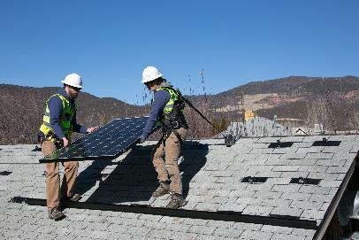
Preventing Overexertion
Protect your body
Know your limits
Stretch before work
Stay hydrated
Frequent breaks
Proper lifting techniques
Control methods
Module hoists, reach forklifts, etc.
2-person lifts
Modules, inverters, ladders, etc.
Notes:
Again, eliminate or control the hazards whenever possible. As a member of a PV crew, know your limits and don’t try to prove anything. You’ll be a way more valuable team member if you’re healthy and consistent. Stretch before work, stay hydrated, take lots of breaks, and practice proper lifting techniques.
-Do not attempt to lift by bending forward. Bend your hips and knees to squat down to your load, keep it close to your body, and straighten your legs to lift.
-Never lift a heavy object above shoulder level, especially by yourself
-Avoid turning or twisting your body while lifting or holding a heavy object.
Then there are the control methods- equipment we discussed in L1 to lift modules to the roof
Use 2 people to carry heavy equipment such as modules whenever possible. This will help to prevent overexertion as well as trips and fall hazards. We’ll get into how to safely carrying and mount modules later in this lesson.

Slide 15
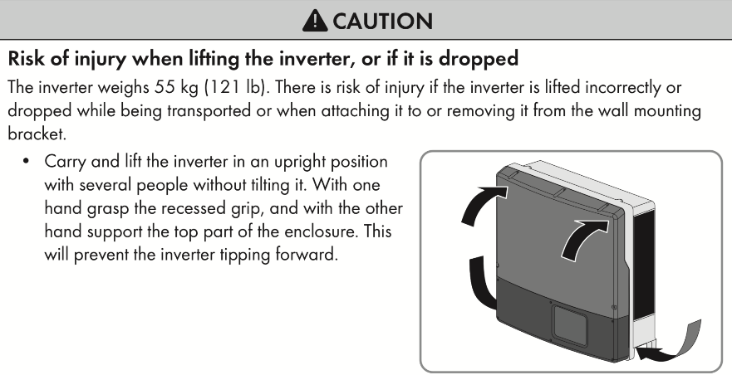
Preventing Overexertion
See manufacturer instructions for safety tips
Notes:
Finally, check installation instructions!
Manufacturers will sometimes provide tips on how to to safely manage equipment- here in SMA’s installation manual they point out that this inverter is heavy at 121 pounds; calls out specifically where and how to hold the inverter when mounting it to a wall, recommends a 2-person lift.

Slide 16
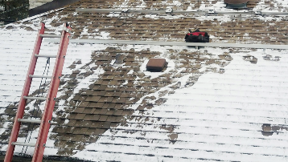
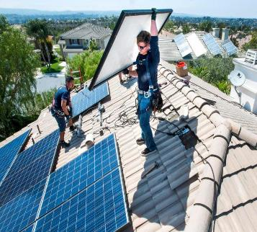
Slips, Trips, & Fall Hazards
Slips
Water, oil, ice, moss, etc.
Avoid wet metal roofs
Trips
Equipment, tools
Lifelines, cords
Round things roll!
Skylights, vents
Other people
Falls
Off roof, ladder, scaffolding
Through skylights
Notes:
- There are slips, trips, and fall hazards when working on a roof
-Slips are when a contaminant (water, ice, moss, mud, etc.) covers a walking or climbing surface and causes it to become treacherous. SO be careful when working in inclement weather!
-Your employer should perhaps call off the job if you’ve got an install on a metal roof in the rain- it’s a giant slide! But, it’s also up to you to recognize when something isn’t safe and speak up.
- Beware of north-facing roofs (here in the northern hemisphere)- often have moss build up, greater shingle damage.
-Trips are when a person’s foot contacts unexpected obstacles, causing a loss of balance. On a PV installation, there can be all sorts of things up on the roof- equipment and tools that you’re working with, safety gear like lifelines can cause a hazard because round things roll!, and also fixed objects like skylights or vents, then there’s other people on the roof that you can bump into or presumably both people are using fall protection so you can have moving lifelines
-Falls result from a loss of balance. You can fall off a ladder, off a roof, off scaffolding, through a skylight, etc.

Slide 17
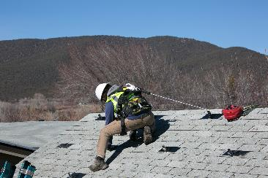
Protecting Against Slips, Trips, and Falls
Keep work site clean & organized, secure tools
Consider weather and roof surface
Avoid wet metal / shake roofs
Wear appropriate footwear
Engineering controls
Skylight covers, toe boards, etc.
Be aware of your surroundings
Never walk backwards
Communicate!
Use proper PPE
Fall protection, safety vest, etc.
Source: tritechfallprotection.com
Notes:
So what can you do- well remember, the first step is to always eliminate hazards- keep your work site clean and organized, secure tools. This will help with efficiency.
Also consider the weather and roof surface- avoid wet metal roofs, wear appropriate footwear
Then there are engineering controls like skylight covers and toe boards that can help control the hazard
And then safe work practices- be aware of your surroundings, don’t walk backwards, communicate with co-workers
And then there’s your PPE- the last line of defense. Remember from the intro lesson that PPE is totally necessary but it’s your least effective form of hazard control effectiveness.

Slide 18
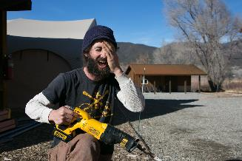
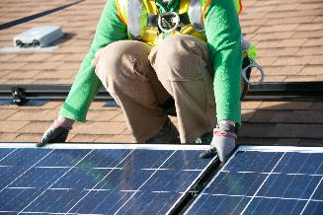
Struck By & Caught In/between
Struck by
Flying object
Falling object
Swinging object
Person
Caught in/between
Person (or body part) is crushed, squeezed, or pinched in between or under object
Cranes, lifts, or trenching (cave-ins)
Tools - especially if misused
PV equipment – rails and modules
Notes:
On a PV installation site, there’s also the hazard of being struck by something- a flying object like aluminum particles when you’re cutting rails; something falling off the roof; something swinging like a rail, or struck by another person that might be tripping or falling, or you just aren’t paying attention and you run into each other.
You can also get caught in or between or under an object, this includes getting hazards of lifting equipment like a crane, or getting your sleeve caught in a drill if you’re not paying attention, getting your hand caught under a module, etc.

Slide 19
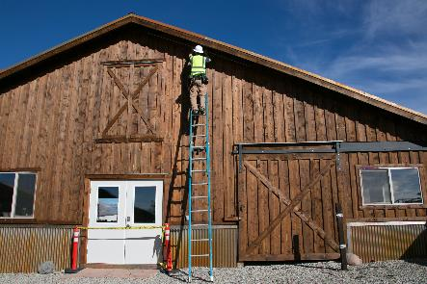
Struck by Falling Objects
Eliminate / minimize hazards from above
Establish restricted access zones
Mark falling objects hazard area with barricades and/or caution tape
Block doors with caution tape and/or cones
Erect canopy structure
Notify homeowner or tenants
PPE
Hard hats, safety glasses
Notes:
What can you do to eliminate or mitigate this struck by falling object hazard?
So first step- eliminate the hazards from above (we’ll talk more about managing parts on a roof later in this presentation).
Then, you can take control measures like establishing restricted access zones with barricades, caution tape, cones, etc. You can also erect a canopy structure to work underneath (also provides some shade). On every roof-mounted PV job site, there’s pretty much always people down below- homeowner, your own crew doing ground preparation, conduit runs, BOS, etc. Can notify homeowner or tenants of potential hazards from above.
Finally, you can wear hard hats, safety glasses that are rated to protect against falling objects

Slide 20
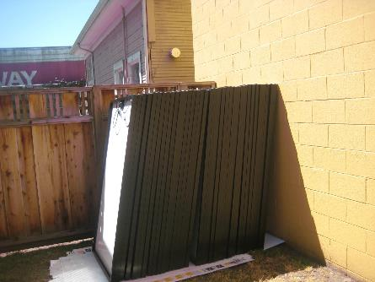
Caught In/Between Modules OSHA 1926.250
Hazard
Modules can fall
Worker can be crushed!
OSHA Safety Violation
All materials stored in tier shall be stacked, racked, blocked, interlocked, or otherwise secured to prevent sliding, falling, or collapse
Notes:
- One other thing to point out- stacking a large number of unsecured modules is actually an OSHA violation- 1926.250 states that all materials must be stacked, racked, blocked, interlocked, or otherwise secured to prevent sliding, falling, or collapse- which could certainly lead to injury or equipment damage

Slide 21
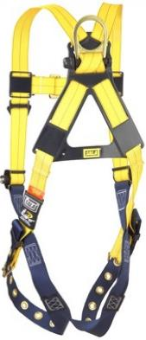
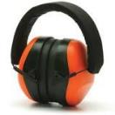
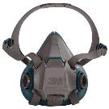
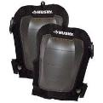
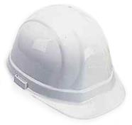
Personal Protective Equipment (PPE) OSHA 1926.95
Identify, eliminate control hazards first!
PPE is the last line of defense!
Fall protection
Eye / face protection
Ear protection
Hard hats
Gloves
Rated for electrical work as needed
Mask / respirator
Foot protection - shoes, work boots
Knee pads
Notes:
-Now let’s take a look at some personal protective equipment which may be worn during a PV installation- most of standards cited in this section are from 1926 Subpart E, section on Personal Protective and Live Saving Equipment
Remember, first identify and eliminate or control hazards as much as possible
-PPE is your last line of defense- purpose of PPE is to protect workers from injuries resulting from physical, electrical, or mechanical hazards
-Employees must be trained in the use and care of PPE
-There are a lot of different levels of PPE, depending on the work you’re doing. Examples include….
- Next let’s dive deeper into some of PPE listed here

Slide 22
PPE: Eye Protection OSHA 1926.102 / ANSI Z87.1
Ability to protect against specific hazards
Should fit properly & be reasonably comfortable
Should provide unrestricted vision & movement
Should be durable (impact resistant) & cleanable
Safety spectacles
Safety goggles
Standard sunglasses
Notes:
-OSHA requires that many categories of PPE meet or be equivalent to standards developed by the American National Standards Institute (ANSI). ANSI has been preparing safety standards since the 1920s, when the first safety standard was approved to protect the heads and eyes of industrial workers.
- Here we have eye protection- Ordinary glasses do not provide proper protection. Per ANSI standards, eye proteciont must protect against specific hazards, fit and be reasonably comfortable, provide unrestricted vision and movement, and be durable, impact resistant, and cleanable
-Safety spectacles are typically made of plastic or metal, have impact-resistant lenses, side shields available
-Safety goggles completely cover the eyes, eye sockets and the facial area immediately surrounding the eyes and provide protection from impact, dust and splashes. Some goggles will fit over corrective lenses.
- Remember, standard eye glasses or sunglasses do not provide proper protection

Slide 23

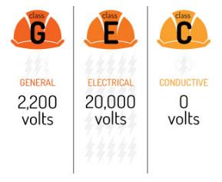
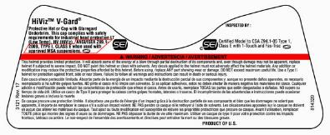
PPE: Head Protection OSHA 1926.100 / ANSI Z89.1
Must be worn when
Possibility of contact with fixed objects
Objects might fall from above
Possibility of head contact with electrical hazards
Overhead power lines
Class E hard hats
Protection from impact and penetration from falling objects
High-voltage shock and burn protection
CLASS E
Hard hat label example
Source: coopersafety.com
Notes:
It’s a good idea to wear a hard hard during all phases of a PV installation; hard hats not only protect from falling or fixed objects, but depending on the rating can also protect against electrical hazards like an overhead power line.
ANSI ratings for both type and class of hard hat:
Hard Hat Types: The two types of hard hats are defined by the area of the head that is protected.
Type I offers protection to the top of the head and is commonly used in the United States
Type II offers protection to the top and sides of the head and is commonly used in Europe
Hard Hat Classes: The three classes are based on the level of protection they provide from electrical hazards.
Class G (General) hard hats are rated for 2,200 volts
Class E (Electrical) hard hats are rated for 20,000 volts
Class C (Conductive) hard hats do not offer electrical protection
-Class E hard hats not only protect from impact and penetration from falling objects, also provide high-voltage shock and burn protection
-Here you can see an example of a hard hat label specifying that it is a type 1, class E hardhat -One other thing to note- hard hats must be replaced if they show signs of damage (dents, cracks, penetration, or fatigue due to rough treatment). It is essential to inspect hard hats each time they are used. In addition to visual inspections, another way to test a hard hat is to grasp it in two hands and apply force by squeezing the hat. If you hear creaking or other unusual sounds, it is time to replace the hard hat.
-While OSHA has no specific provision for an expiration date, manufacturers are allowed to determine if their equipment expires on a specific calendar date. In lieu of an expiration date, a generally accepted rule is to replace the support strap yearly and to replace the hard hat every five years. Harsh chemicals and extreme temperatures can make a hard hat degrade more quickly- something for solar installers to consider. Be sure to check with the manufacturer for guidelines on hard hat replacement and maintenance.

Slide 24
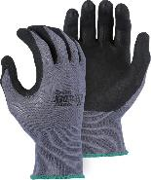
PPE: Gloves Electrical: OSHA 1926.97 / ASTM D120-09
Synthetic gloves
Commonly used for PV mounting work
Finger dexterity
Cut and abrasive-resistant
Resistant to some chemicals
Do not protect against electrical hazards!
Insulating rubber gloves
For electrical safety
See lesson on Solar Electric Safety!
Notes:
-Shown in the first picture are nitrile gloves, commonly used by PV installers. They allow for good mobility and dexterity, provide some protection against sharp objects and abrasive surfaces, but do not be fooled- they don’t provide protection against electrical hazards.
To provide electrical safety, you need something entirely different- insulating rubber gloves, which are classified by the level of voltage and protection they provide. Leather protector gloves worn over the top to provide mechanical protection.
More on electrical safety gear in the PV electric safety course!! (we just want to be sure you recognize the difference here)
- Rubber insulating equipment meeting the American Society for Testing and Materials (ASTM) D120-09, Standard Specification for Rubber Insulating Gloves.
national consensus standards is deemed to be in compliance with the OSHA performance requirments

Slide 25
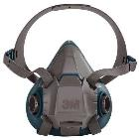
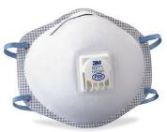
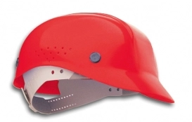
Working in Attic Spaces
May need to access
Structural info, upgrades
Conduit runs
Be aware of hazards
Dust & particles
Fiberglass
Asbestos
Nails through roof deck
Exposed electrical wiring
Falls between joists
Low light levels
Heat
Mold
Plan work to limit time in attic
Wear proper PPE
Eye protection
Proper mask / respirator
Long sleeve shirt
Hard hat or bump cap
Notes:
If attic access is available, it’s likely that solar installers will access it. Might just be for a short time to gather structural information- rafter size, spacing, etc. Or could be for a longer period of time- to do structural upgrades, run conduit
There’s lots of hazards that can exist in an attic space…(list)
Really important to minimize any time spent in the attic (certainly take breaks if working in there for a long time); wear proper PPE
When work requires a respirator, the employer needs to provide a respiratory protection program that includes medical evaluations, fit testing, and training for respirator use.
Much more PPE is required to work safely around asbestos and certain molds

Slide 26
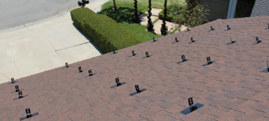
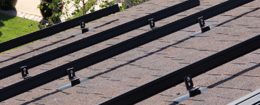
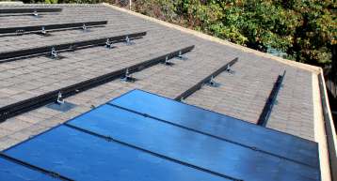

Roof-mount Installation Process
Ground preparation
Lay out PV array
Install flashings / mounting brackets
Secure rails to mounts
Complete pre-wiring and/or MLPE installation
Mount & secure modules
All workers exposed to fall hazards ≥ 6 feet must use proper fall protection
Notes:
-Now that we’ve described some of the hazards that may exist during racking and mounting work, let’s walk through the basic steps of an installation and identify where some of the hazards may be present: (list)
-As we go, we’ll talk about not only safety requirements but also best practices for working safety and efficiently
- Remember from lesson 2 on fall protection, whenever you’re exposed to a fall hazard of 6 ft or more, you must use proper fall protection

Slide 27
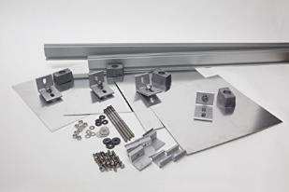
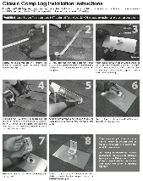
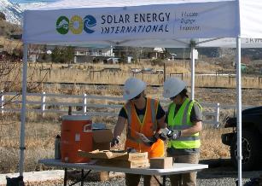
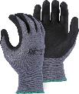

Ground Preparation
Study plan sets & component instructions before going to roof
Pre-assemble hardware (clamps, ground lugs, splices)
Beware of falling objects
Complete drilling or cutting work - use eye and ear protection, and gloves
Notes:
First step, ground preparation.
Complete as much preparation and planning work as possible BEFORE you go up to the roof. Take the time to study plan sets before going to the roof- get a good feel for array location, distance between attachment points, access pathways, take note of any roof obstructions like skylights or vents and the plan for the module layout to avoid them.
Hardware for mounting brackets and module mid and end clips sometimes does not come pre-assembled, depending on the manufacturer- so if you have to assemble these parts, find a safe comfortable space on the ground to put these small parts together. Locate somewhere free from any threat of falling objects, for instance beneath a canopy away from the roof
Or even better yet- do this at the shop before you even get to the job site to minimize the time you spend there (exposed to heat, cold, daylight constraints, etc.). Thinking ahead and planning like this is one way to be more efficient- many companies strive for one-day installs.
Also complete any drilling or cutting work you can do on the ground, and be sure to wear proper PPE

Slide 28
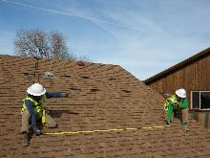
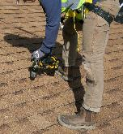
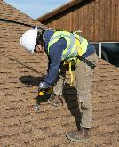
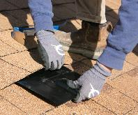
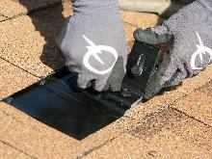
Array Layout
Slips, trips, falls, falling object hazards
Installers typically traverse the roof when laying out array
Be aware of your surroundings - never walk backwards
Wear proper fall protection!
Tool hazards - overexertion, caught in/between
Ensure a safe, stable body position before using tools
Wear gloves, eye protection
Notes:
- Next step is the array layout. You’re up on the roof you have tools with you- tape measure, hammer to find rafter, drill with finder bit, chalk line, etc. but you don’t have any mounts or rails installed yet, so unless there’s somewhere safe to set these items, you have to be really careful about tripping, falls, and falling object hazards- good idea to have a secure tool bag, tool lanyard,
Installers are often likely traversing the roof as they are laying out the array, so make sure your fall protection is set up for all areas you might access, and be careful of roof edges, skylights, etc.
Beware of insects like wasps!
Once you actually start using drill, ensure a stable body position, wear proper PPE like gloves and eye protection.

Slide 29
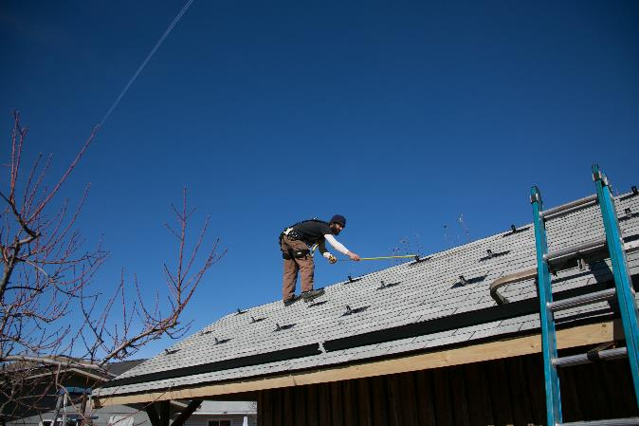
Never Walk Backwards on a Roof
Installer is walking backwards and not roped in!
Notes:
Remember, it’s really dangerous to walk backwards on a roof! Especially a hazard when you’re doing a layout with tape measure in hand.
Here, installer is wearing harness but not roped in!
Remember the fatality we saw in lesson 2 with the installer who doing something to line up mounting rails- stepped backwards and fell to his death on the concrete below

Slide 30
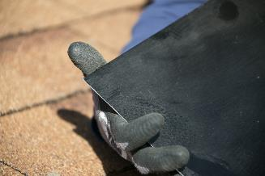

Flashings and Mounts
Wear gloves to protect hands
Flashings have sharp edges
Caution using utility knife blades
Be aware of roof sealant
Avoid contact with lifelines & harnesses
Don’t leave flashings unsecured
Drills may twist, be prepared
Safely position body to avoid caught in-between, overexertion, fall hazards
Notes:
You’ve located your structural members, now it’s time to get the flashings and mounts installed, which nowadays are an all-in-one product.
These things are sharp!- typically cut aluminum. Wear gloves, be careful when using blades to cut shingles.
Be careful when using roof sealant- it can get all over things and create untidy work place.
Don’t leave flashings unsecured. Some installers will tuck them under shingles near the attachment point, but especially on a steeper roof, they can slide free and create a serious hazard. So keep them secured in a box until you’re ready to install them.
Be careful with drills, they may twist and you can lose your balance or get a glove or loose sleeve caught. Safely position body

Slide 31


Mounting on Tile Roofs
Tile cutting exposes workers to hazards
Silica dust
Wet grinding / cutting
Vacuum collection
Saw / grinder blades
Keep fingers away!
Electrical cords
Wear proper PPE
Respirator
Gloves
Eye and ear protection
Wet cutting; cut tiles on ground when possible
Source: Quick Mount PV
Source: Quick Mount PV
Notes:
-Lots of PV being installed on tile roofs, especially in places like CA where you have a very strong solar market and a lot of tile roofs.
-When cutting tiles, installers can be exposed to silica dust- those that inhale these very small crystalline silica particles are at increased risk of developing serious silica-related diseases, including silicosis, an incurable lung disease that can lead to disability and death; Lung cancer; Chronic obstructive pulmonary disease (COPD); and Kidney disease
Blades can also pose the risk of getting cut
Also be careful of electrical cords, as they’re commonly a corded tool
- Important to know the hazards and wear proper PPE- respirator, gloves, ear and eye protection. Wet grinding and cutting is the best method of protection.
-To better protect workers exposed to respirable crystalline silica, OSHA has issued two new respirable crystalline silica standards: one for construction, and the other for general industry and maritime. OSHA began enforcing most provisions of the standard for construction on September 23, 2017

Slide 32


Hazards Working with Rails
Rails (~ 14’ - 20’) are conductive aluminum
Must maintain minimum 10’ clearance from < 50 kV
Many houses have service entrance cables near roof
Contact between rail & utility power line may cause electrocution
Electrical hazard AND person on roof not wearing fall protection!
Notes:
- You’ve got your flashings and mounts installed, now it’s time to bring those aluminum rails up to the roof. These are typically 14-20’ long, they’re conductive aluminim
-‘OSHA’s standard requires that all equipment – ladders, scaffolds, cranes, trucks, forklifts, etc. – MUST maintain a minimum 10 foot clearance from 50 kV or less, including service entrance cable (unless insulated- which they might be, but you need to assume they’re not.
Contact between rail and power line can cause electrocution as electricity is seeking a path to ground through the conductive object, which can include you. Why we stay away from power lines, we use fiberglass ladders, better to set up the ladder, hand your rail up, in a different location entirely.
Here in photo they’re awful close to power line with aluminum rail, person on roof also not wearing fall protetction
https://www.osha.gov/dte/grant_materials/fy09/sh-19504-09/electrical_safety.pptx

Slide 33

Solar Installation Fatality
A solar installer was electrocuted & fell off a scaffold to his death after a 20-foot mounting rail contacted a high voltage power line
Source: cdc.gov
Notes:
In 2009 a solar installer was electrocuted and fell off a scaffold to his death after a 20 ft mounting rail contacted a high voltage power line.
So again, these hazards are real and accidents, sometimes fatal, to happen

Slide 34


How to Safely Manage Rails
Be aware of surroundings
Overhead powerlines
Set up ladders away from power lines
Ropes, lifelines, extension cords
Other workers
Create site-specific safety plan
Engineering controls
Request for utility to wrap power lines
Remind workers each day at safety meeting
✓
Notes:
Awareness is critically important when handling rails! Be aware of your surrounding
If you need to change orientation of a rail or move it on the roof, always keep in low to the roof, be aware of swinging radius, walk with rail down in front.
As part of the job hazard assessment, consider engineering controls such as requesting utility place an insulated wrap around the power lines or even disconnect power from the pole, and a daily reminder at tailgate meetings.

Slide 35



Managing Parts on the Roof
Keep small parts in bags or boxes (no buckets)
Wear tool belts with zippered bags
Nuts and bolts, module clamps
Tools secured behind rails or in anchored bags
When task is complete, remove unneeded tools
✓
Notes:
We talked earlier about protection from falling objects, and this starts with proper management of equipment, tools, and small parts on the roof.
Keep items in bags or boxes (we recommend avoiding buckets because they can roll if tipped over) that can be secure- hang from unused anchor point, secure behind rails, toe board, skylight, scaffold, etc.
Be careful if you’re using a tool belt that has open pouches- you want something with zippers or a way to prevent objects from falling out- installers might be leaning over to access underneath an array and you don’t want things to fall out.
Continuously clean up and organize- remove tools or any parts you no longer need

Slide 36


Prevent Falling Objects
Erect toe boards, screens, or guardrail systems
Rails can be used to position people & materials
Fall protection still required, don’t anchor to rail
Ensure rails are properly secured!
Tie tools to carabiners & clip to tool belt
Source: quickmountpv.com
Source: blueridgercd.com
Notes:
To further elaborate because this is a really important concept…
The falling object could be you!- On steep roofs it’s common practice to install rows of rails and work up the roof. This doesn’t meet the definition of fall protection so fall protection equipment is still required, but rails can provides a lot of support for positioning yourself and your tools/equipment.
If doing this, be sure to tighten your bolts to the proper torque settings and then re-tighten after you’re done climbing on them.
Lanyards for tools
http://www.blueridgercd.com/projects/

Slide 37

Mounting Prep Work
Prep module & wires on ground whenever possible
Follow manufacturer’s instructions & safe practices
Module mounting brackets for MLPE (module level power electronics )
Maximize ground work to minimize roof work!
Source: quickmountpv.com
Notes:
Rails are installed, now it’s time to mount module level power electronics (MLPE) and do any prewiring.
Do as much of this on the ground as possible. Pre-tie your module leads so that you can quickly connect them once they’re installed.
Manufacturers offer MLPE mounting brackets that allow you to manage the module leads on the ground.
Always follow manufacturer’s instructions
See the PV Electric Safety course for wiring safety

Slide 38

Safely Staging Equipment
Never pile equipment or supplies on roof
Structure has a limited load capacity
Spread out rather than concentrate in one spot
Sloped roofs, one module to roof at a time
Unsecured modules could get blown / fall
MLPE
Install one at a time
Leave others in box
Notes:
Also the structure may not be able to handle the heavy concentrated load- spread out
On a sloped roof, best practice to bring one module to the roof at a time and mount it, then move to the next- can present a falling objects hazard- wind, etc.
Some equipment (reach forklift, module hoists, etc.) will bring multiple modules up at a time, the key is that the modules are in a safe stable place while awaiting install.

Slide 39


Safely Carrying Modules
No 3 points of contact on ladder
No fall protection
Could lead to overexertion, fall hazards
Notes:
-Finally, let’s look at some examples of unsafe practices- you can see the installer climbing the ladder is not maintaining 3 points of contact as we discussed in the ladder safety course, no fall protection is used by the installer on the roof, and 1 person carrying a module like that can certainly lead to some overexertion injuries.

Slide 40


Safely Carrying Modules
Ok
Better
✓
Not OSHA violation but could lead to hazards
Overexertion, falls
Modules weigh 30-50 lbs.
15+ modules per job
2 people per module
Establish firm grip
Less susceptible to wind gusts
Establish clear pathway
Avoid tripping/fall hazards
Notes:
Here are some examples of better ways to carry modules.
In the picture to the left, the installers do look like they’re being careful and using fall protection, but you’ve got tripping and overexertion hazards, better to carry with 2 people.
Picture to the right is better with the 2-person carry, want to establish a firm grip (a module becomes like a sail in a wind gust!) and a clear pathway.

Slide 41

Safely Mounting Modules
No fall protection
Overexertion
Use 2 people
Practice safe lifting techniques
Falling objects
Unsecured modules
Mid and end clips
Tools
Notes:
- Here, we have someone trying to mount modules by themselves- overexertion and an unsecured module creating a falling objects hazard (you can also see the module is mounted way out of the manufacturer mounting zone!)

Slide 42


Safely Mounting Modules
One person holds module securely in place while the other person clamps it to the racking
Notes:
- Always mount modules with 2 people: one to keep the module secure, one to secure it to the racking.

Slide 43


Solar Installation Fatality
A solar installer fell through this skylight to his death while carrying a solar module
Skylight should be properly guarded & personal fall protection used
✓
Notes:
Another solar installation fatality. In 2009, an installer accidentally stepped through this skylight and fell to his death.
Hazard assessment was conducted prior to start of work, but no engineering controls to guard skylights or personal fall protection were used.
- Options include skylight screens and guardrails

Slide 44


Working with PV Modules
Do not lean, stand or walk on modules
Slipping / fall hazard
Can damage modules
Micro cell cracks even if glass does not break
Violate manufacturer’s installation instructions / warranty
Notes:
Don’t stand on PV modules, either during install or maintenance. They’re made of glass, so they’re slippery, especially when wet or dusty.
Also presents a quality issue- as standing or walking on a module can create micro-cracks not visible to the eye. Many PV manufacturers specifically call this out in their installation manuals.

Slide 45

Finishing Up
Cutting rails after modules are installed
Wear eye and ear protection
Beware of roof edges - keep using fall protection!
Do not drop rail pieces off roof
Never use tools with missing guards or other protection
Use eye and ear protection when cutting rails!
Notes:
- After everything is installed, commonly go around the array and cut extra rail to create nice aesthetics.
Wear proper PPE! Fall protection, gloves, eye/ear protection, don’t drop loose rail pieces
Make sure guards are on tools if you’re using a sawzall or bandsaw

Slide 46
Additional Resources
OSHA (Occupational Safety and Heath Administration)
Quick Card 3154: Protecting Workers from Heat Stress
Quick Card 3156: Protecting Workers from Cold Stress
OSEIA (Oregon Solar Energy Industry Association)
Solar Construction Safety
Cal/OSHA
Preventing Worker Deaths in the Solar Industry
Notes:
https://www.cdph.ca.gov/Programs/CCDPHP/DEODC/OHB/FACE/Pages/Solar.aspx

