Slide 1
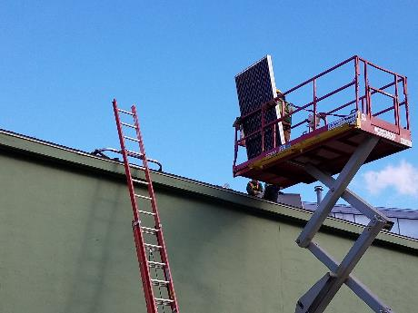
Ladder and Lift Safety
Disclaimer: This material was produced under grant number SH-31237- SH7 from the Occupational Safety and Health Administration, U.S. Department of Labor. It does not necessarily reflect the views or policies of the U.S. Department of Labor, nor does mention of trade names, commercial products, or organizations imply endorsement by the U.S. Government.
Notes:
Welcome to the SEI presentation on Ladder and Lift Safety.

Slide 2
Learning Objectives
Choose appropriate ladder(s) for a PV system installation
List requirements for proper ladder inspection, set up, and use
Identify equipment and methods for safely lifting PV modules and materials to the roof
Notes:
Upon completion of this course, participants will be able to:
Choose the appropriate ladder(s) for a PV system installation
List requirements for proper ladder inspection, set up, and use
Identify equipment and methods for safely lifting PV modules and other materials to the roof

Slide 3
Why is Ladder Safety Important?
Falls from ladders are leading cause of deaths on construction sites
Most ladder deaths are from falls of 10 feet or less
Ladders included in top 10 most frequently cited OSHA violations in 2017
OSHA Part 29 CFR 1926 covers construction industry
https://www.nachi.org/ladder-safety.htm
Notes:
Falls from ladders are the leading cause of deaths on construction sites
Most ladder-related deaths happen from falls of 10 feet or less – need to think about ladder safety whenever you get on a ladder, no matter how high or how simple the task
Falls are leading cause of ladder injuries, then using ladder improperly, using a faulty or defective ladder, followed by carelessness
You’ll be going up and down a ladder all day on an installation- it’s critical that you use the right ladder for the job, inspect it, set it up and use it properly to avoid becoming a statistic!
If your own safety isn’t important enough to take ladders safety seriously, consider that there’s a high likelihood of your contractor receiving a fine for you not following the OSHA standards in the area, which may mark the end of the job.
Remember, OSHA standards save lives- OSHA is not the enemy!

Slide 4
Employer Responsibility - Ladders OSHA 1926.1060(a)
Employer shall provide training program for each employee using ladders
Trained by competent person
Identify fall hazards in work area
Proper construction, use, placement, & care in handling all ladders
Maximum intended load-carrying capacities of ladders
Retraining as necessary
Employee Safety Training
Notes:
Under OSHA law, employers have a responsibility to provide a safe workplace. They must provide a workplace free from serious recognized hazards and comply with standards, rules and regulations issued under the OSH Act, examine workplace conditions to make sure they conform to applicable OSHA standards, make sure employees have and use safe tools and equipment and properly maintain this equipment, use color codes, posters, labels or signs to warn employees of potential hazards, establish or update operating procedures and communicate them so that employees follow safety and health requirements, and employers must provide safety training in a language and vocabulary that workers can understand.
Employers have a responsibility to keep their employees safe, and must provide a training program for each employee using ladders
An OSHA "competent person" is defined as "one who is capable of identifying existing and predictable hazards in the surroundings or working conditions which are unsanitary, hazardous, or dangerous to employees, and who has authorization to take prompt corrective measures to eliminate them" [29 CFR 1926.32(f)].
Explain listed training requirements for working with ladders

Slide 5
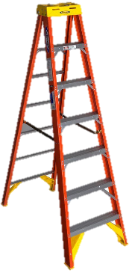
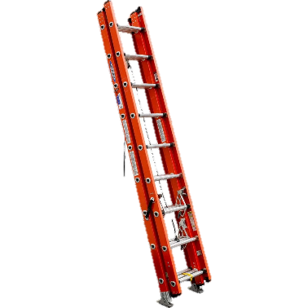
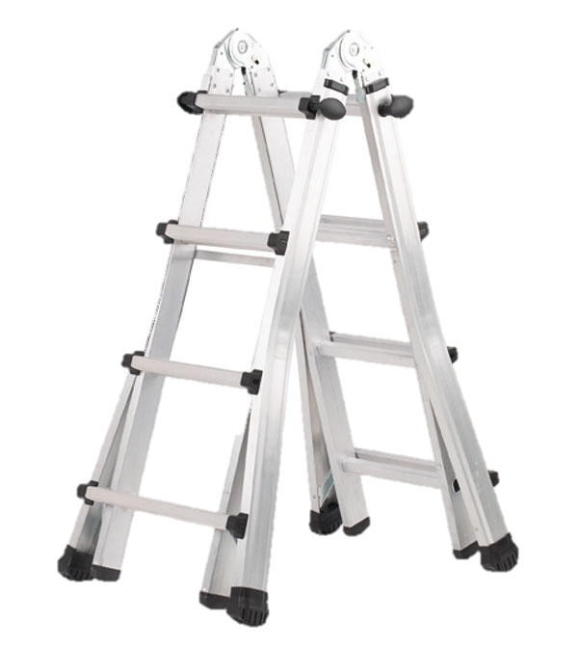
Portable Ladder Types
Stepladder
Self-supporting, portable ladder with fixed height, flat steps, & hinged back
Extension ladder Non-self-supporting portable ladder, adjustable in length
Combination ladder
Portable - may be used as stepladder, extension ladder, trestle ladder, or stairway ladder
Notes:
Review different ladder types- first step in choosing the correct ladder for a job
Stepladders are self supporting- great for running conduit in attics or basements. Step ladders require level ground support of all four feet and there needs to be a clear space to set the ladder up where the work will happen.
Extension ladders are adjustable in height and need to be leaned up against a stable structure such as a building. They are commonly used to access the roof of the building during a solar installation.
There are also combination ladders that can be set up as either a step ladder or can be made flat like an extension ladder.

Slide 6
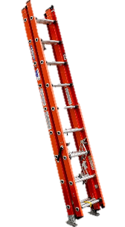
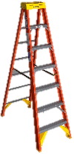
Portable Ladder Materials
Wood ladders
Non-conductive, but some made with metal fasteners → not suitable for electrical work
Aluminum ladders
Lightweight, easy to transport. Do not use near power lines or electrical wiring
Fiberglass ladders
Durable, non-conductive side rails, safe to use near power lines & electrical wiring
OSHA 1926.1053(b)(12)
Notes:
The next consideration when choosing a ladder is the material that the ladder is made out of.
Working near sources of electricity means you need to use a ladder made with non-conductive material
You don’t want your body to complete the electrical circuit- the electrical source, your body, the ladder, ground.
An electrical shock on a ladder could cause you to lose balance and fall
Wood ladders, while the wood is not conductive, there are metal fasteners making it not appropriate to use for electrical work
Aluminum ladders are light weight, making them a preferred choice when not doing electrical work
Fiberglass ladders overall the best fit for a PV installation since they are non-conductive, not to mention they are built to last
Note- for certain parts of a solar installation, when not working near an electrical source, it may be safe to use a ladder other than a fiberglass ladder. But having multiple ladder types available on a site can increase that odds that someone may grab the incorrect ladder and be exposed to a hazard.

Slide 7
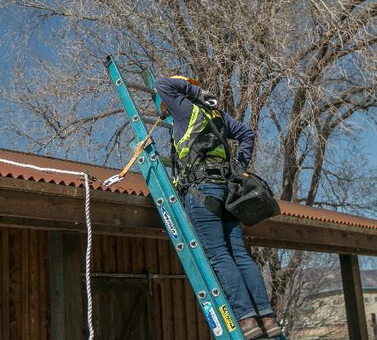
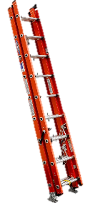
Portable Ladder Duty Ratings OSHA 1926.1053(b)(3)
Load Rating
Person → 200 lbs?
Tools / Equipment weight → 60 lbs?
Total → 260 lbs → Type IA or IAA
Load Capacity | ANSI* Code
200 lbs. / 91 kg | Type III
225 lbs. / 102 kg | Type II
250 lbs. / 113 kg | Type I
300 lbs. / 136 kg | Type IA
375 lbs. / 170 kg | Type IAA
* American National Standards Institute
Notes:
Ladders have a load rating that you can find on the ladder label. This load rating includes the weight of the person (including clothing and PPE), any equipment/tools they may be carrying or may be stored on the ladder. Do not exceed the manufacturer's rated capacity.
ANSI stands for American National Standards Institute. This is a national (USA) standards rating organization that oversees the creation of standards, including ladder ratings standards. See chart on screen for ladder ratings and ANSI codes.
Consider all employees on the jobsite and choose a ladder that is safe for any employee that may use it.
In most circumstances, it is smart to use a Type IA or Type IAA ladder to ensure the rating is not exceeded.
Note that for single-sided step ladders, the duty rating is only for the one side with steps that it’s safe to use. There are also dual-sided, or twin stepladders- for these the duty rating is per side. So if you had a 300 lb. load capacity twin stepladder, that’s 300 lbs. per side.

Slide 8
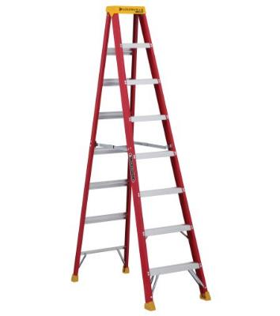
Stepladder Size OSHA 1926.1053(b)(13)
Maximum Reach
Stepladder Label
x
300 lbs.
136 kg
Type IA
8’
12’3”
5’8”
x
Load Capacity
Duty Rating
Highest safe standing level
is two steps from the top
Ladder Size
Maximum Reach
Highest Standing Level
Ladder Size
OSHA
* Stepladder size ≈ Desired maximum reach - 4 feet
Notes:
The final main factor required for proper ladder selection is size. We will be talking about ladder setup requirements in more detail later in this lesson, some of which are important for determining the correct ladder size for a specific job
Focusing on stepladders first- the top platform of a step ladder and the top step should not be used as a standing platform due to instability.
Ladder labels may give multiple different length values. It is important to know the difference in order to choose the right ladder for the job
Ladder size is the actual physical length of the ladder
Maximum reach is an estimate of how high a person can safely reach, assuming a 5’6’ person
The highest standing level is based on the ladder height and the fact that it is not safe to stand on the top two steps of the ladder.

Slide 9
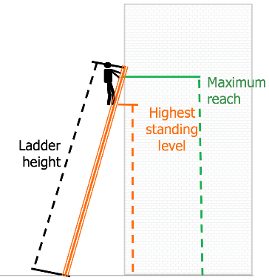
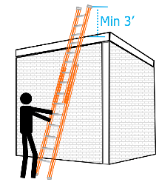
Extension Ladder Size
Extension Ladder Label
375 lbs.
170 kg
Type IAA
24’
23’
17’5”
Load Capacity
Duty Rating
Ladder Size
Maximum Reach
Highest Standing Level
OSHA
* Ladder height ≈ Height to gutter or top support + (7 to 10 feet)
Accounts for ladder angle, overlap of ladder sections, highest standings level
** To access roof/platform, ladder must extend 3’ above surface
Notes:
Ladder labels for extension ladders may have similar attributes listed
To figure out the extension ladder size needed, you can typically estimate 7 to 10 feet above the height of the building. This will account for things that we will talk more about later in this lesson such as the proper angle for ladder placement, the overlap of ladder sections and the highest level it is safe to work on an extension ladder.
Selection of proper extension ladder size requires knowledge of the height of the top support point. In the event the top support point is a roof eave, the top of the extension ladder must extend 1-3 feet above the roof eave if the climbers’ intent is to access the roof.
The purpose of the 3’ minimum is not always understood- it acts as support to the worker getting on and off the ladder. There is no maximum.
An Extension Ladder must never be placed upon other objects such as boxes, barrels, scaffolds, or other unstable bases in an effort to obtain additional height. Extension ladders or the ladder sections must not be tied or fastened together to provide a longer length unless specifically designed for the fastening means employed.

Slide 10
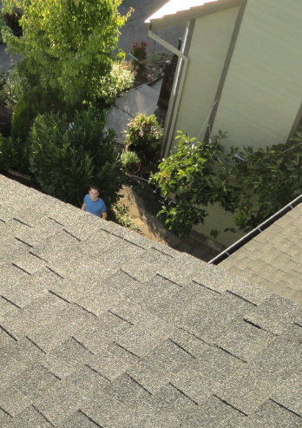
Pre-installation Site Visit
Assess installation work zones & access points
Identify potential hazards & hazard zones
Determine ladder style, material, duty rating, size
Job Hazard Analysis (JHA)
Competent person
Notes:
A site visit helps determine the viability of a PV site for an installation. This is also an opportunity to assess the site and map out where the work will be taking place, how employees will access those work zones, and what equipment is needed to do so safely.
The site assessor should also be looking for potential hazards in order to make a plan of how to keep the crew safe on the job.
A job hazard analysis is a technique that focuses on job tasks as a way to identify hazards before they occur. It focuses on the relationship between the worker, the task, the tools, and the work environment. Ideally, after you identify uncontrolled hazards, you will take steps to eliminate or reduce them to an acceptable risk level (from OSHA 3071 publication).

Slide 11
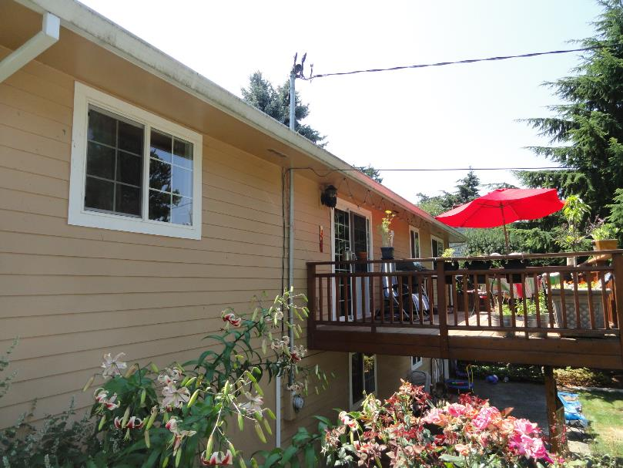

Pre-Installation Site Visit: Identify Work Zones and Access Points
Roof work zone
Array on south roof
Indoor attic access
Roof access by extension ladder
Solar conduit run through eve, down south exterior wall
9 ft
Conduit work zone
Notes:
Talk about the roof zone for array installation
Need to set up ladder for roof access
Talk about conduit run and how to access
It is also helpful to check out the attic to evaluate if a ladder is needed to access this space

Slide 12
Pre-Installation Site Visit: Identify Hazards
Hazards! In Attic
Hazard!
Overhead power line
Min 10’
Min 10’
Hazard!
Pathway
Hazard!
Wood deck slippery if wet
Hazard!
Obstructions / uneven surface
Notes:
After the work zones have been defined, it is important to identify possible hazards on the job site
Overhead power lines for a service drop are a hazard on a work site
Could be an issue when setting up/moving ladders, bringing equipment to the site, or moving rails/conduit around.
A minimum distance of 10’ on either side of the power lines is required to keep workers safe
Since the deck makes for a shorter distance to the roof, it could be a great area to stage tools and equipment and also place the ladder to access the roof
If there has been rain or snow, this area could be slippery
There is a sliding glass door that opens on to the deck. It may be a good idea to put prevent people from coming in/out that door while work is happening because they could be at risk from possible falling objects
Having the conduit bringing the wires from the PV array down near the service drop conduit could make a clean conduit run
The access to that location has some plants as obstructions and the surface is uneven

Slide 13
Pre-Installation Site Visit: Determine Equipment
Roof access
extension ladder height = 9’ + 7’
= 16’ Type IAA fiberglass extension ladder (can use conduit installation ladder)
Roof work zone
Indoor attic access
Roof access/staging
17 ft
9 ft
Conduit work zone
8’ Type IA
step ladder needed to access attic
Conduit installation
extension ladder height = 17’ + 7’
= 24’ Type IAA fiberglass extension ladder, ladder stabilizers, tie off
Notes:
Finally, determine what ladders are needed for this site
To access the roof the distance from the deck to the gutter is 9 feet. Using the general guideline for extension ladder sizing, you can add 7 feet to that height and get a full extension ladder height of 16 feet. Since employees will be working near electrical power sources, this will be a fiberglass ladder.
To install the conduit on the side of the building, the ladder will be located on the ground (not the deck) so it will need some more height. 17 feet + 7 feet = 24 feet total. This ladder will also be a fiberglass ladder.
At this home, there is an attic access hole that requires an 8 foot step ladder to safely access the attic. Not this ladder could be either fiberglass or aluminum.

Slide 14
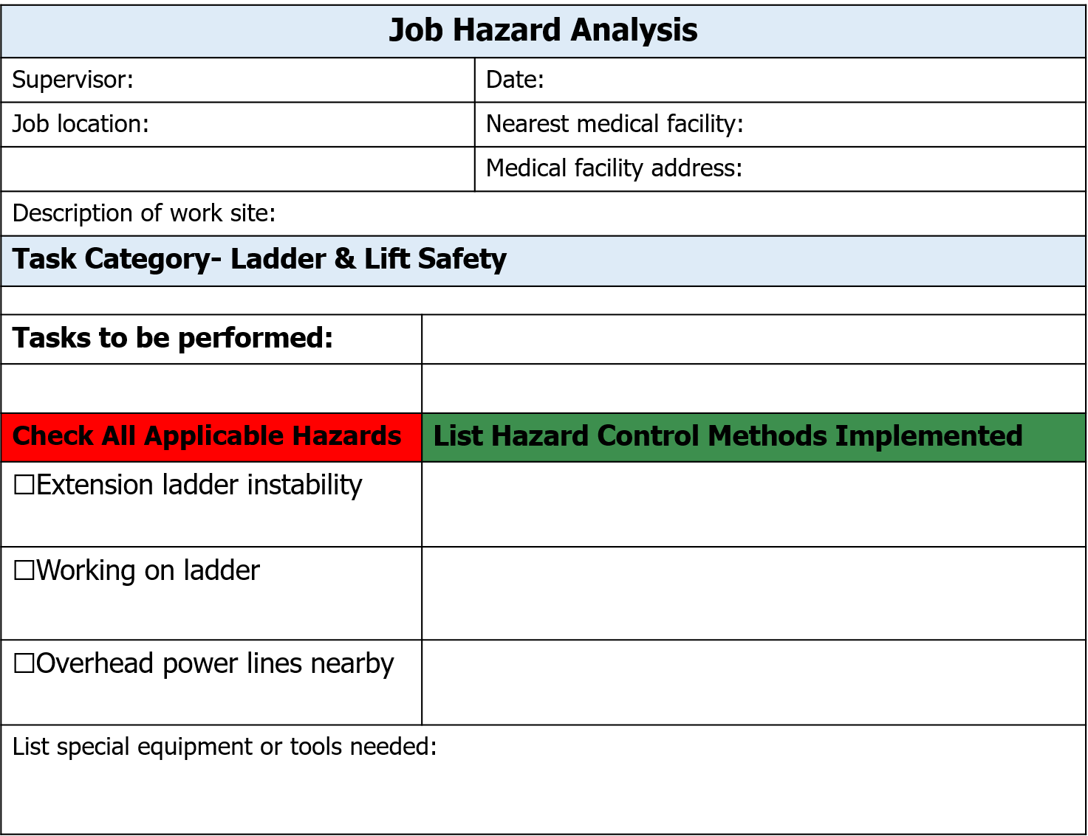
JHA
Kayla
1/1/2018
39854 Matthews Ln.
Paonia, CO
Delta Hospital
1501 E 3rd St. Delta, CO
Two story building with overhead utility line
Installing conduit
Getting on the roof
☑
Ladder location determined /set up by a competent person, may need levelers
☑
3 points of contact when moving up or down the ladder
☑
Use non-conductive ladder, get utility to wrap power lines
24’ fiberglass extension ladder, 8’ step ladder to install conduit, levelers, ladder tie-off
Notes:
Here is an example of an Job Hazard Analysis form, something like this form should be filled out for every job site
The top section includes basic information about the site, nearest medical facility, and a basic description of the work to be performed
The second section varies depending on what stage of the installation is happening. This example shows information for installing conduit and getting on the roof.
There are a list of possible hazards listed, and any that are present on the job site should be checked off
The right hand column labeled “List Hazard Control Methods Implemented” is a location that can be customized for each site and is a place where you can list the various ways to mitigate the hazards on site.
The last section of the form is a place to list any special equipment or tools needed for the jobsite.

Slide 15
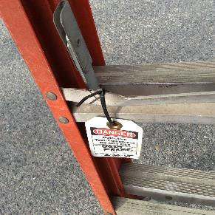
Ladder Inspection OSHA 1926.1053(b)
Inspected by competent person each work shift
Free of oil, grease, and other slipping hazards
Identify any visible defects
Replace damaged labels
If structural issue or defect found
Immediately tag “Dangerous: Do Not Use” or similar language
Remove from service until repaired or replaced
If unrepairable, destroy it!
Notes:
In order to protect workers, OSHA requires that Ladders are inspected by a competent person for visible defects on a regular basis or if something happens that might affect the integrity of the ladder.
It is helpful to use a ladder inspection checklist to ensure that all parts of the ladder are inspected and the ladder is in good shape to be used
Something that is important to look for when inspecting a ladder is to make sure the steps don’t have any oil or grease on them which could cause a person to slip
If there are any issues with the ladder, it should be tagged with a sign that says “Danger: Do not use” (or similar) and be removed from use. Some examples include:
Broken or missing rungs, cleats or steps
Broken or split rails
Corroded components
It’s important to ensure it is not used until repaired or replaced. If unrepairable, destroy it! You don’t want to risk someone else finding it in the dumpster and deciding to use it. Duct tape is not a good repair for a broken rung!
Any repairs must be done in accordance with the manufacture recommendations.

Slide 16
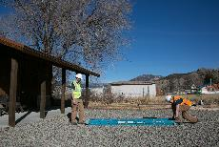
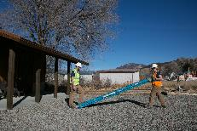
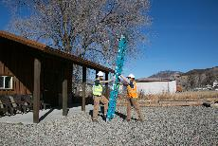
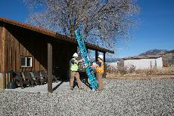
Ladder Setup & Handling
Do not drag or drop ladder
Be sure extension ladder is facing the correct way
Get help to safely set up ladder
Especially long ladders
Ensure extension ladder rung locks are engaged and step ladders are fully open
Notes:
Since most people have some familiarity with ladders, it may seem strange to talk about the details of setting up and handling ladders. But many people have never been trained on how to use a ladder properly, so there are always new things to learn or remember.
In order to keep a ladder in good working condition, don’t drag or drop a ladder
Be sure the extension ladder is facing the correct way- the fly section must be at the top and the base section at the bottom
Shown here is a safe sequence for setting up an extension ladder using two people.
Step ladders need to be fully opened and secured before a person uses them.
Before walking on an extension ladder, it is important to make sure the rung locks are engaged so the ladder does not side under the weight of a person.

Slide 17
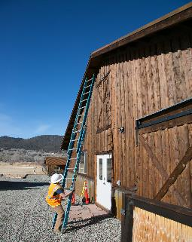
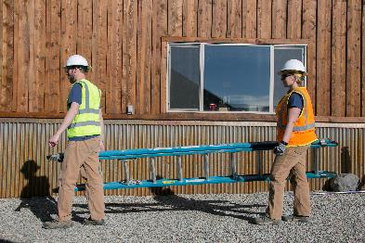
Ladder Setup & Handling
Do not carry in extended position
Retract ladder before relocating
Top heavy and awkward
Two people to carry
✓
Notes:
It’s tempting to try to “walk the ladder” to get it to a new location- do not do this, it is dangerous! Never attempt to move the ladder without first descending, relocating the ladder, and then re-climbing.
Do not attempt to mount the ladder from the side or step from one ladder to another.
Never move a ladder when someone is on the ladder because this creates a dangerous situation.
Also don’t try to move an extension ladder when it’s in the extended position- it is long, can be unbalanced, and is awkward. A ladder should not be carried in this position. The ladder should be shortened to make it more manageable and is best carried by two people.

Slide 18
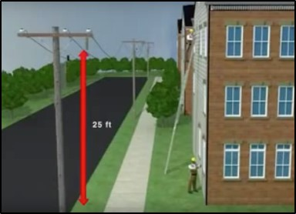
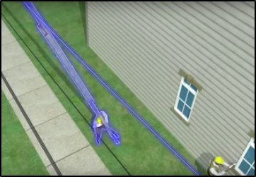
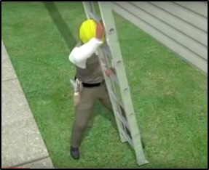
Ladder-Related FATALITY
Construction worker was using aluminum ladder near powerlines
Metal ladder fell backward, hit powerline, and electrocuted worker
Worker tried to move it in extended position and lost control
Source: OSHA
Notes:
A construction worker was using an aluminum ladder on a jobsite that was near powerlines.
When the worker needed to move the ladder to continue working safely, they decided to try to move the ladder while fully extended and did so on their own
The ladder was top-heavy and it fell over backwards hitting the powerlines. This energized the aluminum ladder, which the worker was holding and electrocuted the worker.
This could have been prevented if the worker was using a fiberglass worker since they were near powerlines. When needing to move the ladder, the worker should have asked their partner for help. The could have safely brought the ladder down, both people could move the ladder, carrying it horizontally, then put it back up at the spot safely.

Slide 19
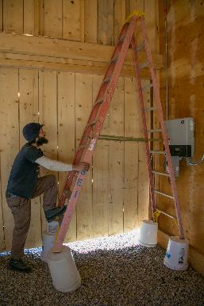
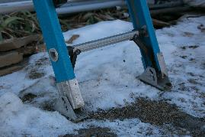
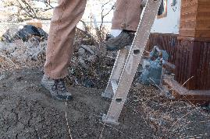

Ladder Placement OSHA 1926.1053(b)
Use only on stable & level surfaces unless secured
Do not place on boxes or other unstable bases for additional height
Do not tie ladders together
Keep area around top & bottom of ladders clear
Equally support both top rails of extension ladder
Best to tie off top and bottom
Notes:
It is important to spend some time placing a ladder- make sure the feet at aligned correctly, that they are solidly on a level surface, and the ladder is secured (if need be). Taking some extra time to ensure you have a solid base will greatly decrease the hazard of working on a ladder. Try to avoid placing ladders on slippery surfaces, but if it can not be avoided, slip-resistant ladder feet can be used and the ladder can be tied off to make it safe to work on.
Ladders are not meant to be placed on top of anything in order to gain height. This creates a very unstable condition.
It is important to keep any work zone clear, but it is especially important to make sure the area around the top and the bottom of the ladder are clear so when a person is getting on or off they do not have obstacles to avoid.
Along with making sure the feet of an extension ladder are properly supported, it is equally important to make sure the top rails of the ladder are also properly supported for safety.

Slide 20
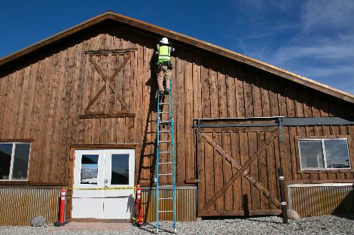
Ladder Placement OSHA 1926.1053(b)
When placed in passageways, doorways, or driveways where they can be displaced
Secure to prevent accidental displacement and place sign “Do not unlock, worker on other side”, or
Guard by a temporary barricade
Cones, caution tape
“Lock it or block it!”
✓
Door is locked AND a barricade erected
Notes:
It is best to avoid putting a ladder in front of a passageway or doorway. But this can not always be avoided. There are a couple things that you can do in order to make the situation safer. You can secure the ladder so that it could not be accidentally moved or pushed over.
You can lock the door and place a sign on it letting others know that workers are on the other side
You can also make it so that people do not go through the area while the ladder is in use by putting up traffic cones in front of the passageway or using caution tape to block off the door.
You can also do both!
“Lock It or Block it”

Slide 21
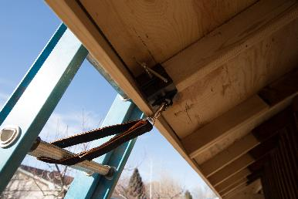
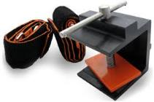
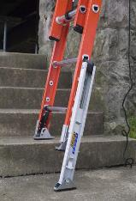
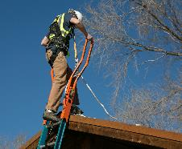
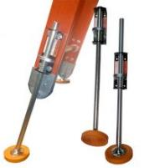
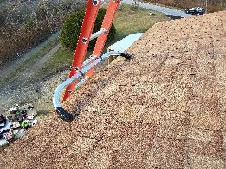
Ladder Accessories
Tie-offs
Ladder extension
Leg levelers
Stabilizers
Notes:
Ladder tie-offs and stabilizers can be used to secure the top of an extension ladder. Tie-offs can help the ladder from falling over backwards or slipping out- especially in the most dangerous transition time of moving from the top of the ladder on to the roof surface.
There are ladder extensions available that extend the ladder so it is a safe distance above the roof surface, have handles for easy grip, and allow for a person to step through it directly onto a roof instead of having to go around the side of the ladder.
Leg levelers attach to the bottom legs of a ladder and can be used when there is an uneven surface where a ladder needs to be set up which is unavoidable. The levelers can be adjusted to make the ladder placement stable.

Slide 22
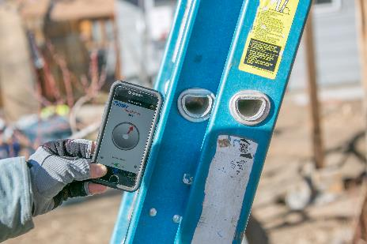
Safe Ladder Positioning OSHA 1926.1053(b)
Ladder Positioning Ratio
Tie-off point to
prevent sliding
Ladder/wall contact height (vertical)
Wall to ladder base distance (horizontal)
3’
:
= 4 : 1 ratio or 75.5°
16 ft
4 ft
Example:
Height = 16’ : Distance = 4’
Notes:
The positioning of an extension ladder is very important. If it is placed too far away from the building, the ladder could slide out. If it is placed too close to the building, the ladder could tip over backwards when walked on.
The correct positioning ratio is for every four feet up a building, a ladder should be moved horizontally one foot away from the building. So if a building is 16 feet tall, then the ladder base should be four feet from the side of the building.
An simple way to get a feel for the placement ratio, is if a person is standing with their toes touching the base of the ladder and they extend their arms out at a 90 degree angle, their fingers should touch the ladder.
There are also smartphone apps that can verify the ladder angle. These can be a quick way to know that you did the job right!
When an extension ladder is being used to access an upper level or a roof, the ladder must be extended at least three feet above the landing. The not only ensures that the ladder will not deflect, but it also allows for a person to grip the ladder when getting on and off of the upper level.

Slide 23
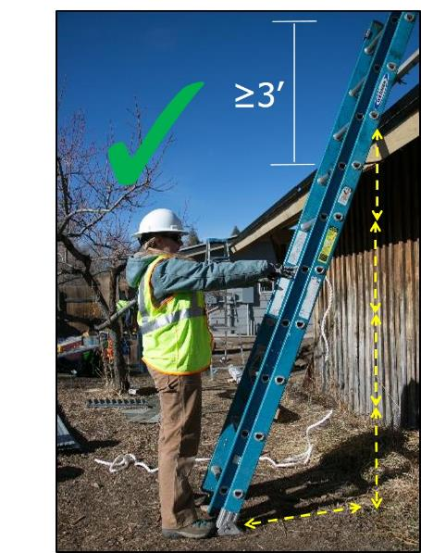
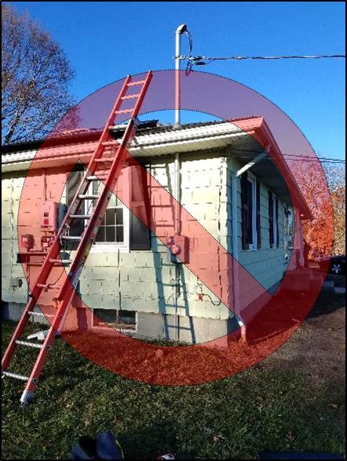
Ladder Positioning
Must be minimum 10 feet from power lines
✓
≥3’
Angle too shallow-
could slip out!
Notes:
The picture on the left slide of the slide shows a ladder that is set at about a 3:2 ratio, which has the danger of slipping out when walked on.
This picture also shows an electrical hazard- the ladder is set up within feet of the power lines
The picture on the right hand side of the screen shows correct ladder placement ratio (4:1)

Slide 24
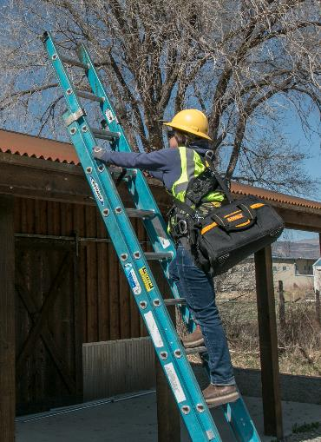
Proper Ladder Use OSHA 1926.1053(b)
✓
Follow manufacturer’s instructions
Face the ladder when climbing
Stay centered between side rails
3-point control method
3 of 4 limbs on ladder for reliable, stable support
Use backpack or tool bag with strap
1✓
2✓
3✓
Notes:
As with any equipment, it is important to read and follow the manufacturer’s instructions.
When climbing up or down a ladder, you should be facing the ladder. It is very unsafe to walk down a ladder as you would do with stairs.
One common violation is not staying centered between the side rails. One should never lean off the side of a ladder to complete a task, for risk of becoming unstable and falling.
(from OSHA Alliance document) Workers should consider using the three-point control technique. Three-point control requires a worker to use three limbs for reliable, stable support, including gripping a horizontal support using a horizontal power grip. It is safer for a worker to hold a horizontal support member than a vertical one. Research has shown that holding a horizontal round object or grab bar with a horizontal power grip provides a greater safety margin for preventing a fall than holding onto a vertical side object or rail when a fall starts.
Unlike three-point control, three-point contact requires three points of support without specified body parts with an unspecified ladder or structure. No shapes or sizes exist for adequate support using three points of contact. Three-point control requires using the hands to grab and hold a support so that one hand can reasonably support the climber’s body weight or more in an emergency.
Three-point control means that a user must always have three limbs touching the ladder at all times. This means having two hands on the ladder when taking a step, which means that your hands must not be holding tools or equipment. Tool bags with straps or a backpack can be used to bring up tools while keeping your hands free.

Slide 25

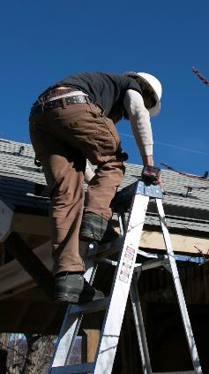
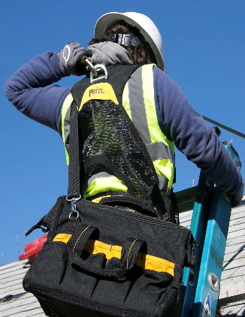
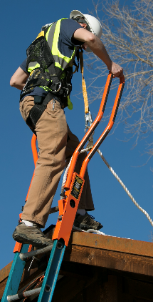
Transitioning From Ladder To Roof
Caution! Transitioning from ladder to roof
is statistically most dangerous fall hazard
✓
✓
Do not use stepladder!
Tie off before transition
Use ladder extension for clear access
Notes:
When you are transitioning from ladder to roof, this is a very dangerous move.
Tie into the fall protection system before making the transition.
Make sure you pay extra attention at this time and you do not rush.

Slide 26
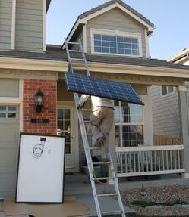
Improper Ladder Use
OSHA Safety Violation
Do not carry any object on ladder that could cause you to lose balance and fall
PV modules act like sails in the wind!
Possible OSHA Violation
Do not exceed ladder’s maximum duty rating
Includes person, tools, equipment, & materials
Solar modules typically weigh 30 - 50 pounds
Notes:
Let’s look a few common OSHA violation related to ladders.
This person is climbing up a ladder while using one hand to hold a PV module on his back.
This violates OSHA’s rule about not carrying an object up a ladder that could cause you to lose balance or fall. A PV module is like a sail- if a gust of wind comes along it can easily knock a person off balance.
Another violation is that the weight of the person, their clothing and gear, and the PV module exceed the rating of the ladder.

Slide 27
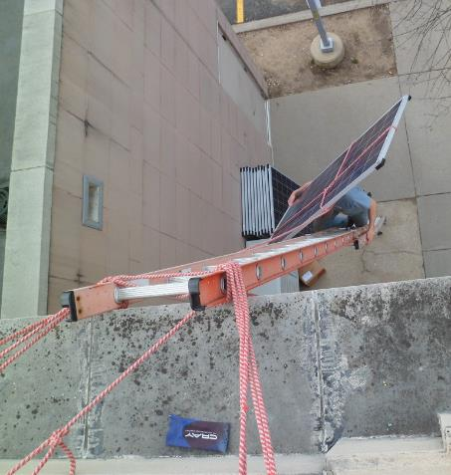
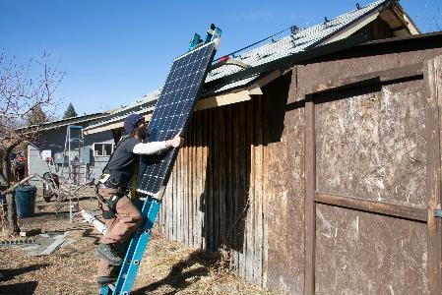
Improper Ladder Use
OSHA Safety Violation
Each employee shall use at least one hand to grasp the ladder when progressing up and/or down the ladder
Notes:
Although this person used ropes to stabilize and support the PV module; carrying a PV module does not allow the person to have three limbs always touching the ladder, making climbing the ladder unsafe.

Slide 28
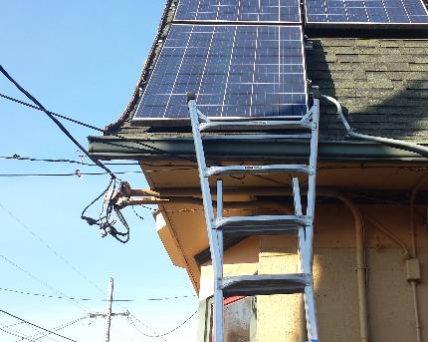
Improper Ladder Use
OSHA Safety Violation
Keep at least 10 feet away from utility power lines
OSHA Safety Violation
Ladders shall have nonconductive side rails if they are used where employee or ladder could contact exposed energized electrical equipment
A wet fiberglass ladder can also be hazardous around electricity!
Notes:
See the wires coming to the side of the building? Those are utility lines. The ladder should be set up with a minimum of ten feet clearance from the utility lines.
This is also an aluminum ladder- due to the proximity to electrical hazards, the ladder should be fiberglass, which has nonconductive side rails. Metal ladders should not be used when there is an electrical hazard.
Note - A wet fiberglass ladder can also be hazardous around electricity

Slide 29
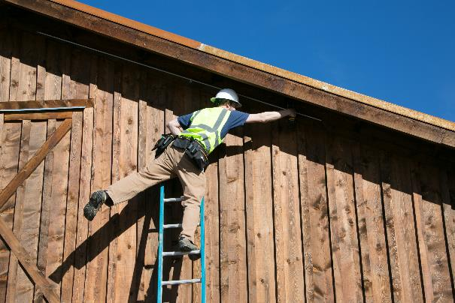
Improper Ladder Use
OSHA Safety Violation
Stay centered between side rails
Notes:
This installer should not be leaning over the edge of the ladder side rails to complete their work. They should take the time to go to the ground and move the ladder to a location where they can easily work while being centered on the ladder.
Keep belt buckle between the rungs. In order to prevent tipping the ladder over sideways due to over-reaching, the user must climb or work with the body near the middle of the rungs.

Slide 30
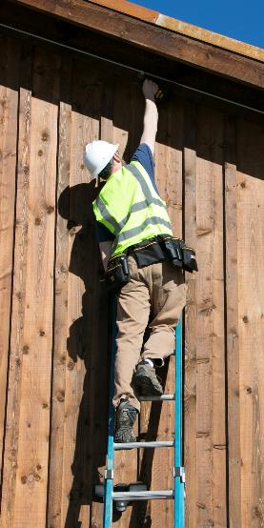
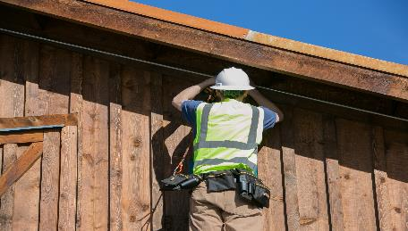
Ergonomics for Overhead Work
Working overhead while on a ladder can result in injuries (sprains, strains, etc.)
Pulling wire
Conduit runs
Use the right equipment to avoid injuries
Taller ladder
Lifts (scissor lift, aerial lift, etc.)
✓
Drill attached to tool lanyard!
Notes:
Solar installation work that may involve working overhead includes pulling wire from a junction box or conduit body, or running conduit.
To avoid injury, use the proper equipment
Although you may be able to reach a task, does not mean that you are at the right height to perform the task
Doing repeated overhead work can cause strain on an employees shoulders, neck and arms which could lead to chronic injuries
OSHA has ergonomics guidelines in order to protect workers from sprains and strains
https://www.osha.gov/dts/vtools/construction/pullingcables_fnl_eng_web.html
Musculoskeletal symptoms among electricians, survey by Dr. Katherine L.Hunting. This survey highlights that: 1) low back discomfort is common in young construction workers, and resulted in medical care, missed work, or light duty for almost 35% of the participants; 2) neck discomfort is also very common and required doctor visits or work modification for almost one quarter of the participants; 3) these construction workers continued to work with symptoms that are classifiable as a CTD; and 4) history of injury is correlated with the subsequent prevalence of musculoskeletal symptoms. © 1994 Wiley-Liss, Inc.

Slide 31
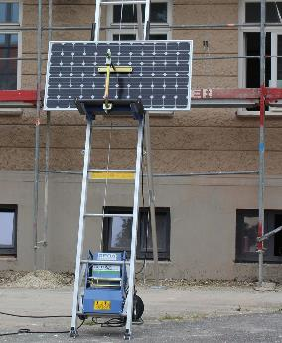
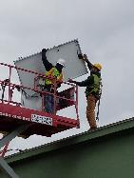



Safely Getting Modules on Roof
Notes:
There are many ways to safely get modules on the roof. OSHA recommends the use of lifting equipment, such as ladder hoists, swing hoists, or truck-mounted cranes/conveyors whenever possible. The next series of slides will go into details on the different lift options available.

Slide 32


Ladder Lifts
Safely lift PV modules to roof
“Panel lift”, “ladder lift”, “ladder hoist”
Solar cradle attachment
Some can extend up roof plane
Ladder hoisting wheel to lift materials
Source: gedausa.com
Source: tranzporter.com
Notes:
Ladder lifts, also sometimes referred to as panel lifts are a safe way to get modules on to the roof. After setting up the lift, a PV module is loaded in to the slot and secured, the motor is turned on and the modules go up to the roof.
Some are meant for a single module at a time and others can hold multiple modules.
Some manufacturers design their entire product specifically for solar, others are platform hoists typically used for roofing materials with a cradle attachment specifically for solar modules.
These lifts are typically several thousand dollars. While this might sound like a lot, consider the labor savings as well as the cost of an injury, including safety violations, insurance costs, and lost production.
Ladder hoisting wheels can help to safely get small tools to the roof. People on the ground can load up a bucket or tool bag then someone on the roof can wheel the bucket up to the roof, keeping it upright. This is one way to ensure employees have both hands free when going up a ladder.

Slide 33

Ladder Lift Safety
Follow manufacturer’s instructions
Load capacity
Lifting speed
Lifting height
Follow safe handling & set up requirements
Often heavy!
Source: gedausa.com
Fall protection requirements when unloading modules on roof
Notes:
Make sure to review manufacturer’s instructions and carefully review the load capacity restrictions. Overloading the device could not only be dangerous, but could also damage the product. There will also be information about the product’s lifting speed and maximum lifting height, which are important characteristics to make sure the product is right for the job.
When setting up the unit, exercise caution because it may be heavy. The instructions should show how to safely set up the unit for use.
Employees on the roof who are unloading the modules will be close to the edge of the roof and must comply with applicable fall protection requirements to ensure safety. See OSHA 29 CFR 1926.500-503 for fall protection requirements. SEI also has another OSHA course on Fall Protection.
****** For reference- will be deleted ****
https://www.osha.gov/pls/oshaweb/owadisp.show_document?p_table=INTERPRETATIONS&p_id=22594
Ladders are required to be secured to prevent accidental displacement when employees are using them on unstable, slippery or non level surfaces. However, when using a ladder to lift materials with a hoisting wheel, employees would not be using the ladder for climbing and therefore would not be subjected to ladder use requirements.
When involved in this lifting activity, the ladder would not be considered a hoist for the purposes of OSHA's hoisting regulations and would therefore not be subject to the provisions of Subpart N-Cranes, Derricks, Hoists, Elevators, and Conveyors. However, those employees exposed to fall hazards during lifting activities must comply with the applicable fall protection requirements in accordance with 29 CFR 1926.500-503, (e.g. safety monitor for low sloped roofs).
We agree, if used properly and within manufacturer's guidelines, this ladder hoisting wheel could reduce or eliminate injuries from lifting heavy loads while climbing ladders.

Slide 34

Scaffolding OSHA 1926.451
Many requirements based on situation
Requires more training
Competent person must supervise set-up & take-down
Can rent equipment & set-up / take-down
Above 10 feet must be equipped with guardrails
Must be fully planked and secured
Notes:
There are lots of general and specific requirements depending on what type of scaffolding is being used – so employees will need additional training. This presentation will make you are of the basic requirements and where to look for more information on various equipment in OSHA’s guidelines.
A competent person must supervise the setup and take-down of scaffold in order to ensure the safety of employees on site. For medium to large scale commercial sites, it may make sense for a company to have scaffolding set up professionally at a site (a service sold when renting scaffolding equipment). The solar installation crew may appreciate not having to spend the time installing a lot of scaffolding and it puts the liability of setup/tear-down with the specialized scaffolding company.
Scaffolding does take time to properly set up and take down, so it is not commonly used for residential systems. With that being said, it could improve the safety of some residential installations to have scaffolding available- so it good to have it as an option.
When employees are on scaffolding over 10 feet in height above a lower level, they must be protected from falling by using a personal fall arrest system or have guardrails set up.
There are specific requirements for platform on all working levels of scaffolds to be fully planked or decked between the front uprights and the guardrail supports. When working with scaffolding, you must know the specifics of these planking requirements.

Slide 35

Scaffolding Safety OSHA 1926.451
Follow manufacturer’s instructions
Never exceed load ratings
Operators must
Be properly trained
Be aware of surroundings
Overhead power lines, open trenches, etc.
Never stand on/lean beyond guardrails
Prohibit work on scaffolds covered with snow, ice, or other slippery material except for removal of such materials
Notes:
Along with knowing all the details related to OSHA requirements for working with scaffolding, you must know and follow the scaffolding manufacture's instructions and never exceed load ratings.
As we look at types of ”mobile scaffolding”, the operators of the equipment must be properly trained for the equipment.
There are lots of obstacles on a site. During job hazard assessments and every morning at job safety meetings, it is important that everyone on site be reminded of where any overhead powerlines are, or if there are any open trenches that could be a fall hazard. Being aware of your surroundings at all times and not rushing to complete a job, will ensure safety on a job site.
Guardrails are not designed for people to stand or lean on them- and it is dangerous to do so. Stay within the confines of the platform/guardrail system.
Employees should be prohibited from working on scaffolds covered with snow, ice, or other slippery material except as necessary for removal of such materials. It is unsafe to have employees exposed to a slippery surface, especially an elevated slippery surface that could result in a more substantial fall.

Slide 36
Employer Responsibility- Scaffolding OSHA 1926.454
Employer shall have each employee who works on scaffolding trained by qualified person
Identify electrical, fall, and falling object hazards
Procedures to deal with electrical hazards and erecting, maintaining, and disassembling fall protection
Proper use of scaffold and proper handling of materials on scaffold
Maximum intended load and load-carrying capacities of scaffolds
Employee Safety Training
Competent person shall determine feasibility & safety of providing fall protection for employees erecting or dismantling supported scaffolds
Notes:
Scaffolding is a broad category under OSHA including not only traditional scaffolding, but also crawling boards (commonly referred to as chicken ladders), and scissor lifts and aerial boom lifts (which are considered mobile scaffolding).
The employer shall have each employee who performs work while on a scaffold trained by a qualified person qualified in scaffolding.
Employees must be able to recognize the hazards associated with the type of scaffold being used and to implement the procedures to control or minimize those hazards.
Employees should identify any electrical hazards, fall hazards and falling object hazards in the work area and know the procedures to minimize these hazards.
Employees must know the correct procedures for erecting, maintaining, and disassembling the fall protection systems and falling object protection systems being used on job sites.
Employees must also know the proper use of the scaffold, and the how to safely handle materials while on scaffolding and how know the maximum load capacity as to not overload scaffolding.
Employees need to know the correct procedures for erecting, disassembling, moving, operating, repairing, inspecting, and maintaining the type of scaffold in question and any other pertinent requirements of the OSHA subpart L.
A competent person is also required to determine the feasibility and the possible need for fall protection procedures for employees assembling or disassembling scaffolding to keep employees safe.

Slide 37
Crawling Boards (‘Chicken Ladder’) OSHA 1926.451(g) & 1926.452(m)
Must extend from roof peak to eaves
Must be secured to roof
Ridge hooks
Or equivalent strength and durability
Source: fasttoolnow.com
Employee on crawling board shall be protected by
Personal fall arrest system
Guardrail system
¾” diameter grab line
Notes:
Crawling boards, sometimes called chicken ladders, are a ladder that extends over the peak of a pitched roof and connects with ridge hooks (or equivalent). They are typically used on steep pitched roofs in order to safely get up to the roof ridge.
Crawling boards are not a substitute for fall protection. Each employee on a crawling board must be protected by a personal fall arrest system, a guardrail system, or a ¾” diameter grab line handhold securely fastened beside each crawling board.

Slide 38


Scissor Lifts OSHA 1926.452(w)
Considered ”mobile scaffold”
Operated from platform
Lift workers & materials
PV modules to roof
Awning mounts / carports
Conduit runs
Move vertically up & down
Typically 20 - 50 feet
Extendable platforms may be available
Notes:
Scissor lifts are large platforms that can hold multiple workers and equipment/tools (modules, conduit, etc). Since they are a platform that moves- they are considered “mobile scaffolding”. While scissor lifts to do not have their own provision, employers must comply with both1926.451 general and 1926.452(w) mobile scaffolds.
Scissor lifts are really handy since they are both a working platform, and a way to get people and equipment to a roof.
Scissor lifts move up and down vertically and typically range in size from about 20-50 feet.
When the scissor lift has permanently installed (and properly maintained) guardrails, employees are not required to be tied-off when working on a scissor lift.
Talk about difference between two scissor lifts pictured, orange for indoor use on a level surface, lower designed for outdoor use and uneven surfaces, to a point
****NEED OSHA CLARIFICATION, Will delete afterwards****
https://www.osha.gov/pls/oshaweb/owadisp.show_document?p_table=INTERPRETATIONS&p_id=23874
From letter of intent, scissor lifts do not have a specific provision, they are considered Mobile scaffold, so employers have to comply with 1926.451 general and 1926.452(w) mobile scaffolds.
No, neither §1926.451 or §1926.452(w) require employees to be tied-off when working from scissor lifts that have properly maintained guardrails.

Slide 39


Scissor Lift Safety OSHA 1926.452(w) & ANSI A92.3-2006 / A92.6-2006
Follow manufacturer instructions
Never exceed load ratings
Operators must
Be properly trained
Be aware of surroundings
Overhead power lines, open trenches, etc.
Never stand on/lean beyond guardrails
Tie-off not required with guardrails
Avoid de-stabilization of unit
Sloped terrain, wind
Avoid ‘caught in/between’ injuries
✓
Notes:
It is always critical to follow manufacture's instructions and never exceed the load ratings of the equipment.
Operators of this equipment must be properly trained on how to use the equipment.
Obstacles such as overhead power lines or open trenches can pose a major threat to scissor lifts- so it is extremely important that they are properly identified and that hazard control methods are put in place to keep workers safe.
OSHA 29 CFR 1926.454 specifies that employers must provide training to workers on a scissor lift which includes what to do if you come in contact with electrical wires, how to handle materials on the lift platform, and how to report equipment defects or maintenance needs.
While the guardrails are meant to protect employees, they are not designed to put used to stand or lean on- just like other forms of scaffolding. This is very unsafe and should never be done.
Destabilization of the unit should be avoided - this means avoiding sloped terrain and not operating the unit if conditions are windy.
Since scissor lifts are moving platforms, there is the possibly of an injury as a result of crushing between objects. All employees must be trained and safety plans should be in place in order to avoid such injuries.

Slide 40

Aerial Boom Lifts OSHA 1926.453
Mobile elevated platform
Operated from platform
Lift workers & materials
Modules, equipment, etc.
Articulating boom lifts can maneuver around objects
Height up to 130 feet
Smaller platform, limited weight capacity
Notes:
Aerial boom lifts are also considered a “mobile elevated platform” under OSHA’s definitions. While, like scissor lifts, they are used to lift both workers and materials, they have a bending arm which allows more flexibility. The platform can move both vertically and horizontally.
Boom lifts can reach heights of up to 130 feet, making them a good choice for multi-story buildings.
The platform is limited in it’s size and weight capacity. It is important to verify that it will meet the needs of the jobsite.

Slide 41


Aerial Lift Safety OSHA 1926.453
Follow manufacturer instructions
Do not exceed load limits
Operators must
Be properly trained
Set brakes
Use wheel chocks on incline
Use outriggers if provided
Use body harness or restraining belt with lanyard attached to boom or basket
Watch for hazards!
Overhead power lines, basket rails, etc.
Source: runonsun.com
Notes:
As with other equipment, it is important to follow the manufacturer’s instructions. Since the weight capacity may be limited, it is important to verify that the load limits will not be exceeded when including workers and equipment.
Operators must be properly trained to use a boom lift. Special requirements such as setting brakes & use wheel locks on incline would be part of the specialty training required. Some machines also have outriggers for stabilization.
Aerial lifts require the use a body harness or restraining belt with a short lanyard attached to boom or basket for workers on the platform for fall restraint. This is to protect a worker from being ejected from the basket.
Never move the unit with workers on the elevated platform unless the unit was been specifically designed for this.
Identifying and planning to mitigate any jobsite hazards such as overhead power lines, basket rails, etc. should be done before commencing work at a job site.
Establish and clearly mark a danger zone around the aerial lift support vehicle.

Slide 42

Reach Forklift OSHA 1910.178
Used to lift materials
Not people
Unless specifically designed
Lift pallets of modules, materials to safe position on roof for unloading
Operated on ground by driver
Maintain eye contact with driver - if you can’t see their eyes, they can’t see you!
Notes:
Reach forklifts requirements are located in OSHA 29 CFR 1920.178. They are considered “powered industrial trucks”.
Reach forklifts are designed to lift equipment and materials. They can be used to move pallets of modules around a job site or safely lifting modules to a roof.
If the manufactures indicated the forklift is approved to lift people, then it can as long as there is a proper platform attached to the forks and the operator is in the seat.
They are operated from the ground and can navigate rough terrain on a jobsite
When working around forklifts, be sure to maintain eye contact with the driver. If you can’t see their eyes, they can’t see you!

Slide 43


Forklift Safety OSAH 1910.178(I)
Follow manufacturer instructions
Do not exceed load limits
Operators must
Be properly trained & certified
Watch for hazards
Overhead power lines, etc.
Notes:
Always follow manufacturer’s instructions and pay special attention to load limits of the equipment.
Operators must be properly trained and certified to operate this equipment.
Since there is more flexibility and options for movement, this increases the risk from overhead hazards such as powerlines. Make sure proper safety procedures are in place to keep the crew safe.

Slide 44
Cranes OSHA Subpart CC 1926.1400
Typically used on commercial installation sites
Hire licensed crane company to operate
Installers should understand crane signals and load capacity
Avoid caught in/between injuries
Watch for hazards
Source: niosh
Source: mysafetysign.com
Notes:
If using a crane additional training is required that is outside the scope of this training.
Cranes may be used on commercial installation sites, car ports or possibly pole mounts. The regulations for cranes for OSHA fall under 29 CFR Subpart CC ‘Cranes and Derricks’.
With this specialized equipment, you must hire a licensed crane company to operate the unit. Many states now require rigging training and certification to connect loads to cranes. A poorly rigged load can mean death.
All workers on the site should understand crane signals and load capacity to ensure the proper use of the equipment.
As with the other types of machinery, job hazard forms should include provisions to avoid caught-in-between injuries and plans to avoid contact with overhead power lines.

Slide 45



Lift Considerations
Location
Is there access to desired lift location?
Level ground for lift safety
Desired location near roof / staging area
Distance from hazards (overhead power lines, trees)
Safety
Is using a lift the safest option?
Cost
Evaluate time savings verses cost
System size, difficulty
Rental cost (scissor, aerial, forklift, crane)
Purchase price (ladder lifts)
Notes:
How do you choose what type of equipment you need for a specific job site?
Some of the main factors that go into making that decision include the work zones and location of the jobsite and the cost of the equipment.
Location
Many of the lifts need a level ground surface to safely navigate to a location, so if there is uneven terrain, that could be a deciding factor.
Does the site require an elevated working surface or just the need to get equipment safely to the roof?
Where are the hazards at the site and what equipment would be best in order to avoid them?
Cost
When it comes to cost- the size of the system is a big factor. The cost of the equipment verses the labor hour time savings should be evaluated when deciding what equipment to choose.

Slide 46
Additional Resources
OSHA
Reducing Falls in Construction: Safe Use of Extension Ladders
Reducing Falls in Construction: Safe Use of Stepladders
Stairways and Ladders: A Guide to OSHA Rules
Falling Off Ladders Can Kill: Use Them Safely
Sprains and Strains in Construction/Pulling Cables
OSHA Aerial Lifts Factsheet
Hazard Alert: Working Safely with Scissor Lifts
Fall Protection in Construction
U.S. Department of Labor
Electrocution/Work Safely with Ladders Near Power Lines www.youtube.com/watch?v=4QcctfnUeOM&feature=youtu.be
Notes:
Please review the following resources to deepen your knowledge about ladder and lift safety.

