Slide 1
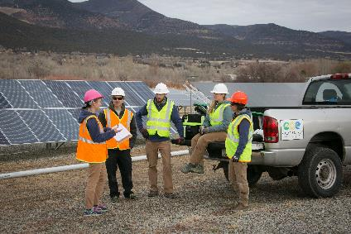
Introduction to Solar Installation Safety
Disclaimer: This material was produced under grant number SH-31237- SH7 from the Occupational Safety and Health Administration, U.S. Department of Labor. It does not necessarily reflect the views or policies of the U.S. Department of Labor, nor does mention of trade names, commercial products, or organizations imply endorsement by the U.S. Government.
Notes:
Hello, and welcome to this course on solar installation safety
Sarah Wilder, Director of Curriculum Development and also an instructor at Solar Energy International (SEI)
Before we get started, like to mention that this course was produced under a Susan Harwood Training Grant through OSHA, the Occupational Safety and Health Administration
Here at SEI, we’re really excited to have been awarded this grant to develop this course and offer it for free, because
Installation safety has always been important to SEI and included in our courses; been great to dive deeper into some of these topics and offer more extensive training
Thankful that OSHA recognizes the growing solar PV industry, it’s a relatively high hazard industry, therefore there’s a need for solar-specific safety training
And then a quick disclaimer that although this material was produced under a grant from OSHA, which is an agency of the US Department of Labor, this training material does not necessarily reflect the views or policies of the U.S. Department of Labor, nor does mention of trade names, commercial products, or organizations imply endorsement by the U.S. Government

Slide 2
Learning Objectives
Understand what is covered in this solar installation safety course and what is not
Define OSHA and its mission
List employer safety training responsibilities
Describe the key elements of a job hazard analysis
Notes:
Ok, let’s check out the learning objectives for this short introductory lesson..
Ensure students understand what is covered and what is not- the course covers four targeted solar installation safety topics and is not a comprehensive solar safety course
Define OSHA and its mission: how and why it was created
Review employer safety training responsibilities
Describe key elements of a job hazard analysis
A job hazard analysis is one component of the larger commitment of a safety and health management system
Really critical step in the planning and installation process that sometimes gets overlooked
Talk about hob hazard analysis, or JHA, over and over again throughout lessons
You can speed up presentation at anytime if I’m talking too slow, or pause/slow it back down whenever you need to

Slide 3
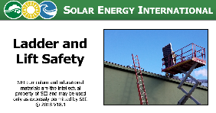



Targeted Topics- Not a Comprehensive Safety Course!
Focus on residential / small commercial, roof-mounted
Goal is to bring awareness of specific hazards
Recommended
OSHA 10 or 30-hour course
Intro solar design & installation course- SEI’s PV101
Notes:
So what is this course? Via the Susan Harwood Training Grant, SEI developed lessons for 4 targeted solar installation safety topics: ladder and lift safety, fall protection, safe PV roof mounting methods, and solar electric safety
Focus is on residential and small commercial roof-mounted systems
Smaller projects can be the most challenging in regards to OSHA compliance- every site is different, jobs move quickly, easier to fly under the radar..
We do hope to expand this course in the future and offer additional lessons- for instance in this course we don’t cover hazards of ground mount installations- trenching, excavation, etc.
Goal here is to bring awareness of specific hazards on PV installation sites- it’s not a comprehensive safety course
We encourage folks to take an OSHA 10 or 30 hour course for the construction industry
If you are new to solar, we highly encourage you to take an introductory level design and installation course
SEI’s PV101 course; online and in person
Esp important when talking about electrical safety

Slide 4
Basics of PV Resources
Home Power issue #144
PV Systems Simplified
Home Power issue #142
PV Racking Strategies
Home Power issue #83
Series: Linked Together in One Electrical Path
Home Power issue #84
Parallel: Side by Side
Notes:
But if you are totally new to solar photovoltaics and excited to start this course, at very least check out some of these resources that we provide with this lesson
Great articles by Home Power magazine
In each lesson: presentation like this one (or several presentations), interactive exercises- present the materials in different way and challenge you to see if you understand concepts, videos, quiz- need to complete quizzes and view all the rest of the content to finish the course and receive ROC. Then links to some additional resources if interested.

Slide 5

What is OSHA?
Occupational Safety and Health Act of 1970 (OSH Act) was passed to prevent workers from being killed or seriously harmed at work
Employers have responsibility to provide safe workplace
Law created the Occupational Safety and Health Administration (OSHA)
Sets and enforces protective workplace safety and health standards
Notes:
The Occupational Safety and Health Act of 1970 (OSH Act) was signed into law by president Nixon, with the goal of preventing workers from being killed or seriously harmed at work
Law acknowledges that the right to a safe workplace is a basic human right
Under the OSH Act, employers have the responsibility to provide a safe workplace-
This law the created OSHA, which sets and enforces protective workplace safety and health standards
Complying with OSHA regulations is actually the law!

Slide 6

What is OSHA?
OSHA also provides information, training, and assistance to employers and workers
This course developed under OSHA Training Grant!
For more information, visit www.osha.gov
Notes:
OSHA not only sets and enforces standards, but they also provide a lot of great information, training, and assistance to employers and workers
A great example is this course, developed under an OSHA Susan Harwood Training Grant
OSHA not only there to provide citations- they’re there to help you be safe on the job site and ensure that the company you work for is providing you with the training and resources you need in order to work safety
For more information about OSHA, visit their website, osh.gov
Here, find not only various OSHA standards that we show in course
Also some terrific educational resources.

Slide 7
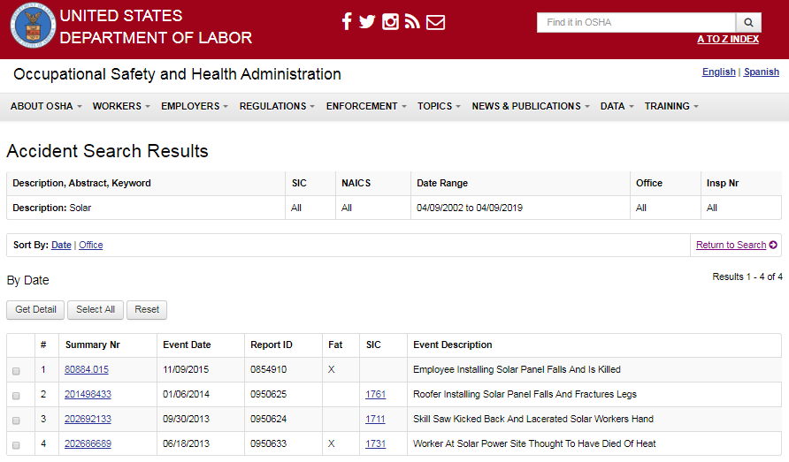
OSHA Accident Search
www.osha.gov/pls/imis/accidentsearch.html
Notes:
Also on the OSHA website, you can search reported accident records by keywords within a given date range.
This is a stark reminder that accidents really do happen- here are the people and the details behind the statistics.

Slide 8
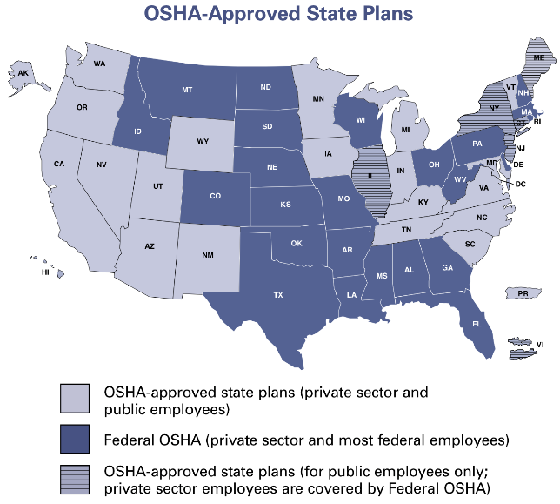
OSHA Federal & State Plans
Source: osha.gov
Notes:
It’s important to note that most private sector employers and workers are going to be covered directly through Federal OSHA or through an OSHA-approved state plan, depends on where you work
See on this map (covers all 50 states as well as PR and Virgin Islands):
Dark purple- Federal OSHA private sector and most federal employees
Light purple- States with OSHA-approved state plans- private sector and public employees
State plans, which are state-run safety and health programs, must be at least as effective as the Federal OSHA program- many exceed federal requirements
Purple lines- Hybrid states where you have OSHA-approved state plan for public employees, but then private sector employees covered under federal OSHA
In course we focus on federal OSHA standards
So, we definitely encourage you to visit OSHA’s website to find out more information about the rules in the states or territories you might be working in, including contact information for your regional OSHA office

Slide 9
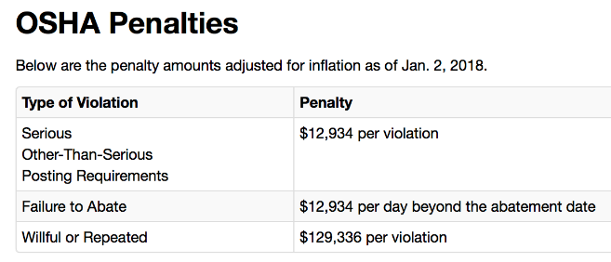
Inspection Priorities & Penalties
Imminent danger
Catastrophes / fatalities
Worker complaints and referrals
Targeted inspections
High injury / illness rates
Severe violators
Follow-up inspections
Source: osha.gov
Notes:
Here we see OSHA’s inspection priorities: not necessarily randomly driving around- prioritize reports of imminent danger, fatalities, worker complaints and referrals, companies that have high injury or illness rates, or companies that are severe violators. They also do follow-up inspections.
See in chart here that penalties for OSHA violations can be significant- $12- $130k
In Nov 2016 a CA solar company was fined $130k after a worker fell 29 feet through a skylight
Company did not provide employees with required fall protection
http://www.businessinsurance.com/article/20161118/NEWS08/912310578/California-OSHA-cites-solar-panel-installer-employee-falls-29-feet
Note that fall protection was the #1 most frequently cited standard by federal OSHA in 2017
One of our targeted lessons

Slide 10
Whistleblower Program
OSHA’s Whistleblower Protection Program enforces whistleblower provisions of more than 20 whistleblower statutes protecting employees who report violations of various workplace safety and health issues
Section 11(c) of OSH Act prohibits employers from discriminating against employees for exercising their rights under the OSH Act
Rights include filing an OSHA complaint, participating in an inspection or talking to an inspector, seeking access to employee exposure and injury records, reporting an injury, and raising a safety or health complaint with employer
Complaints must be reported to OSHA within 30 days following retaliatory action
For more information, visit www.whistleblowers.gov
Notes:
Lastly, OSHA’s Whistleblower Protection Program protects employees who report safety violations- the OSH Act prohibits employers from discriminating against employees for doing so.
As an employee, you have the right to file an OSHA complaint, participating in an inspection or talk to an inspector, seek access to employee exposure and injury records, reporting an injury, or raising a safety or health complaint with employer.
If you file a complaint, OSHA keeps your information confidential
Once thing to note is that if you are discriminated against for exercises your rights under the OSHA act, must report within 30 days following retaliatory action.
For more information, visit the whiteblowers.gov website.

Slide 11

OSHA & PV Installation Safety OSHA 29 CFR 1926
Code of Federal Regulations (CFR) Part 1926, Title 29 applies to construction
30 Subparts, including:
C: General Safety & Health Provisions
D: Occupational Health & Environmental Controls
E: Personal Protective & Life Saving Equipment
I: Hand & Power Tools
K: Electrical
M: Fall Protection
X: Stairways & Ladders
Notes:
Most solar installation work falls under the Code of Federal Regulations (CFR) part 1926, title 29, which applies to the construction industry
Within it are 30 subparts; including the subparts listed here; coverage of solar installation work is certainly not limited to what’slisted here- depends on the specific installation and equipment being used.
Note that employers could also get cited under OSHA’s general duty clause when no specific standard applies to a serious hazard
General duty clause requires that each employer provide employees with a workplace that is free from recognized hazards that are causing or likely to cause death or serious physical harm.

Slide 12
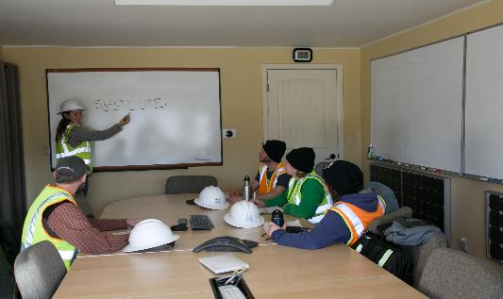
Employer Responsibility OSHA 29 CFR 1926 Subpart C
Employer must instruct each employee on
Recognition & avoidance of unsafe conditions
Applicable regulations to control or eliminate hazards
In-house training led by “competent person”
Employee Safety Program
Notes:
Subpart C of part 1926: General Safety and Health Provisions, states that it’s the employer’s responsibility to instruct each employee on the recognition and avoidance of unsafe conditions, as well as the applicable regulations to control or eliminate hazards
There are several ways to train employees
a) Perform the training within the business
b) Send employees to professional training courses such as free classroom training offered by OSHA or first aid training offered by the Red Cross.
c) Add to training by requiring that employees complete content-specific courses such as this one.
-A combination is best
-If you’re an employer (or an employee) and you’re thinking that safety training is a waste of time and money, consider what one lost workday injury might cost the company in terms of:
♦ Installation down-time- time lost by injured employees and supervisors helping the accident victim.
-Admin cost: paperwork generated by the accident.
♦ Time to hire or train a worker to replace the injured installer until they return to work.
♦ Time and cost for repair or replacement of damaged equipment or materials.
♦ Increased insurance cost
♦ Reduced morale among your employees and perhaps lower efficiency.
♦ Not to mention OSHA penalties
-Create a culture of safety!- not something that’s dreaded, just an embedded part of the job and work environment
-In-house training must be led by a “competent person”, which we’ll define on the next slide

Slide 13
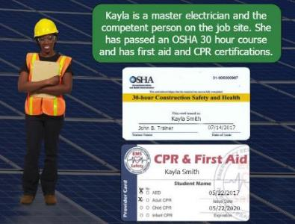
Competent Person
Capable of identifying existing and predictable hazards in surroundings or working conditions which are unsanitary, hazardous, or dangerous to employees
Has authorization to take prompt corrective measures to eliminate them
Notes:
OSHA defines a competent person, as someone who is capable of identifying existing and predictable hazards in surroundings or working conditions which are unsanitary, hazardous, or dangerous to employees
AND ALSO has authorization to take prompt corrective measures to eliminate or control hazards.
The second part is really important for when we talk about the job hazard analysis. which also needs to be led by a competent person- it’s critical to have someone on the job side that not only recognizes a hazard, but has the authority to do something about it
If there’s an inspection or accident investigation, OSHA inspector will ask who the designated competent person is, to see if other employees know
Absence of competent person among most frequently cited OSHA violations
Competent person knowledge can come from someone’s skills, experience and training. Typically they’ve completed training such as OSHA 30 course and CPR/First Aid
Some OSHA standards outline additional specific requirements to be met by the competent person, such as the standards for Fall Protection, Scaffolding, Excavations, and Ladders.

Slide 14
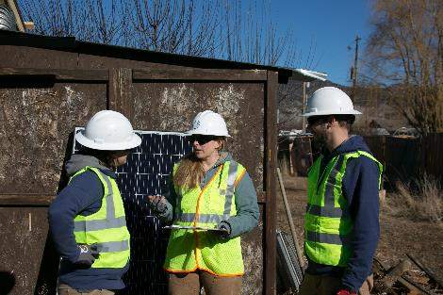
Job Hazard Analysis (JHA)
Identify, eliminate, control hazards
Led by competent person, all participate!
Safety plan & job briefing
Job-site specific hazards
Safe work procedures
Tools and materials
PPE requirements
Location of first aid and safety equipment
Nearest medical facility
Document each meeting
All attendees sign off!
Notes:
A job hazard analysis is one component of a company’s broader safety program
A job hazard analysis is a technique that focuses on job tasks as a way to identify hazards before they occur.
Site specific- every installation is different, we’re not just talking about repetitive work in a factory
It focuses on the relationship between the worker, the task, the tools, and the work environment. Ideally, after you identify uncontrolled hazards, you will take steps to eliminate or control the hazards- meaning reduce them to an acceptable level
Led by the competent person, though everyone on the job site should participate and approach the site with awareness
From this analysis, develop a safety plan and host job briefing at the jobsite to go over job-site specific hazards, safe work procedures, tools and materials and PPE, where to located first aid equipment, location of nearest medical facility.
It’s also critical to document each safety meeting, and have all attendees sign off- not only for participation and buy-in, but also to keep a written record in the event of an accident.
Important not to confuse competent person with qualified person.
OSHA part 1926 defines qualified person as one who “by possession of a recognized degree, certificate, or professional standing, or who by extensive knowledge, training and experience, has successfully demonstrated ability to solve or resolve problems relating to the subject matter, the work, or the project”
Qualified workers might have more technical expertise (design and installation) than those designated as competent, but they would not necessarily have expertise in hazard recognition or the authority to correct identified hazards

Slide 15
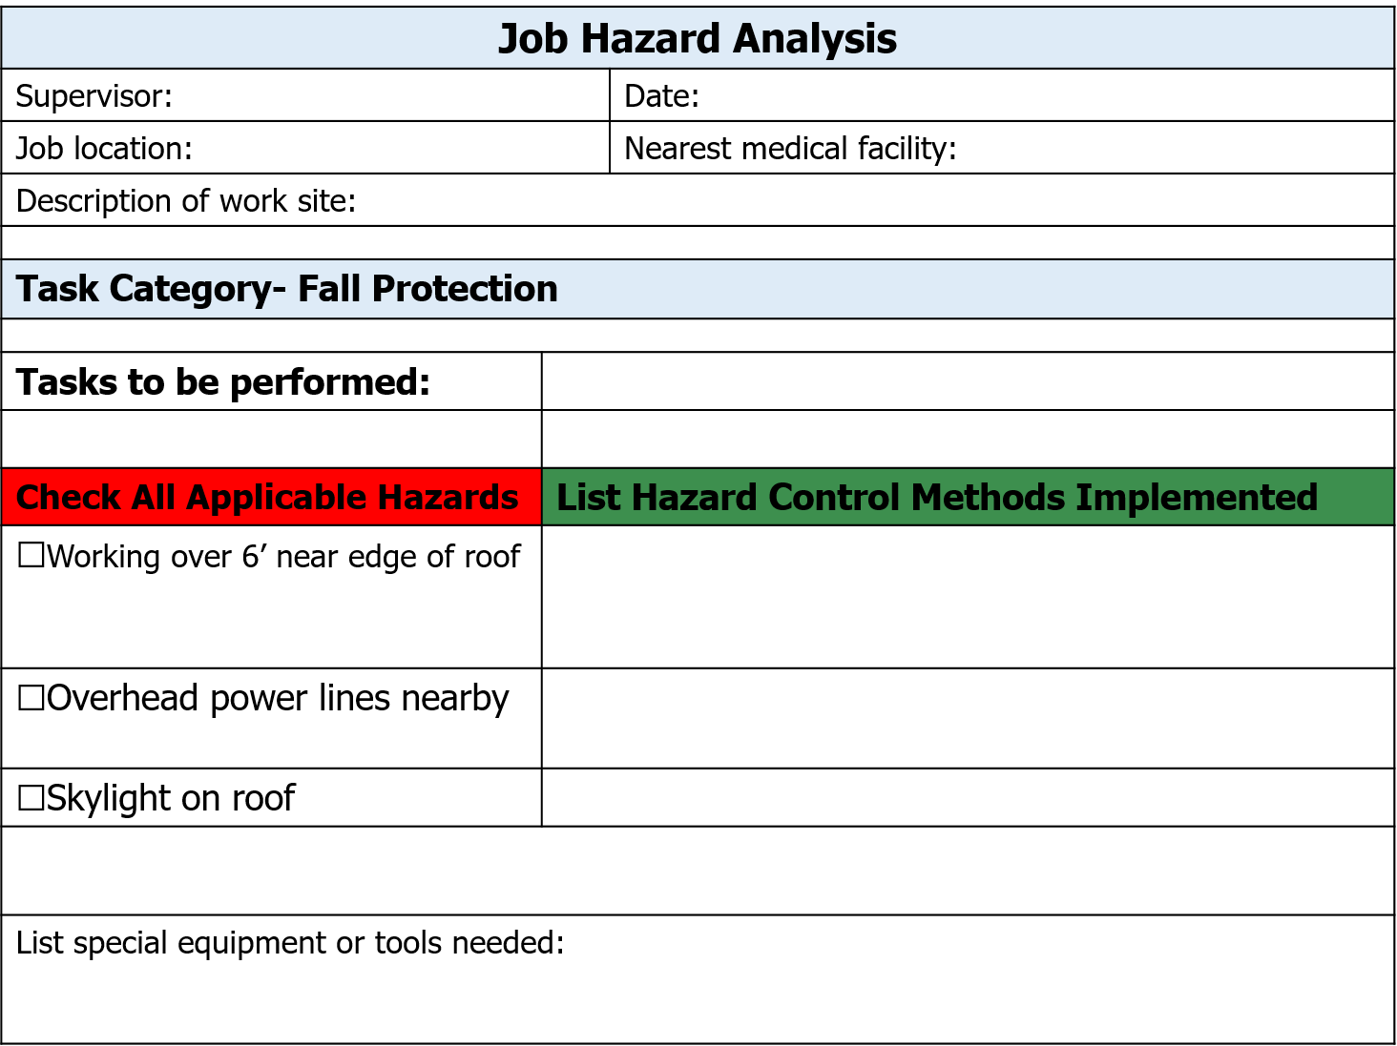
JHA
Jen
1/1/2018
123 Main St. Paonia, CO
Delta Hospital
One story building with deck on southern side
Installing racking
☑
2 employees on roof with personal fall arrest systems, create job specific plan for safely connecting/disconnecting to anchors
☑
Stay at least 10’ away from power lines - mark out area, remind crew daily
☑
Use skylight net to guard against hazard
(2) body harnesses, anchors, rope, skylight net
Notes:
Here is an example of a JHA for the racking crew: see that we’ve identified hazards and control methods to be implemented, along with PPE
We’ll return to these JHA forms specific to each work task in the lessons

Slide 16
Control Effectiveness
Type | Examples
Elimination or substitution | Perform task at ground level Automated material handling
Engineering controls | Skylight covers Tool guards
Warnings | Signs, labels
Training & procedures | Safe work practices Inspect safety equipment Hazard communication
Personal Protective Equipment (PPE) “Last line of defense” | Gloves Safety glasses Fall arrest equipment
Most effective
Least effective
Notes:
One concept that’s important to understand when implementing safety measures is this hierarchy of control, or control effectiveness.
When dealing with a particular hazard, it’s way more effective to eliminate the hazard altogether; for example can you do a particular task on the ground rather than the roof to avoid a fall or slip hazard.
Next most effective are engineering controls like skylight covers or tool guards to mitigate the hazard, followed by safe work practices and administrative procedures.
Notice that personal protective equipment, or ”PPE” is considered the least effective form of hazard control- it’s really the last line of defense.
For example, when using fall arrest equipment- if used properly it will protect you from striking the ground or a lower level in the event of a fall- but you’ve already fallen and there’s still a chance of injury. Consider this in comparison to say, rather than installing the a system on a steep, complex roof- perhaps you could eliminate the fall hazard altogether by installing the system as a ground mount.

Slide 17
Safety & Policy Log Example
By signing my initials below DAILY, I acknowledge that:
I participated in a pre-construction safety meeting that identified the hazards associated with all aspects of presumed construction activities
I participated in a brief ‘refresher’ safety meeting this morning before commencing rooftop work
I or a member of the installation crew have visually inspected the fall protection system, including the ropes, flag lines, harnesses, lanyards and anchors
I understand that given the height and exposure of the rooftops, I am working in an environment that requires 100% fall protection / fall arrest and spatial awareness at all times, and that a fall from the rooftop could cause serious injury or death
I understand that there is a zero-tolerance fall protection policy in place and that if I am caught not fully protected using company supplied PPE I may be asked to leave the jobsite or have employment terminated
While working on Array B, I must stay within the flag line perimeter, and can only exit it if directly connecting to a fall arrest system as provided
Credit: Same Sun of Vermont
Notes:
In addition to a completing a job hazard analysis form, here’s an example of safety and policy log, which is specific to the job site but also informs employees of general company safe work practices.
Generally highlight some of the lines…

Slide 18
Safety & Policy Log Example
By signing my initials below DAILY, I acknowledge that:
I acknowledge that the company has provided the necessary PPE to keep me safe, and that if I had/have any concerns to the contrary I have notified the company of such concerns
I understand that working with a sense of urgency is important, but my safety shall never be compromised based on timeline
I understand that I and every member of the crew has every right to vacate the roof immediately if any signs of impending weather events cause concern – high winds, heavy rain, thunder storms…
I understand that I or a member of the team must always keep the roof hatch closed
 | DATE | SW | JV | LW
MON | 1/8/18
TUES | 1/9/18
WED | 1/10/18
THUR | 1/11/18
FRI | 1/12/18
Credit: Same Sun of Vermont
Notes:
Safety log can not only be about requirements, but also to let employees know that that the company values a culture of safety.
For example, it states “I understand that working with a sense of urgency is important, but my safety shall never be compromised based on timeline”- this is great
Here you see how each worker must sign off daily, or any time site conditions change

Slide 19

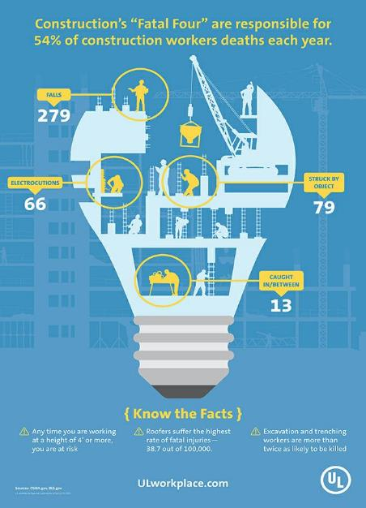
The FATAL Four
Falls
Struck by
Electrocutions
Caught in/Between
In the PV industry, we often work at height (falls) and always work with electricity (electrocutions)!
Notes:
To conclude, why is this solar-specific safety training important?
The solar industry is growing quickly- and it’s a high hazard industry with unique safety training needs. Employers are hiring new installers all the time, and safety training really varies by company. Even technically experienced workers may not have received proper safety training,
Solar installers are commonly exposed to each of the construction industry’s “fatal four”- which are responsible for 54% of construction worker deaths each year.
We’ll into depth on these hazards in the course
We hope you enjoy this course and learn a lot- not only about minimum safety requirements but about best practices for working safely and doing quality installation work.

Slide 20
Additional Resources
OSHA
All About OSHA
Job Hazard Analysis (OSHA 3071)
Solar Pro issue #4.6
Implementing a Successful Safety Program
Installation Hazards and Mitigation
Cal / OSHA
Setting up a Tailgate / Toolbox Safety Meeting

