Slide 1
Fall Protection in Construction
Training
This material was produced under grant number SH-31228-SH7 from the Occupational Safety and Health Administration, U.S. Department of Labor. It does not necessarily reflect the views or policies of the U. S. Department of Labor, nor does mention of trade names, commercial products, or organizations imply endorsement by the U. S. Government.

Slide 2
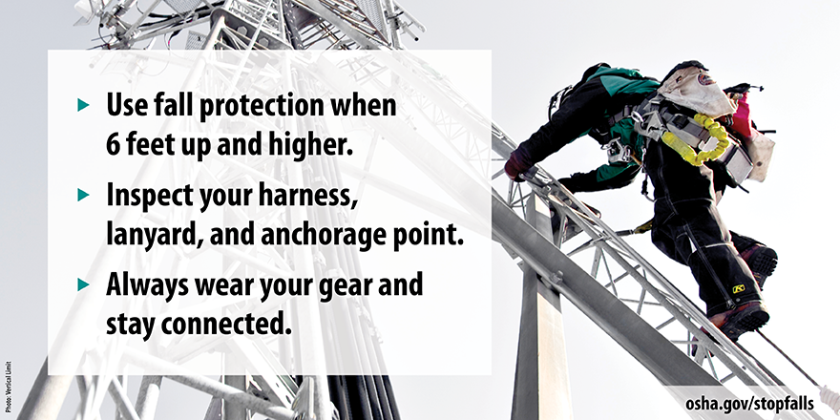
Photo Sources
  Bureau of Labor Statistics (BLS)
  Centers for Disease Control and Prevention (CDC)
  National Institute for Occupational Safety and Health (NIOSH)
  Occupational Safety and Health Administration (OSHA)

Slide 3
Learning Objectives
  Discuss why fall protection is important
  Know general OSHA fall protection regulations & standards, especially
      Heights requiring fall protection
      Fall protection design and performance specifications
  Recognize common fall hazards requiring fall protection
  Understand the hierarchy of controls for fall protection
      Discuss importance of 1st three controls in preventing falls
      Discuss importance of 4th (fall arrest) in reducing the severity of a fall
      Discuss why controlled access zones (CAZ) are a last resort
  Describe the different types of fall protection control options

Slide 4
Section 1:
Why should we be concerned with fall protection?

Slide 5
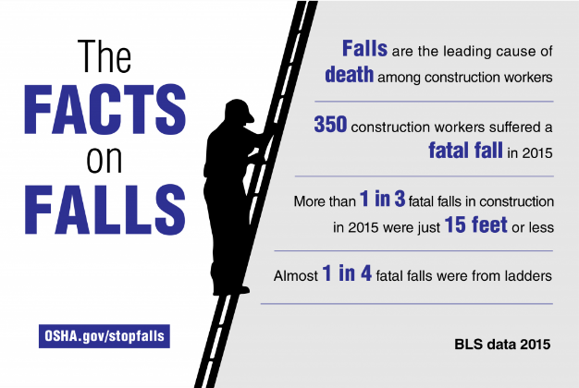
OSHA Facts on Falls

Slide 6

Construction Injury Statistics
(Construction Management November 4, 2014)
One in ten are injured each year
Over a 45-year career, a construction worker has a 1 in 200 chance of dying
Falls are the greatest cause of fatalities
The most violated OSHA standard is fall protection
60% of injuries occur during the first year of employment
  Source: Clipart

Slide 7
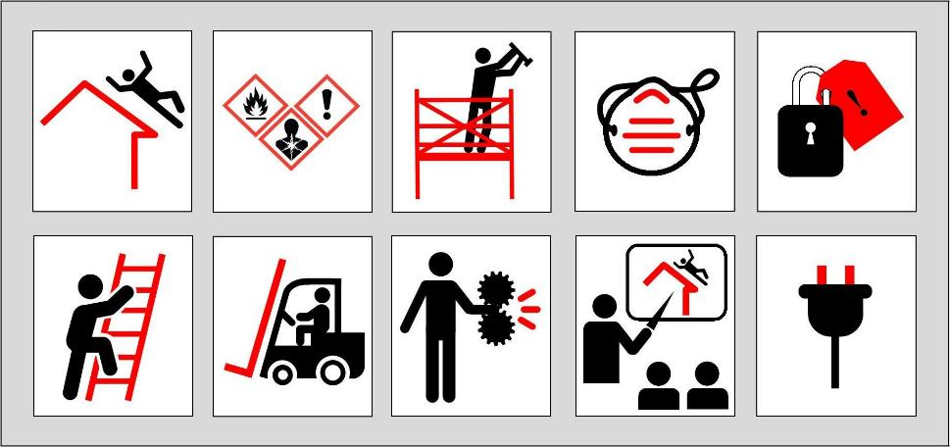
OSHA Top 10 Cited Violations for 2017

Slide 8
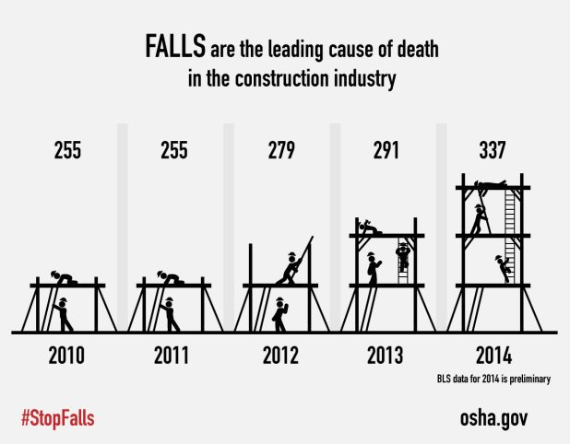
Increasing fatalities in construction

Slide 9
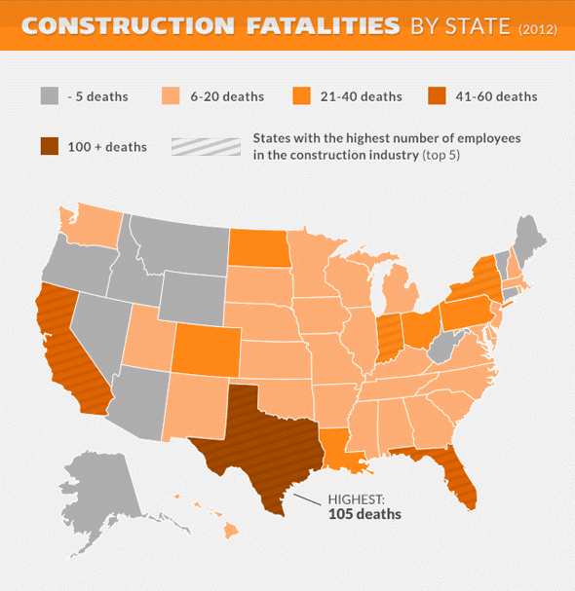
Construction fatalities by state
Texas has the highest number of fatalities due to falls followed by California and Florida
We can work together to reduce those numbers
Source: Bureau of Labor Statistics (BLS)

Slide 10

#1: The number one reason why we all need to look after each other on the job
We all deserve to go home safe to our family and friends

Slide 11
Section 2:
Fall Protection Requirements & Definitions

Slide 12
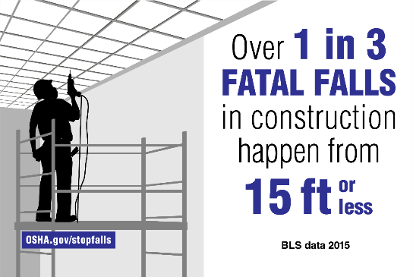
When is Fall Protection Required?
OSHA regulations require use of fall protection with
  Work at heights of 6 feet or greater above a lower level
  Work at heights of 4 feet above a hazard (recommended)

Slide 13
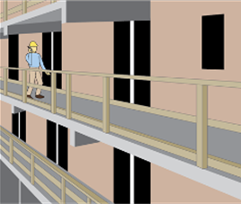
Examples of Fall Hazards Requiring Fall Protection
Elevated surface 6 or more feet above the ground or a lower level
Elevated surface 4 or more feet above a hazard (recommended)
Leading edges - Lack of guard rails or parapets (walls)
Openings, holes or skylights to a lower level
Stairways
Ladder use
Scaffolding use
Aerial lift platform use
Hoist use

Slide 14
OSHA Video: Leading Edge Work (3 min)
Show You Tube Video: Leading Edge Work
Fall Protection Worker Training.pptx

Slide 15

Employer Responsibilities
Continual observational safety checks of work operations
Regular enforcement of the safety policy and procedures
Provide adequate supervision and oversight
  DESIGNATED QUALIFIED PERSON approves fall protection design and changes
  DESIGNATED COMPETENT PERSON identifies and corrects hazards
  CREW SUPERVISOR/FOREMAN is responsible for correcting any unsafe practices or conditions immediately
Supervisors Source: OSHA

Slide 16
Designated Qualified Person
Has a recognized degree or certificate, or extensive professional experience with fall protection
Has the ability to solve fall protection problems at the worksite
According to OSHA, "Qualified" means one who, by possession of a recognized degree, certificate, or professional standing, or who by extensive knowledge, training and experience, has successfully demonstrated his ability to solve or resolve problems relating to the subject matter, the work, or the project.

Slide 17
Designated Competent Person
Has training and experience with fall protection
Is knowledgeable on applicable standards related to fall protection
Is capable of identifying workplace fall hazards
Has the AUTHORITY to correct workplace fall hazards
An OSHA "competent person" is "one who is capable of identifying existing and predictable hazards in the surroundings or working conditions which are unsanitary, hazardous, or dangerous to employees, and who has AUTHORIZATION to take prompt corrective measures to eliminate them"

Slide 18
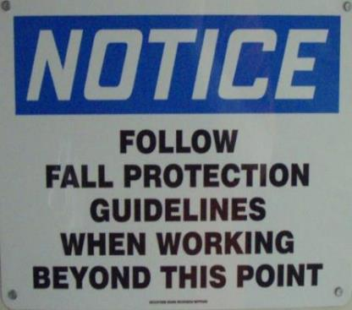
Employee Training and Responsibilities
Each employee trained on procedures and will strictly adhere to them except when doing so would expose the employee to a greater hazard
Employees are to notify the competent person of their concern and have the concern addressed before proceeding

Slide 19
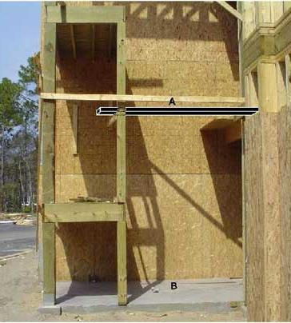
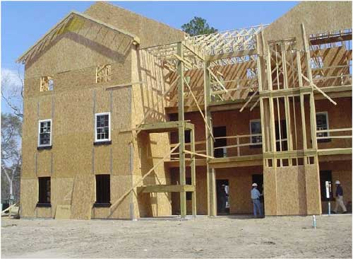

What is wrong here?
“A” is a work platform and “B” is ground level

Slide 20
Lack of fall protection resulted in the death of a 16 year old on the job (NIOSH FACE 2004-06)
The elevated work platform was ten feet above the ground
No guardrails or other fall protection
Victim went home and took aspirin for a headache
Victim was underage for type of work
Victim was on the job for only two weeks
Notes:
NIOSH FACE #2

Slide 21
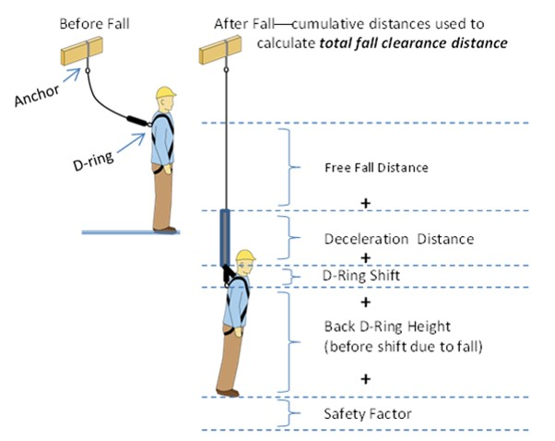
Important Definitions to Know (A to G)
Anchorage
Body belt (not recommended)
Body harness
Competent person
Controlled access zone (CAZ)
Deceleration device
Deceleration distance
Free fall distance
Guardrail system

Slide 22
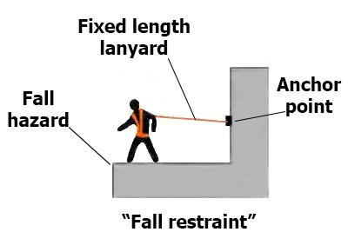
Important Definitions to Know (H to P)
Lanyard
Leading edge
Lifeline
Low-slope roof
Lower levels
Opening
Personal fall arrest system
Positioning device system

Slide 23
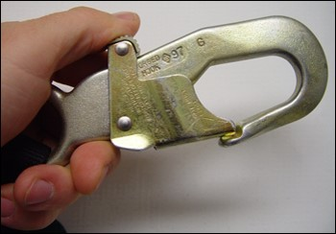
Important Definitions to Know (R to Z)
Qualified (person)
Rope grab
Safety monitoring system
Self-retracting Lifeline/lanyard
Snap hook
Steep roof
Unprotected sides or edges
Warning line system

Slide 24
Section 3:
Fall protection systems to be used on the job

Slide 25
Approach to Prevent and Reduce Fall Hazards
The general approach is to use the hierarchy of controls to prevent and reduce fall hazards
More than two controls should be used to ensure proper protection
  Hierarchy of controls
  Eliminate fall hazards
  Passive fall restraints (Guardrails)
  Active fall restraints
  Fall arrest systems
  Controlled access zones

Slide 26
Hierarchy of Fall Protection Controls
Priority | Control | Examples
First | Eliminate the fall hazard | Bring work to ground level; Use tools to eliminate work above ground level
Second | Passive fall restraint | Install physical barriers, such as guardrails or parapets, to prevent falls
Third | Active fall restraint | Use a restraint system (e.g., full-body harness, lanyard and anchor) to prevent falls
Fourth | Fall arrest | Use a personal fall arrests system or safety net to minimize fall injuries
Fifth | Controlled access zones (CAZ) a last resort | When fall protection is not feasible, provide adequate training, on-site supervision, signage and visible barriers to preclude workers from fall hazard zones

Slide 27
1. Eliminating Fall Hazards
Examples:
Moving tasks to ground level
Changing the work flow and job design to allow more work to be performed at ground level
Using tools (e.g., extension poles) to work from the ground
Designing fixtures and equipment that can be lowered for replacement or repairs
The first and top priority
Implemented whenever feasible

Slide 28
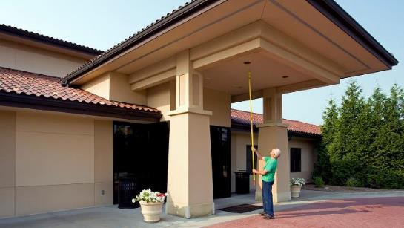
Example 1: Eliminating use of a Ladder
Source: Mr. LongArm

Slide 29
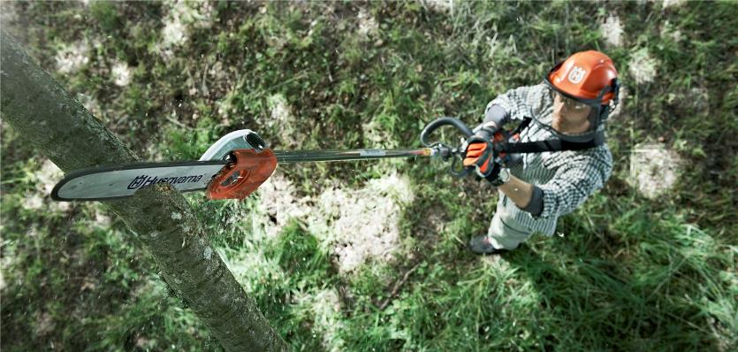
Example 2: Eliminating use of a Ladder or Restraint System (when feasible)
Source: Husqvarna
https://www.husqvarna.com/us/products/pole-saws/

Slide 30
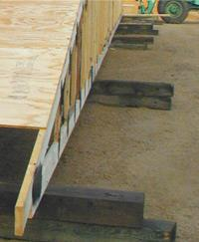
Example 3: Ground Assembly
Source: SBC Magazine, Structural Building Components Association (2012)
Feature: Assembling a Roof from the Ground Up
https://www.sbcmag.info/article/2012/assembling-roof-ground

Slide 31

Do you have any innovative new ideas or old solutions to eliminating fall hazards?
________________________________________________________________________________________________________________________________________________________________________________________________________________________________________________________________________________________________________

Slide 32
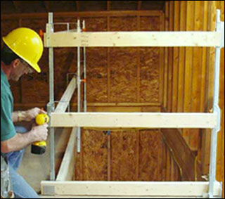
2. Passive Fall Restraints – Guardrail Systems
Physical barriers
Guardrail systems

Slide 33
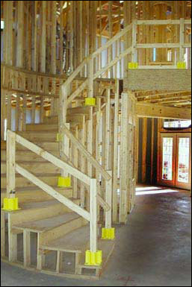
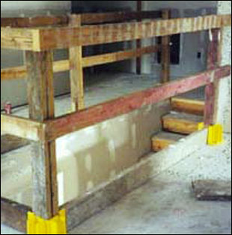
Examples of Temporary Guardrails

Slide 34
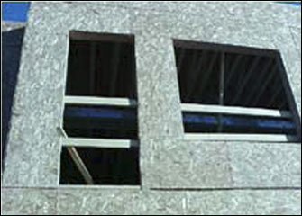
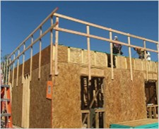
More Examples of Temporary Guardrails

Slide 35
OSHA Video: Floor Opening (3 min)
YouTube Video: OSHA Video: Floor Opening
www.youtube.com/watch?v=93NfcMwnToA

Slide 36
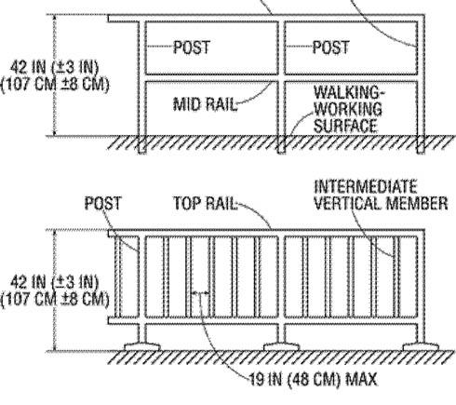
OSHA Guardrail Requirements 1-5
Top rail height 42 ± 3 inches
Horizontal midrail set halfway
Vertical intermediate members no more than 19 inches apart
Top edge (2 inches) must be able to withstand 200 pounds force
Midrail able to withstand 150 pounds force

Slide 37
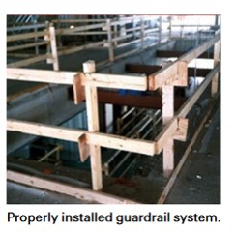
OSHA Guardrail Requirements 6-11
Surfaces must be free of projections that could injure workers
Top rails must not overhang terminal posts
Steel or plastic banding cannot be used
Rails must be at least 1/4 inch in diameter or thickness
For wire rope use flag at 6-foot intervals
Removable guardrail sections for hoisting operations

Slide 38
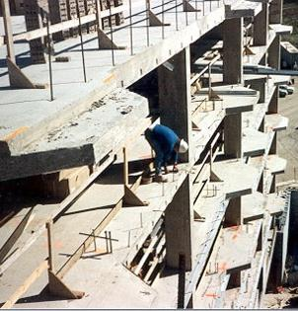
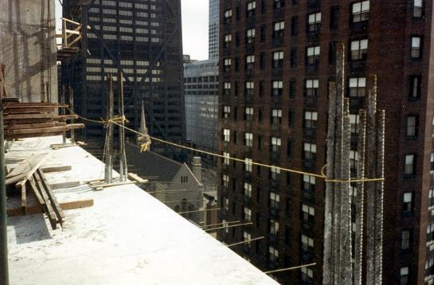
What are wrong with these guardrails?

Slide 39
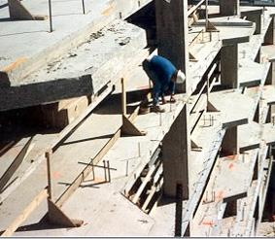
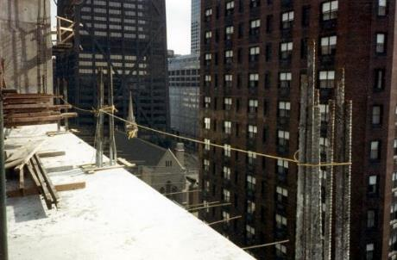
Missing mid rails and worker outside railing
Improper guardrail materials and construction

Slide 40
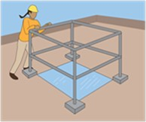
OSHA Guardrail Requirements 12-15
All unprotected sides of holes must be guarded and no more than two sides can be removable (for passage of materials)
When a hole is used as an access point then a gate must be used
On ramps and runways, each unprotected side must be guarded
Manila, plastic, or synthetic rope top rails or midrails must be inspected as frequently to ensure its strength and stability

Slide 41
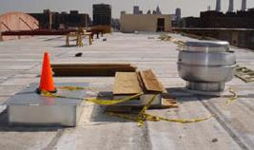
What is possibly wrong with this picture?
Elevator make-up air shaft (5 stories)
Hole covered with metal sheet
Worker asked to secure wood for an upcoming storm
Notes:
NIOSH FACE #5

Slide 42
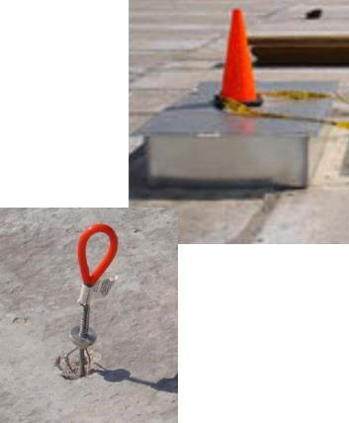
Several things were wrong, which resulted in a 69-foot fall and fatality
(NIOSH FACE 08MI015)
NIOSH Fatality Assessment And Control Evaluation (Face)
No guardrail around hole and the hole cover was not secured
The cover was not labeled “Hole” as a warning
The worker was wearing a harness and lanyard, but he did not use the nearby anchor
The worker was not properly supervised and monitored

Slide 43
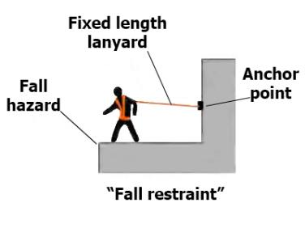
3. Active Fall Restraints
It tethers a worker in a manner that will not allow a fall of any distance
Comprised of a body harness, an anchorage, connectors, and other necessary equipment (e.g., lanyard, a lifeline)
The anchorage must be strong enough to prevent the worker from moving past the point where the system is fully extended, including an appropriate safety factor.

Slide 44
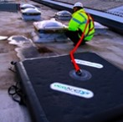
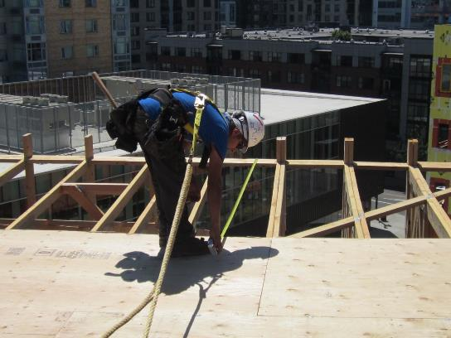
Example of Fall Restraints

Slide 45
Active Fall Restraints and OSHA
While fall restraint systems are not mentioned in Subpart M, OSHA recognizes a fall restraint system as a means of prevention
OSHA suggested that, at a minimum, a fall restraint system must have the capacity to withstand at least 3,000 pounds or twice the maximum expected force that is needed to restrain the person from exposure to the fall hazard.

Slide 46
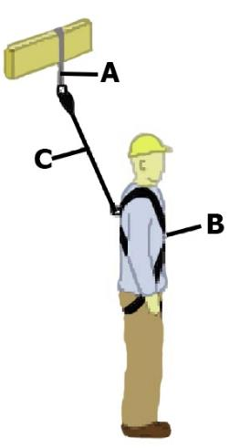
4. Fall Arrest Systems
It is a system used to safely stop (arrest) a worker who is falling from a working level
Consists of an anchorage (A), connectors (C), and a body harness (B).
  See diagram with ABC labels
It also may include a lanyard, deceleration device, lifeline, or suitable combinations of these.
Body belts are prohibited

Slide 47
OSHA Requirements for Fall Arrest Systems
Limit maximum arresting force on a worker to 1,800 pounds
Rigged so worker can neither free fall more than 6 feet nor contact any lower level
Bring a worker to a complete stop and limit the maximum deceleration distance a worker travels to 3.5 feet
Sufficient strength to withstand twice the potential impact energy of a worker free falling 6 feet or the distance permitted by the system, whichever is less.
Be inspected prior to each use for wear, damage, and other deterioration.
Defective components must be removed from service.

Slide 48
OSHA Video: Fall Arrest with Reroofing (3 min)
YouTube Video: OSHA Video: Fall Arrest with Reroofing
www.youtube.com/watch?v=6i6sCbZ4hHQ

Slide 49
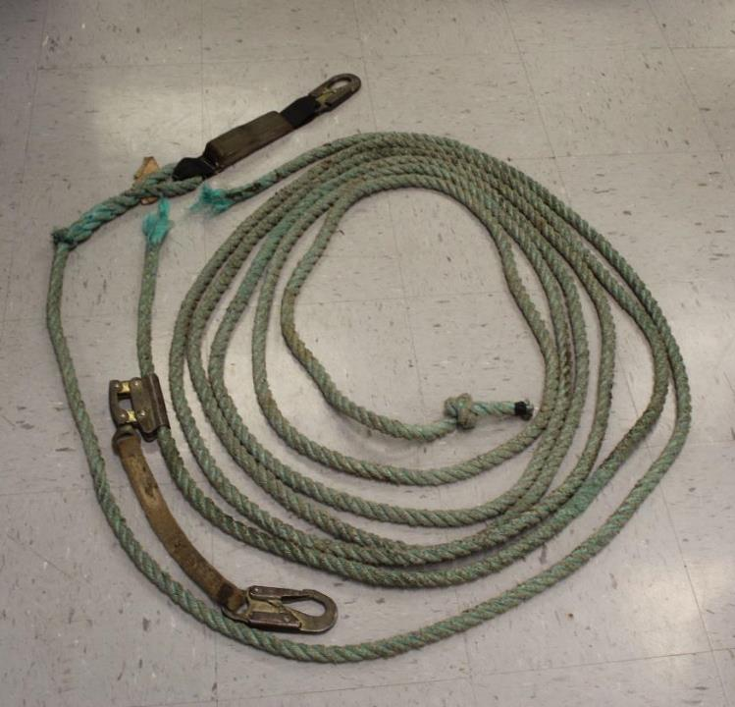
Example of a defective lifeline
About 4 years old
Nylon dry and brittle
Black marks near break
Failed during use
Notes:
NIOSH FACE #7

Slide 50
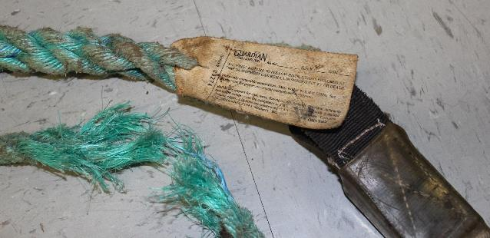
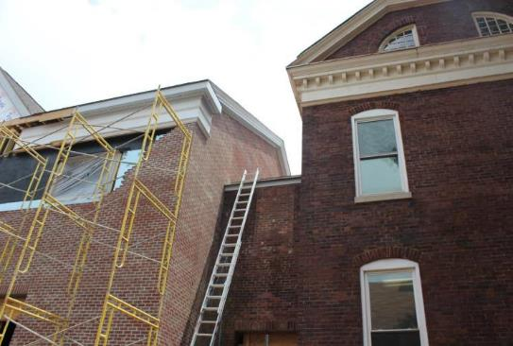
The worker died from a 29.9 foot fall off a roof
(NIOSH FACE 14KY040)
Notes:
NIOSH FACE #7

Slide 51
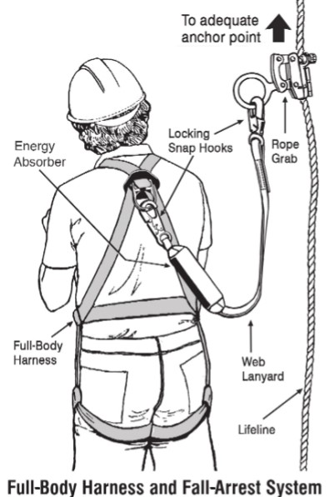
Components of a Fall Arrest System
Full-body harness
Lanyard with energy absorber
Snap hooks (locking-type)
Adequate anchor point
Optional
  Horizontal lifeline with slide or rope grab
  Vertical lifeline and rope grab
  Retractable lifeline

Slide 52
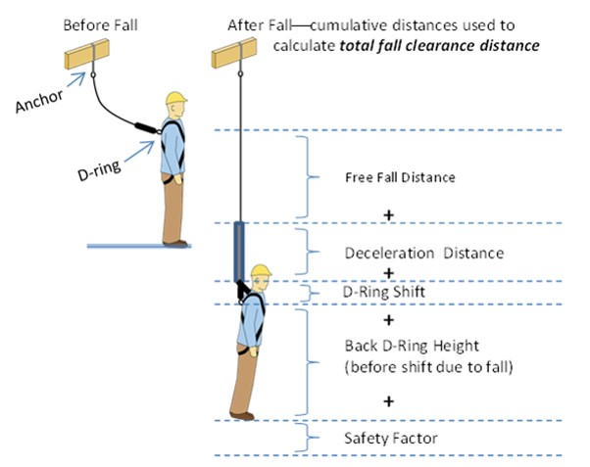
Fall Clearance
A combination of:
Free fall distance
Deceleration distance
D-ring shift
Worker height to D-ring
Safety factor

Slide 53
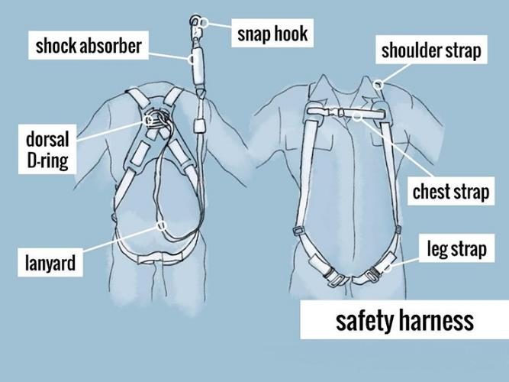
Full-body Harness
Only use American National Standards Association (ANSI) Standard 359 approved equipment capable of meeting and exceeding OSHA standards

Slide 54

How to don a harness – Step 1
First inspect the harness for damage, excessive wear, frayed materials, involvement in a fall arrest (e.g., torn indicator) or other deterioration that could affect performance
A defective harness must be removed from service

Slide 55
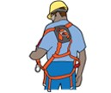
How to don a harness – Step 2
Position back D-ring between shoulder blades

Slide 56
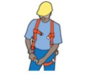
How to don a harness – Step 3
Buckle up legs

Slide 57
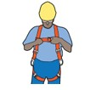
How to don a harness – Step 4
Buckle up front

Slide 58
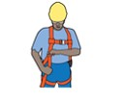
How to don a harness – Step 5
Adjust so the harness fits snuggly and D-ring remains in the correct position

Slide 59
Have you ever put on a harness?
NO
If not, then now is your opportunity
We have harnesses for you to try on
YES
If your answer is yes, then you can help out
Help another go through the steps

Slide 60
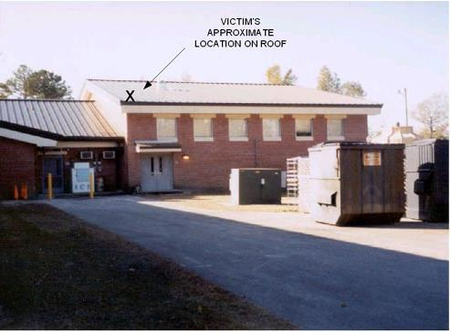
Failure to use Fall Arrest Equipment
(NIOSH FACE 2003-03)
23 year-old roofer fell from roof
Was pulling up extra extension cord near edge of roof
No fall protection in place
Fell 15 feet
Notes:
NIOSH FACE #4

Slide 61
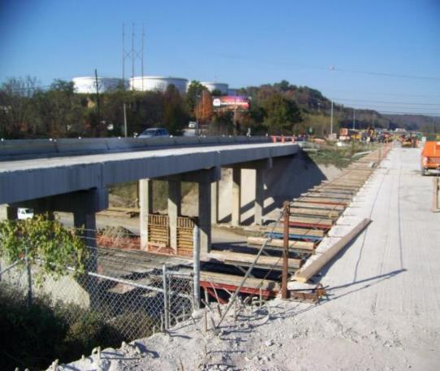
Failure to properly Use Fall Arrest Equipment
(NIOSH FACE 10KY043)
49 year-old steel worker fell from bridge
Donned harness and lanyard
Failed to connect to lifeline
Fell 28 feet
Notes:
NIOSH FACE #8

Slide 62
OSHA Video: Bridge Decking (3 min)
YouTube Video: OSHA Video: Bridge Decking
www.youtube.com/watch?v=XSfkJqtE8Dk

Slide 63
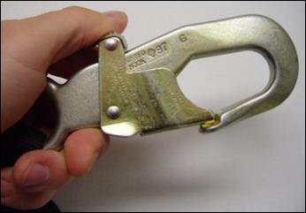
Locking Snap Hooks
Must be locking type
Designed and used to prevent disengagement from any component part of the personal fall arrest system
CANNOT be used for the following connections (unless specifically designed):
  directly to webbing, rope, or wire rope;
  to each other
  to a D-ring with another snap hook or connector attached
  to a horizontal lifeline
  To any incompatible object that could release the lock

Slide 64
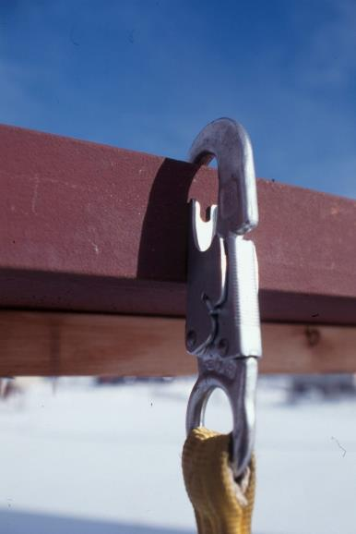
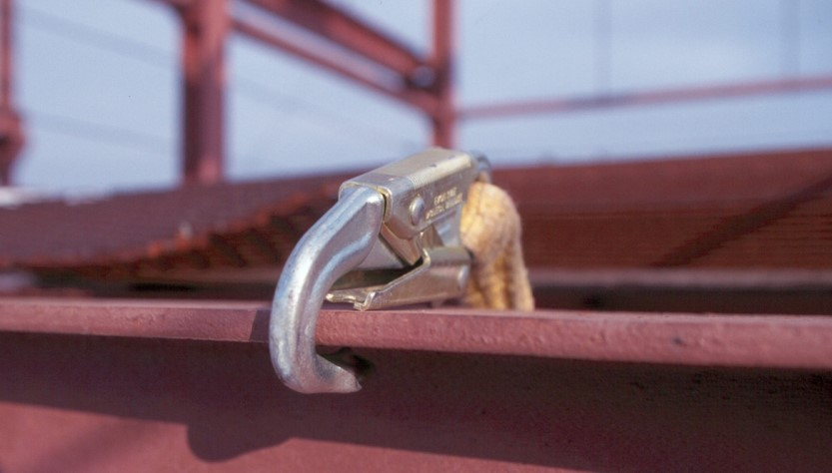
What is wrong with these pictures?

Slide 65

IMPROPER ANCHOR/INCORRECT USE OF SNAP HOOKS The locking mechanisms are disengaged

Slide 66
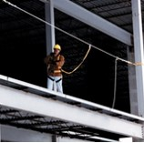
Horizontal Lifelines
Must be designed, installed, and used under the supervision of a qualified person
On suspended scaffolds or similar work platforms with horizontal lifelines that may become vertical lifelines, the devices used to connect to a horizontal lifeline must be capable of locking in both directions on the lifeline

Slide 67


Examples of Horizontal Lifelines

Slide 68

Vertical Lifelines and Lanyards
Must have a minimum breaking strength of 5,000 pounds
Must be protected against being cut or abraded

Slide 69

Ropes and Straps
Ropes and straps used in lanyards, lifelines, and body harnesses must be made of synthetic fibers
Examples include:
  Nylon
  Polypropylene blend

Slide 70


Rope grab and snap hook on a vertical lifeline

Slide 71

Lanyard
(shock absorbing)
Rip-stitch-style Shock Absorbing Lanyard

Slide 72

Self-retracting Lifelines and Lanyards
Load limits in fully extended position
  If it limits free fall distance to 2 feet or less, it must sustain a minimum tensile load of 3,000 pounds
  If it DOES NOT limit free fall distance to 2 feet or less, ripstitch, tearing and deforming lanyards, must sustain a minimum tensile load of 5,000 pounds

Slide 73


Retracting lifelines with different anchors

Slide 74

Anchorages
Must be designed, installed, and used under the supervision of a qualified person
Must be capable of supporting at least 5,000 pounds per worker attached or be capable of supporting at least twice the expected impact load

Slide 75

Strap Anchors (web style)

Slide 76


Roof Peak Anchors

Slide 77


Roof Anchor Locations

Slide 78


What happened?
Roof peak anchor failed

Slide 79


Improper anchor use caused anchor to fail – this resulted in a fatality (NIOSH FACE 2012-02)
Notes:
NIOSH FACE #9

Slide 80


Truss Anchors

Slide 81


Metal Roof Anchors

Slide 82


Bolt-on Anchors

Slide 83


Concrete Anchors

Slide 84


Concrete Anchor Strap with D-ring

Slide 85

Opening Clamp Anchor With Retractable Line

Slide 86


Anchors for I-Beams (Clamp)

Slide 87


Anchors for I-Beams (trolley)

Slide 88


Welded Anchors (D-ring and post)

Slide 89


Cable Anchor

Slide 90


What is wrong with these anchors?

Slide 91

Snap hooks should not be used as anchors
All components must be able to withstand 5,000-lb. force

Slide 92

DailyMail.Com October 8, 2015
Article: What do you mean I'm suspended... Worker saved in dramatic rescue after he slips off Houston bridge and is held by his safety harness from almost certain death
Notes:
DailyMail.Com October 8, 2015
Article: What do you mean I'm suspended... Worker saved in dramatic rescue after he slips off Houston bridge and is held by his safety harness from almost certain death

Slide 93

Rescue Time is Critical
According to the American National Standards Institute (ANSI) Standard Z359, rescue should be initiated within six minutes of a fall arrest.
The picture shows UHCL students evaluating blood pressure changes after being suspended for 2 minutes, as part of a research project

Slide 94

Rescue Plans and Equipment
Workers cannot stay suspended for long
They are at risk of reduced blood flow, oxygen deprivation, brain damage, cardiac arrest and death
All workers must be monitored and promptly rescued in the event of a fall
Use of self-rescue devices are recommended

Slide 95

Relief Step to Restore Blood Flow to Legs and Body
Source: Miller by Honeywell
https://www.millerfallprotection.com/en/products/body%20wear/miller-relief-step-safety-device

Slide 96

Rescue Equipment Needs to be Onsite when Fall Arrest Equipment are Used
Example equipment
  Ladders
  Rescue poles
  Rescue ropes
  Rescue wench
  Crane
  Aerial lift
  Scaffold
  Lifting or lowering device

Slide 97

Example: Self-retracting lifeline with rescue
Source: Western Safety
http://www.westernsafety.com/products/dbisalawind/dbiwindpg3.html

Slide 98

5. Controlled Access Zones (CAZ) –
A Last Resort
When conventional fall protection is deemed not feasible by qualified person
CAZ shall be clearly defined by the competent person as an area where a recognized hazard exists
Demarcation of the CAZ shall be communicated in a recognized manner, either through signs, wires, tapes, ropes or chains

Slide 99

CAZ is clearly marked or controlled by the competent person
The competent person shall ensure that all protective elements of the CAZ be implemented prior to the beginning of work
Workers must be permitted and authorized to work in the CAZ by the competent person
All access to the CAZ must be restricted to authorized entrants

Slide 100

Three Common Elements of a CAZ
Warning line system – Visible barrier
Controlled access – Authorization of trained individuals
Safety monitoring system

Slide 101

Warning Line System
At least 6 feet from the edge
10 feet if mechanical equipment is being used
Parallel to the leading edge
Rope, wire or chain 34-39 inches high
Marked every 6 feet with visible material
Stable and properly installed
  Withstand 16 lbs. force at top
  500 lb. tensile strength

Slide 102

What is wrong with this warning line?

Slide 103

Not at least 6 feet from leading edges
Not parallel to leading edges
Materials on top of line

Slide 104
Safety Monitoring System
All affected workers are trained on the fall hazards, warnings and procedures
Monitor
  Must be a trained competent person
  No other duties or distractions
  Present on the same working level
  Close enough to see and speak with workers

Slide 105



What is wrong with this safety monitor system?

Slide 106



- Monitor not paying attention
- Monitor doing other duties
- Worker crossing warning line
- Warning line NOT
- A rope, wire or chain
- Marked every 6 feet with visible material
- Stable and properly installed
- 10 feet from edge with equipment use
Other fall protection means appear feasible

Slide 107

Why should a CAZ be the last resort?
________________________________________________________________________________________________________________________________________________________________________________________________________________________________________________________________________________________________________

Slide 108
Section 4:
Stairways and Ladders

Slide 109

Stairways
Keep free of projections and slippery conditions
Do not use stairs that are not filled in or incomplete
Do not use spiral stairways that will not be a permanent part of the structure
Stairways must have a guardrail system along unprotected sides or edges

Slide 110
OSHA Requirements for Stairways
Steps at least 22-inches wide, uniform and slip resistant
Vertical distance between landing does not exceed 12 feet
At least 30-inch long landings with 20-inches beyond an open door
Landings same width as stairs
Warning signs if they open into vehicle traffic
Handrails and/or guardrails when there are 4 or more stairs
  30-34 inches above the stair treads
  At least 3-inches space from wall
  Guardrails meet guardrail requirements

Slide 111


Stairway: What is wrong here?
Notes:
Missing guardrails along open sides

Slide 112


Stairway: Temporary guardrails

Slide 113

General Ladder Safety
  Inspect before use and do not use defective, damaged or slippery ladders
  Only use ladder for its designed purpose & intended load
  Keep 3-point contact when climbing up or down
  Face ladder while ascending and descending
  Keep hands free – use a tool belt or hand line
  Do not lean beyond the side rails

Slide 114

General Ladder Safety (continued)
  Only use on level, stable and non-slippery surfaces
  Secure ladders or use a barricade when placed where they may be easily displaced
  Keep away from doorways and hazards
  Keep ladders clear at bottom and top surfaces
  Do not move ladders while in use
  Do not use metal ladders near electrical equipment or power lines

Slide 115

Stepladders
  Only use in an open, locked position
  Do not use closed or as a straight ladder
  Never stand on top step or top cap
  Do not use rear cross-bracing for climbing, unless designed as such

Slide 116

Extension Ladders
  Ladder must extend 3 feet above landing surface (or be equipped with 3 feet grab rail)
  Position base away from the wall at a distance of 1/4 the landing height – no more and no less (1 foot horizontally for every 4 feet vertically)
  For high places, secure ladder at top
  Never step on the top 3 rungs

Slide 117


What is wrong with this scene?

Slide 118

Several problems contributed to a fatal fall from about 8 rungs up (NIOSH FACE 07MI007)
Ladder placed on unstable base (frozen sand) and safety feet not properly used
Base placement possibly higher than a 1:4 ratio
Ladder placement at top was unstable and not 3 feet above roof edge
Person holding ladder should be on other side near base of feet
Person climbing was carrying wood
Notes:
NIOSH FACE #1

Slide 119

Job-made Ladders
Use construction-grade lumber and 12d common wire nails
Free of protruding nails or sharp edges
Not missing any steps or rungs
Width should be between 16-20 inches
Cleats should be at least 1 x 4 inches
Cleats equally spaced 12 inches from one to the next
Filler inserted between cleats and should be 2 in. x 2 in.

Slide 120

He is going down the ladder
What’s wrong with this picture?

Slide 121

When going up or down a ladder
1. Always face ladder
2. Maintain 3-points of contact with ladder at all times
3. Never hold tools or objects
Notes:
Leaning against ladder.

Slide 122

What’s wrong with this picture?

Slide 123

1. Never stand on the top step or cap of a stepladder ladder
2. Face ladder (forward)

Slide 124

A 39-year-old tree-care worker electrocuted
(NIOSH FACE 13-NJ-074)
Work within 10-feet of a power line (not de-energized)
Using a power pole saw that contacted a power line
Ladder metal and conductive
Worker who attempted to catch falling worker broke his leg

Slide 125
Section 5:
Holes and Skylights

Slide 126

Major Requirements
Holes and skylights near work are protected by a cover and labelled as “Hole”
A guardrail system is erected around the hole or skylight
A personal fall arrest system is an alternative

Slide 127


Improper Cover

Slide 128


Skylight Cover
Broken skylight that a worker fell through
Skylight guards

Slide 129
OSHA Video: Skylights (3 min)
YouTube Video: OSHA Video: Skylights
www.youtube.com/watch?v=JbsoVBqrgCU

Slide 130


What’s wrong here?

Slide 131

Uncovered and unguarded hole
Lack of fall protection harnesses and lifelines
Lack of perimeter warnings or guarding

Slide 132
Section 6:
Scaffolds

Slide 133

Scaffold Design & Erection Requirements
Designed by a licensed professional engineer competent in scaffolding
Erected under the supervision of a trained and competent person
In good repair and inspected by a competent person prior to use
Uprights are plumb (vertical) and securely braced to prevent swaying
The scaffold is tied off and secured to a stable structure

Slide 134
Scaffold Planking
Planking is made of 2 x 10 inch scaffold grade lumber/metal
Planking spans no more than
  10 feet for light trades (25 pounds per square foot, psf)
  8 feet for medium trades (50 psf) or
  6 feet for heavy trades (75 psf)
Planks overhang supports by 6 inches (minimum) to 12 inches (maximum)
Planks cover work surface (no gaps or missing planks)

Slide 135

Worker Dies After 10-foot Fall from Improvised Scaffold (NIOSH FACE 03NJ091)
66-year-old installing vinyl siding for his son (the owner)
Plank made from discarded scrap lumber
Only a single plank installed
No guardrail installed or fall protection
Worker lost balance when turning to talk with his son

Slide 136

Scaffold Guardrail Requirements
All open sides above 4 feet have 42-inch high guardrails with a 21-inch midrail
Guardrail supports are no more than 8 feet apart
All open sides above 10 feet have a 4-inch high toe-board

Slide 137

Drywall Installer Dies in 7-foot Fall from Scaffold
(NIOSH FACE 06-OR-003-01)
22-year-old hanging sheetrock
Only a single plank installed
Not all wheels were locked
Scaffold moved during use
No guardrail
Lack of a competent person overseeing scaffold installation and use

Slide 138

Scaffolds: Additional requirements
Ladders for access extend 3 feet above the platform and are securely attached
No work is performed during windy conditions

Slide 139
OSHA Video: Scaffolding (3 min)
YouTube Video: OSHA Video: Scaffolding
www.youtube.com/watch?v=ZjzfPYhxSow

Slide 140
Section 7:
Aerial Lifts

Slide 141

Aerial Lift Operational Requirements
Aerial lifts are operated by a trained and qualified person in accordance with manufacturer’s instructions
Aerial lifts are in good repair and inspected by a competent person prior to use
Load limits are not exceeded
No work is performed during windy conditions (e.g., winds above 27 mph)

Slide 142

Aerial Lift Operational Requirements (continued)
Lift is not moved with a worker elevated (unless permitted by manufacture)
Aerial lifts are properly stabilized on firm, level surfaces and away from hazards
Lifts are operated at least 10 feet away from energized overhead power lines
Brakes are set and wheels chocked when on an incline
Outriggers are used, if provided

Slide 143

Aerial Lift Fall Protection Requirements
All open sides have a guardrail with a midrail or full enclosure
Operators use a body harness with lanyard attached to the boom or basket
    Note: this is recommended with scissor lifts as well

Slide 144

17-foot Fall And Fatality
From An Aerial Lift
(NIOSH FACE 11-MA-043-01)
A 58-year-old maintenance worker
Failure to use fall protection harness and lanyard
Inadequate work zone safety precautions for traffic

Slide 145

Fatality with scissor lift that tips over on unstable surface
(NIOSH FACE 09CA008)
48-year-old welder
Lift extended 12 feet
Worker moved lift while raised
Orange cone was only barrier around pit
Inadequate workplace hazard assessment

Slide 146
Section 8:
Worksite Checklists

Slide 147
Worksite Checklist - checklists are provided for the following
Personal fall restraint systems
Personal fall arrest systems
Warning line systems
Controlled access zones
Safety Monitoring Systems for Low-Slope Roofs
Stairways
Ladders
Guardrails
Holes and skylights
Work on steep roofs
Scaffolds
Aerial lifts

Slide 148

When Completing a Checklist it is Important to
Have a goal to take immediate corrective action
Make efforts to correct deficiencies
Make a record of your efforts
  Mark as “acceptable” if found to be acceptable
  Mark “N/A” if not applicable
  Mark as “addressed by action taken” and describe what corrective actions were taken
Use it as a means of becoming more knowledgeable and competent

Slide 149

Example Checklist – First Part of Stairways

Slide 150

4. Corrective actions taken (Highlighted areas)

Slide 151

Ladder Inspection and Repair
All ladders must be regularly inspected and repaired, at least quarterly, but the cycle depends on use and work conditions
  If ladders are used two or more days a week, then a monthly inspection and repair cycle is recommended.
  If ladders are used daily under harsh work conditions, then a weekly inspection and repair cycle is recommended.
Inspection and repair cycle based on work conditions and use
____ Weekly
____ Monthly
____ Quarterly

Slide 152
Review of Learning objectives
Why fall protection is important?
OSHA fall protection regulations & standards
    What heights require fall protection?
    Provide some fall protection design and performance specifications
What are some common fall hazards requiring fall protection?
Hierarchy of controls for fall protection
    What is the importance of first three controls in preventing falls?
    What is the importance of fourth (fall arrest)?
    Why are controlled access zones are a last resort?
Describe the different types of fall protection control options

Slide 153

Let’s look out for each other…
Make sure everyone goes home safely
Questions?

