Slide 1
Fall Protection in Construction
Train-the-Trainer Workshop
This material was produced under grant number SH-31228-SH7 from the Occupational Safety and Health Administration, U.S. Department of Labor. It does not necessarily reflect the views or policies of the U. S. Department of Labor, nor does mention of trade names, commercial products, or organizations imply endorsement by the U. S. Government.

Slide 2

Workshop Outline
Discuss OSHA grant requirements (0.5 hour)
Discuss adult learning needs (0.5 hour)
Go through worker training materials (5 hours)
    Pre-test
    PowerPoint Slides
    NIOSH FACE Fatality Investigations
    OSHA Videos
    Checklist
    Post-test
Hands-on demonstrations (1.5 hours)
Post-training survey

Slide 3

Ultimate goal
Educate employers and employees on fall protection
Prevent costly fatalities and injuries associated with falls
Protect our greatest American asset – OUR WORKFORCE

Slide 4
Learning Objectives of the Training
  Discuss why fall protection is important
  Know general OSHA fall protection regulations & standards, especially
      Heights requiring fall protection
      Fall protection design and performance specifications
  Recognize common fall hazards requiring fall protection
  Understand the hierarchy of controls for fall protection
      Discuss importance of first three controls in preventing falls
      Discuss importance of fourth (fall arrest) in reducing the severity of a fall
      Discuss why controlled access zones are a last resort
  Describe the different types of fall protection control options

Slide 5

At every stage it is critical to assess learning and implement corrective actions when needed
Level 1. Assess training effectiveness with a survey
  Training materials, organization, delivery and environment
  Trainers
Level 2. Assess that learning objectives are being met
  Pre-test versus post-test assessment
  Attendee self-assessment of learning

Slide 6
Level 1. Post-Training Survey
Item | Not at all | Somewhat | Adequate | Very Much
1. The training facilities were adequate. | 0 | 1 | 2 | 3
2. The training was well organized. | 0 | 1 | 2 | 3
3. The allotted time for training was sufficient. | 0 | 1 | 2 | 3
4. The training materials were helpful. | 0 | 1 | 2 | 3
5. The training was relevant to my needs or company’s needs. | 0 | 1 | 2 | 3
6. The exercises and discussions helped me learn the material. | 0 | 1 | 2 | 3
7. The training objectives were met. | 0 | 1 | 2 | 3
8. The training enhanced my learning and knowledge on the topic. | 0 | 1 | 2 | 3
9. I expect to use the knowledge and skills gained from this training. | 0 | 1 | 2 | 3
10. I would recommend this course to others. | 0 | 1 | 2 | 3
11. The instructor was well prepared and knowledgeable. | 0 | 1 | 2 | 3
12. The instructor was receptive to comments and questions. | 0 | 1 | 2 | 3
Items 11 and 12 are repeated for multiple instructors

Slide 7
Level 1. Self-Assessment of Learning
Before Training Rank from Low (1) to High (5) | Topic | After Training Rank from Low (1) to High (5)
1….…2…….3….…4…….5 | Knowledge of OSHA regulations and standards on fall protection | 1….…2…….3….…4…….5
1….…2…….3….…4…….5 | Knowledge and skill to recognize fall hazards | 1….…2…….3….…4…….5
1….…2…….3….…4…….5 | Knowledge of the hierarchy of controls for fall prevention | 1….…2…….3….…4…….5
1….…2…….3….…4…….5 | Knowledge on the different types of fall prevention control options | 1….…2…….3….…4…….5
1….…2…….3….…4…….5 | Knowledge and skills to evaluate and control fall hazards | 1….…2…….3….…4…….5

Slide 8
Level 2. Pre-test and post-test assessments
The tests are designed to assess the learning objectives in five critical areas
Knowledge of OSHA regulations and standards
Knowledge and skill to recognize fall hazards
Knowledge of the hierarchy of controls
Knowledge on the different types of fall prevention control options
Knowledge and skills to evaluate and control fall hazards
You will take these as we go through the worker training materials

Slide 9

Required Documentation for issuing training completion certificates
Sign-in Sheet
  Course title
  Date, time, number of contact hours
  Location name and address
  Instructor names
  Trainee names, titles, company and signatures
  Instructor signatures and certification
Pre-tests (with trainee name)
Post-tests (with trainee name)
Post-training surveys (anonymous)

Slide 10
Adult Learning Needs

Slide 11

Group and Class Discussion
Let’s take 10 minutes
From your experience with training courses, list five effective techniques the instructor used
  1. _____________________________________
  2. _____________________________________
  3. _____________________________________
  4. _____________________________________
  5. _____________________________________

Slide 12
How we learn
Each person has his or her own way of learning, based on past experiences and sensory processing
Learning through the senses:
  Visual: about 83%
  Auditory: about 11%
  Kinesthetic (activity): about 69%
Learning
Watching
Listening
Doing
Applying Experience
Touching
Thinking

Slide 13
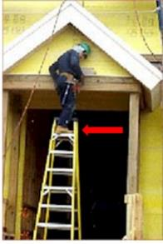
Key adult learning needs
Need to know why
  How does the training apply to their job?
  Opportunity to think about how the information will be used
Need to apply experience
  How does new information relate to past experiences?
  Opportunity to compare new information to past experiences
  Opportunity to share experiences during training
Need to be in control
  Flexible learning environment with some influence
  Actively involved in learning process
  Opportunities to voice concerns (group discussions)
Need for success
  How will the training benefit them?

Slide 14
Applying these principles in the training
Clear learning objectives at the start and finish
Dynamic training presentation
  Visual pictures and illustrations…[Watching & Listening]
  Videos with case studies…[Watching & Listening]
  Case studies with problem solving…[Thinking & Applying Experience]
  Sample equipment and devices… [Touching]
  Hands-on demonstrations…[Doing & Touching]
  Class exercises and discussions…[Thinking & Applying Experience]
  Tests with review of answers… [Thinking]

Slide 15
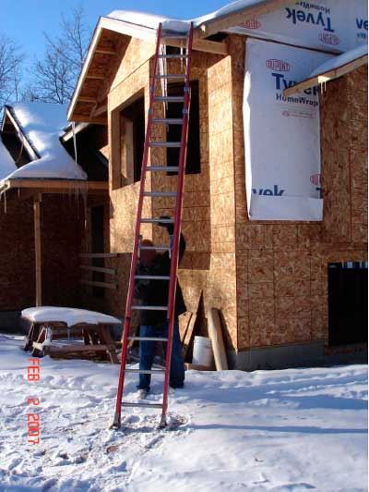
What you will find with the training materials
Comprehensive slides with lots of pictures
OSHA Videos (Six 3-min shorts)
Case studies from NIOSH FACE fatality investigations
Class exercises and discussions
  What’s wrong with this picture?
  Apply your knowledge and experience
Demonstration equipment and devices
Checklists for use on-the-job
Pre- and post-tests to assess learning

Slide 16
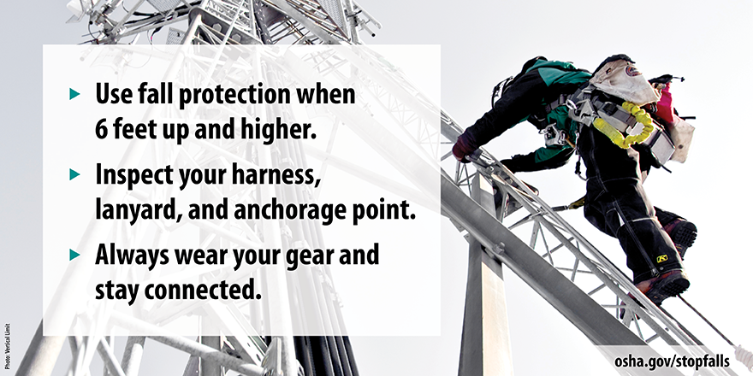
Photo Sources
  Centers for Disease Control and Prevention (CDC)
  National Institute for Occupational Safety and Health (NIOSH)
  Occupational Safety and Health Administration (OSHA)

Slide 17
Occupational Safety and Health Administration (OSHA)
Susan Harwood Training Grant
“Grants are awarded to provide training and education programs for employers and workers on the recognition, avoidance, and prevention of safety and health hazards in their workplaces and to inform workers of their rights and employers of their responsibilities under the Occupational Safety and Health (OSH) Act”

