Slide 1
Excavation and Trenching Safety

Slide 2
OSHA Susan Harwood Grant
This material was produced under Grant Program # SH-31246-SH7 from the OSHA, U.S. Department of Labor. It Does not necessarily reflect the views or policies of the U.S. Department of Labor, nor does mentioning of trade names, commercial products, or organizations imply endorsement by the U.S. Government. Revisions were made to this material under grant number SH-16580-07 from the Occupational Safety and Health Administration, U.S. Department of Labor.

Slide 3
Intended Training Audience
Water Utility Operators
Heavy equipment operators
Electricians
Plumbers
Mechanics
Welders
Carpenters
General laborers
Tradespeople

Slide 4
Training Objectives
Occupational Safety and Health Act and your rights as a whistleblower.
Introduction to the OSHA construction regulations and safety requirements for the 29 CFR 1926, Subpart P-Excavation and Trenching Standards
Introduction to trenching and excavation hazard recognition
How to maintain safe work practices during excavation and trenching work related activities

Slide 5
OSH Act of 1970-SEC.5.Duties
(a) Each employer shall:
(1) Furnish to each of his employees employment and a place of employment which are free from recognized hazards that are causing or are likely to cause death or serious physical harm to his employees;
(2) Comply with occupational safety and health standards promulgated under this Act.
(b) Have each employee comply with occupational safety and health standards and all rules, regulations, and orders issued pursuant to this Act which are applicable to his own actions and conduct.

Slide 6
Your Rights as a Whistleblower
You may file a complaint with OSHA if your employer retaliates against you by taking unfavorable personnel action because you engaged in protected activity relating to ‘workplace safety or health’, asbestos in schools, cargo containers, airline, commercial motor carrier, consumer product, environmental, financial reform, food safety, health insurance reform, motor vehicle safety, nuclear, pipeline, public transportation agency, railroad, maritime, motor vehicle safety, and securities laws.

Slide 7
Unfavorable Personnel Actions
Applying or issuing a policy which provides for an unfavorable personnel action due to activity protected by a whistleblower law enforced by OSHA:
Blacklisting
Demoting
Denying overtime or promotion
Disciplining
Denying benefits
Failing to hire or rehire
Firing or laying off
Intimidation
Making threats
Reassignment to a less desirable position, including one adversely affecting prospects for promotion
Reducing pay or hours
Suspension

Slide 8
Filing a Complaint-Legal Time Limits
Occupational Safety and Health Act -30 days to file
Solid Waste Disposal Act-30 days
Toxic Substance Control Act-180 days
Federal Water Pollution Act-30 days
Compensation and Liability Act-30 days
Clean Air Act-30 days
Safe Drinking Water Act-30 days

Slide 9
Filing A Complaint
Visit or call your local OSHA office
Mailing a written complaint to the regional or area office
Written complaints can be sent by facsimile, electronic communication, hand delivery during business hours
www.whistleblowers.gov

Slide 10
What is my employer required to do to protect workers from excavations Hazards
Excavation safety training
Protective measures
Excavation Inspections
Competent Person

Slide 11
Excavation and Trenching
Between 2011 and 2015, according to the Bureau of Labor Statistics, 94 American workers were killed in trench collapses. In 2016, 23 U.S. workers died.
These are not “accidents” or random occurrences. They are generally caused by unsafe working conditions in clear violation of OSHA safety and health standards or other recognized safe work practices.
All fatalities were preventable if safe work practices were in place

Slide 12
OSHA Standard 29 CFR 1926.650-652 Subpart P
Part 1926 contains the regulations for the Construction Industry. Sections 650-652 contain the Excavation regulations, which are also known as Subpart P.
App A Soil Classification
App B sloping and benching
App C timber shoring for trenches
App D Aluminum hydraulic shoring for trenches
App E Alternatives to timber shoring
App F Selection of protective systems

Slide 13
Myths of Excavation Hazards
“If the trench is not deeper than 5 feet, I don’t have to slope or shore to protect me from a cave-in.”
“Air monitoring is only for confined spaces, not excavations.”
“I can dig myself out if I am buried.”
“Hitting utilities is simply part of the business!”

Slide 14
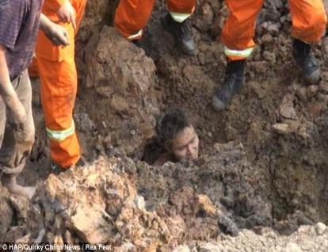

Myth #1of Excavation Hazards
I Can Dig Myself Out
Reality of a cave in:
A cubic yard of soil can weigh as much as a small pickup truck or 3000 pounds causing traumatic injuries.
Soil pressing on the chest can make it impossible to breathe.
Fine dirt can clog your nose, mouth and lungs.
Large rocks and other materials may break bones, puncture the body and cause other serious injuries.

Slide 15
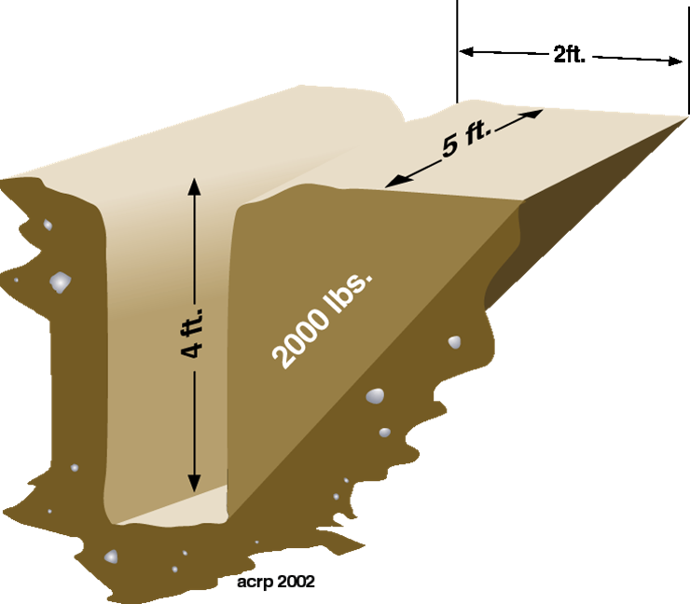
Soil Weight Example
Notes:
This image of the spoil dimensions gives you a good idea of just how much soil can weigh

Slide 16
Collapse Forces
24 inches of soil on a person’s chest weighs 750-1000 lb.
18 inches of soil covering a body weighs 1800-3000 lb.
1 cubic foot of soil can weight from 100-125 lb.
Shear wall collapse speed 45 mph

Slide 17
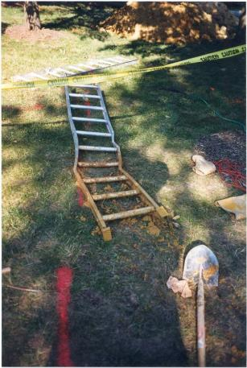
Collapse Forces Continued
Notes:
The impact from a trench collapse can be devastating to the human body. Trench collapses can break bones.

Slide 18
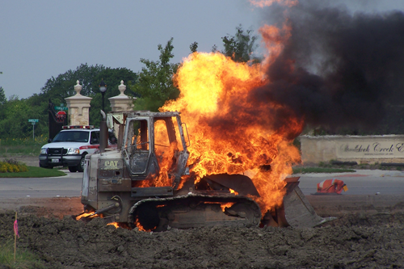
Myth #2 of Excavation Hazards
Hitting Underground Utilities
Live electrical lines in the ground can kill workers and cause significant property damage
A gas line hit can lead may to an explosion
A broken water line can fill a trench in seconds

Slide 19
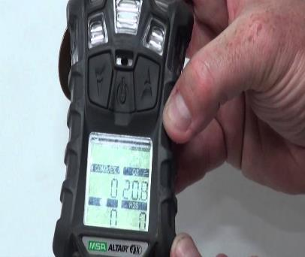

Myth #3 of Excavation Hazards
OSHA requires air monitoring in confined spaces when the air maybe dangerous
Include trenches deeper than 4 feet when hazards are present
Harmful gas and vapors are present in sewer systems
Exhaust fumes emitted by equipment

Slide 20
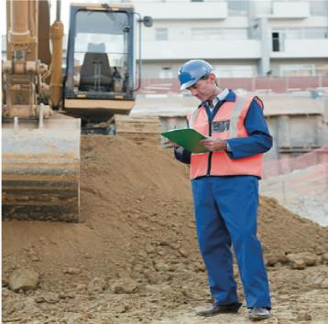
Myths #4 of Excavation Hazards
Under Five feet, Shoring, shielding and sloping Is Not Required
The OSHA regulation actually says: Each employee shall be protected . . . Except when excavations are less than 5 feet and examination of the ground by a competent person provides no indication of a potential cave-in.

Slide 21
Unsafe Attitudes
“I Know what I’m doing.”
“It can’t happen to me.”
“I’ve been doing it that way for years.”
“I’d sleep in that hole!”
“Don’t worry, we’ll watch the walls and tell you if you need to get out.”

Slide 22
OSHA Inspector Observed an Imminent Danger Trench Work in Violation of Safe Work Practices
Show an inspection video

Slide 23
Causes of Excavation Fatalities
OSHA Citations to Include
Improper sloping, shoring and shielding
Inadequate PPE
Lack of or improper use of ladders, ramps, or runway access
Lack of training
Not protecting against impalement

Slide 24
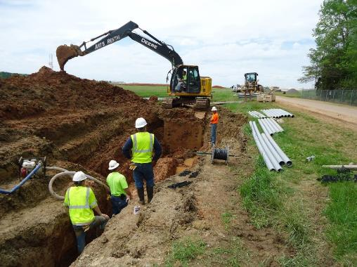
What Causes Cave-ins?
Equipment weight and vibration
Water seeping into the trench
Nearby vehicle traffic
Spoil bank to close of edge of trench
Soil that has been previously disturbed
Soil that is too dry that crumbles easily

Slide 25
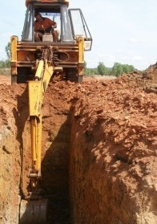
Definitions
OSHA defines an excavation as any man-made cut, cavity, trench, or depression in the Earth’s surface formed by earth removal.
A trench is defined as a narrow excavation (in relation to its length) made below the surface of the ground. In general, the depth of a trench is greater than its width, but the width of a trench (measured at the bottom) is not greater than 15 feet (4.6 m).

Slide 26
Requirement for Excavation Safety
All employees in an excavation 5 feet or deeper shall be protected from cave-ins by an adequate protective system, unless the excavation is made entirely in stable rock.

Slide 27
Leading Excavation Hazards
Crushing injuries
Loss of blood flow
Slip trips and falls
Suffocation due to dangerous air
Struck by injuries caused by equipment or materials
Electrocution or electric shock
Drowning by water flooding into the trench
Falls into excavations

Slide 28

OSHA Defines a Competent Person
"one who is capable of identifying existing and predictable hazards in the surroundings or working conditions which are unsanitary, hazardous, or dangerous to employees, and who has authorization to take prompt corrective measures to eliminate them" [29 CFR 1926.32(f)].

Slide 29
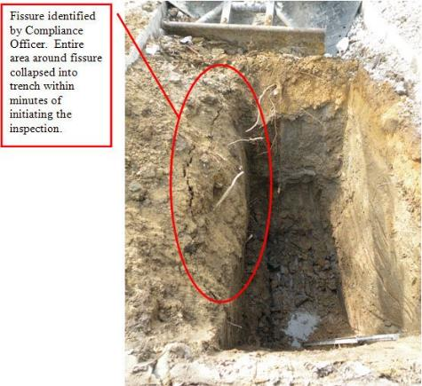
Competent Person Duties
Inspect trenches daily
Detect conditions that lead to cave-ins
Detect failures in protective systems
Detect when hazardous air maybe present
Authority to fix what’s wrong

Slide 30
Additional Competency Requirements
A competent person is one who understands the industry standards under subpart P and its safe work practices
Has received adequate training in addition to experience in excavation and trenching activities
Can classify soils – A, B, C
Knows when and what type of protective systems to use
Determines whether or not excavation equipment is unsafe to operate
Designing of structural ramps
Locate possible underground utilities
Control water
Control equipment movement

Slide 31
What is the last piece of the competent person duties?

Slide 32
AUTHORITY to Fix what is wrong!
Competent person shall communicate the hazards to their supervisor and other operators and construction laborers
Stop all work and remove workers from the trench
The competent person must be clear and concise on the process of mitigating the hazards before any work re-commences on the job site
Must make sure dangerous conditions are corrected before work can continue

Slide 33
Registered professional engineers may be needed if:
The excavation is deeper than 20 feet
An “alternate system” (such as sheet piling) is used
that the Standard does not provide guidance for.

Slide 34
Soil Classification
OSHA assigns 4 Classifications
Solid Rock
Type A
Type B
Type C

Slide 35
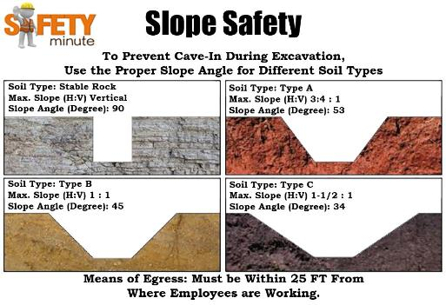
Soil Classification for Solid Rock
Natural solid mineral material
Can be excavated with vertical sides
Will remain intact while exposed
Identification often requires the help of a geologist
If unsure, take the time to ask for a second opinion, lives may depend on it!

Slide 36
Classification For Type A Soil
Various clays soil that include silty clay, sandy clay and or clay loam.
Other type A soil includes hard compacted soil known as hard pan or soils such as sand clay mixed with other various minerals

Slide 37
Classification For Type B Soil
Soils made up of angular gravel, silt and silt loam. Soils that are fissured caused by vibration that could otherwise be type A
Dry rock that is not stable
Sandy loam

Slide 38
Soil Classification for Type C Soil
Typically granular
Gravel, sand, and loamy sand
Submerged soil
Soil from which water is freely seeping
Submerged rock that is not stable
High potential for instability and cave-ins

Slide 39
Hazards While Trenching in Class C soils
Warming conditions increases water saturation
Difficulty maintaining a slope
Increases slips trips and falls
Increases the likely hood of cave-ins

Slide 40
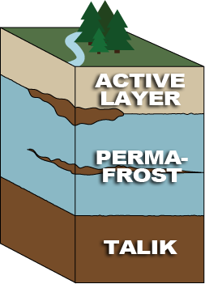
Hazards When Trenching in Permafrost
Beware that when trenching in permafrost regions a competent person must determine what protective system is needed to keep workers safe
Competent person must always determine a protective system
When in permafrost, the competent person must take extra precautions to address rapidly melting ice

Slide 41
Soil Testing
One visual and one manual test, by a competent person, on fresh soil unaffected by weather
Common tests
Ribbon
Thread
Thumb
Dry strength
Sedimentation

Slide 42
It is Critical to Be Correct When Classifying Any Soil
No matter what soil testing process the competent person uses. Soil must be classified before a protective system decision can be made.
Results must be correct; lives will depend upon it.
When in doubt classify as type C soil

Slide 43
Soil Classification
Show a soil classification video

Slide 44
Protective Systems Required When
Employees in a trench must be protected by a protective system.
With the following exceptions:
Entirely stable rock
Less than 5 feet without sign of potential cave-in

Slide 45
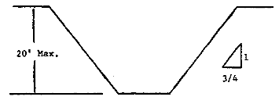
Type A soil Protective System
Sloping soil at 53 degrees
Strongest and most cohesive
The most sloping and benching options
Simple slope of ¾ to 1: for every 1 foot down the soil must be excavated ¾ of a foot out from the toe

Slide 46
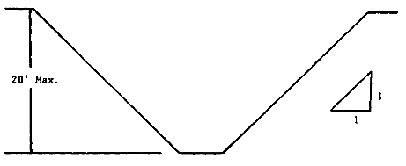
Type B Soil Protective System
Sloping soil at 45 degrees
More options for protecting workers
Benching or multiple benching
Simple slope of 1 to 1: for every 1 foot down the soil must be excavated 1 foot out from the toe

Slide 47
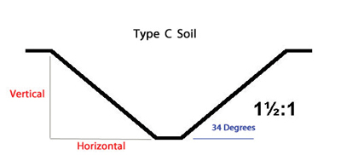
Type C Soil Protective System
Poorest quality
Sloping is still possible
Sloping angle is very low (34 degrees)
For every foot down, the slope must extend 1.5 feet from the toe

Slide 48
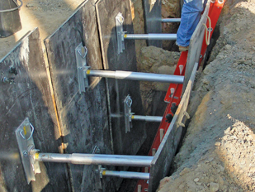
Aluminum Hydraulic Shoring
Must be designed in accordance with 1926.652 manufacture tabular data
Some aluminum hydraulic shoring can be heavy however light weight shoring allows a worker to assemble and install without entering the trench
Gauge regulated to ensure even distribution of pressure along the trench line
Adaptable to various trench depths
Cannot be used for trenches deeper than 20 feet
Tabular data

Slide 49
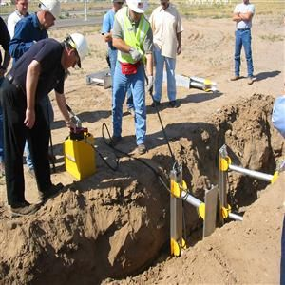
Hydraulic Shoring without Plates
Easily installed by one person
Light weight
Can only be used in cohesive type B soil or better

Slide 50
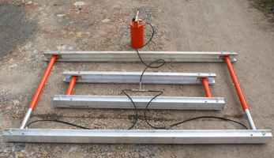
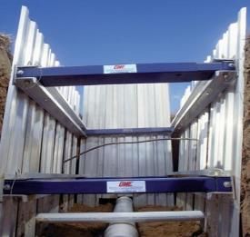
Waler Shoring For Type C Soil
Light weight and assembled outside the trench
Compact design and interchangeable components
Comes in different sizes
More practical in some cases over trench boxes
Transport these systems via airlines to service project locations
Advantages: Less excavation of materials and back filling. Use less fuel and reduce the risk of deep trench hazards

Slide 51
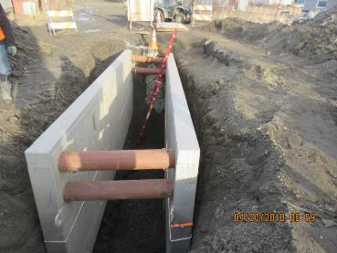
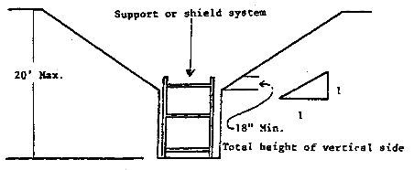
Trench Box or Trench Shield
Only designed to protect workers not prevent cave-ins
Available in a variety of dimensions
Usually aluminum or steel
May be custom-built from tabulated data
Ladder placement must be inside the trench box and 36 inches above the leading edge.
Trench box must extend 18 inches above the leading edge at the base of the slope

Slide 52
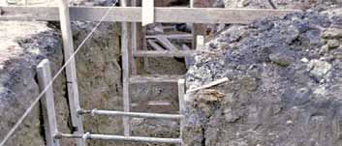
Screw Jack Systems
Provides an efficient, economical protection against cave-ins
Ball socket joints tilt for added safety on angular mounting
Holes on each end facilitates mounting to wood members
Manual adjustable range
Installing them in the trench exposes workers to hazards

Slide 53
Structural Ramps
Structural ramps that are used solely by employees as a means of access or egress from excavations shall be designed by a competent person qualified in structural design.

Slide 54
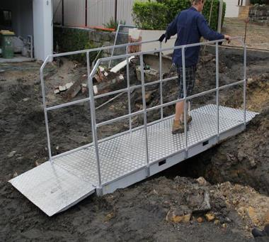
Access and Walkways
Bridges or walkways must always be used when crossing an open cut
Walkways 6 feet or more require handrails.
Never jump across an open trench

Slide 55
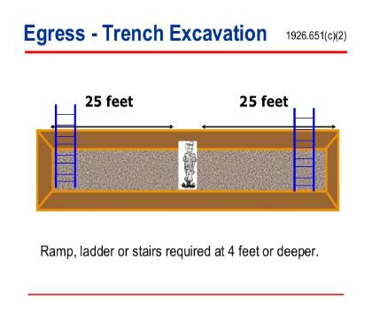
Means of Egress From Trench Excavations
Stairway/Ladder/Ramp
Shall be located in trench excavations that are 4 feet or more in depth so as to require no more than 25 feet of lateral travel for employees.
It must be available for use by the employees at all times.
Must extend at least 3 feet over solid ground
Secure at 4 to 1 angle to prevent movement

Slide 56
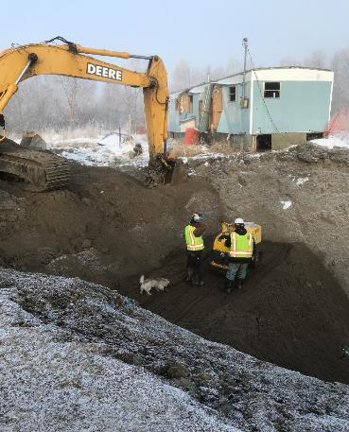
Exposure to Falling Loads
No employee shall be permitted underneath loads handled by digging or lifting equipment
Stand away from vehicle being loaded or unloaded to avoid being struck
Operators may remain in cabs when vehicles are equipped in accordance with 1926.601

Slide 57
Emergency Trench Rescue Equipment
Emergency rescue equipment, such as breathing apparatus, a safety harness and line, or a basket stretcher, shall be readily available where hazardous atmospheric conditions exist or may reasonably be expected to develop during work in an excavation. This equipment shall be attended when in use.

Slide 58
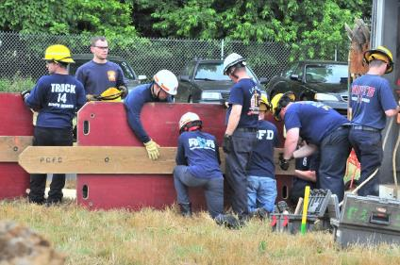
Do We Have Trained Rescue Employees in This Class Room?
Trench rescue awareness
Trench rescue operations
Trench rescue technician
Trench rescue refresher training

Slide 59
Employer Requirements-Work Site Supervisor
Address and plan for anything that could create a hazard within work site area
Ensure employees are healthy and not impaired
Enforce PPE requirement standards for the job task
Identify Safety spotters for specific work task (building, utility work)
Conduct routine risk hazard assessment with each work process
Ensure equipment is operational with installed alarm warning systems

Slide 60
Safety Briefing Considerations
Traffic control plan in place-refers mainly to pedestrians, vehicles, and work equipment
Adequate signage or barriers in place to alert and warn traffic
Spotters to physically direct traffic and escort pedestrians
Ensure sufficient lighting to illuminate the work site area

Slide 61
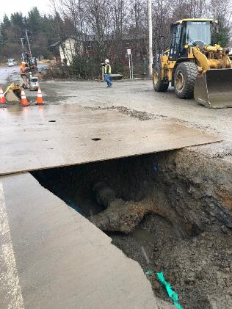
Securing the Job Site
Enforce good housekeeping practices
Secure all operating equipment and power tools
Police up all power cords
Secure all chemicals in proper storage
Ensure all open trenches have barriers in place with adequate signage and illumination

Slide 62
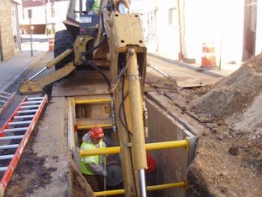

Safety First #1 –Safe or Unsafe Working Conditions?
Notes:
Class Participation: What hazards can you identify in this photograph? Answers should include crushing injuries and struck against injuries caused by moving equipment. In addition there is no ladder to egress from the trench. Safety Tip: Never work under equipment even if you think you have an experienced operator. A competent person should identify all the possible hazards and implement good safe working practices to keep workers safe.

Slide 63
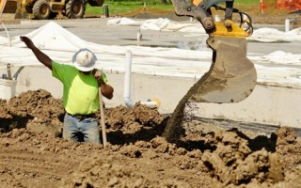
Safety First #2 –Safe or Unsafe Working Conditions?
Notes:
Class Participation: What hazards can you identify in this photograph? As before answers should include crushing injuries and struck against injuries caused by moving equipment. Safety Tip: Never work under equipment even if you think you have an experienced operator. A competent person should identify all the possible hazards and implement good safe working practices to keep workers safe.

Slide 64
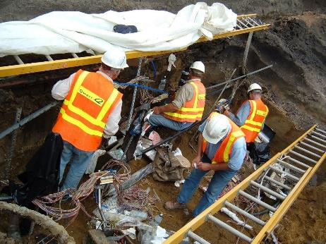
Safety First #3-Safe or Unsafe Working Conditions?
Notes:
Class Participation: What hazards can you identify in this photograph? Answers should include vertical trench wall deeper than 6 feet. Improper use of egress ladders and slips trips and fall hazards. Safety Tip: A competent person should identify all the possible hazards and implement good safe work practices. In addition, all workers should be communicating the hazards and informing the competent person of the potential hazards and or unsafe working conditions.

Slide 65
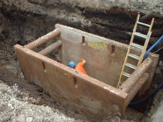
Safety First #4 –Safe or Unsafe Working Conditions?
Notes:
Class Participation: What hazards can you identify in this photograph? Answers should include vertical trench wall deeper than 6 feet with improper use of a trench box and egress ladder. Safety Tip: A competent person should identify all the possible hazards and implement good safe working practices to keep workers safe. Ensure the trench box is level with the surface of the ground and ladder is 3 feet extended above the trench box.

Slide 66
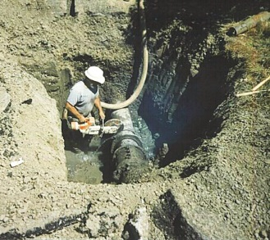
Safety First #5 –Safe or Unsafe Working Condition?
Notes:
Class Participation: What hazards can you identify in this photograph? Answers should include vertical trench wall deeper than 6 feet without an egress ladder in place. In addition, the worker is introducing water into the trench. Safety Tip: A competent person should identify all the possible hazards and implement good safe working practices to keep workers safe. Therefore, water should be removed from the trench to prevent a collapse. Additional safe work practices include shoring, shielding or sloping along with an egress ladder in place.

Slide 67
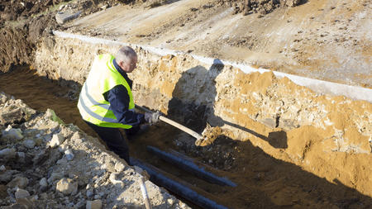
Safety First#6 –Safe or Unsafe?
Notes:
Class Participation: What hazards can you identify in this photograph? Answers should include missing hard hat(PPE) and no ladder in place. Tip: A competent person should identify all the possible hazards and implement good safe working practices to keep workers safe. Additional safe work practices include ensuring all the required PPE is worn by the workers and ladders are placed for every 25 feet of lateral traveling distance in the trench.

Slide 68
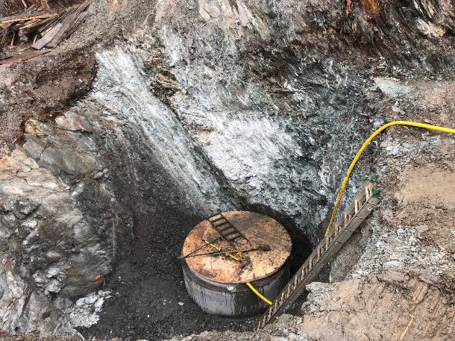
Safety First #7 Safe or Unsafe
Notes:
Class Participation: What hazards can you identify in this photograph? Answers should include improper use of a ladder in the trench. Safety Tip: Ensure ladders are 4-1 ratio and extend 3 feet above the leading edge of a trench.

Slide 69
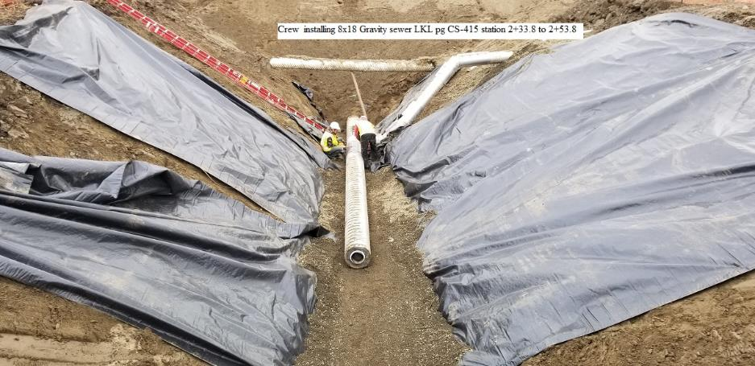
Safety First #8-Safe or Unsafe
Notes:
Class Participation: What hazards can you identify in this photograph? Answers should include the possibility the pipe going across the trench may not be adequately supported and protected. Safety Tip: Ensure that all underground utilities and pipes are adequately supported and protected from equipment during excavation. The competent person identify what type of support and protection is required for all underground utilities and pipes.

Slide 70
Placing Inexperienced Workers in a Trench
add a video here

Slide 71
Excavation Safety Checklist App
Competent person must complete an inspection to ensure the safety of workers before conducting trench work.
Easy useful tool to assess and document trench worksite conditions.
Allows results of each inspection checklist to be automatically emailed to management for record.
Reduces administrative workload of paper checklist.
Excavation Safety Checklist: http://excavation-safety.net
Notes:
Class Participation: Step one-each trainee will type in the address http://excavation-safety.net
Step two-once the web based app is open to have each trainee install and add this app onto their mobile device or computer home screen.
Step three-Go the three lines on the top left of the page ‘click’ to open. Trainee should be able to view home, checklist, trench requirements, settings, contact us and email log.
Step four-Go to setting and add all the required information for the competent person, project name, approver name and your supervisors email address. Make sure all the information is saved after each entry.
Step five-’click’ on the 3 lines top left and go to the checklist. Then fill in the box with trench location and dimensions. Once all that information is entered finish checking all that apply to their job site. Add comments as appropriate and submit report.
All this information will be date and time stamped when the checklist is submitted. Explain that when no data or cell services are available, the data will be sent automatically once the mobile device or computer is in range.

Slide 72

This Concludes our Training

