Slide 1
Electrical Safety

Slide 2
OSHA Susan Harwood Grant
This material was produced under Grant Program # SH-31246-SH7 from the OSHA, U.S. Department of Labor. It Does not necessarily reflect the views or policies of the U.S. Department of Labor, nor does mentioning of trade names, commercial products, or organizations imply endorsement by the U.S. Government. Revisions were made to this material under grant SH-20999-10 and SH-16610-07 from the Occupational Safety and Health Administration, U.S. Department of Labor.

Slide 3
Training Audience
Water Utility Operators
Heavy equipment operators
Electricians
Plumbers
Mechanics
Welders
Carpenters
General laborers
Tradespeople

Slide 4
Training Objectives
Occupational Safety and Health Act and your rights as a whistleblower
Introduction into electrical safety standards
Case studies and exercises
How to use safe work practices to prevent electrical injuries

Slide 5
OSH Act of 1970-SEC.5.Duties
(a) Each employer shall:
(1) Furnish to each of his employees employment and a place of employment which are free from recognized hazards that are causing or are likely to cause death or serious physical harm to his employees;
(2) Comply with occupational safety and health standards promulgated under this Act.
(b) Have each employee comply with occupational safety and health standards and all rules, regulations, and orders issued pursuant to this Act which are applicable to his own actions and conduct.

Slide 6
Your Rights as a Whistleblower
You may file a complaint with OSHA if your employer retaliates against you by taking unfavorable personnel action because you engaged in protected activity relating to ‘workplace safety or health’, asbestos in schools, cargo containers, airline, commercial motor carrier, consumer product, environmental, financial reform, food safety, health insurance reform, motor vehicle safety, nuclear, pipeline, public transportation agency, railroad, maritime, motor vehicle safety, and securities laws.

Slide 7
Unfavorable Personnel Actions
Applying or issuing a policy which provides for an unfavorable personnel action due to activity protected by a whistleblower law enforced by OSHA:
Blacklisting
Demoting
Denying overtime or promotion
Disciplining
Denying benefits
Failing to hire or rehire
Firing or laying off
Intimidation
Making threats
Reassignment to a less desirable position, including one adversely affecting prospects for promotion
Reducing pay or hours
Suspension

Slide 8
When Filing a Complaint-Legal Time Limits
Occupational Safety and Health Act -30 days to file
Solid Waste Disposal Act-30 days
Toxic Substance Control Act-180 days
Federal Water Pollution Act-30 days
Compensation and Liability Act-30 days
Clean Air Act-30 days
Safe Drinking Water Act-30 days

Slide 9
Filing A Complaint
Visit or calling the local OSHA office or
Mailing a written complaint to the regional or area office
Written complaints can be sent by facsimile, electronic communication, hand delivery during business hours.

Slide 10
OSHA’s Electrical Standards, NFPA 70 and 70E Electrical Safety
OSHA's electrical standards are based on the National Fire Protection Association Standards NFPA 70, National Electric Code, and NFPA 70E, Standard for Electrical Safety for Employee Workplaces.
Only qualified employees may conduct electrical work.
Special training is required for qualified employees:
  Safe Work Practices
  Isolation of Electrical Sources
  Test Equipment
  Tools & PPE

Slide 11
Is Compliance with NFPA 70E Standard for Electrical Safety in the Workplace Mandatory?
Answer: No.
NFPA 70E is a national consensus safety standard published by NFPA primarily to assist OSHA in preparing electrical safety standards. Federal OSHA has not incorporated it into the CFRs

Slide 12
Can I be cited for not complying with NFPA 70E?
Answer-Yes.
The employer must assess the workplace for electrical hazards and the need for PPE under 29 CFR 1910.335(a)(1)(i).
The employer is expected to use the best means available to comply with this requirement and that is done through consensus standards.
In the event of an injury or death due to an electrical accident, if OSHA determines that compliance with 70E electrical safety standard would have prevented or lessened the injury, OSHA may cite the employer under the general duty clause.

Slide 13
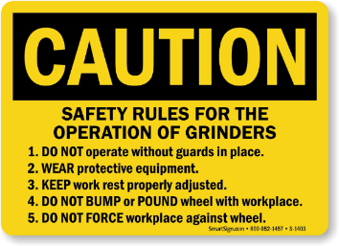
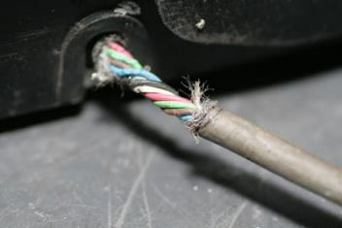
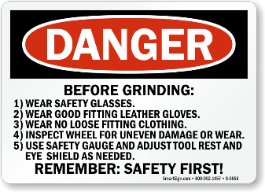
Lets Start with a Few Case History Examples
An employee was electrocuted while using a grinder with a frayed cord. The employee was standing in water, wet-grinding stone countertops…”

Slide 14

Class Discussion
Was there a risk assessment conducted prior to this work?
What hazardous environmental conditions contributed to this death?
Notes:
Class Participation: Answer should include ‘No’ to indicate at least two safety issues were ignored. First, no inspection of the equipment was conducted to determine any deficiencies. If there had been an early discovery of the frayed cord the equipment should have been immediately taken out of service. Second, the environmental conditions added to the hazard when water came into contact with the frayed cord. Safety tip: Always inspect your equipment to ensure it is safe to operate. Lastly, be aware of environmental changes when water is introduced into the operation of equipment.

Slide 15
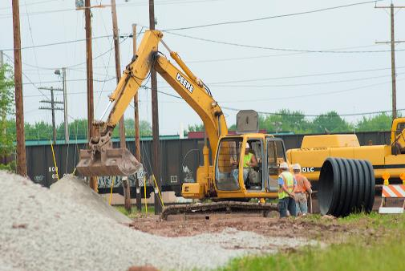
Case History Continued
“An employee was electrocuted when he made contact with a piece of equipment being hoisted from an excavation. The arm of the backhoe hoisting the equipment contacted an overhead power line…”

Slide 16

Classroom Discussion
Was there a risk assessment conducted prior to this work?
What hazardous environmental conditions contributed to this fatality?
Notes:
Class Participation: Answers should include ‘No’ to indicate that a safety brief was not conducted to identify the electrical lines as a hazard. Second, if spotters were assigned to oversee and communicate the hazard to the equipment operator failed to do so. Safety tip: Conduct a risk assessment to identify as many hazards as possible and implement control hazards before work begins.

Slide 17
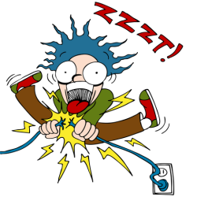
Most Common Causes of Electrocution
Contact with Overhead Power lines
Contact with Live Circuits
Not following Lock/Tag-out procedures
Poorly Maintained Extension Cords
Defective Power Tools

Slide 18

There are direct and indirect types of electrical injuries:
Direct:
    Electrocution or death due to electrical shock
    Electrical shock
    Burns
    Hearing loss from arc blast
Indirect:
    Falls
    Fire

Slide 19
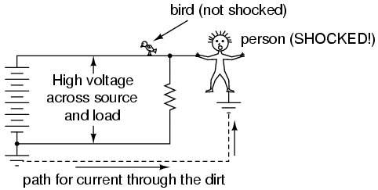
The Anatomy of Electricity Flowing Through the Body
Severity of the shock depends on:
  Path of current through the body
  Amount of current flowing through the body (amps)
  Duration of the shocking current through the body
LOW VOLTAGE DOES NOT MEAN LOW HAZARD!!!!

Slide 20
Its Your Responsibility to Know the Work Hazards
Know the hazards of electricity
Know the equipment
Use Safe Work Practices
Inspect your PPE before each use
Don’t work on energized circuits without permission

Slide 21
Overhead Power Line Hazards
High wires are usually not insulated
Examples of equipment that can contact with these power lines:
  Crane
  Ladder
  Scaffold
  Backhoe
  Scissors lift
  Raised dump truck bed
  Aluminum paint roller

Slide 22
Flashover
High-voltage electric short circuit made through the air between exposed conductors.
Can occur when equipment is operating too close to overhead power lines.

Slide 23
Overhead Power Line Hazard with Equipment
Show a video

Slide 24
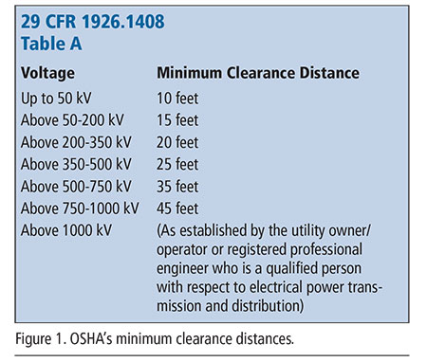
Operating Equipment near Overhead Power lines
The OSHA requirements limit crane operations to a minimum clearance of 10 feet for lines rated at 50 kilovolts (kV).
Follow safe distance operating instructions for all power lift equipment.

Slide 25
Arc Blast/Flash
When an arc fault occurs, the result is a massive electrical explosion. The light and heat emitted by the explosion is known as the arc flash, and the pressure wave is known as the arc blast.
Pressure waves generated by an arc flash explosion can carry a force up to thousands of pounds per square inch.
Powerful enough to knock down or throw nearby workers, and cause damage to the eardrums, lungs, brain and other organs. Other effects of arc blast include:: high temperatures.

Slide 26
Arc Blast
Show a video

Slide 27
Employers must protect workers from hazards posed by flames and electric arc
Identify employees who will be working around these hazards.
Estimate the incident heat energy of any electric-arc hazard to which a worker would be exposed.
With certain exceptions, ensure workers exposed to such hazards wear protective clothing and other protective equipment with an arc rating equal to or greater than the estimated heat energy.

Slide 28
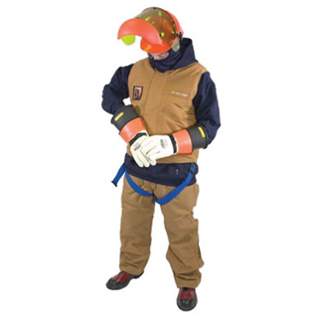
Proper PPE for Electrical Safety Work
100% cotton long sleeve shirts
Heavy duty Leather Coat
Heavy duty cotton long pants
Safety glasses or arc flash shield
Hearing protection
Leather work book –non-steel toe
Gloves rated for the electrical work with outer leather
DO NOT WEAR polyester clothing or clothes that are highly flammable

Slide 29
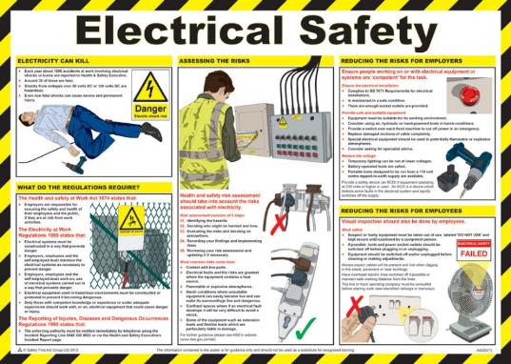
Electrical Safe Work Practices Include:
  Use barriers and guards to prevent passage through areas of exposed energized equipment
  Pre-plan work, post hazard warnings
  Keep working spaces and walkways clear of cords

Slide 30
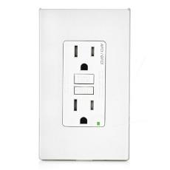
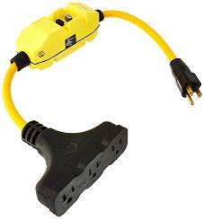
Control – Use of GFCI
(ground-fault circuit interrupter)
Detects difference in current between the black and white wires as low as 2mA.
If ground fault detected, GFCI shuts off electricity in 1/40th of a second.
Protects you from the most common form of electrical shock hazard, the ground fault.
Will not protect you from line contact hazards-such as holding two hot wires and hot wire and neutral in each hand or from an overhead power line.

Slide 31
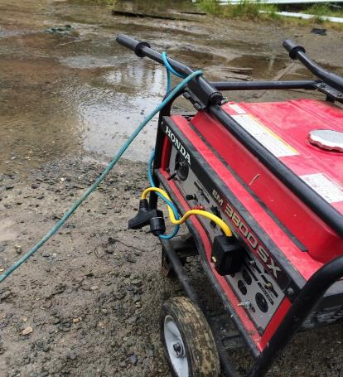
Job Site Generator Equipped with GFCI Protection
Notes:
Safety tip: In the preplanning process selecting the right piece of equipment is essential to help reduce the hazards on the job site.

Slide 32

Control of Hazardous Energy
The OSHA standard for The Control of Hazardous Energy (Lockout/Tagout) (29 CFR 1910.147)

Slide 33

What is LOTO?
Lockout-tag-out (LOTO) or lock and tag is a safety procedure which is used in industry and research settings to ensure that dangerous machines are properly shut off and not able to be started up again prior to the completion of maintenance or servicing work

Slide 34
Training Requirements
Qualified employees, such as engineers, electricians, electronic technicians, and power line workers, among them — work with electricity directly.
Affected employees, such as office workers and sales people, work with it indirectly.

Slide 35
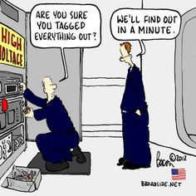
Lock-out/Tag-out Purpose
Workers must understand purpose and function of energy control program
  Authorized employee
  Affected employee
  Other employee
Locks vs. Tags
Steps for energy isolation and removal of isolation.

Slide 36
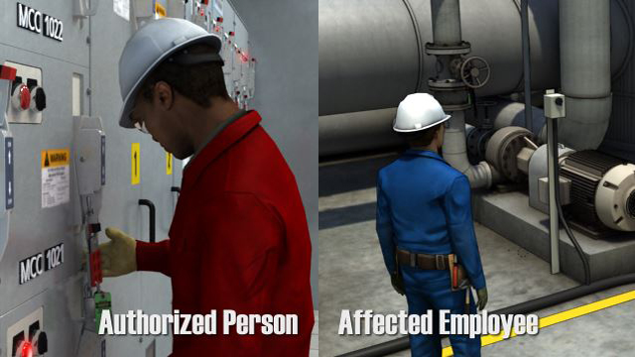
Authorized Employee = Person Applying Controls
Each authorized employee shall receive training in the recognition of applicable hazardous energy sources, the type and magnitude of the energy available in the workplace, and the methods and means necessary for energy isolation and control.

Slide 37
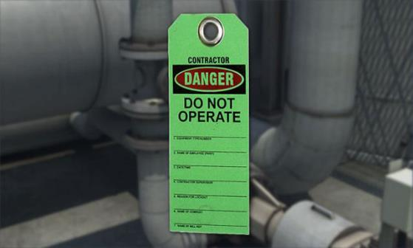
Affected Employee
Each affected employee shall be instructed in the purpose and use of the energy control procedure.

Slide 38
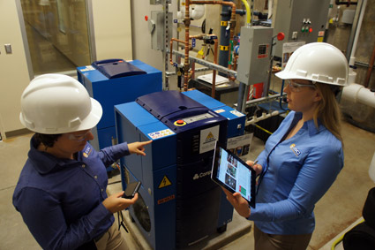
Other Employees
All other employees whose work operations are or may be in an area where energy control procedures may be utilized, shall be instructed about the procedure, and about the prohibition relating to attempts to restart or reenergize machines or equipment which are locked out or tagged out.

Slide 39
Difference Between Lock-out and Tag-out
Lock-out-Uses a lock to hold an energy isolation device in a safe position and prevents the energization of the machine or equipment
Tag-out-is only used when a lockout is not possible. Tags are placed on a piece of equipment to indicate that the equipment being controlled may not be operated until the tag-out device is removed

Slide 40
Hazardous Energy Sources for Lock-out Tag-out
  Electrical
  Mechanical
  Springs
  Hydraulic/Pneumatic Systems
  Flywheels
  Elevated Weight/Gravity
  Chemical, Thermal
  Water, Steam, Gas, Air

Slide 41
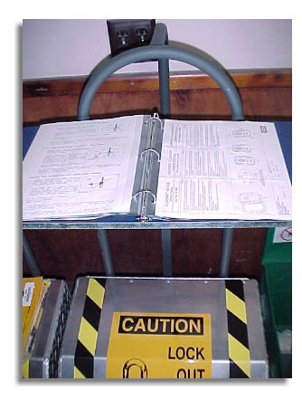
LOTO Program
  List all equipment
  ID energy control methods
  Group equipment by shop
  Describe energy control method for each

Slide 42
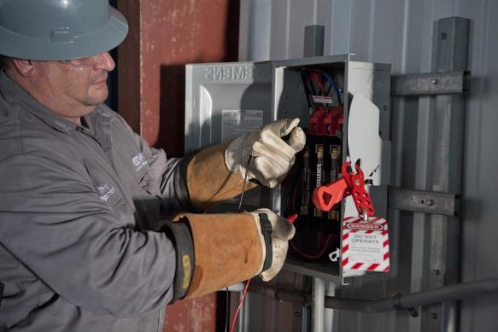
Lock-out/Tag-out Program Continued:
Test each piece of equipment and control method
Train personnel
Periodic inspection and program review

Slide 43
Employer Responsibility to Conduct Periodic Inspection of LOTO Program
The employer must identify any deficiencies or deviations and correct them.
Where lockout is used, the inspector must review each authorized employee's responsibilities under the procedure with that employee (group meetings are acceptable).
Where tag-out is used, the inspector must review both the authorized and affected employee's responsibilities with those employees for the energy control procedure being inspected, and the additional training responsibilities of 1910.147(c)(7)(ii).
The employer must certify that the periodic inspections have been performed

Slide 44
When to Use LOTO
  Maintenance and adjustments of machinery
  Repairing energy controls
  Clearing jammed mechanisms
  Prevent unexpected start-up of machinery

Slide 45
First Day on the Job was his Last
Show a video

Slide 46
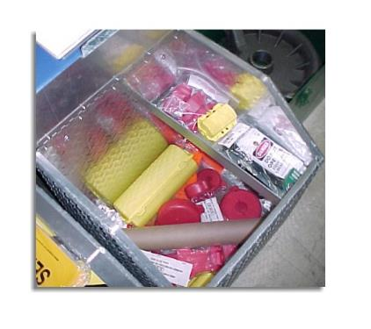
Isolating Devices
A mechanical device that physically prevents the transmission or release of energy
Examples:
  Disconnect switches
  Slide gates
  Valves
  Blocks
  Blind flanges

Slide 47
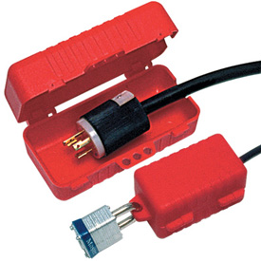
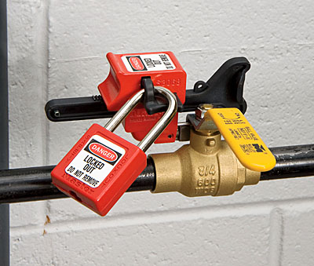
Energy Control Devices
Extension Cord Lock-out
Valve Lock-out

Slide 48
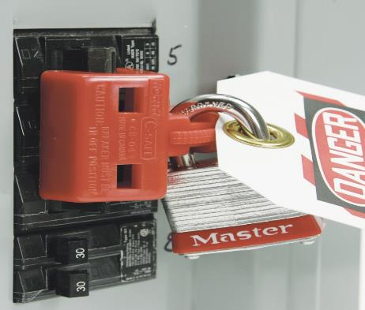
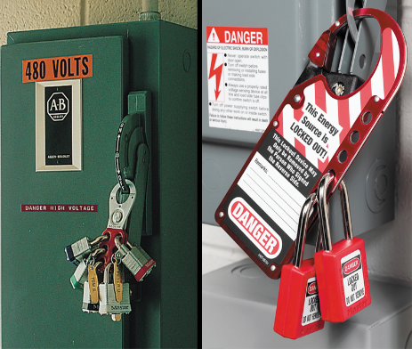
Energy Control Devices Continued
Circuit Breaker Lock-out
Lockout Gang Devices

Slide 49
Basic Steps for Lockout/Tagout Procedures
Step 1: Identify energy sources and shut off energy to the affected equipment. (Use normal stopping or running procedures for the machine.)

Slide 50
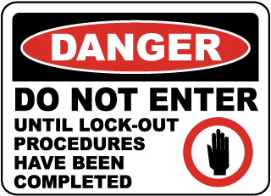
Step #2-Notify all Affected Employees
Notify others – in particular all affected employees and any contractors that may be working in the area
Place WARNING signs and barriers

Slide 51
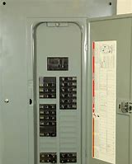
Step #3-Isolate all Affected Equipment
Isolate the equipment from the energy source
Shut off the affected circuit breaker panel switches
Disconnect switches

Slide 52

Step #4-Lock-out and Tag-out Equipment
Lock-out/tag-out the equipment by affixing locks and tags to each energy source controlling device.

Slide 53
Step #5-Release Stored Energy
Release any stored energy from capacitor banks, springs, compressed air, steam, hydraulics, etc.

Slide 54
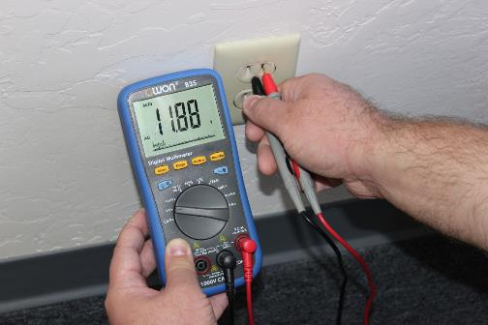
Step #6-Verify Isolation
Verify isolation of energy has occurred with testing equipment.
Visual inspection to verify correct devices have been locked and tagged out in the correct position
Use deliberate attempt to restart equipment

Slide 55
Step #7-Perform Servicing
Do not by pass the lock-out/tag-out process
Ensure the safety of others

Slide 56
Steps for Removing Lock-out Tag-out
Ensure that nonessential items are removed from equipment.
Ensure that equipment components are intact.
Check area to ensure that all affected employees are notified and safely positioned or removed from the work area.
Notify all affected employees and site supervisor before reenergizing the equipment.
Remove lockout/tag out devices only by those who installed them.
Reenergize equipment to ensure safe operation

Slide 57
Special Considerations
Outside contractors
Temporarily by-passing the lockout device
Extended lock-out/tag-out periods
  Notify affected personnel
Non-standard lock removal
  Approval process

Slide 58
The “Fatal Five” Causes of Lock-out/Tag-out-Related Fatalities
Failure to stop equipment
Failure to disconnect from power source
Failure to dissipate (bleed, neutralize) residual energy
Accidental restarting of equipment
Failure to clear work areas before restarting

Slide 59
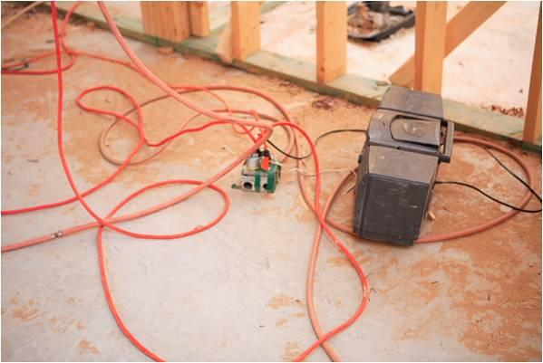

#1 Safe or Unsafe
Notes:
Class participation: How many hazards can you identify in this photograph? Answers should include-Slips trips and fall hazards, improper use of a junction box as a major source of power to plug into. Safety tip: When selecting a source of power for your equipment good safe work practices include plugging into a protected power source.

Slide 60
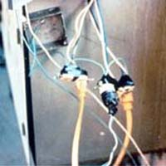
#2 Safe or Unsafe
Notes:
Class Participation: How many hazards can you identify in this photograph? Answers should include splicing wires together with the use of electrical tape. Safety Tip: Never splice wires and depend upon electrical tape to protect you from electrical hazards.

Slide 61
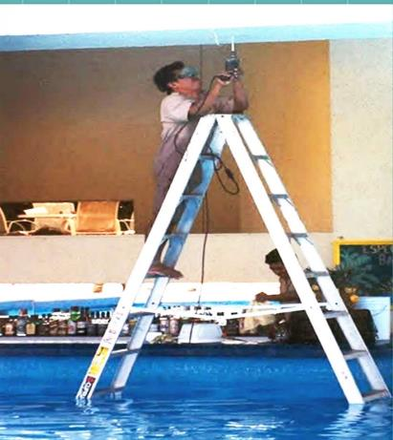
#3 Safe or Unsafe
Notes:
Class Participation: How many hazards can you identify from this photograph? Answers should include water, aluminum ladder and slips trips and falls. Safety tip: Avoid environmental hazards such as water or wet conditions and equipment that is highly conductive to electricity.

Slide 62
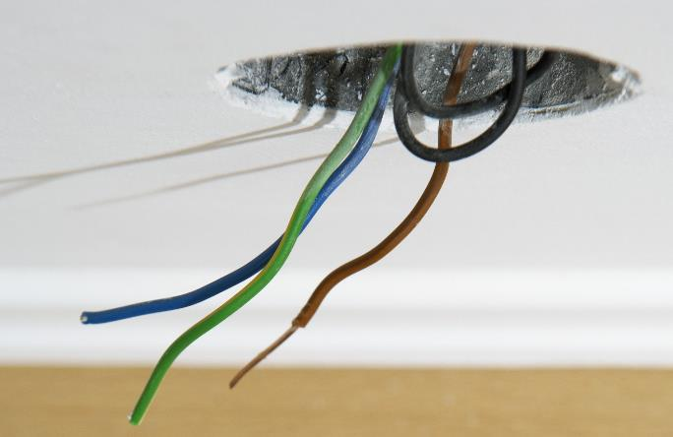
#4 Safe or Unsafe
Notes:
Class Participation: What hazards can you identify in this photograph? Answer should include bare wires. Safety Tip: Bare electrical wires should be considered energized unless the circuit has been locked and tagged out at the breaker panel.

Slide 63
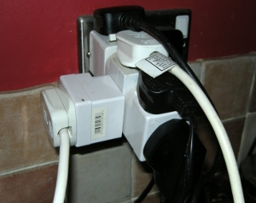
#5 Safe or Unsafe
Notes:
Class Participation: How many hazards can you identify in this photograph? Answers should include the possibility of overloading an outlet with too many power cords. In some cases daisy chaining electrical cords together draws more power through one power source causing an overload in the circuit, which may overheat and cause a fire. Safety tip: Never daisy chain extension cords or overload any one circuit outlet as a single source for electricity.

Slide 64
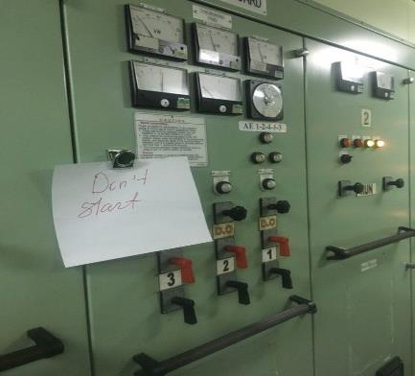
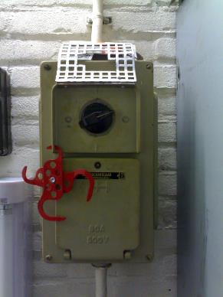
#6 Safe or Unsafe
Notes:
Class Participation: How many hazards can you identify in each of these photographs? Answers should include never depend upon a piece of paper as proper signage to warn employees of the electrical hazards. This piece of paper doesn’t even identify which switch of level is the start button. Second, the lockout device is missing a lock in place. How are you to know if that piece of equipment was supposed to be locked out? We don’t! Safety tip: Following safe work practices in the lockout tagout program can avoid these missteps in communication.

Slide 65
Conclusion
Only qualified employees are trained and qualified to work on energized circuits.
Know the hazards of electricity
Know your equipment
Use Safe Work Practices
Inspect your PPE before each use

Slide 66

This Concludes our Training

