Slide 1

Fall Prevention workshop 2
This material was produced under a Susan Harwood Grant SH-05008-SH8 from the Occupational Safety and Health Administration, U.S. Department of Labor. It does not necessarily reflect the views or policies of the U.S. Department of Labor, nor does mention of trade names, commercial products, or organizations imply endorsement by the U. S. Government. The U.S. Government does not warrant or assume any legal liability or responsibility for the accuracy, completeness, or usefulness of any information, apparatus, product, or process disclosed.

Slide 2


Presentation
Name
Share what you do at this organization
How long have you been at this organization?
Tell a story about a fall from height while working (it can be about someone else)

Slide 3
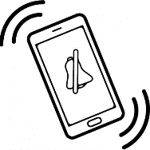


Agreements
Silence your cell phone or take a call outside if it is important
Respect the opinions of others and yours will be respected, too
Raise your hand and wait your turn
Participate! Your experiences and stories are very important!

Slide 4
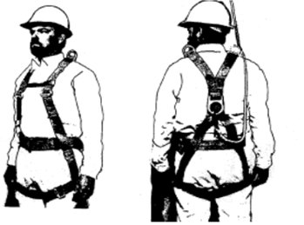
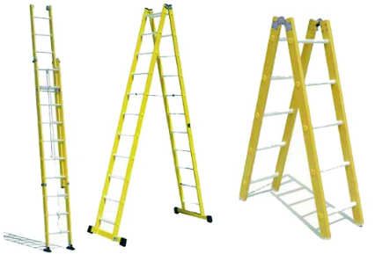
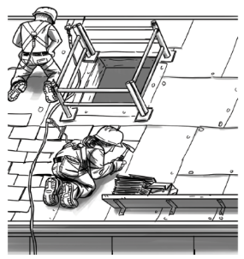
Objectives
How to practice ladder safety while working
How to minimize risk while working at high altitude
How to make a rescue plan for someone who has fallen while working

Slide 5

Agenda
Pre-evaluation
Introduction
Statistics
Stories
Group Activities
What to do in case of a fall
How to report an accident or a dangerous/unsafe work environment
Closing
Post-evaluation

Slide 6
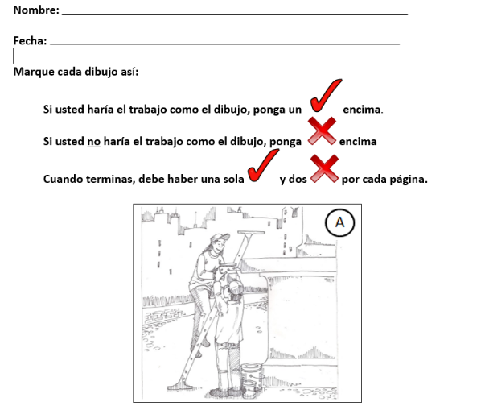
Pre-evaluation

Slide 7
Guiding questions and key statistics
Why is it dangerous to work at high altitude?
On a national level, falls are the #1 cause of death in the field of construction.
Every year in the U.S. more than 800 construction workers die and nearly 137,000 suffer grevious injury while doing this kind of work.
In 2015, 30% of deaths in Washington state were due to a fall.
Is age a factor in the danger of falls?
How dangerous are ladders?
Is it dangerous to work on top of houses?
Is it dangeros to work at a low altitude?

Slide 8
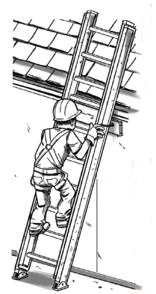
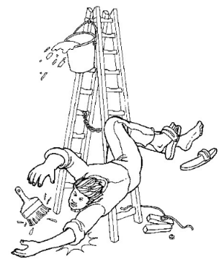

Is it dangerous to work on top of houses?
Yes, working on a house is dangerous.
Between the years 2000 and 2015 in Washington state, 52% of deaths were due to a fall that took place in a residential location.

Slide 9
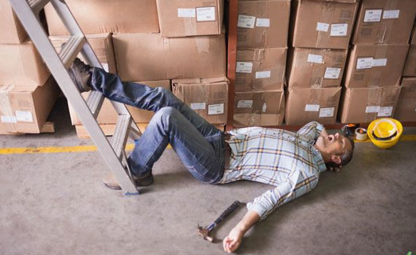
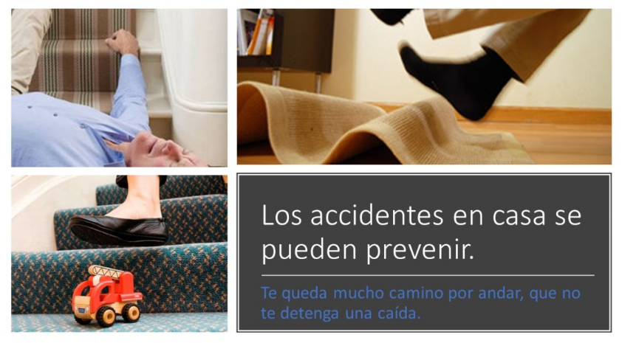
Is age a factor in the danger of falls?
It is; the older you are, the greater the danger of a fall.
More tan 1/3 of people who die from a fall are over 50 years old.
In-home accidents can be prevented.
-----------------------------------------------------------------------------
You have a long way left to go; don’t stop because of a fall.

Slide 10
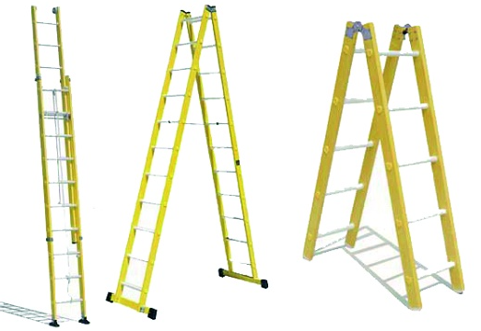
How dangerous are ladders?
Ladders are the most dangerous safety equipment, but also the most utilized because of their simplicity.
25% of workplace, fall-related deaths in Washington are due to falling from a ladder.

Slide 11
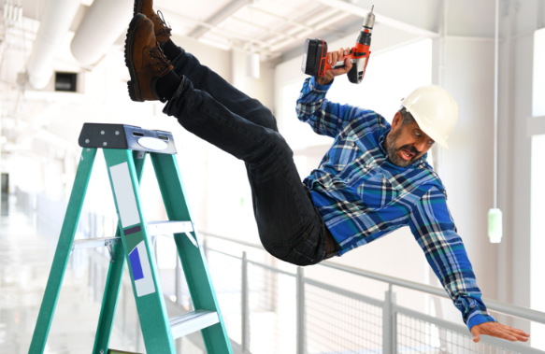
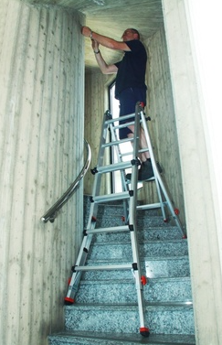
Is it dangerous to work at low altitude?
Yes, working at low altitude can also be dangerous.
59% of deaths occur at an altitude of 25 feet or lower.
20% occur at 10 feet or (below roof level).

Slide 12
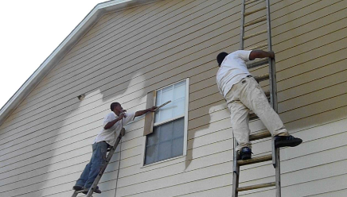
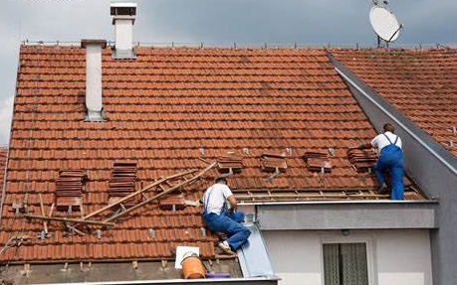
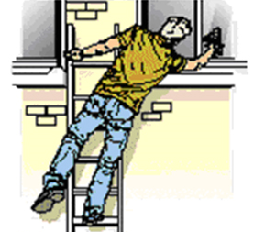
What do you do in the following cases?
Practice activity
Divide into three groups to analyze risks and talk about ncesseray precautions to avoid falls in the following Jobs:
Outdoor painting
Roof work
Cleaning up high (on a ladder/roof, etc)

Slide 13
Outdoor painting
What materials do we need?
What type of ladder are we going to use?
How do we get our materials up the ladder?
What should we check before climbing the ladder?
What are the risks of working on a ladder?
What shouldn’t we do while working on a ladder?
Discuss accidents that you have had while working on a ladder.

Slide 14
Roof work
What are the most common tasks when working on a roof?
How do we get onto the roof?
How do we get our materials to the roof?
What are the risks of working on a roof?
What security equipment can we use while doing roof work?
What shouldn’t we do while working on a roof?
Discuss experience of falls you’ve have while doing roof work.

Slide 15
Cleaning up high
What are the most common house-cleaning jobs?
What types of ladders do you use most?
Why is it better to use a ladder tan a chair, table, or other piece of furniture?
How do you use a ladder for house cleaning?
What are the most common risks in using a ladder for house cleaning?
What experiences have you had in using a ladder for house cleaning?

Slide 16
Video of example cases
Prevention Video (v-Tool) Falls in Construction/Fixed Scaffolds
Video de Prevencion (v-Tool) Caidas en la Construccion/Andamios Fijos
https://www.osha.gov/dts/vtools/construction/scaffolding_fnl_eng_web.html

Slide 17
Important steps for a rescue plan
Call 911
If there are 2 or more people, one person can call emergency response while the other(s) can stay with the injured person.
Remain calm.
Leave space for the injured person to breathe.
DO NOT move the injured person.
Talk to and comfort the injured person.

Slide 18
Options for compensation
If you work at a construction site, you can file a report with OSHA or State OSH Program.
Always report the accident to your employer.

Slide 19
Construction health and safety regulations
Fall protection:
OSHA Regulations on Fall Prevention
Scaffolding:
OSHA Regulations on Scaffold Use
Ladders:
OSHA Regulations on Ladder Use
To report a safety risk at your worksite, contact:
OSHA (800) 321-6742 or post the report online at www.osha.gov/report-online

Slide 20
Conclusions
Key points
Working at high altitude is dangerous, even when using a ladder or working on a roof.
Every job on a ladder (cleaning, painting, etc.) has its own risks and prevention methods that should be applied.
The planning and communication of a job with other workers before starting work is very important.
It is essential to have a rescue plan in the case of an emergency situation.

Slide 21

Post-evaluation

Slide 22
Many thanks!
What did you think of the workshop?
Did you like it?
What would you add to the workshop?
What would you remove?
What did you think of the information?
Did you learn something new?
This material was produced under a Susan Harwood Grant SH-05008-SH8 from the Occupational Safety and Health Administration, U.S. Department of Labor. It does not necessarily reflect the views or policies of the U.S. Department of Labor, nor does mention of trade names, commercial products, or organizations imply endorsement by the U. S. Government. The U.S. Government does not warrant or assume any legal liability or responsibility for the accuracy, completeness, or usefulness of any information, apparatus, product, or process disclosed.

