Slide 1
Machines, Machine Guarding & Preventing Amputations
Susan Harwood Training Grants
#SH-31233-SH7

Slide 2
The Disclaimer
Including information from Georgia Tech Research Institute Machine Guarding Presentation
Thanks to Georgia Tech Research Institute for information compiled from their Machine Guarding PowerPoint (shortened version presented here).
This material was produced under grant number SH-31233-SH7 from the Occuptional Safety and Health Administration, U.S. Department of Labor. It does not necessariy reflect the views or policies of the U.S. Department of Labor, nor does mention of trade names, commercial products, or organizations imply endorsement by the U.S. Government.
Notes:
This presentation includes shortened slides from Georgia Tech Research Institute’s “Subpart O – Machine Guarding” powerpoint. Nebraska Appleseed gratefully acknowledges Georgia Tech’s permission to use these slides for education as noted on their website: “These presentations may be used in education and training if credit is given to Georgia Tech as the developer and owner” (http://www.oshainfo.gatech.edu/powerpoint.html). Nebraska Appleseed’s training includes additional videos on worker safety and lockout tagout, including “Know Your Rights at Work!” produced by Nebraska Appleseed and available at www.neappleseed.org/workersrights and “Lockout Tagout: Control of Hazardous Energy” from National Safety Compliance, Inc., available at www.osha-safety-training.net/product/93-lockouttagout-control-of-hazardous-energy-training-video/

Slide 3
Machine Guarding & Preventing Amputations

Slide 4
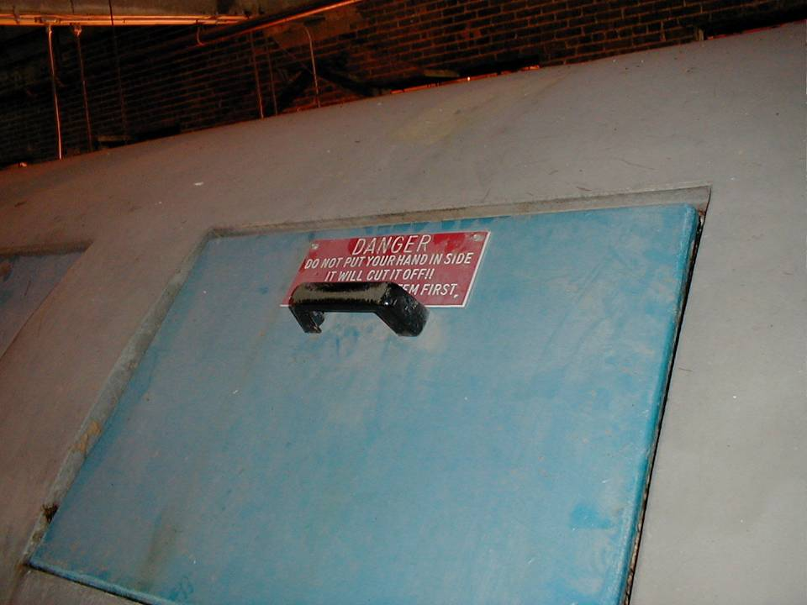

Warnings and signs
Notes:
Some dangers in the workplace will have clear warnings & signs, like this one (“DANGER: Do not put your hand inside. It will cut it off!!”). Others will not. It’s important that you know the dangers and how to keep safe!

Slide 5
Amputations and Injuries
Crushed hands and arms, severed fingers and limbs, lacerations and abrasions - the list of possible machinery-related injuries is long and horrifying. Many hazards are created by moving machine parts.
Notes:
Source: OSHA’s Machine Guarding eTool (General Requirements)

Slide 6
Amputations and Injuries(2)
Unguarded machines are common. Workers suffer approximately 18,000 amputations, lacerations, crushing injuries, abrasions, and over 800 deaths per year.
Amputations in meatpacking: “The line is so fast there is no time to sharpen the knife. The knife gets dull and you have to cut harder. That’s when you cut yourself.”
– Nebraska meatpacking worker, Human Rights Watch
Notes:
Sources: OSHA machine guarding eTool; Human Rights Watch 2006 report “Blood, Sweat, and Fear.”

Slide 7
Why are machines not guarded?
“No one would stick their arm, hand, finger, head, etc. in there.”
“No one is supposed to be back there, in there, around it while it is running.”
“The machine came that way; it never had a guard.”
“I’ve been doing it this way for twenty years without any problems.”

Slide 8
Why are machines not guarded? (cont.)
“The guard is in the way.”
“The OSHA inspector didn’t say anything about it.”
“We’ll put it back on if OSHA comes.”

Slide 9
Amputations: Beware…
  shears
  saws
  slicers
  slitters
  power presses
  (the 4 s’s and a P)
Notes:
Gears
factory

Slide 10
Machine Guarding Requirements
Machine guarding must:
Prevent contact
Be secure
Protect worker from falling objects
Create no new hazards

Slide 11
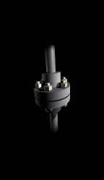
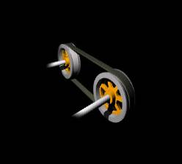

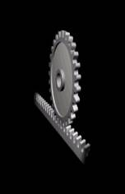

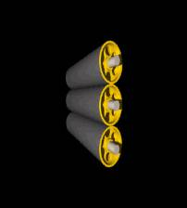
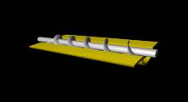


Machine Hazards:
Hazardous Motions

Slide 12
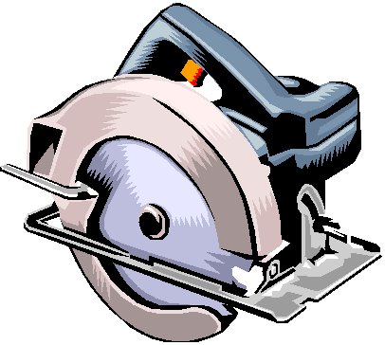
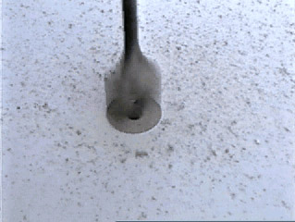
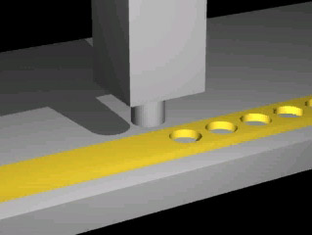
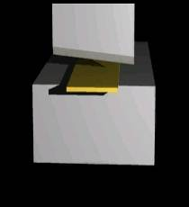
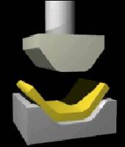
Machine Hazards:
Hazardous Actions
Cutting
Shearing
Bending
Punching

Slide 13
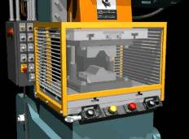
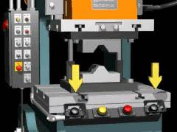

Methods of machine safeguarding
Physical guards
Devices
Location/Distance

Slide 14
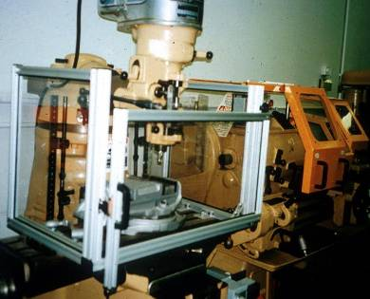
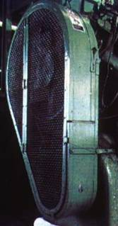
Fixed Guard
Provides a barrier - a permanent part of the machine, preferable to all other types of guards.
Notes:
1910.212(a)(2)
As a general rule, power-transmission apparatus is best protected by fixed guards that enclose the danger area. For hazards at the point of operation, where moving parts actually perform work on stock, several other kinds of safeguarding are possible.

Slide 15
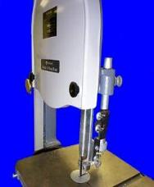
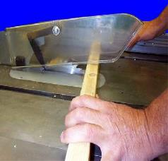
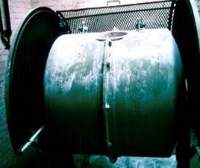
Other types of guards
Interlocked: When opened or removed, power automatically shuts off or disengages
Adjustable: Useful because flexible for different sizes or operations, but subject to human error
Self-adjusting: Moves according to size of stock (avoids human error)
Interlocked guard on revolving drum
Bandsaw blade adjustable guard
Circular table saw self-adjusting guard
Notes:
An interlocked guard may use electrical, mechanical, hydraulic, or pneumatic power or any combination of these. Interlocks should not prevent “inching” by remote control, if required. Replacing the guard should not automatically restart the machine.
Adjustable guards are useful because they allow flexibility in accommodating various sizes of stock, but, because they require adjusting, they are subject to human error.
Self-adjusting guards avoid the potential for human error associated with adjustable guards.

Slide 16
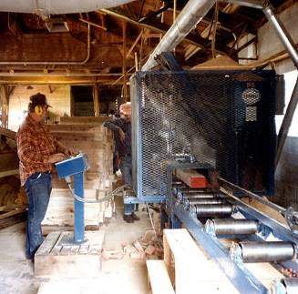
Safeguarding by Location/Distance
Locate the machine or dangerous moving parts so that they do not present a hazard to a worker during normal operation.
Maintain a safe distance from the danger area.
Notes:
One approach to safeguarding by location is shown in this photo. Operator controls may be located at a safe distance from the machine if there is no reason for the operator to tend it.
Another approach is to locate the machine so that a plant design feature, such as a wall, protects the worker and other personnel. Enclosure walls or fences can also restrict access to machines. Another possible solution is to have dangerous parts located high enough to be out of the normal reach of any worker.

Slide 17

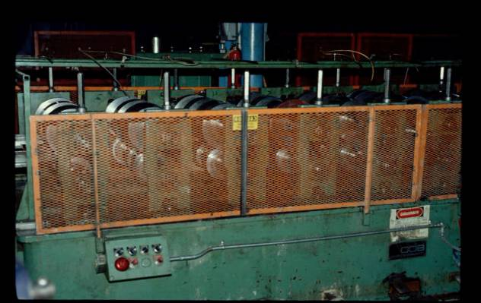
Guarded????
Notes:
Guarded? No: as you can see in this photo, some barriers don’t fully block the hazard.

Slide 18

Requirements for Machines 1910.212
One or more methods of machine guarding shall be provided to protect the operator and other employees in the machine area from hazards…

Slide 19
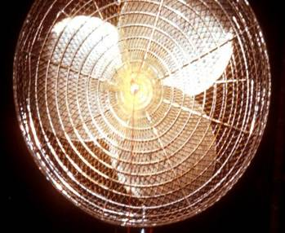
1910.212(a)(5)
Fan blades less than 7 feet above the floor shall be guarded (openings no larger than 1/2 inch)

Slide 20

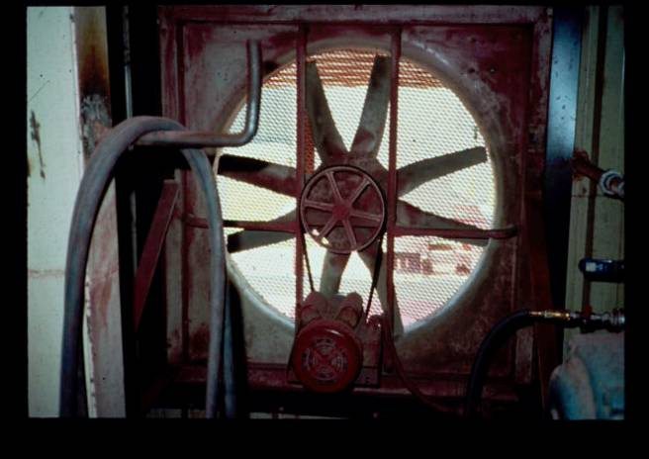
Fan with an ungarded pulley less than 7 feet above the floor
Notes:
Here is a fan with an unguarded pulley less than 7 feet above the floor.

Slide 21
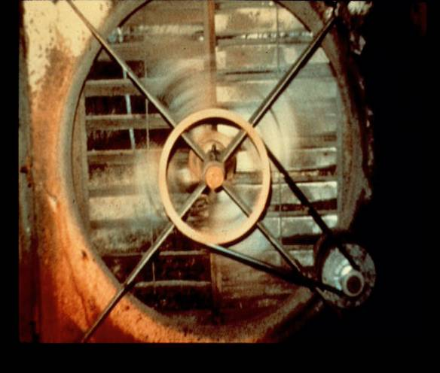

A completely unguarded fan blade and pulley
Notes:
This photo shows a completely unguarded fan blade and pulley.

Slide 22
Belts, pulleys, flywheels, etc.
All belts, pulleys, gears, shafts, and moving parts shall be guarded 1910.213(a)(9)
Flywheels 7 feet or less above the floor shall be guarded 1910.219(b)(1)
Flywheels above working areas: guards must have strength to hold the weight

Slide 23
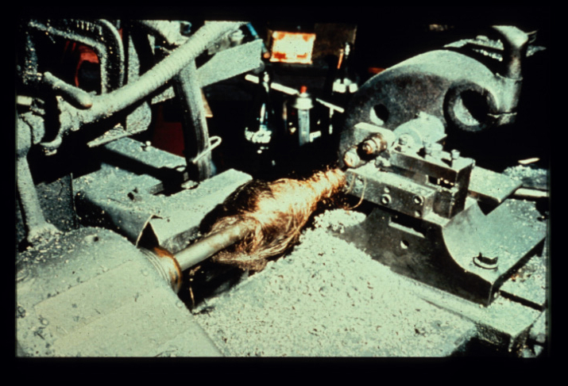

Dangers of unguarded machinery
Notes:
This photo shows the dangers of unguarded machinery and how it can pull you in. In this case, someone’s hair got caught…

Slide 24

saHari ripped from the scalp
Notes:
…and their hair was ripped from their scalp.

Slide 25

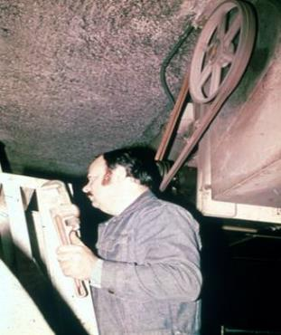
Pulleys
Pulleys 7 feet or less above the floor or platform must be guarded. 1910.219(d)
Pulleys with cracks or pieces broken out of rims shall not be used.
Notes:
In this photo you can see that the pully is less than 7 feet above the floor and so should have been guarded.

Slide 26
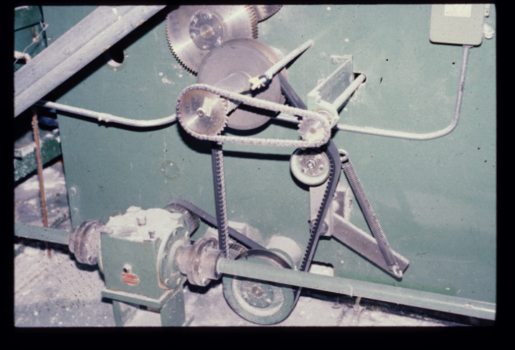

k
Notes:
This photo shows another example less than 7 feet above the floor…

Slide 27
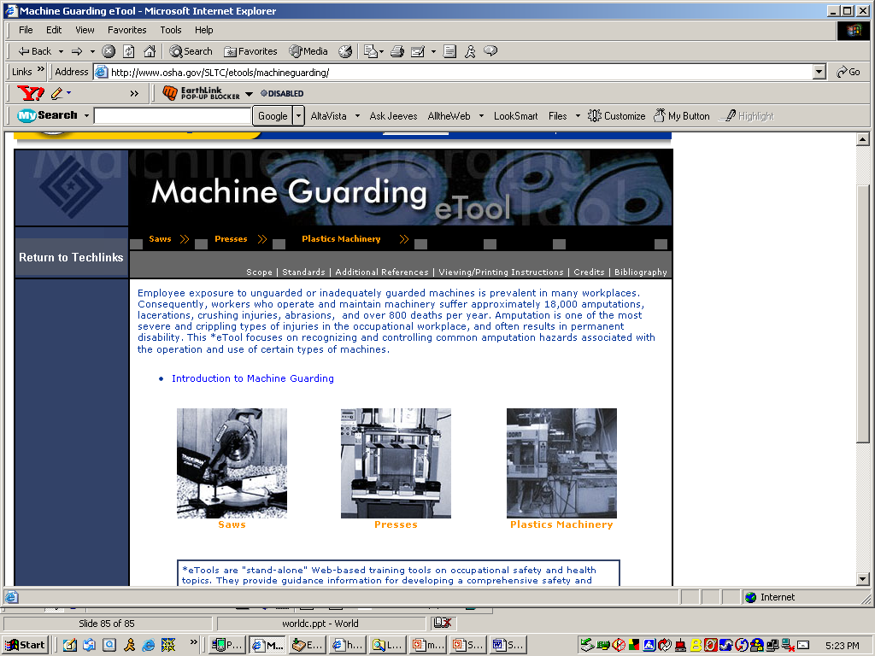
Machine Guarding website

Slide 28
Lockout Tagout
Video: Control of Hazardous Energy
Show a machine guarding lockout/tagout video of your choice
Notes:
“LOCKOUT/TAGOUT: CONTROL OF HAZARDOUS ENERGY” video produced by National Safety Compliance (available at www.osha-safety-training.net/product/lockout-tagout-control-of-hazardous-energy-video-kit/).

