Slide 1

Introduction
Safety and Health
Training for
Tree Care and
Landscape Workers
Train the trainer

Slide 2

Grants Information
SUSAN Harwood TRAINING GRANT
This material was produced under grant number SH-27622-SH5 Occupational Safety and Health Administration, U.S. Department of Labor. It does not necessarily reflect the views or policies of the U.S. Department of Labor, nor does mention of trade names, commercial products, or organizations imply endorsement by the U.S. Government.

Slide 3
Purpose 1
PURPOSE OF SUSAN Harwood
TRAINING GRANT
provides funds for developing training materials
provide training to workers and/or employees to recognize, avoid, abate, and prevent safety and health hazards in their workplace.

Slide 4
Purpose 2
PURPOSE OF SUSAN Harwood
TRAINING GRANT
Educate workers on their rights and employers on their responsibilities
1
Educate small business employers and workers
2
Train workers and employers on new OSHA standards
3

Slide 5
Purpose 3
PURPOSE OF SUSAN Harwood
TRAINING GRANT
Train at-risk populations
4
Train workers and employers about high-risk activities or hazards
5
Provide technical assistance
6

Slide 6
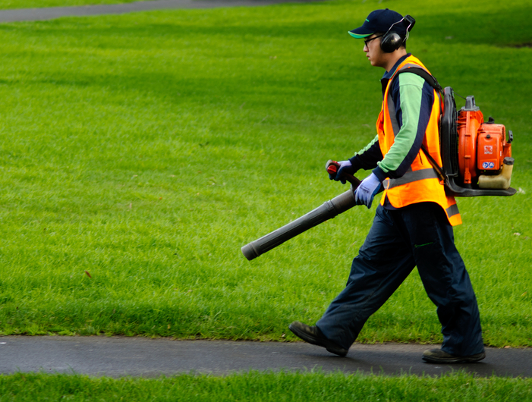
Purpose 4
Safety and
Health
Training
for
Tree Care
and Landscape Workers

Slide 7
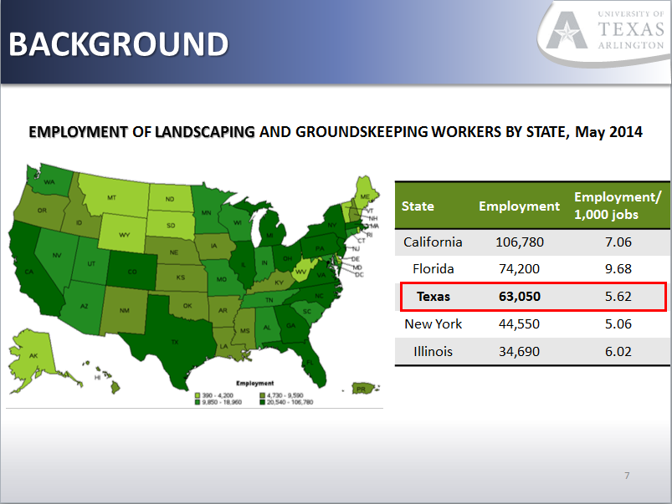
BACKGROUND

Slide 8
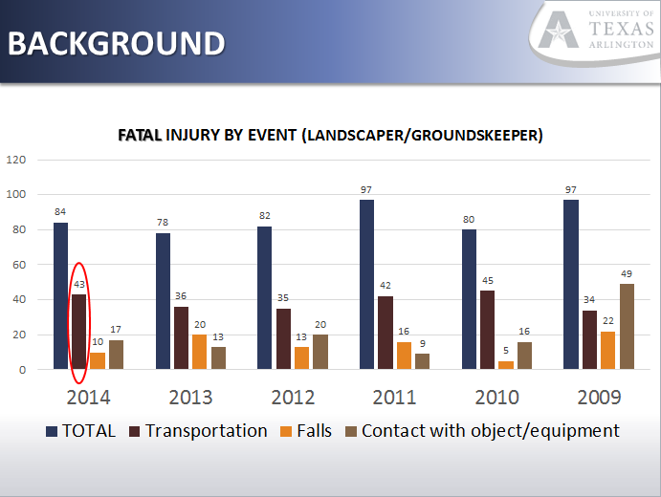
Background

Slide 9
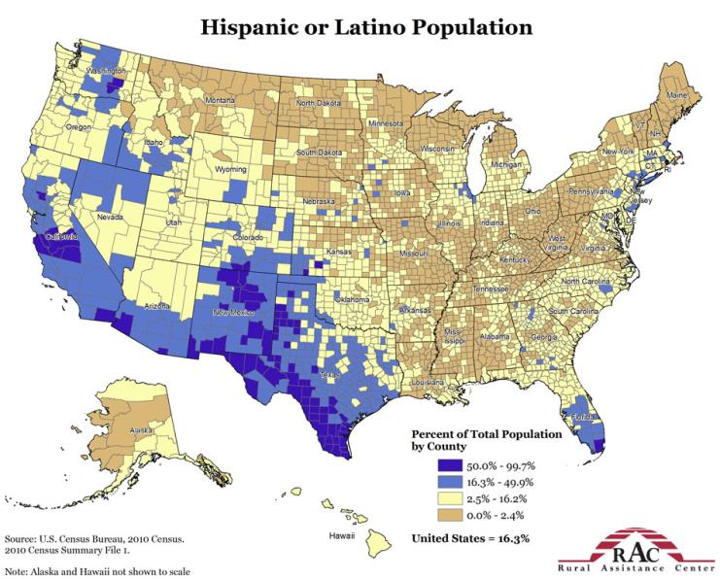
Background – need for Spanish training

Slide 10
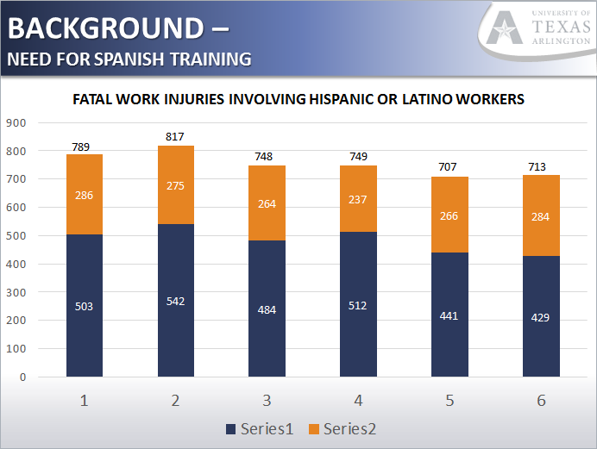
Background – need for Spanish training

Slide 11

Background – need for low literacy training

Slide 12
Training goal
Build an innovative solution to meet the immediate safety needs of the workforce.
Focus training efforts on the underserved population of hard-to-reach, English and Spanish-speaking, low literacy workers, and small business contractors.

Slide 13
REACTION IS NOT PREVENTION
TRAINING MOTTO
PREVENTION
REACTION
Identify safety and health hazards.
Analyze the cause of these hazards.
Bring about a safer, healthier workplace.
Involve co-workers in the above.
Response

Slide 14
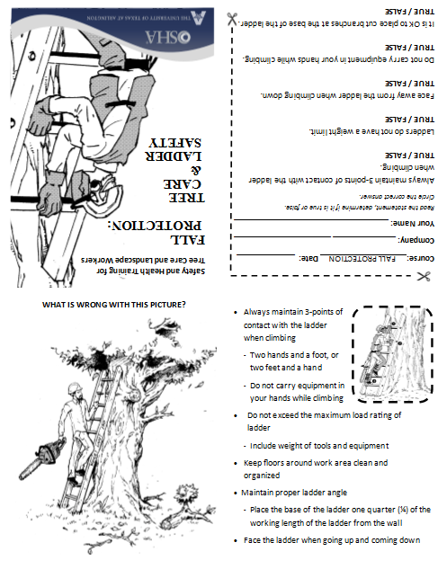
Training format
5 minute ‘Tailgate’ Training
‘What’s Wrong’ Scenarios
Functional Handouts/Reference
Quick Assessment (doubles as attendance verification)

Slide 15
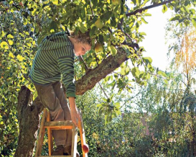
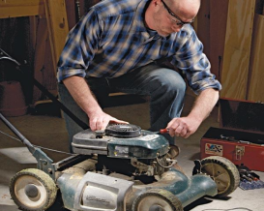
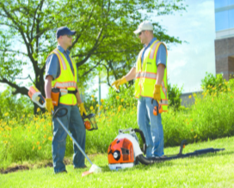
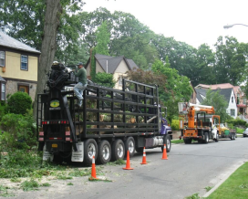
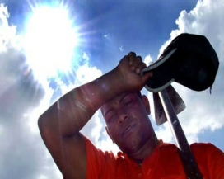
TRAINING TOPICS
Fall Protection
Equipment Safety/ Machine Guarding
Personal Protective Equipment
Transportation
First Aid

Slide 16
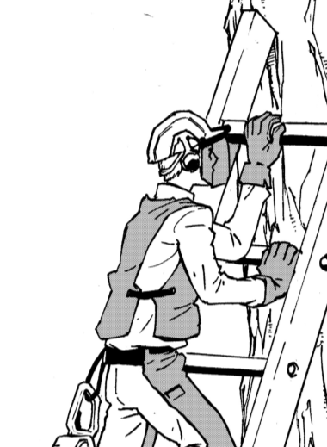
Safety and Health Training for
Tree Care and Landscape Workers
FALL
PROTECTION:
Tree Care
and Ladder Safety

Slide 17
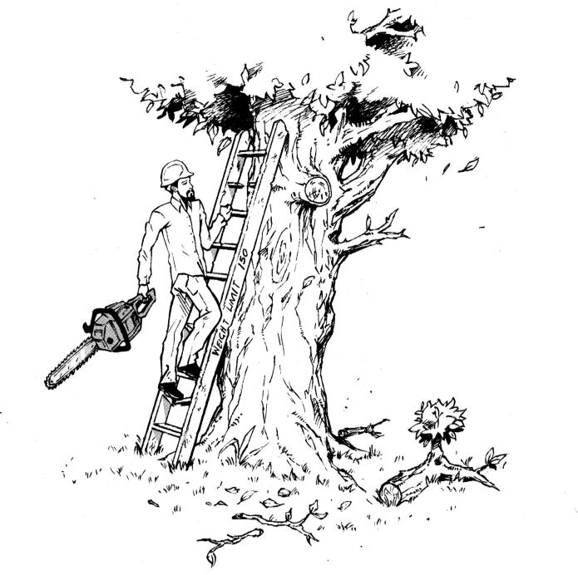
Fall protection
What is wrong with this picture?
# 1

Slide 18
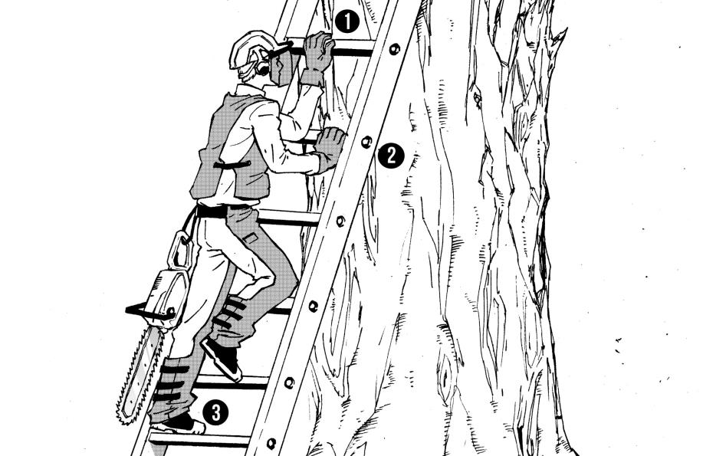
Fall protection
Always maintain 3-points of contact with the ladder when climbing
Two hands and a foot
Or two feet and a hand

Slide 19
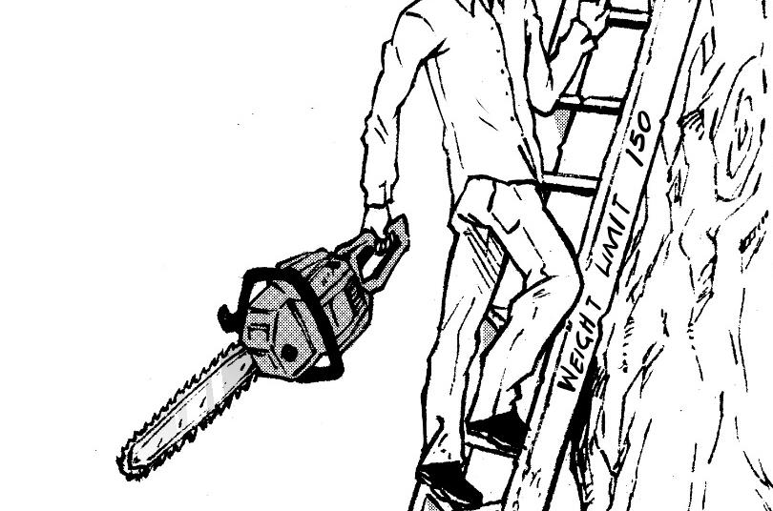
Fall protection
Maintain three points of contact
Do not carry equipment / objects in your hands while climbing

Slide 20


Fall protection
Do not exceed the maximum load rating of the ladder (including weight of any tools or equipment)

Slide 21
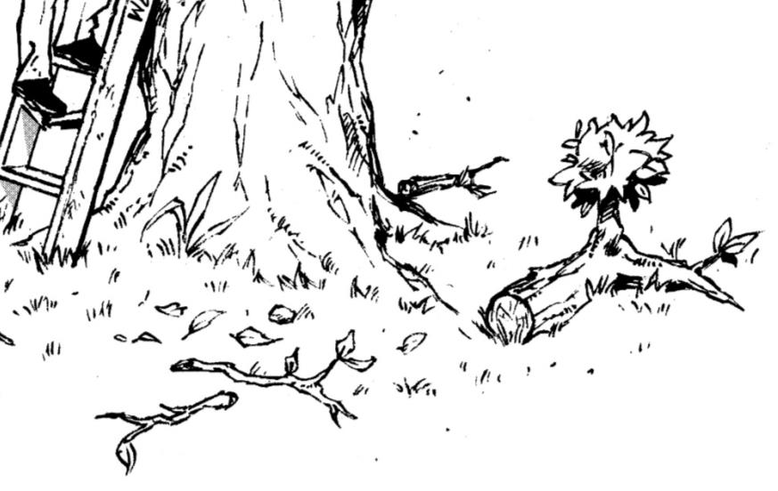

Fall protection
Keep work area clean
and organized

Slide 22
Fall protection
Maintain proper ladder angle
Place base of ladder a quarter (¼) of the working length of the ladder from the wall

Slide 23
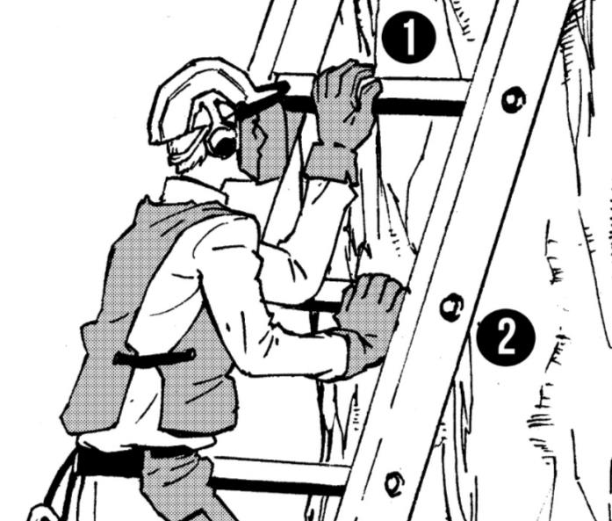
Fall protection
Face the ladder when climbing up and climbing down.

Slide 24
Fall protection
OTHER PROBLEMS?
Keep the ladder in good condition.

Slide 25
Final TEst
Course: FALL PROTECTION Date: ___________
Company: _________________________________
Your Name: ________________________________
Read the statement, determine if it is true or false. Circle the correct answer.
Always maintain 3-points of contact with the ladder when climbing.
TRUE / FALSE
Ladders do not have a weight limit.
TRUE / FALSE
Face away from the ladder when climbing down. TRUE / FALSE
Do not carry equipment in your hands while climbing. TRUE / FALSE
It is OK to place cut branches at the base of the ladder. TRUE / FALSE

Slide 26

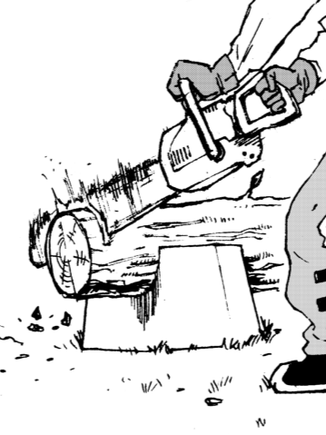
Safety and Health Training for
Tree Care and Landscape Workers
EQUIPMENT
SAFETY:
Machine Guarding

Slide 27
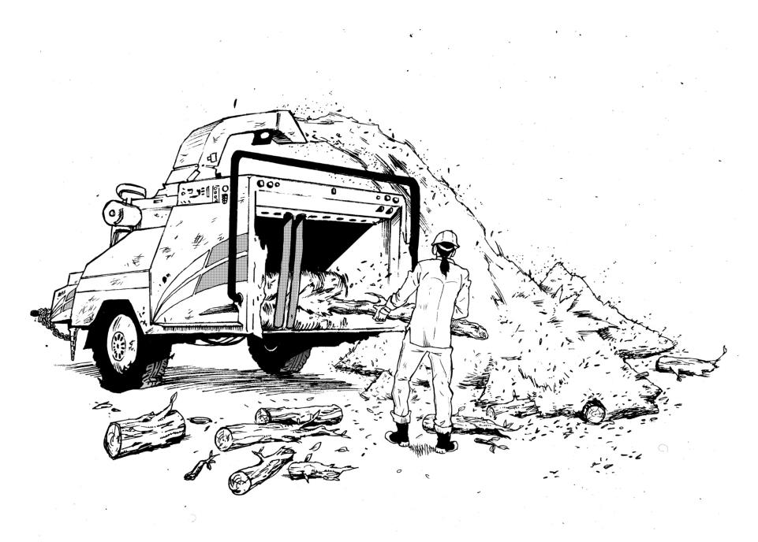
EQUIPMENT SAFETY
What is wrong with this picture?
# 2

Slide 28

EQUIPMENT SAFETY

Slide 29
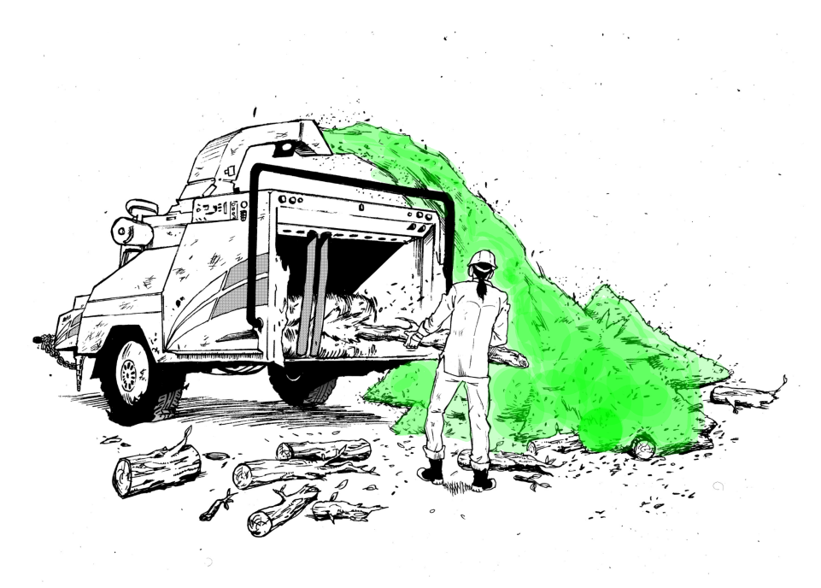
EQUIPMENT SAFETY
Aim discharge chute away from workers and work area

Slide 30
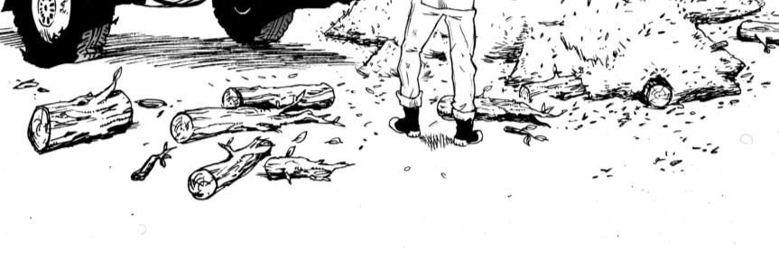
EQUIPMENT SAFETY
Ensure work area is clean and organized

Slide 31
EQUIPMENT SAFETY
Do not wear loose clothing
  -DO NOT wear gauntlet style gloves

Slide 32
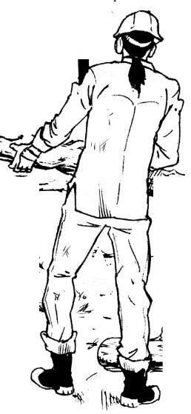
EQUIPMENT SAFETY
Wear appropriate PPE

Slide 33
EQUIPMENT SAFETY
OTHER PROBLEMS?
Safety tray

Slide 34
Final Test
Course: SAFETY EQUIPMENT Date: ___________
Company: ___________________________________
Your Name: __________________________________
Read the statement, determine if it is true or false. Circle the correct answer.
Machine may be operated when guards are missing. TRUE / FALSE
Discharge chute should be aimed away from workers. TRUE / FALSE
Loose fitting clothes is allowed in the work place. TRUE / FALSE
Work area should be kept clean and organized. TRUE / FALSE
Gauntlet style gloves may be worn. TRUE / FALSE

Slide 35

Safety and Health Training for
Tree Care and Landscape Workers
PERSONAL
PROTECTIVE
EQUIPMENT

Slide 36
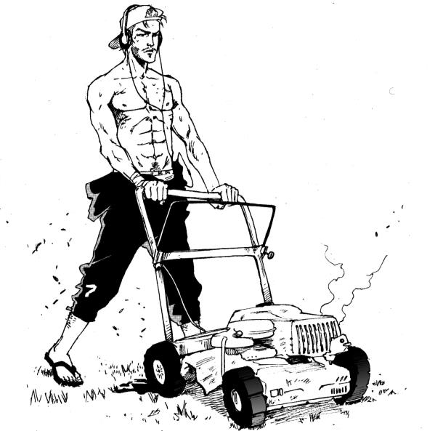
pPE
What is wrong with this picture?
# 3

Slide 37
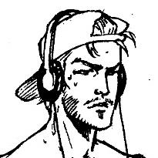
pPE
Wear appropriate PPE:
Safety goggles

Slide 38
pPE
Wear appropriate PPE:
Ear protection

Slide 39
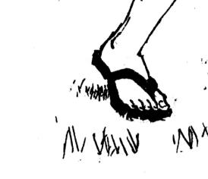
pPE
Wear appropriate PPE:
Safety shoes

Slide 40
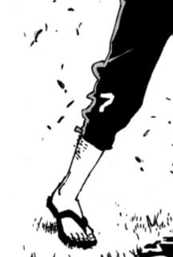
pPE
Wear appropriate PPE:
Long pants

Slide 41
pPE
OTHER PROBLEMS?

Slide 42
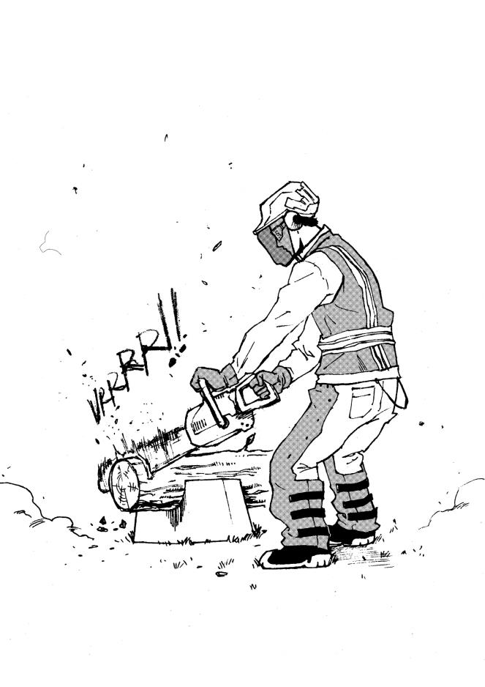
PPE - FOR CHAINSAw
Wear chaps, hearing protection, and face guard
Use 2 hands
Cut over a firm support
Protect chain when walking

Slide 43
Final Test
Course: PPE__ ___ Date: _____________
Company: ____________________________________
Your Name: ___________________________________
Read the statement, determine if it is true or false. Circle the correct answer.
You should wear a face guard when using a chainsaw.
TRUE / FALSE
PPE includes long pants.
TRUE / FALSE
Headphones are good ear protection.
TRUE / FALSE
When walking, the chainsaw should be covered.
TRUE / FALSE
You must wear chaps when using a chainsaw.
TRUE / FALSE

Slide 44
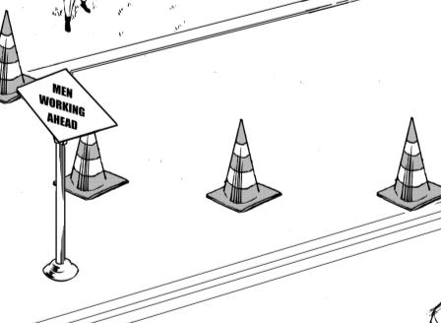
Safety and Health Training for
Tree Care and Landscape Workers
WORK
ZONE
SAFETY

Slide 45
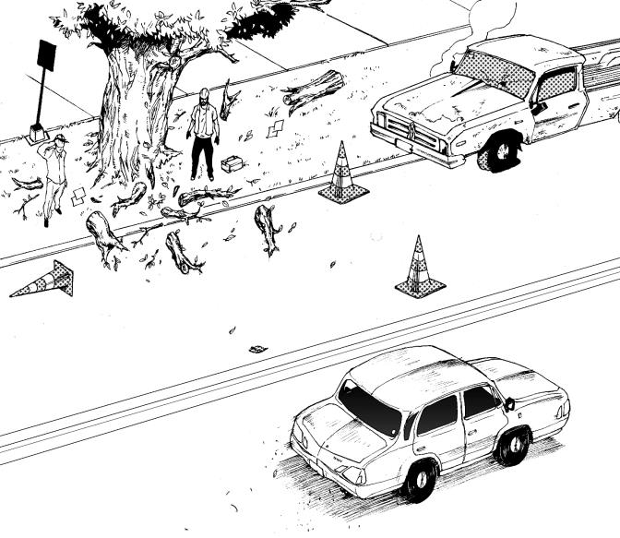
Work zone
# 4
What is wrong with this picture?

Slide 46

work zone

Slide 47
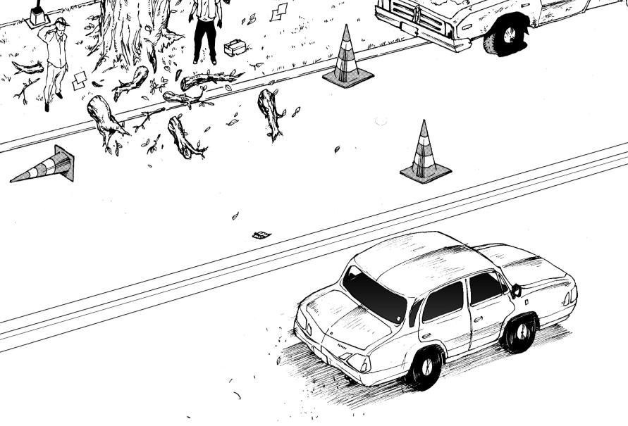
work zone

Slide 48
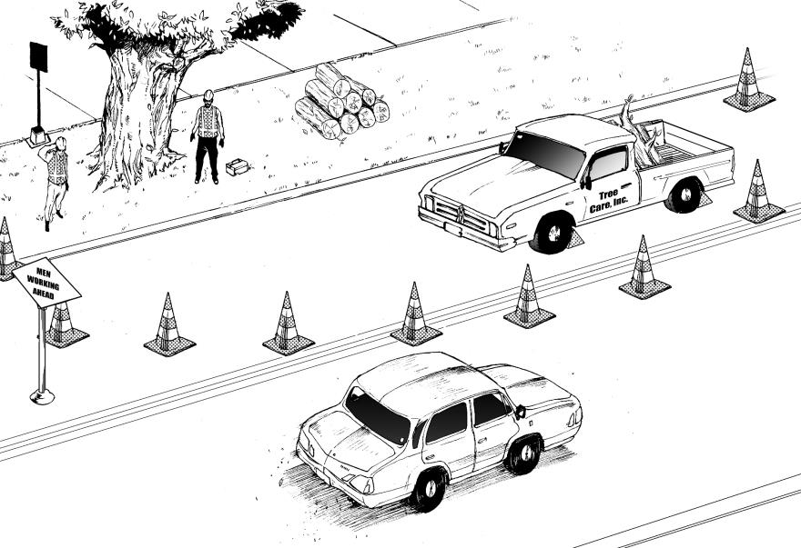
work zone
Clearly identify the work zone

Slide 49
work zone
Safely guide motorist when working
on the side of the road

Slide 50
work zone
Use traffic control devices (cones & signs) that meet MUTCD standards

Slide 51
work zone
Keep traffic control devices (cones & signs) in clean & working condition

Slide 52
work zone
Wear class 3 high-visibility safety vest

Slide 53
Final Test
Course: WORK ZONE Date: ___________
Company: _________________________________
Your Name: ________________________________
Read the statement, determine if it is true or false. Circle the correct answer.
The work zone should be clearly identified. TRUE / FALSE
Cones and signs do not need to meet any standard. TRUE / FALSE
Cones in any condition can be used. TRUE / FALSE
Workers are not required to wear safety vests. TRUE / FALSE
Branches should be kept off of the road. TRUE / FALSE

Slide 54
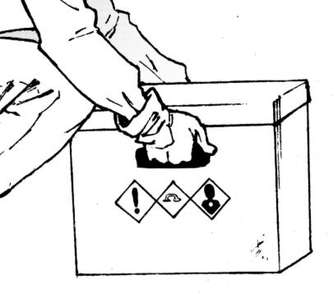
Safety and Health Training for
Tree Care and Landscape Workers
FIRST AID
Heat Stress and
Ergonomics

Slide 55
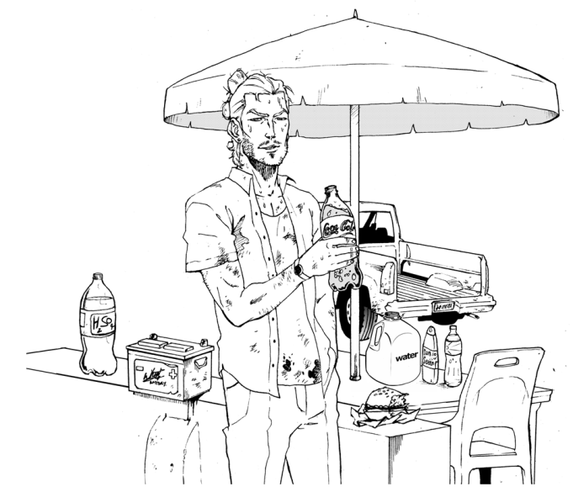
First aid
What is wrong with this picture?

Slide 56
First aid
Drink plenty of water to avoid dehydration
  Avoid drinks with caffeine

Slide 57
First aid
Use sun screen

Slide 58
First aid
Take frequent breaks in a shaded area

Slide 59
First aid
OTHER PROBLEMS?
Original Labels (SDS)

Slide 60
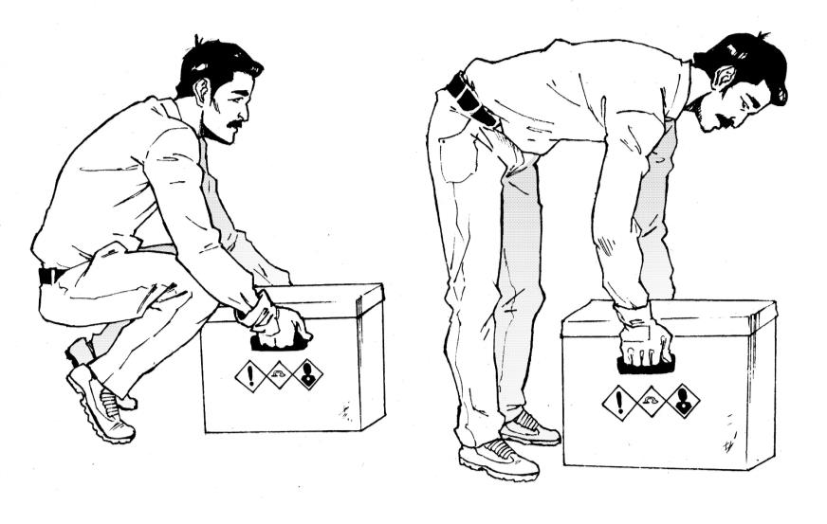
ERGONOMICS
Use the proper lifting technique

Slide 61
ERGONOMICS
Ask for help when needed

Slide 62
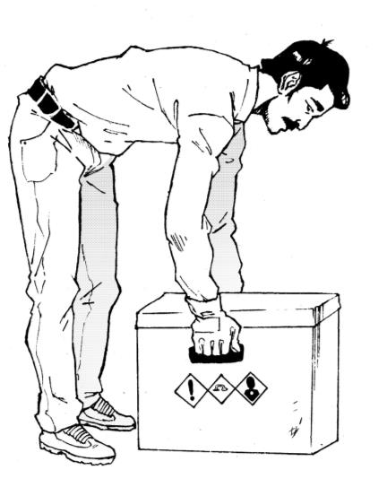
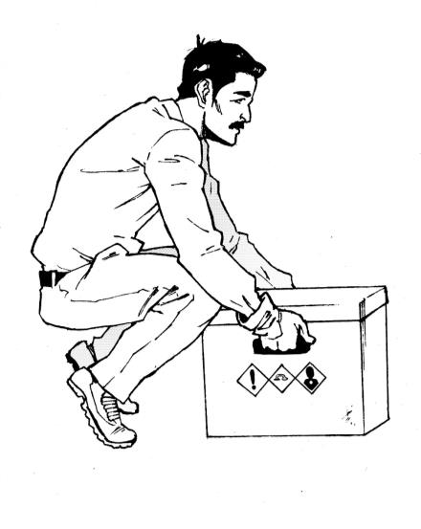
ERGONOMICS
Keep your back straight
Bend the knees
Exercise with a CFR…

Slide 63
FINAL TEST
Course: FIRST AID Date: _____________
Company: ___________________________________
Your Name: __________________________________
Read the statement, determine if it is true or false. Circle the correct answer.
Drinking caffeine will help you stay hydrated.
TRUE / FALSE
You should take frequent breaks in shaded areas.
TRUE / FALSE
When lifting heavy objects, ask for help.
TRUE / FALSE
Keep your knees straight when lifting.
TRUE / FALSE
Keep your back straight when lifting.
TRUE / FALSE

Slide 64
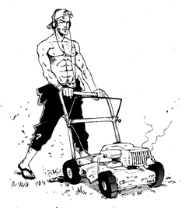
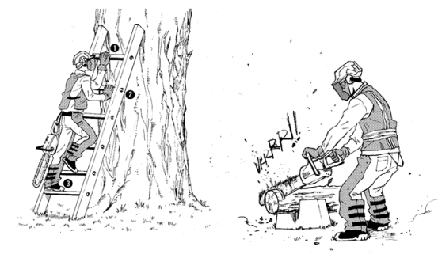
Safety and Health Training for
Tree Care and Landscape Workers
RIGHTS &
RESPONSABILITIES
of the
Employees and
Employers

Slide 65

Employees Rights
All workers have the right to:
A safe workplace.
Raise a safety or health concern with your employer or OSHA, or report a work related injury or illness, without being retaliated against.
Receive information and training on job hazards, including all hazardous substances in your workplace.

Slide 66
Employees Rights
All workers have the right to:
Request an OSHA inspection of your workplace if you believe there are unsafe or unhealthy conditions.
Participate in an OSHA inspection and speak in private to the inspector.
File a complaint with OSHA within 30 days if you have been retaliated against for using your rights.

Slide 67
Responsabilities
All Employers must:
Provide employees a workplace free from recognized hazards.
It is illegal to retaliate against an employee for using any of their rights under the law, including raising a health and safety concern with you or with OSHA, or reporting a work-related injury or illness.

Slide 68
Responsabilities
All Employers must:
Report to OSHA all work-related fatalities within 8 hours, and all inpatient hospitalizations, amputations and losses of an eye within 24 hours.
Provide required training to all workers in a language and vocabulary they can understand.
Prominently display this poster in the workplace.
Post OSHA citations at or near the place of the alleged violations.

Slide 69

Next Step

Slide 70
NEXT STEPS
Schedule the trainings
1
Make copies of the handouts
2
Conduct the trainings
3

Slide 71
PURPOSE OF SUSAN Harwood
TRAINING GRANT
Collect attendance slips
4
Complete a ‘Trainer Recordkeeping Form’ for each training provided
5

Slide 72

The end
Thank you…!

