Slide 1
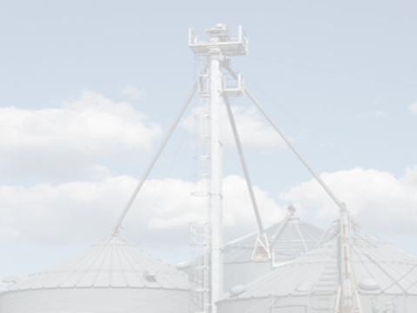
1Reduciendo Riesgos de Entrada al Compartimiento de Granos Curso Academico 2
Este material fue producido bajo el número de concesión SH-27664-SH5 de la administración de seguridad y salud ocupacional, Departamento de trabajo de los Estados Unidos. No necesariamente refleja las opiniones o políticas del Departamento de trabajo de los Estados Unidos, ni la mención de nombres de oficios, productos comerciales u organizaciones implican el aval del gobierno de los Estados Unidos.
Notes:
Safe Grain Bin Entry is a process – a planned response or action to complete a task that should follow a set of specific procedures previously decided upon.
To appreciate the need for procedures, it was necessary to understand:
The types of incidences which often force people to go into a bin
Ways to reduce the need for entry or reduce the types of hazards that can be found
What alternatives to entry are available – especially for severely hazardous, dangerous situations.
EVERY BIN ENTRY CARRIES RISK – EVEN ENTRIES UNDER THE BEST OF CIRCUMSTANCES.
Safe Bin Entry Procedures understand these risks; anticipate the risk; seek to control the risk; make decisions based on the ability to control the risk; continually reassess the risk; APPRECIATES the risk; PROTECT against the risk; and lastly, is able to respond quickly, effectively, and safely to an emergency due to the risk.
Refer back to the clipping on the title page about the man who “knew” the risks. Describe the full story to the participants (http://www.agweb.com/article/experts-2014-could-be-deadliest-year-for-grain-bin-accidents-since-2010-associated-press/ ) or read experts from the article (below).
ASK - refer to this incident through the section and ask participants what actions indicate a clear understanding of the dangers; which actions showed a lack of understanding; what could have been done differently; does their understanding of the dangers match the needed level of appreciation?
It took only seconds. Tim Hansen climbed inside the grain bin with a long pole, planning to shove it down into the corn to clear a crust of kernels stopping corn from funneling out to be loaded into trucks. His grown son, Chris Hansen, stood outside the 60,000 bushel bin northeast of Dixon, Neb., with a two-way radio that let him talk to his 60-year-old dad. They knew going inside a bin could be dangerous and liked to keep in contact as a precaution.
Chris tried to radio his dad but got no response. He banged on the side of the bin, turned off the auger then climbed to the top. "When I got to the top of the bin and looked in, his bar was sitting dead smack over the center of the hole where it should have been but there was no dad," Chris said. Chris jumped in and dug with his hands but couldn't find his dad and business partner.
It took rescue workers more than two hours to find Tim Hansen's body at the bottom of the bin under 10 feet of corn. Chris believes there was a void in the grain that collapsed, causing Tim to fall backward and sucking him under.
Paulsen advised farm workers to stay out of grain bins if they can. But if they have to go in, he said to turn off the auger that moves the grain, have a buddy nearby and use a harness connected to a rope that can pull them out just in case they get sucked in.
It's advice Chris Hansen echoed. Tim Hansen had gone into grain bins countless times to knock grain free, and they thought they had taken proper precautions, he said. Tim Hansen had been a local business owner, an emergency responder and former fire chief in addition to having farmed with his son for 15 years. He knew the dangers.
It took only one slip for a tragic result. Emergency responders, neighbors, family and friends dug by hand, with shovels and tore the bin apart with heavy equipment to get Tim Hansen out. "I don't want that to happen to any of my friends. If I see somebody crawling inside a bin now, I'll stop and yell at them," Chris Hansen said. Nicholas Bergin, Lincoln Journal Star
This section is devoted to discussion about a safe grain bin entry process
Under good circumstances, entering a grain bin carries a risk
Understand, anticipate control, reassess, appreciate, protect against the risk.

Slide 2
1
Procedimientos para la Entrada SEGURA al Compartimiento de Granos
Entrenar, Planear,
Preparar, Actuar
Notes:
Safe Grain Bin Entry is a process – a planned response or action to complete a task that should follow a set of specific procedures previously decided upon.
To appreciate the need for procedures, it was necessary to understand:
The types of incidences which often force people to go into a bin
Ways to reduce the need for entry or reduce the types of hazards that can be found
What alternatives to entry are available – especially for severely hazardous, dangerous situations.
EVERY BIN ENTRY CARRIES RISK – EVEN ENTRIES UNDER THE BEST OF CIRCUMSTANCES.
Safe Bin Entry Procedures understand these risks; anticipate the risk; seek to control the risk; make decisions based on the ability to control the risk; continually reassess the risk; APPRECIATES the risk; PROTECT against the risk; and lastly, is able to respond quickly, effectively, and safely to an emergency due to the risk.
Refer back to the clipping on the title page about the man who “knew” the risks. Describe the full story to the participants (http://www.agweb.com/article/experts-2014-could-be-deadliest-year-for-grain-bin-accidents-since-2010-associated-press/ ) or read experts from the article (below).
ASK - refer to this incident through the section and ask participants what actions indicate a clear understanding of the dangers; which actions showed a lack of understanding; what could have been done differently; does their understanding of the dangers match the needed level of appreciation?
It took only seconds. Tim Hansen climbed inside the grain bin with a long pole, planning to shove it down into the corn to clear a crust of kernels stopping corn from funneling out to be loaded into trucks. His grown son, Chris Hansen, stood outside the 60,000 bushel bin northeast of Dixon, Neb., with a two-way radio that let him talk to his 60-year-old dad. They knew going inside a bin could be dangerous and liked to keep in contact as a precaution.
Chris tried to radio his dad but got no response. He banged on the side of the bin, turned off the auger then climbed to the top. "When I got to the top of the bin and looked in, his bar was sitting dead smack over the center of the hole where it should have been but there was no dad," Chris said. Chris jumped in and dug with his hands but couldn't find his dad and business partner.
It took rescue workers more than two hours to find Tim Hansen's body at the bottom of the bin under 10 feet of corn. Chris believes there was a void in the grain that collapsed, causing Tim to fall backward and sucking him under.
Paulsen advised farm workers to stay out of grain bins if they can. But if they have to go in, he said to turn off the auger that moves the grain, have a buddy nearby and use a harness connected to a rope that can pull them out just in case they get sucked in.
It's advice Chris Hansen echoed. Tim Hansen had gone into grain bins countless times to knock grain free, and they thought they had taken proper precautions, he said. Tim Hansen had been a local business owner, an emergency responder and former fire chief in addition to having farmed with his son for 15 years. He knew the dangers.
It took only one slip for a tragic result. Emergency responders, neighbors, family and friends dug by hand, with shovels and tore the bin apart with heavy equipment to get Tim Hansen out. "I don't want that to happen to any of my friends. If I see somebody crawling inside a bin now, I'll stop and yell at them," Chris Hansen said. Nicholas Bergin, Lincoln Journal Star
This section is devoted to discussion about a safe grain bin entry process
Under good circumstances, entering a grain bin carries a risk
Understand, anticipate control, reassess, appreciate, protect against the risk.

Slide 3
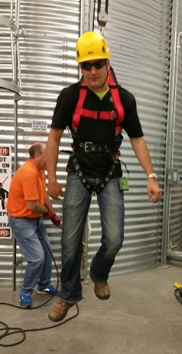
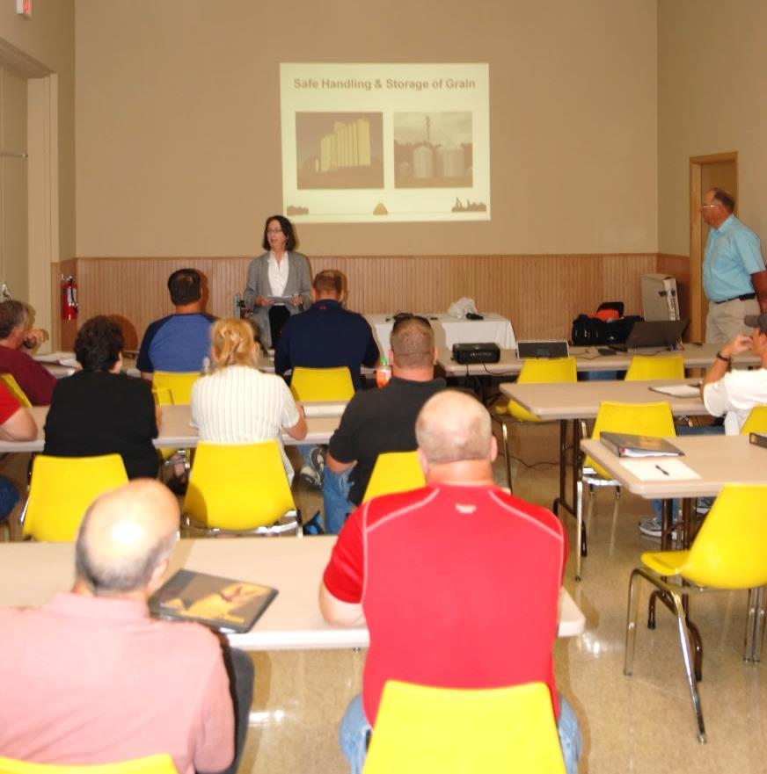
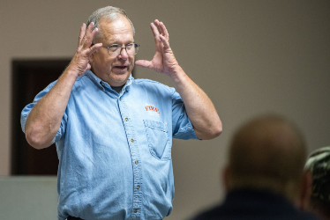
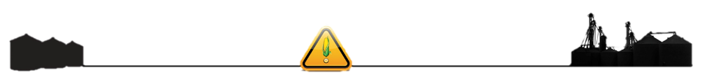
Entrenar - ANTES de entrar.
NADIE debe entrar a un compartimiento sin entrenamiento!
Notes:
EMPHASIZE – Training is MOST IIMPORTANT action to take for anyone going into a grain bin. All persons who may enter a bin should take training.
STRESS – No one should enter a bin without training.
This section on training refers to the training requirements under the 1910.272 Grain Handling Standard.
OSHA grain handling standard 1910.272(e)(1) and (e)(2) provides guidance of general and specific training topics. Training is required annually, when job assignments change & expose employee to new hazards, prior to new employees starting work.
According to the standard - General training for all employees should include at a minimum:
General safety precautions for the facility
Identification and preventive measure for hazards related to dust accumulations and common ignition sources like smoking.
According to the standard - Specific training
Specific procedures & safety practices related to their job tasks
Cleaning procedures for grinding equipment
Clearing procedures for choked legs
Housekeeping procedures
Hot work procedures
LOTO procedures
According to the standard - Secial tasks – training to perform specific tasks safely include: Bin entry and handling of flammable or toxic substance
Stress: The requirements of Note to paragraph (e)(2): Training for an employee who enters grain storage structures includes training about engulfment and mechanical hazards and how to avoid them.
Mechanical hazards include machine guarding.
Stress – Additionally the standard requires the facility to have an Emergency Action Plan – this is a BEST PRACTICE for farms. 1910.272(d) Emergency Action Plan - The employer shall develop and implement an emergency action plan meeting the requirements contained in 29 CFR 1910.38. It is a best practice to review and train on the plan annually.
No one should enter a bin without training!
Training requirements are in OSHA 1910.272

Slide 4
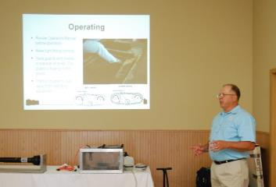
TODOS necesitan ser entrenados en peligros.
Peligros en manejo de grano
Peligros del ambiente de almacenamiento
Inmersión; mecánico (resguardo de las máquinas)
Como eliminar, evadir, mitigar
Candado/Etiqueta (LOTO)
Plan de acción de
emergencia
procedimientos de rescate
Roles & responsabilidades
Tareas de trabajo
Notes:
Emphasize ALL workers need training on hazards in the work environment.
Workers should be trained on how to eliminate the hazard, mitigate or avoid the hazard. This is especially important for grain bin entry as many entries are made because the hazard exists. The worker needs to know how to avoid the hazard or lessen the severity of the hazard and the risk of the hazard.
Stress – All workers need to be trained on LOTO.
Training must also occur on the roles and responsibilities of the worker’s position and the job tasks which the worker is to perform WHEN these tasks or responsibilities change, new training is necessary.
Stress – One of ways to reduce risk is to ensure job tasks do not conflict with job roles. For example, a new, temporary, or seasonal employee would not be the best choice to assess the hazards or to enter a grain bin.
Emphasize – these training topics are equally relevant to a farm environment.
DISCUSS – the earlier engulfment example. What kinds of training do you think the son and father could have benefitted from? Do you think they adequately understood the hazards?
These are the topics all workers should receive training on.
LOTO & hazard identification are crucial to safe bin entry
Understanding job roles and responsibilities in relation to position is crucial.
If a worker is going to do “more” than his job description, make sure appropriate training has occurred.

Slide 5
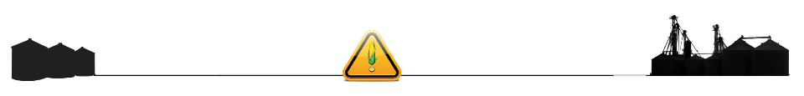
Entrenar al observador y al entrante.
Entrante
Observador
Identificar y corregir peligros
Evaluar continuamente
Candado/Etiqueta LOTO
Resguardo de máquinas
Rol & responsabilidad
No entrar solo
Tarea(s) a realizar
Uso de Cuerda Salvavidas
Identificar y corregir peligros
Candado/Etiqueta LOTO
Resguardo de máquinas
Rol y responsabilidad
Debe permanecer presente
Comunicación constante
Uso de Cuerda Salvavidas
Iniciar rescate sin entrar
Notes:
Explain The entrant and observer require similar training. The difference lies in the role and responsibilities and their understanding of how to perform these roles.
Entrant –
must understand that there is a need to continually assess the hazards in the environment once inside the bin as not all conditions will be known & conditions may change.
understand if hazards appear which he cannot be protected against, there is the need to CANCEL the bin entry and should act upon this.
Is also responsible for ensuring bin entry is not started until the observer is posted. Nor should the entry continue if the observer steps away.
must be trained in the tasks to be completed inside the grain bin as well as have received lifeline training.
The Observer’s role is specific. The observer is to remain present throughout the entry and be in constant communication with the entrant.
The Observer can stop the entry if:
The observer has to leave
There is no means to remain in contact
There are hazards against which the entrant cannot be protected.
The observer perceives the entrant is in danger.
The Observer must be able to initiate rescue without entering the grain bin including knowing how and who to call in the event of an emergency.
The Observer has the responsibility of managing the slack of the lifeline rope in many situations.
Training needs are the same
Difference is role & responsibility
Observer also must know how to call for help and initiate rescue procedures.
Entrant must reassess conditions & cancel entry if it is unsafe

Slide 6
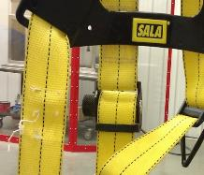
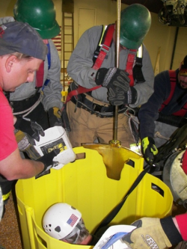
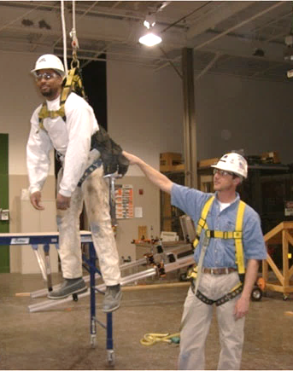
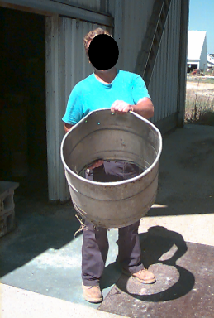
Entrenar en prevención y emergencia.
Iniciar Rescate
Protección contra Caídas
Inspección del equipo
Primer nivel de respuesta
Rescate
Médico
Notes:
All employees should be trained on the emergency action plan.
The plan should include what to do in the case of an engulfment or entrapment.
The plan should designate clear roles & responsibilities for workers and the workers should be trained on them
Fall Protection training - grain bins necessitate work at heights.
An observer during bin entry is likely to be working at height, requiring fall protection.
Workers should be trained in fall protection self-rescue, how to assist if able in their rescue.
Equipment inspection training to ensure proper functioning & equipment is in good repair.
Initiating rescue – Observers must be trained to initiate rescue from outside the bin. May include:
Assisting to keep victim’s airway clear , such as providing a homemade apparatus like a bucket with holes.
Delivering emergency first aid and/or determining the victim’s initial injury assessment (such as if the victim were unconscious.
First Responder – Location of elevators & farms often entails a more lengthy response time from rescue units and there may be an even longer response from technical rescue units. The majority of rural locations are served by volunteer rescue units. The first rescue teams to arrive may not have the appropriate training or skills to assist.
Elevator’s, large farms, or others may choose to train their own employees to be first responders and provide initial rescue or medical services.
ALL components of the emergency action plan should be communicated & known to employees.
Fall protection training needed due to height work
Initiating rescue until first responders arrive

Slide 7

Qué tratar en el entrenamiento: políticas y registros.
QUIEN
Necesidades de entrenamiento
Supervisores
Empleados
QUE Y POR QUÉ
asunto
CUANDO
Fecha de terminación
Anual, frecuencia
Tareas de trabajo cambian
DONDE
ocurrió el entrenamiento
Localidad y Entrenador
Requisito, general
tarea, rol específico
Entidad certificadora
Mantenga registros de entrenamiento
Notes:
Elevators & farms should develop training policies for their workers.
Many workers may be seasonal, temporary, or part-time during peak seasons – such as harvest or planting.
Often workers return repeatedly to a work location.
A training policy helps site managers know what training is needed for different tasks or job roles.
A written record of what type of training a worker has had, what topics, & when they last had training helps ensure the worker has the knowledge & skills for the job responsibilities and tasks assigned.
Stress – it is especially important to not assume a worker knows how to safely & correctly perform a task or job assignment just because he works is a regular temporary employee during a particularly busy season.
One should not assume a worker may be familiar with changes that have been made at the facility or farm.
It is equally important to not rely on memory that someone has had training.
For annual training requirements a written record ensures the training is received timely.
Written records also allow for timely renewal of any specialized certifications.
Emphasize - training policies and records do NOT have to be complicated. Both the policy & record should answer the 5 W’s – Who, What, When, Where, Why.
Training policies and records address the 5Ws

Slide 8
7
fecha de alquiler
Información de identificación
Información de entrenamiento
Notes:
ANIMATED SLIDE – One mouse click for first bullet point & accompanying circles to appear. Second mouse click for next bullet point & circles. Total 2 mouse clicks.
This is a sample employee training record. There are many styles of training records – choose the style which works best for the workplace.
Ensure identifying information of employee is on the record such as name, hire date, and job position or description.
Ensure basic identifying information about the training is on the record – title, date, employee initials, supervisor and/or trainer initials.
ANIMATED SLIDE
Training records should id the employee, the topics, date and be signed.

Slide 9


Planear - ANTES de entrar.
Tenga un plan!
Política - guías
Procedimiento – como hacerlo
Instrucciones de trabajo
Ahorra
Tiempo
Errores
Notes:
Left Image translation: Politica Ave. - Procedimiento Clle. Right Image Translation: Como, donde, cuando, por que, que, de quien, quien
Safe bin entry requires a plan consisting of policy & procedure that provides employees instruction and guidance, assigns responsibility, and eliminates “guess work”.
Policy – guides. It provides direction to make decisions within a specified framework.
Procedure – tells “how to” implement the policy – or how to take action on the policy.
Smaller operations may want to consider using work instructions as procedures.
Policy & procedure benefits the workers by providing clear directions.
Emphasize - A PLAN – saves time and mistakes.
Planning is the policies & procedures that guide the decision making process of whether to enter a bin

Slide 10

La Entrada Segura Necesita un Plan
Plan de Entrada
Escrito
Comunicativo
Entrenamiento
Política y Procedimientos
Política y Procedimientos
Entrada
Candado/Etiqueta
Entrenamiento
Plan de Acción de Emergencia
Notes:
Safe Bin Entry needs an effective plan that addresses the critical components of bin entry.
To be effective a plan MUST be communicated.
Written plans provide consistent guidance and information to all users as well as a way to refer back and check when there are questions.
A Safe Bin Entry Plan will consist of :
Policy & Procedures covering: Bin Entry, Lock Out/Tag Out, Training
Emergency Action Plan
Written & Communicated
Safe bin entry starts with a plan that is communicated to the workers

Slide 11

Utilice la norma Candado/Etiqueta (LOTO) como guía.
Política LOTO
Utilice norma 1910.147.
Programa LOTO
Cuando
Quien lo hace
Procedimientos LOTO
Cada pieza de equipo.
Orden de apagado.
Siga el programa y procedimientos LOTO de la compañía.
Entrenamiento
Contratistas
Quien es afectado
Identificar fuentes y tipos de energía.
Equipo y dispositivos
Desmontar candados
Notes:
Lock out Tag out is crucial to a safe bin entry as well as fundamental to controlling other types of hazards in the grain environment such as entanglement and working with energized equipment.
There are 3 pieces to a strong and effective LOTO.
A LOTO policy sets the rules for when LOTO must be done before a work activity.
A LOTO program tells how the steps of LOTO will be implemented and assigns responsibility.
LOTO procedures are the work instructions for the each piece of equipment . They tell the worker how to shut down & isolate the energy source for the equipment..
When consistently & properly used, the policy, program, & procedures of LOTO significantly reduces the risk of injuries & fatality.
Whether farm or commercial, a LOTO program is a best practice.
Implementing LOTO is one of the best safety protections a farm operation can do.
LOTO is a critical safety measure
Every farm and commercial facility should practice LOTO
Understand the need to LOTO and how it effectively eliminates or control the majority of hazards

Slide 12

Política de entrada – Utilice una Norma.
Política – siga una norma
Norma de Manejo de Granos – 1910.272
Norma de Espacios Confinados – 1910.146
Combinación
Recomendar a granjas que sigan la Norma de Manejo de Granos
Reflejar la norma utilizada
Permiso de Entrada/Lista de Control
Procedimientos
¡Indique cuando la entrada está prohibida!
Notes:
When developing a bin entry policy use a standard as the guide.
Reflect the standard’s requirements in the bin entry checklist and work procedures to maintain consistency.
The most important thing a bin entry policy can offer to workers is clear guidelines when entry is prohibited. This does not have to be complicated and should reflect the main dangers associated with bin entry. (Using pictures or diagrams is helpful.
GHSC recommends farms follow the Grain Handling Standard.
A written policy is a protection for both employers and workers. It provides direction and ensures everyone understands what is expected.
This is especially important when there are seasonal, part-time, and/or temporary workers.
They may not be familiar with the work practices.
They may bring with them other ideas or practices used elsewhere which are inconsistent to the current work location.
Important to managers to have clear expectations of their role in:
Adhering to safe work practices
Protecting workers
ASK – Ask participants about the policy at their employer. Do they know the policy? Do they have examples of when a policy wasn’t followed? What were the circumstances? What were the outcomes?
Use a standard to guide in the development of policy & procedure
Recommended to use the grain handling standard
Should provide guidance on when NOT to enter a bin

Slide 13

Planear como se realiza la entrada.
Persona responsable del permiso/lista de control
Quien puede entrar a los compartimientos
Como se hará la entrada
Que tareas, equipo utilizar, EPP
Cuando se puede realizar
Donde – parte superior o lateral
Por qué – circunstancias en que
alguien puede entrar
Notes:
A bin entry policy or accompanying plan should address the 5 Ws and How.
Who is responsible for the bin entry checklist or permit?
This person should be very familiar and knowledgeable about hazards and potential hazards in the grain environment and know how to accurately assess the risk posed by the hazards.
This person should know how to eliminate or correct hazards.
This person is saying the entrant and observer are protected against hazards.
Who can enter? – The full-time employee/farm worker or the part-time, seasonal, first time working at the farm person? Put down the parameters for this person:
The type of training this person should have
Experience, knowledge, skill sets.
Tasks – think about the reasons why a bin is entered, the task to be completed, and possible hazards. Can they enter just to monitor grain or to break up pyramids? What type of equipment can/should be used? What type of PPE do they need to complete the job correctly?
When, Where, Why – these go together to describe the conditions and circumstance which need to be considered and when entry is prohibited. Take into account the types of tasks which may need to be done.
Consider hazards such as weather. Should a person be climbing a 40 foot ice covered ladder to do a routine task that could wait? If it is necessary to climb that ladder how will the person be protected? How will the person be protected on an ice covered platform or bin roof?
ASK – ask participants to describe how their employer policies address the 5Ws & How? What do they think is missing from it? What do they think is unnecessary? Why? What would they do differently? If they don’t have one, how do they communicate these parameters to workers? What basics would they start with?
Generate discussion and if possible write participants thoughts onto a white board or flipchart.
DISCUSS – the earlier engulfment example. Would a policy have changed the decision making?
Plan how bin entry will occur
Consider training needs, tasks, equipment and type of entry

Slide 14
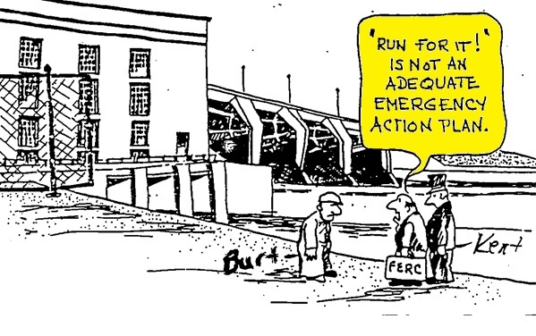

Plan de Acción de Emergencia – preparado para respuesta efectiva.
¡Tenga equipo de rescate disponible!
Referencia
1910.272 Norma de Manejo de Granos
1910.38 Planes de Acción de Emergencia
Notes:
Image translation: “¡Corre por ello!” , no es un plan de acción de emergencia adecuado.
Commercial elevators must have an emergency action plan that includes what to do in the event of an engulfment. The grain handling standard references 1910.138 – Emergency Action Plans.
A plan allows a facility, including a farm, to be prepared to act effectively & swiftly.
Call 911 – is NOT an effective emergency action plan by itself.
One of the reasons for having an emergency action plan is the response time of a local rescue unit to a rural location.
A plan will address what the facility can do while waiting for additional help to arrive.
Farms need to consider response time as they may be even farther from the local fire/rescue department. After placing a 911 call, what kind of immediate assistance can be available & how will they notify them?
DISCUSS – Entrapment & engulfment, entanglements happen quickly. Do participants know how long it would take for a rescue team to reach their location? What can be done without putting others in danger while waiting for a rescue response team? Does anyone have a personal experience?
Working Alone – is another factor to be considered. Small elevators may only have a couple employees and sometimes only one person may be on site. Farms often have people working alone for long stretches of time.
What precautions should be put in place?
If the person can’t call for rescue, how will the emergency be found?
DISCUSS – “John” worked a full-time job in a local factory as well as owning farmland. He lived alone. On Monday morning he did not call or show up to work. This was very unusual. They made several attempts to reach him by phone and talked to all the workers. A co-worker remembered John saying he was going to mow hay over the weekend. The factory sent workers to John’s house where they found his cell phone. They then went searching his fields. John was located in the late afternoon in one of his fields laying under the tractor. An autopsy & investigation revealed John most likely was injured on Saturday, but did not succumb to his wounds until late Sunday/early Monday.
DISCUSS – the earlier engulfment example. What emergency action plan was in place?
Have rescue equipment available – Best practice
It does not have to be fancy – something to keep the victim’s airway clear

Slide 15

Plan de Acción de Emergencia
1910.138 ES DEBER con 10+ empleados
Entrenar y practicar con empleados
Orientación & anualmente
Como utilizar equipo
Roles y responsabilidad
Reunión anual
Practicar – comercial & granjas grandes
Documentar
Lugar de reunión, plan de escape, #s para ayuda y servicios públicos.
ID ubicación de estructura & tipo; fuentes de energía y de agua; peligros
Plan escrito – PRÁCTICA RECOMENDADA
Compartir con departamento local de bomberos/rescate
Notes:
Grain handling standard 1910.272(d) refers to 1910.38 Under 1910.138 locations with 10 or more employees must have a written plan.
To comply with the grain standard and known hazards in the work place, an emergency action plan should address hazards related to grain entrapment, entanglement, fall from height, dust explosions as well as others.
The plan must be known by employees and they need to retrained if the plan changes or their duties & responsibilities change.
STRESS - In the event of an emergency – knowing what roles to play and who is responsible for what saves valuable time! This includes who is to be notified of the emergency, who does the notification, what order to notify. This prevents confusion & misinformation. Knowing what equipment the facility has or does not have and what might be needed also saves time.
A “best practice” is to keep copies of the plan at various locations.
FARM –keep copies at the house, barns, work/tool shed bldg, and in the vehicles including combines, etc.
FARM – have a list of #’s to call for help – including utility companies and have GPS or platt coordinates for the various buildings & fields.
When relying on services from the local rescue squad it is a Best Practice for both commercial elevators and farms to communicate with the rescue squad and when possible practice with them.
Find out how far away the nearest technical rescue team is located – this is the type of rescue team that would assist with a height or grain bin rescue and is trained to go in the bin, other confined space, use ropes, etc.
Good opportunity to assess what types or equipment is available in the local area for help in emergencies – such as grain rescue tubes, grain vacs, etc. Assist department in developing a list for use in other situations.
Good opportunity to assess what training is needed by the facility and/or local rescue department. Not all local rescue squads have technical training for rope rescues, confined spaces, etc.!
Both farms and commercial elevators should provide the local department a map or other document showing:
the location & type of the structures including known hazards – for example confined space hazards
Identify power & water sources
Farms should also show where fields are located.
A good practice is to have a unique identifier clearly visible on the various bins, buildings, etc. at the site – both commercial and farm. For example – use letters or numbers.
Don’t forget to put signage about any chemicals stored/used for the rescue department.
Components of an emergency rescue plan
Ensure employees know the plan
Crucial the know how to use the equipment and practice
Not just for grain emergencies
A good plan can save time

Slide 16

Preparar – ANTES de entrar.
Complete un Permiso de Entrada o Lista de Control
¡Cada vez – Todas las veces!
Entender la razón para la entrada
Permiso o Lista de Control
Revisión de seguridad
Proporcionar un registro escrito
Comercial – cuando el empleador o administrador no está presente
Notes:
The next slides talk about the preparation process for bin entry. The preparation occurs the day of bin entry.
EMPHASIZE - Training and planning should have been completed before any attempt is made at entry to assist in ensuring it can be done safely and there is guidance to the decision making processes that now come into play.
The permit or checklist is a crucial tool to ensure preparation for entry.
It is a safety check to ensure the safety of the entrant & observer are given priority over the task.
It provides a written record of the entry. This is helpful when reviewing policies or when reviewing the entry itself to determine task completion.
For commercial operations a permit MUST be completed with the employer or authorized representative (manager/supervisor/site operations person) is not present during the entire entry operation.
STRESS - It is strongly advocated to complete a permit or checklist each & every time a bin entry occurs whether or not the supervisor is present. Again, the completion of a permit or checklist ensures there is thought put into the decision making, adequate preparation is taken; the safety hazards are addressed, recognized and taken care of appropriately; the decision to enter is based on the policy/guidelines previously put out; and the persons involved in entry are appropriately trained to handle the job.
Complete a bin permit or checklist every time
It is the most important part of preparation

Slide 17
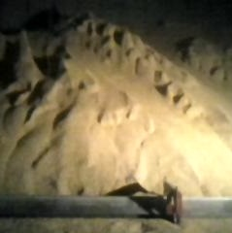
Entender por qué la entrada es necesaria.
Razón para entrar
Rutina
Problema
Tarea(s) a realizar
Equipo de PP
Equipo
Herramientas
IDENTIFICAR
Trabajadores entrenados
Entrante
Observador
Decisión de entrar
Entender la razón
Entender la tarea
Notes:
Explain - Decision to enter is part of the preparation process. The decision to enter should take into account the reason, task, and workers.
Reason for entry – why is there a need to enter? Knowing if the entry is due to a problem will help ensure preparations and cautions are taken to not just fix the problem but the hazards which it may bring. Were alternatives tried or considered?
Some typical reasons for entry include:
Is it because of a problem ?
Clogged sumps
Tower or pyramid
Emergency repair
Is the entry more routine in nature?
Check grain condition
Prepare sweep auger for operation
Final bin clean-out
Pre-storage repairs & maintenance
Task – what task is going to be completed and how will it be completed? What skills, training, equipment will be needed?
WHO – who is going to do the work? Have they been adequately trained for their roles as entrant & observer and adequately trained to complete the work?
Stress – At this point, also begin considering whether a side or top entry is needed for the task so this can be considered in the preparation plans. There are different hazards and circumstances to consider with each entry.
Understand the reason entry for entry.
The reason & tasks to be performed help in the decision of whether the entry can be done safely

Slide 18
El permiso dice que es seguro entrar al compartimiento
Garantiza
Determina
Condiciones del silo antes de la entrada.
Trabajadores
Autoriza
TODOS los problemas de seguridad críticos se tratan ANTES de la entrada!
Uso de Cuerda Salvavidas.
Entrante y observador entrenados.
Da permiso para entrar.
Evaluación de riesgos.
Dice si la entrada segura es posible.
Plan de rescate y equipo en su lugar.
Notes:
STRESS - The purpose of the bin permit or checklist is to ENSURE ALL CRITICAL SAFETY ISSUES ARE ADDRESSED BEFORE ENTRY!
Emphasize - A hazard assessment is one part of addressing safety issues.
Explain - The permit walks the facility or farm through the process to ensure they have considered all aspects and did not forget anything.
Ensures workers have been trained.
Authorizes – gives permission for the entry. It is saying that the hazards/potential hazards are known, accounted for and the worker is protected from them. Says a safe entry is possible.
STRESS - A permit/checklist is a BEST PRACTICE. It should not be taken lightly. Each item should be considered for that particular entry and time and not based on conditions in a prior entry.
It is better to err on the side of caution than to assume conditions are the same or not hazardous.
The permit ensures ALL critical safety issues are addressed before an entry
By using a permit, acknowledging the hazards have been identified and controlled so safe entry is possible.
If during the permit process it is found a hazard cannot be controlled the entry should not be made

Slide 19
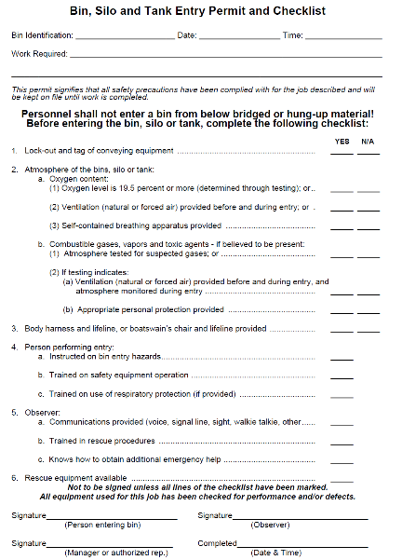
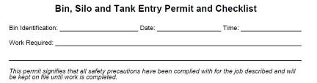

El permiso trata TODOS los problemas críticos de seguridad.
shape
shape
Material colgado o puenteado
Candado/Etiqueta de equipo de transporte
Evaluación de Riesgos y Corrección
Condición del grano
Candado/Etiqueta LOTO
Atmósfera
Uso de Cuerda Salvavidas
Entrenamiento del entrante
Entrenamiento de observador y rol
Disponibilidad de rescate
Atmosfera
Nivel de oxigeno
Información de identificación
Autorización
Arnés y Cuerda salvavidas
Entrante
Observador
Rescate
Notes:
ANIMATED SLIDE – There are 10 clicks total for this slide. See instructions with points to discuss. The 1st. click brings out the identifying information. The next 7 clicks highlight each bullet. The 9th click brings out the signature and authorization. The 10th click returns the screen to the permit and bullets.
At the back of this PPT presentation is a view of the screen for printing purposes that does not show the multiple layers embedded in the animation. If an instructor is uncomfortable clicking through the animation that slide can be substituted in place of the animated slide.
This is an example of a permit. It address the critical safety issues. CLICK.
Every permit should have identifying information including a way to identify the bin being entered, the date, and the time of entry and the work being completed (reason for entry & task). CLICK.
Hazard assessment – (grain condition) – can be a statement as shown. Some permits may have specific items to check concerning the hazard assessment and grain condition. CLICK
Stress - LOTO – Ensures that LOTO of ALL energy sources for equipment servicing that bin is done. This includes mechanical, electrical, pneumatic and others. It covers all equipment such as unlaoding and loading equipment, sumps, gates. CLICK
Atmosphere – If there is a potential for atmosphere concerns has it been tested? If needed was ventilation done prior to entry and will it be continued during entry? CLICK
Lifeline use – How will the worker be protected from engulfment? CLICK
Entrant Training – Asks if the entrant was trained on the hazards and use of safety equipment including a lifeline. CLICK
Observer – Ensures the observer is trained, has a communication means and can obtain help and initiate rescue. CLICK
Rescue – Ensures rescue equipment is available and specifically suited to the bin being entered. NOTE: separate rescue equipment for each bin is not necessary as long as it is available. CLICK
Authorization – The entrant and oberver sign as well as the person responsible for entry – a supervisor etc. CLICK
ANIMATED SLIDE
Example of permit showing the critical safety issues addressed
Point out the identifying information
Show how the authorization or signature is by the entrant, observer, and supervisor if different

Slide 20
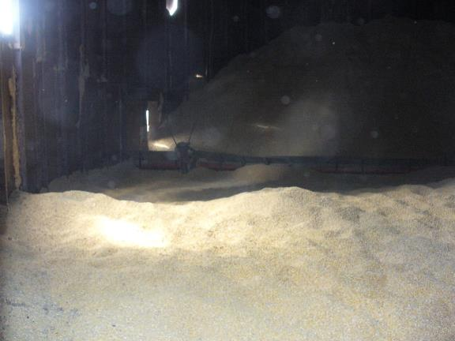
Identificar y tratar TODOS los peligros.
Atrapamiento e Inmersión
Atmósfera
Enredo
Caídas
Eléctrico
Polvo
Notes:
Stress - Permit serves to identify and address ALL hazards and potential hazards that could be encountered during entry.
Entrapment/Engulfment is the first hazard addressed by looking at the grain condition.
Atmosphere – the atmosphere of a bin although normally not a problem CAN BE FATAL.
Entanglement – in augers or other equipment.
Falls – from heights associated with entry – ladders, platforms, access points, catwalks, etc.
Electrical – exposure to live wires due to poor electrical maintenance or from compromised insulation integrity; access points being too close to wires; contact of tools with live wires.
Dust – respiratory concerns; vision concerns.
The permit may not specifically address all issues but all hazards have to be addressed before entry

Slide 21
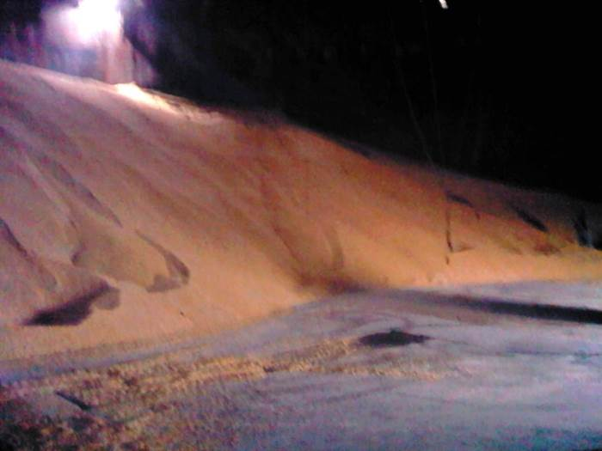

Reconocer peligros de inmersión.
Atrapamiento e inmersión
Angulo de reposo 22-28°
Pendientes irregulares
Superficie no muestra la eliminación previa
Potencial de “puente”
Debe usar cuerda salvavidas asegurada
Pirámides y torres
Grano en movimiento
Utilizar Candado/Etiqueta!
NO
“camine el grano”!
Notes:
STRESS - Identify and correct engulfment hazards or determine the worker cannot be protected against them.
Consider the examples of incidents shown earlier and look for signs of hazards.
Explain - The first indicator of hazards is angle of repose. Steeper than normal angles indicate out of condition grain and potential bridging.
Emphasize - Uneven slopes another indicator of out of condition grain. Uneven slopes also do not allow for good air circulation during aeration processes thereby creating an environment for spoilage.
Remind - Prior removal – if grain has been removed from the bin but the surface does not show signs of this removal it should be considered a hazard due to potential bridging conditions and a lifeline must be used.
Pyramids & towers – Unless the worker can enter above the surface and be protected from engulfment in the event of a collapse or avalanche the worker MUST NOT enter.
STRESS - Flowing grain – Number one hazard. Flowing grain occurs when unloading equipment is running. While the grain may not be flowing due to a clog – the minute the clog is clear the grain will flow trapping the worker.
MUST USE LOCK OUT TAG OUT.
NO WORKER SHOULD ENTER WITH FLOWING GRAIN OR POTENTIAL FOR FLOWING GRAIN.
Flowing grain – often workers are sent to help the grain flow – commonly referred to “walking down the grain”. This is a prohibited activity under OSHA and should NEVER be used at an elevator or farm. Causing the grain to flow downward can trap the worker in seconds and completely engulf him.
DISCUSS – consider the earlier engulfment example. What hazard was not protected against?
Assess the hazards in the environment associated with grain condition

Slide 22
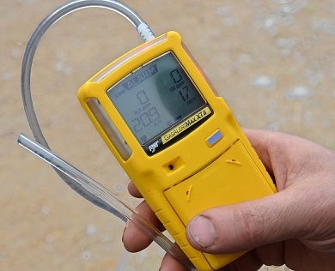
Mal ambiente puede ser fatal.
Atmósfera
Oxígeno Normal 20.9%
Mínimo 19.5%; Máximo 23.5%
CO2 desplaza al Oxígeno
Escape del motor
Grano fermentado/en mal estado
Gases tóxicos – Fumigación
Probar si hay riesgo.
Ventilar o ventilación continua, según sea necesario.
Notes:
Items that affect atmosphere could be
Nearby combustion engine (truck, pump, vacuum, etc). The exhaust fumes can drift into the structure or pulled in through the ventilation process.
Decomposing/decaying grain usually involving high moisture CO2. Corn which has been recently harvested may naturally respires carbon dioxide when not dried naturally or through heat.
Fumigants, PH3,
Hydrogen sulfide measurable especially when deteriorating grain is moved
Carbon monoxide will be present if the grain has spontaneously combusted from the deterioration process (smoke may not be present-do not run fans contact grain salvage company)
Lack of oxygen due to oxygen displacement of other gasses
STRESS – If any of these situations are present, CHECK the atmosphere. Oxygen should be 20.9%
Use a multi-gas monitor to check for oxygen & toxic gas levels.
STRESS – If the readings were not within normal levels, the structure must be ventilated and re-tested before entry can be made. Continue to ventilate and monitor the structure while worker is in the bin. NO ONE should go into the bin until the atmosphere tests normal.
Oxygen not at 20.9 indicates meter issue or atmosphere issue.
Meters should be calibrated and bump tested to ensure accuracy.
Test for gasses you may anticipate is a hazard
Atmosphere testing required if there is potential the bin may have low oxygen levels or toxic gases
Ventilate prior to & throughout entry if readings are abnormal

Slide 23
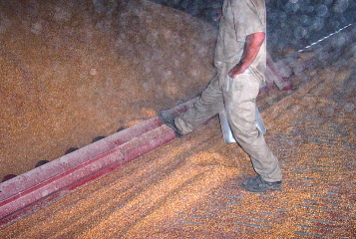
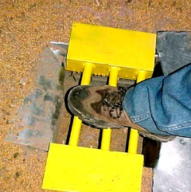
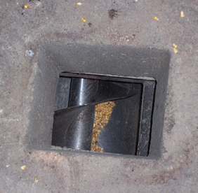
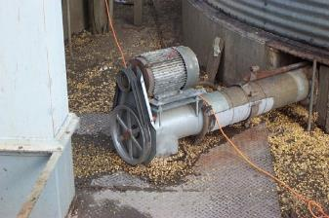
Resguardo y Candado/Etiqueta para evitar enredo.
Enredo
Resguardo de maquinaria - AUTO
Guardas de sumidero y sinfines
de barrido
Descarga y otro equipo
Candado/Etiqueta
no
Notes:
ANIMATED SLIDE – Click once for circles to appear showing hazards. Slide is timed to show “DO NOT” symbol automatically. Foot remains circled to show good example of guarding.
There are many entanglement hazards inside and outside a bin. CLICK to show hazards.
These are all common examples of entanglement hazards.
Lower right – a good example of sum guards.
STRESS - Proper machine guarding and LOTO will prevent entanglement.
STRESS- Guards should follow the AUTO principle. Protect body from reaching moving parts – AROUND – UNDER – THROUGH – OVER.
ANIMATED SLIDE
Ensure all equipment is properly guarded – AUTO
Old work practices concerning need to be replaced with safer strategies

Slide 24
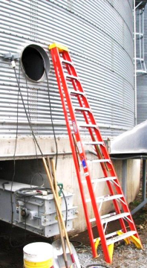
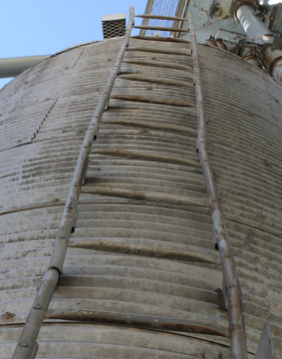
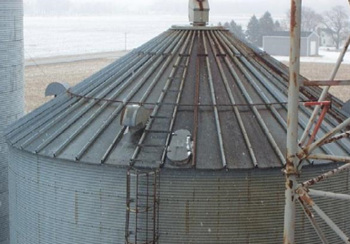
Evitar peligros de caídas durante la entrada.
Uso incorrecto
Peligros de Caídas
Alturas y Acceso
Escaleras y gradas
Pasadizos y plataformas
Puntos de entrada
Escalera deteriorada
Sin extensión
Resbalones y tropiezos
Aceite, lluvia, nieve, hielo
Derrames de productos
Sin plataforma
Notes:
Stress - Fall hazards need to be considered during bin entry.
Ladders should have cages and platforms or fall protection should be used. Stairs should have railings and appropriate treads.
Catwalks & Platforms should have appropriate railings and entry point guarding.
Entry points – access hatches to the bins pose particular problems if there is no platform, and if they can only be reached by portable ladders. Use appropriate fall protection as well as ladder safety.
Consider other hazards such as weather, slippery surfaces, product spills and use appropriate footwear to prevent slips.
Entry may be done at height so fall protection is necessary.
If accessing the bin poses hazards they need to be corrected first.

Slide 25
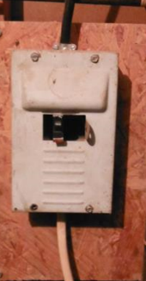
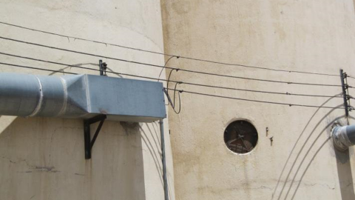
Contacto eléctrico y el polvo pueden dañar.
Abierto a cables con corriente
Eléctrico
Contacto con fuentes de energía
expuestas
Cables, interruptores, etc.
Contacto con líneas
eléctricas
Polvo
Respiratorio – EPP
Servicio de limpieza
Cables desgastados
Demasiado cerca del acceso
Notes:
There are many electrical hazards around bins.
Check to ensure the worker will not be exposed to any live energy sources. LOTO will protect worker from the sources in the bin directly, but consider electrical sources in the bin vicinity that are not locked out during entry.
Also, look at the proximity of power lines to the entry point. Power lines may be too close or pose a hazard for long tools or ladders.
STRESS - Dust hazards are common. Workers should wear appropriate respiratory protection, may need eye googles. Good housekeeping measures help control dust exposure.
Also consider other environmental conditions such as heat exposure and take appropriate measures.
Electric issues may be present and need to be checked
Contact with overhead wires due to the use of long tools
Dust hazards which may obscure vision and create respiratory problems

Slide 26
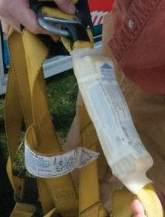
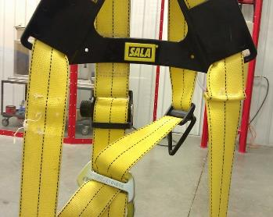
Inspeccionar el equipo antes de entrar.
Arneses, lazos, Cuerda Salvavidas
Escaleras
Equipo de pruebas atmosféricas
Prueba de impacto
Calibrar monitores
Notes:
Another part of the preparation process is to inspect all equipment to be worn or used during bin entry to ensure it is in proper working order.
This includes fully inspecting the full body harness, lifelines, and other fall protection equipment.
Workers should be trained on how to perform an inspection.
Ladder inspections should occur. If the ladder access to the bin entry point is deteriorated or in bad repair the worker should not be exposed to that hazard. Bin entry may need to be postponed until the ladder situation is resolved.
Test atmospheric equipment to ensure accurate readings.
Entry will often involve equipment especially harnesses
These should be thoroughly inspected

Slide 27
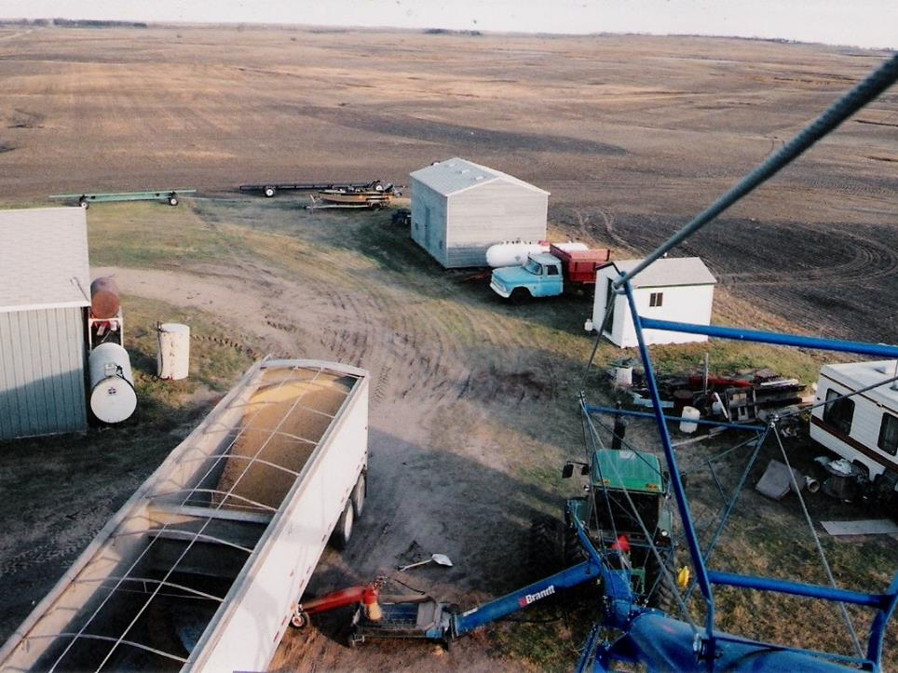
ACTUAR – entrada segura al compartimiento.
No entry should be made if there are hazards present where a worker cannot be protected.
Precipitarse a un compartimiento NUNCA es la mejor respuesta.
Verificar dos veces
Discutir los planes
Nadie debe entrar a un compartimiento si no puede ser protegido de peligros presentes.
Notes:
Preparation consists of completing the bin entry permit thoroughly and inspecting equipment.
All hazards must be accounted for and the proper correction or protective measures taken before entry.
If a worker cannot be protected against a hazard – no entry is allowed.
Before rushing into the bin – take the time to double check and discuss the entry plan with the workers.
Once the preparation is completed, items are double checked, and a discussion about the entry is held, workers are prepared and may enter the bin.
Do NOT rush into a bin
Take the time to plan & prepare
Double check critical safety issues
If the worker cannot be protected from all hazards, the bin entry should not occur.

Slide 28

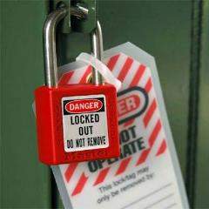
Antes de entrar – verifique dos veces.
Permiso o lista de control - correcto
Verificar Candado/Etiqueta (LOTO)
Equipo de rescate
Preparar rejillas/resguardo del
sumidero
La falta de Candado/Etiqueta,
el mayor peligro potencial que conduce a la fatalidad!
Notes:
Before entry the entrant & observer should double check to ensure LOTO has been done, the rescue equipment & other parts of the emergency rescue plan are available and the permit/checklist was accurately completed.
Stress - The sump guards should be prepared for immediate installation upon entry.
Emphasize - Illinois workers should have install the grain rescue tube locator app on their phones. Other states may also have developed this app. In the event of an emergency this app can save precious time.
Remember – FAILURE TO LOTO is the single biggest hazard of bin entry that leads to fatality!
There is NEVER a reason to not perform LOTO before entering a grain bin.
EVERY farm should use some kind of LOTO system. When working alone (NOT endorsed for any bin entry) it will keep the grain from flowing and prevent an engulfment.
Double check LOTO
Failure to LOTO is the leading cause of fatality.

Slide 29
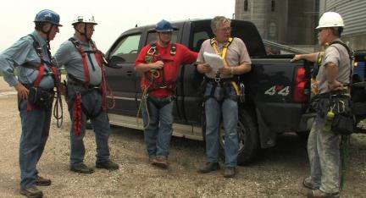
Reunión previa a la entrada, por peligros y trabajo.
Entrante, observador y supervisor (si es diferente)
Verificar permiso o lista de control
Peligros – presentes/potenciales. Eliminación
Entrada superior vs. lateral
Qué tareas y como realizarlas
Herramientas, equipo, EPP.
Notes:
Stress – A Pre-entry meeting helps to ensure all safety measures have been taken, the entrant & observer are aware of any issues and verify the items on the permit or checklist are correct.
The hazards and potential hazards should be discussed especially when entering a bin where there is a potential of bad condition grain or it is known the grain condition is not good.
Decide on top vs side entry if that has not been determined & what is needed to perform the entry successfully.
Ensure the entrant and observer have the correct tools, equipment available and have the correct PPE for the task.
Bin Entry is NOW ready to happen.
Pre-entry meeting ensures all verify the known conditions of the bin
All know tasks to be completed

Slide 30
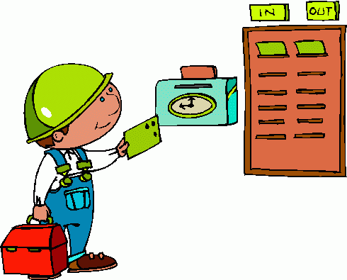
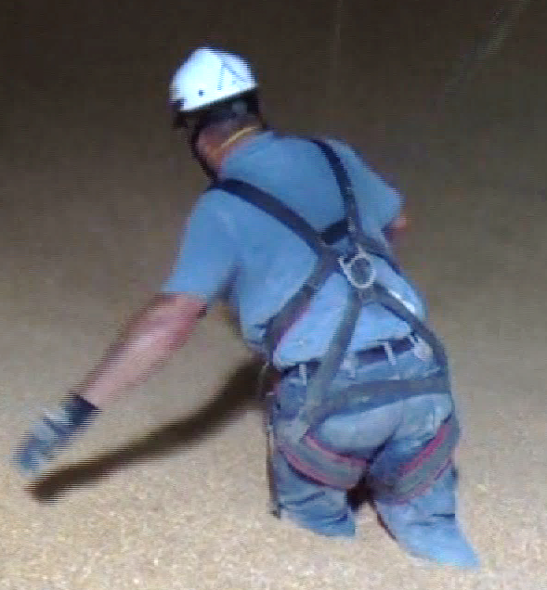
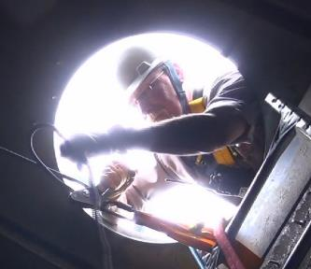
Contacto constante para una entrada segura.
PPE lifeline & harness.
Verify LOTO.
Record entry time.
Entrante
Continuamente reevaluar riesgos
Comunicarse
Completar tarea
Observador
NO debe salir
Comunicación constante
Visual es mejor.
Controlar cuerda salvavidas
Llamar ayuda e iniciar el rescate
Notes:
The responsibilities of the entrant and observer are clear.
STRESS - Entrant must continually assess the hazards and conditions of the bin, remain in contact with the observer and complete the assigned task.
STRESS - Observer MUST remain present throughout the entry operation & in constant contact with the entrant. This means not stepping away for a phone call or to go to the restroom.
In many instances the Observer will be managing the lifeline.
The observer must know how to call for help & initiate a rescue.
At any time the entrant or observer can call off the entry if the hazards are such that the entrant cannot be ensured of protection and constant communication cannot be maintained.
If the observer feels another person is needed inside to help maintain better communication & observation, the entry can be stopped. In this instance, a second observer is posted inside in full view of both the outside observer and the entrant.
Inside the bin maintain the integrity of the roles
The observer must not leave
The entrant needs to continually reassess for hazards

Slide 31
Consideraciones de la entrada superior y lateral.
Entrada Lateral
SOLO entrar sobre el grano
Protección de Caídas
Acceso elevado
Cuerda salvavidas ˃ hasta la cintura
Sinfín de barrido - resguardo
Instale resguardos del sumidero primero
Directrices de equipo energizado
Entrada Superior
Candado/Etiqueta
Protección de Caídas
Pasadizos y escaleras
Plataformas, barandas
Cuerda salvavidas
Notes:
Explain - Side Entry and Top Entry pose different hazards associated with the reasons for entry and tasks to be performed.
Top entry is usually to take care of out of condition grain, plugs and, grain monitoring.
LOTO must be done.
Top entry is through the access opening at the near the edge of the bin roof or elsewhere on the roof.
Fall protection has to be enforced for the observer who is outside the bin.
It is strongly recommended a lifeline always be used by the entrant during a top entry. See explanation below.
Side entry is generally made to clean out bins involving the use of a sweep auger. Side entry is the most common. Side entry is through the hatch on the bin’s sidewall anywhere above ground level. Depending on the location of the access there may still be several feet left of product in the bin. Therefore, workers MUST be protected against engulfment hazards once inside and against fall hazards during access. Because of varying depths of grain, workers should ONLY enter the side if they can enter above the grain’s surface.
Sump guards should be installed first thing upon a side entry.
Fall protection should be used when the side entry point is elevated. The general industry standard is elevations at 4 feet and more must have appropriate fall protection (guarding, rails, or PPE) in place.
Sweep auger use – As shown previously, manually handling a sweep auger is a hazard when it is in operation. This has been a common practice for many years.
Sweep augers need to be LOTO while being put in place and if they need to be repositioned.
Sweep augers should have appropriate guarding.
When tasks necessitate being in the bin with an operating sweep auger, the OSHA guidelines should be used including the use of bin stops, guards, & maintaining 7 feet of distance from the auger.
See the OSHA May 3, 2013 memorandum referring to standard 1910.272(g)(1)(ii) entitled Grain Handling Facility Sweep Auger Enforcement Policy: https://www.osha.gov/pls/oshaweb/owadisp.show_document?p_table=INTERPRETATIONS&p_id=29219
DISCUSS - many entries can be performed safely without a lifeline if there is NO engulfment hazard. When grain is at the natural angle of repose, appropriate LOTO and/or guarding measures have been taken for the task being performed, and the worker cannot sink more than waist deep, an engulfment hazard is not considered to exist.
Side entry has additional hazards
Guard sumps immediately upon entry
Follow guidelines for working with sweep augers
Lifeline if entrant can sink more than waist deep in grain
Top entry has fall hazards to consider
Use a lifeline in top entry

Slide 32
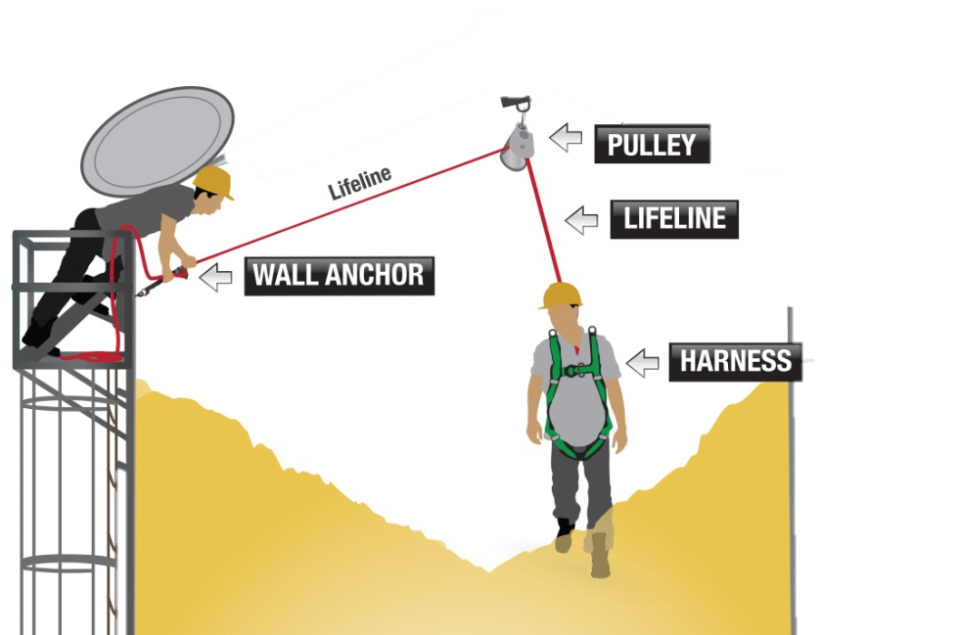
La cuerda salvavidas debe estar asegurada.
Un peligro de caida puede estar presente
Pasadizo y escalera
Cuerda Salvavidas
Asegurada por puntos de anclaje
Pico (arriba)
Lado
Permit filled out
Verify equipment is locked out
Failure to lockout is single biggest hazard leading to fatality
Sostener la cuerda salvavidas o atar la cuerda salvavidas al compartimiento
NO es efectivo y NO protege.
Have sump grates/guards prepared and install first thing if necessary
Un Sistema de cuerda salvavidas apropiado es asegurado por puntos de anclaje, manejado por el observador e incluye un dispositivo mecánico que agarra y bloquea la cuerda salvavidas si hay un tirón repentino para prevenir que el entrante quede atrapado mas allá de la cintura. Simplemente sostener la cuerda salvavidas o atarla al compartimiento NO es efectivo y NO protege al entrante.
Rushing into a bin is never the right answer
Puntos de anclaje
Superior
Lateral
Control de flojedad de la cuerda
Observador maneja
Dispositivo mecánico
Being complacent to hazards and being unprepared to respond can KILL.
Notes:
The use of a lifeline during entry is necessary to protect against engulfment hazards in many situations.
To be effective a lifeline MUST be secured – at the top and side.
Lifelines also require that the slack can be controlled. A mechanical device should be used.
A mechanical device will activate when there is a sudden jerk or pull on the lifeline. The device will lock the rope and keep the entrant from dropping any further.
The observer or other person controlling the slack must be diligent and activate the device in case of a slow moving descent as the mechanical device will not activate.
STRESS - A common practice if to tie a rope onto the bin – such as on the ladder or to have someone hold the end of the rope. Neither of these are effective and DO NOT protect the worker.
Lifelines fail if they are not properly secured
A mechanical device to control the line should be used
Caution – device only locks with sudden jerk or pull – a gradual or slow movement will not activate it.
The observer should be controlling the lifeline and activate the brake if necessary to prevent engulfment.

Slide 33
5 recordatorios críticos para la entrada segura.
5 critical reminders to safe bin entry
Permiso o lista de control
Compruebe la atmosfera
NUNCA SOLO
Candado/Etiqueta
LOTO
Cuerda Salvavidas
Add corn production graph when store longer goes more out of condition
Bushels per acre 200+
Slide of permit/procedures
Summarize the main hazards
Rodding, hung up and go in to break it
Flowing grain.
Bridging grain
Cuando sea necesario
Cuando se indica
Alternatives –
30psi lookup osha
Notes:
Remember these 5 critical steps to ensure a safe entry.
DISCUSS – the earlier engulfment incident. What failed in this case? What protections were not taken?
The 5 items will prevent most incidents in a grain bin.
Many will say they cannot have an observer present.
This subject should be discussed.
LOTO – each and every time.
Bin permit – each and every time.

Slide 34

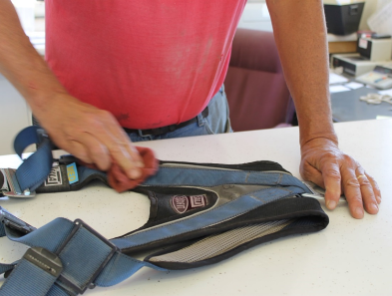
Completando la Entrada al Compartimiento
Remueva todas las herramientas
Permiso
Registre tiempo de salida.
Persona que firmó o registró
Procedimientos LOTO
Notificar del encendido del equipo
Desmontar candados y etiquetas (LOTO)
Registro/discutir cualquier problema
Hacerse cargo de los equipos
Notes:
When the task is completed the entrant is responsible for ensuring all tools and equipment are removed.
The permit need should be completed if required by recording the exit time. Although technically the permit is only needed while the operation is occurring it is HIGHLY RECOMMENDED these permits be kept on file for a year.
Stress - Initiate Lock out tag out procedures for ending the LOTO
Notify affected persons the equipment will be started & ensure the area around the equipment is clear.
Remove the locks & start equipment.
Ensure the equipment is working properly and remove the tags.
Discuss and/or record any problems encountered or issues noticed during the entry such as a repair needed.
Take care of equipment used – clean & store harnesses properly.
Make sure to retrieve all tools
Clean and inspect equipment
Follow procedures for re-energizing equipment

Slide 35

Siga un proceso de entrada seguro.
Entender la necesidad o razón para entrar
Explore Alternativas para la Entrada
Tome la Decisión de Entrar
Complete el Permiso de Entrada
Reunión previa a la entrada
Complete la Entrada
Realice la Entrada
Lateral vs superior
Tareas
EPP, herramientas
Reevaluar peligros
Complete la tarea
Candado/Etiqueta
Política de planear y entrenar
Reduce necesidad de entrada
Prepárese
Evaluar/corregir peligros
Notes:
Following a safe bin entry process can prevent incidents of injury and fatality.
Bin Entry should NEVER be rushed into.
Bin Entry starts with proper training and planning which need to occur PRIOR to the time entry is needed.
Understanding the reason entry is needed helps you prepare for the entry and make decisions concerning the entry.
These will also help to determine the actions that need to be taken to reduce the need for entry in the future.
One of the most crucial decisions is whether to send yourself or a worker into a grain bin.
Alternatives to bin entry should be explored and tried.
Only when the alternatives do not correct the problem should a decision to enter be considered and should be based on the reason entry is needed, the task needing to be performed, the policies in place, the type of entry (side vs top), and whether the worker can be protected against hazards.
The Bin Entry Permit or Checklist is critical to determining the hazards and ensuring the protection of workers. The permit or checklist should be completed EACH and EVERY time!
LOTO is critical to ensuring the safety of the entrant.
A pre-entry meeting ensures that everyone understands the hazards and tasks and is prepared for the entry.
During the bin entry operation the hazards need to be continually reassessed and the entry aborted if at any time the entrant cannot be protected.
Once the entry is complete, address any issues encountered to be better prepared for the future.
Grain Bin entry is a process
Begins before entry is needed
Involves training & planning
Is a last resort

Slide 36
1 Repaso
Notes:
Go through this final review section and emphasize the main points of Reducing Grain Bin Entry Risks.
Key points to remember:
LOTO
Training
Use policy as guide to decision making
Permit
2 people

Slide 37
Resumen y Repaso
La entrada al compartimiento es el ÚLTIMO recurso
Responsabilidad compartida por seguridad
Reducir la necesidad de entrada
Probar alternativas primero
La entrada al compartimiento es un proceso:
Entrenar
Planear
Preparar
Actuar
Notes:
Emphasize Bin Entry should be a LAST resort – NOT the first action taken.
Bin entry is a process. It includes planning & training that MUST BE DONE BEFORE ENTRY IS NEEDED!
There is a shared responsibility for safety for bin entry. This responsibility includes being diligent in understanding and following Best Practices – and not taking unnecessary risks.
DISCUSS – this is a good time to invite participants to discuss their thoughts on risk taking. What do they consider a risk when it comes to entry? Has that view changed with the information? There have been instances where the supervisor or safety director was the victim of engulfment. How does the audience perceive this? That it is therefore unavoidable? Do the views change in when told generally the person was trying to get a task done and ignored the safety rules – entered alone, entered under an avalanche condition, entered with equipment running.
Bin entry is last resort
Safety depends on everyone understanding the bin entry process
Always try alternatives first

Slide 38
ENTRENAR
Failure to lock out the unloading equipment or bin gates is the leading cause of fatalities
Bin entry is the last resort.
Try the alternatives to bin entry first.
Never enter alone, never rush into the bin
Have attendant watching to observe and monitor conditions
Know how to summons help and what rescue plan is
Empleados y supervisores
Peligros
Como identificar y corregir
Plan de Acción de Emergencia
Saber como pedir ayuda
Conocer el plan de rescate
Uso de cuerda salvavidas
Lockout tagout is one of most important items
Guard sump holes immediately when entering a bin
These items can save lives
Policies and procedures are to reduce incidents
NO
entre sin entrenamiento
Anticipate hazards
Control Hazards
Atmosphere addressed
Lifeline/harness for engulfment hazards
Notes:
Emphasize – Training is a KEY element in safe entry.
Training is not just how to enter the bin but the assessment of hazards and the corrective protection to take.
Years of experience are important. But training is also important as it often provides new insight and understanding.
It is easy to become complacent with one’s knowledge level or perception of risk. One of the reasons for annual training is to keep refreshing and learning and avoid falling into complacency.
DISCUSS – the earlier engulfment incident. What training would the participants recommend should have been received prior to that fatal entry. What knowledge did the father and son lack?
Training
No one should enter a bin without training.
Emergency action plan - reduces time & confusion

Slide 39
PLANEAR
Política y procedimientos son para reducir los incidentes
Proporcionar orientación
Instrucciones de trabajo
Reducir tiempo y errores - especialmente en emergencia
Entrada, LOTO, Plan de Acción de Emergencia
Seguir una norma
1910.272 Norma de Manejo de Granos
Cuando NO entrar en un compartimiento!
Notes:
Policy & procedure reduce incidents by providing guidance. A small elevator or a farm need guidance as much as a large corporation – and sometimes more so because they do not have the benefit of a lot of other people to ask if a situation arises.
These do not have to be complicated. Developing them helps the manager/farm owner to think through what situations arise and what they are truly capable of handling on their own – especially when rescue needs are considered.
The policy should always state when entry is prohibited.
Use the grain handling standard as a guide for policy & procedure.
It is a fact many farmers work alone. The BEST PRACTICE is to have an observer when entering a bin. This requires forethought and planning to achieve.
Plan – appreciate that a good plan will reduce incidents
Should always include when NOT to enter a bin

Slide 40
PREPARAR – Cada vez y Todas las Veces
Permiso o Lista de Control
Anticipar y controlar TODOS los peligros conocidos
Candado/Etiqueta LOTO – Lo más importante!
Equipo de descarga, puertas del compartimiento, equipo de carga
Condiciones de la atmósfera
Cuerda salvavidas y arnés–peligro de inmersión
Falta de Candado/Etiqueta
es la causa principal de muertes.
Notes:
Preparation for entry cannot be skipped.
Each entry is different and the conditions of the bin can vary.
A permit or checklist is to ensure that all hazards are anticipated and controlled!
It is too easy to be in a hurry to fix the problem that is causing a delay.
Take the TIME to prepare thoroughly, adequately, and appropriately to ensure a safe entry.
ALWAYS LOCK OUT AND TAG OUT.
The operating motto is – EACH & EVERY TIME – PERMIT & LOTO.
Doing these two activities will almost always ensure a safe entry can be made.
Permit
LOTO.

Slide 41
ACTUAR
Solo si esta protegido contra TODOS los peligros
2 Personas SIEMPRE - observador
Observar al entrante
Monitorear las condiciones
Candado/Etiqueta - SIEMPRE
Cuerda Salvavidas
Entrar con precaución
Reevaluar peligros continuamente
RESGUARDAR agujeros del sumidero inmediatamente
NUNCA
Se apresure al compartimiento!
Notes:
Acting on the entry is the Last part of the process.
Stress - NEVER rush into a bin.
Entering should ONLY BE DONE when the entrant is protected against all hazards.
Emphasize - Two people ALWAYS.
Stress - LOTO – ALWAYS.
2 people always
Double check LOTO
Guard sump holes immediately
Continually reassess

Slide 42
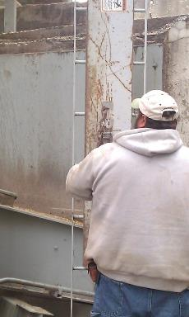
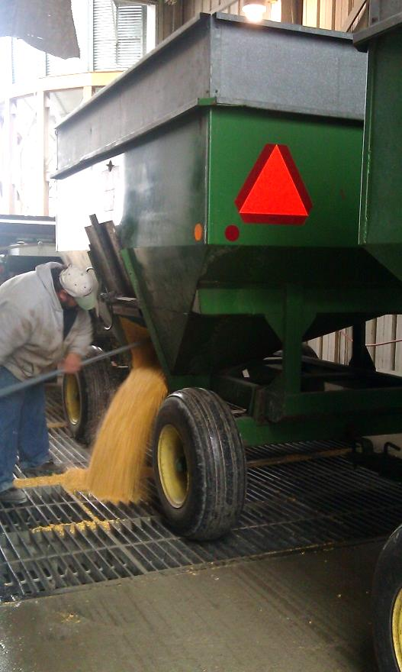
PROTEGER
Entrar a un compartimiento puede llevar a consecuencias devastadoras si no se hace correctamente.
Las Prácticas Recomendadas protegen el grano y el recurso MÁS valioso-NUESTROS TRABAJADORES

Slide 43
¿PREGUNTAS O COMENTARIOS?
Contacte la Coalición para la Seguridad en Manejo de Granos
en info@grainsafety.org

Slide 44
Normas OSHA
1910.72 Norma de Manejo de Granos
1912.146 Espacios Confinados
1910.138 Planes de Acción de Emergencia
1910.147 Candado Etiqueta
1019.10 Subparte D Superficies para caminar y trabajar 1910.21-.30
1910 Subparte I Equipo de protección personal
1910.134 protección respiratoria
1910 Subparte M Gas comprimido y equipo de aire comprimido
1910 Subparte O Maquinaria y resguardo de maquinaria
1910.217(f)(4) guía para la anchura de una abertura
1910.66 Apéndice C Sistema Personal de Detención de Caídas (bajo1910 Subparte F – Plataformas automáticas, elevadores de personas, y Plataformas de trabajo montadas en vehículos)
1926 Subparte M (Norma de Construcción)
Notes:
Summarize the grain facts section.
Emphasize how quickly engulfment can occur.
Stress flowing grain is dangerous.
Emphasize the frequency of entrapments & engulfments continues to rise.

Slide 45


Diapositivas para imprimir

Slide 46
El Permiso trata TODOS los problemas de seguridad críticos.
Evaluación de Peligros y Corrección
Condición del grano
Candado/Etiqueta
Atmósfera
Uso de Cable Salvavidas
Entrenamiento del entrante
Entrenamiento del observador y su rol
Disponibilidad de rescate

Slide 47
FOLLETOS

Slide 48
Siga un proceso de entrada seguro
Entender la necesidad o razón para entrar
Explore Alternativas para la Entrada
Tome la Decisión de Entrar
Complete el Permiso de Entrada
Reunión previa a la entrada
Complete la Entrada
Realice la Entrada
Lateral vs superior
Tareas
EPP, herramientas
Reevaluar peligros
Complete la tarea
Candado/Etiqueta
Política de planear y entrenar
Reduce necesidad de entrada
Prepárese
Evaluar/corregir peligros
Este material fue producido bajo otorgamiento numero
SH-24931SH3 de la Administración de Seguridad y Salud Ocupacional (OSHA), Departamento Laboral de EEUU. No refleja necesariamente los puntos de vista o políticas del Departamento Laboral, la mención de nombres, productos comerciales y organizaciones no implica el respaldo de éstos por el Gobierno de los EEUU.
Notes:
Following a safe bin entry process can prevent incidents of injury and fatality.
Bin Entry should NEVER be rushed into.
Bin Entry starts with proper training and planning which need to occur PRIOR to the time entry is needed.
Understanding the reason entry is needed helps you prepare for the entry and make decisions concerning the entry.
These will also help to determine the actions that need to be taken to reduce the need for entry in the future.
One of the most crucial decisions is whether to send yourself or a worker into a grain bin.
Alternatives to bin entry should be explored and tried.
Only when the alternatives do not correct the problem should a decision to enter be considered and should be based on the reason entry is needed, the task needing to be performed, the policies in place, the type of entry (side vs top), and whether the worker can be protected against hazards.
The Bin Entry Permit or Checklist is critical to determining the hazards and ensuring the protection of workers. The permit or checklist should be completed EACH and EVERY time!
A pre-entry meeting ensures that everyone understands the hazards and tasks and is prepared for the entry.
During the bin entry operation the hazards need to be continually reassessed and the entry aborted if at any time the entrant cannot be protected.
Once the entry is complete, address any issues encountered to be better prepared for the future.

Slide 49
5 recordatorios críticos para la entrada segura
Este material fue producido bajo otorgamiento numero SH-24931SH3 de la Administración de Seguridad y Salud Ocupacional (OSHA), Departamento Laboral de EEUU. No refleja necesariamente los puntos de vista o políticas del Departamento Laboral, la mención de nombres, productos comerciales y organizaciones no implica el respaldo de éstos por el Gobierno de los EEUU.
Permiso o lista de control
Compruebe la atmosfera
NUNCA SOLO
Candado/Etiqueta LOTO
Cuerda Salvavidas
Cuando sea necesario
Cuando se indica
Notes:
Remember these 5 critical steps to ensure a safe entry.
DISCUSS – the earlier engulfment incident. What failed in this case? What protections were not taken?

Slide 50
Entrenamiento de Empleados
Orientación
Anual
ID peligros y corregir
Equipo de Protección Personal
Plan de acción de emergencia
Especifica Tareas
Cambiar tareas
Persona autorizada
Especifica Temas
Requisitos reglamentarios
Salud y seguridad
Temas de administración Manejo de granos
Certificación
Regulador
Candado/Etiqueta
Especifica Tareas
Conciencia de peligros
Plan de acción de emergencia
Política de la compañía
Este material fue producido bajo otorgamiento numero SH-24931SH3 de la Administración de Seguridad y Salud Ocupacional (OSHA), Departamento Laboral de EEUU. No refleja necesariamente los puntos de vista o políticas del Departamento Laboral, la mención de nombres, productos comerciales y organizaciones no implica el respaldo de éstos por el Gobierno de los EEUU.
Notes:
Summarize the grain facts section.
Emphasize how quickly engulfment can occur.
Stress flowing grain is dangerous.
Emphasize the frequency of entrapments & engulfments continues to rise.

Slide 51
ENTRENAMIENTO DE EMPLEADOS
Documentar
Título
Temas
Fecha
Certificación
Tipo
Orientación
Específico para tarea, rol, tema
Nuevas Contrataciones
Empleados Temporales
Cambios de Rol
Anual
Certificaciones
Calendario Anual
Temas Requeridos
Requerido por Regulación
Este material fue producido bajo otorgamiento numero SH-24931SH3 de la Administración de Seguridad y Salud Ocupacional (OSHA), Departamento Laboral de EEUU. No refleja necesariamente los puntos de vista o políticas del Departamento Laboral, la mención de nombres, productos comerciales y organizaciones no implica el respaldo de éstos por el Gobierno de los EEUU.
.

Slide 52
Utilice la Norma Candado/Etiqueta (LOTO) como guía.
Política LOTO
Utilice norma1910.147.
Programa LOTO
Cuando
Quien lo hace
Procedimientos LOTO
Cada pieza de equipo.
Orden de apagado.
Siga el programa y procedimientos LOTO de la compañía.
Equipo y dispositivos
Entrenamiento
Contratistas
Quien es afectado
Desmontar candados
Identificar fuentes y tipos de energía.
Este material fue producido bajo otorgamiento numero SH-24931SH3 de la Administración de Seguridad y Salud Ocupacional (OSHA), Departamento Laboral de EEUU. No refleja necesariamente los puntos de vista o políticas del Departamento Laboral, la mención de nombres, productos comerciales y organizaciones no implica el respaldo de éstos por el Gobierno de los EEUU.
.
Notes:
Lock out Tag out is crucial to a safe bin entry as well as fundamental to controlling other types of hazards in the grain environment such as entanglement issues and working with energized equipment.
There are 3 pieces to a strong and effective LOTO.
A LOTO policy sets the rules for when LOTO must be done before a work activity.
A LOTO program tells how the steps of LOTO will be implemented and assigns responsibility.
LOTO procedures are the work instructions for the each piece of equipment . They tell the worker how to shut down & isolate the energy source for the equipment..
When consistently & properly used, the policy, program, & procedures of LOTO significantly reduces the risk of injuries & fatality.
Whether farm or commercial, a LOTO program is a best practice.
Implementing LOTO is one of the best safety protections a farm operation can do.

Slide 53

Plan de Acción de emergencia
Entrenar y practicar con empleados
Orientación & anualmente
Como utilizar equipo
Roles & responsabilidad
Reunión anual
Practicar– comercial & granjas grandes
Documentar
Lugar de reunión, plan de escape, #s para ayuda y servicios públicos.
ID ubicación de estructura & tipo; fuentes de energía y de agua; peligros
Plan escrito – PRÁCTICA RECOMENDADA
Compartir con departamento local de bomberos/rescate
1910.138 es DEBER con 10+ empleados
Este material fue producido bajo otorgamiento numero SH-24931SH3 de la Administración de Seguridad y Salud Ocupacional (OSHA), Departamento Laboral de EEUU. No refleja necesariamente los puntos de vista o políticas del Departamento Laboral, la mención de nombres, productos comerciales y organizaciones no implica el respaldo de éstos por el Gobierno de los EEUU.
.
Notes:
Grain handling standard 1910.272(d) refers to 1910.38 Under 1910.138 locations with 10 or more employees must have a written plan.
To comply with the grain standard and known hazards in the work place, an emergency action plan should address hazards related to grain entrapment, entanglement, fall from height, dust explosions as well as others.
The plan must be known by employees and they need to retrained annually.
STRESS - In the event of an emergency – knowing what roles to play and who is responsible for what saves valuable time! This includes who is to be notified of the emergency, who does the notification, what order to notify. This prevents confusion & misinformation. Knowing what equipment the facility has or does not have and what might be needed also saves time.
A “best practice” is to keep copies of the plan at various locations.
FARM –keep copies at the house, barns, work/tool shed bldg, and in the vehicles including combines, etc.
FARM – have a list of #’s to call for help – including utility companies and have GPS or platt coordinates for the various buildings & fields.
When relying on services from the local rescue squad it is a Best Practice for both commercial elevators and farms to communicate with the rescue squad and when possible practice with them.
Find out how far away the nearest technical rescue team is located – this is the type of rescue team that would assist with a height or grain bin rescue and is trained to go in the bin, other confined space, use ropes, etc.
Good opportunity to assess what types or equipment is available in the local area for help in emergencies – such as grain rescue tubes, grain vacs, etc. Assist department in developing a list for use in other situations.
Good opportunity to assess what training is needed by the facility and/or local rescue department. Not all local rescue squads have technical training for rope rescues, confined spaces, etc.!
Both farms and commercial elevators should provide the local department a map or other document showing:
the location & type of the structures including known hazards – for example confined space hazards
Identify power & water sources
Farms should also show where fields are located.
A good practice is to have a unique identifier clearly visible on the various bins, buildings, etc. at the site – both commercial and farm. For example – use letters or numbers.
Don’t forget to put signage about any chemicals stored/used for the rescue department.

