Slide 1
Fall Hazards
Fall Prevention in Construction
Susan Harwood Grant FY 17
SH-31220-SH7
This material was produced under Susan Harwood Grant Number SH-31220-SH7 from the Occupational Safety and Health Administration, U.S. Department of Labor. It does not necessarily reflect the views or policies of the U.S. Department of Labor, nor does mention of trade names, commercial products, or organizations imply endorsements by the U.S. Government.

Slide 2

Introduction
The following presentations have been developed in both Spanish and English for the construction industry. These presentations focus in fall Hazards in construction.
This training materials will cover the fall hazards seen regularly on construction sites and will focus on the methods for the recognition and the prevention of these common hazards.

Slide 3
Fall Hazards - Overview
Fall Hazards
Building Structures
Exterior Construction Areas
Accident Prevention
Guardrails
Scaffolds
Stairs
Ladders
Warning Lines
Personal Fall Arrest Systems
Floor Covers

Slide 4


Fall Hazards
Falls are one of the greatest hazards on construction sites.
This program will help you recognize common fall hazards.
The symbols will tell you if the situation in the picture is either safe or not safe.

Slide 5
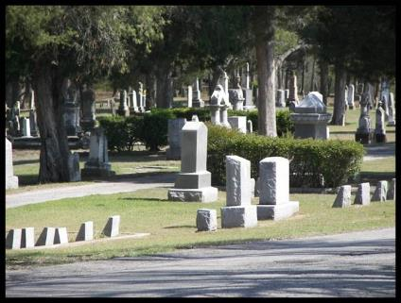
Fall Hazards Statistics
Each year workers die from falls. During the year 2015:
  Total deaths from falls: 648
  Deaths in construction: 298
  A total of 46% of deaths in Construction are from falls
  Approximately 13% of all occupational deaths are falls

Slide 6
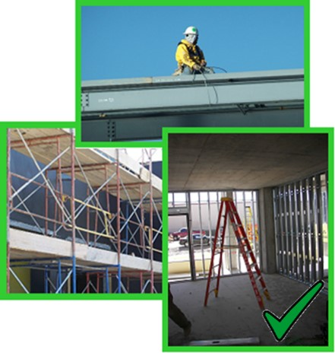
Fall Hazards
Fall hazards can be found on every construction site:
Building structures
Exterior construction areas
Scaffolds
Stairs
Ladders

Slide 7
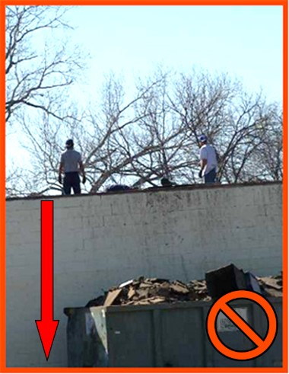
Building Structures
Work conditions 6’ or more above lower level require the use of fall protection:
Unprotected sides, edges
Leading edges
Excavations
Walking/working surfaces

Slide 8
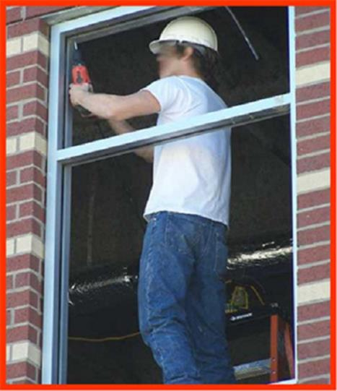
Building Structures
This worker is working 6’ above the lower level without using fall protection.

Slide 9
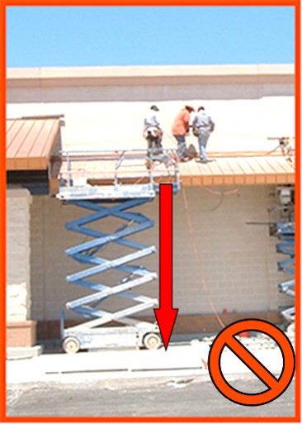
Building Structures
When working at a height of 6’ above the lower level you must use fall protection:
  Personal fall arrest systems
  Guardrails

Slide 10
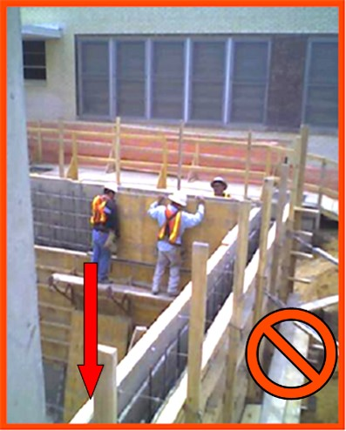
Building Structures
When working at a height of 6’ above the lower level you must use fall protection.
These workers are not utilizing a personal fall arrest system.

Slide 11
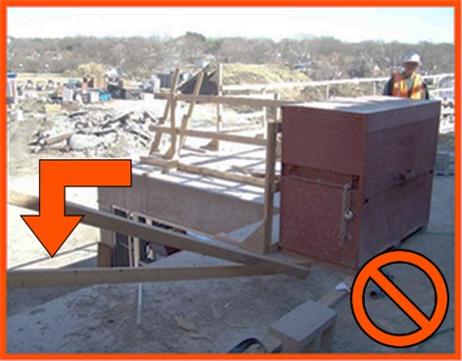
Building Structures
Guardrails must be maintained when working 6’ above lower level.

Slide 12
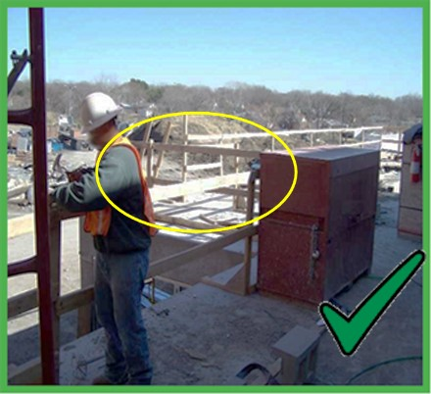
Building Structures
Damaged or missing guardrails must be fixed immediately.

Slide 13
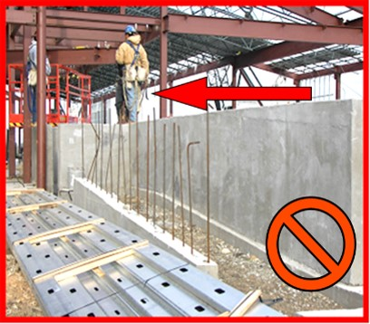
Exterior Construction Areas
Falls from a short distance can result in serious injury.
All workers must be protected from falling onto sharp materials.

Slide 14
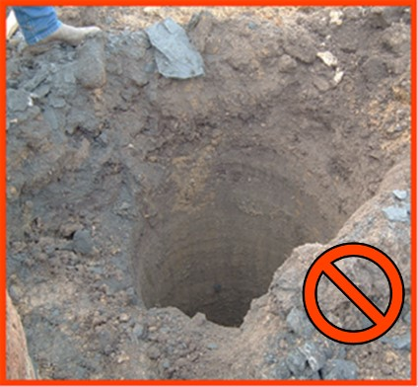
Exterior Construction Areas
All open excavations and pier holes must be guarded or protected.

Slide 15
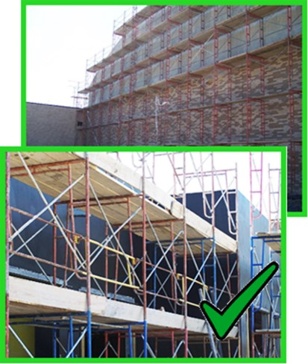
Scaffolds
Scaffolds are elevated,temporary work platforms:
  Supported scaffold
  Guardrails
  Access ladders
  Powered work platforms

Slide 16
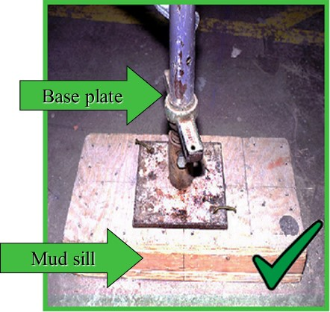
Scaffolds
Scaffold bases must rest on a base plate and a mud sill.
The base plate is designed to level and support the scaffold.

Slide 17
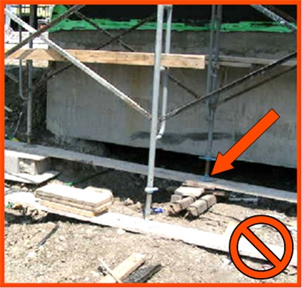
Scaffolds
Only work from scaffolds that are properly constructed and supported.

Slide 18
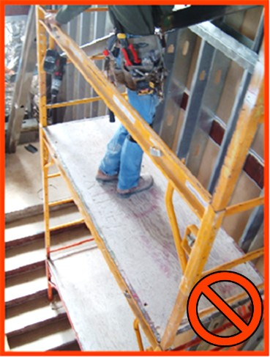
Scaffolds
Scaffolds used in stair wells must be properly constructed.

Slide 19
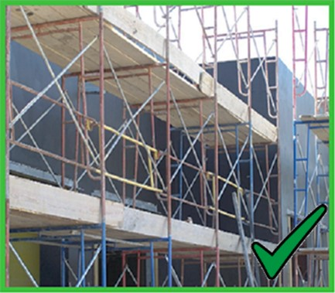
Scaffolds
When working on scaffolds 6’ above lower level, guardrails must be installed.

Slide 20
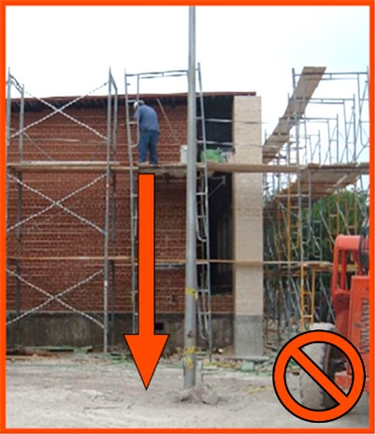
Scaffolds
Never use scaffolds that do not have proper guardrails installed.

Slide 21
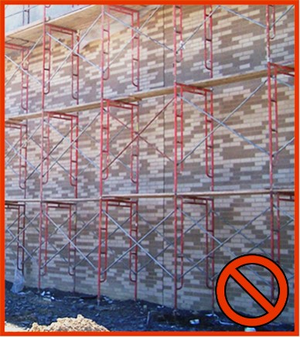
Scaffolds
Scaffold platforms must be fully and properly planked

Slide 22
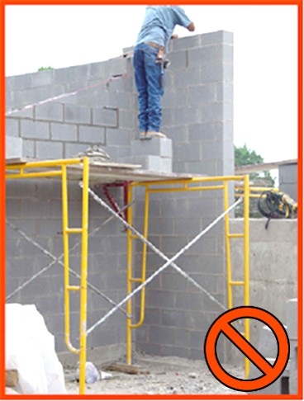
Scaffolds
Never stack blocks, bricks, or use ladders on top of scaffolds for extra height.

Slide 23
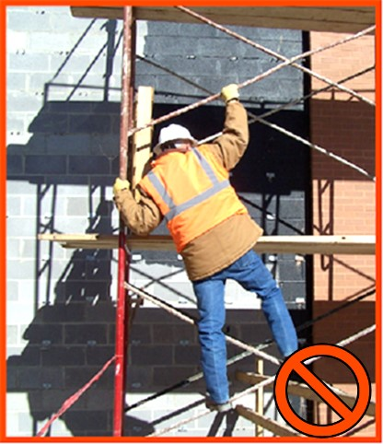
Scaffolds
Workers must have a safe way to access the scaffold.

Slide 24
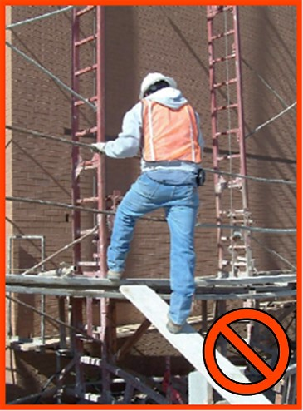
Scaffolds
Never use blocks, bricks, walk boards, and other unsafe methods to access a scaffold.

Slide 25
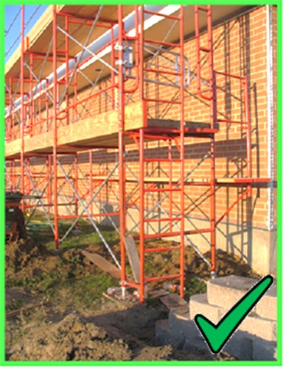
Scaffolds
Use only ladders designed for use with scaffolds.
The ladder must be firmly secured to the scaffold.

Slide 26
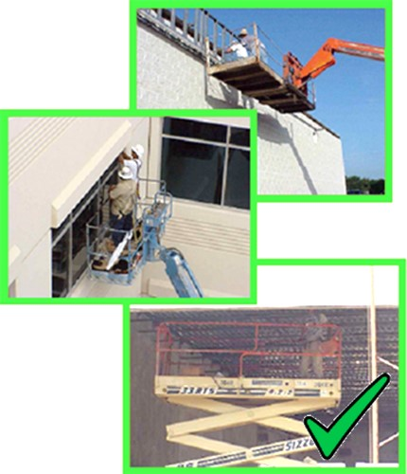
Powered Work Platforms
Powered platforms include:
man-baskets placed on a forklift,
aerial lifts, and
scissor lifts.

Slide 27
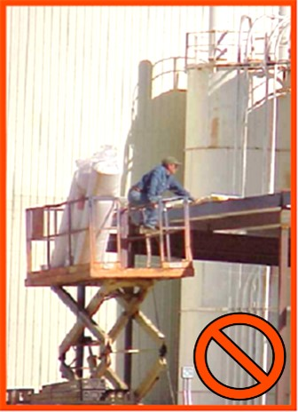
Powered Work Platforms
Always make sure you have proper fall protection and training before using a powered platform.

Slide 28
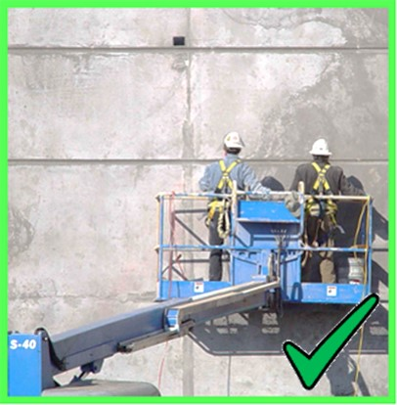
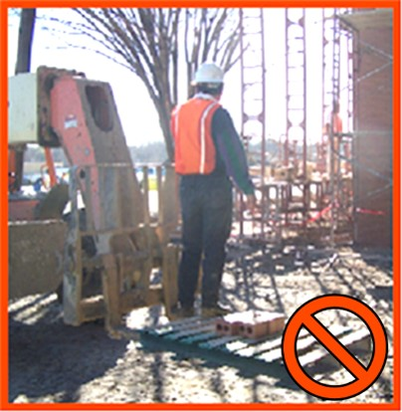
Powered Work Platforms
  Only use equipment that is designed for lifting personnel.

Slide 29
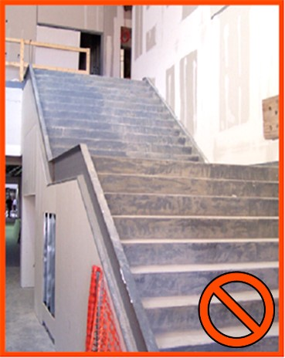
Stairs
Stairways must have a stair rail along each unprotected side or edge.

Slide 30
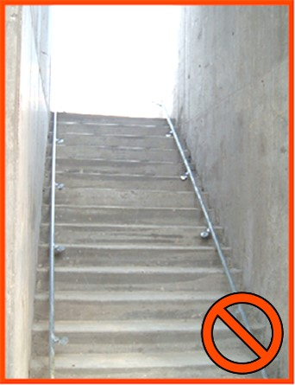
Stairs
Stairs that have walls on both sides must have at least one hand rail on the right-hand side when climbing down.

Slide 31
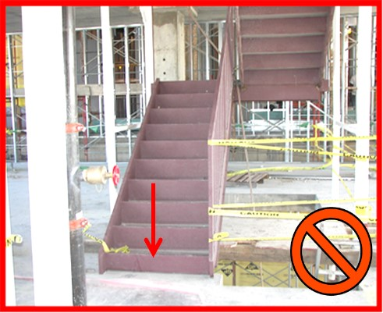
Ladders
Never use stairs that are not complete or unsafe.

Slide 32
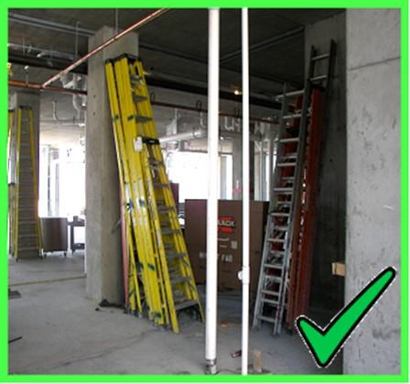
Ladders
Ladders must be inspected prior to use.
Ladders must be
kept in a good
condition and safe
location.

Slide 33
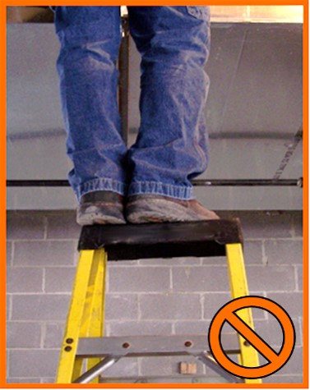
Ladders
Do not stand on the top of a ladder.

Slide 34
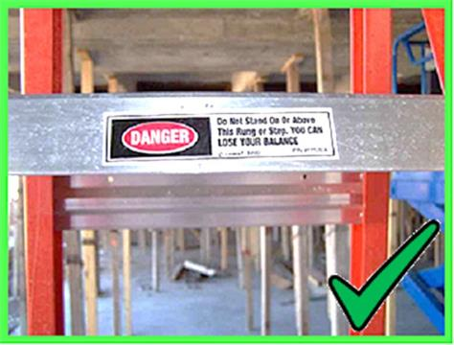
Ladders
Read labels on ladders for instructions to ensure proper use

Slide 35
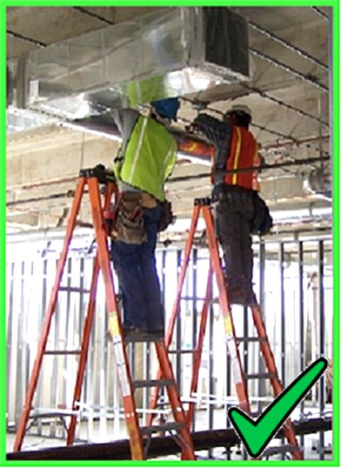
Ladders
Always maintain good footing on a step ladder.
Use the correct size ladder for the work that is to be done.

Slide 36
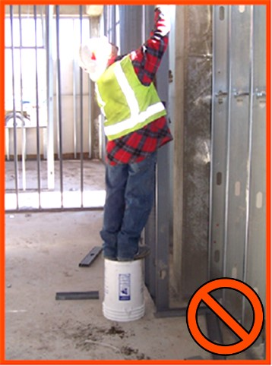
Ladders
Always use the right equipment for the job:
Ladders
Lifts
Scaffolds

Slide 37
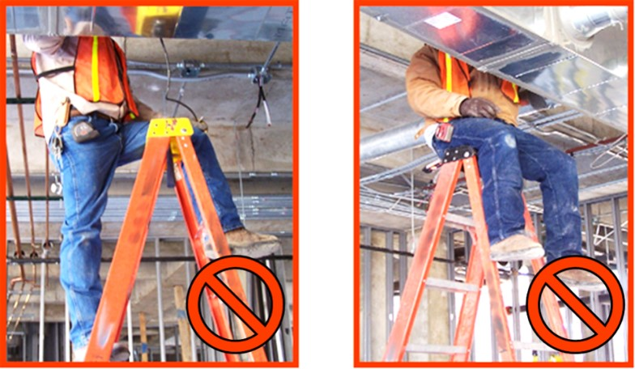
Ladders
Never straddle or sit on top of a step ladder.

Slide 38
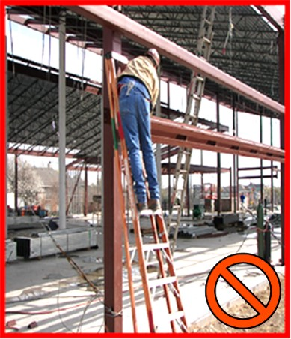
Ladders
An A-Frame ladder must be fully opened and locked into position.
Use ladders only for their designed purpose.

Slide 39
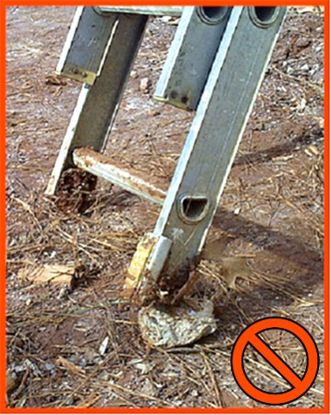
Ladders
Only use ladders on stable and level surfaces to prevent accidental movement.

Slide 40
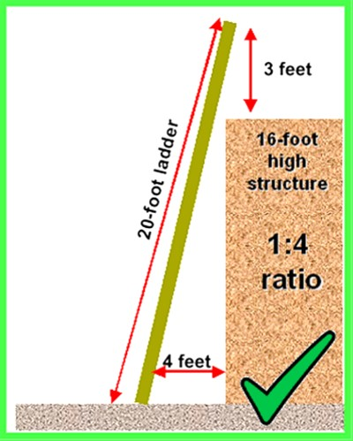
Ladders
Ladders must be positioned at a safe angle to avoid potential fall hazards when climbing.
Extension ladders must extend 3’ over the landing for safe access.

Slide 41
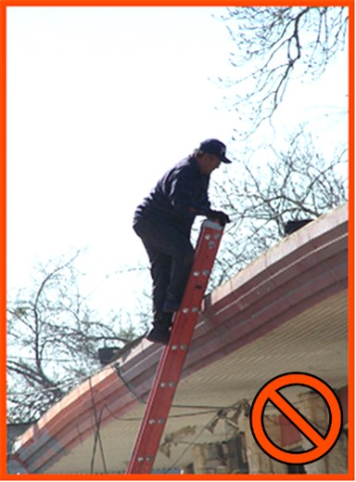
Ladders
When using a portable ladder for access to an upper landing surface, the side rails must extend at least 3’ above the upper landing surface.

Slide 42
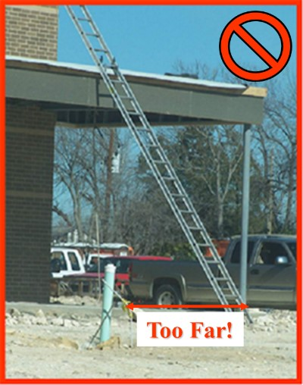
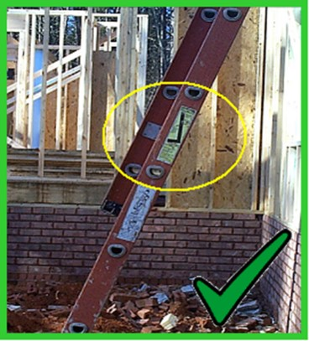
Ladders
  Proper use
vs.
  Improper application

Slide 43
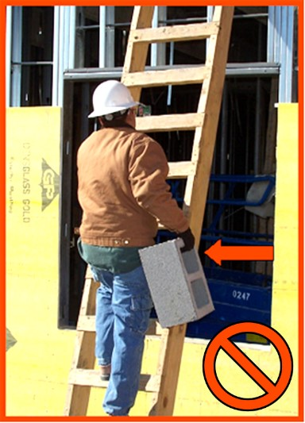
Ladders
Maintain contact with the ladder using both hands to keep a safe grip.
Face ladder when going up or down.
Never climb a ladder while carrying any materials.

Slide 44
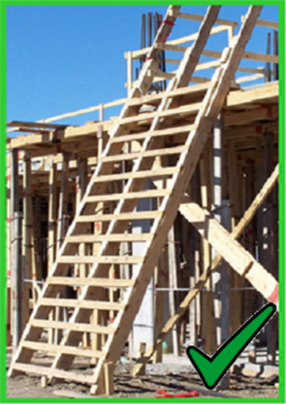
Job Made Ladders
Job made ladders must be properly constructed:
Steps equally spaced
No missing steps or rungs
No sharp edges or nails sticking out

Slide 45
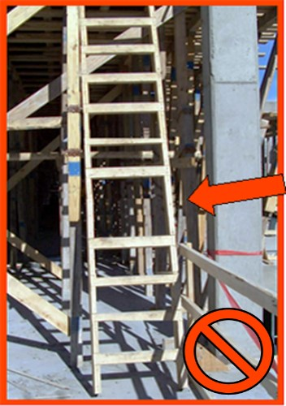
Job Made Ladders
Never use a job made ladder that is damaged or missing steps.
Only use a job made ladder that has been properly built.

Slide 46
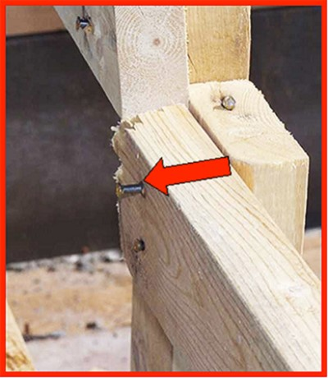
Job Made Ladders
Job made ladders must also be constructed so that no nails protrude or sharp edges exist.
Nails and sharp
edges can catch on
clothing and cause
falls.

Slide 47
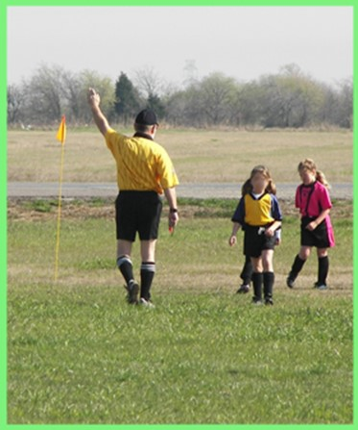
QUIZ
You will be presented with a specific hazard recognition question to test your understanding of this material.

Slide 48
Question 1
Before using a ladder, inspect it for which of
the following?
Cracks in the frame
Broken or missing rungs
Oil, grease or other substances on the rungs
All of the above

Slide 49
Question 1
Before using a ladder, inspect it for which of
the following?
The correct answer is:
D – All of the above

Slide 50
Question 2
Job made ladders may be used if the steps are equally spaced with no steps missing and no sharp edges or nails sticking out.
  True
  False

Slide 51
Question 2
Job made ladders may be used if the steps are equally spaced with no steps missing and no sharp edges or nails sticking out.
The correct answer is:
A - True

Slide 52
Question 3
When erecting scaffolding, the base plate must be placed on what?
  A Firm Foundation
  Cement Blocks
  Soft Dirt
  Wood Blocks

Slide 53
Question 3
When erecting scaffolding, the base plate
must be placed on what?
The correct answer is:
A – A Firm Foundation

Slide 54
Question 4
When working on scaffolding and you need a little more height, you must do the following:
  Stand on a saw-horse
  Jump
  Erect another section of scaffolding
  Use a ladder

Slide 55
Question 4
When working on scaffolding and you need a little more height, you must do the following:
The correct answer is:
C – Erect another section of scaffolding

Slide 56
Question 5
Stairs that are incomplete and missing handrails are acceptable to use during the construction phase of the project.
  True
  False

Slide 57
Question 5
Stairs that are incomplete and missing handrails are acceptable to use during the construction phase of the project.
The correct answer is:
B – False

Slide 58
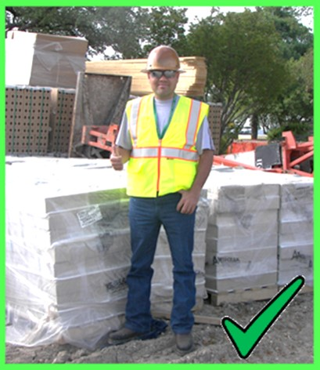
Accident Prevention
A willing, positive attitude towards safety will help make a safer work environment.

Slide 59
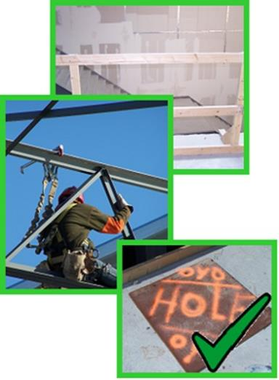
Preventing Fall Accidents
Construction work performed at 6’ or higher above a lower level requires fall protection.
Some fall protection methods include:
  Guardrails
  Warning lines
  Fall arrest systems and
  Floor covers

Slide 60
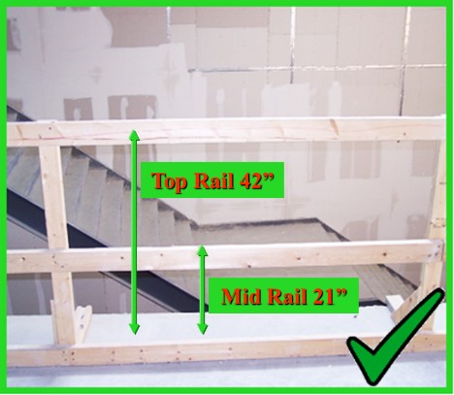
Guardrails
Guardrails must have a top rail, a mid rail and a toe board.
The top rail must be at least 42” from the working surface.

Slide 61
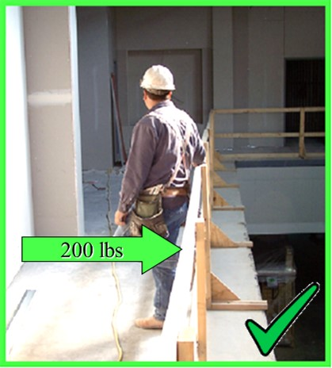
Guardrails
All guardrails must be constructed with a top rail and a mid rail.
The top rail must support 200 lbs. of force downward and outward.

Slide 62
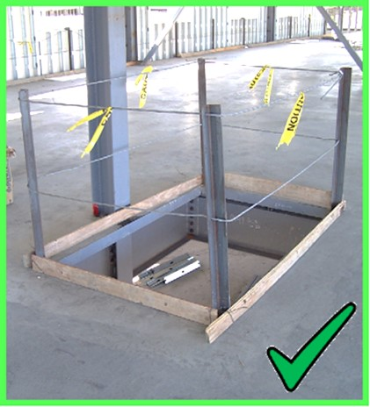
Guardrails
Cable guardrails must meet the same rules as wood guardrails.
The top rail must be at least 42” high and resist up to 200 lbs.

Slide 63

Cable Guardrails
Steel cable guardrails must have the top rail flagged every 6 feet.

Slide 64

Cable Guardrails
The clamps used for a steel cable system must be placed correctly.

Slide 65

Warning Lines
Warning lines are used to keep workers away from an unsafe edge.
The warning line must be at least 6’ away from the edge.

Slide 66

Warning Lines
Warning lines must withstand 16 lbs. of tipping force.
The warning line must be at least 34” from the ground.

Slide 67

Warning Lines
Warning lines must be maintained.
Report any unsafe condition to your supervisor.

Slide 68

Warning Lines
Never work in an area if the warning line has been knocked down or damaged.

Slide 69

Personal Fall Arrest Systems
The fall arrest system components are:
  body harness,
  lanyard, and
  anchorage point

Slide 70

Personal Fall Arrest Systems
Body harness must be worn properly.
D-ring must rest between the shoulders and the chest strap must be secured.

Slide 71

Personal Fall Arrest Systems
Body harness must be:
  inspected before use,
  adjusted to fit the worker, and
  free from other visible damage.

Slide 72

Personal Fall Arrest Systems
Lanyards must be in good condition and free from visible damage.

Slide 73

Personal Fall Arrest Systems
Lanyard must attach to the D-ring on the body harness.

Slide 74

Personal Fall Arrest Systems
Never anchor or tie
off to pipes, wood structures, electrical wires, or other areas not designed for anchorage points.

Slide 75

Personal Fall Arrest Systems
The anchorage point is the place where you tie off to or hook to.
The anchorage point must support the force of a person falling.

Slide 76

Personal Fall Arrest Systems
A life line is used to allow a worker to stay tied off while he moves through the work area.

Slide 77

Personal Fall Arrest Systems
Workers must always be tied off when working with a personal fall arrest system.

Slide 78

Floor Covers
The cover must be marked to make sure everyone knows it is a safety device.

Slide 79

Floor Covers
All floor holes where an employee could fall through must be covered or guarded.

Slide 80

Floor Covers
Sky-lights are another form of floor holes.
Never sit, stand, or place any materials on sky-lights.

Slide 81

Floor Covers
Pier holes must be guarded or protected.
Either a guard rail system or floor hole cover can be used.

Slide 82
QUIZ
You will be presented with a specific accident prevention question to test your understanding of this material.

Slide 83
Question 1
While working in the construction industry, at what height is fall protection required?
  4 feet
  10 feet
  6 feet
  8 feet

Slide 84
Question 1
While working in the construction industry, at what height is fall protection required?
The correct answer is:
C – 6 feet

Slide 85
Question 2
Guardrails are designed to protect you from falling. The top rail must be inches high and be able to withstand pounds of force.
  42 / 300
  36 / 300
  42 / 200
  36 / 200

Slide 86
Question 2
Guardrails are designed to protect you from falling. The top rail must be inches high and be able to withstand pounds of force.
The correct answer is:
C – 42 / 200

Slide 87
Question 3
Guardrails can be made of wood or steel cables. When using steel cables the cable clamps must be placed:
  In alternating directions
  With the U-bolt on the dead end of the cable
  With the saddle on the dead end of the cable
  None of the above, clamps are not required

Slide 88
Question 3
Guardrails can be made of wood or steal cables. When using steal cables the cable clamps must be placed:
The correct answer is:
B – With the U-bolt on the dead end of the cable

Slide 89
Question 4
When inspecting a harness before using it, you
should look for the following:
  Cuts/Abrasions
  Burns
  Other visible damage
  All the above

Slide 90
Question 4
When inspecting a harness before using it, you should look for the following:
The correct answer is:
D – All the above

Slide 91
Question 5
Floor holes can include which of the following:
  Pier holes, skylights and stair openings
  Pier holes, skylights and window openings
  Skylights, stair openings and doorways
  Skylights, stair openings and open sided floors

Slide 92
Question 5
Floor holes can include which of the following:
The correct answer is:
A – Pier holes, skylights and stair openings

Slide 93

Thank You For Attending!
Questions

