Slide 1
Chemicals and Other Hazards in Painting
NDLON

Slide 2

Disclaimer

Slide 3
In this training, you will learn:
To identify hazards associated with the job of painting, such as exposure to chemicals, working at heights and uncomfortable working positions, among others.
To learn about the dangers associated with the use of chemical products, the symptoms of being exposed to chemicals and first aid measures.
To provide preventative measures workers can adopt to protect themselves from hazards in painting.
To provide information on how to read chemical labels to use chemical safely.

Slide 4

What kind of tasks do painters do?

Slide 5
Types of Hazards:
Safety Hazards
Physical Hazards
Chemical Hazards
Biological Hazards
Ergonomic Hazards
Work Organization Hazards
Notes:
Explain to participants that a hazard is the potential for harm (physical or mental) to the health and safety of people. After mention that hazards can be divided an=in the following categories.

Slide 6

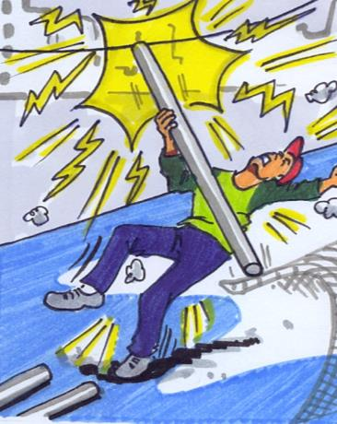
Safety Hazards
Notes:
Safety hazards can cause immediate accidents and injuries. Examples are hot surfaces, broken ladders, and slippery floors. Safety hazards can result in burns, cuts, broken bones, electric shock, or death.

Slide 7
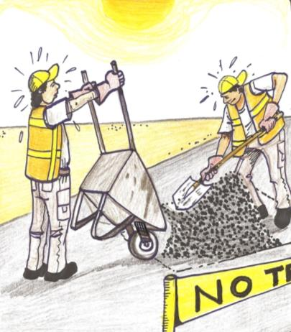
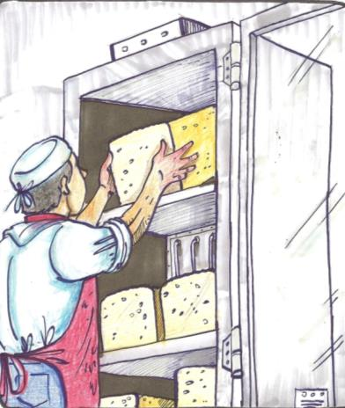
Physical hazards
Notes:
Physical hazards are factors within the environment that can harm the body without necessarily touching it. Physical Hazards include: radiation, high exposure to sunlight/ultraviolet rays, extreme temperatures and constant loud noise.

Slide 8
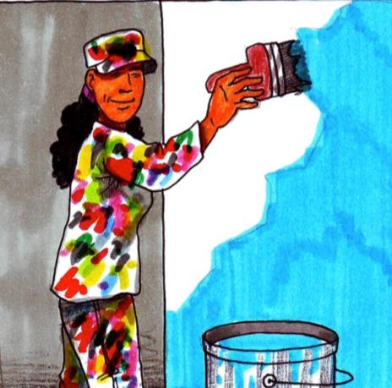
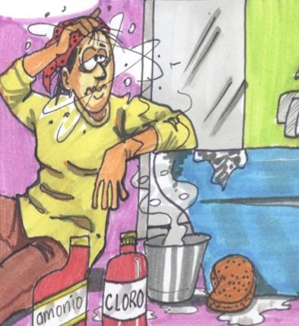
Chemical hazards
Notes:
Chemical hazards are present when a worker is exposed to any chemical preparation in the workplace in any form (solid, liquid or gas). Some are safer than others, but to some workers who are more sensitive to chemicals, even common solutions can cause illness, skin irritation, or breathing problems. Examples include cleaning products, asbestos, and pesticides.

Slide 9
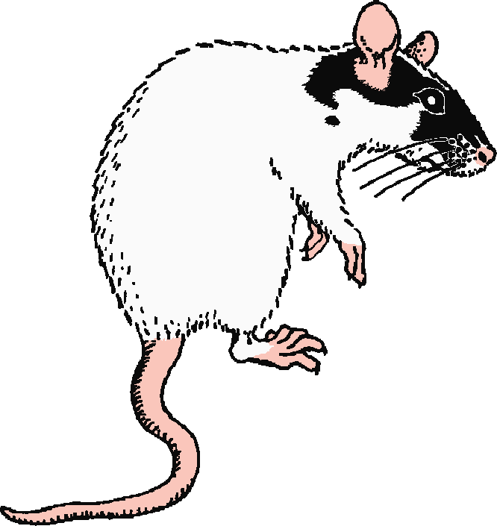
Biological hazards
Notes:
Biological hazards are associated with working with animals, people, or infectious plant materials. Work in schools, day care facilities, colleges and universities, hospitals, laboratories, emergency response, nursing homes, outdoor occupations, etc. may expose you to biological hazards. They include viruses, bacteria, mold, body fluids, animal droppings, plants, etc.

Slide 10
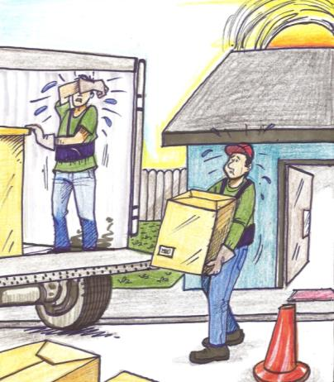

Ergonomic hazards
Notes:
Ergonomic hazards occur when the type of work, body positions and working conditions put strain on your body. They are the hardest to spot since you don’t always immediately notice the strain on your body or the harm that these hazards pose. Short-term exposure may result in “sore muscles” the next day or in the days following exposure, but long-term exposure can result in serious long-term illnesses. Some of the hazards include frequent lifting, poor posture, awkward movements, repeating the same movements over and over, having to use too much force, etc.

Slide 11
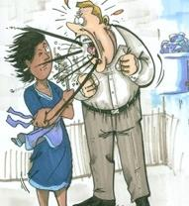
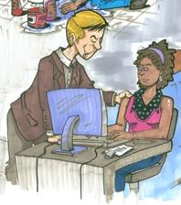
Work organization hazards
Notes:
Work organization hazards are hazards or stressors that cause stress (short-term effects) and strain (long-term effects). These are the hazards associated with workplace issues such as workload, lack of control and/or respect, etc. Examples of work organization hazards include workload demands, intensity and/or fast pace, respect (or lack of), sexual harassment, etc.

Slide 12
color code
Color Code for Types of Hazards

Slide 13

Chemicals used in painting
PIGMENTS
BINDERS
EXTENDERS
SOLVENTS
ADDITIVES
Notes:
Paint contains several kinds of material: pigments, binders, extenders, solvents and additives
All the pigments in paint are used to set the color and opacity. The binder, or resin, holds the pigment in place. With the extender, large pigment particles are added to improve adhesion, strengthen the film and save on binder. There is also the solvent or thinner, which can either be organic or water, that is used to reduce the thickness of the paint to make its application better and easier. Along with those base ingredients, the additives within paint consists of several substances. For example, there are also silicones, which are used to improve the paint's weather resistance and driers are placed in paint to accelerate the drying time. Anti-settling agents are used in paint to prevent pigment settling. The final additives in paint are the fungicides and algaecides, which are used to protect exterior paint from molds, algae and lichen.

Slide 14
What are hazardous chemical products?
Hazardous chemical products are those that can harm people or the environment.
Notes:
Chemicals are organic and inorganic substances, they may be natural or synthetic, toxic or not and they can harm people or the environment.
Hazardous chemical products are those that can harm people or the environment.
Every day we are exposed to countless chemical products that have become essential in our life but unfortunately we are not informed about their effects and consequences. Even nowadays, the possible effect that many products can produce on people’s health and on the environment is not exactly known.

Slide 15
Physical form of chemicals
The physical form of a chemical can influence the way in which it enters the organism, and to some extent, the harm it causes. The main physical forms of chemicals are solids, dusts, liquids, vapors and gases.

Slide 16
Routes of entry to the organism of chemical pollutants

Slide 17
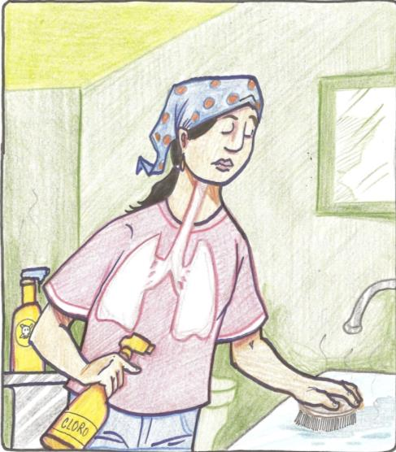
Respiratory Route
Notes:
RESPIRATORY ROUTE through the nose and the mouth, the lungs, etc. This is one of the most important routes of entry or penetration because it is through the air that many toxic substances such as dust, smokes, aerosols and gases can enter our bodies.

Slide 18
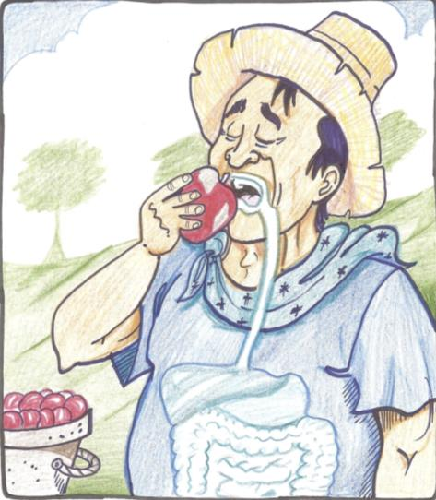
Digestive Route
Notes:
DIGESTIVE ROUTE through the mouth, stomach, intestines, etc. Route of entry through the mouth, the esophagus, the stomach and the intestines. Pollutant ingestions dissolved in mucus in the respiratory system should also be considered.

Slide 19
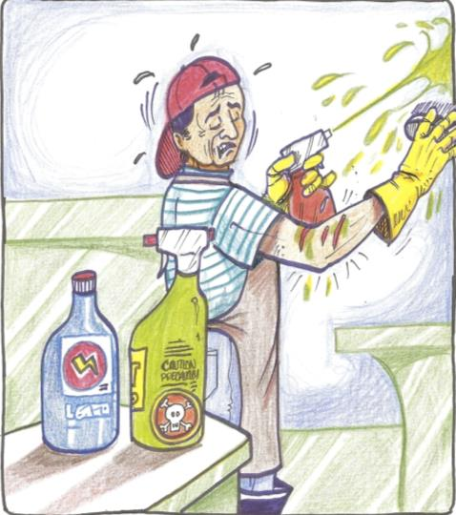
Parenteral Route
Notes:
PARENTERAL ROUTE through open wounds, sores, etc. Route of entry of the pollutant to the body through open wounds, sores, etc.

Slide 20
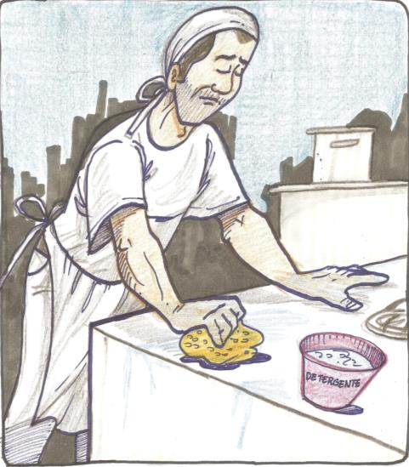
Dermal Route
Notes:
DERMAL ROUTE through the skin. Route of entry of many substances that are able to go through the skin without causing erosion or noticeable alterations and that can enter the blood to later be spread to the whole body.

Slide 21
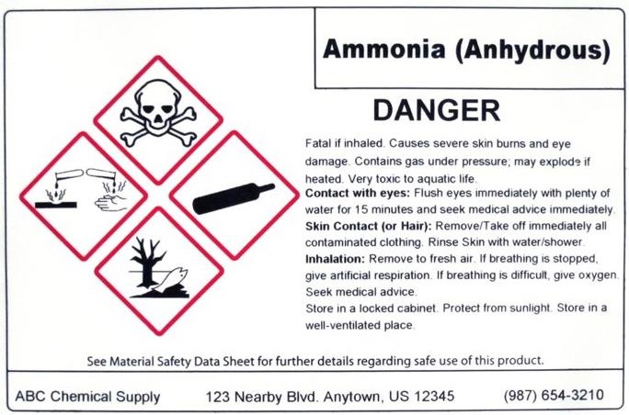
Chemical Labeling: How to read them!

Slide 22
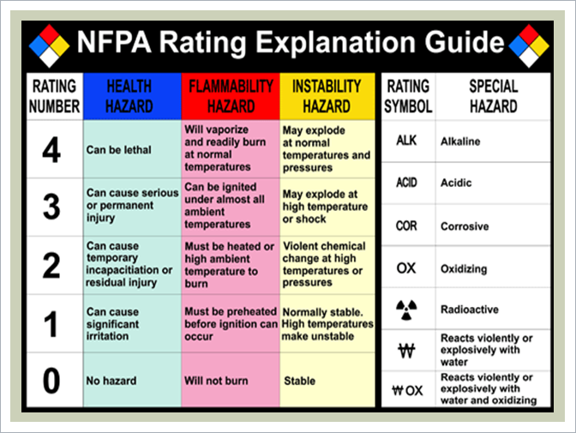
NFPA Rating Explanation guide
Notes:
You may have noticed a diamond shaped label with 4 different colors and numbers in some chemical products. The label may look simple, but it actually carries a lot of information and it may help you identify the hazards associated with that product. This label is color-coded and each color represents a different type of hazard. Also, as mentioned before, it also uses a number system and each number represents the degree of a particular hazard.

Slide 23
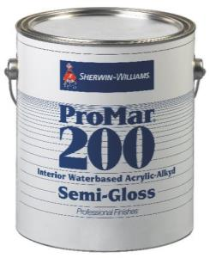
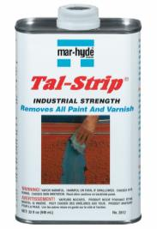
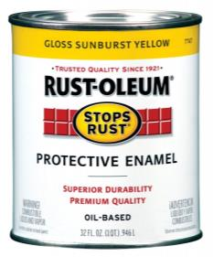
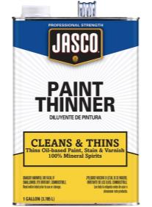
Paint and Chemicals Used in Painting
Notes:
Water Based Paint: Health risks are low, but could affect people who are very sensitive to smells or people allergic to vapors from paint. These products do not pose immediate fire risk. If you get paint on you, wash your hands and any part of your body exposed to the paint with water and soap (do not use detergent).
Oil Based Paint: Oil paint is a type of slow-drying paint that consists of particles of pigment suspended in a drying oil, commonly linseed oil. Oil-based paint contains potentially poisonous hydrocarbons, and high levels of volatile organic compounds, or VOCs, which perform numerous functions in paint and evaporate as the paint dries. The most significant health effects of oil-based paint are due to polluted air from VOCs, inhalation and poisoning. These products can catch fire if they are exposed to excessive temperatures or high temperatures for a long time.
Paint Remover: is a product designed to remove paint and other finishes and also to clean the underlying surface. Two basic categories of chemical paint removers are caustic and solvent. The active ingredients inmost common paint removers are organic solvents, which may damage the skin, eyes, respiratory tract, nervous system, and internal organs. Special precautions must be taken in their use. The fire-causing potential of solvents can be classified as "extremely flammable," "flammable," combustible," or "non-flammable."

Slide 24
Other Hazards
Exposure to silica
Exposure to lead
Falls
Electrical Hazards
Musculoskeletal Disorders
Notes:
Making reference to the answers participants gave during activity 2, review the following hazards with participants. After, divide participants in 5 groups and assign one hazard to each group. Participants have to come up with a basic preventative plan so that workers are not exposed to the particular hazard they were assigned in their group. Presentations will follow.

Slide 25
How can I protect myself from hazardous chemicals?
The Right to Know
Permissible Exposure Limits (PELs)
Ventilation
Substitution
Work practices and behaviors
Use of PPE

Slide 26
Avoiding creating hazards when storing chemicals
Storing Flammable Products:
Store products in a cool environment
Store products away from ignition sources
Do not store incompatible products side by side
Mark storage locations with signs/warnings
Have easy access to fire extinguishers
Fire extinguishers should be appropriate for the products being stored (see MSDS)
Stored products should not block isles or exits
Notes:
Thinners and solvents are flammable products with low flash points. Therefore, they should be stored in cool environments away from ignition sources. Dry chemical, carbon dioxide, foam and water fog are appropriate extinguishing media for most thinners and solvents.

Slide 27
Storing Products that Release Vapor:
Keep product containers tightly closed when not in use.
Keep product containers upright.
Prevent product containers from being damaged (i.e. piercing).
When transferring products to new containers, make sure the container material is compatible with the product and clearly labeled.
Keep product containers in a well-ventilated area.
Keep product containers in a dry location.
Notes:
Thinners and solvents contained in paint have high volatility and easily release vapors into the air. Therefore, when these products are not is use, the containers should be tightly sealed, kept upright and free of punctures.

Slide 28
What if I have been exposed?
Here are some things you can do in case of overexposure to chemical hazards:
Stop what you are doing and leave the contaminated space. Alert your supervisor. Call 911 for emergencies or the Poison Control Center 1-800-222-1222.

Slide 29
Here are some things you can do in case of overexposure to chemical hazards:
In case inhalation: clean air, rest in a semi recumbent position, artificial respiration if needed and medical care.
In case of a spill: take off contaminated clothing, wash area with plenty of water, seek medical care.
In case of splashing: Rinse with plenty of water for several minutes and seek medical care.
In case of consumption: rinse the mouth, DO NOT induce vomiting, drink plenty of water, and seek medical care.

